Slide 1

Using Aerogravity to Produce a Refined Vertical Datum
D.R. Roman and X. Li
XXV FIG Congress
16-21 June 2014
Kuala Lumpur, Malaysia
Session TS01A, Paper 7303

Slide 2
Gravity Field Power Spectrum
Power Spectrum plot of gravity field (blue line). Most power is at longest
wavelengths (λ) at left on the lowest degree harmonics, where satellite
(light blue bar) data dominate. Surface data (brown bar) contain the shortest
to the right. Aerogravity (green bar) overlaps both parts of spectrum (red boxes).

Slide 3
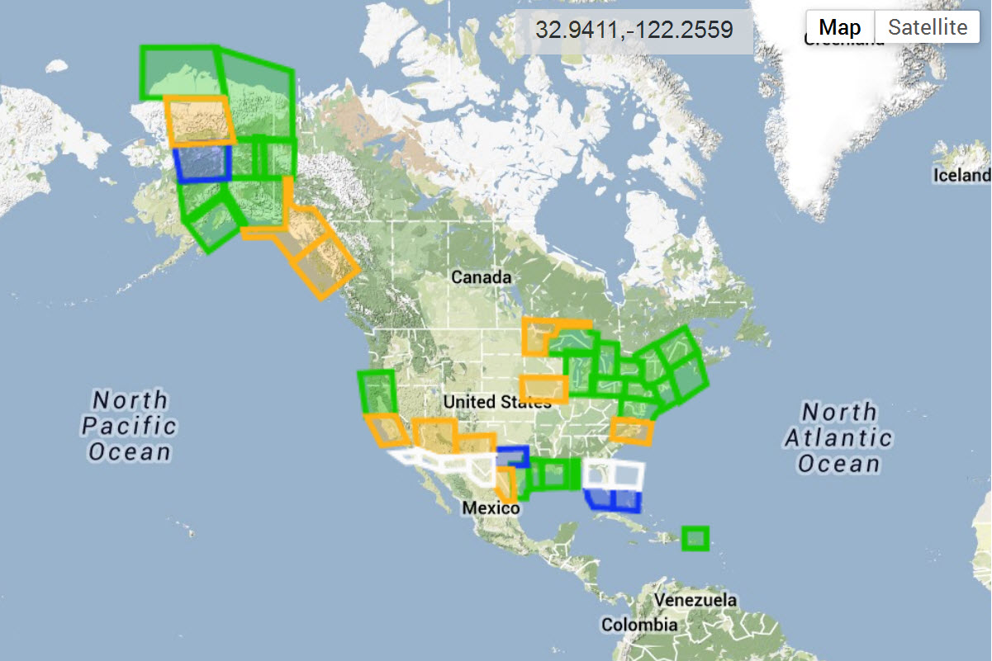
GRAV-D Aerogravity (07 June 2014)
Gravity for the Redefinition of the American Vertical Datum
Map Key - Airborne Gravity Data
Green: Available data and metadata
Blue: Data being processed
Orange: Data collection underway
White: Planned for data collection
http://www.ngs.noaa.gov/GRAV-D/data_products.shtml
Notes:
Roughly 35% complete – see website for latest information

Slide 4
GRAV-D Aerogravity Collection
Aircraft: rotating between King Air, Pilatus, P-3
Equipment: GPS, IMU, & gravity meters
Data sampling: 1 Hz
Nominal Flight elevation: 6.1 km (20 kft)
Nominal air speed: 407 kmh (220 knots)
Track spacing: 10 km track (50 km crossovers)
Typical block: 400 x 500 km (41 profiles)
Nominal spectral band: 20-400 km

Slide 5
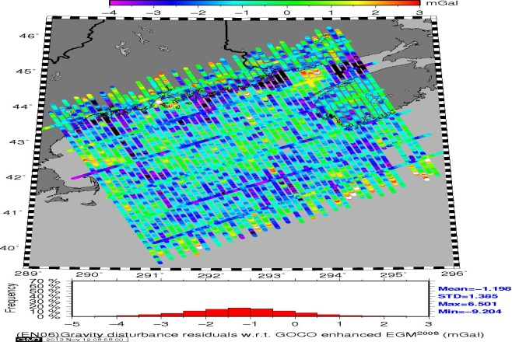
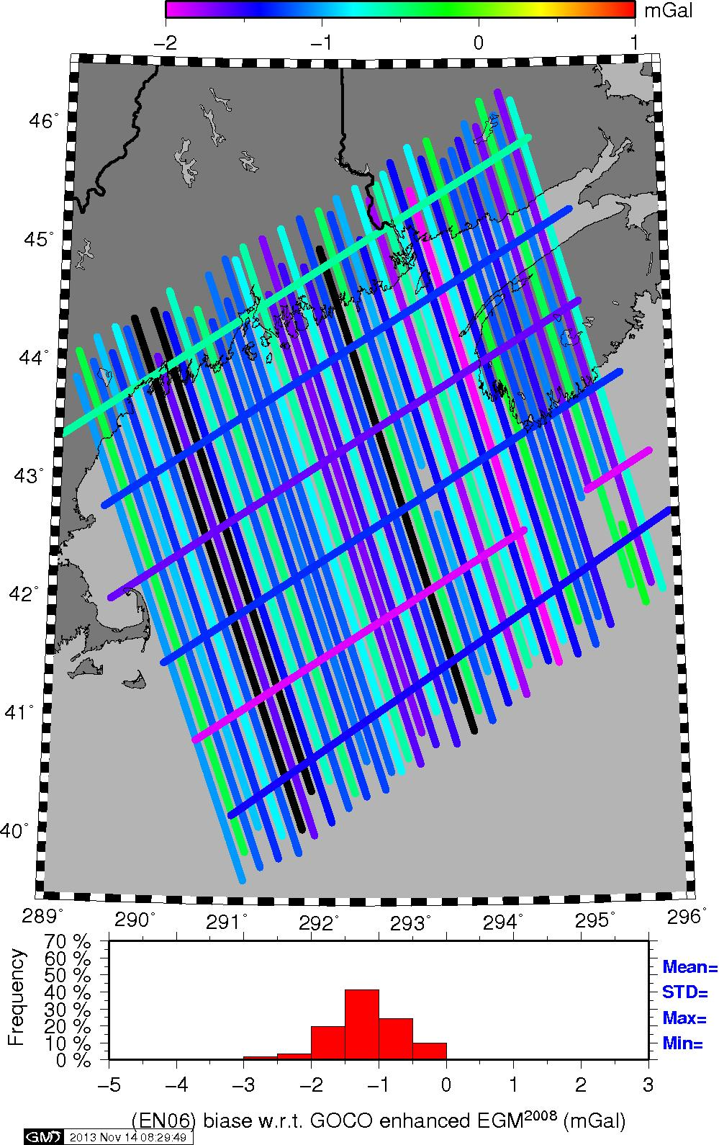
EN06 – Collected over Maine
EN06 Aerogravity (Beta vers.)
Biases by Profile w.r.t. EGM2008

Slide 6
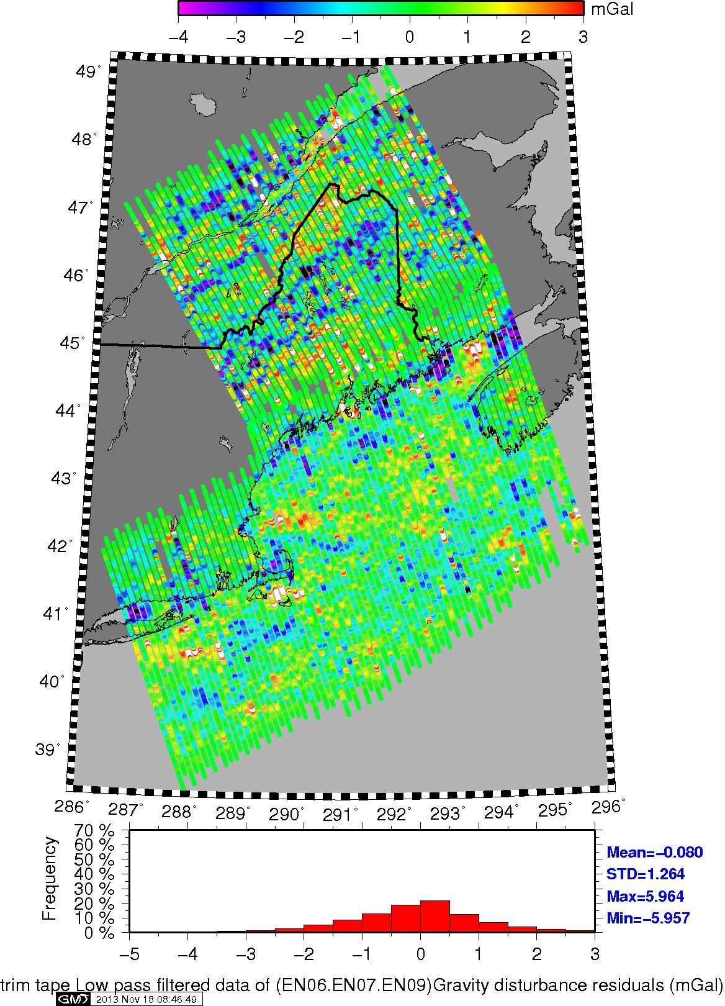
Profiles for 3 regions (no bias)
Each profile is essentially independent
Spatially correlated systematic features between profiles
Likely error sources are in surface gravity:
  Near shore (altimetry)
  Onshore follows topo
  Back bay areas

Slide 7
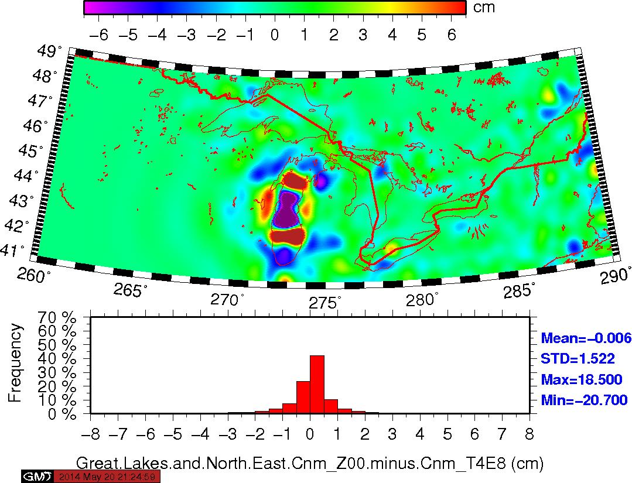
Zoom into Great lakes and NE
(GPSBMs are too dense, will block maps)

Slide 8
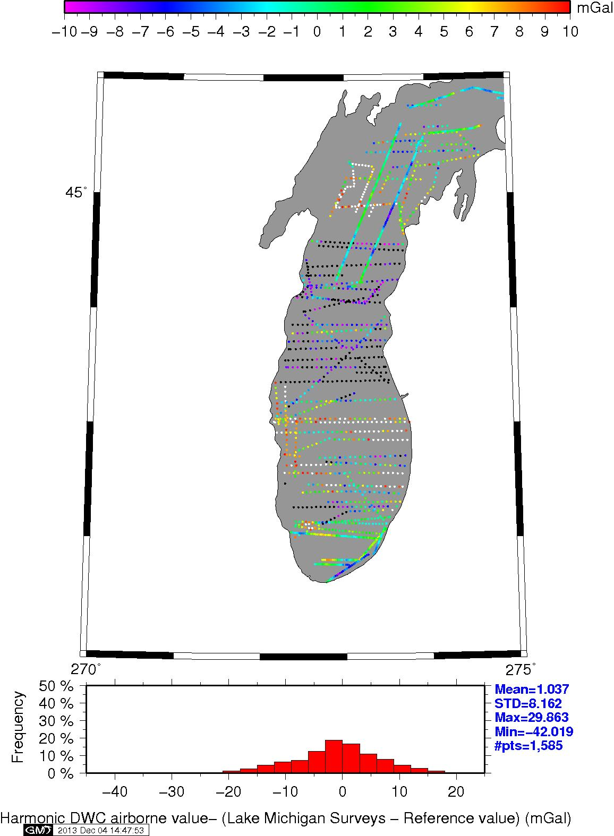
Airborne vs. Surface Gravity
Cleaning of gravity data
Second transition band
Remove biases w.r.t aerogravity (normalize)
Makes surface data consistent with aerogravity
Preserves short wavelength in surface

Slide 9
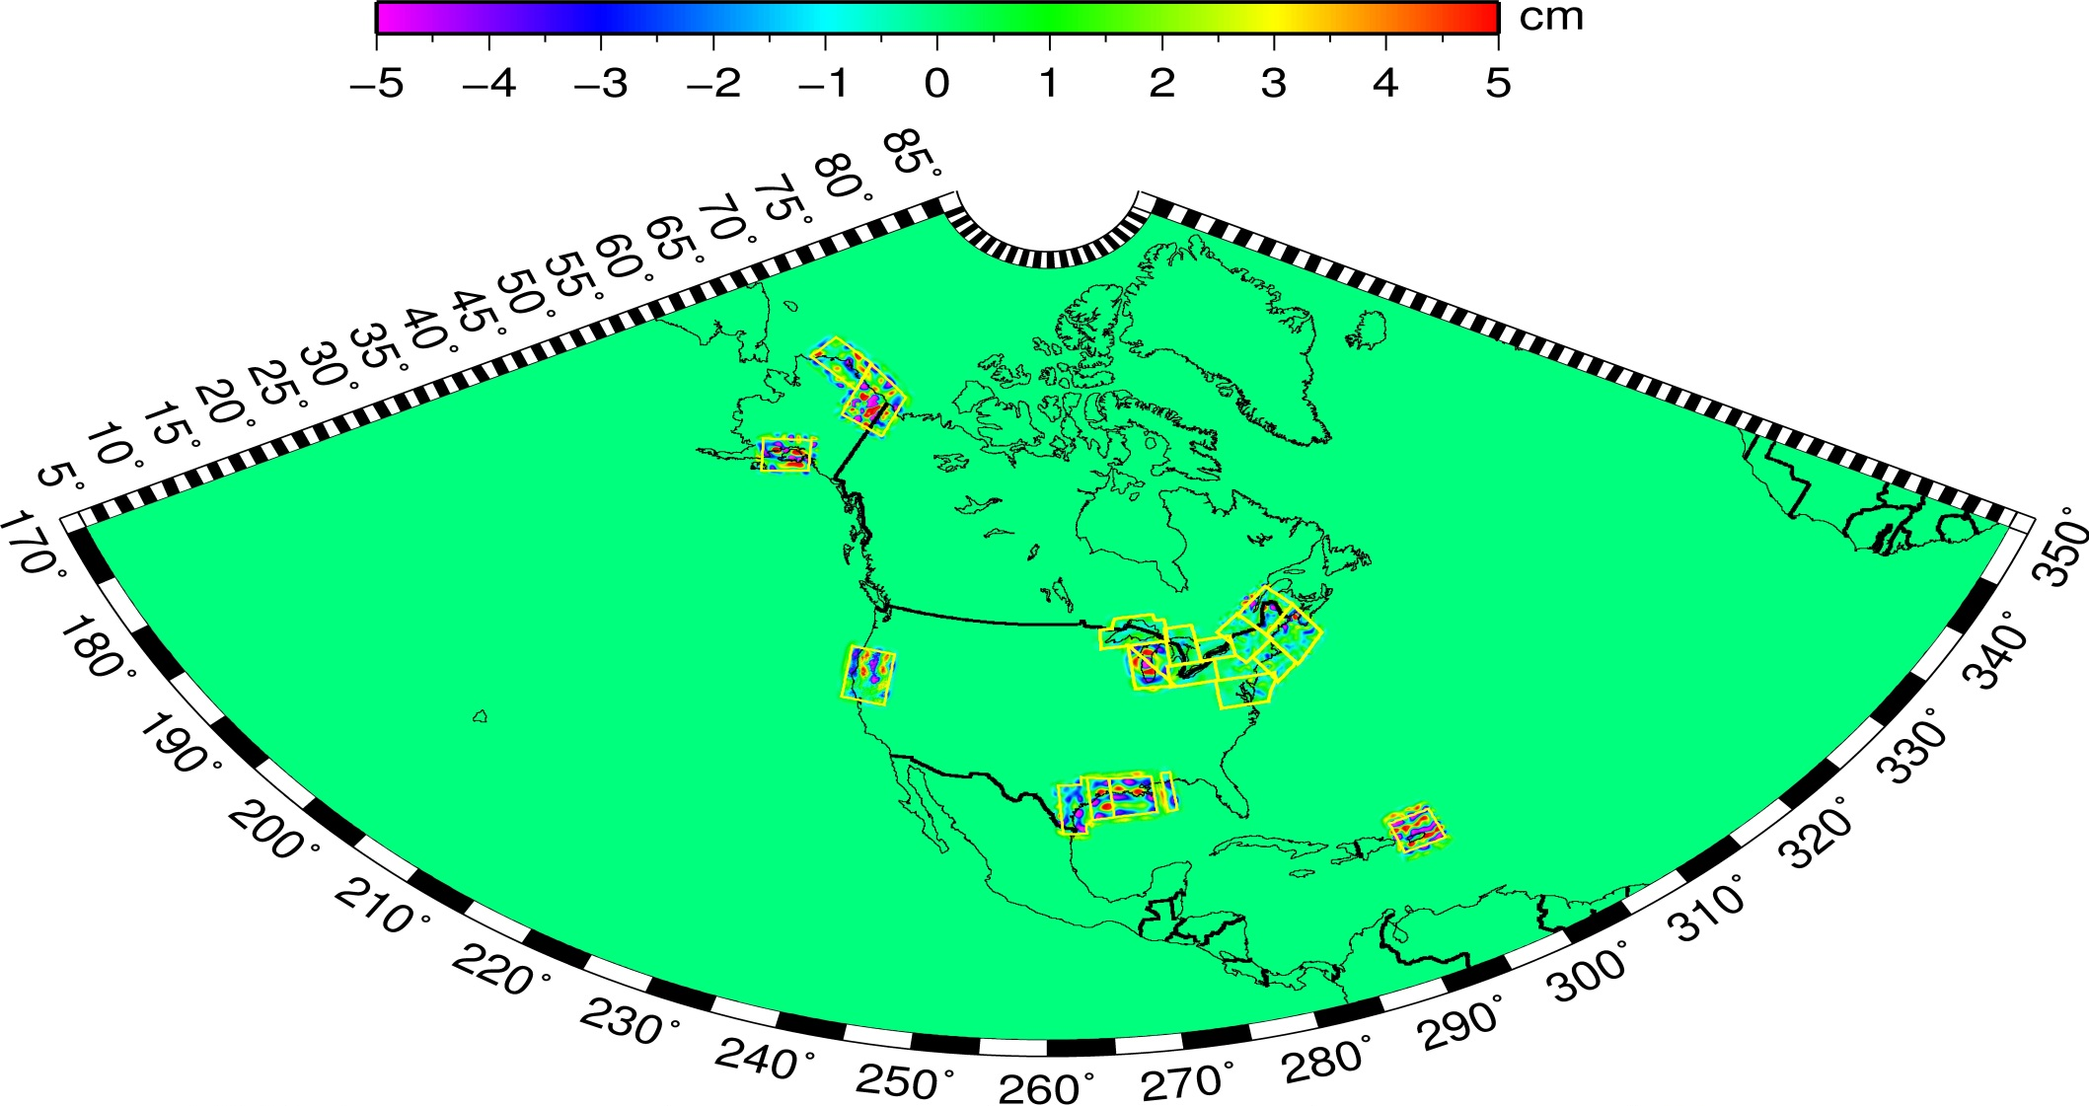
Impact of GRAV-D Aerogravity
(xGEOID14B - xGEOID14A)
Mean = 0.0 cm STDEV = 0.5 cm MIN = -42.8 cm MAX = 34.6 cm

Slide 10
unit | Cnm_T (Ref) | Cnm_Z00 (Ref+Airborn) | Ref+Airborn+Surface No.AK.XGeoid14B
cm | std | std | std | #points
Gulf Coast | 9.93 | 9.26 | 9.23(240) | 482
PRVI | 11.70 | 10.37 | 10.49(240) 10.25(480) | 57
Great Lakes | 10.72 | 10.68 | 10.56(240) | 2116
North East | 3.81 | 2.99 | 3.30(240) 3.19(360) 3.04(480) 2.97(600) | 168 (Altimetry problem ?)
GSVS11 | 1.86 | 1.08 | 1.37 (240) 1.07(480) | 218
CA11 (45N,36N,234W,241W) | 11.64 | 11.27 | 11.21(240) | 581
Lake Michigan (47N,40N,270W,278W) | 7.55 | 7.48 | 7.44(240) | 1777

Slide 11
Outlook
30 June 2014 Beta release of xGEOID14A/B
Look for links on the NGS Main or GEOID pages
Incorporates aerogravity from 20 regions
First experimental model using aerogravity
Annual releases to follow (roughly same time)
Data cleaning: 2,000,000 surface gravity in 1400 different surveys
Eventual usage as vertical datum in 2022

Slide 12
Contact Information
Daniel R. Roman, National Geodetic Survey
Chief (acting) SRSD/GRAV-D P.I./Geoid Team Lead
dan.roman@noaa.gov
301-713-3200 x103
Relevant NGS webpages:
  Geoid Page: http://www.ngs.noaa.gov/GEOID/
  GRAV-D: http://www.ngs.noaa.gov/GRAV-D/

Slide 13
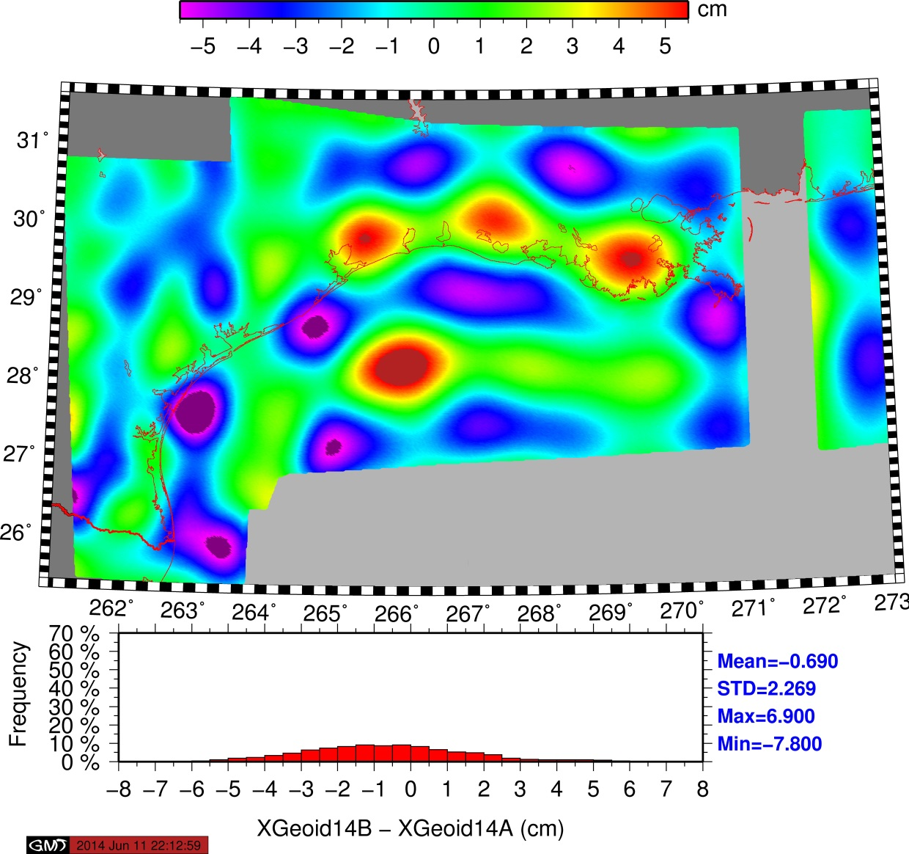
Gulf Coast

Slide 14
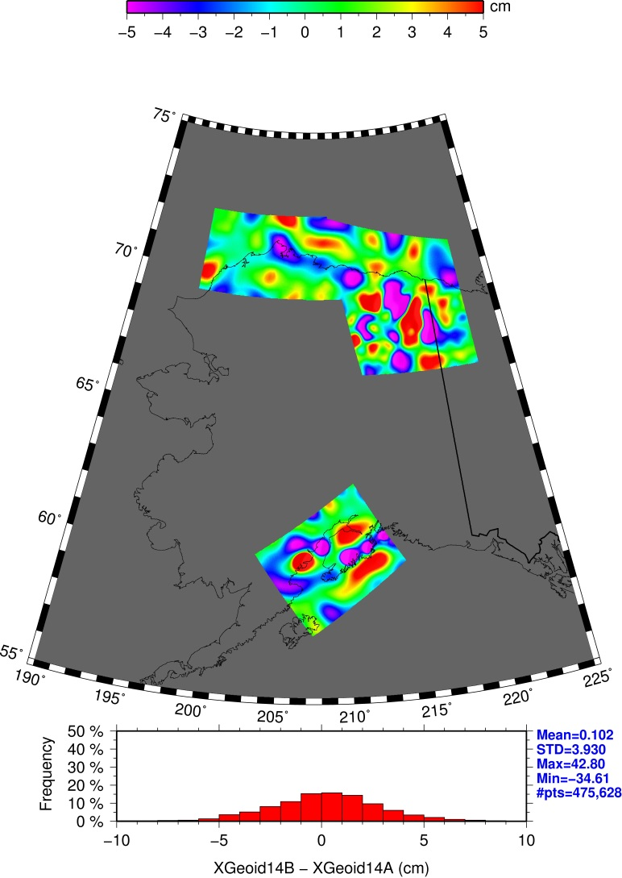
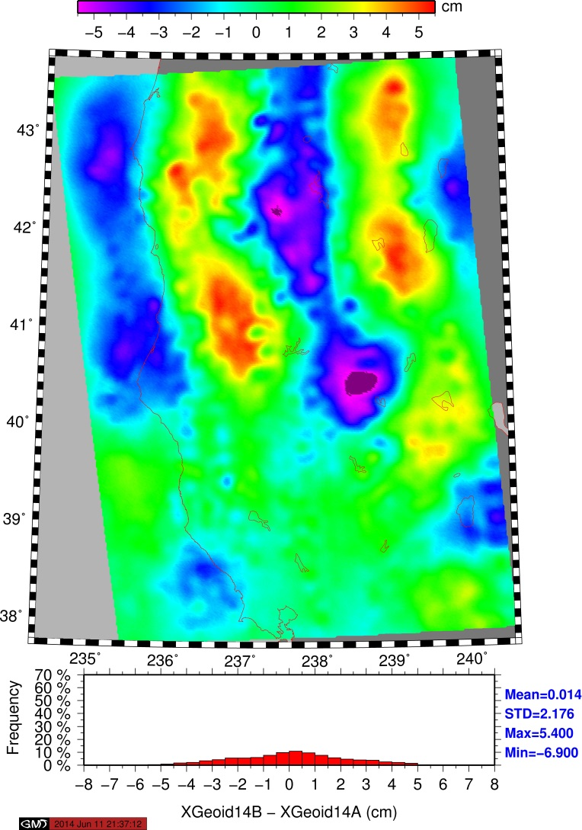
California

Slide 15
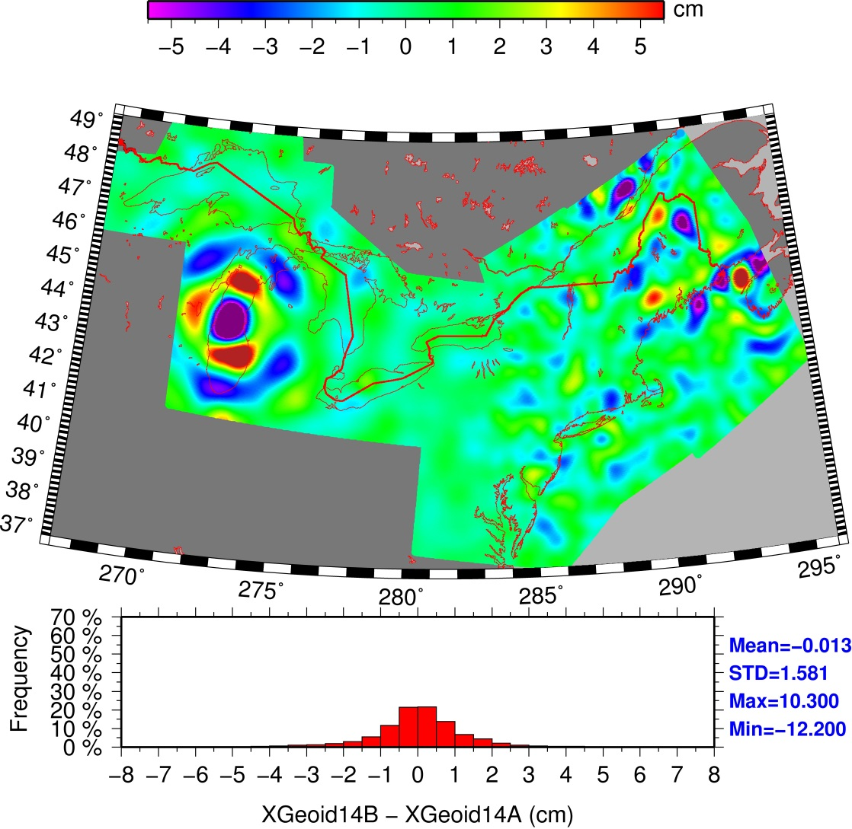
Great Lakes through Northeast U.S.

Slide 16
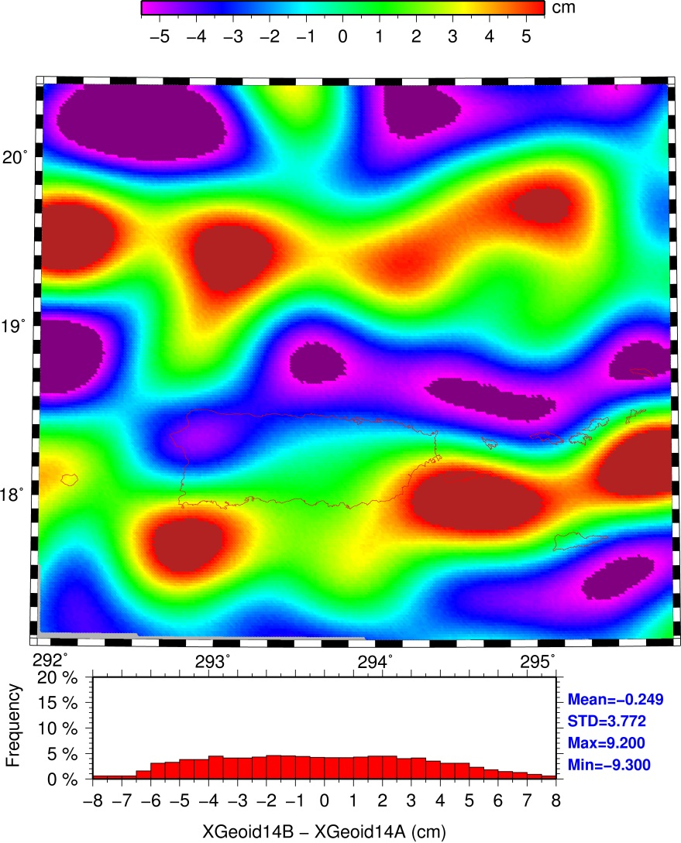
Puerto Rico & USVI

