Slide 1

The Modernized National
Spatial Reference System
Boris Kanazir, Geodesist, RPLS
boris.kanazir@noaa.gov
TRB Geospatial Data Acquisition Technologies (AKD70)
2020 Summer Meeting
August 4, 2020

Slide 2

2022: Will it be this grim?

Slide 3


Slide 4
Geodetic Control
OMB A-16: “The NSRS is the fundamental geodetic control for the United States.”
Easiest way to think of “geodetic control”: Points with Coordinates
  But please do start to think of “Coordinates” as “Coordinates as a function of time”

Slide 5
Active vs. Passive Geodetic Control
It might be best to set aside the terms “active” and “passive” and think solely in terms of trusted geodetic control
However, sometimes this shorthand will be used for simplicity:
  Passive control: Infrequently observed marks
  Active control: A station with continuous data collection

Slide 6
Geodetic Control — Purpose
NGS defines and provides access to a datum
  Points with given coordinates
  The “foundational layer” of any geospatial work
  To be more accurate than any survey or map which builds upon it

Slide 7
Horizontal Datums of the NSRS
Columns not aligned between regions
CONUS | U.S. Standard Datum | NAD 27 | NAD 83(1986) | NAD 83(“HARN”)* | NAD 83(“FBN”)* | NAD 83(NSRS2007) | NAD 83(2011) epoch 2010.00
Alaska | NAD 27 | NAD 83(1986) | NAD 83(2002:AK) | NAD 83(NSRS2007) | NAD 83(2011) epoch 2010.00
Hawaii | Old Hawaiian Datum** | NAD 83(1986) | NAD 83(1993:HI) | NAD 83(PA11) epoch 2010.00
PR/VI | Puerto Rico 1940** | NAD 83(1986) | NAD 83(1993:PR) | NAD 83(1997:PR) | NAD 83(2002:PR) | NAD 83(NSRS2007) | NAD 83(2011) epoch 2010.00
Am. Samoa | American Samoa 1962 | NAD 83(1993:AS) | NAD 83(2002:AS) | NAD 83(PA11) epoch 2010.00
Guam/CNMI | Guam 1963 | NAD 83(1993:GU) | NAD 83(2002:GU) | NAD 83(MA11) epoch 2010.00
St. Paul | St. Paul 1897** | St. Paul 1952** | NAD 83(1986) | NAD 83(2002:AK) | NAD 83(NSRS2007) | NAD 83(2011) epoch 2010.00
St. George | St. George 1897** | St. George 1952** | NAD 83(1986) | NAD 83(2002:AK) | NAD 83(NSRS2007) | NAD 83(2011) epoch 2010.00
St. Lawrence | St. Lawrence 1952** | NAD 83(1986) | NAD 83(2002:AK) | NAD 83(NSRS2007) | NAD 83(2011) epoch 2010.00
St. Michael | St. Michael 1952**
* Actually state-by-state realizations feathered together over a decade or so
** Not an official name at creation. Little public documentation.

Slide 8
Vertical Datums of the NSRS
Columns not aligned between regions
CONUS | NGVD 29 | NAVD 88
Alaska | NGVD 29 | NAVD 88
Hawaii
PR | PRVD 02
USVI | VIVD 09
Am. Samoa | ASVD 02
Guam | GVD 1963 | GUVD 04
CNMI | NMVD 03
St. Paul
St. George
St. Lawrence
St. Michael
Great Lakes | IGLD 55 | IGLD 85

Slide 9
Reminder…
WGS 84 is not part of the NSRS
  It is a military-controlled system
All civilian federal agencies are required to work in the NSRS (as per OMB A-16)
  NAD 83 is part of the NSRS
  NAD 83 ≠ WGS 84
    (unless 2+ meters of systematic bias doesn’t bother you)
Many states and municipalities choose to work in the NSRS
  And often legislate this use

Slide 10
Decision to Modernize
In 2007 NGS announced its decision to completely change how it approached its mission.
In a word, they chose to modernize the NSRS
Let’s look at the issues that drove that decision, and the direction they decided to go

Slide 11
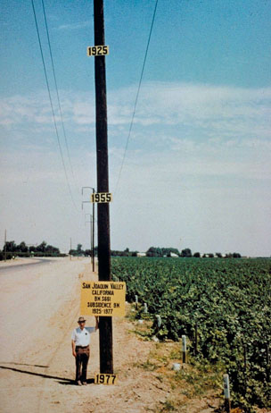
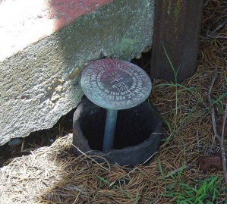
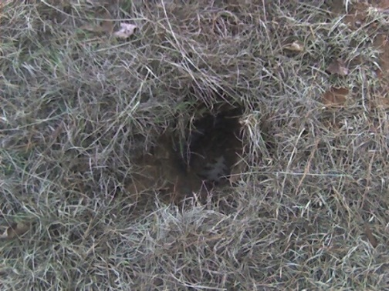
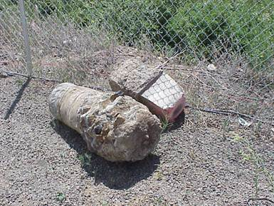
Issues
NAVD 88 suffers from use of passive control that:
Is almost never re-checked for movement
Disappears by the thousands every year
Is not funded for replacement
Is not necessarily in convenient places
Doesn’t exist in most of Alaska
Wasn’t adopted in Canada
Was determined by leveling from a single point, allowing the build up of cross-country error
PID: EZ0840

Slide 12
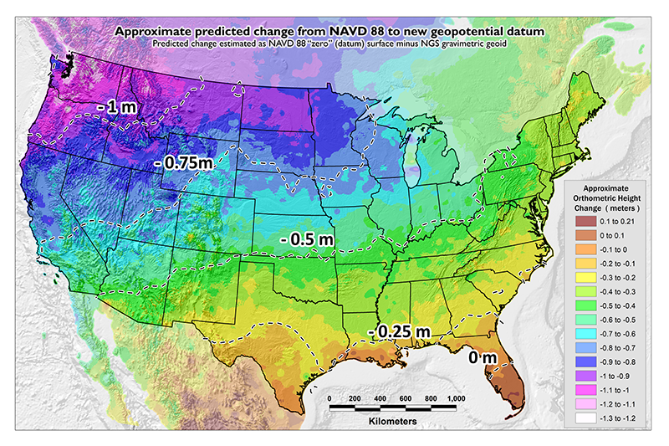
Issues
NAVD 88 suffers from a known bias (50 cm) and tilt (about 1 meter across CONUS) relative to the gravimetric geoid
Approximate level of geoid mismatch known to exist in the NAVD 88 zero surface
PID: EZ0840

Slide 13
Issues
NAD 83 suffers from a 2+ meter non-geocentricity (which misaligns it with ITRF and all GNSS orbits)
Earth’s Surface
h_{ITRF}
h_{NAD83}
ITRF origin
~2.24 m
NAD 83 origin

Slide 14
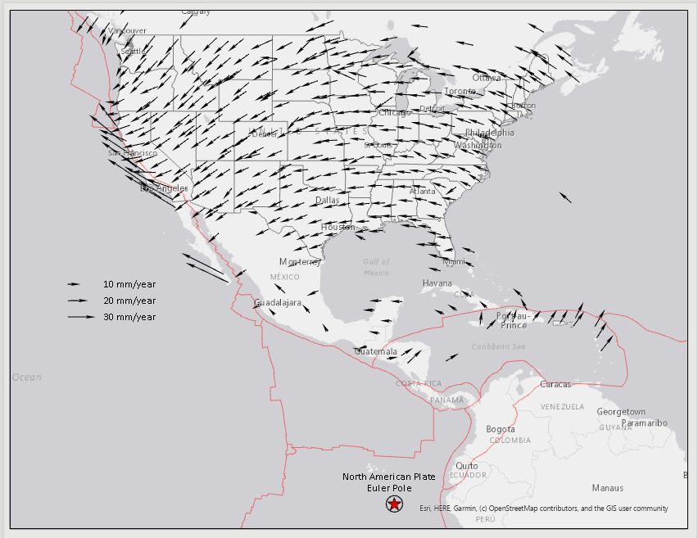
Issues
Geodetic control is usually affixed to a crust that is moving
  Even so-called “plate fixed” frames are only as stable as:
    The rigidity of a plate
    The complete lack of subsidence or uplift

Slide 15
General Direction
Future details would come, but in 2007 the general direction was:
  Replace both NAD 83 and NAVD 88, at the same time
  Transition to a geoid-based vertical datum
  Leverage the rise of GNSS and RTNs
  Completely re-invent “bluebooking”
    Reduce complexity
    Retain ability to standardize geodetic survey files

Slide 16
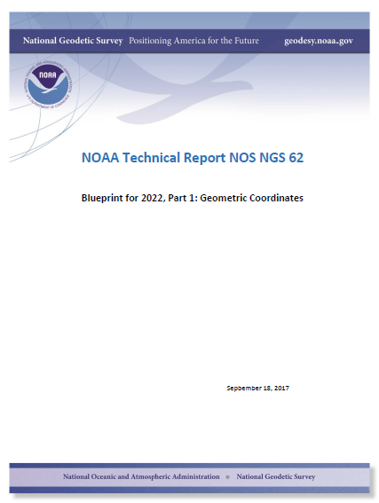
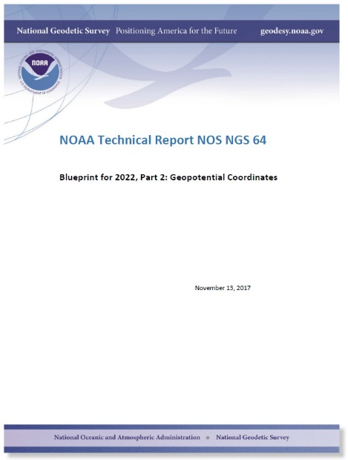
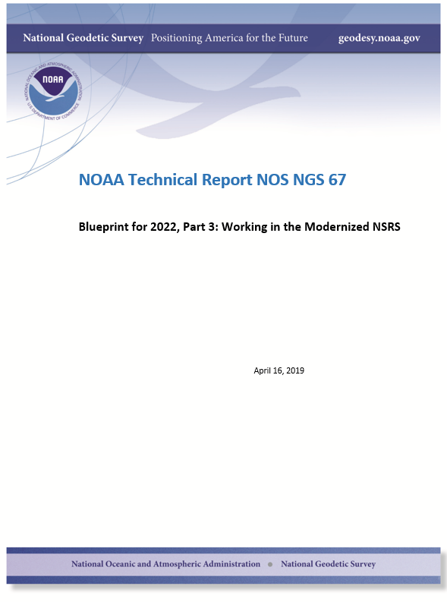
Modernizing the NSRS
The “blueprint” documents: Your best source for information
All three documents are being updated and re-released in 2020!!
Geometric:
Sep 2017
NOAA TR NOS NGS 62
32 pages
Geopotential:
Nov 2017
NOAA TR NOS NGS 64
41 pages
Working in the
Modernized NSRS:
April 2019
NOAA TR NOS NGS 67
77 pages

Slide 17
Replacing the NAD 83s
The Old | The New
NAD 83 (2011) | NATRF2022 - The North American Terrestrial Reference Frame of 2022
NAD 83 (2011) | CATRF2022 - The Caribbean Terrestrial Reference Frame of 2022
NAD 83 (PA11) | PATRF2022 - The Pacific Terrestrial Reference Frame of 2022
NAD 83 (MA11) | MATRF2022 - The Mariana Terrestrial Reference Frame of 2022

Slide 18
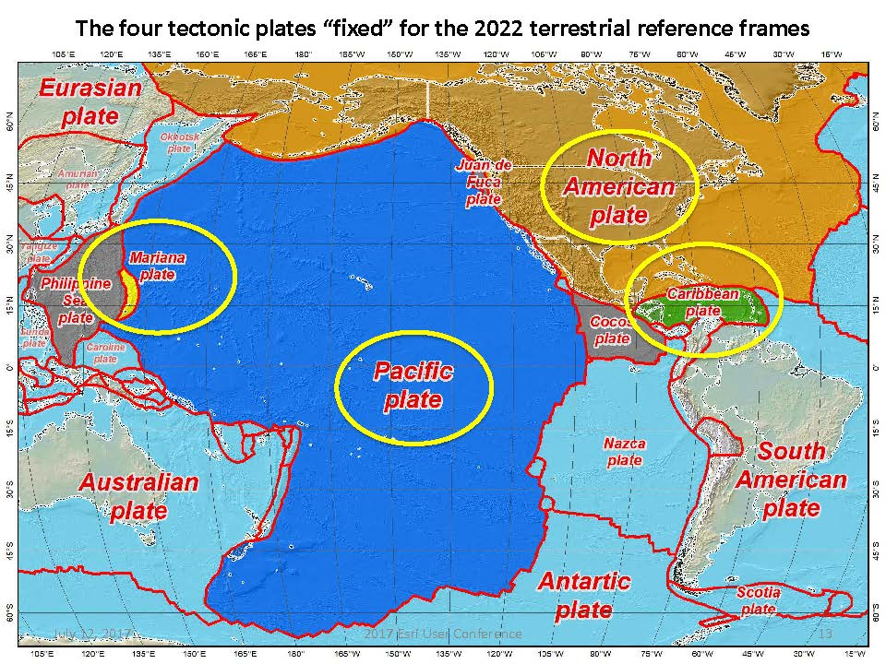
Four Tectonic Plates

Slide 19
The TRFs
All are global frames (no “boundary”)
  This was true for the NAD 83s also, BTW
  But each frame will rotate with one tectonic plate
    Put another way: “The frame rotates so your coordinates don’t have to”

Slide 20
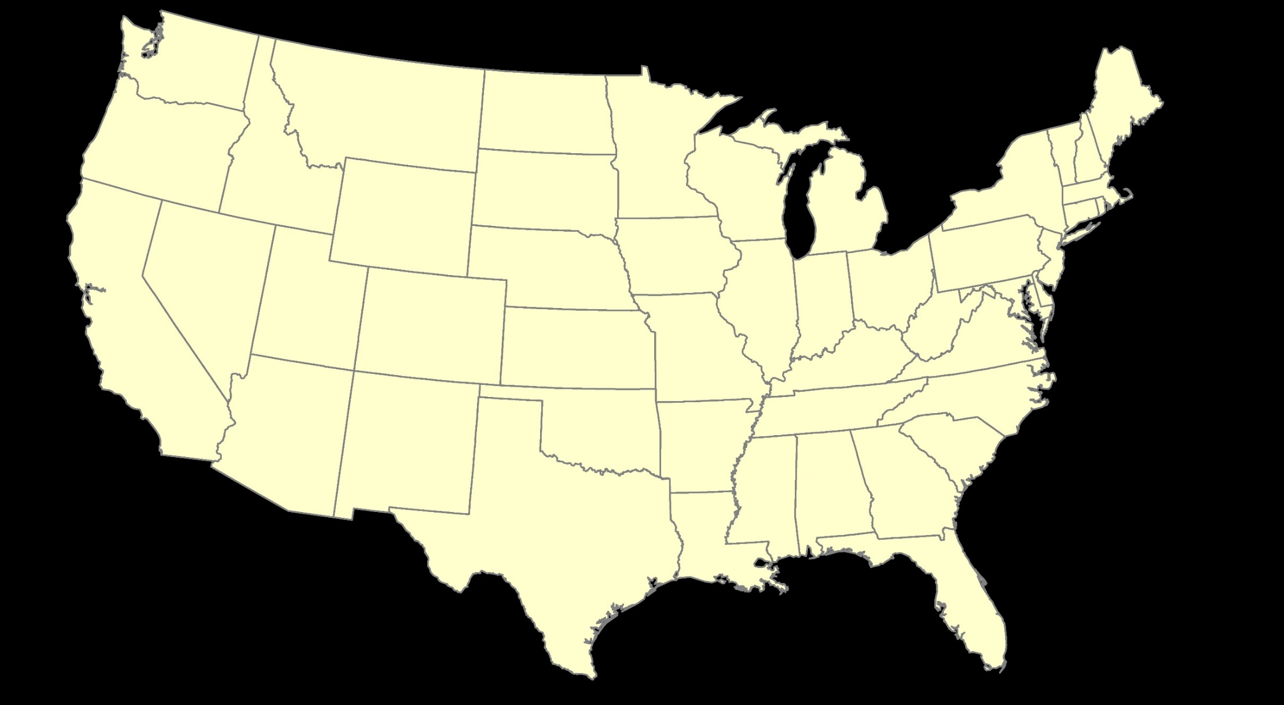
ITRF2020: Constant Frame, Rotating Plate

Slide 21


“Plate-Fixed”
NATRF2020: Constant Frame, Rotating Plate

Slide 22

ITRF2020 or NATRF2022 — Your choice, just use EPP2022

Slide 23
Shift and Drift
When transitioning off of NAD 83, your coordinates will experience shift and drift
  Shift: A one-time jump somewhere in the 0 to 4 meter range (latitude, longitude, ellipsoid height)
    From fixing NAD 83’s non-geocentricity
  Drift: Coordinates are now time-dependent. The shift will take you to 2020.00. Working at any other epoch means you must account for the drift (velocity) of your coordinates
    As well as any other motions over time

Slide 24
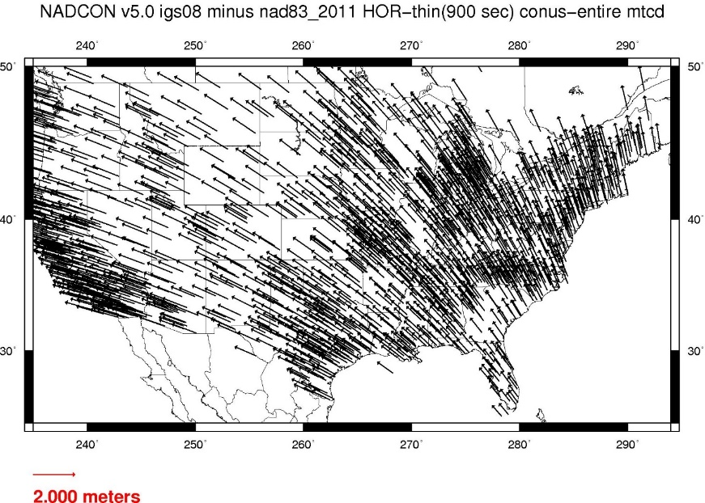
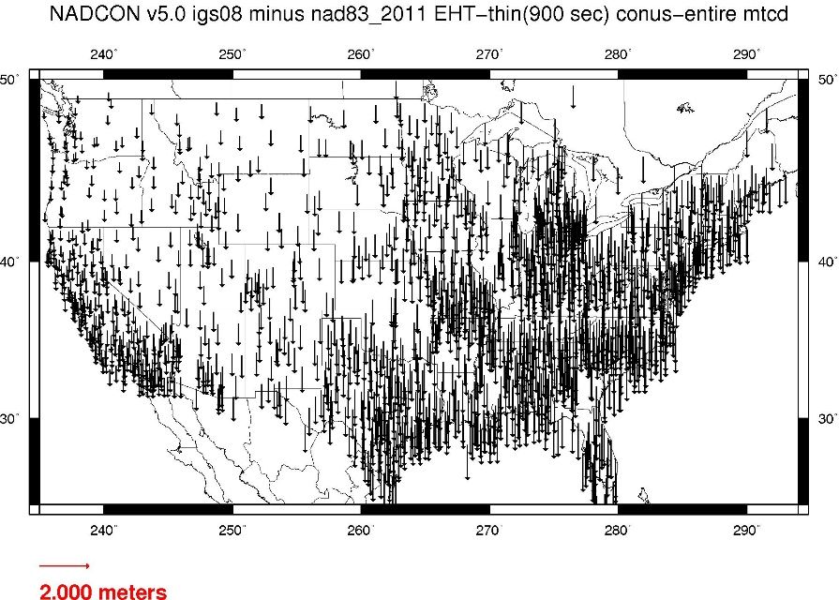
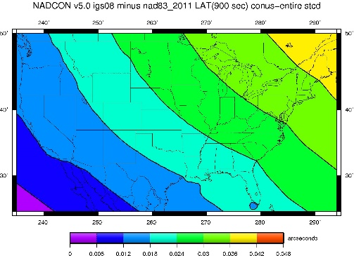
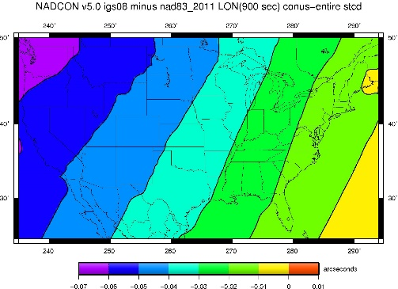
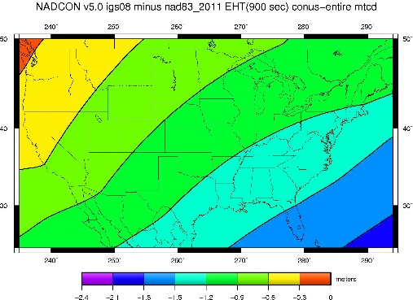
NAD 83(2011) epoch 2010.0 to
NATRF2022 epoch 2020.00 (estimate)

Slide 25
Drift
What does it mean to provide time-dependent coordinates in 5 frames?
  Let’s look at the known velocities of some active control stations in ITRF2020, NATRF2022, PATRF2022, CATRF2022 and MATRF2022

Slide 26
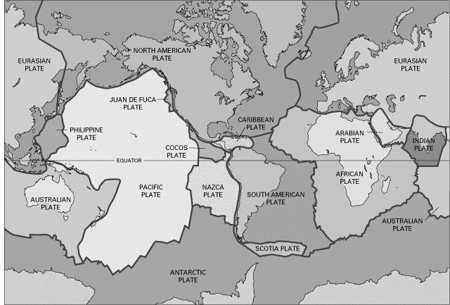
BSMK (North Dakota)

Slide 27
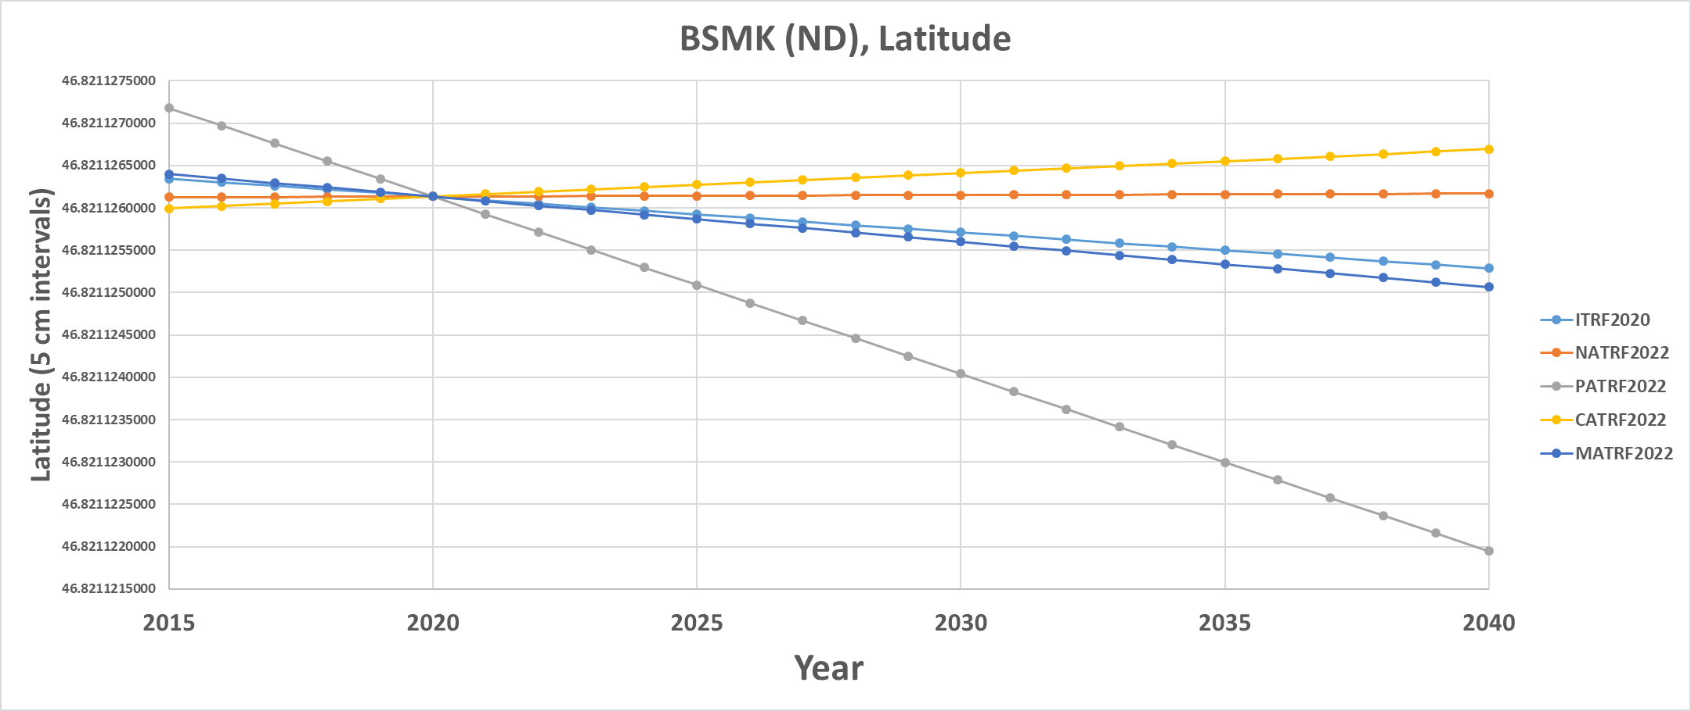
BSMK (North Dakota)
t₀=2020.0, when all five frames are identical
Note the time-dependent coordinate in latitude in NATRF2022 is stable! That means the NATRF2022 IFVM* for latitude will be ZERO for this point.

Slide 28
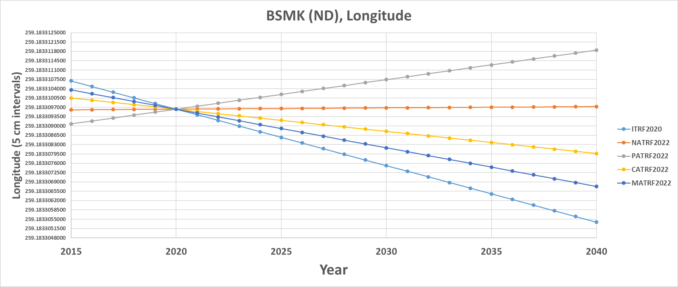
BSMK (North Dakota)
Similarly, the time-dependent coordinate in longitude in NATRF2022 is stable! That means the NATRF2022 IFVM for longitude will be ZERO for this point.

Slide 29
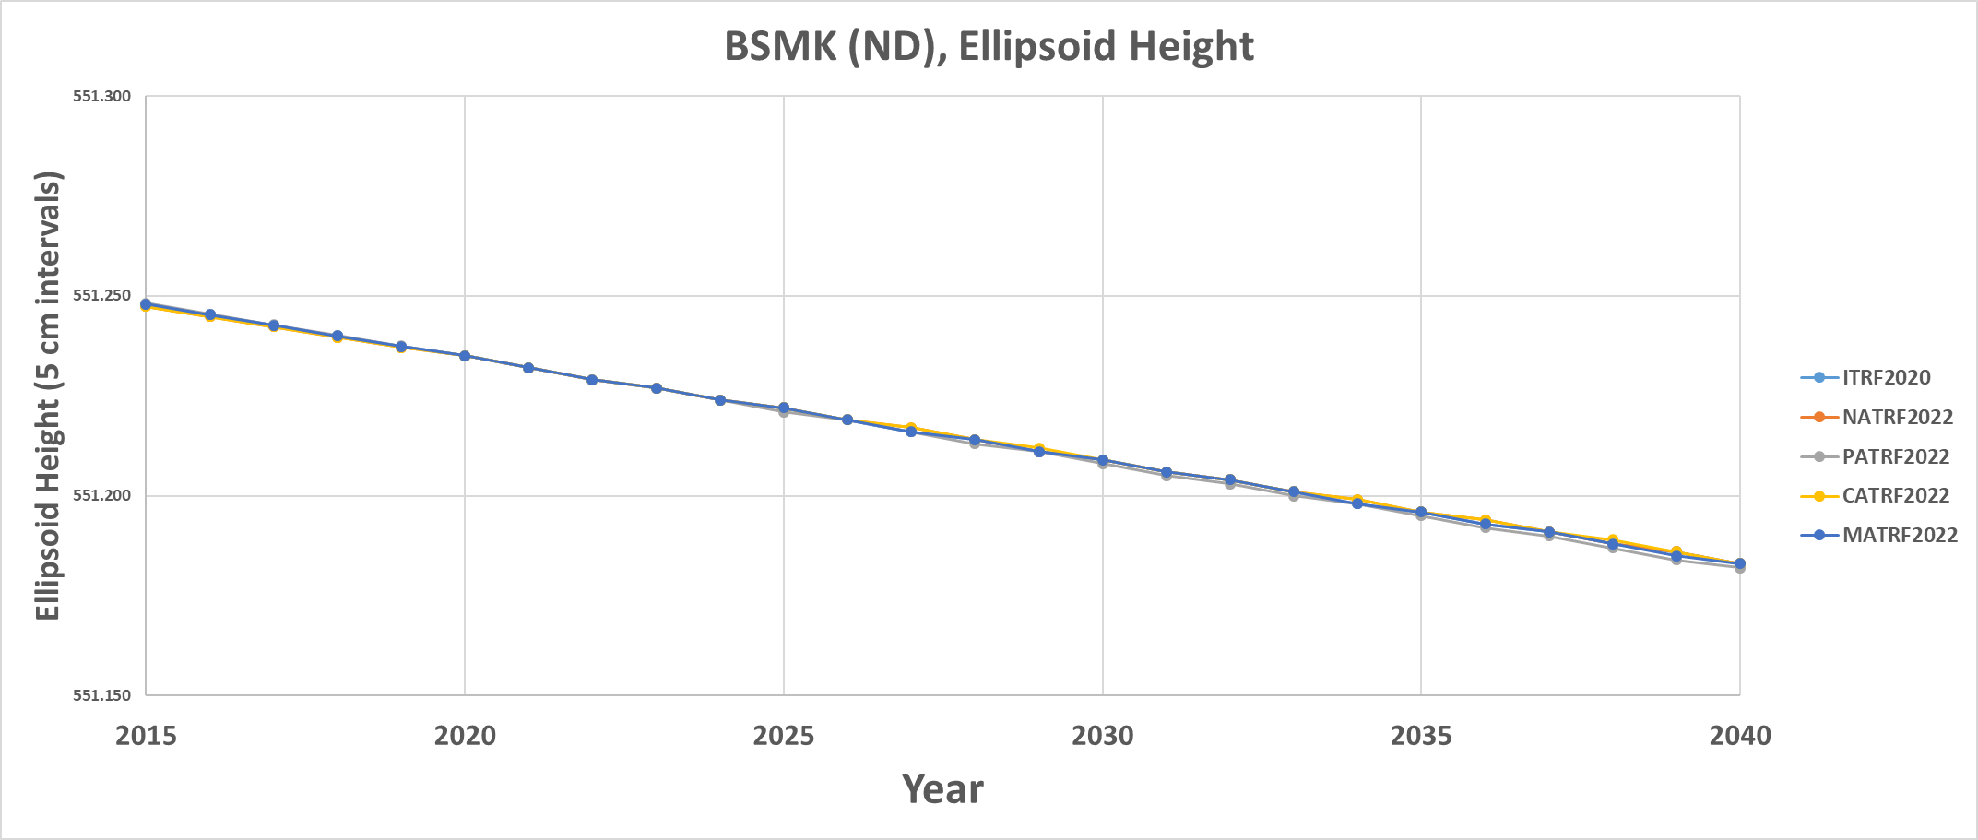
BSMK (North Dakota)
However, in every frame, this point is subsiding! That will be captured in the ellipsoid height component of the IFVM for each frame.

Slide 30
What did all that mean?
Anyone can work in any frame anywhere
“Stable” time-dependent coordinates may look “constant” – don’t get complacent!
  A slight drift, or one earthquake can upset that
Plate fixed frames are nice, but
  Even in “stable” areas (Kansas, for instance) one cannot assume stability

Slide 31
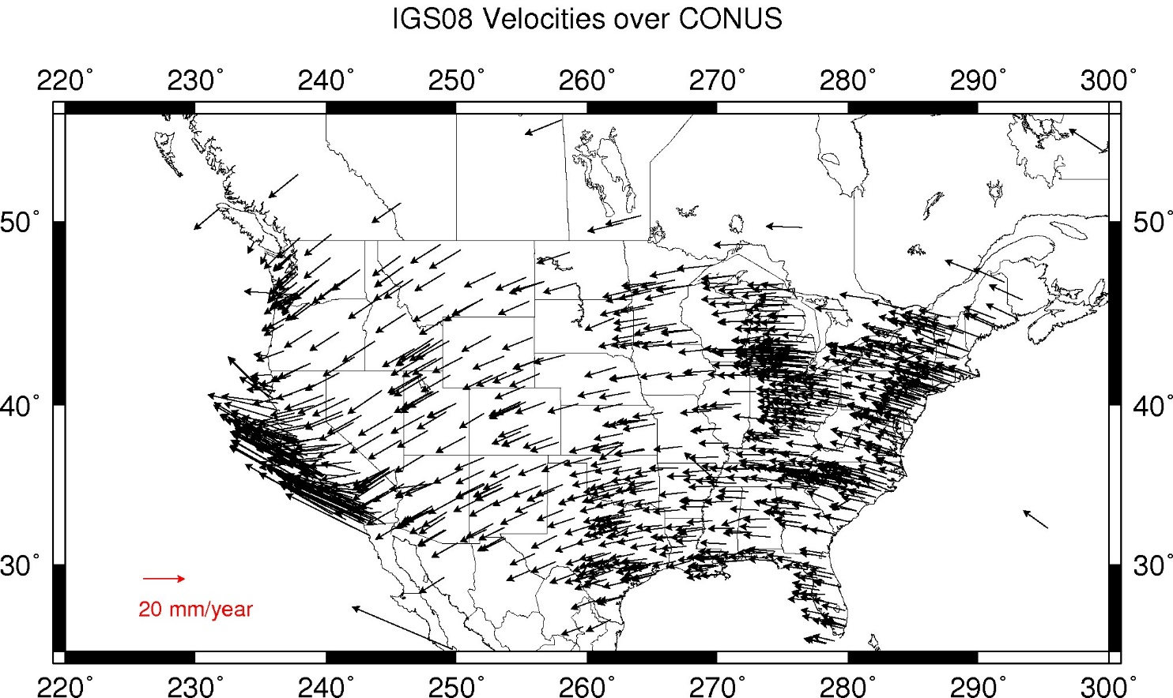
IFVM2022 Velocities – ITRF2020/CONUS

Slide 32
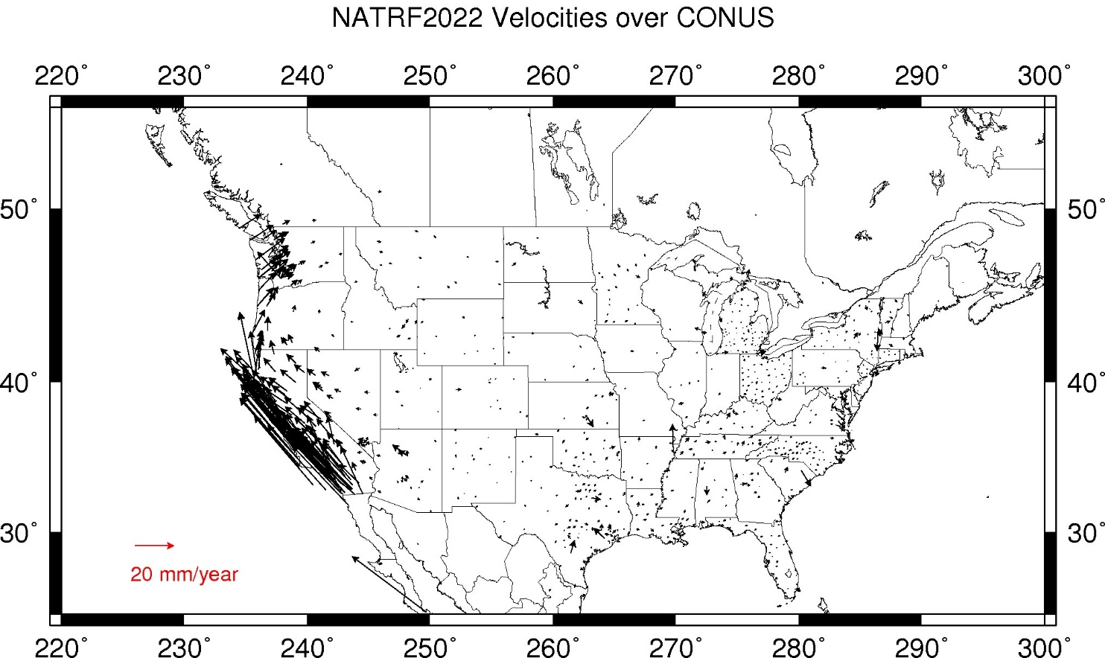
IFVM2022 Velocities – NATRF2022/CONUS

Slide 33
Replacing NAVD 88
  The New:
  The North American-Pacific
  Geopotential Datum of 2022
  (NAPGD2022)
  - Will include GEOID2022
  The Old:
  NAVD 88
  PRVD 02
  VIVD09
  ASVD02
  NMVD03
  GUVD04
  IGLD 85
  IGSN71
  GEOID12B
  DEFLEC12B
Orthometric
Heights
Normal
Orthometric
Heights
Dynamic
Heights
Gravity
Geoid
Undulations
Deflections of
the Vertical

Slide 34
Shift and Drift
When transitioning from NAVD 88 or another vertical datum, your coordinates will shift
and drift:
  Shift: A one-time jump somewhere in the 0 to 2 meter range (orthometric height)
    From fixing biases and/or tilts in NAVD 88 and others
  Drift: Coordinates are now time-dependent. The shift will take you to 2020.00. Working at any other epoch means you must account for the drift (velocity) of your coordinates
    As well as any other motions over time

Slide 35
NAVD 88 (epoch ?) to
NAPGD2022 Epoch 2020.00 (estimate)

Slide 36

Definitional Relationship
$${H(t)}_{NAPGD2022}≡{h(t)}_{ITRF2020}−{N\left(t\right)}_{GEOID2022 }$$
We end with orthometric height in NAPGD2022 at the same epoch as the survey.
All work is done in ITRF2020 XYZ coordinates first.
They are associated with the epoch of the data collection (survey) “t”, then converted to φ, λ and (especially relevant here) h.
Conversion to orthometric heights is definitional through GEOID2022.
Contrast with NGS hybrid geoids where the equation H=h-N did not close.

Slide 37
Drift
In geometric coordinates we needed to only concern ourselves with the movement of marks themselves
In the geopotential datum we must also account for the movement of the geoid

Slide 38
New Types of Coordinates
NGS anticipates that 5 types of coordinates will be used in the NSRS. They are:
Reported
OPUS
Survey Epoch
Reference Epoch
Active

Slide 39
New Types of Coordinates
Reported
  “These are from any source where the coordinate is directly reported to NGS without the data necessary for NGS to replicate the coordinate.”
    Scaled from a map
    Transformed using NCAT or VDatum
    Smartphone
    Reported directly from an RTK rover without data files

Slide 40
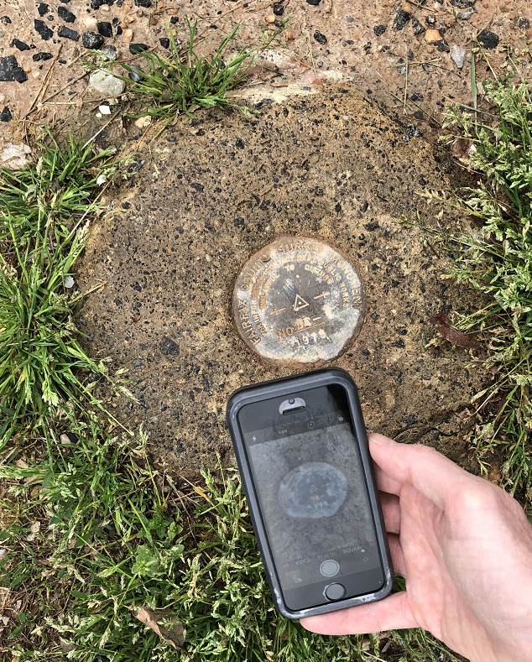
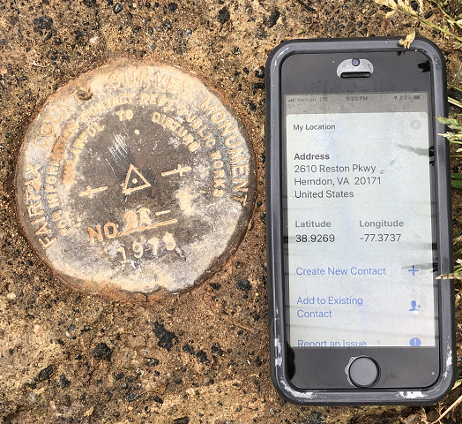
Reported Coordinates

Slide 41
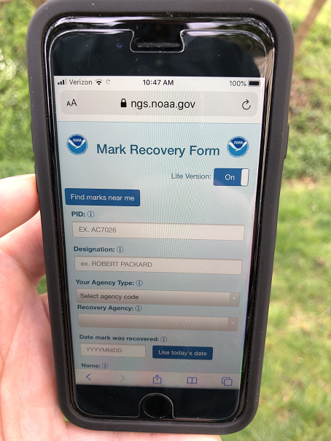
Speaking of Smartphones…
NGS has a new mobile-friendly mark recovery webpage. Please try it out!
https://www.ngs.noaa.gov/cgi-bin/mark_recovery_form.prl

Slide 42
Buyer Beware!
Reported coordinates might be very wrong!
  Reported in NAD 27 or NAD 83 or WGS 84
    Systematic Error: 2–100 meters
  Scaled off of a USGS topographic map
    Random Error: ± 600 meters
  Smartphone
    Random Error: ± 10–50 meters
NGS will show you reported coordinates
  But their function is to get you “in the neighborhood” of a mark, not to use as geodetic control!

Slide 43
New Types of Coordinates
OPUS
  “These are coordinates at any epoch the user wishes to use that have been computed by that user in OPUS”
    User-computed values, such as they might get today from either OPUS-S or OPUS-Projects
    “OPUS” coordinates are the only coordinates a user will get directly from OPUS
    NGS will not evaluate your OPUS coordinates!

Slide 44
New Types of Coordinates
Reference epoch coordinates (RECs)
  “These are coordinates which have been estimated by NGS, from time-dependent age-limited historic survey data, CORS coordinate functions and an intra-frame velocity model, at an official NSRS reference epoch
    NAD 83(2011) epoch 2010.00 (sort of) would’ve fallen under this category
    These will be computed by NGS every 5 years
      On a schedule 2–3 years past the reference epoch
        2020.00 coordinates are computed in CY 2022, etc

Slide 45
New Types of Coordinates
Survey epoch coordinates (SECs)
  “These are coordinates computed by NGS using submitted data and metadata, checked and adjusted and referenced to distinct epochs through time.”
    These represent the best estimates NGS has of the time-dependent coordinates at any mark
    Adjusting multiple surveys in timespans called “adjustment windows”, to a single epoch within that window.
      Initial plan: 4 weeks for GNSS; 1 year for leveling

Slide 46
New Types of Coordinates
Active coordinates (ACs)
  Not discrete, but rather a function through time assigned to some point
    At a CORS GRP*, they will be the coordinate function
      Which will be generated by a “fit” to regularly computed coordinates on a TBD basis, perhaps daily, perhaps weekly
        These daily or weekly coordinates will not generally be used as geodetic control by themselves
* This is the physical point to which coordinates refer at a station like a CORS

Slide 47
What “Access” to the NSRS Will Mean
Very similar philosophically:
  The NSRS remains “geodetic control” for you to “access”
    Geospatial information and metadata about various points
    Passive control will exist…we aren’t getting out bulldozers and shovels
      But gone are the days of getting “the coordinate” on a point from a “datasheet”

Slide 48
What “Access” to the NSRS Will Mean
Very different practically
  Information: from the Data Delivery System (DDS)
    Graphics (pictures, graphs, maps)
  Computations: OPUS
    Do-it-all (mark reporting, positioning, adjustments, etc)
  Heavy emphasis on using GNSS to get to the NSRS
    All constellations will be supported
    Real time helpful CORS information (data availability & quality)
    Use new GNSS
      Or, maybe, some “trusted” passive control
      Otherwise, your OPUS coordinates may say “not NSRS coordinates”
yet

Slide 49
OPUS
The Online Positioning User Service
  NGS will cease the expanding “hyphenated” versions
    OPUS-Projects, OPUS-S, OPUS-RS, OPUS-Share, etc
  Will replace
    All internal versions of OPUS
    All user versions of OPUS
    All forms of “Bluebooking”
      Analyzing, adjusting, submitting geodetic survey data to NGS
    Mark Recovery and Reporting Tool

Slide 50
GNSS Is Key
Leveling can (and will) still tell you differential heights
  But for OPUS to provide you absolute NSRS coordinates, you’ll need to “get into the datum”
    Trusted geodetic control:
      Primary: New GNSS to get ellipsoid heights
        Maybe (still under consideration): “Recently” surveyed passive control
        Then GEOID2022 to get orthometric heights
      Then pick an “appropriate” epoch for your adjustment
      Now you’re “in the datum”.

Slide 51
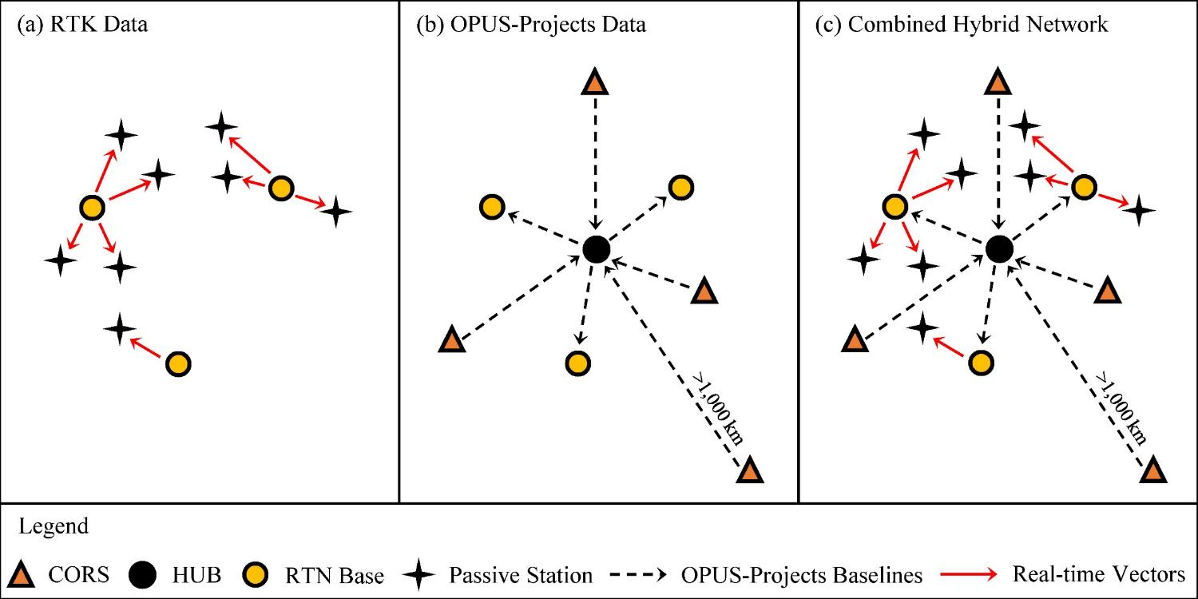
OPUS will soon take in RTK vectors!

Slide 52
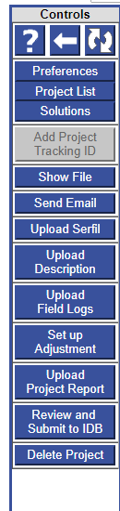
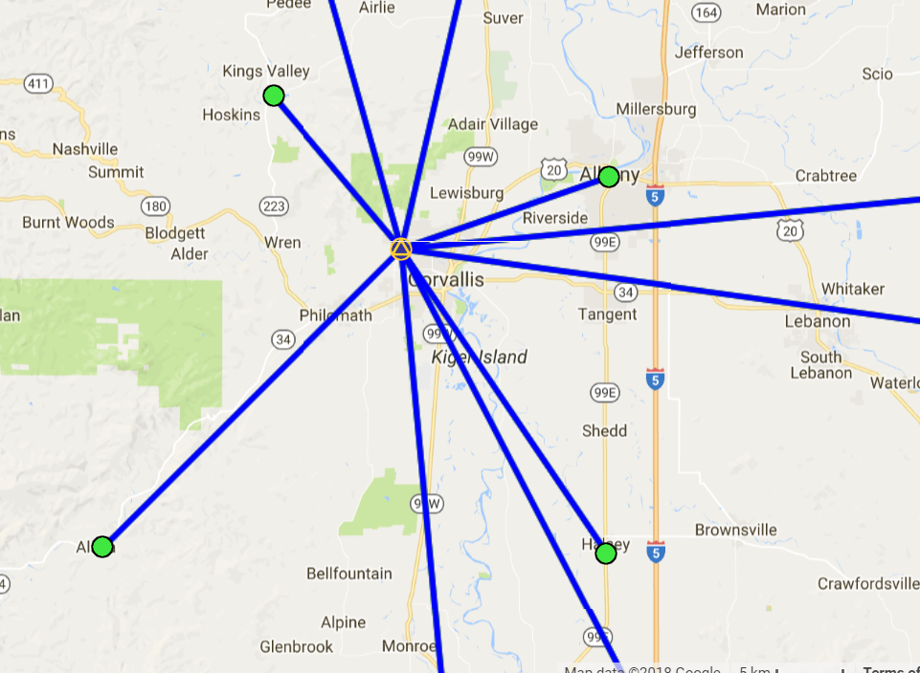
Example: Upload RTN Vectors to
OPUS-Projects
LEGEND
CORS
User Mark
Processed Vector (OPUS-Projects)
Uploaded Vector
Upload Vectors

Slide 53
Conversion? Transformation?
Historically NGS has been inconsistent with these two words. Going forward, we will use them as:
  Conversion: Changing the type of coordinate without changing the datum or frame
    e.g. change NAD 83(1986) latitude and longitude to NAD 83(1986) State Plane Coordinates
  Transformation: Changing the datum or frame, without changing the type of coordinate
    e.g. changing an NAD 27 latitude & longitude to an NAD 83(1986) latitude & longitude
So, for example, “NADCON” which transforms coordinates between datums really should have been called “NADTRAN.” C’est la vie.

Slide 54
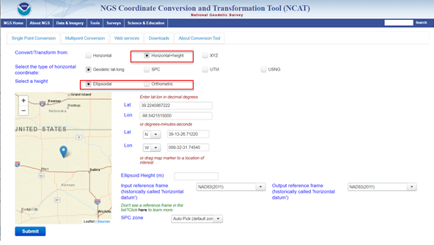
NCAT - with NADCON & VERTCON!

Slide 55
Ways to Use NCAT
Browser: Interactive, 1 point at a time
Browser: Upload a file / get a file back (text, xlsx)
As a Web Service
Download and run locally
  Beware: This works, but NCAT is updated frequently, so the copy you have may be outdated, so always download the latest version

Slide 56
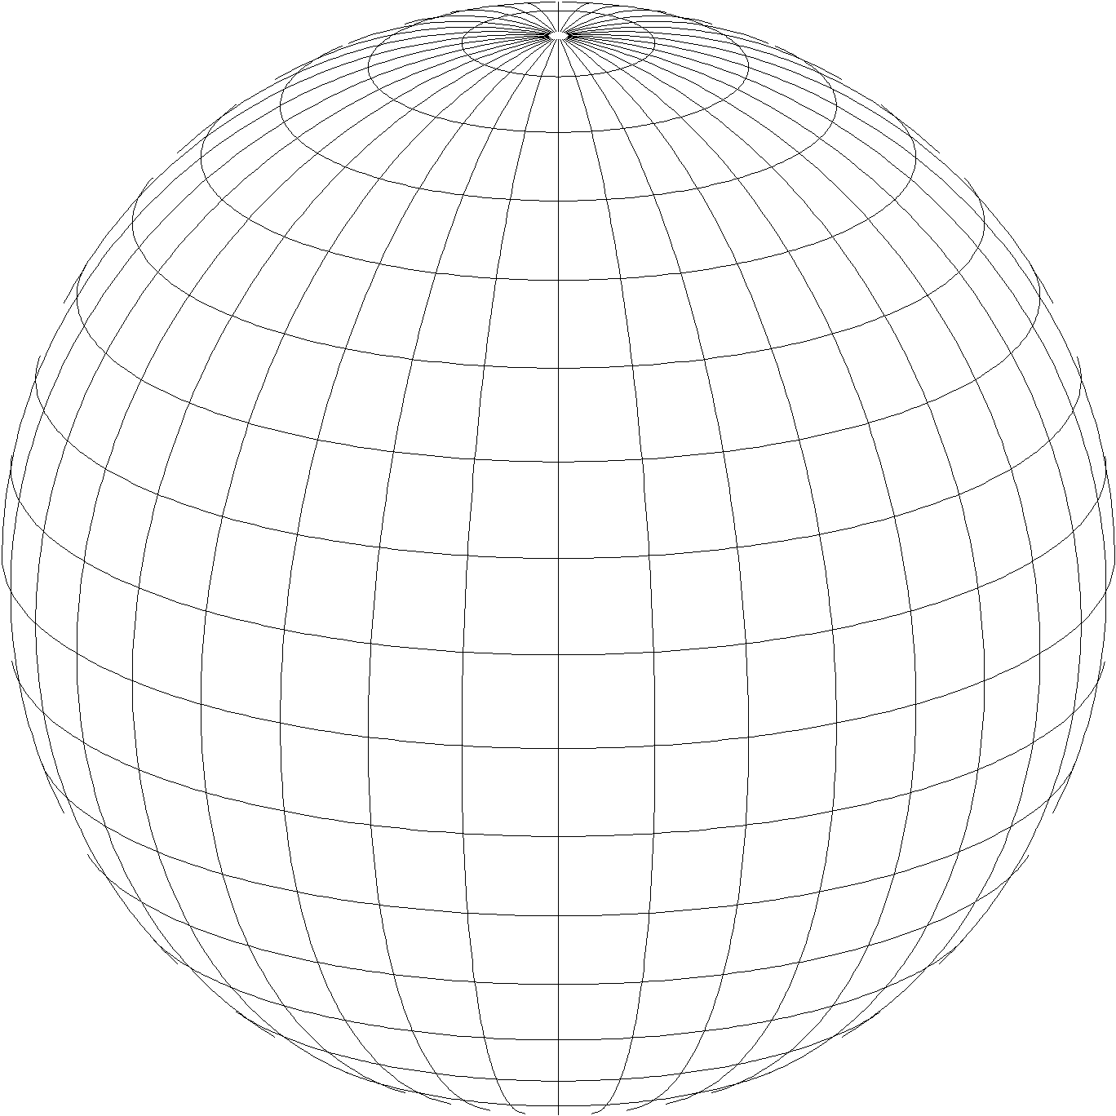
A New State Plane for 2022
State Plane Coordinate System of 2022 (SPCS2022)
  Referenced to 2022 Terrestrial Reference Frames (TRFs)
  Based on same reference ellipsoid as SPCS 83 (GRS 80)
  Same 3 conformal projection types as SPCS 83 and 27:
Lambert Conformal Conic (LCC)
Transverse Mercator (TM)
Oblique Mercator (OM)

Slide 57
Overall SPCS2022 characteristics
Minimize distortion at topo surface, not ellipsoid
NGS will design:
  Statewide zone for every state
  Default zones if no input from stakeholders (most with same zone extents and projection type as SPCS 83)
Max of up to 3 zone “layers” allowed
  1 statewide plus 0, 1, or 2 multiple-zone layers
  Most states will have total of 2 layers

Slide 58
Overall SPCS2022 characteristics
Stakeholders can request and propose preferences
  Proposal and request deadline was March 31, 2020
  Can still change/add/remove zones after 2022
See SPCS2022 policy and procedures for details https://geodesy.noaa.gov/SPCS/policy.shtml
Many states requested and proposed preferences
  All zone designs will be finalized in 2021
  Can change/add/remove zones after official rollout

Slide 59
Linear distortion with respect to ellipsoid and ground
Horizontal ground distance
> ellipsoid distance
and
> grid distance
Topographic surface
Projection
axis
Ellipsoid surface
Ellipsoid distance
Projection surface (secant)
Grid distance > ellipsoidal distance (distortion > 0)
Grid distance < ellipsoidal distance (distortion < 0)
Ellipsoid surface
Ellipsoid distance
This design approach
used for SPCS 27 and 83 (minimizes distortion with respect to ellipsoid)
Positive and negative distortion with respect to ellipsoid is balanced over width of zone; distortion at topo surface not considered.

Slide 60
Changing projection axis to reduce distortion variation
Area of interest
Topographic surface
Topographic surface
Grid distance = ground distance at a point
Grid distance = ground distance at many points
Projection
axis
Projection
axis
Grid distance = ground distance outside area of interest
Non-intersecting
Grid distance ≈ ground distance over finite distance
Non-intersecting
Purpose is to reduce linear distortion at “ground” (topographic surface).
But distortion can vary considerably across area of interest.
ONLY way to reduce variation in distortion is to change projection axis location (or change projection type).
Ellipsoid surface
This design approach is used for SPCS2022 (minimizes distortion with respect to topography)

Slide 61
SPCS2022 zones designed by NGS
Linear distortion design criterion
  Parts per million (ppm), e.g., ±20 , ±50 , ±100 ppm, etc.
Criterion must satisfy all of following:
  90% of population
  75% of all cities and towns (by location only)
  50% of entire zone area
Limitations for designs by NGS
  Minimum design criterion ±50 ppm (1:20,000)
  May be less for default zones if existing zone small
Low distortion projections (LDPs): < ±50 ppm
  Must be designed by others

Slide 62
Bye, bye, U.S. survey foot…
In modernized NSRS, NGS will support only one definition of the “foot”
  Previously called the “international foot”
  Now, just the “foot”
  1 foot = 0.3048 meter (exact)
However
  Recommend using term “international foot” when there is potential for confusion with other foot
  NGS will continue to support U.S. survey foot for legacy applications (e.g., SPCS 83 and 27)

Slide 63
NSRS Modernization: DELAY
It’s official: we are delayed beyond 2022
On June 23, 2020, this message was rolled out via:
  NGS Web Page
  NSRS Modernization News Special Issue
  Granicus Announcement
  Notifications to NSPS, AAGS, FGDC/FGCS

Slide 64
NSRS Modernization: DELAY
A list of FAQs is available. Some summary highlights:
  Why are we delayed?
    GRAV-D issues (COVID-19, airspace, unforeseen maintenance)
    Personnel issues (Losses, hiring issues, probably some “burn out” too)
  How long is the delay?
    Unknown. If we don’t change anything about how we will roll things out, it’ll be in the 2024–2025 timeframe
  Will names change?
    No, “GEOID2022”, “NATRF2022”, etc. will remain the same

Slide 65
Summary
The NSRS of today is based on:
  Pre-space-age geodetic technology
  The concept of one unique coordinate assigned to a point, in perpetuity
The modernized NSRS will:
  Leverage GNSS
  Embrace the movements of points on Earth’s crust

Slide 66
Summary
Your NAD 83 coordinates may change by 2–4 meters
Your orthometric heights may change by up to 2 meters (or more)
Magnitude of change will vary with location:
  NAD 83 will change by about 0.5 to 4 meters horizontally
  Orthometric and NAD 83 ellipsoid heights will change by up to about 2 meters
And that just gets you to a “reference epoch”
  Which continues to perpetuate the “one coordinate in perpetuity” myth
  After that, real motions kick in and become part of the world of geodetic control

Slide 67
Summary
But it’s not all “change”…
  You will still be able to:
    Get a position using OPUS
    Adjust your projects to some reference epoch
    Look at a mark’s “datasheet”
  Only now, there will be a lot more information and a lot more service provided

Slide 68
Thank You

