Slide 1
An Update from the National Geodetic Survey
Daniel R. Roman, Ph.D.
Chief, SRSD GRAV-D P.I.
TRB AFB80 Summer Meeting
Indianapolis, IN 27-29 July 2015

Slide 2
Outline
NGS Personnel Changes
SRSD Personnel Changes
2022 Reference Frames
  Reference Frames≈Datums
  Geometric
    CORS Updates
    OPUS Updates
  Vertical (Geopotential)
    GSVS 11/14/16
    GRAV-D
    xGEOID14/15
Geospatial Summit
Outreach Efforts
Summary and Outlook

Slide 3
NGS Personnel Changes
HQ
  Dru Smith now NSRS Implementation Manager (e.g., 2022 datums)
  Neil Weston is now Chief Geodesist
  Brett Howe is serving as acting Deputy Director
Other Divisions
  Vicki Childers is now the Chief, OAD
  Gerry Mader has retired as Chief, GRD
  Steve Hilla is filling in as acting Chief, GRD
  Ross Mackay is filling in as acting Chief, GSD

Slide 4
Personnel Changes in SRSD
GSA Branch
  Bang Le is new RTN Liaison
  Dave Hatcher and Weibing Wang are OPUS Analyst
  They replace Cindy Craig and Bob Siclari (01 SEP)
CORS Branch
  Kevin Choi is Branch Chief and will soon divest ACC duties
  Sungpil Yoon and Jarir Saleh are Orbiteers
  Fran Coloma and Lijuan Sun are CORS Analysts

Slide 5
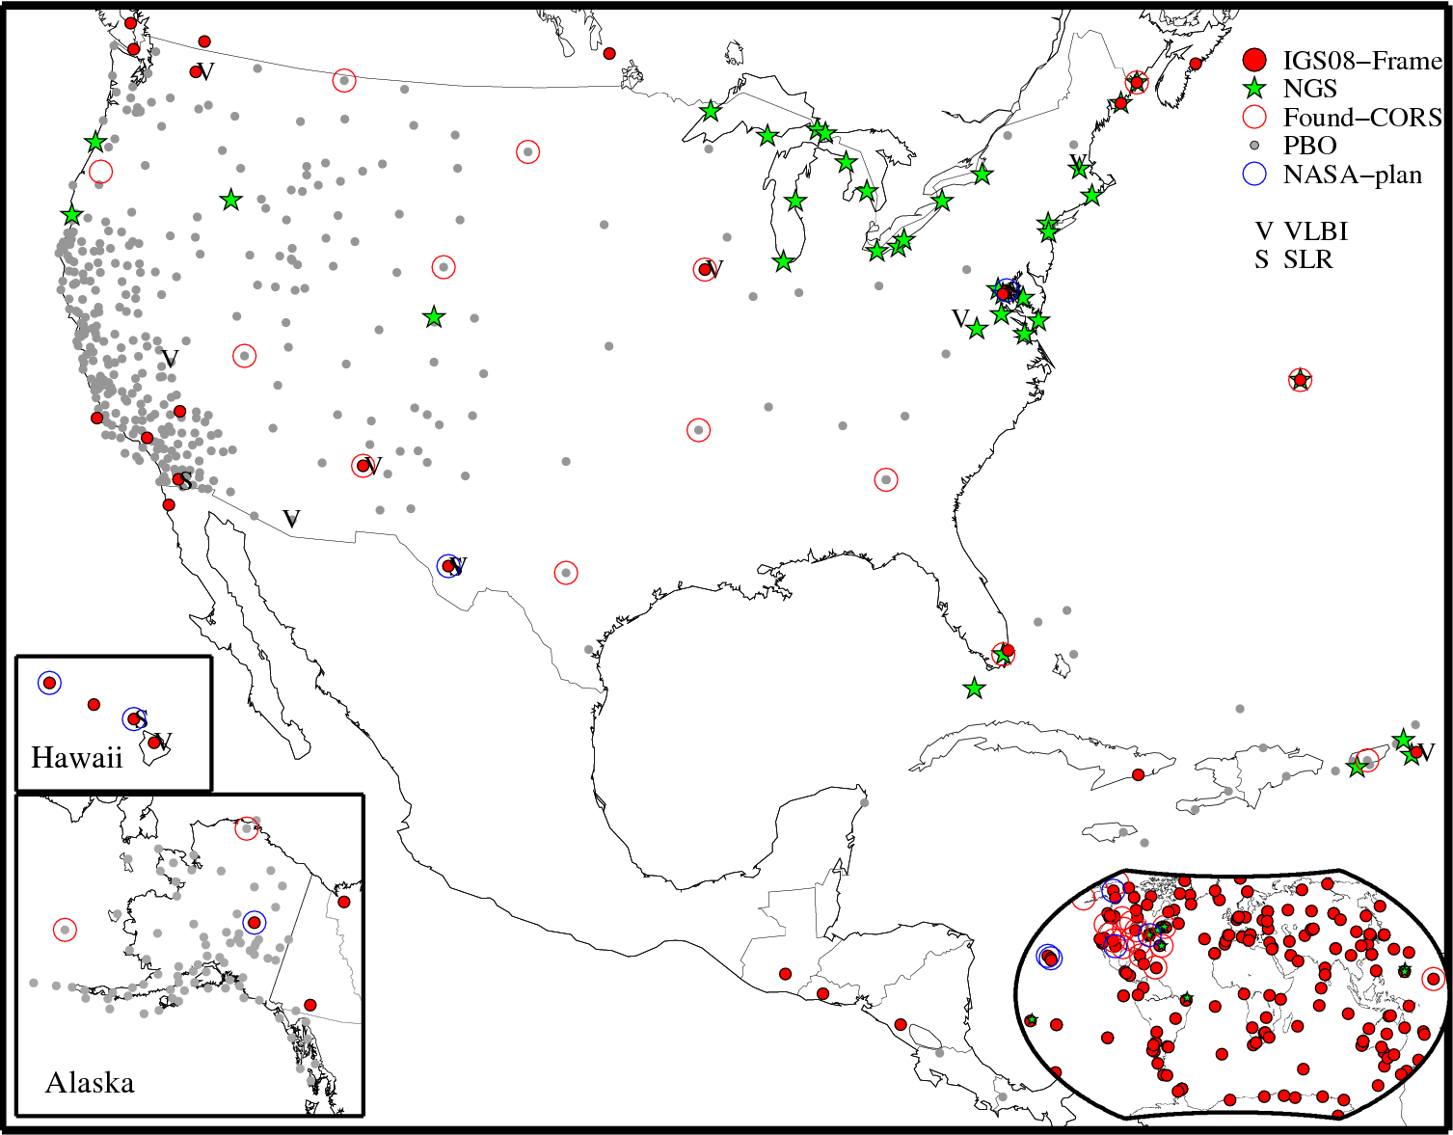
2022 Geometric Reference Frame
Possible Foundation CORS
Will be fit from global to local
  Foundation CORS will be the U.S. subset of IGS global sites
These will adjust the CORS Sites
  Collected/archived at ~ 2000 sites
  Even when a site is dropped, it must be maintained in the list
CORS Sites can then adjust RTN’s
Akin to Helmert Blocking scheme

Slide 6
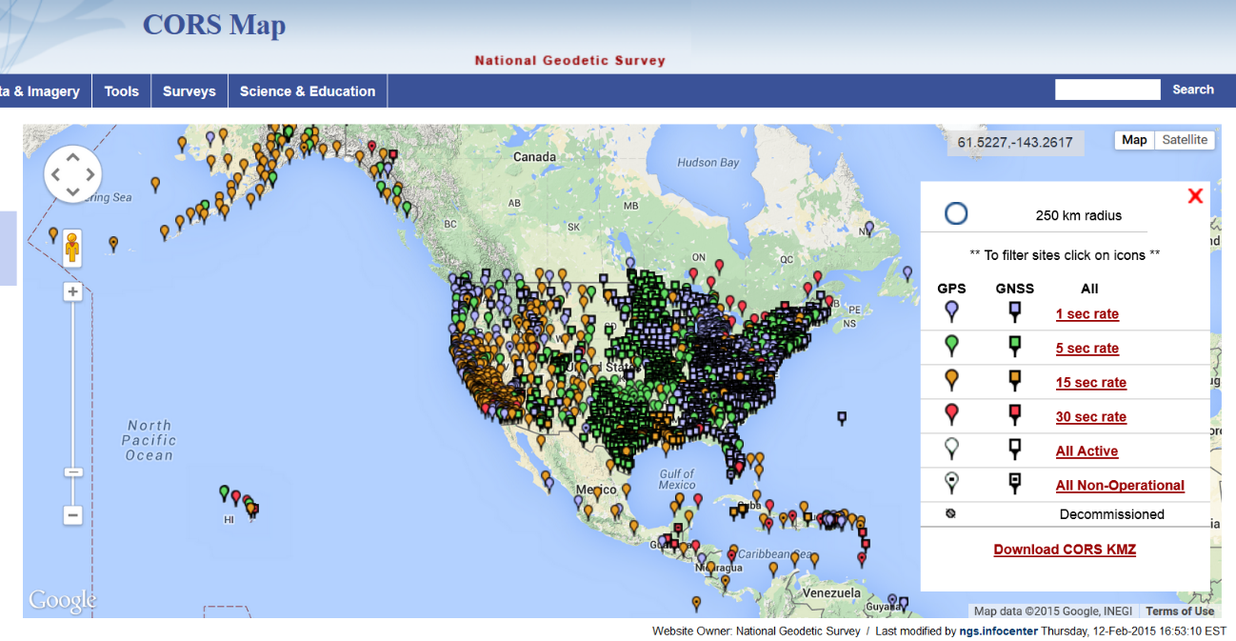
2022 Geometric Reference Frame
The archived CORS data are used in OPUS tools
  Currently, OPUS output is only Shared (e.g., OPUS Database)
  Official coordinates remain those in the NGSIDB
RTN Validator tool in DEV
  Difference between OPUS solution and reported coordinates
  Expedited upload – as frequent as wanted
QA test of OPUS-S with
2-hour data sets at 200 CORS:
Compare output to CORS coord.
Mean: <0.1 cm
N-S RMS: 0.8 cm
E-W RMS: 1.4 cm

Slide 7
Validate RTNs with a modified OPUS process
Major steps in OPUS are shown in left column
Some steps can be skipped for RTN case
Site is well established
Operator would have an ID and appropriate header info
Expedited upload avoids most QC checks
Upload to webpage
RTN appends RINEX header
(OPUS ID)
OPUS Solution
FTP Site
Describe/ OPUS ID
Verify
Approve
Display on RTN Validator
Review
OPUS-DB

Slide 8
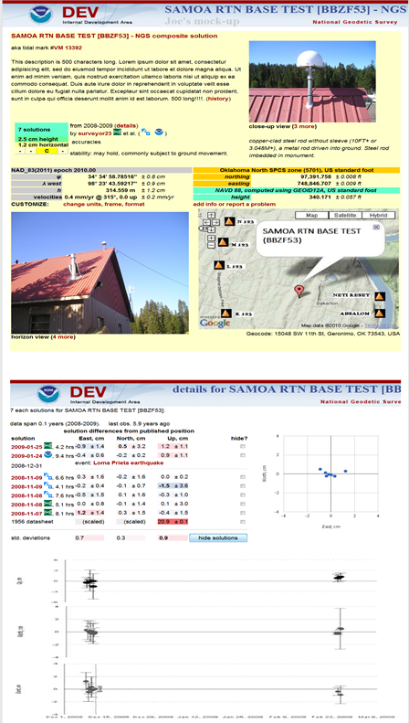
RTN Validator Tool for Base Station
On a periodic (e.g., daily) basis, data are FTP’d and processed
Top section has similar elements as in OPUS-DB
Middle section shows available solutions
Bottom shows a time series for X-Y-Z or lat-lon-ht
Offset and trends are clear

Slide 9
RTN Validation for Users
To evaluate the base station, the RTN operator would make that sheet available and/or publish to OPUS-DB
Additionally, occupy established GPS bench marks listed in either the NGSIDB or OPUS-DB
  Any systematic features observed between the established solutions and those from roving on the RTN would indicate a potential bias/offset
  Should be located within 20 km intervals

Slide 10
CORS Updates
Repro2 – better late than never
  Reprocessing 1 (or repro1) happened as a part of IGS08/MYCS
  After Kevin Choi turns over his IGS ACC duties (December)
  Will reprocess all CORS data (cleaning, stacking, etc.)
  Will bring in newer CORS sites (since 2008) and update velocities
  Will define transformation to IGS2014
  For CORS site coordinates, orbits, and derived positions
  There will not be a new Realization of NAD 83
    Since IGS2014 is expected to nearly equal IGS2008

Slide 11
CORS Updates (continued)
Reference Frame definition
  Likely adopting most recent IGS model (e.g. 2014 if nothing newer)
  Examining plate fixed vs. semi-dynamic vs. dynamic
  Velocities could be as simple as Euler pole rotation to use of HTDP
GNSS data collection
  40% of CORS sites have GNSS receivers (GLONASS)
  Started archiving this data in January of this year
  Not using the GNSS data in OPUSS yet but will eventually (2022 goal)

Slide 12
OPUS
NOS/NGS 58/59 updates
  HT MOD surveys still are being bluebooked
  Goal it so have OPUS Projects (OP) replace this
  Two separate studies: OSU vs. OSU (Ohio State U. vs. Oregon State U.)
  Possibly reduction in collection times
  Still aiming for Fall of 2016
OPUS Projects
  Multiple observations on multiple sites on multiple days
  Uses hub and spoke design to get local control plus national ties

Slide 13
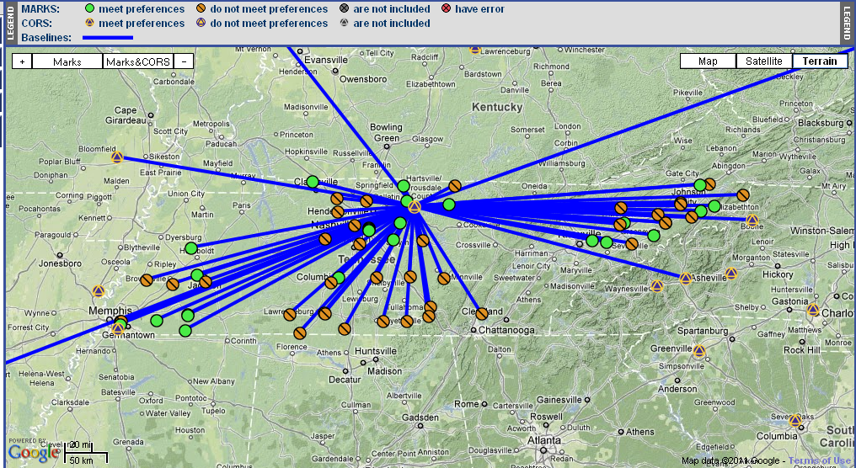
Simple Hub & Spoke Network Design Strategy
Consider a single hub site when that mark has more than 4 hrs of data:
Include and tightly constrain CORS, loosely constrain the hub.
Connection to CORS creates a strong connection to the ITRF.
Provides a consistent reference for each project mark.
Notes:
This is just a suggestion. Generally, there is no right or wrong design. Always follow your project’s specifications.

Slide 14
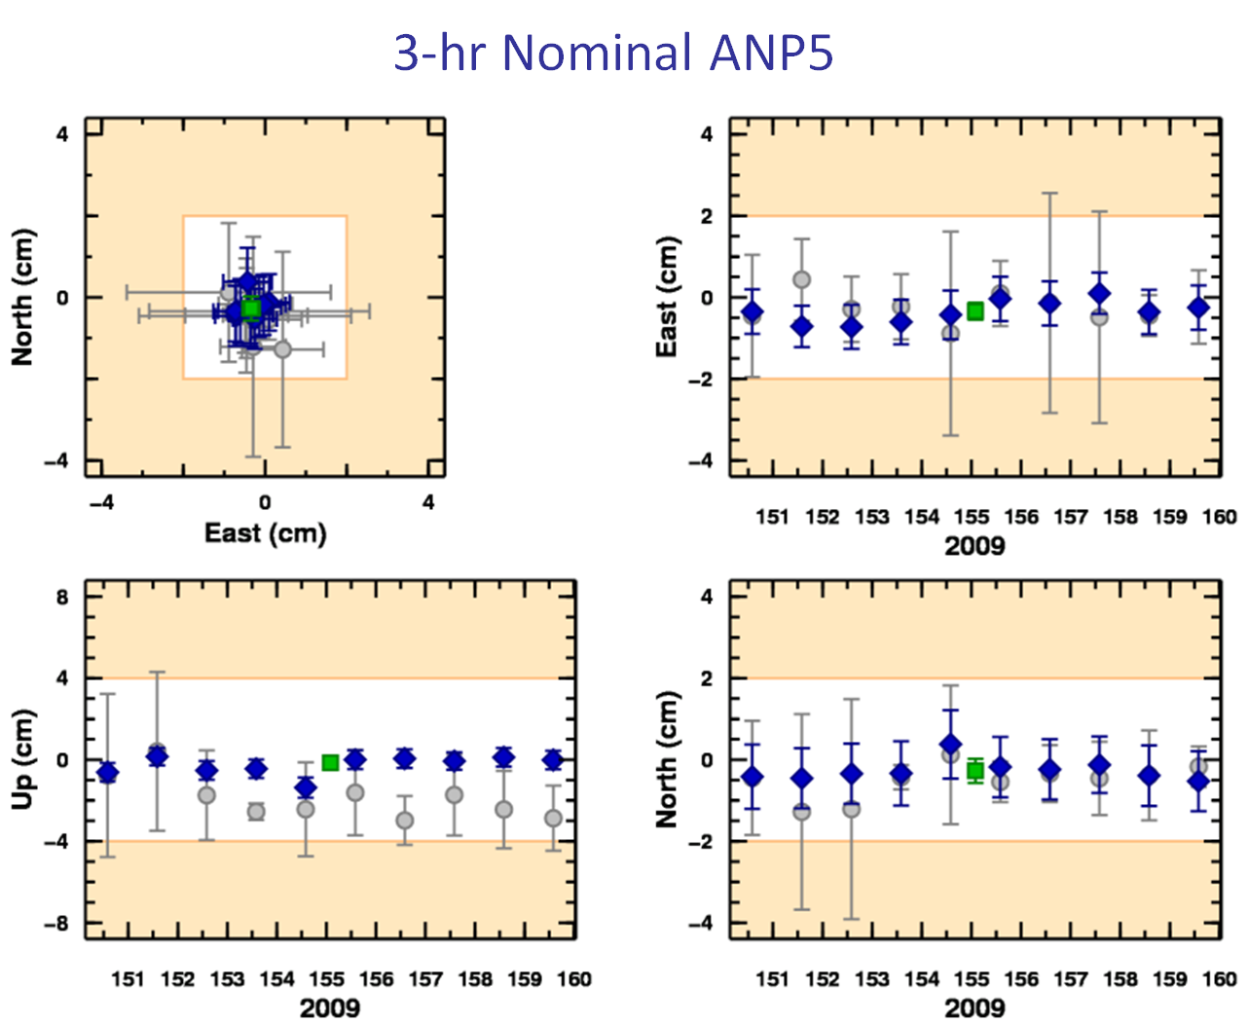
What’s in it for me?
OPUS solutions = pretty good, but each treated as independent and assumes “perfect” CORS.
Sessions = simultaneously-observed marks processed together in sessions increases consistency.
Adjustments = interlinking sessions through network adjustments increases accuracy.

Slide 15
A Possible Strategy for Use of RTN’s
Use the RTN Validator Tool to keep RTN coordinates consistent
During a survey, use RTN stations as supplemental control
OP permits you to weight the various observations
Upweight the RTN and CORS and downweight the GNSS sites
Adjusts the observations locally based on all sites plus RTN’s
Keeps regional and international control from CORS and ITRF

Slide 16
OPUS (continued)
Currently, OP outputs only to the Project
OP output to OPUS Database
  A project is underway to Share into OPUSDB
OP output to NGSIDB
  Must resolve Bluebook vs. OP results
  Can then use OP to process and then load into NGSIDB
OP output to NSRS DB
  With a NSRS DB defined, OP would feed it directly (2022 goal)

Slide 17
2022 Vertical Reference Frame
Defined through a geopotential model (this is a broad term)
Current models use LSC to fill in between control points
  Doesn’t resolve underlying datum defects (1.2 m trend in NAVD 88)
  These “hybrid” geoid models are datum conversion tools only
  Only as reliable as the accuracy and distribution of the control points
Previous studies show data grid > 1’ yields significant omission
Could use a Gravimetric Geoid model (practical method)
  Geoid model is one arc-minute resolution
  Converts ellipsoid height to orthometric height (H = h – N)
  Conversion to other heights/functions of the gravity is difficult

Slide 18
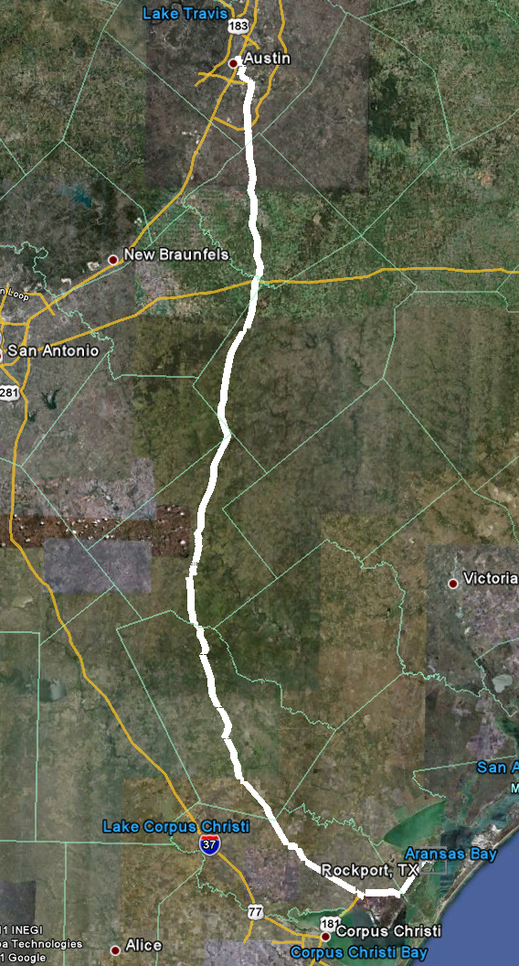
2022 Vertical Reference Frame (continued)
Use a Geopotential model (desired method)
  Geopotential yield any function of gravity field
  Current models limited to degree 2160 => 5’
  For 1’ resolution, require a degree 10,800 model
  Likely ellipsoid harmonics vs. spherical harmonics
Geoid Slope Validation Studies (GSVS)
  GSVS 11 – completed (presented at EGU/elsewhere)
  GSVS 14 – completed but still being processed
  GSVS 16 – being planned (recon IP in Colorado)
  Will be used to check geoid models for vertical RF

Slide 19
Geoid differences from GSVS 11 observations
Data collected along the lines:
  GPS on leveling marks (GPSL)
  Astrogeodetic DoV’s
  Relative & absolute gravity data
Gravity data => xUSGG11 geoid
GPSL => pointwise geoid heights
DoV => pointwise geoid heights

Slide 20
(geoid model – Comb.) along the line
Desire is to compare vs. geoids
Combine the DoV and GPSL
  Long wavelength => GPSL
  Short wavelength => DoV
Now compare against geoids
  xUSGG11 fits closest to zero line
  Other models have large trends

Slide 21
Geoid comparison (model –Comb.)
 | GPSL (mm) | USGG09 (mm) | EGM08 (mm) | xUSGG11 (mm)
Mean | -0.0 | -0.4 | 0.1 | -0.5
STD | 7.6 | 16.9 | 17.2 | 6.7
RMS | 7.6 | 16.9 | 17.2 | 8.2
Min. | -22.2 | -28.0 | -29.1 | -18.2
Max. | 33.0 | 26.7 | 35.1 | 8.7

Slide 22
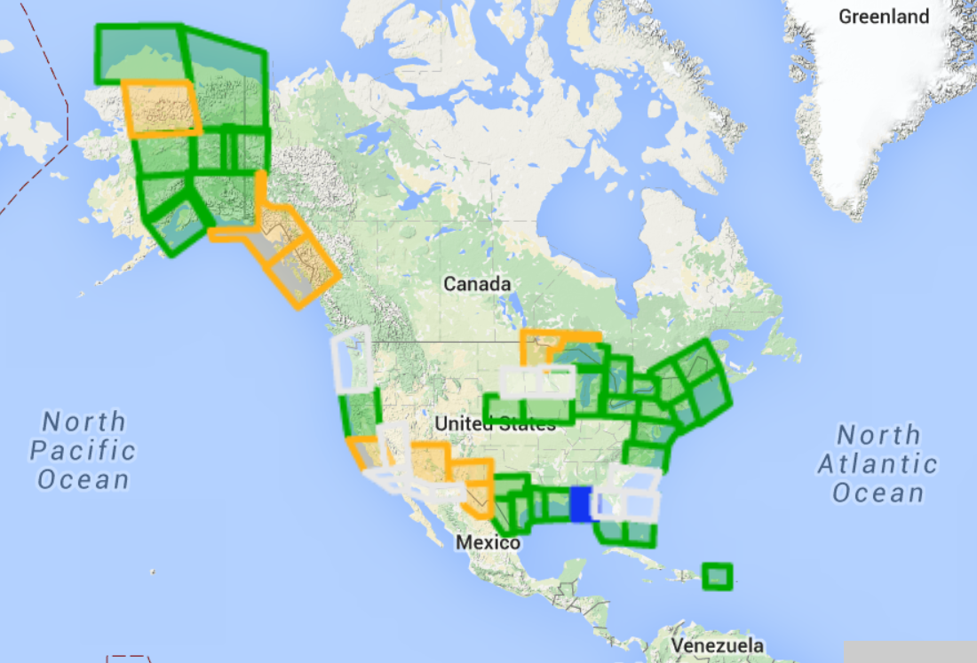
2022 Vertical Reference Frame (continued)
GRAV-D to help define vertical RF
Bridges spectral band between satellite and surface gravity data
Satellite controls long wavelength (global to 500 km scales)
Aerogravity controls intermediate wavelength (40-500 km)
Terrestrial data and terrain models control short wavelength
Map Key - Airborne Gravity Data
Green: Available data and metadata Blue: Data being processed
Orange: Data collection underway White: Planned for data collection

Slide 23
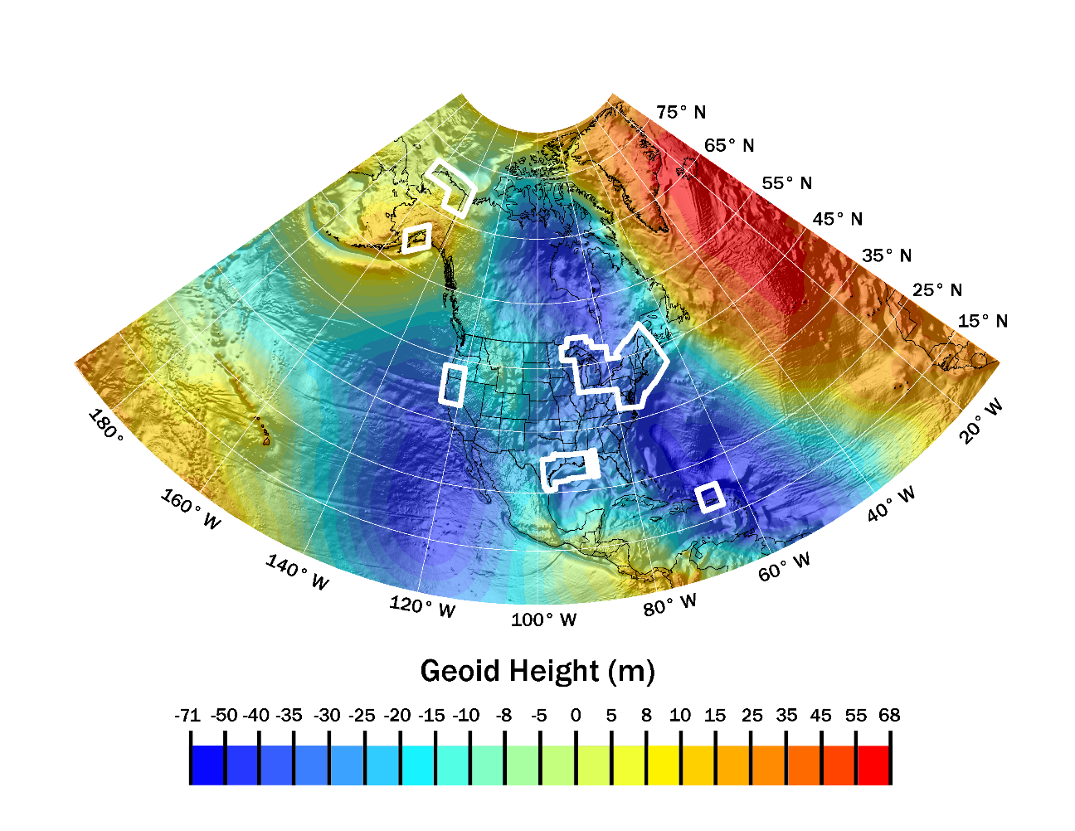
xGEOID14 & xGEOID15
These use available aerogravity
Also use same techniques as USGG models but updated data
xGEOID14A has no aerogravity
xGEOID14B has data available from last year
xGEOID15B is developed but still on Test/DEV website
Will release to Beta in September
beta.ngs.noaa.gov/GEOID/xGEOID14/

Slide 24
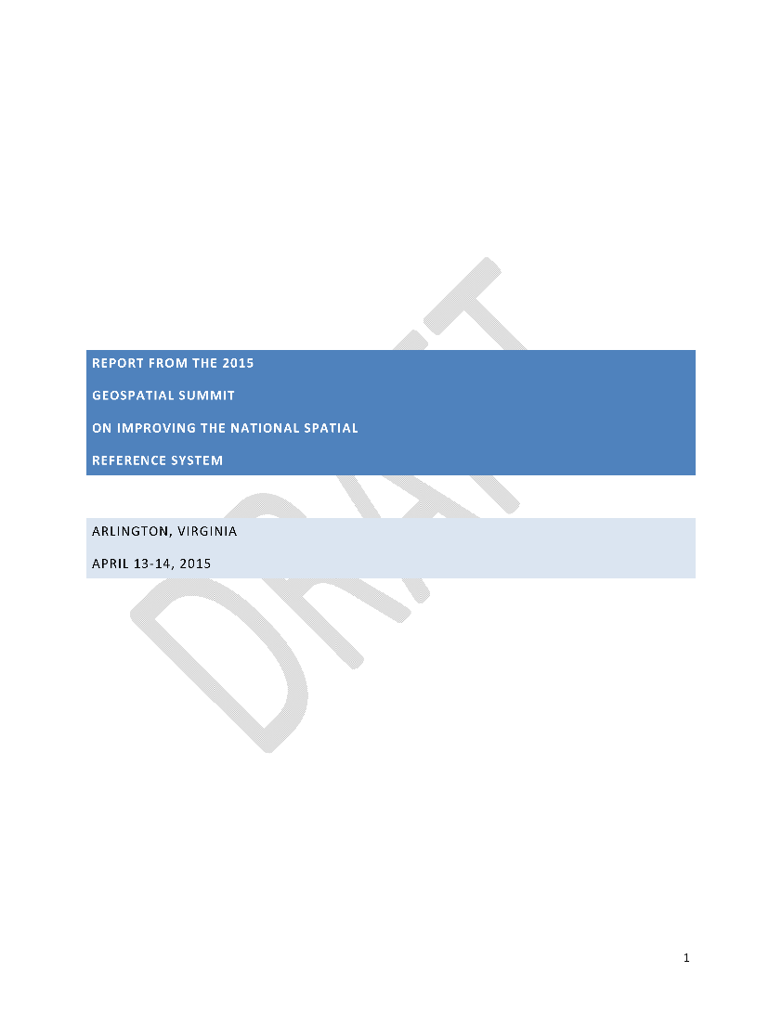
Geospatial Summit Survey Results
Most were from state DOT’s, were surveyors and would favor use of a new SPCS
Desires on plate fixed was mixed
Modeling and removing velocity important
Most valuable NGS services are submitting data to NGS to get a coordinate and downloading data (e.g., CORS and OPUS)
These were followed closely by transformation tools and education/outreach.

Slide 25
Geospatial Summit Survey (continued)
Information specific to the Summit will be discussed at the monthly webinar on Thursday, September 10 at 2 pm eastern
Register online at http://www.ngs.noaa.gov/web/science_edu/webinar_series/Webinars.shtml
It will be recorded for anyone who is interested but cannot attend at that time
There were some NGS Activities and Constituent Activities that seemed to be the consensus coming out of the Summit.

Slide 26
NGS ACTIVITIES
Action 1: Adopt formal project plans and complementary communications plans to outline all activity that must occur between 2015 and the adoption of the new reference frames.
  Deriving a valid path for OPUS-Projects to be loaded into the NGS IDB
  Geometric Transformation Consistency
  NAD 83(86) to NAD 83(NSRS2007) Transformation
  Mathematical Model connecting IGSxx to NewGeRF
  Convert all NGS GPS Software into GNSS
  Common gravity dataset between USA and Canada
  Organize all historic GPS files
  Dynamic Heights from GPS
  NSRS Database

Slide 27
NGS ACTIVITIES
Action 2: Determine the frequency of recurring large summits. These will be supplemented by other communication efforts, including but not limited to: quarterly meetings with surveyors associations, participation in large surveyor and GIS conferences, a monthly NGS Webinar Series, continued and expanding training opportunities, and ever-growing Web resources.
Action 3: Regular communication regarding policies as they are adopted by the Executive Steering Committee regarding the definition or access to the new reference frames.
Action 4: Continued improvement to the Geodetic Toolkit, in anticipation of a geospatially enabled database with robust transformation tools to link NAD 83 and NAVD 88 to the new reference frames.

Slide 28
CONSTITUENT ACTIVITIES
Action 1: Provide feedback and engage with NOAA and NGS through summits and other NGS efforts, monthly meetings, guest columns in trade publications, and through regular NGS website visits.
Action 2: Engage with professional societies such as our summit co-sponsors, NSPS and MAPPS. These societies have a tremendous national and local reach, and NGS will meet with them consistently to best take advantage of their communication networks that translate to the state and local levels.

Slide 29
CONSTITUENT ACTIVITIES
Action 3: Take ownership of this project of transitioning to the new datums, tackling how you manage your data today, change processes moving forward, and prepare for a smooth (as possible) transition.
Action 4: Volunteer and share your data when the opportunities arise. There are some data-sharing options already in place, and NGS will be sure to identify opportunities that are amenable for you to engage in. Most recently NGS has encouraged the public to collect GPS observations on bench marks in conjunction with National Surveyors week, and we expect opportunities like this to recur and expand.

Slide 30
OUTREACH
Will continue at future Geospatial Summits and other national and international meetings.
Continued collaboration with IAG, FIG, and the UN-GGIM
Continued collaboration with Canada, Mexico, and nations in Caribbean and Central America
Will work with state surveying groups through NSPS and others to hone message for States to implement new laws

Slide 31
Summary and Outlook
OPUS Projects (OP) or some derivative thereof will serve as means of determining geometric coordinates in the 2022 Geometric Reference Frame
GNSS data will be used – not just GPS
These coordinates will be used in some type of geopotential model to derive orthometric and other heights
The models will be consistent with other global models and reference systems

Slide 32
Questions?
Daniel R. Roman, Ph.D.
Chief, Spatial Reference System Division
NOAA/NOS, National Geodetic Survey
W: +1-301-713-3200 x103
F: +1-301-713-4324
E: dan.roman@noaa.gov

