Slide 1
Agenda, Part II
TIDAL DATUMS in the South SF Bay
Computing Tidal Datums
-Basic tidal computations
-Common tidal datums
VDATUM
-Sources of error
-Sample values
Bathymetry mapping effort (2005)
-Tidal zonation in South SF Bay for MLLW datum
Preliminary data from new (2011) tide gages
-Dumbarton (9414509)
-Coyote Ck/Alviso Sl (9414575)
Notes:
You’ll be able to tell that I took most of the slides in this next section from CO-OPS webinar. As my last slide, I’ll show you where to find several webinars on Geodetic Vertical and Tidal Datums on NGS webpages.

Slide 2
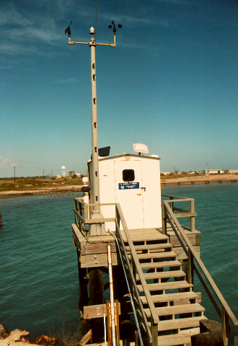
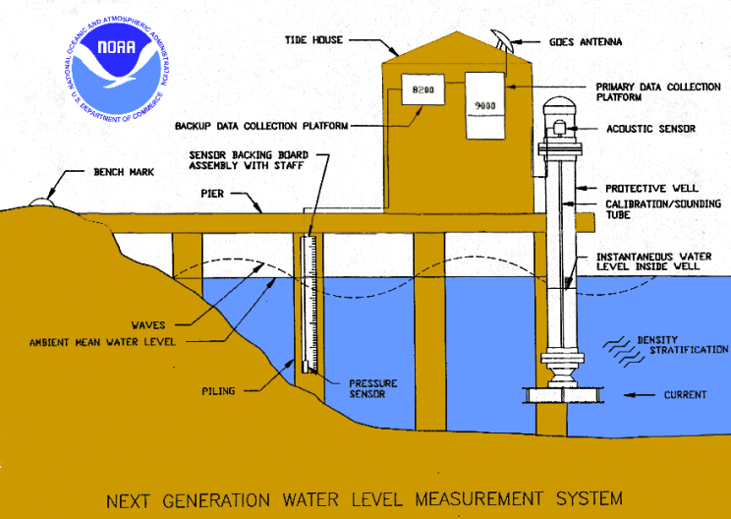
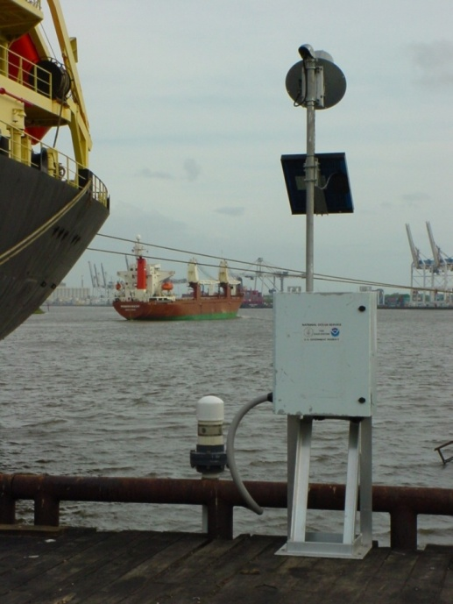
NWLON Stations
Essential Equipment
Control Stations
Automatic water level sensor
Backup water level sensor
Backup & Primary data collection platform
Protective well
Shelter
Solar Panel
GOES satellite radios
Telephone modem
Ancillary geophysical instruments
System of Bench Marks
Water Level
Wind Speed/Direction
Barometric Pressure
Air/Water Temp.
Conductivity/Temp
Chart Datum
Tsunami/Storm Surge
Short term stations
Data Collection Platform
Acoustic or pressure sensor
Solar Panel
GOES Transmitter
Observations
Collected

Slide 3
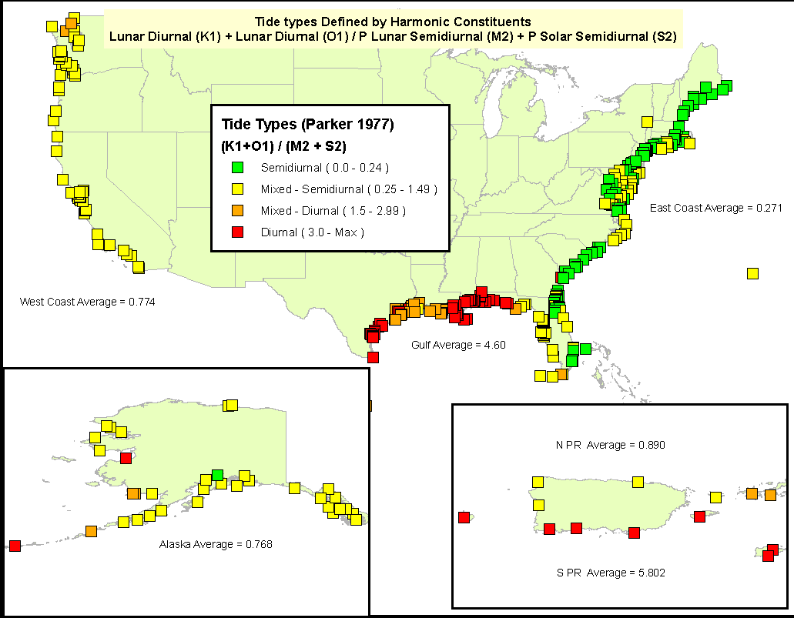
Types of Tides
Tide Type Varies by Region due to Local Hydrodynamics

Slide 4
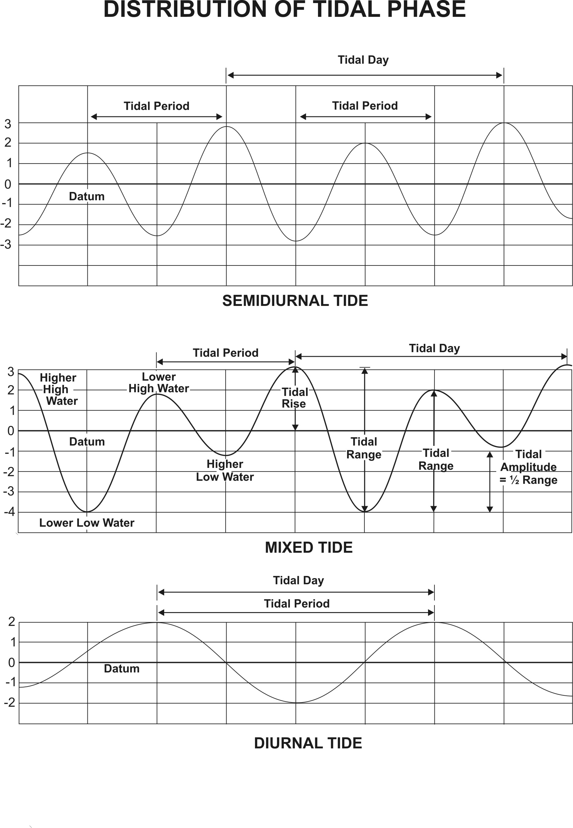
Types of Tides
Semidiurnal
two daily highs & lows
~ similar height
Most common
Mixed
two daily highs & lows
~ not similar height
Diurnal
one daily high & low

Slide 5
Tide Generating Forces
Astronomical Forces:
Gravitational pull of Moon creates bulge directly beneath Moon
Centrifugal forces due to the Earth-Moon’s rotation creates second bulge opposite of Moon
Variations in the positions of the Moon & Sun relative to the Earth produce monthly variations in tides
Variations in the path of the Moon about the Sun produce decadal (18.6 yr) variations in tides
Variations in the distance of the Earth/Moon from the Sun/Earth due to their elliptical orbits produce annual/monthly variations in tides
Variations in the declination of the Moon produces daily variations in the tides
Tides:
Deterministic; predictable
With enough water level data, the tides can be predicted indefinitely for that location until/when there are changes to the geometry—bathymetrically or along the coastline

Slide 6
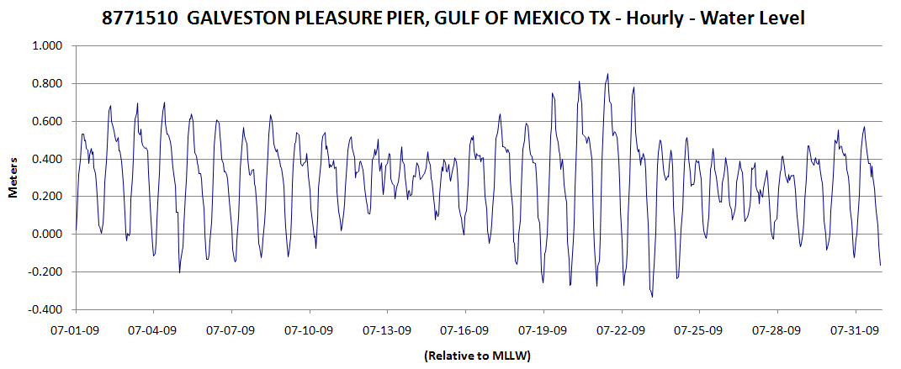
Moon Phase Inequality
Affects the amplitude of the tides (tidal range)
Moon Phases:
Spring
Neap
Spring
Neap

Slide 7
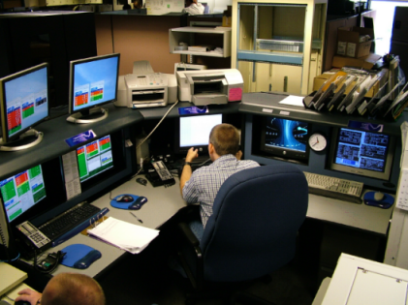
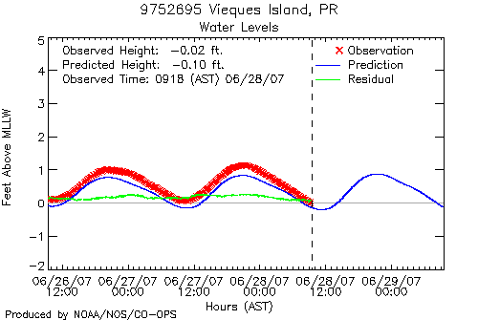
Data Processing
Continuous Operational Real-Time Monitoring System (CORMS)
Real-Time 24x7 QA/QC
Human Analysis
Data Quality Flags (e.g. Rate of Change)
Corrective Action
Post-Processing
Error in Data (e.g. spikes, missing data)
Data Quality Flags: shifts, bias, changes
Tabulation & Product Generation
Backup Gain and Offset
Verification & Acceptance

Slide 8
Data Processing
Criteria for determining a Tide
Programmed into the computer algorithms.
Two-hour rule: Adjacent high and low waters must be different by 2 hours or more in time in order to be counted as a tide.
One-tenth of a foot rule (same as 0.03 m rule): Adjacent high and low waters must be different in elevation by one tenth of a foot (or 0.03 m) or more in order to be counted as a tide for tabulation.
Difference in elevation
Difference in time
Notes:
So we know that there’s a lot of statistics in computing tidal datums, and many of them represent the mean of various water levels measured at the water-land interface over a period of time. What tidal datum is NOT the mean of water level observations?

Slide 9
Tidal Datums
Station Datum: Unique to each water level station
- Established at a lower elevation than the water is ever expected to reach.
- Referenced to the primary bench mark at the station
- Held constant regardless of changes to the water level gauge or tide staff
MHHW: Mean Higher High Water
The average height of the higher high water of each tidal day observed over the NTDE MHW: Mean High Water
The average of all the high water heights observed over the NTDE
MTL: Mean Tide Level
The arithmetic mean of mean high water and mean low water
MSL: Mean Sea Level or LMSL: Local Mean Sea Level
The arithmetic mean of HOURLY heights observed over the NTDE
MLW: Mean Low Water
The average of all the low water heights observed over the NTDE
MLLW: Mean Lower Low Water
The average of the lower low water height of each tidal day observed over the NTDE
GT: Great Diurnal Range
The difference in height between mean higher high water and mean lower low water
Notes:
These tidal datums are recomputed every 19 or so years. In some parts of our jurisdiction, the period is much shorter, eg, 5 years, because the land-sea interface is changing that rapidly, eg, plate tectonics causing upward land motion in Alaska.
Because LMSL includes the hourly values for the 19-yr period, it is the most accurately calculated tidal datum.
The 18.6 year period is called a NTDE.

Slide 10
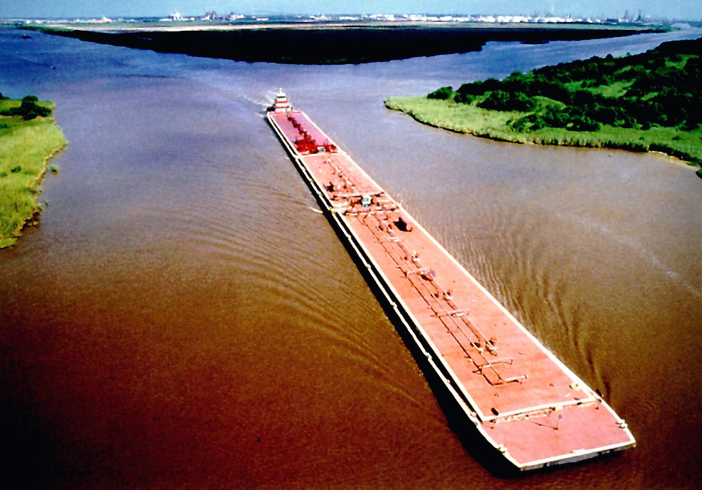
National Tidal Datum Epoch (NTDE)
A common time period to which tidal datums are referenced
A specific 19 year period that includes the longest periodic tidal variations caused by the astronomic tide-producing forces.
Averages out long term seasonal meteorological, hydrologic, and oceanographic fluctuations.
Provides a nationally consistent tidal datum network (bench marks) by accounting for seasonal and apparent environmental trends in sea level that affect the accuracy of tidal datums.
The NWLON provides the data required to maintain the epoch and make primary and secondary determinations of tidal datums.
Notes:
To understand tidal datums, you need to understand what a tidal epoch is and why we have them. Other than both having ‘time’ in their basic meaning, a tidal epoch has nothing to do with a geodetic epoch (or a geological epoch). A geodetic is a moment in time, a geological is a really really long time, and a tidal epoch is 18.6 years.
Epoch is how long it takes for the Sun, Moon, & Earth to complete an epoch tidal cycle
This takes 18.6 yrs, so we use 19 yrs (because statistically the 0.4 is not significant out of the 19 yr avg.)

Slide 11
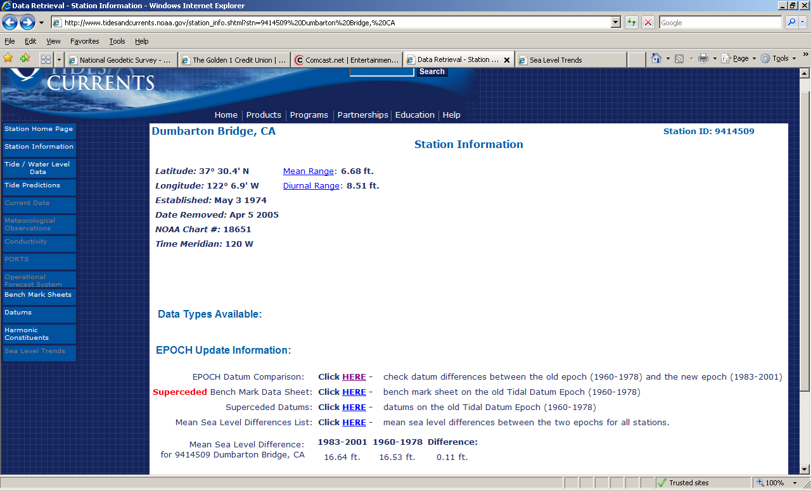
Go to Station Information to find Epoch Differences
Notes:
For all tidal datums; MSL difference, here for example, 0.11 ft, is shown at the bottom of this section for each tide gage

Slide 12
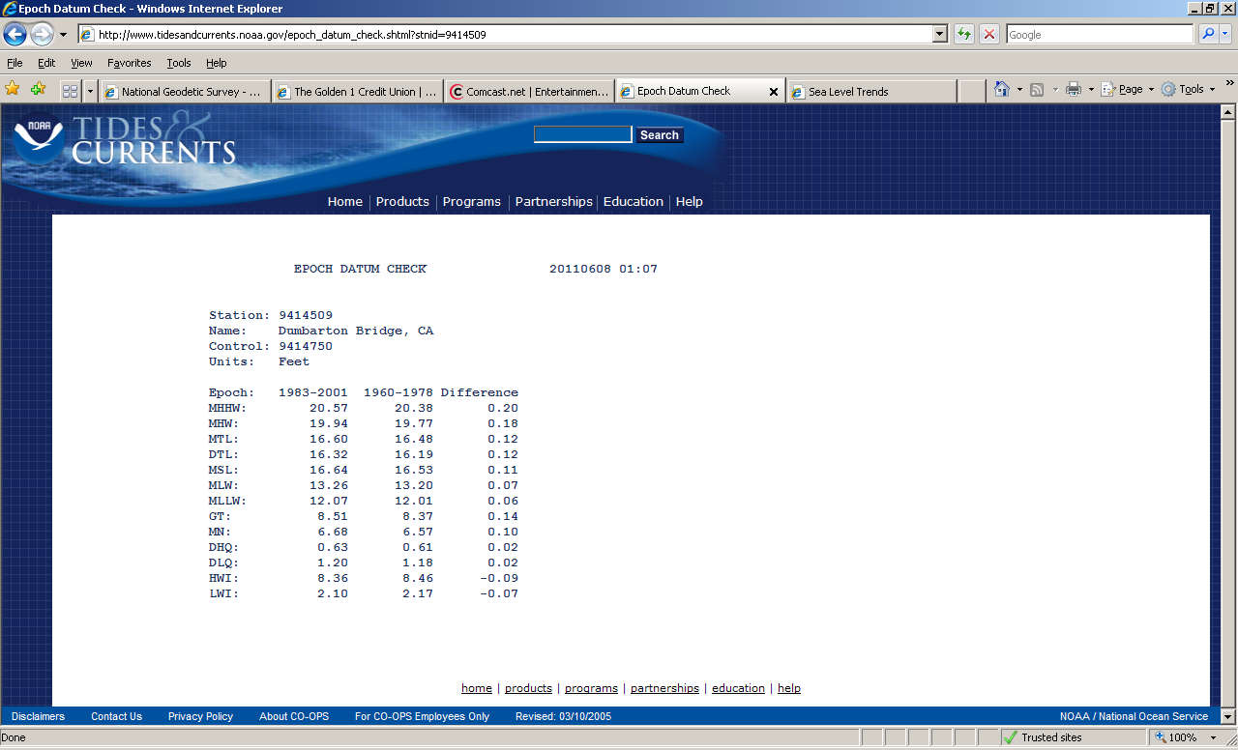
0.2 ft difference is not insignificant
Notes:
But what is the DATUM for these numbers? Yes, station datum

Slide 13
Station datum
Unlike water level (tidal) datums that will change each epoch because the world is dynamic, a station datum is FIXED forever and ever (hopefully).
It is used to calculate and relate the difference in datum heights between tidal epochs.
MLLW datum, by convention, is always the reference tidal datum, eg, 0.0, for each tidal epoch. To know how much change there was between tidal epochs, one references the values to the station datum.

Slide 14
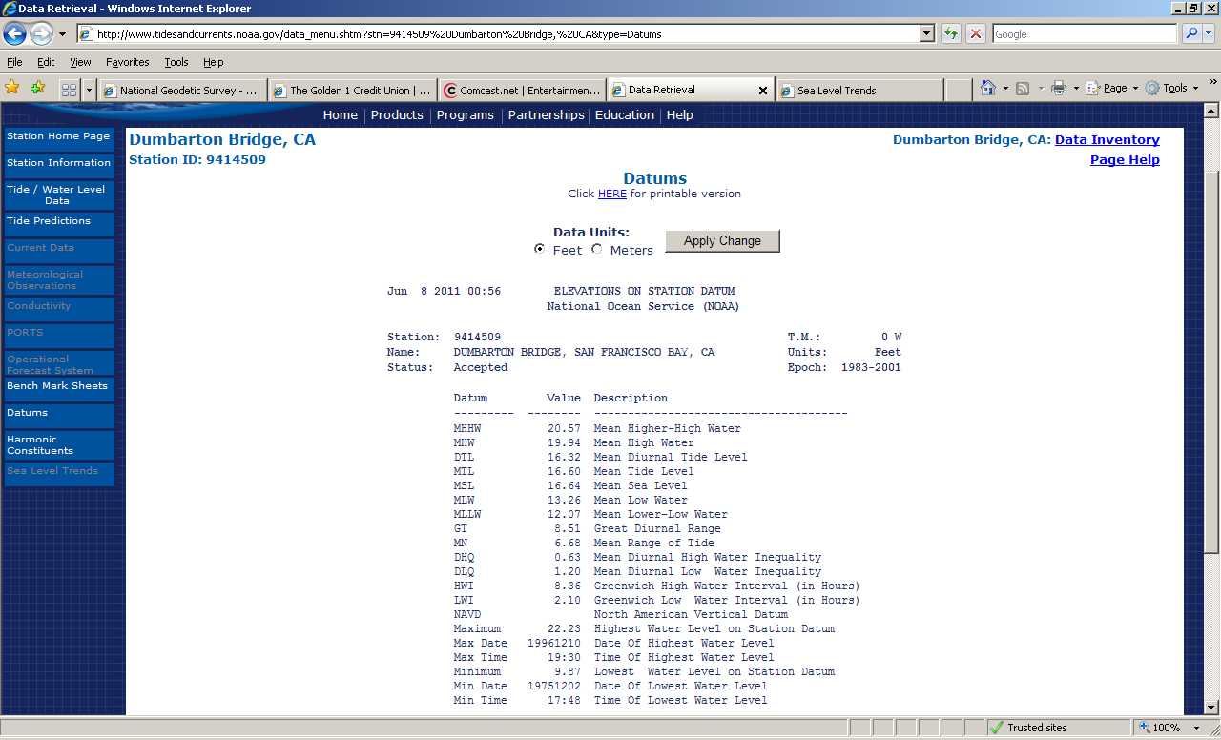
Station datum: misunderstood, risk of misuse
Blank ≠ 0 !
Notes:
People are looking for ‘datum’ information, so they click on that, and don’t understand what station datum means. If there is no entry for a geodetic datum, then these numbers are ‘arbitrary’ in that the station datum zero was selected just in relation to potentially low water levels, and has no relation to geodetic elevations at all.

Slide 15
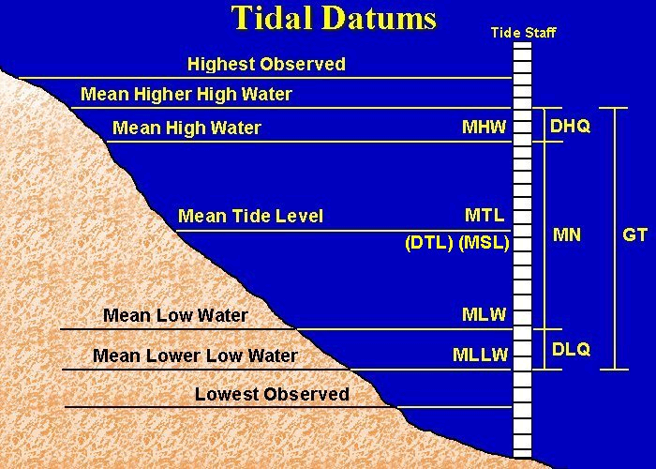

MHHW
Notes:
Highest and Lowest Observed are not a tidal datum or a computation.
The definitions can be found in a Glossary
Standard Method (MTL, MSL, Mn, DHQ & DLG are known):
MLW= MTL-(0.5*Mn)
MHW= MLW+Mn
MLLW= MLW-DLQ
MHHW= MHW-DHQ
DTL= 0.5*(MHHW+MLLW)
GT= MHHW-MLLW
MRR Method (MTL, DTL, MSL, Mn & GT are known):
MLW= MTL-(0.5*Mn)
MHW= MLW+Mn
MLLW= MLW-0.5*GT
MHHW= MHW+GT
DHQ= MHHW-MHW
DLQ= MLW-MLLW
GT is known as the spring or diurnal range depending on what coast it is on.

Slide 16
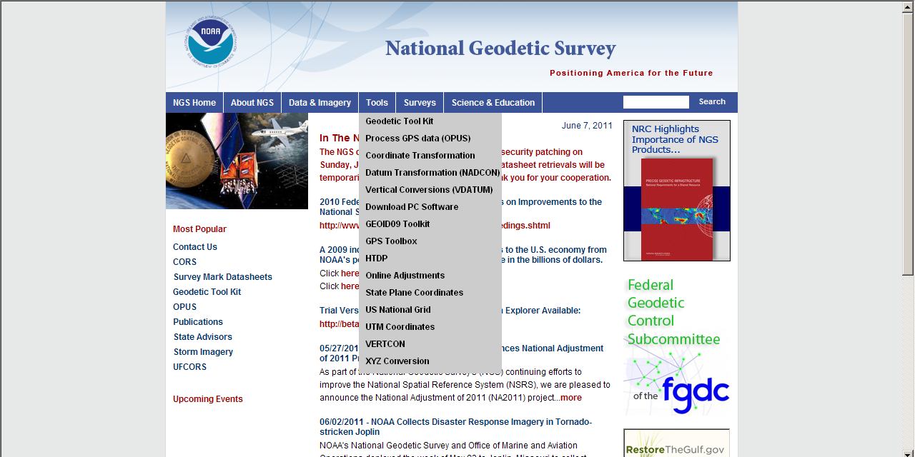
Notes:
There is a graphic representation available in the Geodetic Tool Kit.

Slide 17
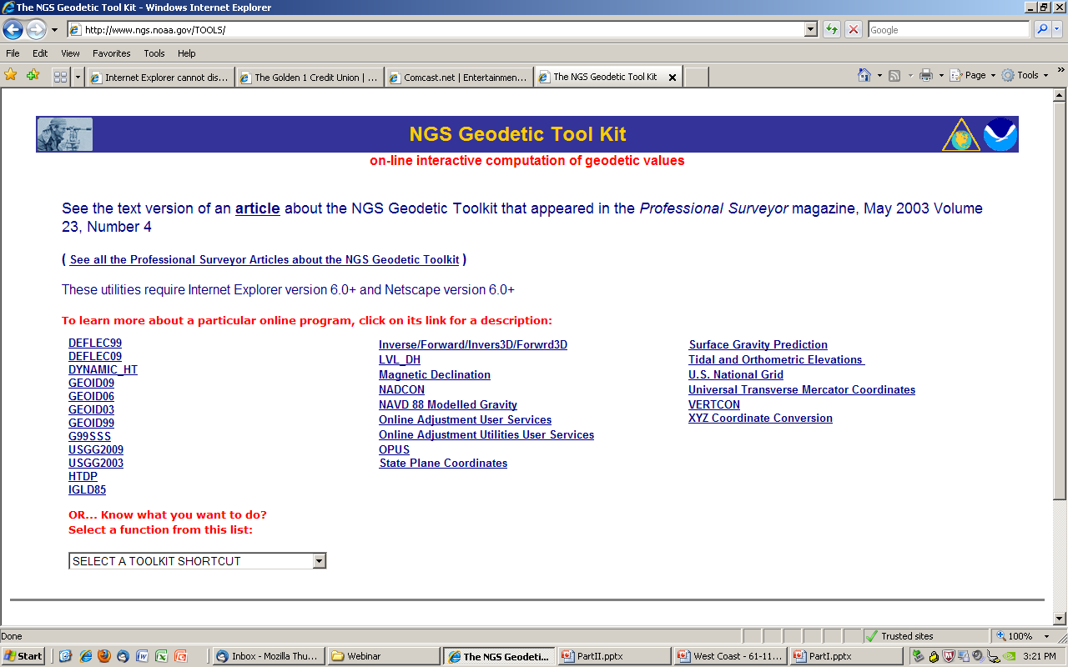

Slide 18
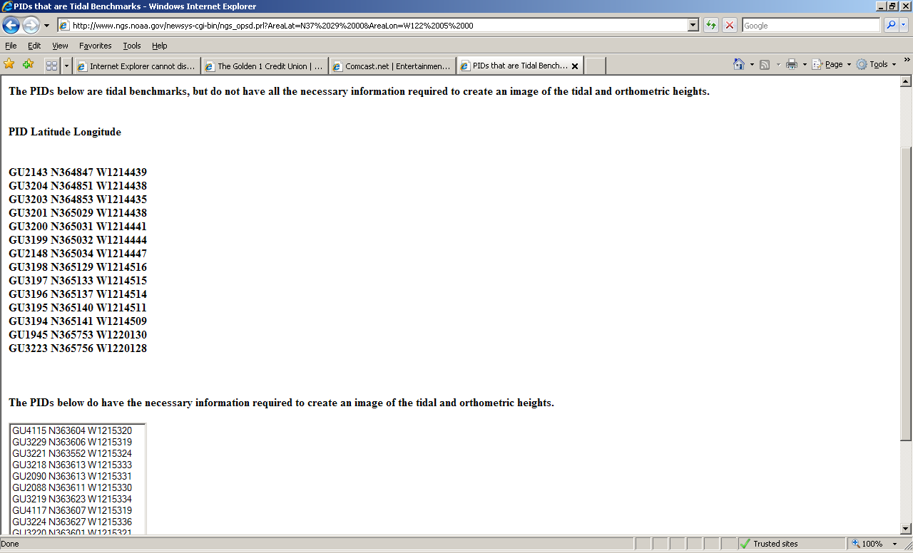

Slide 19
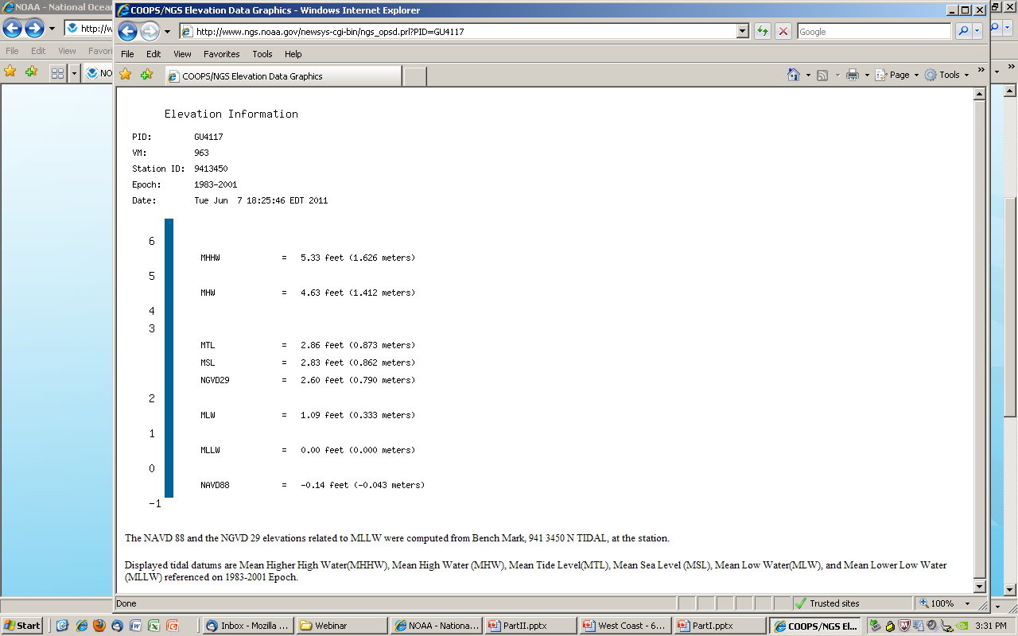
Don’t know this one’s Designation, only its PID, so retrieved DS by PID
GU4117 DESIGNATION - 941 3450 N TIDAL
Feet AND meters
Primary Bench Mark for the tide gage
Notes:
This PID happens to be the Primary BM for the gage

Slide 20
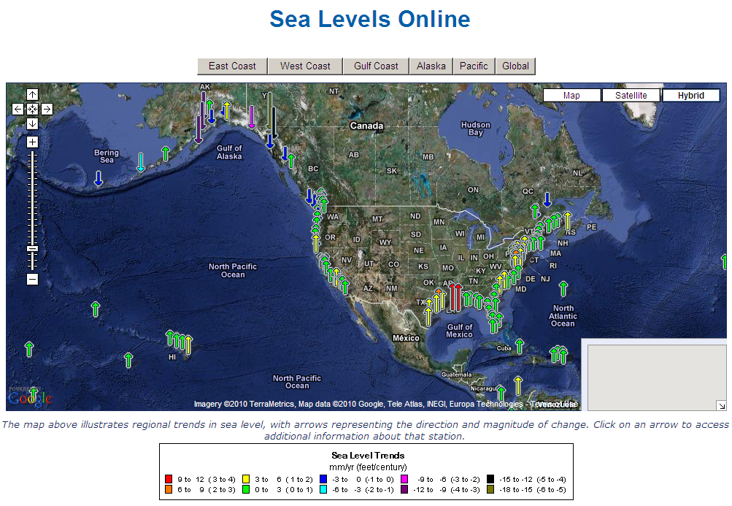
Relative Sea Level Trends
Notes:
We make sure to say “RELATIVE SL Trends” In order to

Slide 21
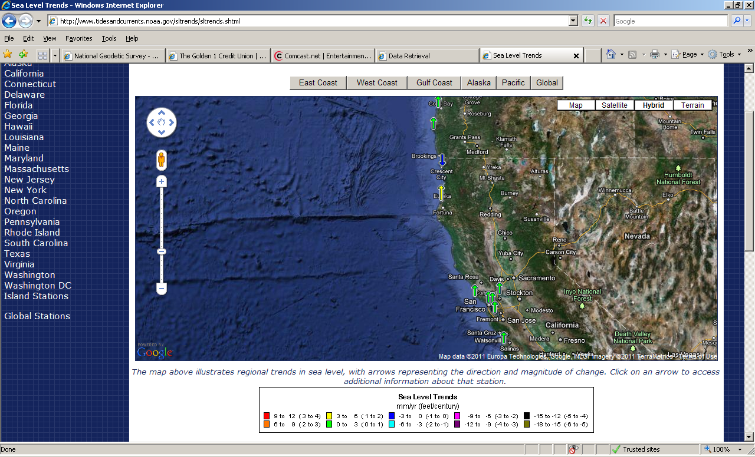
Notes:
All stations in the Bay Area are in the 0-3 mm/year range. But Eureka and Crescent City of the northern California coast are exceptions. Geologists say that the land around Eureka is subsiding as a result of the complicated plate tectonics associated with the ‘triple junction’—see the ridge in the ocean that represents, I think, a plate collision. So, the rate for Eureka is double, in the 3-6 mm range. The rate at Crescent City is completely opposite direction, the relative sea level is declining 0-3mm/yr. Farther up the coast, in Oregon, the trends are the same as most places in the US, 0-3 mm/yr rise.

Slide 22
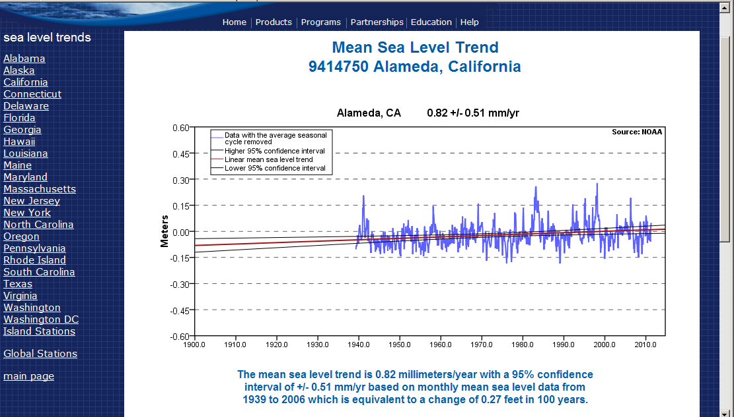
Long-term trends have to account for tidal epoch changes
Notes:
Each primary gage has a Sea Level Trend link at the bottom of the lower left column. These trends should be considered for anything that will or will likely be impacted, whether it’s wetland restoration, or STP inundation or highway flooding potential.

Slide 23
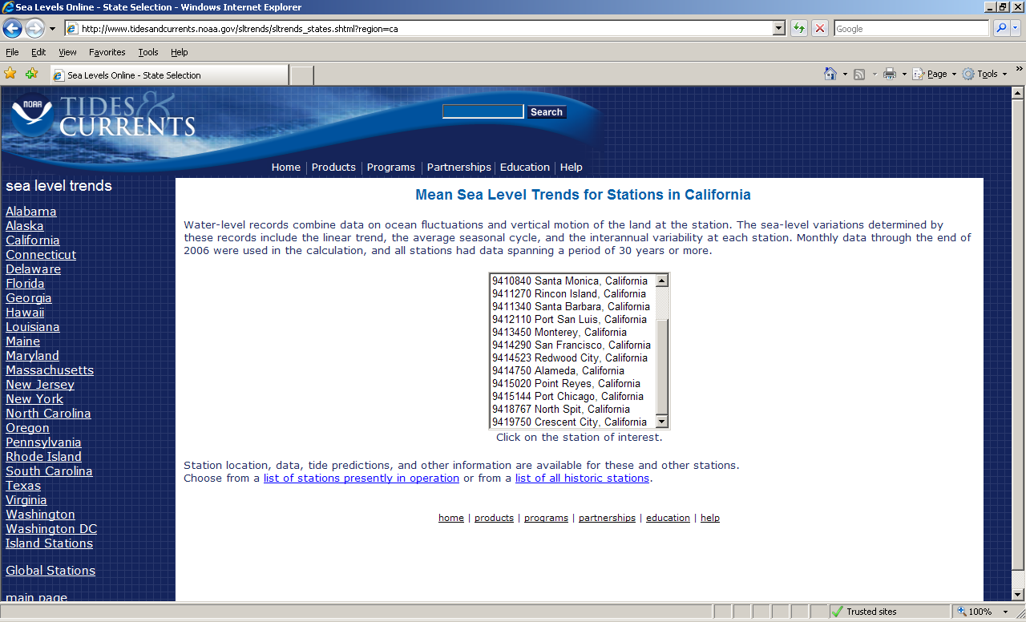

Slide 24
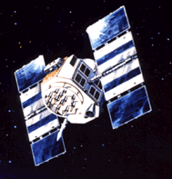

NWLON Stations
Vertical Datum Reference
Vertical Datum Reference characteristics are:
Water levels accurately known relative to the latest tidal datums on the latest National Tidal Datum Epoch (NTDE)
Water levels accurately known relative to the land and a local network of recoverable tidal bench marks
Precise connections to the national geodetic vertical datum (NAVD88) using level connections or GPS connections to the bench marks in the National Spatial Reference System (NSRS)
NGS Accuracy Standards
2nd Order, Class I for long-term stations
3rd Order for short-term stations
Annual leveling for NWLON
installation and removal
levels for short-term stations
Emergency leveling for storm
events
GPS
Receiver
GPS Receivers collecting simultaneous data at bench marks .
Tide
Gauge
Tidal Bench mark
4811 G 2004
3.150 m
NOAA
Pier
1.150 m
(example)
MHW
2.736 m
Tidal Bench mark
4811 G 2004
Geodetic Benchmark
(and its WGS84 value)
Relative to Tidal Datum
2.000 m
1.220 m
Bench mark
with geodetic control
(NAVD88)
MLLW
NAVD88
0.7428 m
Orifice
Station Datum
Notes:
Couldn’t enlarge diagram. Original has reference to WGS84, which I have eliminated here as NGS does not produce anything referenced to WGS84.
Stability used to be ‘relative’, whether movement was detected among the 5 or 10 BMs surrounding the gage. But no check to the larger world. Utilizing GPS enables that relation, which is becoming increasingly important as people want more info about SLR and the stability of the gages. It is a goal to establish a CGPS at a tide gage so that the setting is constantly monitored; field recon for SF (4290) has been done.

Slide 25
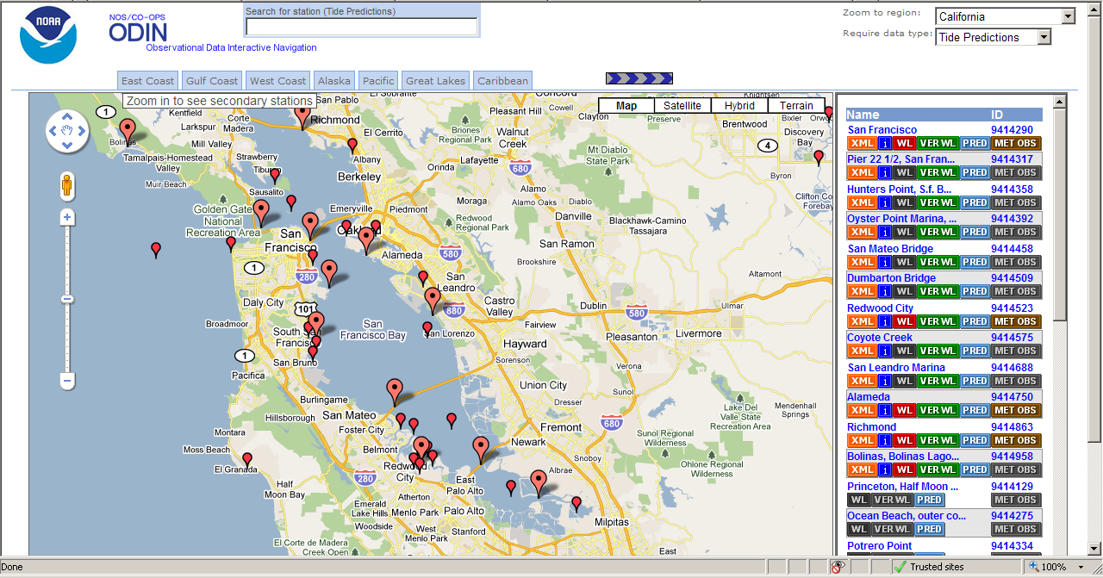
Non-primary (secondary and tertiary) stations are plotted if you change datatype to ‘Tide Predictions’
Notes:
And zoom in sufficiently
Primary tide stations have a red WL button on the right; Primary> 19 years.
Secondary > 1yr <19; Tertiary < 1yr.
Non-primary stations ‘I’ button links to the info for the PRIMARY tide station to which it is referenced.
I’m showing this tool because you can get a sense of what tidal data was included in the VDATUM modeling, which I’m show you shortly. How much data was included, and what epoch was it?

Slide 26
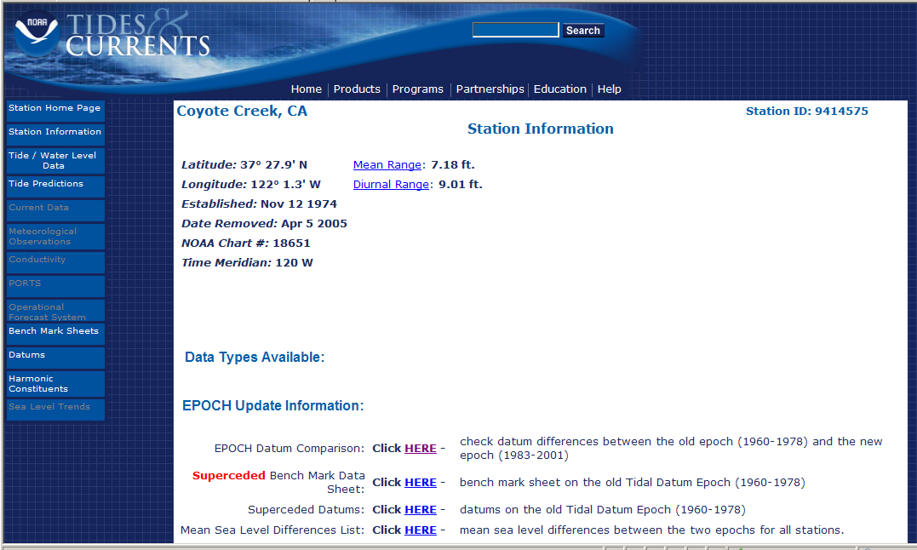
Nov 12 ‘74 – Apr 5 ’05?
Notes:
I picked a small marker to find out how much data it had. Looks here like over 30 years! Well, maybe. Let’s check the bench mark sheets to see what that says.

Slide 27
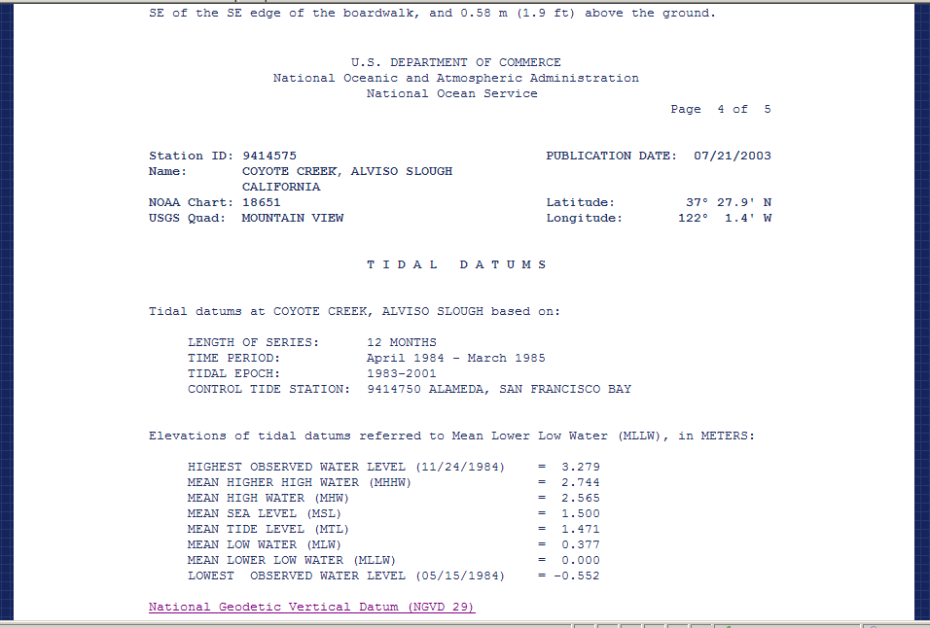
The time period was 12 months, fr Apr 84-Mar 85, epoch 1983-2001
Notes:
This sheet indicates that the published datums were based on 12 months of data, 25 years ago.

Slide 28
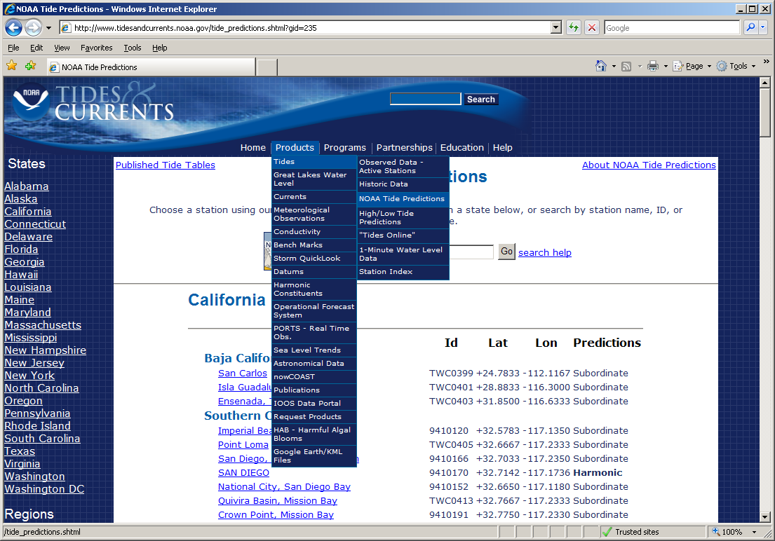

Slide 29
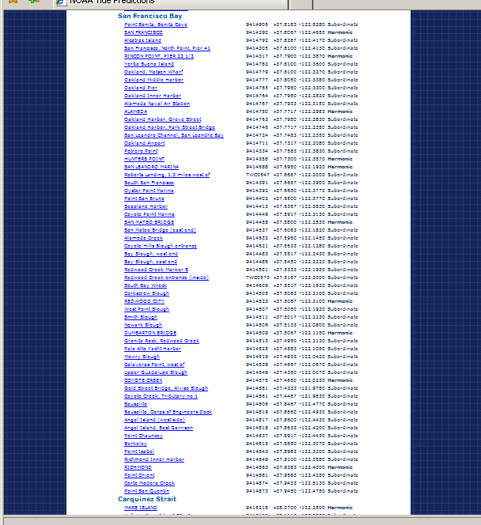

Slide 30
VDATUM
Modeling program that enables conversions between multiple vertical datums—ellipsoidal, geodetic, tidal- at your specified location
Be fully aware of the errors, eg, Standard Deviation, from transformations among datums, and from source data; types of error include:
variations in the tidal range, tidal phase differences, bathymetric and coastal features, the density and proximity of nearby stations used in the corrections

Slide 32
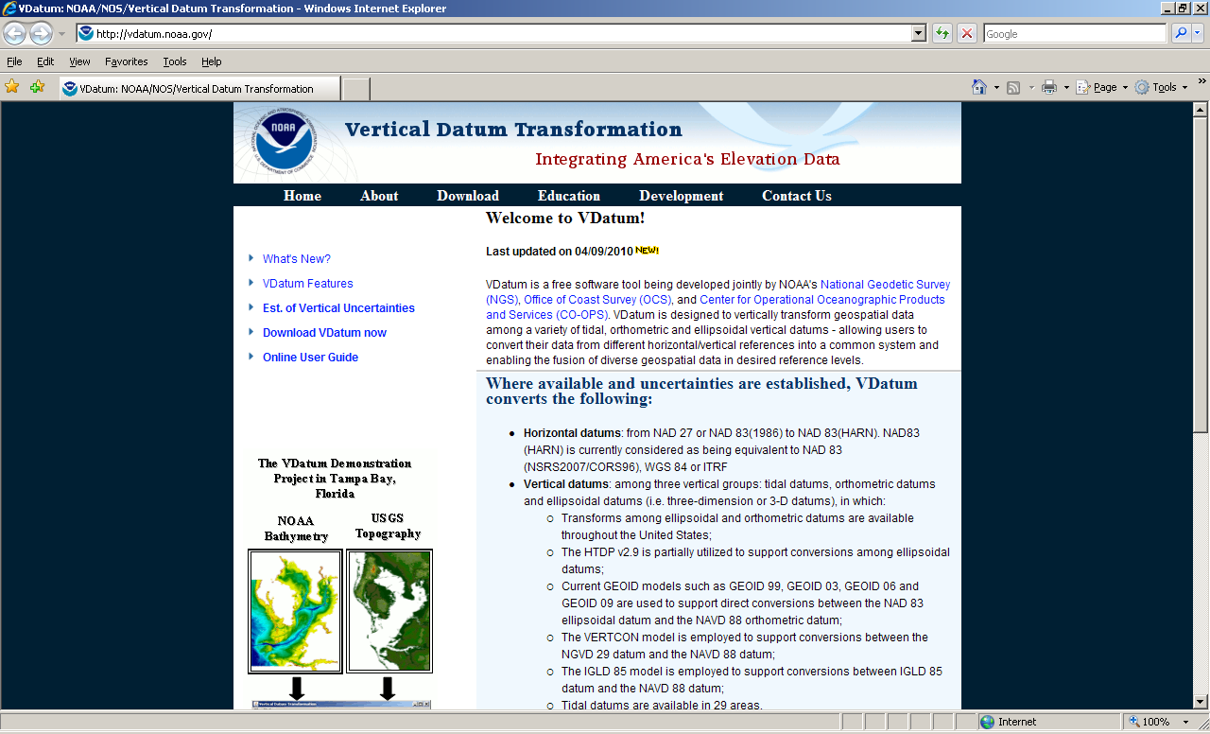

Slide 33
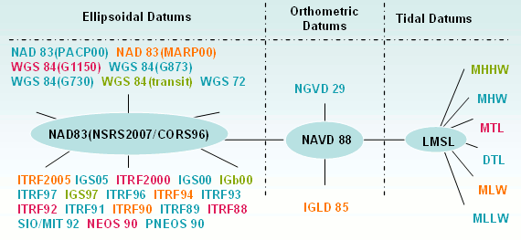
Datums available in VDATUM
Notes:
The most common datums are highlighted

Slide 34
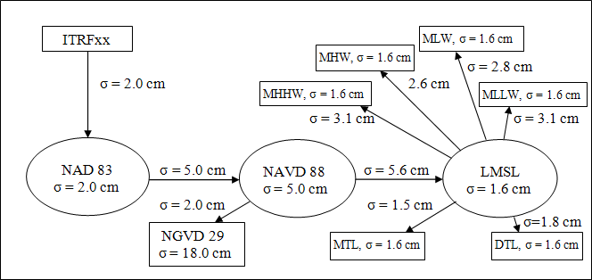
Errors from source data and transformations, using Chesapeake Bay dataset as an example
Notes:
Error in source data (eg, NAD83=2 cm) AND in transformations (eg going fr 83 to 88 = 5cm)

Slide 35
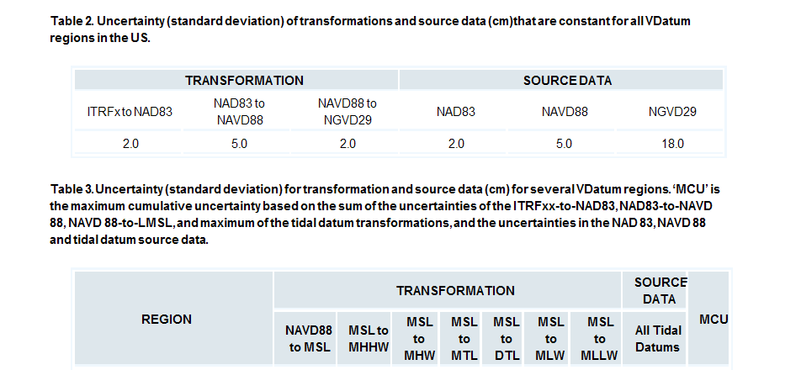
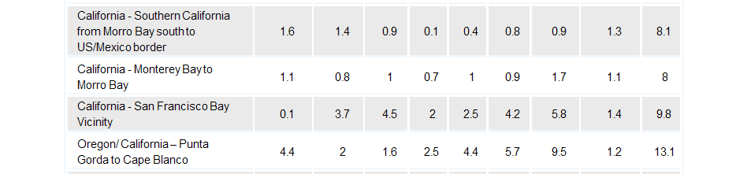
Each
Notes:
These show the actual errors for each of the 4 CA datasets for the vertical transformations as well as for the source data. If you involve another tidal datum besides just MSL, you have to add, for the SF Bay dataset, 1.4cm for MSL AND 1.4cm for another tidal datum.
So, if you start from a WGS ellipsoid height, which is equivalent to ITRF, and transform to MLLW:
2.0+5.0+2.0+5.0+0.1+5.8+1.4+1.4 –square each of those and add them= 93.61, sq rt of = 9.67 cm

Slide 36
South SF Bay Info, fr 2005
USGS Bathymetric survey
Needed Zonation scheme for area to indicate delay in time and range corrector relative to the primary gage(s) (all Harmonic predictions)
4688: San Leandro Marina
4458: San Mateo Bridge
4523: Redwood City
4509: Dumbarton

Slide 37
Notes:
Dumbarton, 1.2 ft vs VDATUM 0.7 ft

Slide 38
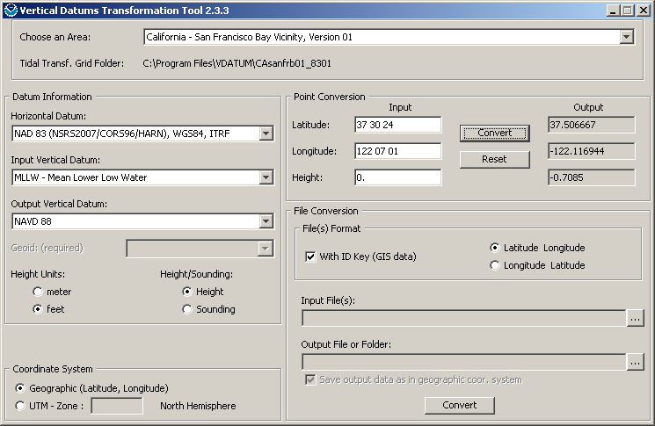
Notes:
Convert to feet in this case because values from zonation diagram and table are in feet.
Note that VDATUM gives the conversion of a POINT relative to the ‘output’ datum. The sign for the elevation of a point is the opposite of the sign, or sense, when comparing DATUMS. So, NAVD88 DATUM is above MLLW, eg, is +some number above MLLW, but for a point, whose elevation you know referenced to MLLW, you need to subtract some number from that elevation to get the new elevation referenced to NAVD88.

Slide 41
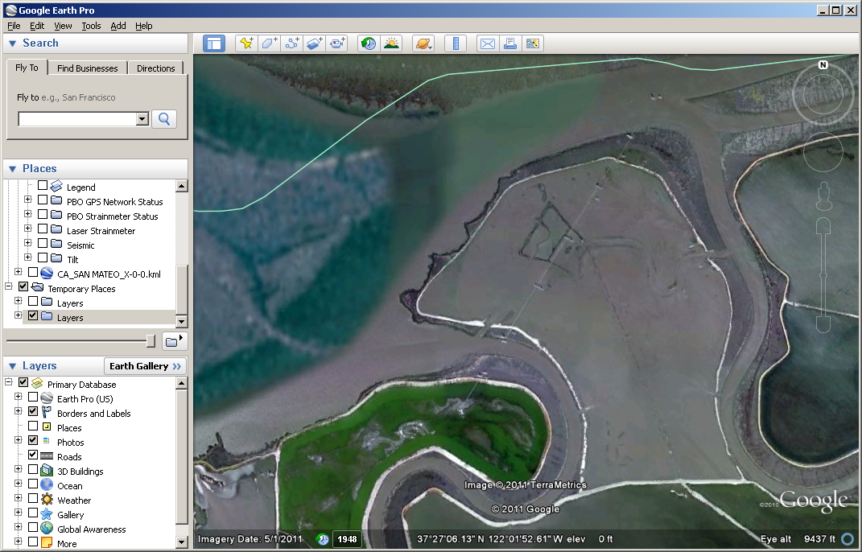
Notes:
Imagery date 5/1/11!

Slide 42

“Angle pt” in County Boundary
Notes:
Angle pt in County Boundary; zonation map shows 1.4 ft vs .82 in VDATUAM

Slide 43

Nr Coyote Creek/Alviso Slough
Notes:
Coyote Creek is 1.5 ft vs 0.6 ft. VDATUM has not incorporated the 2005 research because they are not published CO-OPS tidal datums.

Slide 44
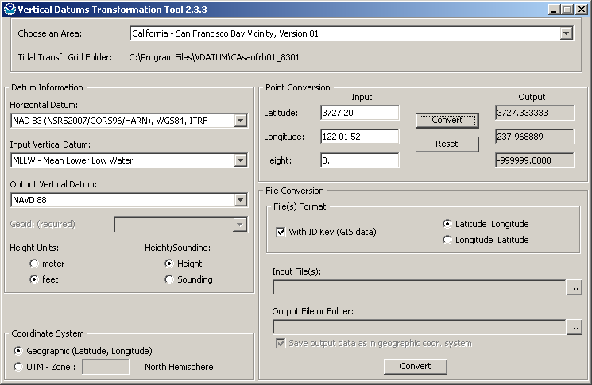
-999999: out of range or bad format

Slide 45
2011 Tide gage Installation
Dumbarton, 9414509, 3 months (Tertiary)
Coyote Ck/Alviso Sl, 9414575, 1 year (Secondary)

Slide 46
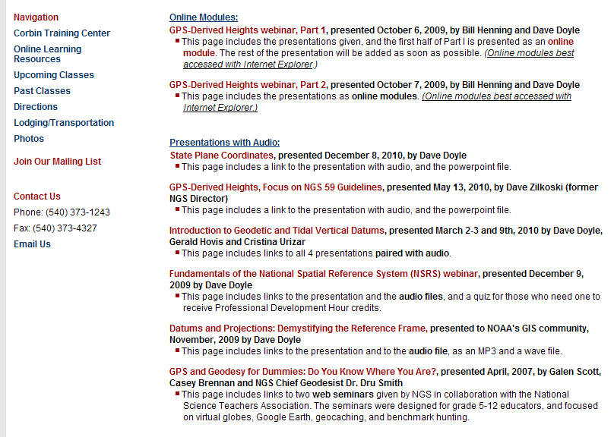

Slide 47
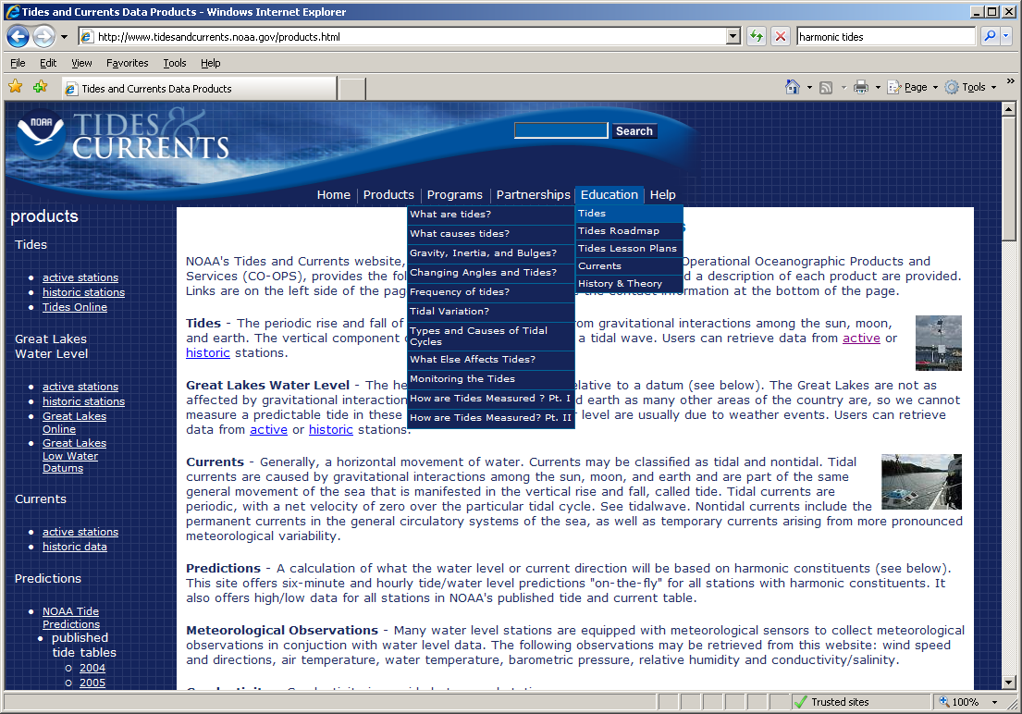

Slide 48
