Slide 1



The Last Mile:
Final push for new datums, progress, and what is still to come
New Jersey Society of Professional Land Surveyors
February 22, 2024
Dan Martin
Northeast Regional Geodetic Advisor
Dan.martin@noaa.gov
240-676-4762

Slide 2
Today’s Topics
Modernization Review
Modernization Progress
GRAV-D
GPSonBM
Laser
Sproccet
Alpha Page
OPUS
BETA OPUS 5 (M-Pages)
OPUS Projects 5.2 (Production)
GVX
Publish
Online Videos and Tutorials
NCAT Version 2.1
Beta Time Series Tool
NGS Map
Passive Marks Page
Timeline
Rollout, Testing Replacement

Slide 3
National Spatial Reference System (NSRS)
NGS Mission: To define, maintain & provide access to the National Spatial Reference System (NSRS) to meet our Nation’s economic, social & environmental needs
Consistent National Coordinate System
Latitude/Northing
Longitude/Easting
Height
Scale
Gravity
Orientation
& how these values change with time

Slide 4
GEODETIC DATUMS
HORIZONTAL
2 D (Latitude and Longitude) (e.g. NAD 27, NAD 83 (1986))
VERTICAL
1 D (Orthometric Height) (e.g. NGVD 29, NAVD 88, Local Tidal)
GEOMETRIC
3 D (Latitude, Longitude and Ellipsoid Height)
Fixed and Stable - Coordinates seldom change
(e.g. NAD 83 (1996), NAD 83 (2007), NAD 83 (CORS96) NAD 83 (2011))
also
4 D (Latitude, Longitude, Ellipsoid Height, Velocities) Coordinates change with time
(e.g. ITRF00, ITRF08)

Slide 5
Why change datums/Realizations
NAD27 based on old observations and old system
NAD83(86) based on old observations and new system
NAD83(96) based on new and old observations and same system (HARN)
NAD83(NSRS2007) based on new observations and same system. Removed regional distortions and made consistent with CORS
NAD83(2011) based on new observations and same system. Kept consistent with CORS

Slide 6
National Spatial Reference System (NSRS) Improvements over time
NETWORK TIME NETWORK LOCAL SHIFT
SPAN ACCURACY ACCURACY
NAD 27 1927-1986 10 meter s (1:100,000)
NAD83(86) 1986-1990 1 meter (1:100,000) 10-200 m
NAD83(199x)* 1990-2007 0.1 meter (1:1 million) 0.3-1.0 m
“HARN”, “FBN” (1:10 million) 0.05
NAD83(NSRS2007) 2007-2011 0.01 meter 0.01 meter 0.03 m
NAD83(2011) 2011- 2025 0.01 meter 0.01 meter 0.01 m
NATRF2022 2025- 0.01 meter 0.01 meter ≈ 1.30 m

Slide 7
Horizontal Datums/Coordinates…What do we (you) use in your state?
NAD 27
NAD 83 (Lat-Lon) SPC
Which one???
NAD 83 (1986)
NAD 83 (19xx) - HARN
NAD 83 (1996) - FBN
NAD 83 CORS96(2002)
NAD 83 (NSRS2007)
NAD 83 (2011) epoch 2010.00
WGS 84
Which one???
WGS 84 (1987)
WGS 84 (G730)
WGS 84 (G873)
WGS 84 (G1150)
WGS 84 (G1674)
WGS 84 (G1762)
WGS 84 (G2139)
ITRFxx (epoch xxxx)
IGSxx (epoch xxxx)

Slide 8

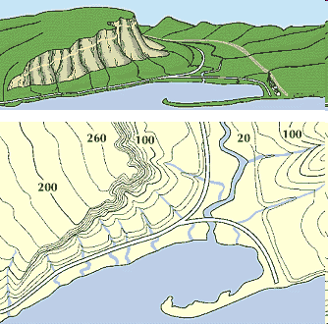
What is a Vertical Datum?
Strictly speaking, a vertical datum is a surface representing zero elevation
Traditionally, a vertical datum is a system for the determination of heights above a zero elevation surface
Vertical datum comprised of:
Its definition: Parameters and other descriptors
Its realization: Its physical method of accessibility
"topographic map." Online Art.
Britannica Student Encyclopædia.
17 Dec. 2008
<http://student.britannica.com/ebi/art-53199>

Slide 9
History of vertical datums in the USA
NGVD 29
National Geodetic Vertical Datum of 1929
Original name: “Sea Level Datum of 1929”
“Zero height” held fixed at 26 tide gauges
Not all on the same tidal datum epoch (~ 19 yrs)
Did not account for Local Mean Sea Level variations from the geoid
Thus, not truly a “geoid based” datum

Slide 10
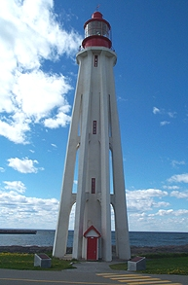
Current Vertical Datum in the USA
NAVD 88: North American Vertical Datum of 1988
Definition: The surface of equal gravity potential to which orthometric heights shall refer in North America*, and which is 6.271 meters (along the plumb line) below the geodetic mark at “Father Point/Rimouski” (NGSIDB PID TY5255).
Realization: Over 500,000 geodetic marks across North America with published Helmert orthometric heights, most of which were originally computed from a minimally constrained adjustment of leveling and gravity data, holding the geopotential value at “Father Point/Rimouski” fixed.
Father Point Lighthouse, Quebec
*Not adopted in Canada
Notes:
By fixing the geopotential value at the origin point, it was possible to ensure that the origins of IGLD 85 and NAVD 88 aligned.
*It should be pointed out that while the datum was defined in such a way as to be usable on the North American continent, it was never actually adopted in Canada. It can be used there, but it’s not their official civilian datum.
Note that the designation of the vertical control point at Father Point is “1250 G=NAVD 88 DATUM POINT” for PID# TY5255 and is not available from the publicly accessible NGSIDB.

Slide 11
History of vertical datums in the USA
NAVD 88
North American Vertical Datum of 1988
One height held fixed at “Father Point” (Rimouski, Canada)
…height chosen was to minimize 1929/1988 differences on USGS topo maps in the eastern U.S.
Thus, the “zero height surface” of NAVD 88 wasn’t chosen for its closeness to the geoid (but it was close…few decimeters)

Slide 12
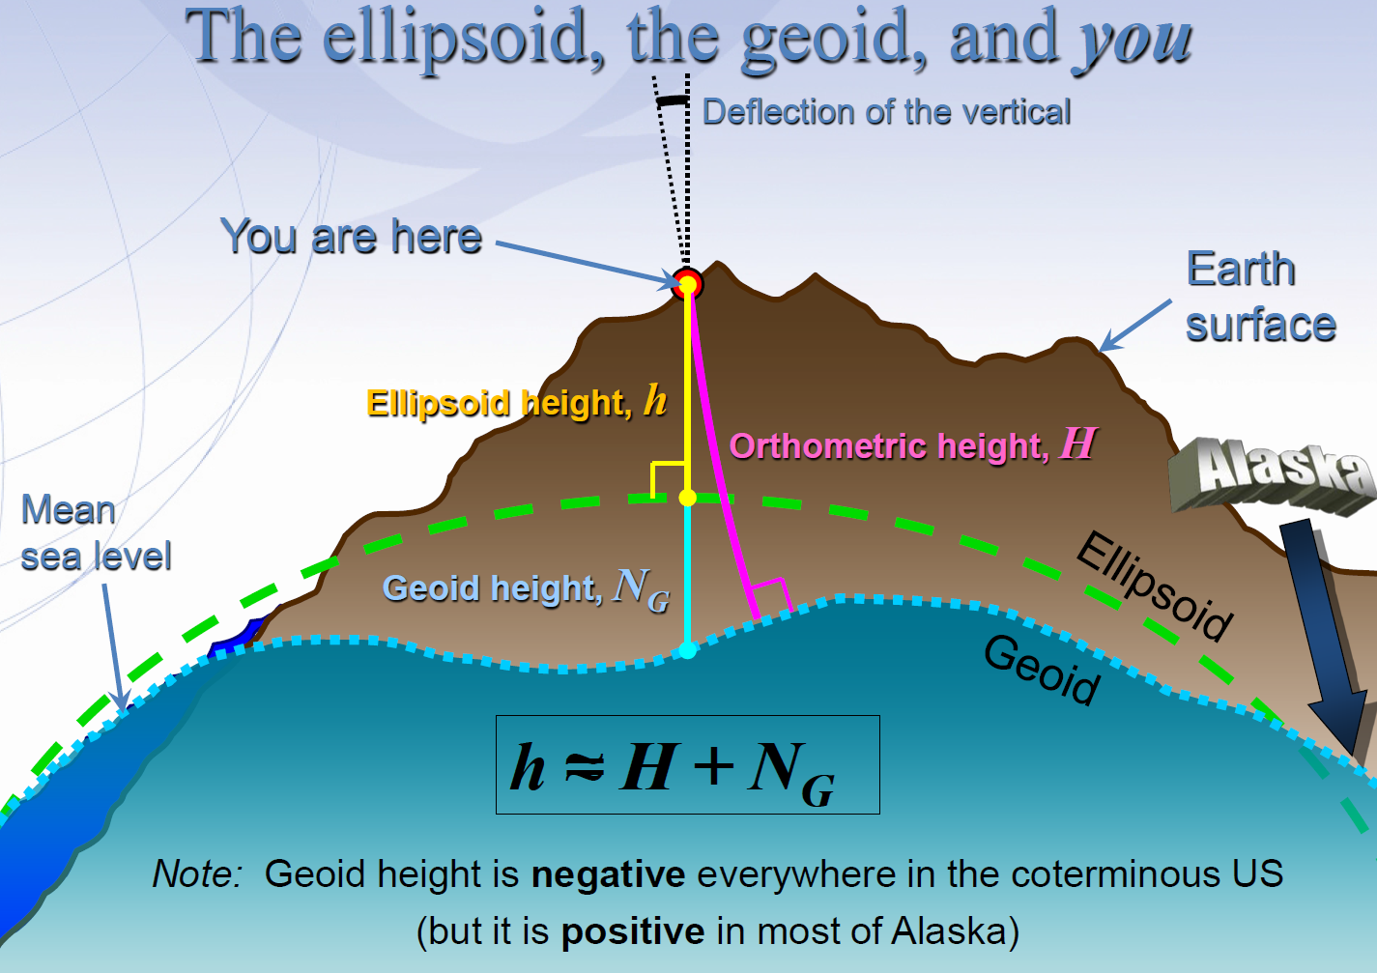
Notes:
GNSS Users get an ellipsoid height calculated from GNSS satellite data.
Ultimately we need an orthometric height (height in relationship to the geoid) to know where water will flow
Problem: we need to know the difference between the ellipsoid height and geoid (aka geoid height or undulation)
In the past this geoid height was calculated by NGS using large scale leveling and GNSS campaigns. Then provided to users through a realization of NAVD-88
The new NGS vertical datum North American-Pacific Geopotential Datum of 2022 will be based on gravimetric calculations rather than traditional leveling surveys

Slide 13

Problems with NAD 83 and NAVD 88
NAD 83 is not as geocentric as it could be (approx. 2 m)
Positioning Professionals don’t see this - Yet
NAD 83 is not well defined with positional velocities
NAVD 88 is realized by passive control (bench marks) most of which have not been re-leveled in at least 40 years.
NAVD 88 does not account for local vertical velocities (subsidence and uplift)
Post glacial isostatic readjustment (uplift)
Subsurface fluid withdrawal (subsidence)
Sediment loading (subsidence)
Sea level rise (0.70 ft – 3.00 ft per 100 years)
Bar Harbor, ME 2.0 mm/yr (0.007 ft/yr) 1947-2006
Miami Beach, FL 2.39 mm/yr (0.008 ft/yr) 1931-1981
Grand Isle, LA – 9.05 mm/yr (0.030 ft/yr) 1947- 2015
Seattle, WA– 2.0 mm/yr (.007 ft/yr) 1899-2015

Slide 14
Why replace NAVD 88 and NAD 83?
ACCESS!
easier to find the sky than a 60-year-old bench mark
GNSS equipment is cheap and fast
ACCURACY!
easier to trust the sky than a 60-year old bench mark
immune to passive mark instability
GLOBAL STANDARDS!
systematic errors of many meters across the US
aligns with GPS, international efforts
aligns with Canada, Mexico
Notes:
Things are looking up! GNSS technologies simplify and improve access to and accuracy of our spatial reference system.
While we can continue to leverage this technology to maintain the old datums, it makes sense to adopt GRAV-D results in an unpolluted form, and align it to modern global standards.

Slide 15

The National Geodetic Survey 10 year plan
Mission, Vision and Strategy
2008 – 2018, 2013-2023
http://www.ngs.noaa.gov/INFO/NGS10yearplan.pdf
Official NGS policy as of Jan 9, 2008
Modernized agency
Attention to accuracy
Attention to time-changes
Improved products and services
Integration with other fed missions
2022 Targets:
NAD 83 and NAVD 88 re-defined
Cm-accuracy access to all coordinates
Customer-focused agency
Global scientific leadership
Notes:
Realization and unification of NAD83 in Canada and the U.S. via the ITRF.
http://www.geod.nrcan.gc.ca > Geodetic Survey Division > Publications > Papers

Slide 16
Replacing NAD83
develop four "plate-fixed" reference frames
remove non-geocentricity of NAD83
align to ITRF2020 at epoch 2020.00
remove most of tectonic plate rotation from ITRF2020 via Euler Pole Parameters
(pronounced: “oiler”)
Shift and Drift…

Slide 17
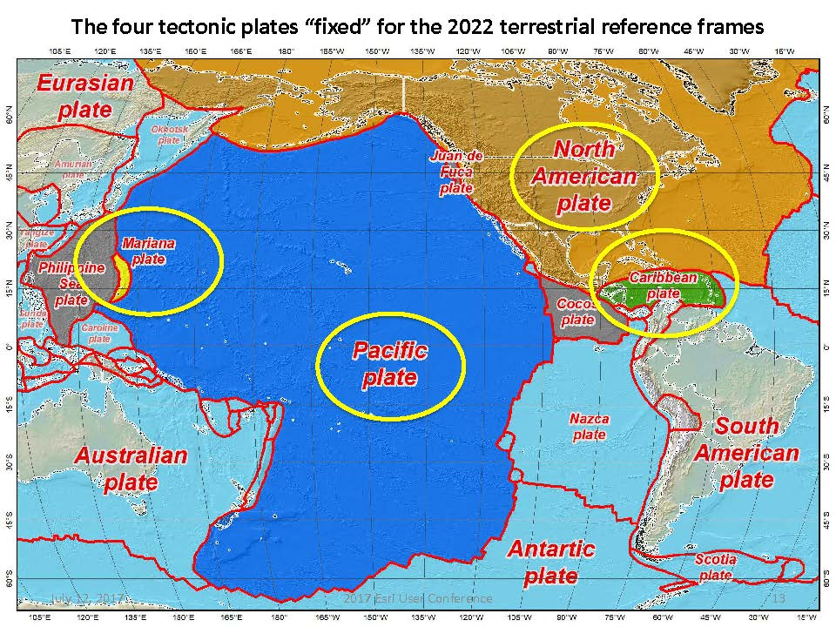
Notes:
-there’s four reference frames because there are four major tectonic plates within the NGS Area of Responsibility.
-As the National Geodetic Survey, we’re part of the DoC so we must cater to all US States and Territories
-thus we’ve got four tectonic plates in our Area of Operations, so four Ref Frames
-But…

Slide 18
Names
The Old:
NAD 83(2011)
NAD 83(PA11)
NAD 83(MA11)
The New:
The North American Terrestrial Reference Frame of 2022
(NATRF2022)
The Caribbean Terrestrial Reference Frame of 2022
(CTRF2022)
The Pacific Terrestrial Reference Frame of 2022
(PTRF2022)
The Mariana Terrestrial Reference Frame of 2022
(MTRF2022)

Slide 19
Replacing NAD83
develop four "plate-fixed" reference frames
remove non-geocentricity of NAD83
align to ITRF2020 at epoch 2020.00
remove most of tectonic plate rotation from ITRF2020 via Euler Pole Parameters
(pronounced: “oiler”)
Shift and Drift…
Notes:
-NON-geocentricity… well the goal was a geocentric NAD but it was the 80s, so they were off a little bit

Slide 20
Non-geocentricity of NAD83
Earth’s
Surface
h₁₄
h₈₃
NAD83
origin
ITRF2020
origin
~2.2 meters
GRS80
ellipsoid
Notes:
-picture this, there’s one quarter of an ellipsoid, notice they are the same geometry (size, shape) but different origin

Slide 21

What are we trying to say??

Slide 22
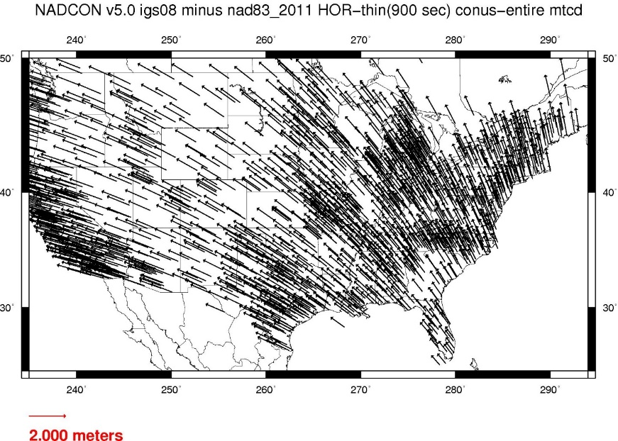
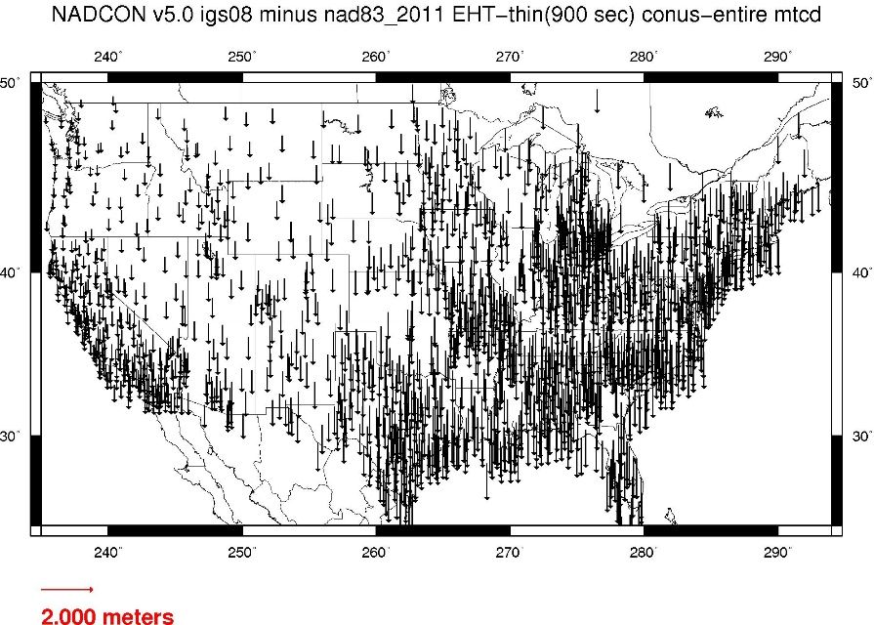
Geometric change due to ellipsoid non-geocentricity
Horizontal (Lat, Lon)
Ellipsoidal (h)
Shift…
Notes:
-Estimate of shift from NAD83(2011) epoch 2010.00 to NATRF2022 epoch 2020.00
-so this represents the positional shift due to non-geocentricity that we’re addressing/fixing
-now remember this is the Geometric component only, so the graphic on the right illustrates a somewhat constant shift because it is representing Ellipsoidal shift, not Orthometric
-Look at the size of those arrows, based on the scale bar there we’re looking at about 1 meter-ish lat,lon shift and somewhere around the same ellipsoidally around here
-REMEMBER, this is easy to address compared to geoid/ortho heights!

Slide 23
Replacing NAD83
develop four "plate-fixed" reference frames
remove non-geocentricity of NAD83
align to ITRF2020 at epoch 2020.00
remove most of tectonic plate rotation from ITRF2020 via Euler Pole Parameters
(pronounced: “oiler”)
Shift and Drift…
Notes:
We’ll talk about that ‘plate fixed’ later.
Now wait a minute Jeff, what is the IGS? You just explained the ITRF and told us about that!!
IGS Reference Frame is pretty much equivalent to the ITRF, created by the Intl. GNSS Service, of which NGS is a contributing partner.
The Intl. GNSS Service, let’s take a look at their website for a minute.
-pronounced “oiler” poles

Slide 24
Replacing NAD83
develop four "plate-fixed" reference frames
remove non-geocentricity of NAD83
align to ITRF2020 at epoch 2020.00
remove most of tectonic plate rotation from ITRF2020 via Euler Pole Parameters
(pronounced: “oiler”)
Shift and Drift…
Notes:
We’ll talk about that ‘plate fixed’ later.
Now wait a minute Jeff, what is the IGS? You just explained the ITRF and told us about that!!
IGS Reference Frame is pretty much equivalent to the ITRF, created by the Intl. GNSS Service, of which NGS is a contributing partner.
The Intl. GNSS Service, let’s take a look at their website for a minute.
-pronounced “oiler” poles

Slide 25
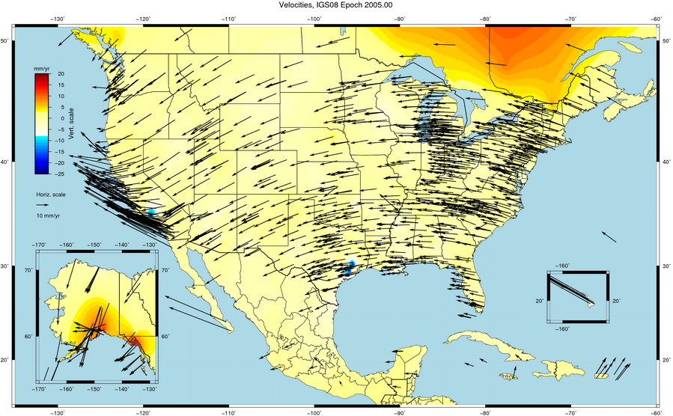

Slide 26
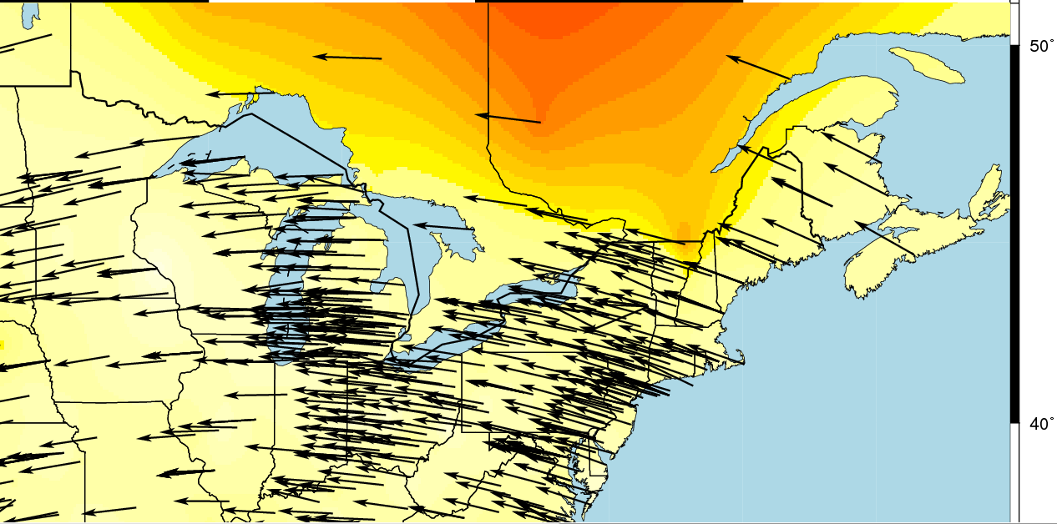
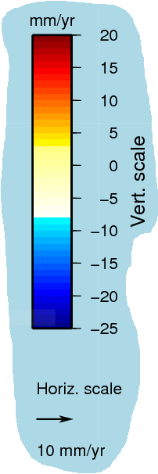

Slide 27
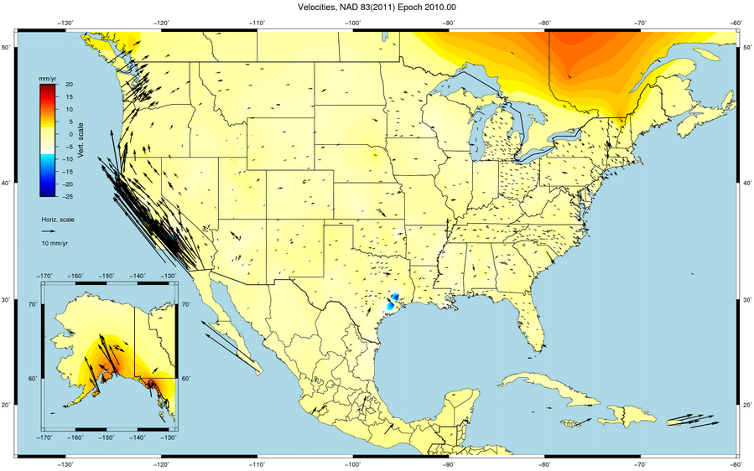

Slide 28
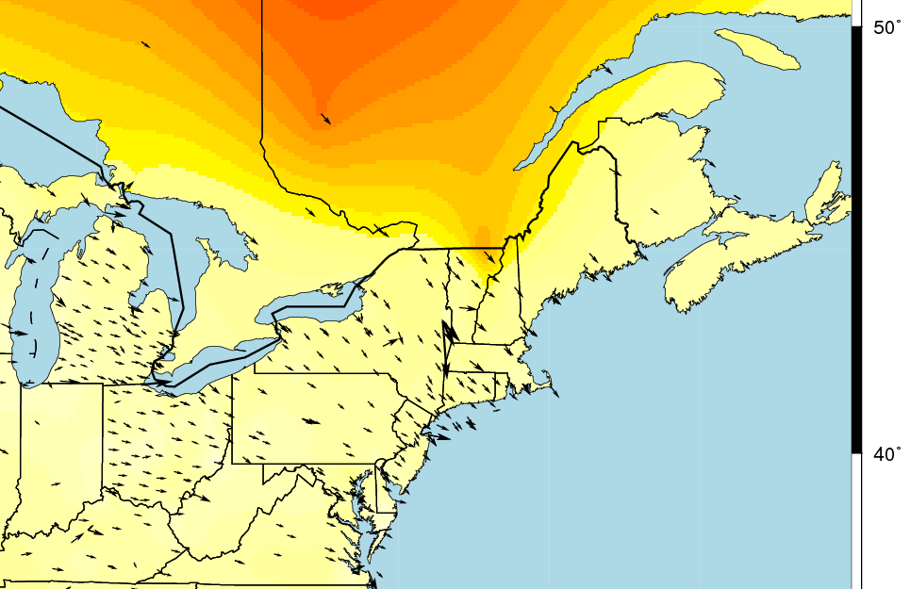
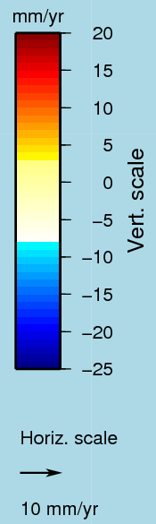

Slide 29
Two types of drift
Tectonic Plate Rotation
horizontal
Everything Else
residual motions left after rotation
regional linear motions
localized subsidence or uplift
simple to model
complex
Notes:
-there’s two types of drift you’ll see

Slide 30
Tectonic Plate Rotation
Horizontal
simple to model
Euler Pole Parameters
of 2022
EPP2022
Notes:
-there’s two types of drift you’ll see

Slide 31
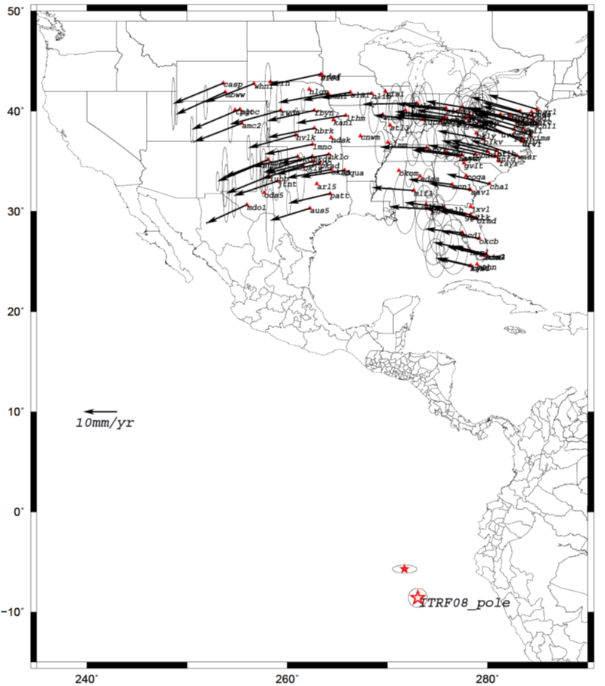
Euler Poles and “Plate-Fixed”
In the ITRF, many tectonic plates have a dominant motion: rotation
Euler Pole - point about which a plate rotates (yellow star)
Euler Pole Parameters
Lat
Lon
Rotation Rate
NATRF2022 Euler Pole
Notes:
We say “NATRF2022” is “fixed” to the N.A. Plate, making it a “plate fixed” frame
-the frame is constant to itself, but rotating within ITRF, and moving in a different direction than the other 3 frames

Slide 32
Euler Poles and “Plate-Fixed”
ITRF
Frame = constant
NA Plate = rotating
NATRF
Frame = rotating
(relative to ITRF)
NA Plate = constant
(relative to NATRF2022)
Notes:
We say “NATRF2022” is “fixed” to the N.A. Plate, making it a “plate fixed” frame
-the frame is constant to itself, but rotating within ITRF, and moving in a different direction than the other 3 frames

Slide 33
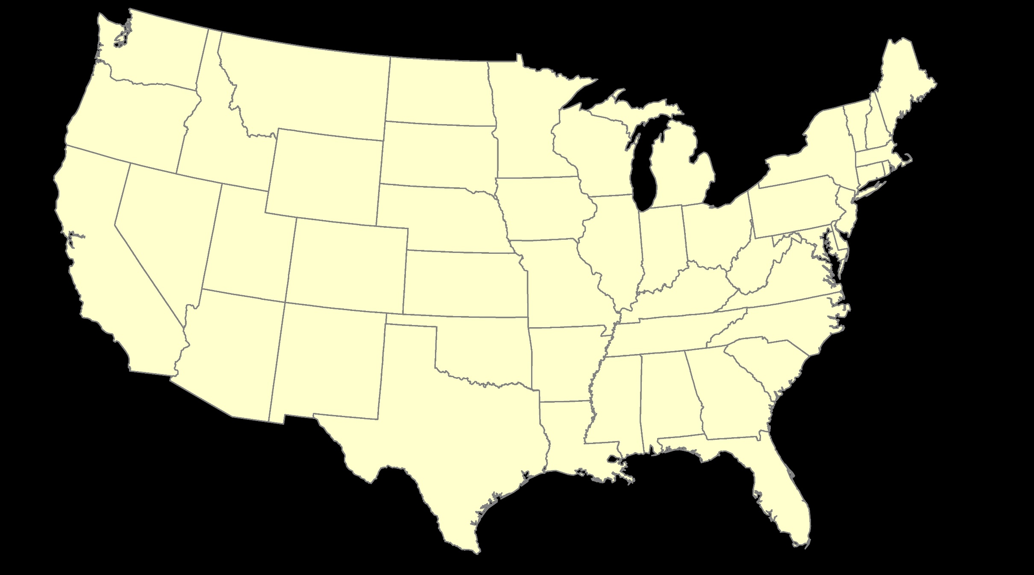
ITRF – constant frame, rotating plate

Slide 34
“Plate-Fixed”
NATRF – rotating frame, constant with plate

Slide 35
ITRF or NATRF – your choice, just use EPP

Slide 36
ITRF2020 + EPP2022 = --TRF2022
Rotation of the
North American Plate
The North American Terrestrial Reference Frame of 2022
(NATRF2022)
The Caribbean Terrestrial Reference Frame of 2022
(CATRF2022)
The Pacific Terrestrial Reference Frame of 2022
(PATRF2022)
The Mariana Terrestrial Reference Frame of 2022
(MATRF2022)
Rotation of the
Caribbean Plate
ITRF2020
Rotation of the
Pacific Plate
Rotation of the
Mariana Plate
EPP2022
Notes:
-So it all starts with ITRF
-OPUS is already running all your processing in ITRF, take a look at one of your recent solution reports and you’ll see ITRF2014 coordinates on the right hand side (or IGS/IGb08)
-Not just North America, Each plate gets a set of EPP associated with it, as each plate is rotating around a different Euler Pole

Slide 37
Two types of drift
Tectonic Plate Rotation
horizontal
Everything Else
residual motions left after rotation
regional linear motions
localized subsidence or uplift
simple to model
complex
Notes:
-there’s two types of drift you’ll see

Slide 38
Everything Else
residual motions left after rotation
regional linear motions
localized subsidence or uplift
Still SomeDrift…
complex
Notes:
-there’s two types of drift you’ll see

Slide 39
Intra-Frame Deformation Model of 2022
IFDM2022

Slide 40
Still Some Drift…
Everything in the world moves
Coordinates will be associated with the actual date when the data was collected!
Velocities at all marks can be estimated using this Intra-Frame Deformation Model
IFDM goal is to move collected data thru time to Reference Epochs for coordinate comparisons/analysis

Slide 41
Intra-Frame Deformation Model
A model of all residual velocities, after removal of tectonic rotation via EPP:
Horizontal residual motion
Total vertical motion (ellipsoid heights)
Given t₁ and t₂, compute Df, Dl, Dh at any point, accounting for all motions (drifts, earthquakes, GIA, etc.)
Likely be built upon CORS data, geodynamic models and InSAR
Notes:
-Model of all residual/leftover horizontal velocities after applying those EPPs
HTDP hasn’t been updated, but the IFVM will be even better than HTDP.
That bottom bullet is what the current plan is stating

Slide 42
EPP2022 – Euler Pole Parameters – Simple Rotation
Three parameters: lat, lon, rotation speed
Horizontal only: just latitude and longitude
Changes the frame: ITRF2020 + EPP2022 = NATRF2022
Does not change the epoch
IFDM2022 – Intra-Frame Deformation Model - Complex
Complex set of parameters
Residual horizontal motion: all the motion leftover after Euler Pole rotation
All vertical motion: localized subsidence or uplift
Changes the epoch
Does not change the frame: “intra” = on the inside; within

Slide 43
Names
The Old:
NAVD 88
PRVD 02
VIVD09
ASVD02
NMVD03
GUVD04
IGLD 85
IGSN71
GEOID12B
DEFLEC12B
Orthometric
Heights
The New:
The North American-Pacific Geopotential Datum of 2022 (NAPGD2022)
- Will include GEOID2022
one vertical datum
pole-to-equator
Normal
Orthometric
Heights
Dynamic
Heights
Gravity
Geoid
Undulations
Deflections of
the Vertical

Slide 44
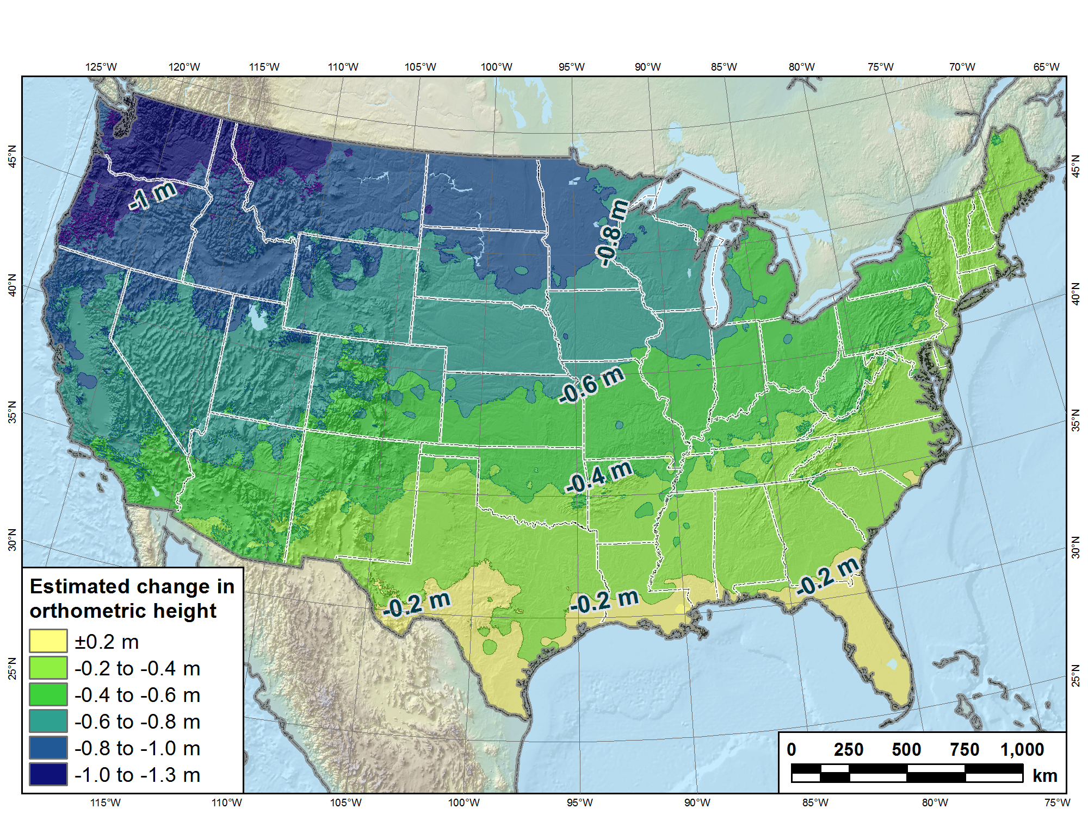
Estimated change in orthometric heights from NAVD88 to NAPGD2022
(NAPGD2022 approximated using xGEOID16B)

Slide 45
Recent Progress

Slide 46
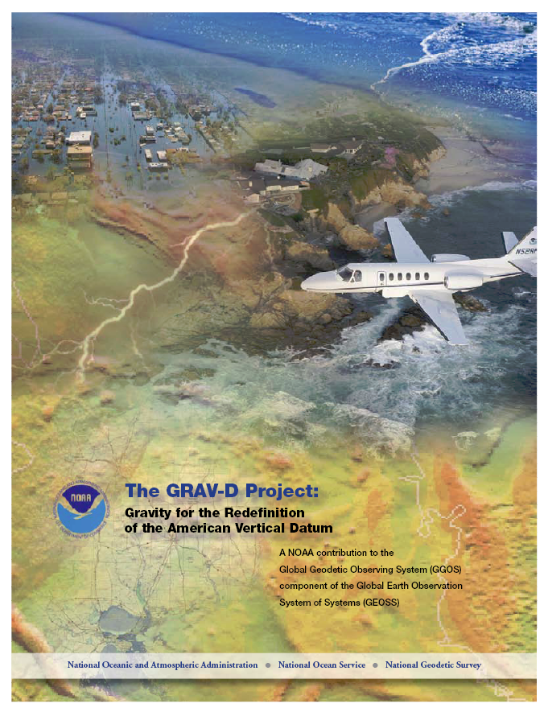
GRAV-D Project Overview
Overall Target: 2 cm accuracy orthometric heights from GNSS and a geoid model
GRAV-D Goal: Create gravimetric geoid accurate to 1 cm where possible using airborne gravity data
GRAV-D: Two thrusts of the project
Airborne gravity survey of entire country and its holdings
Long-term monitoring of geoid change
Leveraging partnerships to improve and validate gravity data
Notes:
Target is to be able to achieve 2 cm accuracy orthometric heights (where possible) using a GNSS receiver and a geoid model
Roughly 1 cm uncertainty from GNSS and 1 cm from the geoid model
GRAV-D
Phase 1: snapshot of the entire country to provide a consistent data set
Phase 2: long term monitoring of geoid change – in development
Work with partners to incorporate additional gravity data, particularly surface gravity data, validate existing data, and monitor change

Slide 47
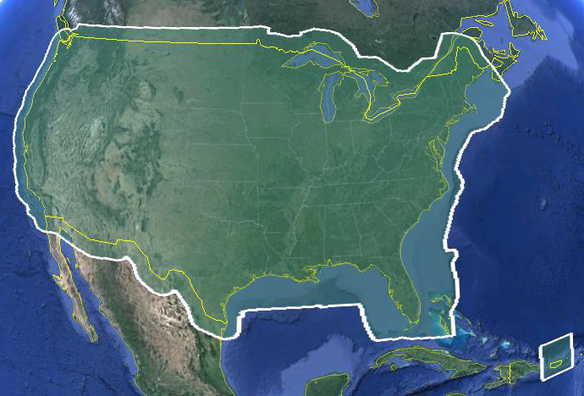
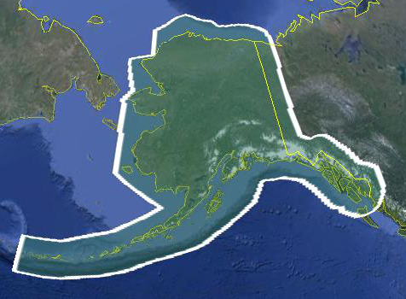
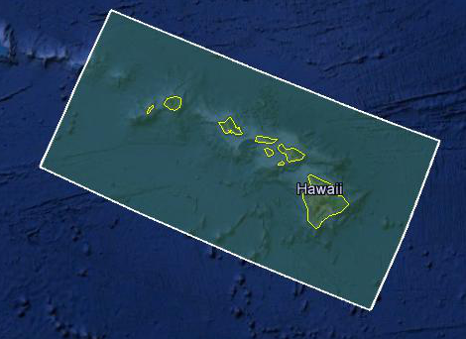
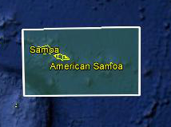
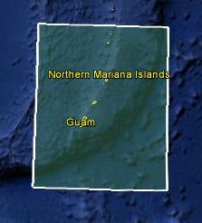
Data Collection Scope
Entire U.S. and territories
Total Square Kilometers: 15.6 million
Initial target area for 2022 deadline
~200 km buffer around territory or shelf break if possible
Notes:
Project Scope:
Scope of the project: cover roughly 15.6 million square kilometers – contiguous united states, Alaska, Hawaii, Guam, and American Samoa
In order to blend with satellite altimetry data the airborne survey is done to the continental shelf where possible or ~ 200 km beyond the shoreline or border, whichever is further
Deadline of 2022 for datum rollout, which means a target of 2021 to finish the airborne survey
Priority areas were defined as Alaska and coastal areas
Challenges:
Fixed annual budget and time → design of surveys had to fit within an annual budget of $3.5 million and meet the deadline
This was a major factor in setting altitude and line spacing

Slide 48
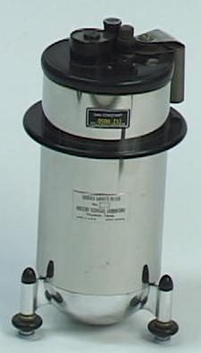
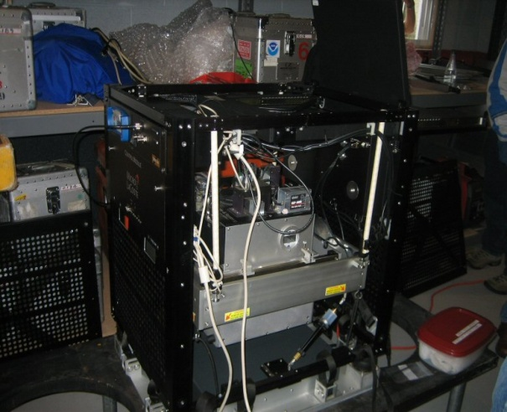
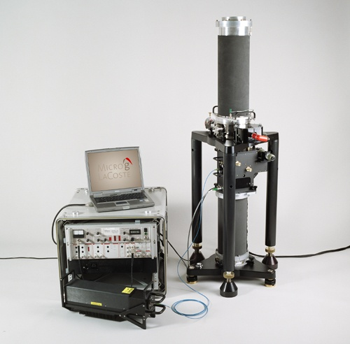
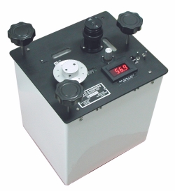
Gravity Survey Plan
National Scale Part 1
Predominantly through airborne gravity
With Absolute Gravity for ties and checks
Relative Gravity for expanding local regions where airborne shows significant mismatch with existing terrestrial

Slide 49
Priority- Greatest Datum Need
Alaska
Puerto Rico/US Virgin Islands (PRVI)
Coastal US and Great Lakes
Great Lakes
Gulf of Mexico & FL
Eastern Seaboard
Western Seaboard
Hawaii and Pacific Islands
Aleutian Islands
Interior CONUS
Mountainous areas first

Slide 50
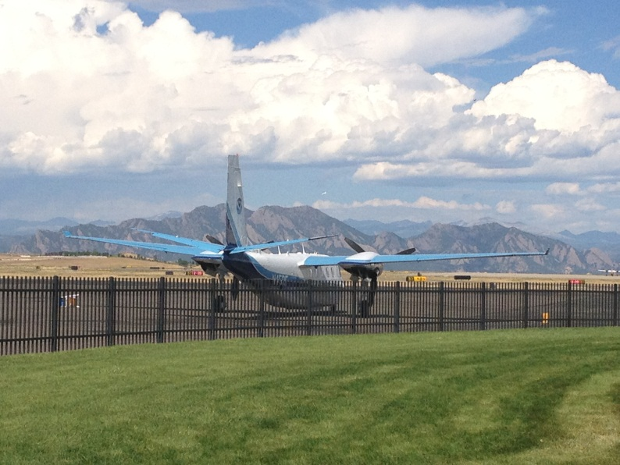
Other Variables to Consider
Time of Year, Need Smooth Air
Likelihood of Turbulence: Hurricanes, Tornados
Prevailing winds and weather patterns, especially wintery conditions and thunderstorms
Aircraft Available
Differing Capabilities
Funding
Areas already completed
GPRA
NOAA TurboCommander at
Denver Rocky Mountain Airport
September 2012
*GPRA = Government Performance and Results Act of 1993

Slide 51
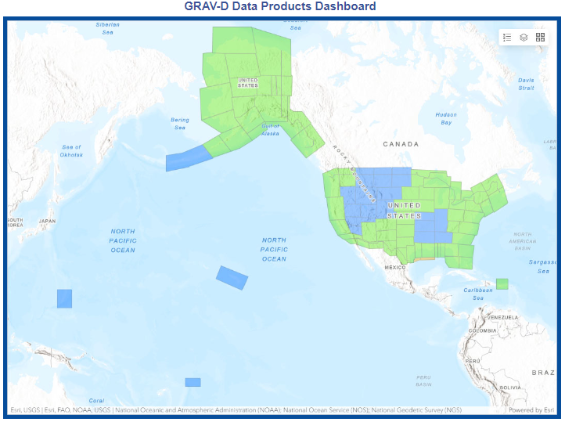

Airborne Gravity Current Coverage
http://www.ngs.noaa.gov/GRAV-D/data_products.shtml

Slide 52
GRAV-D Progress
100% of target area flown!
Currently re-flying older, lower quality lines
Will continue to improve data holdings as schedule permits
Beginning to plan some Terrestrial Gravity to densify relative gravity in areas with interesting gravity signals.
Planning absolute gravity 10-15 sites in the NW to support GeMS (Geoid Monitoring Service)

Slide 53
Geoid Monitoring Service GeMS
Following slides taken from presentations by Kevin Ahlgren, GeMS Project Manager

Slide 54
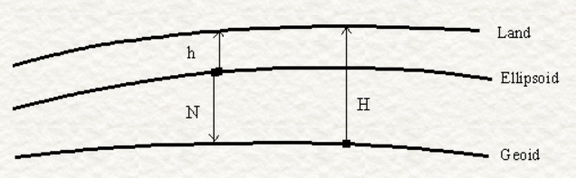
Monitoring Geoid Change: Static vs. Dynamic From Damiani, 2017 Geospatial Summit
Measured with GPS
Deforms, subsides, uplifts at all length scales
Static, except for model updates
Changes along with large-scale gravity change (caused by mass movement)
Calculated from geoid models
The height that U.S. National Spatial Reference System Users need
h = ellipsoidal height;
N = geoid height (undulation);
H = orthometric height
In a static world, H ≈ h - N
2022 aim is to achieve 1 cm geoid height accuracy (wherever possible) and 1 cm ellipsoidal height accuracy.
In a changing world, Ḣ ≈ ḣ - Ṅ.
Option 1: Provide a series of static geoids, updated whenever change somewhere in the U.S. reaches 0.5 cm. [Not NGS’ choice]
Option 2: Provide a static geoid (N₀) and geoid change over time (Ṅ) so that orthometric heights remain accurate to 1 cm at all times. H_{t} = h_{t}-(N₀+ Ṅ*t) [NGS’ choice]

Slide 55
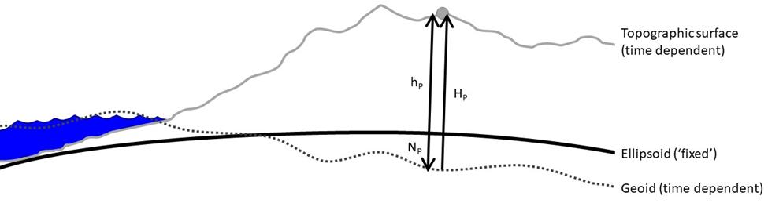
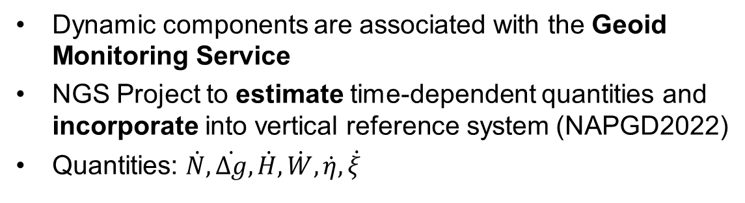
GeMS Project
Dynamic components are associated with the Geoid Monitoring Service
NGS Project to estimate time-dependent quantities and incorporate into vertical reference system (NAPGD2022)
Quantities: $\dot{N},\dot{∆g},\dot{H},\dot{W},\dot{η},\dot{ξ}$
Notes:
Stress: Need a lot of mass and (gravity) change over large areas to get ‘significant’ geoid change. It is not just a surface deformation event. There actually has to be mass redistribution causing gravity change.
Need to validate how well this changes reflect what is happening on the ground.

Slide 56

GeMS Motivation
Initially proposed as the 2nd component of Gravity for the Re-definition of the American Vertical Datum (GRAV-D)
“low-resolution movie to track the temporal changes to the gravity field on a broad scale—a re-occurring survey with very coarse spatial coverage and a long temporal span”
Specified in NGS Strategic Plan 2019-2023: Objective 2-2: “Replace NAVD 88”
Define and provide access to a geocentric, time-dependent, geopotential datum by year 2022.
Notes:
GeMS is not a ‘new’ project as it was originally proposed as the 2nd component of the GRAV-D project.

Slide 57
GeMS Project Status
Research and Development
Scope:
What can NGS do? What can NGS not do?
What are the costs, benefits, and risks of doing or not doing a particular element within GeMS?
Status:
Nearly completed (95% done).
Deliverables:
NOS NGS Technical Report 69: A Preliminary Investigation of the NGS’s Geoid Monitoring Service (GeMS)
Alpha Products: xDGEOID19 – a dynamic geoid model will be available for testing with xGEOID19.
Supporting Tools: Software, documentation, and details.
Recommendations that will drive subsequent GeMS stages.
Operations and Development (TBD)
Refinement and Improvement (TBD)

Slide 58
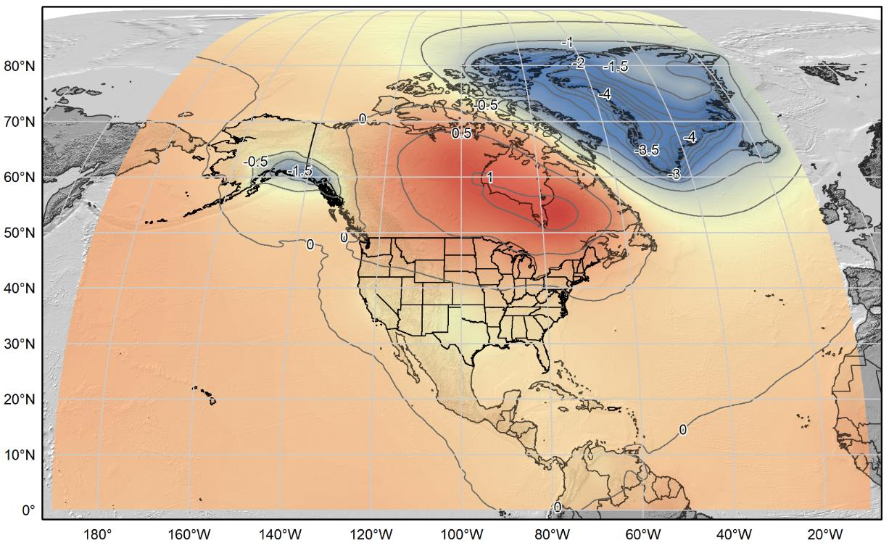
xDGEOID20
Alpha model based on secular trend from GRACE (NASA GSFC mascon v02.4, Luthcke, et al. 2013)).
Units: mm/yr.
Contour Interval: 0.5 mm/yr

Slide 59
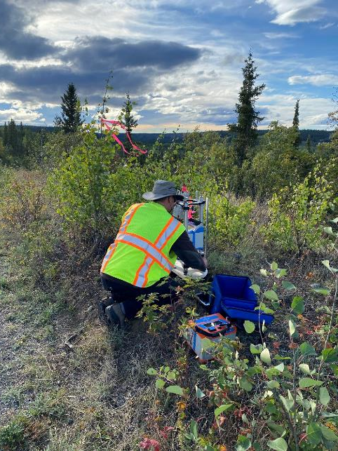
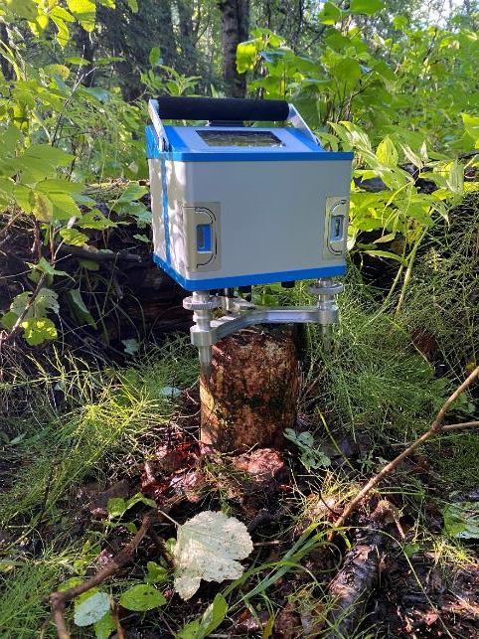
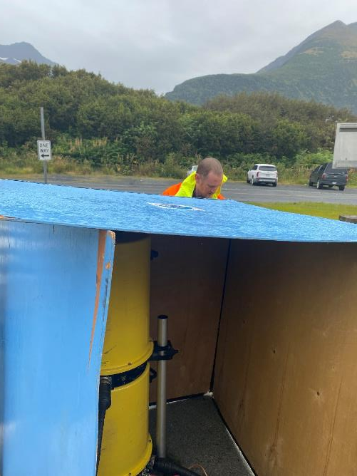
Gravity:

Slide 60
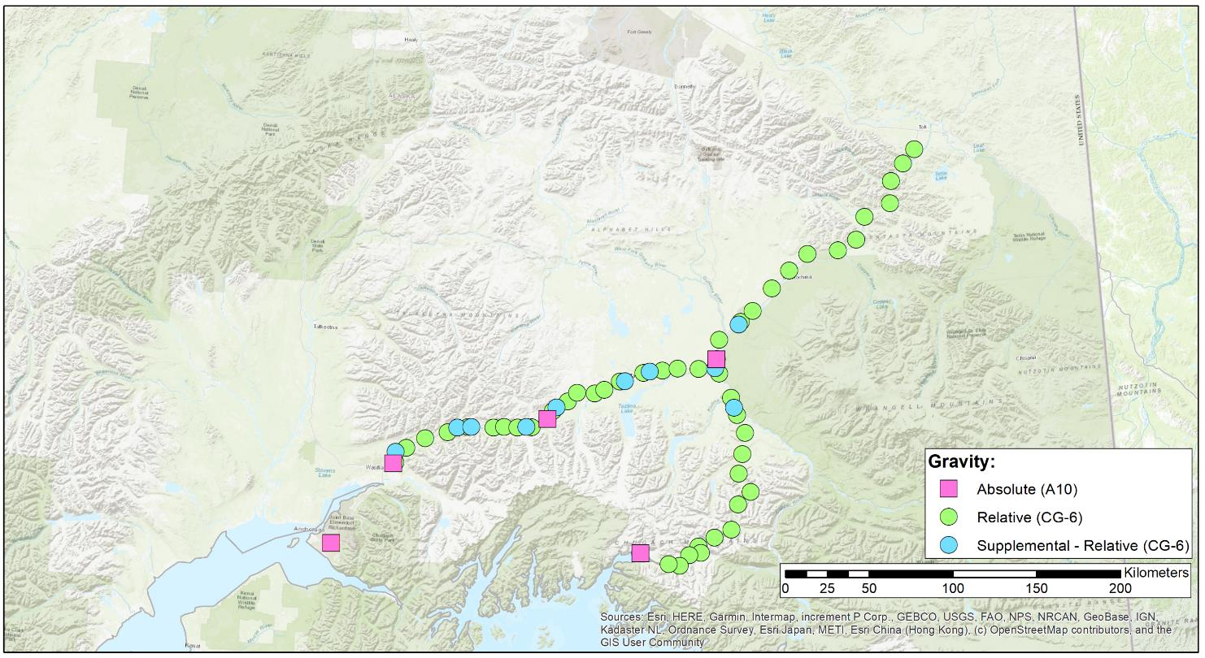
GeMS-VS: Gravity
GeMS Validation Survey
Tok
Glennallen
Palmer
Anchorage
Valdez

Slide 61
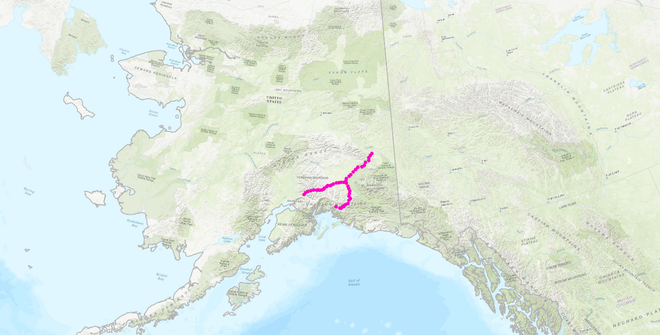
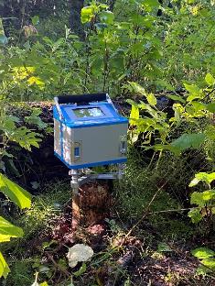
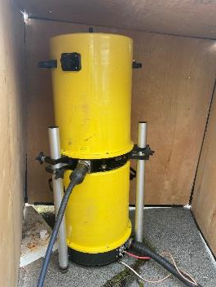
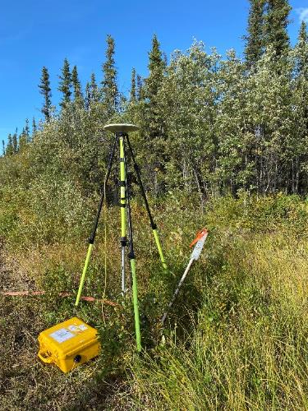
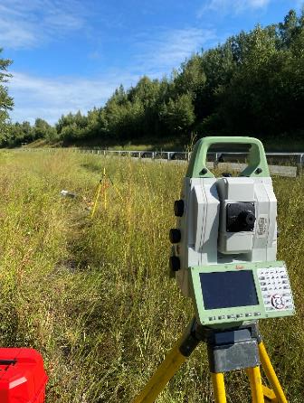
GeMS Validation Survey (GeMS-VS)
Tok
Palmer
Glennallen
Anchorage
Valdez

Slide 62
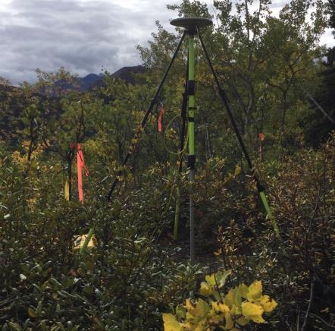
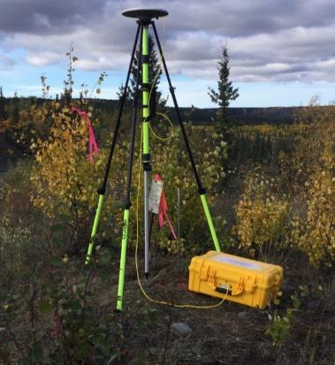
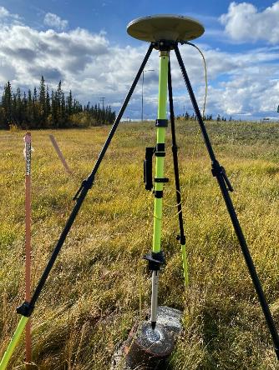
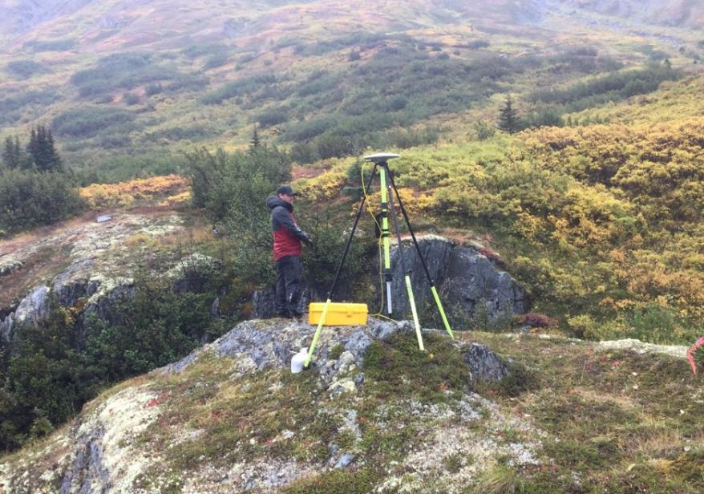
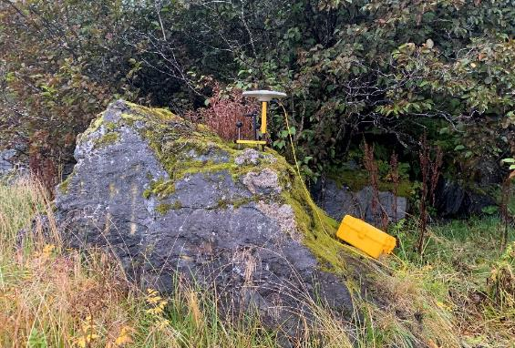
GNSS:

Slide 63
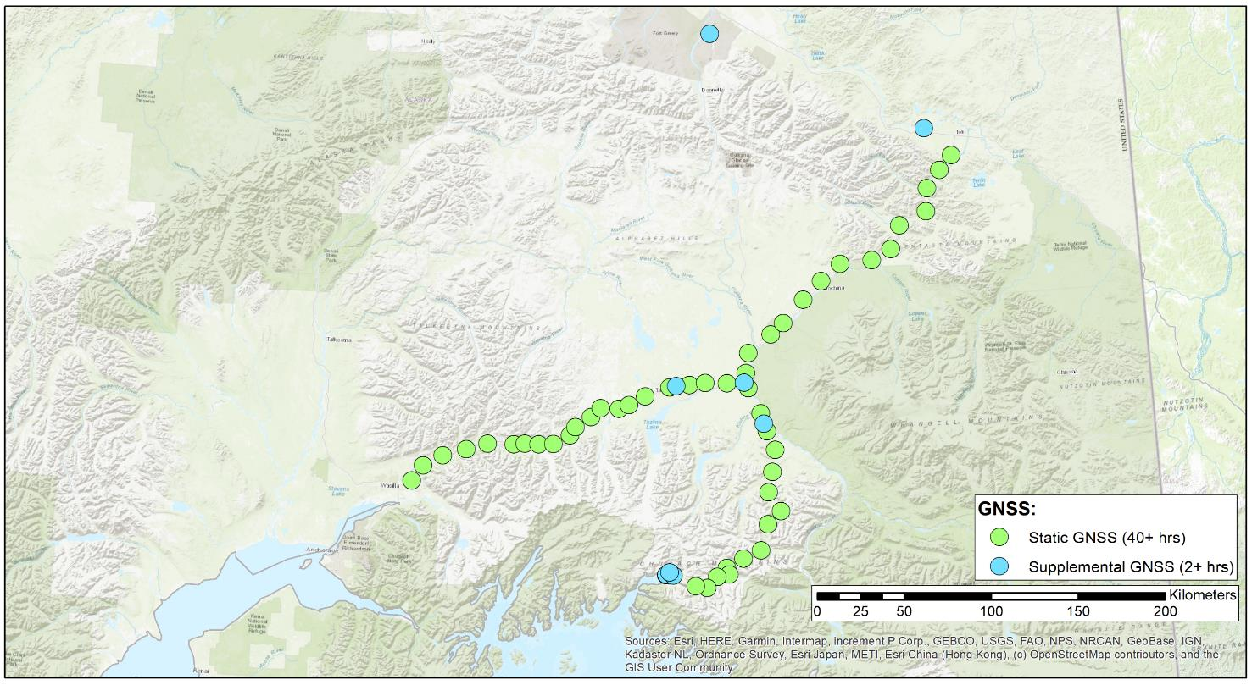
GeMS-VS: GNSS
Tok
Glennallen
Palmer
Anchorage
Valdez

Slide 64
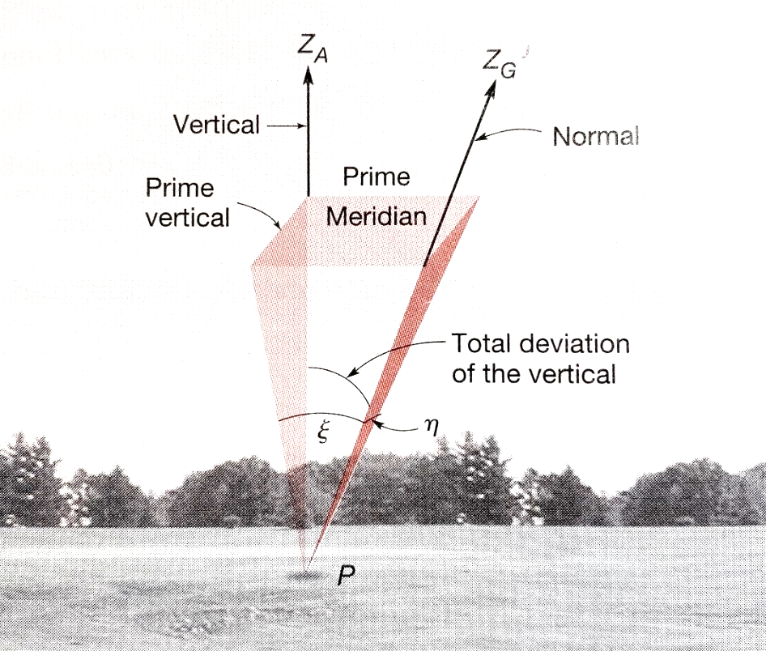
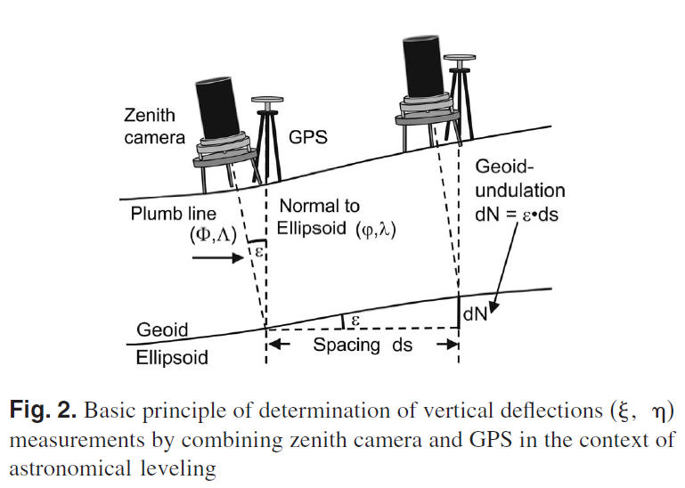

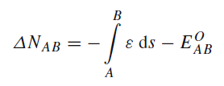

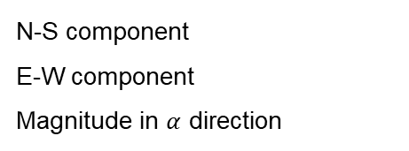


Deflection of the vertical
$$\left(Φ,Λ\right)$$
$$\left(φ,λ\right)$$
Ghilani & Wolf, 2015
Hirt, et al. 2010
N-S component
E-W component
Magnitude in $α$ direction
Notes:
Hirt, C., Bürki, B., Somieski, A., & Seeber, G. (2010). Modern determination of vertical deflections using digital zenith cameras. Journal of Surveying Engineering, 136(1), 1-12.

Slide 65


GeMS-VS: DOV
Tok
Glennallen
Palmer
Anchorage
Valdez

Slide 66


GPSonBM for Transformation Tool
Deadline was extended until Feb. 29, 2024
This will be the LAST extension.

Slide 67

All in all, an amazing effort

Slide 68

Way to go NJ!!

Slide 69

Observe and Share one in your area…there is still time!

Slide 70
LASER
Least squares Adjustments: Statistics, Estimates and Residuals
Contract began in August 2020
Solves many LSA problems
Has been tested on historic NGS archives
Uses the pre-existing Eigen library of linear algebra routines

Slide 71
A (probably incomplete) history of LSA software at NGS
INERT1 (1982) …….. Inertial
HOACOS (1979)…… Precursor to Adjust
HAVAGO (1979)……. Precursor to Adjust for 3D djustments
ADJUST ……………. Horizontal, modified for GPS, used by OP
GPSCOM/LLSOLV...Used to compute CORS network, early OP
ASTA………………...Geodetic leveling
NETSTAT …………...Built for 2007 adjustment, used again in 2011
APOGEE…………….Relative Gravity
CALIBRATE……….. Calibration Baselines
Additionally, LSAs are encompassed within this NGS software tool:
PAGES
Also, there is the following stand-alone set of matrix manipulation subroutines:
Heart Of Gold (1984)

Slide 72
Concerns: General
Inconsistency
Different languages, different variable names, and different times lead to inconsistency in code
Some programs might be perfectly compatible, but it’s difficult to know with such a vast number of authors and code over the years.
Lack of generality
Code written to adjust only one type of geodetic observation has limited usefulness to other applications
Languages: FORTRAN, C++, MATLAB are all in use today
Scalability

Slide 73
Software for PRojecting Observations, Constraints and Cofactor matrices/Errors through Time (SPROCCET)
Replaces HTDP
Support for orthometric data
Use of Geodetic Data eXchange (GDX) format
Use of IFDM2022
Error propagation through time
Distinct modules for 14-parameter Helmert transformations and deformation models

Slide 74
Reference Epoch Coordinates (RECs)
The Geometric and Orthometric REC projects are underway!
Geometric:
N/P/C/MATRF2022 epoch 2020.00 XYZ coordinates
About 120,000 passive marks
Orthometric
NAPGD2022 epoch 2020.00 orthometric heights
About 950,000 passive marks
Final data pull: April 2024
Expected early results: Late 2024

Slide 75
NSRS Modernization Alpha Site
Provides examples of the content, format, and structure of select data and products that NGS plans to release as a part of the Modernized NSRS
Products found on this page are for testing purposes only and do not contain any authoritative NGS data or tools

Slide 76


Slide 77


Slide 78



Slide 79



Slide 80
What’s New in OPUS World?
OPUS Projects 5.1 moved to Production
Current version 5.2
Full support for Bluebooking
Supports the uploading, QA/QC, adjustment, and submission for publication of real-time kinematic (RTK) vectors in the GVX file format.
Working to replace mandatory, instructor-led Managers training with self-paced, online videos and tutorials.
OPUS 5.0 in Beta (includes M-PAGES)
Multi-constellation

Slide 81
GNSS Vector EXchange Format (GVX)
Website: https://www.ngs.noaa.gov/data/formats/GVX/index.shtml
Detailed documentation
Schema (XSD)
Example vector files
GVX is written in Extensible Markup Language (XML)
Designed to store and carry data in plain text format
Flexible representation of arbitrary data structures
Extensible – new elements can be added later without breaking applications
Both machine-readable and human-readable
Schemas can be used to define “must haves” and “should haves”

Slide 82
GVX Do’s and Don’t’s
Make sure your manufacturer supports GVX
Collect RTK/RTN observations
Recommend between 3 and 6, 5-min observations, some should be on a different day
Make sure that you are storing the vector in addition to coordinates
If RTN, make sure the vector is from a Physical Reference Station, not from a Virtual Reference Station
If Base is not a NCN station, collect static data on it to be processed in OP

Slide 83
GVX Do’s and Don’t’s Cont…
Load observations to your office software
some manufactures allow the creation of GVX in the data collector.
Convert your vector(s) to GVX Format
Upload to an OPUS Project

Slide 84

Design for OPUS-Projects and GVX
GVX file (from RTK survey or baseline processing in other software)
OPUS-Projects (from static GNSS session processing)
500-800 km
500-800 km
RTK Base or “From” Mark
RTK Rover or “To” Mark
Vector
Vector in GVX File
[Adapted from Weaver et al. 2018]

Slide 85



Three Cases for RTK/RTN Bases
RTN Base = CORS
Automatically attaches GVX vectors to official coordinates for CORS
Constrain CORSs
RTK/RTN Base = Not a CORS and new to NGS
Upload static GPS data logged at the base during the days of the RTK survey
Perform session baseline processing to connect to CORSs
Constrain CORSs
3. RTK/RTN Base = Not a CORS but has a datasheet
Could constrain coordinates on datasheet
Or, upload static data at the RTN base, logged during the days of the RTK survey; perform session baseline processing; constrain CORSs

Slide 86


Slide 87


Slide 88
M-PAGES = Multi-GNSS PAGES
Currently in BETA!!
Capable of ingesting all GNSS observables currently supported by the global infrastructure
Capable of using more than two frequencies.
Capable of ingesting RINEX 2 or 3
Version 2 only supports GPS and GLONASS, Galileo (to a limited extent)
Submission of proprietary data will result in RINEX 2.11 (limitation of TEQC). NGS will ONLY accept RINEX submission in the near future.
Capable of using pseudorange and phase.
Uses a single-difference processing strategy.
M-PAGES can support NGS strategic objectives.
January 26, 2021
Multi-GNSS OPUS : First Call for Internal Testing

Slide 89
M-PAGES
GPS : Global Positioning System
GLONASS: Globalnaya Navigatsionnaya Sputnikovaya Sistema
Galileo :
BeiDou : BeiDou Navigation Satellite System BDS, BeiDou-2, COMPASS
IRNSS : Indian Regional Navigation Satellite System NavIC
QZSS : Quasi-Zenith Satellite System Michibiki
SBAS : Satellite-based Augmentation Systems
https://en.wikipedia.org/
January 26, 2021
Multi-GNSS OPUS : First Call for Internal Testing

Slide 90


Slide 91


Slide 92


Slide 93


Slide 94


Why All the Fuss?
The distribution of and changes in the relative positions of the satellites with respect to the receiving antenna are the most important data characteristics for high accuracy positioning.
GPS (left) is good. Multi-GNSS (right) is better.
https://www.gnssplanning.com/#/settings
January 26, 2021
Multi-GNSS OPUS : First Call for Internal Testing
Notes:
Geographic center of CONUS, 2021-1-12 12:00 PM - 6:00 PM CST

Slide 95


Obstructed View
Simulated sky coverage in urban or natural canyon.
GPS-only (left) isn’t viable. Multi-GNSS (right) is.
http://www.gnssplanningonline.com
January 26, 2021
Multi-GNSS OPUS : First Call for Internal Testing

Slide 96

NCAT v2.1
Added selection of units on heights
Added option to customize data exported

Slide 97

CORS Page short-term series only shows last 90 days

Slide 98


Slide 99


Slide 100


Slide 101

Replaces NGS Data Explorer

Slide 102
Modernization Timeline
In 2022, NGS diverted resources from tool-building to data assurance
“Limited tools, excellent coordinates”
Set a goal of roll-out by 2025
NGS is on-track to roll out the modernized NSRS by the middle of 2025.
Work on additional tools will continue in the out-years

Slide 103
Rollout, Testing, Replacement
NGS will roll out components of the modernized NSRS over time (2024-2025)
As each component is rolled out, it can be tested
Once the final component (likely VERTCON) is rolled out (likely late 2025), testing will continue for at least 6 months
Once enough testing is done, and all modernized NSRS components seem stable and correct, the FGCS will vote (likely 2026)
If affirmative, the modernized NSRS will replace the current NSRS

Slide 104
Initial rollout
NGS promised many things in the three Blueprint documents
Not all can be built in a timely manner
So when we say “rollout”, we mean initial rollout, which is at least the minimum viable products needed to replace the current NSRS with the modernized NSRS
Future products and services supporting the modernized NSRS will be rolled-out after the FGCS vote

Slide 105
Rollout: Alpha, Beta, Live
NGS will use three different websites (URLs) as we roll-out the modernized NSRS:
Live: www.ngs.noaa.gov
Will hold the current NSRS until the modernized NSRS has been fully tested and the FGCS has voted to replace the current NSRS with the modernized NSRS
Beta: beta.ngs.noaa.gov
Soon to be re-designed to hold modernized NSRS products only
Every component of the modernized NSRS will be placed here
Products assumed to be complete and correct
For testing
Subject to change or deletion
Alpha: alpha.ngs.noaa.gov
“Incomplete, early, possibly incorrect”
Not everything will go on alpha

Slide 106
Current NSRS during rollout and testing
While the modernized NSRS is being rolled out and tested, the current NSRS will remain the official NSRS of the United States
This will not change until the FGCS vote (probably 2026)
URL www.ngs.noaa.gov will only hold current NSRS
Only two major improvements to the current NSRS are expected during this time:
Multi-GNSS support within OPUS-S
ITRF2020 in all products and services

Slide 107
Snapshot of the modernized NSRS at the end of initial rollout
Not everything promised in the Blueprint documents will be built in time for the initial rollout. But the following will be:
ITRF2020, N/P/C/MATRF2022, NAPGD2022, SPCS2022
NSRS Database, new datasheets for marks and stations
RECs
OPUS-S with multi-GNSS
OPUS-Projects (GPS only):
GDX, SPROCCET, LASER, NSRS DB submission
The ability for NGS to generate RECs from OPUS submissions in a timely manner

Slide 108
Not all products will be public
NGS is building SPROCCET
Replaces HTDP
Contains IFDM2022, 14H, DGEOID2022
Will be plugged directly into the modernized OPUS-Projects
Users will engage with it via OPUS-Projects

Slide 109
Rollout onto Beta
www.ngs.noaa.gov:
ITRF2020 on NCN
SPCS 83
NAVD 88
OPUS-Share
NADCON 5
OPUS-S (GNSS)
NAD 83
GEOID18
OPUS-RS (GPS)
VERTCON 3
OPUS-Projects (GPS)
(Bluebooking, HTDP, ADJUST, NGS IDB, Datasheets)
DEFLEC18
beta.ngs.noaa.gov:
ITRF2020 on NCN
EPP2022
N/P/C/MATRF2022
Geometric RECs
in N/P/C/MATRF2022
NADCON 6?
SPCS2022
IFDM2022
GM2022
Orthometric RECs
in N/P/C/MATRF2022
VERTCON 4?
GEOID2022
NAPGD2022
GRAV2022
DEM2022
DEFLEC2022
OPUS-S (GNSS)
OPUS-Projects (GPS)
(GDX, SPROCCET, LASER, NSRS DB, New Datasheets)
Mid 2024
Late 2024
Early 2025
Late 2025

Slide 110
Testing into replacement
From late 2025 into sometime in 2026, all modernized NSRS components on Beta will go through testing and feedback
After the FGCS vote, a few months of work remain:
The FGCS will issue an FRN officially announcing the adoption of the modernized NSRS
The beta website may be wiped of submitted data*
All modernized NSRS components moved to the Live website
Submissions will then begin in earnest and won’t be deleted
All current NSRS components moved to the Beta website
No further submissions to the NGS IDB will be allowed at this point
Notes:
Notes: NGS is considering what to do with data submitted during testing. The cleanest solution is to delete it as “test data” and not attempt to move it onto the Live website. If we were to consider moving it to Live, we would need to re-submit the data to ourselves, which is a tremendous amount of work. It is best to assume that NGS will ask submitters to re-submit after the switch.

Slide 111
After testing and the FGCS vote
www.ngs.noaa.gov:
ITRF2020 on NCN
SPCS 83
NAVD 88
OPUS-Share
NADCON 5
OPUS-S (GNSS)
NAD 83
GEOID18
OPUS-RS (GPS)
VERTCON 3
OPUS-Projects (GPS)
(Bluebooking, HTDP, ADJUST, NGS IDB, Datasheets)
DEFLEC18
beta.ngs.noaa.gov:
ITRF2020 on NCN
EPP2022
N/P/C/MATRF2022
Geometric RECs
in N/P/C/MATRF2022
NADCON 6?
SPCS2022
IFDM2022
GM2022
Orthometric RECs
in N/P/C/MATRF2022
VERTCON 4?
GEOID2022
NAPGD2022
GRAV2022
DEM2022
DEFLEC2022
OPUS-S (GNSS)
OPUS-Projects (GPS)
(GDX, SPROCCET, LASER, NSRS DB, New Datasheets)
All submissions provided during testing get deleted

Slide 112
After testing and the FGCS vote
www.ngs.noaa.gov:
ITRF2020 on NCN
EPP2022
N/P/C/MATRF2022
Geometric RECs
in N/P/C/MATRF2022
NADCON 6?
SPCS2022
IFDM2022
GM2022
Orthometric RECs
in N/P/C/MATRF2022
VERTCON 4?
GEOID2022
NAPGD2022
GRAV2022
DEM2022
DEFLEC2022
OPUS-S (GNSS)
OPUS-Projects (GPS)
(GDX, SPROCCET, LASER, NSRS DB, New Datasheets)
All submissions from this point forward get saved
beta.ngs.noaa.gov:
ITRF2020 on NCN
SPCS 83
NAVD 88
OPUS-Share
NADCON 5
OPUS-S (GNSS)
NAD 83
GEOID18
OPUS-RS (GPS)
VERTCON 3
OPUS-Projects (GPS)
(Bluebooking, HTDP, ADJUST, NGS IDB, Datasheets)
DEFLEC18
No submissions to the NGS IDB allowed any longer

Slide 113
Summary
The modernized NSRS is coming soon!
Starting this year!
All components should be on Beta by 2025
For testing only!
It won’t replace the current NSRS until an FGCS vote (2026)
NGS will continue to support the current NSRS through the rollout and testing of the modernized NSRS
We encourage you to test each component as it is released

Slide 114
Lets go Live
NGS Web Map

Slide 115
Thank You! Questions?
Presentation will be available at:
https://www.ngs.noaa.gov/web/science_edu/presentations_library/
Dan Martin
Northeast Regional Geodetic Advisor
ME, NH, VT, MA, CT, RI, NY, NJ
Dan.martin@noaa.gov
240-676-4762

