Slide 1

“State of NGS” update overview at LCSO’s Geospatial Symposium
Marti Ikehara, CA Geodetic Advisor
NOAA’s National Geodetic Survey
April 5, 2012
www.ngs.noaa.gov

Slide 2
Table of contents
NSRS Ref frame improvements
  For CORS, for passive, Geoid model
NSRS Evolution
  GRAV-D, GSVS, NSRS revolution
NGS FY12 Budget & Geodetic Advisor Program
Coastal Products & Services
  Shoreline Change, VDATUM, SLR, GLOSS, CSC
Lightning topics

Slide 3
Recent and near-future changes to the geometric datum(s) realization
New Coordinates and Epoch for CORS (done)
Consequent Adjustment of 80K Passive Stations (in progress)
Subsequent Development of GEOID12

Slide 4
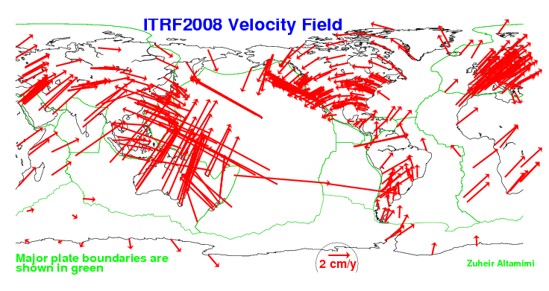
Rationale for Updating the NSRS (CORS)
Definition starts with a global RF: ITRF##
No fixed tectonic plate results in velocities

Slide 5
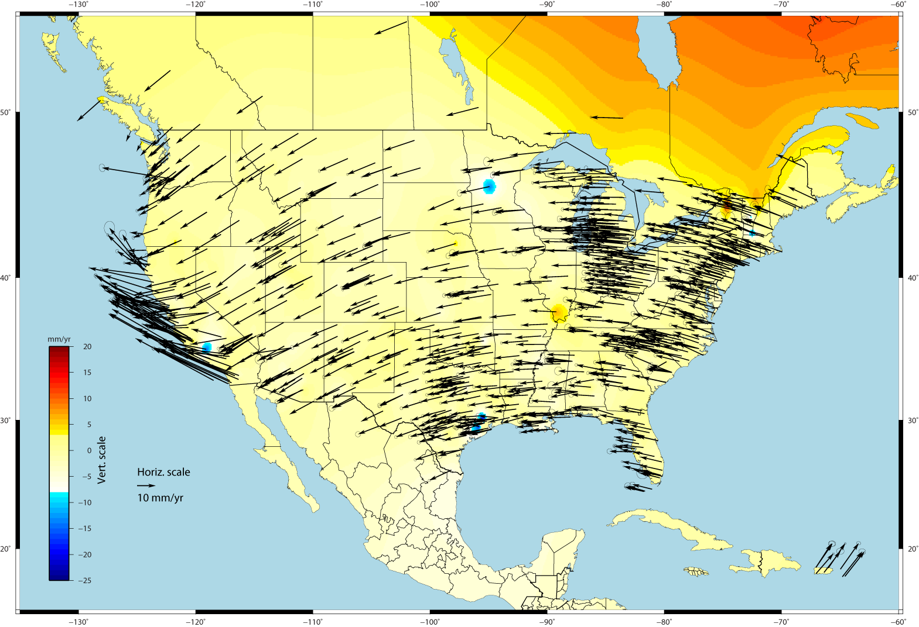
U.S. CORS Velocity Field – ITRF2008
Notes:
Color shading represents vertical velocities; Canadian shield is experiencing glacial isostatic rebound and going up.

Slide 6
Rationale for updating CORS RF
NSRS’s global frame was ITRF00 epoch 1997.00. Projecting 13 yrs was unrealistic because of velocities; NAD 83(CORS96) epoch 2002.00 projecting 8 yrs was becoming a problem
Coordinates and velocities were a mixture from last reprocessing (1994-2002) and adjustments using 8 to 3 IGS reference sites
Mixture of Computed and HTDP velocities
Assumed NAD83 vertical velocity = 0 mm/yr
Change fr Relative to Absolute antenna phase center values in ITRF definition
Metadata issues, eg, discontinuities/offsets
Significant software changes since 2002
Notes:
Computed velocities from those CORS with >2.5 yrs data stored at NGS

Slide 7
Multi-year CORS Solution: MYCS
“Multiyear” effort began 7 years ago
IGS proposed re-processing all data to re-compute station coordinates, orbits, and EOPs (earth orientation parameters) fr 1994-present
NGS began with a revision of PAGES software and processing strategy driven by weak NGS orbit contributions to IGS
860 weekly (full history) CORS+ ~230 global SINEX files containing X,Y,Z positions and full variance-covariance information
Coordinates published (online) on Sept 6, 2011

Slide 8
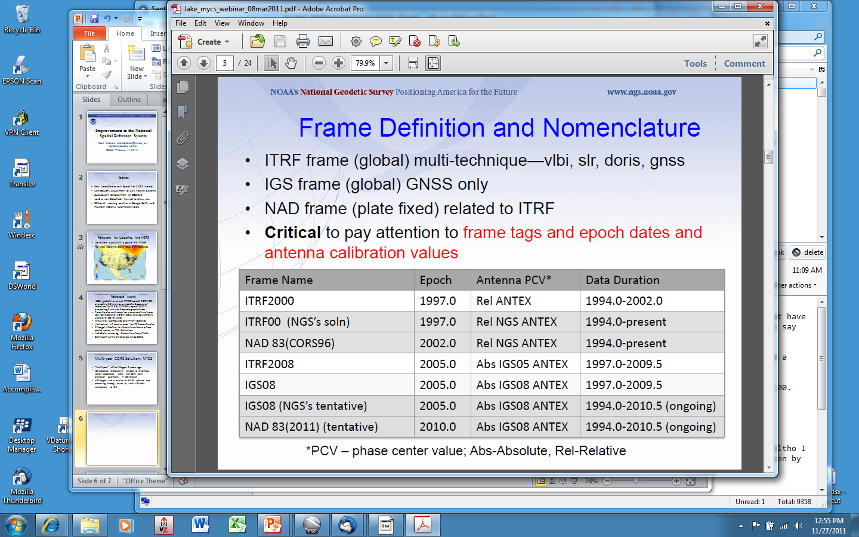
Geodetic Reference Frames past and present
xxxxxxxx
xxxxxxxxxxx

Slide 9
NEED for a new national adjustment, NA2011 project, for passive geodetic stations
Optimally align passive control with CORS
>1000 projects submitted since 2007 NatlReadj
  Number of stations increased by 1/3 in just 5 years!
  Plus Observations for Hawaii & other Pacific islands
Database pull as of 3/28/12; includes some critical leveling (& GPS obs) in Gulf States
More consistent results in tectonically active areas:
  Longer time series for CORS, as well as
  More current data for passive, and better tectonic modeling for applying HTDP to obs back 20+ years

Slide 10
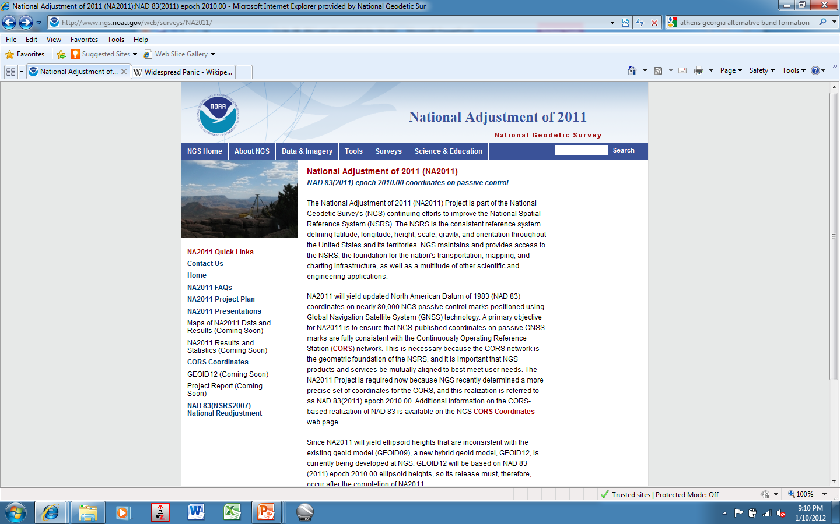

Slide 11
Current status of NA2011, late-Mar 2012
Primary/secondary adjustment approach for CONUS
Projects older than 1994 (start of CORS program) in secondary except have included HARNs in primary
5321 stations common to both used as constraints
PRIMARY: 3472 projects; 62.4K unique stations;
343,482 vectors total; rejected reduced to 3%
SECONDARY: 614 projects; 22.5K stations
Downweighting vertical component (eht) in subs areas
99% of residuals <3cm horizontal and <4cm vertical
Alaska: 142 projects; Hawaii: 39 projects
Completion anticipated in mid-May

Slide 12
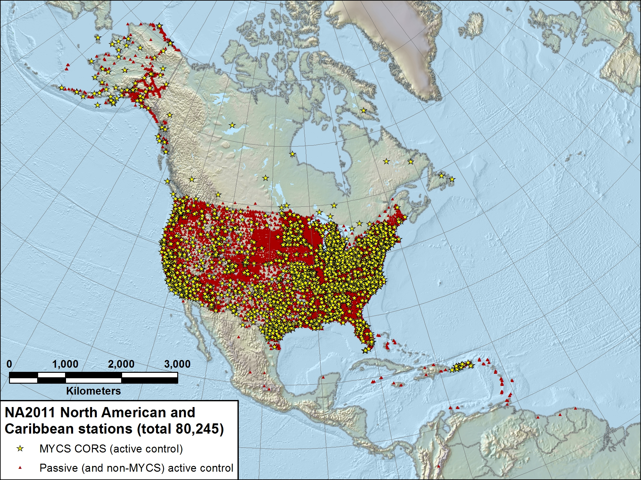

Slide 13
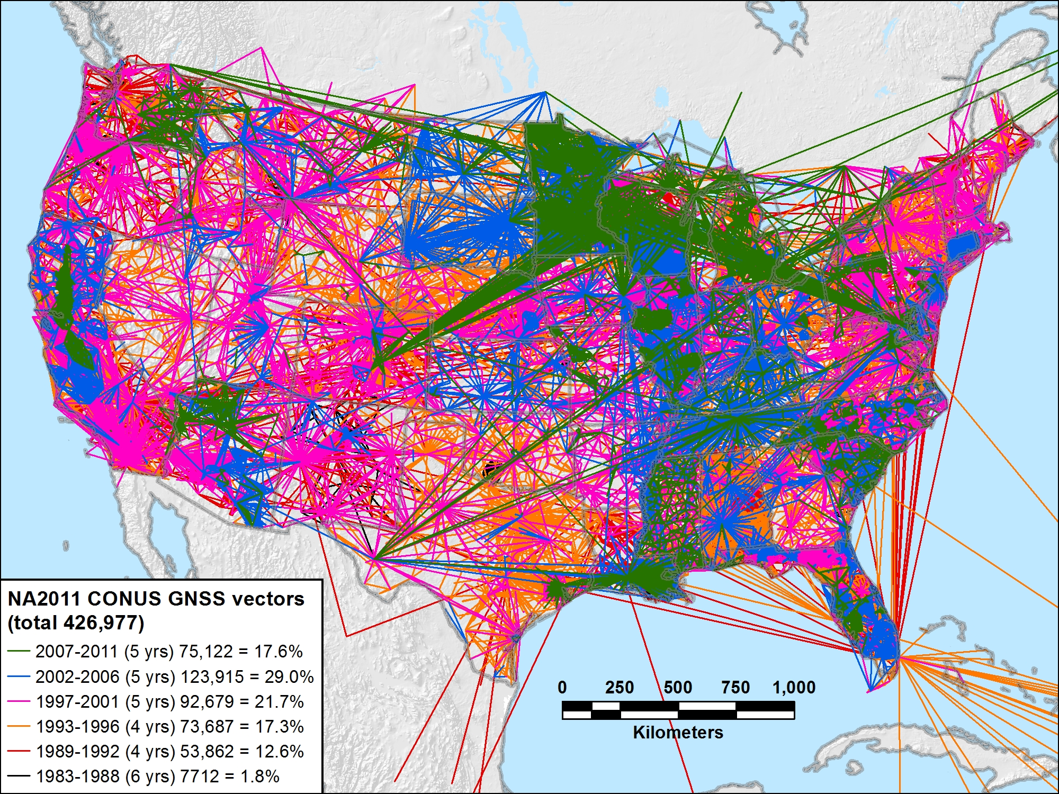
NA2011 CONUS 1983-2011 (29 yrs): 426,977 vectors

Slide 14
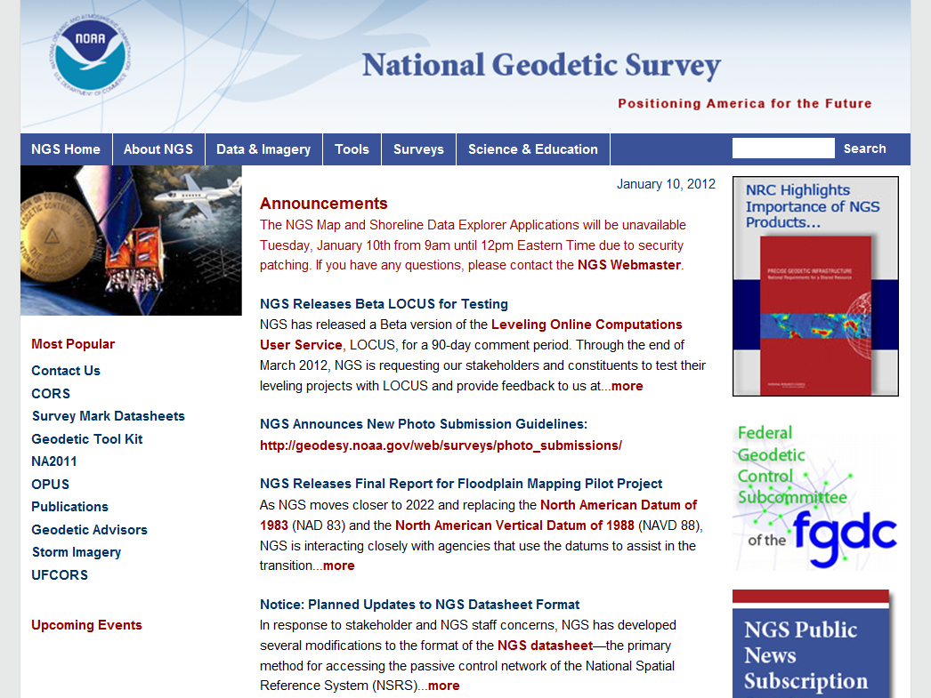
More information…
geodesy.noaa.gov

Slide 15
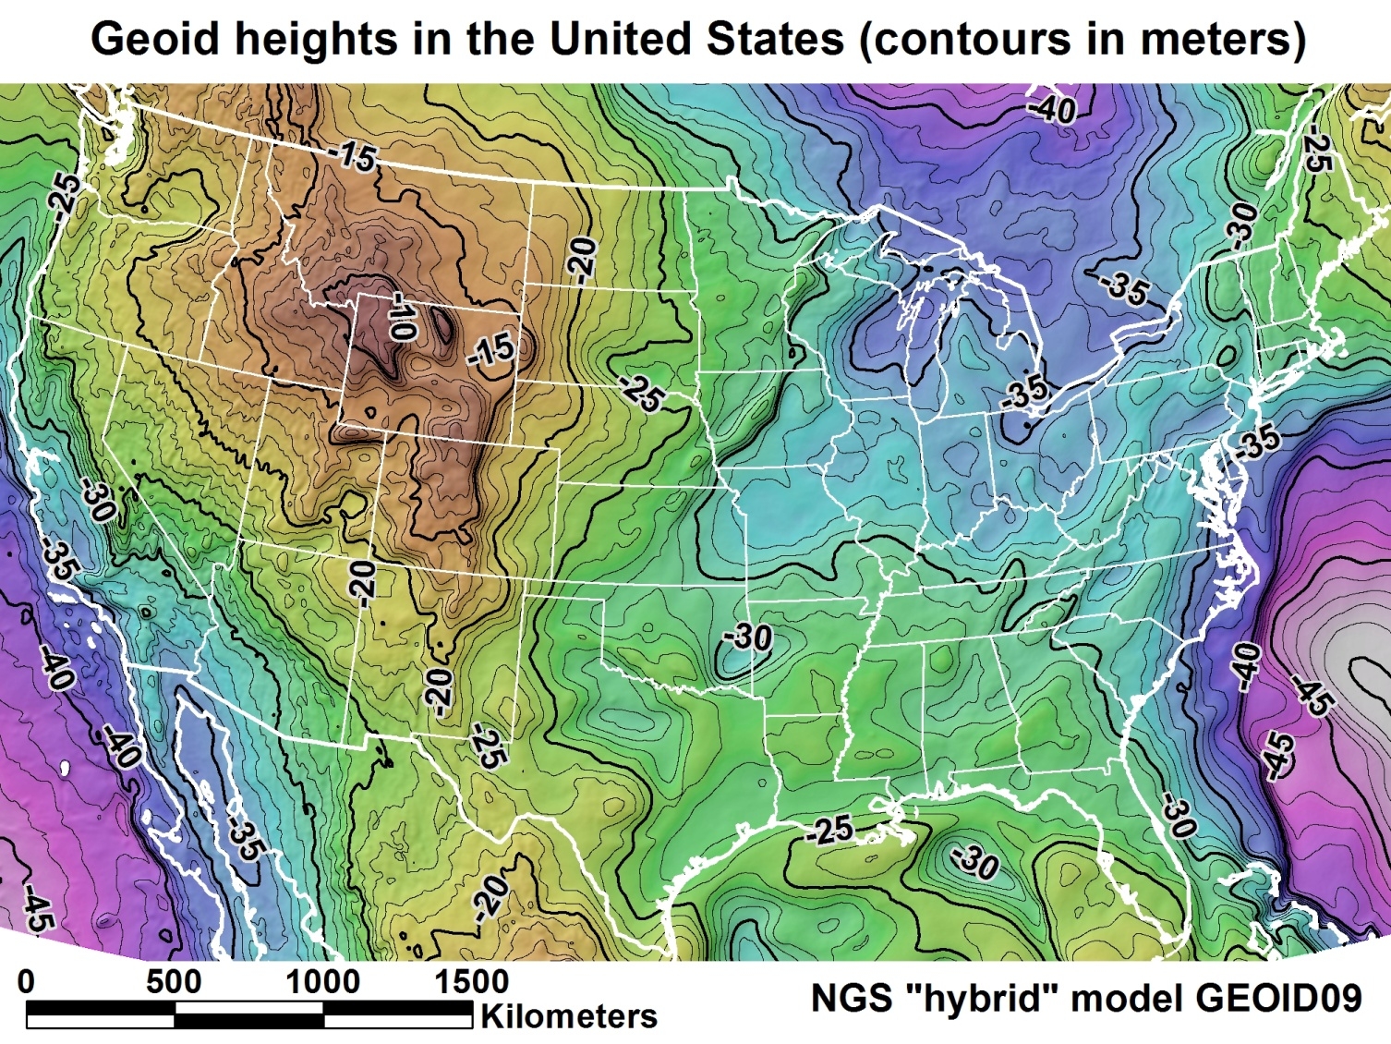
Geoid Modeling
Building models from gravity to derive heights from GPS/GNSS

Slide 16
GEOID12 Development
Model will be based on ellipsoid heights published from NA2011 project
Proposed stations, different than for GEOID09, for inclusion/exclusion distributed to geodetic advisors for review, checking:
Stations rejected in NAD83(07) included in (11)
Stations with new data or new stations
Stations that should have been rejected in G09
Release of GEOID12 NLT June 30
NOTE: Two months after changes, all adjustments (and OPUS) must/will use NAD83(2011) datum and GEOID12

Slide 17
Table of contents
NSRS Ref frame improvements
  For CORS, for passive, Geoid model
NSRS Evolution
  GRAV-D, GSVS, NSRS revolution
NGS FY12 Budget & Geodetic Advisor Program
Coastal P&S
  Shoreline Change, VDATUM, SLR, GLOSS, CSC
One-minute topics

Slide 18

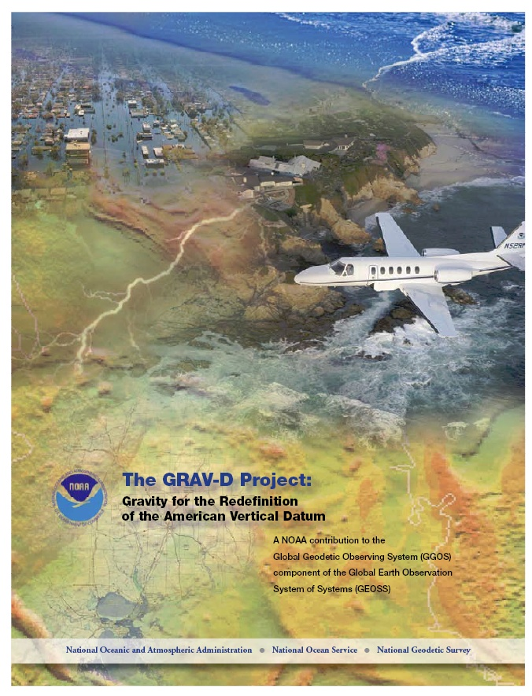
Gravity for the Redefinition of the American Vertical Datum (GRAV-D)
Replace the Vertical Datum of the USA by 2022 (at today’s funding) with a gravimetric geoid accurate to 1 cm
GOAL: Orthometric heights accessed via GNSS accurate to 2 cm
Three thrusts of project:
  Airborne gravity survey of entire country and its holdings
  Long-term monitoring of geoid change
  Partnership ground surveys
Working to launch a collaborative effort with the USGS for simultaneous magnetic measurement
Gravity and Heights are
inseparably connected
Notes:
GRAV-D is the NGS project designed to replace NAVD88 with a vertical datum based upon a gravimetric geoid accurate to 1 cm. Heights above this datum will be accessed via GNSS measurements. Three thrusts of project. Launch USGS collaboration for simultaneous mag measurement.

Slide 19
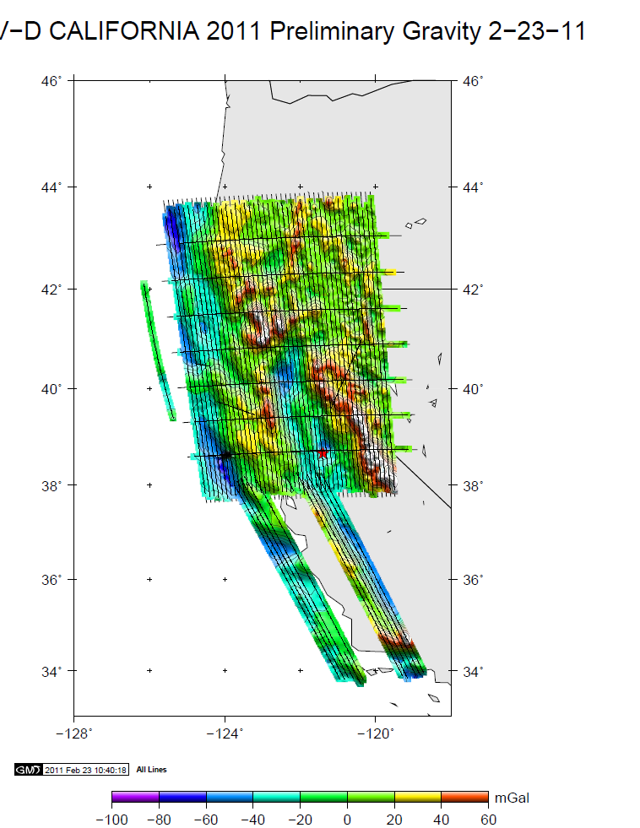
GRAV-D Survey in California, Jan-Feb 2011
Look for article written by Ikehara in CA Surveyor issue, Spring 2011
Notes:
The “tails” in central CA are data collected after the original data acquisition plan was completed ahead of schedule.

Slide 20
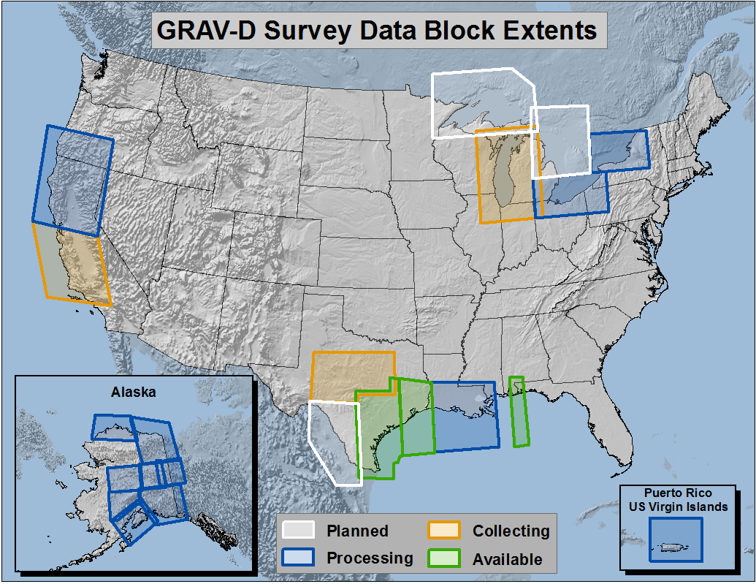
Gravity for the Redefinition of the American Vertical Datum (GRAV-D), FY 2012

Slide 21
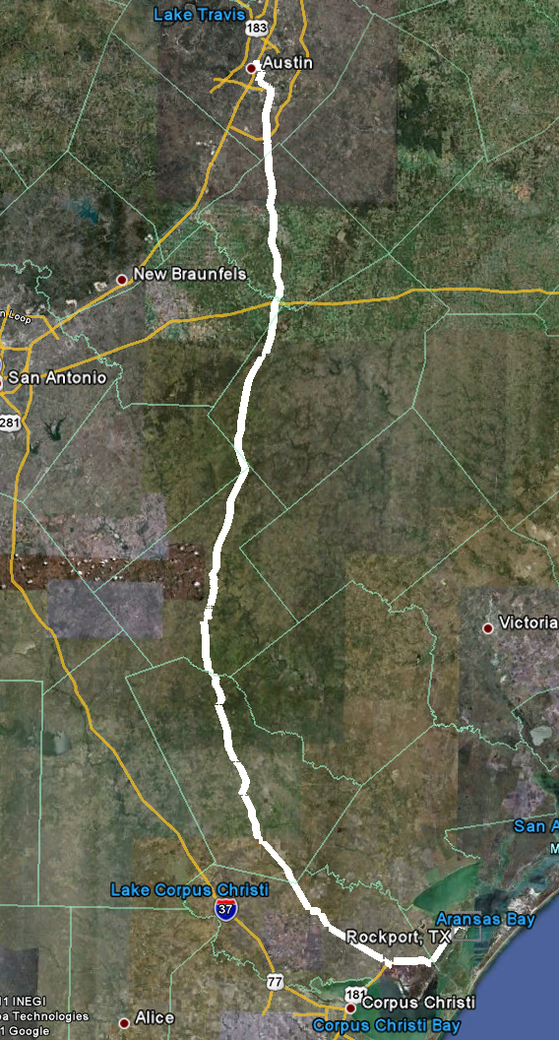
Geoid Slope Validation Survey
Austin
Observe geoid shape (slope) using multiple independent terrestrial survey methods
  GPS + Leveling
  Deflections of the Vertical
Compare observed slopes (from terrestrial surveys) to modeled slopes (from gravimetry or satellites)
  With / Without new GRAV-D airborne gravity
325 km
218 points
1.5 km apart
Rockport
Notes:
But will this method produce a sufficiently accurate geoid?
This summer, we conducted an experiment to determine the accuracy of our geoid. We selected a line that extended 325 km from downtown Austin, Texas (North end) to Rockport, Texas (South end). There were 218 official survey points along the line, with an average spacing of 1.5 km between them. We compared the slope of the geoid along the line determined with GPS + leveling with deflections of the vertical as measured by the ETH Zurich DIADEM zenith camera. We also compared the observed geoid slope with slopes calculated from various geoid models to evaluate the their quality. As for NGS models, we tested geoids that both included and didn’t include new GRAV-D airborne gravity.

Slide 22
Surveys Performed
GPS: 20 identical units, 10/day leapfrog, 40 hrs ea.
Leveling: 1st order, class II, digital barcode leveling
Gravity: FG-5 and A-10 anchors, 4 L/R in 2 teams
DoV: ETH Zurich DIADEM GPS & camera system
LIDAR: Riegl Q680i-D, 2 pt/m² spacing, 0.5 km width
Imagery: Applanix 439 RGB DualCam, 5000’ AGL
Other: RTN, short-session GPS, extra gravity marks around Austin, gravity gradients

Slide 23
The “1 cm
geoid”
Notes:
This slide is a companion to the previous one, but the h-H errors have been removed, in an RMS sense, from the total h-H-N errors, leaving, ostensibly, gravimetric geoid errors only. As seen previously, the airborne geoid is the best performer, by far. In fact, as a general statement, it could be said that USGG2012x02, an airborne gravity data enhanced geoid model, is effectively at the 1 cm differential geoid undulation accuracy level across all distances, in the region of GSVS11.

Slide 24
Geoid Slope Survey Conclusions
Including airborne gravity data improves geoid slope accuracy at nearly all distances <325 km
The NGS geoid in the TX survey meets the 1 cm accuracy objective only if airborne data are included
  No other model achieved 1 cm accuracy
Gravimetric geoid models and GPS ARE a viable alternative to long-line leveling
Notes:
The Survey verified that the inclusion of the GRAV-D airborne survey improved the geoid slope accuracies at all distances measured by the survey.

Slide 25
GSVS 2013 proposed
East-West instead of North-South
Include greater relief—eg, mountains
“central” latitudes of US west of Miss River
Scientifically ‘interesting’
Good partnership with ‘locals’, eg State DOT
Three candidate areas:
  Nebraska
  Colorado
  California

Slide 26

National Geodetic Survey Ten-Year Plan
Explains Revolution of NSRS
Official NGS policy as of January 2008
Replace NAVD 88 with a GPS/geoid datum
Replace NAD 83 with a geocentric GPS/GNSS based datum

Slide 27
Why New Datums?
NAD 83
  non-geocentric, i.e. inconsistent with GNSS positioning
  NAD 83 coordinates of the CORS network are inconsistent with passive marks
  Lack of velocities, i.e. NAD 83 does not utilize station motion for passive marks
NAVD 88
  cross-country build up of errors (“tilt” or “slope”) from geodetic leveling
  Passive marks inconveniently located and vulnerable to disturbance and destruction
  A 0.5 m bias in the NAVD 88 reference surface from the geoid surface best approximating global mean sea level
  Subsidence, uplift, freeze/thaw, and other crustal motions invalidate heights of passive marks, and can make it difficult to detect such motions.
  Passive marks without adequate geophysical models make it difficult to reliably detect sea level change
  Changes to Earth’s gravity field cause changes in orthometric heights, but NAVD 88 does not account for those changes (because it is based on a static gravity model)
  The gravity model and modeling techniques used to determine NAVD 88 are not consistent with those currently used for geoid modeling

Slide 28
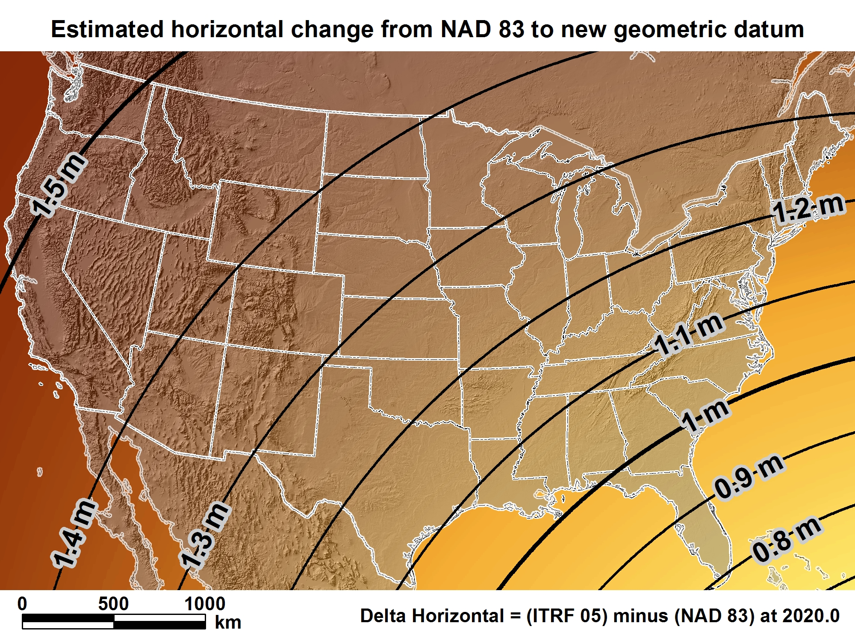
New geometric datum minus NAD 83 (horizontal)

Slide 29
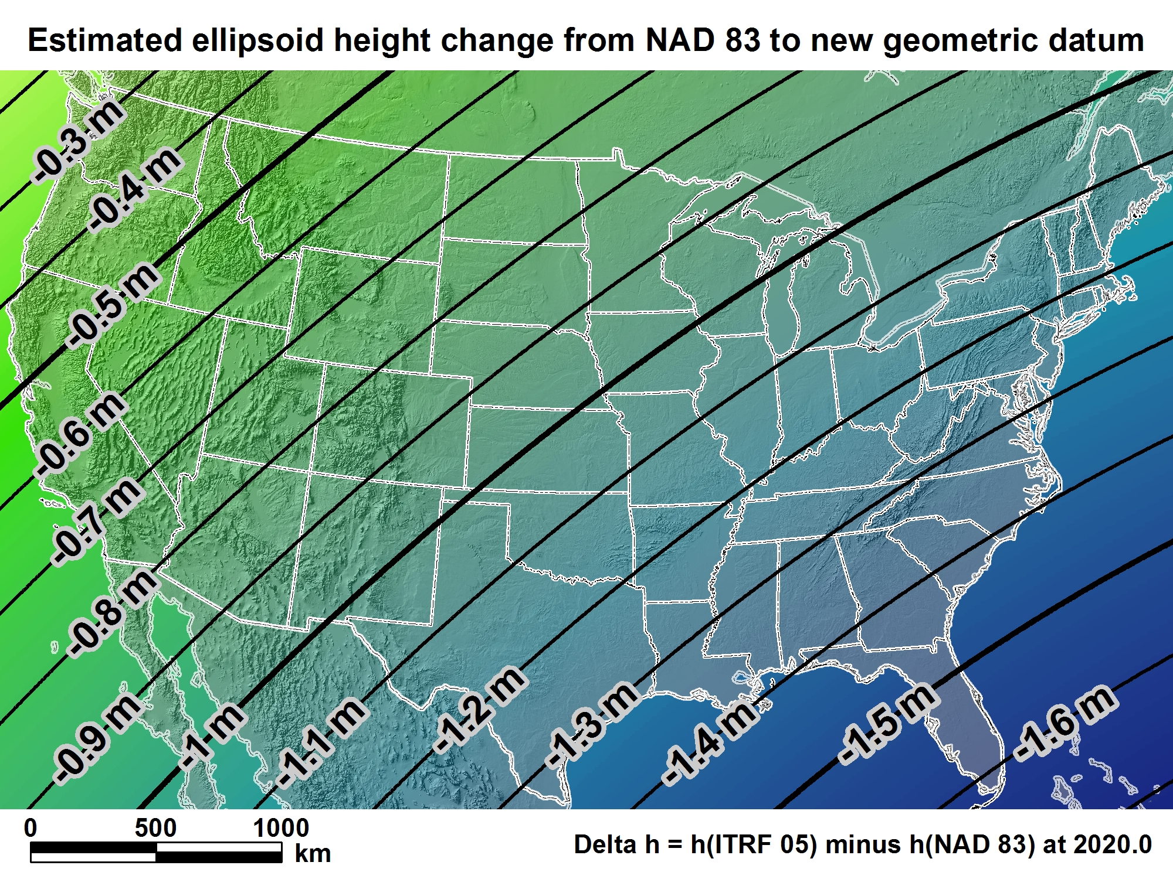
New geometric datum minus NAD 83
(ellipsoid height)

Slide 30
Orthometric Heights
(currently NAVD 88 elevations)
“By 2018, a new geopotential datum (for orthometric and dynamic heights) is defined and realized through the combination of GNSS technology and gravity field modeling.”
In other words, orthometric heights will NOT be based on leveling data and they too will change.
2022

Slide 31
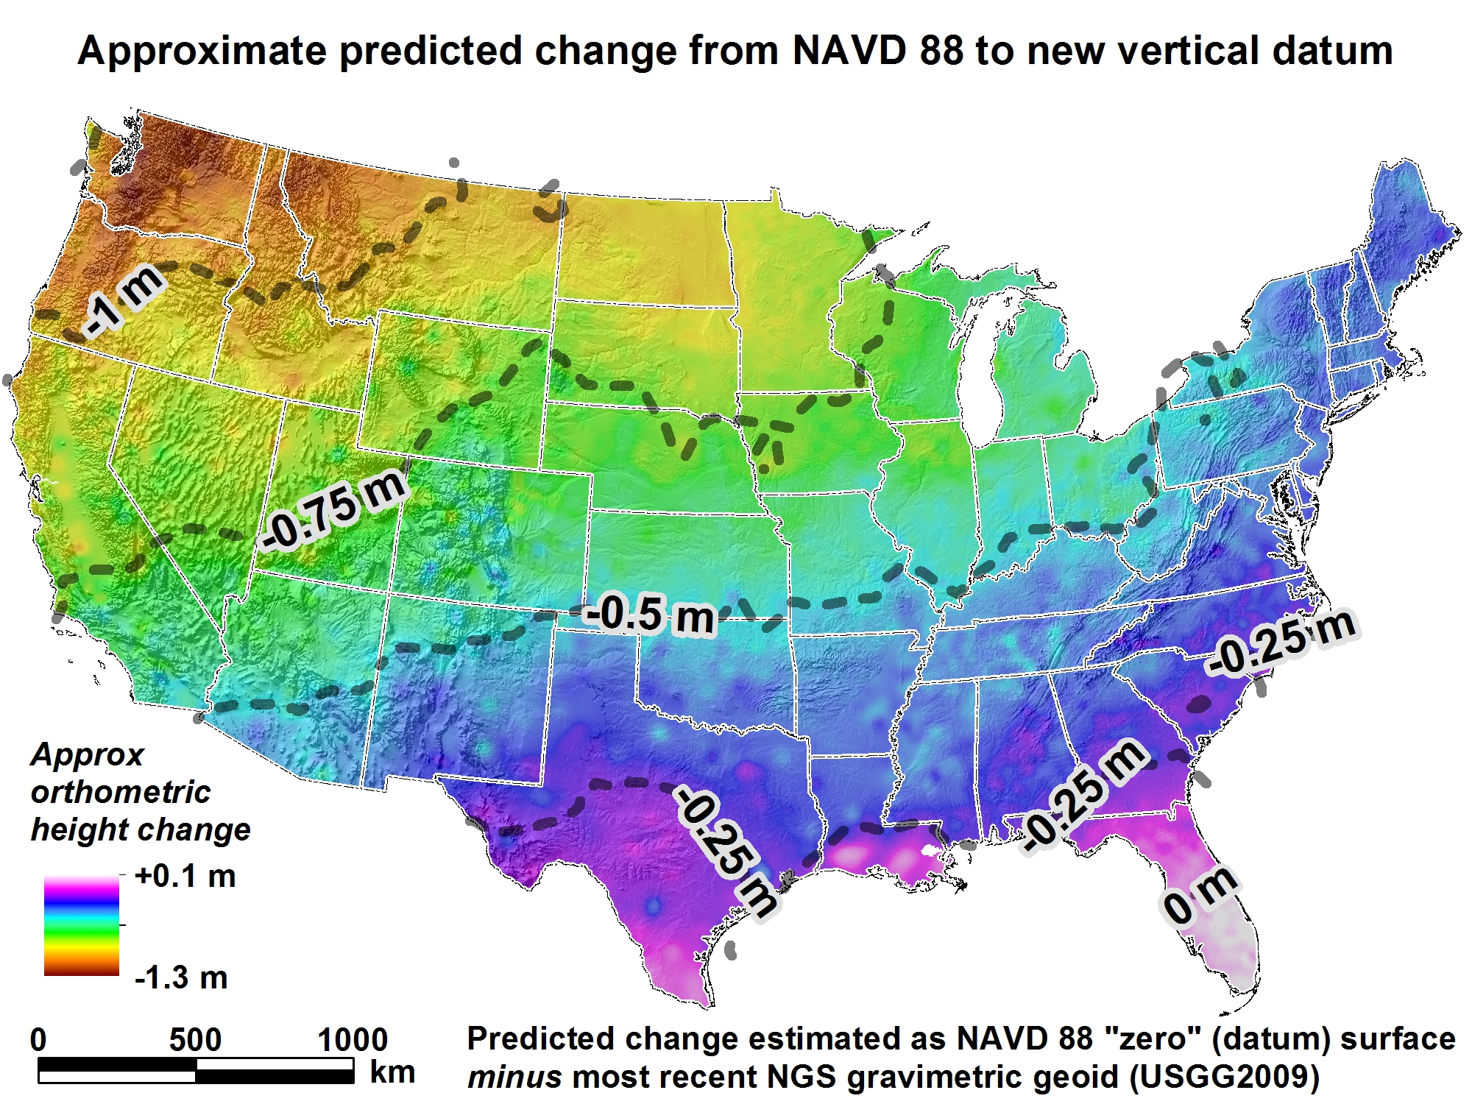

Slide 32

2012 Geospatial Summit
July 22, Sunday, 9-5
Manchester Grand Hyatt, downtown SanDiego
Register via ESRI/ACSM registration checkbox or NGS webpage link (future)
Feedback desired re impact to NGS customers

Slide 33

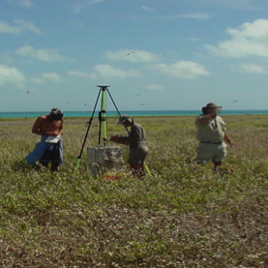
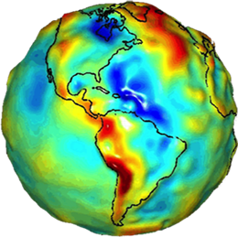
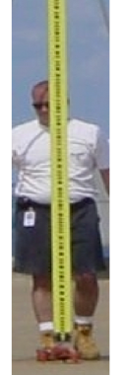
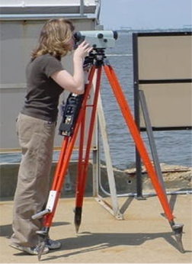

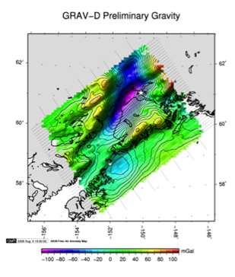
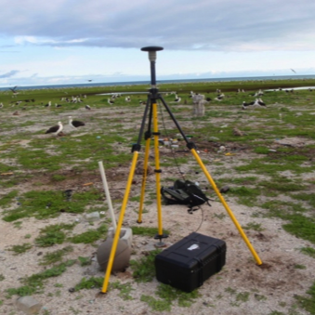
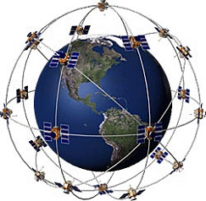
How We Maintain and Modernize the NSRS
GPS and GLONASS Receivers
Leveling
Modeling

Slide 34
Table of contents
NSRS Ref frame improvements
  For CORS, for passive, Geoid model
NSRS Evolution
  GRAV-D, GSVS, NSRS revolution
NGS FY12 Budget & Geodetic Advisor Program
Coastal P&S
  Shoreline Change, VDATUM, SLR, GLOSS, CSC
One-minute topics

Slide 35
NGS FY 2012 BUDGET
(4/4/2012 excluding FAA reimbursables, earmarks, and ARRA funding)
Geodesy Base: $26.314 M
National Height Modernization: $2.389 M
Mapping and Charting Base: $4.526 M
Shoreline Mapping: $2.257 M
Total: $35.486 M

Slide 36
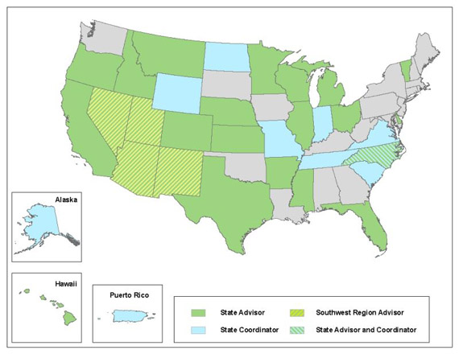
NGS Geodetic Advisors Program in the West
SW Region
(AZ,NM,NV,UT)
William Stone
Oregon
Mark L. Armstrong
Colorado
Pam Fromhertz
Idaho/Montana
Curt Smith
Wyoming
Mike Londe (BLM)
Geodetic Advisor Branch Chief: Ross.Mackay@noaa.gov

Slide 37

The Changing Face of the Geodetic Advisor Program
1. What are we not?
GEODENTIST
2. What/who are we?
3. How is it changing?

Slide 38
The Changing Face of the Geodetic Advisor Program
1. What are we not?
2. What are we?
We provide the link between
Geodesy and other customers, typically surveyors but also anyone wanting to connect to the NSRS
Who are we?
20 advisors; 3 are PLS, 2 of those also PE, 2 are PhD
1/3 transitioned from NGS field assignments; others came fr other gov, 2 came fr the cooperator

Slide 39
The Changing Face of the Geodetic Advisor Program
1. What are we not? 2. What/who are we?
3. How is it changing? We are…
Baby boomers! Aging…Retiring
Fewer cooperative partners (states)
can justify the financial agreement
Recommendation from some many years ago was for Fedgov to fully fund Advisor program
Advisors to be located at NOAA or Fed office

Slide 40

The Changing Face of the Geodetic Advisor Program, Geography
Provide equal service to non-coop states
REGIONALIZATION
15 advisors total for 50 states, PR, Pacific islands
Regions being discussed in NGS Advisory Group
Ross.Mackay@noaa.gov is Chair (SAB Chief)
Situated in a city with decent airport!
Proposal includes “State Coordinator” as POC
Transition in next 4 years, with attrition

Slide 41
Table of contents
NSRS Ref frame improvements
  For CORS, for passive, Geoid model
NSRS Evolution
  GRAV-D, GSVS, NSRS revolution
NGS FY12 Budget & Geodetic Advisor Program
Coastal P&S
  Shoreline Change, VDATUM, SLR, GLOSS, CSC
One-minute topics

Slide 42

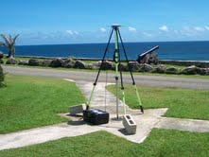
NGS Leverages Geospatial Products and Tools (GIS) Related to Maritime Activities
Online Positioning User Service (OPUS)
LIDAR and Derivative Products (DEMs)
Shoreline for NOAA Nautical Charts
Emergency Response Activities
Monitoring Sea Level Change
VDATUM model for geodetic/tidal datums

Slide 43
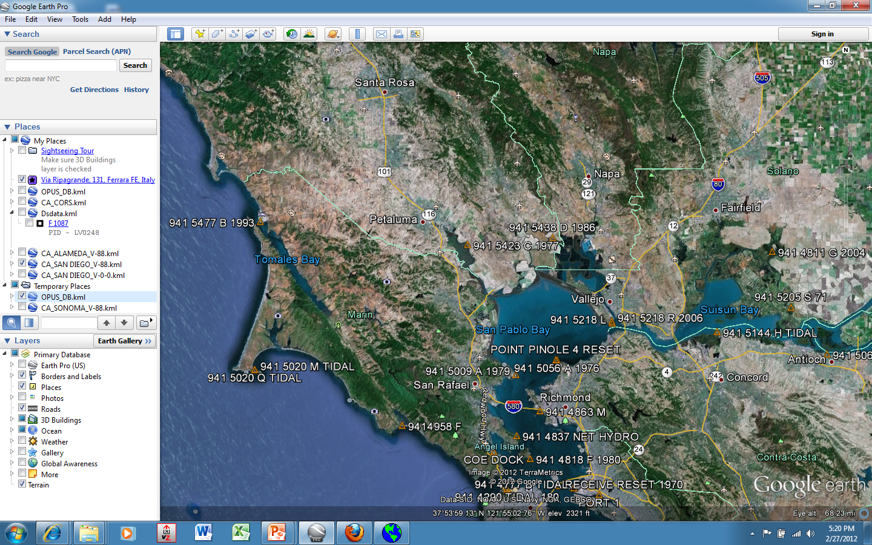
OPUS-DB, tidal BMs
Notes:
An option for data collected at least 4 hrs is to publish in the OPUS database online.
Until the new vertical RS is adopted the next geoid models might be tapping OPUS-DB results. Would need a rough (eg, 0.1 dm) comparison between computed and last published Oht to help determine vertical stability/reliability

Slide 44
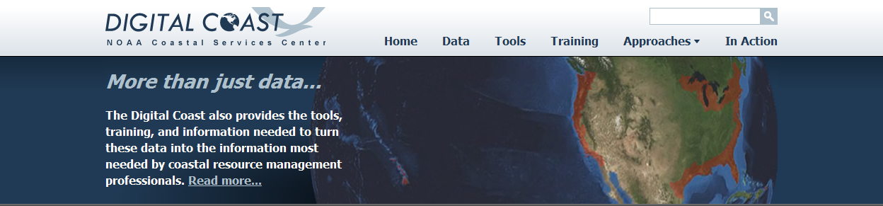
NOAA’s Coastal Services Center, SC:
Digital Coast website
Approach: Bring the geospatial and coastal management communities together
Outcome: A constituent-driven, integrated, enabling platform supporting coastal resource management
www.csc.noaa.gov

Slide 45
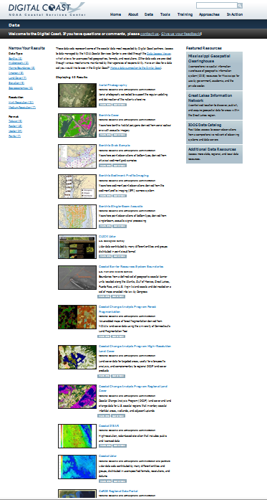
http://www.csc.noaa.gov/digitalcoast/data/coastallidar/download
California’s data posting completed last month
NOAA/USGS/USACE
COASTAL LIDAR

Slide 46
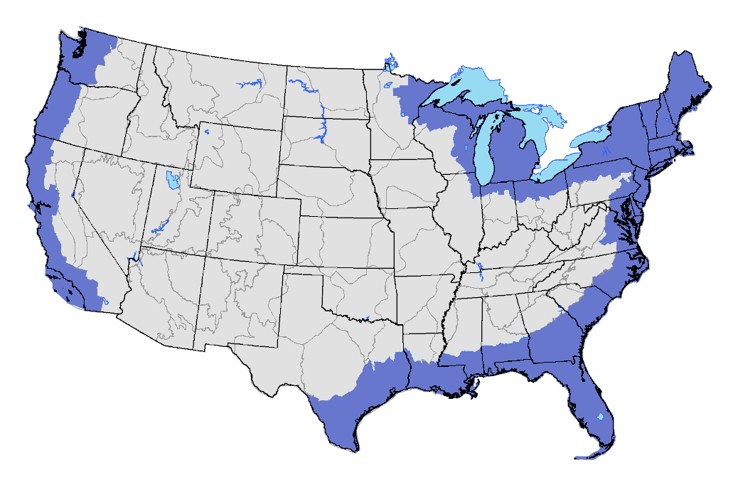
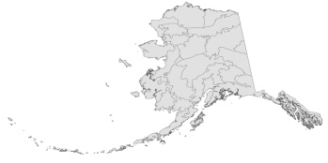
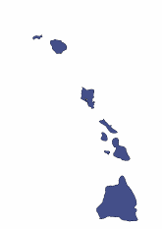
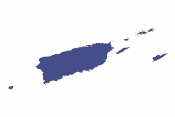
Coastal-Change Analysis Program
National coastal land cover and change mapping program
Consistent, accurate products with standard data and methods
Focus on intertidal areas, wetlands, and adjacent upland

Slide 47
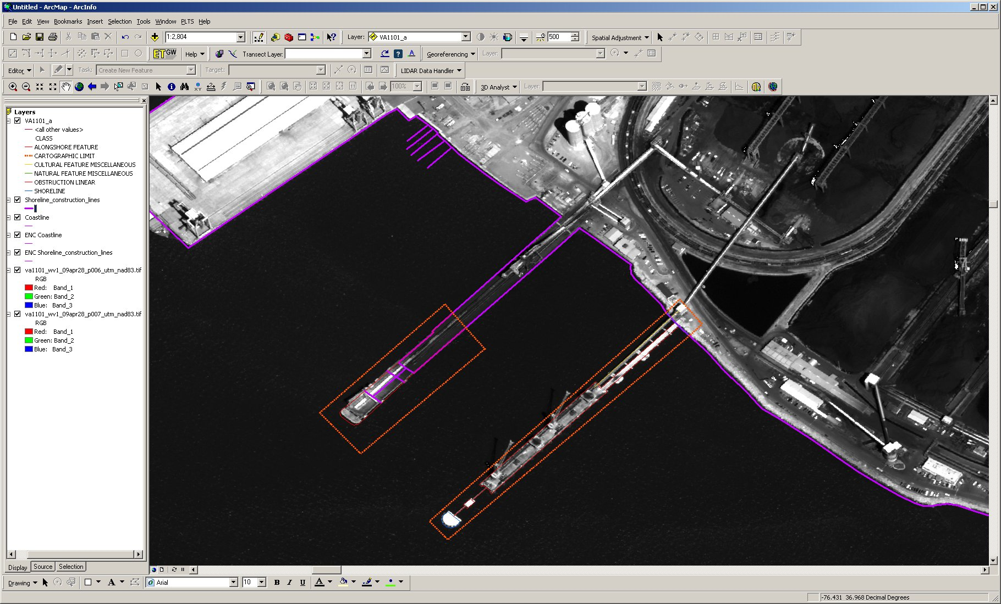
CSCAP Compilation
Pier Extension
New Pier
VA1101
Notes:
Coastal and Shoreline Change Analysis Program

Slide 48

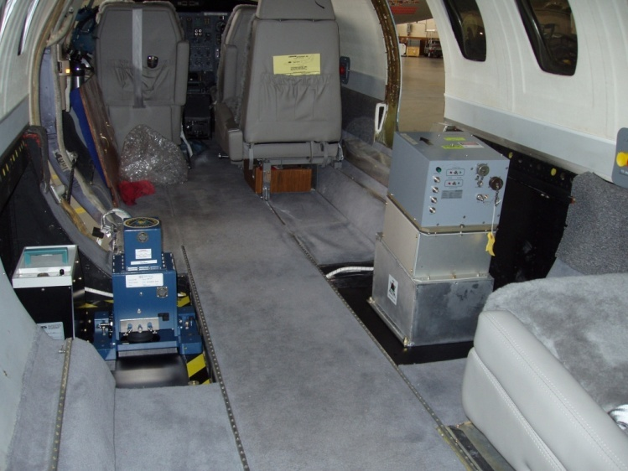
Emergency Response
Sensors utilized:
  Digital Camera (DSS)
  LiDAR
  Hyperspectral
  Thermal
CASI-2
DSS
ALTM
Beachcraft King Air 350
Cessna Citation II

Slide 49
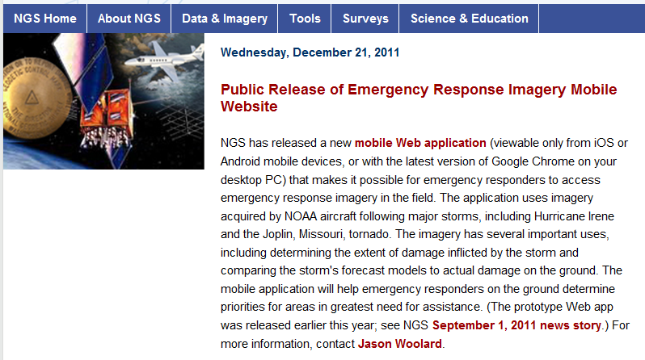
Mobile Application for Imagery

Slide 50
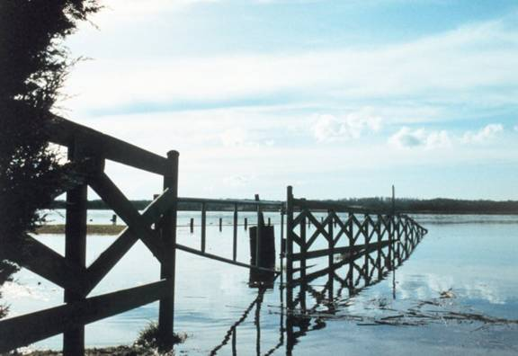
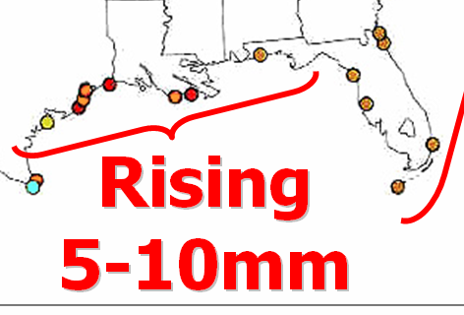
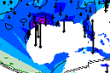
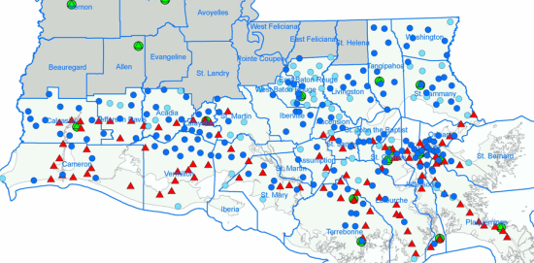

Sea Level Change
Integration of local sea level trends and vertical land velocities.
NWLON
Local Height Modernization
CORS velocities
Local Sea Level Rise
Local Surveys
Land Movement Velocities

Slide 51
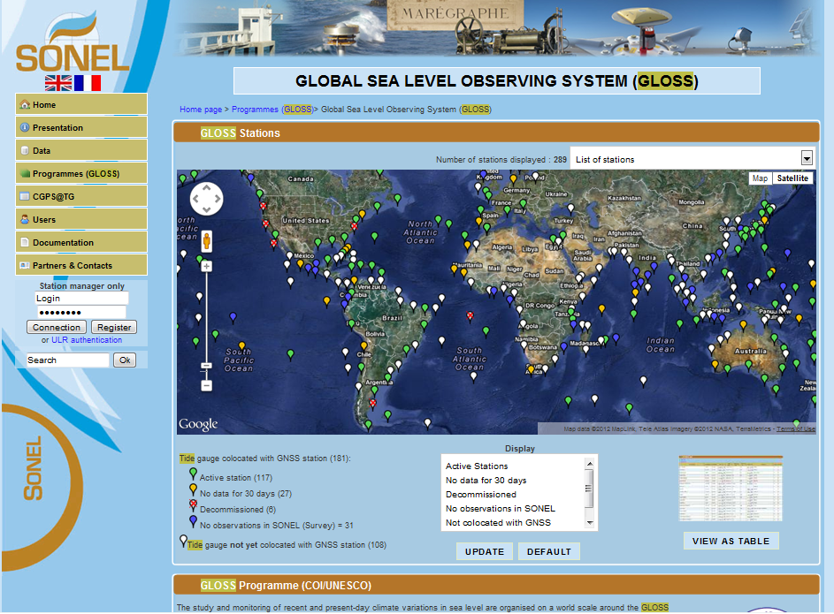
GLOSS: Global sea Level Observing SyStem

Slide 52
NGS and CO-OPS establish CORS at NWLON stations
210 NWLON or Primary Tide Gage sites
Funding from NOAA’s Climate Program Office
Key climate observation locations, namely 10 ocean island and/or remote stations in the Pacific, Alaska, and the Caribbean
3 GLOSS stations (Global Sea Level Observation System) on West Coast: South Beach, OR; La Jolla, CA, Crescent City, CA

Slide 53
CORS/CGPS Collocation at GLOSS Sites, in CA http://www.sonel.org/-GLOSS,81-.html
SIO3: 9410230; La Jolla, CA
  --Scripps Institution of Oceanography
  Met (wet vapor/humidity) sensors
CACC: 9419750; Crescent City, CA
  Installed in winter 2012
Planned: 9415290; San Francisco, CA
  on Presidio Park Land; Searching for site that meets stringent requirements for tourism/view-driven area

Slide 54
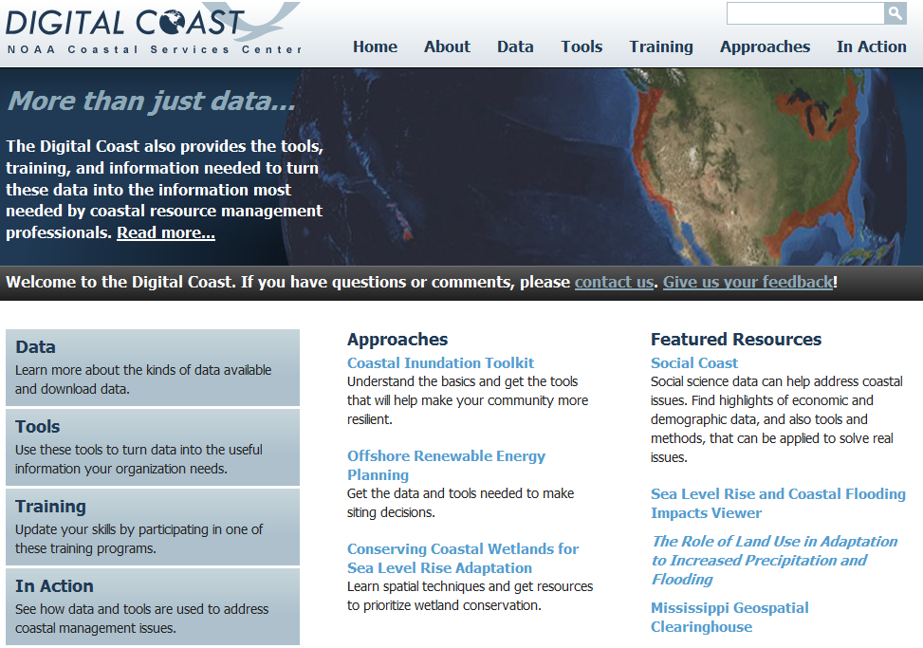

Slide 55
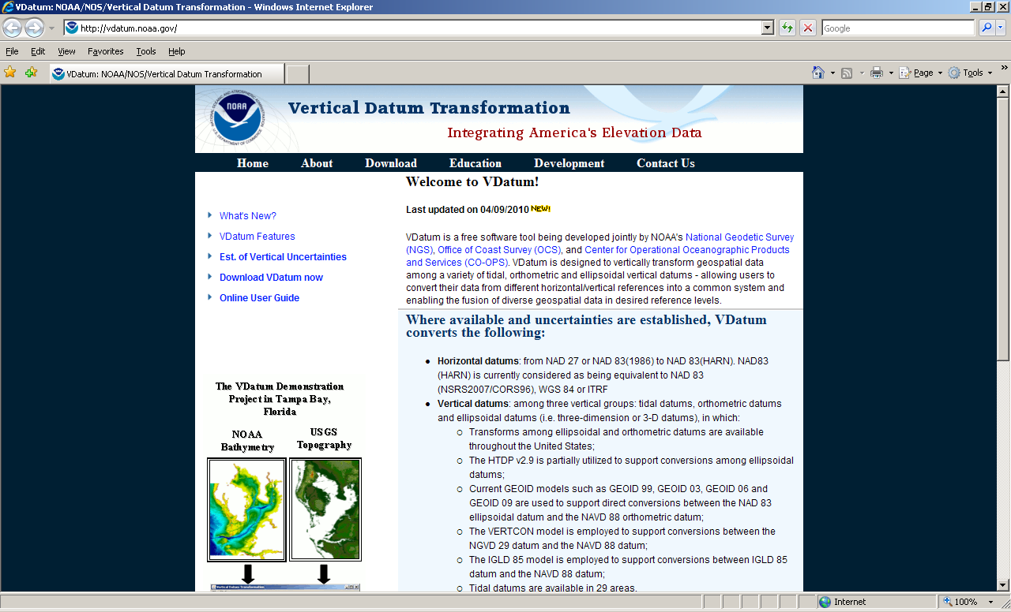
HTTP://VDATUM.NOAA.GOV

Slide 56
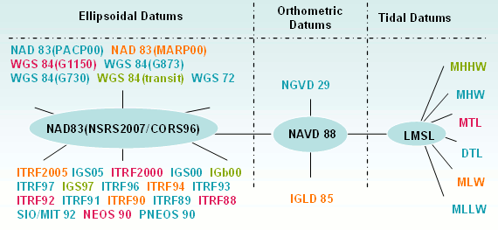
Datums available in VDATUM
Notes:
The most common datums are highlighted

Slide 57
Other Recent NGS Activities: the Lightning Reports
Lightsquared Signal Interference Testing
RTN Guidelines: RTK and RTN Operators
RTN Validation, using OPUS-DB output
HTDP: deci-year format option available, now 3.1.2
DSWorld mapping/submission software interface
CT OLS Personnel Changes
Training/Workshop Calendar, email listserve
NGS News Subscription Service
Presentation Library

Slide 58
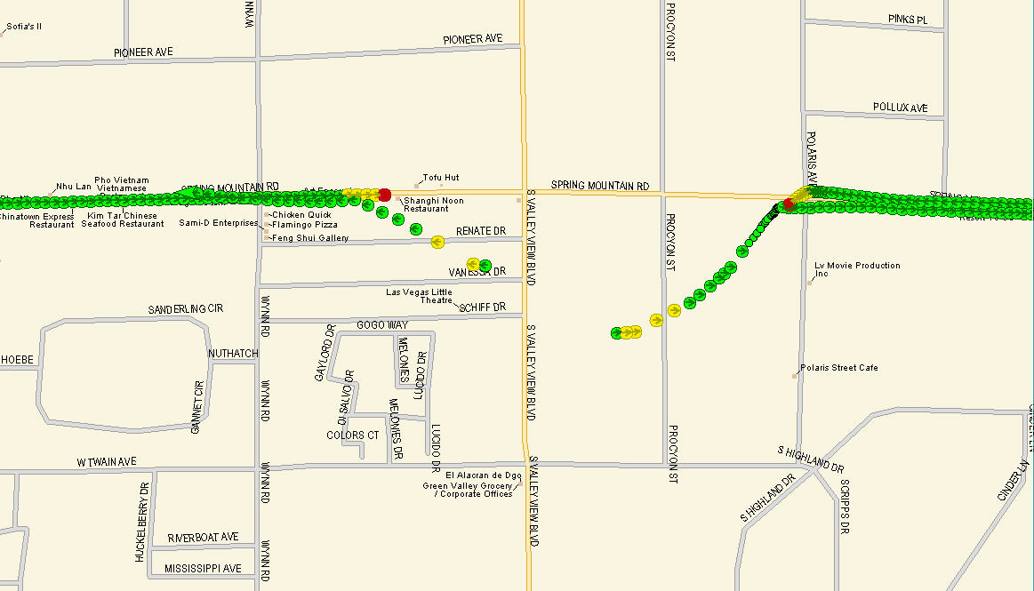
LightSquared Transmitter

Slide 59
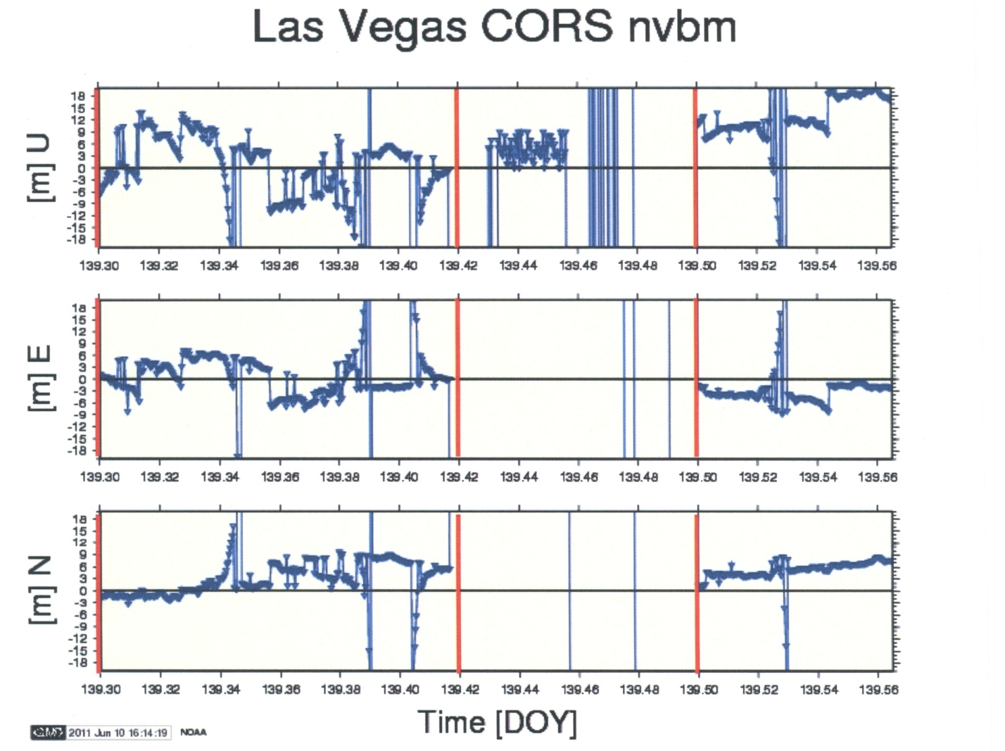
Loss of Tracking at CORS Site NVBM
26 km From LightSquared Site 53 on May 19, 2011

Slide 60
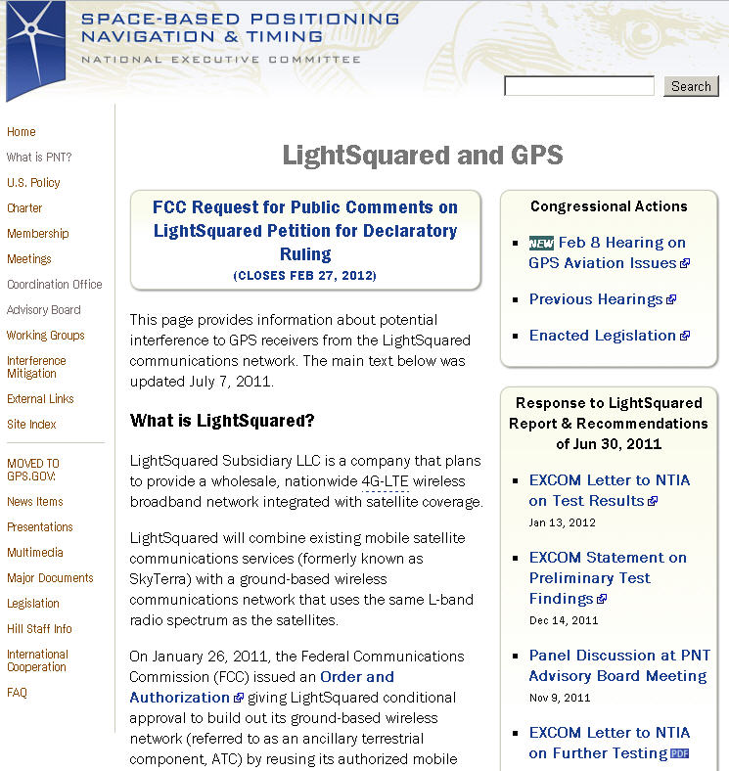
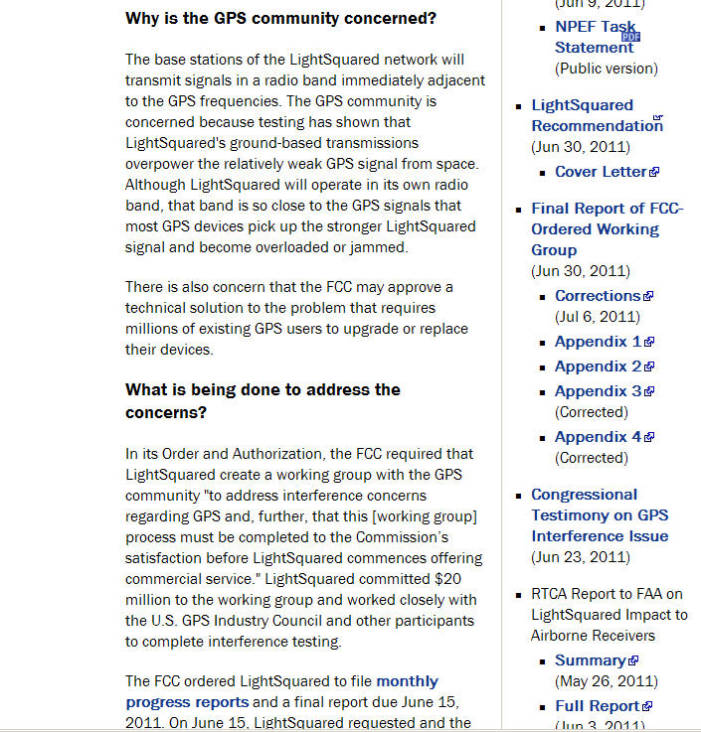
LightSquared PNT Working Group Report
www.pnt.gov/interference/lightsquared/

Slide 61
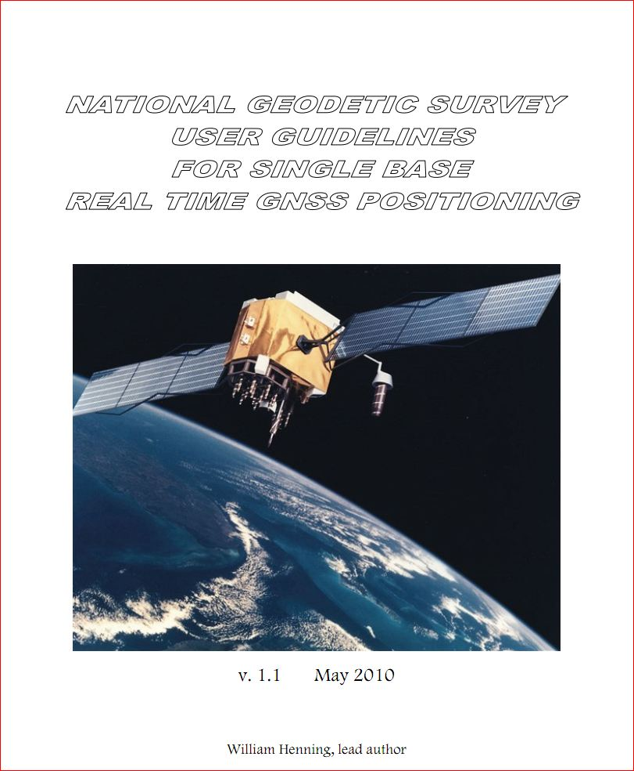
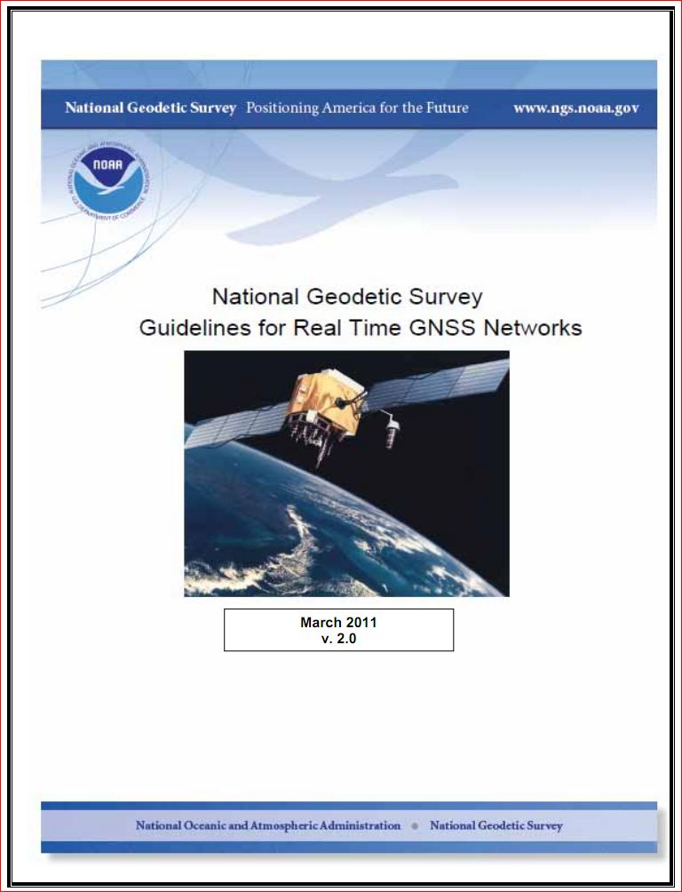
NGS Real-time Guidelines: Single-base and Network

Slide 62
RTN Validation by NGS
Desire to have all RTNs—public, commercial—tied to/based on the NSRS
Developing a procedure for RTNs to follow
Results submitted/reviewed
Periodic (annual?) check
ORGN RTN (OR DOT) is pilot study

Slide 63
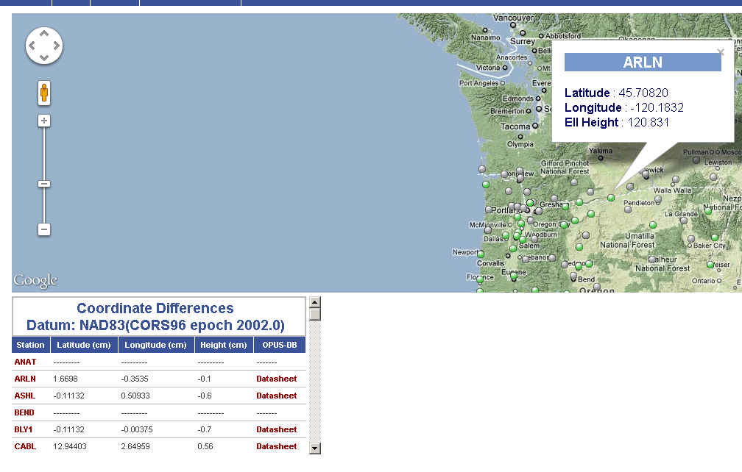
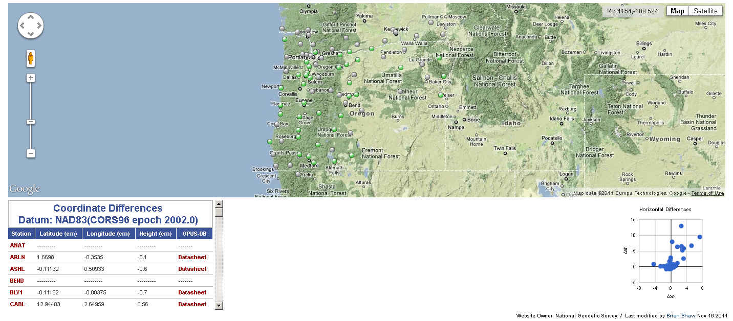

ON-LINE VALIDATION TOOL WOULD PROVIDE NSRS RTN COMPLIANCE

Slide 64
HTDP, v. 3.1.2
4th option: Interactively transform positions between reference frames and/or dates.
Epoch date format now includes deci-year
All NAD83 realizations are treated the same
After new realization published, will have transforms available between 2007 & 2011
  Changes due to RF very small—mm—versus changes due to velocity (time)—dm to m

Slide 65

DSWorld: mapping tool and more
Need to have Google Earth installed
Tools, Download PC Software, USER-CONTRI-BUTED SOFTWARE, DSWorld
http://www.ngs.noaa.gov/PC_PROD/PARTNERS/index.shtml
FIRST: Tools, Update program to 4.10.22
Enhancement enables you to distinguish VERTCON NAVD88 from other(control) NAVD88
Windows7 (settings) could preclude easy updates

Slide 66


Slide 67

CT OLS Updates
Mark Turner, Acting Chief, OOP and PI
Acting Chief, OLS, 4/2: Rob McMillan
Chief, GPS and Geodetic Control Surveys

Slide 68


Slide 69


Slide 70


Slide 71

With knowledge comes clarity

Slide 72

Marti.ikehara@noaa.gov

