Slide 1
Global Reference Frames: What They Are and How/Why NGS Aligns to Them
NGS Webinar Series - October 8, 2020
Phillip McFarland

Slide 2
Outline
What is a reference frame?
Traditional geodetic datums
Global reference frames
the International Terrestrial Reference System (ITRS)
the International Terrestrial Reference Frame (ITRF)
How is the ITRF realized?
The International GNSS Service (IGS) realization of the ITRF
How NGS aligns the U.S. National Spatial Reference System (NSRS) with the ITRF through the IGS frame

Slide 3
Outline
What is a reference frame?
Traditional geodetic datums
Global reference frames
the International Terrestrial Reference System (ITRS)
the International Terrestrial Reference Frame (ITRF)
How is the ITRF realized?
The International GNSS Service (IGS) realization of the ITRF
How NGS aligns the U.S. National Spatial Reference System (NSRS) with the ITRF through the IGS frame
Disclaimer: this presentation covers geometric reference frames

Slide 4
What is a reference frame?

Slide 5
What is a reference frame?
Reference frames give us a means to assign self-consistent coordinates to physical locations and to describe how those coordinates change over time

Slide 6
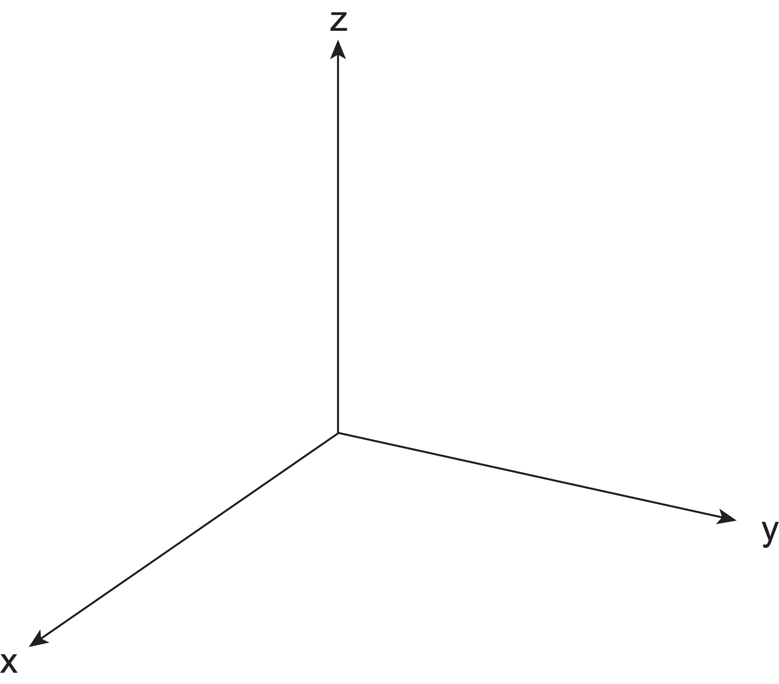
What is a reference frame?
A simple reference frame can be defined in 3D with a triad of orthogonal axes

Slide 7
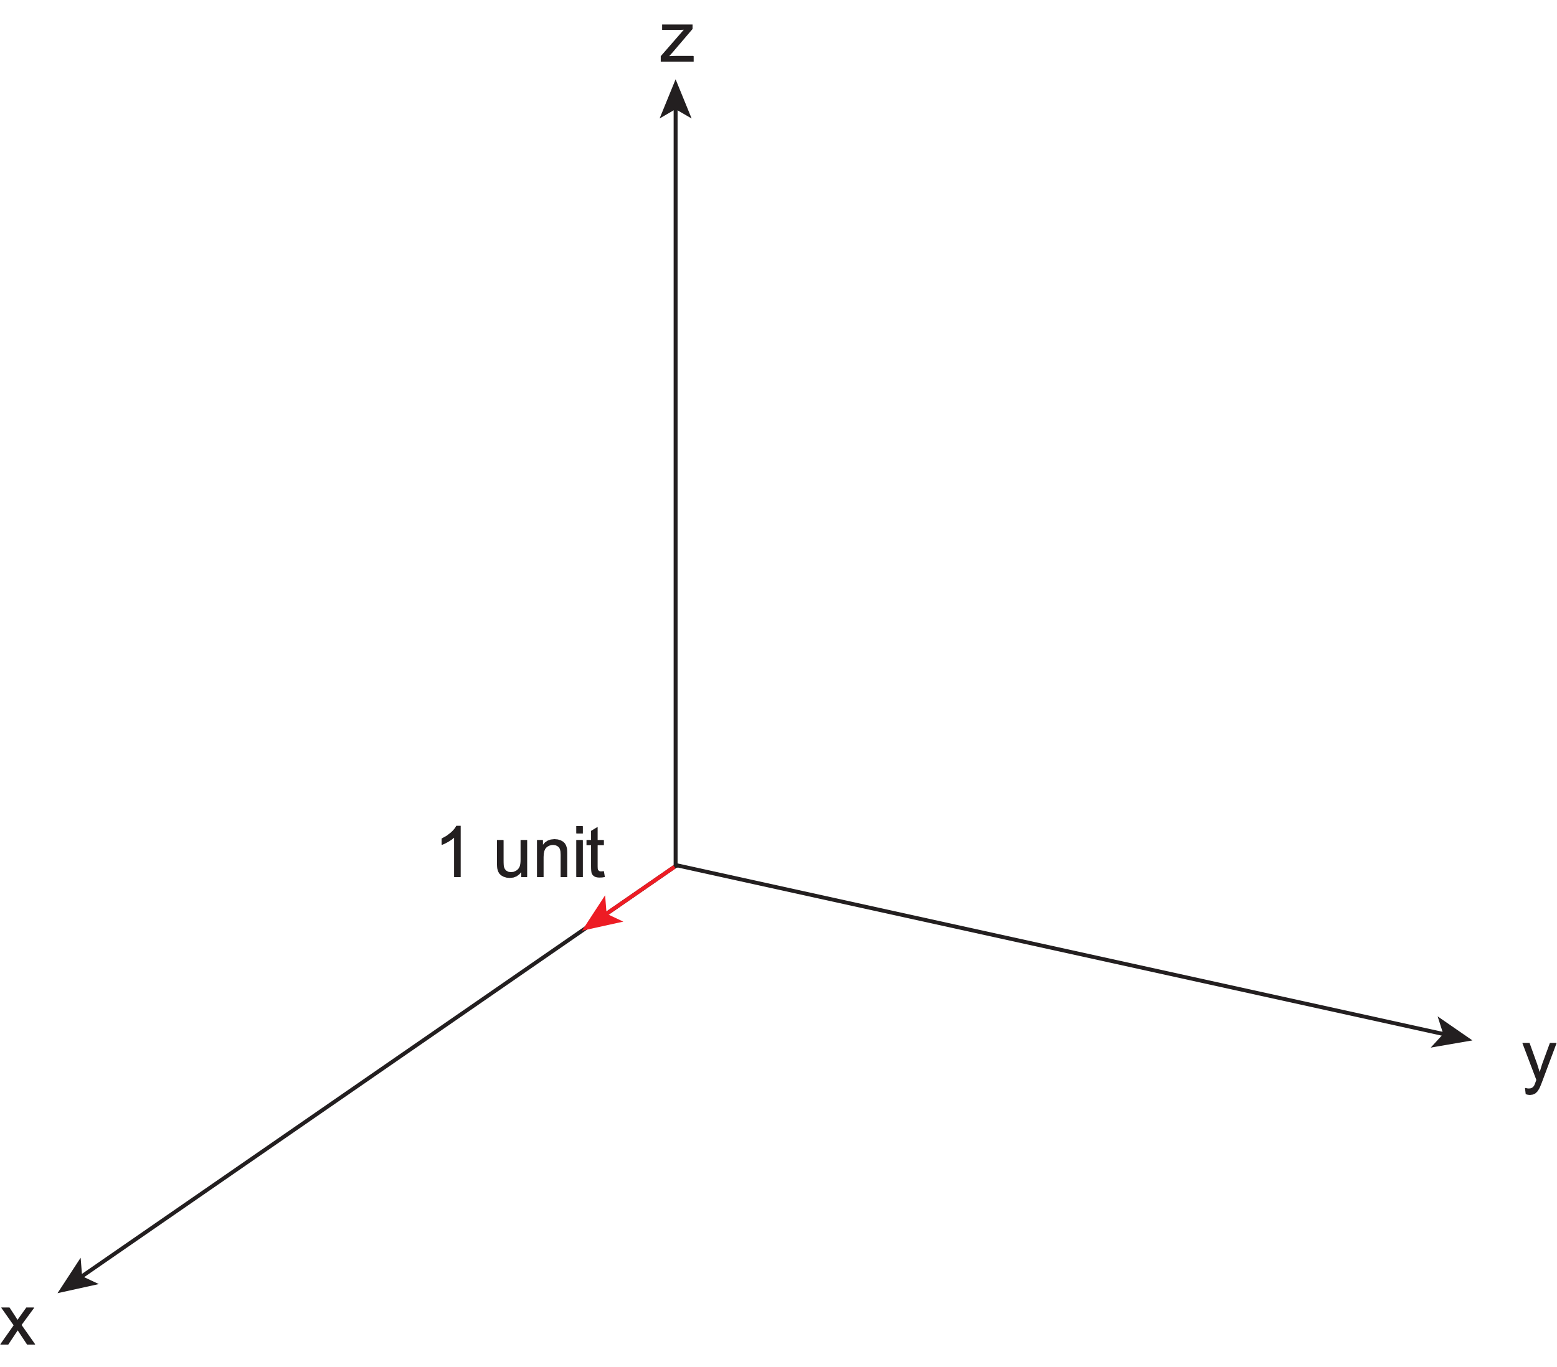
What is a reference frame?
A simple reference frame can be defined in 3D with a triad of orthogonal axes
Once we define a standard unit of length we can use these axes to define coordinates for physical points

Slide 8
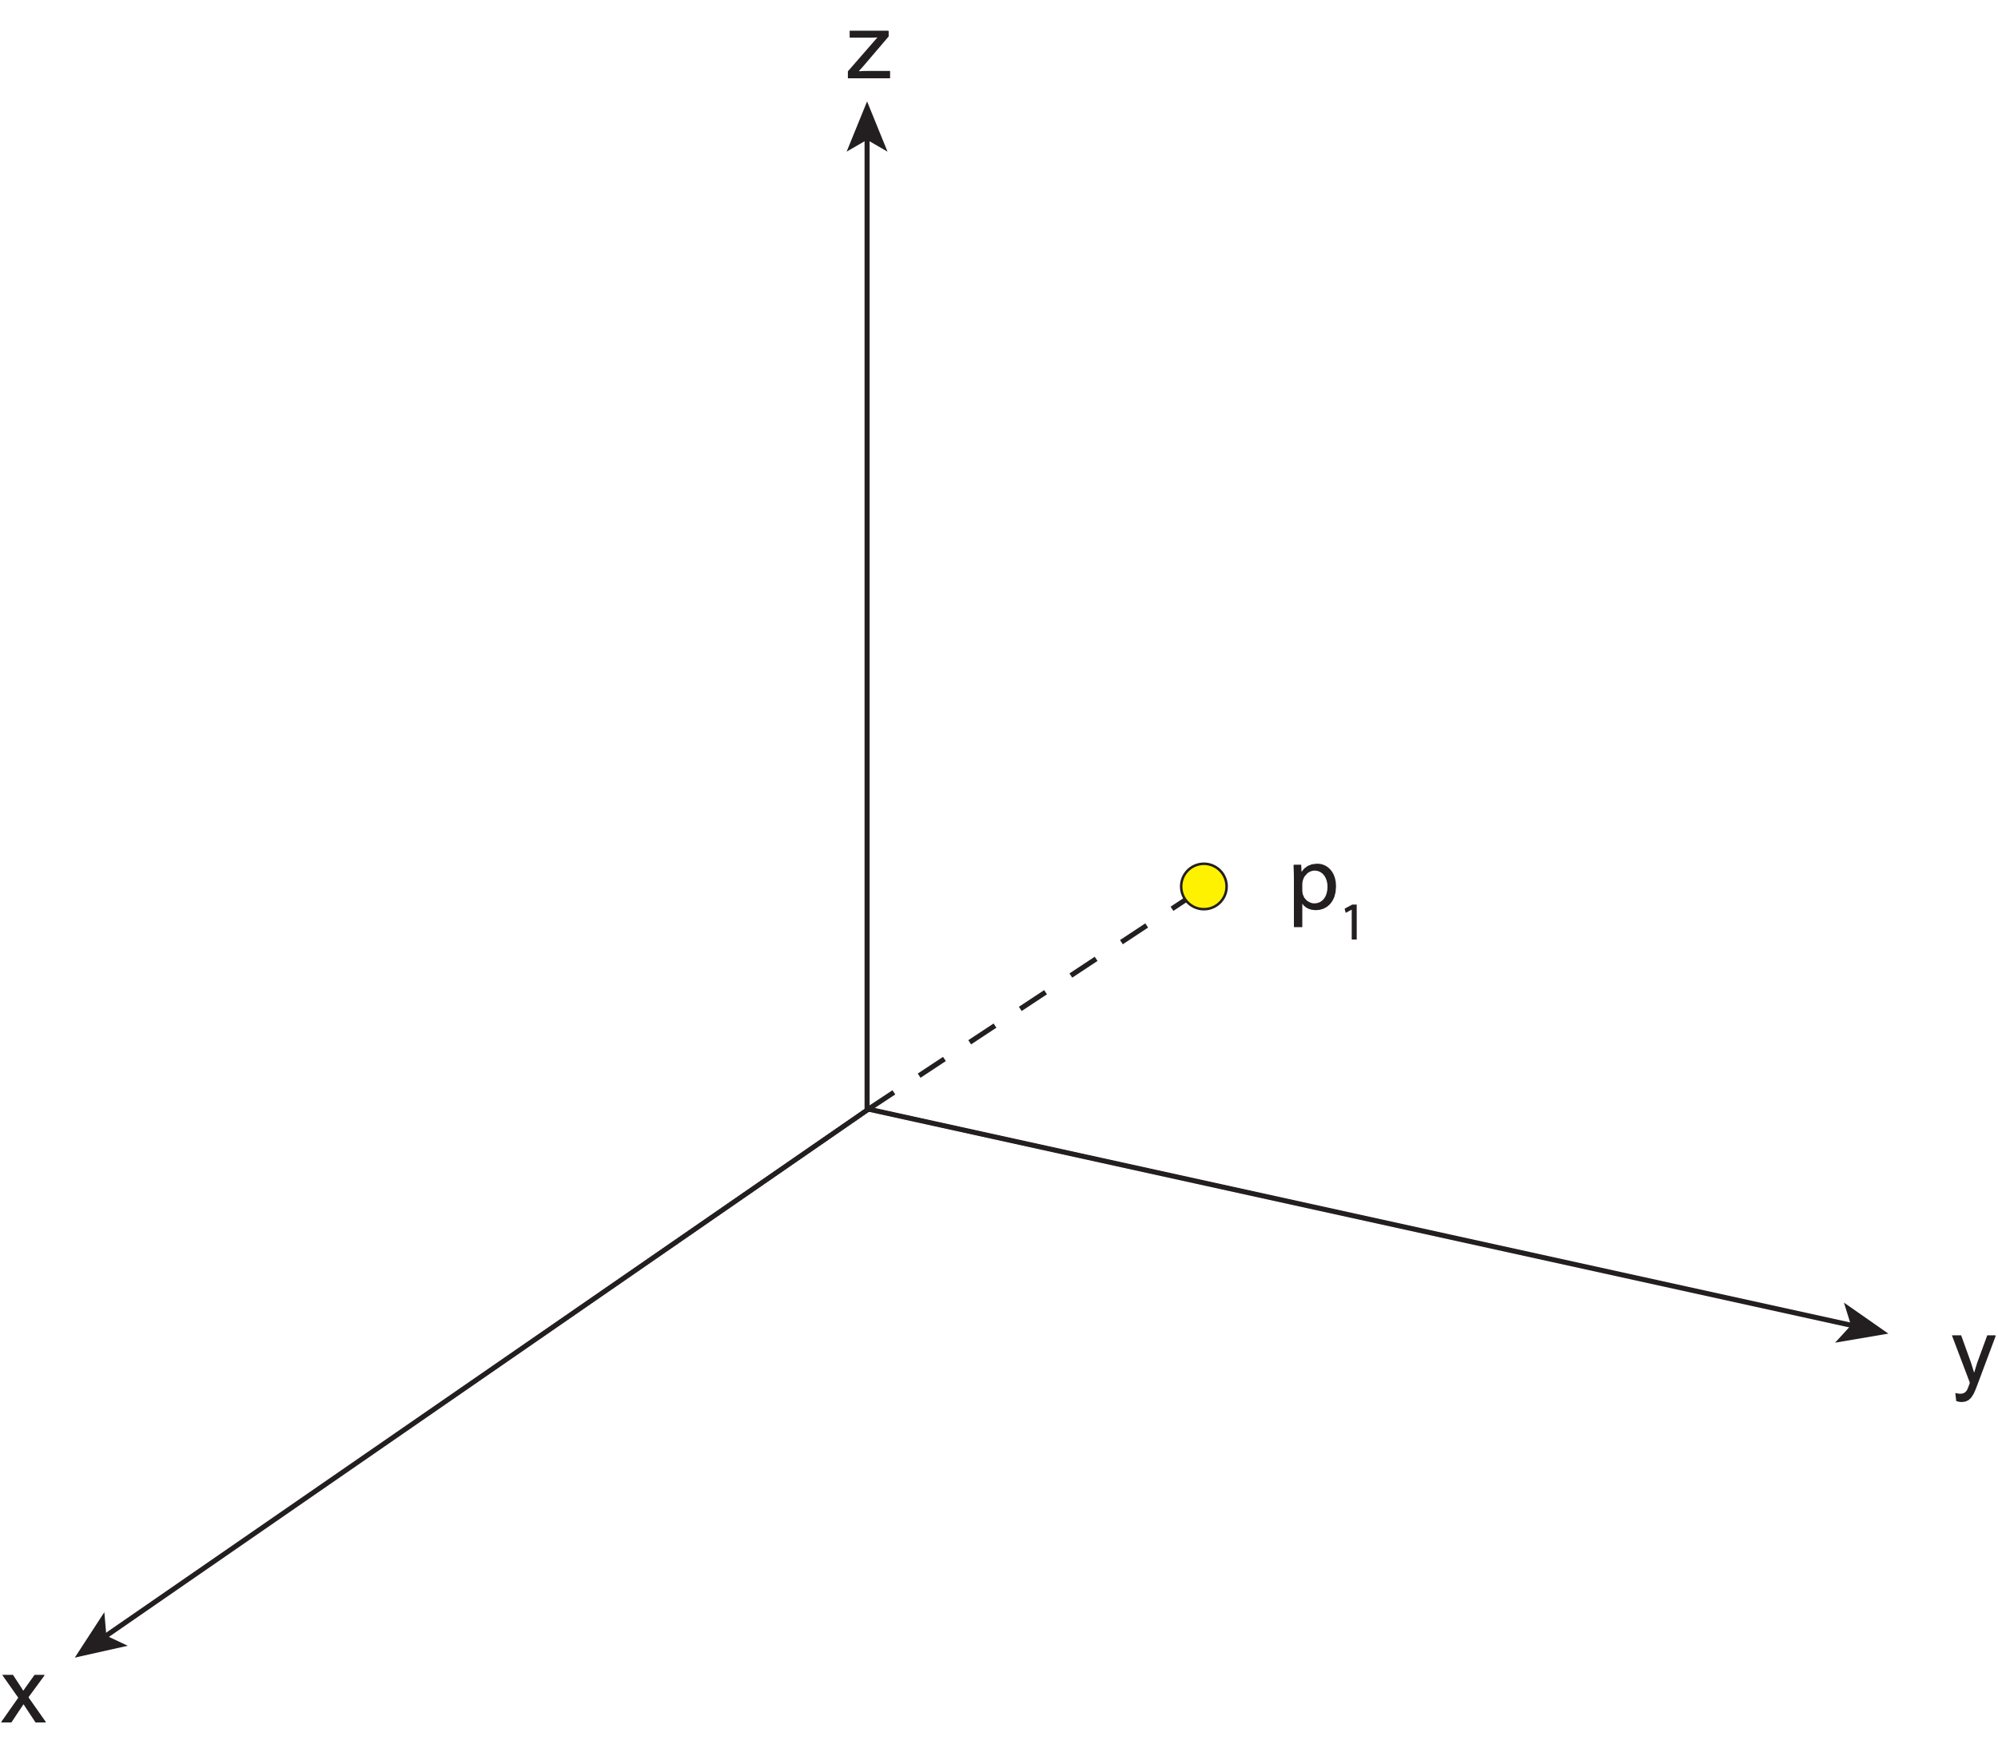
What is a reference frame?
A simple reference frame can be defined in 3D with a triad of orthogonal axes
Once we define a standard unit of length we can use these axes to define coordinates for physical points

Slide 9
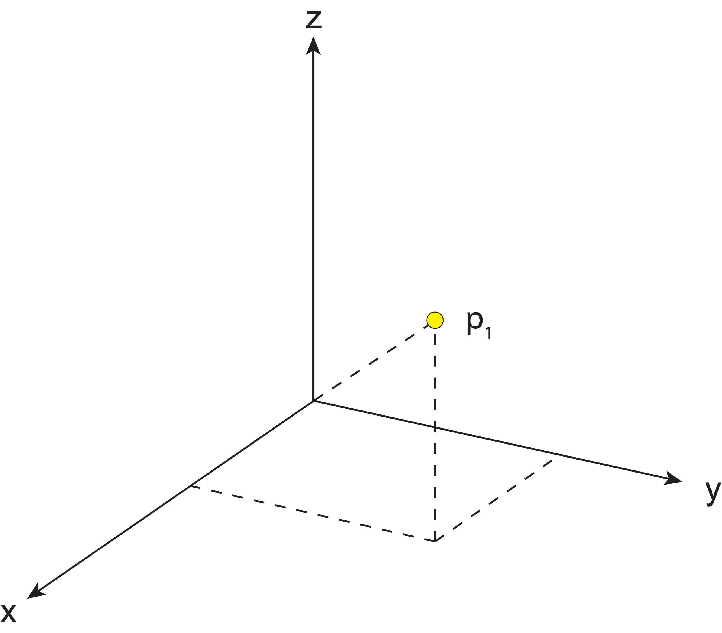
What is a reference frame?
A simple reference frame can be defined in 3D with a triad of orthogonal axes
Once we define a standard unit of length we can use these axes to define coordinates for physical points

Slide 10
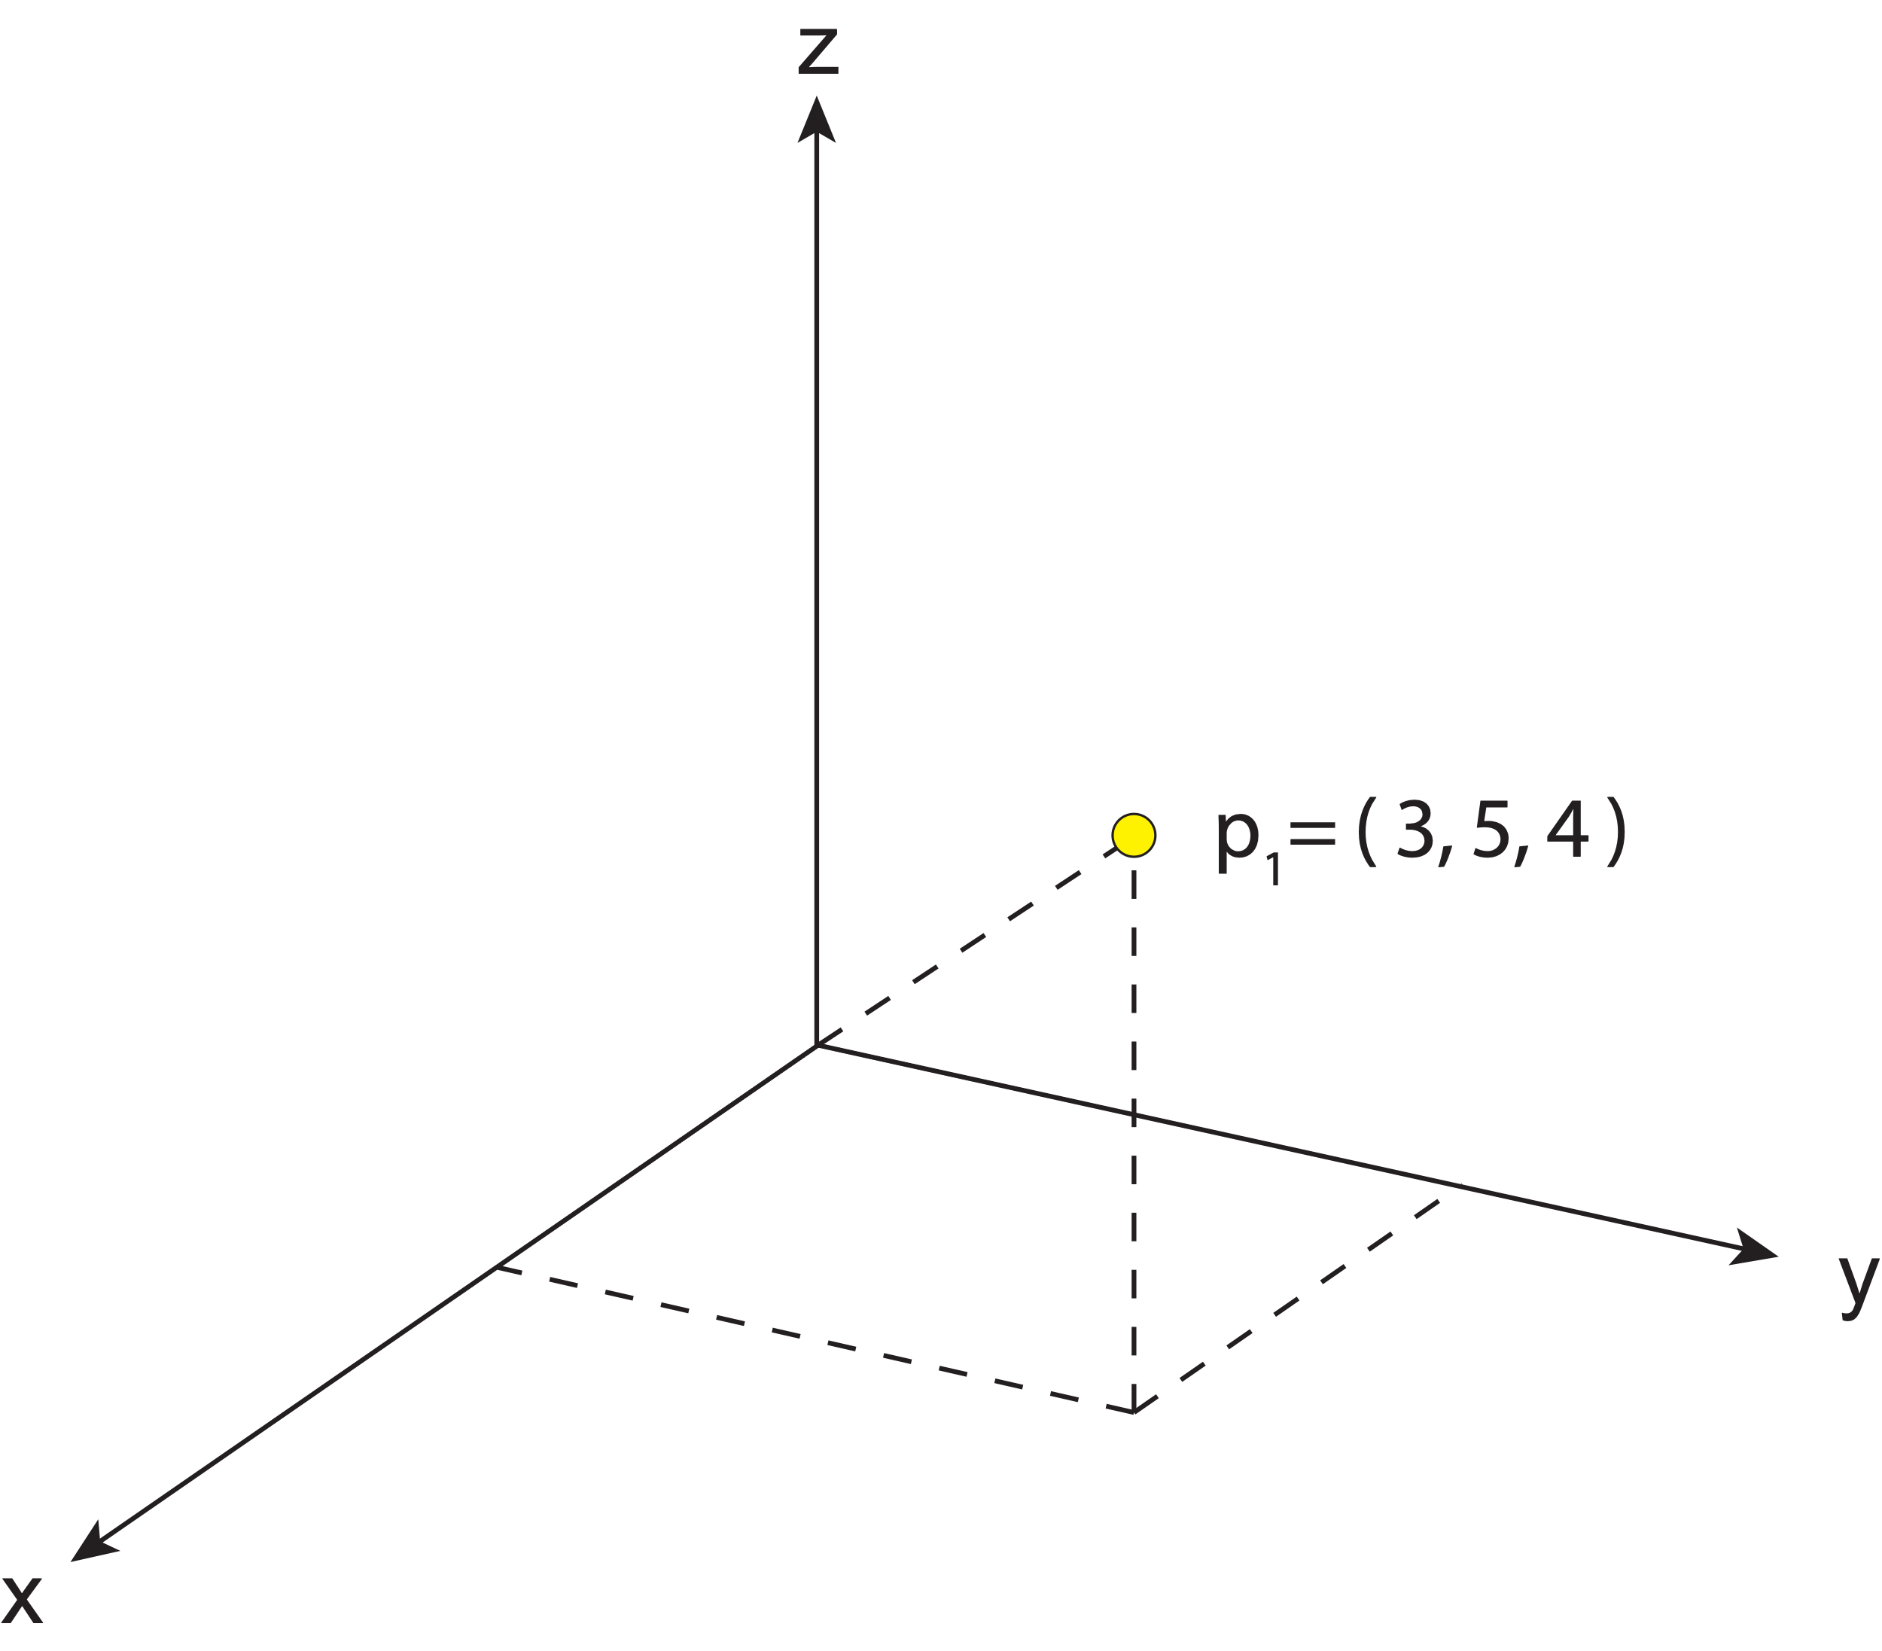
What is a reference frame?
A simple reference frame can be defined in 3D with a triad of orthogonal axes
Once we define a standard unit of length we can use these axes to define coordinates for physical points

Slide 11
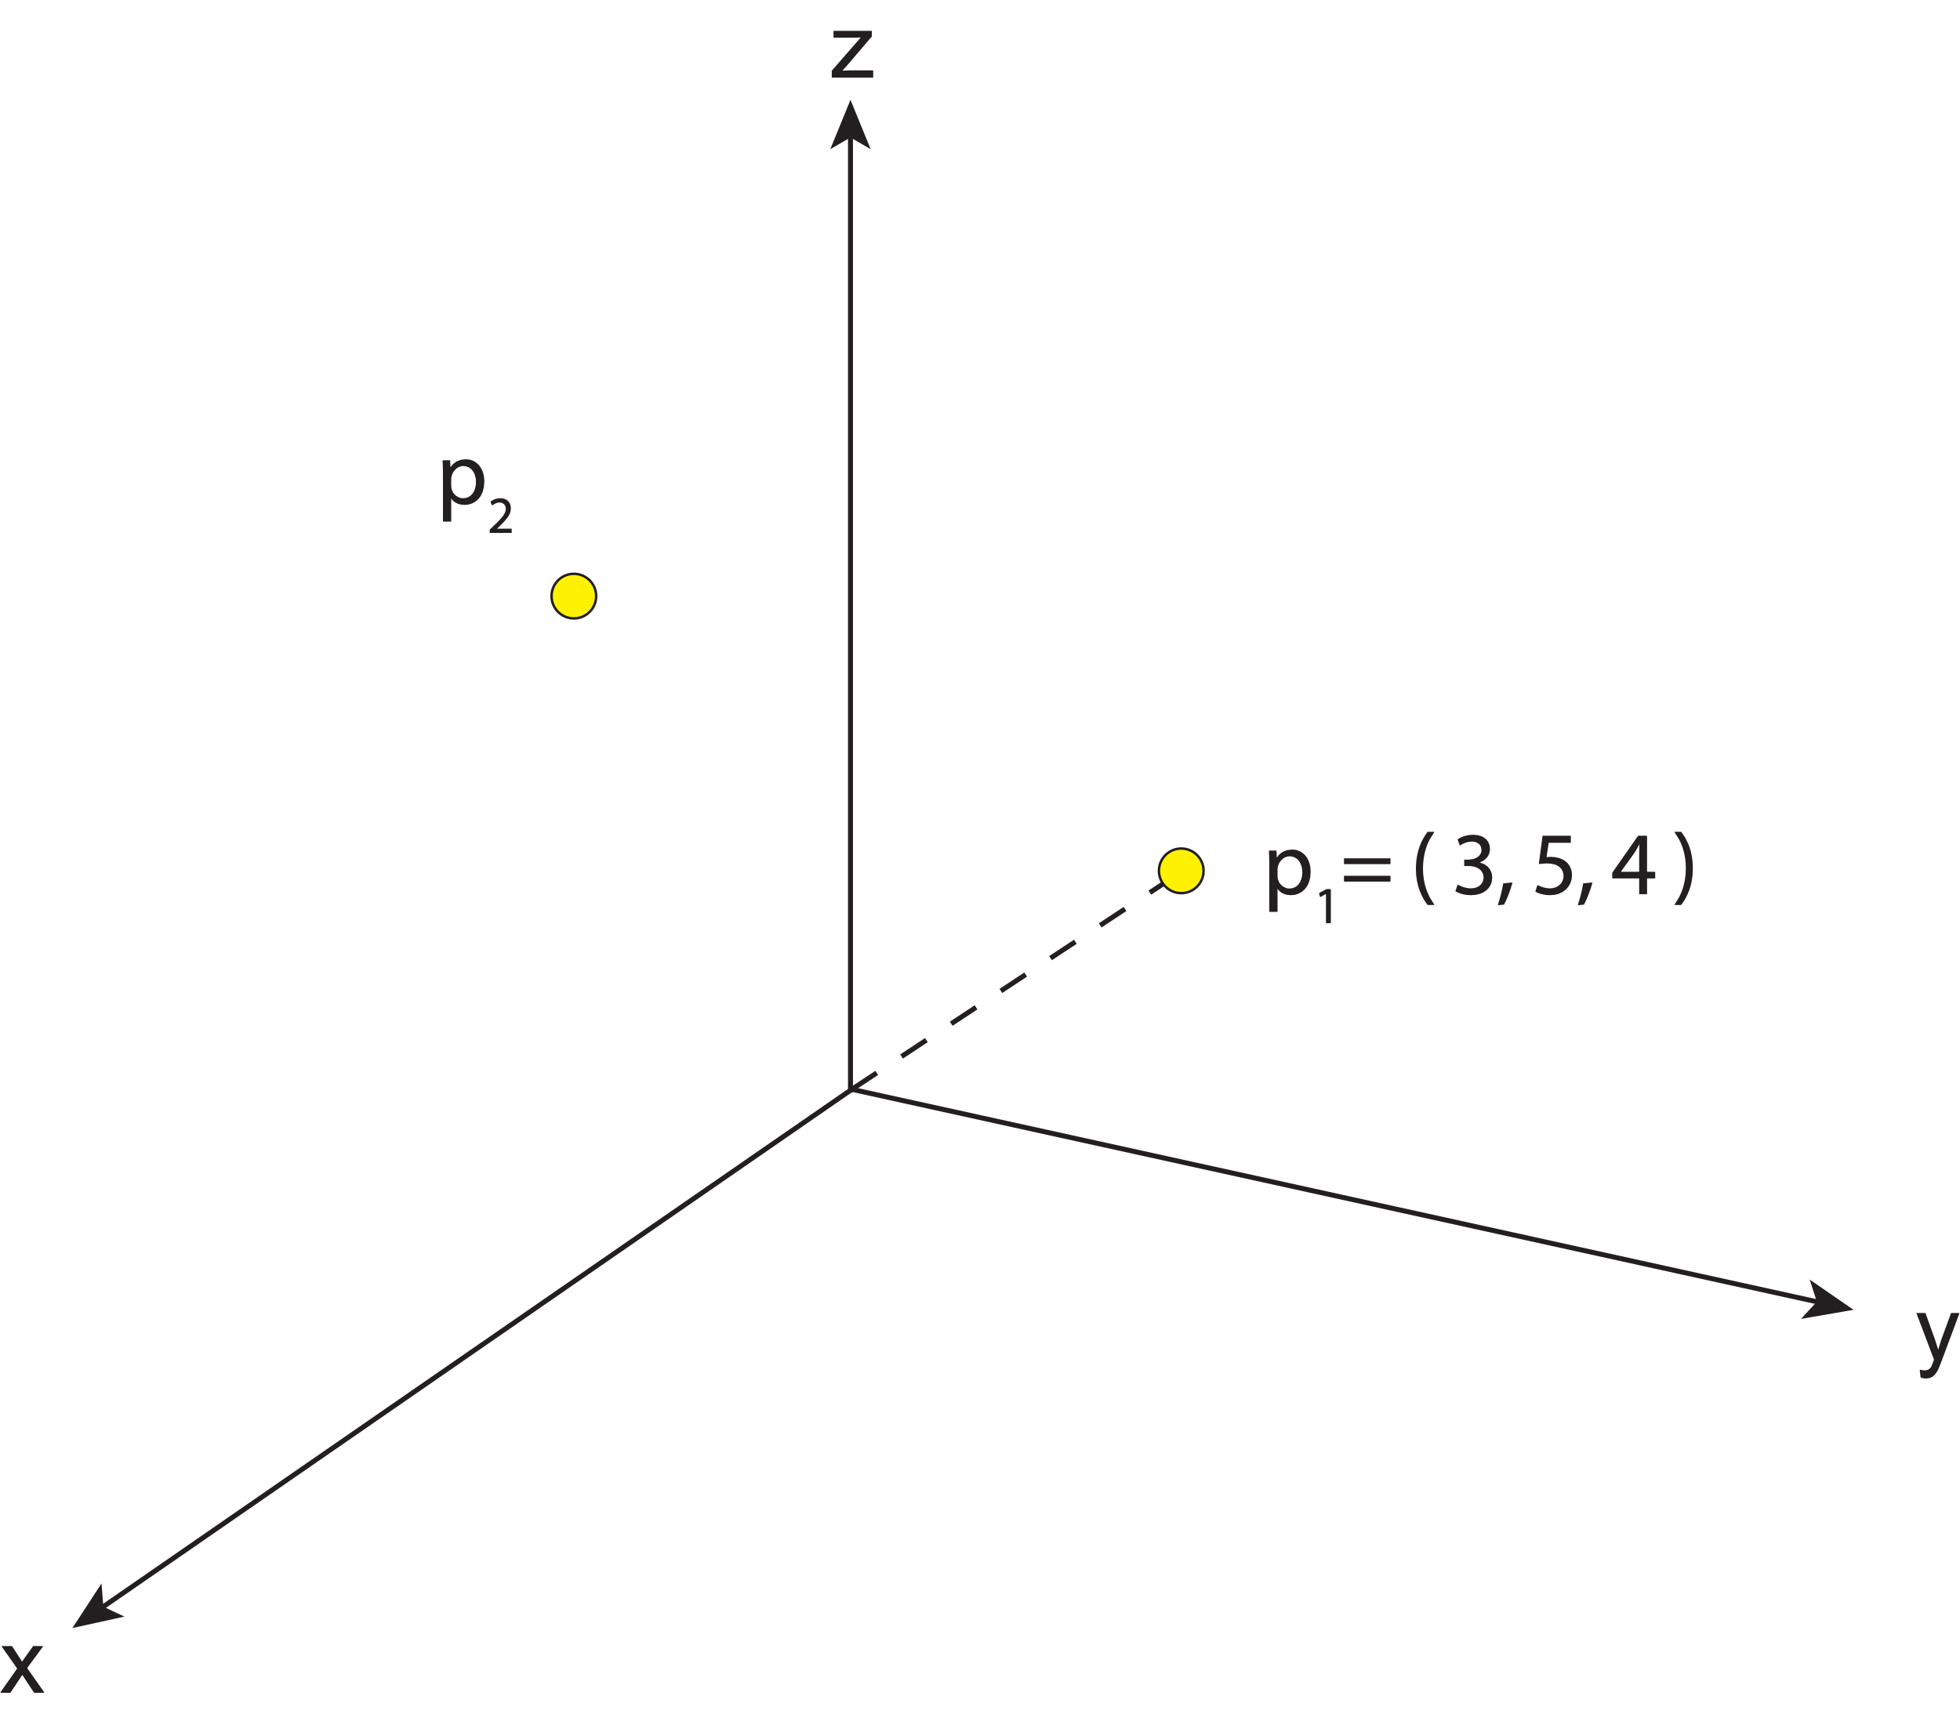
What is a reference frame?
Once we have defined coordinates for one point in the frame, we can position relative to that point.

Slide 12
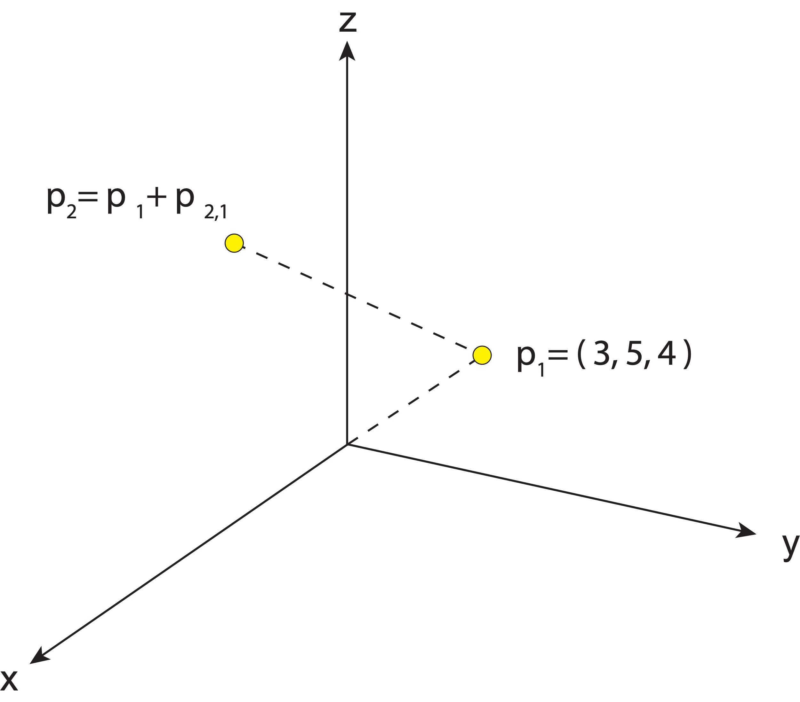
What is a reference frame?
Once we have defined coordinates for one point in the frame, we can position relative to that point.
By simple addition, the relative position of p₂ w.r.t. p₁ can be added to the absolute position of p₁ to obtain the absolute position of p₂ in the frame.

Slide 13
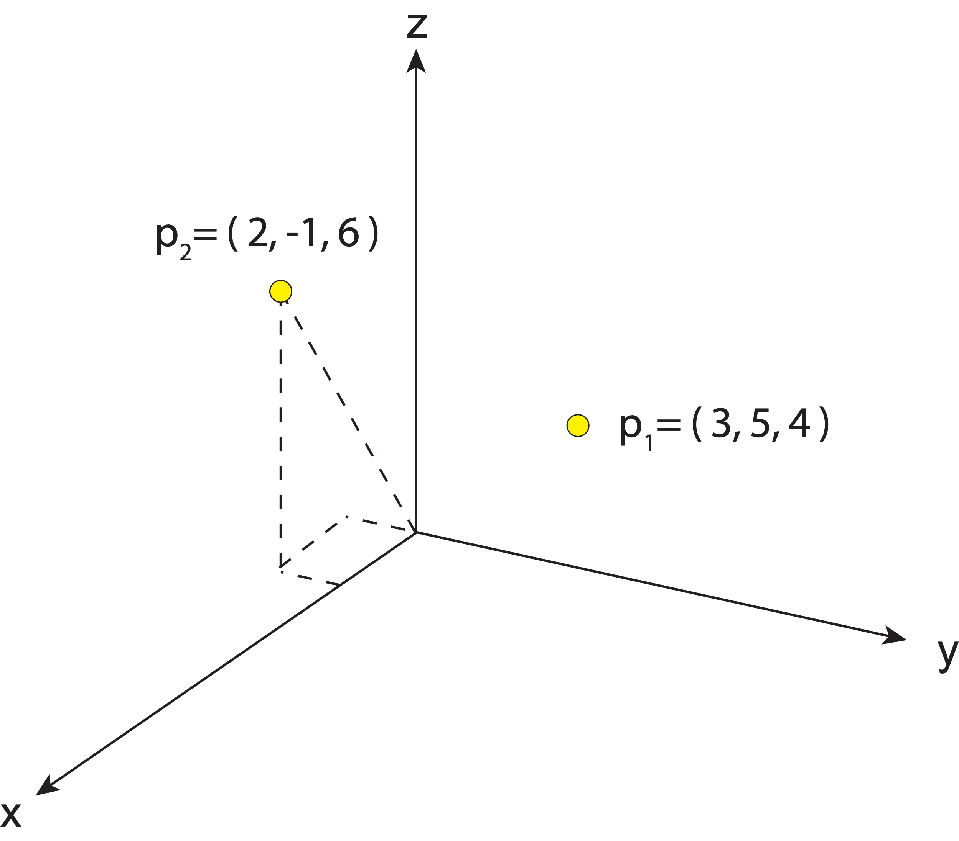
What is a reference frame?
Once we have defined coordinates for one point in the frame, we can position relative to that point.
By simple addition, the relative position of p₂ w.r.t. p₁ can be added to the absolute position of p₁ to obtain the absolute position of p₂ in the frame.

Slide 14
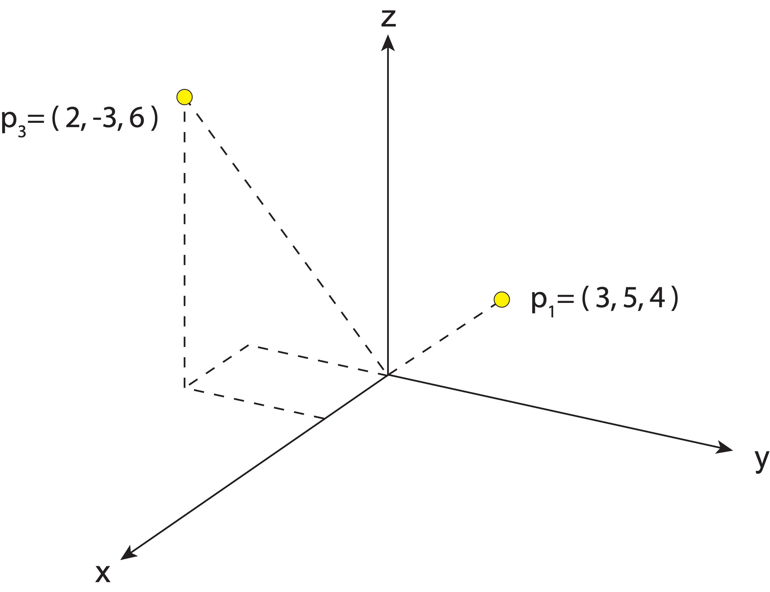
What is a reference frame?
If we know the absolute position of two points in the frame, we can easily obtain the position of one relative to the other by simple subtraction.

Slide 15
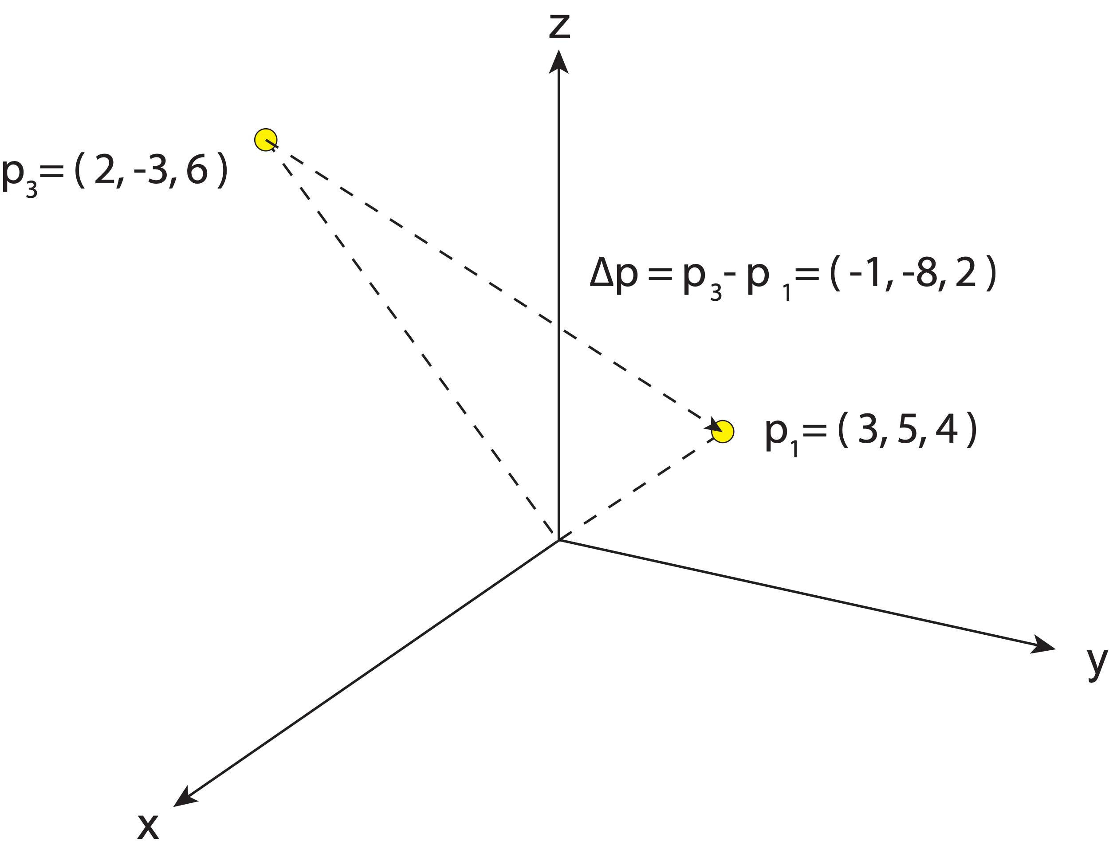
What is a reference frame?
If we know the absolute position of two points in the frame, we can easily obtain the position of one relative to the other by simple subtraction.

Slide 16
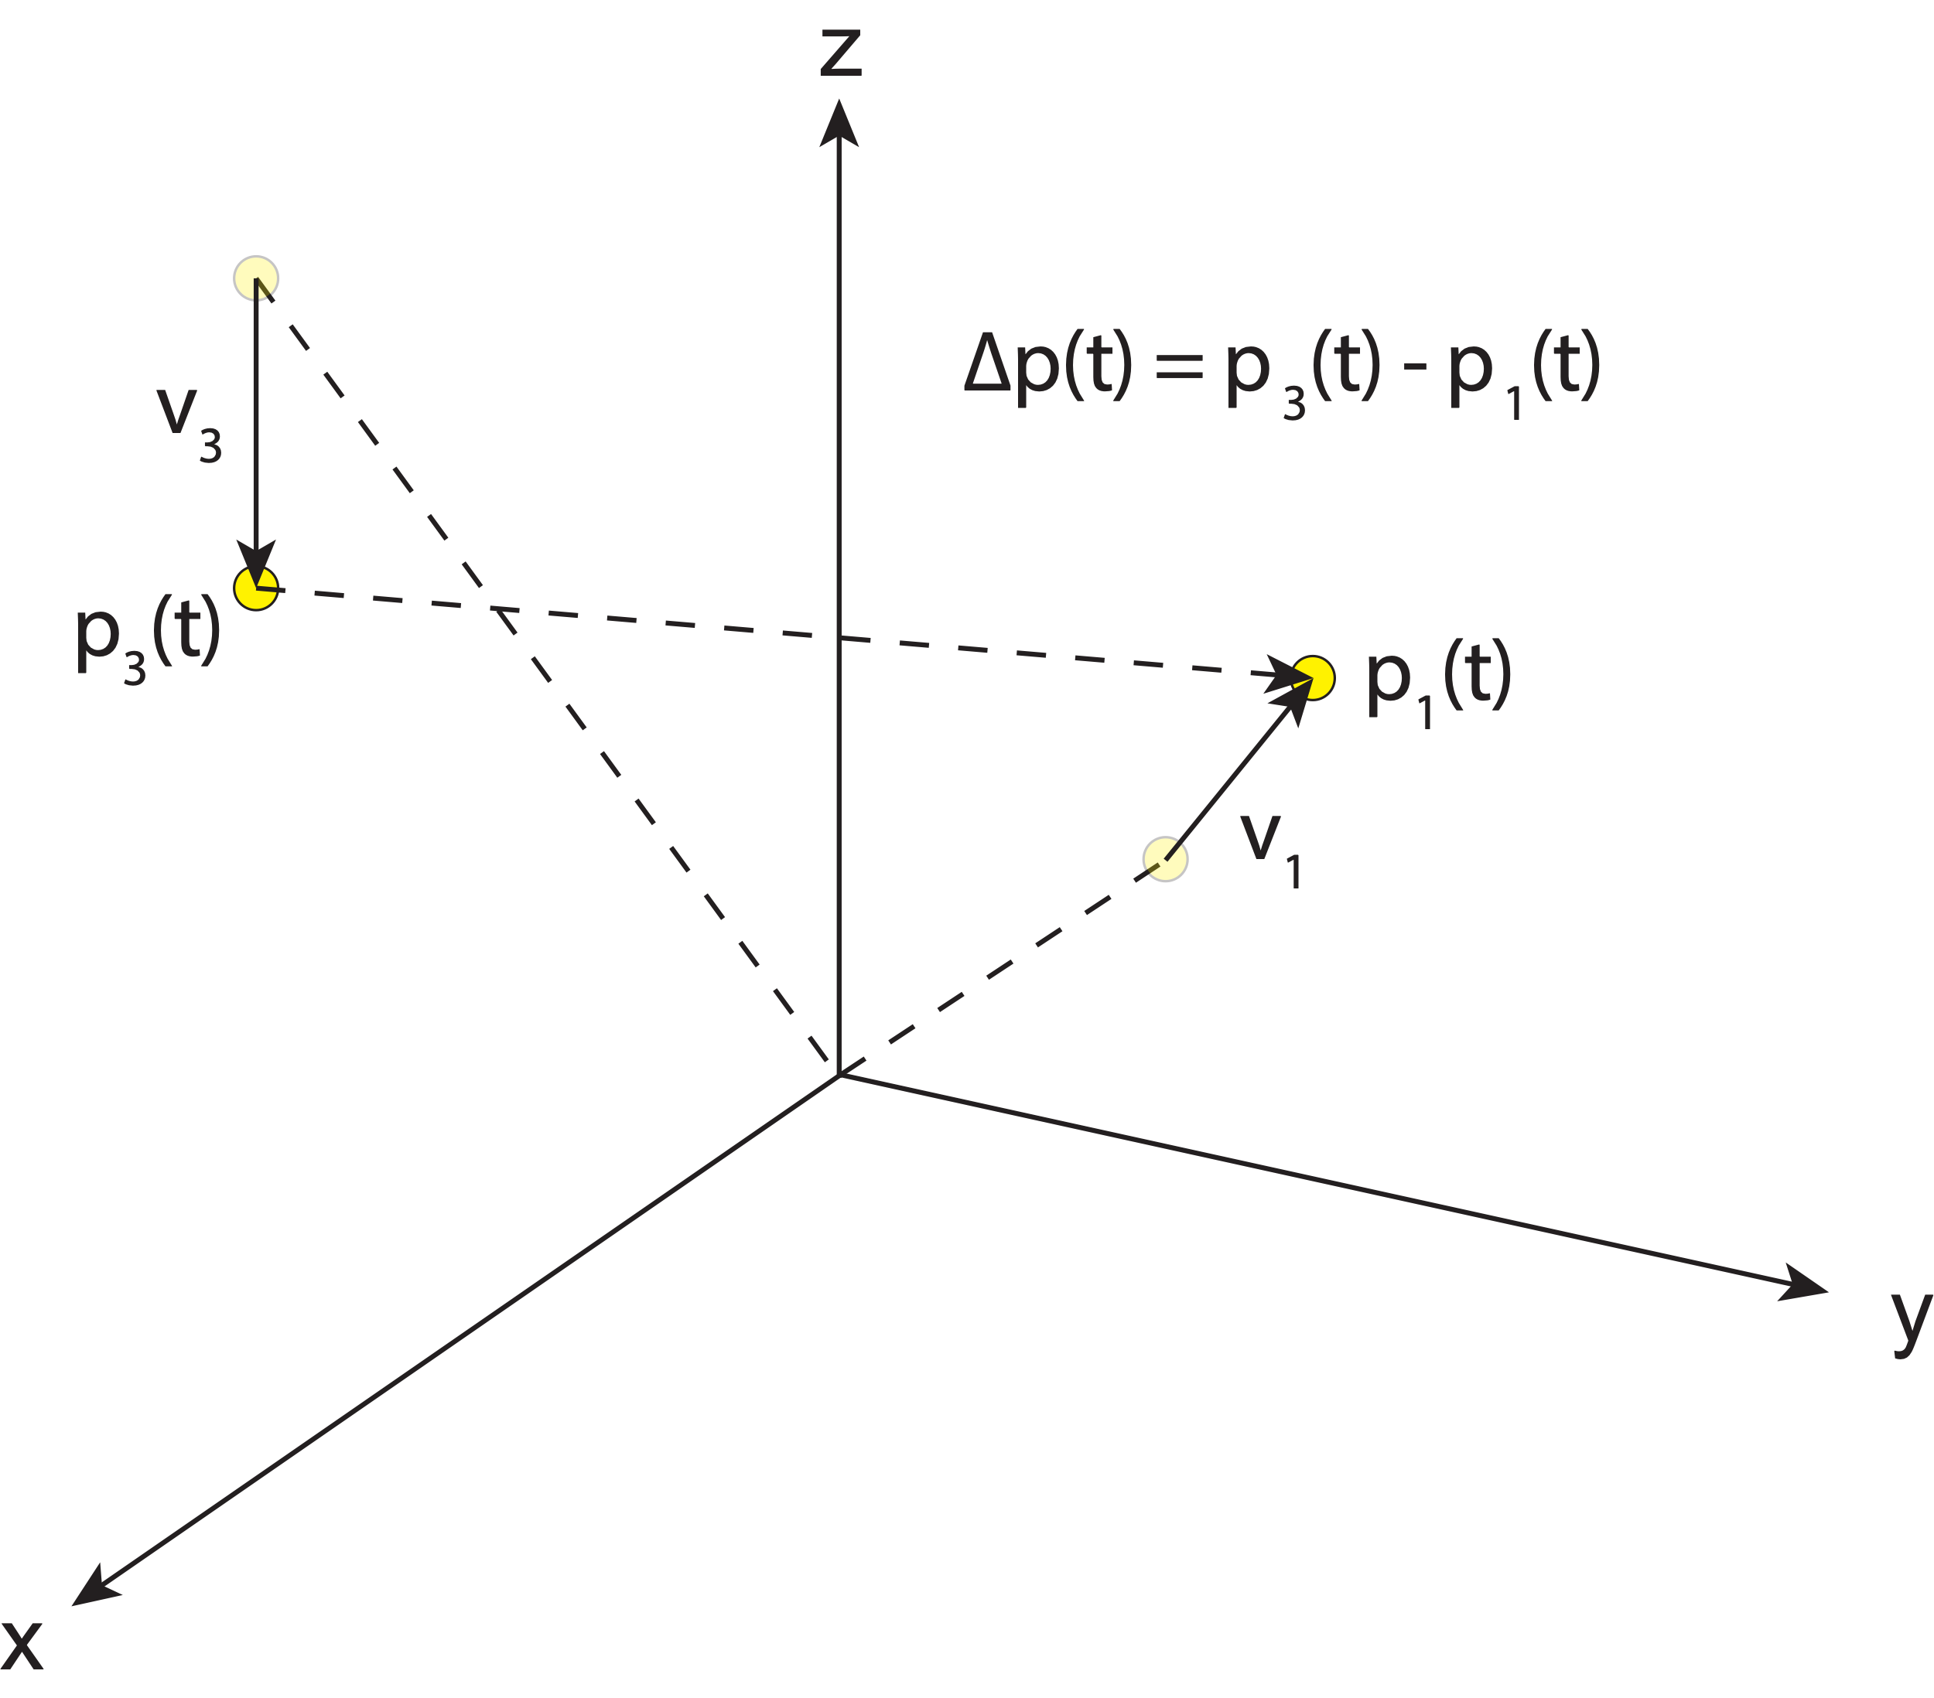
What is a reference frame?
If we know the absolute position of two points in the frame, we can easily obtain the position of one relative to the other by simple subtraction.
Even if our points are moving, if we track their motion in the same frame, then relative motion as a function of time can also be easily obtained.

Slide 17
What is a reference frame?
One can imagine how quickly the complexity might grow

Slide 18
What is a reference frame?
One can imagine how quickly the complexity might grow

Slide 19
What is a reference frame?
One can imagine how quickly the complexity might grow
Navigation
Engineering
Earth science
Surveying

Slide 20
Outline
What is a reference frame?
Traditional geodetic datums
Global reference frames
the International Terrestrial Reference System (ITRS)
the International Terrestrial Reference Frame (ITRF)
How is the ITRF realized?
The International GNSS Service (IGS) realization of the ITRF
How NGS aligns the U.S. National Spatial Reference System (NSRS) with the ITRF through the IGS frame

Slide 21
Outline
What is a reference frame?
Traditional geodetic datums
Global reference frames
the International Terrestrial Reference System (ITRS)
the International Terrestrial Reference Frame (ITRF)
How is the ITRF realized?
The International GNSS Service (IGS) realization of the ITRF
How NGS aligns the U.S. National Spatial Reference System (NSRS) with the ITRF through the IGS frame

Slide 22
Real world reference frame example:
traditional geodetic datums

Slide 23
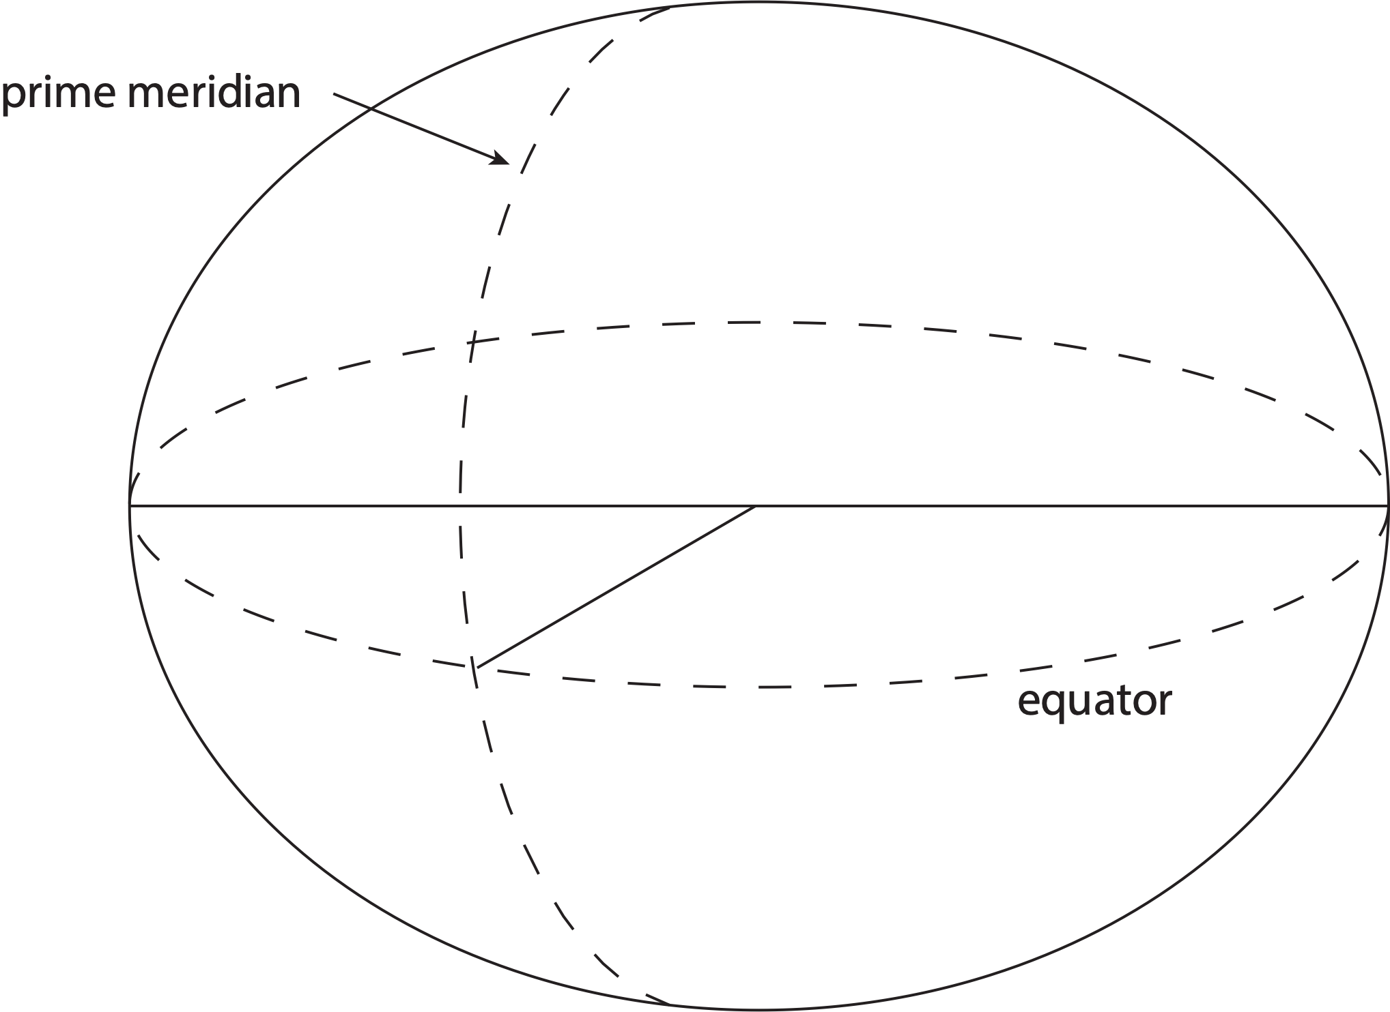
Traditional horizontal geodetic datums
Positions of points on Earth’s surface are reduced to the surface of a reference ellipsoid

Slide 24
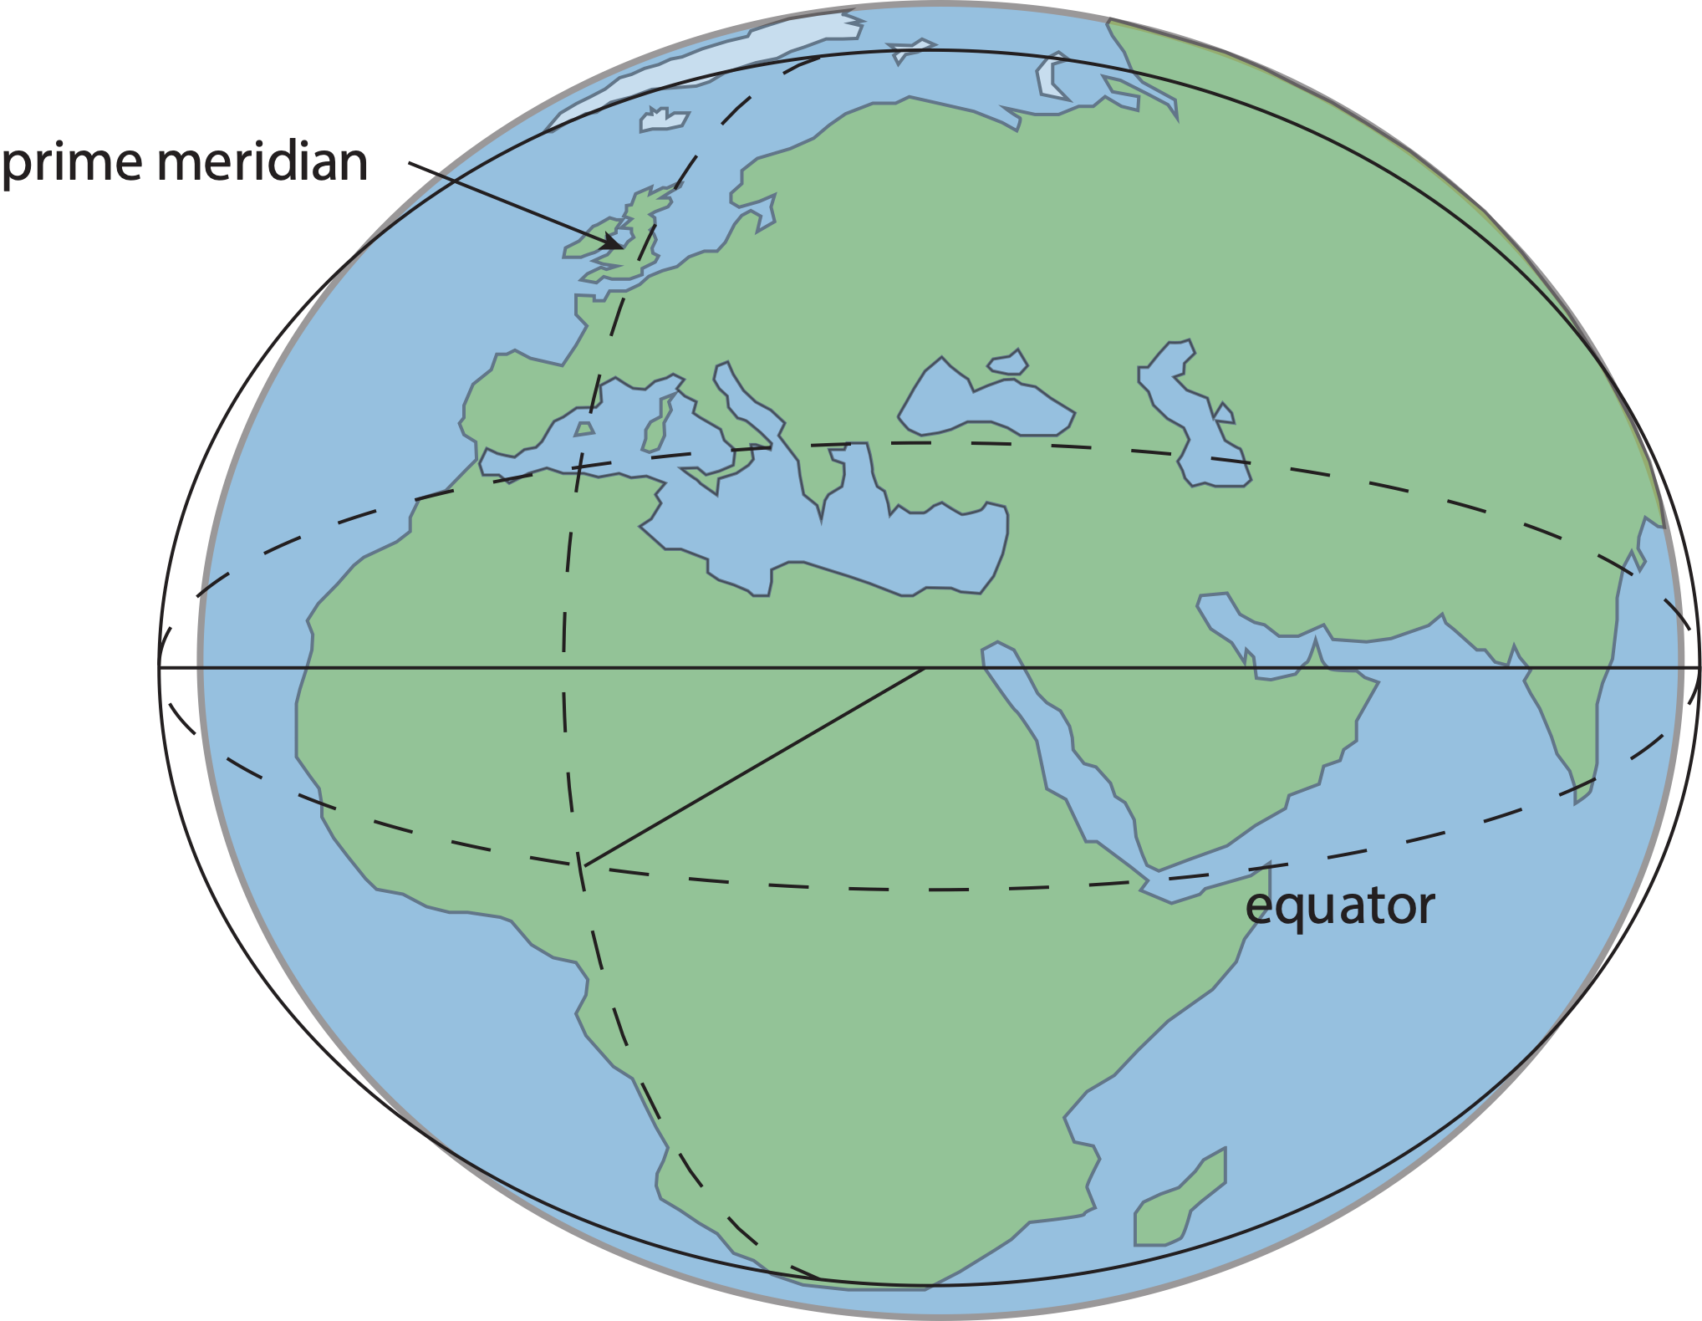
Traditional horizontal geodetic datums
Positions of points on Earth’s surface are reduced to the surface of a reference ellipsoid
The reference ellipsoid matches the shape of the Earth roughly, but not exactly

Slide 25
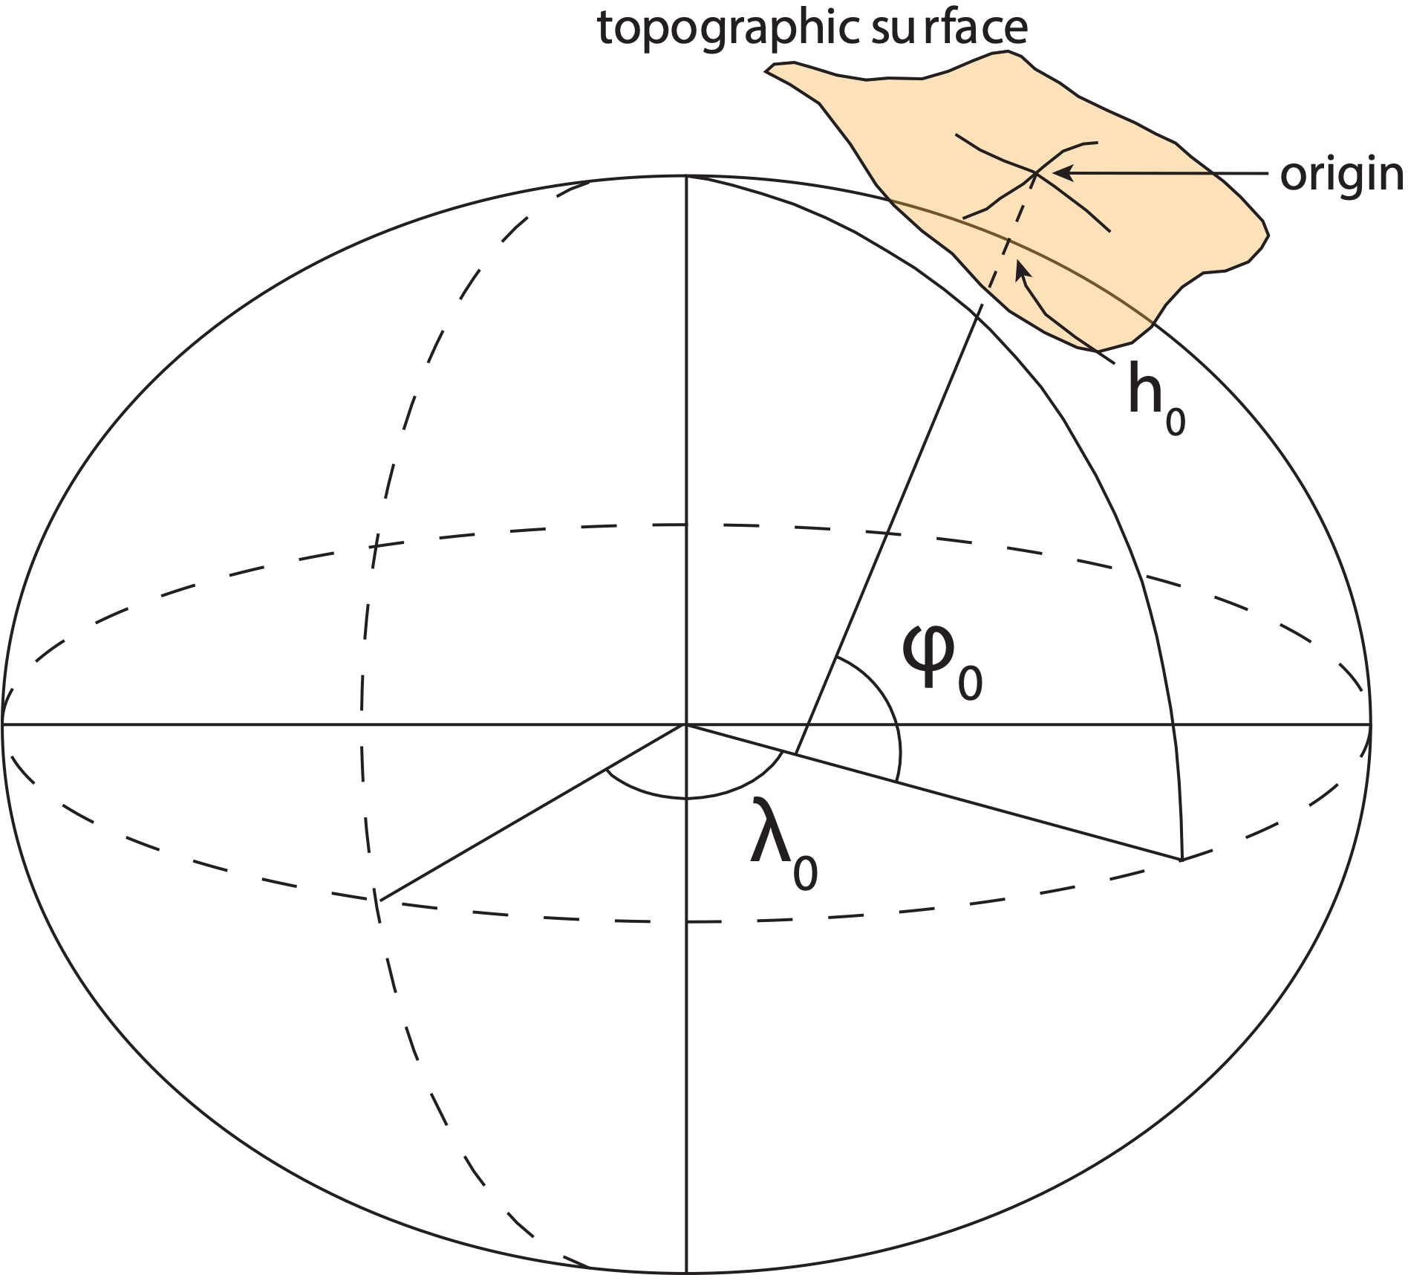
Traditional horizontal geodetic datums
Positions of points on Earth’s surface are reduced to the surface of a reference ellipsoid
The reference ellipsoid roughly matches the shape of the Earth
A reference point is selected as the origin, all other positions are given with respect to that point

Slide 26
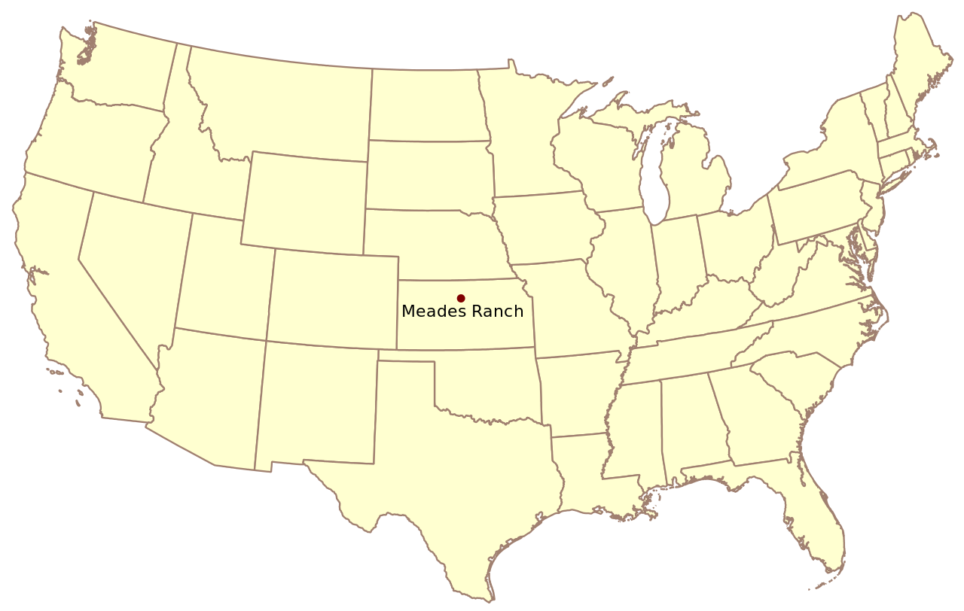
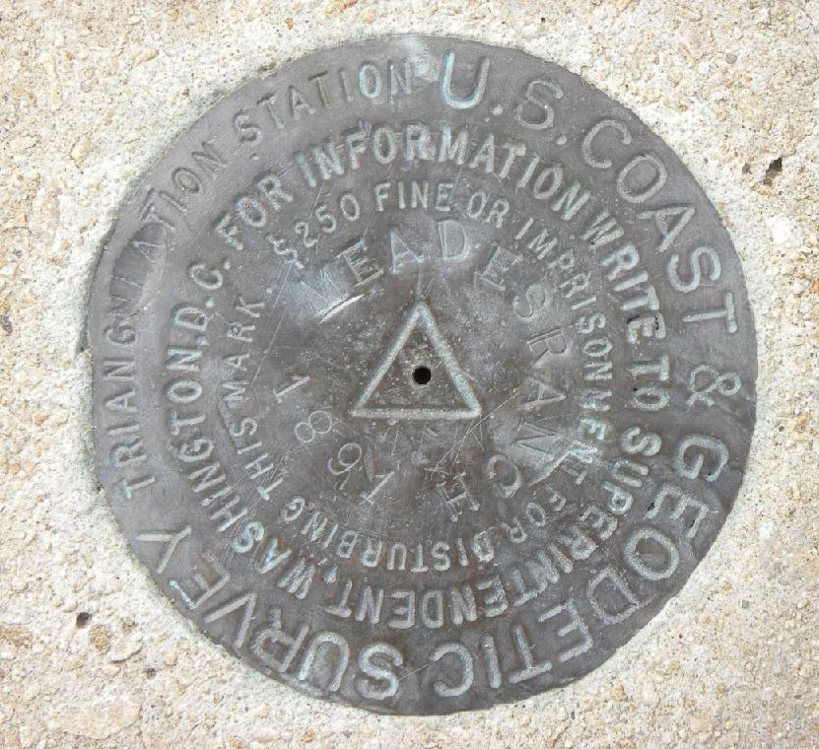
Traditional horizontal geodetic datums
North American Datum of 1927 (NAD27)

Slide 27
Traditional horizontal geodetic datums
North American Datum of 1927 (NAD27)

Slide 28
Traditional horizontal geodetic datums
North American Datum of 1927 (NAD27)

Slide 29
Traditional horizontal geodetic datums
North American Datum of 1927 (NAD27)

Slide 30
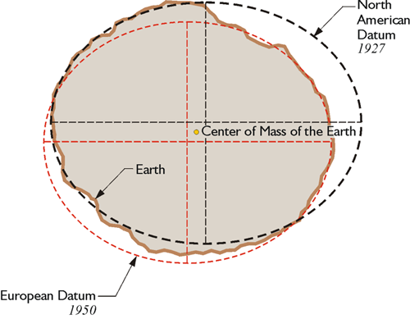
Traditional geodetic datums
Drawbacks of using this approach:
The reference ellipsoid is optimized for the region; it is not suitable for global positioning
The center of the reference ellipsoid does not coincide with the location of the center of mass of the Earth
Neighboring countries may use different datums which can cause unnecessary complications when dealing with points of interest in border regions
This method is static – dynamic process are unaccounted for
https://www.e-education.psu.edu/geog862/node/1797

Slide 31
Outline
What is a reference frame?
Traditional geodetic datums
Global reference frames
the International Terrestrial Reference System (ITRS)
the International Terrestrial Reference Frame (ITRF)
How is the ITRF realized?
The International GNSS Service (IGS) realization of the ITRF
How NGS aligns the U.S. National Spatial Reference System (NSRS) with the ITRF through the IGS frame

Slide 32
Outline
What is a reference frame?
Traditional geodetic datums
Global reference frames
the International Terrestrial Reference System (ITRS)
the International Terrestrial Reference Frame (ITRF)
How is the ITRF realized?
The International GNSS Service (IGS) realization of the ITRF
How NGS aligns the U.S. National Spatial Reference System (NSRS) with the ITRF through the IGS frame

Slide 33
Introducing global reference frames

Slide 34
Reference system:
A set of prescriptions and conventions together with the modeling required to define at any time a triad of coordinate axes¹
Reference frame:
Realizes the system by means of coordinates of definite points that are accessible directly by occupation or observation¹
¹Springer Handbook of Global Navigation Satellite Systems, Ch. 2, p. 34

Slide 35
Reference system:
A set of prescriptions and conventions together with the modeling required to define at any time a triad of coordinate axes¹
ITRS
International Terrestrial
Reference System
Reference frame:
ITRF
International Terrestrial
Reference Frame
Realizes the system by means of coordinates of definite points that are accessible directly by occupation or observation¹
¹Springer Handbook of Global Navigation Satellite Systems, Ch. 2, p. 34

Slide 36
International Terrestrial Reference System (ITRS)
Defined and maintained by the International Earth Rotation and Reference System Service (IERS)
https://www.iers.org/IERS/EN/Home/home_node.html

Slide 37
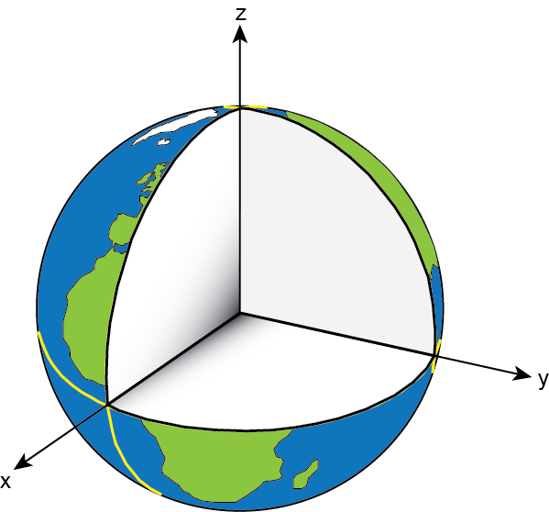
International Terrestrial Reference System (ITRS)
Need to define
conventions for:
origin – where is the zero point?
scale – what is our measure of length?
orientation – how are the axes oriented in space?

Slide 38
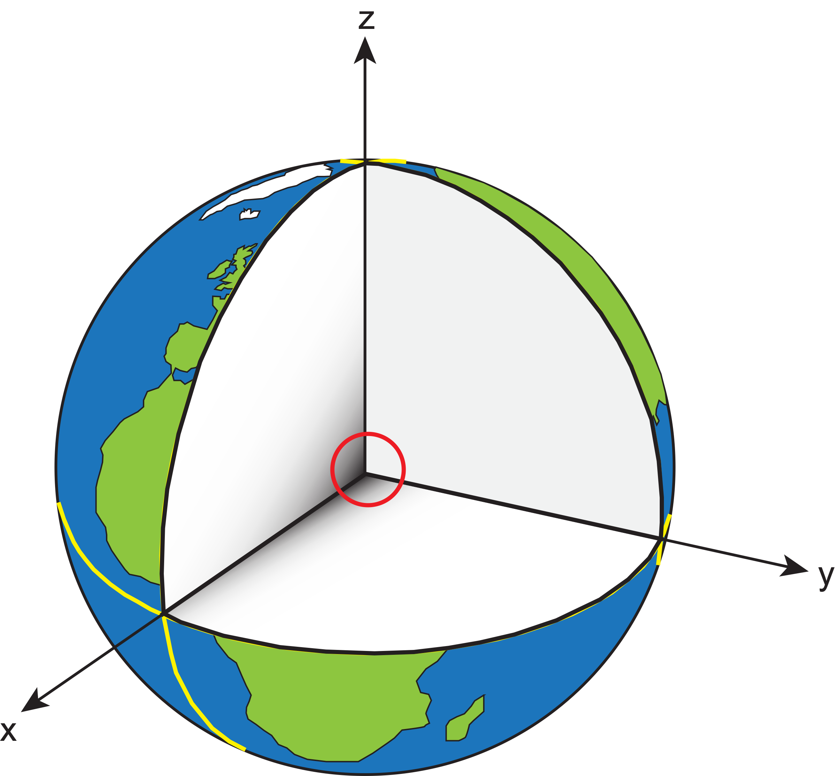
International Terrestrial Reference System (ITRS)
Origin:
Earth’s geocenter; average center of total mass of Earth, including ocean’s and atmosphere

Slide 39
International Terrestrial Reference System (ITRS)
Scale:
SI unit of length, meter

Slide 40
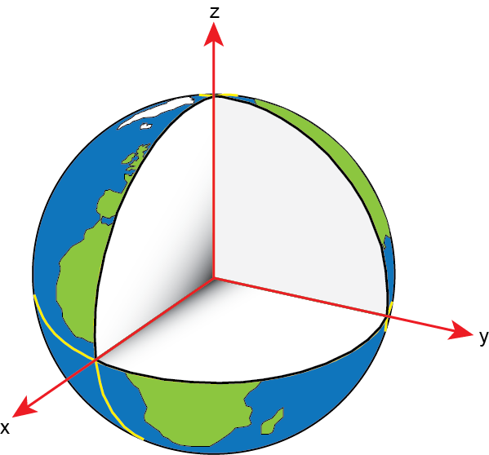
International Terrestrial Reference System (ITRS)
Orientation:
x-axis passes through reference meridian of the Conventional Terrestrial System at the equator
z-axis aligned with the International Reference Pole
y-axis defined to form a right-handed system
Notes:
- Pronounce Greenwich properly (Grenich)

Slide 41
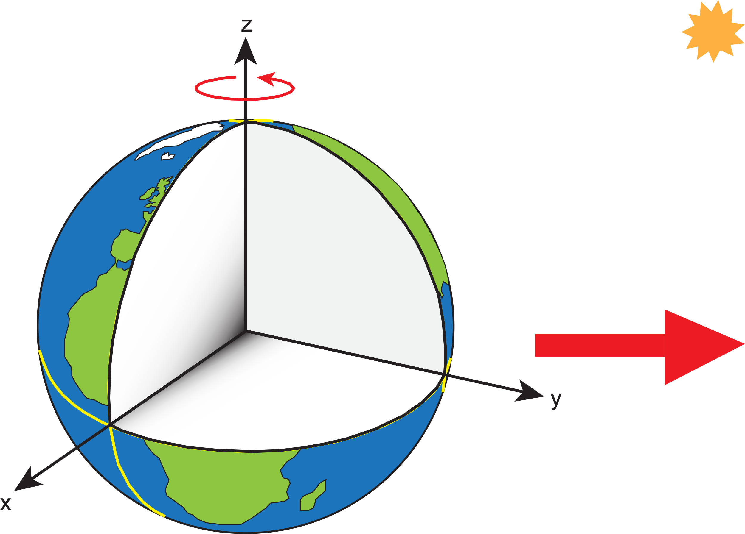
International Terrestrial Reference System (ITRS)
The frame rotates with and is fixed to the Earth as it orbits the Sun. It is a so-called Earth-centered-Earth-fixed frame (ECEF).

Slide 42
International Terrestrial Reference Frame (ITRF)
“Realization” of the idealized reference system occurs when coordinates are assigned to physical points in a self-consistent manner that honors the rules of the reference system.

Slide 43
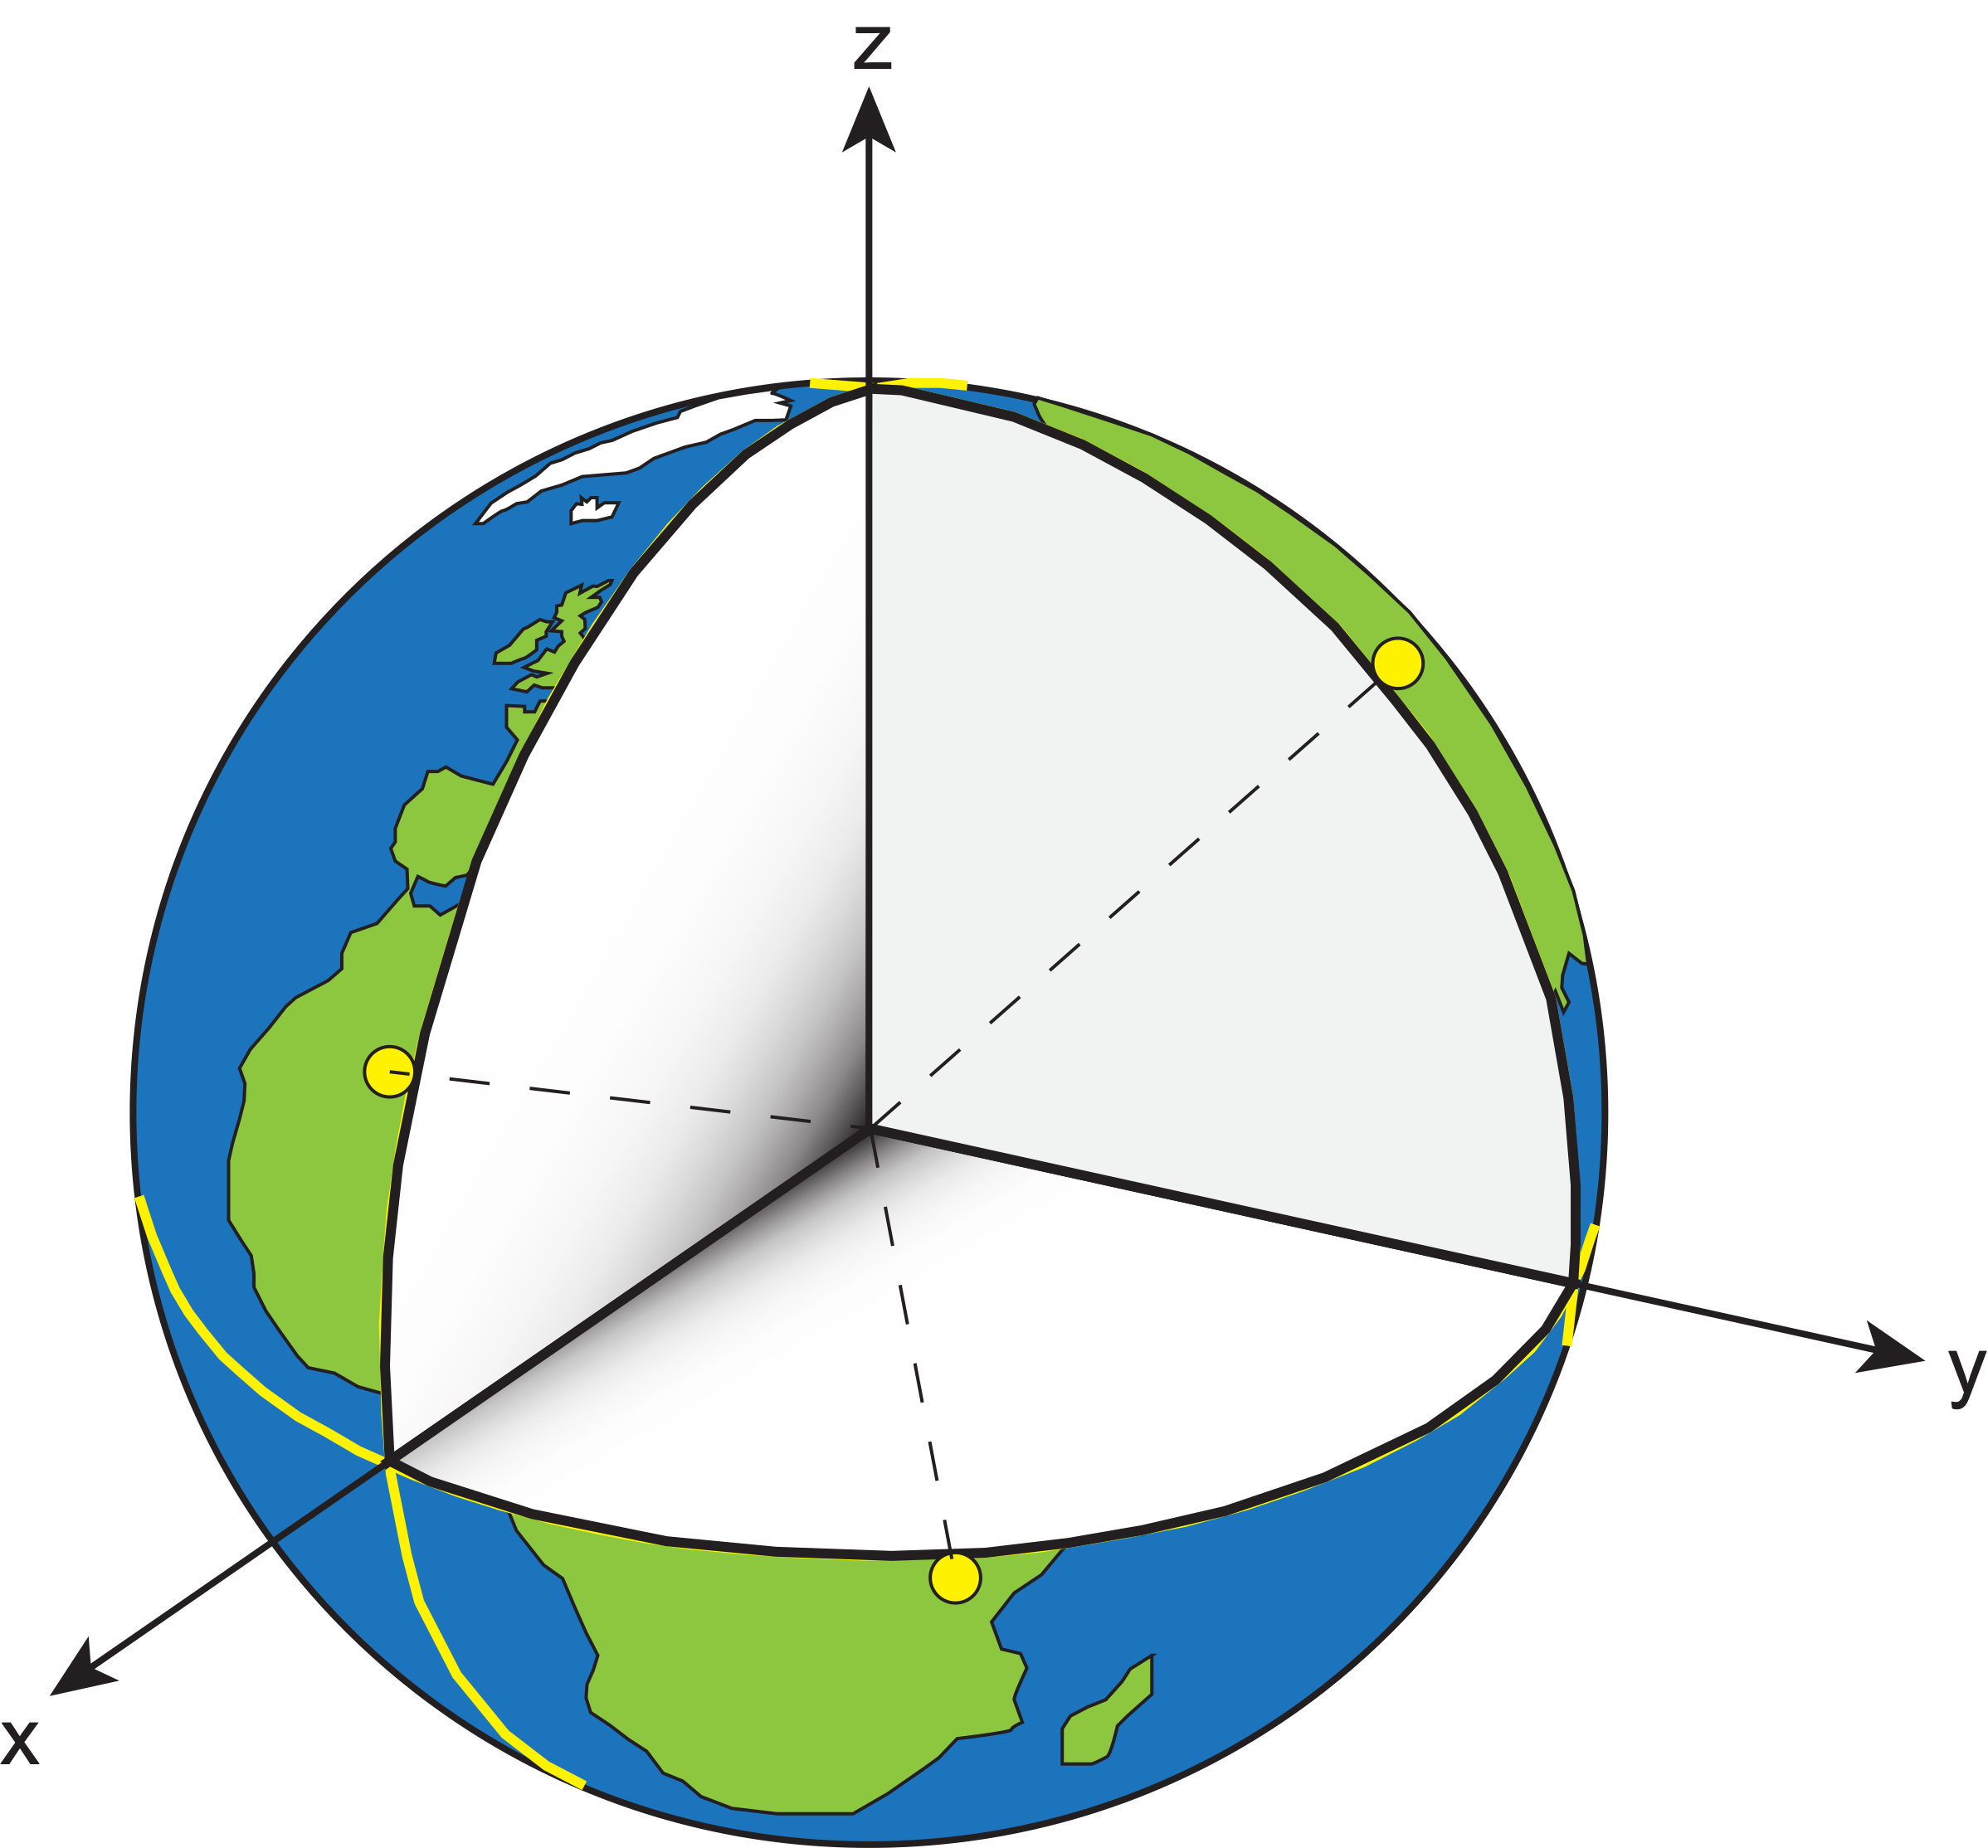
International Terrestrial Reference Frame (ITRF)
“Realization” of the idealized reference system occurs when coordinates are assigned to physical points in a self-consistent manner that honors the rules of the reference system.

Slide 44
Outline
What is a reference frame?
Traditional geodetic datums
Global reference frames
the International Terrestrial Reference System (ITRS)
the International Terrestrial Reference Frame (ITRF)
How is the ITRF realized?
The International GNSS Service (IGS) realization of the ITRF
How NGS aligns the U.S. National Spatial Reference System (NSRS) with the ITRF through the IGS frame

Slide 45
Outline
What is a reference frame?
Traditional geodetic datums
Global reference frames
the International Terrestrial Reference System (ITRS)
the International Terrestrial Reference Frame (ITRF)
How is the ITRF realized?
The International GNSS Service (IGS) realization of the ITRF
How NGS aligns the U.S. National Spatial Reference System (NSRS) with the ITRF through the IGS frame

Slide 46
Realization of the ITRF

Slide 47
Realization of the ITRF
Realization of the ITRF requires assigning self-consistent coordinates to physical points on or near Earth’s surface that can be occupied or observed directly.

Slide 48
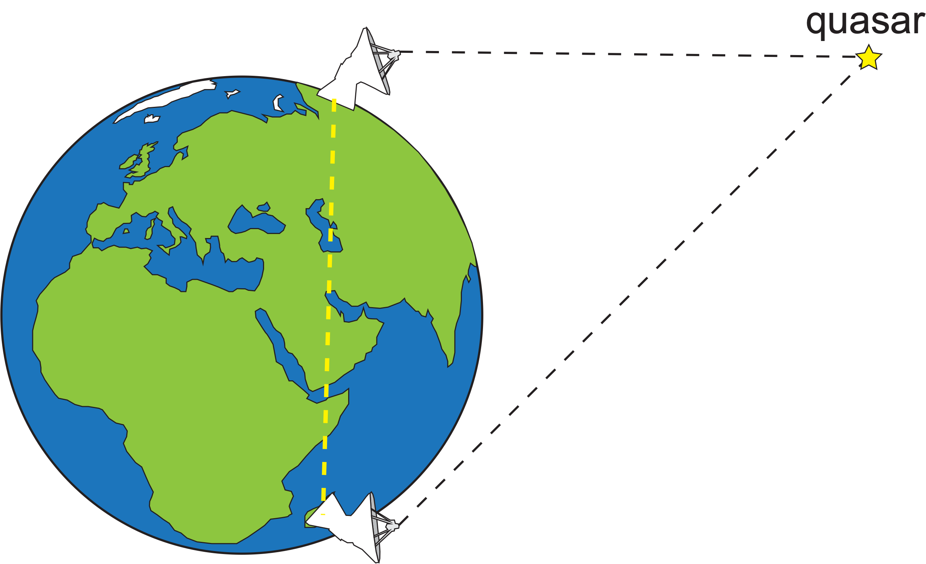
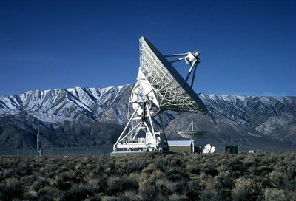
Realization of the ITRF
Very Long Baseline Interferometry (VLBI)
Observation of quasars hundreds of millions of light years away
Up to ~12,000 km baselines with mm accuracy
Contributes to the orientation and scale of the ITRF
International VLBI Service (IVS)
https://www.usno.navy.mil/USNO/astrometry/vlbi-products

Slide 49
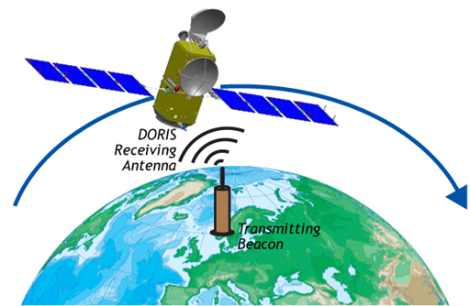
Realization of the ITRF
Doppler Orbitography by Radiopositioning Integrated on Satellite
(DORIS)
GPS in reverse
Ground station emits radio signal - doppler shift is used to estimate position and velocity of satellite
Contributes to orientation and scale of ITRF
International DORIS Service (IDS)
https://space-geodesy.nasa.gov/techniques/DORIS.html

Slide 50
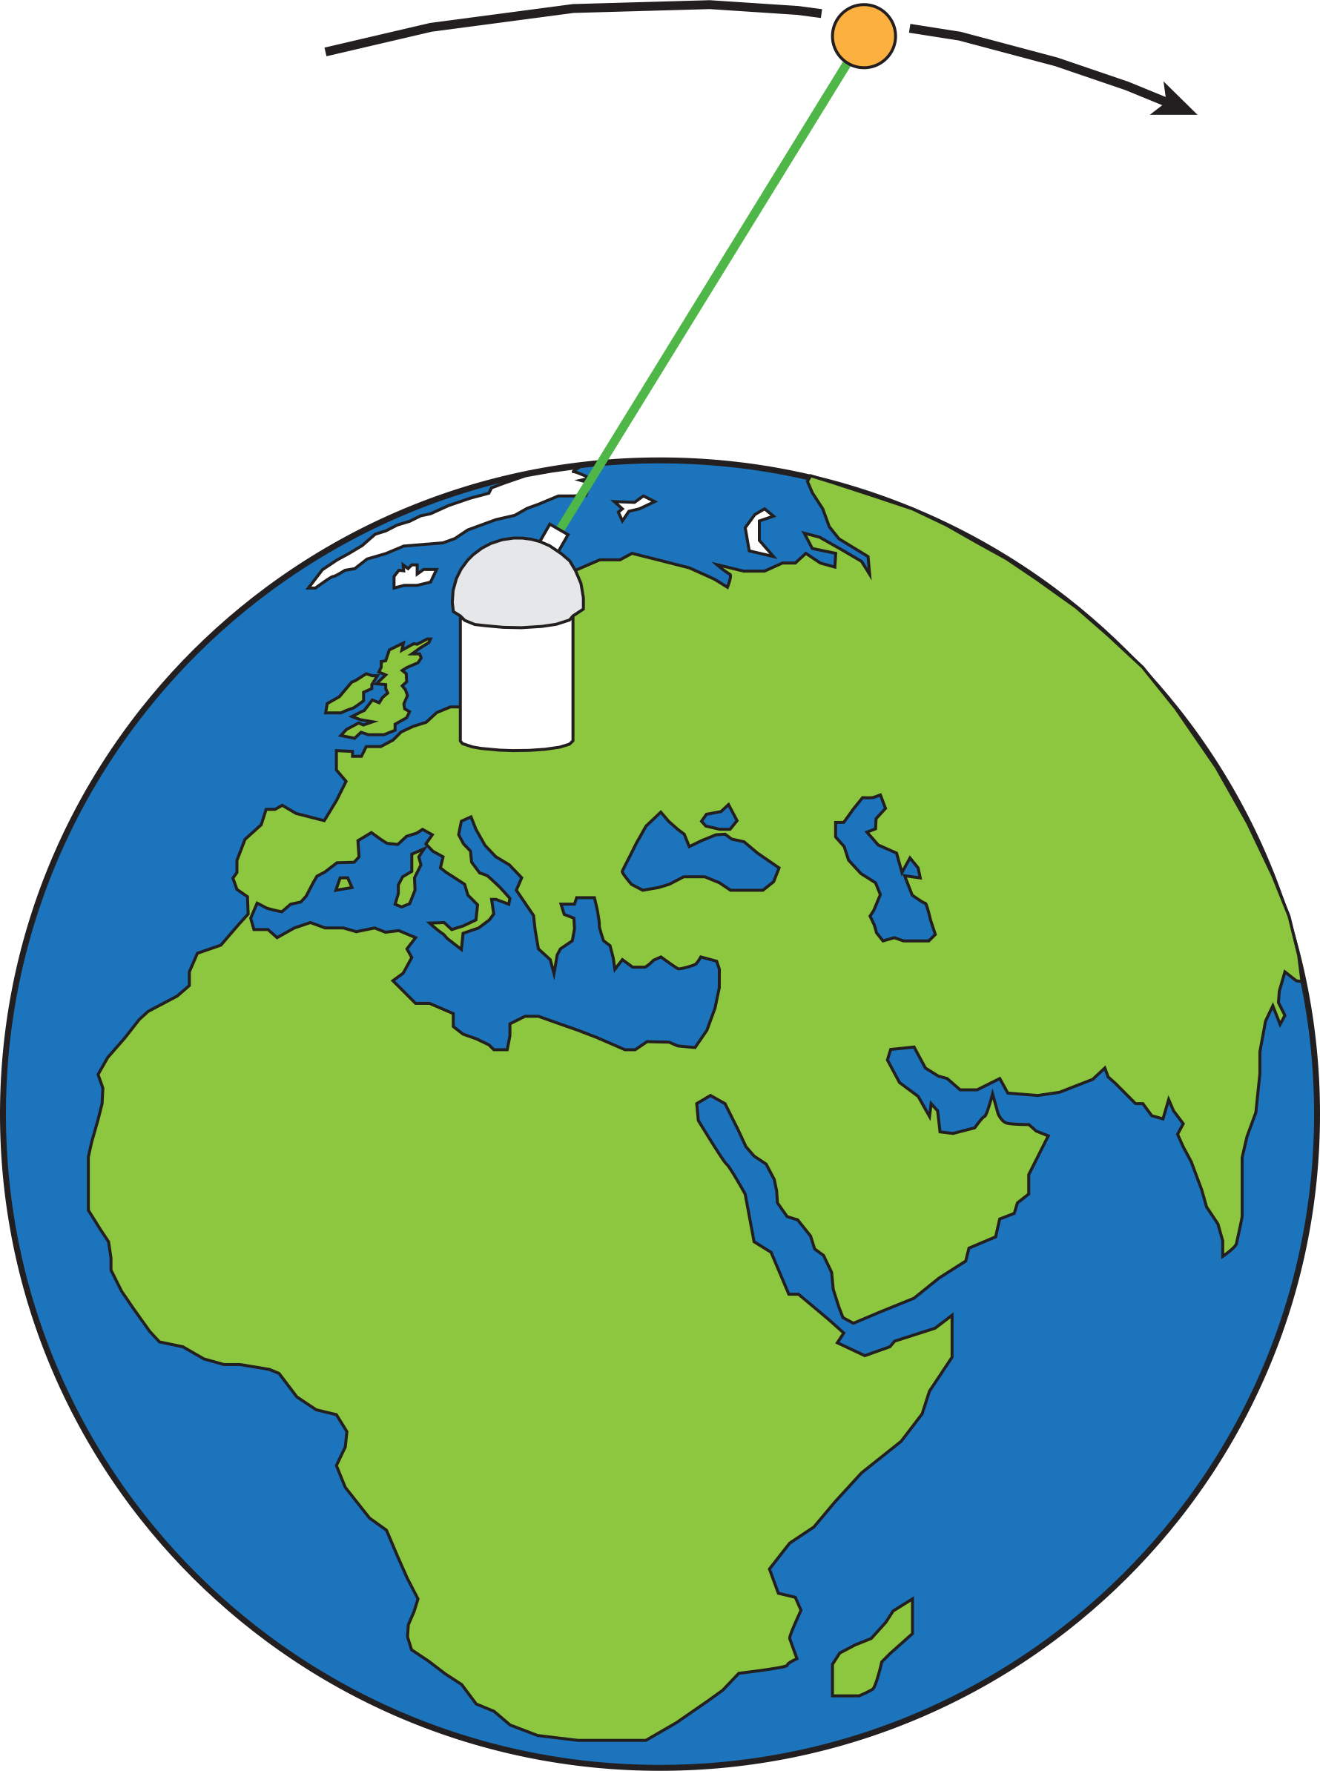
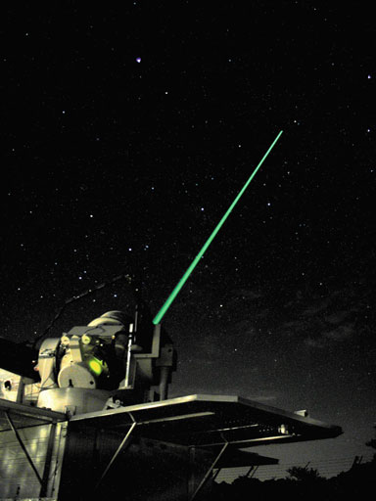
Realization of the ITRF
Satellite Laser Ranging (SLR)
Two-way travel time of laser reflection is used to estimate position of station and satellite
Orbits are known very well
Only technique to contribute to estimate of Earth center of mass
International Laser Ranging Service (ILRS)
LAGEOS-1 source: wikipedia
Sciences of Geodesy I, Advances and Future Directions (pp.301-338)
Edition: 1st
Chapter: Satellite Laser Ranging

Slide 51
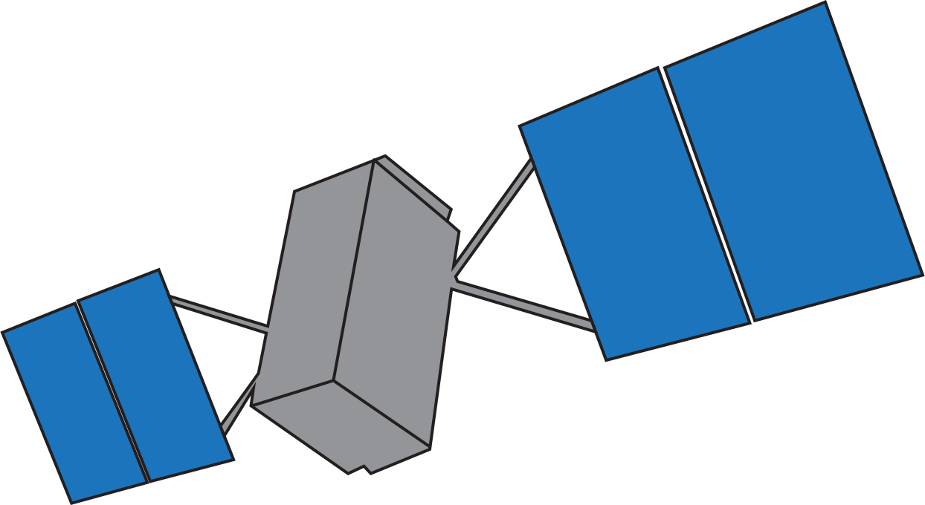
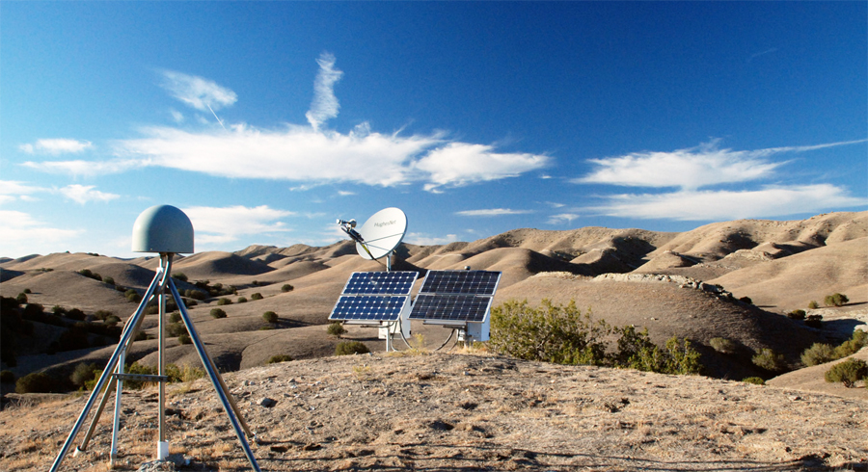
Realization of the ITRF
Global Navigation Satellite Systems (GNSS)
GNSS is a general term – the Global Positioning System (GPS) was the first such system
Trilateration is used to estimate the position of ground tracking stations and satellites
Contributes to orientation of ITRF
International GNSS Service (IGS)
Most common way for users to access the ITRF is through GNSS
https://www.unavco.org/projects/past-projects/pbo/pbo.html

Slide 52
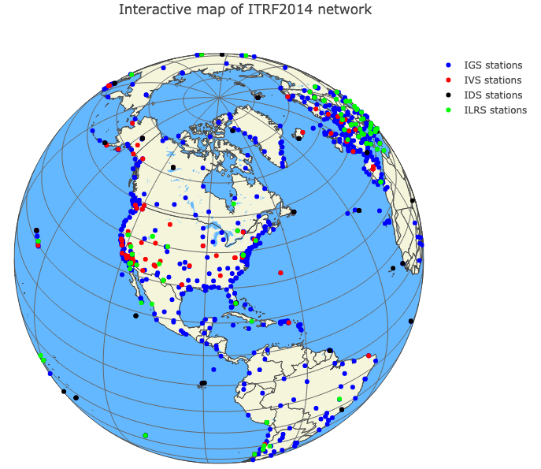
Realization of the ITRF
The IERS uses a global distribution of observing stations
Blue dots show locations of GNSS stations
https://www.iers.org/IERS/EN/DataProducts/ITRF/map/itrfmap.html

Slide 53
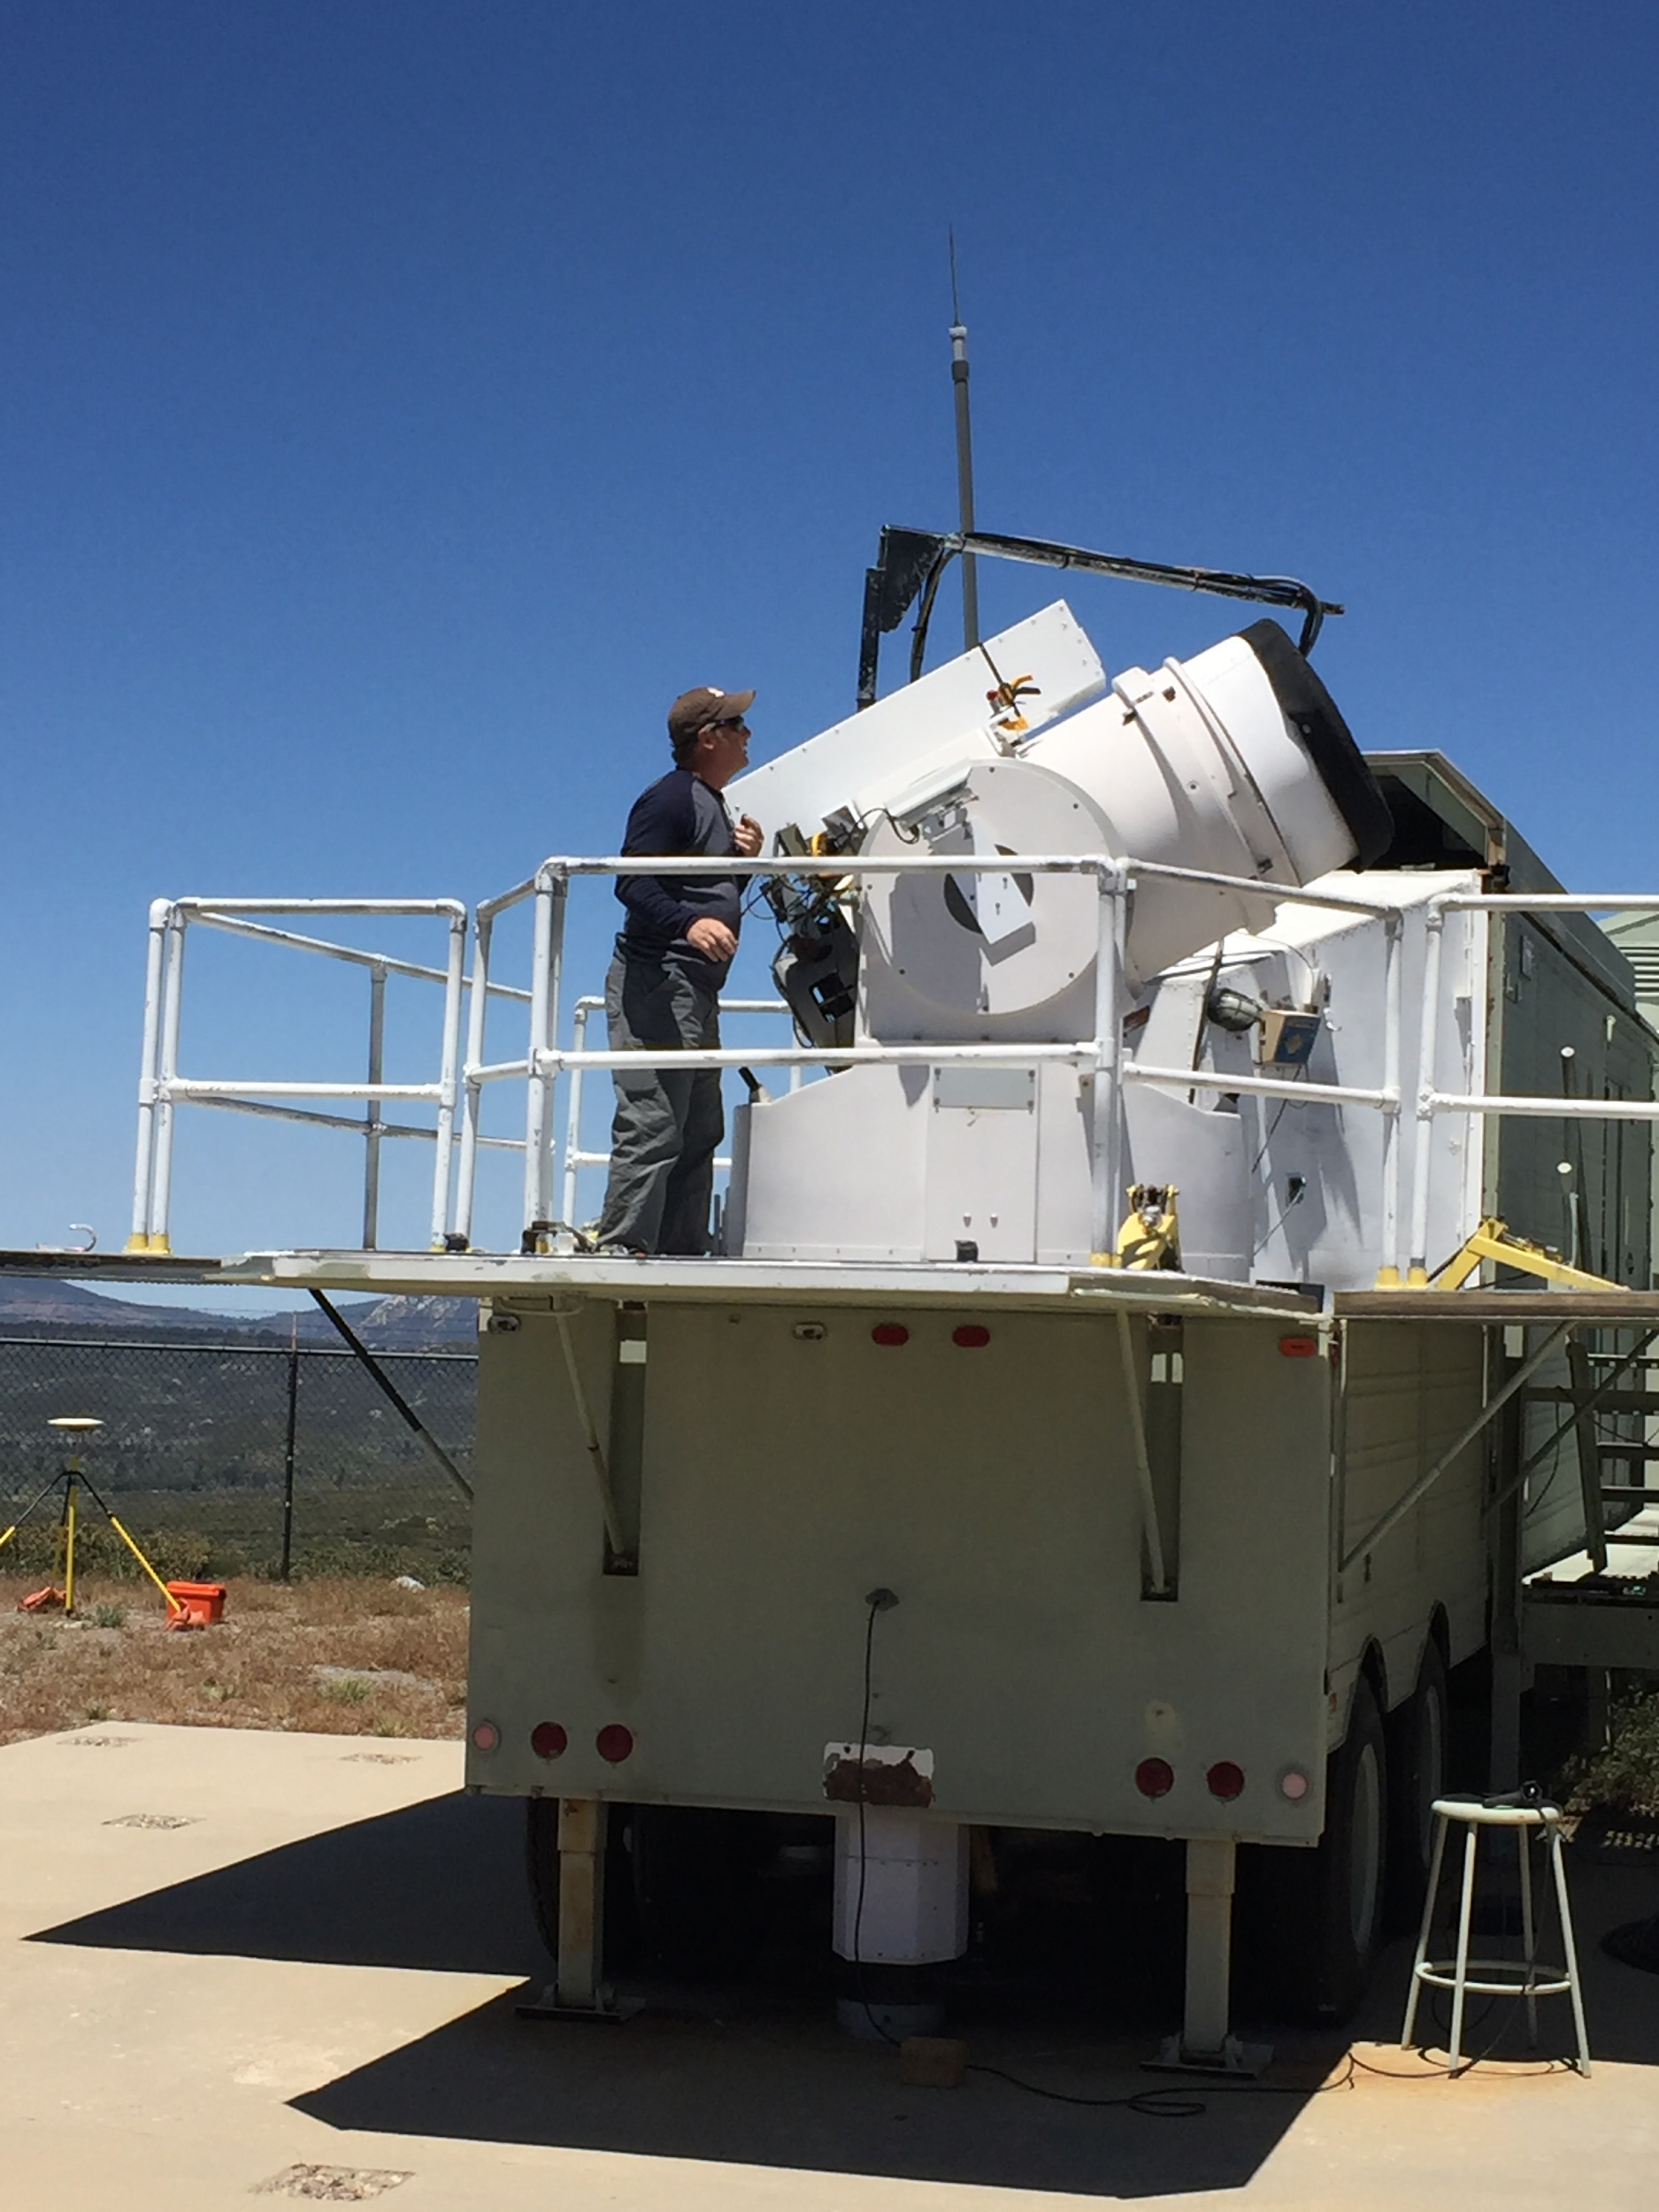
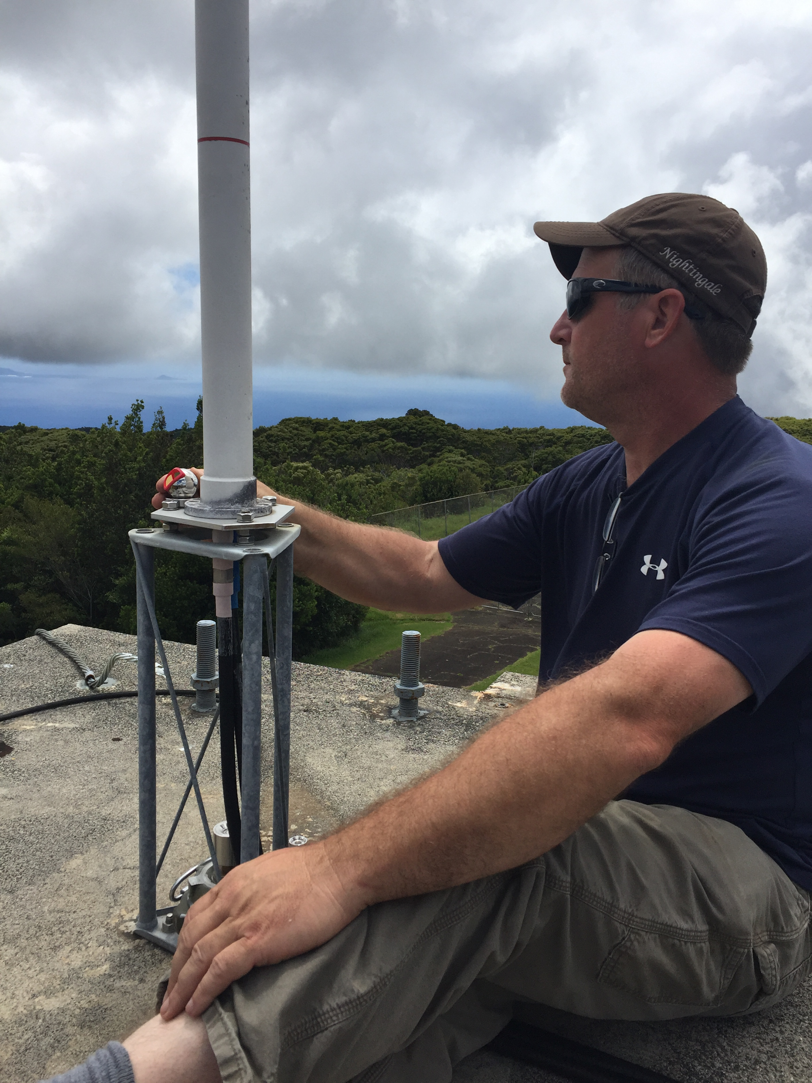
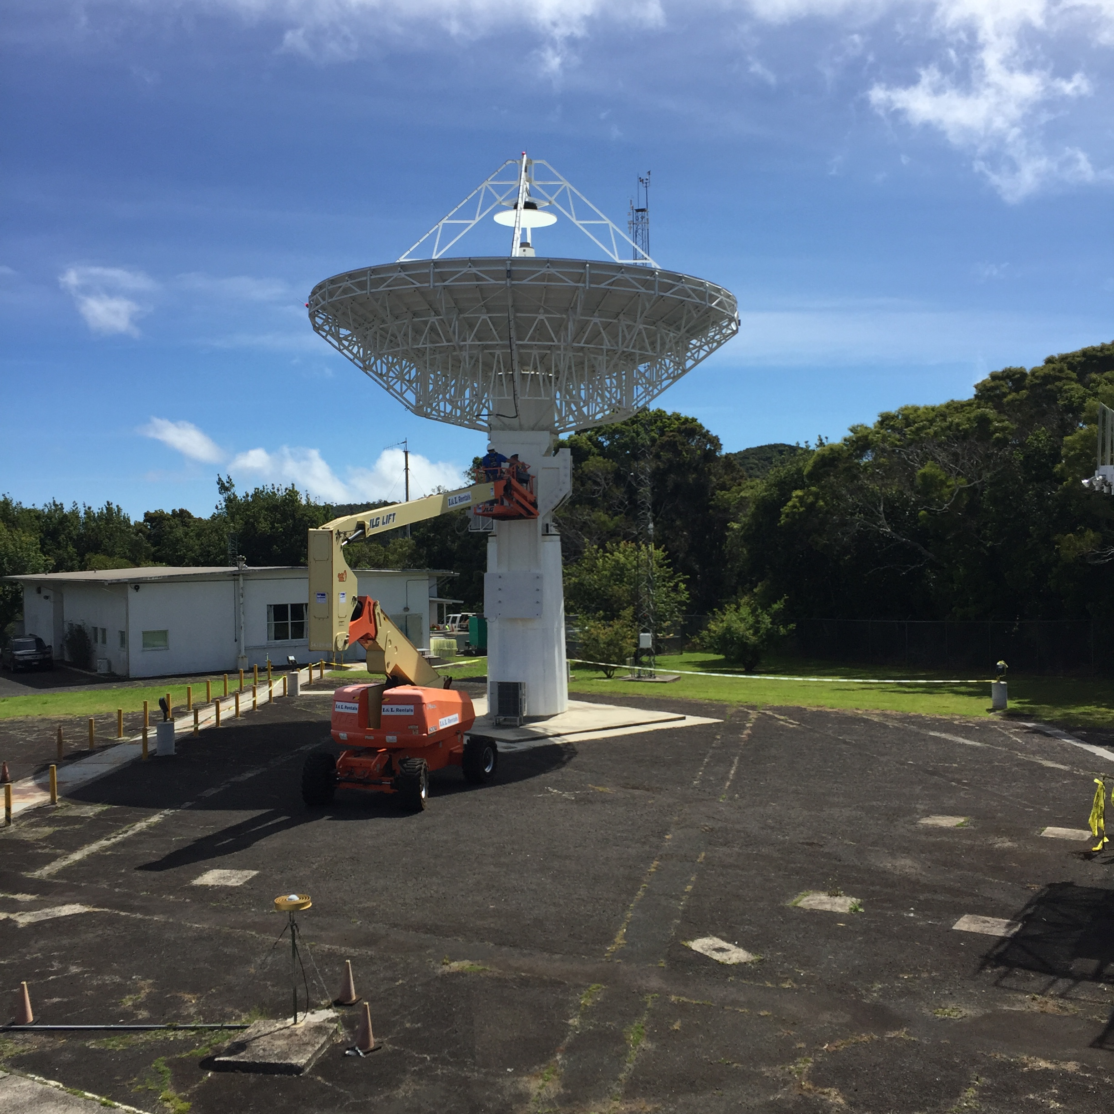
Realization of the ITRF
Steve Breidenbach from NGS at Monument Peak
Local tie surveys at sites with co-located techniques are essential for using all the techniques together to define the ITRF
Steve B. at (KOKB), DORIS (above) and VLBI (right)

Slide 54
Outline
What is a reference frame?
Traditional geodetic datums
Global reference frames
the International Terrestrial Reference System (ITRS)
the International Terrestrial Reference Frame (ITRF)
How is the ITRF realized?
The International GNSS Service (IGS) realization of the ITRF
How NGS aligns the U.S. National Spatial Reference System (NSRS) with the ITRF through the IGS frame

Slide 55
Outline
What is a reference frame?
Traditional geodetic datums
Global reference frames
the International Terrestrial Reference System (ITRS)
the International Terrestrial Reference Frame (ITRF)
How is the ITRF realized?
The International GNSS Service (IGS) realization of the ITRF
How NGS aligns the U.S. National Spatial Reference System (NSRS) with the ITRF through the IGS frame

Slide 56
The International GNSS Service (IGS) realization of the ITRF

Slide 57
The International GNSS Service (IGS) realization of the ITRF
The International GNSS Service (IGS) frame is computed using only data from GNSS tracking stations in the IGS network. It is aligned in origin, scale and orientation with the ITRF.

Slide 58
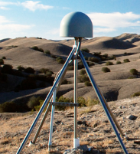
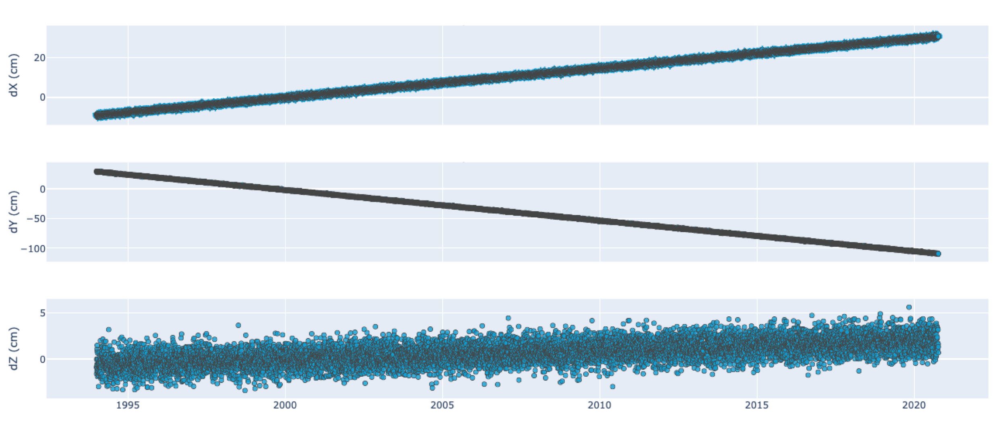
The IGS reference frame
Notes:
- relate this somehow to LLH and/or ENU coordinates

Slide 59
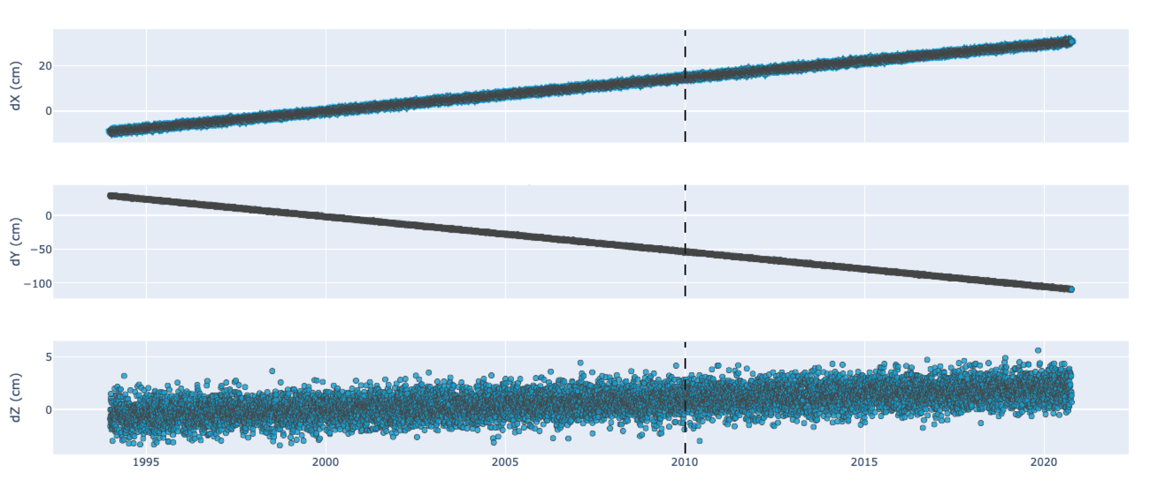
The IGS reference frame
t_{o} = reference epoch
Notes:
- tie this back to OPUS solution report reference epoch
- mention that the reference epoch should be near the midpoint of the data (data-weighted mean epoch)
- mention that reference epoch is just convention

Slide 60
The IGS reference frame
t_{o} = reference epoch
x = x_{o}
x_{o}
y_{o}
z_{o}

Slide 61
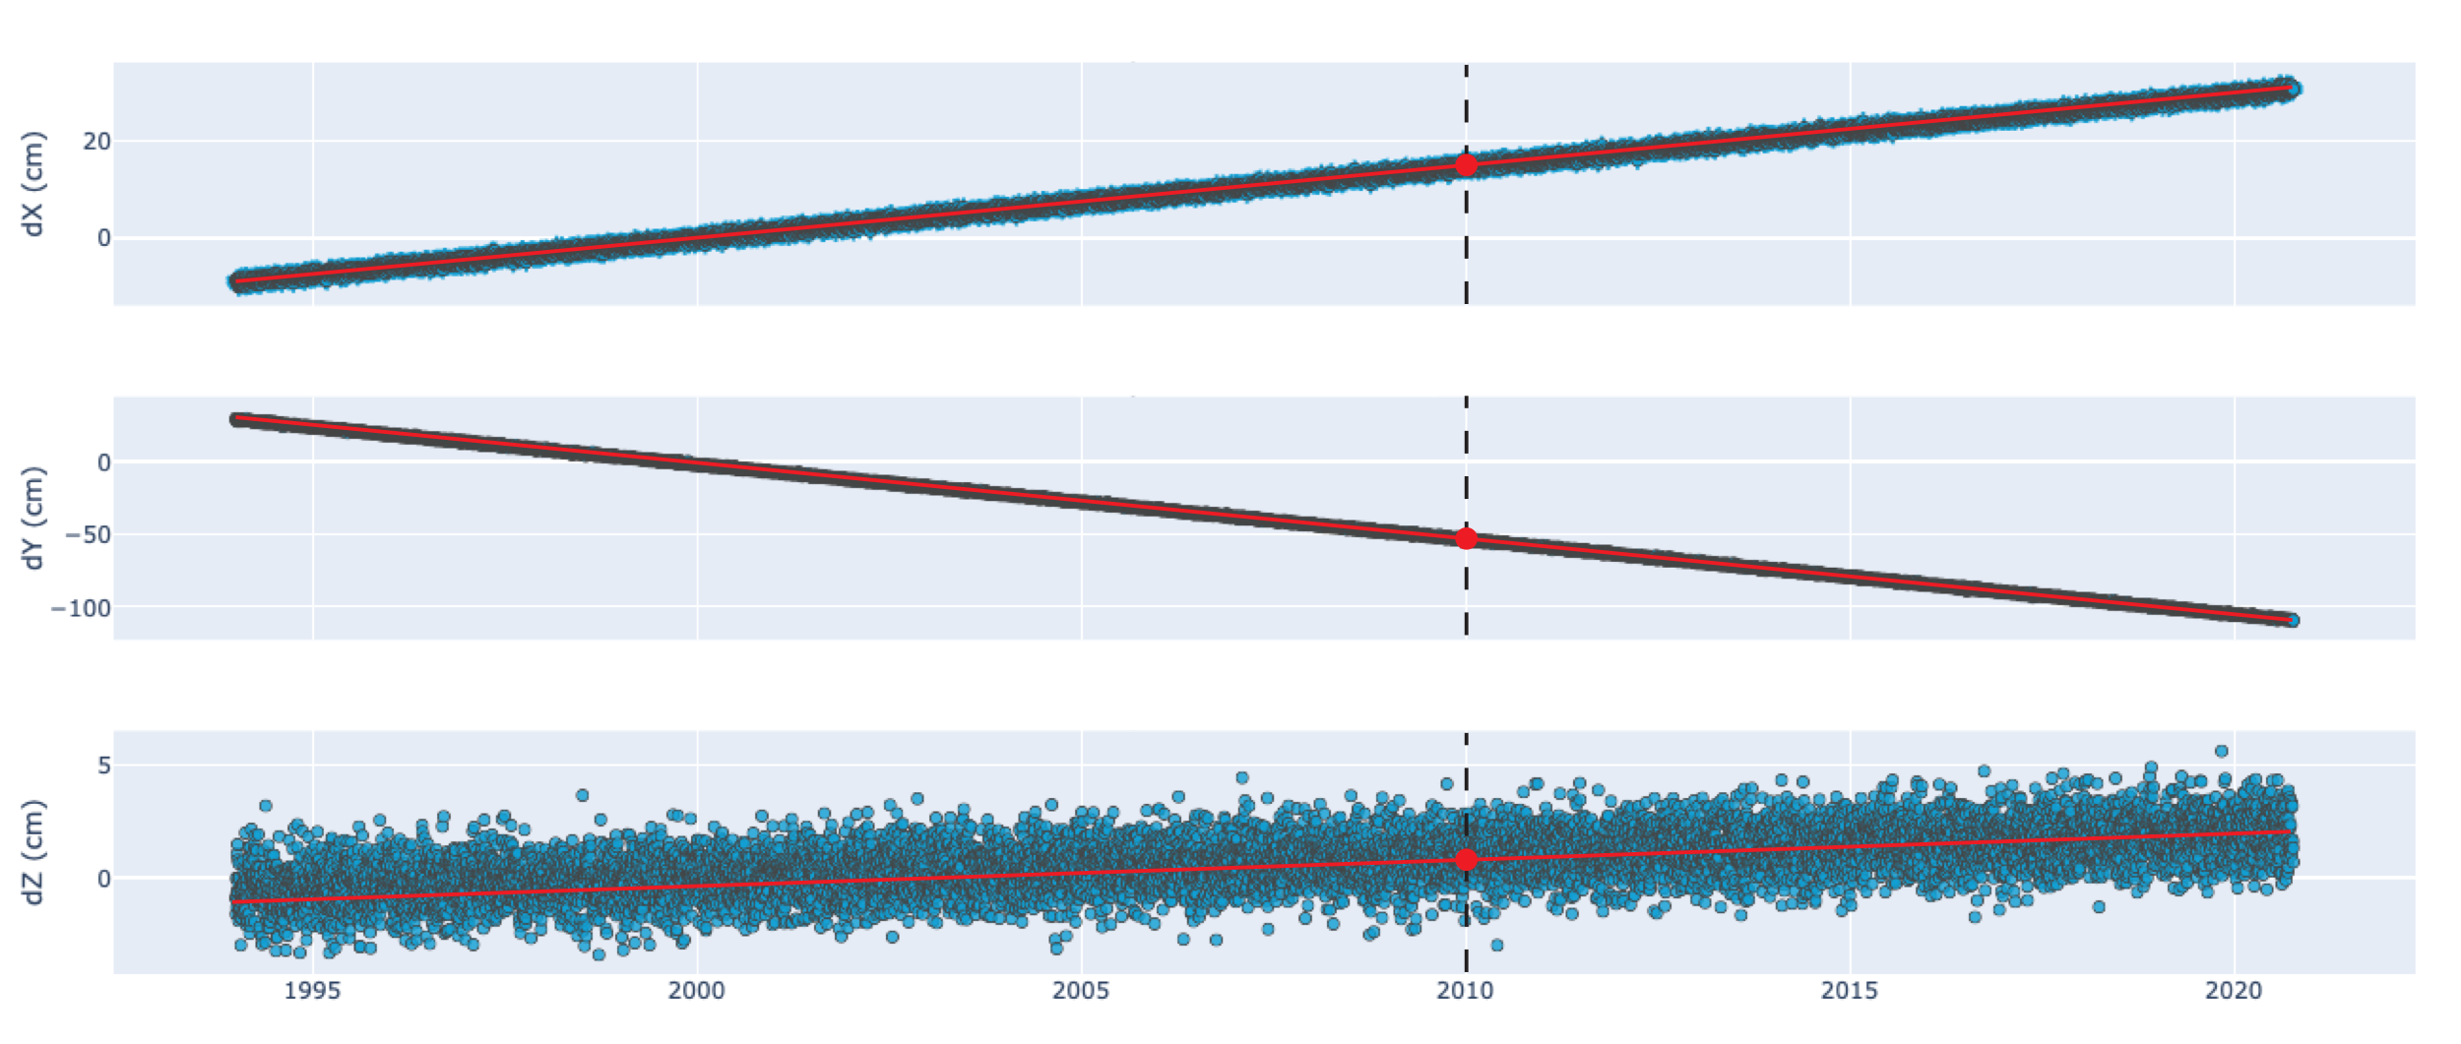
The IGS reference frame
t_{o} = reference epoch
x = x_{o} + v(t – t_{o})
x_{o}
v_{x} = 1.5 cm/yr
y_{o}
v_{y} = -5.0 cm/yr
v_{z} = 0.01 cm/yr
z_{o}
Notes:
- reiterate that the frame remains fixed even as the points on the crust move

Slide 62
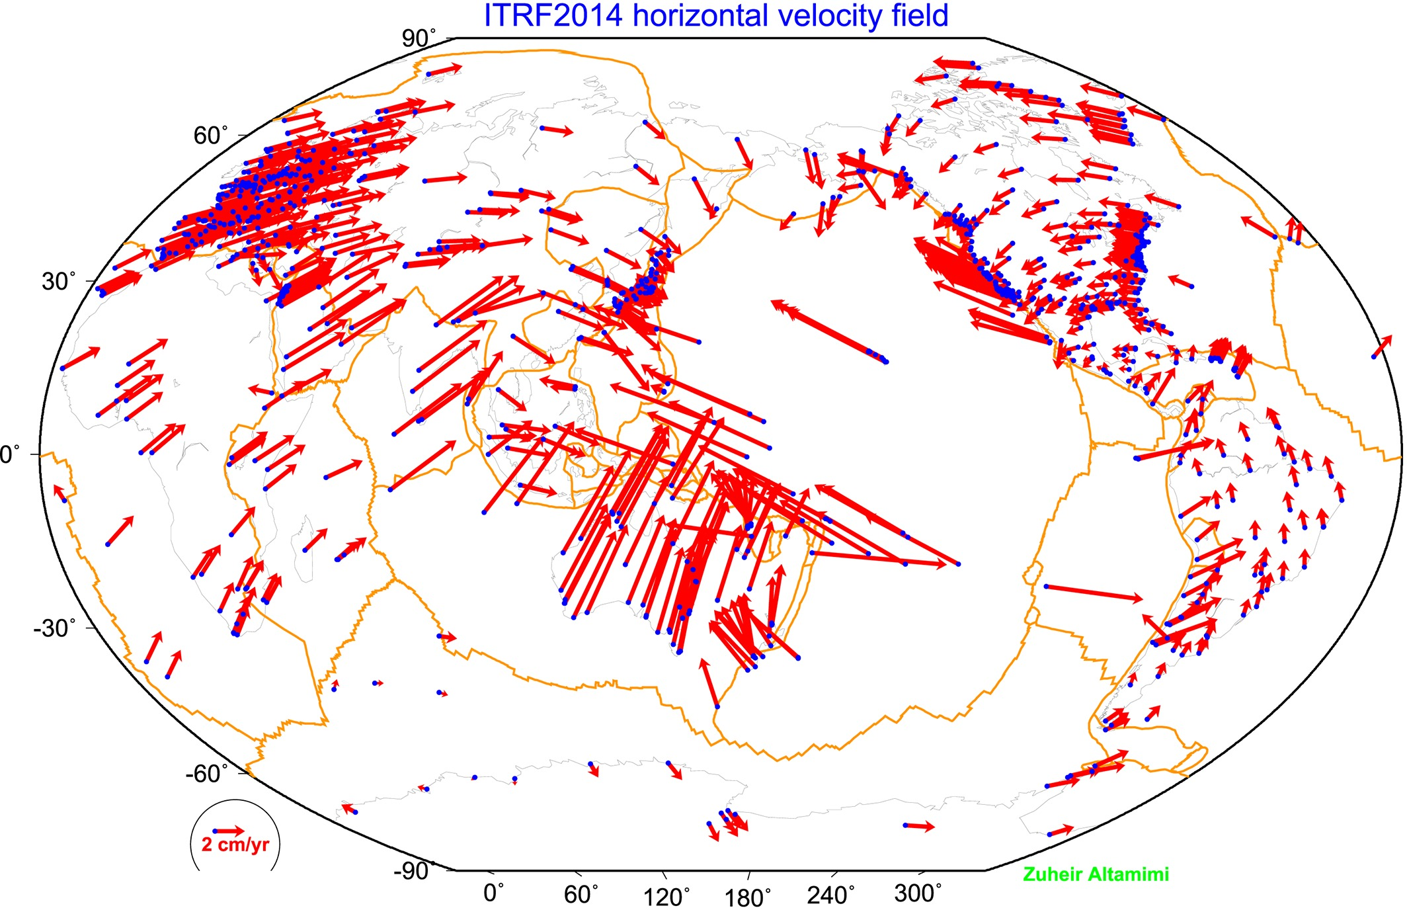
The IGS reference frame
The ITRF is defined by reference epoch coordinates AND velocities at stations
The ITRF velocity field very closely resembles absolute plate motion
The ITRF and IGS frames are both no-net-rotation frames – the sum of the angular velocities is constrained to be zero.
Altamimi et al., 2016, JGR
Notes:
- Work on flow for this slide

Slide 63
Outline
What is a reference frame?
Traditional geodetic datums
Global reference frames
the International Terrestrial Reference System (ITRS)
the International Terrestrial Reference Frame (ITRF)
How is the ITRF realized?
The International GNSS Service (IGS) realization of the ITRF
How NGS aligns the U.S. National Spatial Reference System (NSRS) with the ITRF through the IGS frame

Slide 64
Outline
What is a reference frame?
Traditional geodetic datums
Global reference frames
the International Terrestrial Reference System (ITRS)
the International Terrestrial Reference Frame (ITRF)
How is the ITRF realized?
The International GNSS Service (IGS) realization of the ITRF
How NGS aligns the U.S. National Spatial Reference System (NSRS) with the ITRF through the IGS frame

Slide 65
How does NGS align the U.S. National Spatial Reference System (NSRS) with the ITRF/IGS?

Slide 66
How does NGS align the U.S. National Spatial Reference System (NSRS) with the ITRF/IGS?
When we say the NSRS is aligned with the ITRF/IGS frames, we mean that stations in the NOAA CORS Network (NCN) are aligned with those frames in the computation of the Multi-Year CORS Solutions (MYCS).

Slide 67
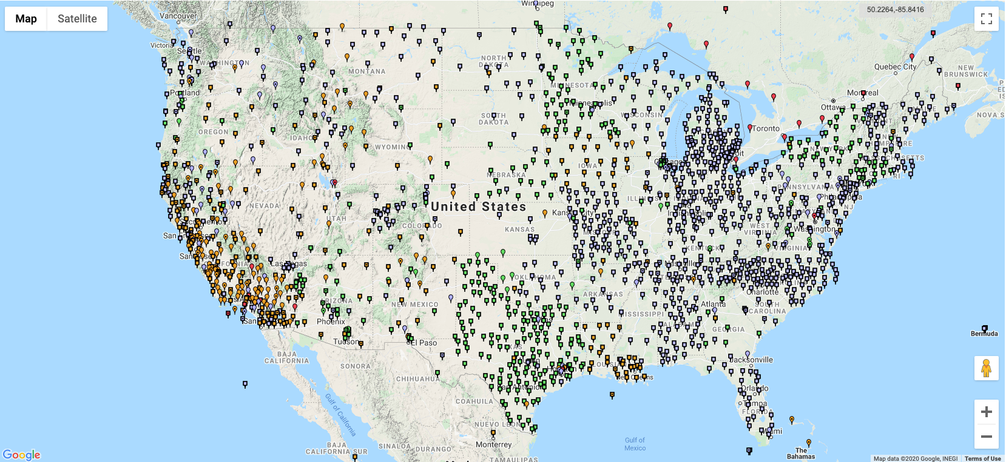
NOAA CORS Network (NCN)
https://geodesy.noaa.gov/CORS_Map/

Slide 68
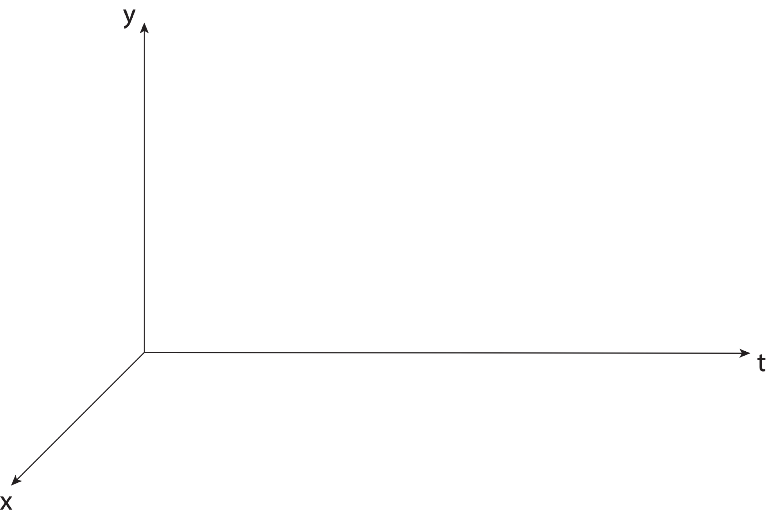
Aligning the NSRS to the IGS reference frame
Notes:
- In these slides mention that we have our frame that we want to align to the IGS frame

Slide 69
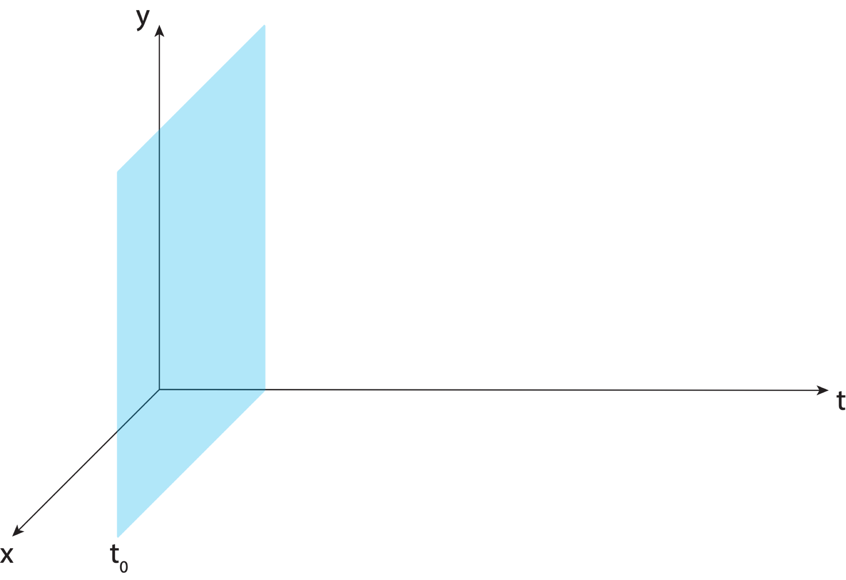
Aligning the NSRS to the IGS reference frame

Slide 70
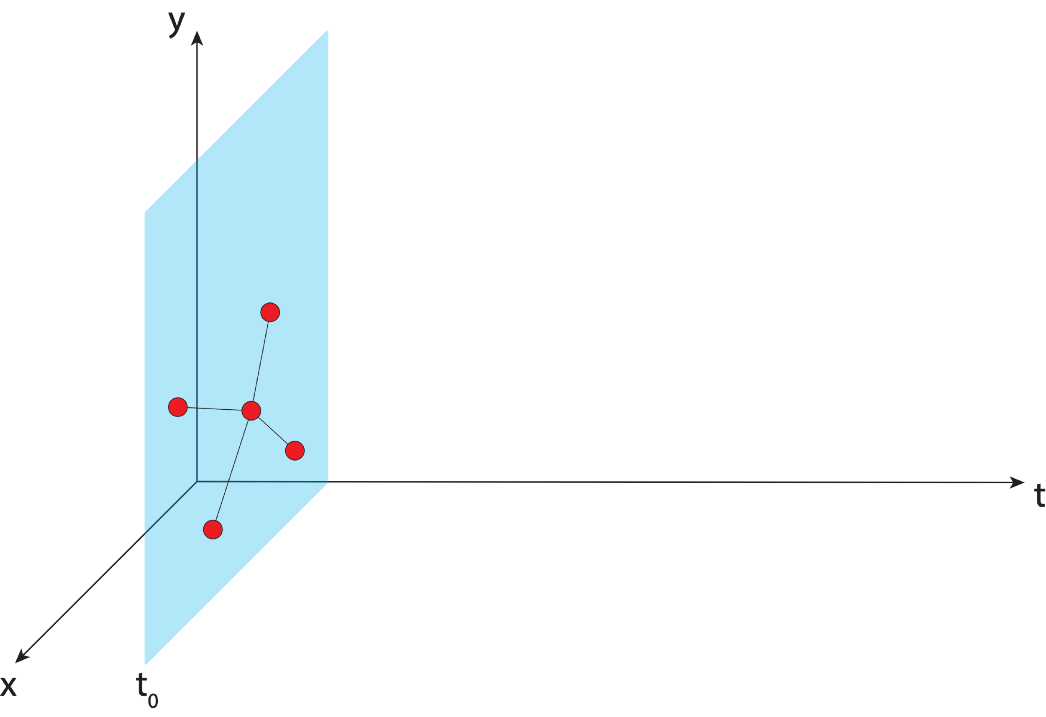
Aligning the NSRS to the IGS reference frame
IGS GNSS station
station trajectory

Slide 71
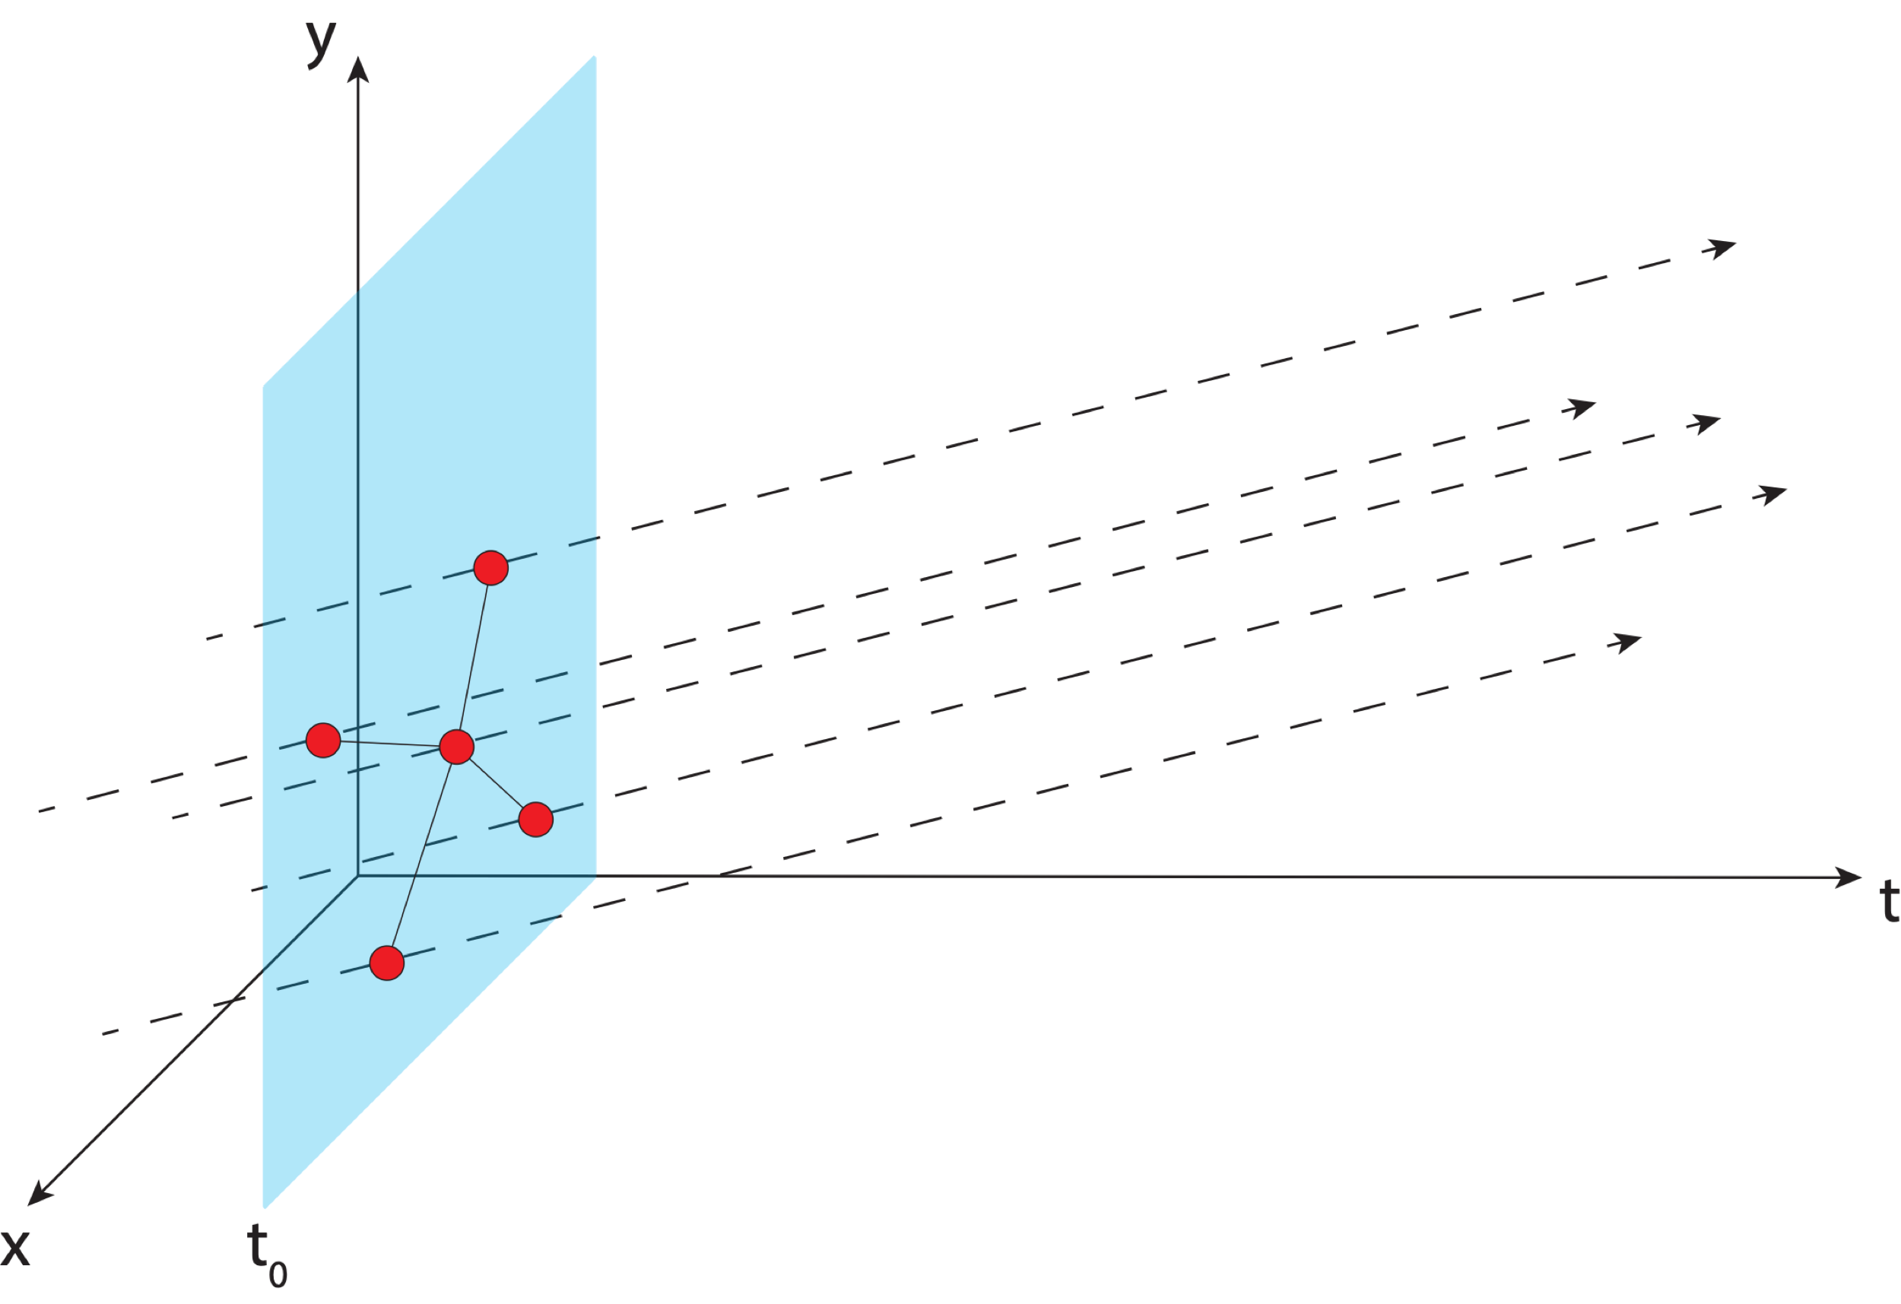
Aligning the NSRS to the IGS reference frame
IGS GNSS station
station trajectory

Slide 72
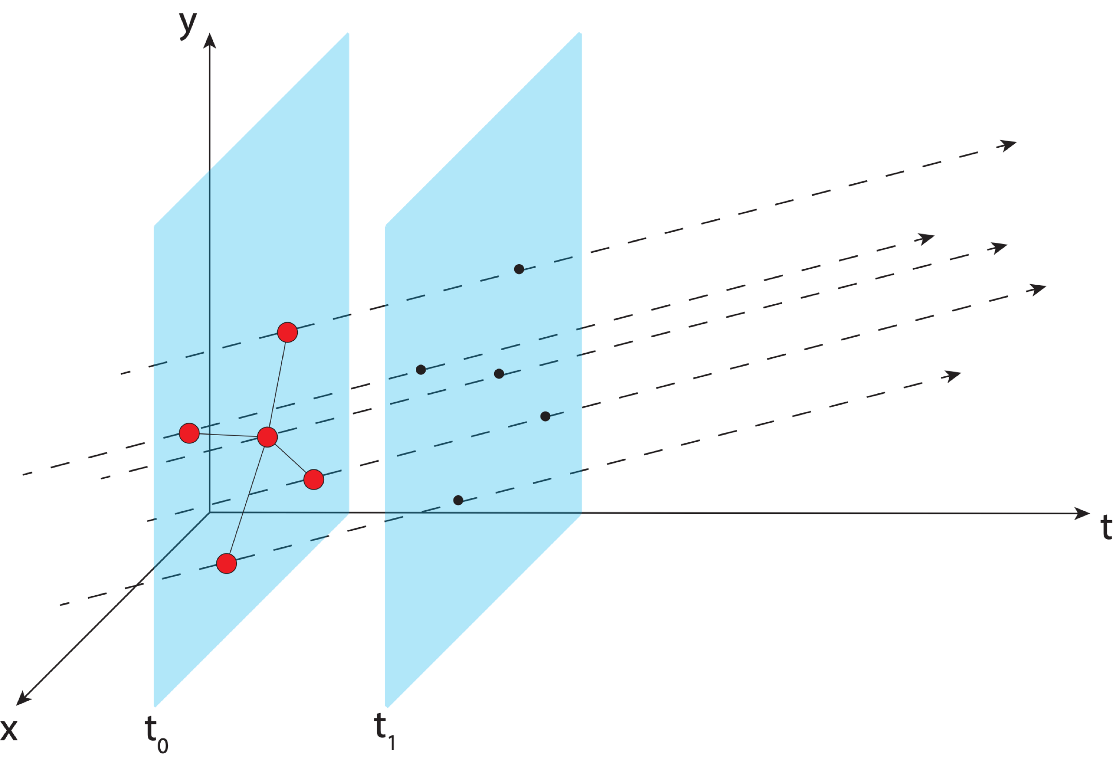
Aligning the NSRS to the IGS reference frame
IGS GNSS station
station trajectory
projected IGS station position

Slide 73
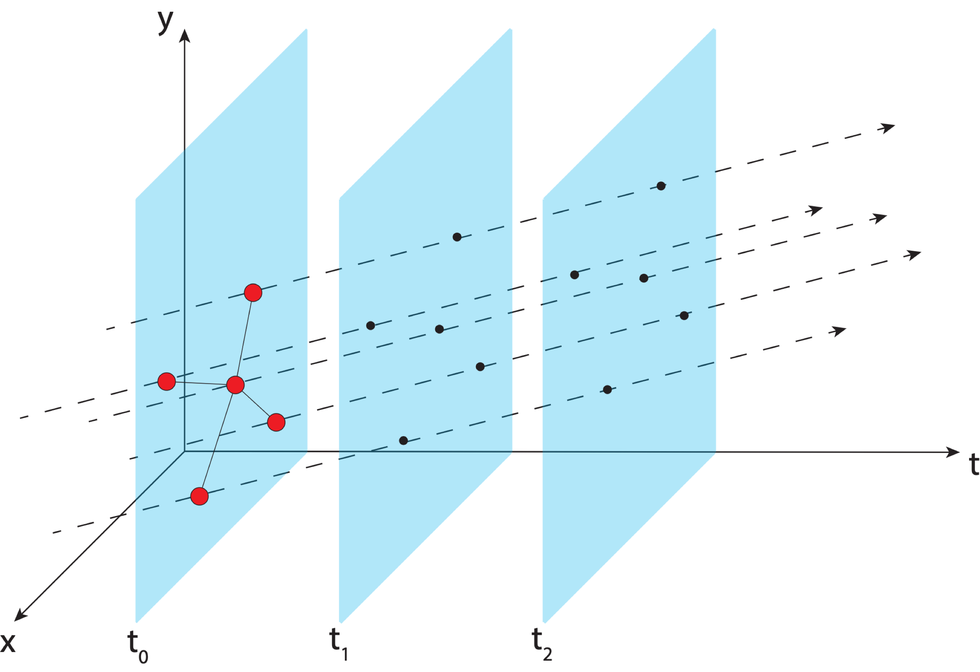
Aligning the NSRS to the IGS reference frame
IGS GNSS station
station trajectory
projected IGS station position

Slide 74
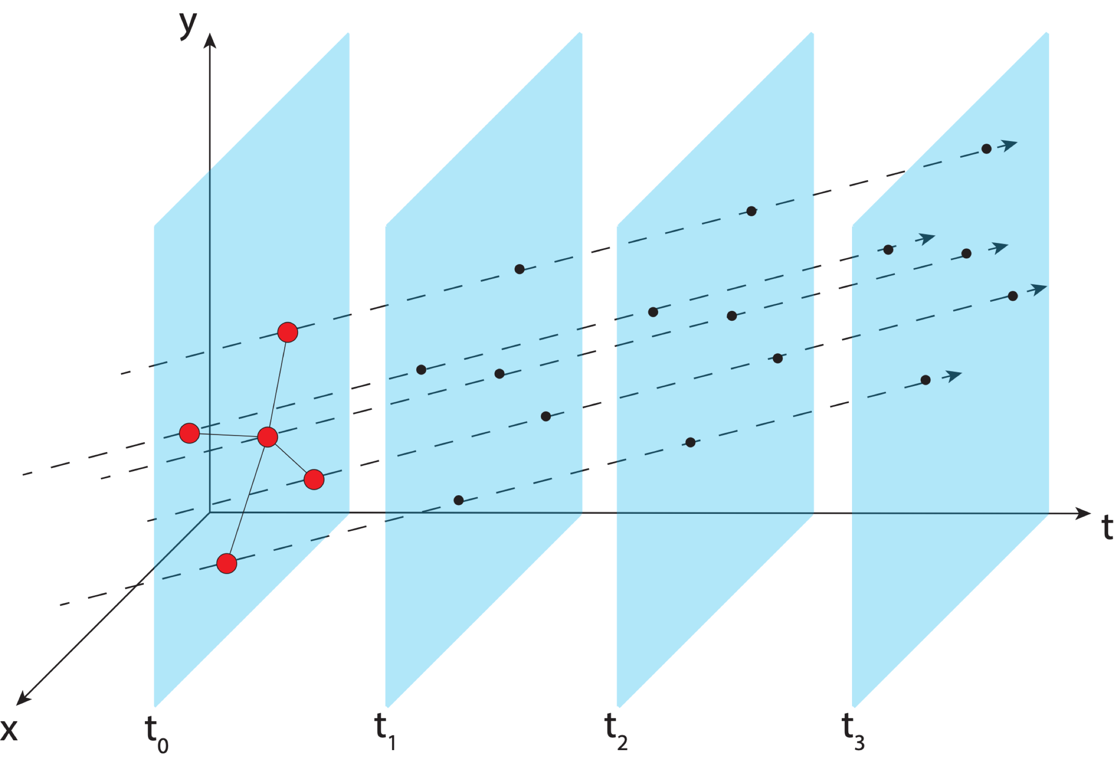
Aligning the NSRS to the IGS reference frame
IGS GNSS station
station trajectory
projected IGS station position

Slide 75
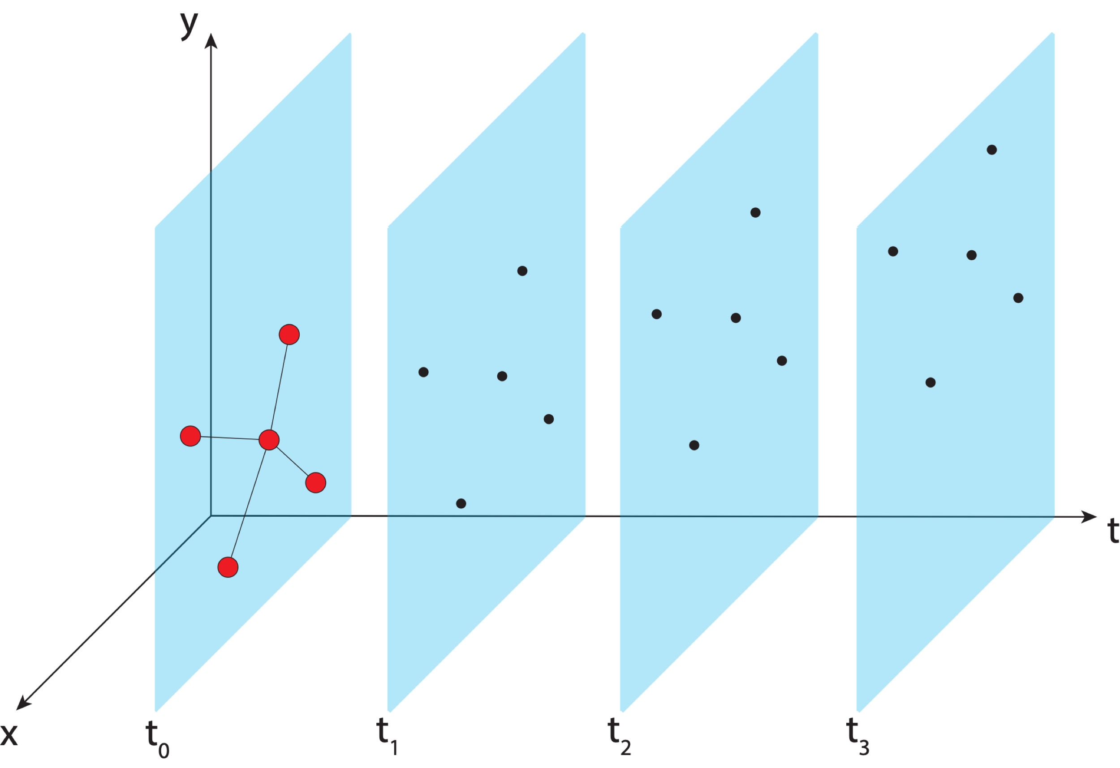
Aligning the NSRS to the IGS reference frame
IGS GNSS station
station trajectory
projected IGS station position

Slide 76
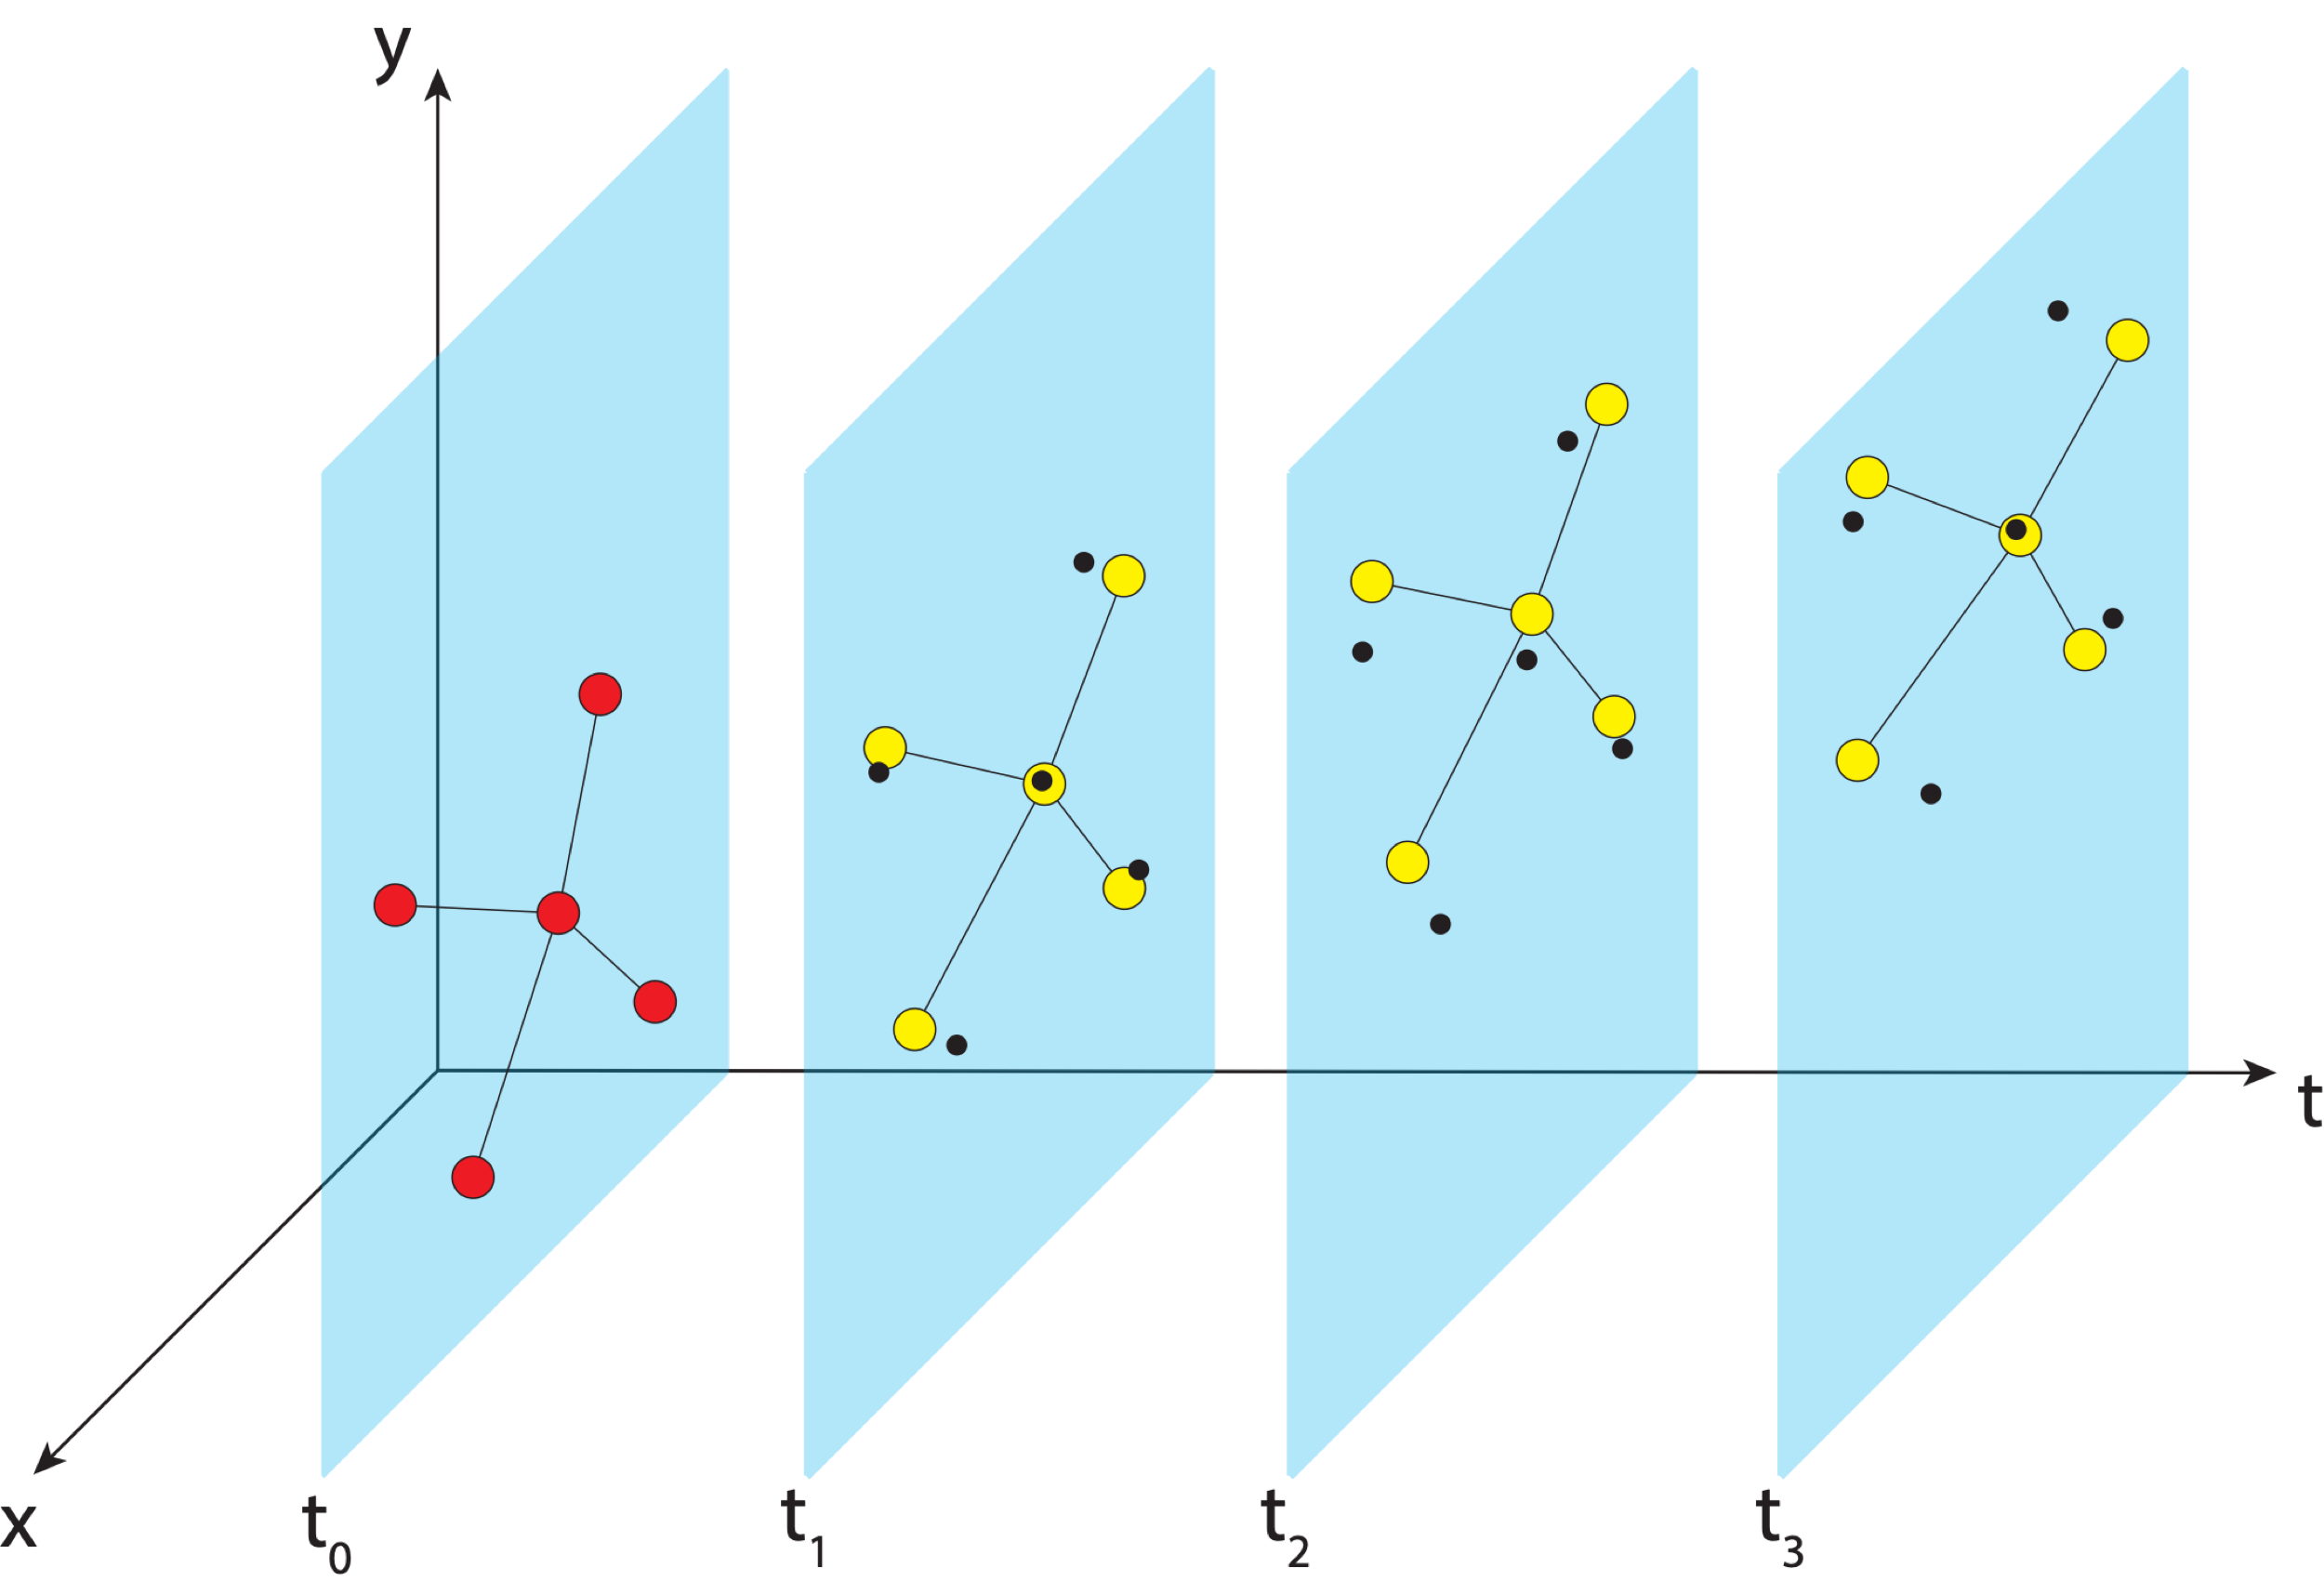
Aligning the NSRS to the IGS reference frame
IGS GNSS station
station trajectory
projected IGS station position
NGS estimate of IGS station position

Slide 77
Aligning the NSRS to the IGS reference frame
IGS GNSS station
station trajectory
projected IGS station position
NGS estimate of IGS station position

Slide 78
Aligning the NSRS to the IGS reference frame
IGS GNSS station
station trajectory
projected IGS station position
NGS estimate of IGS station position

Slide 79
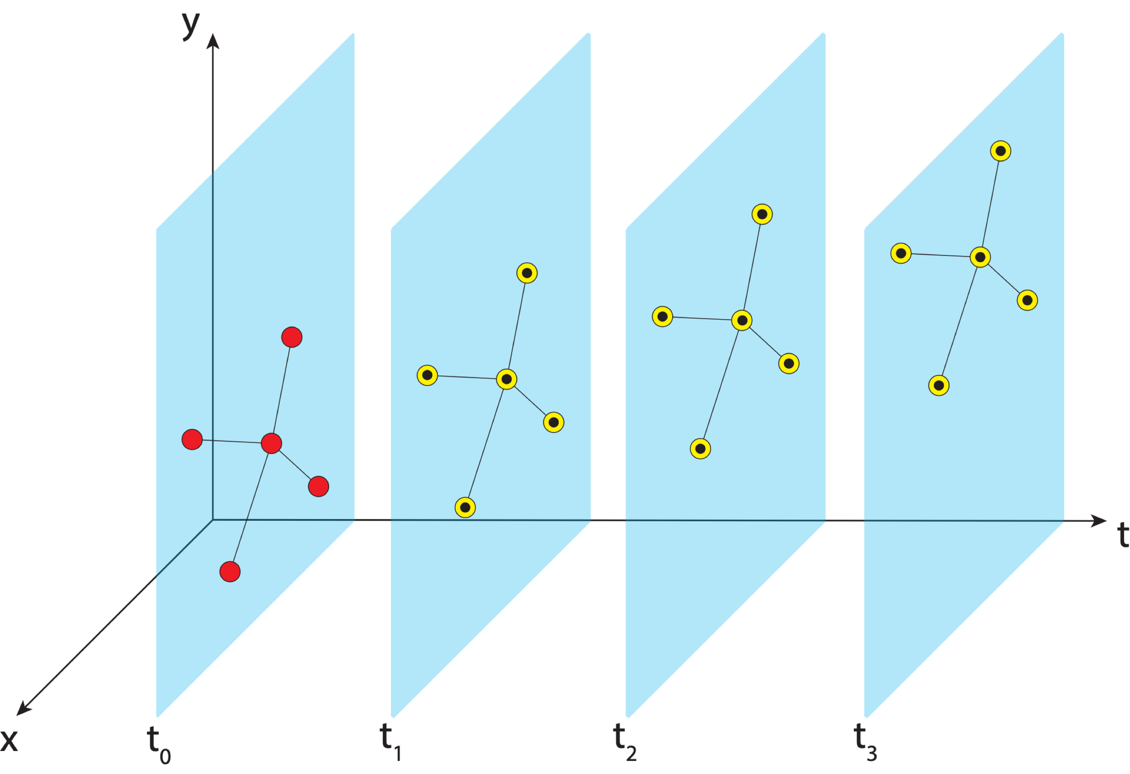
Aligning the NSRS to the IGS reference frame
IGS GNSS station
station trajectory
projected IGS station position
NGS estimate of IGS station position

Slide 80
Aligning the NSRS to the IGS reference frame
IGS GNSS station
station trajectory
projected IGS station position
NGS estimate of IGS station position
NCN GNSS station

Slide 81
Aligning the NSRS to the IGS reference frame
IGS GNSS station
station trajectory
projected IGS station position
NGS estimate of IGS station position
NCN GNSS station

Slide 82
Aligning the NSRS to the IGS reference frame
IGS GNSS station
station trajectory
projected IGS station position
NGS estimate of IGS station position
NCN GNSS station

Slide 83
Aligning the NSRS to the IGS reference frame
IGS GNSS station
station trajectory
projected IGS station position
NGS estimate of IGS station position
NCN GNSS station

Slide 84
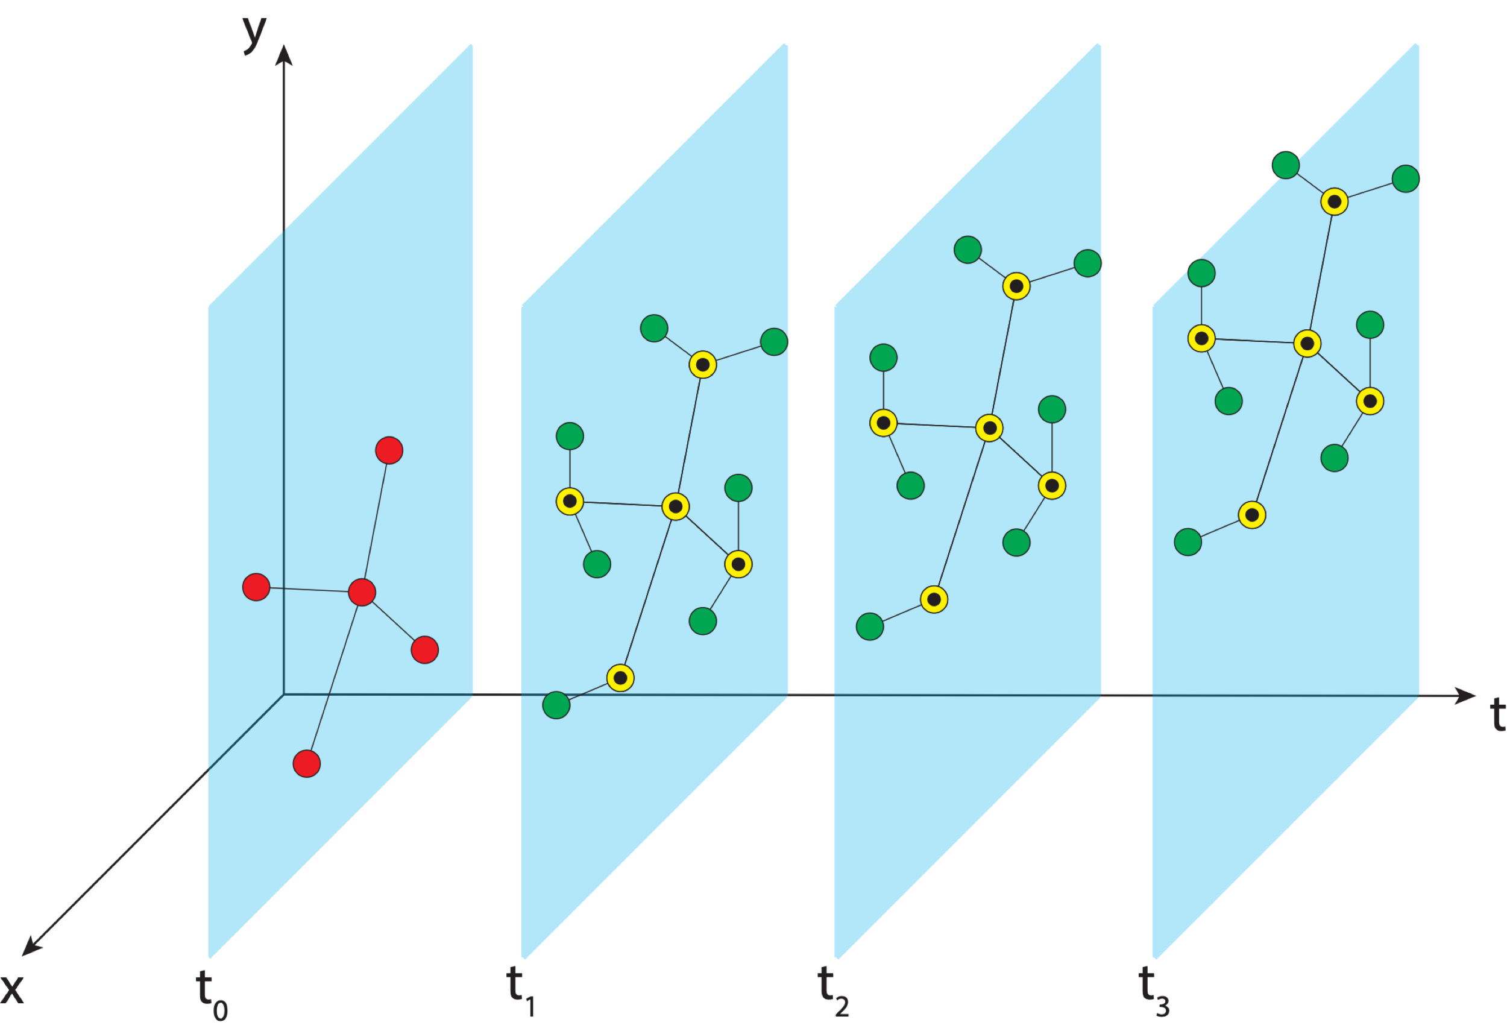
Aligning the NSRS to the IGS reference frame
IGS GNSS station
station trajectory
projected IGS station position
NGS estimate of IGS station position
NCN GNSS station

Slide 85
Aligning the NSRS to the IGS reference frame
IGS GNSS station
station trajectory
projected IGS station position
NGS estimate of IGS station position
NCN GNSS station

Slide 86
Aligning the NSRS to the IGS reference frame
IGS GNSS station
station trajectory
projected IGS station position
NGS estimate of IGS station position
NCN GNSS station

Slide 87
Aligning the NSRS to the IGS reference frame
IGS GNSS station
station trajectory
projected IGS station position
NGS estimate of IGS station position
NCN GNSS station

Slide 88
Aligning the NSRS to the IGS reference frame
IGS GNSS station
station trajectory
projected IGS station position
NGS provides access to the NSRS through reference epoch positions and velocities for NCN stations
When users access the NSRS through OPUS, a very similar process is performed using NCN stations as the reference
NGS estimate of IGS station position
NCN GNSS station

Slide 89
Aligning the NSRS to the IGS reference frame
IGS GNSS station
station trajectory
projected IGS station position
NGS estimate of IGS station position
NCN GNSS station

Slide 90
Aligning the NSRS to the IGS reference frame
IGS GNSS station
station trajectory
projected IGS station position
NGS estimate of IGS station position
NCN GNSS station

Slide 91
Aligning the NSRS to the IGS reference frame
MYCS2 is the most recent iteration of this process– alignment of the NSRS with ITRF2014/IGS14
Recently IGb14 was released to account for several large earthquakes since the release of ITRF2014 – the NSRS was updated to reflect these changes
ITRF2020 will be released sometime in 2021 – MYCS3 will align the NSRS with this new frame
https://www.ngs.noaa.gov/CORS/coords.shtml#2ndReprocessingCampaign

Slide 92
Recap
Reference frames give us a means to assign coordinates to physical points on or near Earth’s surface and to describe how those points move through time.
The ITRF is a global reference frame. It is generated by combining data from several space geodetic techniques. The frame is realized when self-consistent coordinates are assigned to points on or near stations where those techniques operate.
The U.S. National Spatial Reference System is aligned to the ITRF/IGS by aligning coordinates and velocities of GNSS stations with those that comprise the GNSS realization of the ITRF. The coordinates and velocities produced for GNSS stations in the NOAA CORS Network through this process comprise the Multi-Year CORS Solutions (MYCS) that are released periodically.

