Slide 1

Multi-Year CORS Solution V3 (MYCS3)
NGS Webinar Series – 10 October 2024
P.K. McFarland, R.A. Bennett and A. Whetter

Slide 2

Outline
What is a multi-year CORS solution?
What is the International Terrestrial Reference System?
How do we “realize” the International Terrestrial Reference Frame?
How does NGS align an MYCS with the ITRF?
MYCS3 Results
Remaining tasks

Slide 3
What is a multi-year CORS solution?

Slide 4
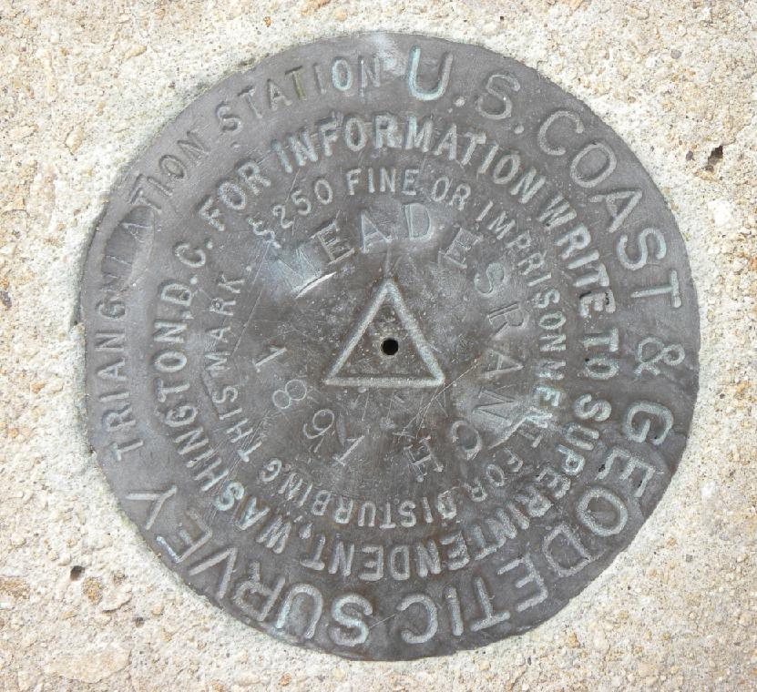
What is a CORS?
Continuously Operating Reference Station
Traditional Survey
Marker
(lon, lat, ht)

Slide 5
What is a CORS?
Continuously Operating Reference Station
Traditional Survey
Marker
(lon, lat, ht)
Point of interest – unknown position

Slide 6
What is a CORS?
Continuously Operating Reference Station
Traditional Survey
Marker
(lon, lat, ht)
Point of interest – unknown position

Slide 7
What is a CORS?
Continuously Operating Reference Station
Traditional Survey
Marker
(lon, lat, ht)
Point of interest – unknown position

Slide 8
What is a CORS?
Continuously Operating Reference Station
Traditional Survey
Marker
(lon, lat, ht)
Point of interest – unknown position

Slide 9

What is a CORS?
Continuously Operating Reference Station
$$(Δlon, Δlat, Δht)$$
Traditional Survey
Marker
(lon, lat, ht)
Point of interest – unknown position

Slide 10
What is a CORS?
Continuously Operating Reference Station
$$(Δlon, Δlat, Δht)$$
Traditional Survey
Marker
(lon, lat, ht)
Point of interest – unknown position
(lon_{x}, lat_{x}, ht_{x})

Slide 11
What is a CORS?
Continuously Operating Reference Station
$$(Δlon, Δlat, Δht)$$
Traditional Survey
Marker
(lon, lat, ht)
Point of interest – unknown position
(lon_{x}, lat_{x}, ht_{x})
Notes:
Mention that the newly determined coordinates for spot X will be in the same frame or with respect to the same reference datum as the coordinates used for the known marker.

Slide 12
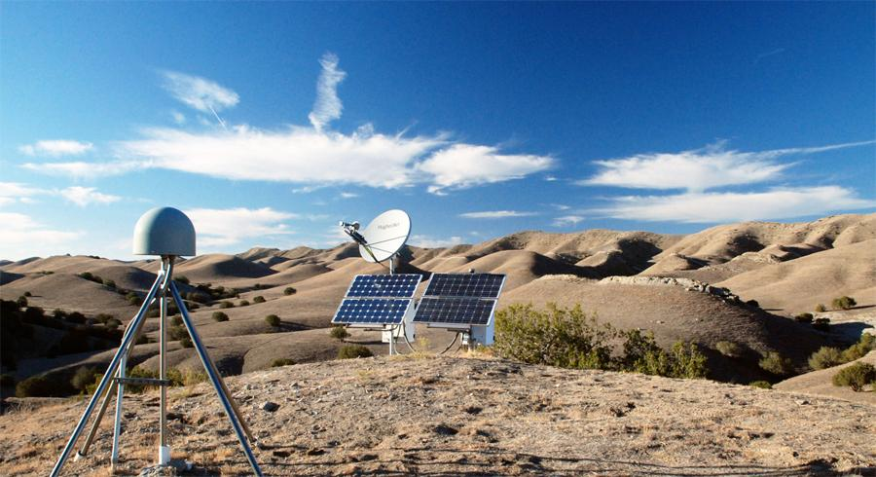
What is a CORS?
Continuously Operating Reference Station
https://www.unavco.org/projects/past-projects/pbo/pbo.html

Slide 13
What is a CORS?
Continuously Operating Reference Station
Ref. point(s)
(x, y, z)
https://www.unavco.org/projects/past-projects/pbo/pbo.html

Slide 14
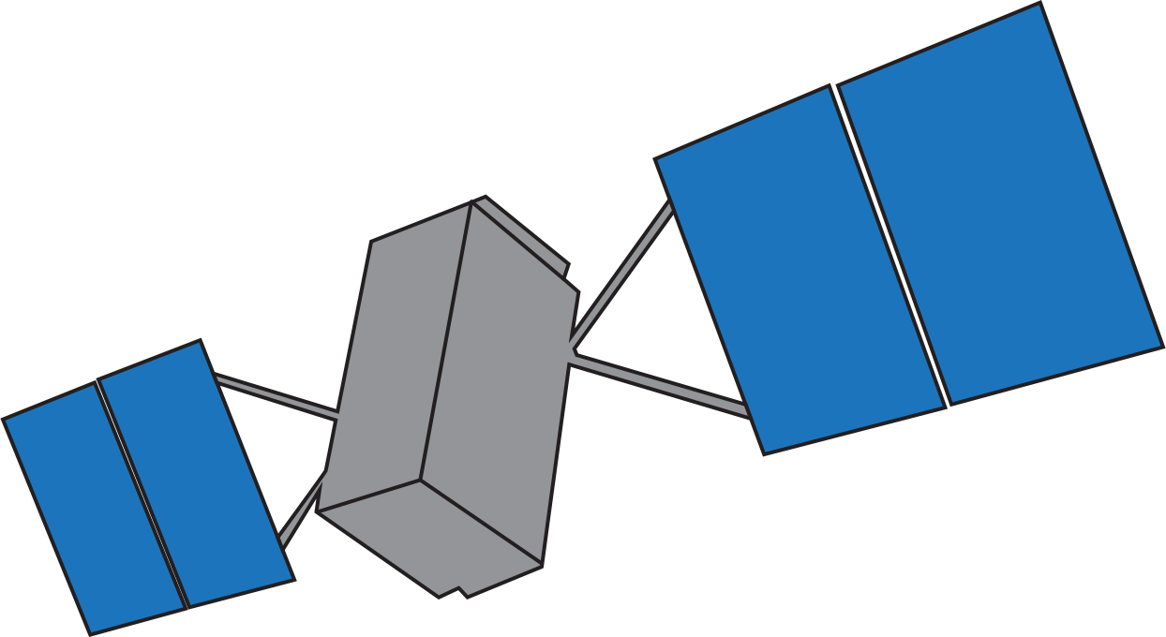
What is a CORS?
Continuously Operating Reference Station
Ref. point(s)
(x, y, z)
https://www.unavco.org/projects/past-projects/pbo/pbo.html

Slide 15
What is a CORS?
Continuously Operating Reference Station
Ref. point(s)
(x, y, z)
https://www.unavco.org/projects/past-projects/pbo/pbo.html

Slide 16
What is a CORS?
Continuously Operating Reference Station
Point of interest – unknown position
Ref. point(s)
(x, y, z)
https://www.unavco.org/projects/past-projects/pbo/pbo.html

Slide 17
What is a CORS?
Continuously Operating Reference Station
Point of interest – unknown position
Ref. point(s)
(x, y, z)
https://www.unavco.org/projects/past-projects/pbo/pbo.html

Slide 18
What is a CORS?
Continuously Operating Reference Station
Point of interest – unknown position
Ref. point(s)
(x, y, z)
https://www.unavco.org/projects/past-projects/pbo/pbo.html

Slide 19

What is a CORS?
Continuously Operating Reference Station
Point of interest – unknown position
(x_{x}, y_{x}, z_{x})
Ref. point(s)
(x, y, z)
$$(Δx, Δy, Δz)$$
https://www.unavco.org/projects/past-projects/pbo/pbo.html
Notes:
Mention that the newly determined coordinates for the location X will be in the same reference frame as the coordinates used for the CORS.

Slide 20
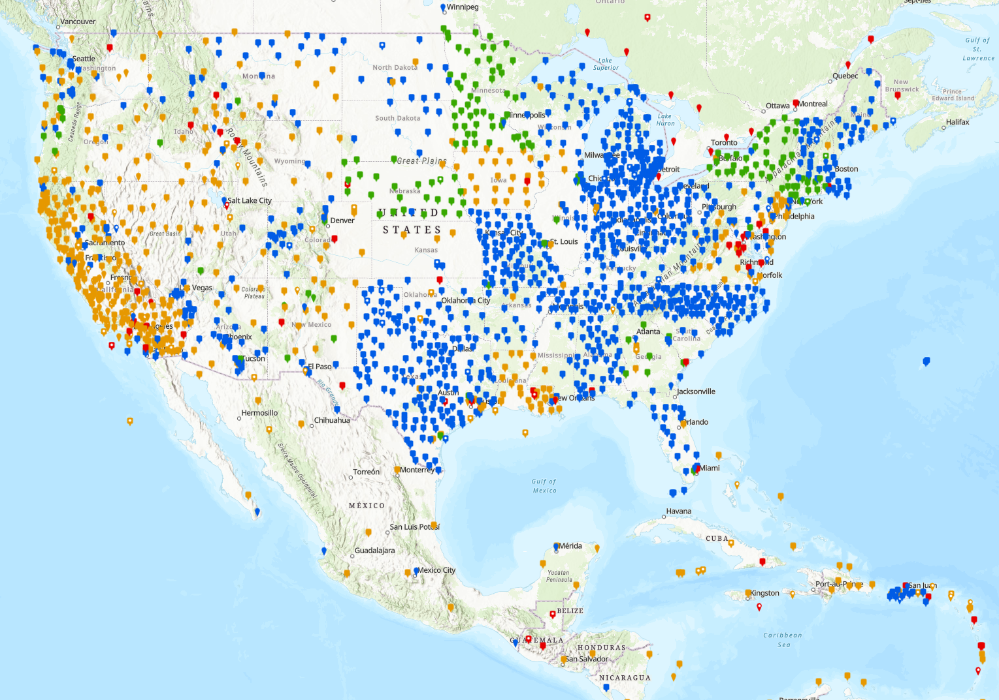
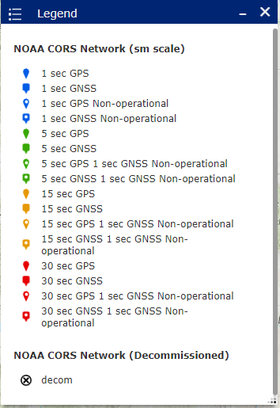
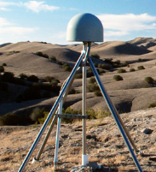
The NOAA CORS Network (NCN)
https://arcg.is/18fWq8

Slide 21
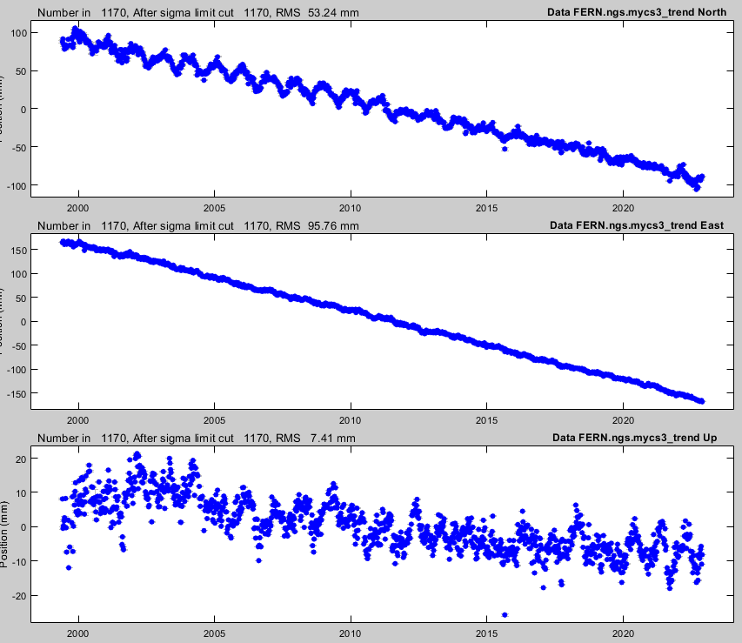
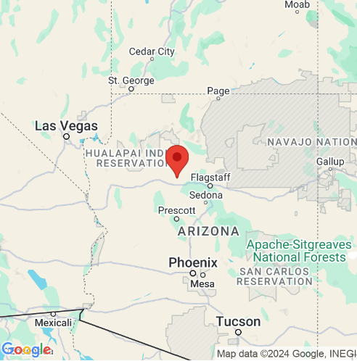
Coordinate Functions
https://www.unavco.org/instrumentation/
networks/status/nota/overview/FERN

Slide 22
Coordinate Functions
https://www.unavco.org/instrumentation/
networks/status/nota/overview/FERN

Slide 23



Coordinate Functions
$$x_{n}\left(t\right)=x_{n}\left(t_{o}\right)+v_{n}(t−t_{o})$$
$$x_{e}\left(t\right)=x_{e}\left(t_{o}\right)+v_{e}(t−t_{o})$$
https://www.unavco.org/instrumentation/
networks/status/nota/overview/FERN
$$x_{u}\left(t\right)=x_{u}\left(t_{o}\right)+v_{u}(t−t_{o})$$

Slide 24
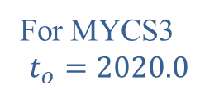
Coordinate Functions
For MYCS3
$$t_{o}=2020.0$$
$$x_{n}\left(t\right)=x_{n}\left(t_{o}\right)+v_{n}(t−t_{o})$$
$$x_{e}\left(t\right)=x_{e}\left(t_{o}\right)+v_{e}(t−t_{o})$$
https://www.unavco.org/instrumentation/
networks/status/nota/overview/FERN
$$x_{u}\left(t\right)=x_{u}\left(t_{o}\right)+v_{u}(t−t_{o})$$

Slide 25
Coordinate Functions
For MYCS3
$$t_{o}=2020.0$$
$$x_{n}\left(t\right)=x_{n}\left(t_{o}\right)+v_{n}(t−t_{o})$$
Aligned with
ITRF2020
$$x_{e}\left(t\right)=x_{e}\left(t_{o}\right)+v_{e}(t−t_{o})$$
https://www.unavco.org/instrumentation/
networks/status/nota/overview/FERN
$$x_{u}\left(t\right)=x_{u}\left(t_{o}\right)+v_{u}(t−t_{o})$$

Slide 26
Why do we update the MYCSs?
New stations added to NCN since last MYCS
Some stations will have drifted away from the CF computed in the previous MYCS
Earthquakes and antenna changes since last MYCS

Slide 27
What is the International Terrestrial Reference System?

Slide 28

What is ITRF2020?
International Terrestrial Reference System (ITRS)
Defined and maintained by the International Earth Rotation and Reference System Service (IERS)
https://www.iers.org/IERS/EN/Home/home_node.html

Slide 29
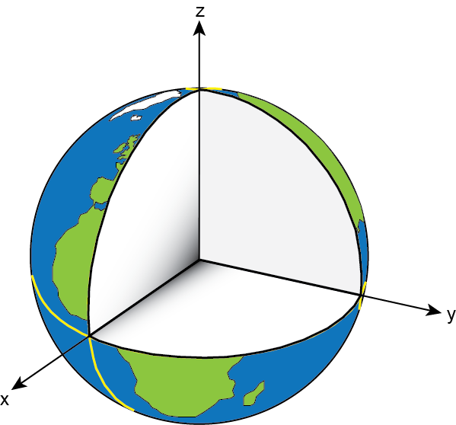
What is ITRF2020?
International Terrestrial Reference System (ITRS)
Need to define
conventions for:
origin – where is the zero point?
scale – what is our measure of length?
orientation – how are the axes oriented in space?

Slide 30
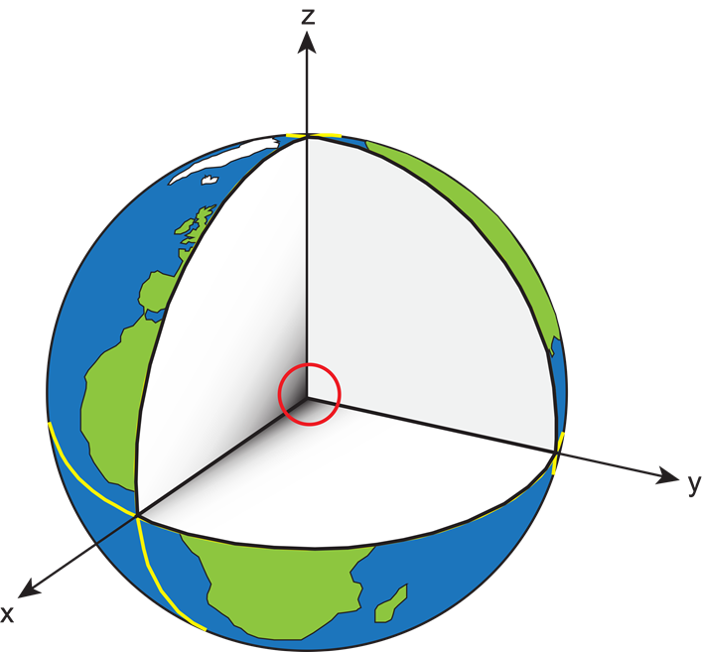
What is ITRF2020?
International Terrestrial Reference System (ITRS)
origin – Earth’s geocenter; average center of total mass of Earth, including ocean’s and atmosphere

Slide 31
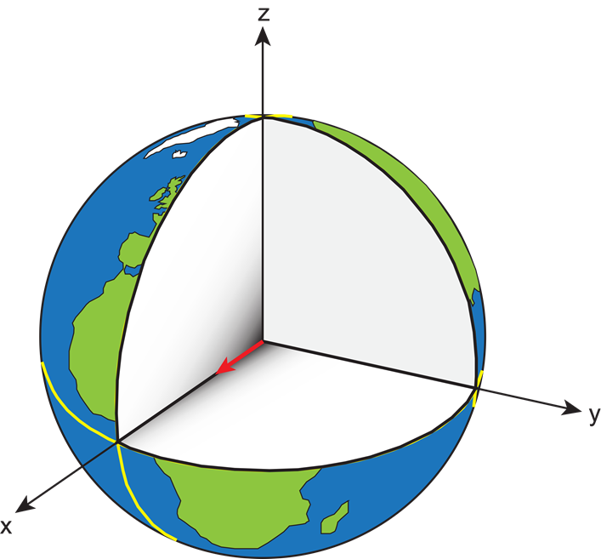
What is ITRF2020?
International Terrestrial Reference System (ITRS)
scale – SI unit of length, meter

Slide 32
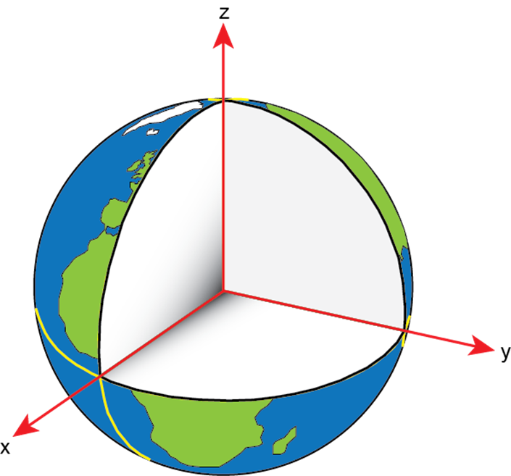
What is ITRF2020?
International Terrestrial Reference System (ITRS)
orientation –
x-axis passes through the reference meridian of the Conventional Terrestrial System at the equator
z-axis aligned with the International Reference Pole
y-axis defined to form a “right-handed” system

Slide 33
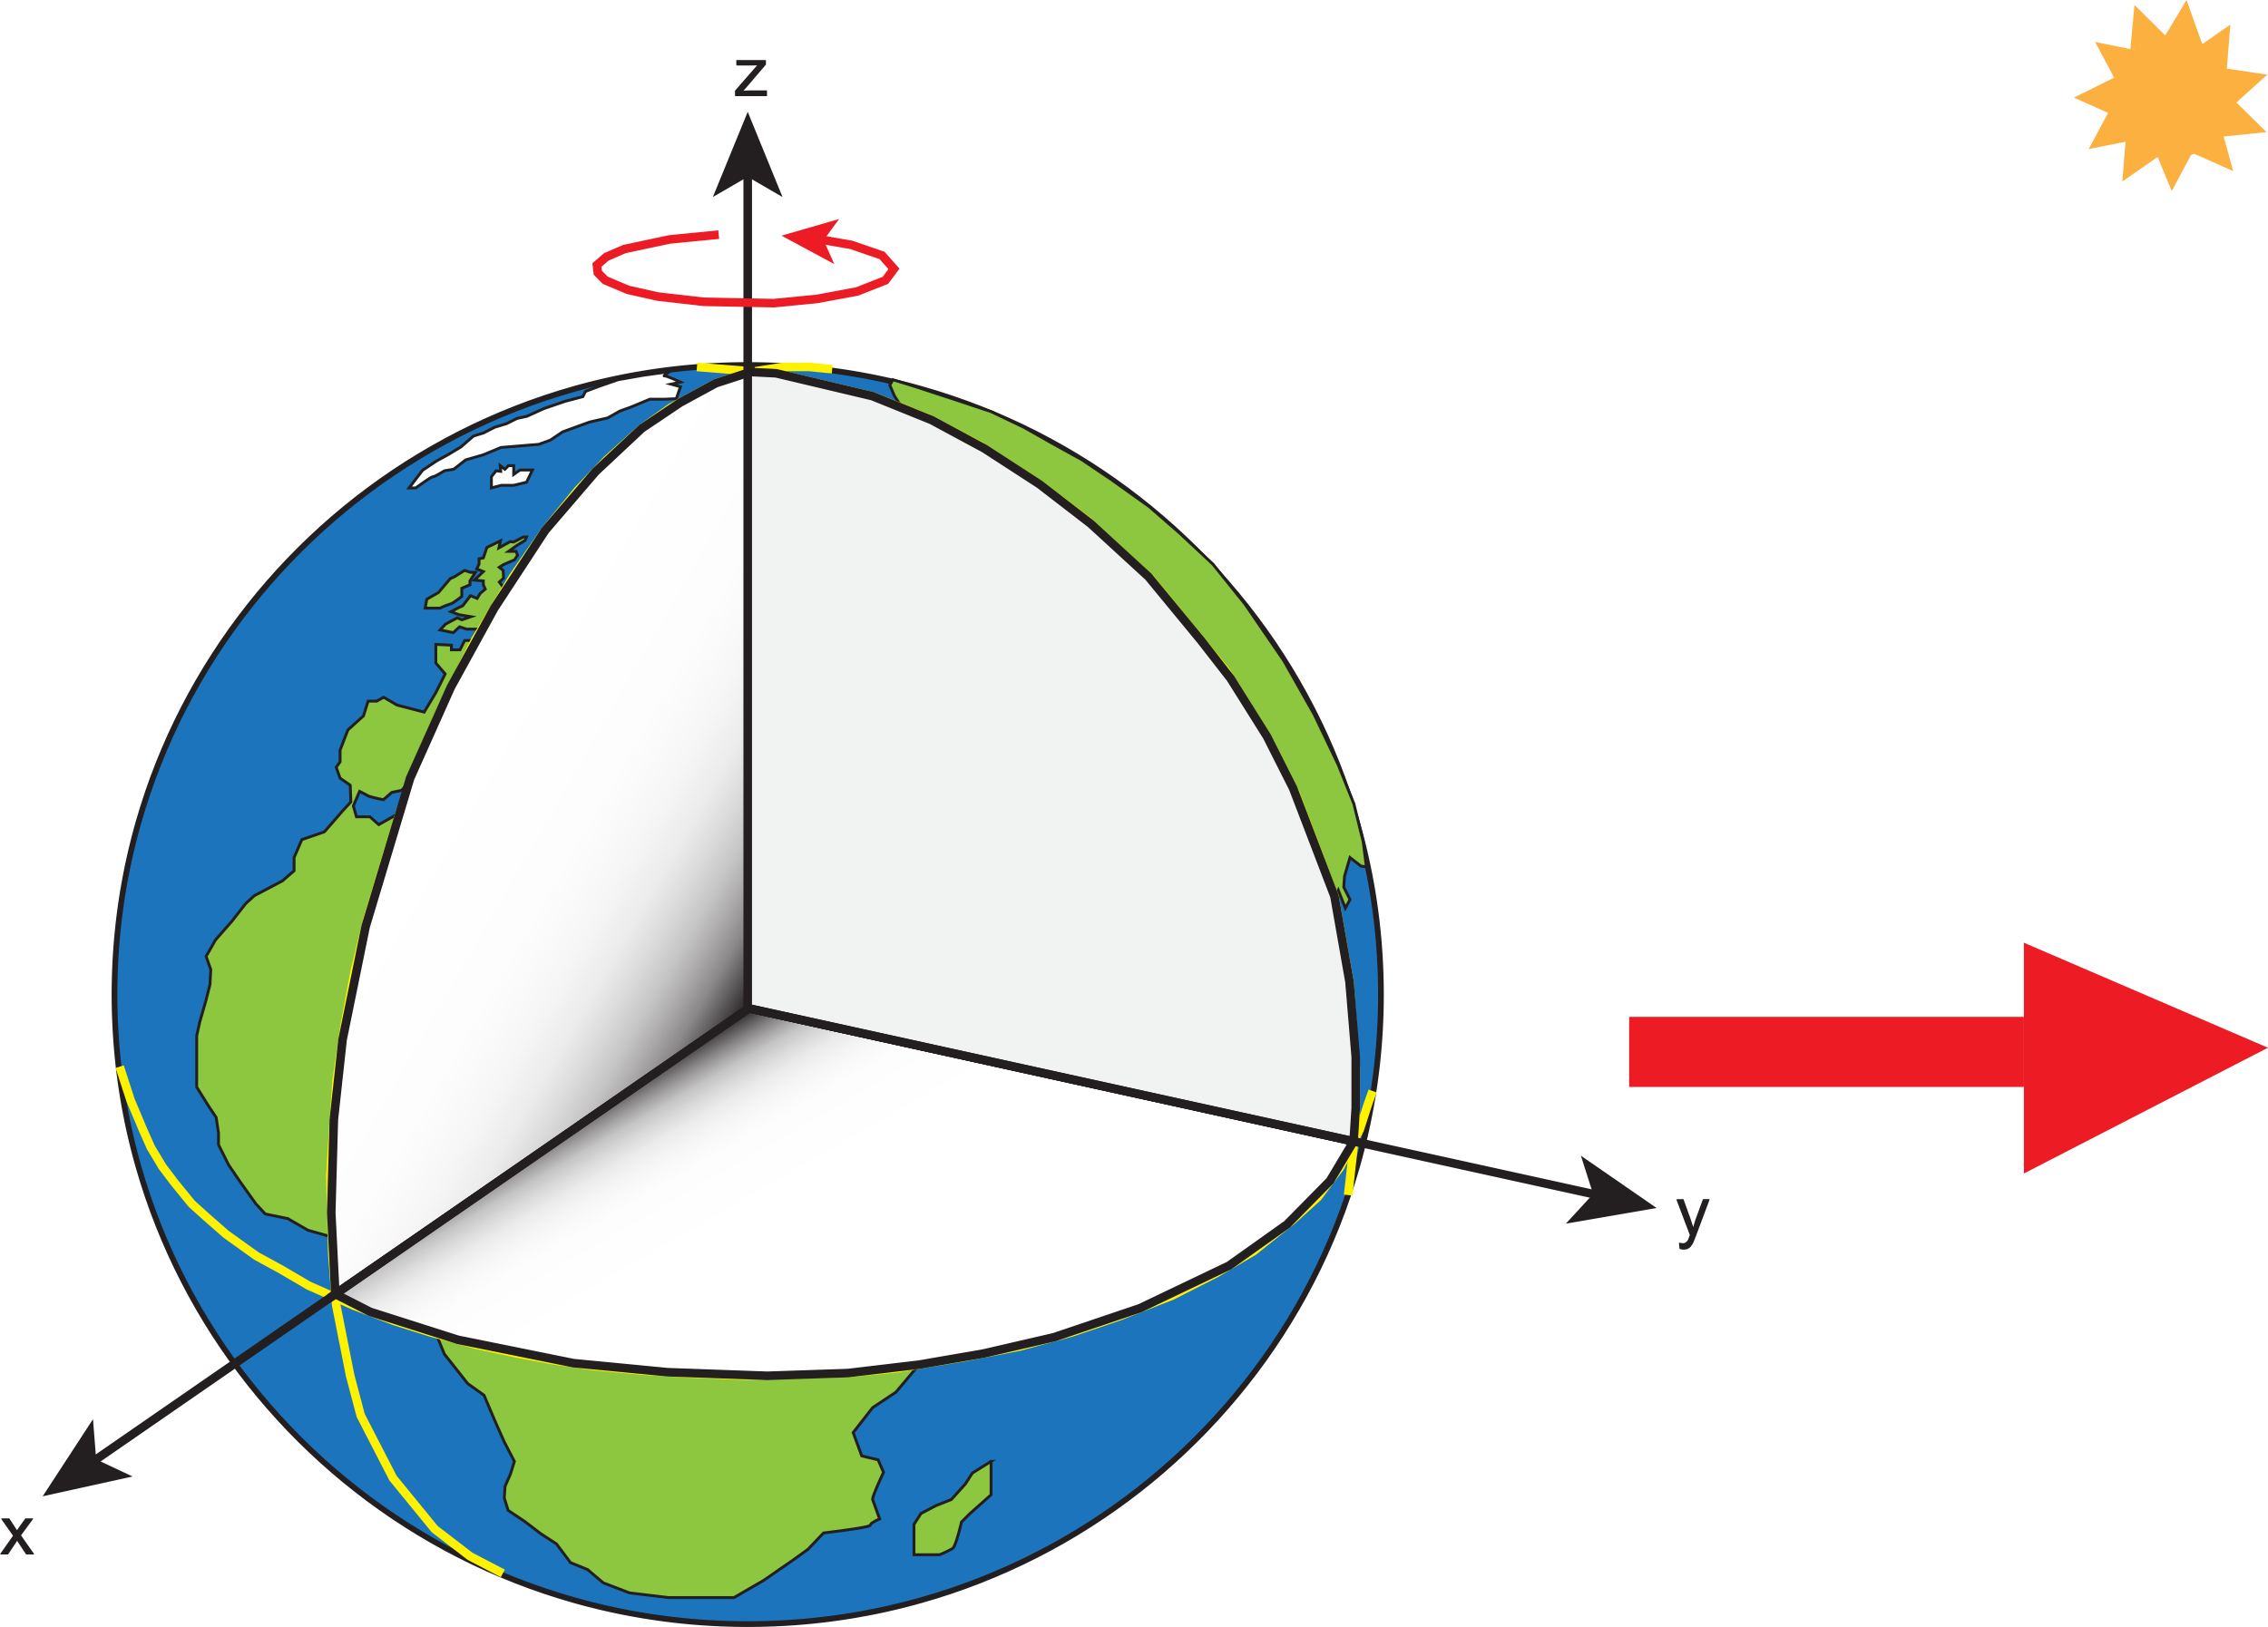
What is ITRF2020?
International Terrestrial Reference System (ITRS)
The frame rotates with and is fixed to the Earth as it orbits the Sun. It is an Earth-centered-Earth-fixed frame (ECEF).

Slide 34

What is ITRF2020?
ITRS → ITRF
ITRF2020 is the most recent realization of the ITRS
“Realization” of the idealized reference system occurs when coordinates are assigned to physical points by applying the rules of the reference system.

Slide 35
Realization of ITRF2020

Slide 36
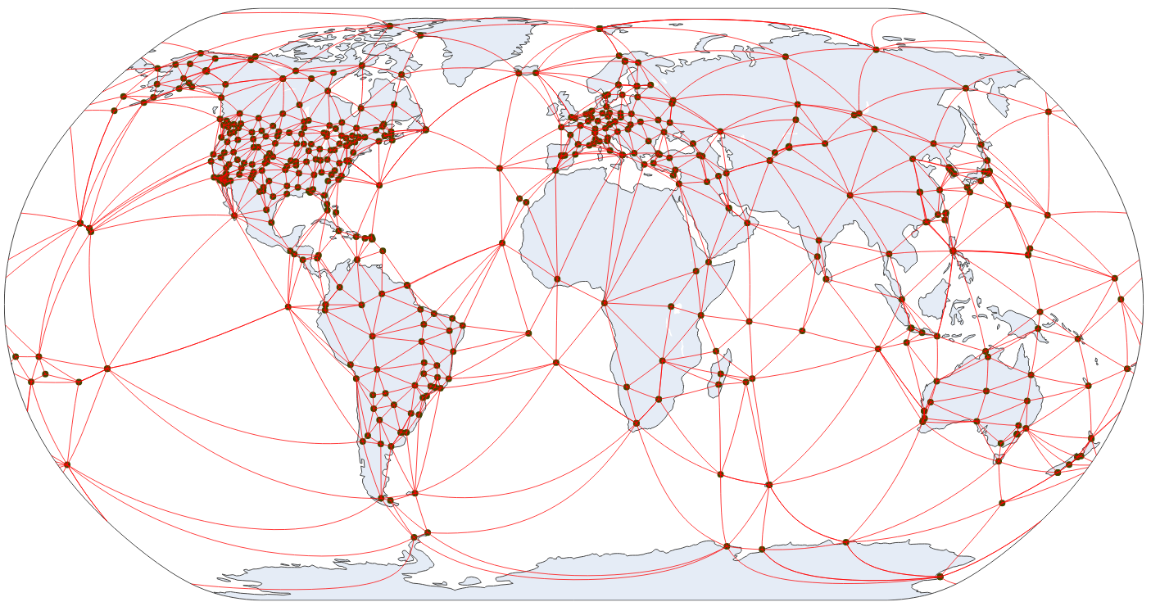
Realization of ITRF2020
NGS’s contribution
International GNSS Service (IGS) 3rd Reprocessing Campaign (repro3)
NGS processed data from ~800 stations
1 January 1994 through 26 November 2022 (10556 days of data)
Repro3
2020:233

Slide 37
Realization of ITRF2020
NGS’s contribution
International GNSS Service (IGS) 3rd Reprocessing Campaign (repro3)
NGS processed data from ~800 stations
1 January 1994 through 26 November 2022 (10556 days of data)
Repro3
2020:233

Slide 38
Realization of ITRF2020
NGS’s contribution
International GNSS Service (IGS) 3rd Reprocessing Campaign (repro3)
NGS processed data from ~800 stations
1 January 1994 through 26 November 2022 (10556 days of data)
Repro3
2020:233

Slide 39
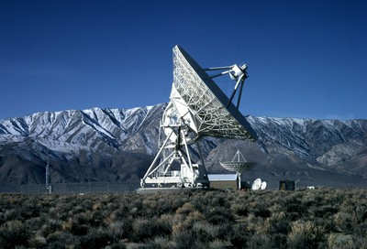
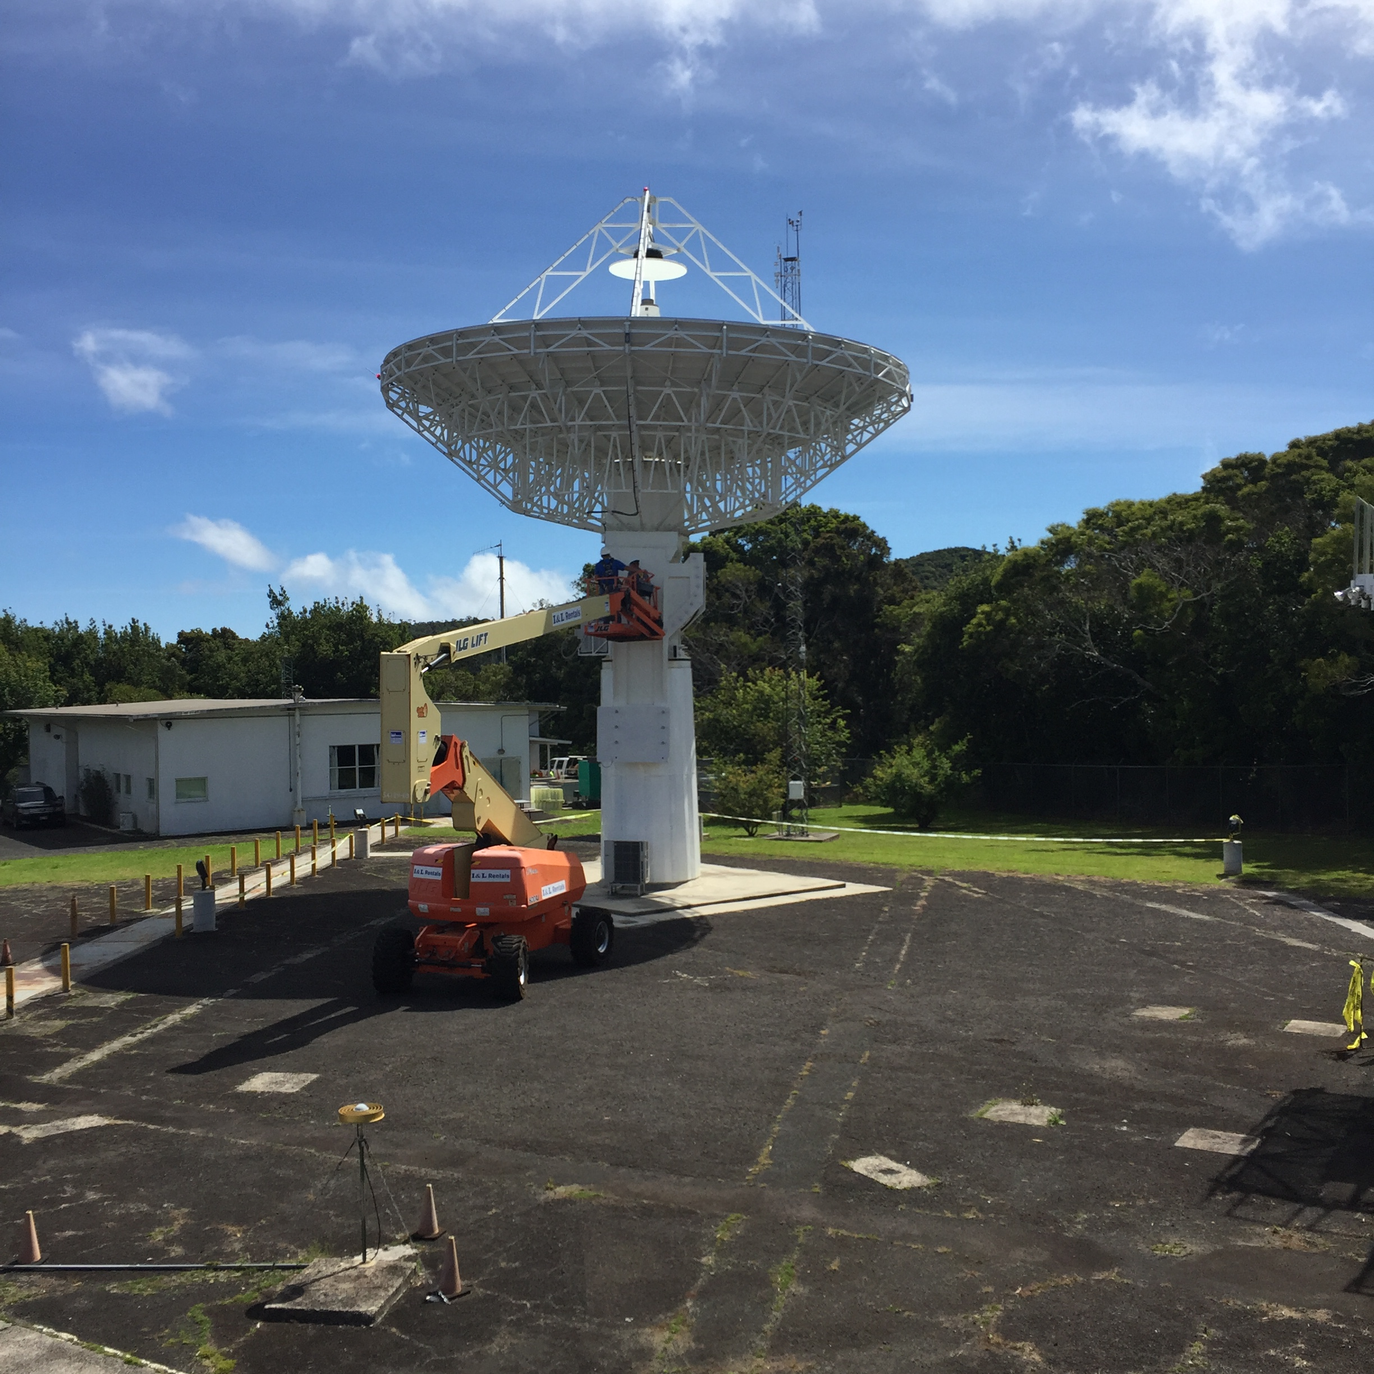
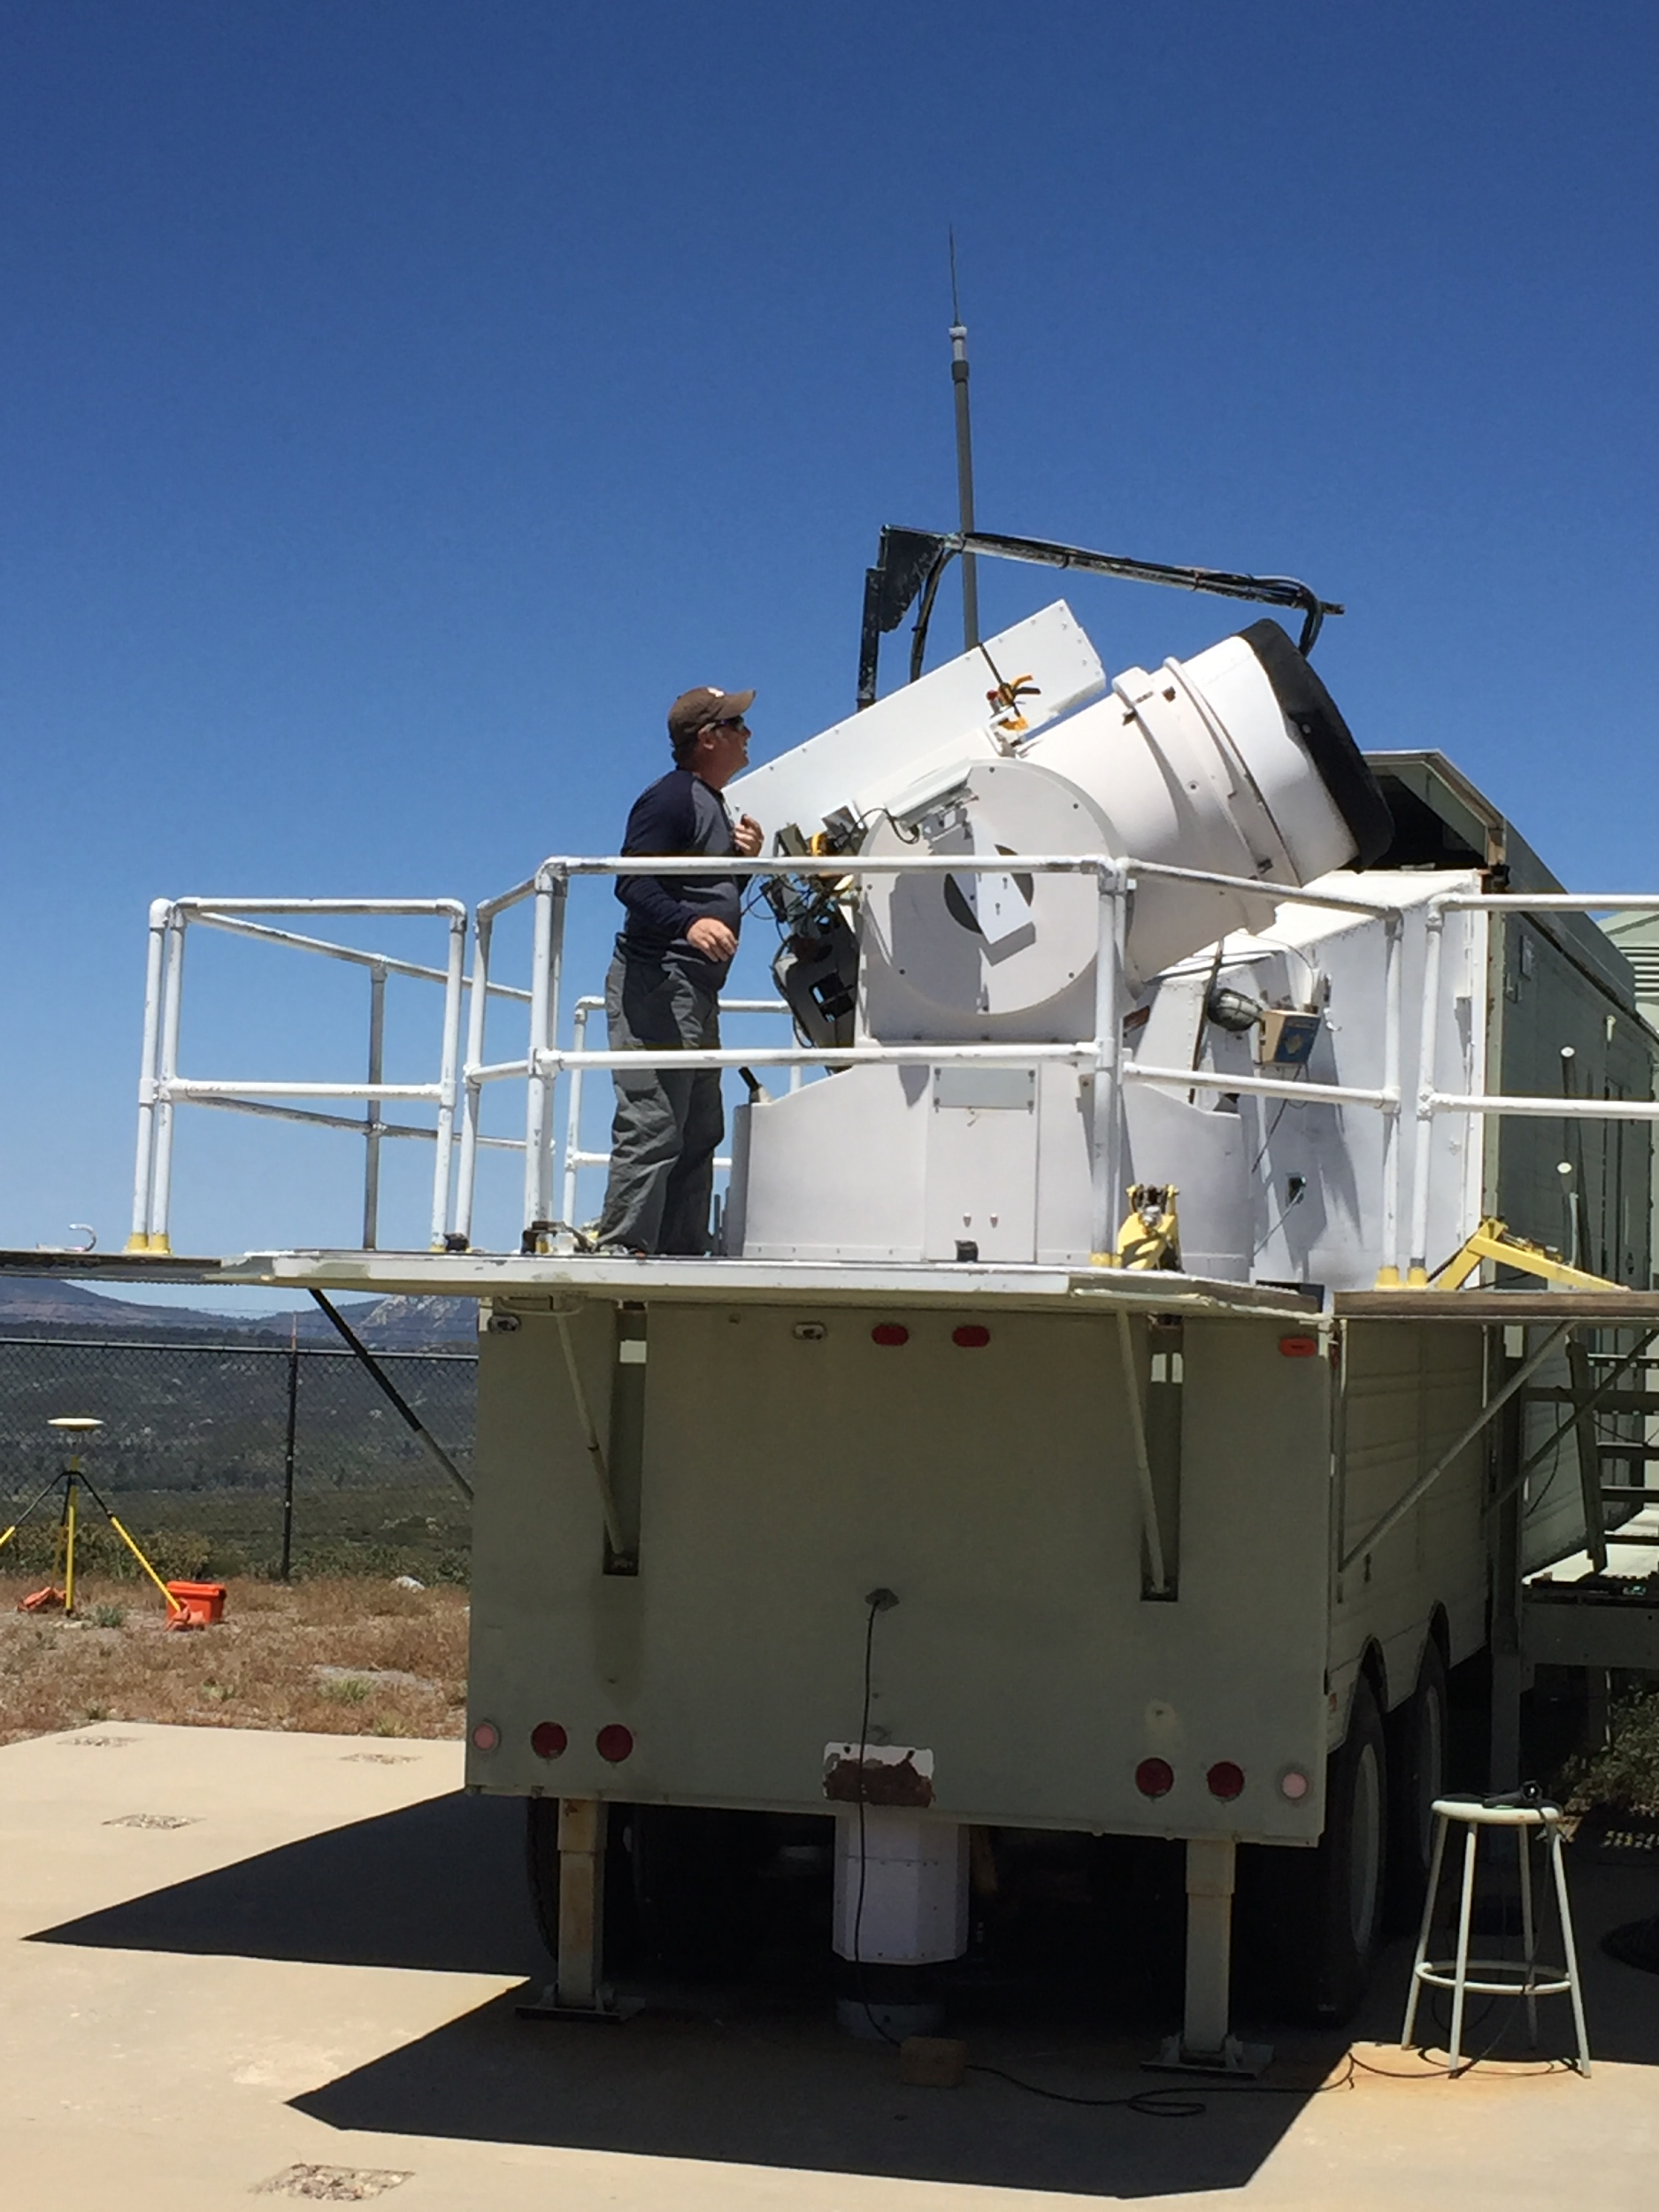
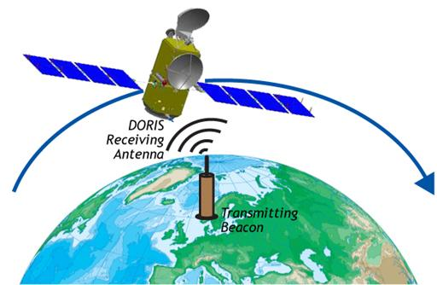
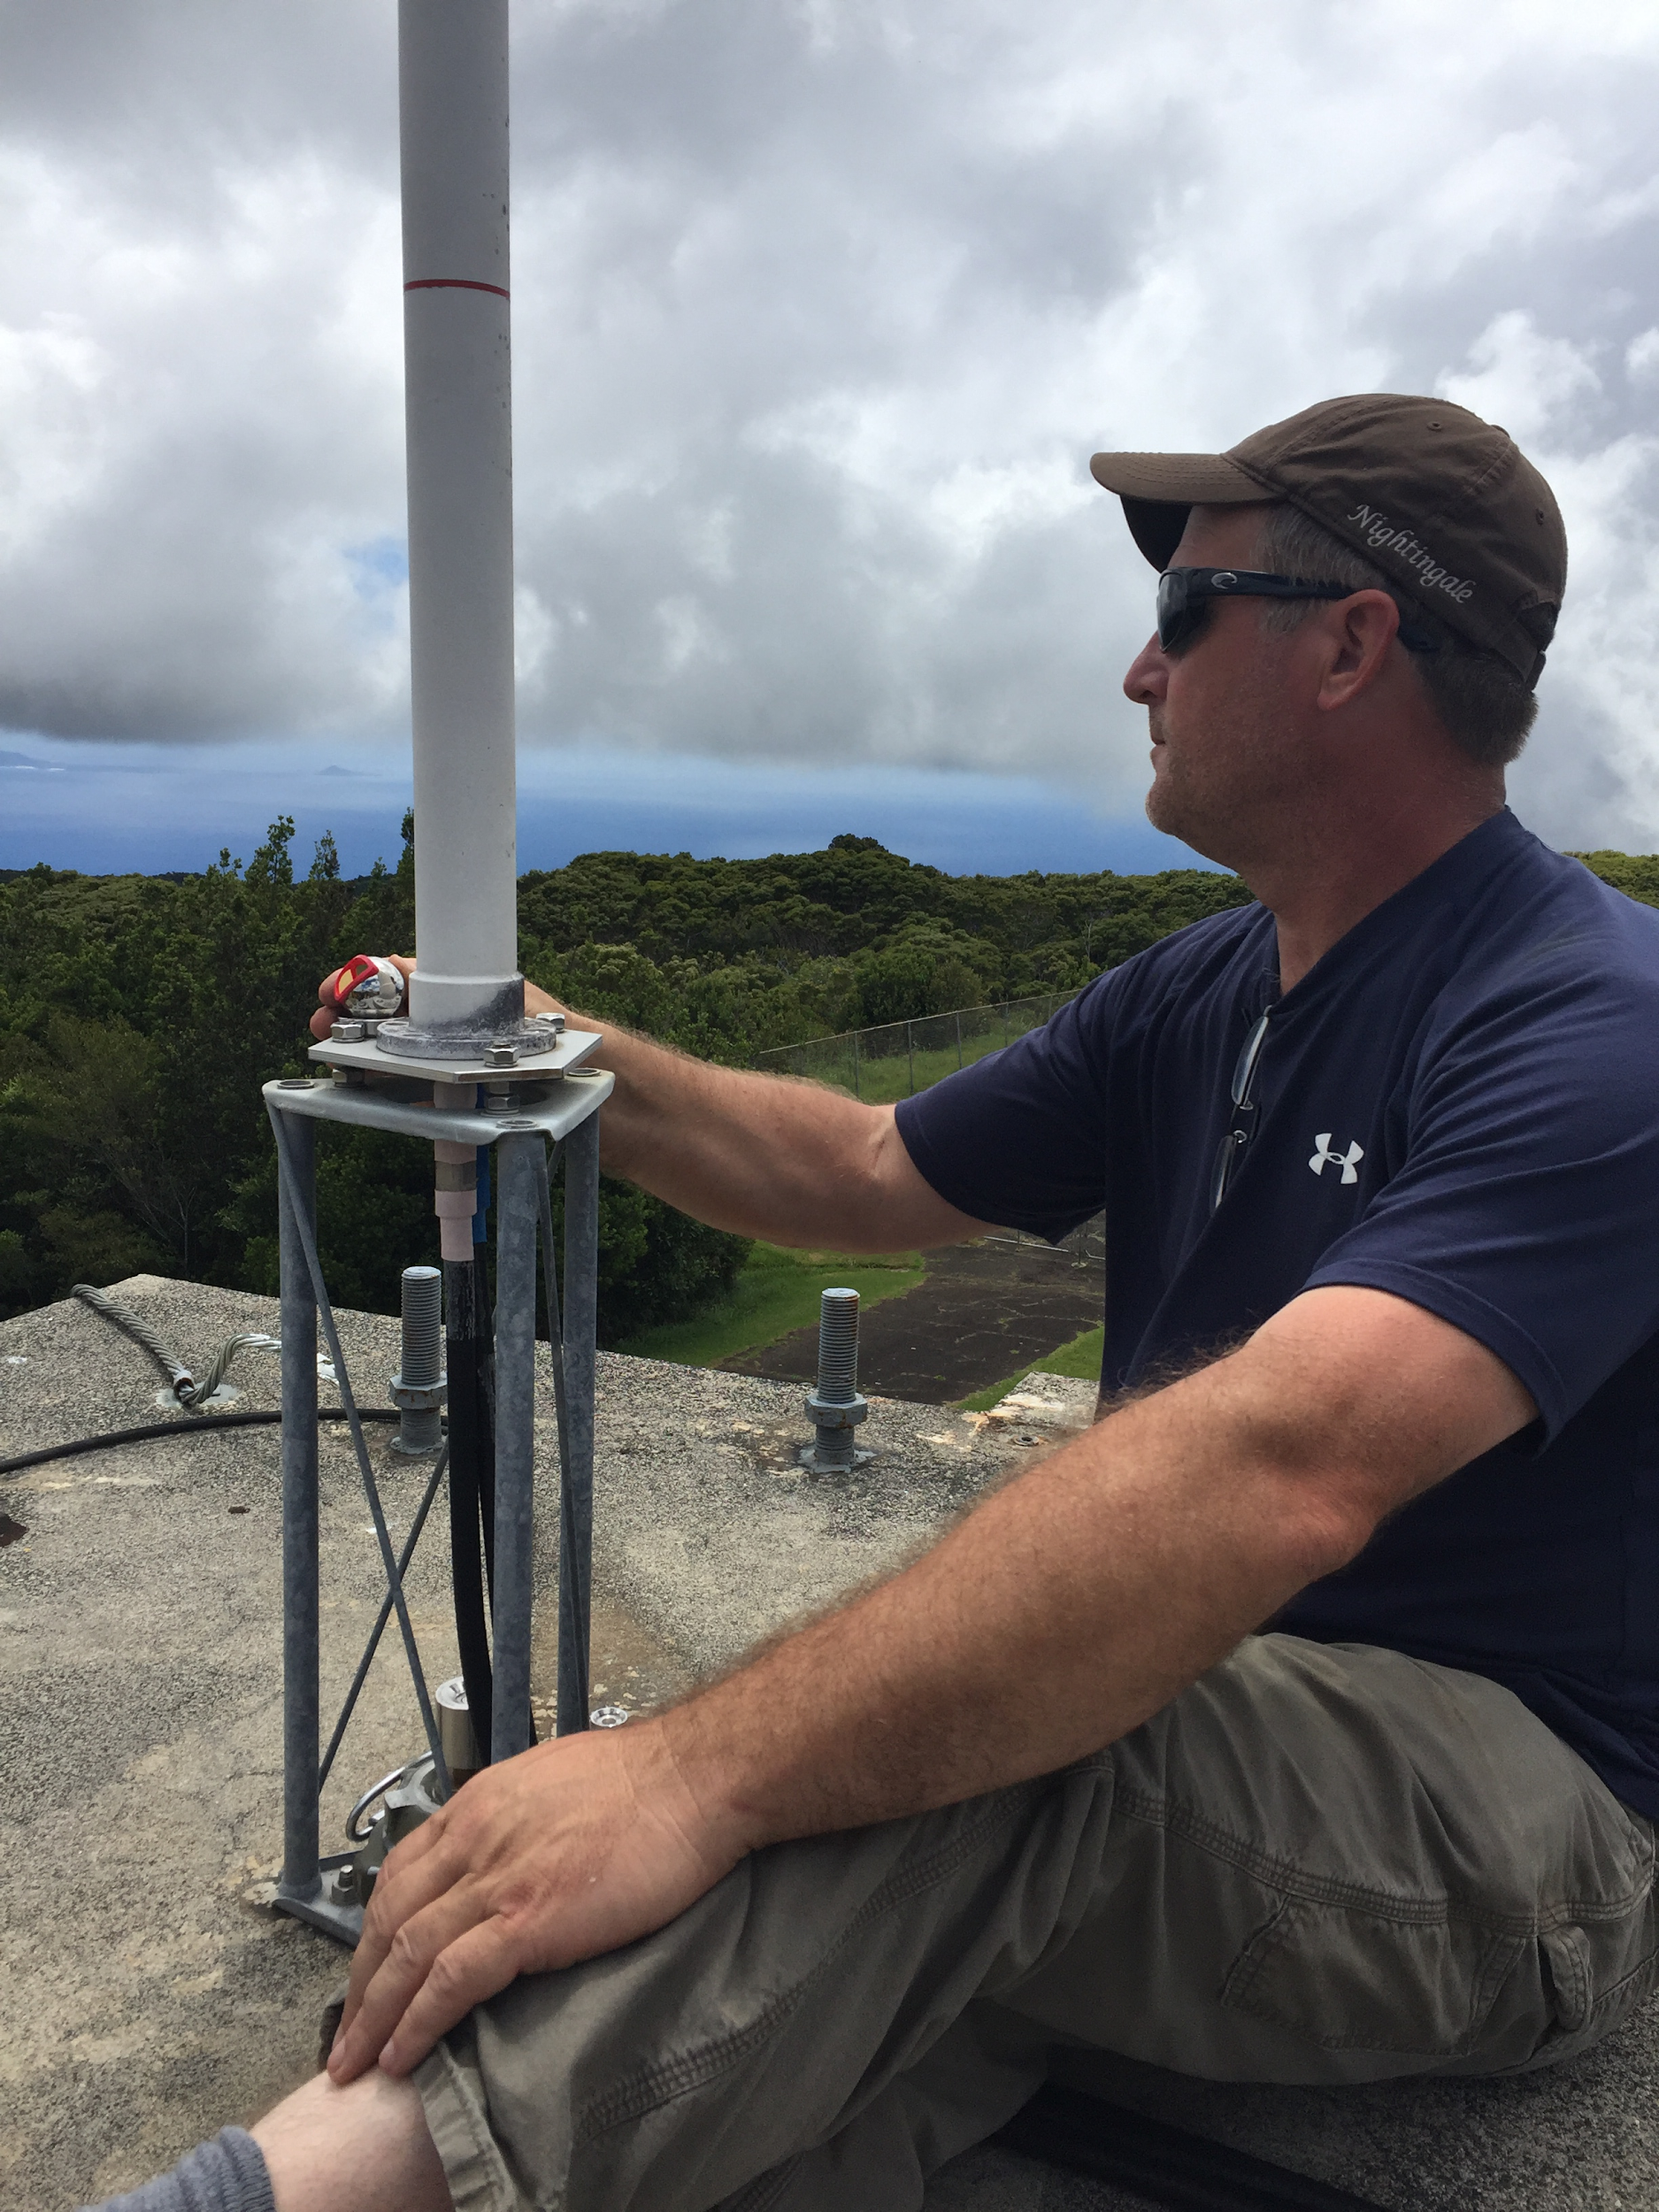
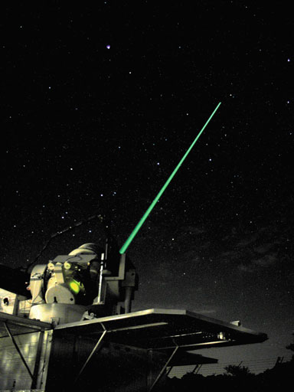
Realization of ITRF2020
A global effort
WHU
IGS
ULR
IGN
ITRF2020
TUG
IVS
NGS
Local Ties
Steve Breidenbach from NGS at Monument Peak
MIT
IDS
JPL
GRG
Steve B. at (KOKB), DORIS (left) and VLBI (above)
GFZ
ILRS
ESA
CODE
https://itrf.ign.fr/en/solutions/ITRF2020
Notes:
Mention that

Slide 40
Aligning MYCS3 to ITRF2020

Slide 41
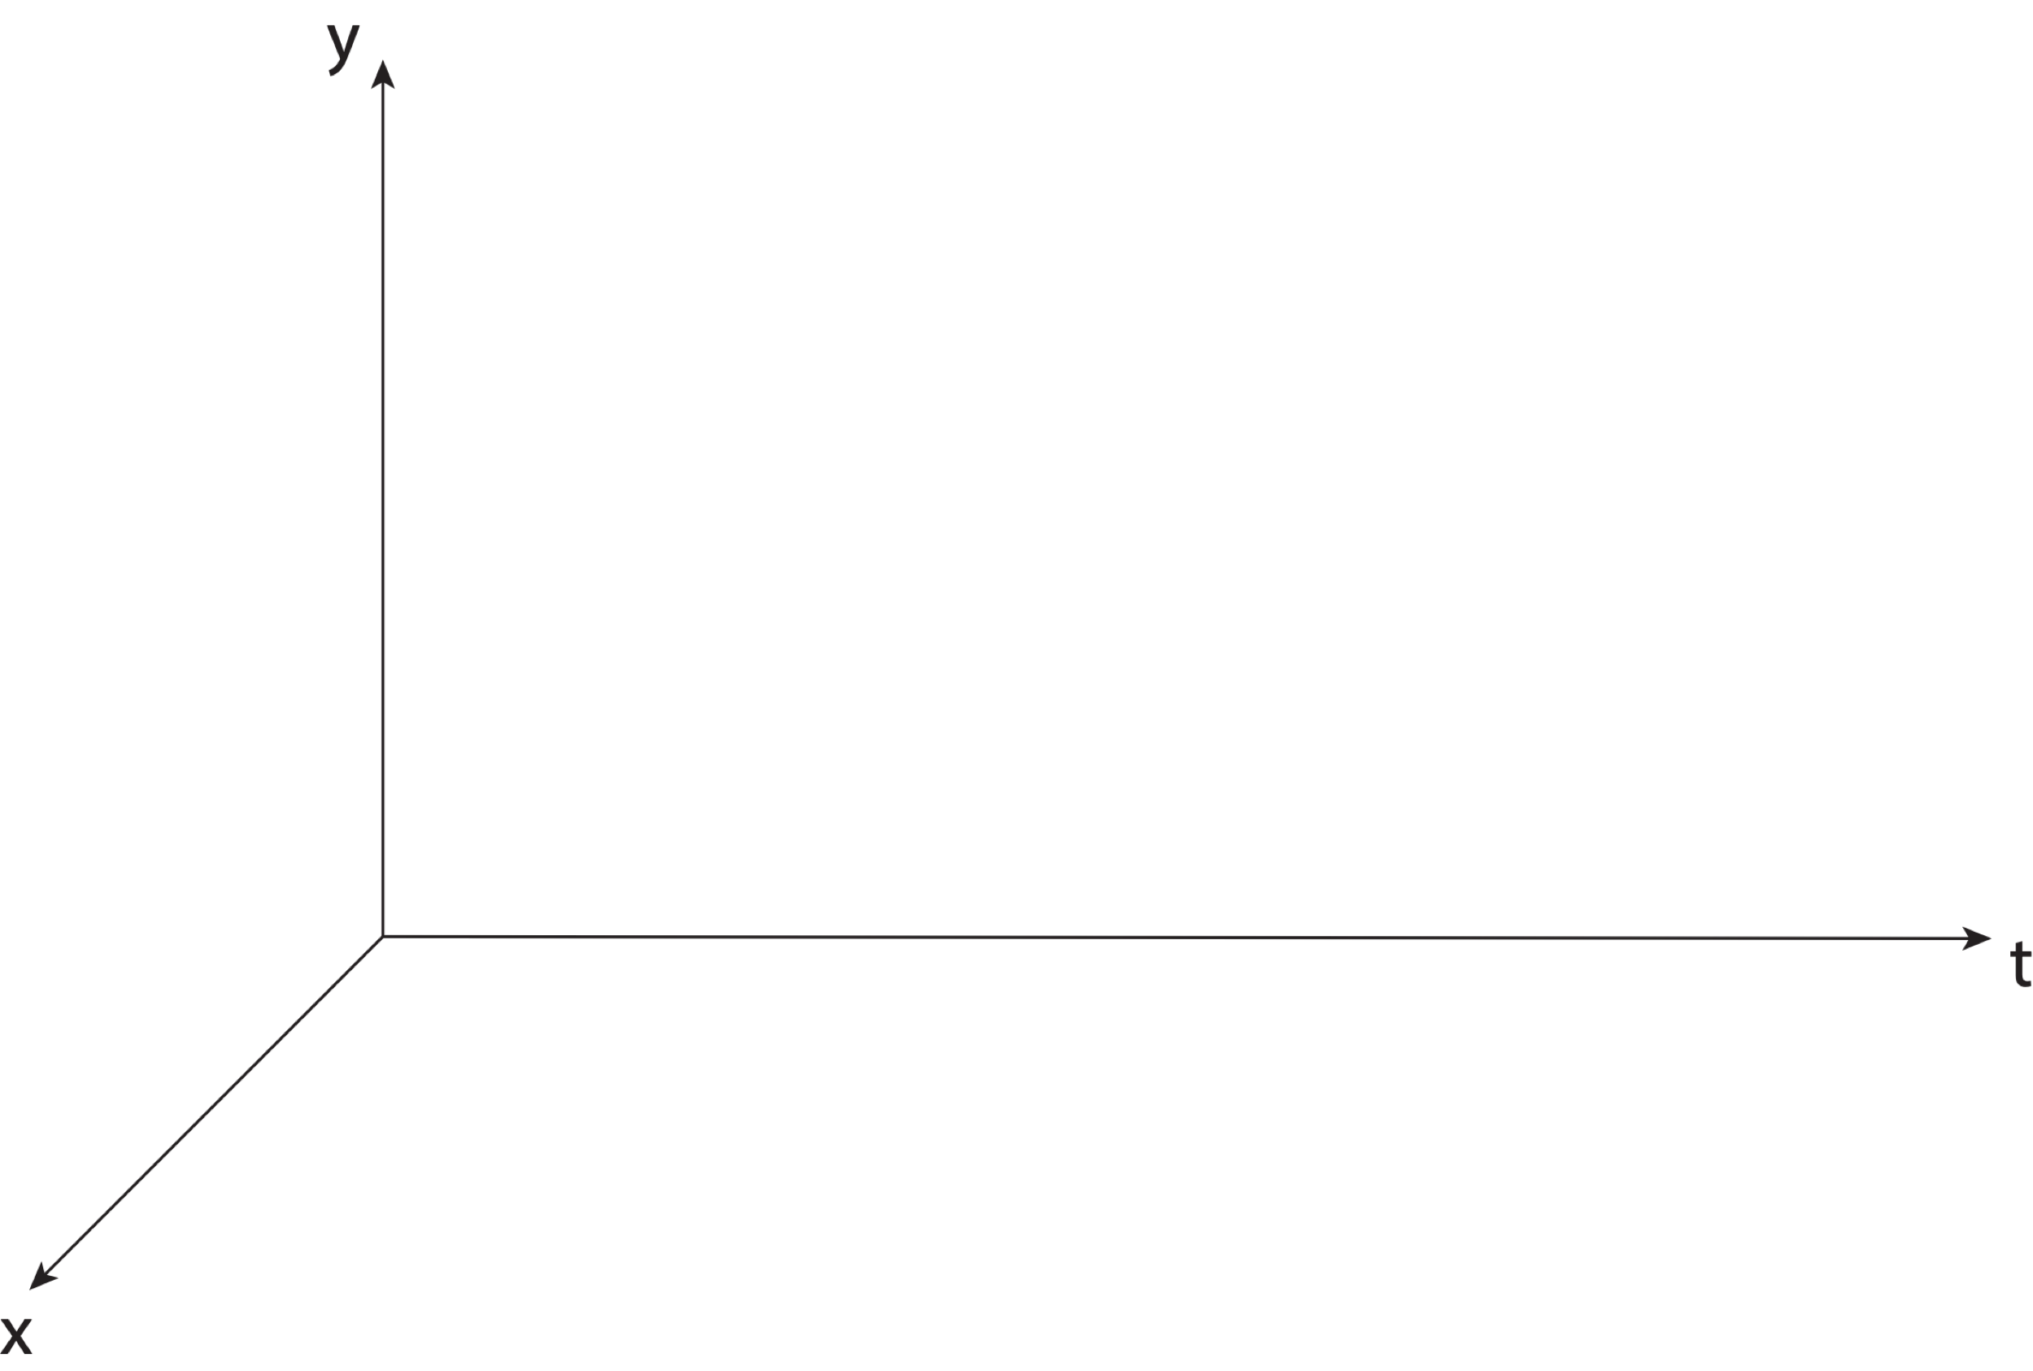
Aligning MYCS3 with ITRF2020
Steve Breidenbach from NGS at Monument Peak
Notes:
Mention that

Slide 42
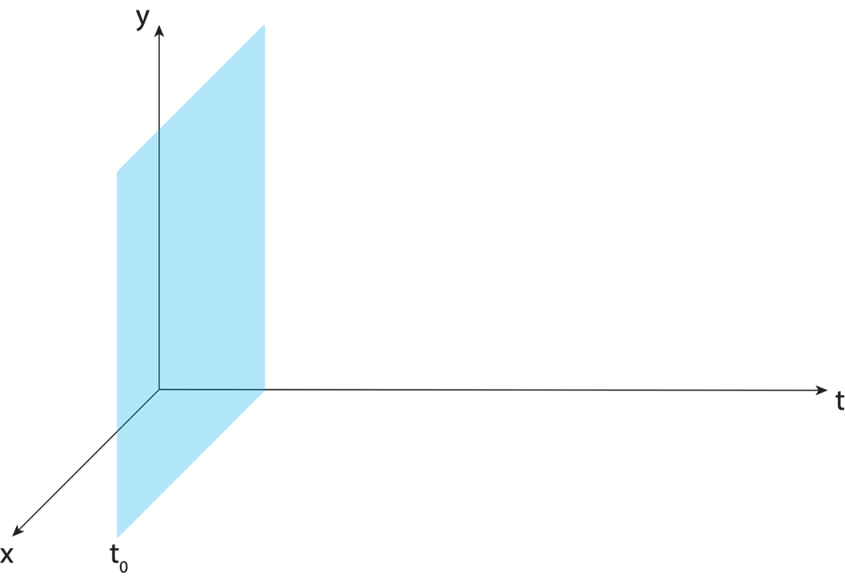
Aligning MYCS3 with ITRF2020
Steve Breidenbach from NGS at Monument Peak
Notes:
Mention that

Slide 43
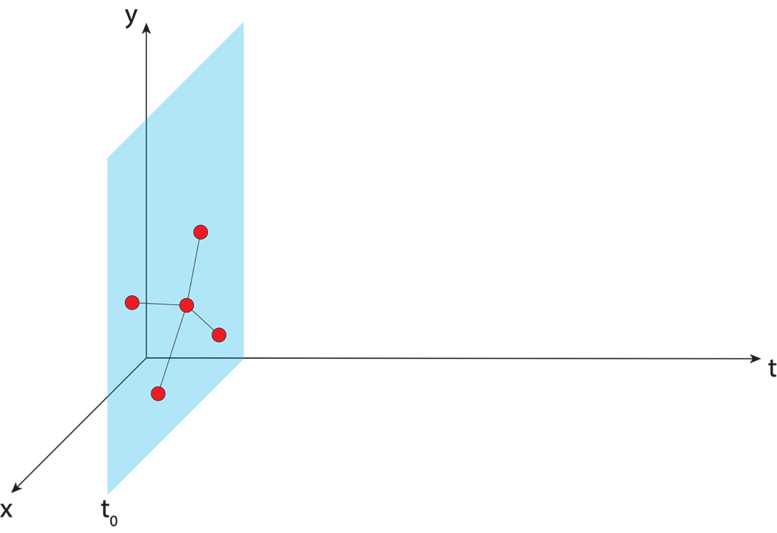
Aligning MYCS3 with ITRF2020
IGS GNSS station
Steve Breidenbach from NGS at Monument Peak
Notes:
Mention that

Slide 44
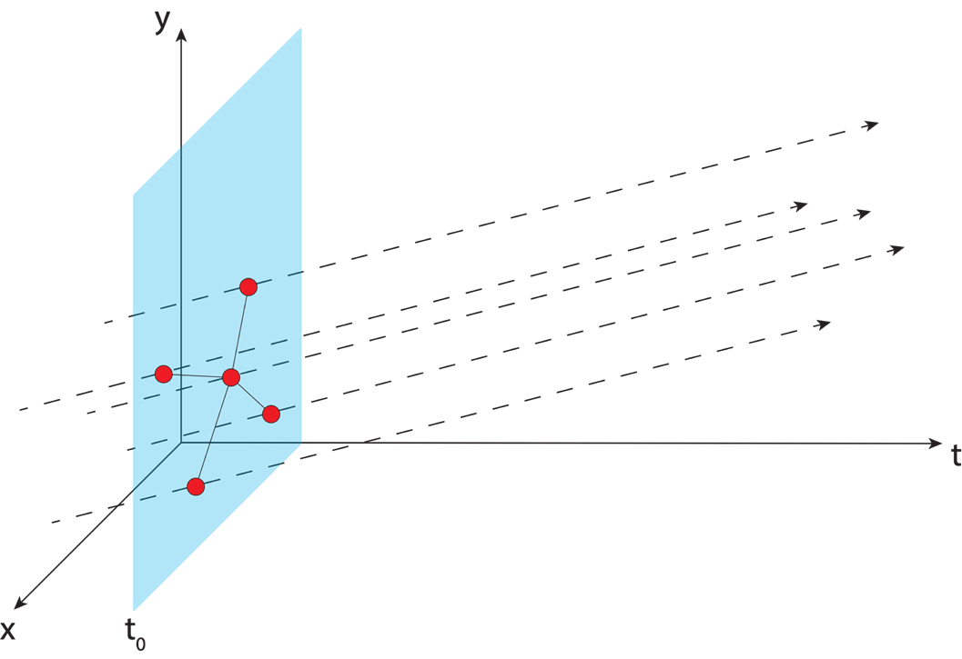
Aligning MYCS3 with ITRF2020
IGS GNSS station
station trajectory
Steve Breidenbach from NGS at Monument Peak
Notes:
Mention that

Slide 45
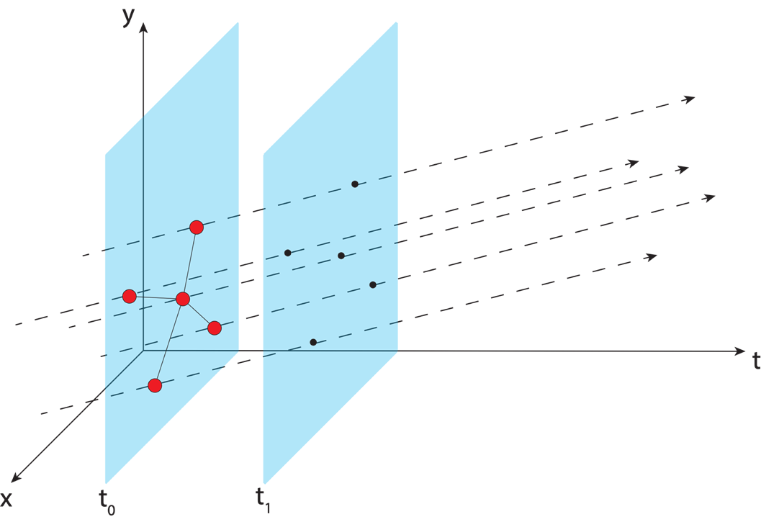
Aligning MYCS3 with ITRF2020
IGS GNSS station
station trajectory
projected IGS station position
Steve Breidenbach from NGS at Monument Peak
Notes:
Mention that

Slide 46
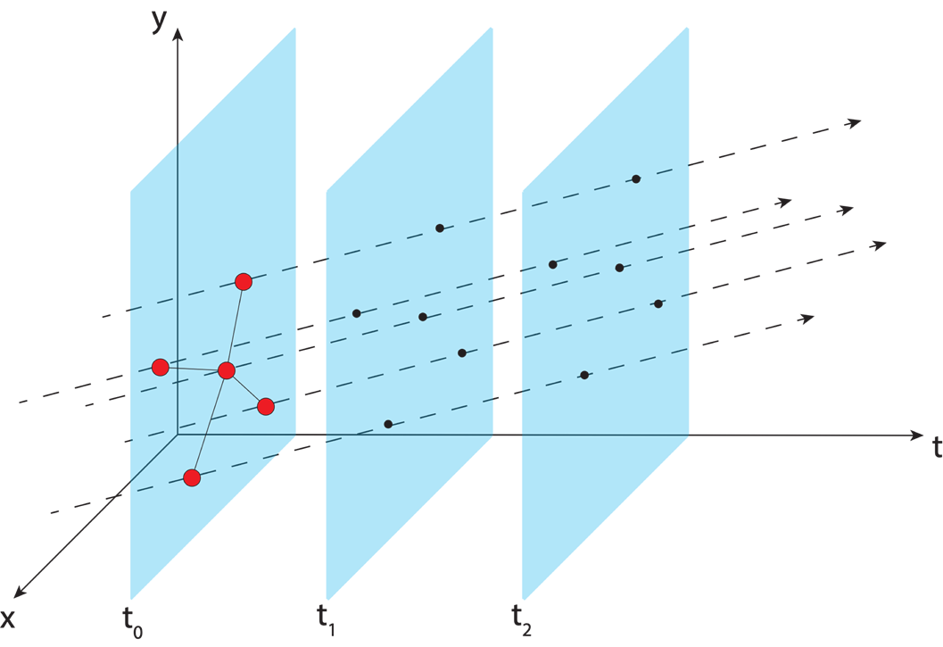
Aligning MYCS3 with ITRF2020
IGS GNSS station
station trajectory
projected IGS station position
Steve Breidenbach from NGS at Monument Peak
Notes:
Mention that

Slide 47
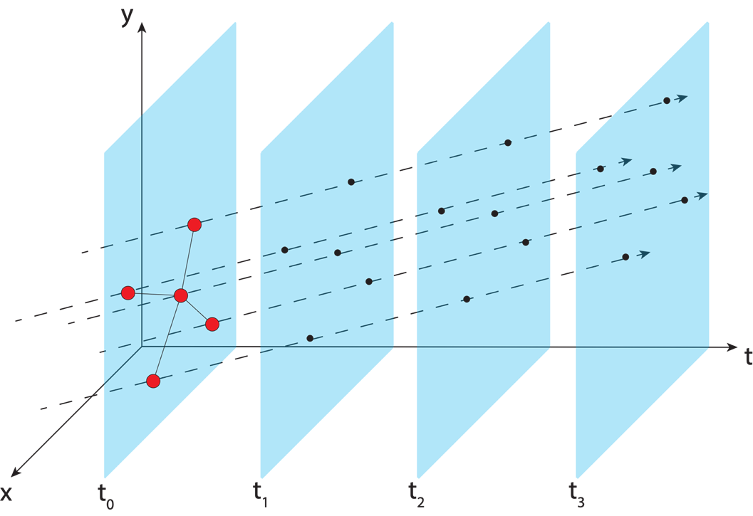
Aligning MYCS3 with ITRF2020
IGS GNSS station
station trajectory
projected IGS station position
Steve Breidenbach from NGS at Monument Peak
Notes:
Mention that

Slide 48
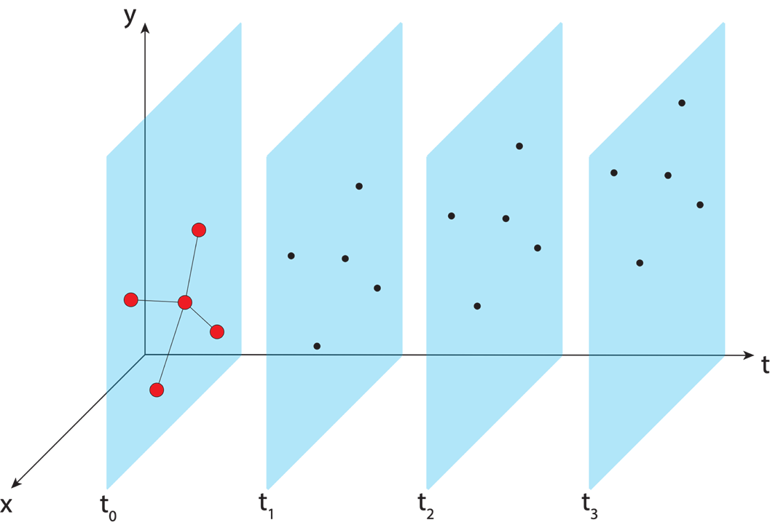
Aligning MYCS3 with ITRF2020
IGS GNSS station
station trajectory
projected IGS station position
Steve Breidenbach from NGS at Monument Peak
Notes:
Mention that

Slide 49
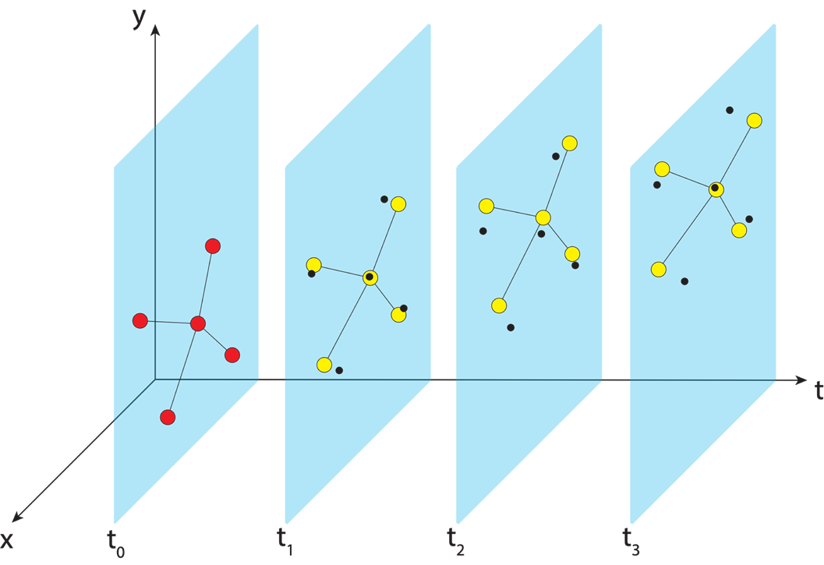
Aligning MYCS3 with ITRF2020
IGS GNSS station
station trajectory
projected IGS station position
Steve Breidenbach from NGS at Monument Peak
NGS estimate of IGS station position
Notes:
Mention that

Slide 50

Aligning MYCS3 with ITRF2020
IGS GNSS station
station trajectory
projected IGS station position
Steve Breidenbach from NGS at Monument Peak
NGS estimate of IGS station position
Notes:
Mention that

Slide 51
Aligning MYCS3 with ITRF2020
IGS GNSS station
station trajectory
projected IGS station position
Steve Breidenbach from NGS at Monument Peak
NGS estimate of IGS station position
Notes:
Mention that

Slide 52
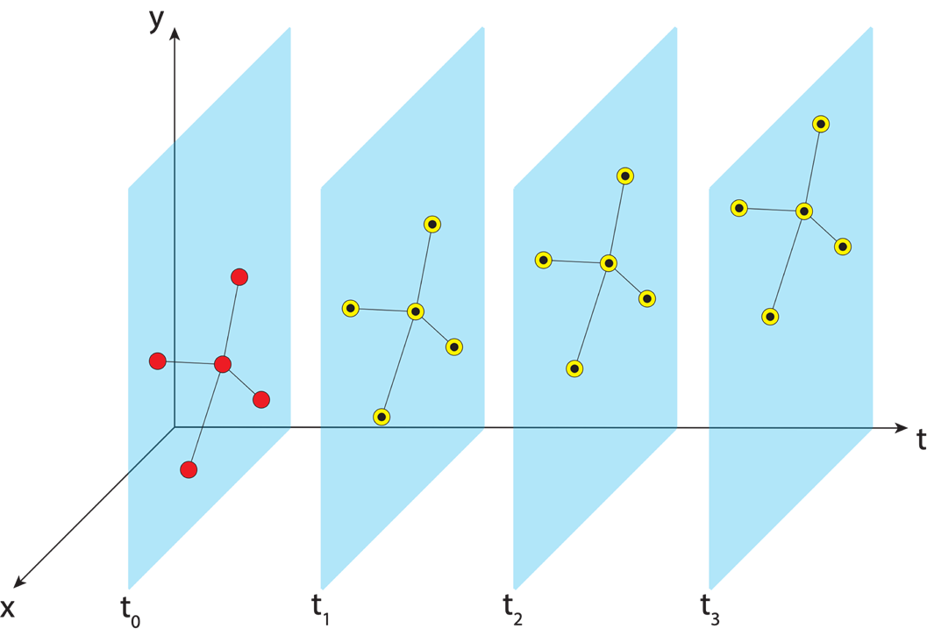
Aligning MYCS3 with ITRF2020
IGS GNSS station
station trajectory
projected IGS station position
Steve Breidenbach from NGS at Monument Peak
NGS estimate of IGS station position
Notes:
Mention that

Slide 53
Aligning MYCS3 with ITRF2020
IGS GNSS station
station trajectory
projected IGS station position
Steve Breidenbach from NGS at Monument Peak
NGS estimate of IGS station position
Notes:
Mention that

Slide 54

Aligning MYCS3 with ITRF2020
IGS GNSS station
station trajectory
projected IGS station position
Steve Breidenbach from NGS at Monument Peak
NGS estimate of IGS station position
NCN GNSS station
Notes:
Mention that

Slide 55

Aligning MYCS3 with ITRF2020
IGS GNSS station
station trajectory
projected IGS station position
Steve Breidenbach from NGS at Monument Peak
NGS estimate of IGS station position
NCN GNSS station
Notes:
Mention that

Slide 56
Aligning MYCS3 with ITRF2020
IGS GNSS station
station trajectory
projected IGS station position
Steve Breidenbach from NGS at Monument Peak
NGS estimate of IGS station position
NCN GNSS station
Notes:
Mention that

Slide 57
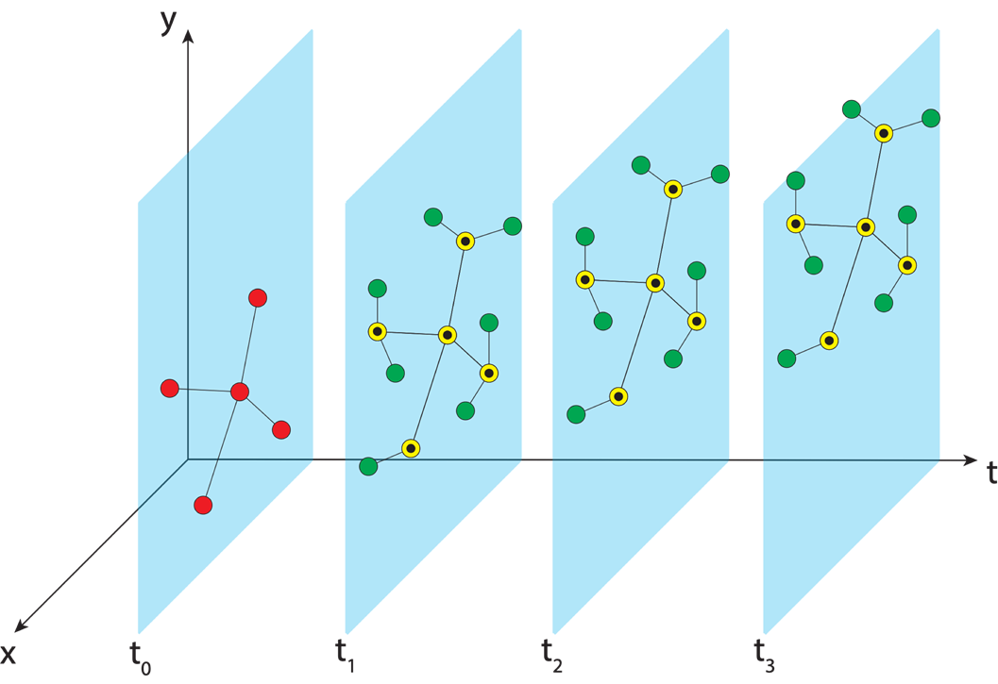
Aligning MYCS3 with ITRF2020
IGS GNSS station
station trajectory
projected IGS station position
Steve Breidenbach from NGS at Monument Peak
NGS estimate of IGS station position
NCN GNSS station
Notes:
Mention that

Slide 58
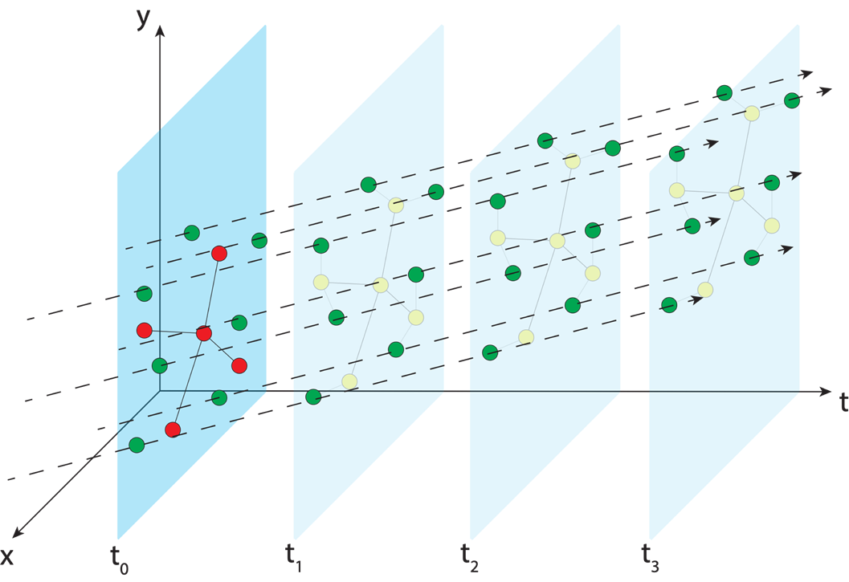
Aligning MYCS3 with ITRF2020
IGS GNSS station
station trajectory
projected IGS station position
Steve Breidenbach from NGS at Monument Peak
NGS estimate of IGS station position
NCN GNSS station
Notes:
Mention that

Slide 59

Aligning MYCS3 with ITRF2020
IGS GNSS station
station trajectory
projected IGS station position
Steve Breidenbach from NGS at Monument Peak
NGS estimate of IGS station position
NCN GNSS station
Notes:
Mention that

Slide 60
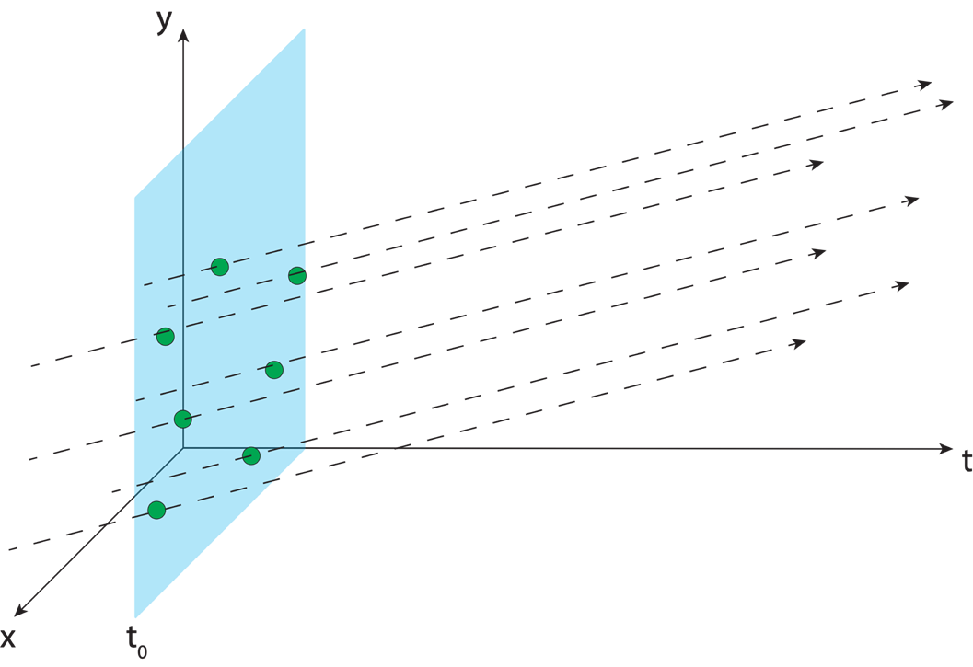
Aligning MYCS3 with ITRF2020
IGS GNSS station
station trajectory
projected IGS station position
Steve Breidenbach from NGS at Monument Peak
NGS estimate of IGS station position
NCN GNSS station
Notes:
Mention that

Slide 61
Aligning MYCS3 with ITRF2020
IGS GNSS station
station trajectory
projected IGS station position
Steve Breidenbach from NGS at Monument Peak
NGS estimate of IGS station position
NCN GNSS station
CATREF Software - Zuheir Altamimi,
Patrick Sillard & Claude Boucher.
Notes:
Mention that

Slide 62
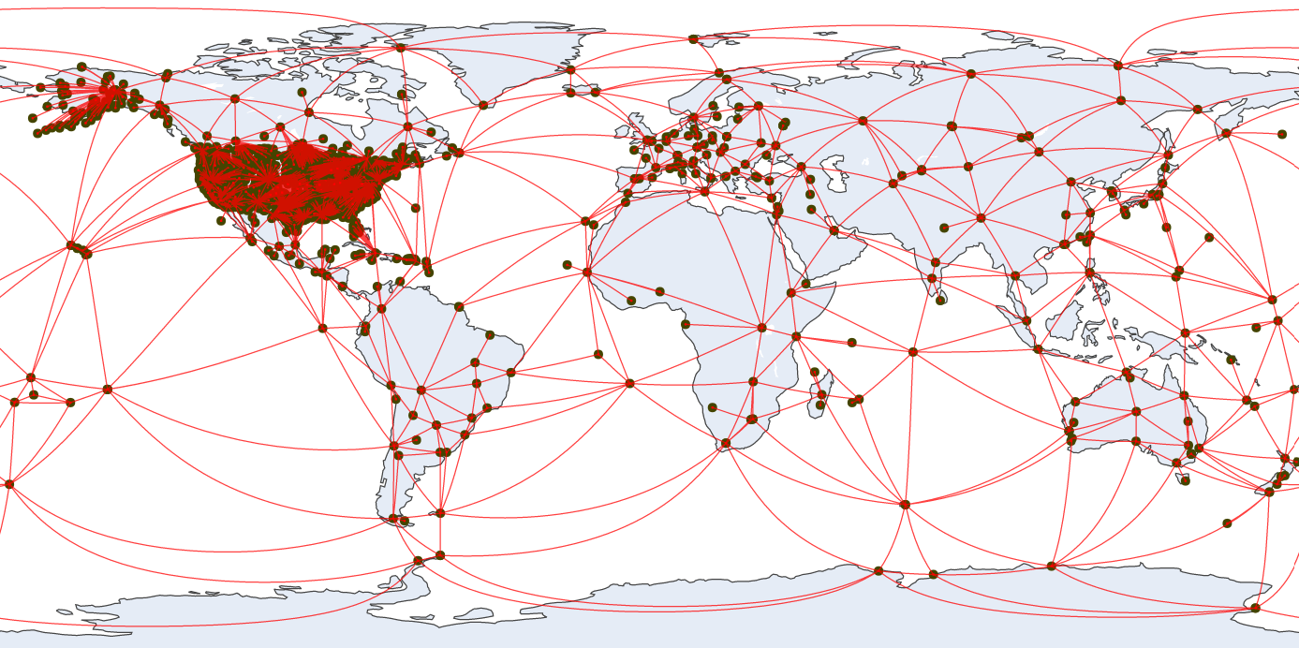
Aligning MYCS3 with ITRF2020
Steve Breidenbach from NGS at Monument Peak
Day 2020:233
Notes:
Mention that

Slide 63
Aligning MYCS3 with ITRF2020
Steve Breidenbach from NGS at Monument Peak
Day 2020:233
Notes:
Mention that

Slide 64
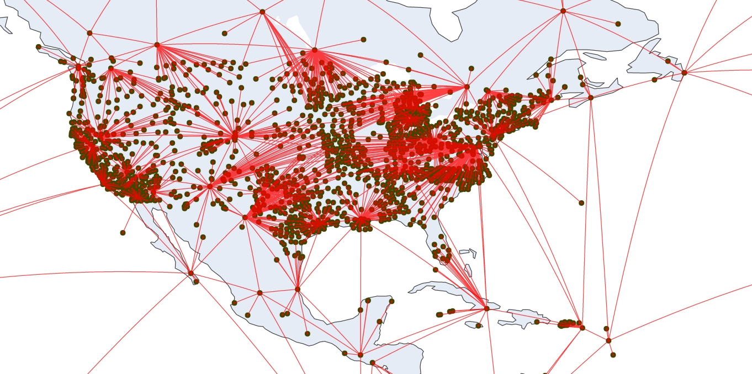
Aligning MYCS3 with ITRF2020
Network Processing:
3355 Total Stations
1 January 1996 through 26 November 2022
9827 days
1402 weeks
Steve Breidenbach from NGS at Monument Peak
Day 2020:233
Notes:
Mention that

Slide 65
Results

Slide 66
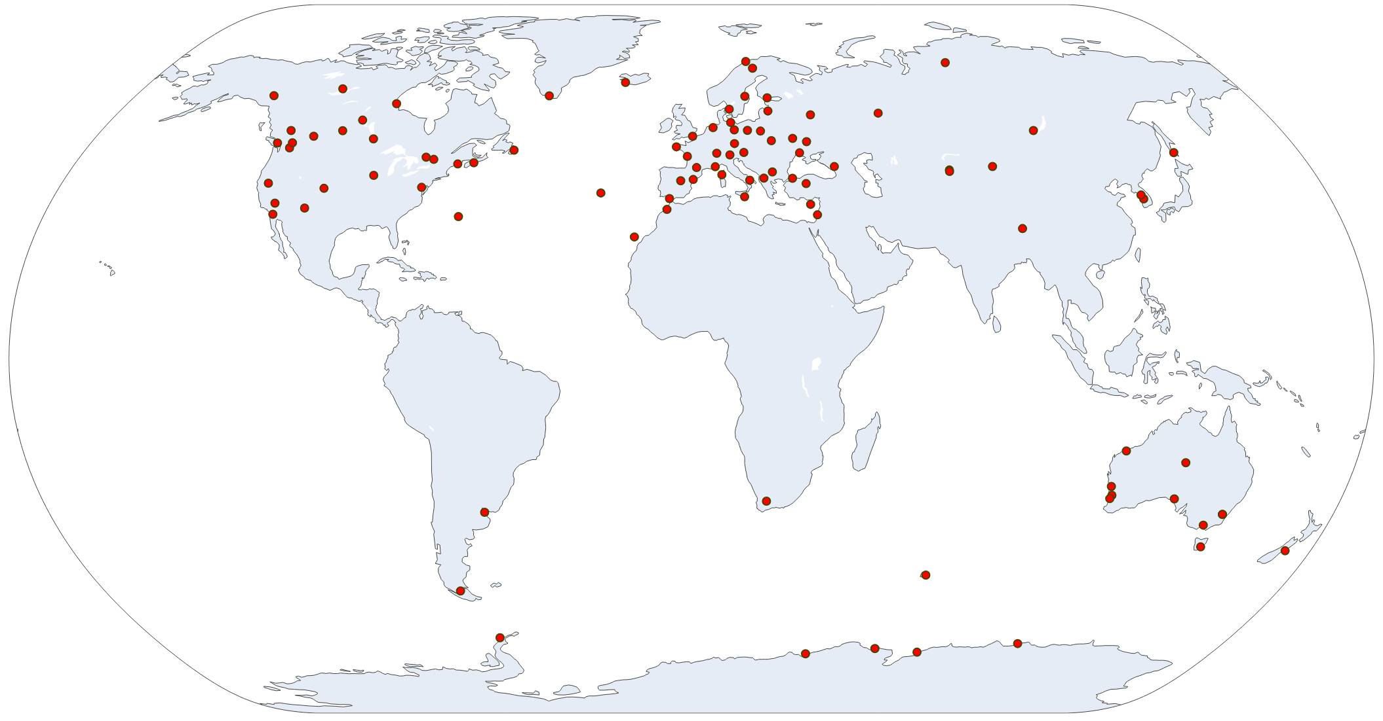
MYCS3 Results
Solution Alignment with ITRF2020
97 IGS Stations
w/ data spanning
> 80% solution
time span

Slide 67



MYCS3 Results
Solution Alignment with ITRF2020
Translation:
97 IGS Stations
w/ data spanning
> 80% solution
time span
$$X:0.00±0.06 m$$
$$Y:0.00±0.06 m$$
$$Z:0.00±0.06 m$$

Slide 68



MYCS3 Results
Solution Alignment with ITRF2020
Translation Rate:
97 IGS Stations
w/ data spanning
> 80% solution
time span
$$\dot{X}:0.00±0.06 m/yr$$
$$\dot{Y}:0.01±0.06 m/yr$$
$$\dot{Z}:0.01±0.06 m/yr$$

Slide 69

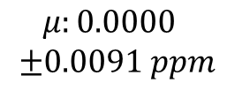
MYCS3 Results
Solution Alignment with ITRF2020
Scale:
97 IGS Stations
w/ data spanning
> 80% solution
time span
$$μ:0.0000$$
$±0.0091 ppm$

Slide 70
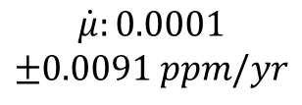
MYCS3 Results
Solution Alignment with ITRF2020
Scale rate:
97 IGS Stations
w/ data spanning
> 80% solution
time span
$$\dot{μ}:0.0001$$
$$±0.0091 ppm/yr$$

Slide 71




MYCS3 Results
Solution Alignment with ITRF2020
Orientation:
97 IGS Stations
w/ data spanning
> 80% solution
time span
$$RX:0.000±0.023′′$$
$$RY:0.000±0.023′′$$
$$RZ:0.000±0.023′′$$

Slide 72



MYCS3 Results
Solution Alignment with ITRF2020
Orientation Rate:
97 IGS Stations
w/ data spanning
> 80% solution
time span
$$\dot{RX}:0.001±0.023′′/yr$$
$$\dot{RY}:0.001±0.023′′/yr$$
$$\dot{RZ}:0.001±0.026′′/yr$$

Slide 73
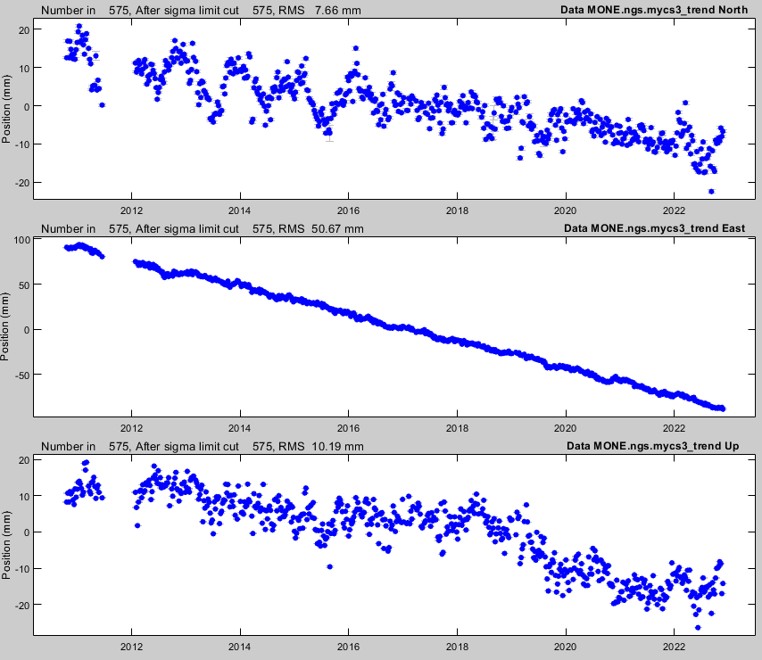
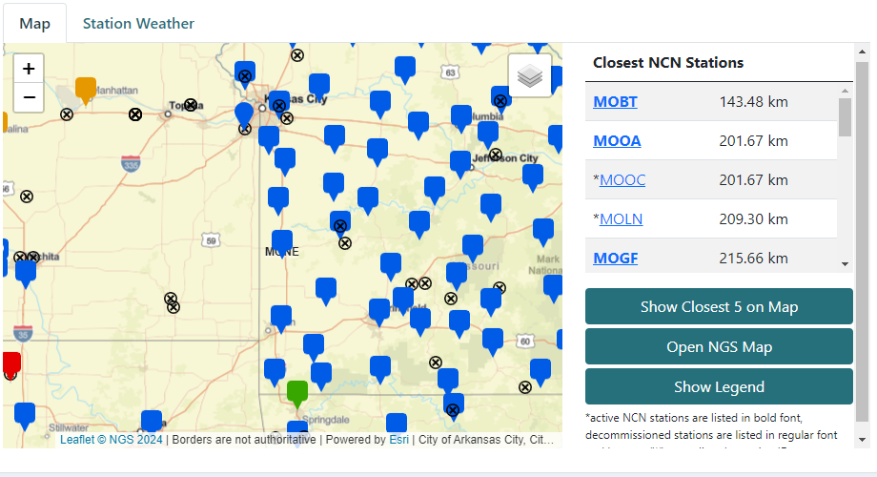
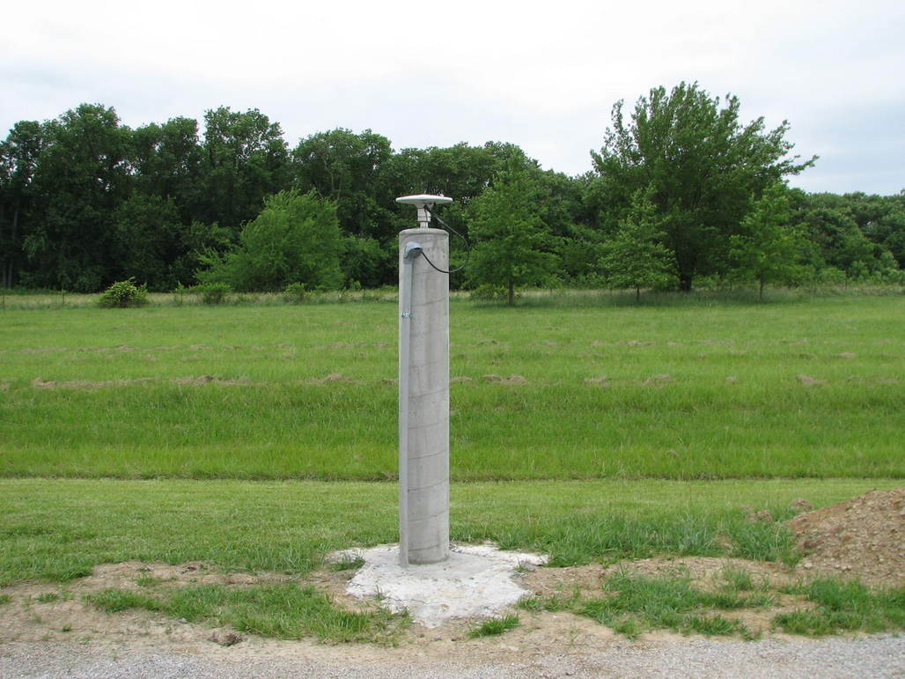
MYCS3 Results
Station Solution Examples - MONE
https://geodesy.noaa.gov/CORS/ncn_station_pages/index.html?stationID=MONE

Slide 74
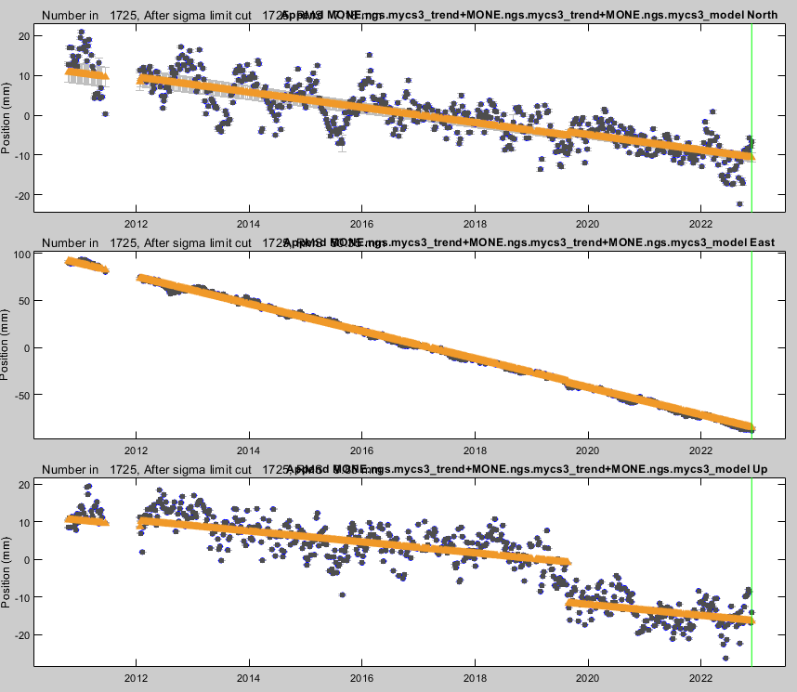
MYCS3 Results
Station Solution Examples - MONE
https://geodesy.noaa.gov/CORS/ncn_station_pages/index.html?stationID=MONE

Slide 75
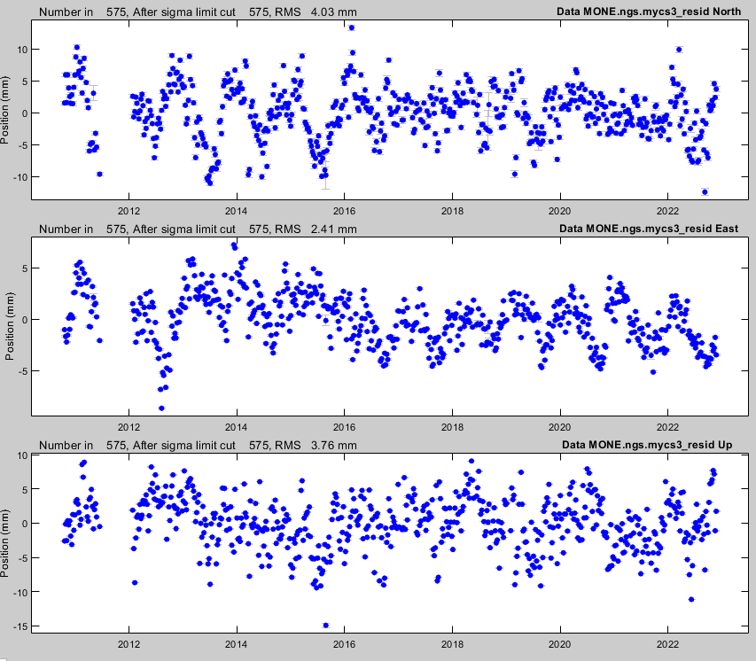
MYCS3 Results
Station Solution Examples - MONE
WRMS: 1.80 mm
WRMS: 3.21 mm
WRMS: 3.54 mm
https://geodesy.noaa.gov/CORS/ncn_station_pages/index.html?stationID=MONE

Slide 76
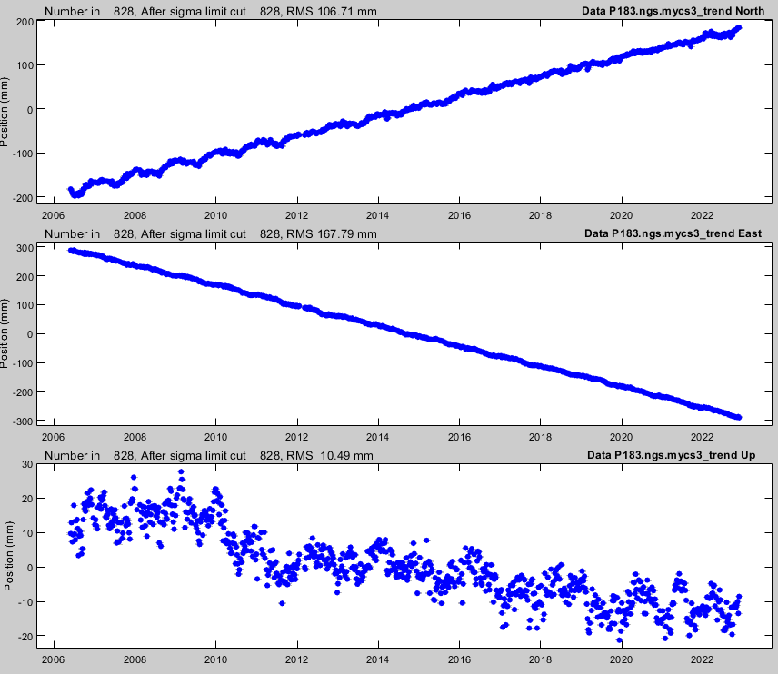
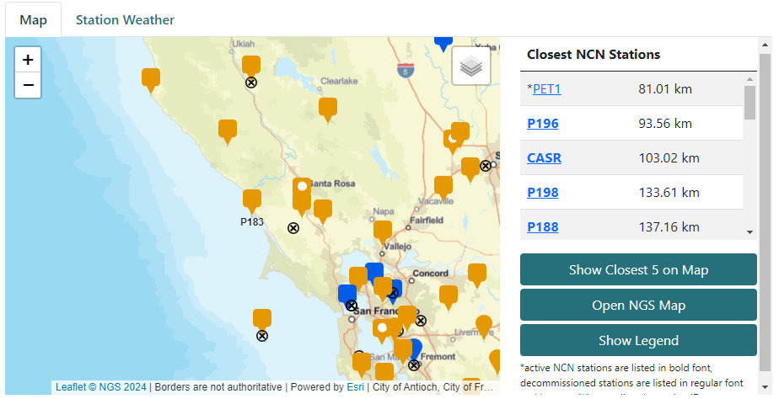
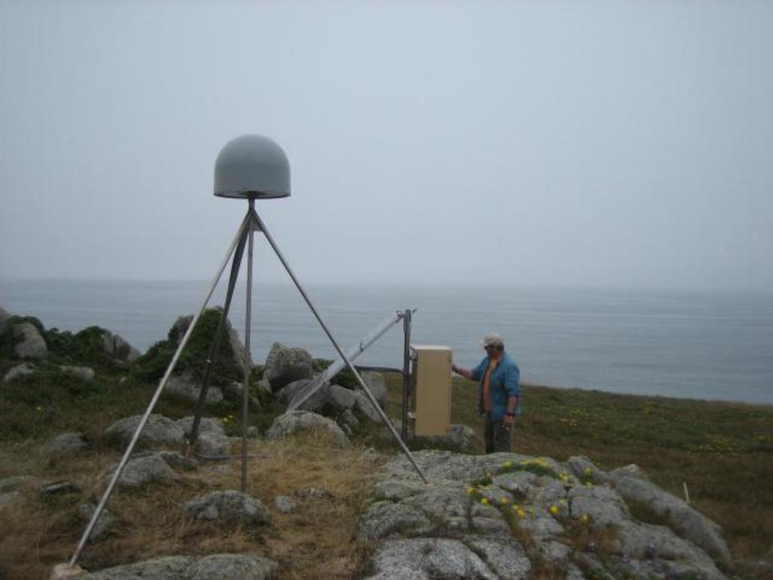
MYCS3 Results
Station Solution Examples – P183
WRMS: 1.80 mm
WRMS: 3.21 mm
WRMS: 3.54 mm
https://geodesy.noaa.gov/CORS/ncn_station_pages/index.html?stationID=P183

Slide 77
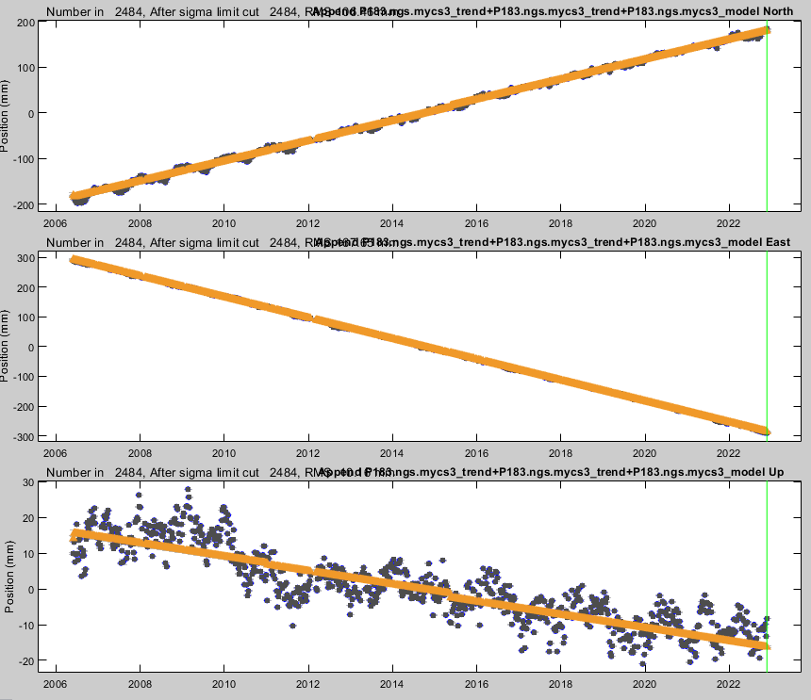
MYCS3 Results
Station Solution Examples – P183
WRMS: 1.80 mm
WRMS: 3.21 mm
WRMS: 3.54 mm
https://geodesy.noaa.gov/CORS/ncn_station_pages/index.html?stationID=P183

Slide 78
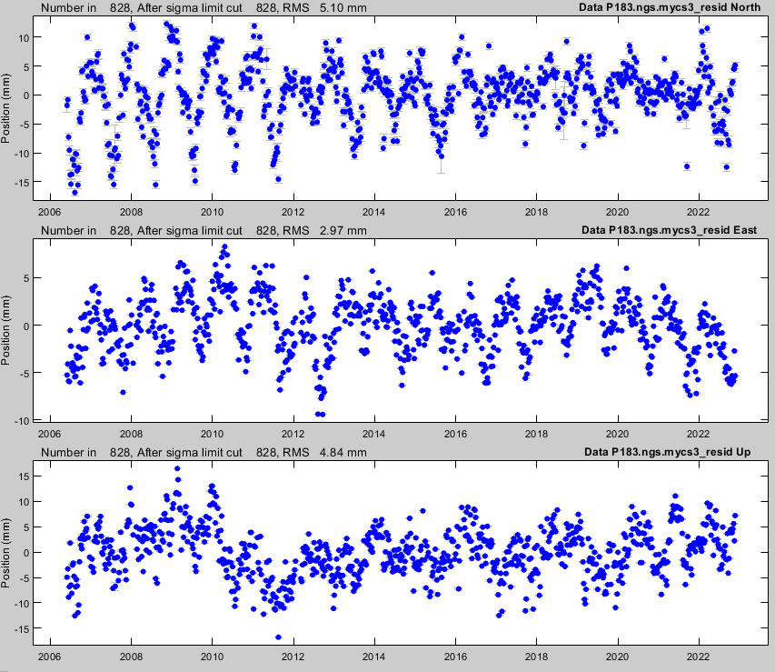
MYCS3 Results
Station Solution Examples – P183
WRMS: 2.16 mm
WRMS: 3.65 mm
WRMS: 4.72 mm
https://geodesy.noaa.gov/CORS/ncn_station_pages/index.html?stationID=P183

Slide 79
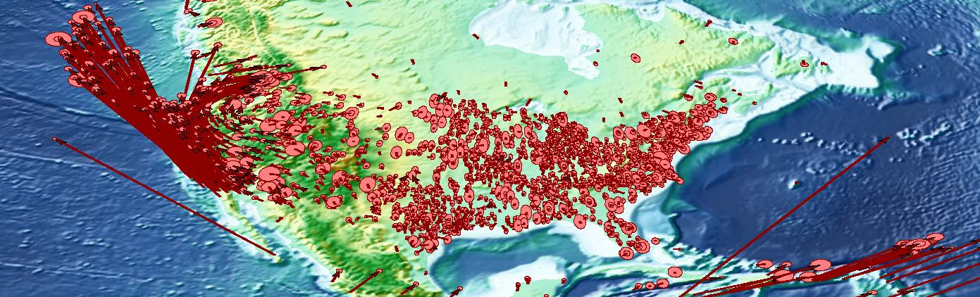
MYCS3 Results
CONUS velocity field

Slide 80
What is left to do?
Compute seasonal terms to add to CFs
Analyze noise characteristics of CFs to appropriately compute uncertainties for CF model parameters
Upload solution to database
Go live with solution in NGS apps (i.e. OPUS, station pages, etc.)

Slide 81
Acknowledgements
Co-authors: Rick Bennett and Amy Whetter
Contributors: Jordan Krcmaric, Lijuan Sun, Josh Jones
IT Support: Jason Stribling, David Gietka, Jose Duran
Technical Guidance: Zuheir Altamimi and Jarir Saleh

