Slide 1


The State Plane
Coordinate System
History, Policy, and Future Directions
Michael L. Dennis, RLS, PE
NOAA’s National Geodetic Survey

Slide 2
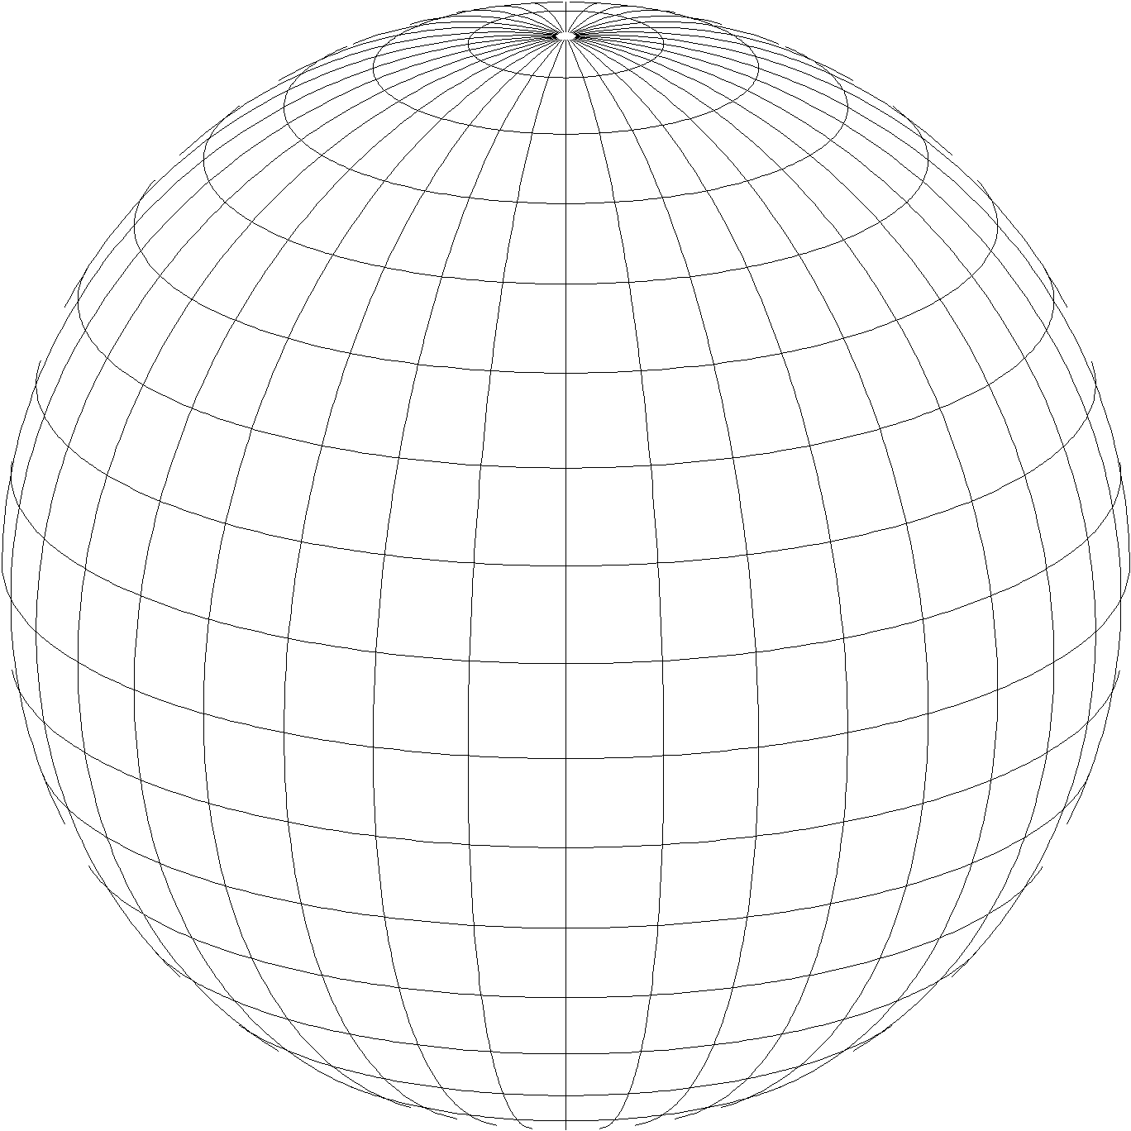
A New State Plane Coordinate System
State Plane Coordinate System of 2022 (SPCS202)
  Referenced to new 2022 Terrestrial Reference Frames (TRFs)
  Based on same reference ellipsoid (GRS 80)
  Same 3 conformal projection types:
Lambert Conformal Conic
Transverse Mercator
Oblique Mercator

Slide 3
Recent activity at NGS on State Plane
New report on State Plane history, policy, and future
  NOAA Special Publication NOS NGS 13
Draft SPCS2022 policy and procedures
  Defines characteristics and requirements for SPCS2022
  Instructions on state requests and proposals for their zones
Federal Register Notice (FRN) published April 18, 2018
  Requests public comment on policy and procedures
  Includes “special purpose” zones
State Plane NGS Webinar Series
  Given on March 8 and April 12 (recordings, slides, and Q&A documents available)

Slide 4
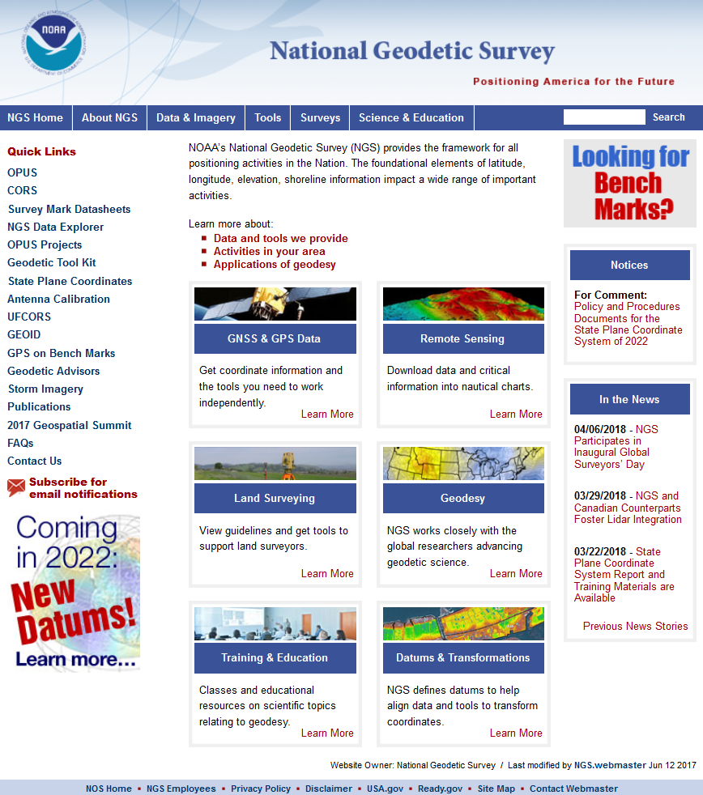
Why a new State Plane system?
geodesy.noaa.gov
New State Plane web pages
Required as part of new 2022 Terrestrial Reference Frames

Slide 5
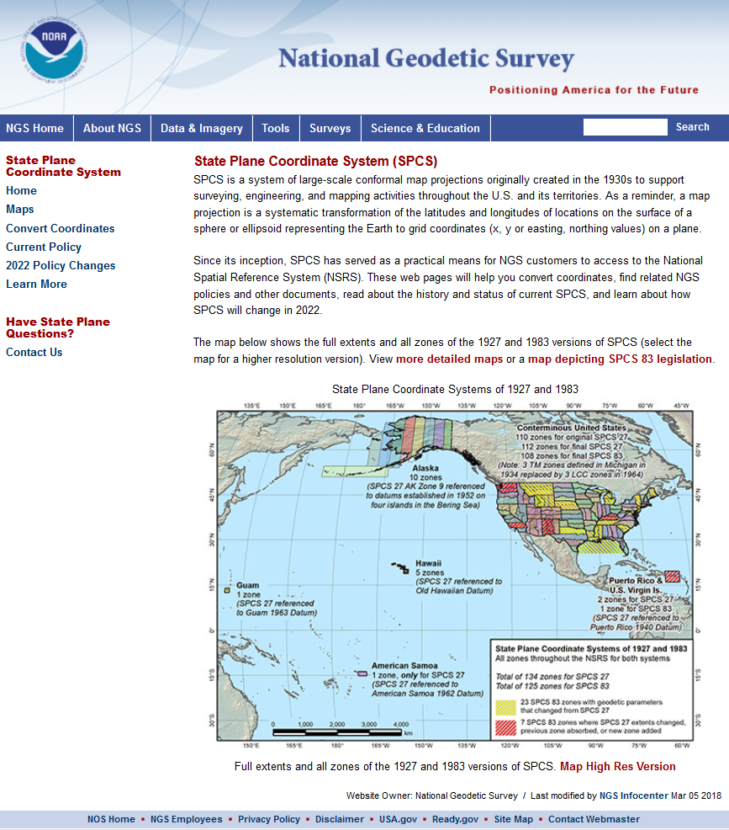
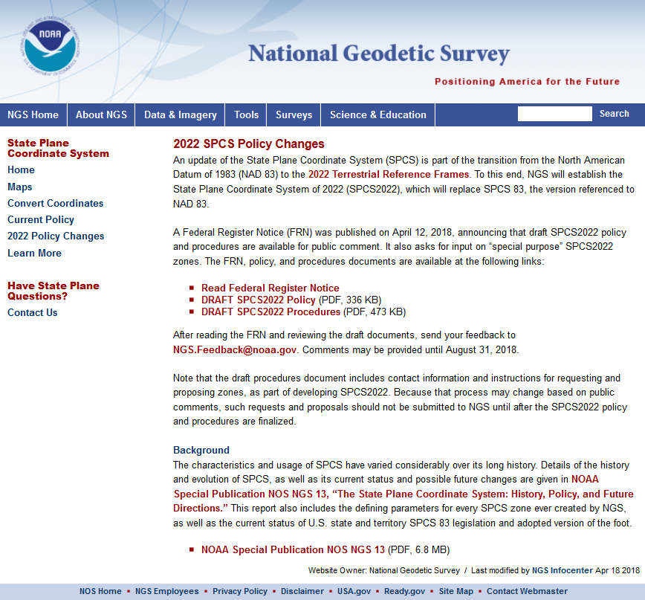
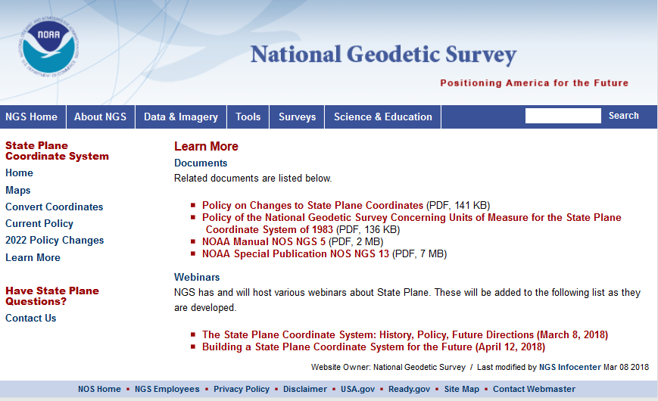
geodesy.noaa.gov/SPCS/

Slide 6
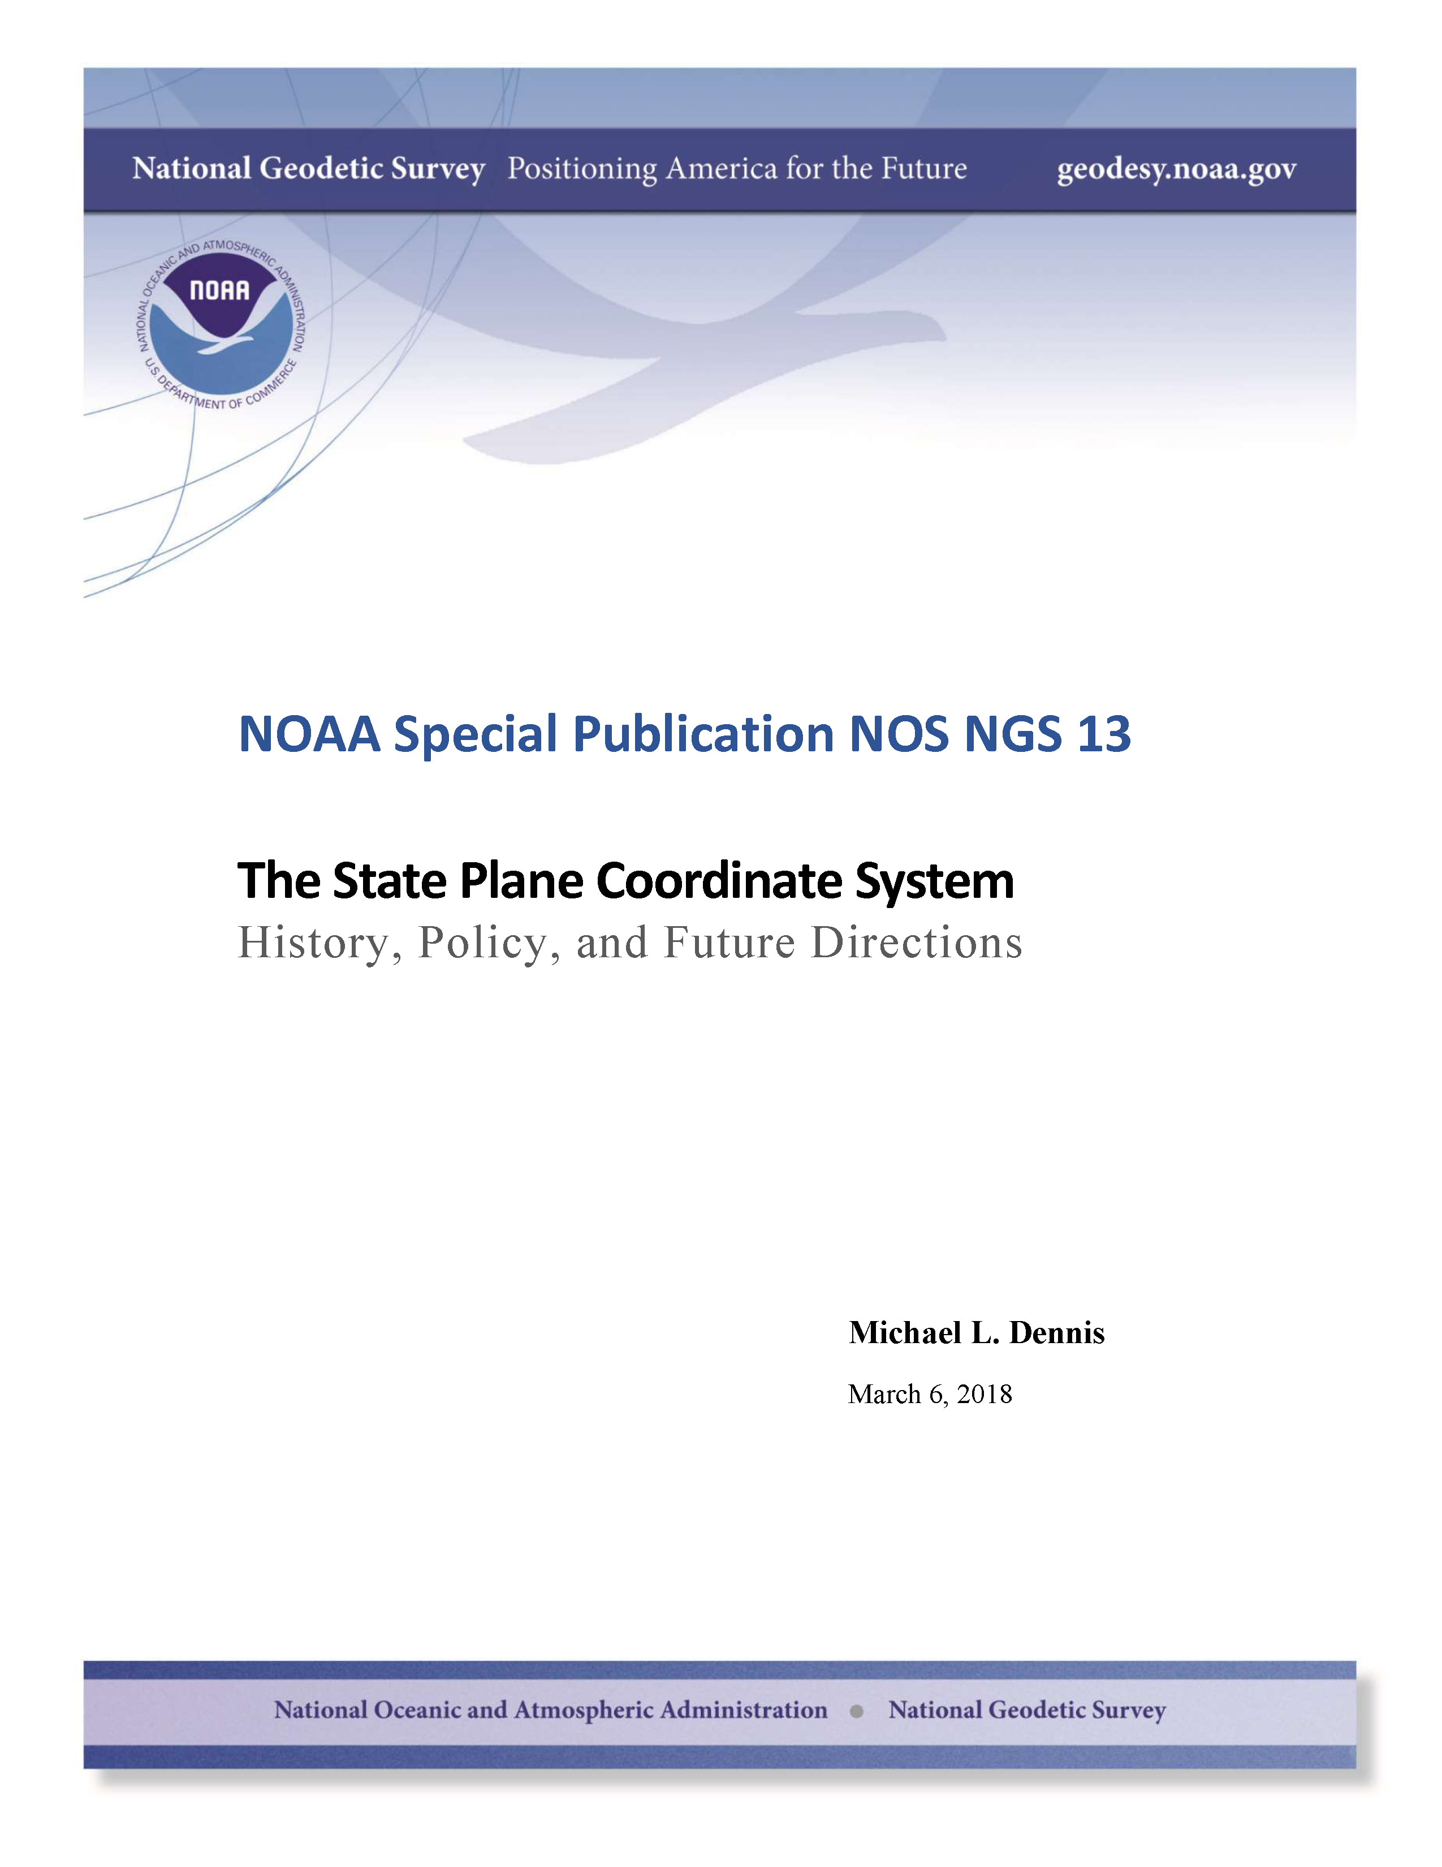
SPCS Special Publication
History of NGS projections (1853 to present)
SPCS policies and legislation
Departures from policy and convention
Recent developments in projected coordinate systems
Appendices
  Defining parameters for ALL zones of ALL versions of SPCS, plus additional information
  Status of SPCS 83 legislation and foot conversions
https://geodesy.noaa.gov/library/pdfs/ NOAA_SP_NOS_NGS_0013_v01_2018-03-06.pdf

Slide 7
History and future of State Plane
SPCS created 85 years ago
  SPCS 27: 1933 – 1986 (53 years, with some changes)
  SPCS 83: 1986 – 2022 (36 years, with some changes)
  SPCS2022: 2022 – ? (at least a few decades…)
SPCS2022 will likely be around for a long time
  Honor the history and legacy of SPCS…
  …while building a system for the future
High visibility and big impact

Slide 8
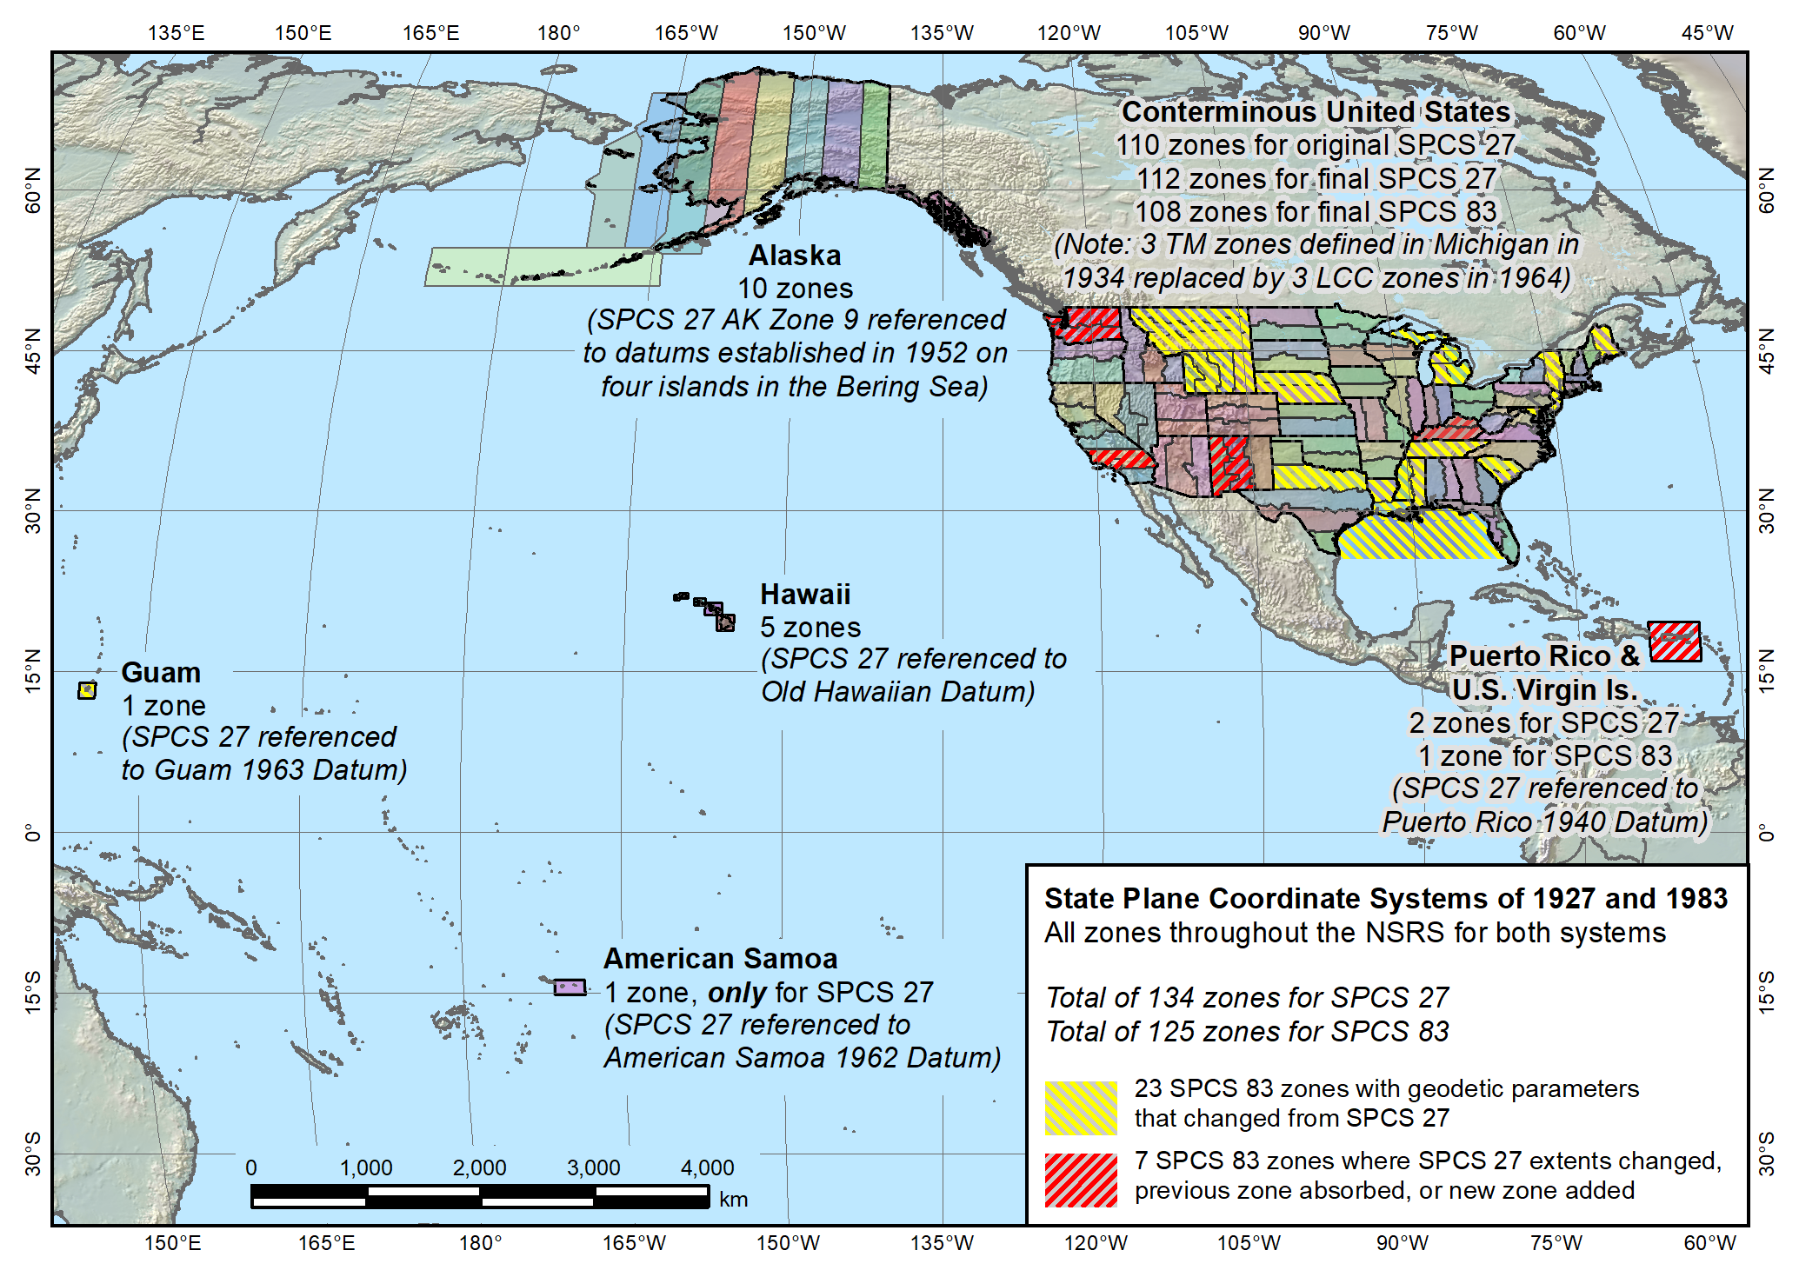
State Plane
Coordinate Systems
of 1927 (134 zones)
and 1983 (125 zones)
Reduced distortion zones added to SPCS 27:
CA 7 (1945) and MI (1964)
Guam SPCS 83 zone added in 1995
MT, NE, and SC changed from multiple to single zones from SPCS 27 to 83
Guam SPCS 27 zone a non-conformal projection
Kentucky statewide zone added in 2001
Puerto Rico and US Virgin Islands: Two zones in SPCS 27, one in SPCS 83
American Samoa only in SPCS 27, not SPCS 83

Slide 9
SPCS2022 characteristics (draft)
Technical requirements
  Linear distortion design criterion at topographic surface (not at ellipsoid surface)
    Difference in distance between “grid” and “ground”
  Use 1-parallel definition for LCC projections
Other characteristics
  Default designs (if no consensus stakeholder input)
  “Layered” zones
  Low-distortion projections (LDPs)
  “Special purpose” zones

Slide 10
Linear distortion with respect to ellipsoid
Projection
axis
Ellipsoid surface
Ellipsoid distance
Projection surface (secant)
Grid distance > ellipsoid distance
This design approach
used for SPCS 27 and 83 (minimizes distortion with respect to ellipsoid)
Ellipsoid distance
Grid distance <
ellipsoid distance

Slide 11
Linear distortion with respect to topographic surface
Horizontal ground distance
> ellipsoid distance
and
> grid distance
Topographic surface
Projection
axis
Ellipsoid surface
Ellipsoid distance
Projection surface (secant)
Grid distance
> ellipsoid distance
< ground distance
This design approach
used for SPCS 27 and 83 (minimizes distortion with respect to ellipsoid)
Ellipsoid distance
Grid distance
< ellipsoid distance
< ground distance

Slide 12
Linear distortion with respect to topographic surface
Horizontal ground distance
> ellipsoid distance
and
> grid distance
Topographic surface
Projection
axis
Ellipsoid surface
Ellipsoid distance
Grid distance
> ellipsoid distance
≈ ground distance
Projection surface (non-intersecting)
This design approach
will be used for SPCS2022 (minimizes distortion with respect to topography)

Slide 13
Linear distortion magnitudes ppm = parts per million (mm/km)
±20 ppm = 2 cm/km = 0.1 ft/mile = 1 : 50,000
  Often used as “low distortion” design criterion (at ground)
±50 ppm = 5 cm/km = 0.3 ft/mile = 1 : 20,000
  Min design criterion for SPCS2022 designs by NGS (at ground)
±100 ppm = 10 cm/km = 0.5 ft/mile = 1 : 10,000
  “Nominal” maximum State Plane value (on ellipsoid); Can be much greater at topo surface
±400 ppm = 40 cm/km = 2.1 ft/mile = 1 : 2,500
  Max design criterion for SPCS2022 zones (at ground); Max UTM value (on ellipsoid)

Slide 14
SPCS2022 characteristics (draft)
Technical requirements
  Linear distortion design criterion at topographic surface (not at ellipsoid surface)
    Difference in distance between “grid” and “ground”
  Use 1-parallel definition for LCC projections
Other characteristics
  Default designs (if no consensus stakeholder input)
  “Layered” zones
  Low-distortion projections (LDPs)
  “Special purpose” zones

Slide 15
Why a 1-parallel Lambert Conformal Conic?
Consistency
  Explicitly define projection scale (same as TM and OM)
  Can use same number of parameters as TM
  Applicable to both “secant” and “non-intersecting” cases
Simplicity
  Easier to design with respect to topography
  Scale due to separation of 2 standard parallels not obvious
  Can more readily use “clean” values for parallels
Mathematically identical to 2-parallel
  Any 2-parallel LCC can be recast as 1-parallel that behaves exactly the same

Slide 16
SPCS2022 characteristics (draft)
Technical requirements
  Linear distortion design criterion at topographic surface (not at ellipsoid surface)
    Difference in distance between “grid” and “ground”
  Use 1-parallel definition for LCC projections
Other characteristics
  Default designs (if no consensus stakeholder input)
  “Layered” zones
  Low-distortion projections (LDPs)
  “Special purpose” zones

Slide 17
Default SPCS2022 designs (draft)
Default needed in absence of stakeholder input
Same projections and zones for most SPCS 83 zones
Performance and coverage very similar to SPCS 83
Characteristics that differ from SPCS 83:
  Projection scale modified to minimize distortion at ground
  Lambert Conformal Conic converted to one-parallel type
  But a few zones may use different projections and zone extents

Slide 18
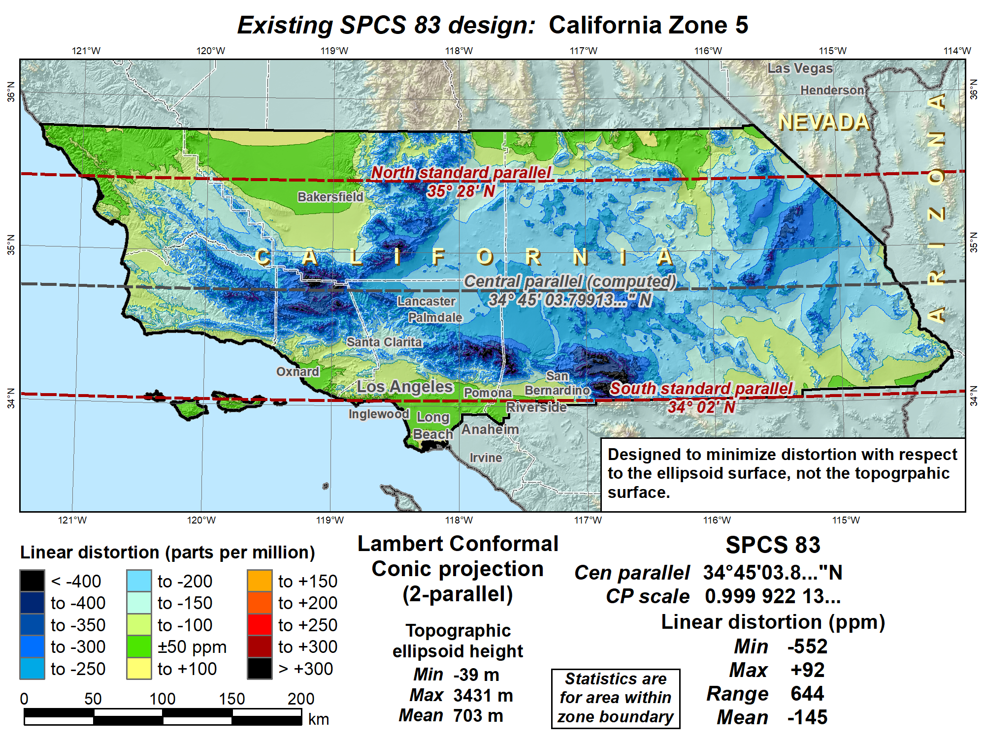
Distortion in cities:
Range = 438 ppm
Median = -62 ppm
Mean = -31 ppm (weighted by pop)

Slide 19
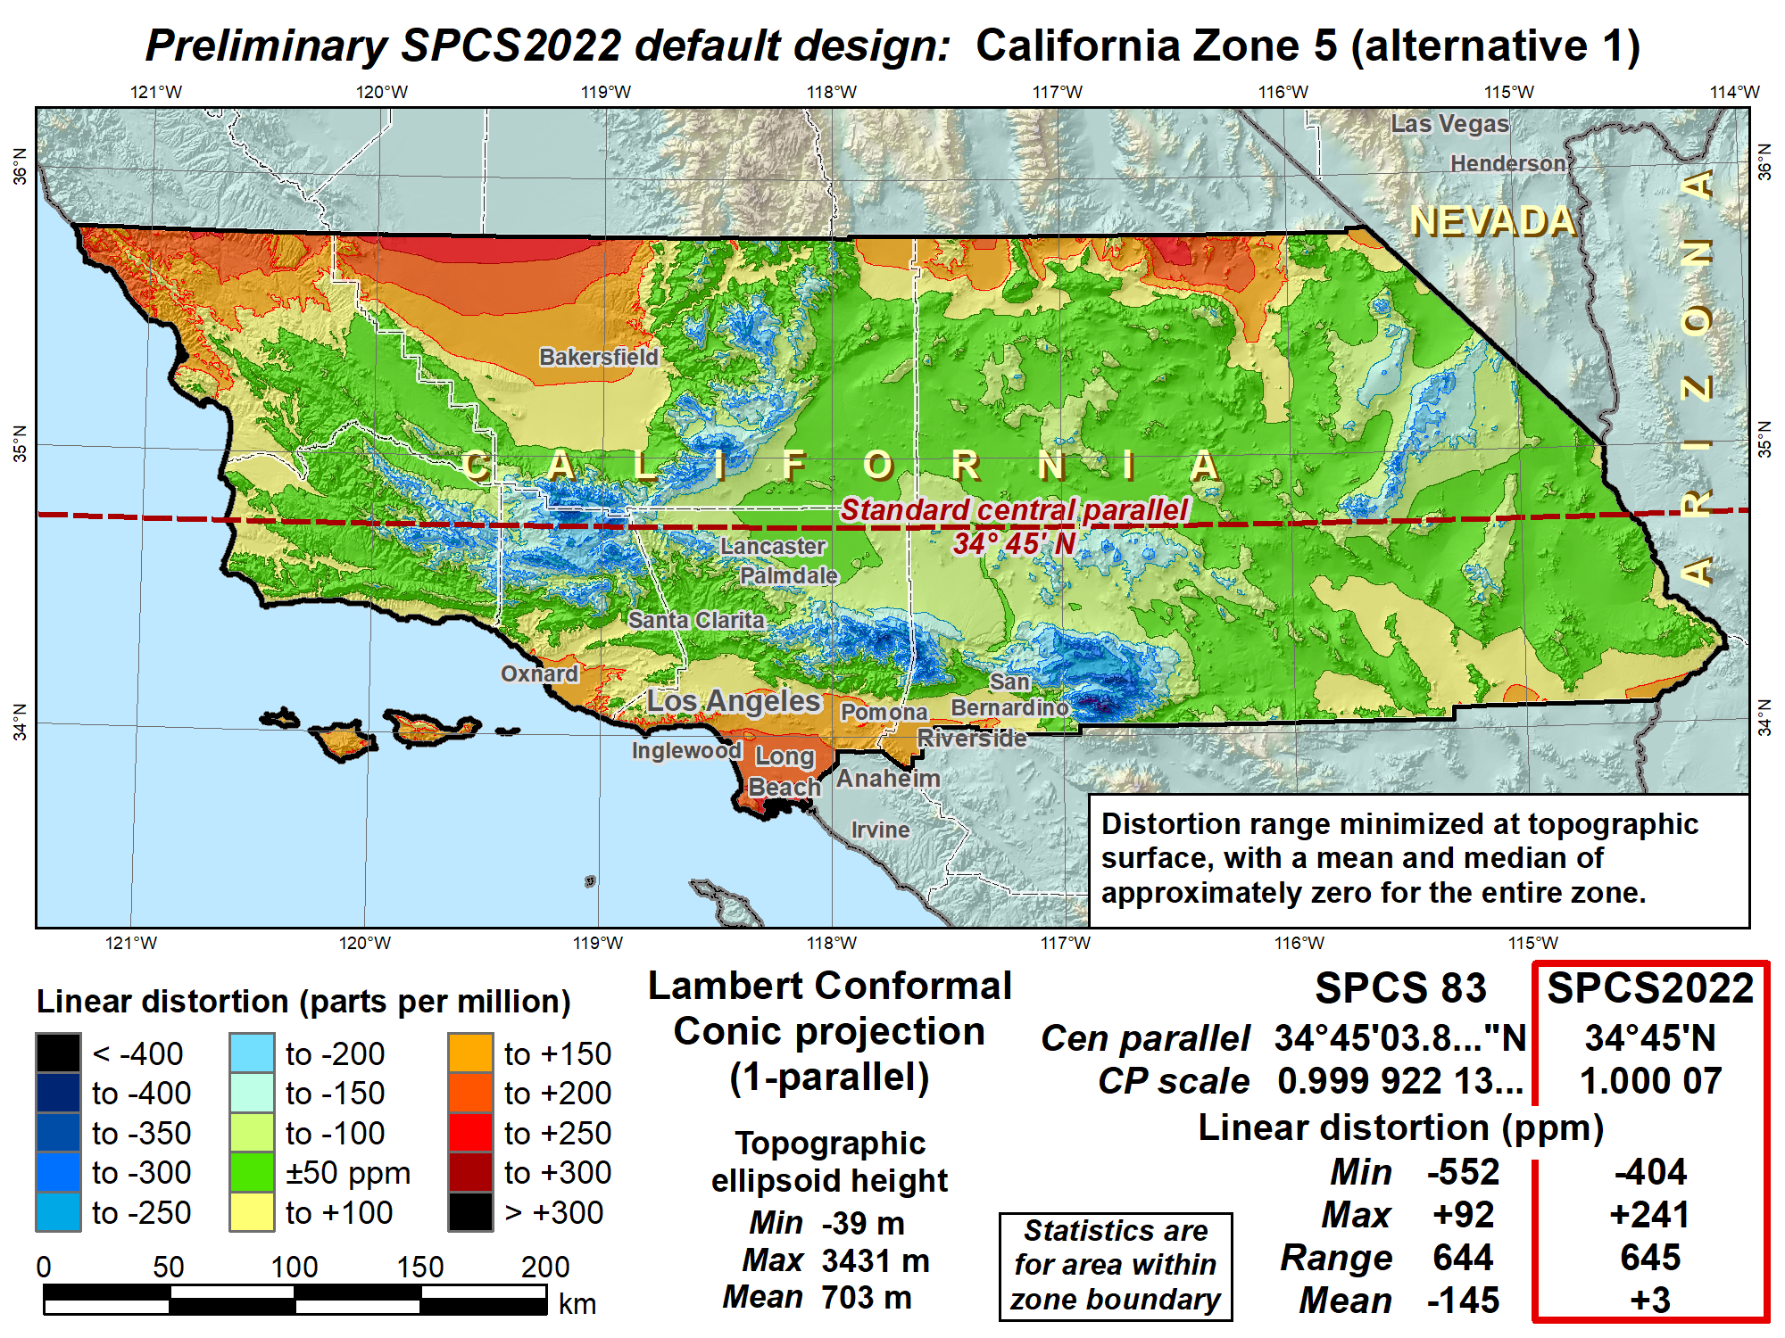
Distortion in cities:
Range = 438 ppm
Median = +86 ppm
Mean = +117 ppm (weighted by pop)
No change in projection type or zone extents

Slide 20
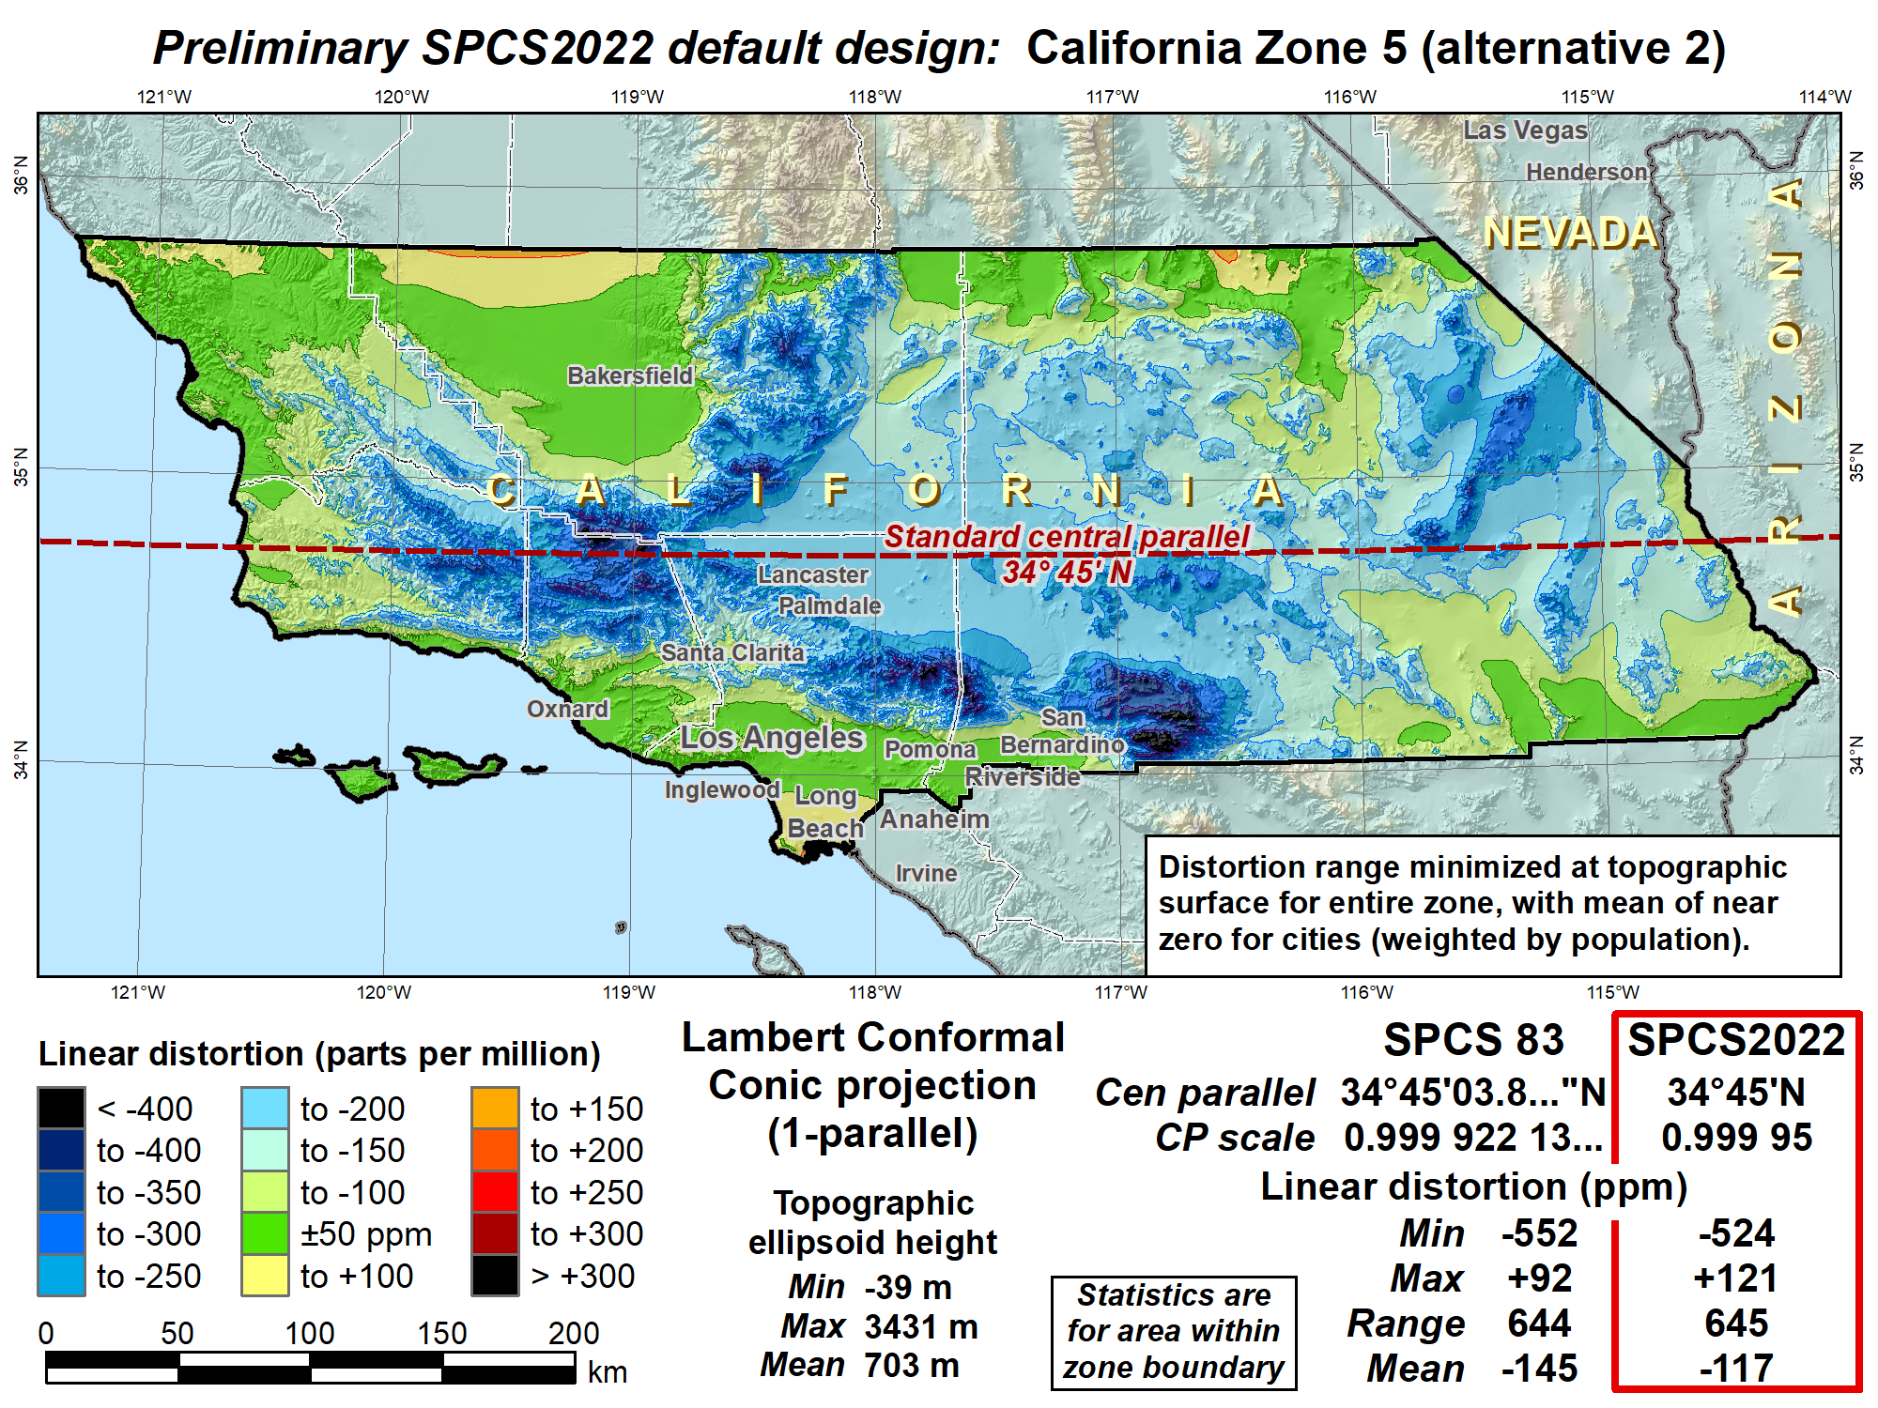
Distortion in cities:
Range = 438 ppm
Median = -34 ppm
Mean = -3 ppm (weighted by pop)
No change in projection type or zone extents

Slide 21
Distortion in cities:
Range = 438 ppm
Median = -62 ppm
Mean = -31 ppm (weighted by pop)

Slide 22
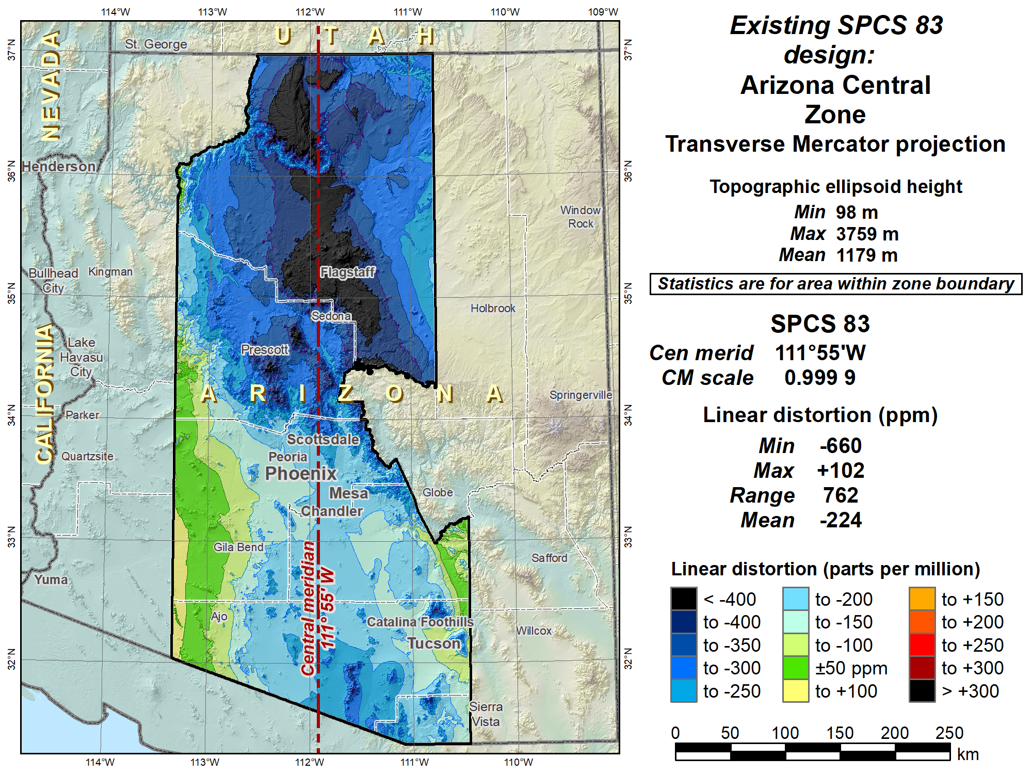
Distortion in cities:
Range = 544 ppm
Median = -164 ppm
Mean = -151 ppm (weighted by pop)

Slide 23
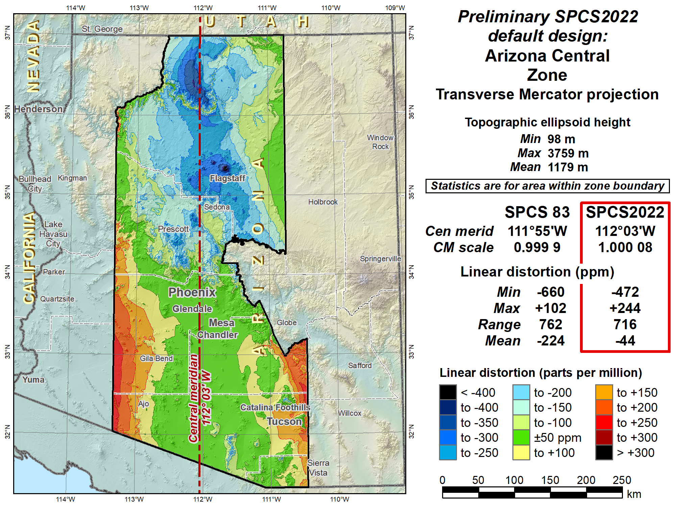
Distortion in cities:
Range = 511 ppm
Median = +23 ppm
Mean = +34 ppm (weighted by pop)
No change in projection type or zone extents

Slide 24
“Layered” zones (draft)
Limitations
  Max of TWO layers: Statewide and sub-zones
  If two layers, one MUST be statewide
  Minimum sub-zone dimension > 50 km wide
States often want statewide and small zones
  Statewide: Single geometry required for state GIS
  Sub-zones: Lower distortion for surveying/engineering
Accommodates state needs, but with restrictions
  Prevent poor design choices for statewide zones (and one already exists…)

Slide 25
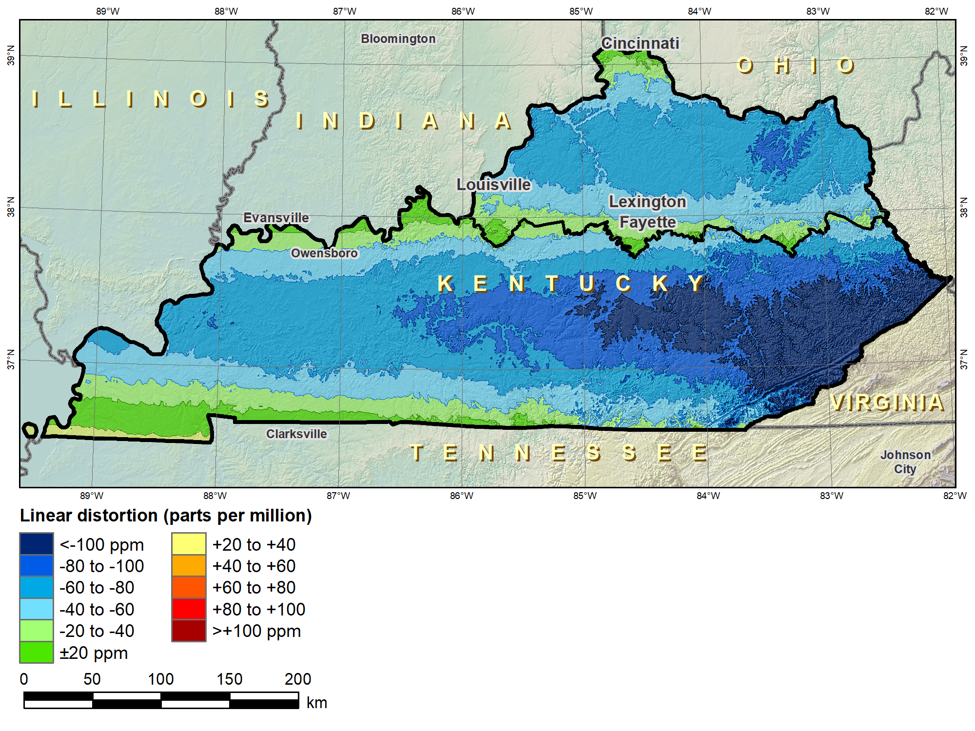
“Layered” zones
SPCS 83 Kentucky N and S zones (Lambert Conformal Conic)
 |  | North | South
N parallel |  | 38°58’N | 37°56’N
S parallel |  | 37°58’N | 36°44’N
 |  | Distortion (ppm)
Min |  | -93 | -211
Max |  | +17 | +42
Mean |  | -56 | -67

Slide 26
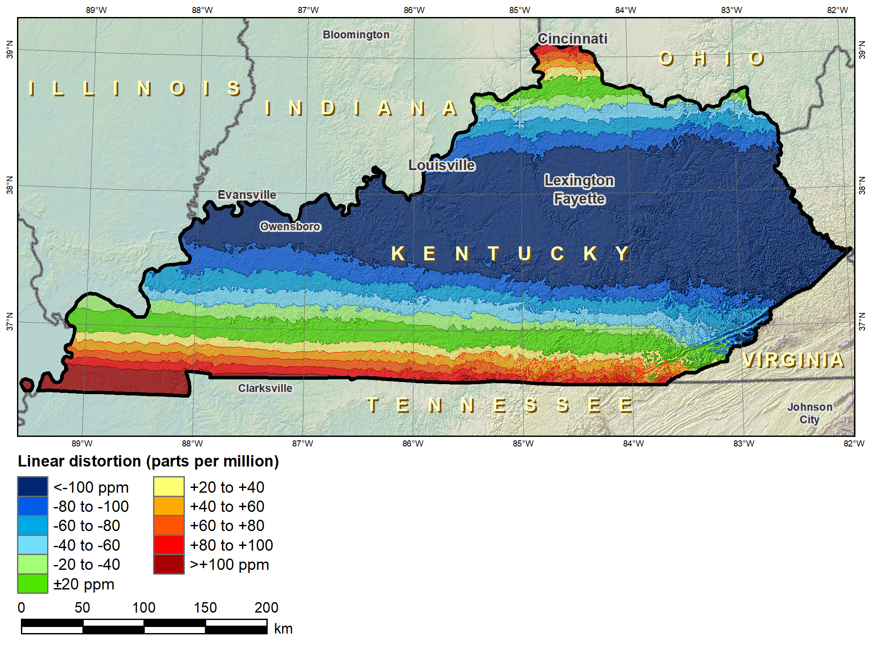
“Layered” zones
SPCS 83 Kentucky statewide zone (Lambert Conformal Conic)
 |  | North | South | Statewide
N parallel |  | 38°58’N | 37°56’N | 38°40’N
S parallel |  | 37°58’N | 36°44’N | 37°05’N
 |  | Distortion (ppm)
Min |  | -93 | -211 | -166
Max |  | +17 | +42 | +181
Mean |  | -56 | -67 | -58

Slide 27
Linear distortion design criteria (draft)
NGS design of zones requested by stakeholders
  Limited to zones with 50-400 ppm distortion criterion
    50 ppm = 5 cm/km = 0.3 ft/mi = 1:20,000
    400 ppm = 40 cm/km = 2.1 ft/mi = 1:2,500
Design criterion < 50 ppm (“low distortion”)
  Min criterion 20 ppm = 2 cm/km = 0.1 ft/mi = 1:50,000
  Must be designed by others (not by NGS)
  Proposed and final design reviewed by NGS
What is the current situation with “low distortion” projected coordinate systems?

Slide 28
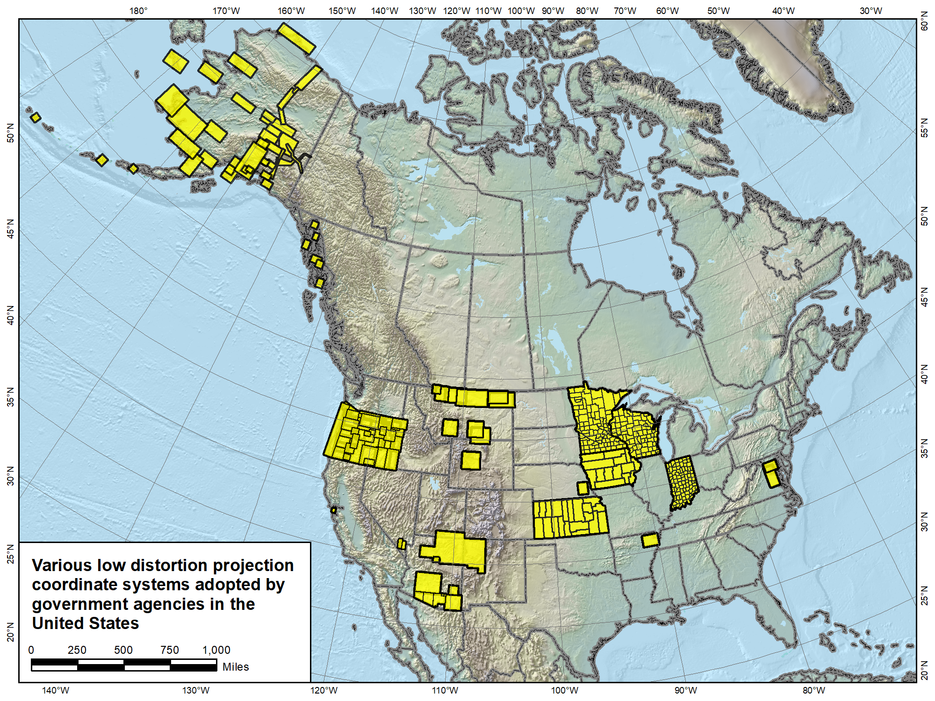

Slide 29
“Special purpose” zones (in FRN)
For areas with inadequate SPCS zone coverage
  Usually areas that are in more than one zone
Categories:
  Major urban areas (e.g., New York, Chicago, St. Louis)
  Large Indian reservations (e.g., Navajo Nation)
  Federal applications covering large areas (e.g., coastal mapping of Atlantic Coast)
Permitted for metro areas in 1977 policy (but never used)
Only in FRN, not in draft policy & procedures
  Intent is to get input on concept first

Slide 30
Deadlines for SPCS2022 input
NGS.Feedback@noaa.gov by August 31, 2018
Response to Federal Register Notice (FRN)
  On draft SPCS2022 policy & procedures
  Includes input on “special purpose” zones
Consensus input per SPCS2022 procedures
  Requests are for designs done by NGS
  Proposals are for designs by contributing partners
Submittal of approved designs
  Proposal must first be approved by NGS
  Designs must be complete for NGS to review
NGS.SPCS@noaa.gov
by December 31, 2019 for requests and proposals
by December 31, 2020 for submittal of approved designs

Slide 31
Summary
State Plane Coordinate System of 2022
State Plane has a long and varied history
Main characteristics of SPCS2022 (draft)
  Designed with respect to “ground”
  Use 1-parallel definitions for LCCs
  Default designs similar to existing State Plane
  Can include a statewide zone plus a sub-zone layer
  LDPs can be used but must be designed by others
Federal Register Notice for public comment on policy & procedures
CONSENSUS state stakeholder input required for requests and proposals
Questions about State Plane? NGS.SPCS@noaa.gov
Want to respond to the FRN? NGS.Feedback@noaa.gov

