Slide 1
State Plane Coordinate System of 2022 and associated datum changes
American Association of State Geologists
Silver Spring, MD
February 28, 2019
Michael Dennis, PhD, PE, RLS,
Michael.Dennis@noaa.gov

Slide 2


geodesy.noaa.gov

Slide 3
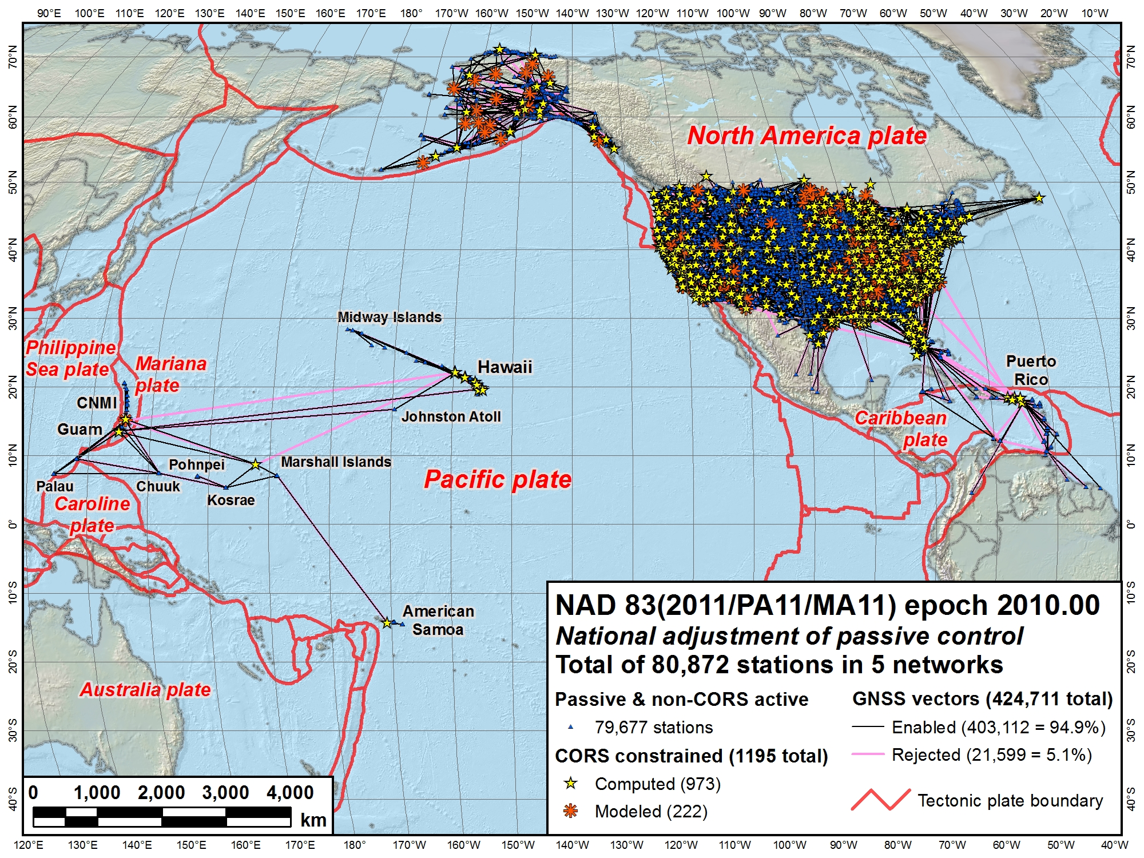
NAD 83 (2011)
NAD 83
(MA11)
NAD 83 (PA11)
North American Datum of 1983
Three current frames (all at epoch 2010.0):
NAD 83 (2011): North America and Caribbean plates
NAD 83 (PA11): Pacific plate
NAD 83 (MA11): Mariana plate
Notes:
This the current situation with geometric reference frames (“horizontal datums”) of the NSRS
There are 3 separate (but related) frames, all called North American Datum of 1983 (NAD 83)
Each is nominally referenced to a different tectonic plate, indicated by the “datum tag” in parentheses:
(2011): North America plate. Includes CONUS, Alaska, and the Caribbean (but not referenced to Caribbean plate)
(PA11): Pacific plate. Includes Hawaii and American Samoa
(MA11): Mariana plate. Includes Guam and the Commonwealth of the Northern Mariana Islands (CNMI)
Each of these frames is semi-dynamic, with the intent that the frame moves with the tectonic plate (to reduce change in coordinates with time)
But the plate motion is not necessarily well modeled
In addition, the frames are not geocentric (offset from Earth center of mass by about 2 meters)

Slide 4
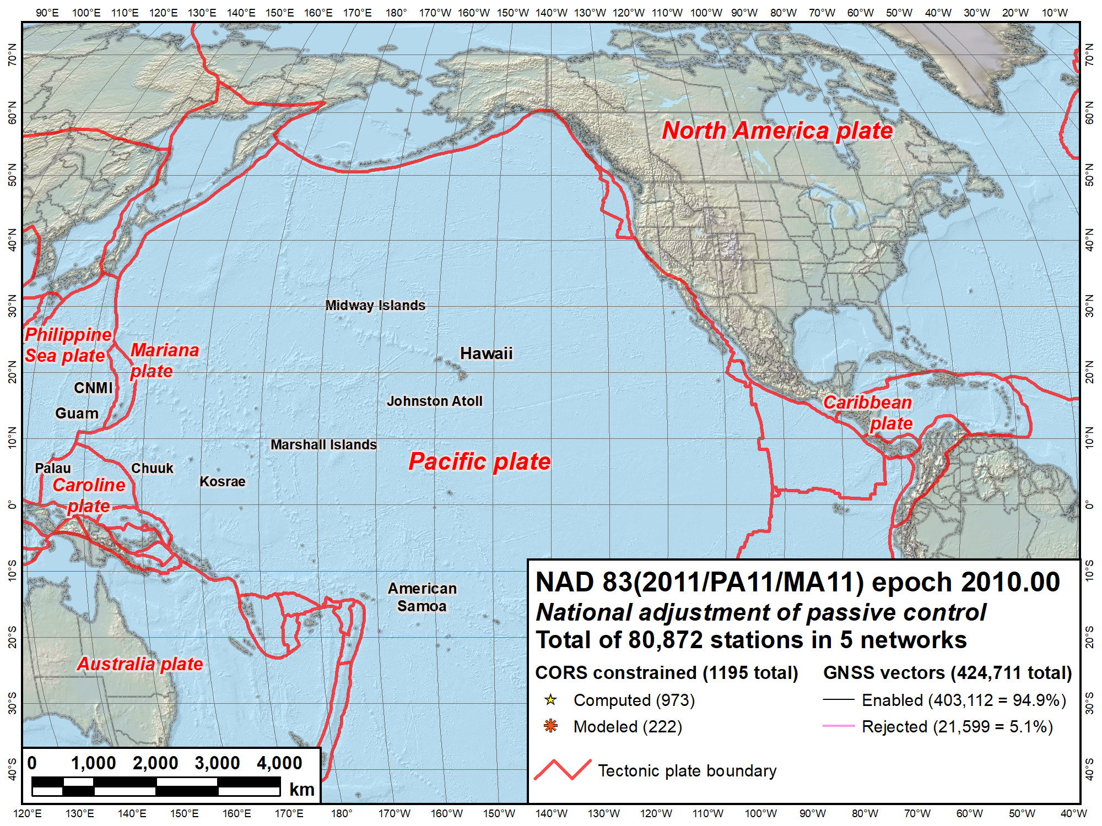
NAVD 88
IGLD 85
NAVD 88
PRVD02
NMVD03
VIVD02
GUVD04
Current vertical datums of the NSRS
ASVD02
NA and Caribbean
NAVD 88
IGLD 85
PRVD02
VIVD09
Pacific
GUVD04
NMVD03
ASVD02
Notes:
This the current situation with vertical datums of the NSRS
There are 7 different vertical datums, all based on differential leveling to give orthometric heights (except for IGLD 85)
North American Vertical Datum of 1988 (NAVD 88): CONUS and Alaska
International Great Lakes Datum of 1985 (IGLD 85): Derived from NAVD 88 for Great Lakes using lake water levels. Uses dynamic (not orthometric) heights for water levels and flow.
Puerto Rico Vertical Datum of 2002
Virgin Islands Vertical Datum of 2009
Guam Vertical Datum of 2004
Northern Mariana Vertical Datum of 2003
American Samoa Vertical Datum of 2002 (in process of being deprecated due to earthquakes)
Have so many because cannot level across substantial expanses of water
Since based on (often old) leveling, susceptible to obsolescence due to height change (e.g., subsidence, earthquakes) and loss of bench marks over time

Slide 5
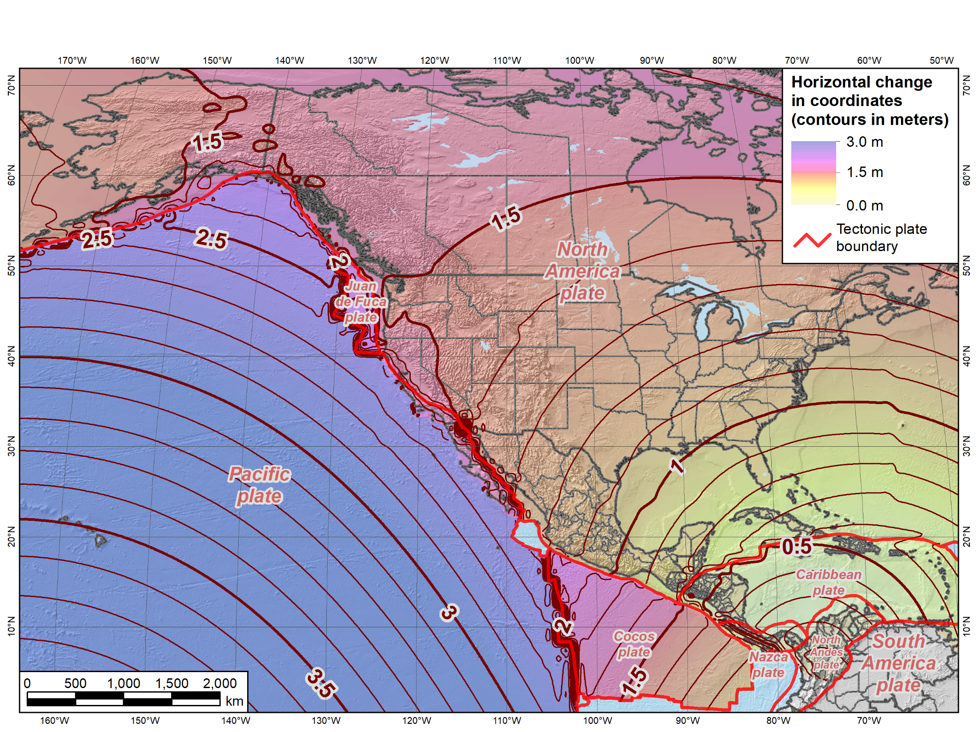
Horizontal change in coordinates: NAD 83 epoch 2010.0 → TRF2022 epoch 2020.0
NATRF2022
PATRF2022
CATRF2022
Notes:
Map showing change in horizontal coordinates from current NAD 83 epoch 2010.0 to the TRFs at epoch 2020.0
Shows NATRF2022, CATRF2022, PATRF2022 (but not MATRF2022)
Note that first reference epoch will be 2020.0 when released in 2022
Magnitude of change varies with tectonic plate (and location on plate):
0.8 to 1.7 m in CONUS and Alaska (but up to ~2 m in California)
0.6 m in Puerto Rico
Much greater on Pacific plate (3.5 m in Hawaii)
TRF2022 coordinates will change very slowly at most locations on their respective plates

Slide 6
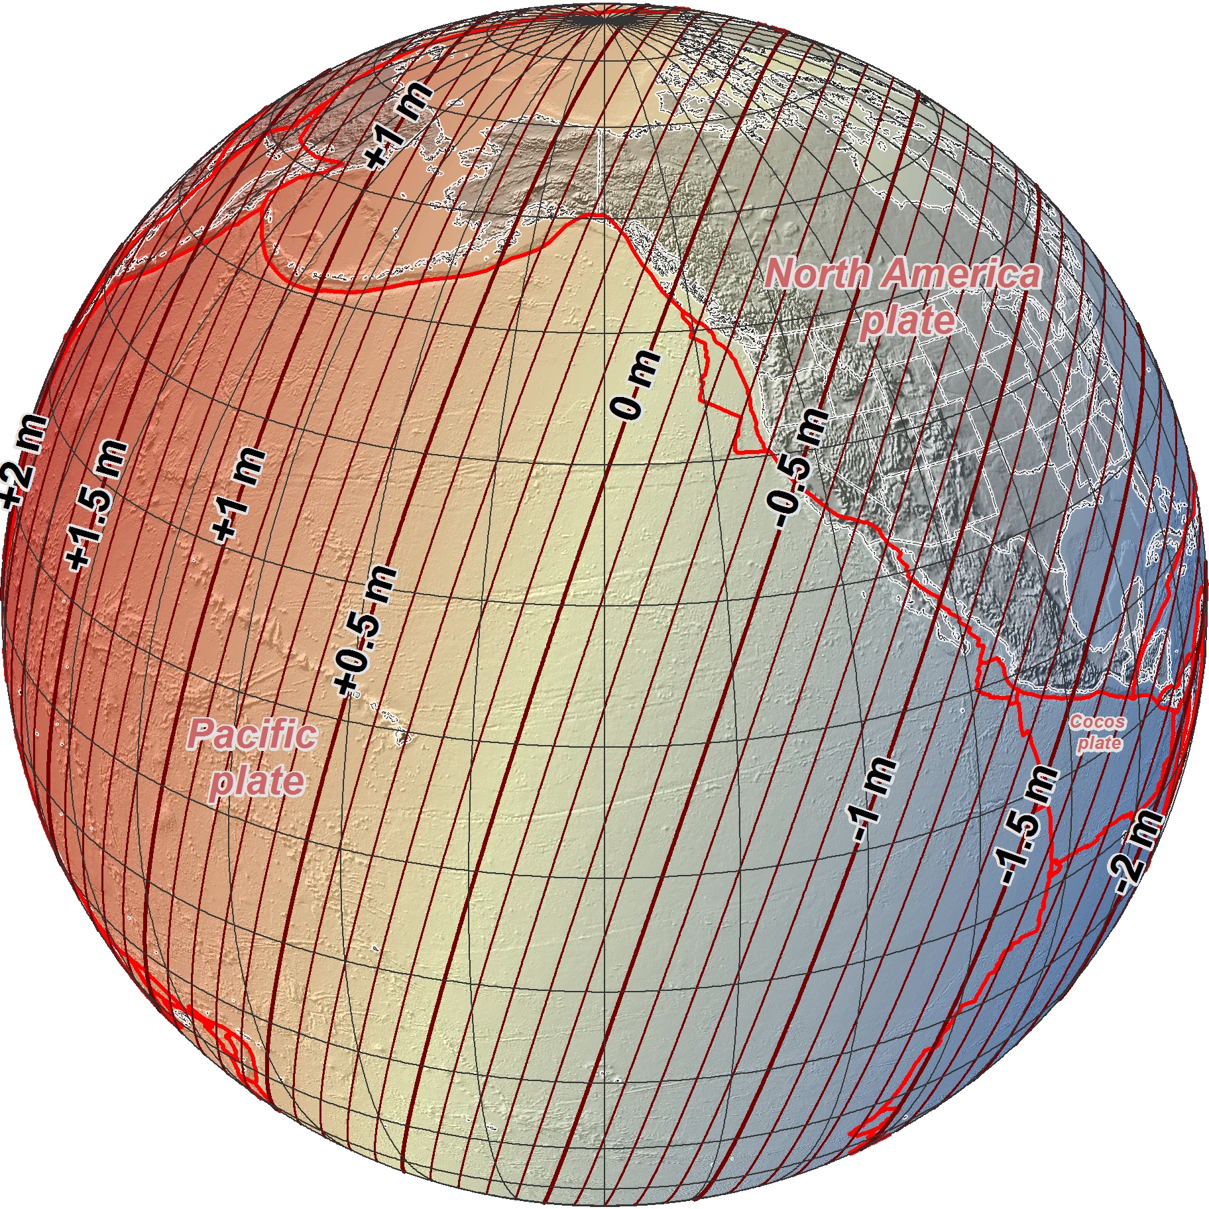
NAD 83 epoch 2010.00 →
2022 Terrestrial
Reference Frames
Change in ellipsoid heights at epoch 2020.00
(contours in meters)
Notes:
Map showing change in ellipsoid heights from current NAD 83 epoch 2010.0 to the TRFs at epoch 2020.0
Change is about ±2 m, which is the amount of non-geocentricity of NAD 83 (essentially shifting entire ellipsoid by ~2 m)
Change depends only on location, independent of tectonic plate rotation (which is modeled as purely horizontal)
2022 TRF ellipsoid heights are identical to ITRF2014 ellipsoid heights
Although given here for epoch 2020.0, overall ellipsoid heights change very slowly with time
But large changes do occur, due to local effects like subsidence and regional effects like post-glacial isostatic adjustment

Slide 7
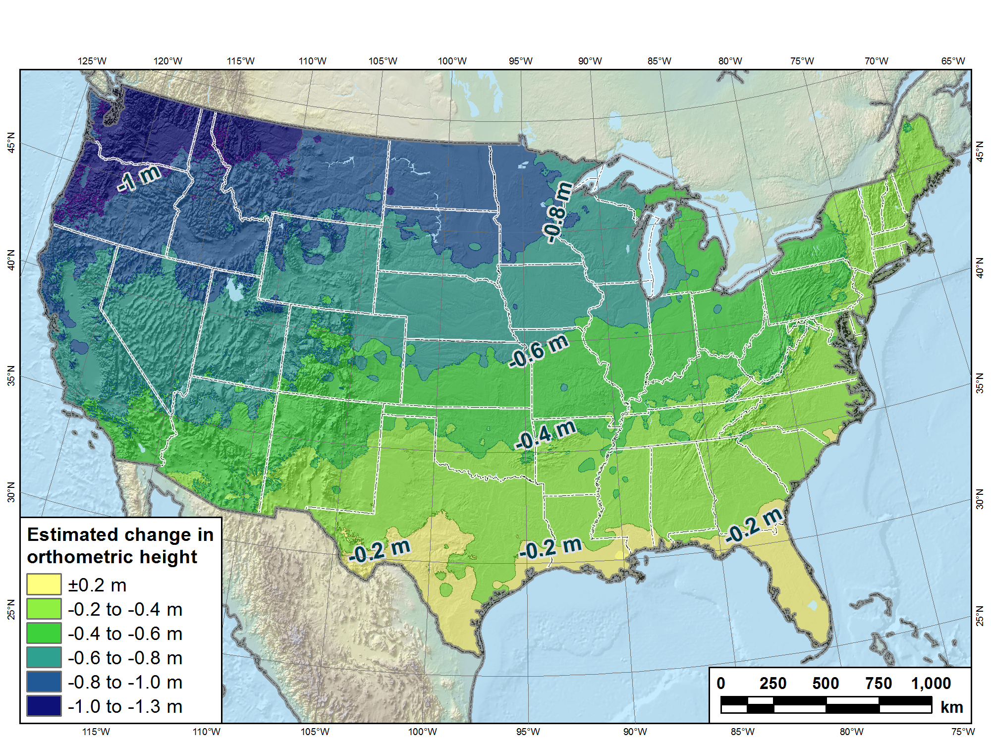
Estimated change in orthometric heights from NAVD 88 to NAPGD2022
NAPGD2022 approximated using xGEOID16B
Notes:
Map showing estimated change in orthometric heights (“elevations”) from NAVD 88 to NAPGD2022 for CONUS
Orthometric heights will decrease in most areas, from about zero in Florida to -1.3 m in Pacific Northwest
Heights in southern Florida will increase by up to +0.2 m
Tilt and bias of NAVD 88 likely due to accumulation of systematic errors in leveling used in its original realization (constrained to single point in St. Lawrence Seaway).

Slide 8
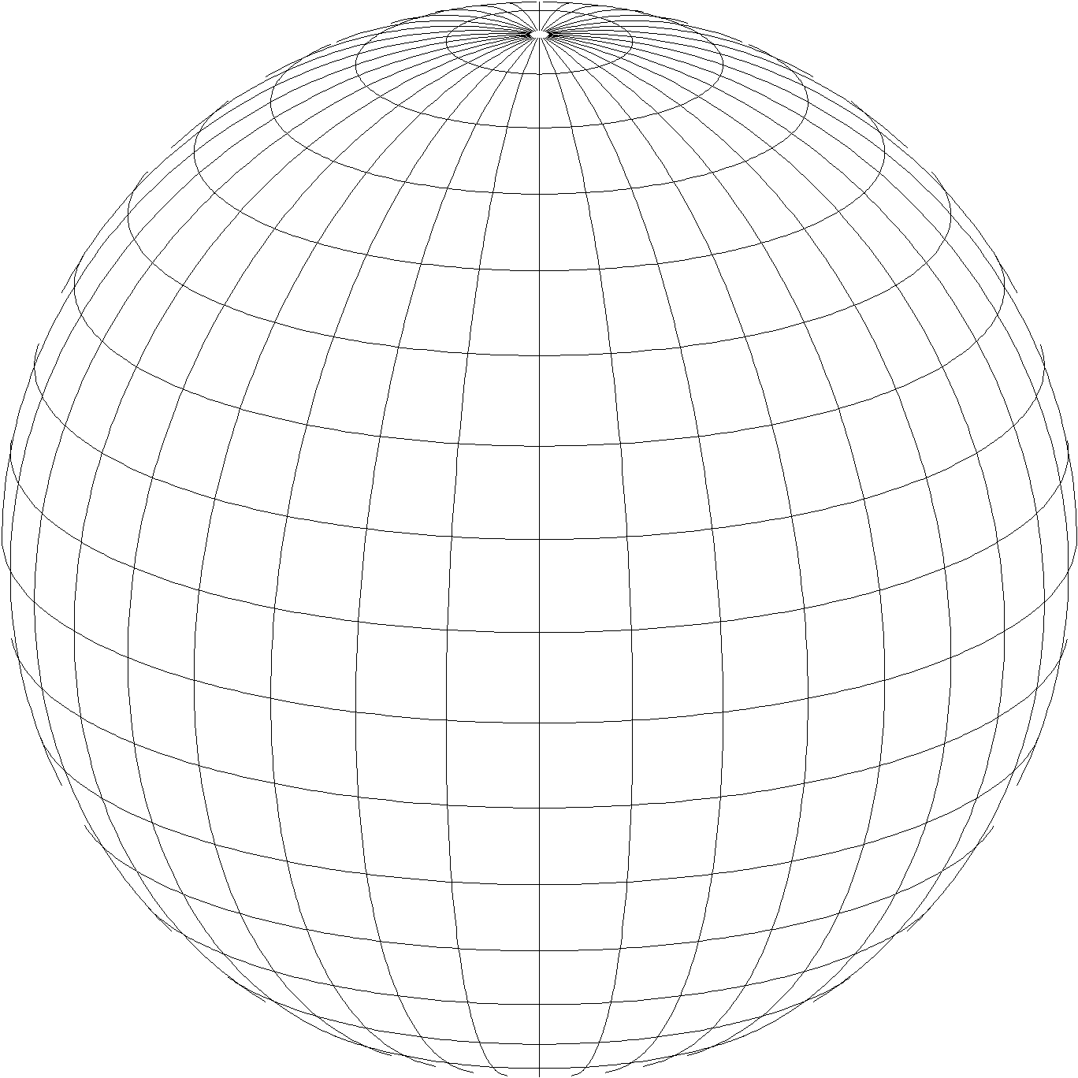
A New State Plane Coordinate System
State Plane Coordinate System of 2022 (SPCS2022)
  Referenced to 2022 Terrestrial Reference Frames (TRFs)
  Based on same reference ellipsoid as SPCS 83 (GRS 80)
  Same 3 conformal projection types as SPCS 83 and 27:
Lambert Conformal Conic (LCC)
Transverse Mercator (TM)
Oblique Mercator (OM)
Notes:
Now for the second part of the presentation, on new State Plane Coordinates
State Plane Coordinate System of 2022 (SPCS2022) is also part of modernizing the NSRS
Referenced to the new 2022 TRFs (not to NAD 83)
But still uses same reference ellipsoid (GRS 80) and same 3 conformal projections

Slide 9
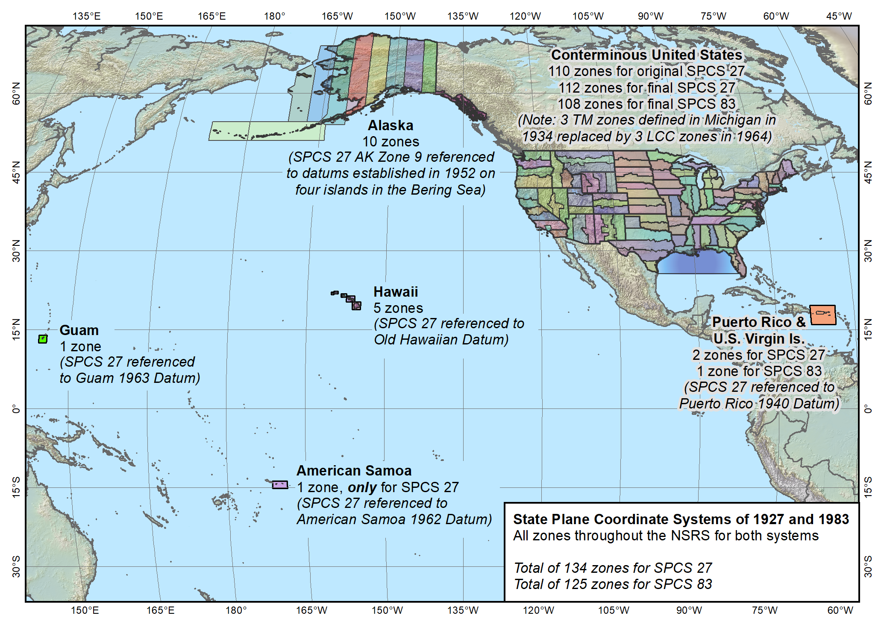
Entire SPCS
State Plane Coordinate Systems of 1927 (134 zones) and 1983 (125 zones)
Notes:
Map of the overall existing and previous versions of SPCS (1983 and 1927)
Shows the full large extent of the system.
Include CONUS, Alaska, and Hawaii
Also includes territories of Puerto Rico, U.S. Virgin Islands, American Samoa, and Guam (American Samoa included in SPCS 27 but not in 83)
Does NOT include Washington DC or islands of CNMI (but those will be included in SPCS2022)

Slide 10
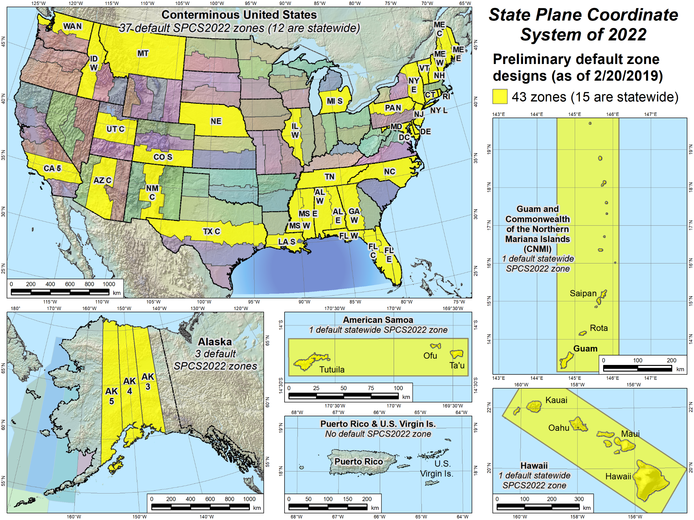
Default zones
Notes:
Larger scale maps of the areas included in the NSRS where SPCS2022 zones will be established
Yellow zones are preliminary designs of SPCS2022 default zones that have been completed.
Some of the default zones are statewide (or territory-wide, as the case may be)
Maps for (most of) these designs are currently available for download, along with maps of the corresponding SPCS 83 zones for comparison (will show examples).

Slide 11
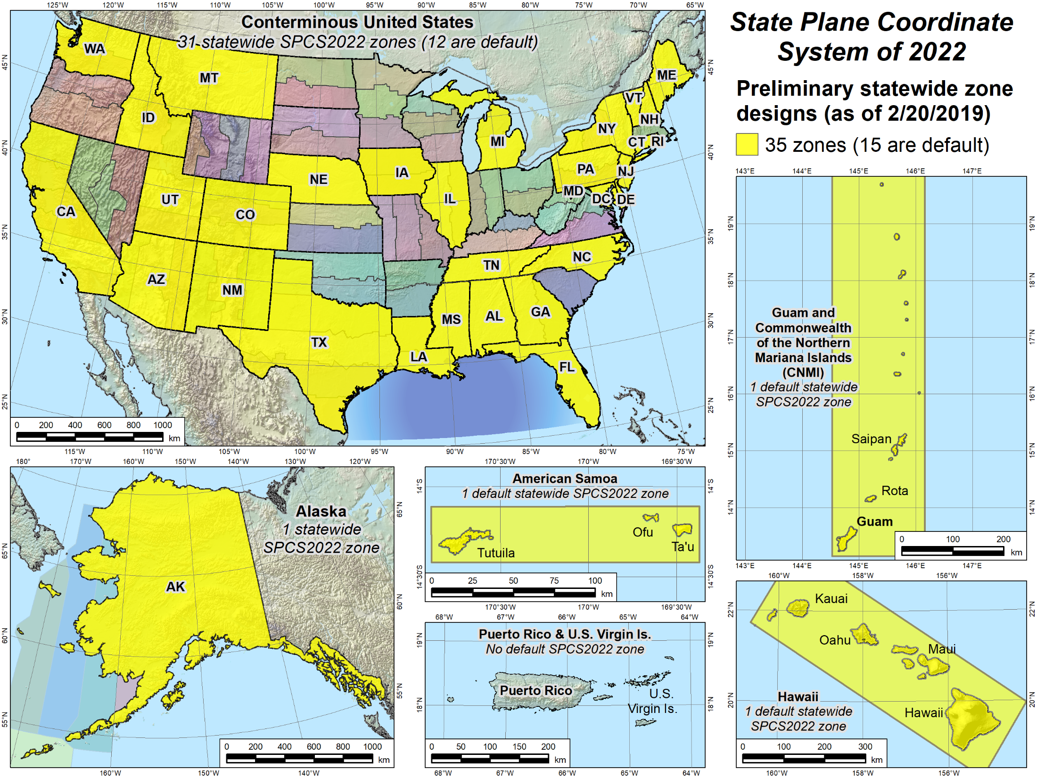
Statewide zones
Notes:
Similar to previous slide, but showing statewide SPCS2022 zones that have preliminary designs and maps available for download.
Note that some of the statewide zones are the same as the default zones in the previous slide
Note also that some states have a preliminary statewide zone design but no default zone design (e.g., Iowa).
States with no default design are ones that will design their own LDP system that provides statewide coverage and will not use the NGS default designs (that correspond to the existing SPCS 83 zones)
Reminder: All sates will get a statewide zone

Slide 12
Linear distortion with respect to ellipsoid
Projection
axis
Projection surface (secant)
Ellipsoid distance
Grid distance > ellipsoid distance
Ellipsoid distance
Ellipsoid surface
This design approach
used for SPCS 27 and 83 (minimizes distortion with respect to ellipsoid)
Grid distance <
ellipsoid distance

Slide 13
“Non-intersecting” conformal map projection
Topographic surface
Grid distance = ground distance at a point
Projection
axis
Grid distance = ground distance at a point
Non-intersecting
Grid distance ≈ ground distance over finite distance
Purpose is to reduce linear distortion at “ground” (topographic surface).
But distortion can vary considerably across area of interest.
Ellipsoid surface

Slide 14
“Non-intersecting” conformal map projection
Topographic surface
Projection
axis
Non-intersecting
Ellipsoid surface

Slide 15
Changing projection axis to reduce distortion variation
Topographic surface
Grid distance = ground distance at many points
Projection
axis
Non-intersecting
Ellipsoid surface
This design approach is being used for SPCS2022 (minimizes distortion with respect to topography)

Slide 16
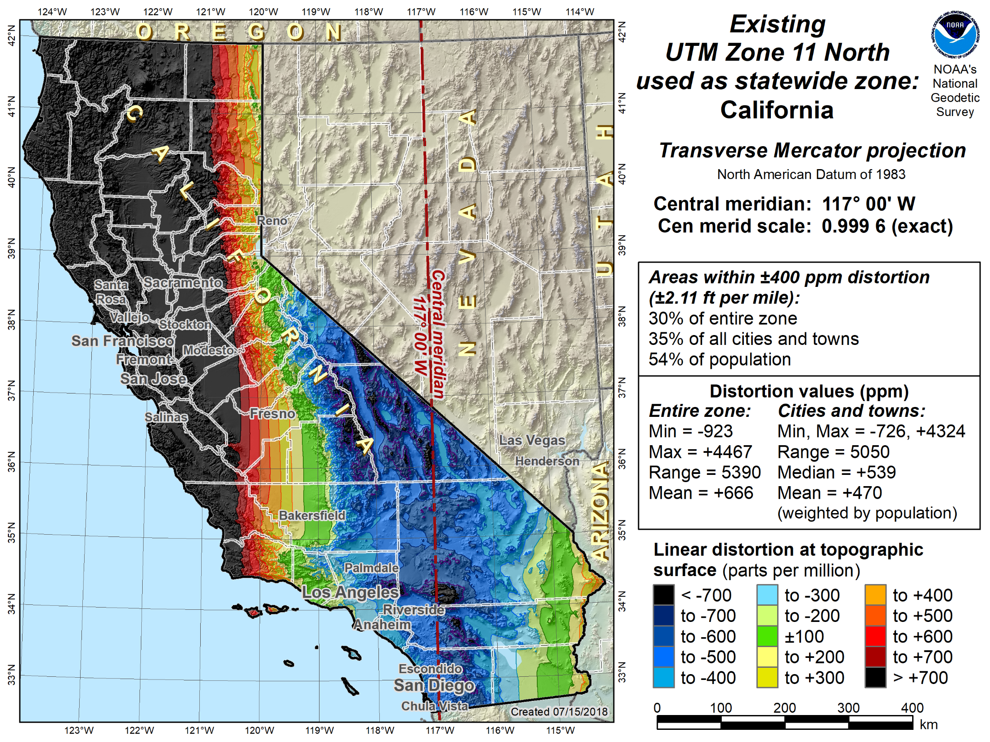

Slide 18
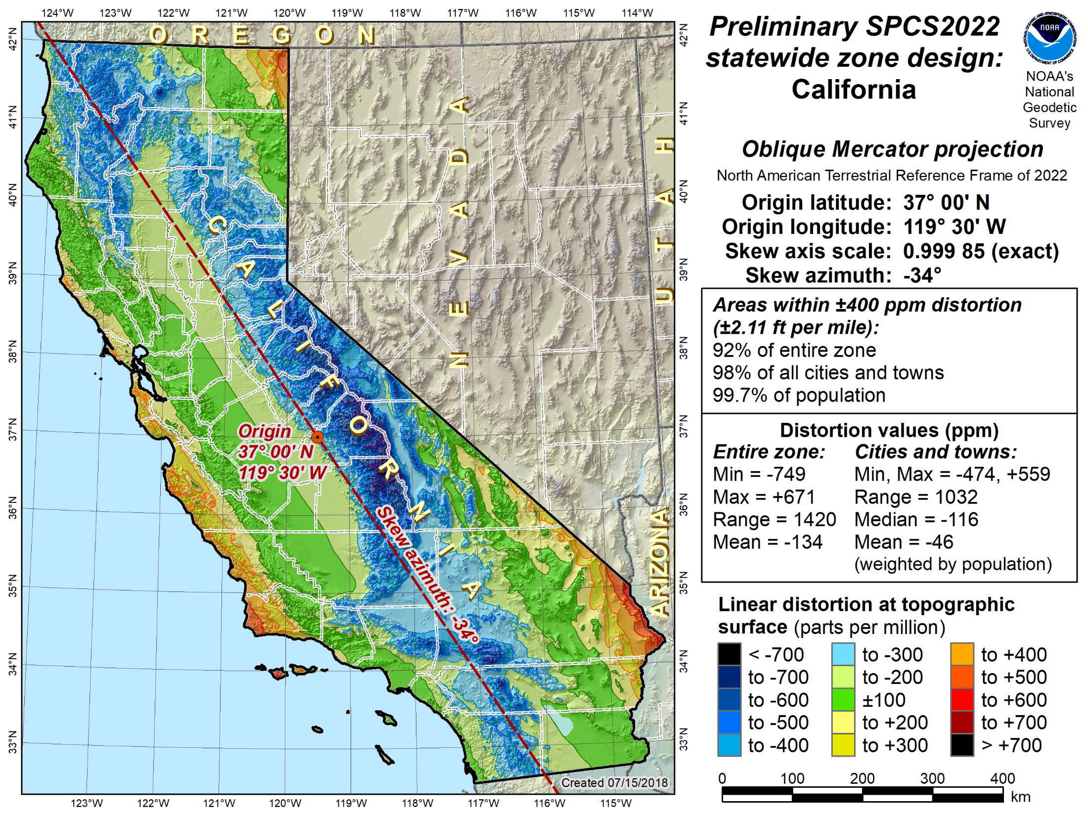

Slide 19
Summary
New “datums”
  4 new terrestrial reference frames (TRFs)
  1 new geopotential (“vertical”) datum
  Semi-dynamic (all locations will have velocities)
  Change of about 1-2 m in most locations
State Plane Coordinate System of 2022 (SPCS2022)
  Referenced to 2022 TRFs and replaces SPCS 83
  Minimize distortion at topo surface, not ellipsoid
  NGS will design statewide and default zones
  Stakeholders can request and propose their preferences
  Coordinate changes of at least 10,000 m everywhere
More information at https://geodesy.noaa.gov/
Notes:
To summarize, new “datums” are part of modernizing the NSRS
Will be more accurate and efficient
Consistent with GNSS (in part because geocentric)
GNSS-based (through the NGS CORS), but still compatible with classical terrestrial methods (e.g., leveling, total stations)
Will include of four new TRFs “fixed” to 4 different tectonic plates (based on global ITRF2014)
Will include 1 geopotential datum, allowing for consistent heights (and other gravity-based data) everywhere in the NSRS
Semi-dynamic, meaning it takes into account change with time (velocities) everywhere
Yet it will allow for determining coordinates at any epoch date, and it will include “reference” epochs (the first being 2020.0)
An intra-frame velocity model (IFVM) will be an explicit part of the NSRS to allow movement of coordinates through time
Initial change will be at about 1-2 meters in most location, followed by very slow change over time
In many locations, the changes will be very close to zero
There is much more to this topic than covered here – see the NGS website for more information!

