Slide 1

Implementation plan for the
UN-GGIM GGRF Resolution
Dr. Daniel Roman
Chief Geodesist, NGS

Slide 2
What is UN-GGIM?
UN-GGIM
  Committee of Experts on Global Geospatial Information Management
  Economic and Social Council on 27 July 2011
  To promote international cooperation in the field of global geospatial information
  TOR: Committee comprised of experts from all Member States, as well as experts from international organizations as observers.
UN-GGIM-Regionals - Formerly UNRCC’s
UN-GGRF WG => Subcommittee on Geodesy

Slide 3

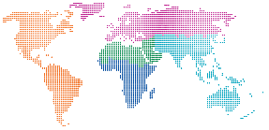

Frameworks, guides,
norms, standards and
methodological
development
Normative strengthening,
capacity building and
implementation of GGIM
in support of the 2030 Agenda
Legal and policy frameworks and issues related to authoritative data
Adoption of standards and technical specifications
Strengthening global geospatial information management
Contribution of regional committees, thematic groups and networks
Trends in national institutional arrangements
Strengthening collaboration with UNGEGN
United Nations activities in geospatial information management
Secretariat programme management
UN-GGIM:
Strengthening
the Global Data
Ecosystem
Global geodetic reference frame
Global fundamental geospatial data themes
Integration of geospatial, statistical and other information
Land administration and management
Geospatial information for sustainable development
National geospatial data and information systems
Geospatial information and services for disasters
Marine geospatial information
The activities and efforts
that contribute to the
unique local-to-global
value of UN-GGIM
for Member States

Slide 4

UN-GGIM: Global meetings
Annual Sessions of the UN-GGIM Committee of Experts:
Seoul, Republic of Korea, October 2011
UNHQ, New York, August 2012
Cambridge, United Kingdom, July 2013
UNHQ, New York, August 2014
UNHQ, New York, August 2015
UNHQ, New York, August 2016
UNHQ, New York, August 2017
High-Level Forums on Global Geospatial Information Management:
Seoul, Republic of Korea, October 2011
Doha, Qatar, February 2013
Beijing, China, October 2014
Addis Ababa, Ethiopia, April 2016
Mexico City, Mexico, November 2017
Positioning geospatial information to address global challenges

Slide 5

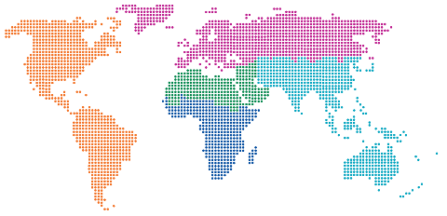
UN-GGIM: Integration of regions
Establishing a regional architecture of UN-GGIM
UN-GGIM Bureau:
Co-Chairs: USA, China and the Netherlands; Rapporteur: Cameroon
UN-GGIM Regional Committees & Chairs:
Asia-Pacific: Japan
Americas: Mexico, Chile
Europe: Sweden
Africa: Ethiopia
Arab States: Saudi Arabia
UN-GGIM International Networks:
Geospatial Societies, Academic Network, Private Sector Network
Positioning geospatial information to address global challenges

Slide 6
UN-GGIM - Committee of Experts
UN-GGIM- Asia-Pacific
(2012)
UN-GGIM: Americas
(2013)
UN-GGIM: Europe
(2014)
UN-GGIM:
Arab States
(2014)
UN-GGIM: Africa
(2015)
Regional Committees
Bureau
Japan(Chair)
Rep. of Korea
Mongolia
Mexico (Chair)
Chile
Mexico
Sweden (Chair)
Netherlands
Spain
Saudi Arabia (Chair)
Algeria
Jordan
Ethiopia (Chair)
South Africa
Burkina Faso
Tunisia
WG 1
Geodetic Reference Frame
WG1
Integration of Statistical and Geospatial Information
WG 1
Core Data
WG1
Inst. Arrangements, Legal and Policy Issues; Awareness and Capacity Building
WG 1
African Geodetic Reference Frame
WG 2
Disaster Risk Management
WG 2
Access & Use of GI in Disaster Risk Reduction and Climate Change
WG 2
Data Integration
WG 2
Fundamental Data and Geo-Standards
WG 2
Fundamental Datasets
Working Groups
WG 3
Regional SDI
WG 3
Promotion and Assessment of SDI
WG 3
Geodetic Reference Frame
WG 3
Geodetic Reference Frame
WG 3
Institutional Arrangements and Legal Frameworks
WG 4
Cadastre and Land Management
WG 4
Standards and Technical Specifications
WG 4
Integration of Geospatial & Statistical Information
WG 4
Capacity and Capability Development
WG 5
Regional Coordination and Cooperation
16
SIRGAS
Geodetic Reference Frame
Outside Working Groups

Slide 7
United Nations
Subcommittee on Geodesy
UN SCoG

Slide 8
Americas Members on UN SCoG
1. Argentina - Diego Piñón. Email dpinon@ign.gob.ar
Director of Geodesy, National Geographic Institute
2. Canada - Calvin Klatt. Email calvin.klatt@canada.ca
Director and Chief Geodesist, Canadian Geodetic Survey
3. Mexico - Francisco Javier Medina Parra
Email: Francisco.Medina@inegi.org.mx
Director of Geodetic Framework, National Institute of Statistics and Geography
4. United States of America - Daniel Roman
Email: dan.roman@noaa.gov
Chief Geodesist, National Geodetic Survey, National Oceanic and Atmospheric Administration
5. Vacant
6. Vacant
7. Vacant
Notes:
Mr. William Martinez is an observer for SIRGAS and Dr. Keith Miller is an observer for the Caribbean

Slide 9
The mandate
The UN-GGIM Committee of Experts
Endorsed the global geodetic roadmap as a “principle-based briefing document for national Governments”
Welcomed the development of an implementation plan to link the road map recommendations to national policy developments
Elevated the GGRF working group (WG) to a Sub-Committee on Geodesy (SCoG) to strengthen the GGRF
Requested the development of a position paper to define the appropriate governance arrangements for the GGRF
Notes:
The road map also revealed to the Committee of Experts that an appropriate governance structure is needed to effectively implement the road map and that this governance structure best is owned and driven by UN Member States. Due to this revelation the Committee strengthened the GGRF working group’s mandate through elevating the working group to a Sub-Committee on Geodesy (SCoG). The Committee also requested the development of a position paper to define the appropriate governance arrangements for the GGRF, “while balancing the sustainability, investment and data-sharing needs”.

Slide 10
The vision of the implementation plan
“An accurate, sustainable and accessible Global Geodetic Reference Frame to support science and society”
Notes:
The vision of the road map implementation plan is “An accurate, sustainable and accessible Global Geodetic Reference Frame to support science and society”.

Slide 11
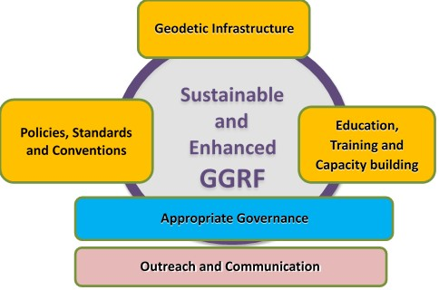
GGRF road map key issue categories
Notes:
The road map has five key issue categories, reflecting five of the six the operational paragraphs in the resolution, as explained by Markku.
Develop a global geodetic roadmap for the GGRF
(Global cooperation in providing technical assistance in geodesy for those countries in need to ensure the development, sustainability and advancement of a GGRF )
Implement open geodetic data sharing
Improve and maintain national geodetic infrastructure
Enhanced multilateral cooperation that addresses infrastructure gaps and duplications globally
Improved Outreach to make the GGRF more visible and understandable to society

Slide 12
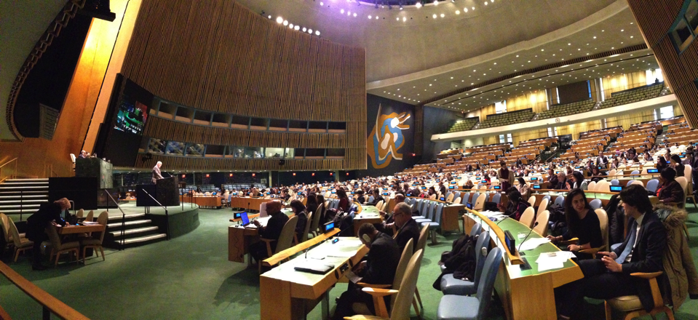
Target audience
General Assembly, 26 February 2015
Photo: Kyoung-Soo Eom
Notes:
The audience for the implementation plan is UN Member States and other interested parties.

Slide 13
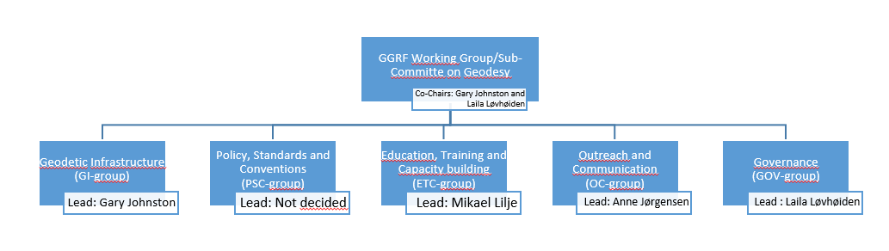
Organisational structure
Lead: Mike Craymer
Figure 2: Organisation of work
Notes:
The first discussions regarding the work with the implementation plan started in August 2016.
Based on the experiences with developing the road map, the GGRF working group/sub-committee decided to organise the work with the implementation plan into four smaller groups mirroring four of the focus areas in the road map; Geodetic infrastructure; Policy, standard and conventions; Education, training and capacity building; Communication and outreach.
One additional focus group was established with the mandate to develop the position paper defining the appropriate governance arrangements. Figure 2 Organisation of work
The invitation to participate in the focus groups was open and not limited to the formal members of the GGRF WG.
The number of focus group members range from 7 in the PSC-group to 16 in the GI-group, and in addition to Member States, IAG and NASA is represented in all groups.
The role of the focus group lead is to organise the group activity to ensure good discussions and proper documentation of the group production.
To ensure good communication and cooperation between the focus groups, the plan is to establish a practice where the focus leads meet on a regular basis and a common platform for sharing documents is accessible for all involved.
Work has been performed though email correspondence, telecons and a few face to face meetings. As telecon meetings can be a challenge, the groups are working hard to find meeting arenas where they can meet face to face.

Slide 14
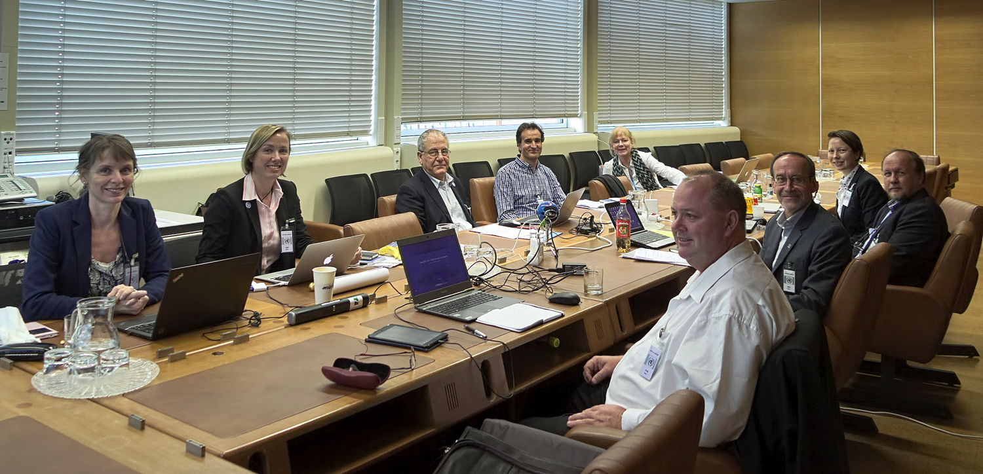
Activities of the focus groups
Photo: Markku Poutanen
Notes:
From our working group meeting in Vienna in 2016 (UN-building)

Slide 15
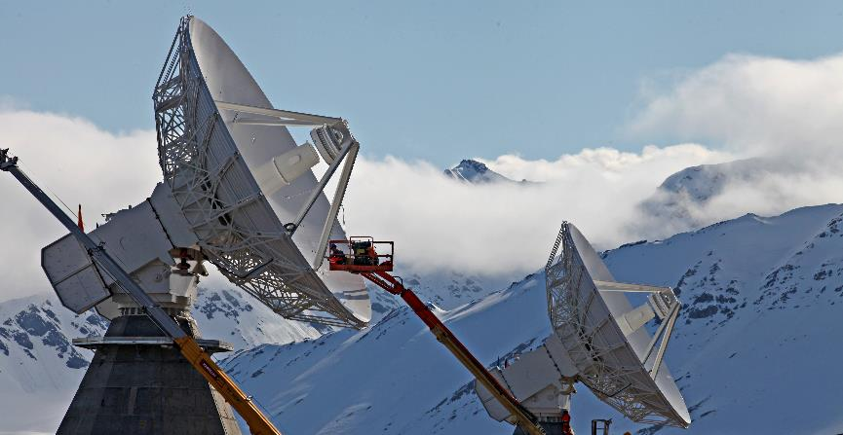
Geodetic Infrastructure
Photo: Bjørn-Owe Holmberg
Notes:
The geodetic infrastructure to be considered here is not limited to the networks of geodetic observatories, but comprises also the workforce that operates data collection and analysis, leading to the GGRF generation and its associated geodetic products.
The GI-group has just recently started its work. The first meeting was in April 2017 alongside the European Geosciences Union General Assembly. This area has a lot of diversity; the needs of large and small countries are not the same and there are differences between the regions.

Slide 16
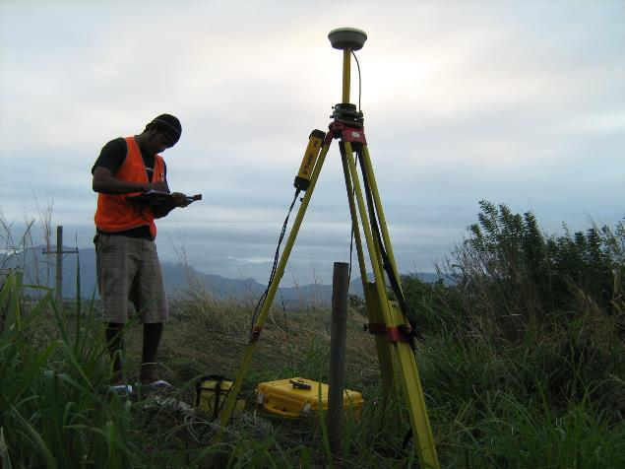
Policy, Standards and Conventions
Photo: Andrick Lal. SPC
Notes:
As the name of the group indicates, the focus area of this group is policy, standards and conventions. But it also includes data sharing.
In terms of data sharing, the current policy of the NMAs and space agencies who are contributing to the global GGRF products, such as the ITRF, is to make publicly and freely available the geodetic data collected at the observing sites. Similarly, the geodetic products generated by the IAG technique services are also freely and publicly available to all users. However, a certain number of countries are still reluctant to share their geodetic data, especially GNSS and more specifically their gravity data.
Up till now there have been no activities in the PSC-group. One of the reasons for this is that the group lead is not yet appointed.

Slide 17
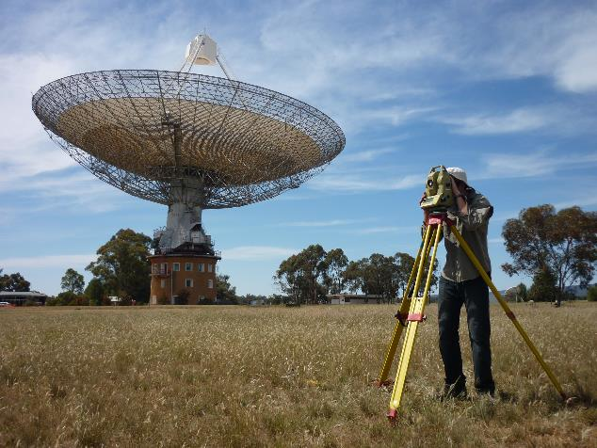
Education, Training and Capacity building
Photo: Geoscience Australia
Notes:
Geodetic education and training are not well developed in most countries. This focus area is about strengthening geodetic education, training and capacity building to a level that allows all countries an easy and efficient access to modern geodetic capabilities.
The ETC-group has had good progress in its work. There are many good examples to follow and potential organisations to cooperate with, and the challenge is to find a path that is feasible.

Slide 18
Outreach and Communication
Notes:
The success the GGRF Working Group has had with the adoption of the UN resolution has been partially due to dedicated and strategic communication work. This communication effort has to continue to secure success with implementing the roadmap. And this the challenge that is facing the OC focus group.

Slide 19
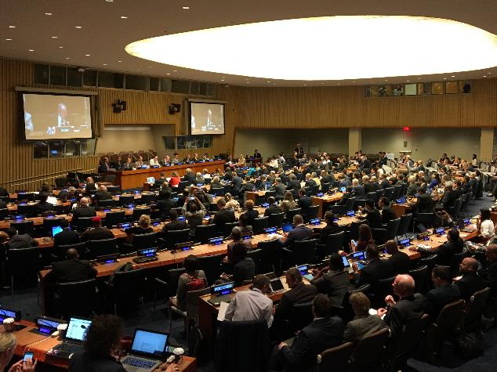
Governance
Photo: Anne Jørgensen
Notes:
The challenge of the GOV-group is to propose to the Committee of Experts a governance mechanism for global geodesy that will secure the development and sustainability of the GGRF.
The GOV-group has had productive discussions. The assignment of the group is to develop a position paper to define the appropriate governance arrangements for global geodesy, which is slightly different from the assignments of the other focus groups. The ambition is to move from “best effort” to an international government arrangement where UN Member States commit to contribute to the vision of the implementation plan in accordance with their abilities and the societal needs.

Slide 20
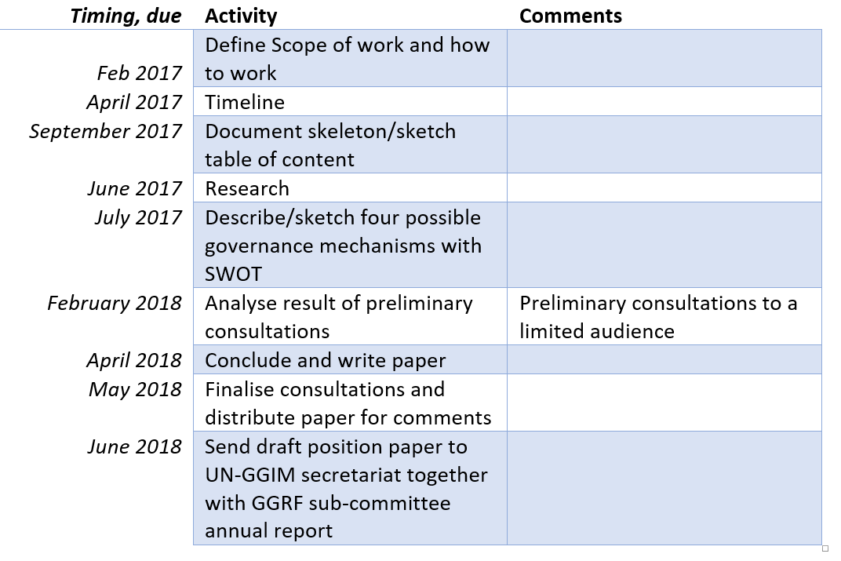
Work plan GOV-group
Notes:
To illustrate the timeline for the implementation plan I have included the work plan of the GOV-group.
The plan is to finish this both the implementation plan and the position paper so that the result can be reported to the Committee of Experts late June 2018.
You can find more detailed information regarding the work status of the different focus groups in the paper.

Slide 21
The new role
Formally transformed the GGRF working group to the Sub-Committee on Geodesy (August 2017)
Arranged first formal meeting of the Sub-Committee on Geodesy (November 2017)
GGRF utilized in conjunction with other fundamental datasets
Through the Sub-Committee provide geodetic expertise to the broader intergovernmental community, especially relating to Sustainable Development Goals but also to hazards, environment, and economic development.
Notes:
This summer the GGRF working group’s/Sub-Committee of Geodesy’s annual report will describe the status of the work with the implementation plan, the position paper, the transition of the GGRF WG to the SCoG and request the Committee of Experts to endorse the Terms of Reference for the SCoG. The first official SCoG meeting is planned adjacent to the UN-GGIM high level forum in Mexico City late November.
While the implementation plan is the current focus, the SCoG will take on a broader agenda in the medium term about how the GGRF is utilized in conjunction with the other foundation spatial datasets. The SCoG will have an ongoing role in providing geodetic expertise to the broader intergovernmental community, especially relating to Sustainable Development Goals but also to hazards, environment, and economic development.

Slide 22
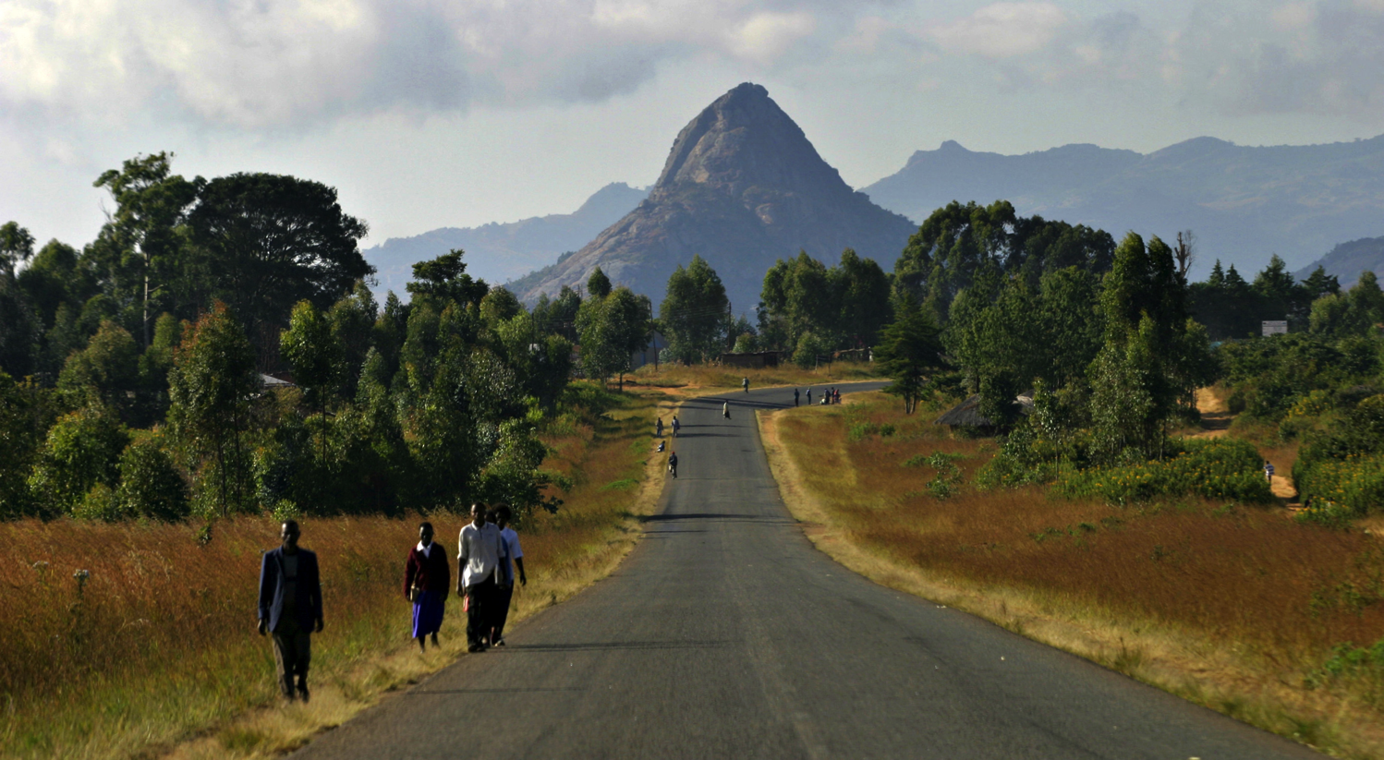
Towards sustainability
Photo: Bjørn-Owe Holmberg
Notes:
There is a long road ahead of us! Developing the implementation plan and the position paper is only the beginning of the process of making “an accurate, sustainable and accessible Global Geodetic Reference Frame to support science and society”. The appropriate governance arrangements must most likely be in place before most of the objectives of the road map will commence to be implemented. Experience from other organisations show that a time span from five to ten years of negotiations and hard work is to be expected before a governance structure may be in place.
The desire is of course that the implementation plan will become a success and that governments will use it to improve the focus areas. And not the least that we manage to propose an appropriate governance structure for global geodesy that will secure the intention of the UN-resolution – Sustainability.
For this to happen it is a necessity to show the benefits, including secondary benefits, of the recommended implementation actions and the investments required. The arguments promoting the actions must be based on reproducible evidence and credible science. Questions like “what is required where” and “what is the impact of not having it” must be answered. This will require patience, endurance and a loads of lot of solid work and not to forget targeted and professional outreach and communication.

Slide 23





Thank You !
QUESTIONS?

Slide 24
SIRGAS as defined by SIRGAS
Is the Geocentric Reference System for the Americas
  Corresponds to the ITRS
  Includes the definition and realization of a vertical reference system
UNRCC-Americas 7th Conference recommended adoption of SIRGAS for all of the Americas
  SIRGAS is a member of the IAG Commission 1 through SC 1.3b (Regional Reference Frame for South- and Central America)
  Working Group of the Cartographic Commission of the PAIGH

Slide 25
SIRGAS Structure
US Concerns
  Functionally a scientific organization only
  Limited in scope of constituency (IAG SC 1.3b)
  Permanently assists UN-GGIM-Americas
  Outside of the UN governance structure
  Weak link between SIRGAS & UN-GGIM-Americas
Potential Remedies
  Include IAG SC 1.3c (Ref. Frame for N. America)
  Include IAG SC 2.4b (Grav. & Geoid for S. America)
  Include IAG SC 2.4c (G. & G. for N. & C. America)
  Needs to be inside the UN Governance Structure
Notes:
IAG generates the models, but UN SCoG must recommend adoption through its role in governance. That’s why SIRGAS should functionally fall within UN-GGIM-Americas as a Working Group – like all the other regional entities.

Slide 26
IAG Commission Structure
SC 1.3 Regional Reference Frames
Chair: C. Bruyninx (Belgium)
SC 2.4: Regional Geoid Determination
Chair: M.C. Pacino (Argentina)
SC 1.3a Europe
Chair: M. Poutanen (Finland)
SC 1.3b South and Central America
Chair: W. Martinez (Colombia)
SC 1.3c North America
Chairs: M. Craymer (Canada) and D. Roman (USA)
SC 1.3d Africa
Chair: E. Saria (Tanzania)
SC 1.3e Asia-Pacific
Chair: J. Dawson (Australia)
SC 1.3f Antarctica
Chair: M. Horwath (Germany)
SC 2.4a Europe
Chair: Heiner Denker (Germany)
SC 2.4b South America
Chair: M.C. Pacino (Argentina)
SC 2.4c Central and North America
Chairs: M. Veronneau (Canada)
SC 2.4d Africa
Chair: Hussein Abd-Elmotaal (Egypt)
SC 2.4e Asia-Pacific
Chair: Jay Hyoun Kwon (Korea)
SC 2.4f Antarctica
Chair: Mirko Scheinert (Germany)
Notes:
SC 2.4a: Gravity and Geoid in Europe
Chair: Heiner Denker (Germany)
SC 2.4b: Gravity and Geoid in South America
Chair: Maria Cristina Pacino (Argentina)
SC 2.4c: Gravity and Geoid in North and Central America
Chair: Marc Véronneau (Canada)
SC 2.4d: Gravity and Geoid in Africa
Chair: Hussein Abd-Elmotaal (Egypt)
SC 2.4e: Gravity and Geoid in Asia-Pacific
Chair: Jay Hyoun Kwon (Korea)
SC 2.4f: Gravity and Geoid in Antarctica
Chair: Mirko Scheinert (Germany)

