Slide 1

NOAA’s National Geodetic Survey
Rocky Mountain Regional Update
2023 CGSIC
Brian Shaw
brian.shaw@noaa.gov
September 11, 2023

Slide 2

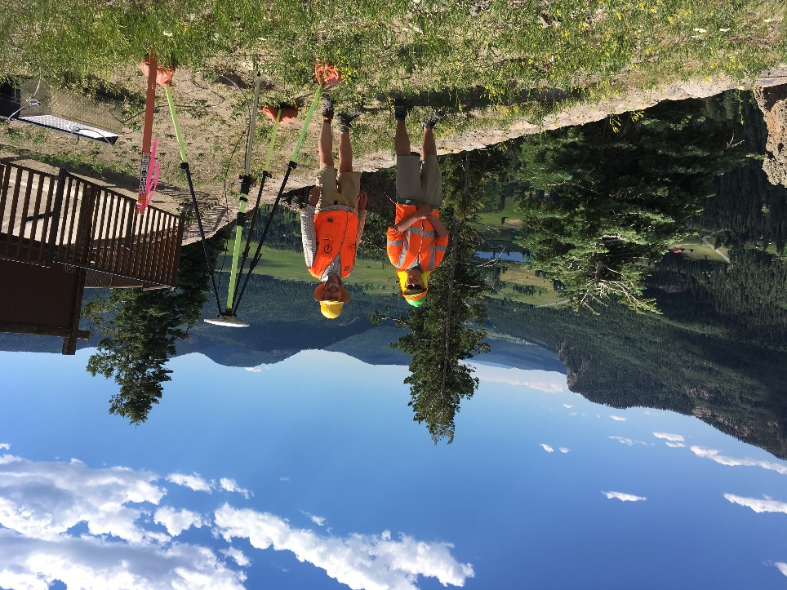

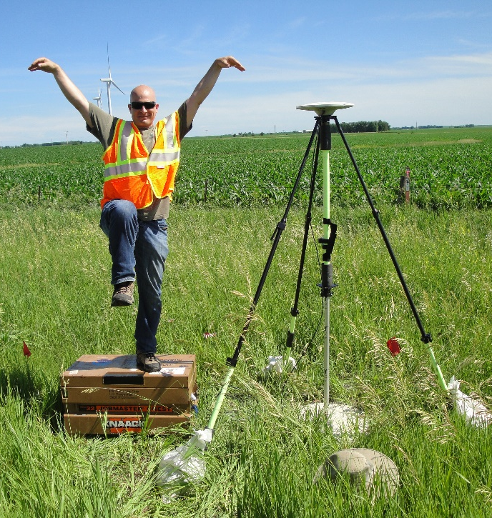
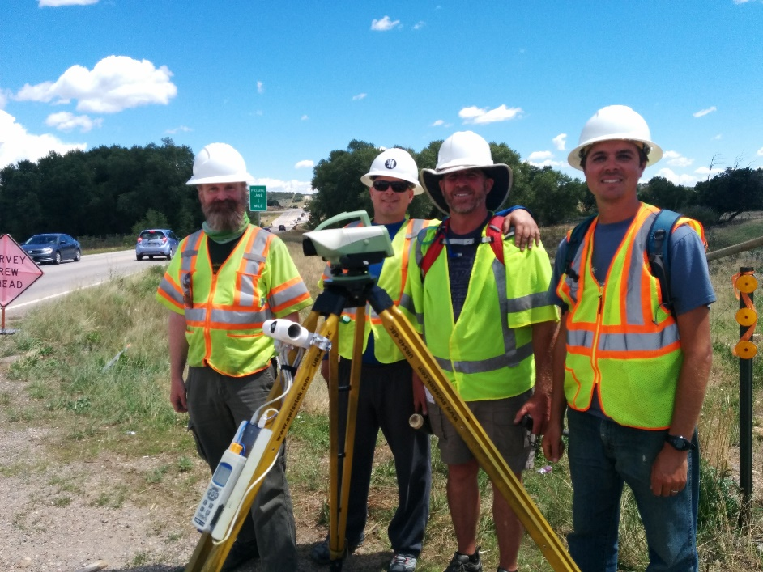
Brian Shaw
Rocky Mountain Advisor
brian.shaw@noaa.gov

Slide 3
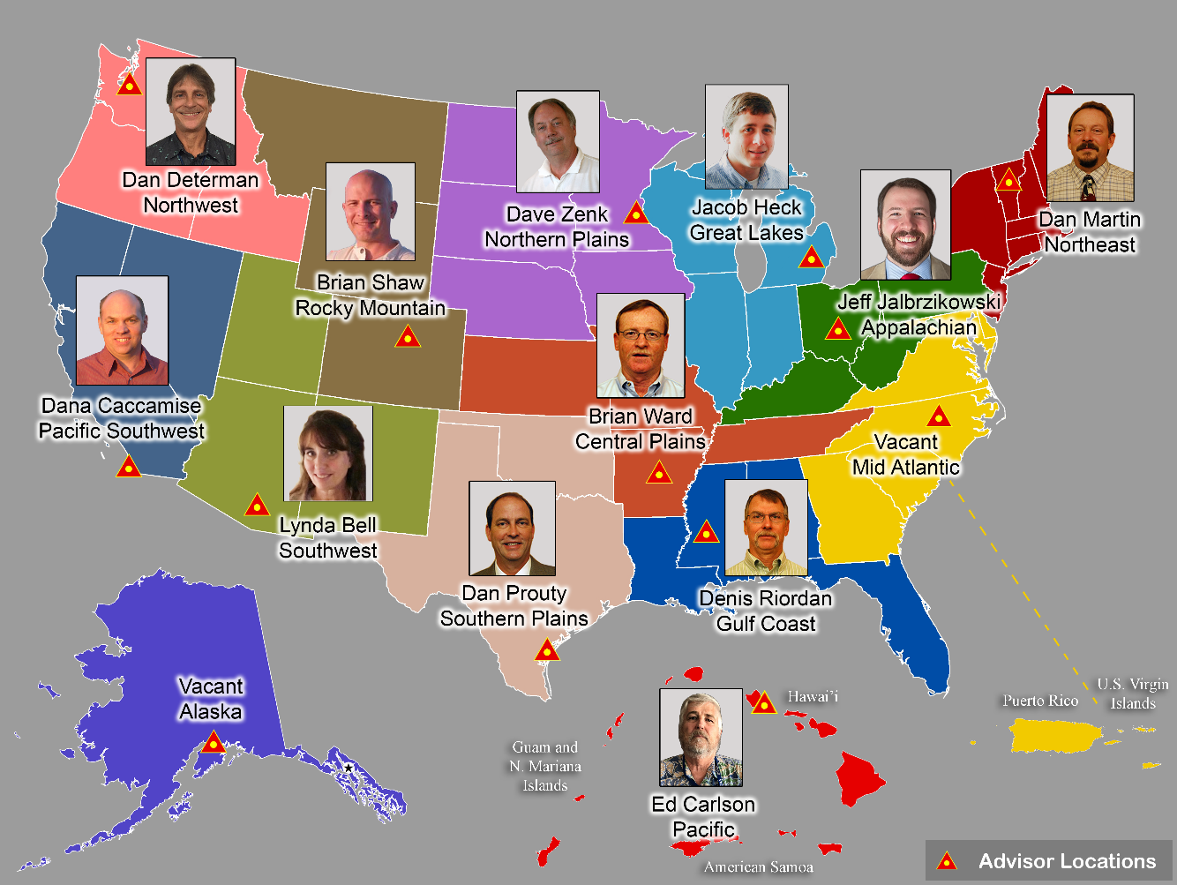
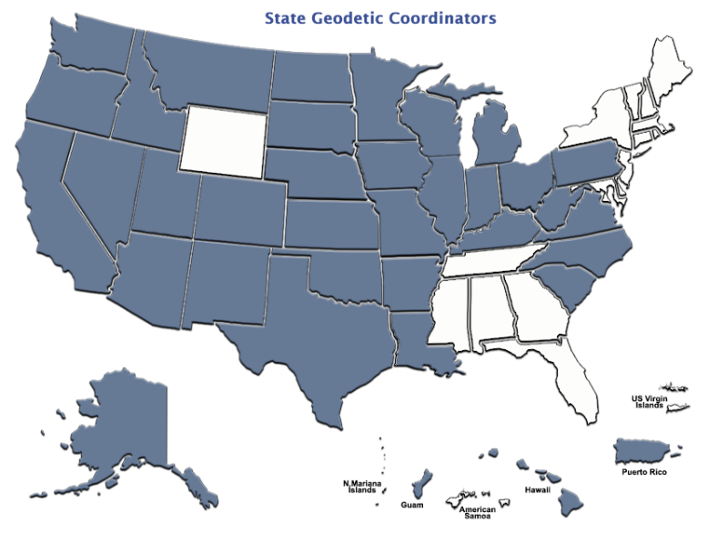
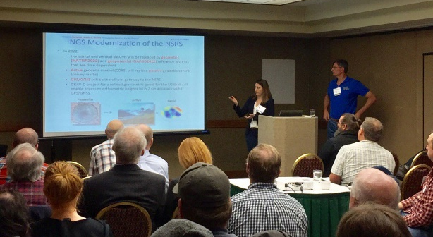
Importance of Coordination
14 Advisors
(1 acting)
UPDATE
39 Coordinators
Notes:
NGS Regional Geodetic Advisors
https://geodesy.noaa.gov/ADVISORS/
State Geodetic Coordinators
https://geodesy.noaa.gov/ADVISORS/state-geodetic-coordinators.shtml

Slide 4
NGS’s Mission
To define, maintain and provide access
to the National Spatial Reference System (NSRS) to meet our Nation’s economic, social, and environmental needs.
…………………………………………….........................
The NSRS is a consistent coordinate system that defines latitude, longitude, height, scale, gravity, orientation, and shoreline throughout the United States.
Notes:
The National Spatial Reference System is our nations geospatial infrastructure from which all positioning (with the exclusion of military/DOD) is referenced to.
This system provides a consistent framework that allows people to use data in the same reference system to perform analysis and make meaningful comparisons and decisions from that analysis.

Slide 5
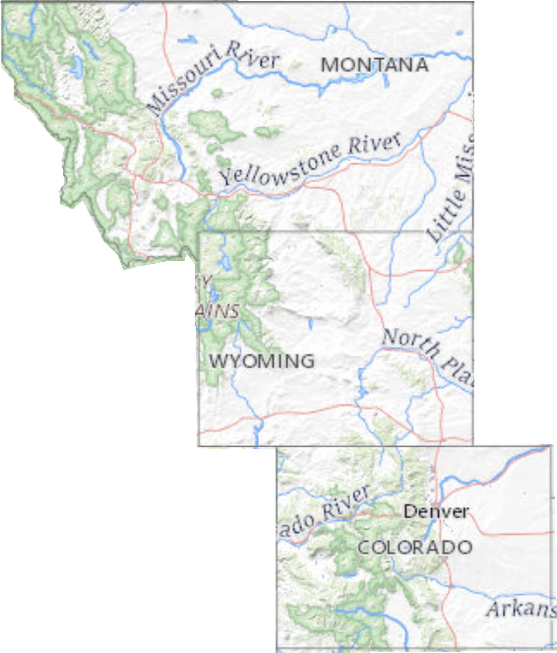
Rocky Mountain Region
Montana
Wyoming
Colorado
Regional Challenges
  Rugged Terrain
  High Elevations
  Limited Cell Coverage
  Sparse CORS Networks

Slide 6
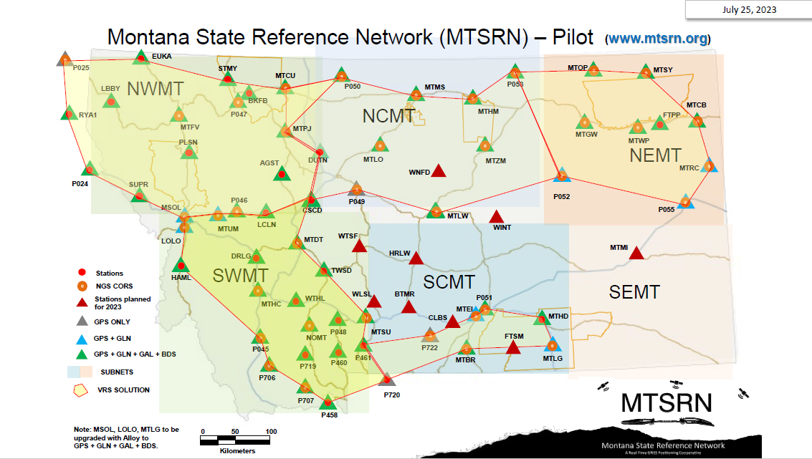
Montana
Highlights
  Started as Pilot with WA
  Currently free planned subscription
  200 current users
  5 subnetworks
  10-12 new stations this year
https://msl.mt.gov/mtsrn/ http://www.mtsrn.org

Slide 7
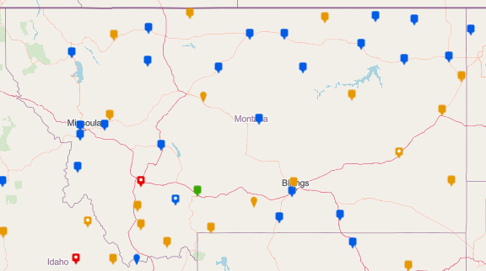
Montana
NOAA CORS Network (39)

Slide 8
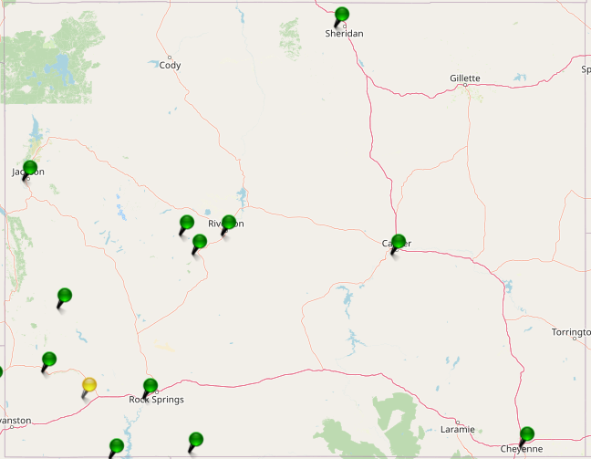
Wyoming
Highlights
  RTN Pilot with UT TURN (manages subscriptions)
  Mixture of sites owned by BLM, Wind River Tribe, Dominion Power and City.
http://turngps.utah.gov/Map/SensorMap.aspx

Slide 9
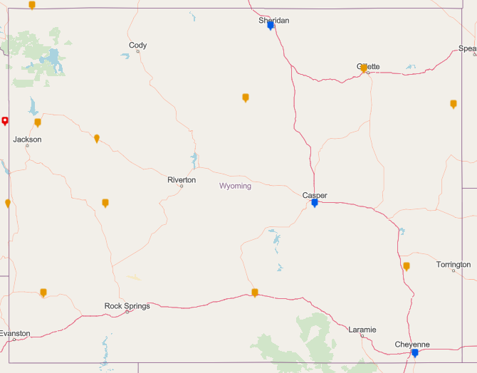
Wyoming
NOAA CORS Network (13)

Slide 10
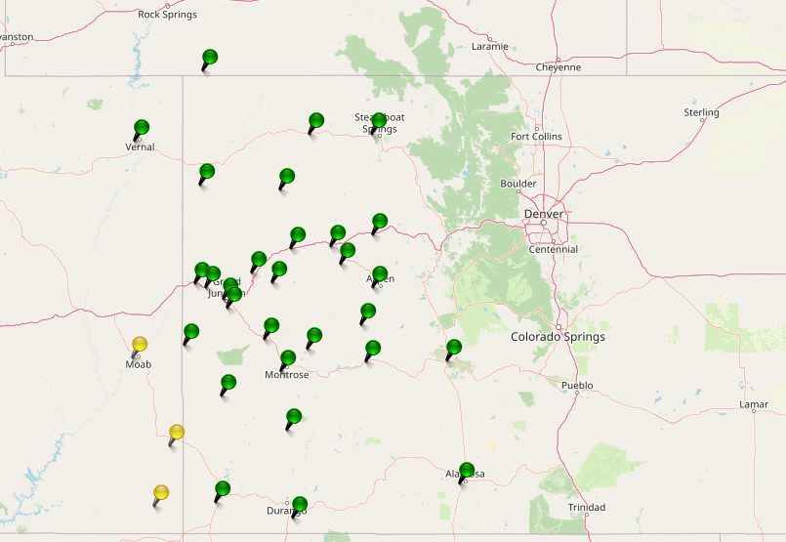
Colorado
Mesa County’s Real Time Virtual Reference Network
Highlights
  No Statewide RTN
  Mesa County (free)
  32 stations
  15 NOAA CORS Network
  Private Networks along Front Range
https://www.mesacounty.us/departments-and-services/gis/gps-survey/rtvrn

Slide 11
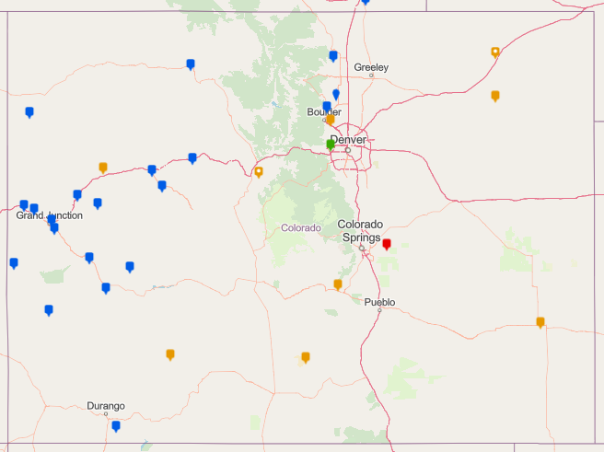
Colorado
NOAA CORS Network (31)

Slide 12
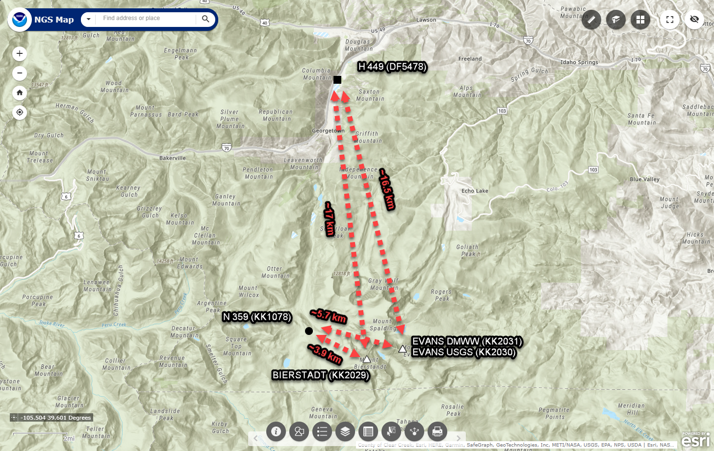
Colorado 14k Mountain Heights
Mt Evans and Mt Bierstadt Height Modernization Survey
Surveyed 5 marks
  2 on Mt Evans
  1 on Mt Bierstadt
  2 Bench Marks for vertical constraints

Slide 13
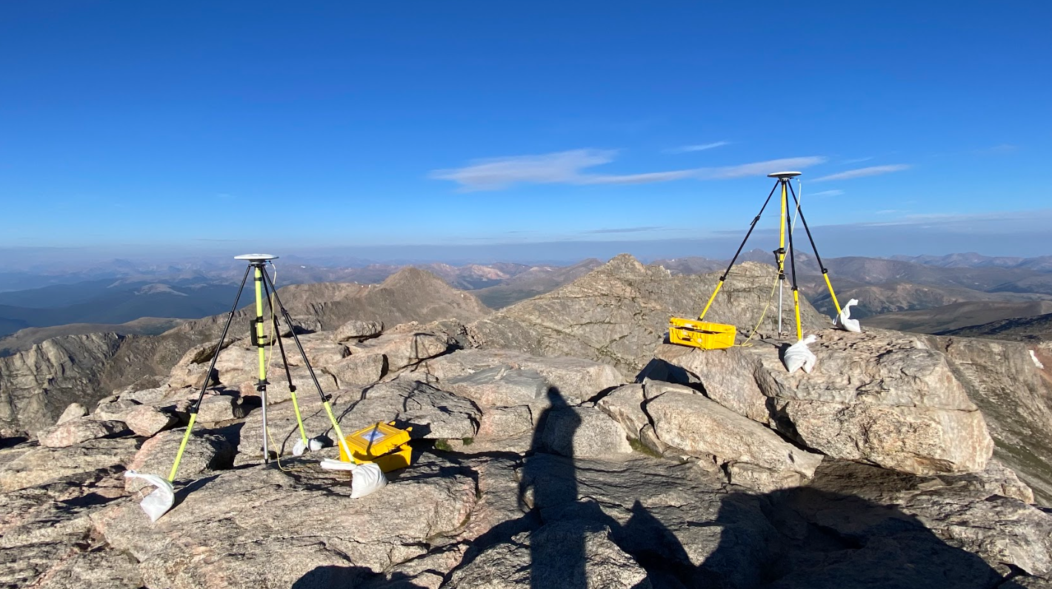
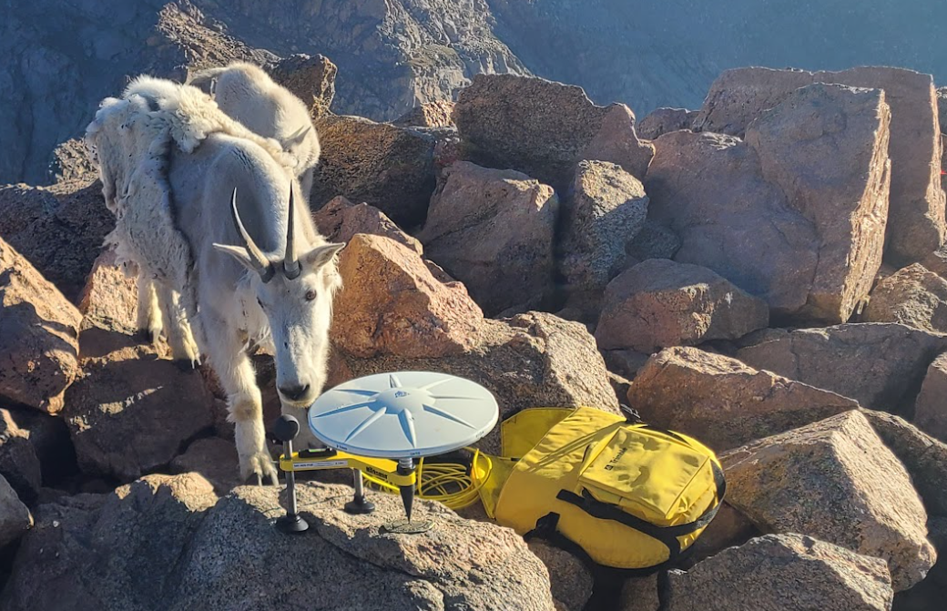
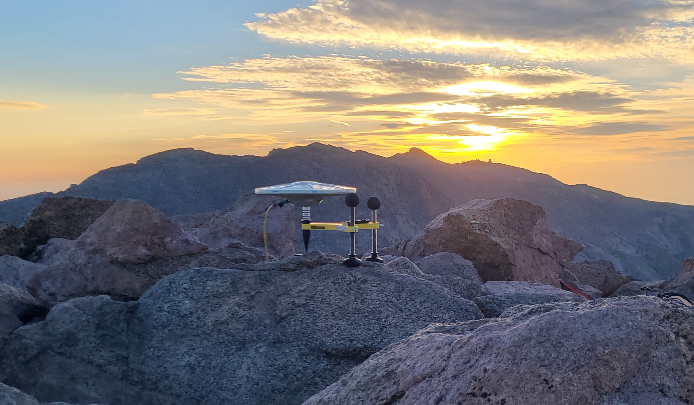
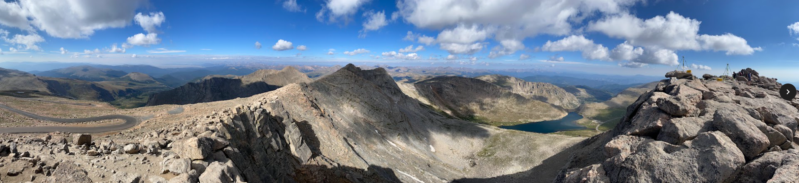
Mt Evans and Mt Bierstadt

Slide 14
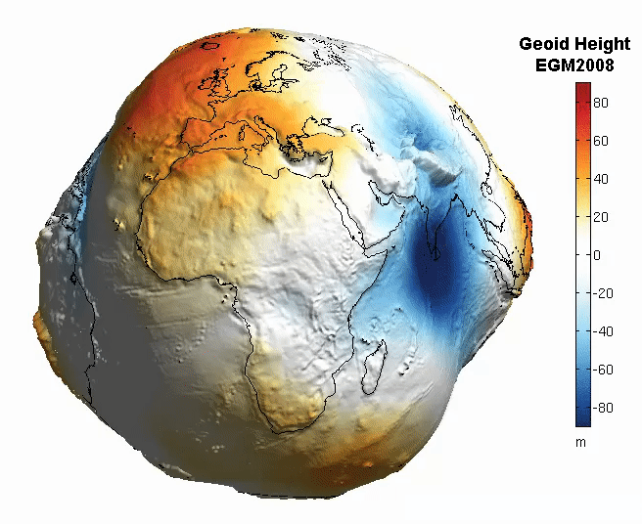
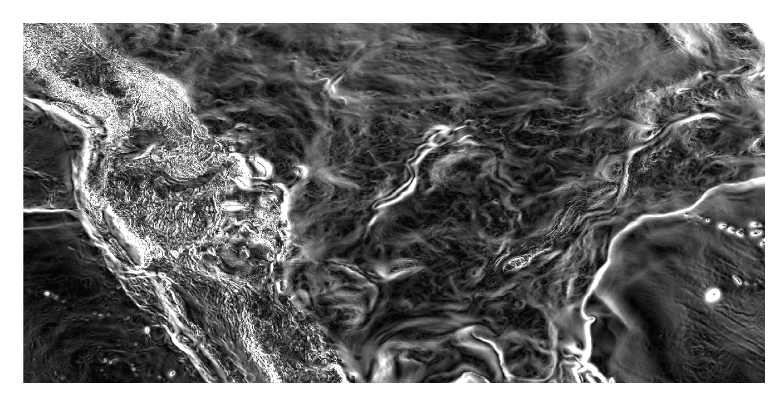
Questions?
Magnitude of the Deflection of the Vertical
Brian Shaw
brian.shaw@noaa.gov

