Slide 1
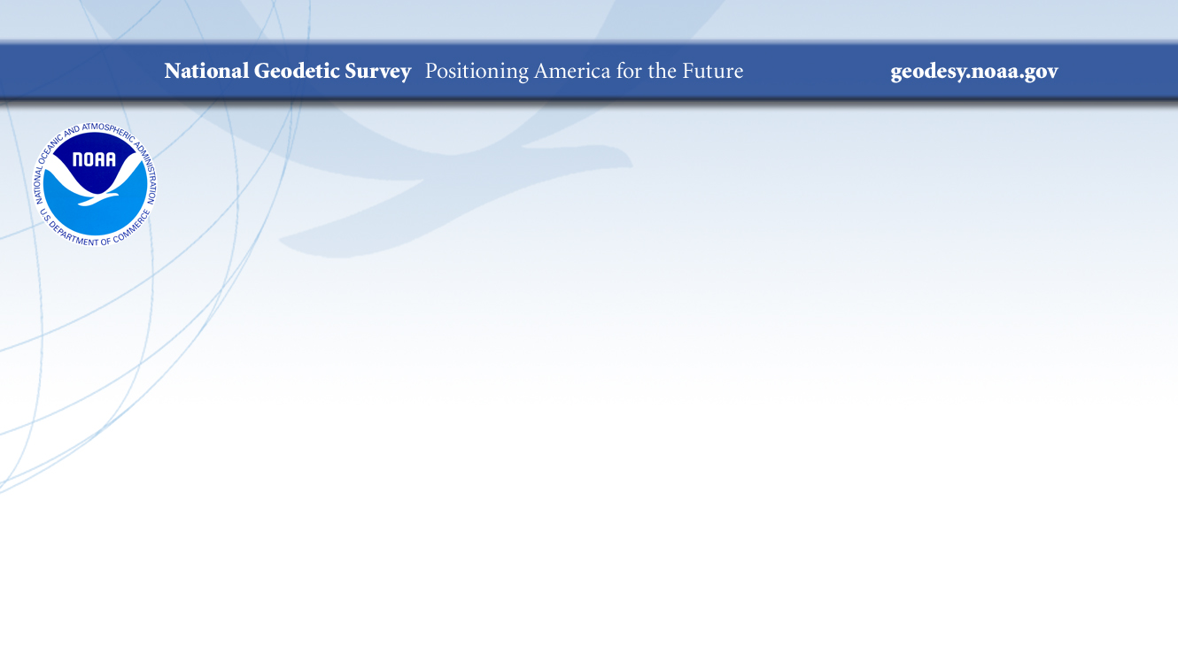

Best Practices for science communication with high stakes audiences:
Visualizing data from the National Geodetic Survey
SOS Users Collaborative Network Workshop
Brian Shaw
brian.shaw@noaa.gov
December 1, 2020

Slide 2

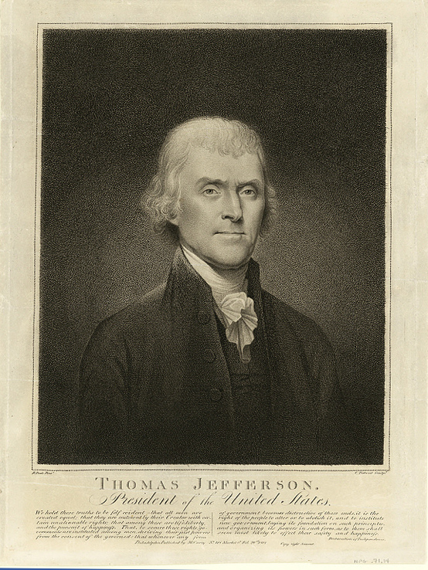
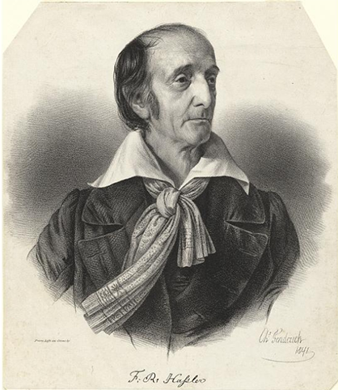
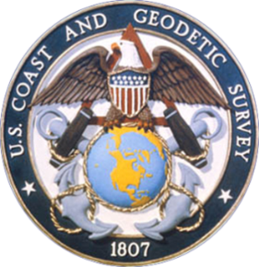
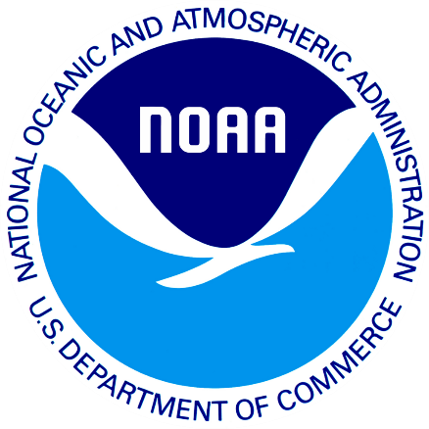
NOAA and NGS
Our Nation’s First Civilian Science Agency
1807
Thomas Jefferson
Survey of the Coast
1811
Ferdinand Hassler
Superintendent
1836
U.S. Coast
Survey
1878
U.S. Coast and
Geodetic Survey
1970
NOAA is established
Notes:
NGS has been around a long time. For more than 200 years, NGS and its predecessor agencies have collaborated with public and private organizations to establish reference stations at precisely determined locations.
We began on a mission established by Thomas Jefferson in 1807 to conduct a “Survey of the Coast” (as the United States Coast Survey).
(Pictured are Thomas Jefferson and Ferdinand Hassler, the first Superintendent of the Coast Survey). We were renamed the U.S. Coast and Geodetic Survey in 1878. NOAA was established in 1970.
Traditionally, precise positioning locations have been identified by setting a survey mark—usually a brass, bronze, or aluminum disk. Locations might also be identified by a deeply driven rod, or a prominent object, such as a water tower or church spire.

Slide 3
NGS’ Mission
To define, maintain and provide access
to the National Spatial Reference System (NSRS) to meet our Nation’s economic, social, and environmental needs.
…………………………………………….........................
The NSRS is a consistent coordinate system that defines latitude, longitude, height, scale, gravity, orientation, and shoreline throughout the United States.
Notes:
The National Spatial Reference System is our nations geospatial infrastructure from which all positioning (with the exclusion of military/DOD) is referenced to.
This system provides a consistent framework that allows people to use data in the same reference system to perform analysis and make meaningful comparisons and decisions from that analysis.

Slide 4
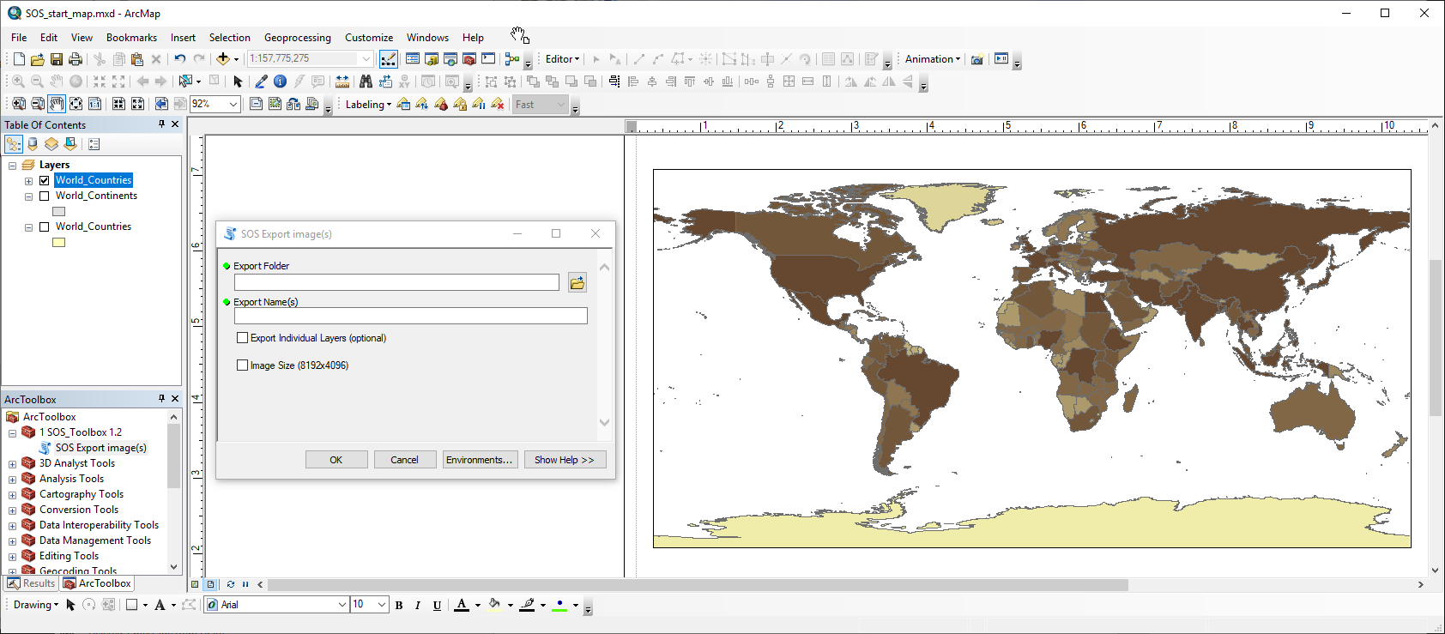
Map Template and Script

Slide 5
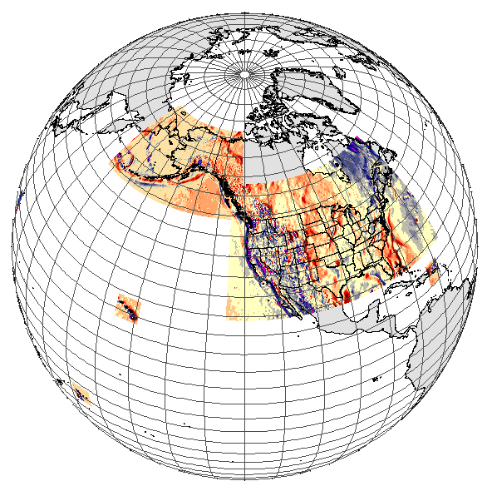
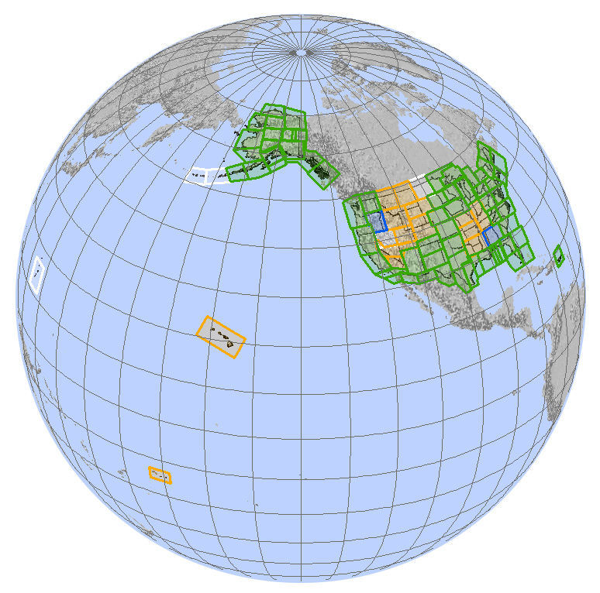
Non Global Datasets
DEFLEC12B
GRAV-D
Notes:
https://geodesy.noaa.gov/GEOID/DEFLEC12B/
https://geodesy.noaa.gov/GRAV-D/data_products.shtml

Slide 6
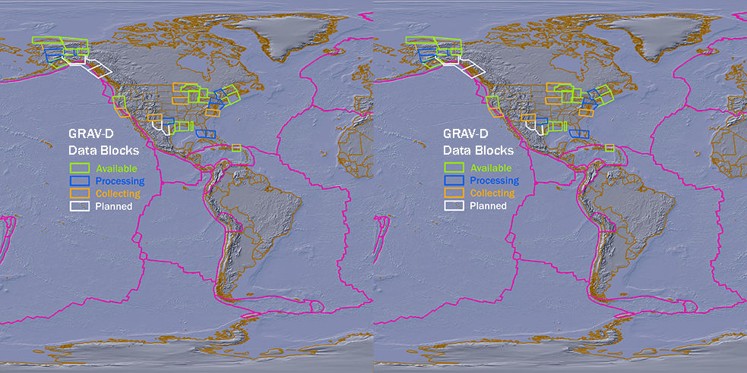
Slicing Non Global Datasets
2013
Notes:
https://geodesy.noaa.gov/GRAV-D/data_products.shtml

Slide 7
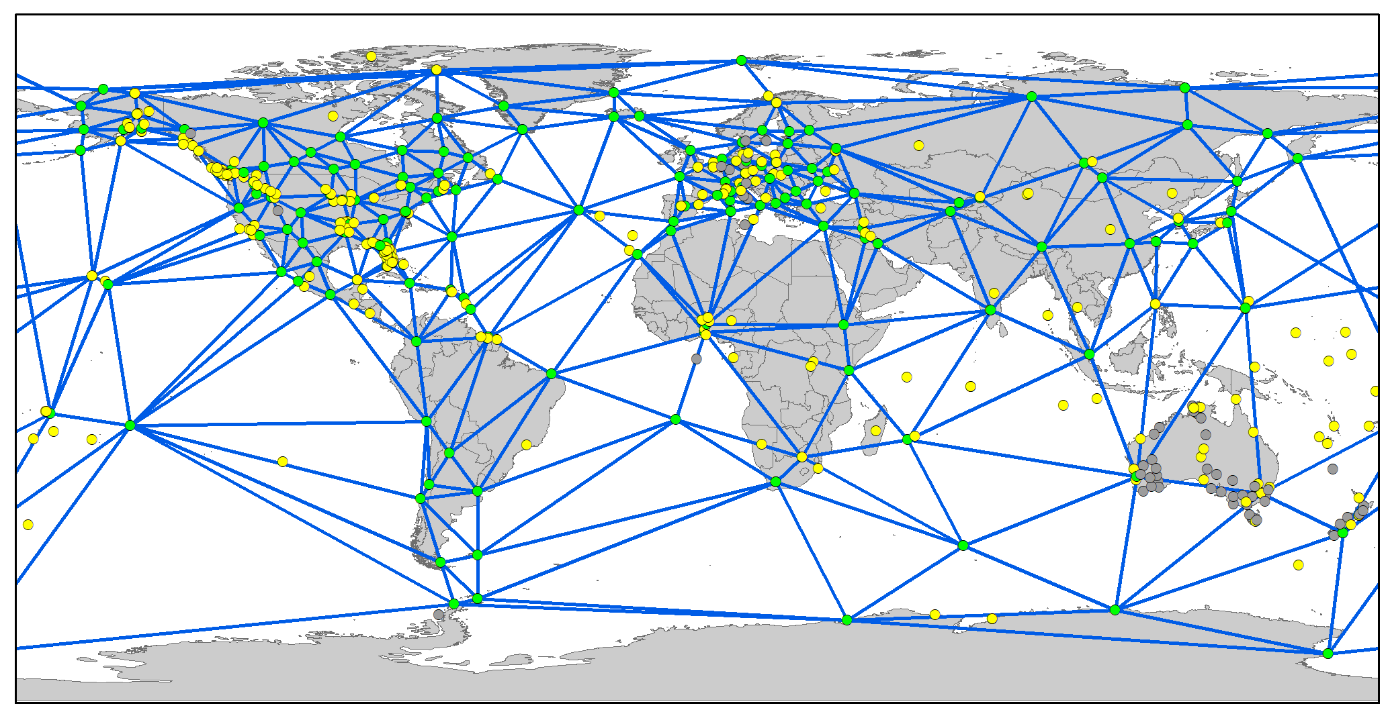
Global GNSS Orbit Processing

Slide 8
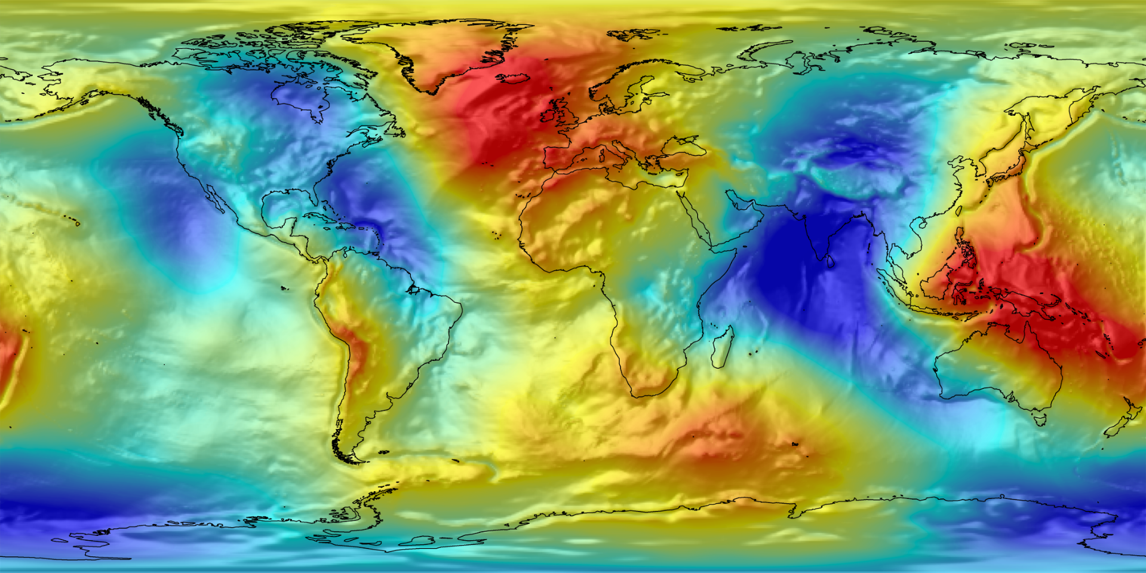
EGM08 Global Geoid

Slide 9
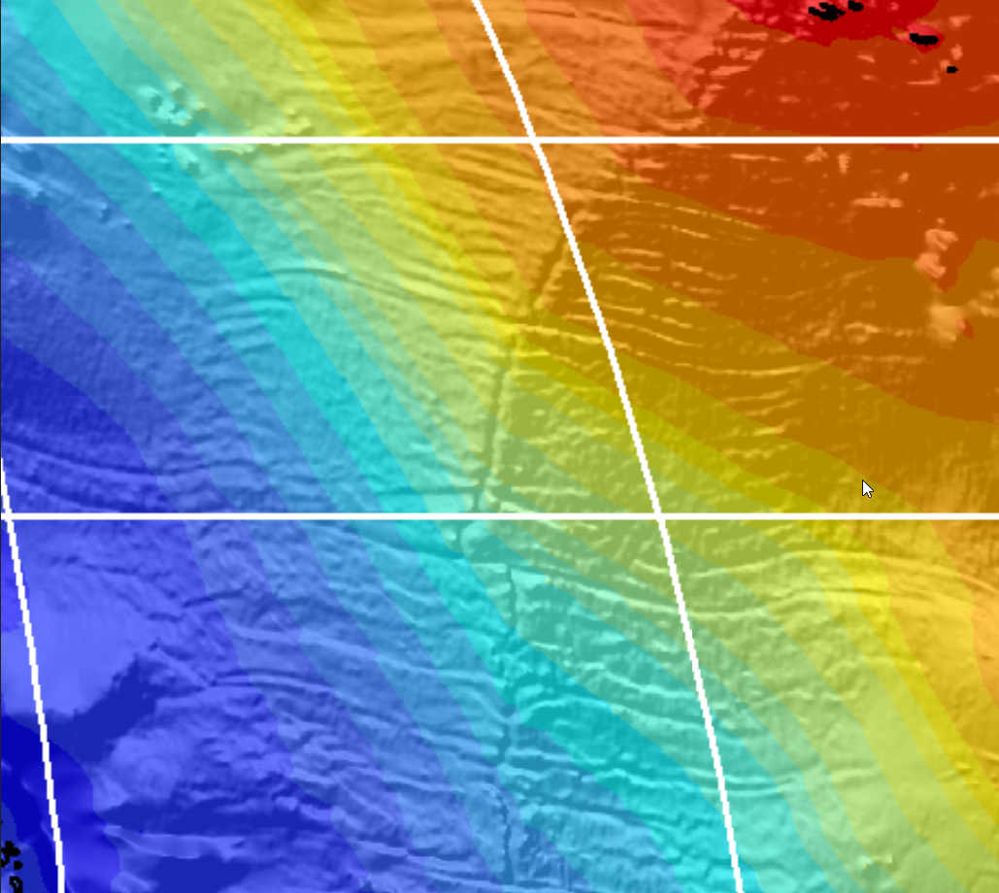
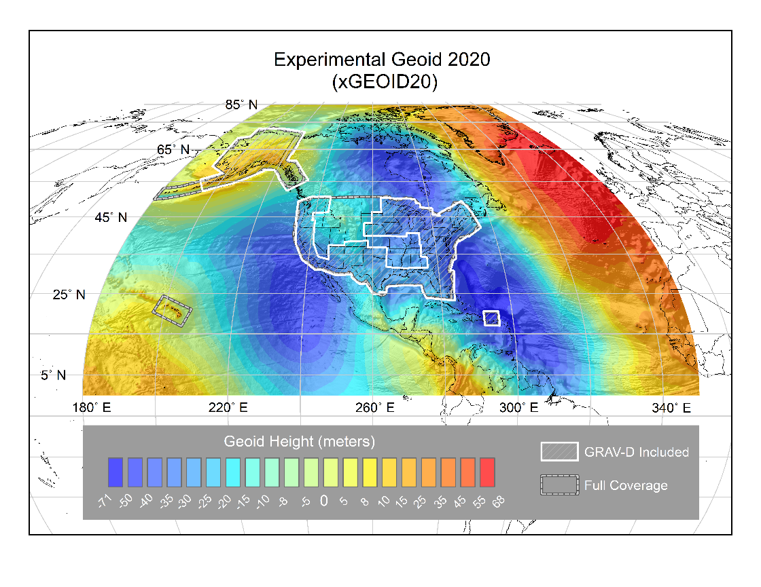
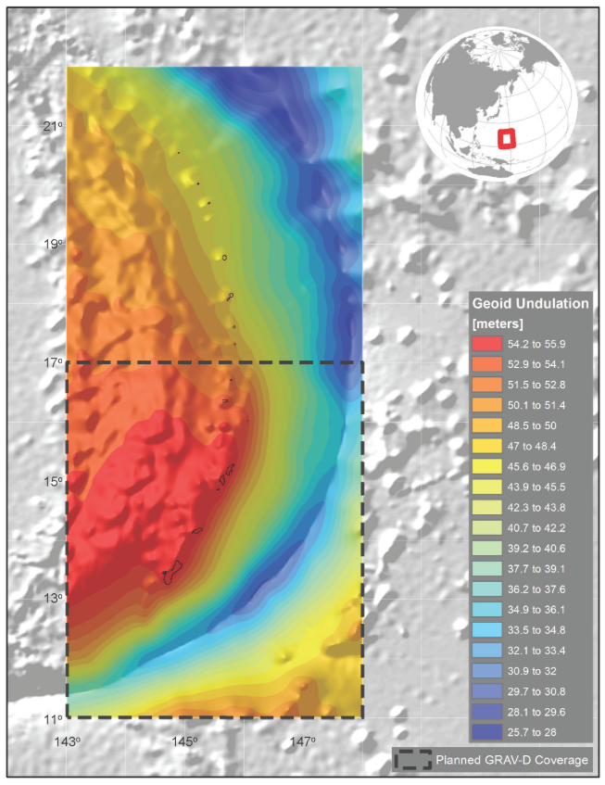
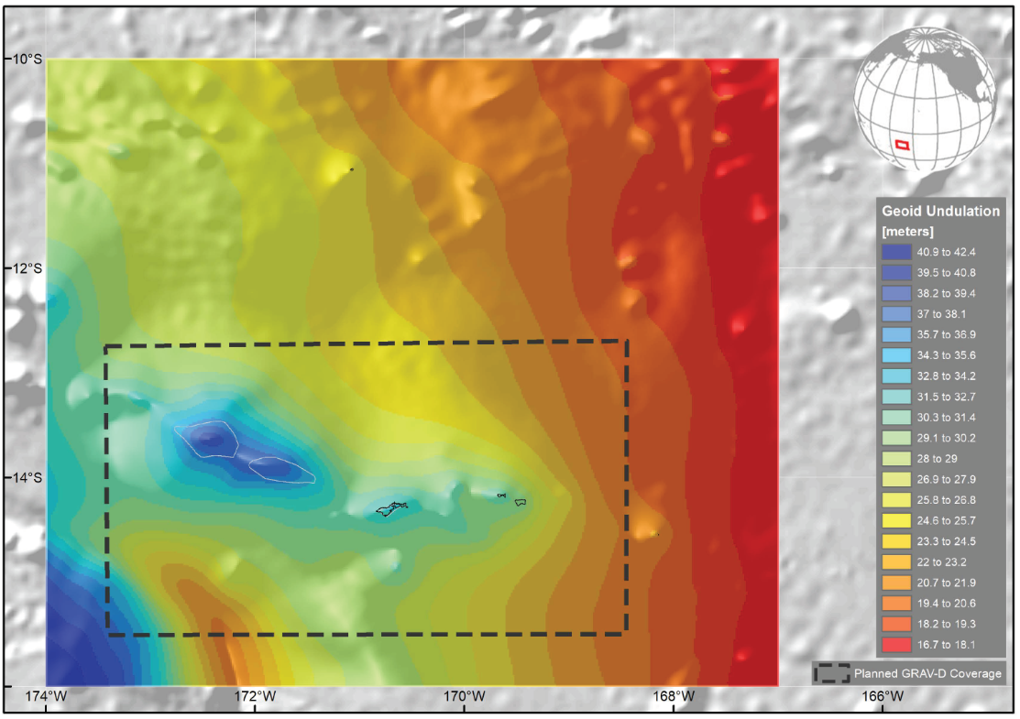
xGEOID20 Future US Geoid
American Samoa
Guam/CNMI
Mid Atlantic Ridge
¼ Earth’s Surface
Notes:
https://beta.ngs.noaa.gov/GEOID/xGEOID20/

Slide 10
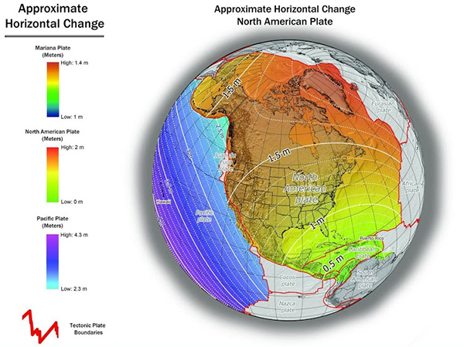
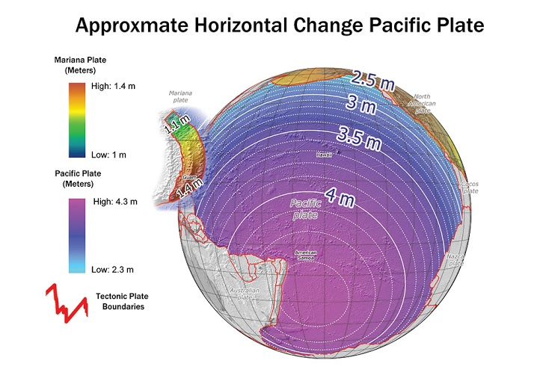
Modernizing the NSRS
Notes:
https://geodesy.noaa.gov/datums/newdatums/WhatToExpect.shtml

Slide 11
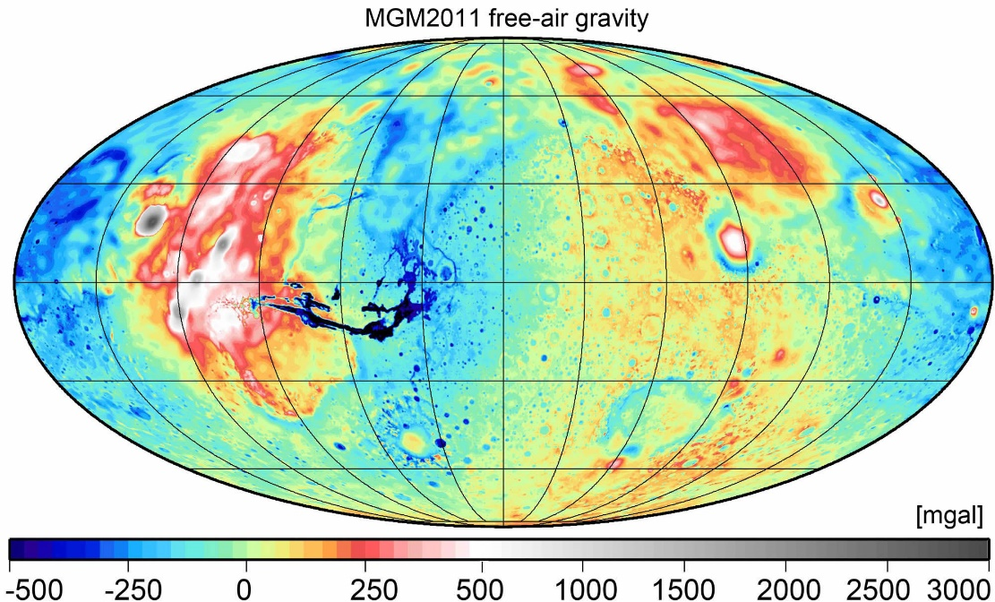
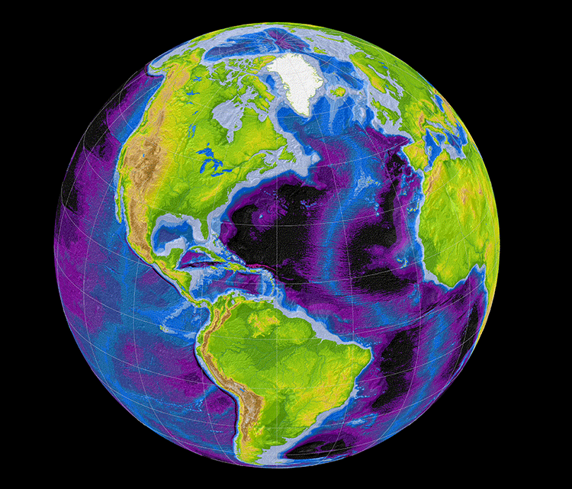
Visiting Scientists
Mars Gravity
Earth2014 Topo
Christian Hirt
http://ddfe.curtin.edu.au/models/
Notes:
You can see Olympus Mons (20,000 foot cliffs, 85,000ft high) with the largest gravity signal as well as Valles Marineris with the lowest gravity signal
http://ddfe.curtin.edu.au/models/MGM2011/images/MGM2011_FIG2_FREE-AIR_lge.jpg
Earth2014
http://ddfe.curtin.edu.au/models/Earth2014/

Slide 12
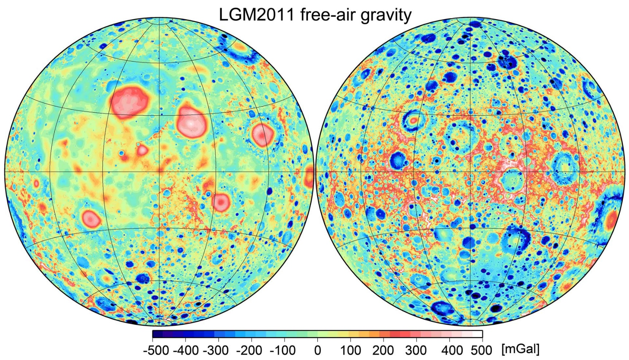
Visiting Scientists
Christian Hirt
http://ddfe.curtin.edu.au/models/
Lunar Gravity Model
Notes:
Seeing all of the Moons craters via gravity.
http://ddfe.curtin.edu.au/models/LGM2011/images/LGM2011_freeair_lge.jpg

Slide 13
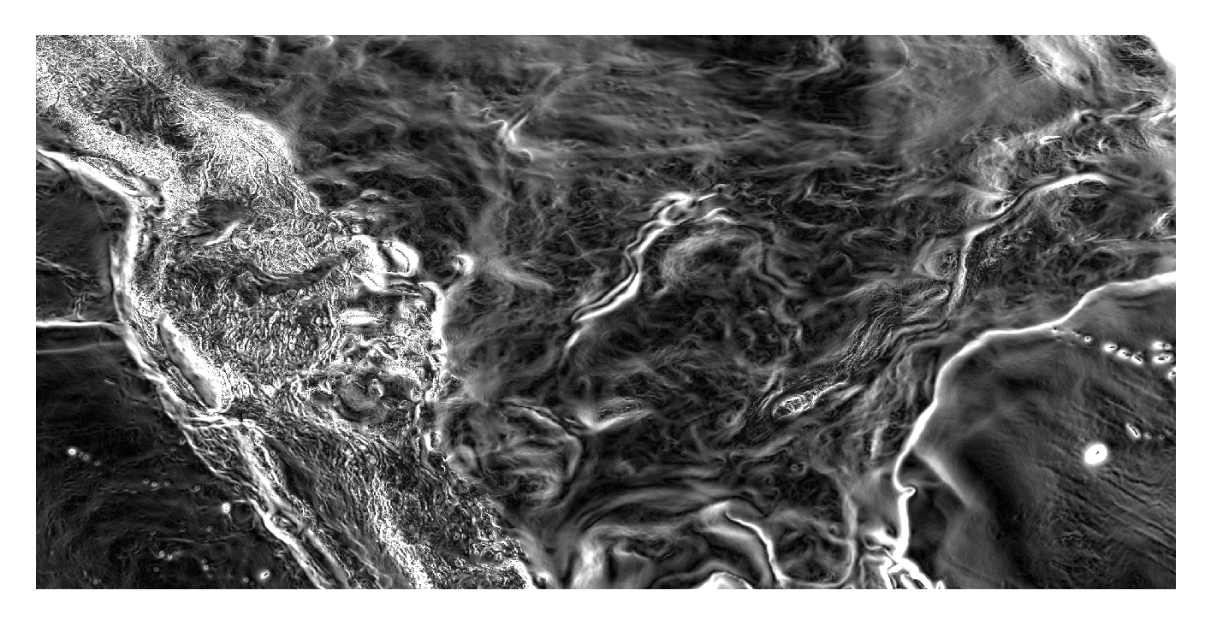
Magnitude of the Deflection of the Vertical
Questions?
SOS Workshop
December 1, 2020
Brian Shaw
brian.shaw@noaa.gov

Slide 14
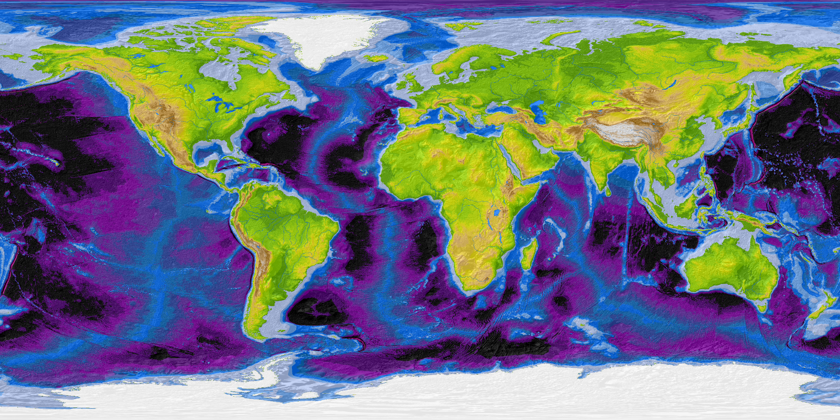
Christian Hirt
http://ddfe.curtin.edu.au/models/
Earth2014
Notes:
Seeing all of the Moons craters via gravity.
http://ddfe.curtin.edu.au/models/LGM2011/images/LGM2011_freeair_lge.jpg

Slide 15
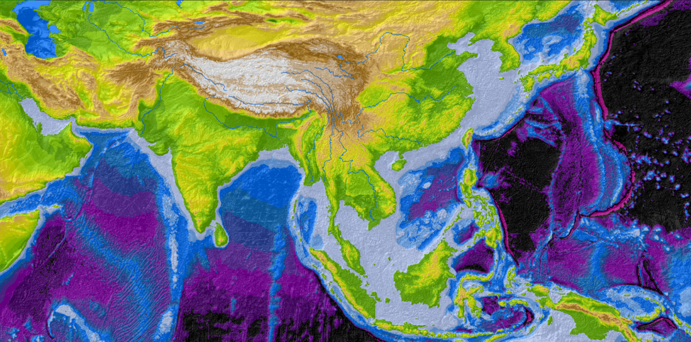
Christian Hirt
http://ddfe.curtin.edu.au/models/
Earth2014
Notes:
Seeing all of the Moons craters via gravity.
http://ddfe.curtin.edu.au/models/LGM2011/images/LGM2011_freeair_lge.jpg

Slide 16
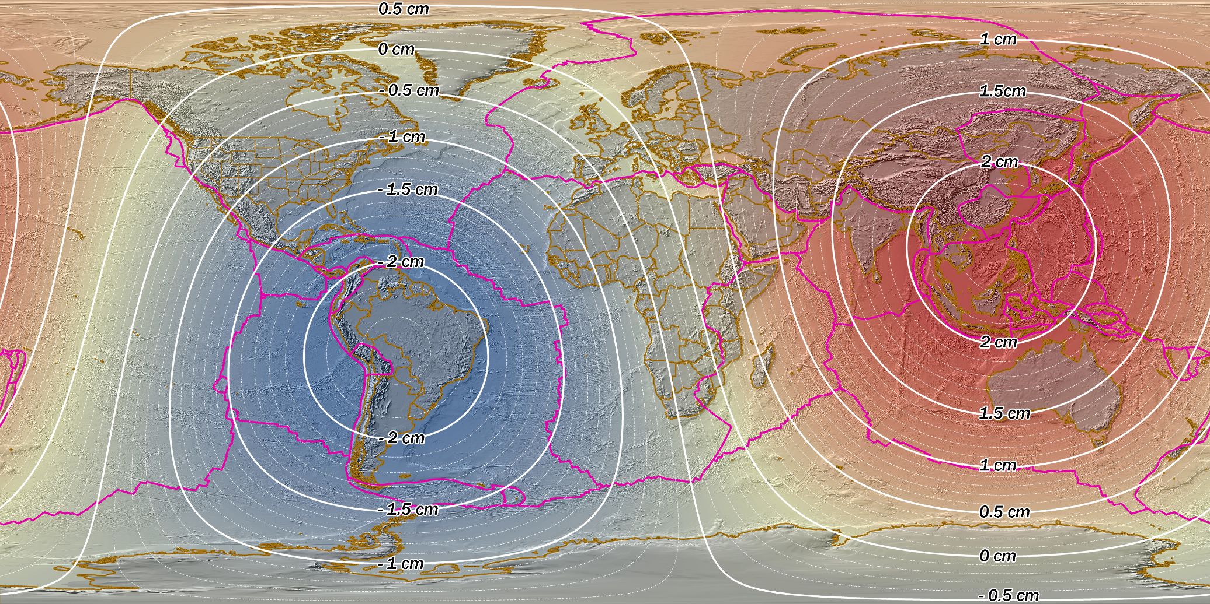
Modernizing the NSRS
Notes:
https://geodesy.noaa.gov/datums/newdatums/WhatToExpect.shtml
Approximate Ellipsoid Height change

Slide 17
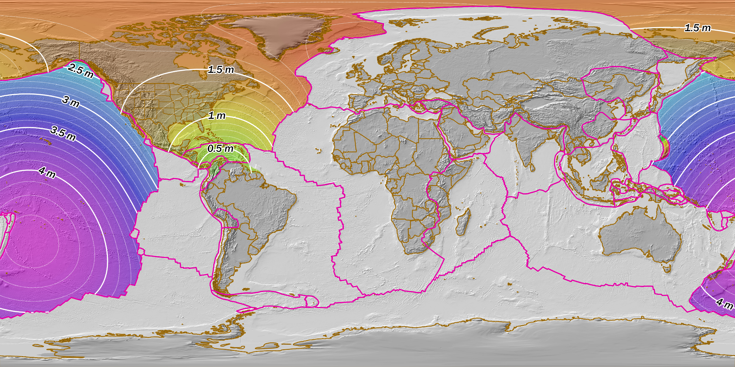
Modernizing the NSRS
Notes:
https://geodesy.noaa.gov/datums/newdatums/WhatToExpect.shtml
Approximate Horizontal change

