Slide 1
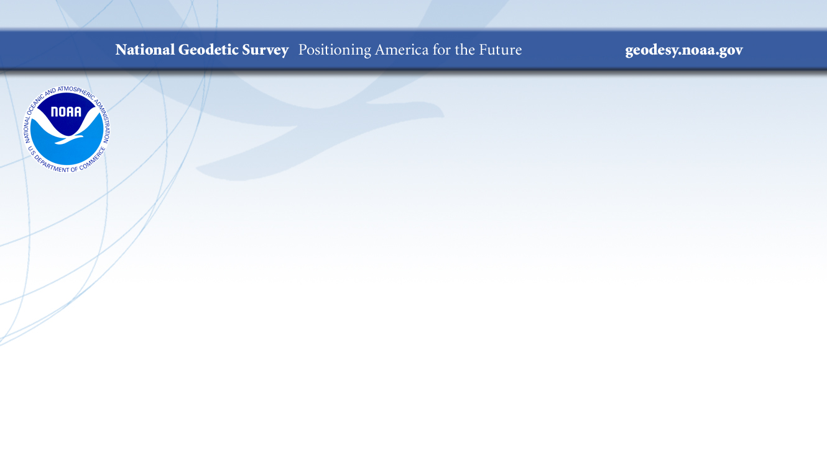
The History of our Static National Spatial Reference System
NSGIC Midyear Meeting
Brian Shaw
brian.shaw@noaa.gov
March 7, 2019
Notes:
A brief presentation on the history of the NSRS

Slide 2

NGS’ Mission
To define, maintain and provide access to the National Spatial Reference System (NSRS) to meet our Nation’s economic, social, and environmental needs.
…………………………………………….........................
The NSRS is a consistent coordinate system that defines latitude, longitude, height, scale, gravity, orientation, and shoreline throughout the United States.
Notes:
The National Spatial Reference System is our nations geospatial infrastructure from which all positioning (with the exclusion of military/DOD) is referenced to.
This system provides a consistent framework that allows people to use data in the same reference system to perform analysis and make meaningful comparisons and decisions from that analysis.

Slide 3
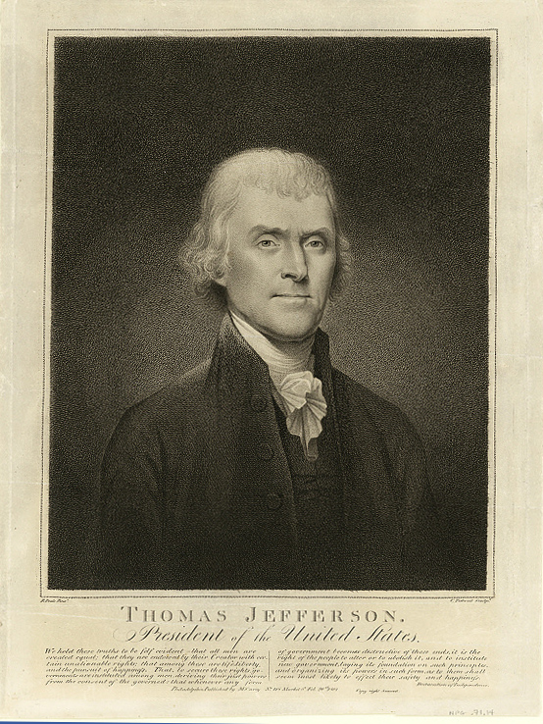
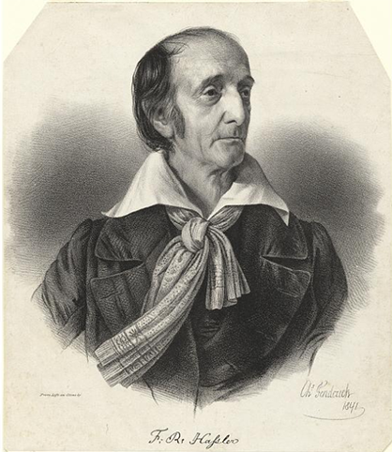


NOAA and NGS
Our Nation’s first civilian science agency
1807
Thomas Jefferson
Survey of the Coast
1811
Ferdinand Hassler
Superintendent
1836
U.S. Coast
Survey
1878
U.S. Coast and
Geodetic Survey
1970
NOAA established
Notes:
NGS has been around a long time. For more than 200 years, NGS and its predecessor agencies have collaborated with public and private organizations to establish reference stations at precisely determined locations.
We began on a mission established by Thomas Jefferson in 1807 to conduct a “Survey of the Coast” (as the United States Coast Survey).
(Pictured are Thomas Jefferson and Ferdinand Hassler, the first Superintendent of the Coast Survey). We were renamed the U.S. Coast and Geodetic Survey in 1878. NOAA was established in 1970.
Traditionally, precise positioning locations have been identified by setting a survey mark—usually a brass, bronze, or aluminum disk. Locations might also be identified by a deeply driven rod, or a prominent object, such as a water tower or church spire.

Slide 4
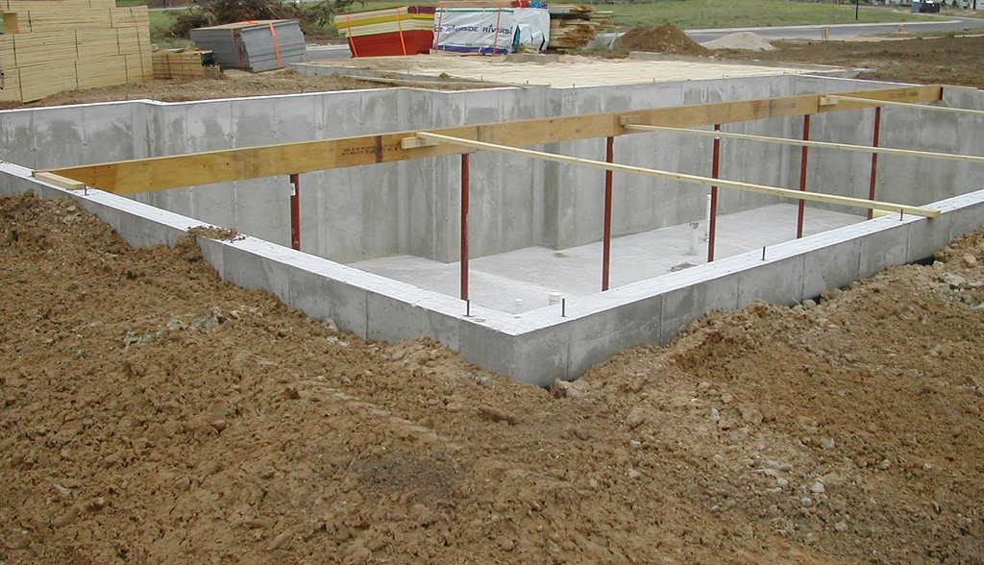
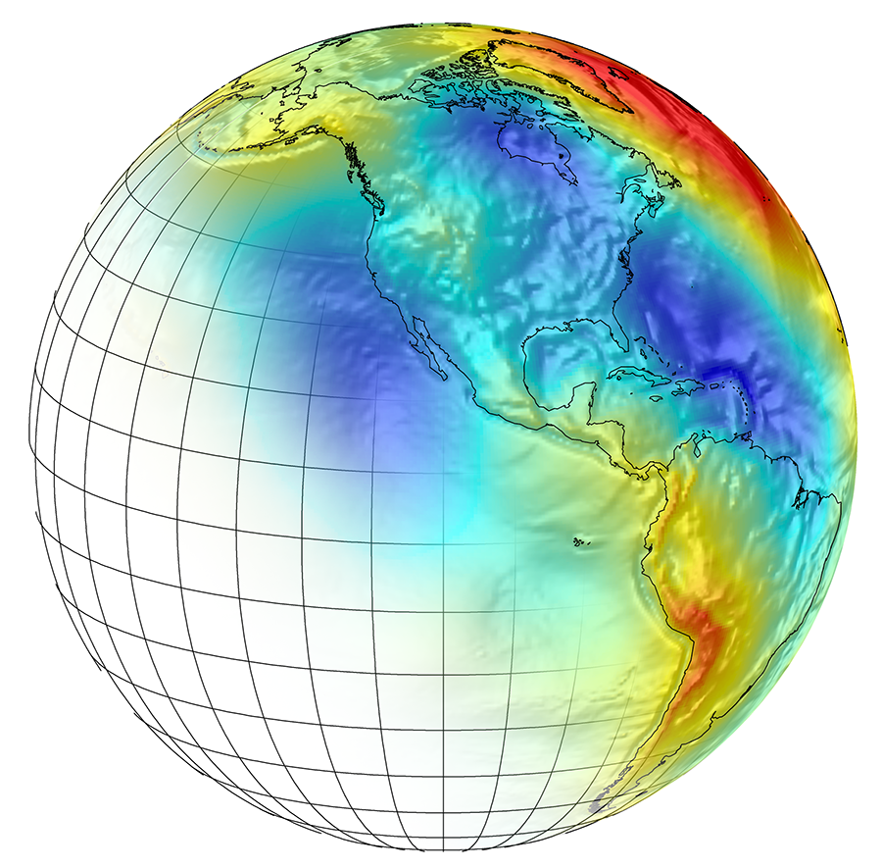
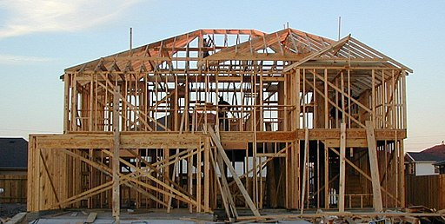
What is the NSRS?
A common and consistent
Geospatial Infrastructure for positioning
Notes:
Foundation image credit Armchairbuilder.com - http://armchairbuilder.com/resources/how-to-build-your-own-home
The National Spatial Reference System is our nations geospatial infrastructure from which all positioning (with the exclusion of military/DOD) is referenced to.
This system provides a consistent framework that allows people to use data in the same reference system to perform analysis and make meaningful comparisons and decisions from that analysis.

Slide 5
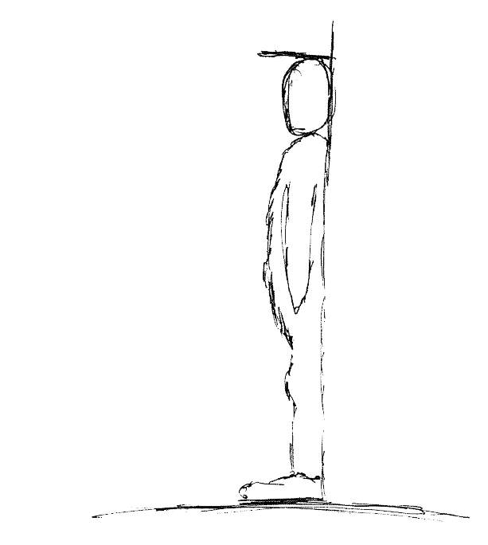
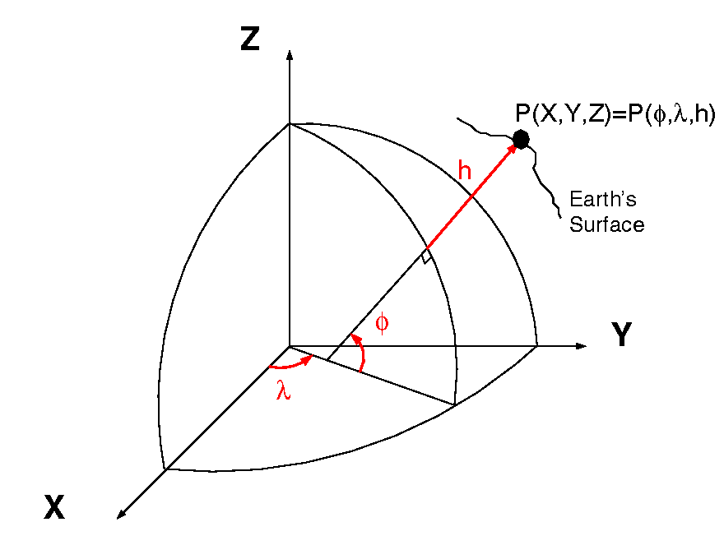
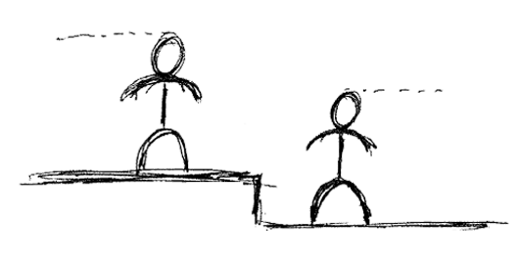
What is a Datum or Reference Frame?
60”, 2019
52”, 2018
60”
= ht.
aka P(L,L,H)
40”, 2017
40”
60”
= lat.
20”
= long.
X,Y,Z vs Lat,Lon,Ht
A reference surface or framework to reference your data to for consistency
Notes:
What is a datum? https://oceanservice.noaa.gov/facts/datum.html
Datums Overview https://geodesy.noaa.gov/datums/
New Datums https://geodesy.noaa.gov/datums/newdatums/
Horizontal and Geometric Datums https://geodesy.noaa.gov/datums/horizontal/
Vertical Datums https://geodesy.noaa.gov/datums/vertical/
A Datum or reference frame is in essence a reference surface or framework to reference your data to for consistency.
In the first image on the right there is a person who has been measuring their height over time (2017-2019 in this example). For consistency you can imagine that the floor next to the wall they are being measured is this ‘reference surface’ or datum. Lets say the first measurement was taken when the floor was carpet and you installed hard wood floors before the 2018 measurement you would have in essence changed the ‘reference surface’ and it would be inaccurate to compare the 2018 and 2019 values without a proper transformation, or height offset value.
The second image (when animating) shows why you should not try to compare values when using two different reference surfaces.

Slide 6
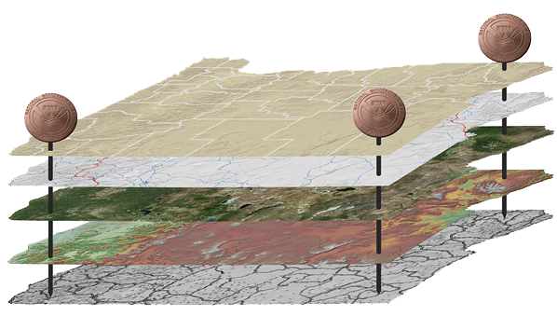
Why do we need Datums?
Provide consistent coordinates
Precise reference system
Align disparate geospatial data
A reference surface or framework to reference your data to

Slide 7
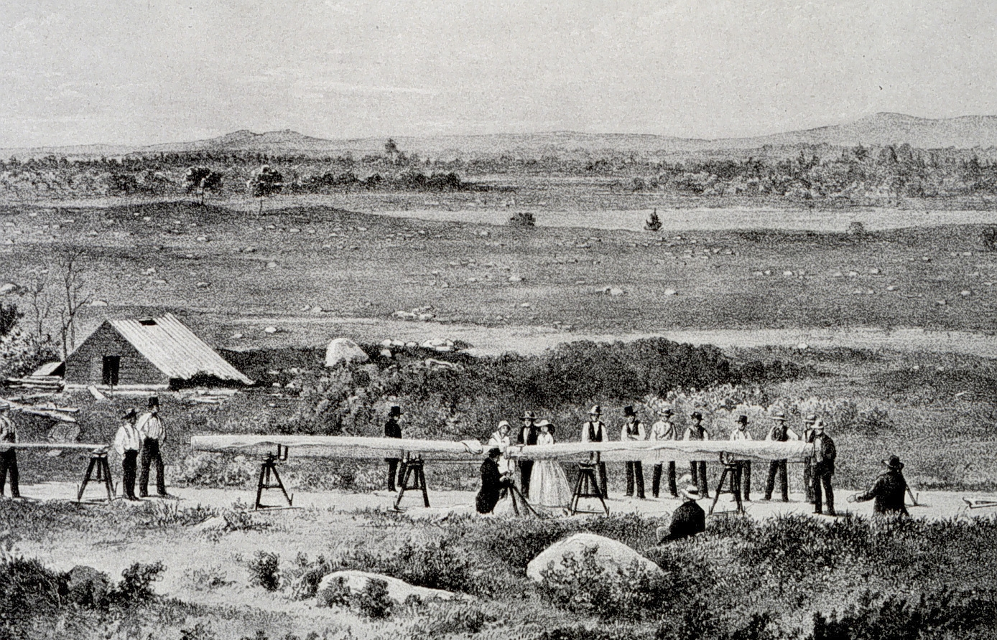
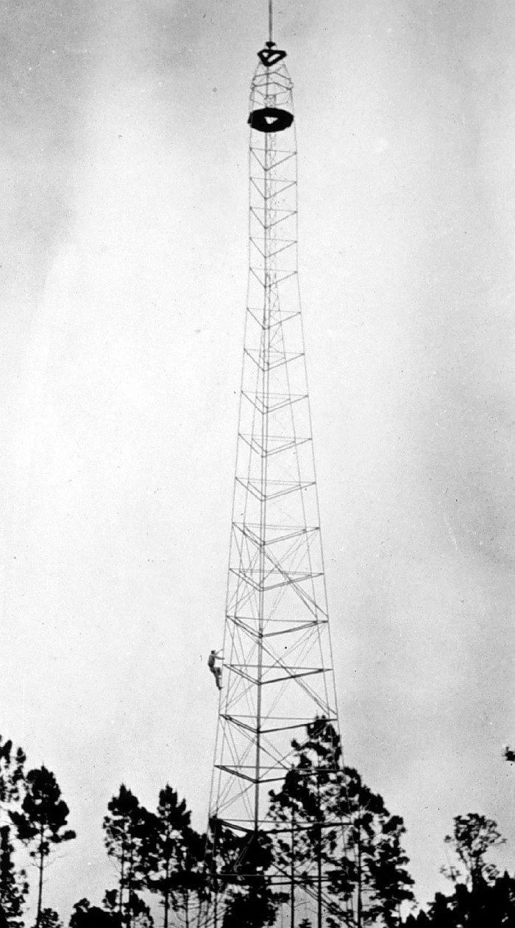
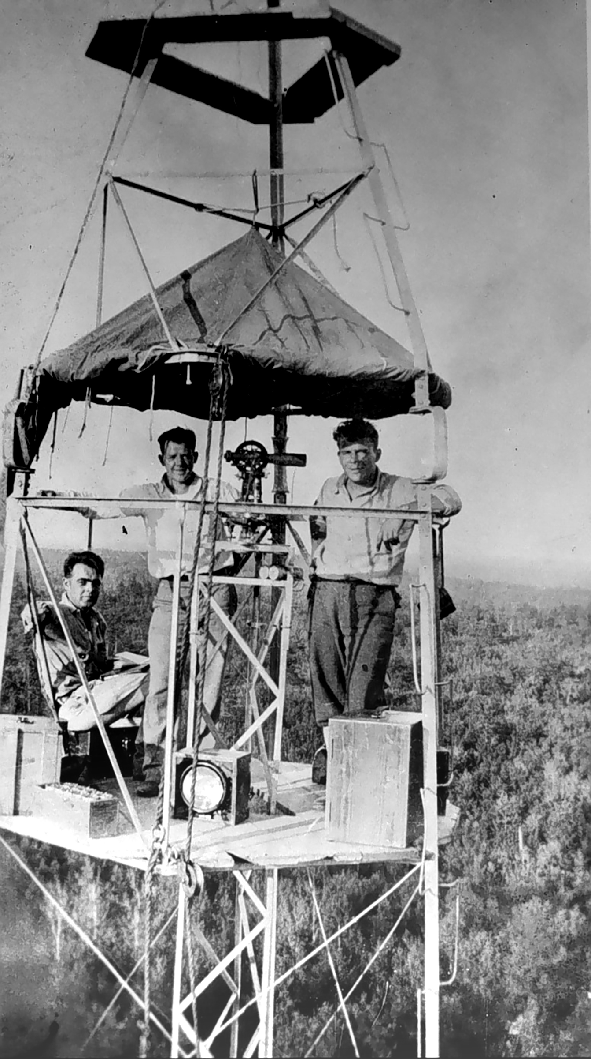
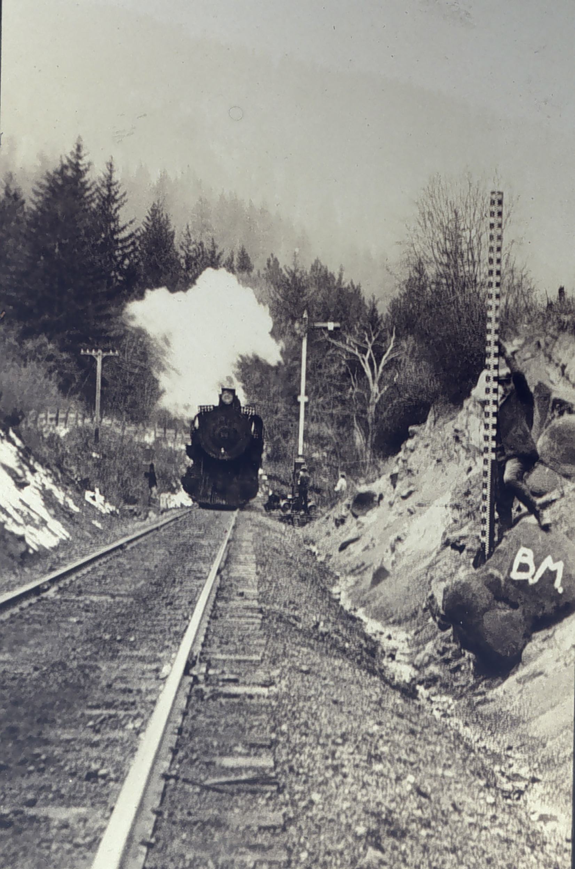
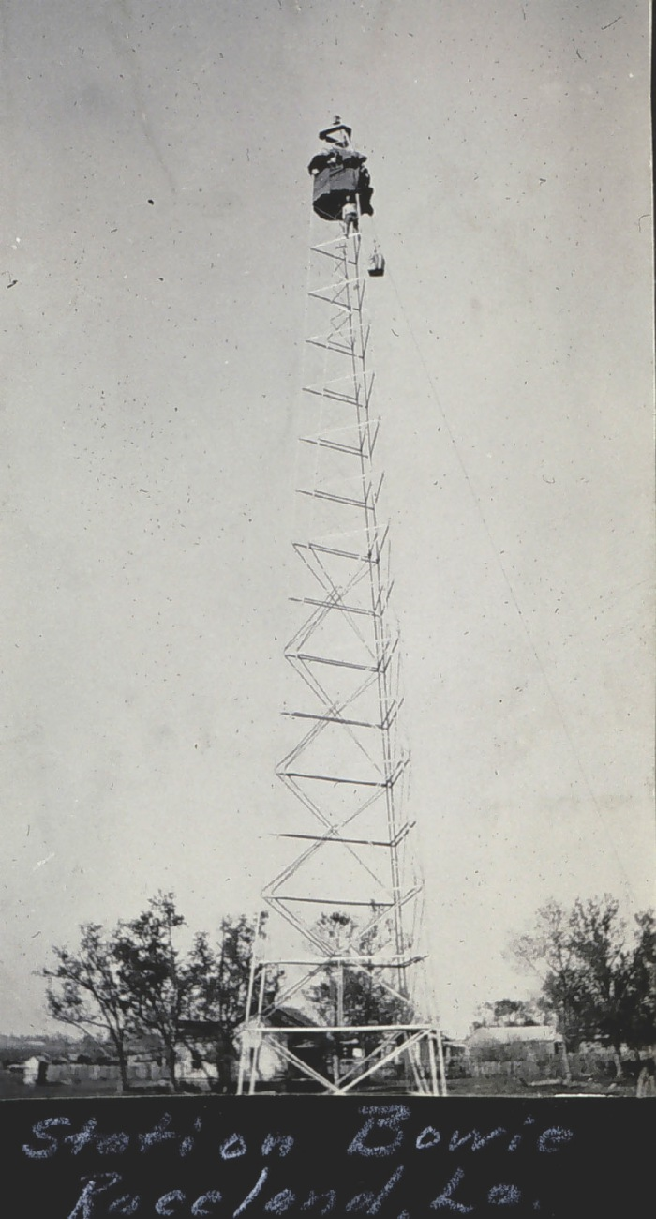
Station Hunter
159ft Bilby Tower
1935
Ebbing Plains Baseline
1857
Notes:
Through the years of surveying done by the National Geodetic Survey and its predecessor agencies technologies have greatly improved.
<this is an animated slide with 5 images)
1 - In the old days we used massive calibrated physical baselines for measuring distances and was extremely arduous.
Vertical Positioning to develop NGVD29 and NAVD88
2 - To get very precise and accurate height differences many field parties performed leveling from coast to coast and on many islands. People had to physically walk all of this area.
Horizontal Positioning to determine NAD27 and NAD83
3,4 and 5 – In the early 1900s the bilby tower was invented and was used to perform triangulation/trilateration surveys across the entire US. These towers would often take 2 days to build and 1 day to tear down by groups of people. You would generally make observations at night with 2-5 more towers observing at a time. There would be lights on the tops of the tower for other locations to turn angles using a theodolite and there would be observers at a specific location to turn angles from the tower. Small sketch on the next slide.

Slide 8
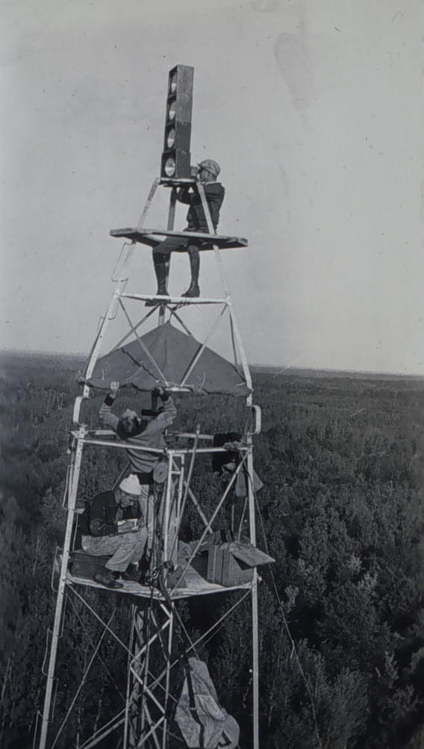
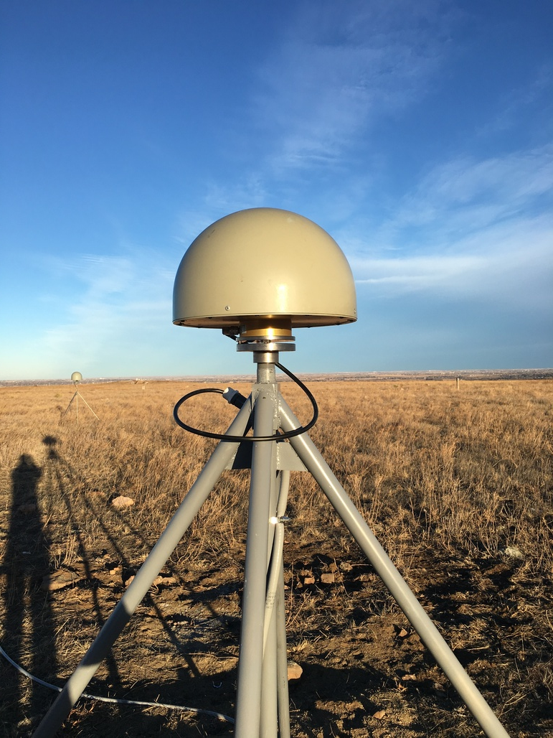
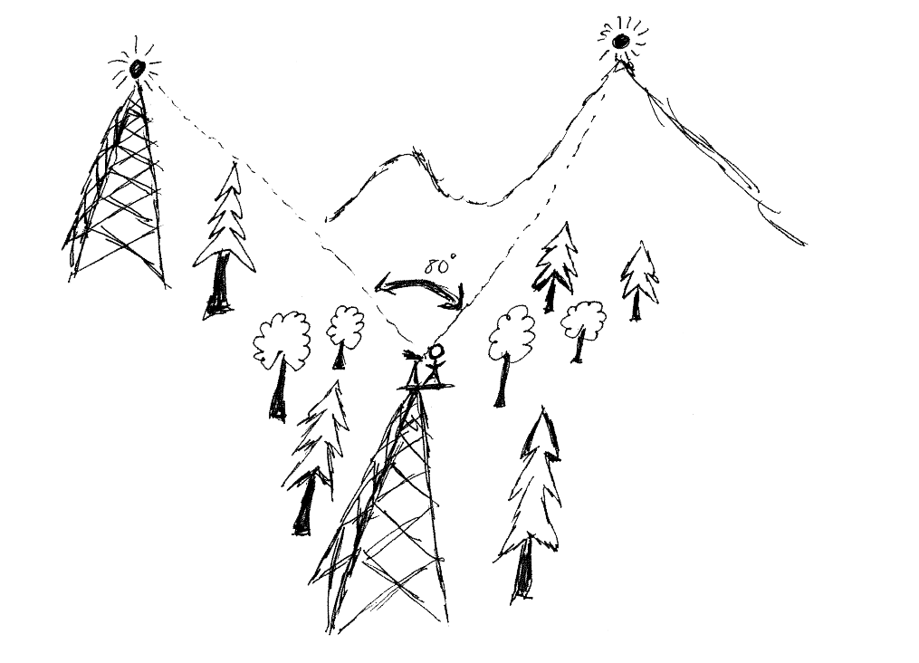
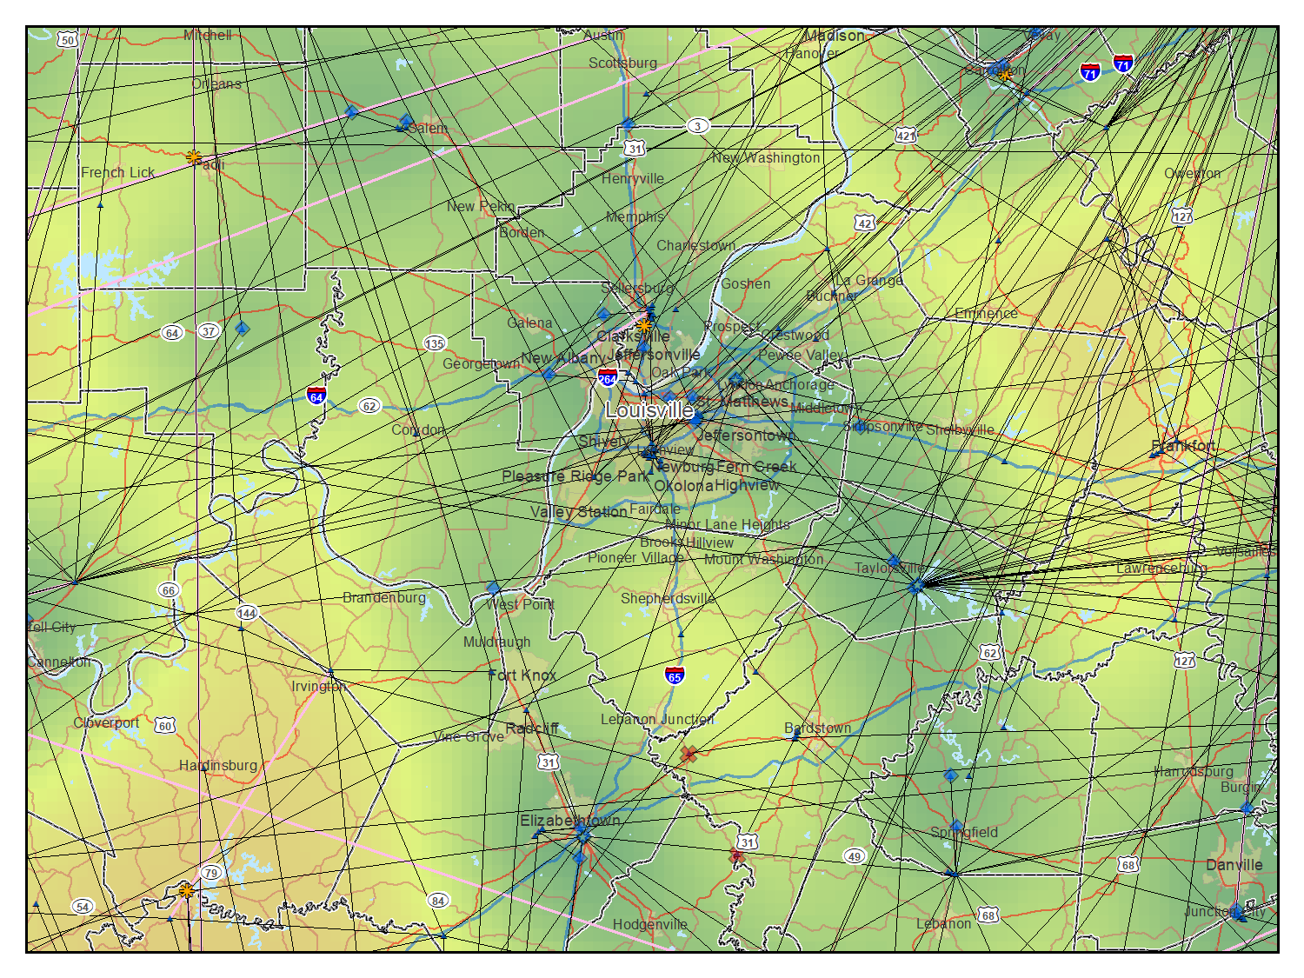
Horizontal Measurements
Last Century (Horizontal)
Today (Geometric)
Notes:
As mentioned in the old days horizontal positioning was used primarily with Bilby Towers. Today we use GNSS to position in 3 dimensions using satellites and antennaes/receivers

Slide 9
NSRS Horizontal Evolution
Datum | Time Span | Network Accuracy | Method of Reference
NAD27 | 1927 - 1986 | 10 meters | Traverse and Triangulation. Ground marks used for referencing the NSRS
NAD83 (86) | 1986 - 199* | 1 meter
NAD83 (HARN) | 199* - 2007 (varies by state) | 0.1 meter | GPS becomes the means of positioning. Ground marks.
NAD83 (NSRS2007) | 2007 - 2012 | 0.01 meter | GPS – CORS are the means of reference for the NSRS
NAD83 (2011) | 2012 - present | 0.01 meter
Notes:
As technology, scientific discoveries and surveying methodologies and analysis have all improved so has the accuracy of the datums.
Continuous improvements have driven the need for NGS to modernize the NSRS in 2022.

Slide 10
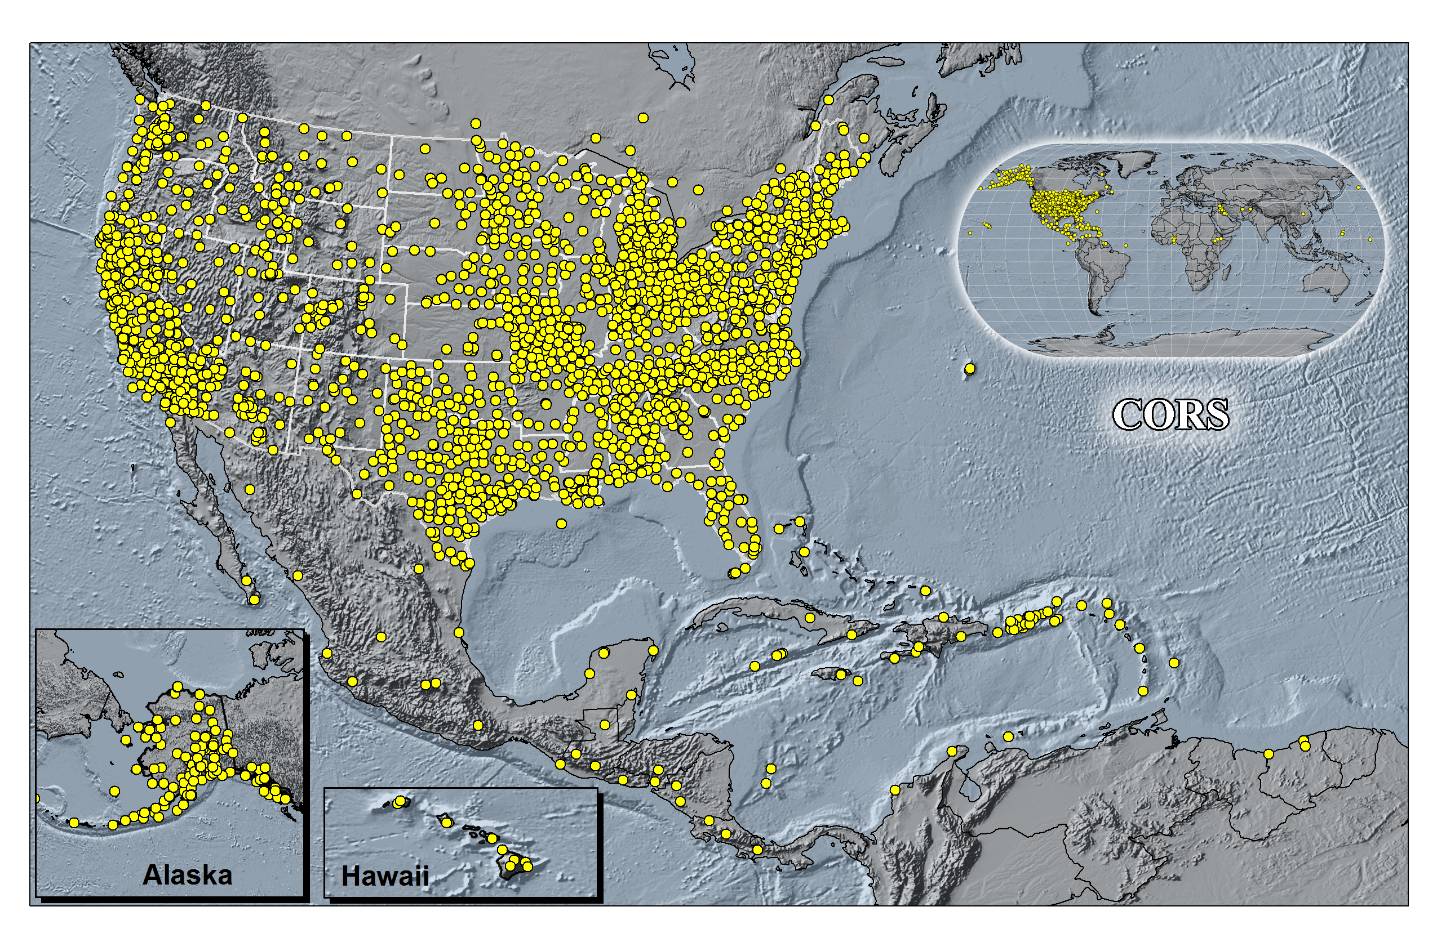
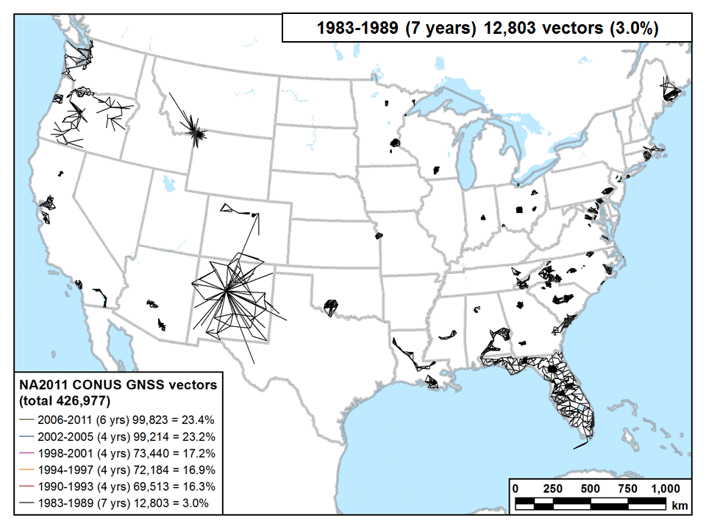
GNSS
CORS, OPUS and NA2011 GNSS data
Notes:
CORS, right animated gif is a time series of GNSS vectors used for the 2011 National Adjustment used to develop NAD83 (2011)
NOAA’s National Geodetic Survey (NGS) manages a network of Continuously Operating Reference Stations (CORS) that provide Global Navigation Satellite System (GNSS) data to support three-dimensional positioning, meteorology, space weather, and geophysical applications throughout the United States, its territories, and a few foreign countries.
The CORS network is a multi-purpose cooperative endeavor involving over 200 government, academic, and private organizations.
CORS enables users to determine (with the proper tools and equipment) centimeter-level positions with respect to the NSRS, by simultaneously processing their own GNSS data with data from the CORS Network.
Co-located with tide stations, CORS can contribute to local and global sea-level rise calculations by measuring land subsidence relative to water levels.
CORS data can also used to monitor and predict the distribution of moisture and electrons in the atmosphere, as well as produce ionosphere models of total electron content (TEC) that impact GNSS-derived position accuracy.
A 2009 socioeconomic scoping study, estimated CORS benefits to the nation are $750 million per year.

Slide 11
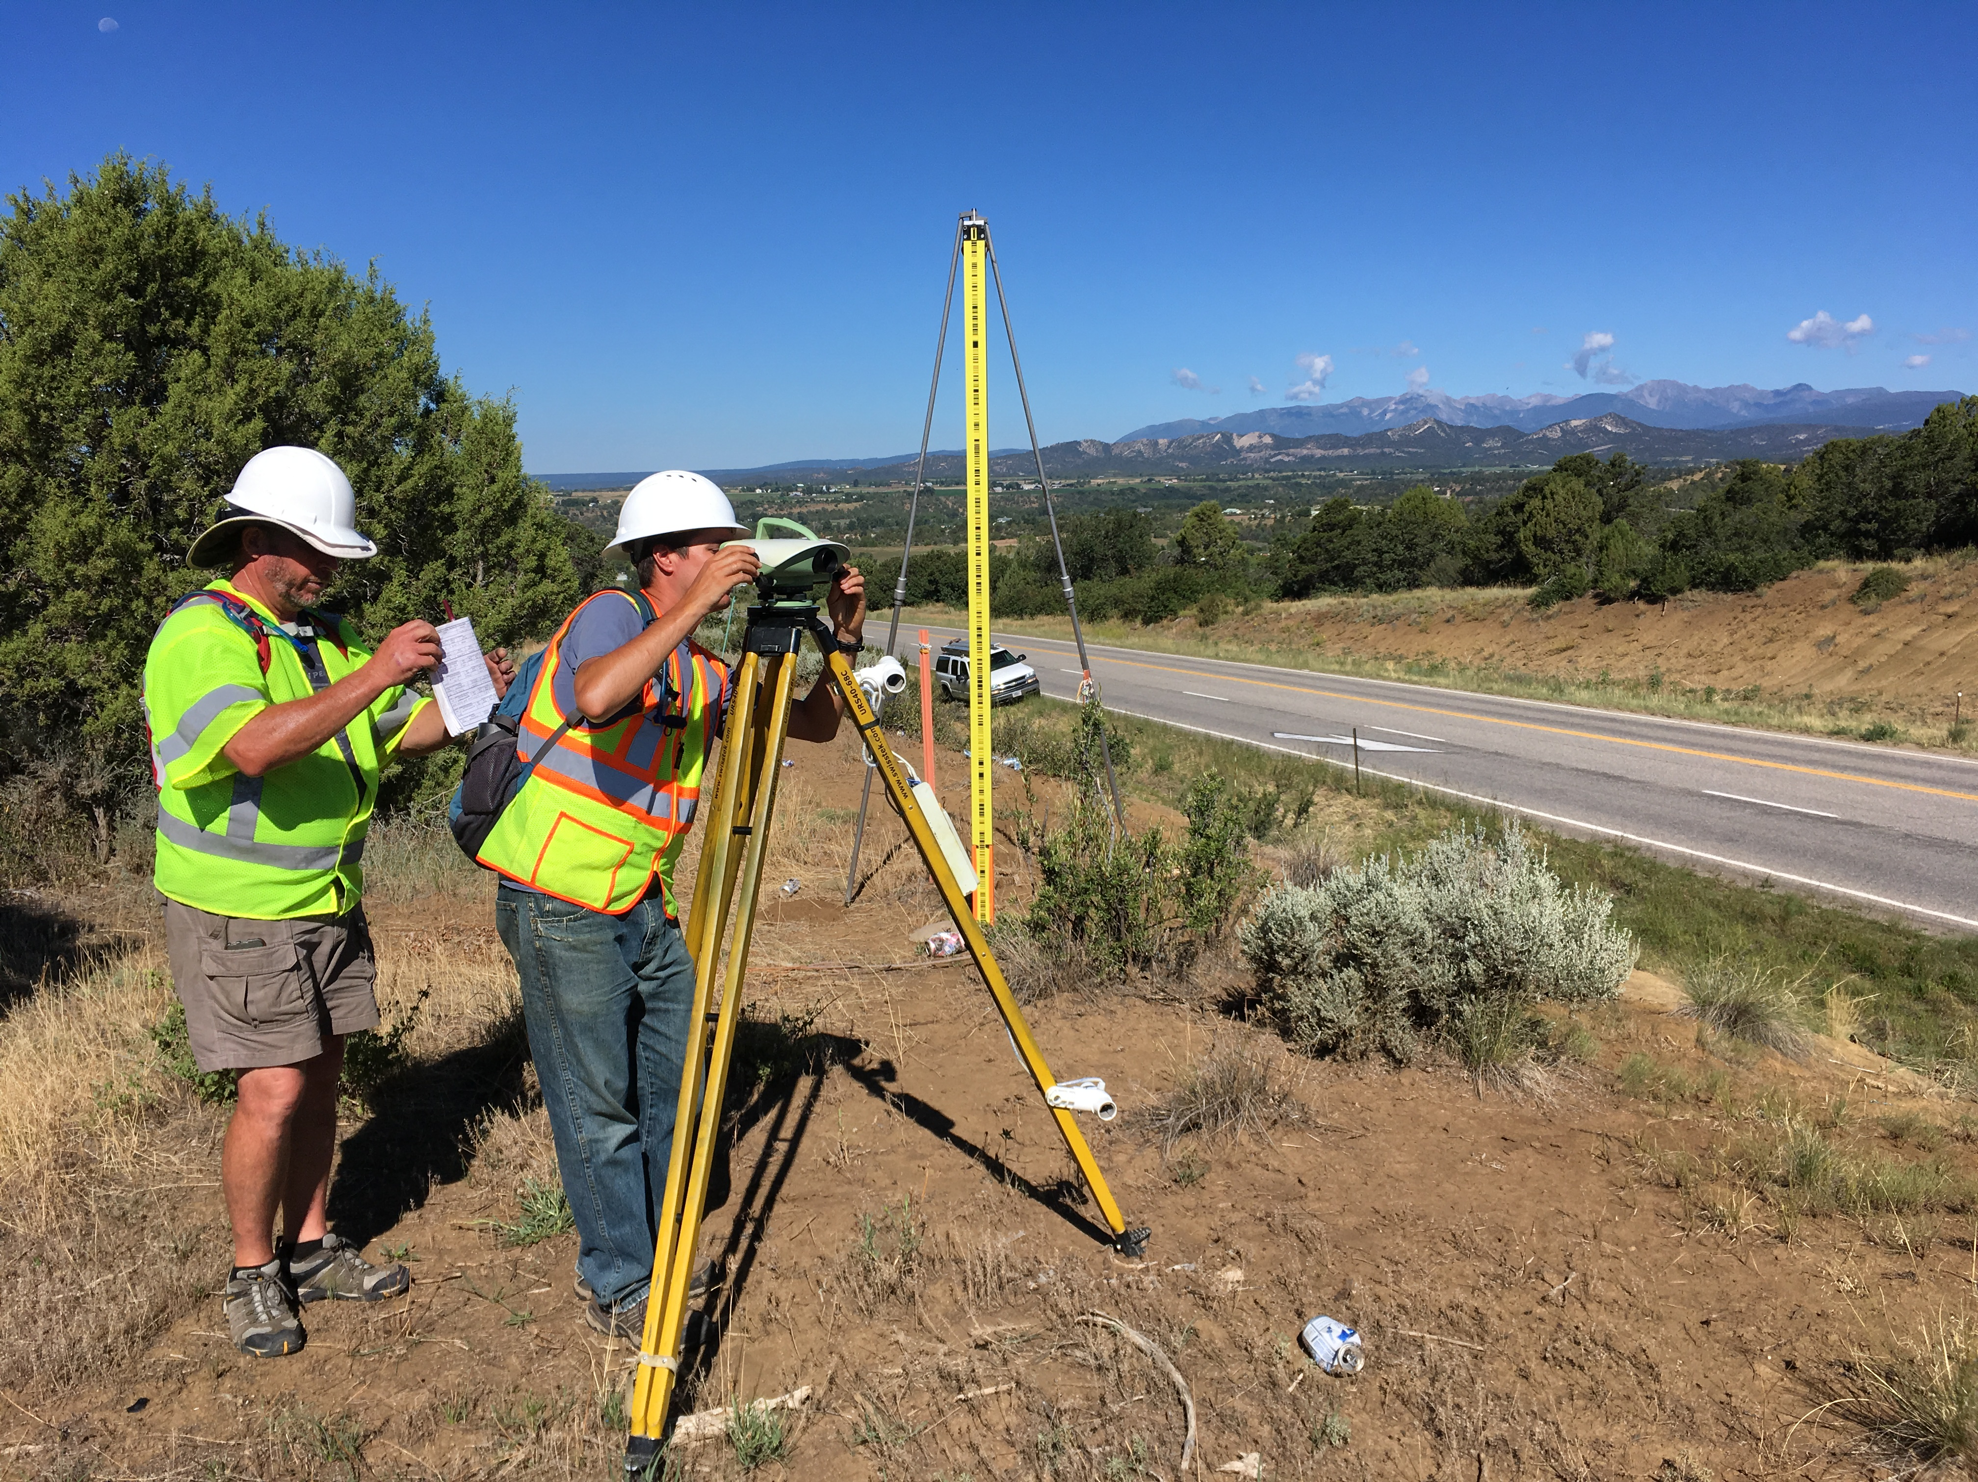
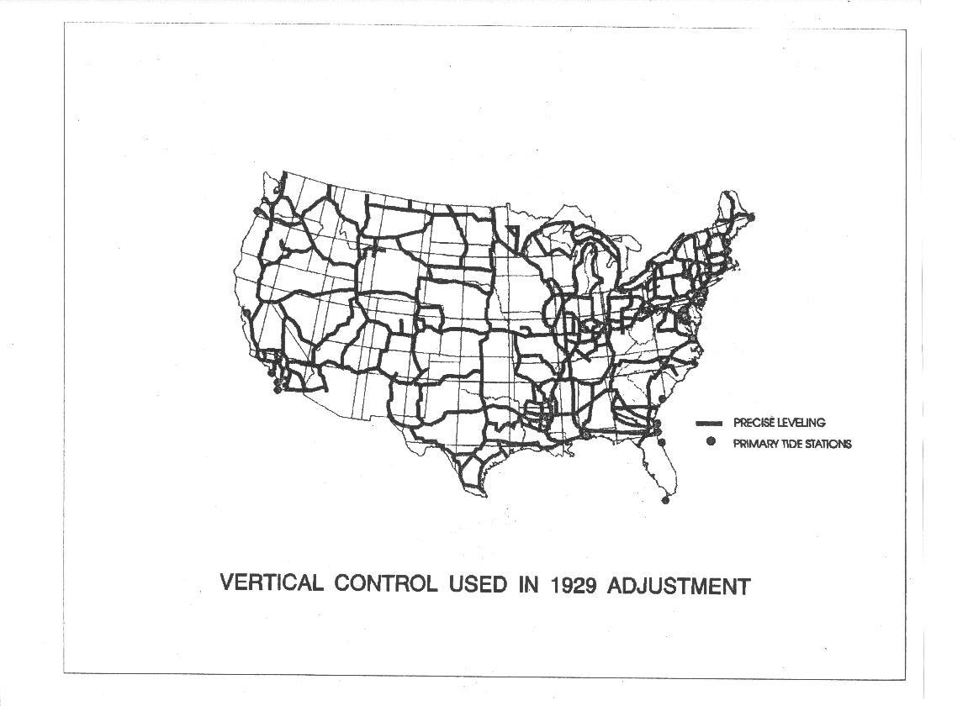
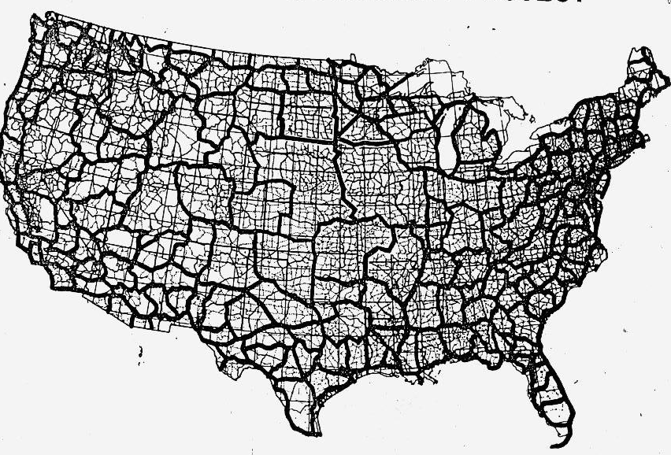
NSRS Vertical Evolution
NGVD 29
NAVD 88
Notes:
NGVD29 on left
NAVD88 on the right
Over the last 100+ years NGS has continued to densify the network that defined for the heights of the US. Leveling is a very arduous and time consuming surveying method but provides height difference much more precise and accurate than can be achieved with most other methods.

Slide 12
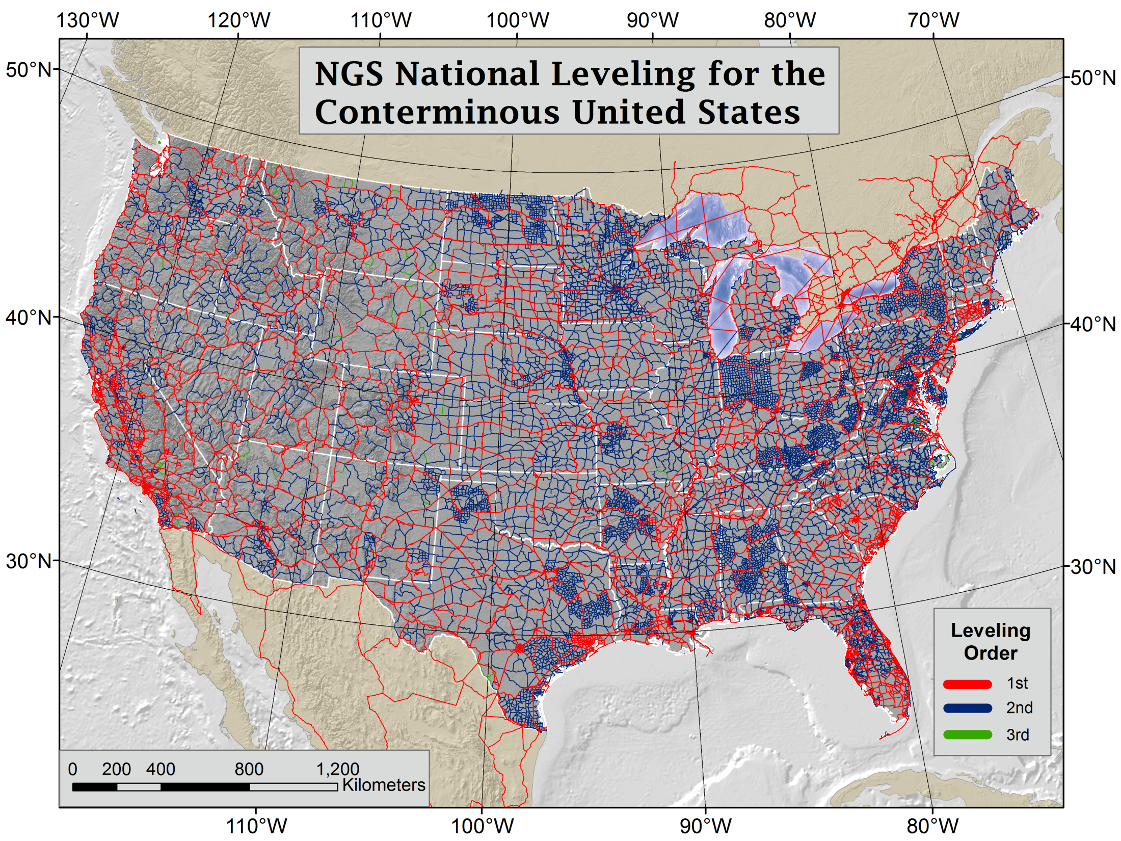
Todays Leveling Derived Vertical Datums
NAVD 88
ASVD02
GUVD04
NMVD03
PRVD02
VIVD09
Notes:
These Vertical Datums are all developed using leveling based data for the respective areas. This leveling data was collected over the last 200 years but most of it in the 1930s and 1940s.
Explanation of 1930s leveling by Dave Doyle:
Why more activity in the 30s. First of all it was both triangulation as well as leveling. The development of the portable Bilby Steel Tower in 1927 was a major advancement in the ability of USC&GS to conduct triangulation. With Roosevelt's election in 1933 and his initiative of the New Deal there was improved funding for many of the C&GS programs. As to specifically the leveling there were actually two parts - 1) new hires and improved funding for the full array of C&GS surveying and charting programs and 2) the instigation of the Civil Works Administration (CWA) which set up geodetic surveying programs in virtually all 48 states some of which are still in place today (NC, NJ and SC). The CWA surveying programs were funded by congress and the monies passed through C&GS but they had little control beyond that. Each state had their own coordinator and in some cases thousands of marks were set and surveyed. For example go into the archives and look for two red books "Geodetic Survey of Georgia." There was a really significant amount of traverse and leveling that was conducted under the CWA effort - regrettably virtually all of it was never submitted to C&GS for inclusion in the national reference frame - while many of the marks still exists only a very small percentage were ever later tied in by C&S/NGS field parties into the reference frame. In most cases the marks used were inscribed U.S. Coast & Geodetic Survey and State Survey.

Slide 13
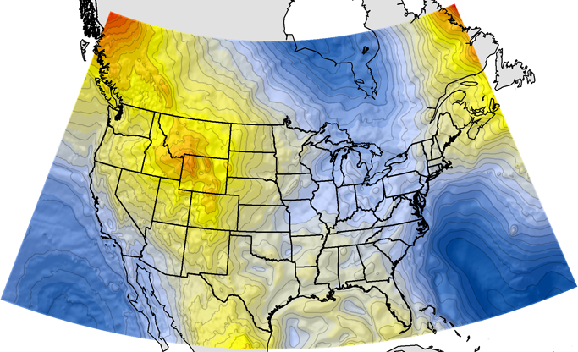
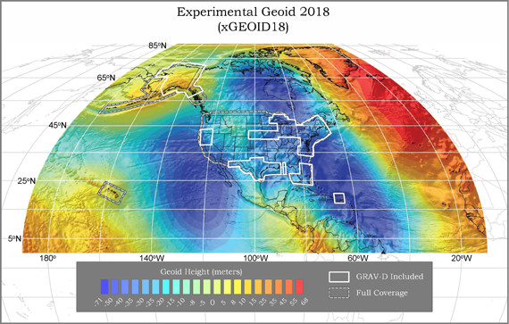
Geoid Models
GEOID12B
Hybrid (NAVD 88)
xGEOID18
Gravimetric (aka Scientific)
Past/Present
Present/Future
Notes:
Gravimetric Geoid models are developed using the best gravity data and topography data of the time. The geoid is an approximate reference surface that often termed “Sea Level”. This is what is used by GNSS observations to convert an ellipsoid height (provided using GNSS) into an elevation also known as an Orthometric Height.
Hybrid geoid models are generated by developing a gravimetric geoid and then fitting it to a known vertical datum. In the case of NGS we take a beautifully formed gravimetric model and hammer it to fit NAVD88 so that you can get a precise NAVD88 elevation from GNSS.

Slide 14
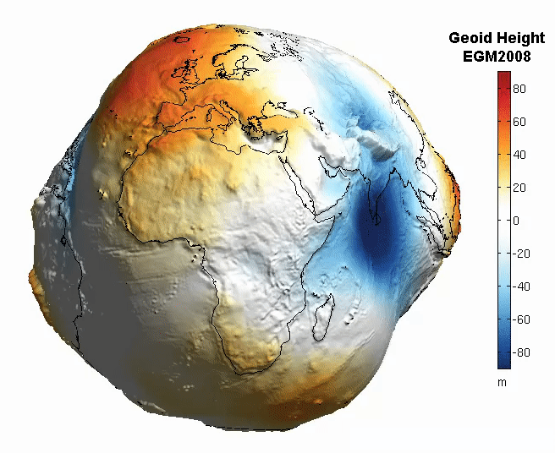
Which geoid to use?
NAD 83 (realization) | Geoid Model
NAD 83 (1986) | N/A
NAD 83 (HARN) | GEOID96/GEOID99
NAD 83 (FBN) | GEOID03
NAD 83 (CORS96) | GEOID03
NAD 83 (NSRS2007) | GEOID09
NAD 83 (2011) | GEOID12B
Make sure you use the proper geoid with the appropriate datum
Notes:
Metadata is pivotal to understanding what system your data is in so you can make appropriate comparisons with other data. There have several realizations of NAD83 and many of them have specific geoid models that should be used with. Using the wrong geoid model with data in a different datum will provide inaccurate heights due to variations in the horizontal and vertical data.

Slide 15
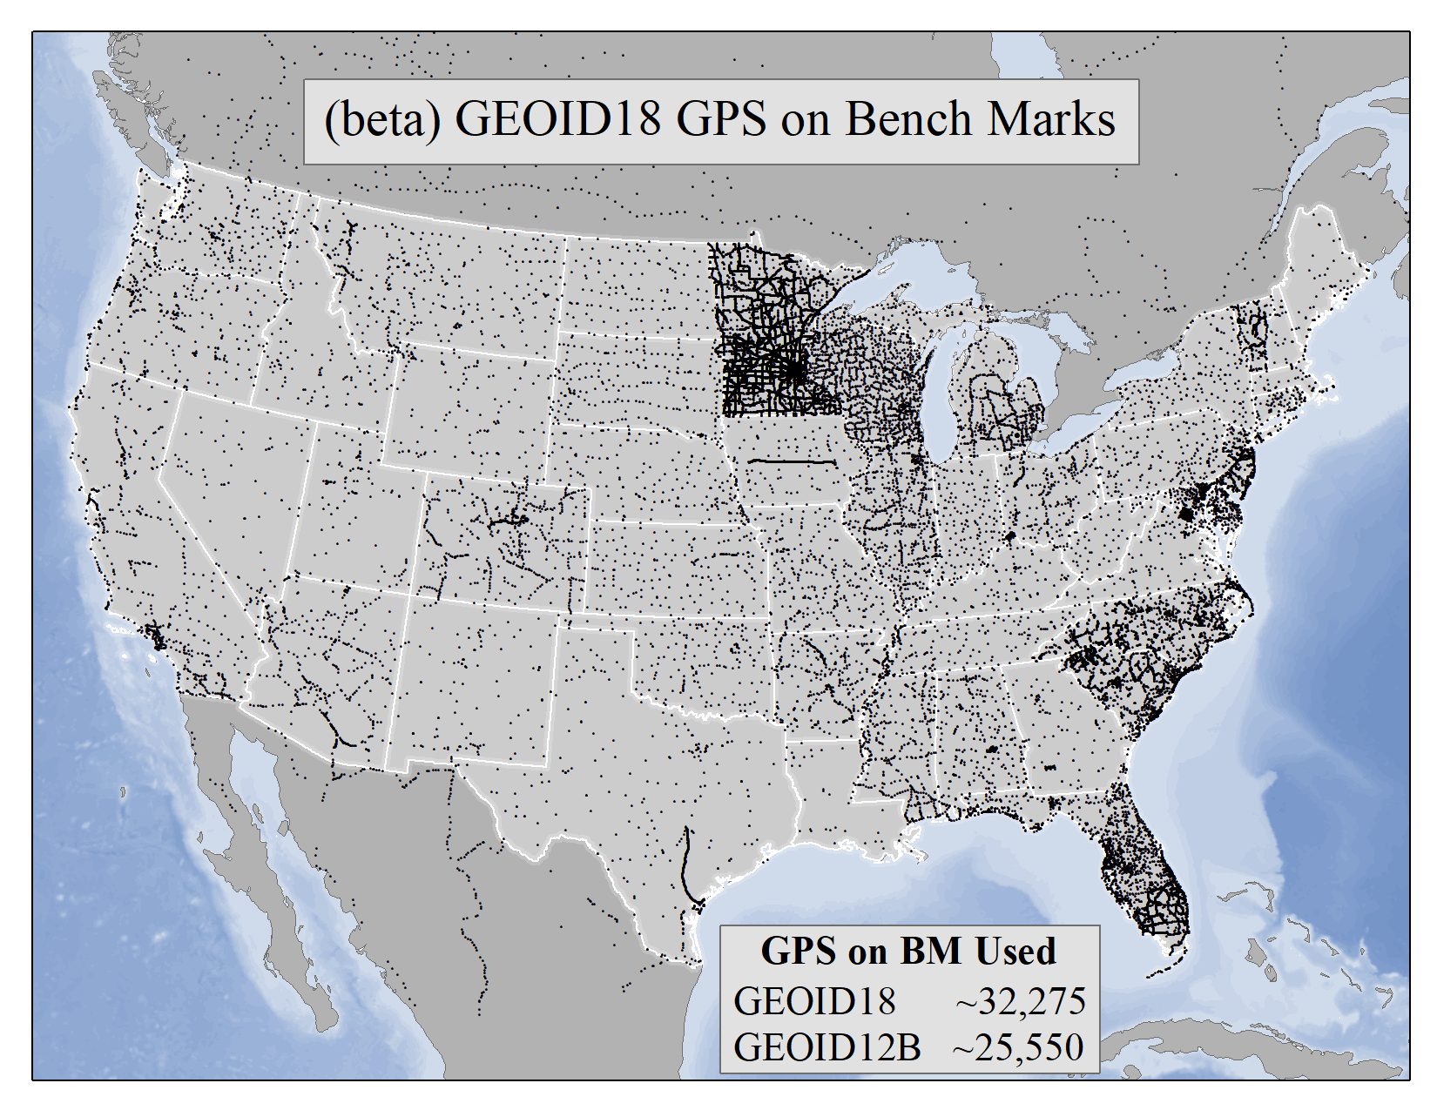
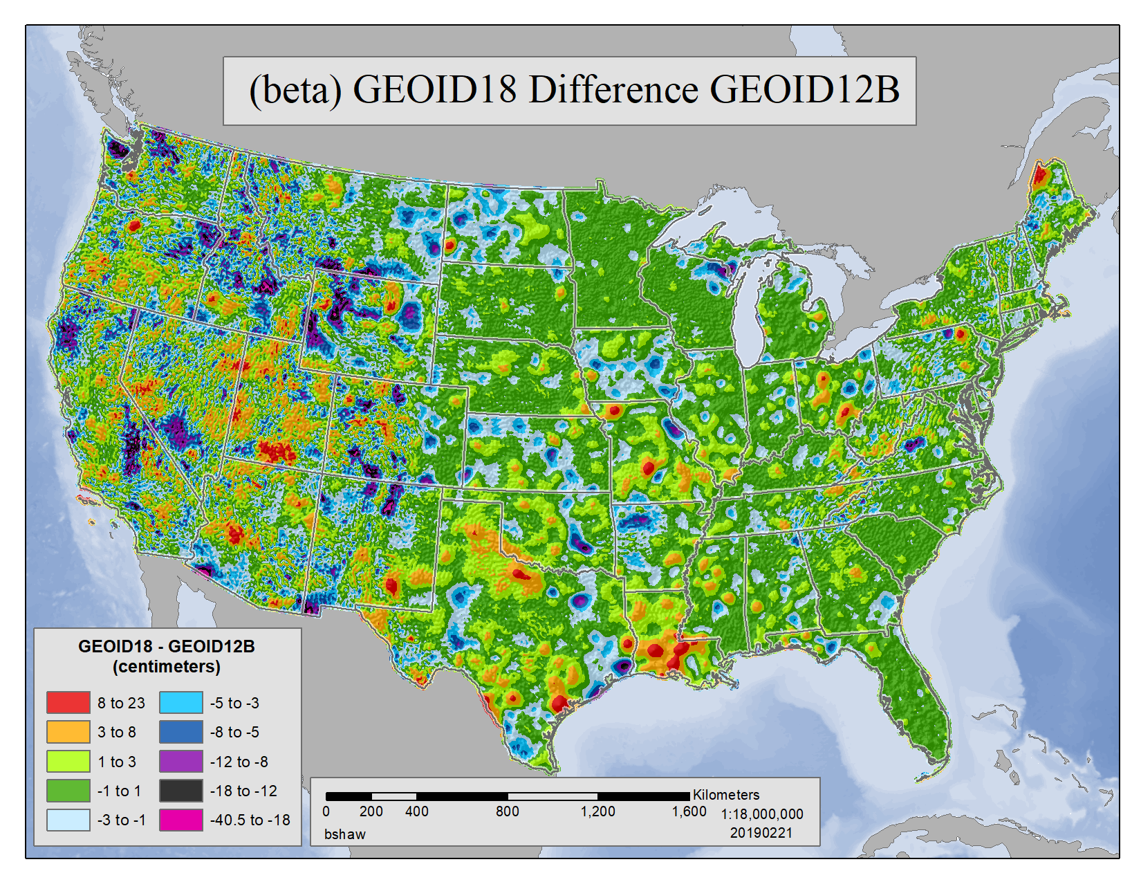
GEOID18
Notes:
Geoid18 has just been released to beta. This will be the final geoid model for NAVD88 and the best science was used to create it.
https://beta.ngs.noaa.gov/GEOID/GEOID18/

Slide 16
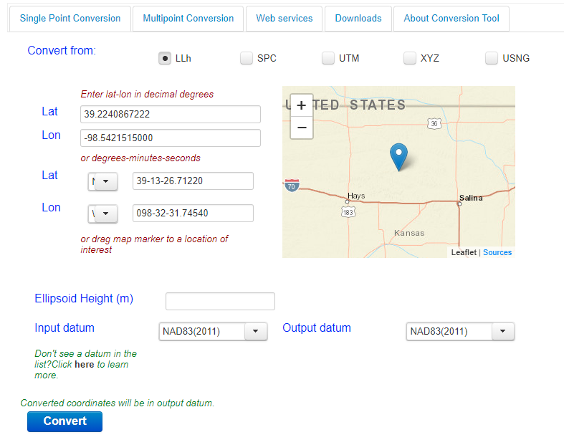
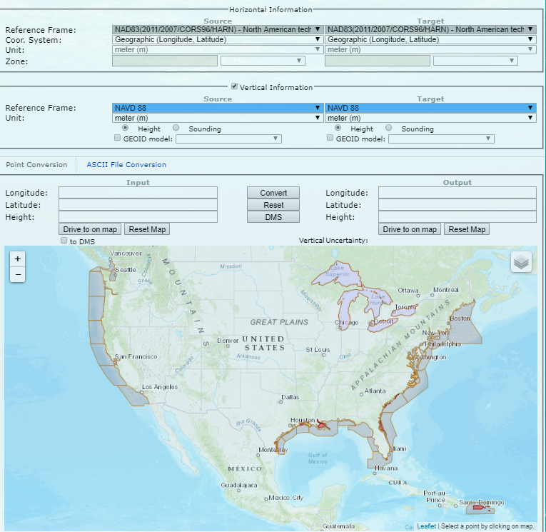
Transformations
NCAT
VDATUM
Newest Horizontal, Projections, Web Services
Horizontal, Vertical, Tidal
Notes:
There are plans to make all the transformations in these applications consistent, currently NCAT is the most accurate for horizontal transformations.
NCAT https://geodesy.noaa.gov/NCAT/
Vdatum https://vdatum.noaa.gov/vdatumweb/

Slide 17
Prepare for NSRS Modernization
Metadata is essential
Improves reliability and accuracy of data
Increases value and usefulness
Transform and collect data in current datums
NAD83 (2011), NAVD88
Preserve all original observations
particularly when referenced to ellipsoid (GNSS)

Slide 18
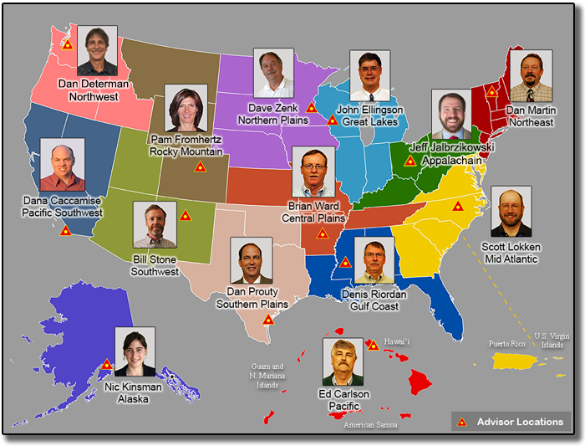
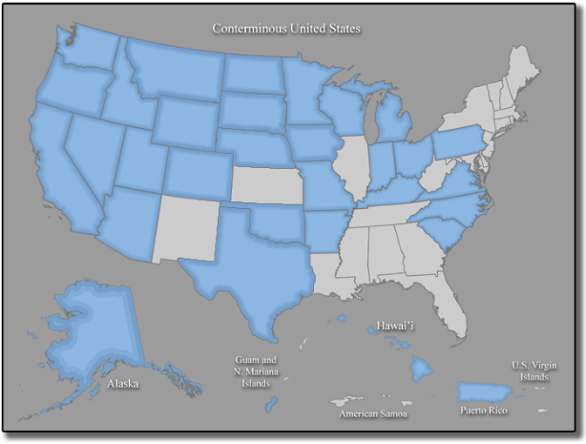
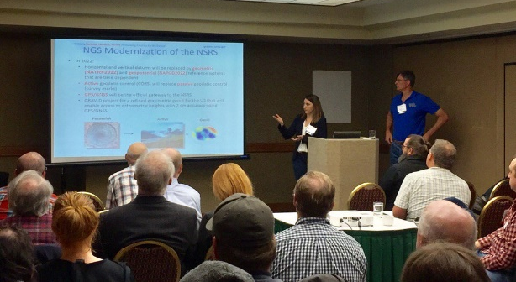
NGS Regional Geodetic Advisors
Notes:
The NGS Regional Geodetic Advisors are a pivotal resource to helping federal, states and local governments understand geodesy in their unique locations.
https://geodesy.noaa.gov/ADVISORS/
We hope to have a state or university coordinator in every state to help feed state level information up to NGS as well has filter NGS information down
https://geodesy.noaa.gov/ADVISORS/state-geodetic-coordinators.shtml

Slide 19
Education is a lifelong pursuit
NGS Training Center
https://geodesy.noaa.gov/web/science_edu/training/
Educational Videos
https://geodesy.noaa.gov/datums/newdatums/WatchVideos.shtml
NGS Webinar Series
https://geodesy.noaa.gov/web/science_edu/webinar_series/
Geospatial Summit (May 6-7, 2019 Silver Spring, MD)
https://geodesy.noaa.gov/geospatial-summit/
Presentation Library
https://geodesy.noaa.gov/web/science_edu/presentations_library/

Slide 20
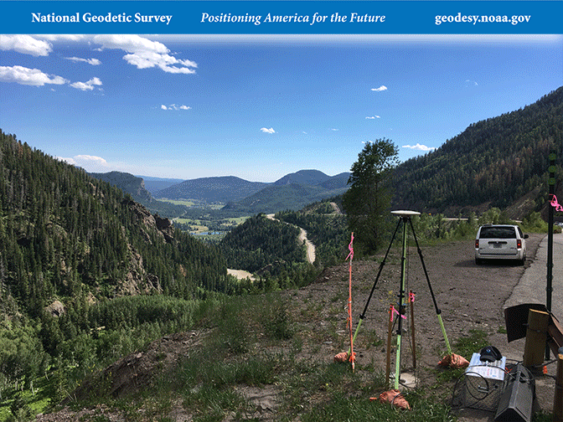
Questions?
NSGIC Midyear Meeting
March 7, 2019
Brian Shaw
brian.shaw@noaa.gov

