Slide 1

Modernizing the
National Spatial Reference System
GEO Week 2024
Brian Shaw
brian.shaw@noaa.gov
February 12, 2024

Slide 2
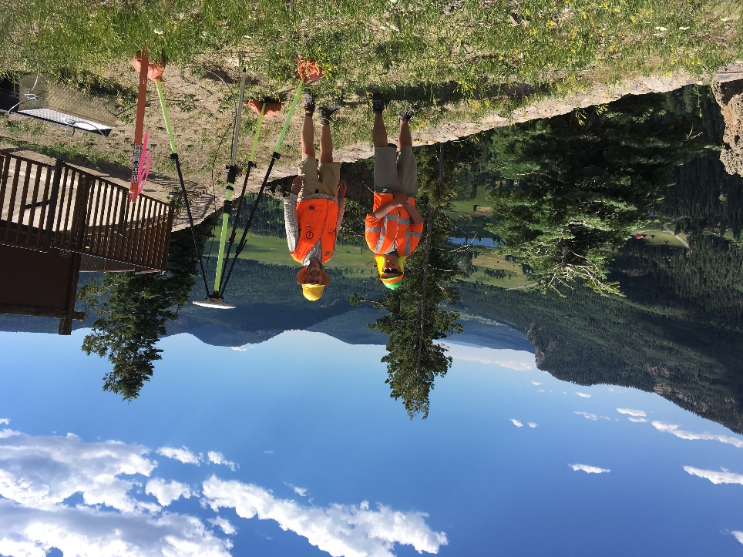

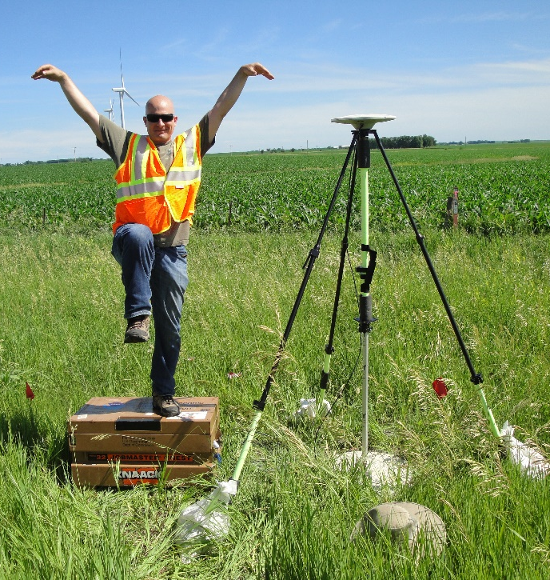
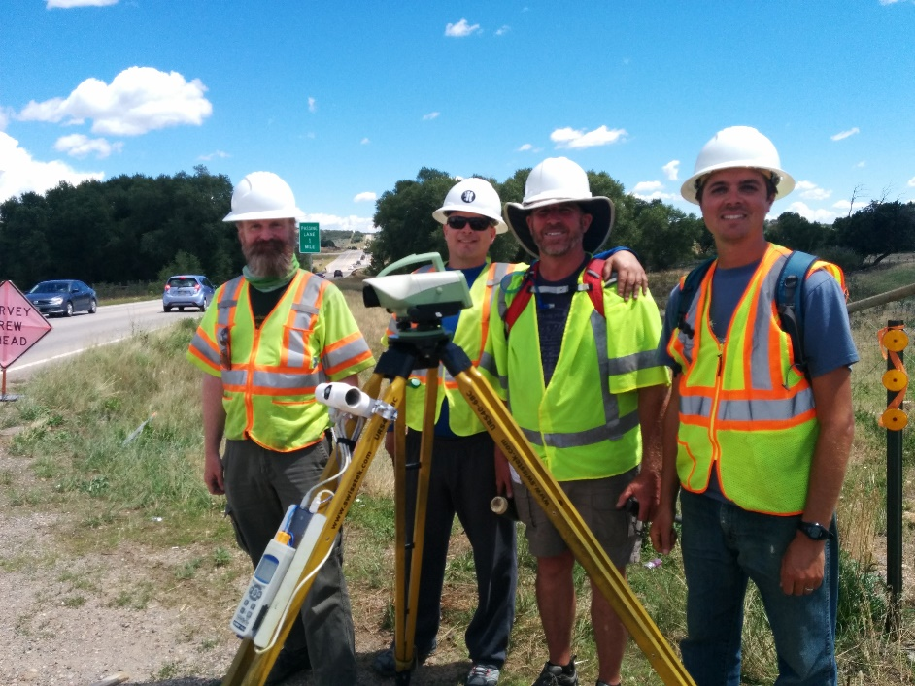
Brian Shaw
Rocky Mountain Advisor
brian.shaw@noaa.gov

Slide 3
NGS Resources
NGS Training Center
  https://geodesy.noaa.gov/web/science_edu/training/
Educational Videos
  https://geodesy.noaa.gov/datums/newdatums/WatchVideos.shtml
NGS Webinar Series
  https://geodesy.noaa.gov/web/science_edu/webinar_series/
Geospatial Summit (2021, 2019 recorded sessions)
  https://geodesy.noaa.gov/geospatial-summit/
Presentation Library
  https://geodesy.noaa.gov/web/science_edu/presentations_library/

Slide 4
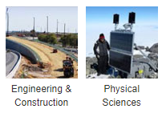
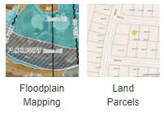
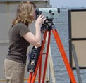
NGS’s Mission
To define, maintain and provide access
to the National Spatial Reference System (NSRS) to meet our Nation’s economic, social, and environmental needs.
…………………………………………….........................
The NSRS is a consistent coordinate system that defines latitude, longitude, height, scale, gravity, orientation, and shoreline throughout the United States.
Land
Surveying
Sectors that Rely on Geodesy

Slide 5
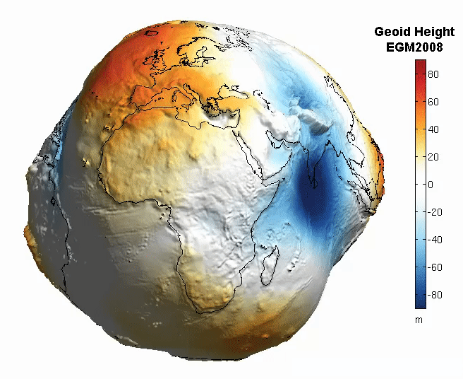
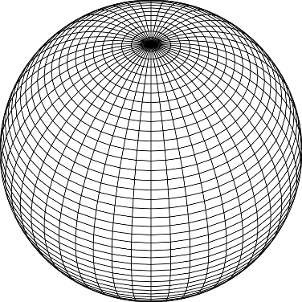
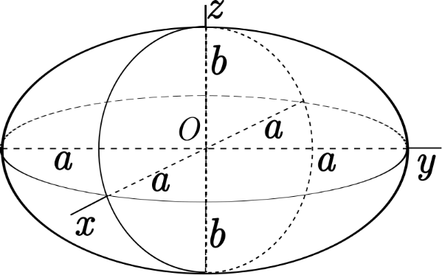
The Earth is Infinitely Complex
Build Models to Simplify

Slide 6
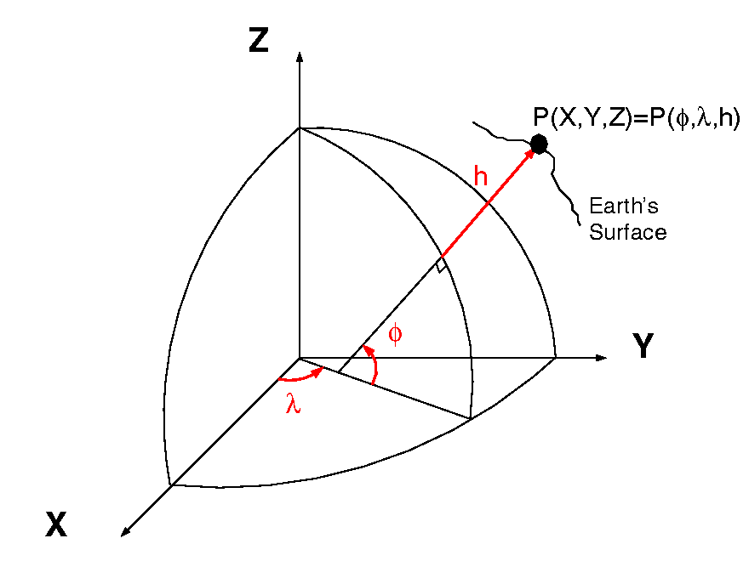
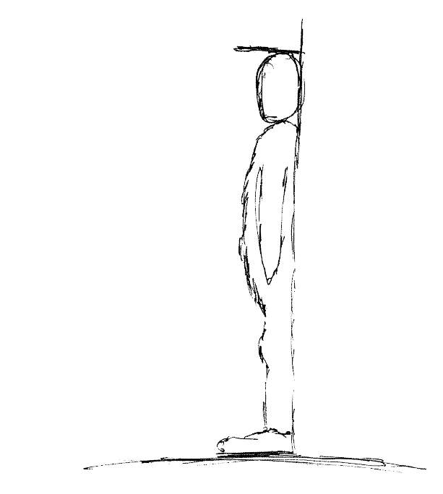
Datums and Reference Frames
60”, 2019
aka P(Lat,Lon,Ht)
52”, 2018
= ht.
46”, 2017
= lat.
= long.
X,Y,Z vs Lat, Lon, Ht
A reference surface or framework to reference your data to for consistency

Slide 7
Why Modernize the NSRS
Current models built on old technology
  NAD 83 not truly Geocentric (~2.2m)
  NAVD 88 relies on marks in the ground
  and is not easily maintained
  Today’s technology needs better accuracy

Slide 8
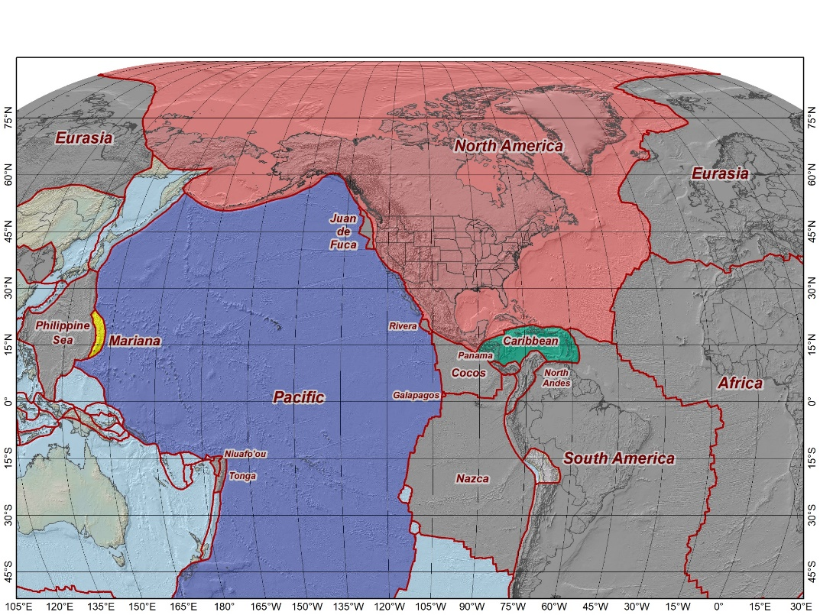
The Future Reference Frames
Tectonic Plate based
Each Plate is based on the same
densified ITRF model
North America NATRF
Caribbean CATRF
Pacific PATRF
Mariana MATRF
The tectonic plates “fixed” for the
2022 Terrestrial Reference Frames
NATRF2022
MATRF2022
PATRF2022
CATRF2022

Slide 9
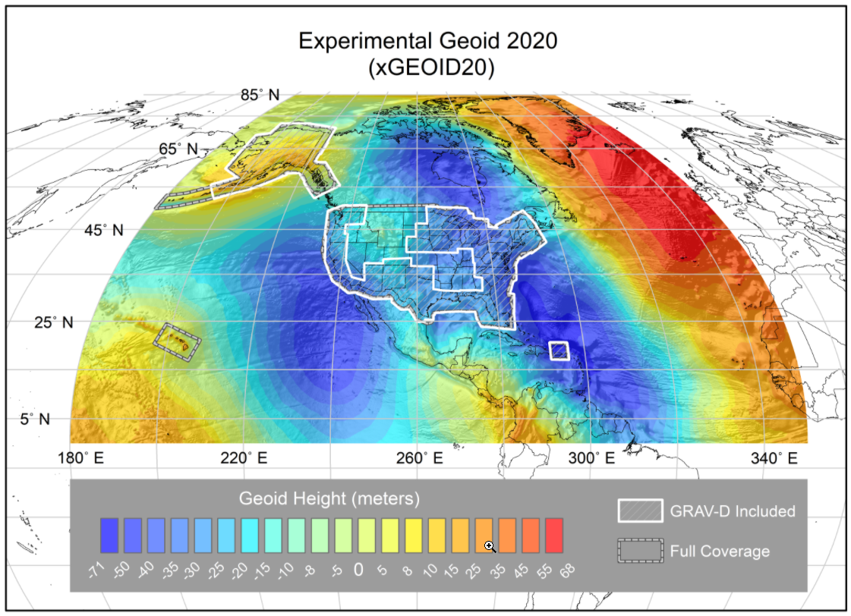
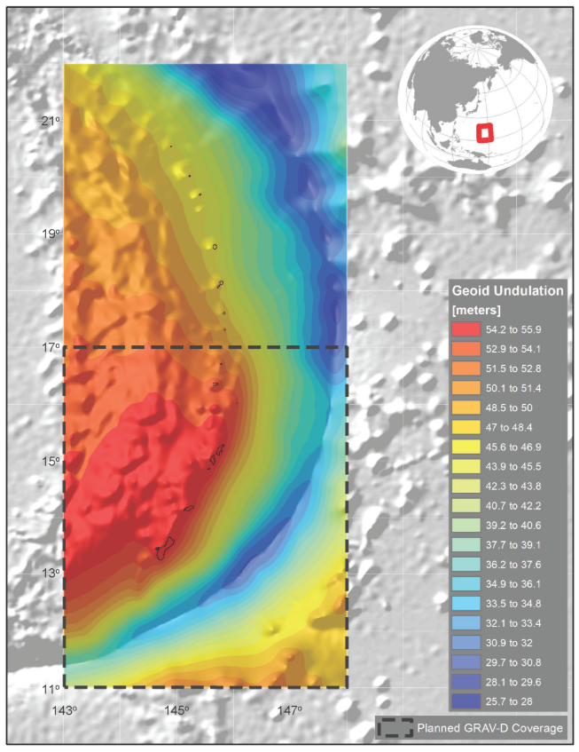
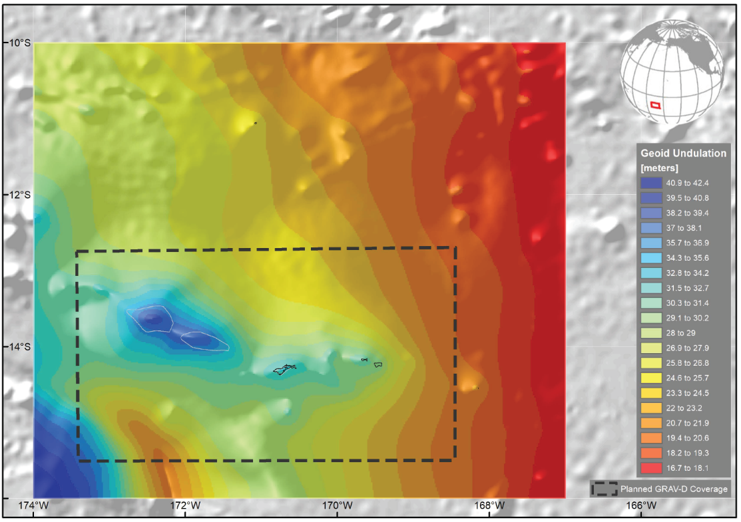
NAPGD2022 Geopotential Datum
North American-Pacific Geopotential Datum of 2022
Models included: Geopotential Deflection Gravity
Geoid
Not a vertical datum, it is more than just heights.
¼ Earth’s Surface
Guam/CNMI
American Samoa

Slide 10
Shift and Drift
A sudden shift
  Horizontal change: 0.5 to 4 m (1.5 to 13 ft)
  Ellipsoid height change: ±2 m (±6 ft)
  Elevation change: -0.5 to +2 m (-1.5 to +6 ft)
A continuous drift
  Coordinates associated with specific dates
Two components of drift:
  Tectonic plate rotation (easy to model, 2D only)
  All other residual motion (hard to model, 3D)

Slide 11
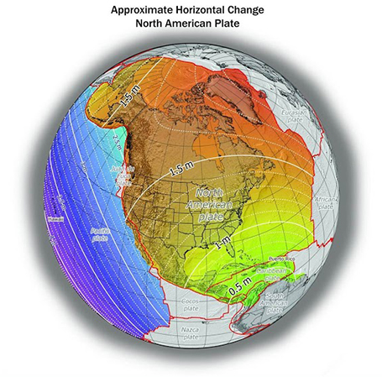
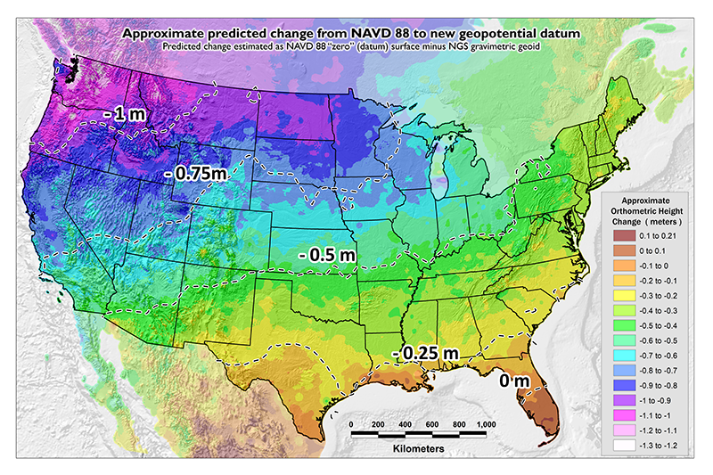
Shift: datum changes
~1 to 1.5 meters North America
~2.5 to 4 meters in Pacific
0 to 1.3 meters CONUS

Slide 12
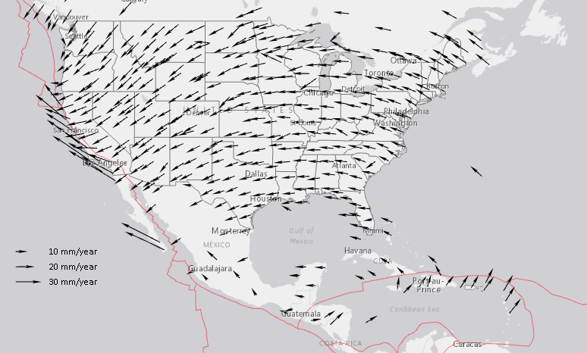
Drift: Plate Tectonics and Velocities
Annual changes to
ITRF2014 coordinates

Slide 13
How Can You Prepare
Metadata is essential
    Improves reliability and accuracy of data
    Increases value and usefulness
Transform and collect data in current datums
    NAD 83 (2011), NAVD 88
Make sure to note Geoid Models used for GNSS data

Slide 14
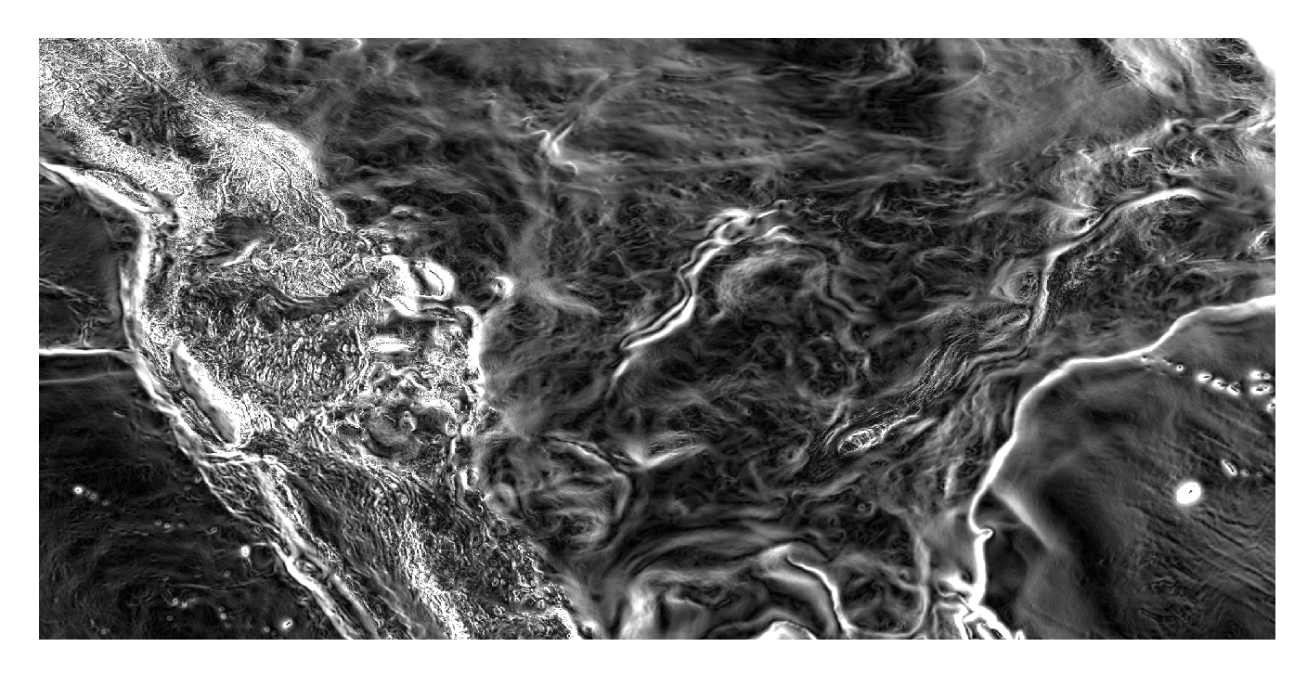
Magnitude of the Deflection of the Vertical
Questions?
Brian Shaw
brian.shaw@noaa.gov

