Slide 1
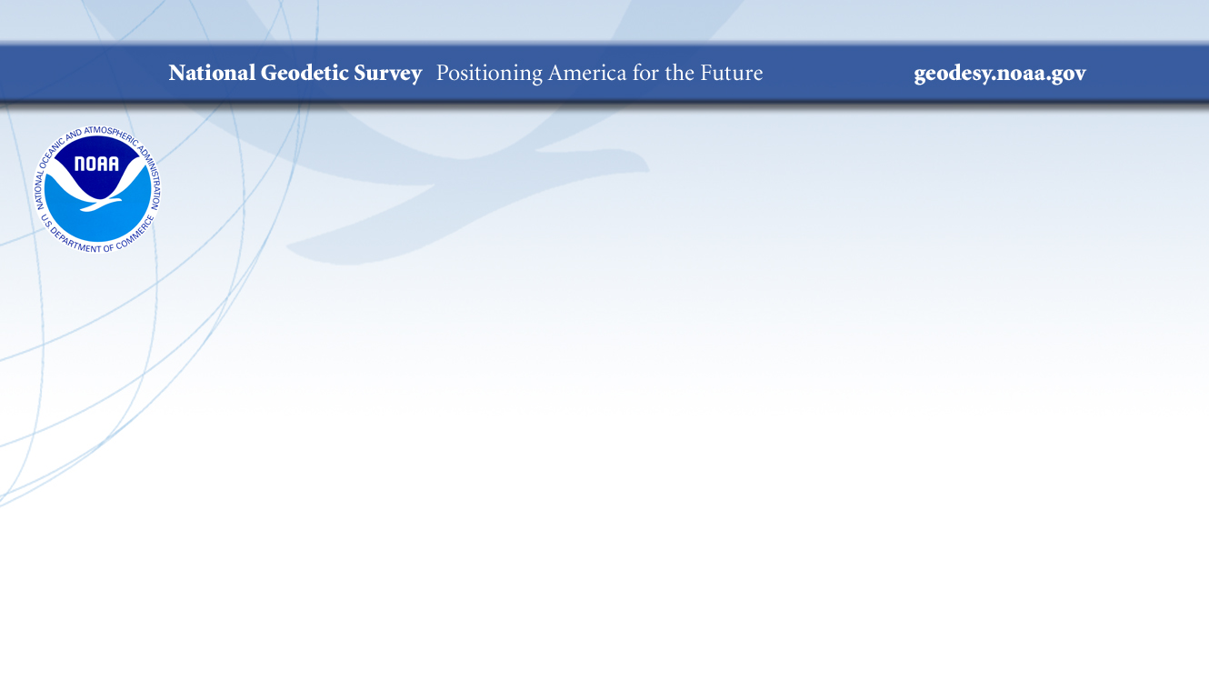
The National Spatial Reference System: the Common Foundation of Surveying and GIS
2024 Elevations Geospatial Summit
Brian Shaw
brian.shaw@noaa.gov
May 9, 2024

Slide 2

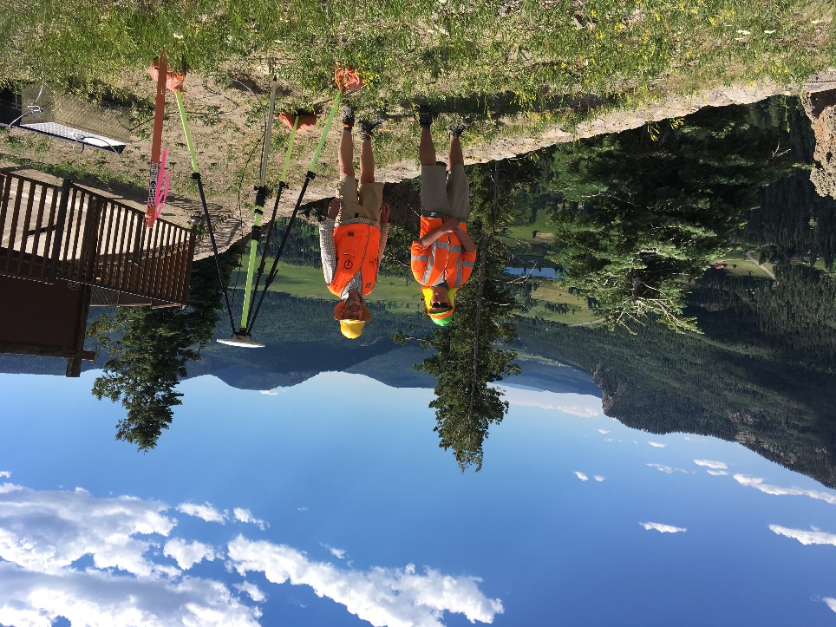

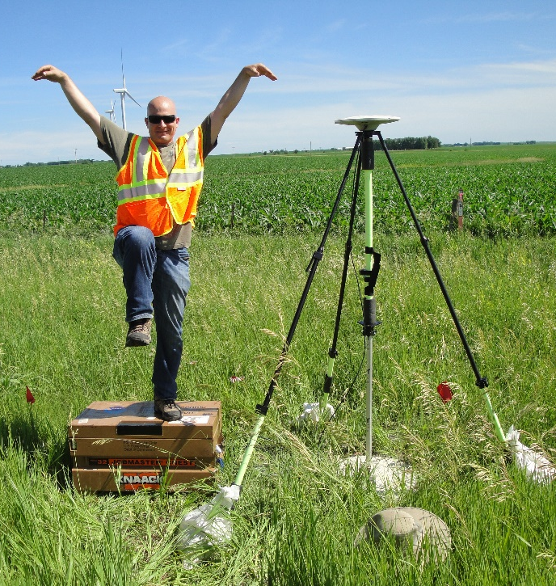
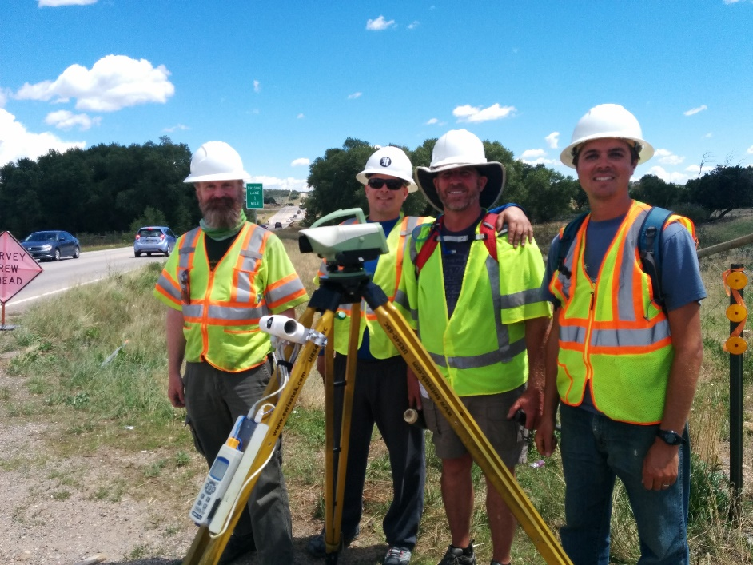
Brian Shaw
Rocky Mountain Advisor
brian.shaw@noaa.gov

Slide 3
NSRS Modernization Delay
Operational, workforce retention and other issues have delayed NSRS Modernization
SPCS2022 zones will be finalized in 2024 but will not be rolled out until all of the NSRS is modernized.
Beta rollout planned for 2025, full rollout in 2026
https://geodesy.noaa.gov/datums/newdatums/delayed-release.shtml
https://geodesy.noaa.gov/datums/newdatums/FAQNewDatums.shtml
Notes:
The National Spatial Reference System is our nations geospatial infrastructure from which all positioning (with the exclusion of military/DOD) is referenced to.
This system provides a consistent framework that allows people to use data in the same reference system to perform analysis and make meaningful comparisons and decisions from that analysis.

Slide 4
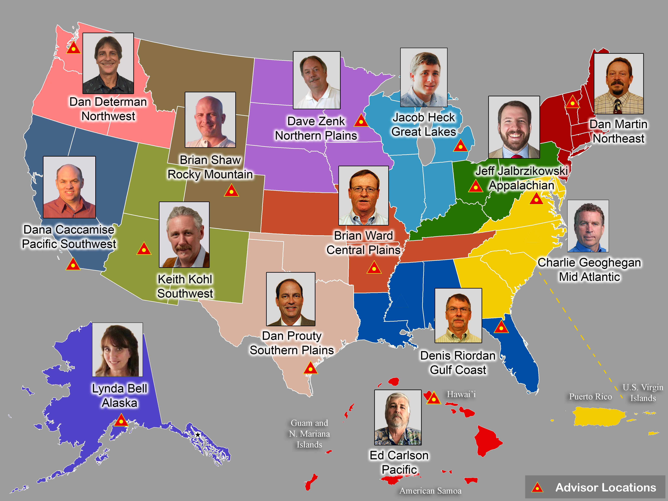
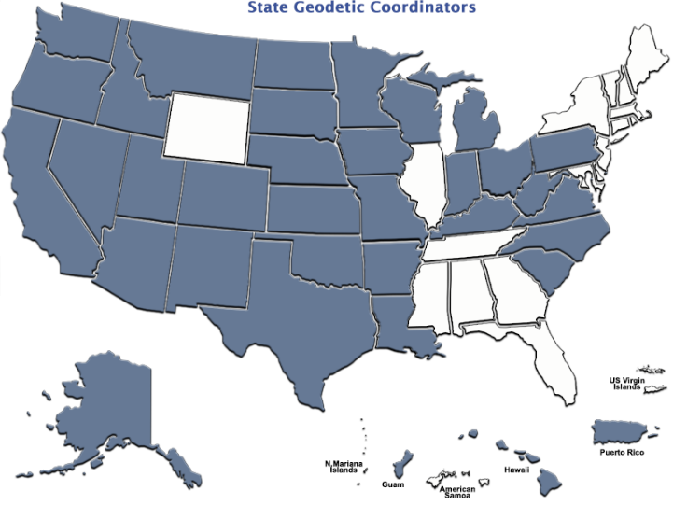
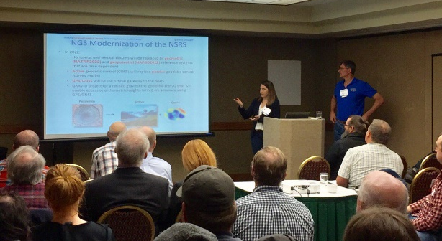
Importance of Coordination
14 Advisors
39 Coordinators
Notes:
NGS Regional Geodetic Advisors
https://geodesy.noaa.gov/ADVISORS/
State Geodetic Coordinators
https://geodesy.noaa.gov/ADVISORS/state-geodetic-coordinators.shtml

Slide 5

NGS Resources
NGS Training Center
  https://geodesy.noaa.gov/web/science_edu/training/
Educational Videos
  https://geodesy.noaa.gov/datums/newdatums/WatchVideos.shtml
NGS Webinar Series
  https://geodesy.noaa.gov/web/science_edu/webinar_series/
Geospatial Summit (2021, 2019 recorded sessions)
  https://geodesy.noaa.gov/geospatial-summit/
Presentation Library
  https://geodesy.noaa.gov/web/science_edu/presentations_library/

Slide 6
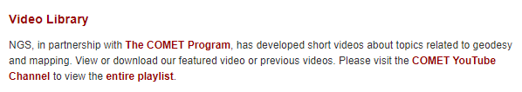
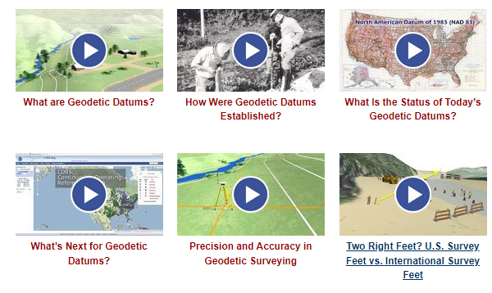
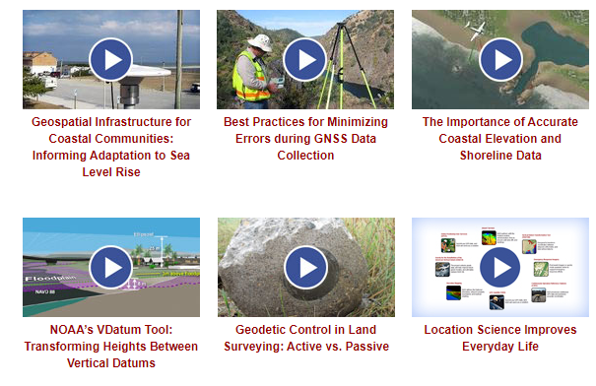
NGS Resources – Educational Videos
  https://geodesy.noaa.gov/datums/newdatums/WatchVideos.shtml

Slide 7
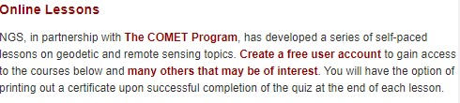
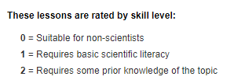
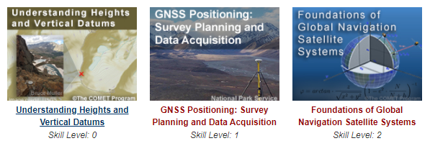
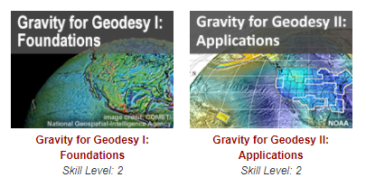
NGS Resources – Online Lessons
  https://geodesy.noaa.gov/web/science_edu/online_lessons/index.shtml

Slide 8
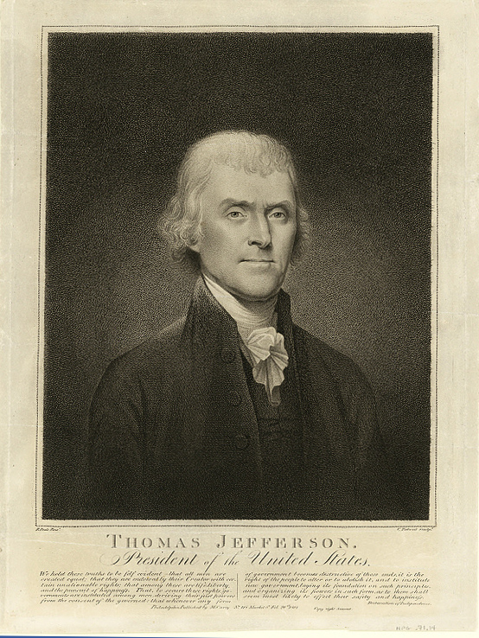
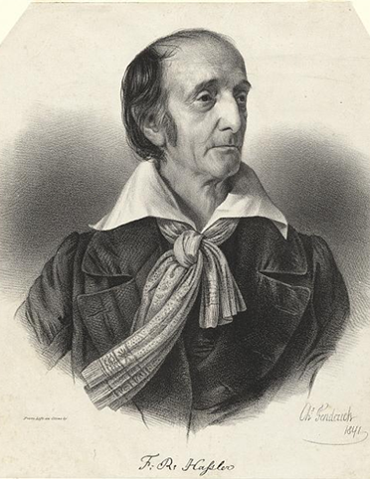



NOAA and NGS
Our Nation’s First Civilian Science Agency
1807
Thomas Jefferson
Survey of the Coast
1811
Ferdinand Hassler
Superintendent
1836
U.S. Coast
Survey
1878
U.S. Coast and
Geodetic Survey
1970
NOAA is established
Notes:
NGS has been around a long time. For more than 200 years, NGS and its predecessor agencies have collaborated with public and private organizations to establish reference stations at precisely determined locations.
We began on a mission established by Thomas Jefferson in 1807 to conduct a “Survey of the Coast” (as the United States Coast Survey).
(Pictured are Thomas Jefferson and Ferdinand Hassler, the first Superintendent of the Coast Survey). We were renamed the U.S. Coast and Geodetic Survey in 1878. NOAA was established in 1970.
Traditionally, precise positioning locations have been identified by setting a survey mark—usually a brass, bronze, or aluminum disk. Locations might also be identified by a deeply driven rod, or a prominent object, such as a water tower or church spire.

Slide 9
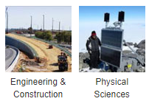
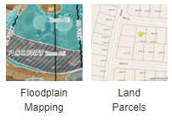
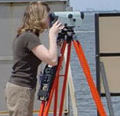
NGS’s Mission
To define, maintain and provide access
to the National Spatial Reference System (NSRS) to meet our Nation’s economic, social, and environmental needs.
…………………………………………….........................
The NSRS is a consistent coordinate system that defines latitude, longitude, height, scale, gravity, orientation, and shoreline throughout the United States.
Land
Surveying
Sectors that Rely on Geodesy
Notes:
The National Spatial Reference System is our nations geospatial infrastructure from which all positioning (with the exclusion of military/DOD) is referenced to.
This system provides a consistent framework that allows people to use data in the same reference system to perform analysis and make meaningful comparisons and decisions from that analysis.

Slide 10
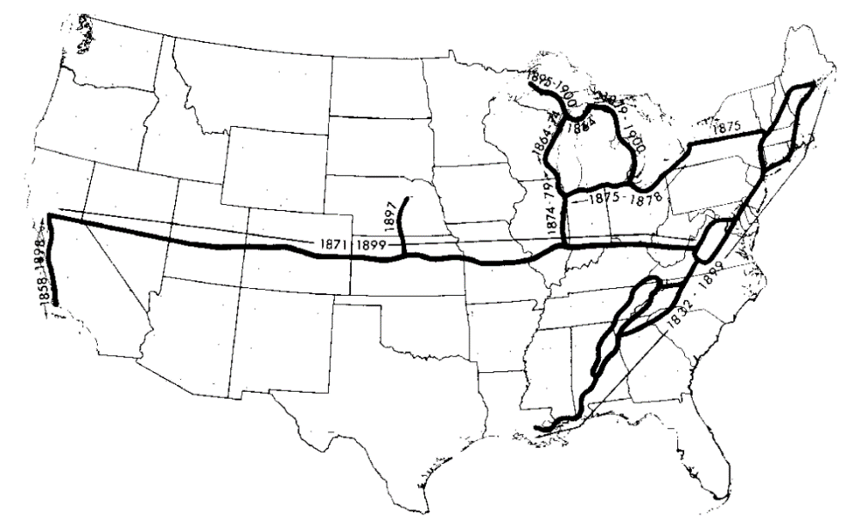
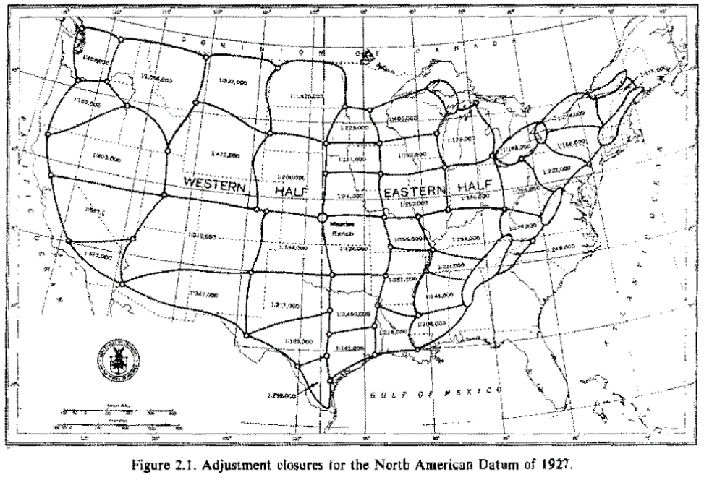
NGS’s Historical Horizontal Networks
US Standard Datum 1900
North American Datum of 1927 (NAD 27)
http://www.geodesy.noaa.gov/PUBS_LIB/NADof1983.pdf

Slide 11
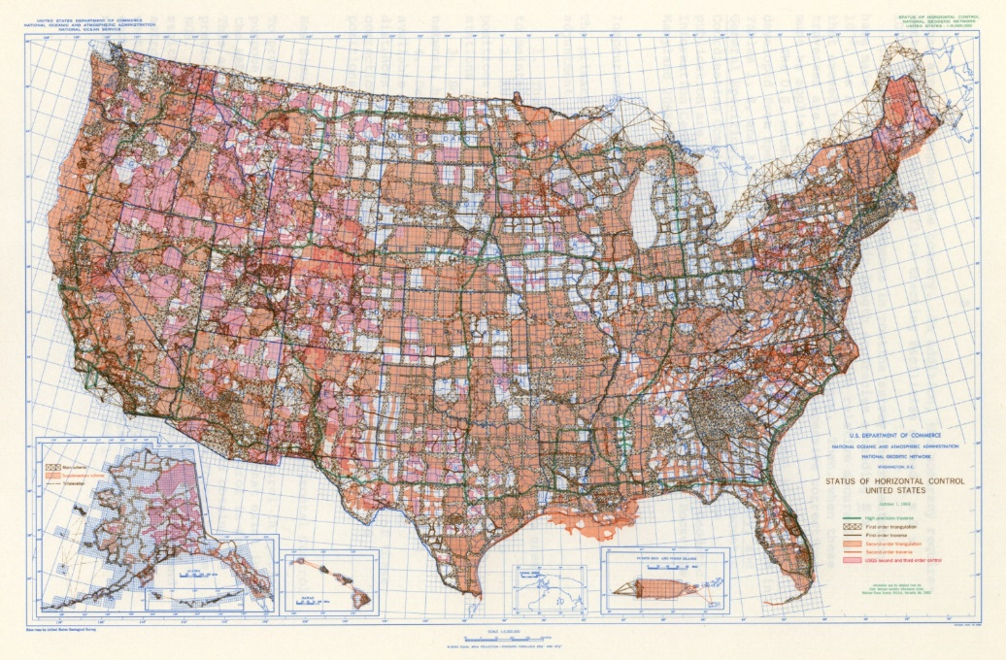
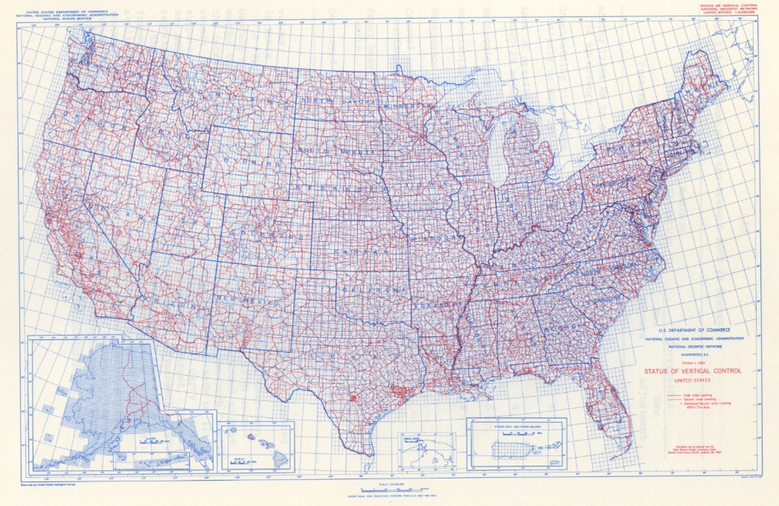
1983 Control Networks
Status of Horizontal Control 1983
Status of Vertical Control 1983

Slide 12
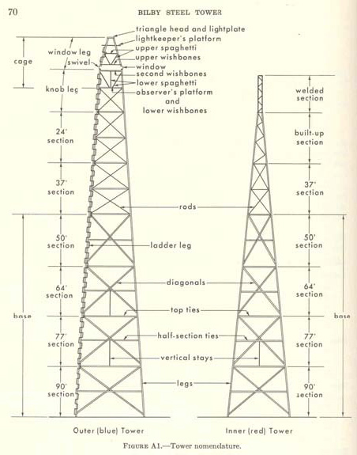
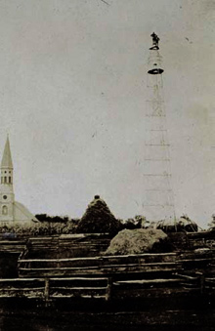
The Bilby Tower

Slide 13


Slide 14
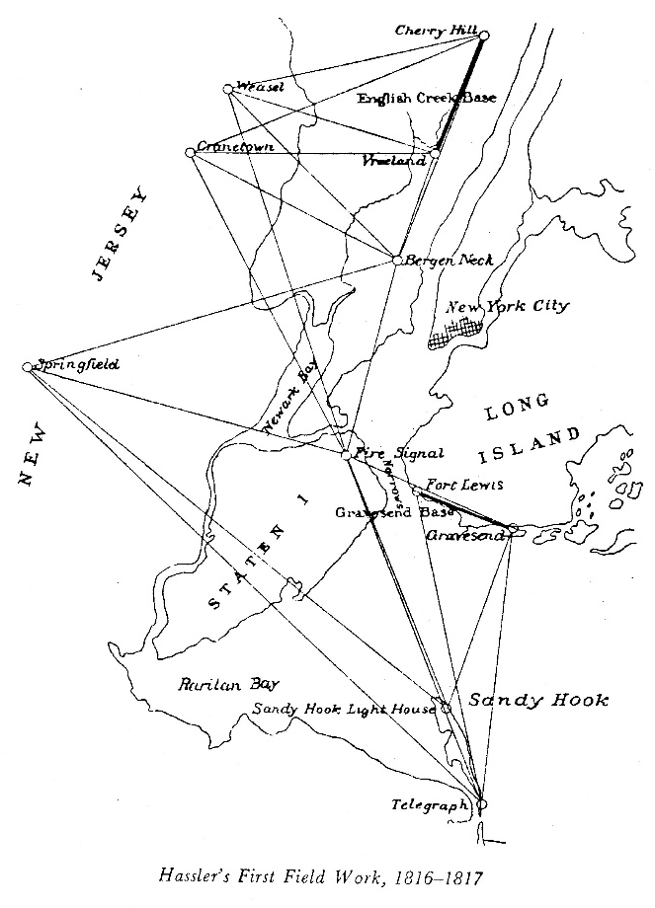
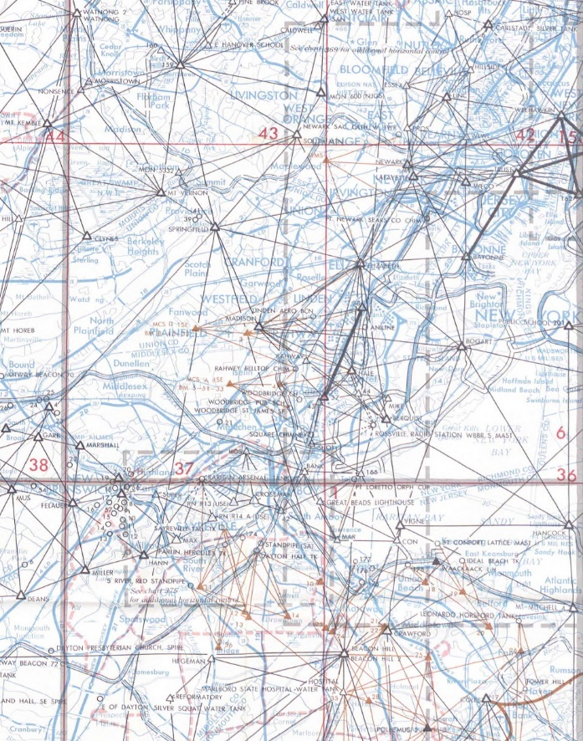
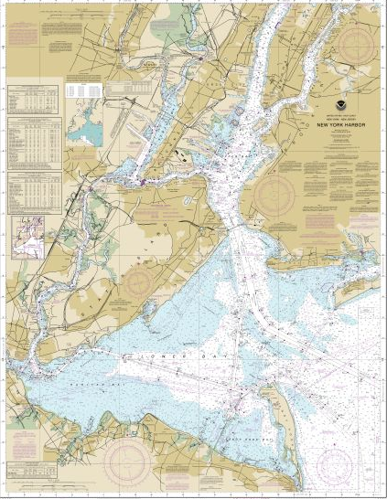
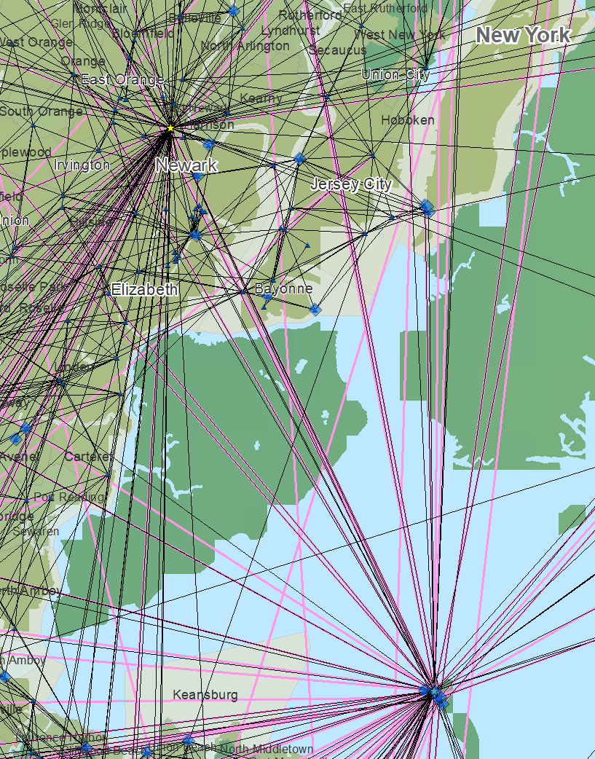
The Importance of Geodesy
1816-1817
1969
Today

Slide 15
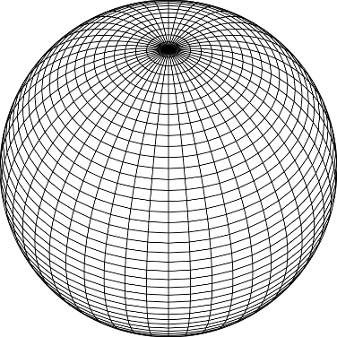
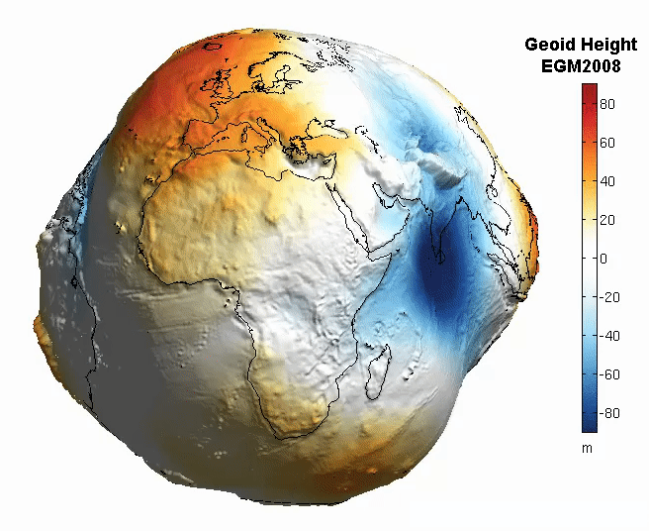
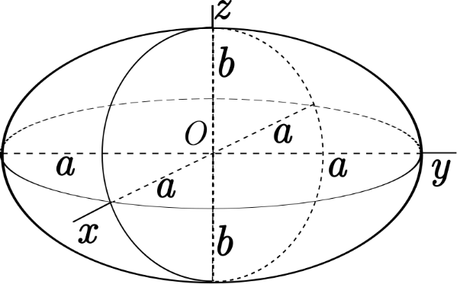
The Earth is Infinitely Complex
Build Models to Simplify
Notes:
Models are used to simplify complex phenomena for humans and computers to understand and perform calculations and analysis.
The geoid is an approximation of sea level and used to calculate elevations (orthometric heights) above this “sea level” surface
Spheroid image https://www.kisspng.com/png-sphere-shape-ball-grid-line-circle-draw-5378189/
Ellipsoid image https://www.kisspng.com/png-figure-of-the-earth-oblate-spheroid-ellipsoid-4129812/
Geoid Image https://www.reddit.com/r/MapPorn/comments/3xf6a0/geoid_height_of_new_global_gravity_field_models/

Slide 16
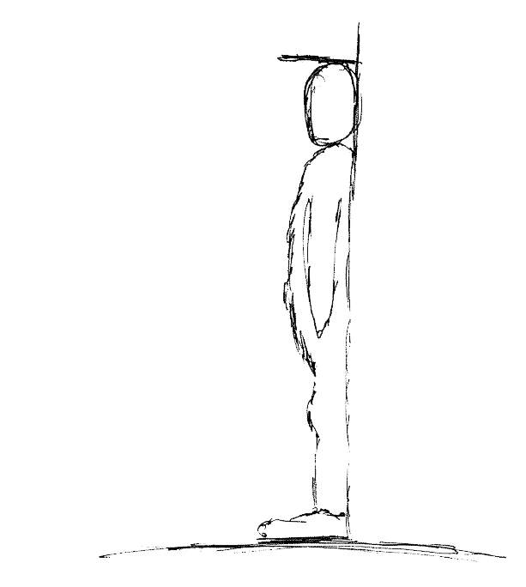
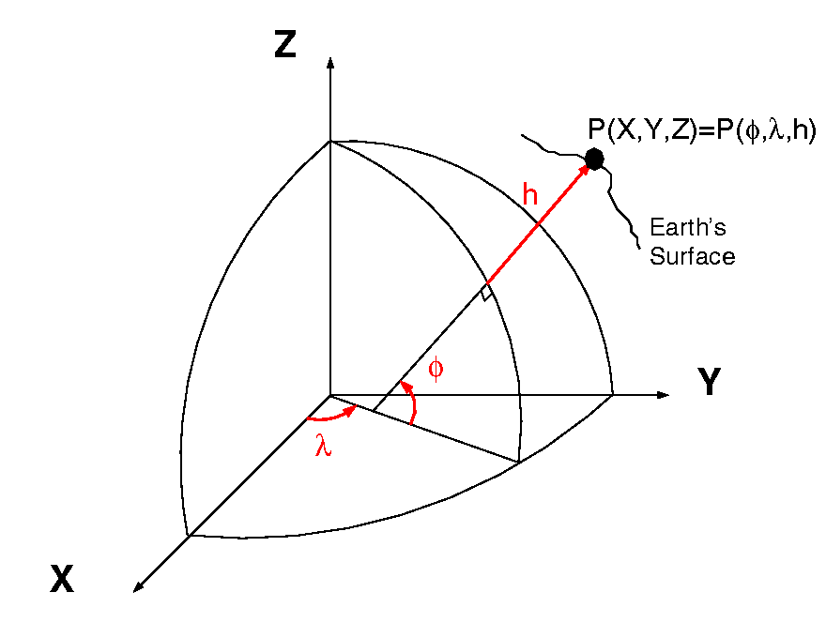
Datums and Reference Frames
60”, 2019
52”, 2018
46”, 2017
aka P(Lat,Lon,Ht)
= ht.
= lat.
= long.
A reference surface or framework to reference your data to for consistency
X,Y,Z vs Lat, Lon, Ht

Slide 17

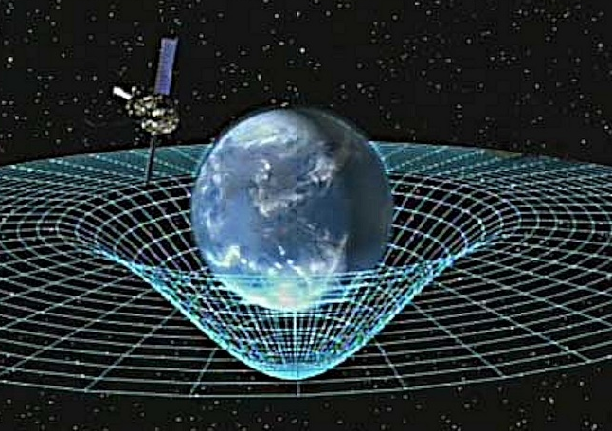
Gravity is Fundamental
Aristotle (350BC)
Objects fall proportional to mass
Al-Khazini (1121)
Gravitational potential energy
Galileo (1590)
Terminal velocity
Newton (1687)
Gravity inverse-square law
Einstein (1913)
Theory of general relativity
Notes:
Galileo graphic https://commons.wikimedia.org/wiki/File:GalilEXP.jpg
Spacetime curvature graphic https://www.nasa.gov/mission_pages/gpb/gpb_012.html
Aristotle (384–322 BCE)
Objects fall at a speed proportional to their mass.
The Aristotelian explanation of gravity is that all bodies move toward their natural place. For the elements earth and water, that place is the center of the (geocentric) universe;
al-Khazini (11th to 12th centuries)
In 1121, al-Khazini, in The Book of the Balance of Wisdom, proposed that the gravity and gravitational potential energy of a body varies depending on its distance from the centre of the Earth.
Galileo Galilei (1564-1642)
Leaning Tower of Pisa Experiment (1589-92) - Law of Falling Bodies
Objects fall at the same speed, independent of their mass or shape
Isaac Newton (1643-1727)
In 1687, English mathematician Sir Isaac Newton published Principia, which hypothesizes the inverse-square law of universal gravitation.
Albert Einstein (1879-1955)
Between 1911-1915 Einstein developed the theory of general relativity. In general relativity, the effects of gravitation are ascribed to spacetime curvature instead of to a force. To deal with this difficulty, Einstein proposed that spacetime is curved by matter, and that free-falling objects are moving along locally straight paths in curved spacetime. (This type of path is called a geodesic).

Slide 18
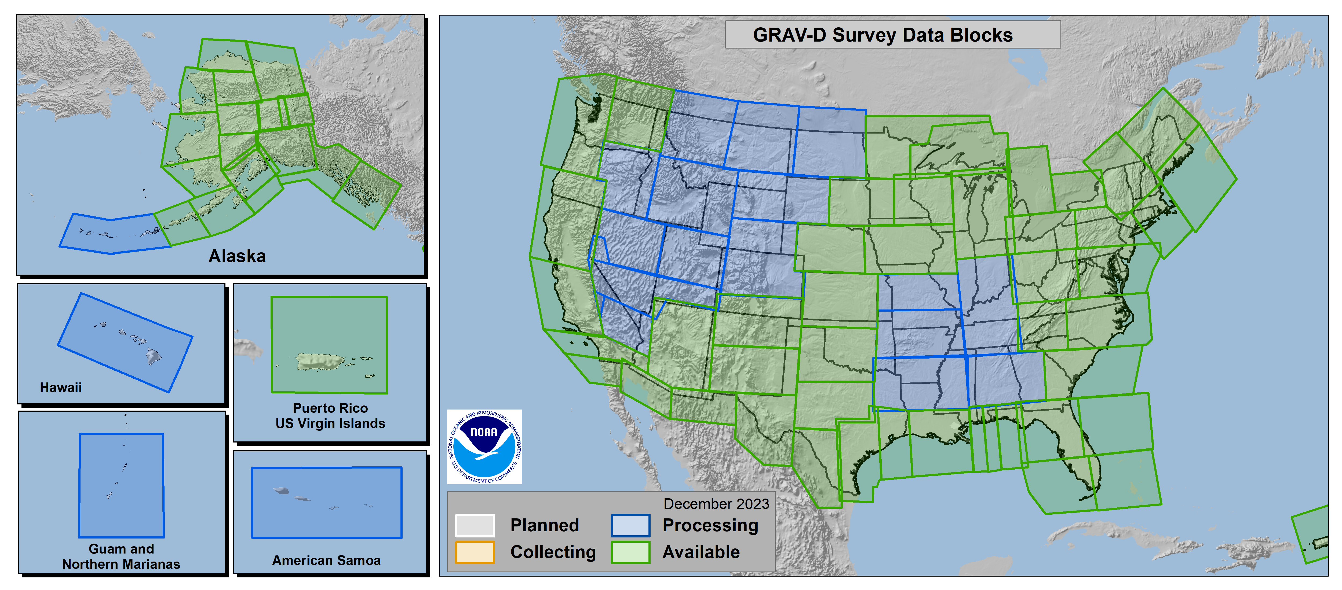
Gravity of the Redefinition of the American Vertical Datum
GRAV-D
100% Complete (12/2023)
Notes:
More information on GRAV-D
https://geodesy.noaa.gov/GRAV-D/
Data Download for GRAV-D blocks
https://geodesy.noaa.gov/GRAV-D/data_products.shtml

Slide 19
Why Modernize the NSRS
Current models built on old technology
  NAD 83 not truly Geocentric (~2.2m)
  NAVD 88 relies on marks in the ground
  and is not easily maintained
  Today’s technology needs better accuracy
Notes:
NSRS Modernization News
https://geodesy.noaa.gov/datums/newdatums/TrackOurProgress.shtml

Slide 20
Main Benefits of Modernized NSRS
Fast, Accurate, Consistent Elevations Everywhere
Improved Public Safety
  Flood Plain Maps
  Emergency Route Planning
Accurate Positioning
  Autonomous vehicles, BIMs, Smart Cities
Notes:
NSRS Modernization News
https://geodesy.noaa.gov/datums/newdatums/TrackOurProgress.shtml

Slide 21
Best ways to determine coordinates in Modernized NSRS
Resurvey: Return to the field and collect new observations, relying upon geodetic control that has coordinates in the new datum
Readjust: Using existing observations, re-compute new coordinates based upon geodetic control (CORS) that has been defined in the new datum
Transform: Take finished products which have coordinates in the old datum and use transformation software to estimate coordinates in the new datum

Slide 22
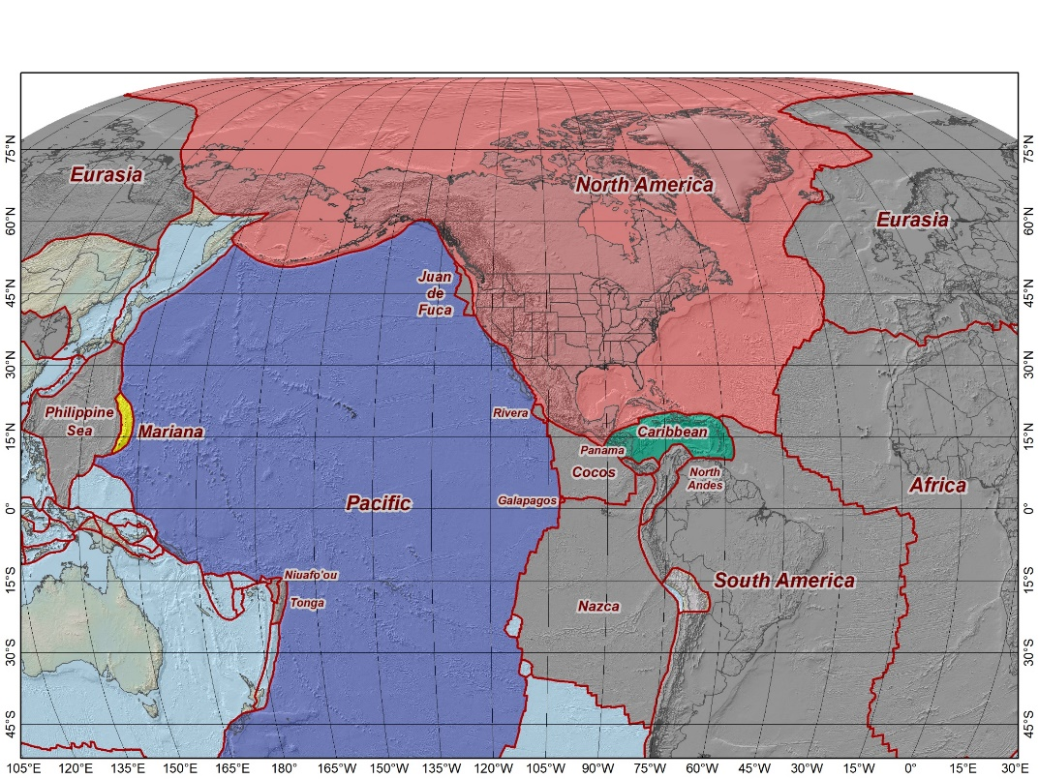
The Future Reference Frames
The tectonic plates “fixed” for the
2022 Terrestrial Reference Frames
Tectonic Plate based
Each Plate is based on the same
densified ITRF model
North America NATRF
Caribbean CATRF
Pacific PATRF
Mariana MATRF
NATRF2022
MATRF2022
PATRF2022
CATRF2022
Notes:
NSRS Modernization Naming Conventions https://geodesy.noaa.gov/datums/newdatums/naming-convention.shtml

Slide 23
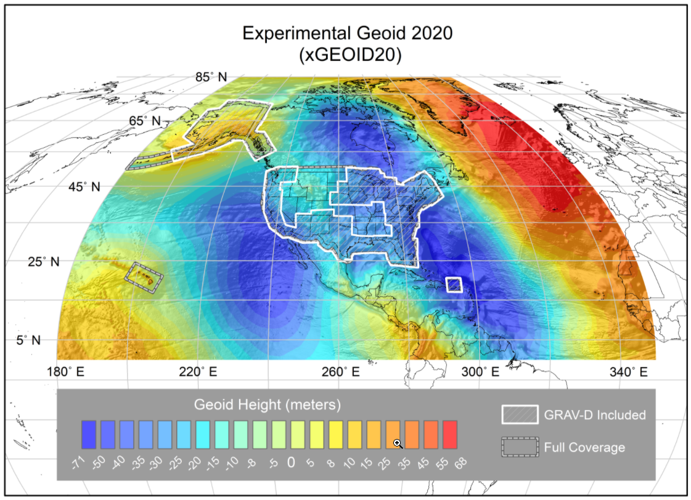
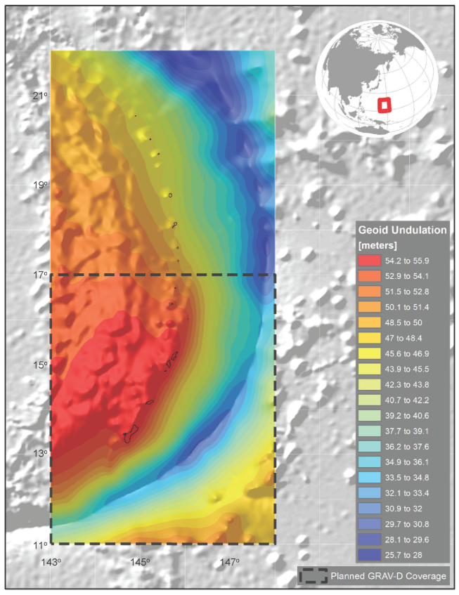
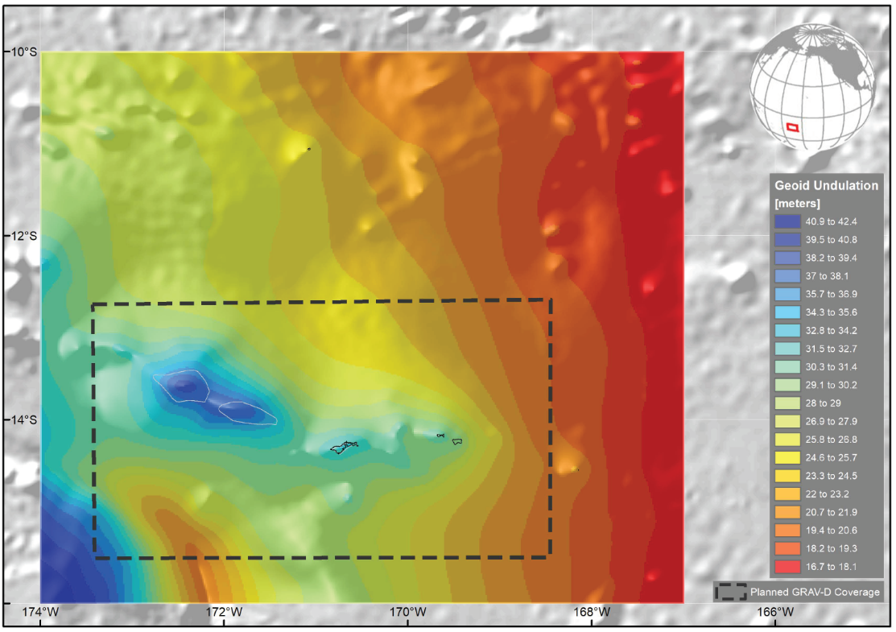
NAPGD2022 Geopotential Datum
North American-Pacific Geopotential Datum of 2022
Not a vertical datum, it is more than just heights.
Models included: Geopotential Deflection Gravity
Geoid
¼ Earth’s Surface
Guam/CNMI
American Samoa
Notes:
NSRS Modernization News
https://geodesy.noaa.gov/datums/newdatums/TrackOurProgress.shtml
Experimental Geoid Models
https://beta.ngs.noaa.gov/GEOID/xGEOID20/
As noted in the Blueprint 2 document
https://geodesy.noaa.gov/library/pdfs/NOAA_TR_NOS_NGS_0064.pdf
NAPGD2022 will include all of the following
Geopotential Model of 2022 (GM2022) will include:
Static Geopotential model of 2022 (SGM2022)
Dynamic Geopotential model of 2022 (DGM2022)
GEOID2022 will include:
Static Geoid model of 2022 (SGEOID2022)
Dynamic Geoid model of 2022 (DGEOID2022)
DEFLEC2022 will include:
Static Deflection of the Vertical model of 2022 (SDEFLEC2022)
Dynamic Deflection of the Vertical model of 2022 (DDEFLEC2022)
GRAV2022
Static Gravity model of 2022 (SGRAV2022)

Slide 24
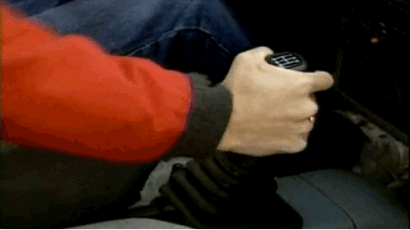

NSRS Modernization Catch Phrase
Shift and Drift
Not the Fast and Furious

Slide 25
Shift and Drift
A sudden shift
  Horizontal change: 0.5 to 4 m (1.5 to 13 ft)
  Ellipsoid height change: ±2 m (±6 ft)
  Elevation change: -0.5 to +2 m (-1.5 to +6 ft)
A continuous drift
  Coordinates associated with specific dates
Two components of drift:
  Tectonic plate rotation (easy to model, 2D only)
  All other residual motion (hard to model, 3D)
Notes:
NSRS Modernization News
https://geodesy.noaa.gov/datums/newdatums/TrackOurProgress.shtml

Slide 26
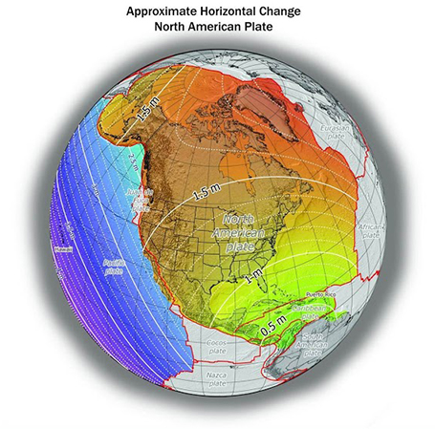
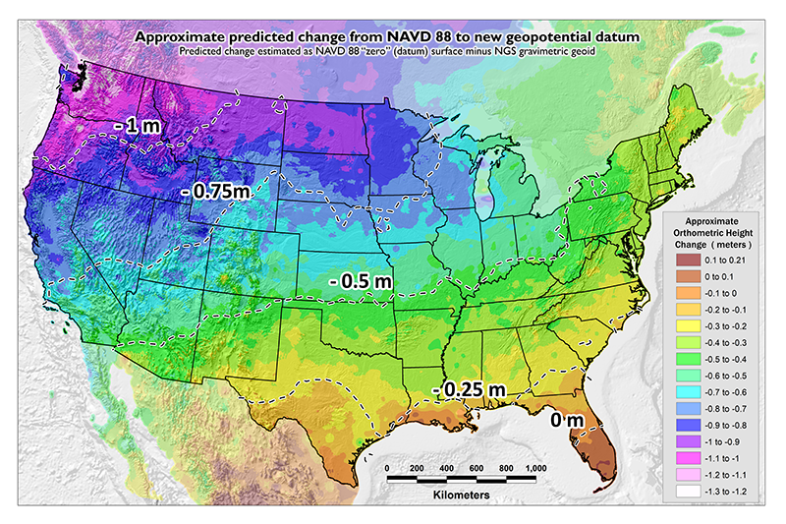
Shift: datum changes
~1 to 1.5 meters North America
~2.5 to 4 meters in Pacific
0 to 1.3 meters CONUS
Notes:
New Datums What to expect https://geodesy.noaa.gov/datums/newdatums/WhatToExpect.shtml
NGS is not shifting the land, merely shifting the reference surfaces to which we reference the geospatial data to.

Slide 27
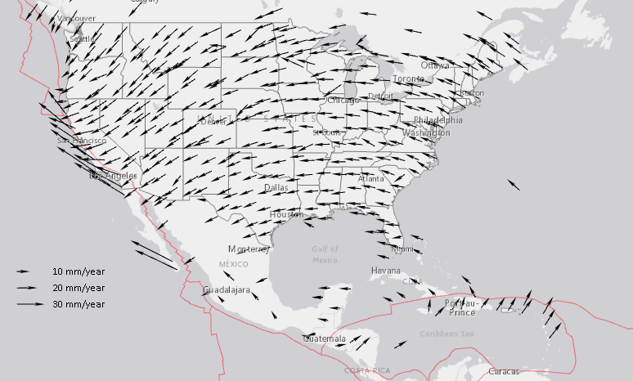
Drift: Plate Tectonics and Velocities
Annual changes to
ITRF2014 coordinates
Notes:
All plates are moving and through the constant collection of GNSS data using CORS we can now model where the land is moving. In the center of tectonic plates there is generally motion that can be measured but where plates converge can be thought of as a crunch zone and the modeling has much more uncertainty due to geophysical phenomena.

Slide 28
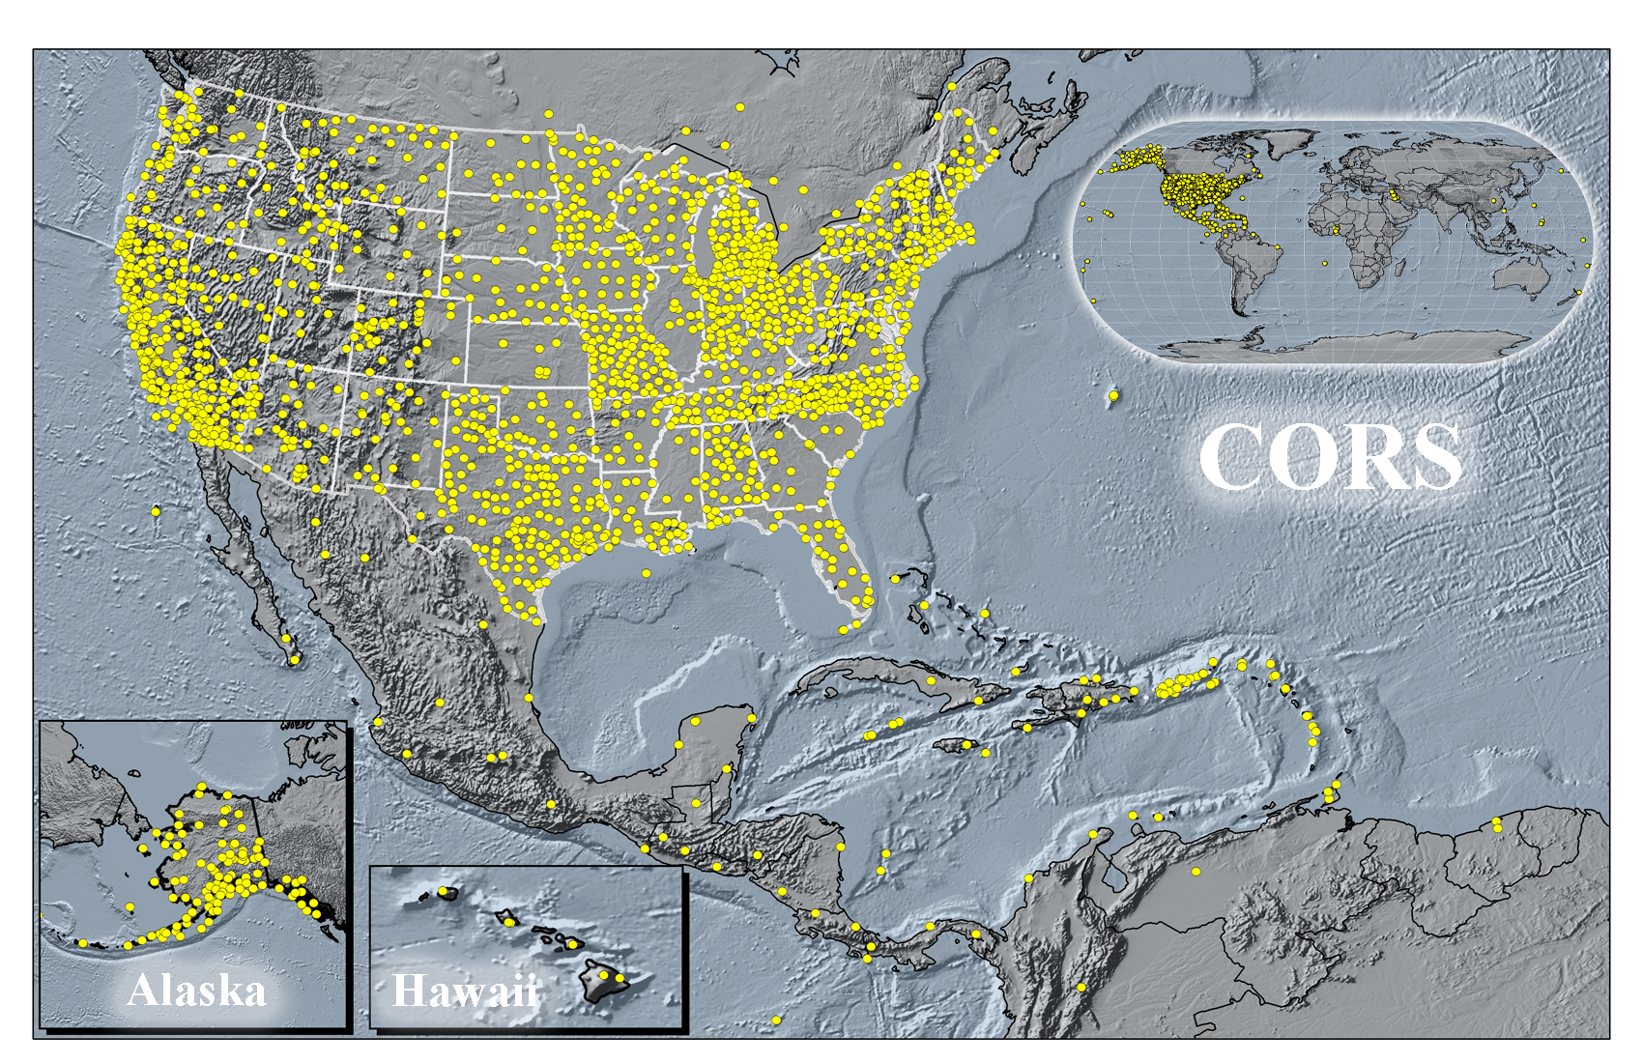
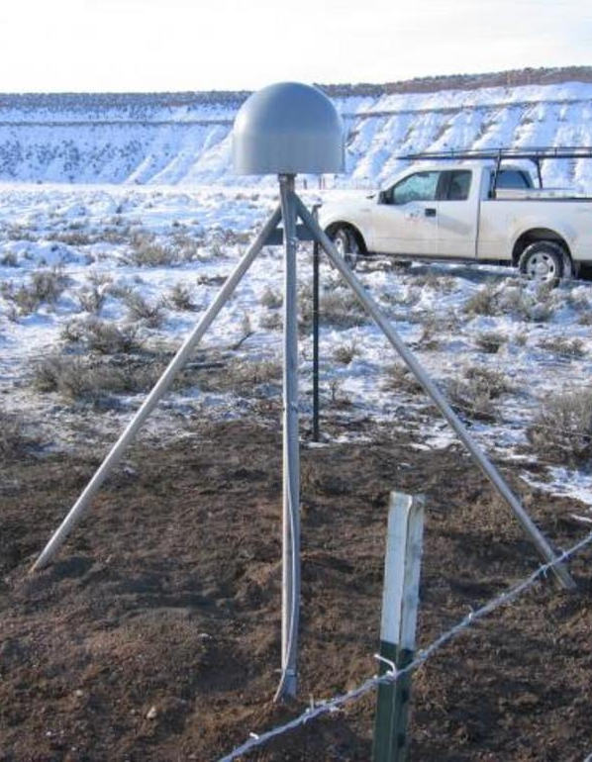
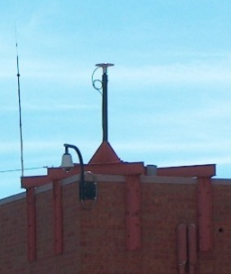
Continuously Operating Reference Stations
P033
Ten Sleep
Wyoming
CTMC
Golden
Colorado

Slide 29
Vertical Motion
Subsidence
  Ground fluid withdrawal, sedimentation
Glacial Isostatic Adjustment (GIA)
  Crustal rebound from glaciers (uplift)
Geophysical Phenomena
  Earthquakes, calderas, Earth tides

Slide 30
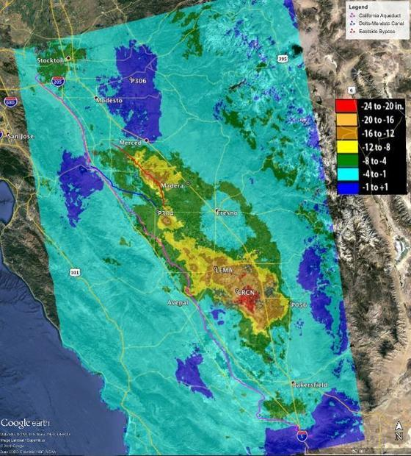
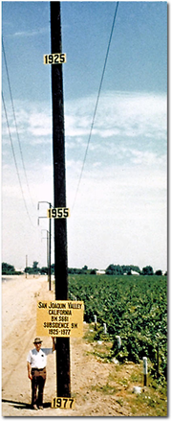
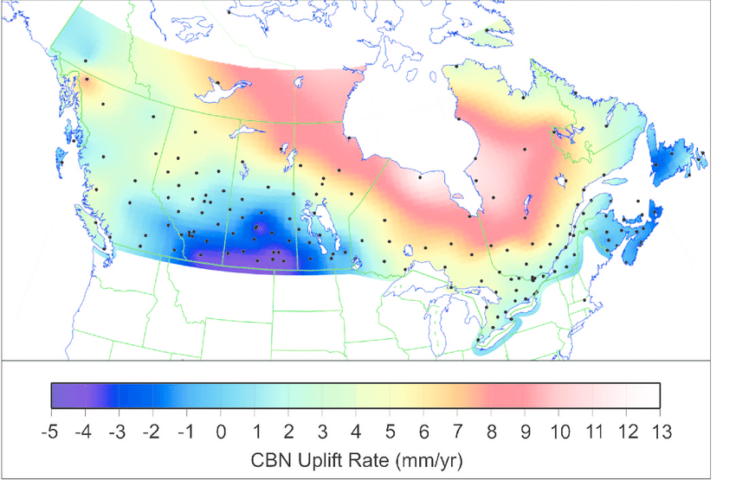
Vertical Motion
8.5 meters
50 years
May 2015
to
Sept 2016
Hudson Bay Uplifting
8 -13 mm/year
San Joaquin Subsiding
20-24” in 16 months
Notes:
San Joaquin Subsidence article
http://www.digitaljournal.com/tech-and-science/technology/sinking-san-joaquin-valley-of-california-seen-from-space/article/487393
Hudson Bay Uplift article (GIA)
https://www.researchgate.net/figure/Contour-map-of-observed-CBN-vertical-rates-Preliminary-results-from-the-combination-of_fig3_286867540
Photo of San Joaquin Valley Subsidence to 1977
https://lh4.googleusercontent.com/ymKsoXwZEP4rk4F4GqPD5S9FyMO4d0mrfL2GiLI0mXe7djBwYH3t0-OwncYltY8OJNmYk0DKh4pOLqS9DGItCHK3i23maqpjdDDISQH5ux0uqDVbrEnWTnFLPb7Woe2cka61EXC6

Slide 31

Horizontal and Vertical Motion - Earthquakes
2019 China Lake, CA
6-10 feet Horizontally
2020 Puerto Rico
16 cm Vertically
Notes:
China Lake Earthquake
https://www.usgs.gov/news/update-magnitude-71-earthquake-southern-california?qt-news_science_products=7#qt-news_science_products
Puerto Rico Earthquake
https://cunycis.maps.arcgis.com/apps/webappviewer/index.html?id=5f516f41baa84f9ba9e8207c2005ee4d

Slide 32


GPS on Bench Marks
Dashboard
~3,400 Completed in 2020
~4,900 Completed in 2021
~2,500 Completed in 2022
~2,100 Completed in 2023
Web Map Application
CO 14% Complete
WY 21% Complete
Notes:
China Lake Earthquake
https://www.usgs.gov/news/update-magnitude-71-earthquake-southern-california?qt-news_science_products=7#qt-news_science_products
Puerto Rico Earthquake
https://cunycis.maps.arcgis.com/apps/webappviewer/index.html?id=5f516f41baa84f9ba9e8207c2005ee4d

Slide 33

OPUS Shared Solutions Dashboard
Dashboard enables sorting and visualization of Shared Solutions by
Month & Year, State, Agency Type, and submitting agency
Agency type | # Shared Solutions on NGS marks
State | ~44,900
Private Sector | ~7,900
Federal | ~4,700
Academic | ~1,800
2018
Note the impact of GPSonBM Campaigns
2020
2021

Slide 34

CO OPUS Shared Solutions
115
116
57
Notes:
GPS on Bench Marks Web Map
https://noaa.maps.arcgis.com/apps/webappviewer/index.html?id=6093dd81e9e94f7a9062e2fe5fb2f7f5
GPS on Bench Marks Dashboard
https://noaa.maps.arcgis.com/apps/dashboards/449e3051fbf44202ba6606e2dbcb0e29

Slide 35

WY OPUS Shared Solutions
115
116
57
Notes:
GPS on Bench Marks Web Map
https://noaa.maps.arcgis.com/apps/webappviewer/index.html?id=6093dd81e9e94f7a9062e2fe5fb2f7f5
GPS on Bench Marks Dashboard
https://noaa.maps.arcgis.com/apps/dashboards/449e3051fbf44202ba6606e2dbcb0e29

Slide 36



NGS Mark Recovery Webpage
Crowd sourced mark recoveries help update the GPSonBM map, let NGS and others know if the mark is still usable, and pictures make it easier to find.
https://geodesy.noaa.gov/surveys/mark-recovery
Now with Find Marks Near Me!
Maintain your local control network: Submit a Recovery Note for each mark you find (up to once per year)
Did you find it?
Is it GPSable?
Got new photos?

Slide 37

National Adjustments
Geometric (approximate numbers)
    Projects: ~5,300
    Stations: ~107,000
    Vectors : ~446,000

Slide 38

National Adjustments
Orthometric (approximate numbers)
  USA
    Projects : ~23,900
    Stations : ~1M
    Observations : ~2.1M
  Canada
    Projects : ~2,900
    Stations : ~177,000
    Observations : ~204,000

Slide 39




State Plane Coordinate System of 2022 (CONUS, Alaska and Hawaii)
Three territory zones not shown:
Puerto Rico and U.S Virgin Islands
  American Samoa
  Guam and Commonwealth of the Northern Mariana Islands
https://geodesy.noaa.gov/SPCS/

Slide 40


CO SPCS 2022
https://geodesy.noaa.gov/SPCS/
Notes:
Rocky Mountain Coordinate Reference System Handbook
https://www.marls.com/wp-content/uploads/2022/02/RMCRS-Manual-v2.0.pdf

Slide 41


CO SPCS2022 Experience
1 Statewide Zone
35 LDPs
https://experience.arcgis.com/experience/dddb7bc0be6f4e56a1c370c8d529d1a0
Notes:
Rocky Mountain Coordinate Reference System Handbook
https://www.marls.com/wp-content/uploads/2022/02/RMCRS-Manual-v2.0.pdf

Slide 42


WY SPCS 2022
https://geodesy.noaa.gov/SPCS/
Notes:
Rocky Mountain Coordinate Reference System Handbook
https://www.marls.com/wp-content/uploads/2022/02/RMCRS-Manual-v2.0.pdf

Slide 43


WY SPCS 2022
https://geodesy.noaa.gov/SPCS/
Notes:
Rocky Mountain Coordinate Reference System Handbook
https://www.marls.com/wp-content/uploads/2022/02/RMCRS-Manual-v2.0.pdf

Slide 44


WY SPCS2022 Experience
1 Statewide Zone
4 Complete Zones
1 LDP
https://experience.arcgis.com/experience/dddb7bc0be6f4e56a1c370c8d529d1a0
Notes:
Rocky Mountain Coordinate Reference System Handbook
https://www.marls.com/wp-content/uploads/2022/02/RMCRS-Manual-v2.0.pdf

Slide 45



WY SPCS2022 Experience
1 Statewide Zone
4 Complete Zones
1 LDP
Low Distortion Projection (LDP)
https://experience.arcgis.com/experience/dddb7bc0be6f4e56a1c370c8d529d1a0
Notes:
Rocky Mountain Coordinate Reference System Handbook
https://www.marls.com/wp-content/uploads/2022/02/RMCRS-Manual-v2.0.pdf

Slide 46

Newish NGS Map
https://noaa.maps.arcgis.com/apps/webappviewer/index.html?id=190385f9aadb4cf1b0dd8759893032db
Notes:
https://noaa.maps.arcgis.com/apps/webappviewer/index.html?id=190385f9aadb4cf1b0dd8759893032db

Slide 47

Newish NGS Map
Share widget – shares location
https://arcg.is/1zybir
https://noaa.maps.arcgis.com/apps/webappviewer/index.html?id=190385f9aadb4cf1b0dd8759893032db
Notes:
https://noaa.maps.arcgis.com/apps/webappviewer/index.html?id=190385f9aadb4cf1b0dd8759893032db

Slide 48
NGS ArcGIS Online Resources
Feature Services
Raster Tile Services
NGS Datasheets
NOAA CORS Network
GPS on Benchmarks Priority List
(4 layers - marks, hexagons)
GEOID18 GPS on Benchmarks
GEOID12B GPS on Benchmarks
OPUS Shared Solutions
Mark Recoveries Submitted to NGS
GEOID18 Height (CONUS, PRVI)
GEOID18 Difference (CONUS, PRVI)
GEOID18 Uncertainty (CONUS, PRVI)
GEOID18 Improvements (CONUS, PRVI)

Slide 49


Passive Marks Page
Notes:
https://geodesy.noaa.gov/datasheets/passive-marks/index.html

Slide 50

OPUS-Projects 5.2 for RTN/RTK Vectors
NGS is developing a new Standardized GNSS Vector EXchange Format (GVX) that will be used to ingest vectors into OPUS Projects

Slide 51

OPUS-Projects 5.2 for RTN/RTK Vectors

Slide 52

Questions?
Magnitude of the Deflection of the Vertical
Brian Shaw
brian.shaw@noaa.gov

