Slide 1

Gravimetric Models and Geopotential NSRS Modernization Updates part 2
2025 Rocky Mountain Survey Summit
Brian Shaw
brian.shaw@noaa.gov
Mach 26, 2025

Slide 2

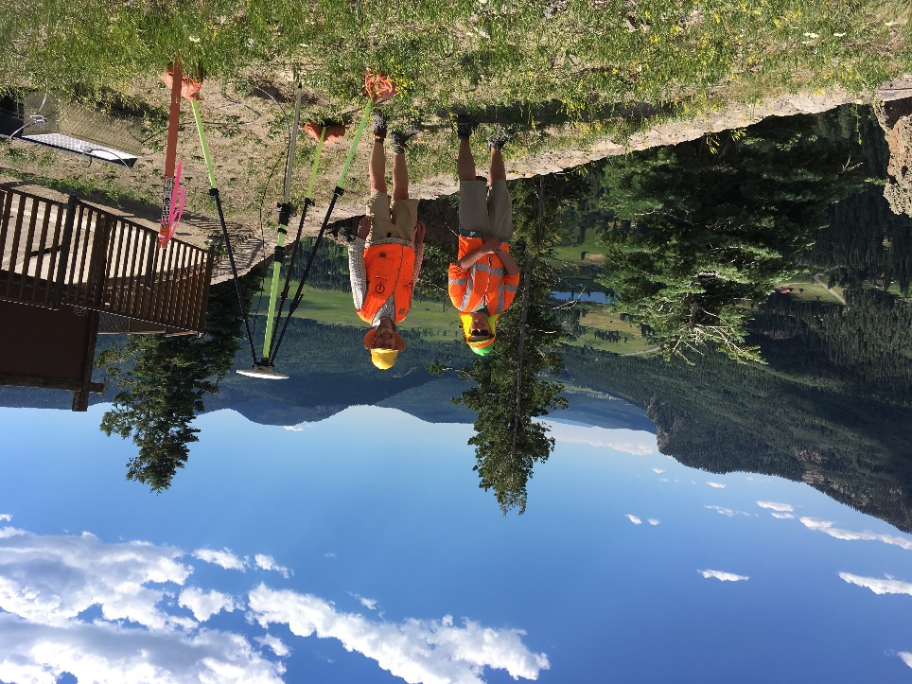

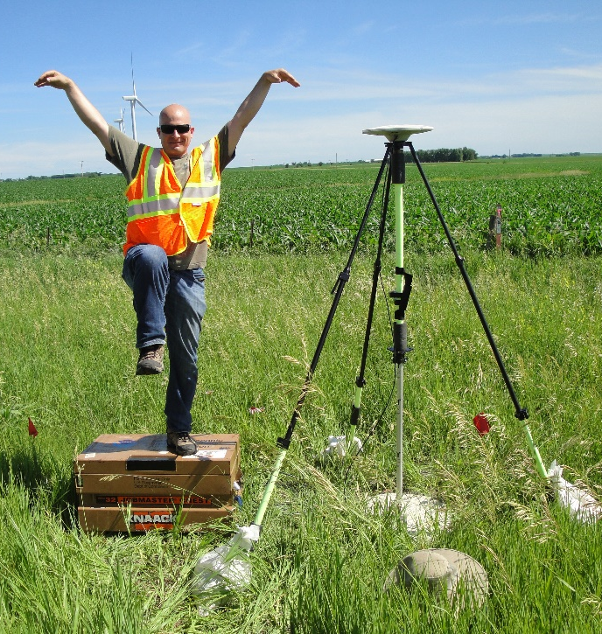
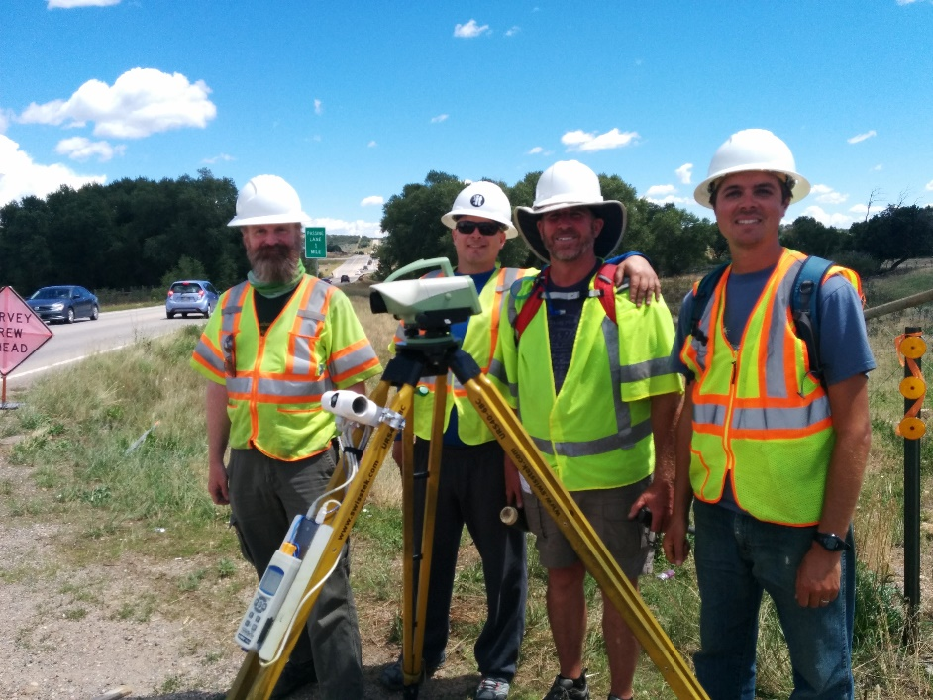
Brian Shaw
Rocky Mountain Advisor
brian.shaw@noaa.gov
Notes:
The National Spatial Reference System is our nations geospatial infrastructure from which all positioning (with the exclusion of military/DOD) is referenced to.
This system provides a consistent framework that allows people to use data in the same reference system to perform analysis and make meaningful comparisons and decisions from that analysis.

Slide 3
What challenges do you
have today working in the
National Spatial Reference System?
Notes:
The National Spatial Reference System is our nations geospatial infrastructure from which all positioning (with the exclusion of military/DOD) is referenced to.
This system provides a consistent framework that allows people to use data in the same reference system to perform analysis and make meaningful comparisons and decisions from that analysis.

Slide 4
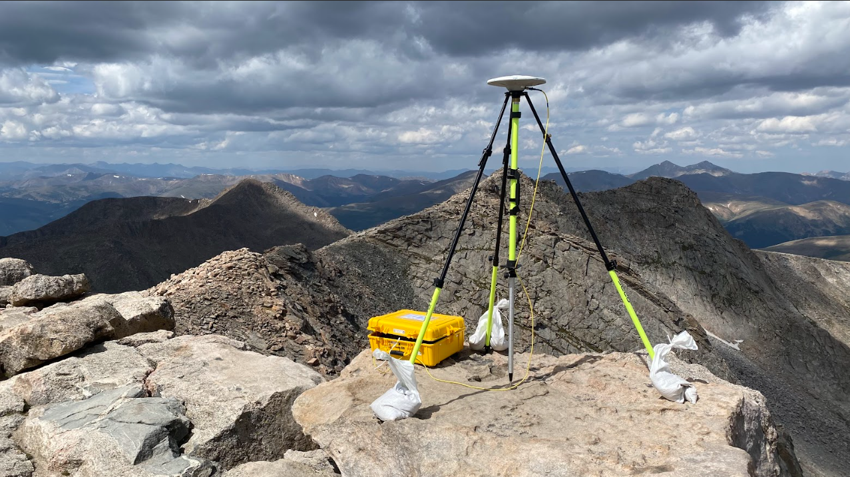
Moving Mountains: Reevaluating the elevations of the Colorado mountain summits using modern geodetic techniques
Kevin Ahlgren, Derek van Westrum, Brian Shaw
https://geodesy.noaa.gov/web/news/moving-mountains.shtml
https://link.springer.com/article/10.1007/s00190-024-01831-8
Notes:
The National Spatial Reference System is our nations geospatial infrastructure from which all positioning (with the exclusion of military/DOD) is referenced to.
This system provides a consistent framework that allows people to use data in the same reference system to perform analysis and make meaningful comparisons and decisions from that analysis.

Slide 5
Will Colorado lose any 14ers with modernization?
NGS evaluated 60 peaks around or above 14,000 feet (4267.2 meters)
58 14,000+ ft mountains, 2 just under 14,000 ft
32 peaks had historical triangulation vertical angles reanalyzed
Historical NGS surveys
60 peaks analyzed using LiDAR coverage
USGS 3DEP data and Colorado Water Conservation Board data
Notes:
The National Spatial Reference System is our nations geospatial infrastructure from which all positioning (with the exclusion of military/DOD) is referenced to.
This system provides a consistent framework that allows people to use data in the same reference system to perform analysis and make meaningful comparisons and decisions from that analysis.

Slide 6
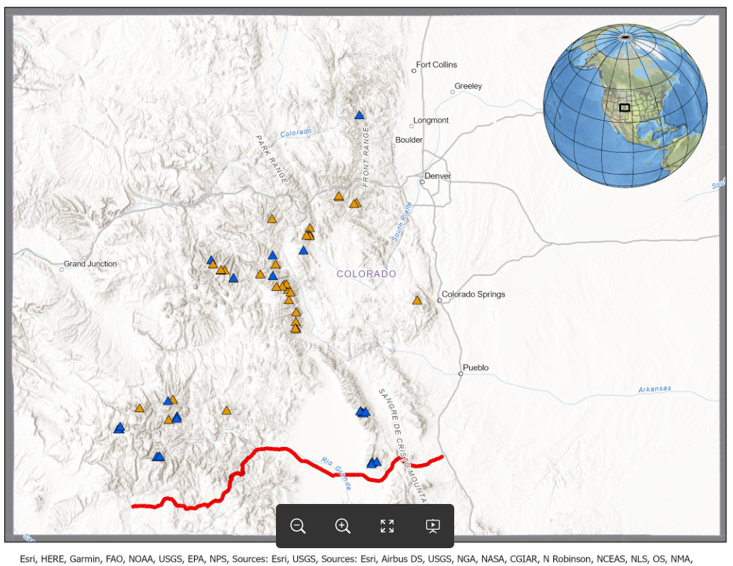
Orange triangles had historical triangulation and LiDAR
(32 marks)
Blue triangles only had LiDAR
(28 marks)
Red line is the GSVS17 line
(223 marks)
Notes:
The National Spatial Reference System is our nations geospatial infrastructure from which all positioning (with the exclusion of military/DOD) is referenced to.
This system provides a consistent framework that allows people to use data in the same reference system to perform analysis and make meaningful comparisons and decisions from that analysis.

Slide 7
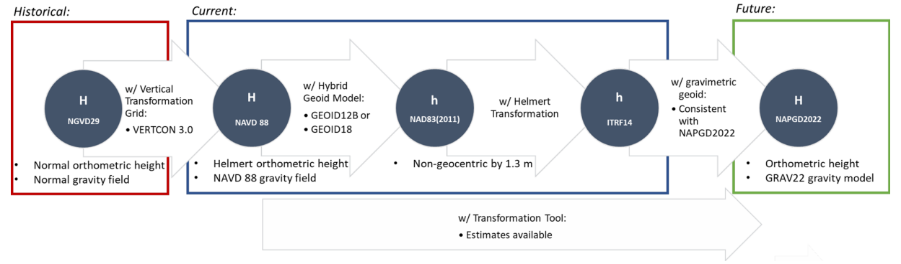
Vertical Datums and Geometric Frames Relationships
Relationship between various vertical datums, geometric frames, and their realizations used historically, currently and in the future.
Notes:
The National Spatial Reference System is our nations geospatial infrastructure from which all positioning (with the exclusion of military/DOD) is referenced to.
This system provides a consistent framework that allows people to use data in the same reference system to perform analysis and make meaningful comparisons and decisions from that analysis.

Slide 8
Reprocessed Historical Triangulation Networks
Notes:
The National Spatial Reference System is our nations geospatial infrastructure from which all positioning (with the exclusion of military/DOD) is referenced to.
This system provides a consistent framework that allows people to use data in the same reference system to perform analysis and make meaningful comparisons and decisions from that analysis.

Slide 9
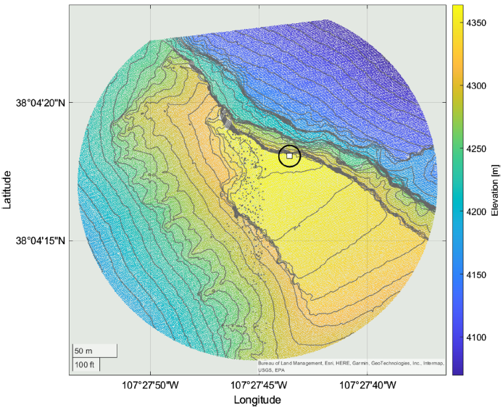
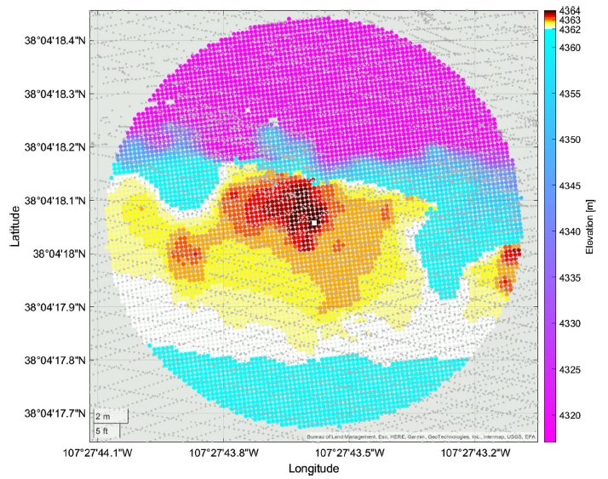
LiDAR point Cloud in NAVD88 for Uncompahgre Peak
A 200 m search radius with 10 m contour interval. White Square is highest elevation.
High resolution gridded terrain model.
Notes:
The National Spatial Reference System is our nations geospatial infrastructure from which all positioning (with the exclusion of military/DOD) is referenced to.
This system provides a consistent framework that allows people to use data in the same reference system to perform analysis and make meaningful comparisons and decisions from that analysis.

Slide 10
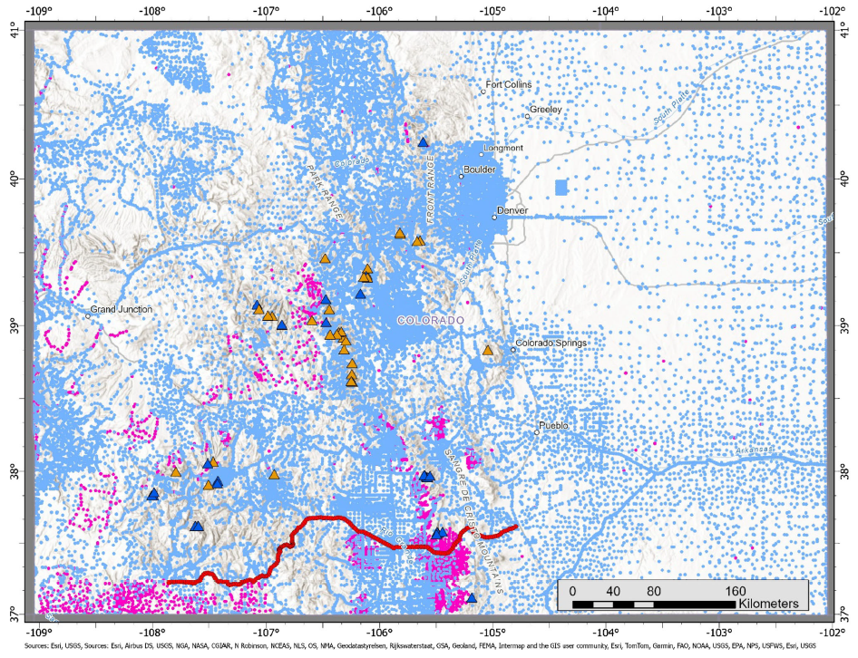
Terrestrial gravity distribution in Colorado
used in the geoid modeling
Light blue dots are old gravity data
Pink dots are new gravity data
Notes:
The National Spatial Reference System is our nations geospatial infrastructure from which all positioning (with the exclusion of military/DOD) is referenced to.
This system provides a consistent framework that allows people to use data in the same reference system to perform analysis and make meaningful comparisons and decisions from that analysis.

Slide 11
Estimated orthometric height of mountain summits
Notes:
The National Spatial Reference System is our nations geospatial infrastructure from which all positioning (with the exclusion of military/DOD) is referenced to.
This system provides a consistent framework that allows people to use data in the same reference system to perform analysis and make meaningful comparisons and decisions from that analysis.

Slide 12
Estimated orthometric height of mountain summits
Rank | Name: | Ellipsoidal height (ITRF2014): [m] | Geoid undulation: [m] | Elevation (NAPGD2022* Orthometric Height): [m] | Estimated Total Uncertainty (1s): [m] | Elevation (NAPGD2022* Orthometric Height): [feet]
1 | Mt. Elbert | 4387.17 | -13.42 | 4400.58 | ±0.064 | 14437.6
2 | Mt. Massive | 4383.22 | -13.2 | 4396.43 | ±0.061 | 14423.9
3 | Mt. Harvard | 4381.99 | -13.75 | 4395.74 | ±0.062 | 14421.7
4 | Blanca Peak | 4357.51 | -15.92 | 4373.43 | ±0.080 | 14348.5
5 | La Plata Peak | 4358.12 | -13.64 | 4371.77 | ±0.068 | 14343
6 | Uncompahgre Peak | 4348.3 | -15.15 | 4363.46 | ±0.065 | 14315.8
7 | Crestone Peak | 4342.6 | -15.06 | 4357.66 | ±0.121 | 14296.8
8 | Mt. Lincoln | 4342.71 | -13.09 | 4355.79 | ±0.060 | 14290.6
9 | Grays Peak | 4338.52 | -12.66 | 4351.18 | ±0.061 | 14275.5
10 | Castle Peak | 4336.19 | -14.01 | 4350.2 | ±0.065 | 14272.3
11 | Torreys Peak | 4336.87 | -12.67 | 4349.54 | ±0.061 | 14270.1
12 | Quandary Peak | 4336.43 | -13.05 | 4349.48 | ±0.058 | 14269.9
13 | Mt. Antero | 4334.92 | -14.29 | 4349.21 | ±0.067 | 14269
14 | Mt. Blue Sky | 4335.66 | -12.64 | 4348.3 | ±0.068 | 14266.1
15 | Longs Peak | 4332.92 | -12.3 | 4345.22 | ±0.073 | 14255.9
16 | Mt. Wilson | 4328.09 | -16.56 | 4344.64 | ±0.066 | 14254.1
17 | Mt. Cameron | 4329.08 | -13.08 | 4342.16 | ±0.061 | 14245.9
18 | Mt. Shavano | 4322.42 | -14.37 | 4336.79 | ±0.064 | 14228.3
19 | Mt. Princeton | 4314.01 | -14.2 | 4328.21 | ±0.077 | 14200.1
20 | Mt. Belford | 4314.32 | -13.72 | 4328.04 | ±0.065 | 14199.6
Notes:
The National Spatial Reference System is our nations geospatial infrastructure from which all positioning (with the exclusion of military/DOD) is referenced to.
This system provides a consistent framework that allows people to use data in the same reference system to perform analysis and make meaningful comparisons and decisions from that analysis.

Slide 13
Estimated orthometric height of mountain summits
Rank | Name: | Ellipsoidal height (ITRF2014): [m] | Geoid undulation: [m] | Elevation (NAPGD2022* Orthometric Height): [m] | Estimated Total Uncertainty (1s): [m] | Elevation (NAPGD2022* Orthometric Height): [feet]
20 | Mt. Belford | 4314.32 | -13.72 | 4328.04 | ±0.065 | 14199.6
21 | Mt. Yale | 4313.35 | -13.89 | 4327.24 | ±0.063 | 14197
22 | Crestone Needle | 4311.52 | -15.06 | 4326.58 | ±0.125 | 14194.8
23 | Mt. Bross | 4308.35 | -13.1 | 4321.45 | ±0.060 | 14177.9
24 | El Diente Peak | 4303.38 | -16.6 | 4319.99 | ±0.064 | 14173.2
25 | Kit Carson Peak | 4302.5 | -15.06 | 4317.56 | ±0.113 | 14165.2
26 | Maroon Peak | 4302.29 | -14.13 | 4316.42 | ±0.063 | 14161.5
27 | Tabeguache Peak | 4300.72 | -14.33 | 4315.05 | ±0.067 | 14157
28 | Mt. Oxford | 4301.13 | -13.71 | 4314.84 | ±0.062 | 14156.3
29 | Mt. Sneffels | 4297.83 | -16.09 | 4313.93 | ±0.070 | 14153.3
30 | Mt. Democrat | 4300.57 | -13.06 | 4313.64 | ±0.061 | 14152.3
31 | Capitol Peak | 4294.51 | -14.24 | 4308.76 | ±0.060 | 14136.3
32 | Pikes Peak | 4284.66 | -15.17 | 4299.83 | ±0.067 | 14107
33 | Snowmass Mountain | 4283.98 | -14.22 | 4298.19 | ±0.060 | 14101.7
34 | Windom Peak | 4277.82 | -15.91 | 4293.72 | ±0.070 | 14087
35 | Mt. Eolus | 4277.09 | -16.01 | 4293.11 | ±0.071 | 14085
36 | Challenger Point | 4277.92 | -15.07 | 4292.99 | ±0.113 | 14084.6
37 | Mt. Columbia | 4275.56 | -13.79 | 4289.35 | ±0.064 | 14072.6
38 | Missouri Mountain | 4274.55 | -13.74 | 4288.29 | ±0.069 | 14069.2
39 | Humboldt Peak | 4272.45 | -15.05 | 4287.5 | ±0.118 | 14066.6
40 | Mt. Bierstadt | 4274.27 | -12.61 | 4286.88 | ±0.072 | 14064.5
Notes:
The National Spatial Reference System is our nations geospatial infrastructure from which all positioning (with the exclusion of military/DOD) is referenced to.
This system provides a consistent framework that allows people to use data in the same reference system to perform analysis and make meaningful comparisons and decisions from that analysis.

Slide 14
Estimated orthometric height of mountain summits
Rank | Name: | Ellipsoidal height (ITRF2014): [m] | Geoid undulation: [m] | Elevation (NAPGD2022* Orthometric Height): [m] | Estimated Total Uncertainty (1s): [m] | Elevation (NAPGD2022* Orthometric Height): [feet]
41 | Sunlight Peak | 4269.3 | -15.9 | 4285.2 | ±0.071 | 14059
42 | Handies Peak | 4268.75 | -15.49 | 4284.24 | ±0.069 | 14055.9
43 | Ellingwood Point | 4268.02 | -15.92 | 4283.94 | ±0.081 | 14054.9
44 | Culebra Peak | 4266.95 | -16.48 | 4283.43 | ±0.068 | 14053.2
45 | Mt. Lindsey | 4267.61 | -15.82 | 4283.43 | ±0.083 | 14053.2
46 | Mt. Sherman | 4266.39 | -13.13 | 4279.52 | ±0.064 | 14040.4
47 | North Eolus | 4263.35 | -16 | 4279.35 | ±0.071 | 14039.8
48 | Little Bear Peak | 4263.24 | -16 | 4279.24 | ±0.089 | 14039.5
49 | Redcloud Peak | 4262.79 | -15.39 | 4278.18 | ±0.097 | 14036
50 | Conundrum Peak | 4263.77 | -14.01 | 4277.78 | ±0.065 | 14034.7
51 | Pyramid Peak | 4261.39 | -14.09 | 4275.47 | ±0.067 | 14027.1
52 | Wilson Peak | 4256.87 | -16.55 | 4273.42 | ±0.075 | 14020.4
53 | San Luis Peak | 4258.23 | -15.13 | 4273.36 | ±0.071 | 14020.2
54 | North Maroon Peak | 4259.16 | -14.12 | 4273.28 | ±0.063 | 14019.9
55 | Wetterhorn Peak | 4257.75 | -15.22 | 4272.97 | ±0.062 | 14018.9
56 | Mt. of the Holy Cross | 4256.15 | -12.65 | 4268.8 | ±0.060 | 14005.2
57 | Sunshine Peak | 4253.17 | -15.42 | 4268.58 | ±0.075 | 14004.5
58 | Huron Peak | 4254.68 | -13.76 | 4268.45 | ±0.063 | 14004.1
59 | Grizzly Peak A | 4252.05 | -13.59 | 4265.64 | ±0.057 | 13994.9
60 | Sunlight Spire | 4249.57 | -15.9 | 4265.47 | ±0.070 | 13994.3
Notes:
The National Spatial Reference System is our nations geospatial infrastructure from which all positioning (with the exclusion of military/DOD) is referenced to.
This system provides a consistent framework that allows people to use data in the same reference system to perform analysis and make meaningful comparisons and decisions from that analysis.

Slide 15
The Modernized
National Spatial Reference System
Notes:
The National Spatial Reference System is our nations geospatial infrastructure from which all positioning (with the exclusion of military/DOD) is referenced to.
This system provides a consistent framework that allows people to use data in the same reference system to perform analysis and make meaningful comparisons and decisions from that analysis.

Slide 16
NSRS Release Schedule
Operational, workforce retention and other issues have delayed NSRS Modernization
SPCS2022 zones will be finalized in 2025 but will not be rolled out until all of the NSRS is modernized.
Beta rollout planned for 2025, full rollout in 2026
https://geodesy.noaa.gov/datums/newdatums/delayed-release.shtml
https://geodesy.noaa.gov/datums/newdatums/FAQNewDatums.shtml
Notes:
The National Spatial Reference System is our nations geospatial infrastructure from which all positioning (with the exclusion of military/DOD) is referenced to.
This system provides a consistent framework that allows people to use data in the same reference system to perform analysis and make meaningful comparisons and decisions from that analysis.

Slide 17
NSRS Modernization Schedule
Modernized NSRS Development (Alpha Testing)
Ongoing Today
Modernized NSRS Beta Release
Planned 2025
FGDC Federal Geodetic Control Committee Vote
No less than 6 months after Beta Release
Federal Register Notice (FRN)
After Approval Vote
Modernized NSRS Production Release
After Approval Vote
Notes:
The National Spatial Reference System is our nations geospatial infrastructure from which all positioning (with the exclusion of military/DOD) is referenced to.
This system provides a consistent framework that allows people to use data in the same reference system to perform analysis and make meaningful comparisons and decisions from that analysis.

Slide 18


AI Images
NSRS Modernization
Geodesy
Notes:
The National Spatial Reference System is our nations geospatial infrastructure from which all positioning (with the exclusion of military/DOD) is referenced to.
This system provides a consistent framework that allows people to use data in the same reference system to perform analysis and make meaningful comparisons and decisions from that analysis.

Slide 19
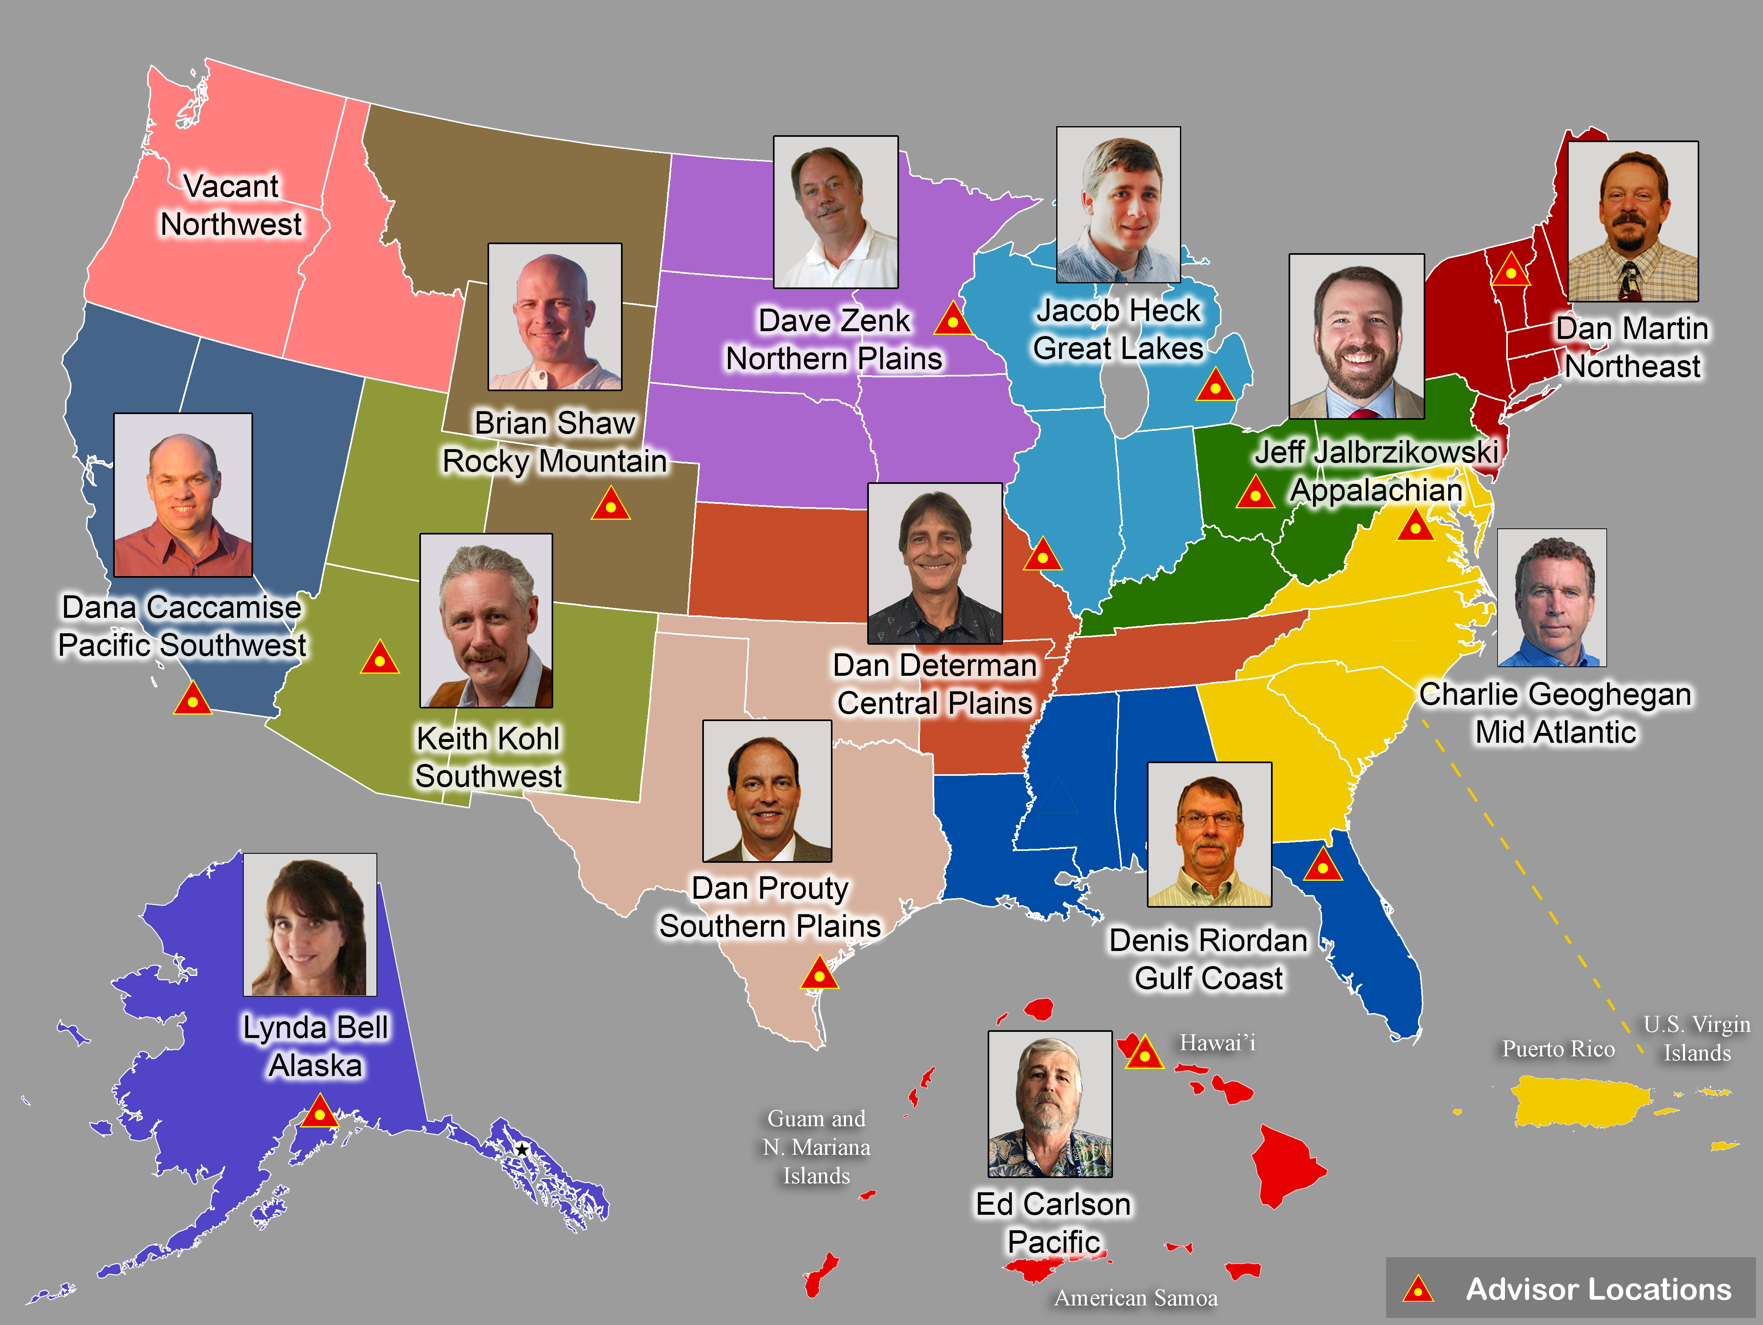
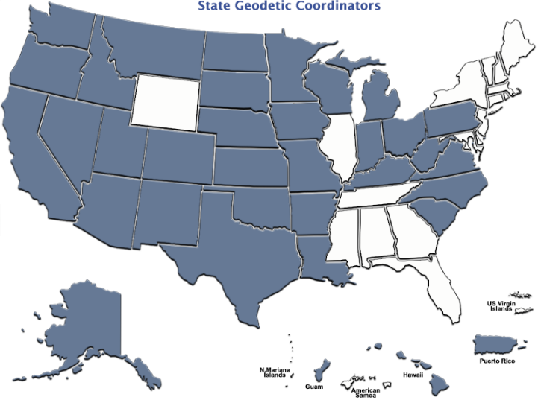
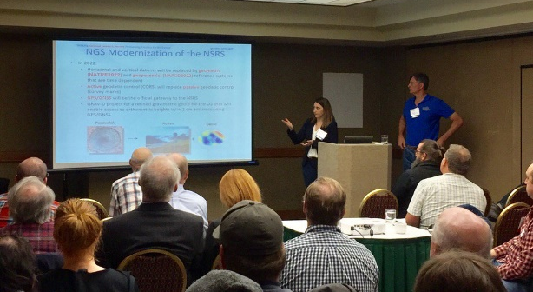
Importance of Coordination
14 Advisors
39 Coordinators
Notes:
NGS Regional Geodetic Advisors
https://geodesy.noaa.gov/ADVISORS/
State Geodetic Coordinators
https://geodesy.noaa.gov/ADVISORS/state-geodetic-coordinators.shtml

Slide 20
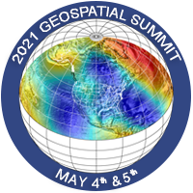
NGS Resources
NGS Training Center
  https://geodesy.noaa.gov/web/science_edu/training/
Educational Videos
  https://geodesy.noaa.gov/datums/newdatums/WatchVideos.shtml
NGS Webinar Series
  https://geodesy.noaa.gov/web/science_edu/webinar_series/
Geospatial Summit (2021, 2019 recorded sessions)
  https://geodesy.noaa.gov/geospatial-summit/
Presentation Library
  https://geodesy.noaa.gov/web/science_edu/presentations_library/

Slide 21
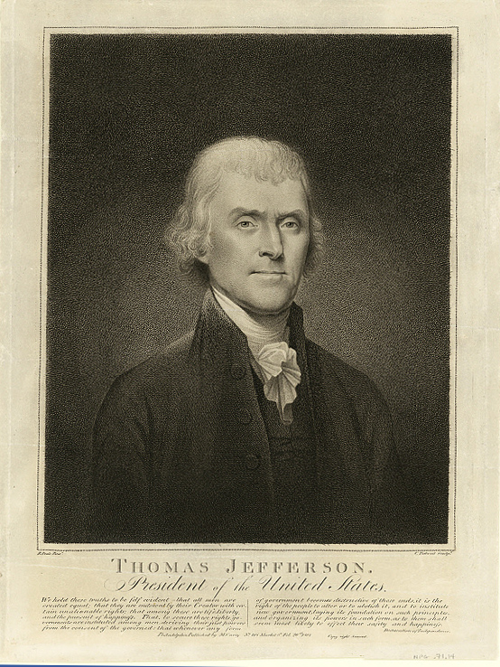
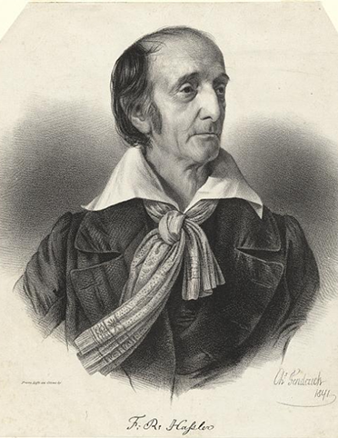



NOAA and NGS
Our Nation’s First Civilian Science Agency
1807
Thomas Jefferson
Survey of the Coast
1811
Ferdinand Hassler
Superintendent
1836
U.S. Coast
Survey
1878
U.S. Coast and
Geodetic Survey
1970
NOAA is established
Notes:
NGS has been around a long time. For more than 200 years, NGS and its predecessor agencies have collaborated with public and private organizations to establish reference stations at precisely determined locations.
We began on a mission established by Thomas Jefferson in 1807 to conduct a “Survey of the Coast” (as the United States Coast Survey).
(Pictured are Thomas Jefferson and Ferdinand Hassler, the first Superintendent of the Coast Survey). We were renamed the U.S. Coast and Geodetic Survey in 1878. NOAA was established in 1970.
Traditionally, precise positioning locations have been identified by setting a survey mark—usually a brass, bronze, or aluminum disk. Locations might also be identified by a deeply driven rod, or a prominent object, such as a water tower or church spire.

Slide 22
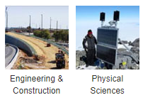
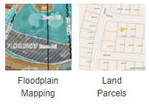
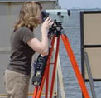
NGS’s Mission
To define, maintain and provide access
to the National Spatial Reference System (NSRS) to meet our Nation’s economic, social, and environmental needs.
…………………………………………….........................
The NSRS is a consistent coordinate system that defines latitude, longitude, height, scale, gravity, orientation, and shoreline throughout the United States.
Land
Surveying
Sectors that Rely on Geodesy
Notes:
The National Spatial Reference System is our nations geospatial infrastructure from which all positioning (with the exclusion of military/DOD) is referenced to.
This system provides a consistent framework that allows people to use data in the same reference system to perform analysis and make meaningful comparisons and decisions from that analysis.

Slide 23
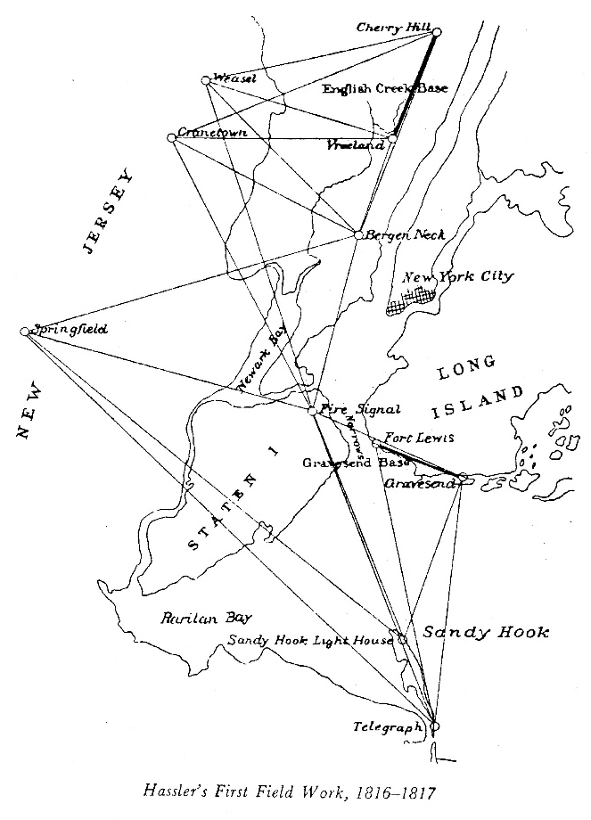
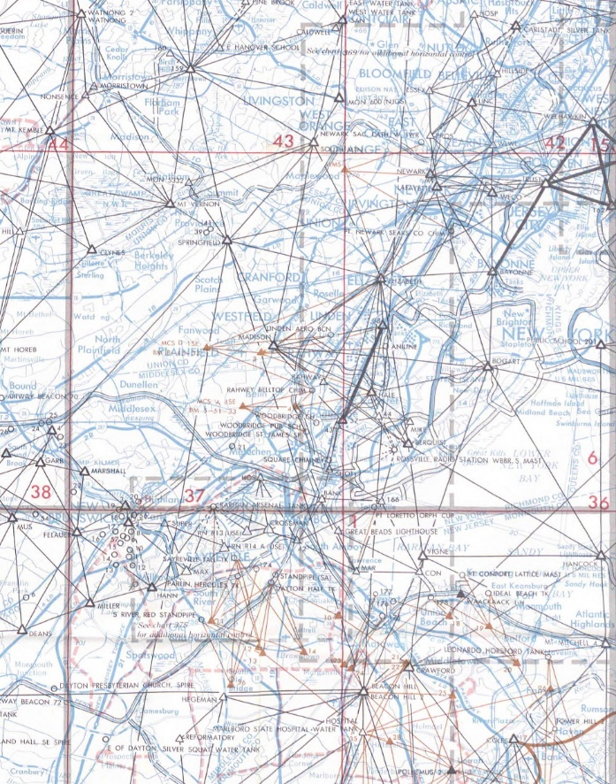
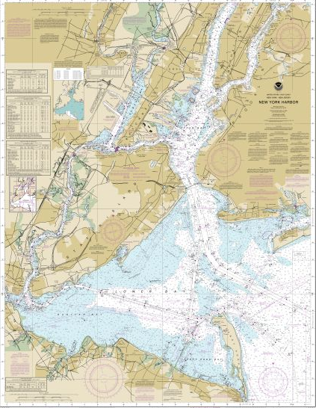
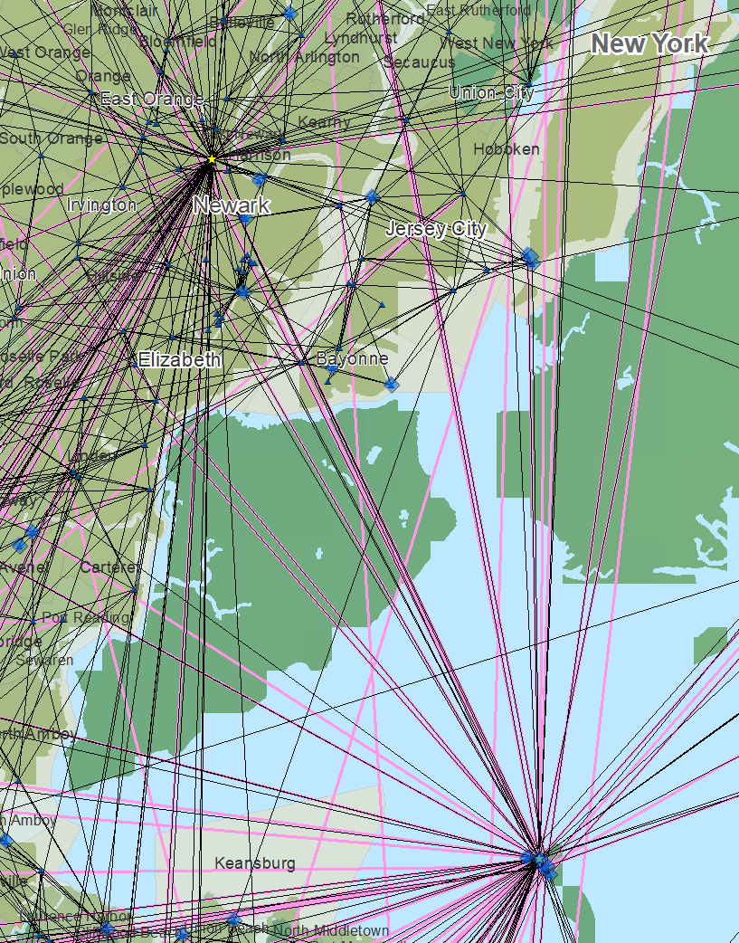
The Importance of Geodesy
1816-1817
1969
Today

Slide 24
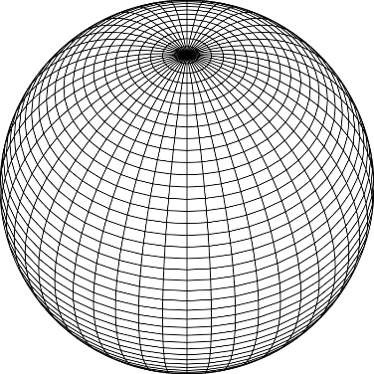
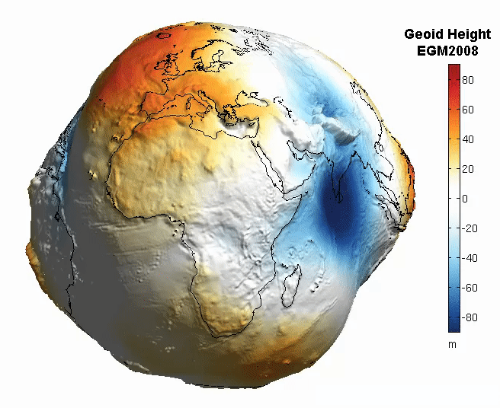
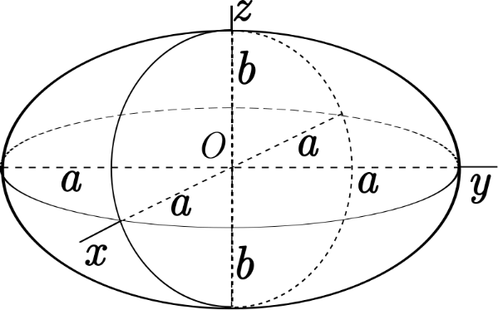
The Earth is Infinitely Complex
Build Models to Simplify
Notes:
Models are used to simplify complex phenomena for humans and computers to understand and perform calculations and analysis.
The geoid is an approximation of sea level and used to calculate elevations (orthometric heights) above this “sea level” surface
Spheroid image https://www.kisspng.com/png-sphere-shape-ball-grid-line-circle-draw-5378189/
Ellipsoid image https://www.kisspng.com/png-figure-of-the-earth-oblate-spheroid-ellipsoid-4129812/
Geoid Image https://www.reddit.com/r/MapPorn/comments/3xf6a0/geoid_height_of_new_global_gravity_field_models/

Slide 25
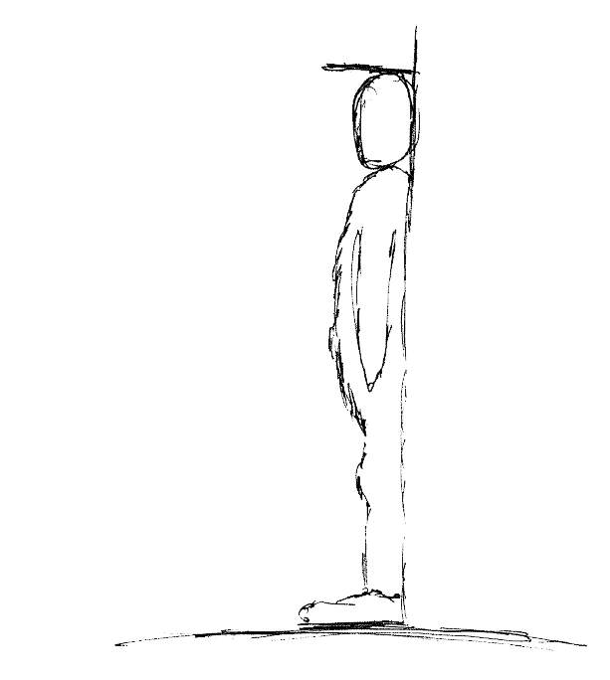
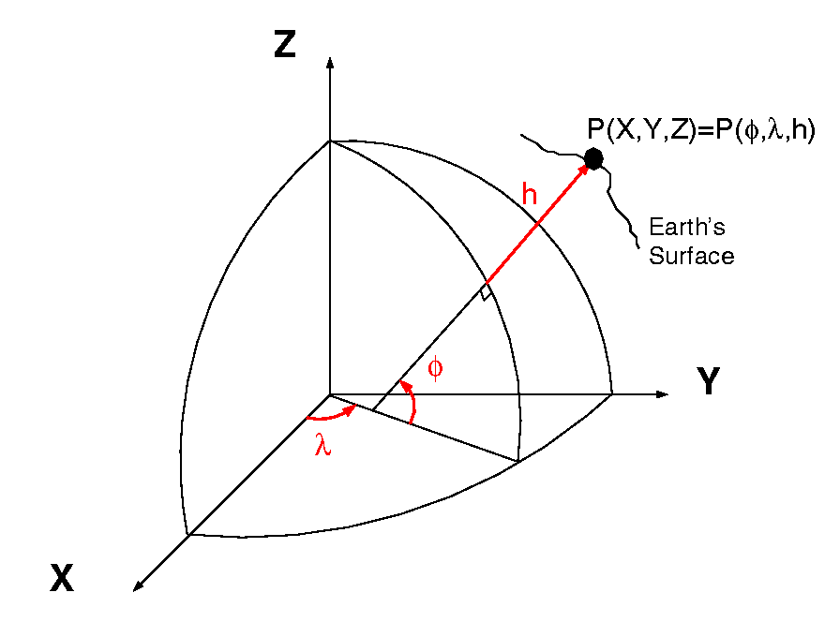
Datums and Reference Frames
60”, 2019
52”, 2018
46”, 2017
aka P(Lat,Lon,Ht)
= ht.
= lat.
= long.
A reference surface or framework to reference your data to for consistency
X,Y,Z vs Lat, Lon, Ht

Slide 26
Analyses of NGVD 29 General Adjustment
Year of Adjustment | Kilometers of Leveling | Number of Tide Stations
1900 | 21,095 | 5
1903 | 31,789 | 8
1907 | 38,359 | 8
1912 | 46,468 | 9
1929 | 75,159 (U.S.) | 21 (U.S.)
 | 31,565 (Canada) | 5 (Canada)
http://www.geodesy.noaa.gov/PUBS_LIB/NAVD88/navd88report.htm
Notes:
The National Spatial Reference System is our nations geospatial infrastructure from which all positioning (with the exclusion of military/DOD) is referenced to.
This system provides a consistent framework that allows people to use data in the same reference system to perform analysis and make meaningful comparisons and decisions from that analysis.

Slide 27
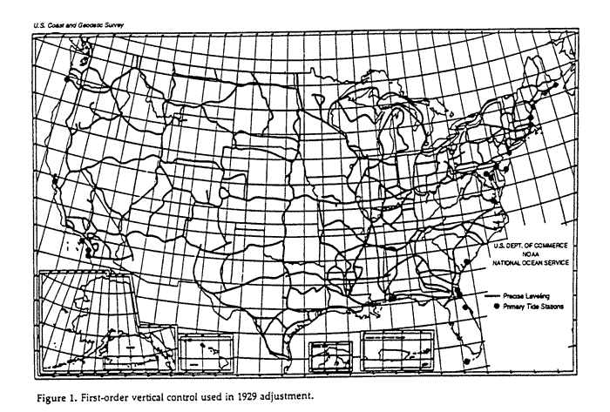
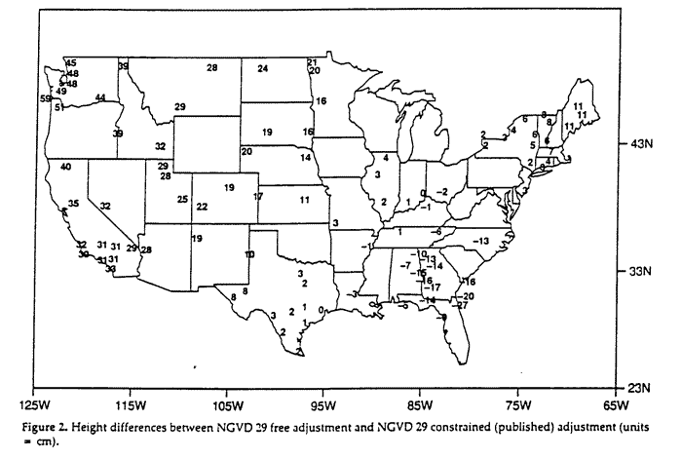
Analysis of NGVD 29 General Adjustment
First-order control used in 1929 adjustment
NGVD29 Height Differences between
Free adjustment and Constrained adjustment
http://www.geodesy.noaa.gov/PUBS_LIB/NAVD88/navd88report.htm
Notes:
The National Spatial Reference System is our nations geospatial infrastructure from which all positioning (with the exclusion of military/DOD) is referenced to.
This system provides a consistent framework that allows people to use data in the same reference system to perform analysis and make meaningful comparisons and decisions from that analysis.

Slide 28

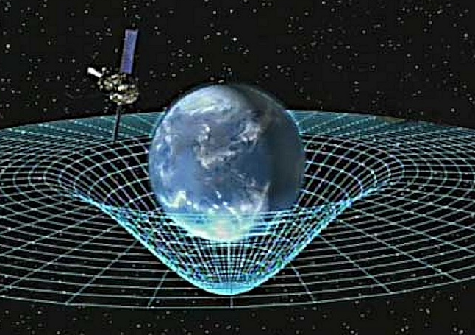
Gravity is Fundamental
Aristotle (350BC)
Objects fall proportional to mass
Al-Khazini (1121)
Gravitational potential energy
Galileo (1590)
Terminal velocity
Newton (1687)
Gravity inverse-square law
Einstein (1913)
Theory of general relativity
Notes:
Galileo graphic https://commons.wikimedia.org/wiki/File:GalilEXP.jpg
Spacetime curvature graphic https://www.nasa.gov/mission_pages/gpb/gpb_012.html
Aristotle (384–322 BCE)
Objects fall at a speed proportional to their mass.
The Aristotelian explanation of gravity is that all bodies move toward their natural place. For the elements earth and water, that place is the center of the (geocentric) universe;
al-Khazini (11th to 12th centuries)
In 1121, al-Khazini, in The Book of the Balance of Wisdom, proposed that the gravity and gravitational potential energy of a body varies depending on its distance from the centre of the Earth.
Galileo Galilei (1564-1642)
Leaning Tower of Pisa Experiment (1589-92) - Law of Falling Bodies
Objects fall at the same speed, independent of their mass or shape
Isaac Newton (1643-1727)
In 1687, English mathematician Sir Isaac Newton published Principia, which hypothesizes the inverse-square law of universal gravitation.
Albert Einstein (1879-1955)
Between 1911-1915 Einstein developed the theory of general relativity. In general relativity, the effects of gravitation are ascribed to spacetime curvature instead of to a force. To deal with this difficulty, Einstein proposed that spacetime is curved by matter, and that free-falling objects are moving along locally straight paths in curved spacetime. (This type of path is called a geodesic).

Slide 29
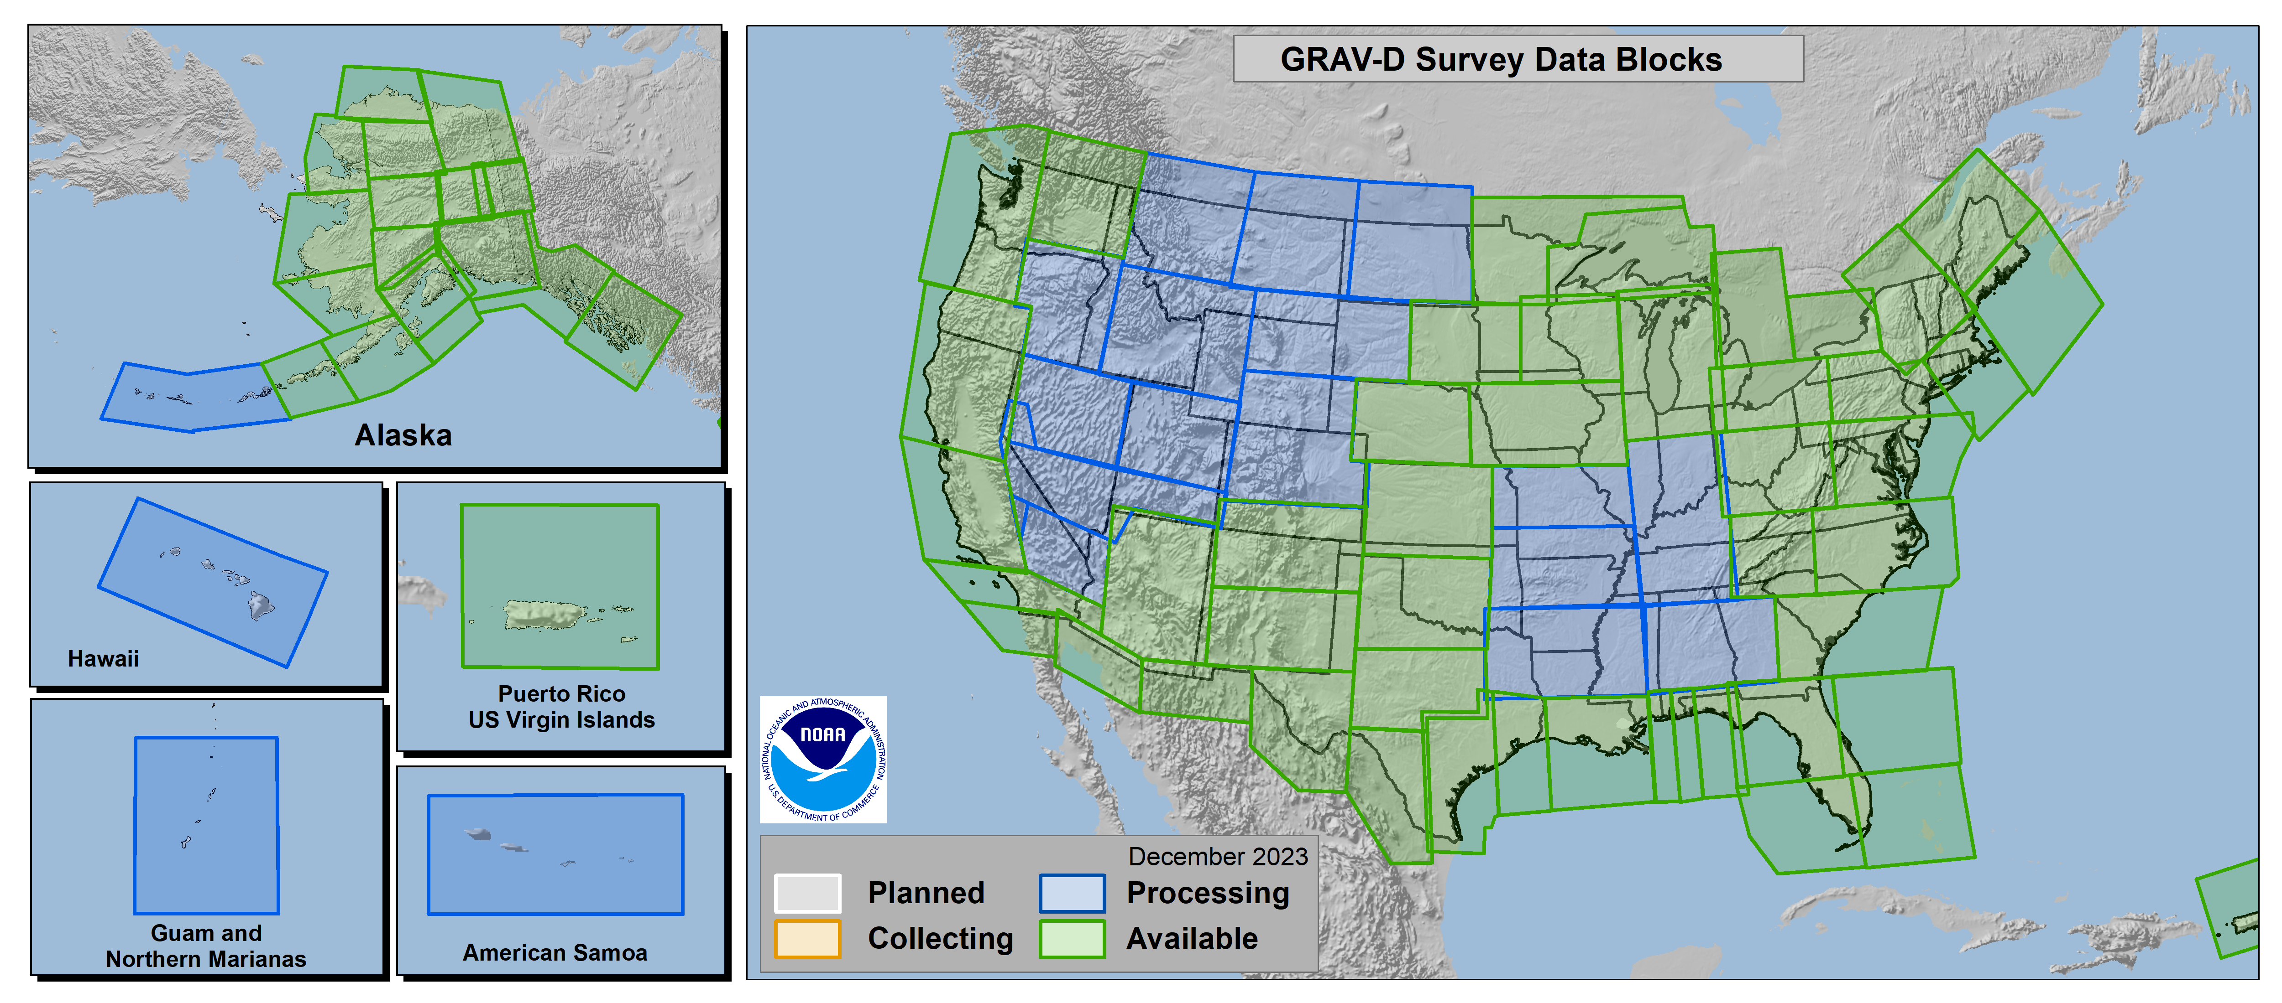
Gravity of the Redefinition of the American Vertical Datum
GRAV-D
100% Complete (12/2023)
Notes:
More information on GRAV-D
https://geodesy.noaa.gov/GRAV-D/
Data Download for GRAV-D blocks
https://geodesy.noaa.gov/GRAV-D/data_products.shtml

Slide 30
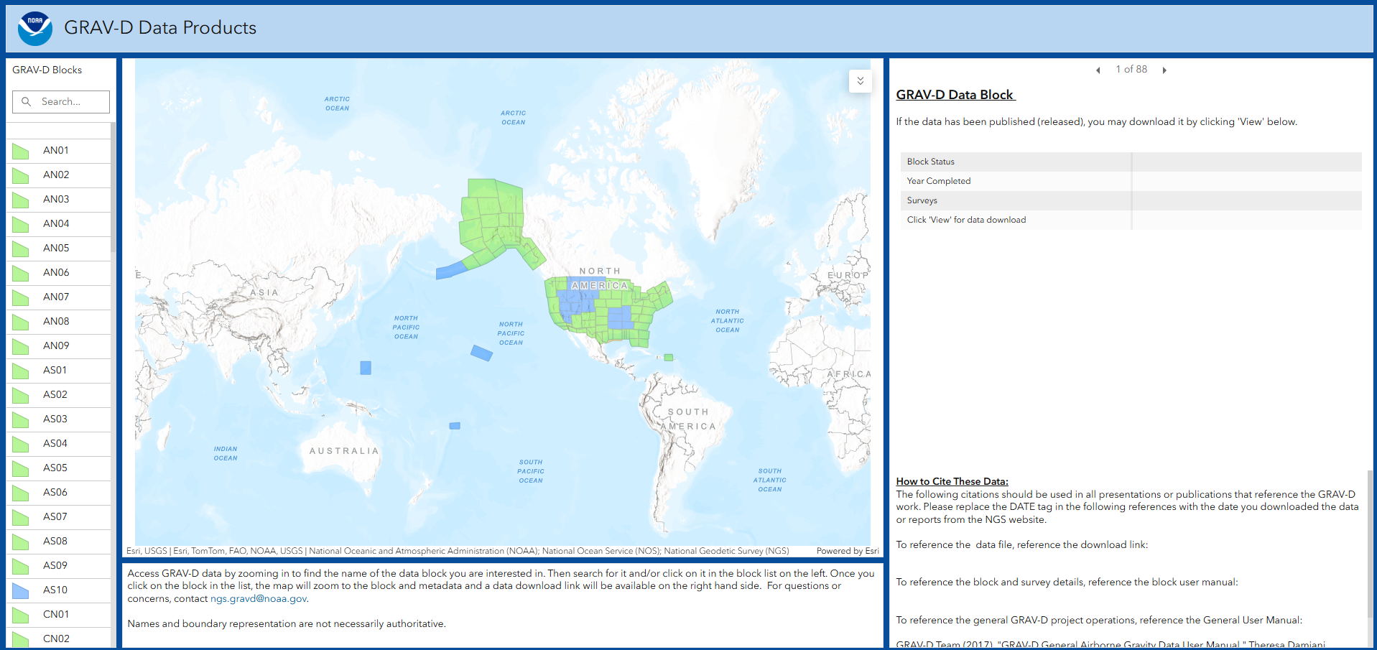
GRAV-D Data Products
Notes:
More information on GRAV-D
https://geodesy.noaa.gov/GRAV-D/
Data Download for GRAV-D blocks
https://geodesy.noaa.gov/GRAV-D/data_products.shtml

Slide 31
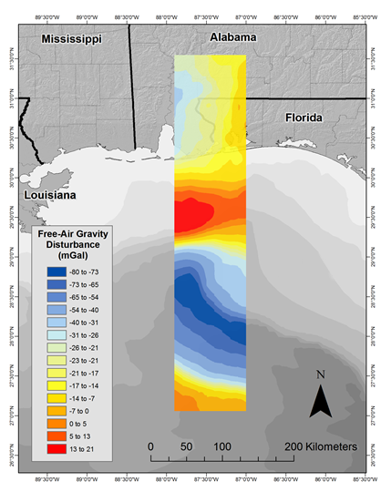
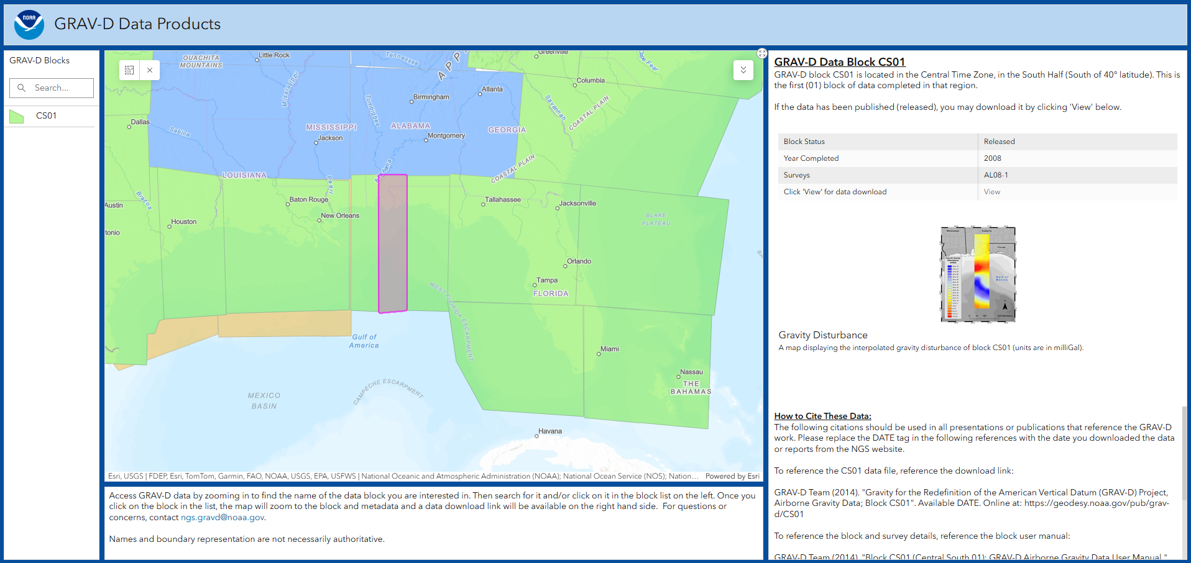
GRAV-D Data Products
Notes:
More information on GRAV-D
https://geodesy.noaa.gov/GRAV-D/
Data Download for GRAV-D blocks
https://geodesy.noaa.gov/GRAV-D/data_products.shtml

Slide 32
Why Modernize the NSRS
Current models built on old technology
  NAD 83 not truly Geocentric (~2.2m)
  NAVD 88 relies on marks in the ground
  and is not easily maintained
  Today’s technology needs better accuracy
Notes:
NSRS Modernization News
https://geodesy.noaa.gov/datums/newdatums/TrackOurProgress.shtml

Slide 33
Main Benefits of Modernized NSRS
Fast, Accurate, Consistent Elevations Everywhere
Improved Public Safety
  Flood Plain Maps
  Emergency Route Planning
Accurate Positioning
  Autonomous vehicles, BIMs, Smart Cities
Notes:
NSRS Modernization News
https://geodesy.noaa.gov/datums/newdatums/TrackOurProgress.shtml

Slide 34
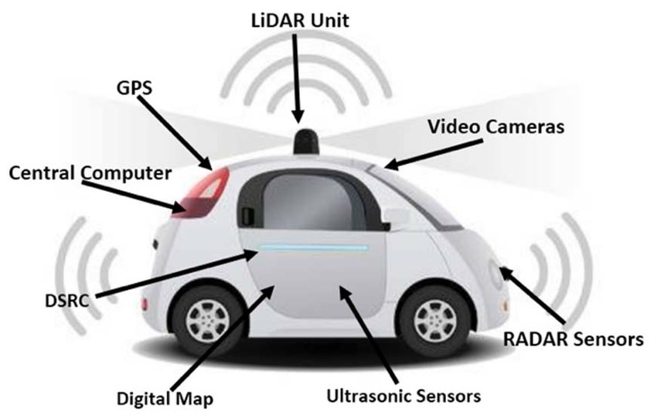


Benefits of a Modernized NSRS
Our society and economy are becoming more “spatially enabled”
Digital
twins
Project life cycles
Autonomous vehicles
Emergency response
Smart
infrastructure
Facilities
asset management
2D, 3D, 4D, 5D, etc. design
The Modernized NSRS will help make this a reality
Notes:
The National Spatial Reference System is our nations geospatial infrastructure from which all positioning (with the exclusion of military/DOD) is referenced to.
This system provides a consistent framework that allows people to use data in the same reference system to perform analysis and make meaningful comparisons and decisions from that analysis.

Slide 35
How Can You Prepare
Metadata is essential
    Improves reliability and accuracy of data
    Increases value and usefulness
Transform and collect data in current datums
    NAD 83 (2011), NAVD 88
Evaluate The Alpha Products Impacts In Your Area
    SPCS2022, NCAT, GEOID2022, EPP2022
Notes:
NSRS Modernization News
https://geodesy.noaa.gov/datums/newdatums/TrackOurProgress.shtml

Slide 36
Metadata to Consider
Document what realization of NAD83
Original, HARN, FBN, 2007, 2011
Document Geoid Models used for GNSS data, Lidar, etc
Document transformations and workflows applied to data
Understanding the term Epoch
Datum epoch of NAD83(2011) is epoch 2010.00
All data used was processed to same epoch
Date of observations is epoch data collected
Notes:
NSRS Modernization News
https://geodesy.noaa.gov/datums/newdatums/TrackOurProgress.shtml

Slide 37
Best ways to determine coordinates in Modernized NSRS
Resurvey: Return to the field and collect new observations, relying upon geodetic control that has coordinates in the new datum
Reprocess: Using existing observations, re-compute new coordinates based upon geodetic control (CORS) that has been defined in the new datum
Transform: Take finished products which have coordinates in the old datum and use transformation software to estimate coordinates in the new datum

Slide 38
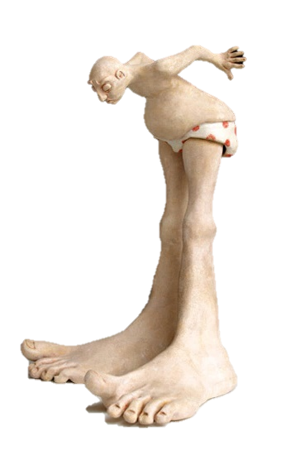
A tale of two feet
Two versions of “foot” in current use:
“Old” U.S. survey foot
(adopted 1893)
“New” international foot
(adopted 1959)
‭1 ft = 1200/3937 m
(0.3048006096…‬ m)
1 ft = 0.3048 m exactly
Differ by
2 parts per million (ppm) or ~0.01 ft (~1/8 inch) per mile
  A real problem with real costs (especially for State Plane of the NSRS)
January 7, 2025
TRB Annual Meeting 2025
38

Slide 39
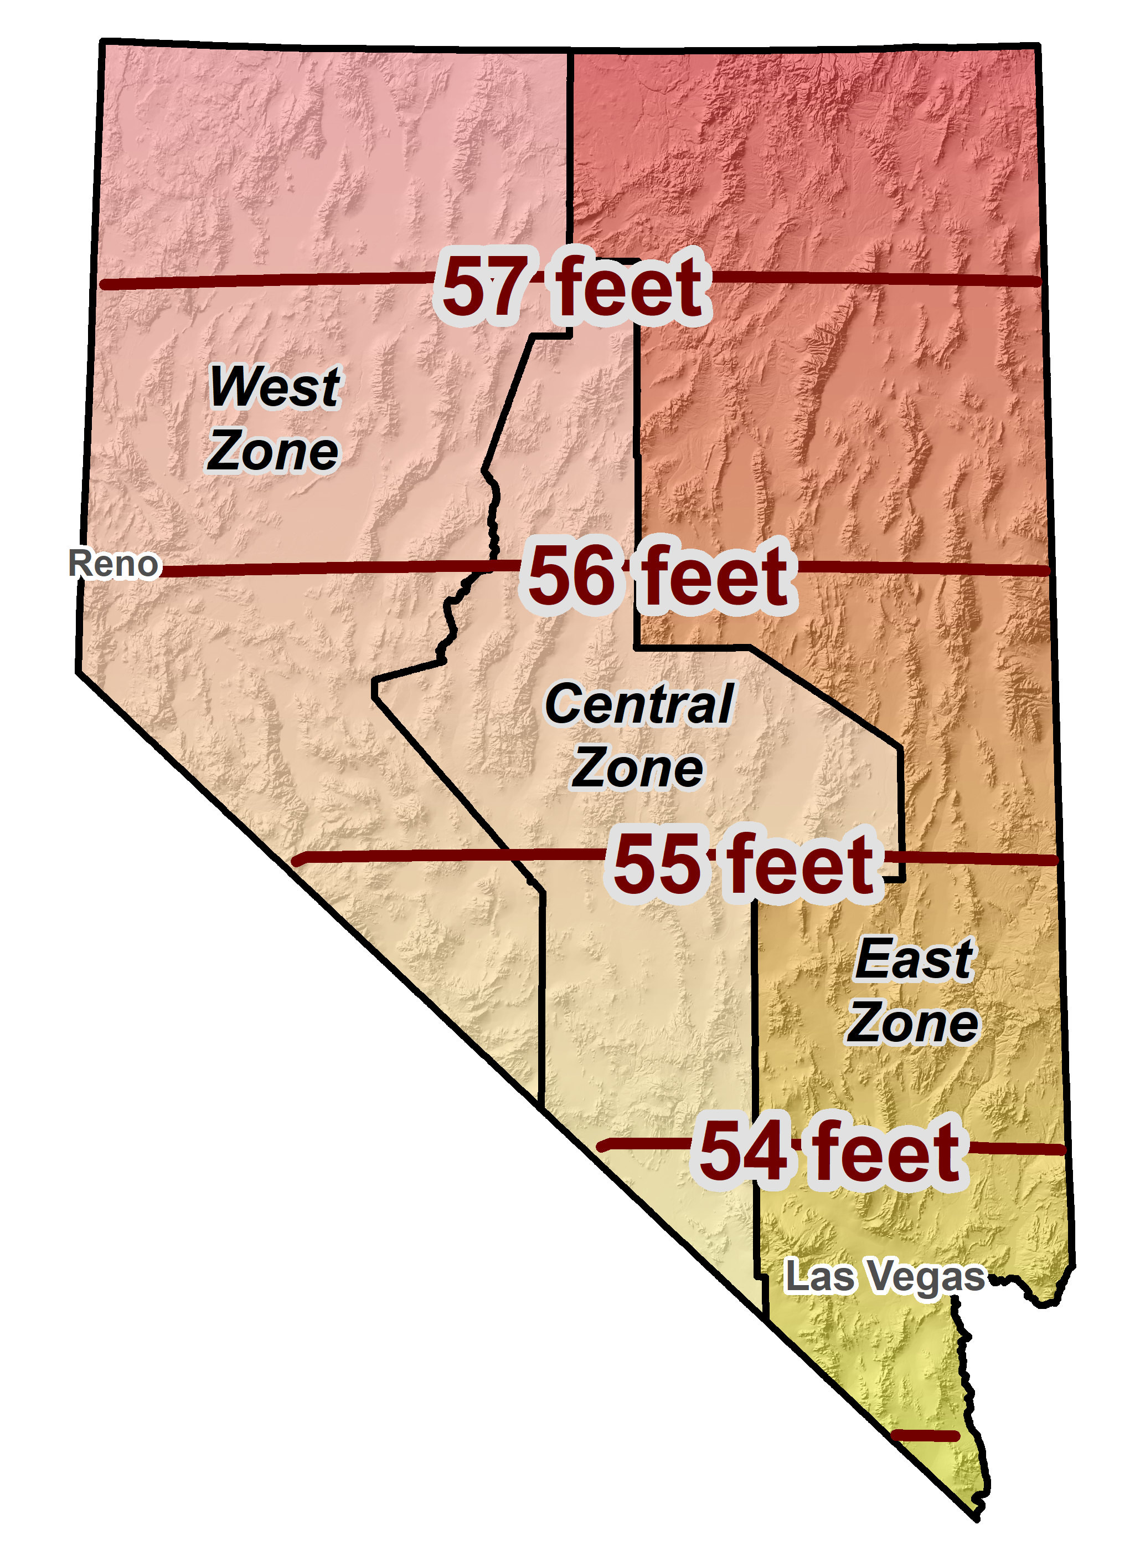
Horizontal error when mixing up feet…
SPCS 83 Nevada East Zone
January 7, 2025
TRB Annual Meeting 2025
39

Slide 40
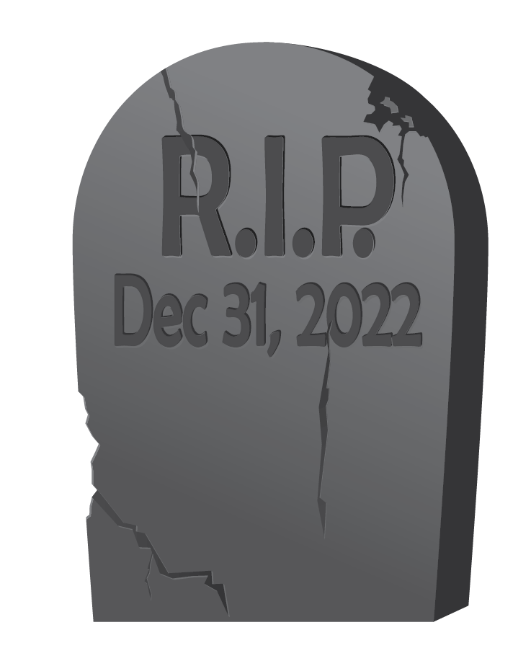
End of an era for the U.S. survey foot
U.S. survey foot has been “deprecated” (retired)
  Not supported for State Plane Coordinate System of 2022
  (or any part of modernized NSRS)
  Only international foot definition will be supported by NGS
Effective December 31, 2022
  But U.S. survey foot will still be supported for legacy products
  (e.g., existing State Plane)
However, NGS will NOT support NAD 83 after NSRS Modernization complete
NGS will always support
U.S. survey foot for SPCS 83 and 27
Thank you.
January 7, 2025
TRB Annual Meeting 2025
40

Slide 41
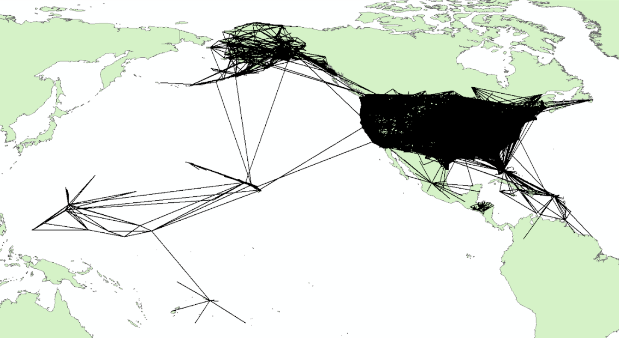
National Adjustments
Geometric (approximate numbers)
    Projects: ~5,300
    Stations: ~107,000
    Vectors : ~446,000

Slide 42
National Adjustments
Orthometric (approximate numbers)
  USA
    Projects : ~23,900
    Stations : ~1M
    Observations : ~2.1M
  Canada
    Projects : ~2,900
    Stations : ~177,000
    Observations : ~204,000

Slide 43
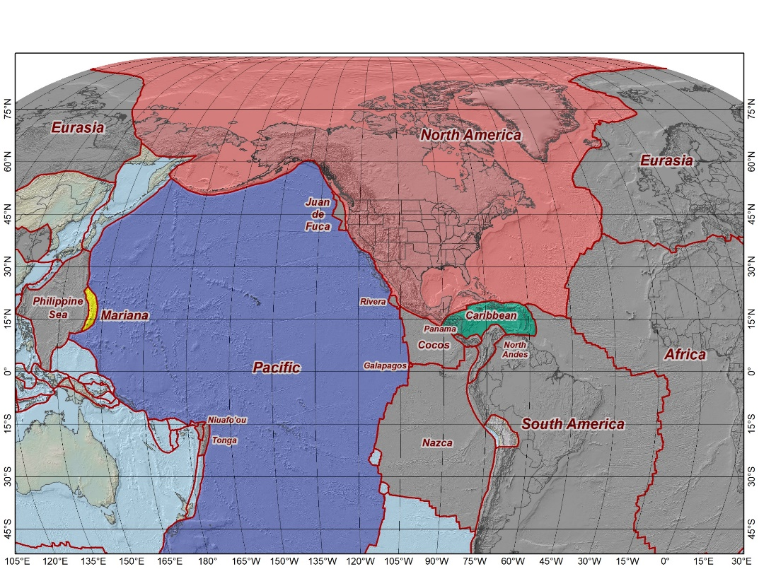
The Future Reference Frames
The tectonic plates “fixed” for the
2022 Terrestrial Reference Frames
Tectonic Plate based
Each Plate is based on the same
densified ITRF model
North America NATRF
Caribbean CATRF
Pacific PATRF
Mariana MATRF
NATRF2022
MATRF2022
PATRF2022
CATRF2022
Notes:
NSRS Modernization Naming Conventions https://geodesy.noaa.gov/datums/newdatums/naming-convention.shtml

Slide 44
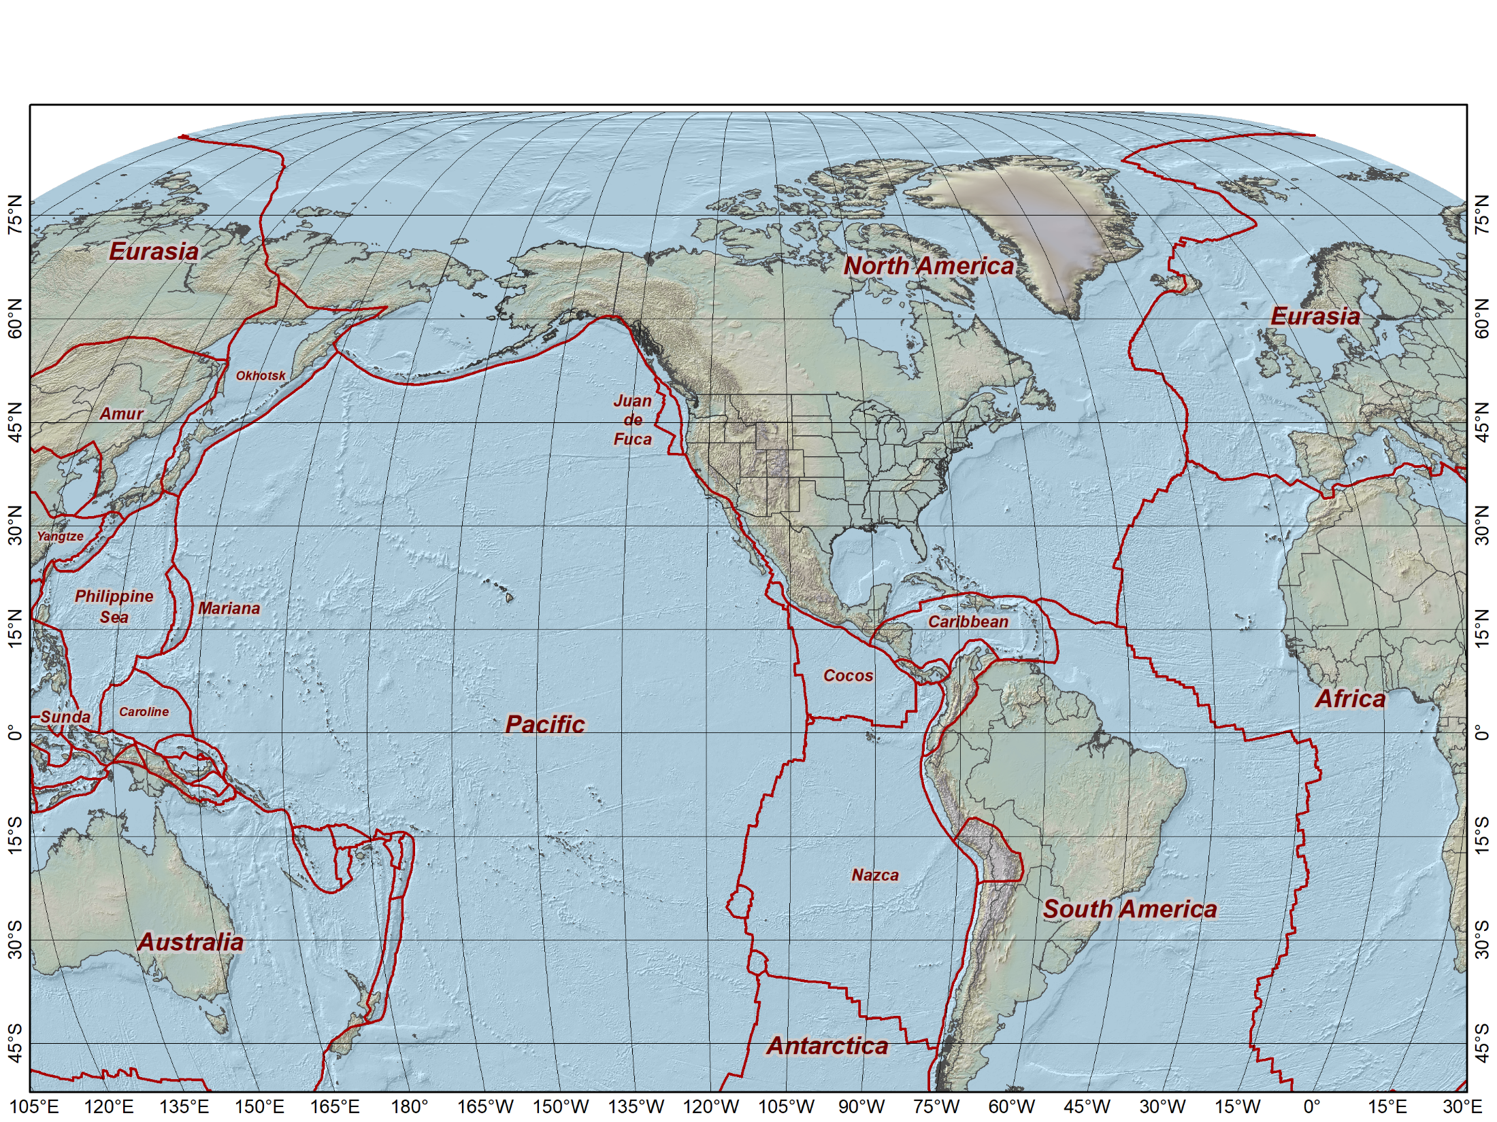
Current vertical datums of the National Spatial Reference System
North America and Caribbean
NAVD 88
IGLD 85
PRVD02
VIVD09
Pacific Ocean
GUVD04
NMVD03
ASVD02
NAVD 88
IGLD 85
NAVD 88
NMVD03
PRVD02
GUVD04
VIVD09
ASVD02

Slide 45
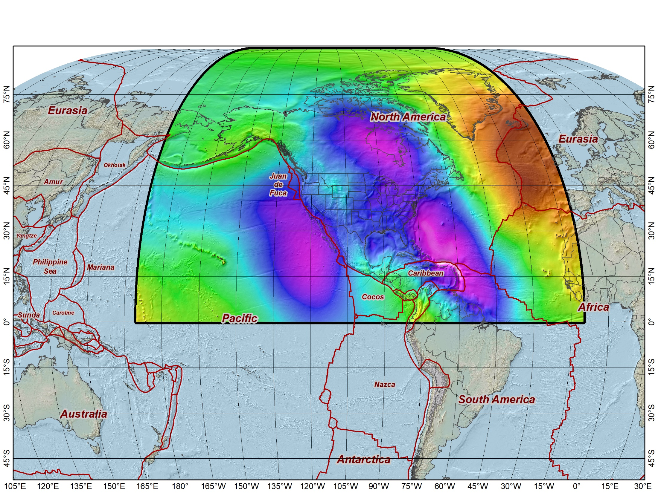
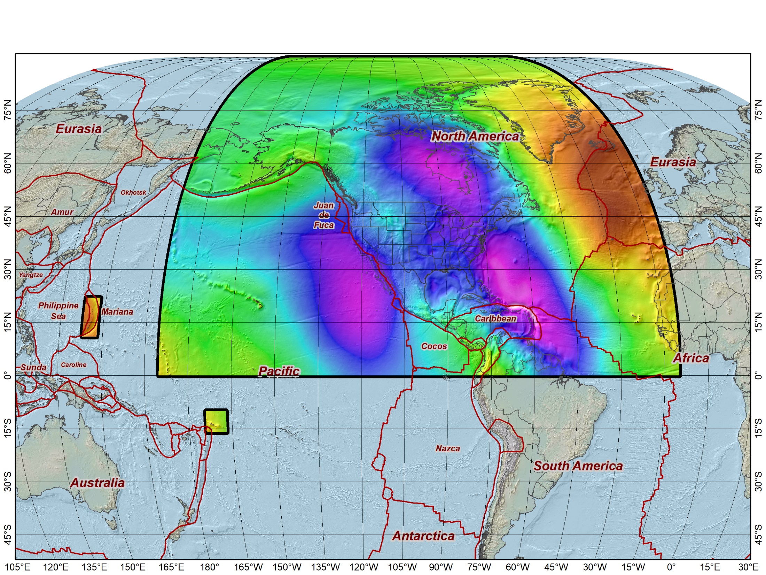
Extent of the new geopotential (“vertical”) datum
North American-Pacific Geopotential Datum of 2022 (NAPGD2022)
Includes the following
(time-varying) models:
Geoid Model (GEOID2022)
Surface Gravity Model (GRAV2022)
Deflection of the Vertical Model (DEFLEC2022)
Guam and Northern Marianas Islands
American Samoa

Slide 46
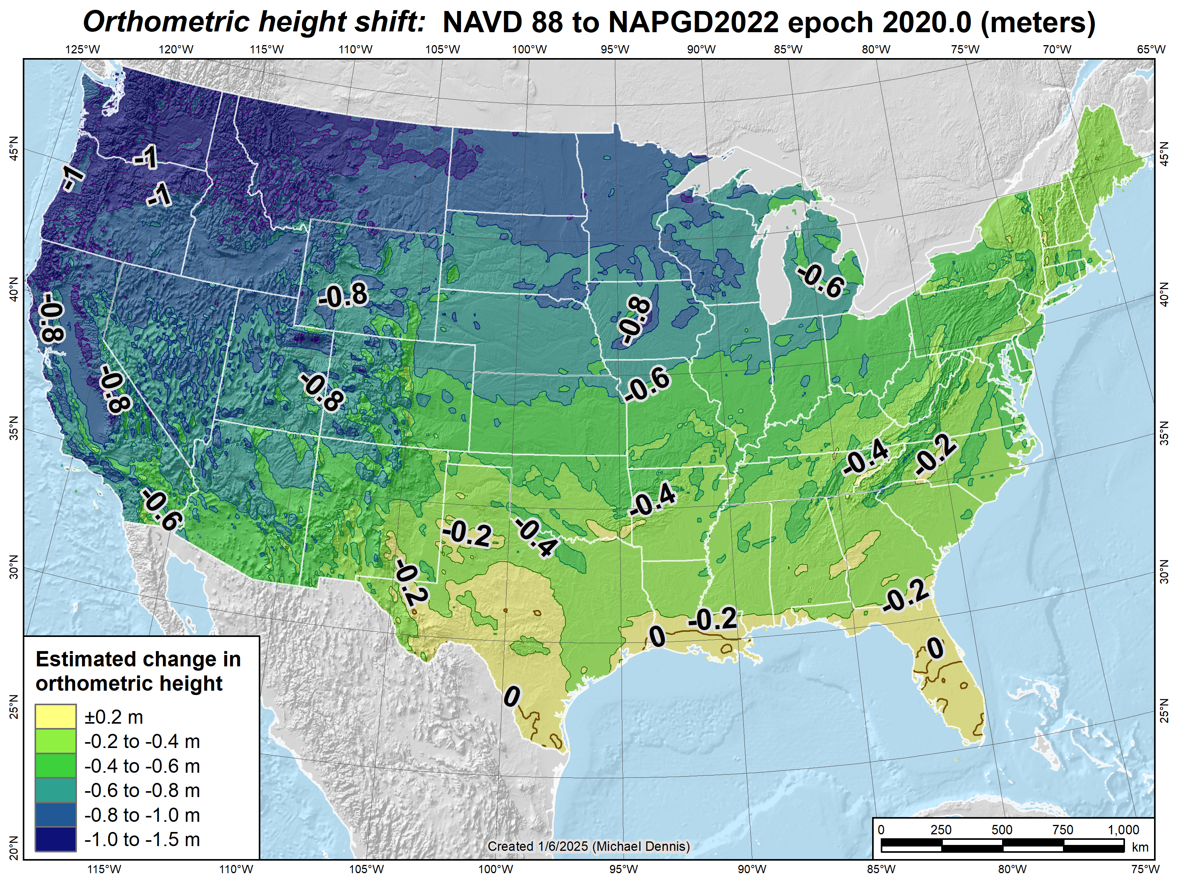
Estimated orthometric height shifts (CONUS):
NAVD 88 to NAPGD2022 epoch 2020.0 (meters)

Slide 47
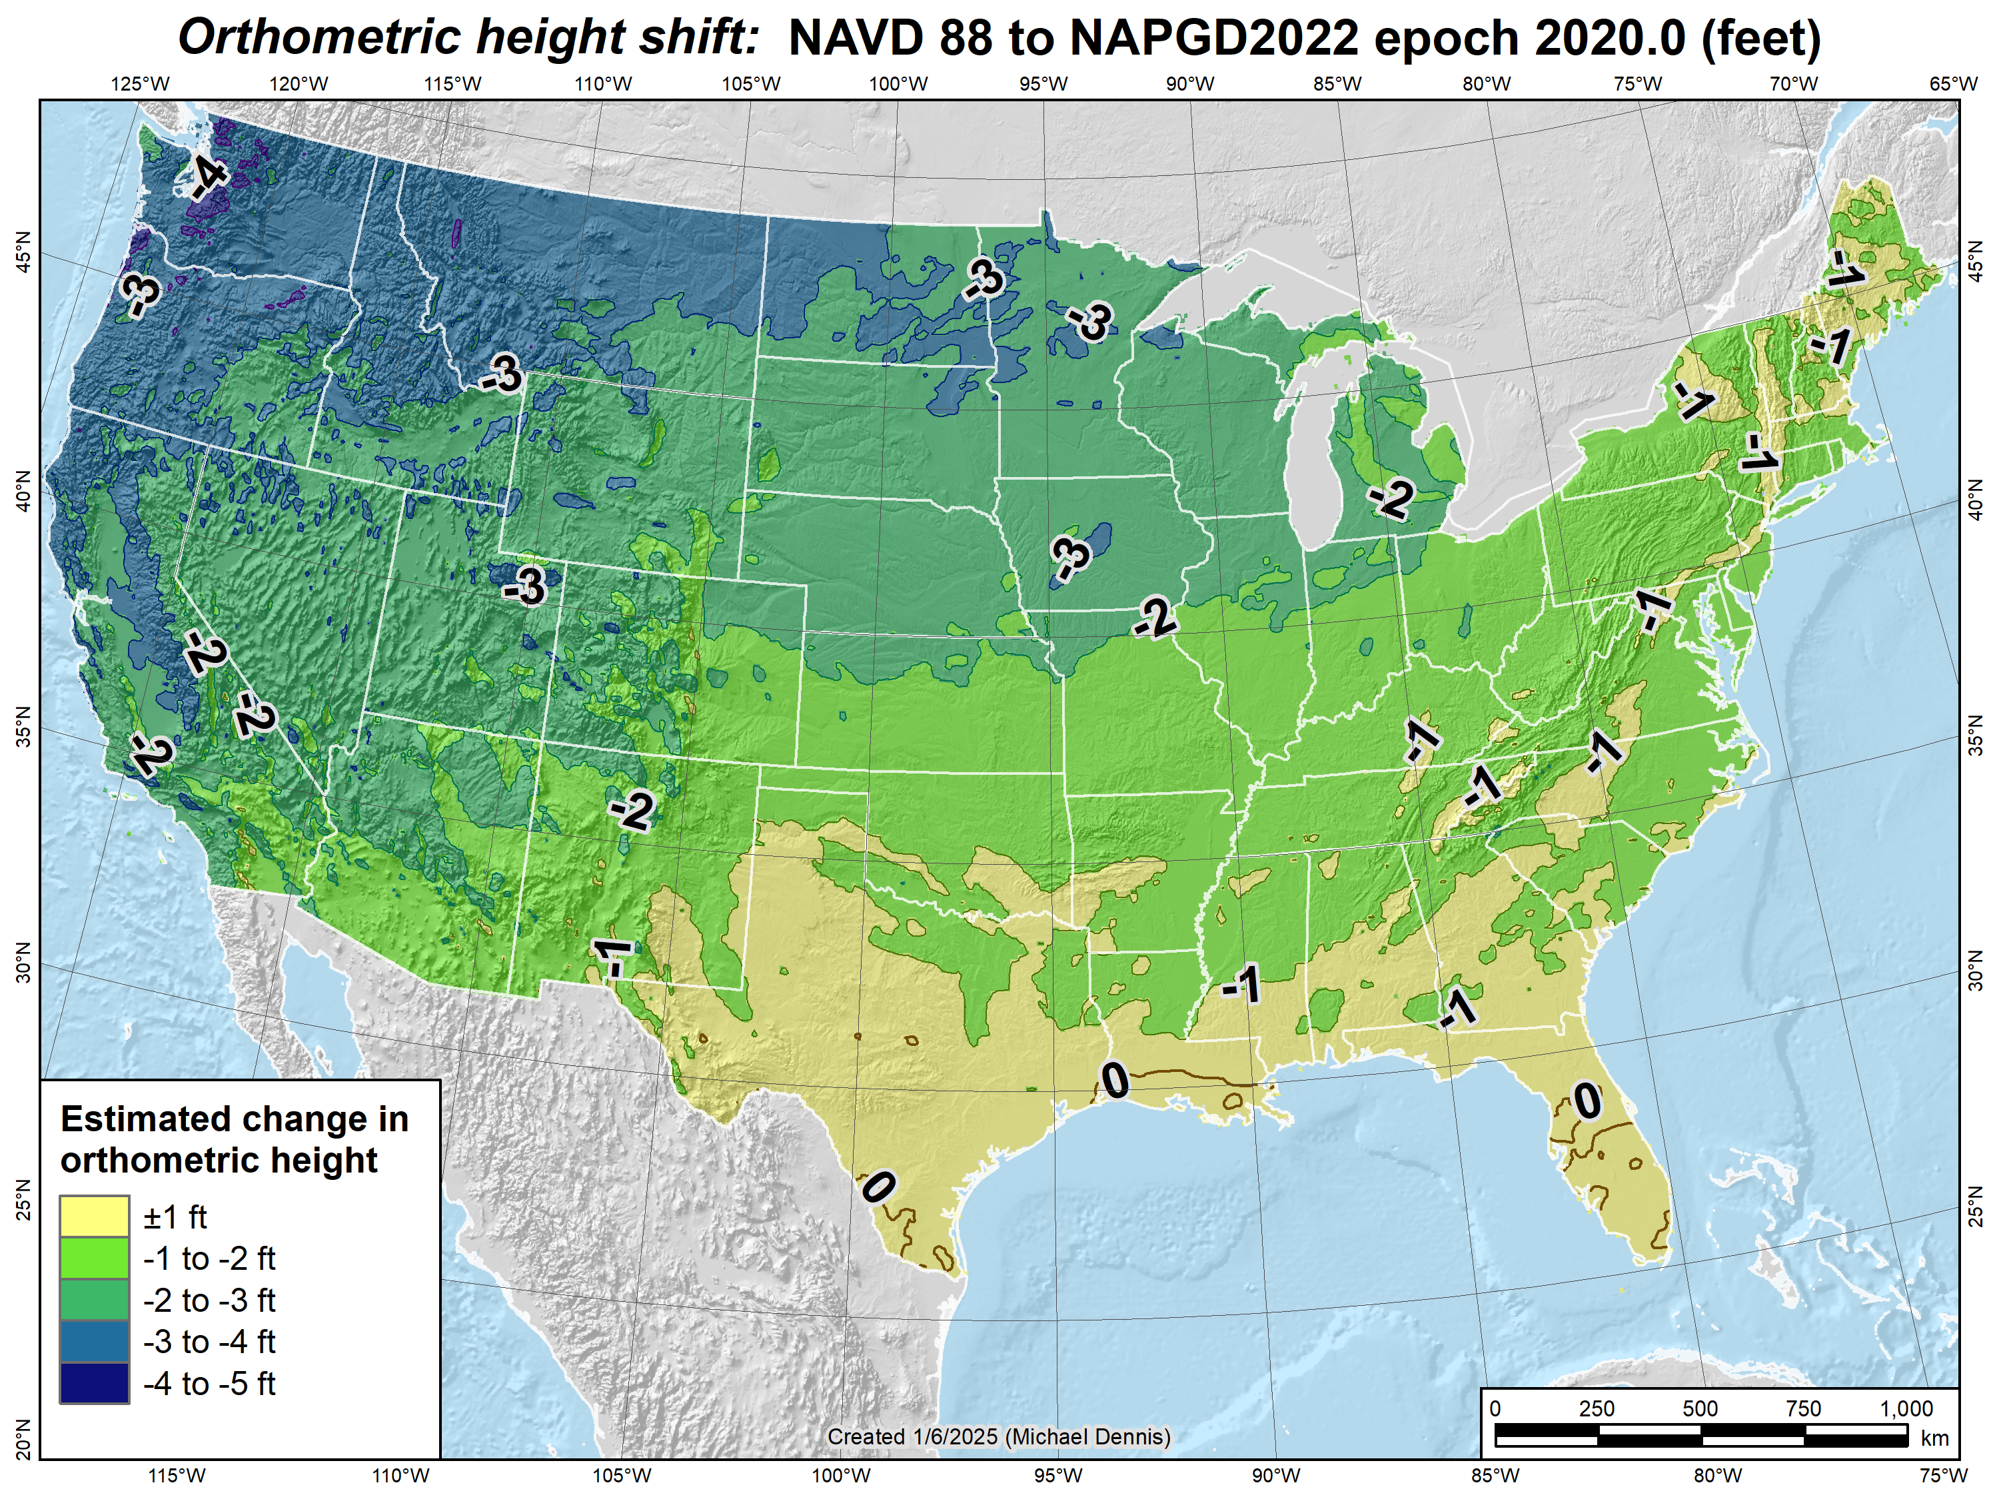
Estimated orthometric height shifts (CONUS):
NAVD 88 to NAPGD2022 epoch 2020.0 (feet)

Slide 48
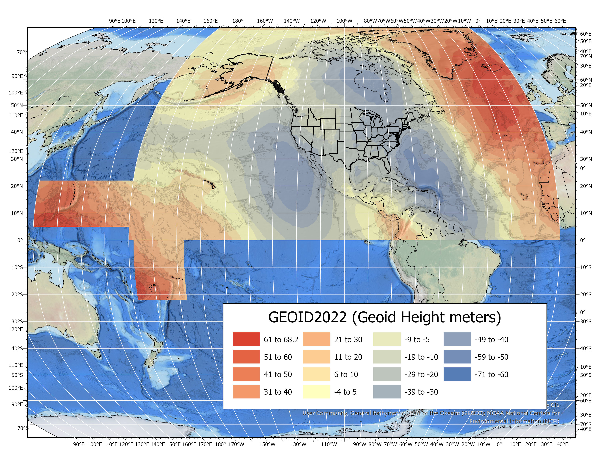
NAPGD2022 Geopotential Datum
North American-Pacific Geopotential Datum of 2022
Not only a vertical datum,
it is more than just heights.
Models included: Geopotential Deflection Gravity
Geoid
¼ Earth’s Surface
American Samoa
Guam/CNMI
Notes:
"Now crossing the land / water interface for improved coastal & riverine modeling"
As noted in the Blueprint 2 document
https://geodesy.noaa.gov/library/pdfs/NOAA_TR_NOS_NGS_0064.pdf
NAPGD2022 will include all of the following
Geopotential Model of 2022 (GM2022) will include:
Static Geopotential model of 2022 (SGM2022)
Dynamic Geopotential model of 2022 (DGM2022)
GEOID2022 will include:
Static Geoid model of 2022 (SGEOID2022)
Dynamic Geoid model of 2022 (DGEOID2022)
DEFLEC2022 will include:
Static Deflection of the Vertical model of 2022 (SDEFLEC2022)
Dynamic Deflection of the Vertical model of 2022 (DDEFLEC2022)
GRAV2022
Static Gravity model of 2022 (SGRAV2022)

Slide 49
Shift and Drift
A sudden SHIFT. At epoch 202.0 for change from NAD 83
  Horizontal change: 0.5 to 4 m (1.5 to 13 ft)
  Ellipsoid height change: ±2 m (±6.5 ft)
  Elevation change: -0.5 to +2 m (-1.5 to +6.5 ft)
A continuous drift due to crustal motion
  Up to about 8 cm/yr (0.3 ft/yr) horizontal
  Remove most by modeling tectonic plate (horizontal only)
  Remaining 3D motion minimized with crustal motion models
Purpose:
  Minimize change in coordinates with time
  Determine coordinates at any time (epoch)
Coordinates in
Modernized NSRS
Will always have a date
Notes:
NSRS Modernization News
https://geodesy.noaa.gov/datums/newdatums/TrackOurProgress.shtml

Slide 50
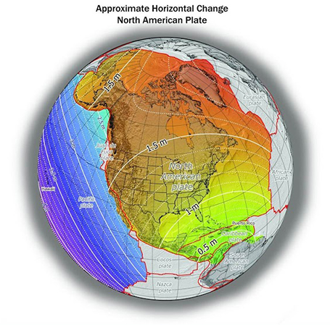
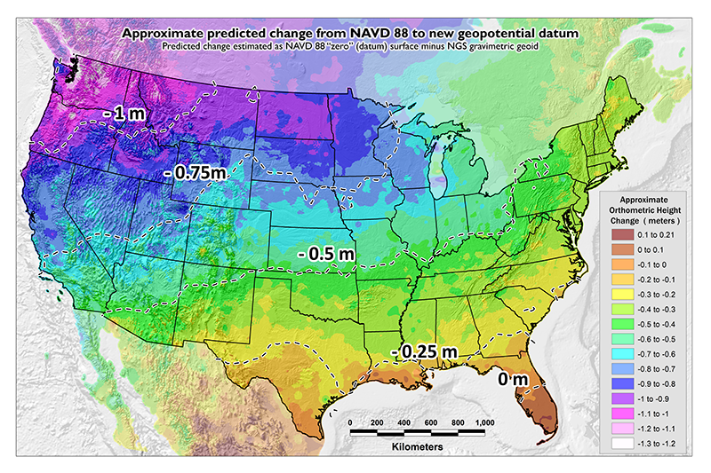
Shift: datum changes
~1 to 1.5 meters North America
~2.5 to 4 meters in Pacific
0 to 1.3 meters CONUS
Notes:
New Datums What to expect https://geodesy.noaa.gov/datums/newdatums/WhatToExpect.shtml
NGS is not shifting the land, merely shifting the reference surfaces to which we reference the geospatial data to.

Slide 51
Drift: Plate Tectonics and Velocities
Annual changes to
ITRF2014 coordinates
Notes:
All plates are moving and through the constant collection of GNSS data using CORS we can now model where the land is moving. In the center of tectonic plates there is generally motion that can be measured but where plates converge can be thought of as a crunch zone and the modeling has much more uncertainty due to geophysical phenomena.

Slide 52
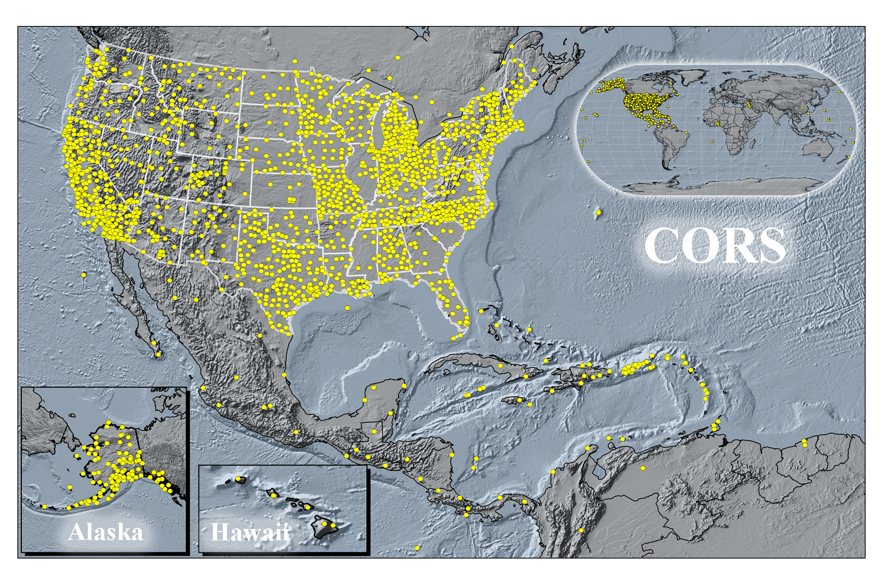
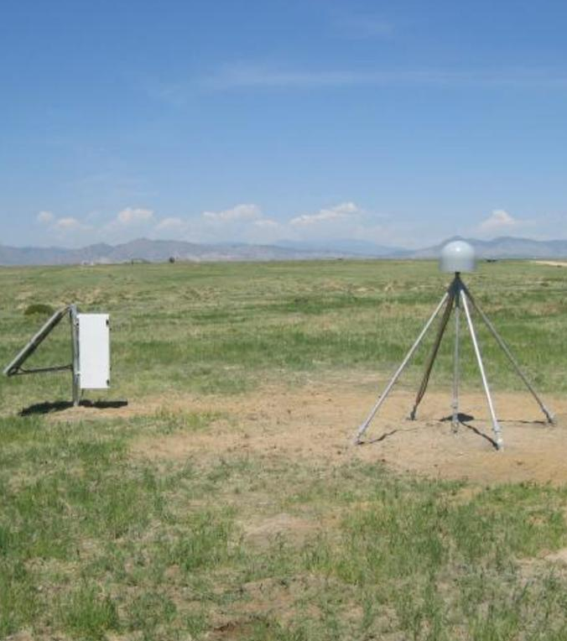

Continuously Operating Reference Stations
P037
Canyon City
Colorado
CTMC
Golden
Colorado

Slide 53
Vertical Motion
Subsidence
  Ground fluid withdrawal, sedimentation
Glacial Isostatic Adjustment (GIA)
  Crustal rebound from glaciers (uplift)
Geophysical Phenomena
  Earthquakes, calderas, Earth tides

Slide 54



Vertical Motion
8.5 meters
50 years
May 2015
to
Sept 2016
Hudson Bay Uplifting
8 -13 mm/year
San Joaquin Subsiding
20-24” in 16 months
Notes:
San Joaquin Subsidence article
http://www.digitaljournal.com/tech-and-science/technology/sinking-san-joaquin-valley-of-california-seen-from-space/article/487393
Hudson Bay Uplift article (GIA)
https://www.researchgate.net/figure/Contour-map-of-observed-CBN-vertical-rates-Preliminary-results-from-the-combination-of_fig3_286867540
Photo of San Joaquin Valley Subsidence to 1977
https://lh4.googleusercontent.com/ymKsoXwZEP4rk4F4GqPD5S9FyMO4d0mrfL2GiLI0mXe7djBwYH3t0-OwncYltY8OJNmYk0DKh4pOLqS9DGItCHK3i23maqpjdDDISQH5ux0uqDVbrEnWTnFLPb7Woe2cka61EXC6

Slide 55

Horizontal and Vertical Motion - Earthquakes
2019 China Lake, CA
6-10 feet Horizontally
2020 Puerto Rico
16 cm Vertically
Notes:
China Lake Earthquake
https://www.usgs.gov/news/update-magnitude-71-earthquake-southern-california?qt-news_science_products=7#qt-news_science_products
Puerto Rico Earthquake
https://cunycis.maps.arcgis.com/apps/webappviewer/index.html?id=5f516f41baa84f9ba9e8207c2005ee4d

Slide 56

NGS Map
https://noaa.maps.arcgis.com/apps/webappviewer/index.html?id=190385f9aadb4cf1b0dd8759893032db
Notes:
https://noaa.maps.arcgis.com/apps/webappviewer/index.html?id=190385f9aadb4cf1b0dd8759893032db

Slide 57
NGS ArcGIS Online Resources
Feature Services
Raster Tile Services
NGS Datasheets
NOAA CORS Network
OPUS Shared Solutions
GPS on Benchmarks Priority List
(4 layers - marks, hexagons)
GEOID18 GPS on Benchmarks
GEOID12B GPS on BenchmarksMark Recoveries Submitted to NGS
GEOID18 Height (CONUS, PRVI)
GEOID18 Difference (CONUS, PRVI)
GEOID18 Uncertainty (CONUS, PRVI)
GEOID18 Improvements (CONUS, PRVI)
Alpha Tiled Image Services
SPCS2022 Experience
NAPGD2022 Experience

Slide 58

Alpha Products
https://alpha.ngs.noaa.gov/index.shtml

Slide 59

Alpha NAPGD2022 Interactive Web Map
North American-Pacific Geopotential Datum of 2022
https://experience.arcgis.com/experience/474f5934f5ff468bb77a1a16f10aa578/
Notes:
Rocky Mountain Coordinate Reference System Handbook
https://www.marls.com/wp-content/uploads/2022/02/RMCRS-Manual-v2.0.pdf

Slide 60
Alpha NAPGD2022 Interactive Web Map
Demo
Notes:
Rocky Mountain Coordinate Reference System Handbook
https://www.marls.com/wp-content/uploads/2022/02/RMCRS-Manual-v2.0.pdf

Slide 61

Questions?
Magnitude of the Deflection of the Vertical
Brian Shaw
brian.shaw@noaa.gov

