Slide 1
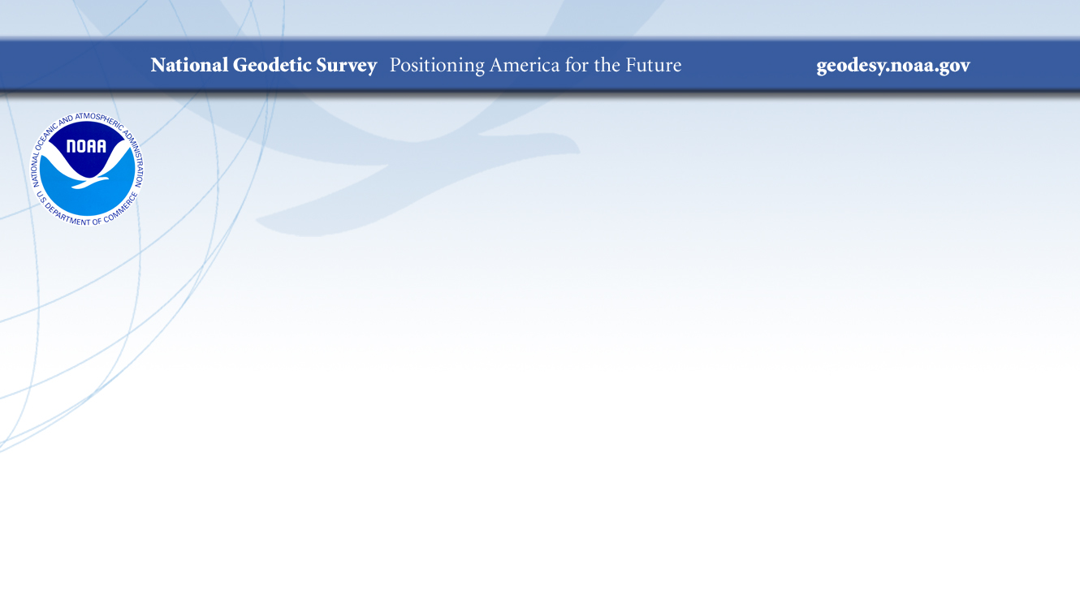
The Datums Are Changing!
A more accurate, accessible, and efficient spatial reference system is on its way
2024 NOAA Enterprise Data
Management Workshop
Brian Shaw
brian.shaw@noaa.gov
May 16, 2024

Slide 2

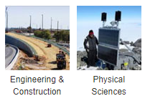
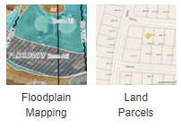

NGS’s Mission
To define, maintain and provide access
to the National Spatial Reference System (NSRS) to meet our Nation’s economic, social, and environmental needs.
…………………………………………….........................
The NSRS is a consistent coordinate system that defines latitude, longitude, height, scale, gravity, orientation, and shoreline throughout the United States.
Land
Surveying
Sectors that Rely on Geodesy
Notes:
The National Spatial Reference System is our nations geospatial infrastructure from which all positioning (with the exclusion of military/DOD) is referenced to.
This system provides a consistent framework that allows people to use data in the same reference system to perform analysis and make meaningful comparisons and decisions from that analysis.

Slide 3
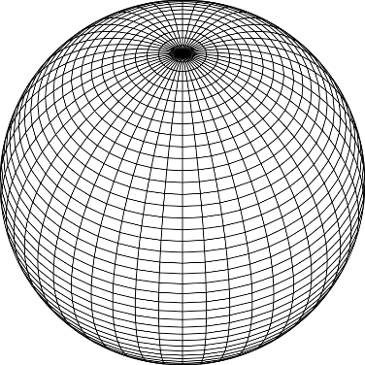
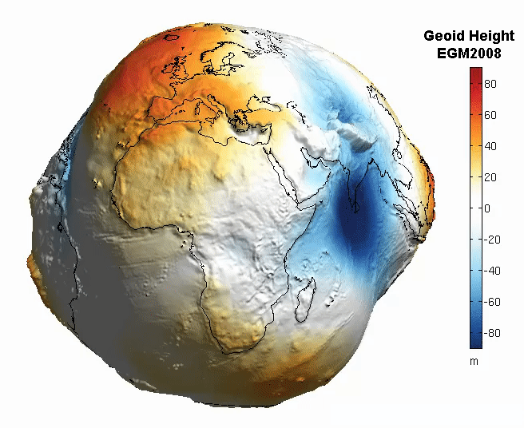
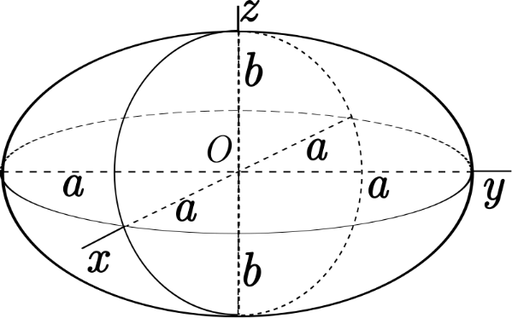
The Earth is Infinitely Complex
Build Models to Simplify
Notes:
Models are used to simplify complex phenomena for humans and computers to understand and perform calculations and analysis.
The geoid is an approximation of sea level and used to calculate elevations (orthometric heights) above this “sea level” surface
Spheroid image https://www.kisspng.com/png-sphere-shape-ball-grid-line-circle-draw-5378189/
Ellipsoid image https://www.kisspng.com/png-figure-of-the-earth-oblate-spheroid-ellipsoid-4129812/
Geoid Image https://www.reddit.com/r/MapPorn/comments/3xf6a0/geoid_height_of_new_global_gravity_field_models/

Slide 4

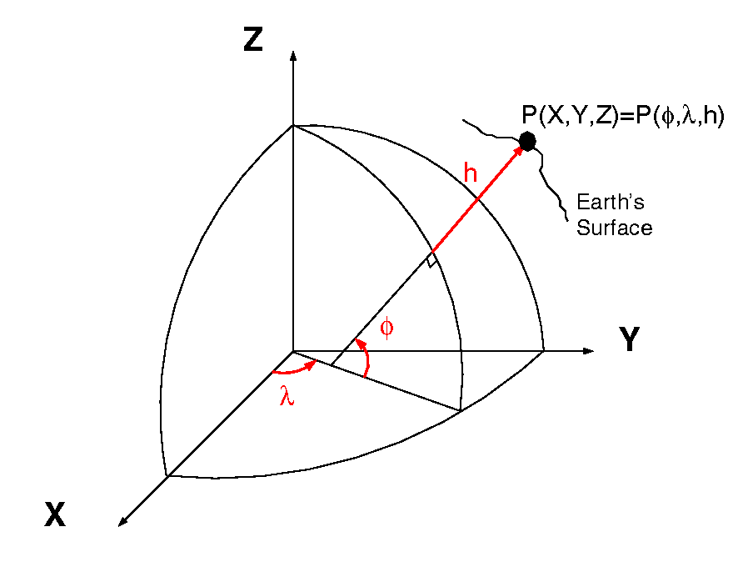
Datums and Reference Frames
60”, 2019
52”, 2018
46”, 2017
aka P(Lat,Lon,Ht)
= ht.
= lat.
= long.
A reference surface or framework to reference your data to for consistency
X,Y,Z vs Lat, Lon, Ht

Slide 5
Why Modernize the NSRS
Current models built on old technology
  NAD 83 not truly Geocentric (~2.2m)
  NAVD 88 relies on marks in the ground
  and is not easily maintained
  Today’s technology needs better accuracy
Notes:
NSRS Modernization
https://geodesy.noaa.gov/datums/newdatums/

Slide 6
Main Benefits of Modernized NSRS
Fast, Accurate, Consistent Elevations Everywhere
Improved Public Safety
  Flood Plain Maps
  Emergency Route Planning
Accurate Positioning
  Autonomous vehicles, BIMs, Smart Cities
Notes:
NSRS Modernization
https://geodesy.noaa.gov/datums/newdatums/
A big challenge we have at NGS is working to modernize our ingestion of data as well as how we present the data to our users.

Slide 7
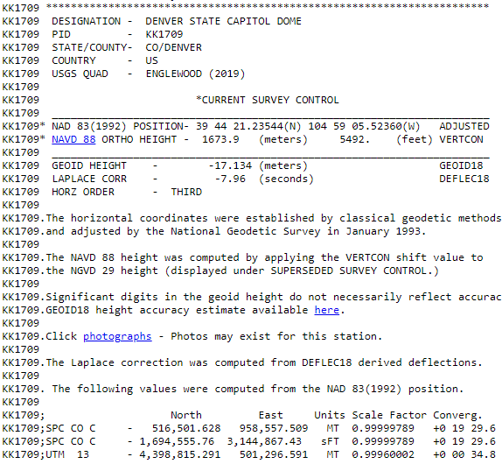
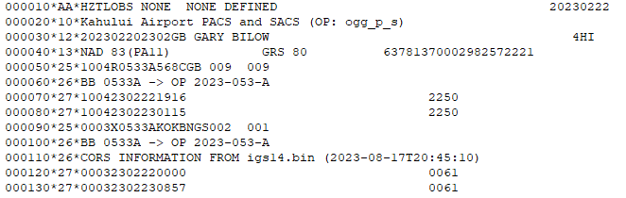
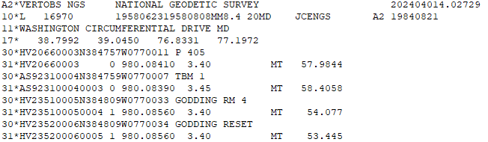
NGS Datasheet and Bluebook Files
80 Character Text Formats (Punch Cards)
GPS Data File (bfile)
Datasheet
Leveling Data File (r6)
Notes:
Working to transition old formats that were used for submitting and loading data into more visual and usable formats.

Slide 8
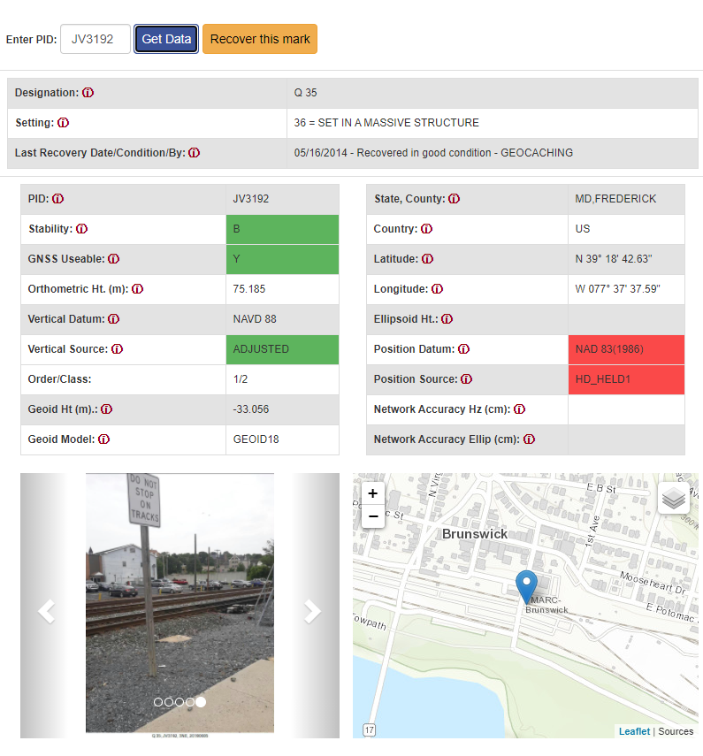
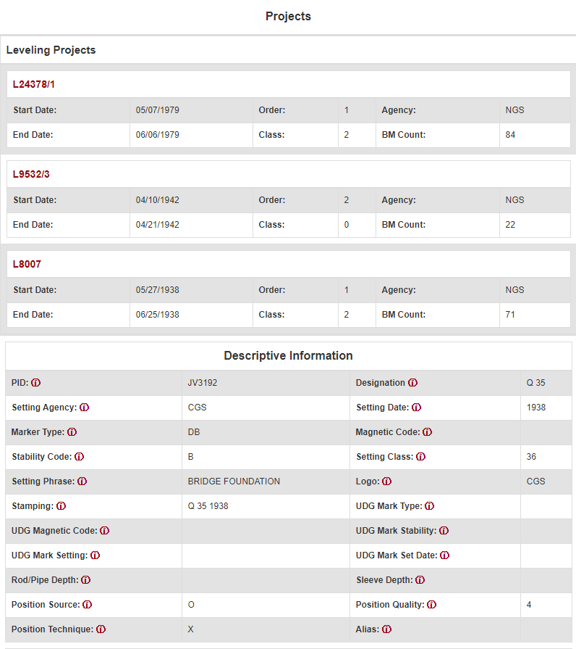
Passive Marks Page
Notes:
https://geodesy.noaa.gov/datasheets/passive-marks/index.html
Passive Marks Page is a first attempt to modernize the Datasheet

Slide 9
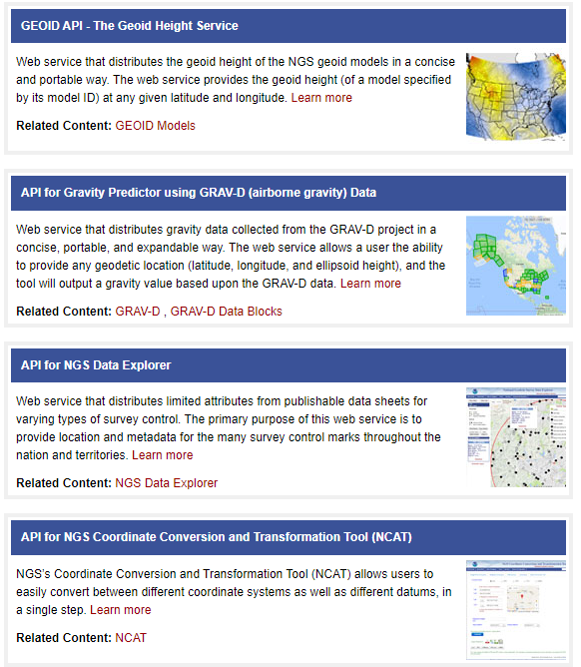
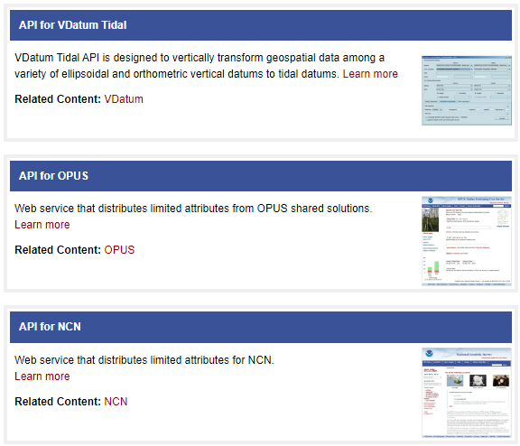
NGS REST Web Services
https://geodesy.noaa.gov/web_services/
Notes:
Web Services make more of our data and services available for use by users and application

Slide 10
NGS ArcGIS Online Resources
Feature Services
Raster Tile Services
NGS Datasheets
NOAA CORS Network
GPS on Benchmarks Priority List
(4 layers - marks, hexagons)
GEOID18 GPS on Benchmarks
GEOID12B GPS on Benchmarks
OPUS Shared Solutions
Mark Recoveries Submitted to NGS
GEOID18 Height (CONUS, PRVI)
GEOID18 Difference (CONUS, PRVI)
GEOID18 Uncertainty (CONUS, PRVI)
GEOID18 Improvements (CONUS, PRVI)
Notes:
ArcGIS Online Resource make more of our data available for people using GIS software. We work to have it presymbolized so that users can have it come into their maps like we have it on out maps.

Slide 11
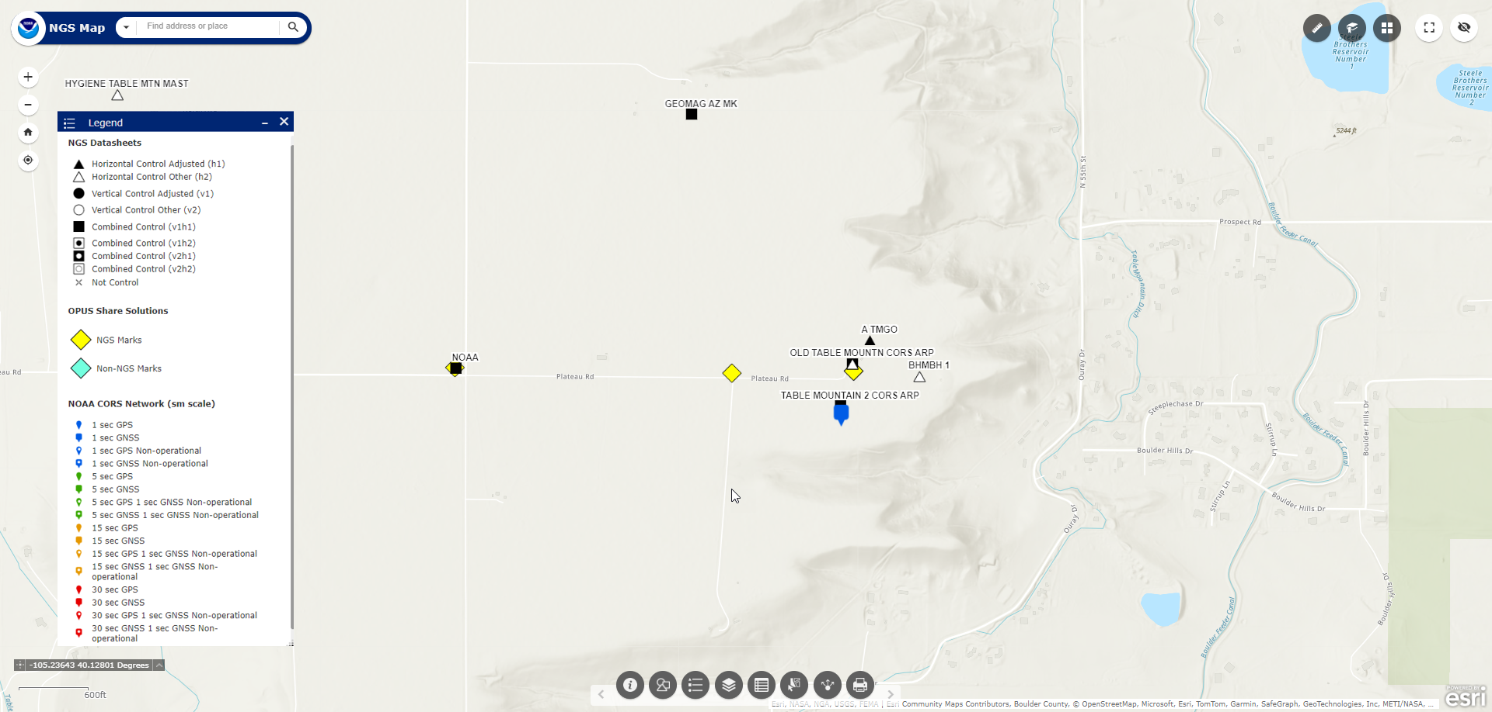
NGS Map
https://noaa.maps.arcgis.com/apps/webappviewer/index.html?id=190385f9aadb4cf1b0dd8759893032db
Notes:
The NGS Map is a Web Map Application that was created to integrate 3 different web maps so you can overlay the data. It also utilizes feature services states and local governments can integrate into their own maps.
These feature services have been setup to automate updating them nightly and weekly. In the past they were updated manually and less frequently.

Slide 12
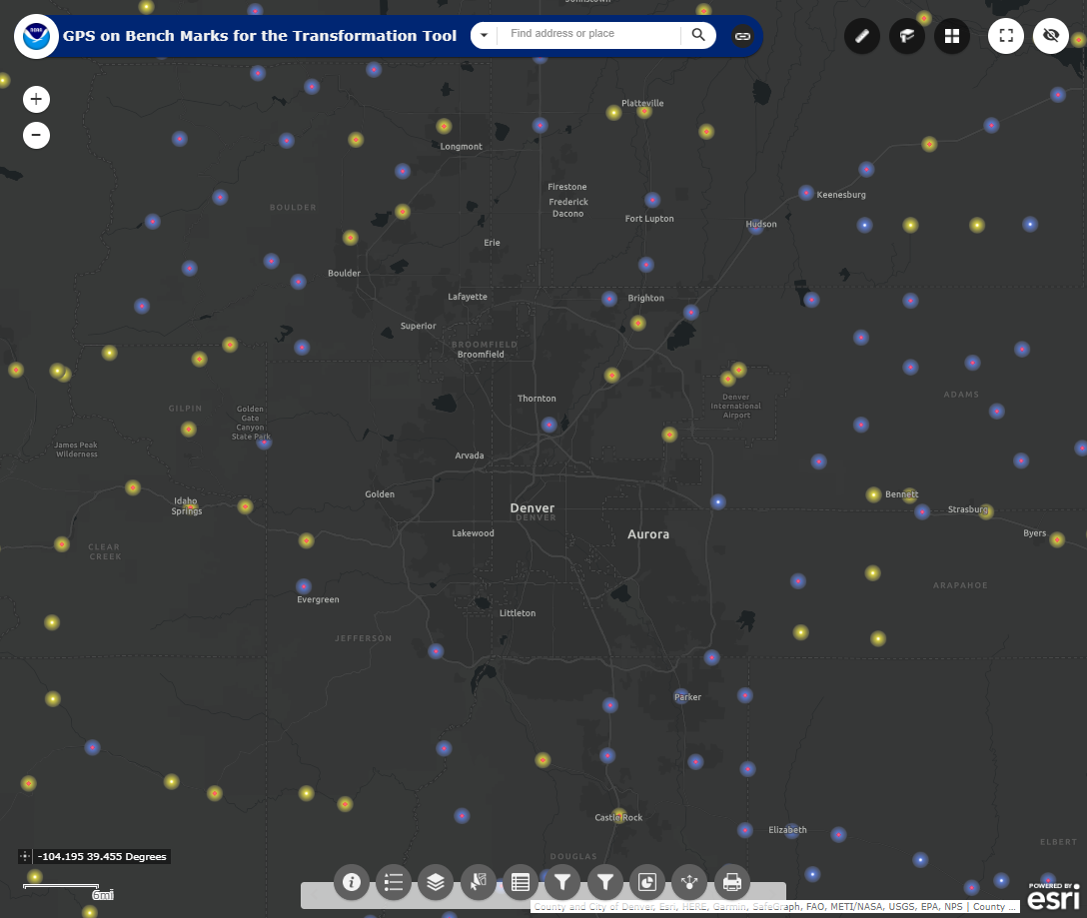
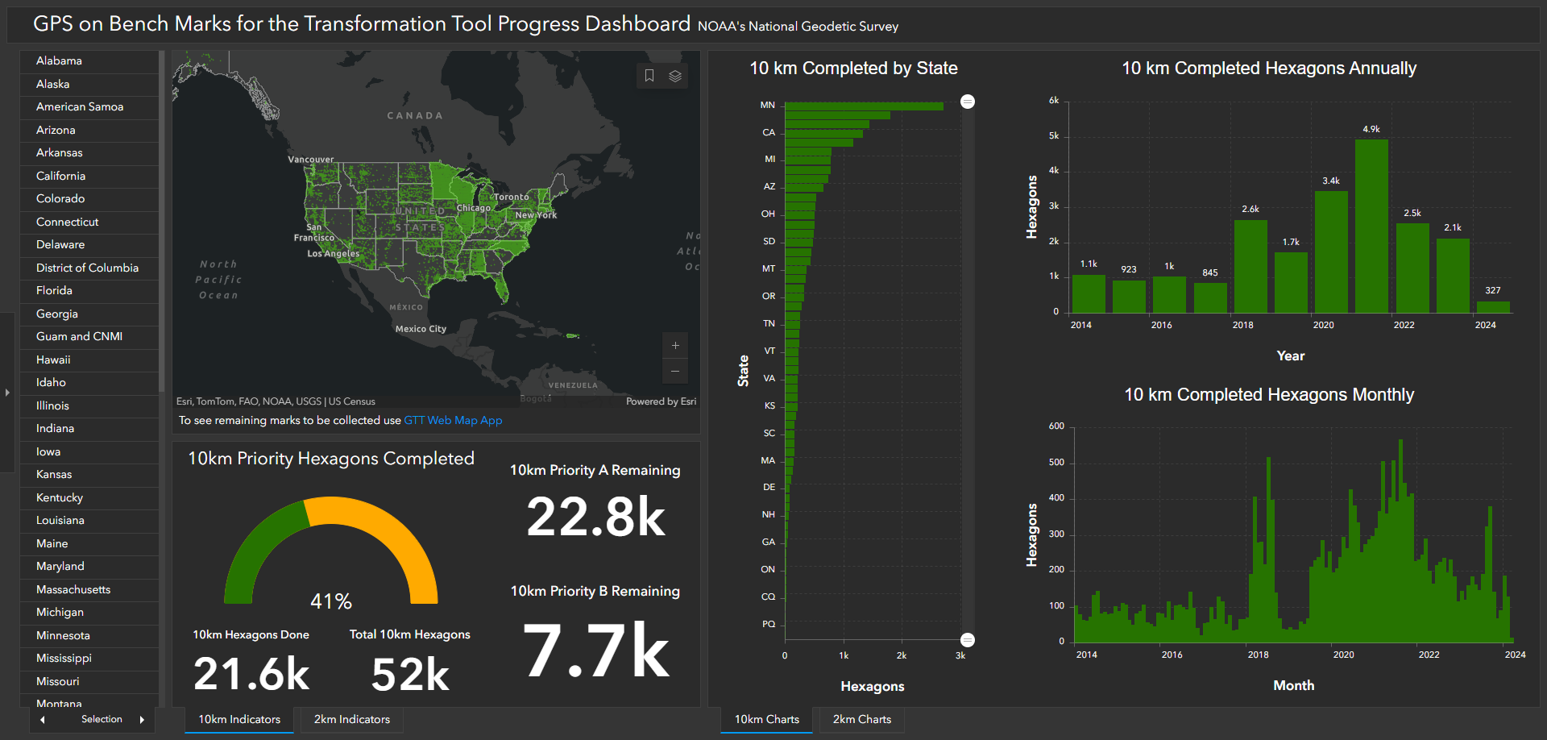
GPS on Bench Marks
~3,400 Completed in 2020
~4,900 Completed in 2021
~2,500 Completed in 2022
~2,100 Completed in 2023
Web Map Application
Dashboard
Notes:
The GPS on Bench Marks campaign was utilized to prioritize data for our constituents to go out and collect data.

Slide 13
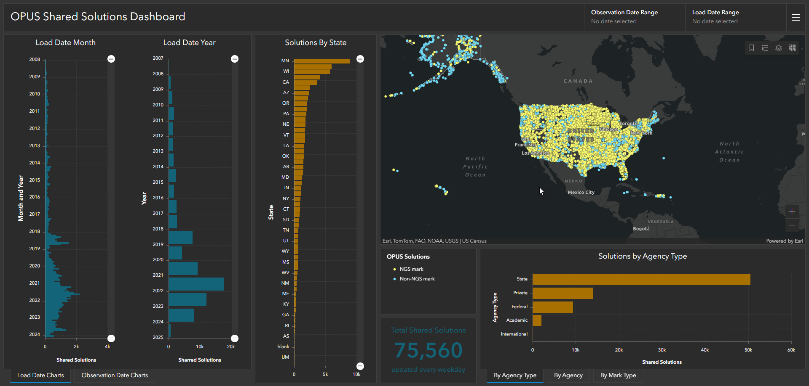
OPUS Shared Solutions Dashboard
Dashboard enables sorting and visualization of Shared Solutions by
Month & Year, State, Agency Type, and submitting agency
Agency type | # Shared Solutions on NGS marks
State | ~44,900
Private Sector | ~7,900
Federal | ~4,700
Academic | ~1,800
2018
Note the impact of GPSonBM Campaigns
2020
2021
Notes:
OPUS Share is the primary way people submit data to NGS for the GPS on Bench Marks Campaign and using this Dashboard you can see how it really ramped up after 2018.
Dashboards like this really give NGS and our constituents the ability to dig into the data and investigate when data was submitted and by whom.

Slide 14
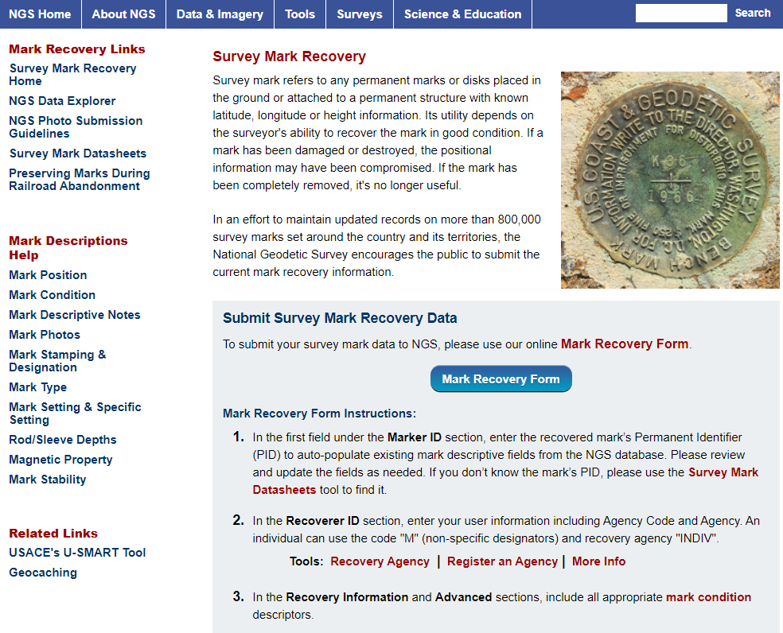
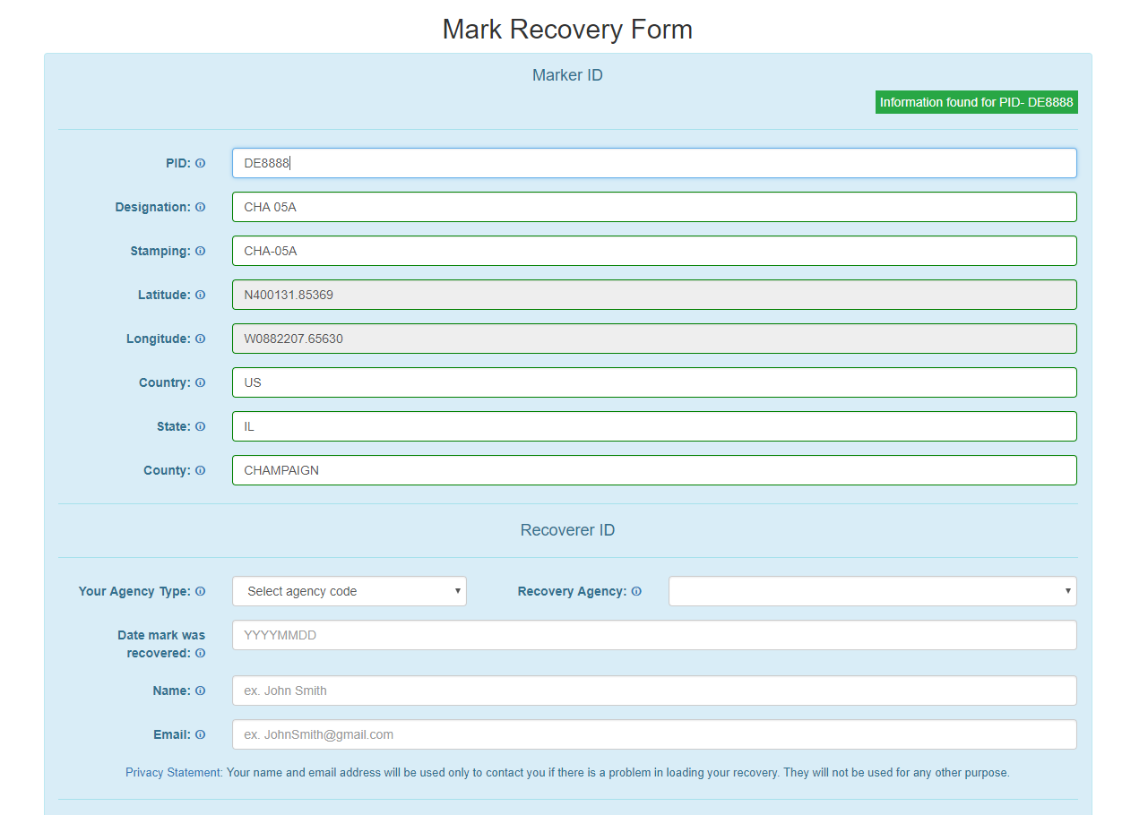
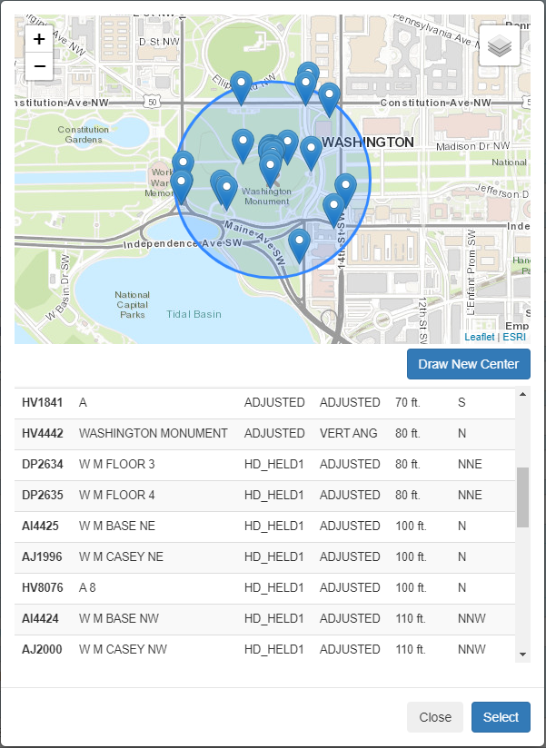
NGS Mark Recovery Webpage
Crowd sourced mark recoveries help update the GPSonBM map, let NGS and others know if the mark is still usable, and pictures make it easier to find.
https://geodesy.noaa.gov/surveys/mark-recovery
Now with Find Marks Near Me!
Maintain your local control network: Submit a Recovery Note for each mark you find (up to once per year)
Did you find it?
Is it GPSable?
Got new photos?
Notes:
Providing applications with a responsive design greatly helps make it easier for our users to submit information to us about survey control

Slide 15
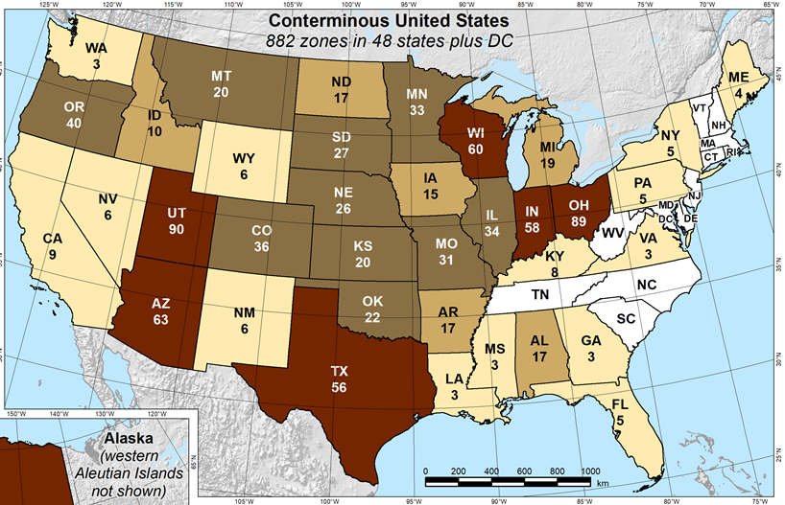
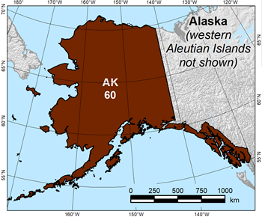
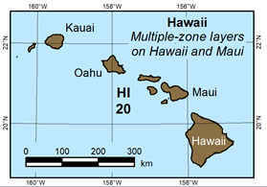
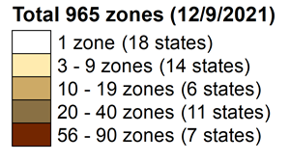
State Plane Coordinate System of 2022 (CONUS, Alaska and Hawaii)
Three territory zones not shown:
Puerto Rico and U.S Virgin Islands
  American Samoa
  Guam and Commonwealth of the Northern Mariana Islands
https://geodesy.noaa.gov/SPCS/
Notes:
SPCS83 has 124 zones in the current system and moving to 965 zones in the Modernized NSRS

Slide 16
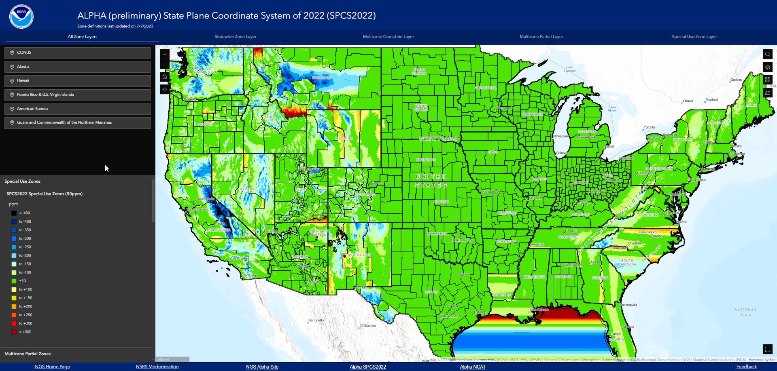
SPCS2022 Experience
https://experience.arcgis.com/experience/dddb7bc0be6f4e56a1c370c8d529d1a0
Notes:
The SPCS2022 Experience provides users the ability to investigate the current preliminary zones to investigate the parameters and distortion while working to finalize the zones prior to the SPCS2022 rollout.

Slide 17
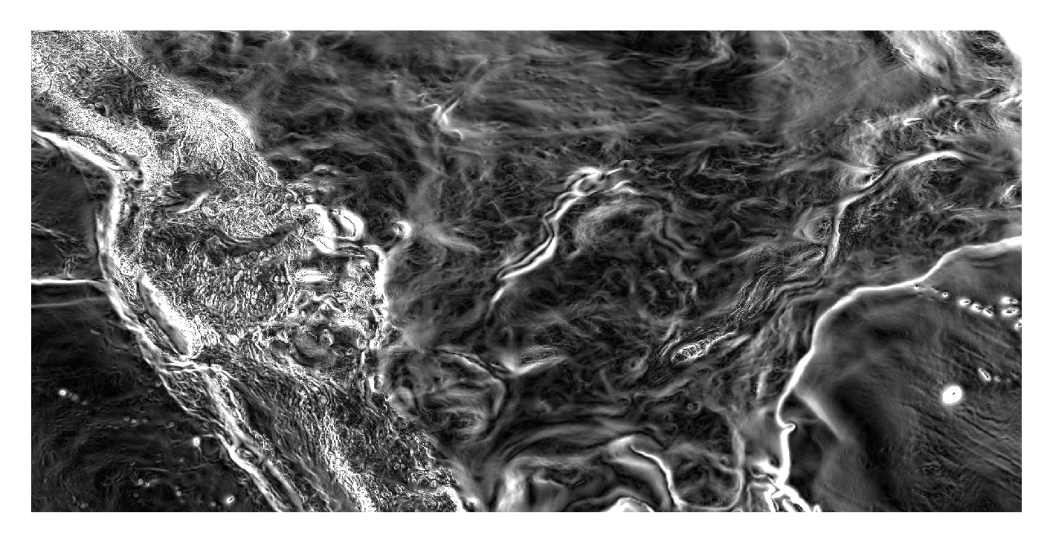
Questions?
Magnitude of the Deflection of the Vertical
Brian Shaw
brian.shaw@noaa.gov

