Slide 1

Colorado Case Studies Submitting
GPS Surveys Using OPUS Projects
2024 Rocky Mountain Survey Summit
Brian Shaw
brian.shaw@noaa.gov
March 27, 2024

Slide 2

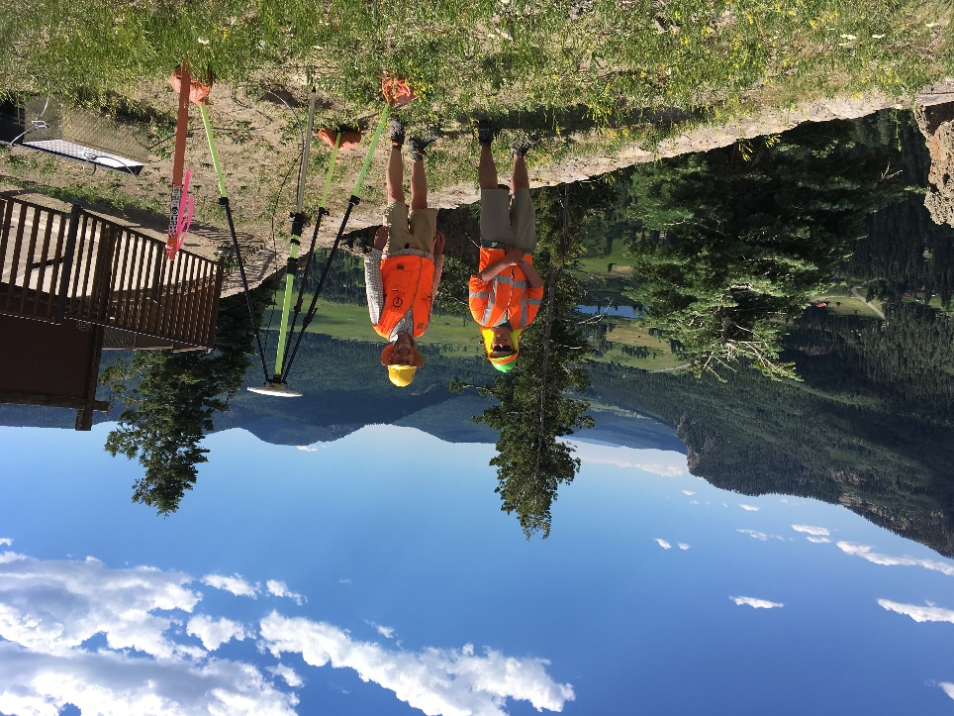
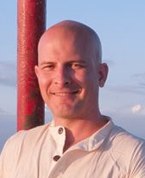
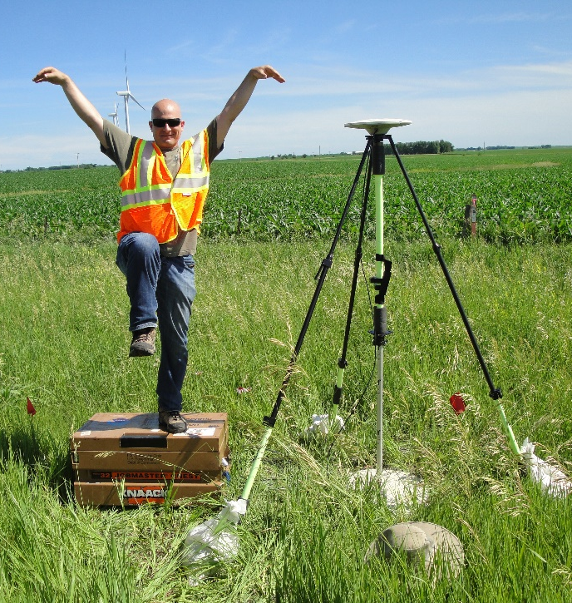
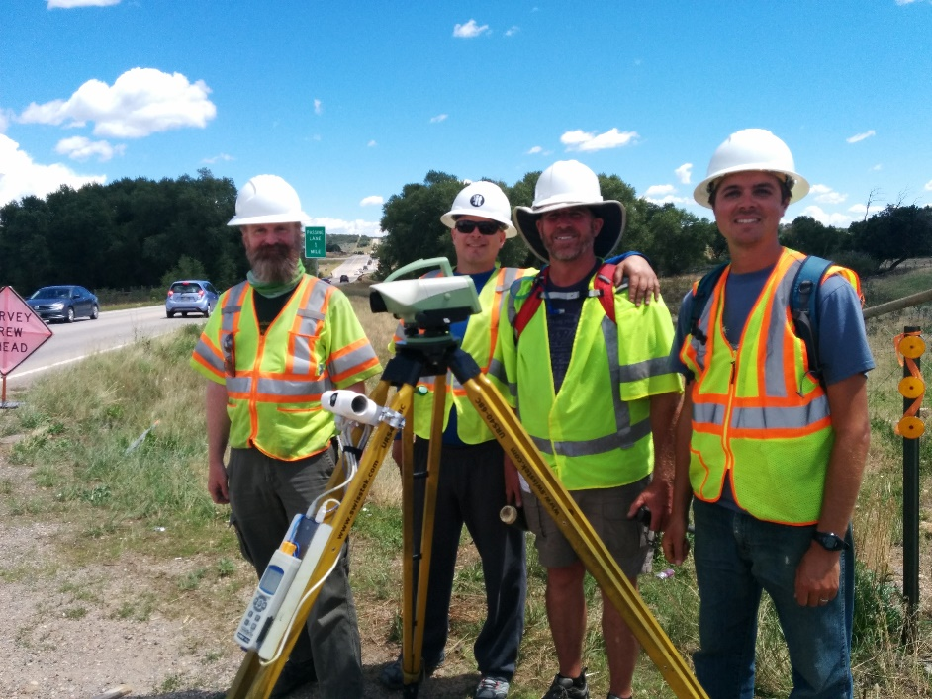
Brian Shaw
Rocky Mountain Advisor
brian.shaw@noaa.gov

Slide 3
Course Outline?
        What is OPUS and how to use it
        What is OPUS Projects
        Procedures to Submit Data to NGS
        Use Case: Mt Blue Sky and Mt Bierstadt HTMOD Survey
        Use Case: Greeley GPS on BM Survey
        Use Case: Vail HTMOD Survey
        *15 minute Break in the middle of the course

Slide 4
What is OPUS?
A tool for processing GPS data collections (GNSS soon)
15 min to 2 hrs
Email Solution
OPUS Rapid Static
4 hr minimum
(single solution)
RSPGS
OPUS Share
2 hrs to 48 hrs
OPUS Static
2 hr minimum (static)
(network adjustment)
PAGES
OPUS Projects
RTK/RTN Vectors (minutes)
COTS Software

Slide 5
How to use OPUS?
5 Easy Steps
        Upload your data file
        Select the antenna used
        Enter your Antenna Reference Point (ARP) height
        Enter your email
        Select additional options

Slide 6
How Does OPUS-S Work?
OPUS-S processing highlights:
Everything is “done” in the IGS14 Reference Frame (soon IGS20).
SV coordinates are held rigidly fixed.
CORS coordinates are heavily constrained.
Neutral atmosphere (tropo) dry component modeled.
Neutral atmosphere (tropo) wet component estimated.
Double-differenced, ion-free carrier phase observable.
Carrier phase ambiguities are fixed to their integer values where possible; float ambiguities are estimated otherwise.
Individual baselines are processed and the results combined generating mean coordinates and peak-to-peak uncertainties.

Slide 7
Upload Your Data
Data files must meet the following requirements
From dual frequency GPS receiver
Include static data only (antenna must not be moved during observations)
Include minimum of 15 minutes and maximum of 48 hours of data not crossing UTC midnight more than once
Files under 2 hours must include both P2 observables and either P1 or C1 observables
Record data at intervals of 1,2,3,5,10,15 or 30 seconds

Slide 8
OPUS Upload
Demonstration

Slide 9
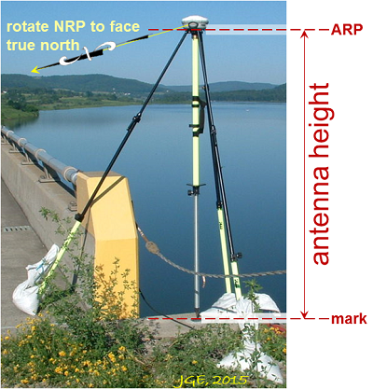
Measuring Antenna Height
The height is measure vertically (NOT slant height) from the mark to the ARP of the antenna in meters.
The ARP is almost always the center of the bottom-most, permanently attached, surface of the antenna.
See GPS Antenna Calibration for photo’s and diagrams that show where the ARP is on most antennas:
https://geodesy.noaa.gov/ANTCAL/

Slide 10
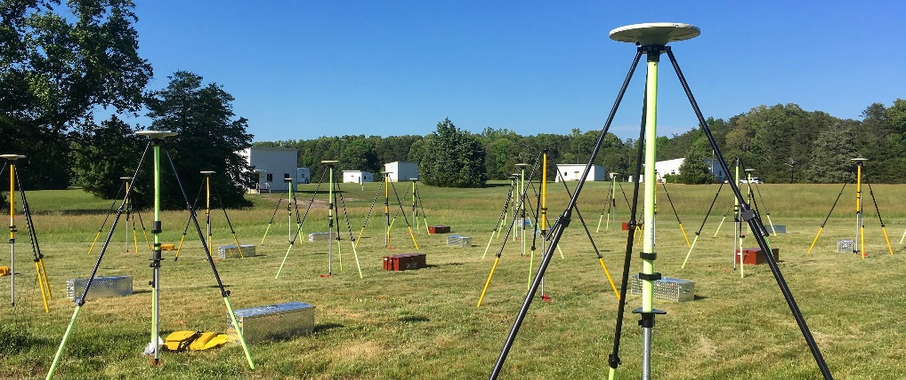
GSVS17 Equipment Calibration
Calibrated, fixed-height antennas, all identical models
In Colorado 2017:
  20+ complete sets of equipment (2 parties, 10 sets each)
  Each party observed 10 stations each day
  Each station continuously collected data for 2-3 days
  Project processed with OPUS Projects

Slide 11
GSVS17 Equipment Calibration
Even Two-meter fixed Height poles can vary
Full antenna recalibration check before survey
Each fixed height tripod height measured before and after the survey
Over 20 complete sets of equipment
          2 parties with 10 sets of equipment + spares
          Each party occupied 5 new and 5 repeat stations each day. Replaced batteries every day.
          Project processed with OP while in field.
          2m “Fixed Ht” varied by up to 3 mm
Tripod | Height
A | 2.0024
B | 2.0010
C | 2.0016
D | 2.0005
E | 2.0019
F | 1.9996
G | 1.9993
H | 2.0013

Slide 12
OPUS Accuracy
Various factors impact the accuracy including user error, multipath or adverse atmospheric conditions
Static: For each coordinate (X, Y, Z, Φ, λ, h, and H), static processing provides the range of the three individual single baselines, called peak-to-peak errors. One advantage of peak-to-peak errors is that they include any error from the CORS (base station) coordinates.
Rapid-Static: The best estimates of coordinate errors are the standard deviations reported by single baseline analysis. Our experiments indicate that the actual error is less than these estimated accuracies more than 95 percent of the time.

Slide 13
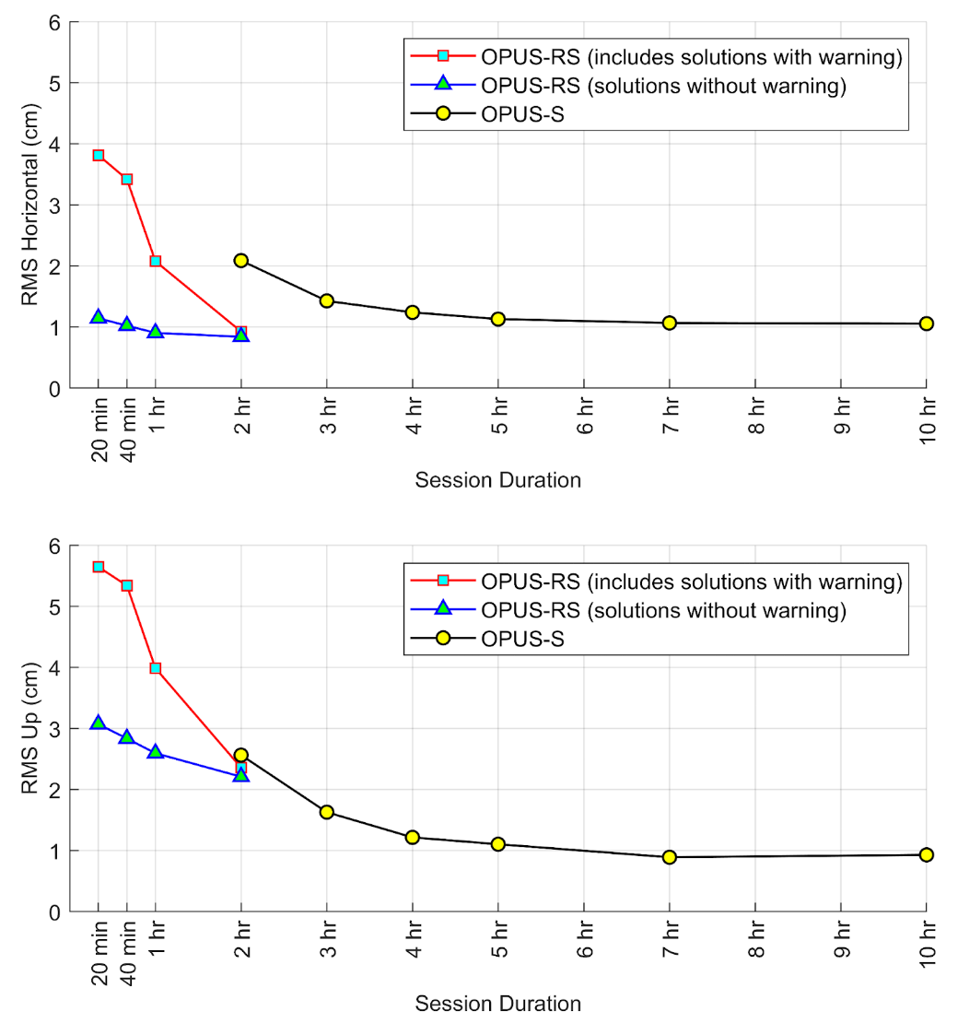
Improving your OPUS results
Observe longer: A longer session provides OPUS a better opportunity to accurately fix ambiguities and mitigate multipath error.
At 5 Hours you get to about 1 cm RMS horizontally and vertically

Slide 14
Accurate OPUS solution characteristics
Orbits used are precise or rapid
Over 90% of observations are used
Over 50% of ambiguities are fixed
The correct antenna type and ARP height are entered
For OPUS-S:
Overall RMS is less than 3 cm
Peak-to-peak errors are less than 5 cm (Lat/Lon), 8 cm (Ellip Ht)
For OPUS-RS: the solution contains no warning messages

Slide 15
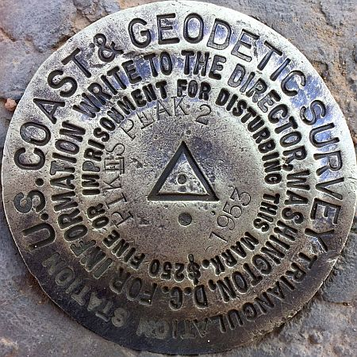
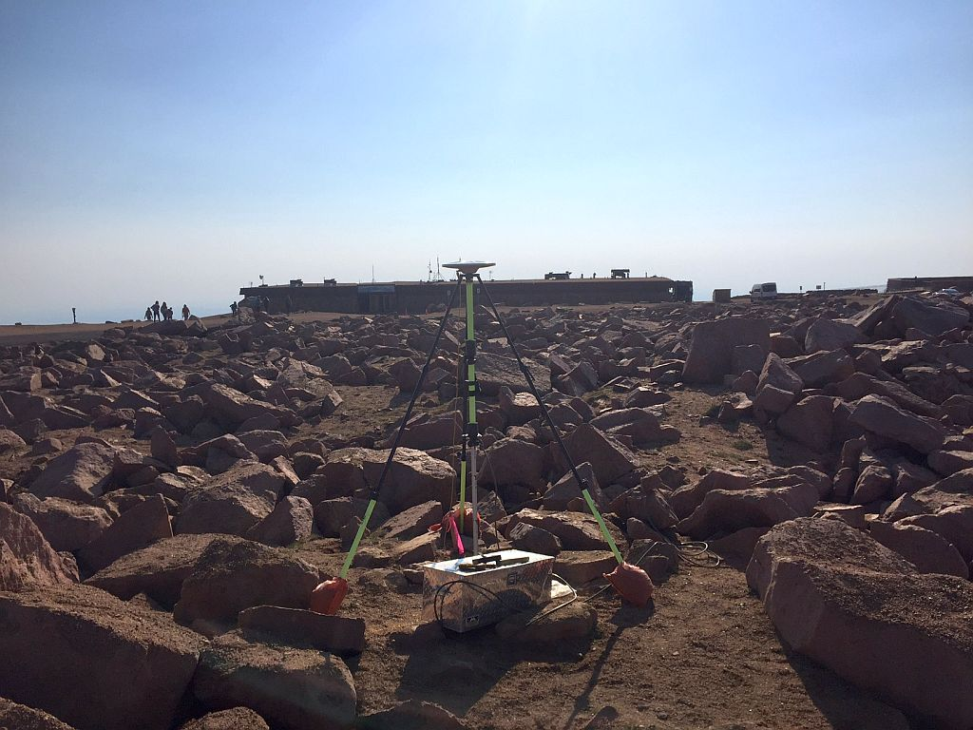
Example of Very Good OPUS Solution
In 2017 NGS Performed a Height Modernization Survey for several marks on Pikes Peak.
Collected data continuously for ~4 days
Mark
PIKES PEAK 2

Slide 16
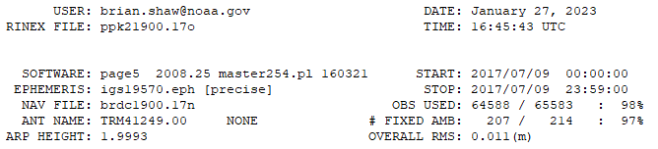
Reading an OPUS Solution
Date/Time of Solution
User Email
RINEX File Submitted
Which Ephemeris?
Start/Stop Time of Occupation
Double Check Selected Correct Antenna
and Entered Correct ARP Height
Quality Control Desired Results
OBS USED > 90%
# FIXED AMB > 50% (80%)
OVERALL RMS < 3 cm

Slide 17
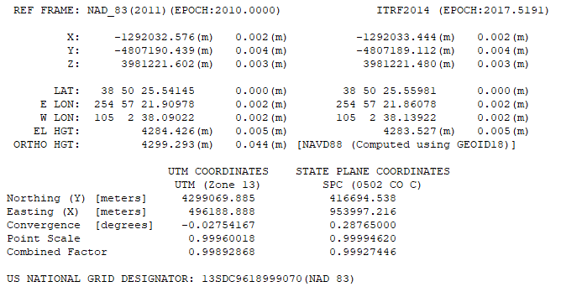
Reading an OPUS Solution
NAD 83 (2011) Coordinates
ITRF2014 Coordinates
Peak
to
Peak
< 5 cm
Peak
To
Peak
< 5 cm
Projected Coordinates
UTM
SPCS
USNG

Slide 18
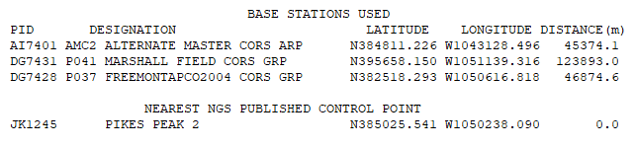
Reading an OPUS Solution
3 CORS that were used for the final solution, coordinates and distance
The nearest mark to the final solution, coordinates and distance

Slide 19
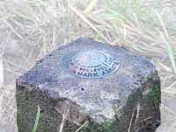
What are Peak to Peak Values
φ
peak-to-peak values
a box containing mark coordinates from
all 3 baselines
λ
CORS baseline 2
h
CORS baseline 1
mark position:
average of 3 most
coherent baselines
CORS baseline 3

Slide 20
What is OPUS Projects?

Slide 21
OPUS Projects
Free, web-based software
  • Online training available
  • Designed for managing campaign-style GPS surveys
  • Multiple repeat occupations of several marks
  • Ability to add GPS data from NOAA CORS Network
  • Session baseline processing using PAGES
  • Customize tropospheric delay models, elevation cutoff masks,
  constraint weighting
  • Network least squares adjustments of multiple sessions
  • Choice of reference frames and geoid models
  • Currently requires ≥ 2-hour static GPS observation for post-processing

Slide 22
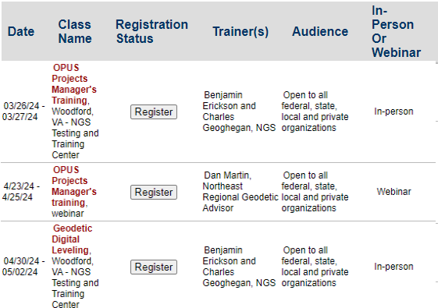

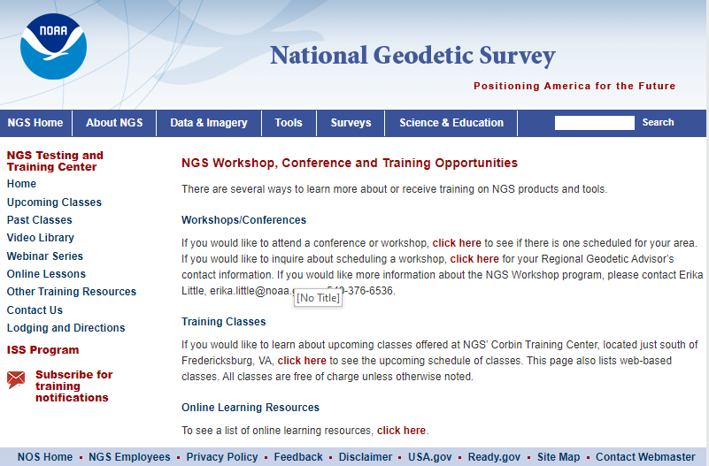
OPUS Projects Training

Slide 23
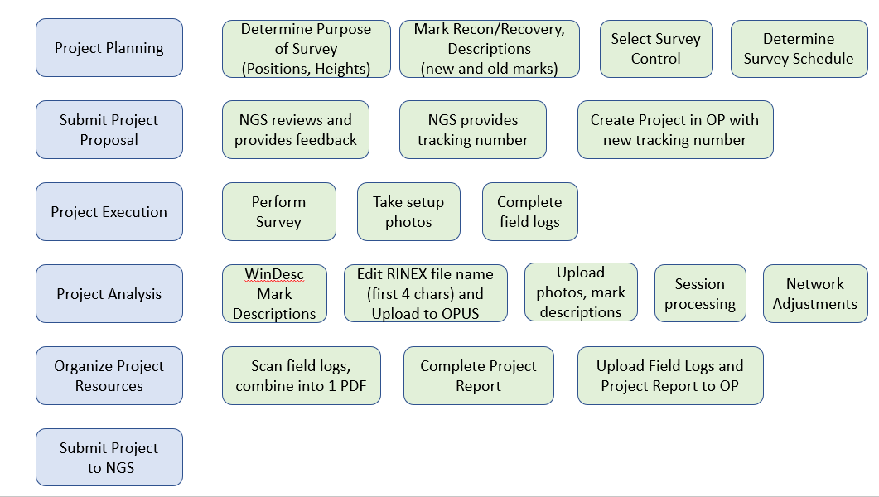
OPUS Projects Bluebooking Summary

Slide 24
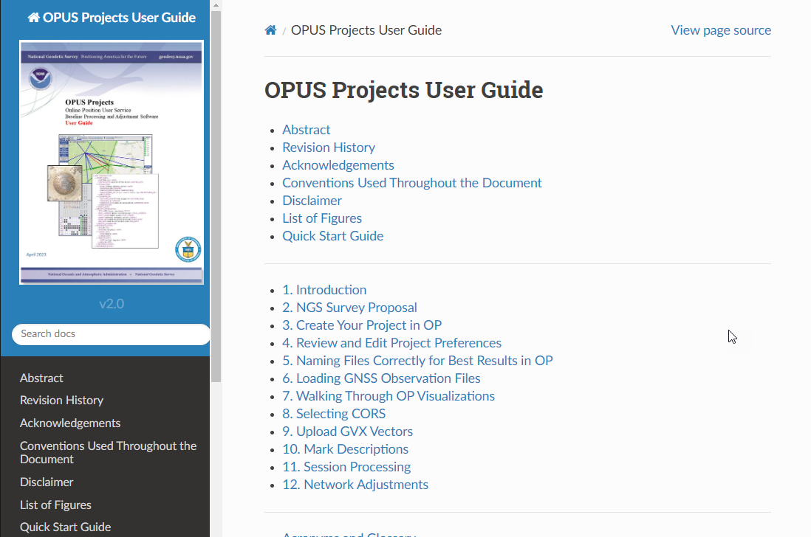
Great News!
There is a HTML based OPUS Projects User Guide with extensive documentation
https://geodesy.noaa.gov/OPUS-Projects/user_guide/user_guide.html

Slide 25

Planning Your Project
Exploring the requirements for planning a successful GNSS project for submission to NGS for publication
What survey marks will I use as control?
What is the project’s objective?
How accurate does my survey need to be?

Slide 26
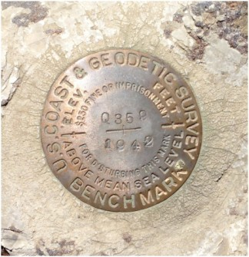
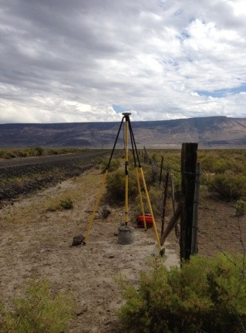
Project Objectives
If your project objectives include any of the following, OPUS-Projects is an excellent tool…
Least squares adjustment of a static GPS survey network
  - Network solution for simultaneously occupied user marks
  - Aligned to NAD 83, NAVD 88 or other datums in the NSRS
Establishment and publication of new control
          - Submittal of survey to NGS for consideration of inclusion in
          national database of survey control, available through NGS
          datasheets
Check on existing survey control
Verification of published coordinates and/or heights on
existing marks

Slide 27
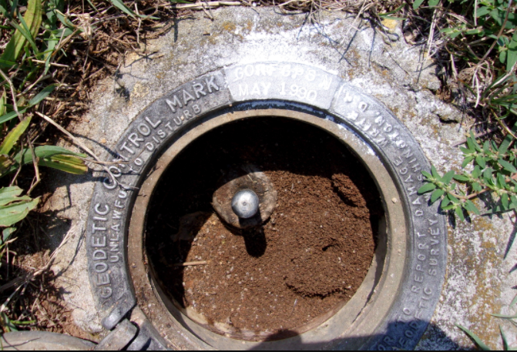
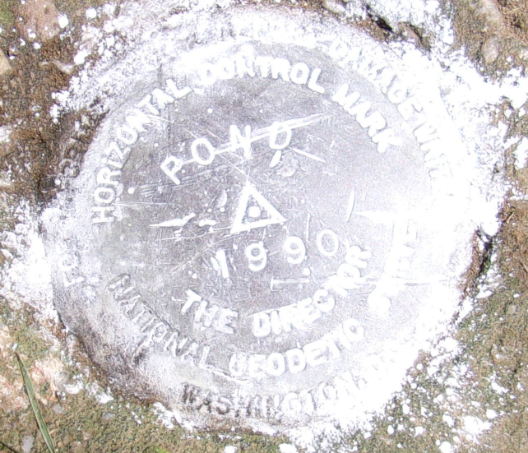
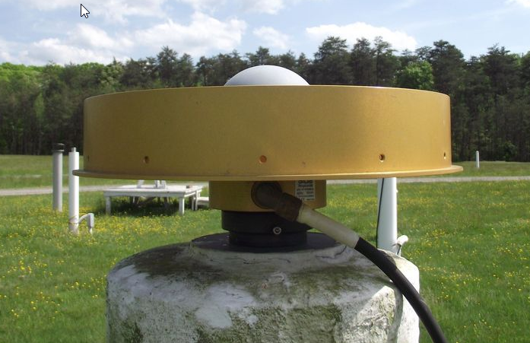
Important Considerations
1. Is the project horizontal (lat/lon) only?
What are good horizontal control stations? (Hint: CORSs)
2. Do you need vertical (orthometric heights), too?
What are valid vertical control marks? (Hint: BMs)

Slide 28
Important Considerations
GPS is 3-D technology
Latitude
Longitude
Ellipsoid Height
GPS is more accurate horizontally than vertically
Vertical requirements “drive” survey design

Slide 29
Planning Your Survey
Horizontal – only GPS Survey
Set/identify new marks for survey
Choose horizontal control
        - Select CORSs
- Recover passive marks in
project vicinity (if desired)
Develop a session schedule
- Occupation durations
- Repeat occupations
Assign a 4-character ID to your user marks
Horizontal + Vertical GPS Survey
Set/identify new marks for survey
Choose horizontal control
        - Select CORSs
- Recover passive marks in project vicinity
(if desired)
Find vertical control distributed throughout the project
        - Recover valid bench marks
- Spacing requirements
Develop a session schedule
- Occupation durations
- Repeat occupations
Assign a 4-character ID to your user marks

Slide 30
Outline
Set/identify new marks for survey
Choose horizontal control
  Select CORSs
  Recover passive marks in project vicinity (if desired)
Find vertical control distributed throughout the project
  Recover valid bench marks
  Spacing requirements
Develop a session schedule
  Occupation durations
  Repeat occupations
Assign a 4-character ID to your user marks

Slide 31
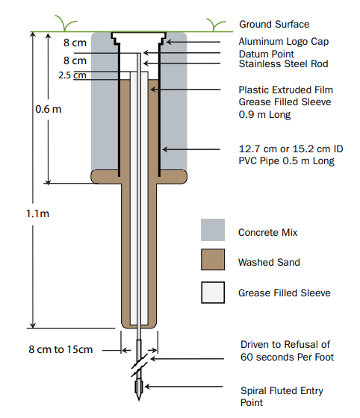
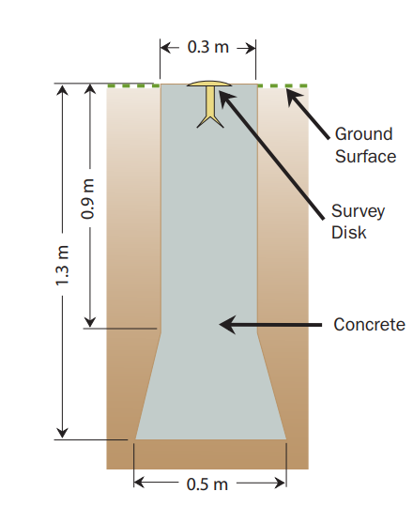
Setting New Marks
Smith, C.L. (2010). “Bench Mark Reset Procedures”, National Geodetic Survey, Silver Spring, MD

Slide 32
Outline
Set/identify new marks for survey
Choose horizontal control
  Select CORSs
  Recover passive marks in project vicinity (if desired)
Find vertical control distributed throughout the project
  Recover valid bench marks
  Spacing requirements
Develop a session schedule
  Occupation durations
  Repeat occupations
Assign a 4-character ID to your user marks

Slide 33
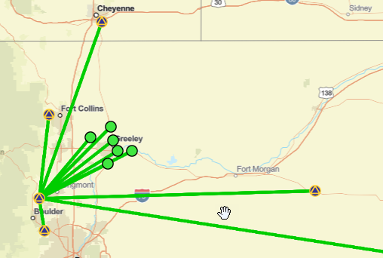
Select CORSs for Control
One of the more critical aspects of designing your project
OPUS-Projects automatically loads CORSs into each session from the OPUS-S solutions
Best practice is to check the quality of the CORSs prior to starting your project—have a plan before your survey!
The User Guide provides more details

Slide 34
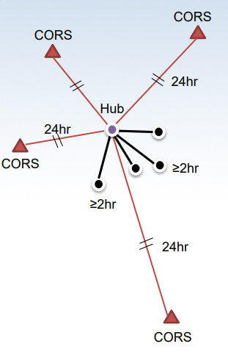
CORS Considerations
"Hub design" recommended by NGS
Hub to project marks recommended to be ~100 km
Use multiple CORSs
Use one very long baseline from hub to CORS (improves tropospheric modeling)
OPUS-Projects does session baseline processing

Slide 35
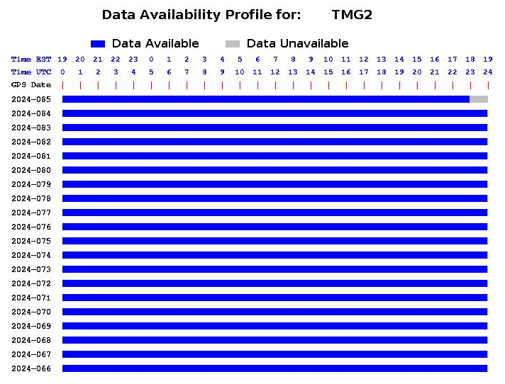
CORS Selection Criteria
Data must be available at the time of the survey!

Slide 36
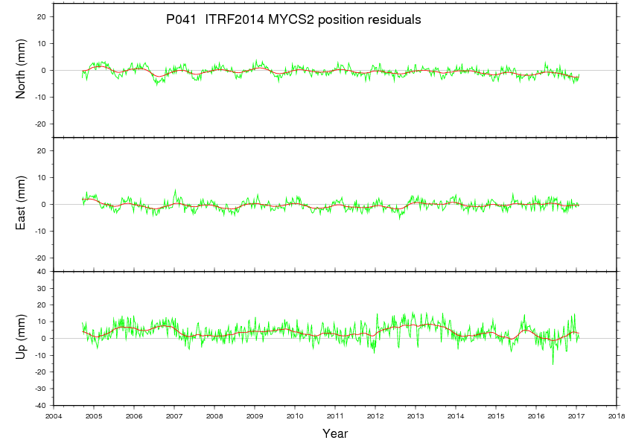
CORS Selection Criteria
Data must be available at the time of the survey!
Longer time series likely leads to better coordinates

Slide 37
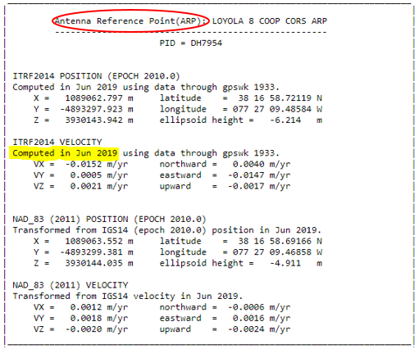
CORS Selection Criteria
Data must be available at the time of the survey!
Longer time series likely leads to better coordinates
Computed velocities (from CORS Position and Velocities page –as opposed to “modeled velocities”)

Slide 38
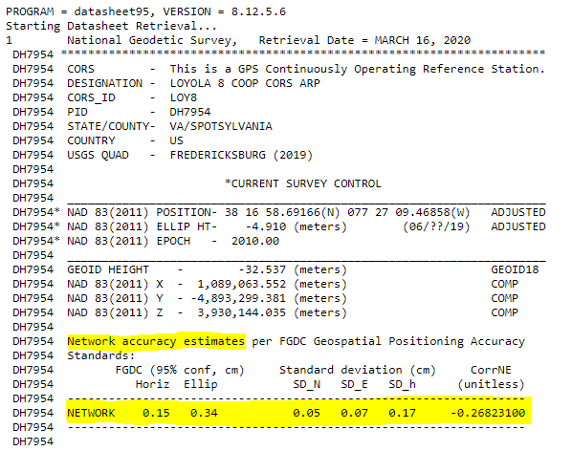
CORS Selection Criteria
Data must be available at the time of the survey!
Longer time series likely leads to better coordinates
Computed velocities (from CORS Position and Velocities page –as opposed to “modeled velocities”)
Good network accuracies (< 3cm EH, <1.5cm Lat/Lon) – see CORS datasheet

Slide 39
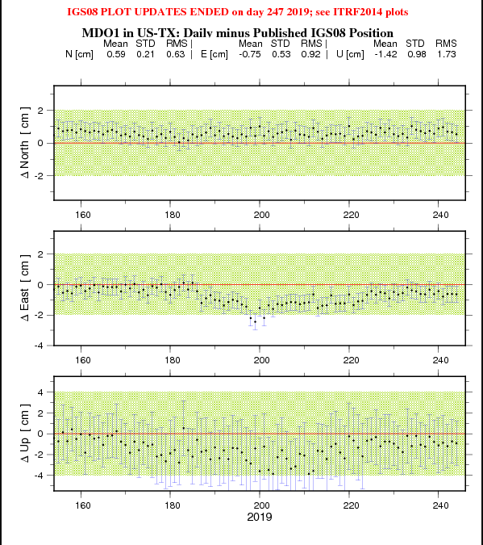
CORS Selection Criteria
Data must be available at the time of the survey!
Longer time series likely leads to better coordinates
Computed velocities (from CORS Position and Velocities page –as opposed to “modeled velocities”)
Good network accuracies (< 3cm EH, <1.5cm Lat/Lon) – see CORS datasheet
Short term plots show low RMS, no bias, and consistent data
Bias shown here

Slide 40
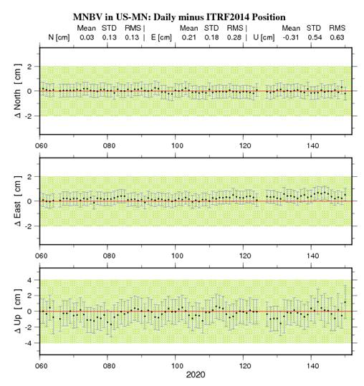
CORS Selection Criteria
Data must be available at the time of the survey!
Longer time series likely leads to better coordinates
Computed velocities (from CORS Position and Velocities page –as opposed to “modeled velocities”)
Good network accuracies (< 3cm EH, <1.5cm Lat/Lon) – see CORS datasheet
Short term plots show low RMS, no bias, and consistent data
Better Data!

Slide 41
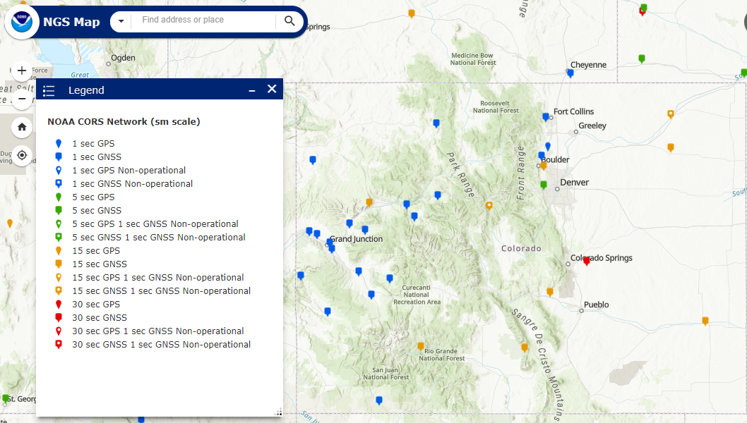
CORS Selection Criteria
Data must be available at the time of the survey!
Longer time series likely leads to better coordinates
Computed velocities (from CORS Position and Velocities page –as opposed to “modeled velocities”)
Good network accuracies (< 3cm EH, <1.5cm Lat/Lon) – see CORS datasheet
Short term plots show low RMS, no bias, and consistent data
Select a distant CORS (375 - 800 km away) for tropospheric modeling

Slide 42
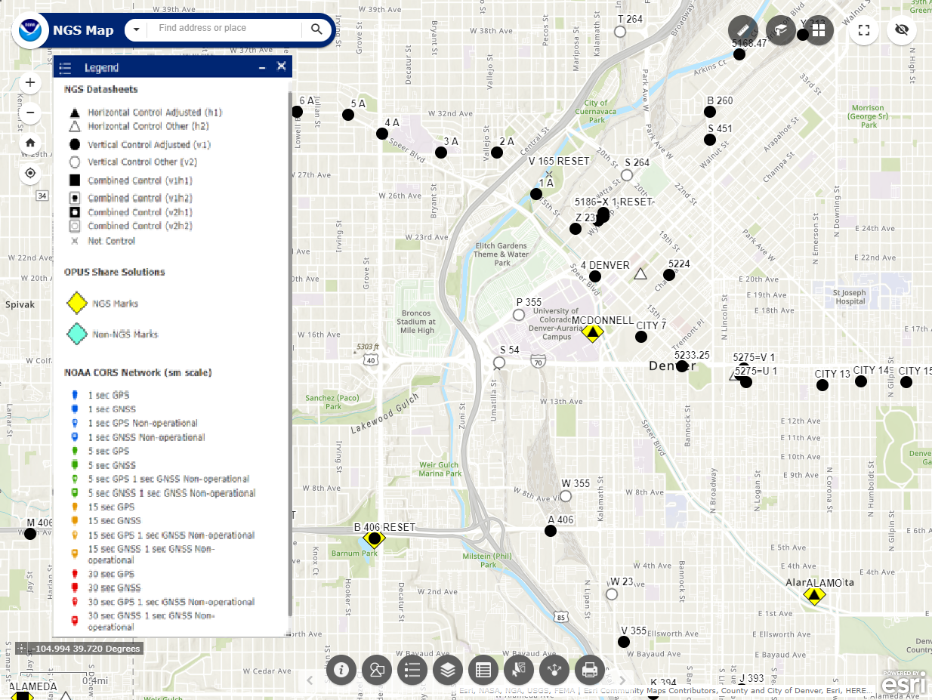
Passive Control
How to find control in your area: NGS Map
https://geodesy.noaa.gov/datasheets/ngs_map/
Includes Basic and Advanced Tutorials
You can use the Search utility at the top left to input city, state, or lat/lon
You can also search by PID, Designation and CORS Site ID
This will show you what control may be present. Use the NGS “Passive Mark Page” to get more detailed information on each mark of interest

Slide 43

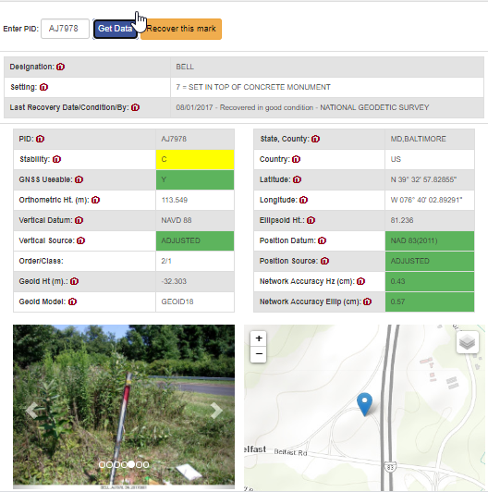
Passive Control
Try the NGS Passive Mark Page to get more information on each mark of interest (https://geodesy.noaa.gov/datasheets/passive-marks/index.html)
Input Permanent Identifier (PID)

Slide 44
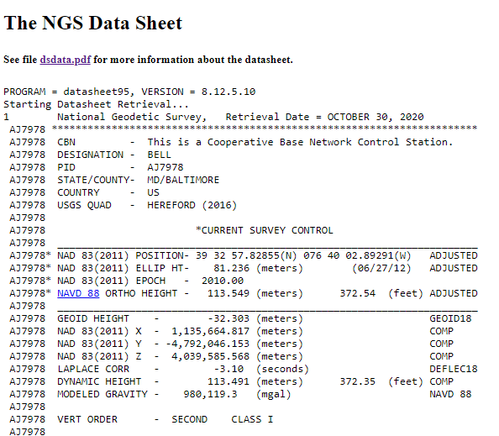
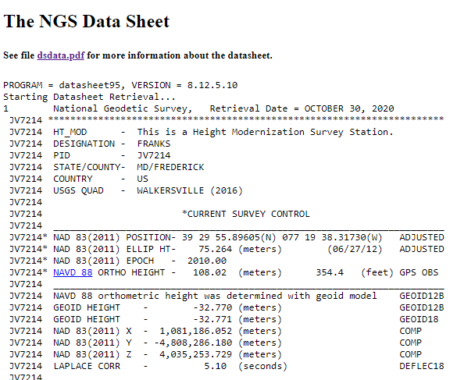
Recommended Vertical Control
Find bench marks that are:
Leveled heights (ADJUSTED and RESET)
GPS-Derived Orthometric Height
  Height Mod Heights (2cm/5cm)
“HT_MOD”
Height published to 2 decimal places
Leveled
Height published to 3 decimal places

Slide 45
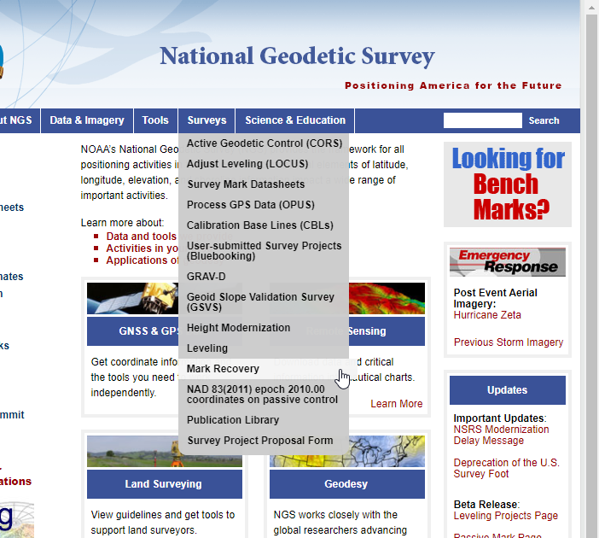
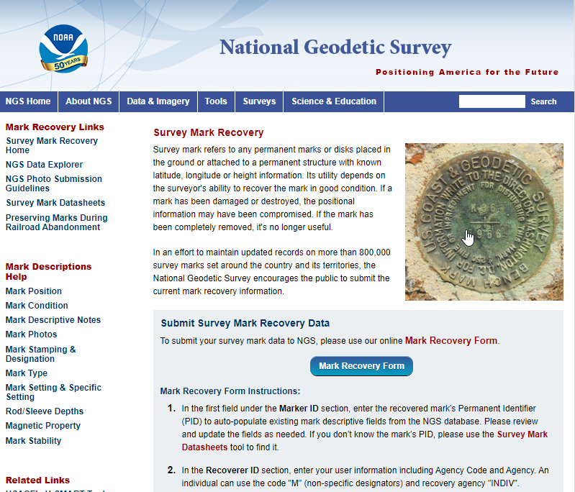
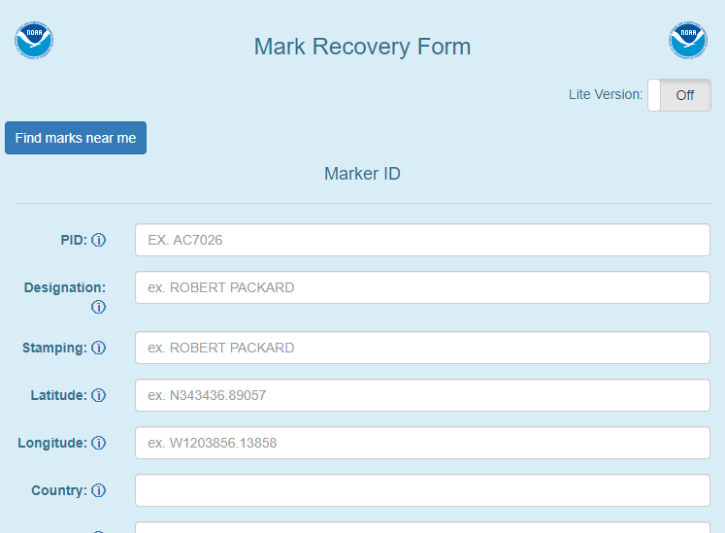
Mark Recovery
Try the NGS mark recovery tool for existing marks: https://geodesy.noaa.gov/cgi-bin/mark_recovery_form.prl
Note: Online mark recovery will not help you build your WinDesc Descriptions file

Slide 46
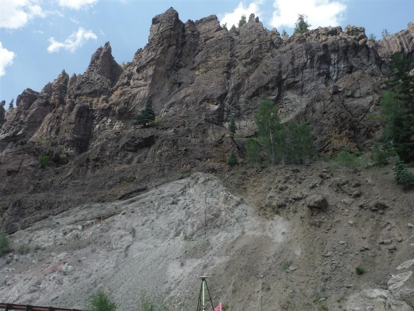
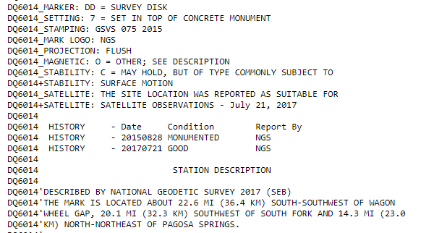
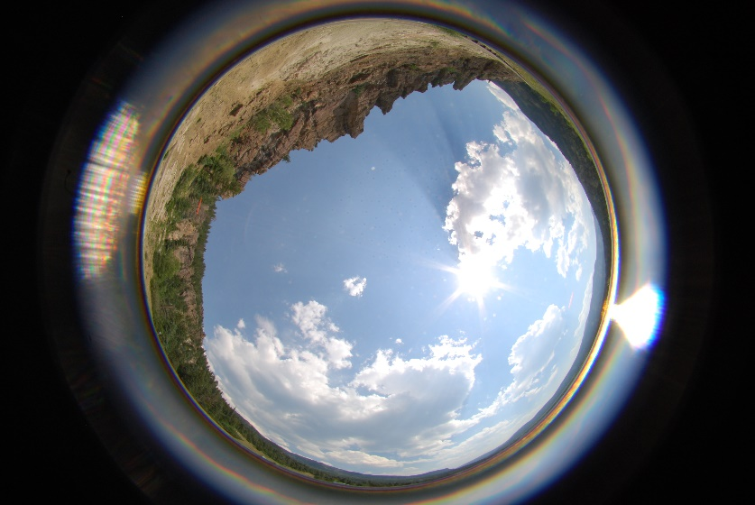
Field validation
Time to hit the field!
Are the marks still in good condition?
Do they have clear, unobstructed sky view?
Sky view from fish-eye camera lens

Slide 47
Outline
Set/identify new marks for survey
Choose horizontal control
  Select CORSs
  Recover passive marks in project vicinity (if desired)
Find vertical control distributed throughout the project
  Recover valid bench marks
  Spacing requirements
Develop a session schedule
  Occupation durations
  Repeat occupations
Assign a 4-character ID to your user marks

Slide 48
Requirements for Vertical Control
Non-control or “new” marks must be within a certain distance of 2 vertical control marks
OPUS-Projects currently* requires a minimum of 2-hour occupations per session
Maximum distance between new marks and vertical control is between 30-50 km, based on occupation session duration
Recommended/Permitted occupation per session
Not Permitted*
*OP 5.1 permits real-time vectors from shorter occupations

Slide 49
Requirements for Vertical Control
Deep dive on control mark spacing
30km radius
Occupy bench marks with “valid” orthometric heights
  Distributed every ~30-50 km
  Minimum of two (2) valid control marks per non-control or new mark
  Adhere to distance-occupation requirement
Use latest hybrid geoid model (i.e., GEOID18)
  H = h - N
Perform constrained vertical least squares adjustments of the GNSS network holding the vertical control heights constrained
Existing vertical survey control mark
New survey control mark

Slide 50
Requirements for Vertical Control
How many valid vertical control marks would you need* at a 30 km spacing?
*At a minimum
30km radius
Existing vertical survey control mark
New survey control mark

Slide 51
Requirements for Vertical Control
How many valid vertical control marks would you need at a 30 km spacing?
30km radius
6 valid vertical control marks within 30 km would cover minimum requirements for only 3 new marks!
30 km spacing require a minimum of only 2-hr occupations
Existing survey control mark
New survey control mark
New survey control mark with sufficient vertical control

Slide 52
Requirements for Vertical Control
By increasing your spacing to 40km all 9 new marks would be covered by at least two vertical control marks.
40km radius
However, minimum occupation time would increase from 2 to 4 hours
Existing survey control mark
New survey control mark
New survey control mark with sufficient vertical control

Slide 53
Outline
Set/identify new marks for survey
Choose horizontal control
  Select CORSs
  Recover passive marks in project vicinity (if desired)
Find vertical control distributed throughout the project
  Recover valid bench marks
  Spacing requirements
Develop a session schedule
  Occupation durations
  Repeat occupations
Assign a 4-character ID to your user marks

Slide 54
Requirements for Vertical Control
Now that we’ve discussed distance (X-axis), let’s talk Occupation Length (Y-axis)
To meet NGS requirements, you need to do a minimum of two 2-h observations on every mark in the network.
But how accurate will it all be?
Two important considerations:
Redundancy (how many reps)
Duration (how long an observation)
Recommended/Permitted
Not Permitted*
*Future developments of OP will permit real-time vectors from shorter occupations

Slide 55
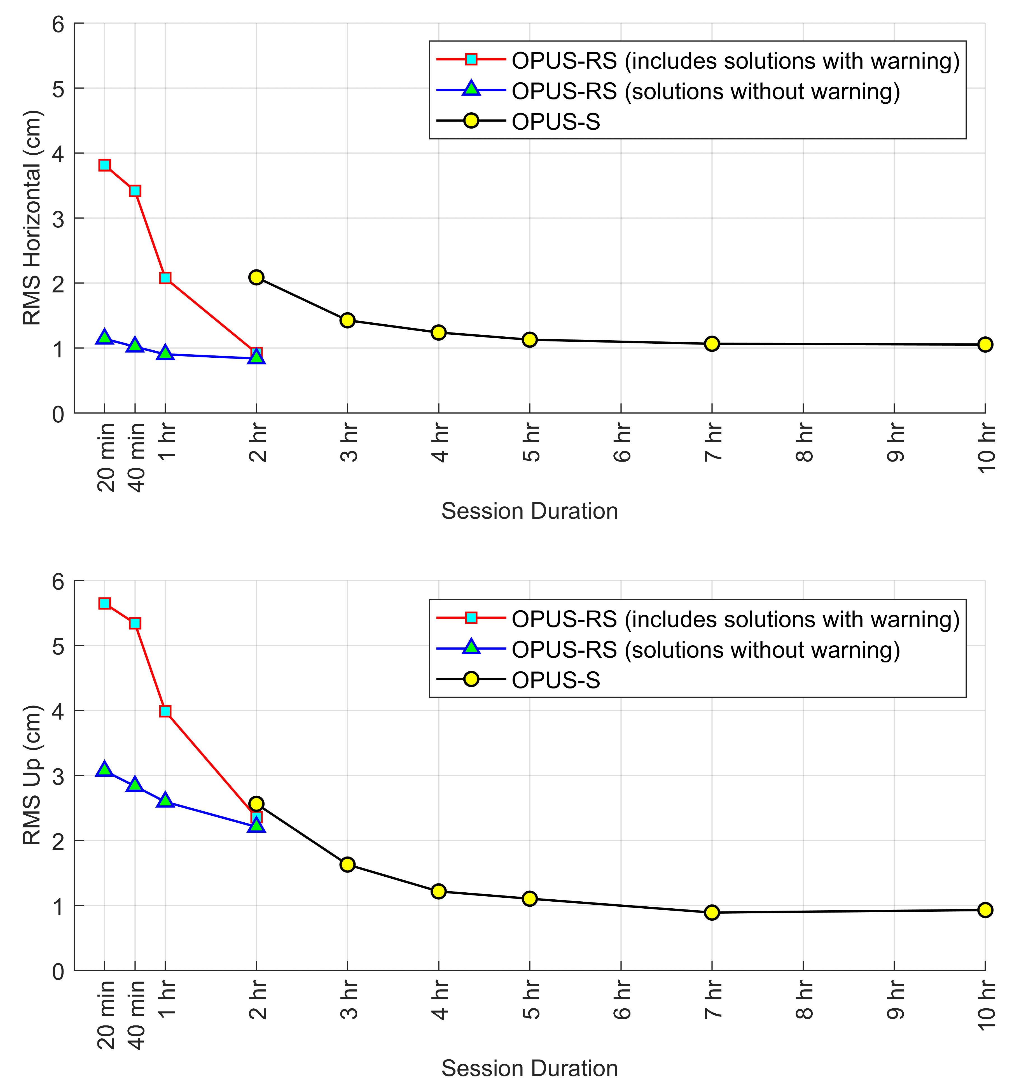
Accuracy of OPUS versus Occupation Duration
How long should each occupation be?
A look at OPUS Accuracies
Source: Gillins et al. 2019

Slide 56
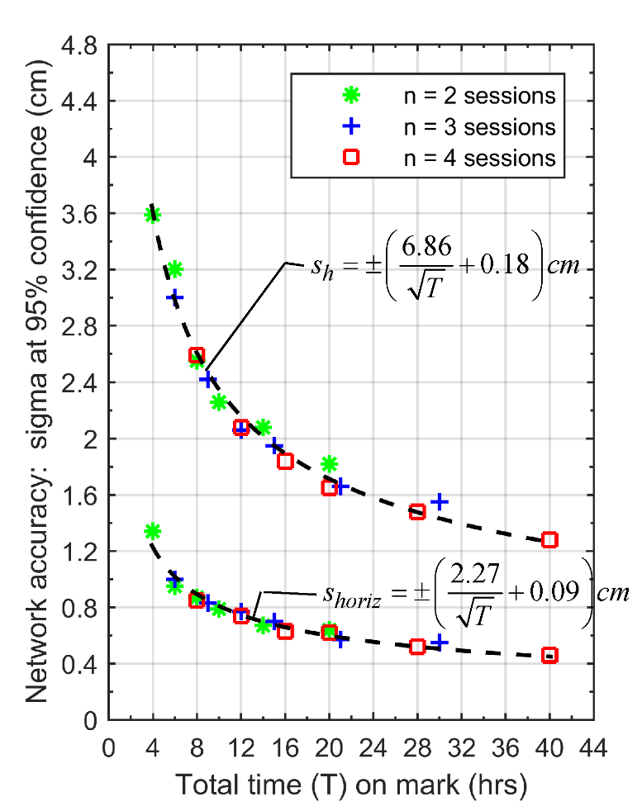
Accuracy of OPUS-Projects
OPUS Projects Network Accuracies
Most important variable for reducing error is Total Time
Note! Cumulative time, not individual occupations

Slide 57
Accuracy of OPUS-Projects
95% Confidence Interval values shown
(Ellipsoid Height)

Slide 58
“Design Curve” for OPUS-Projects
Vertical Network Accuracies, OPUS Projects
Source: Park et al. 2017
95% CI values shown
TOTAL time on mark

Slide 59
Recommendations
Summary on Expected Accuracy of OPUS-Projects
Expected Ellipsoid Height Accuracy | Expected Horizontal Accuracy | Total Time on Mark (h) | Recommended Sessions and duration
3.0 cm | 1.5 cm | 4 | (2) 2-h
2.5 cm | 1.3 cm | 8 | (2) 4-h or (3) 3-h
2.0 cm | 1.0 cm | 20 | (2) 10-h or (3) 7-h

Slide 60
Planning Your Project
Recap:
You have identified your project goals/objectives
You have determined the number/distribution of control marks required in your project area to meet these objectives
You have identified and recovered potential marks to control your project
You have identified CORSs that you intend to use as control for your project

Slide 61
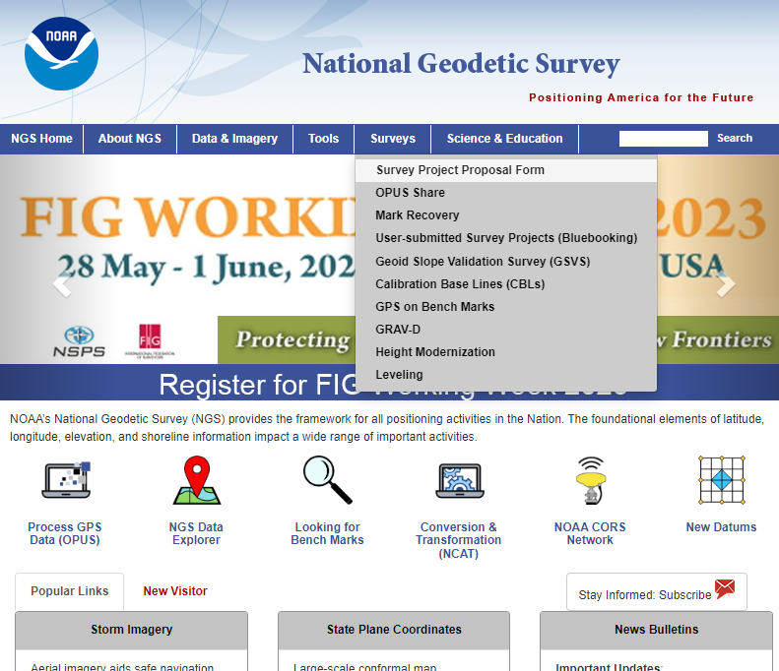
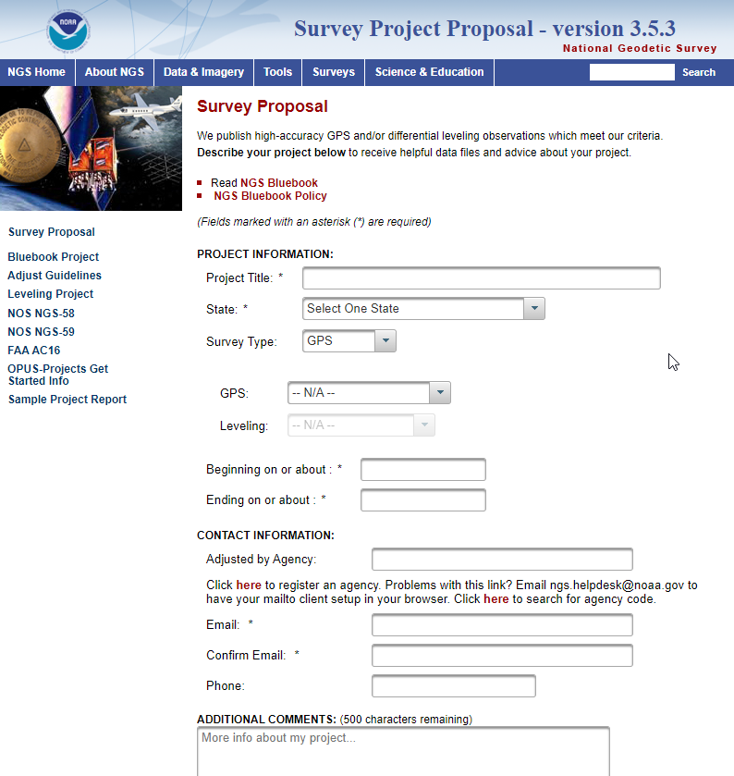
Submit your Project Proposal for Review
Now that you have your Project Proposal, time to submit it to NGS for review!

Slide 62
NGS Survey Project Proposal
Why submit your GNSS Project Plan to NGS (https://geodesy.noaa.gov/SurveyProposal/ ):
Subject Matter Expert will review your plan, make sure it will meet NGS standards
NGS will assign a Project Tracking ID, which will enable you to use the advanced features of OPUS Projects
With a Project Tracking ID, you will be able to submit your project to NGS for consideration of inclusion into the national database of geodetic control, available through published datasheets
If you do not intend on submitting your project to NGS, but still wish your project to be tied to the national reference frames/datums, you can use the “dummy” tracking ID “0000”

Slide 63
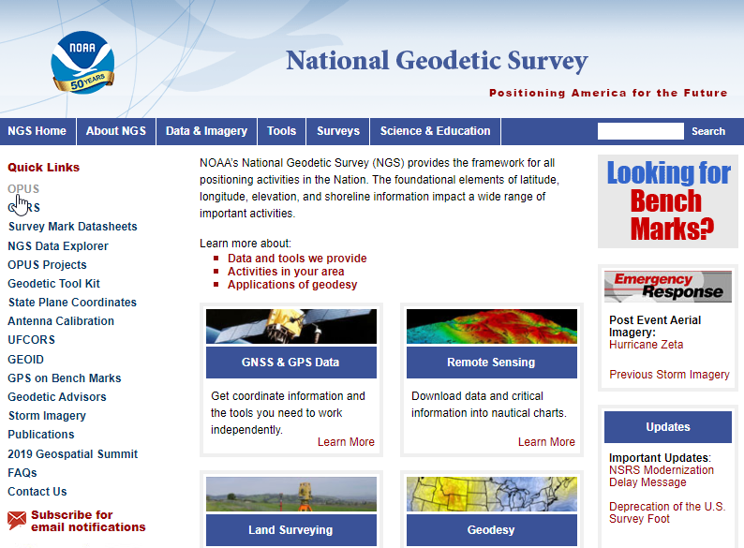
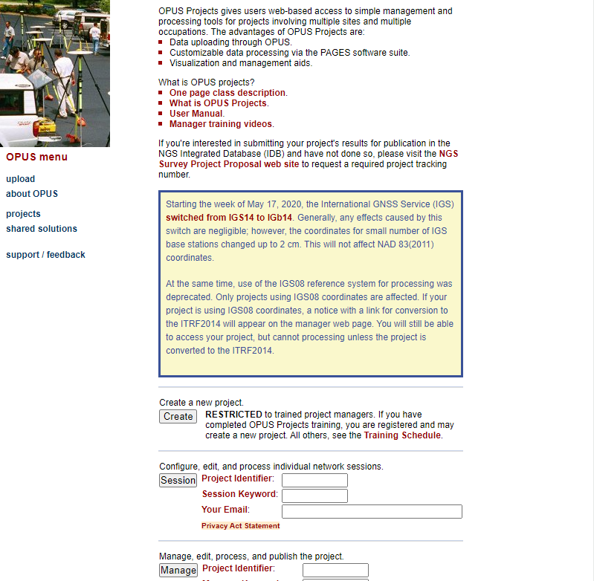
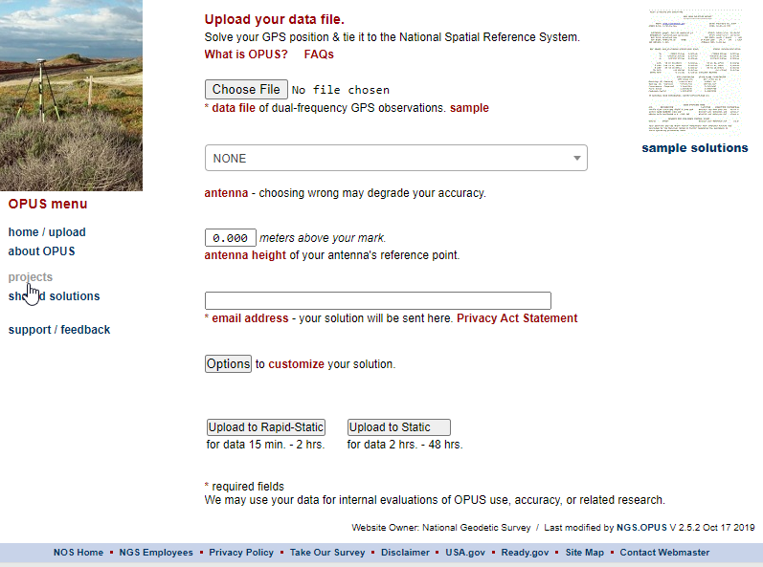
Creating your OPUS Project
Ready to create your project!

Slide 64

Creating your OPUS Project
Insert your NGS Project Tracking ID here
By associating a NGS Project Tracking ID to your project, the advanced features of OP (which support submitting a project to NGS) will become available

Slide 65

Ready to Upload Data!
Congratulations!
You have successfully created a project:
The project plan has been reviewed by NGS
The advanced features of OPUS Projects are now enabled
Now you are ready to upload your data files

Slide 66
Outline
Set/identify new marks for survey
Choose horizontal control
  Select CORSs
  Recover passive marks in project vicinity (if desired)
Find vertical control distributed throughout the project
  Recover valid bench marks
  Spacing requirements
Develop a session schedule
  Occupation durations
  Repeat occupations
Assign a 4-character ID to your user marks

Slide 67

Best practices for GNSS observation files
When converting raw data files to RINEX, best practice is to ensure all header information is correct
For ease of associating specific RINEX files to specific user marks in your project, start each RINEX file name with the corresponding OPUS Projects 4-Character mark ID
Recommended RINEX file naming structure: start w/ 4CharID, Day-of-year, session#
e.g. PIP12810.20O
More on 4-Character IDs in OP Training
4CharID
DOY
Session#

Slide 68

Session Processing Overview
The software PAGES is used to process baselines
The network design specified in session processing is carried through to the eventual network solutions.
Results are sent via email and can be seen via “Show Files” button on the Manager or Session webpages.

Slide 69

Session Processing Overview
OPUS recommends one hub* constrained 3D
Nothing else constrained
*Note: user may have to select additional hubs if needed – see User Guide

Slide 70

Session Processing Results
Standard error of unit weight should be near 1.0
Verify total # of marks
OVERALL RMS should be small (≤ 2cm)
A priori coordinate shifts should be small (≤ 2 cm horizontal, ≤ 4 cm vertical)

Slide 71


Session Processing Results
Obs Used should be high
AMB Fixed should be high
P2P’s should typically be small

Slide 72
Network Solutions Overview
Network solutions apply least squares adjustments (and various amounts of error reduction) to session baselines.
Network solutions will not recreate different baselines than the ones already created in session processing.
Preliminary Network Solution
Seen in OP101: OP recommends holding the hub (CORS) constrained in 3D; many other adjustments possible*
Uses adjustment (and error reduction) software GPSCOM
Horizontal Network Solutions
Only available with NGS Project Tracking ID or “0000”
Uses adjustment software ADJUST
Requires a Preliminary Network Solution using GPSCOM
*User should use hub design for submitting project to NGS

Slide 73

Network Solutions Overview
To submit your project to NGS, a sequence of 5 network adjustments are needed:
Preliminary
Horizontal Free
Horizontal Constrained
Vertical Free
Vertical Constrained

Slide 74
Why 5 Adjustments?
Each adjustment plays a critical role:
Preliminary Adjustment: provides input to subsequent network adjustments
Horizontal Free Adjustment: evaluates that the observations are internally consistent while being minimally constrained to the geometric datum
Horizontal Constrained Adjustment: evaluates that your network is correctly and fully constrained to the geometric datum
Vertical Free Adjustment: equivalent to the horizontal free adjustment, but minimally constrained to the vertical datum
Vertical Constrained Adjustment: evaluates how your network should be correctly and fully constrained to the vertical orthometric datum

Slide 75

OPUS-Projects 5.2 for RTK/RTN Vectors
NGS is developing a new Standardized GNSS Vector EXchange Format (GVX) that will be used to ingest vectors into OPUS Projects

Slide 76

OPUS-Projects 5.2 for RTK/RTN Vectors

Slide 77
Case Study:
Mt Blue Sky and Mt Bierstadt HTMOD Survey

Slide 78

Overview Map

Slide 79


Survey Purpose
Establish GPS Derived HTMOD heights on the marks at the summits of Mt Blue Sky (formerly Mt Evans) and Mt Bierstadt.
Mt Blue Sky Mt Bierstadt.

Slide 80




Bench Marks Occupied
Designation: H 449
PID: DF5478
Vertical Order: 1st
Vertical Class: II
Surveyed : 2001
Designation: N 359
PID: KK1078
Vertical Order: 1st
Vertical Class: II
Surveyed : 1954

Slide 81






Other Marks Occupied
Designation: BIERSTADT
PID: KK2029
Designation: EVANS USGS
PID: KK2030
Designation: EVANS DMWW
PID: KK2031

Slide 82



Mark Distances and Baseline Overview

Slide 83


Survey Logs

Slide 84


Mark Descriptions (WinDesc)

Slide 85


Survey Schedule and Statistics
2023-08-23
2023-08-22
2023-08-24

Slide 86


Review and Submit to NGS

Slide 87


Project Report

Slide 88
OPUS Projects Demo:
Mt Blue Sky and Mt Bierstadt HTMOD Survey

Slide 89
Case Study:
Greeley GPS on Bench Marks Survey

Slide 90
Survey Purpose
Greeley was the largest populated gap in Colorado for the GPS on Bench Marks Campaign. This survey was intended to occupy 6 bench marks around the Greeley area to help improve the transformation tool and also get REC coordinates on these marks.

Slide 91

Overview Map

Slide 92



Colorado GPS on BM Population Gap Map

Slide 93



Bench Marks Occupied
Designation: M 261
PID: LL0201
Order/Class: 1st/II
Designation: Q 136
PID: LL0263
Order/Class: 2nd/0
Designation: A 390
PID: LL1096
Order/Class: 1st/II

Slide 94



Bench Marks Occupied
Designation: E 390
PID: LL1101
Order/Class: 1st/II
Designation: B 414
PID: LL1146
Order/Class: 1st/II
Designation: F 414
PID: LL1150
Order/Class: 1st/II

Slide 95


Mark Distances and Overview

Slide 96


Survey Schedule and Statistics
2023-12-15
2023-12-18

Slide 97
OPUS Projects Demo:
Greeley GPS on Bench Marks Survey

Slide 98
Case Study:
Vail HTMOD Survey

Slide 99
Survey Purpose
Establish GPS Derived HTMOD heights on marks around Vail, Colorado.*
* This project was performed with additional marks for other purposes but the surveyor provided the data to me so that I could Blue Book the project.

Slide 100




Bench Marks Occupied
Designation: VAIL PASS
PID: AB2084
Vertical Order: 1st
Vertical Class: II
Designation: T 280
PID: KL0004
Vertical Order: 2nd
Vertical Class: 0

Slide 101






Other Marks Occupied
Designation: MCLAUREN
PID: AB2082
Designation: SPRADDLE
PID: AB2083
Designation: GPS 004
PID: AH7730

Slide 102








Other Marks Occupied
Designation: GPS 005
PID: AH7731
Designation: GPS 009
PID: AH7735
Designation: GAME ET
PID: KL0616
Designation: RED RESET
PID: New Mark

Slide 103

Overview Map

Slide 104


Mark Distances and Overview

Slide 105


Survey Schedule and Statistics
2022-09-15
2022-09-12
2022-09-14
2022-09-16
2022-09-11
2022-09-13

Slide 106
OPUS Projects Demo:
Vail HTMOD Survey

Slide 107


Magnitude of the Deflection of the Vertical
Questions?
Brian Shaw
brian.shaw@noaa.gov

Slide 108
Extra

Slide 109
OPUS Share
To share your OPUS solution publicly:
  1 - Upload your data file to OPUS
  2 - After entering and verifying your antenna type and ARP height,
  click the Options button
  3 - For the option share my solution, choose Options > yes, share

Slide 110
OPUS Share
OPUS shared solutions must meet the following requirements:
  Your GPS data file must be 4 hours or longer.
  Your mark must be a permanent mark of public interest.
  The mark must be durable, have a stable setting, and good satellite visibility.
  Include a description and photos to help others find your mark.
  Your shared solution must be a high-quality solution:
≥ 70% observations used and ambiguities fixed
≤ 3 cm RMS
≤ 4 cm peak-to-peak error ranges for latitude and longitude
≤ 8 cm peak-to-peak error range for ellipsoid height

Slide 111

OPUS Share Map
https://geodesy.noaa.gov/opusmap/

Slide 112

OPUS Shared Solutions Dashboard
Dashboard enables sorting and visualization of Shared Solutions by
Month & Year, State, Agency Type, and submitting agency
Agency type | # Shared Solutions on NGS marks
State | ~44,900
Private Sector | ~7,900
Federal | ~4,700
Academic | ~1,800
2018
Note the impact of GPSonBM Campaigns
2020
2021

Slide 113

OPUS Shared Solutions in Colorado

Slide 114

CORS Selection – additional thoughts
For most projects, plan to use the same hub in every session
EXCEPT:
For large projects, you may need more than one hub in a session
If user marks are spread out so far in a session that it is not possible to have one hub within 100 km, then designate more hub(s)
For multi-hub projects, designate the same CORSs as hubs in every session

