Slide 1

Using Online Positioning User Service
(OPUS) and OPUS Projects
2023 Rocky Mountain Survey Summit
Brian Shaw
brian.shaw@noaa.gov
February 22, 2023

Slide 2

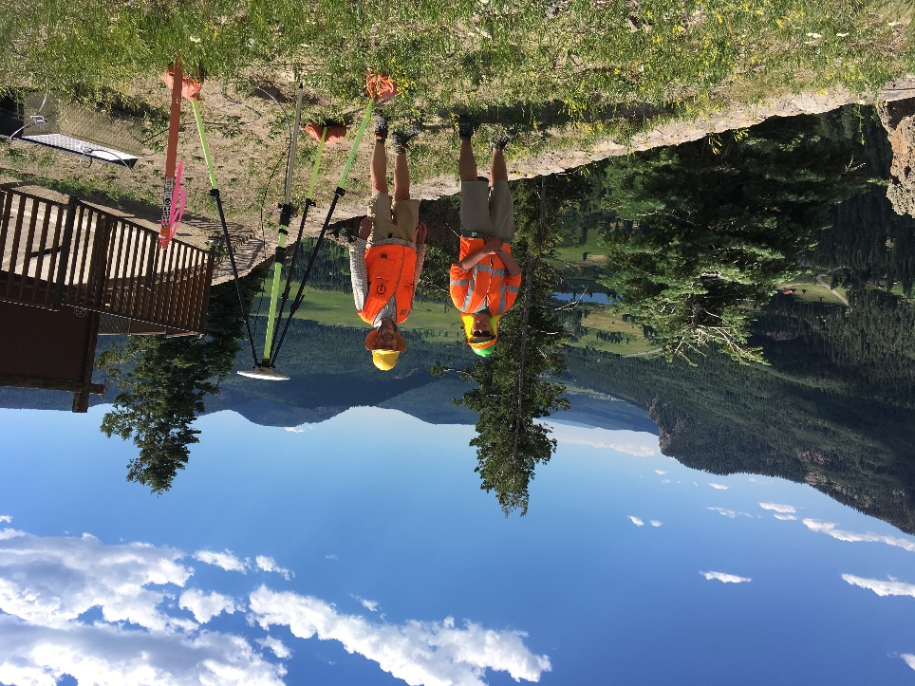
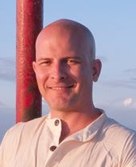
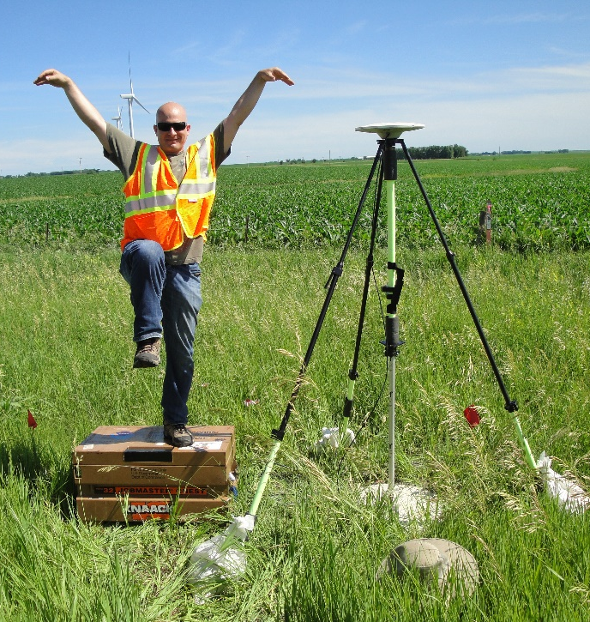
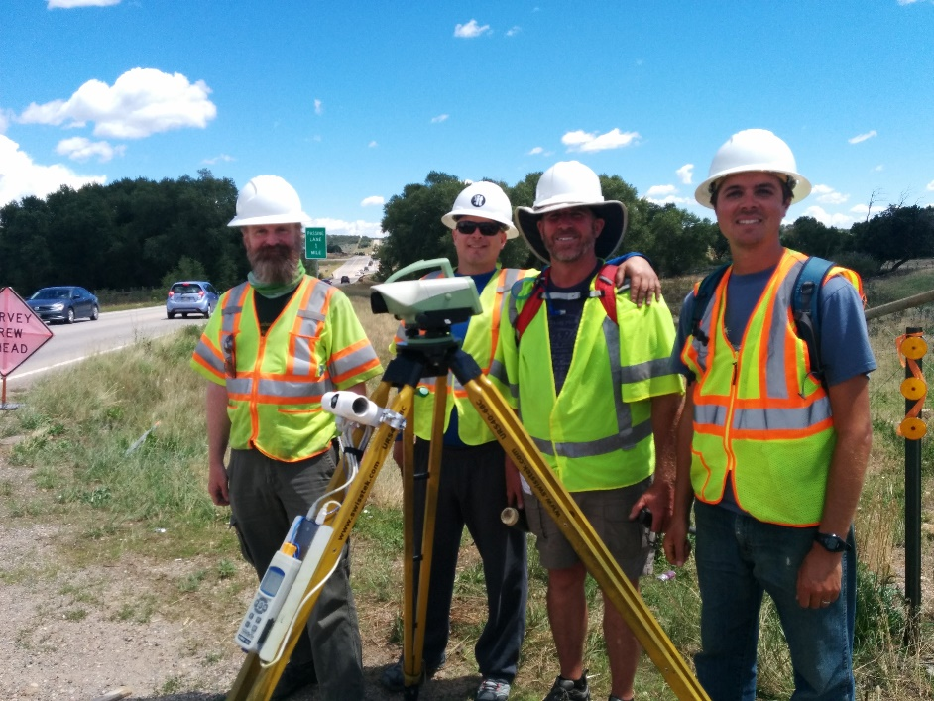
Brian Shaw
Rocky Mountain Advisor
brian.shaw@noaa.gov

Slide 3
What is OPUS?
A tool for processing GPS data collections (GNSS soon)
15 min to 2 hrs
Email Solution
OPUS Rapid Static
4 hr minimum
(single solution)
RSPGS
OPUS Share
2 hrs to 48 hrs
OPUS Static
2 hr minimum (static)
(network adjustment)
PAGES
OPUS Projects
RTK/RTN Vectors (minutes)
COTS Software

Slide 4
How to use OPUS?
5 Easy Steps
        Upload your data file
        Select the antenna used
        Enter your Antenna Reference Point (ARP) height
        Enter your email
        Select additional options

Slide 5
How Does OPUS-S Work?
OPUS-S processing highlights:
Everything is “done” in the IGS14 Reference Frame.
SV coordinates are held rigidly fixed.
CORS coordinates are heavily constrained.
Neutral atmosphere (tropo) dry component modeled.
Neutral atmosphere (tropo) wet component estimated.
Double-differenced, ion-free carrier phase observable.
Carrier phase ambiguities are fixed to their integer values where possible; float ambiguities are estimated otherwise.
Individual baselines are processed and the results combined generating mean coordinates and peak-to-peak uncertainties.

Slide 6
Upload Your Data
Data files must meet the following requirements
From dual frequency GPS receiver
Include static data only (antenna must not be moved during observations)
Include minimum of 15 minutes and maximum of 48 hours of data not crossing UTC midnight more than once
Files under 2 hours must include both P2 observables and either P1 or C1 observables
Record data at intervals of 1,2,3,5,10,15 or 30 seconds

Slide 7
Upload Your Data
Accepted data formats include
RINEX 2
RINEX 3
Compressed UNIX, gzip, pkzip and Hatanaka formats
          For compressed files, all files must share the
          same antenna type and height
Many other raw data formats

Slide 8
Upload Your Data
A few notes on data types:
OPUS currently only uses GPS observables (even if file contains other GNSS observables)
OPUS decimates all data to 30 seconds
OPUS accepts all mask angles but only satellites more than 10 degrees above the horizon are used

Slide 9
Select Antenna type and enter ARP height and email
Select the Antenna type used
    This is very important to use the correct antenna as OPUS uses
    the antenna calibrations so choosing an incorrect antenna may
    result in a height error as large as 80 cm and a horizontal error
    up to 1 cm.
    Verify by looking up the ANTCAL https://geodesy.noaa.gov/ANTCAL/
Enter your Antenna Reference Point (ARP) height
This is also very important as any errors in the entered height
will be reflected in the solution heights.
Enter your email address

Slide 10
Select additional options
Customize your solution format
Choose your base stations
Choose your State Plane Coordinate System (SPCS) zone
Include a project identifier (for OPUS Projects)
Choose to share your solution publicly (for OPUS Share)
Set a profile:
    If you choose to set a profile, OPUS will save your email, antenna type
    and height, and options used.
Subsequent uploads will require only your email and a data file to apply
your customized defaults.
Caution! If you choose to set a profile, your selections will override the
optimized defaults for all subsequent uploads.

Slide 11
OPUS Upload
Demonstration

Slide 12
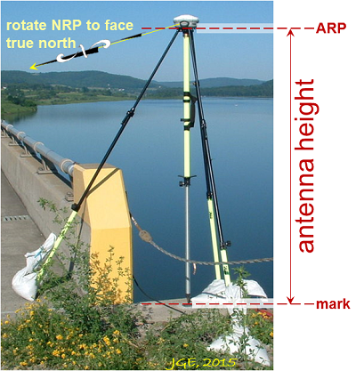
Measuring Antenna Height
The height is measure vertically (NOT slant height) from the mark to the ARP of the antenna in meters.
The ARP is almost always the center of the bottom-most, permanently attached, surface of the antenna.
See GPS Antenna Calibration for photo’s and diagrams that show where the ARP is on most antennas:
https://geodesy.noaa.gov/ANTCAL/

Slide 13
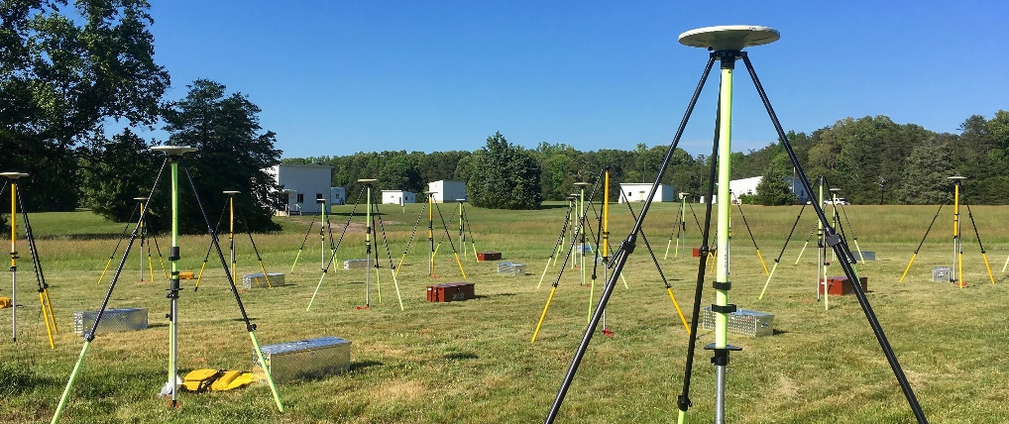
GSVS17 Equipment Calibration
Calibrated, fixed-height antennas, all identical models
In Colorado 2017:
  20+ complete sets of equipment (2 parties, 10 sets each)
  Each party observed 10 stations each day
  Each station continuously collected data for 2-3 days
  Project processed with OPUS Projects

Slide 14
GSVS17 Equipment Calibration
Even Two-meter fixed Height poles can vary
Full antenna recalibration check before survey
Each fixed height tripod height measured before and after the survey
Over 20 complete sets of equipment
          2 parties with 10 sets of equipment + spares
          Each party occupied 5 new and 5 repeat stations each day. Replaced batteries every day.
          Project processed with OP while in field.
Tripod | Height
A | 2.0024
B | 2.0010
C | 2.0016
D | 2.0005
E | 2.0019
F | 1.9996
G | 1.9993
H | 2.0013

Slide 15
OPUS Accuracy
Various factors impact the accuracy including user error, multipath or adverse atmospheric conditions
Static: For each coordinate (X, Y, Z, Φ, λ, h, and H), static processing provides the range of the three individual single baselines, called peak-to-peak errors. One advantage of peak-to-peak errors is that they include any error from the CORS (base station) coordinates.
Rapid-Static: The best estimates of coordinate errors are the standard deviations reported by single baseline analysis. Our experiments indicate that the actual error is less than these estimated accuracies more than 95 percent of the time.

Slide 16
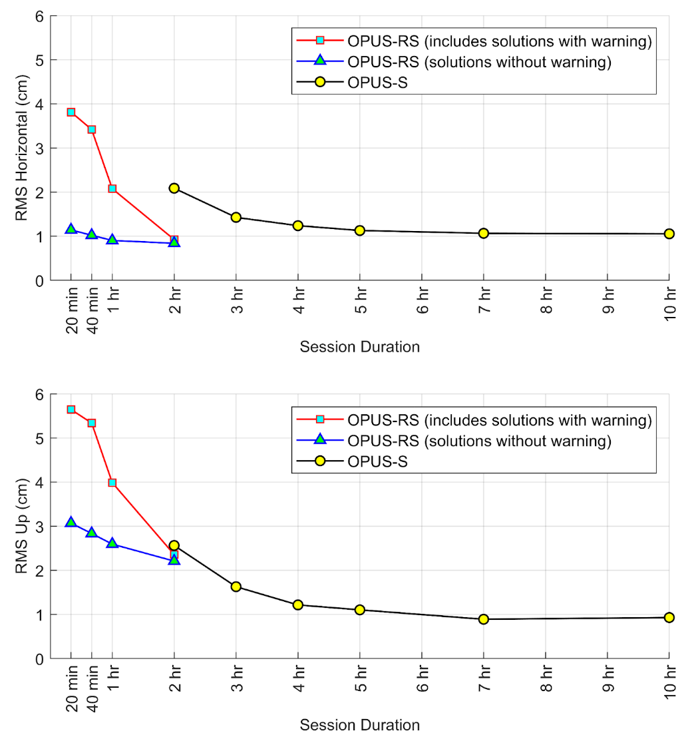
Improving your OPUS results
Observe longer: A longer session provides OPUS a better opportunity to accurately fix ambiguities and mitigate multipath error.
At 5 Hours you get to about 1 cm RMS horizontally and vertically

Slide 17
Accurate OPUS solution characteristics
Orbits used are precise or rapid
Over 90% of observations are used
Over 50% of ambiguities are fixed
The correct antenna type and ARP height are entered
For OPUS-S:
Overall RMS is less than 3 cm
Peak-to-peak errors are less than 5 cm (Lat/Lon), 8 cm (Ellip Ht)
For OPUS-RS: the solution contains no warning messages

Slide 18
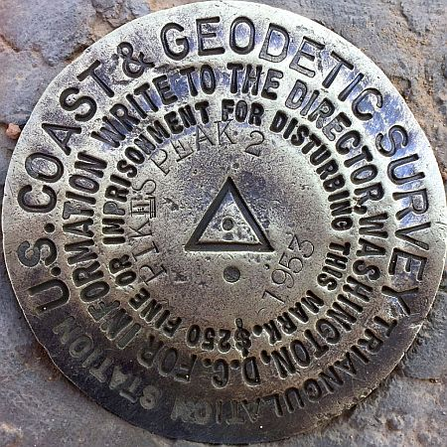
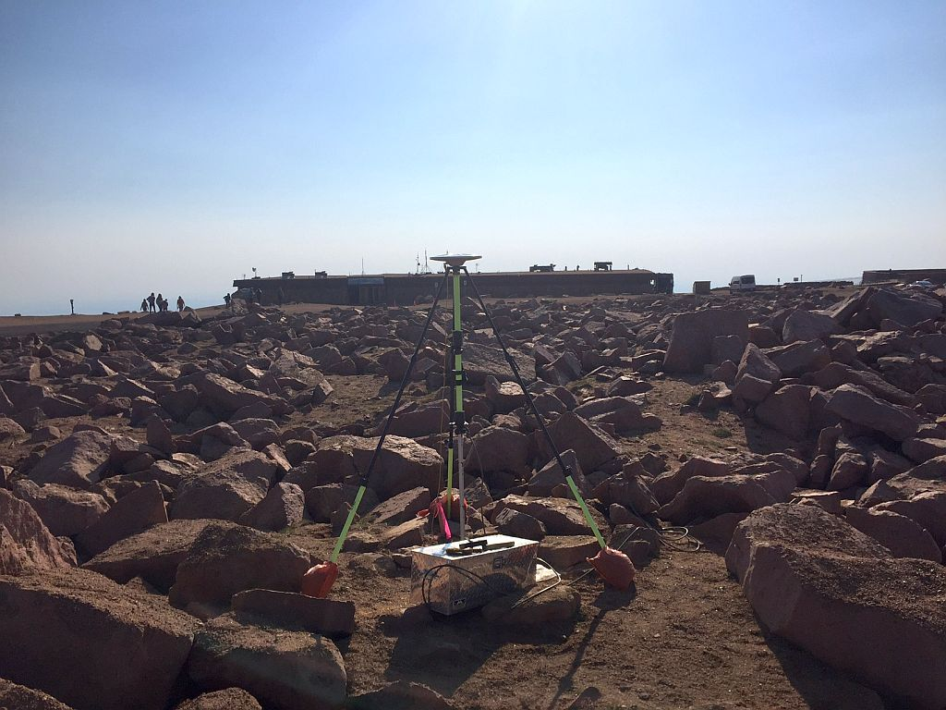
Example of Very Good OPUS Solution
In 2017 NGS Performed a Height Modernization Survey for several marks on Pikes Peak.
Collected data continuously for ~4 days
Mark
PIKES PEAK 2

Slide 19
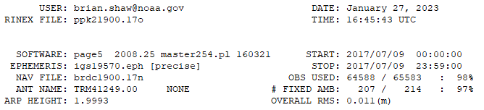
Reading an OPUS Solution
Date/Time of Solution
User Email
RINEX File Submitted
Which Ephemeris?
Start/Stop Time of Occupation
Double Check Selected Correct Antenna
and Entered Correct ARP Height
Quality Control Desired Results
OBS USED > 90%
# FIXED AMB > 50% (80%)
OVERALL RMS < 3 cm

Slide 20
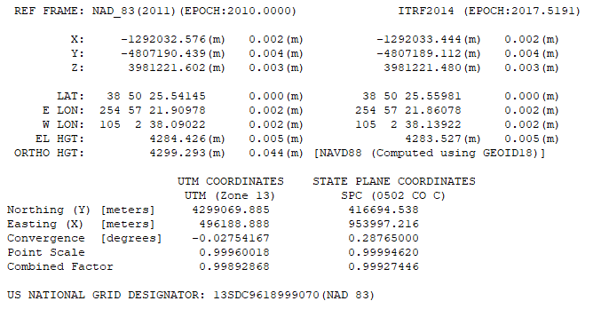
Reading an OPUS Solution
NAD 83 (2011) Coordinates
ITRF2014 Coordinates
Peak
to
Peak
< 5 cm
Peak
To
Peak
< 5 cm
Projected Coordinates
UTM
SPCS
USNG

Slide 21
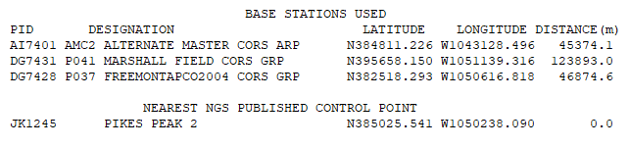
Reading an OPUS Solution
3 CORS that were used for the final solution, coordinates and distance
The nearest mark to the final solution, coordinates and distance

Slide 22
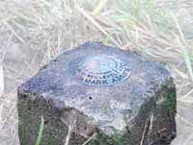
What are Peak to Peak Values
φ
peak-to-peak values
a box containing mark coordinates from
all 3 baselines
λ
CORS baseline 2
h
CORS baseline 1
mark position:
average of 3 most
coherent baselines
CORS baseline 3

Slide 23
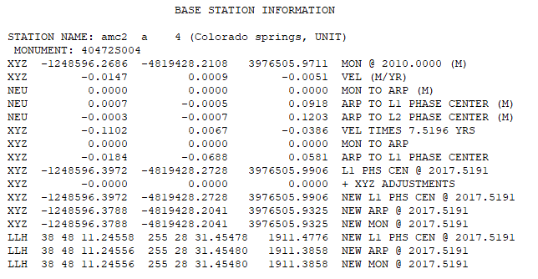
OPUS Solution Extended Output
Base Station Information

Slide 24
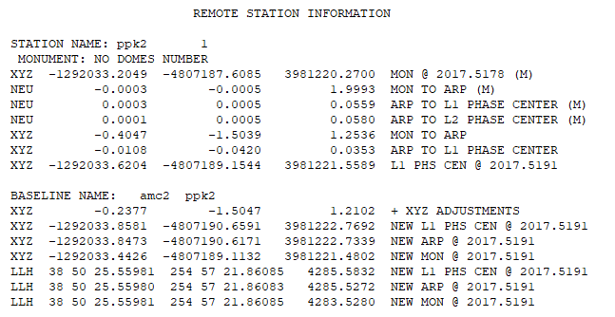
OPUS Solution Extended Output
Remote Station Information
Baseline

Slide 25
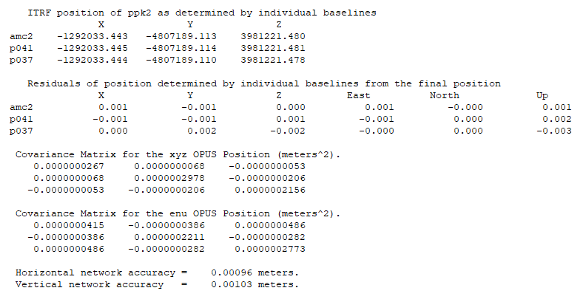
OPUS Solution Extended Output

Slide 26
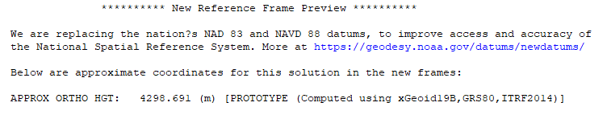
OPUS Solution Extended Output
Standard Solution Orthometric Height (elevation)
Extended Solution Prototype Orthometric Height (elevation)
Pikes Peak 2 Height Difference of :
-0.602 meters (-1.975 feet)

Slide 27
OPUS Share
To share your OPUS solution publicly:
  1 - Upload your data file to OPUS
  2 - After entering and verifying your antenna type and ARP height,
  click the Options button
  3 - For the option share my solution, choose Options > yes, share

Slide 28
OPUS Share
OPUS shared solutions must meet the following requirements:
  Your GPS data file must be 4 hours or longer.
  Your mark must be a permanent mark of public interest.
  The mark must be durable, have a stable setting, and good satellite visibility.
  Include a description and photos to help others find your mark.
  Your shared solution must be a high-quality solution:
≥ 70% observations used and ambiguities fixed
≤ 3 cm RMS
≤ 4 cm peak-to-peak error ranges for latitude and longitude
≤ 8 cm peak-to-peak error range for ellipsoid height

Slide 29
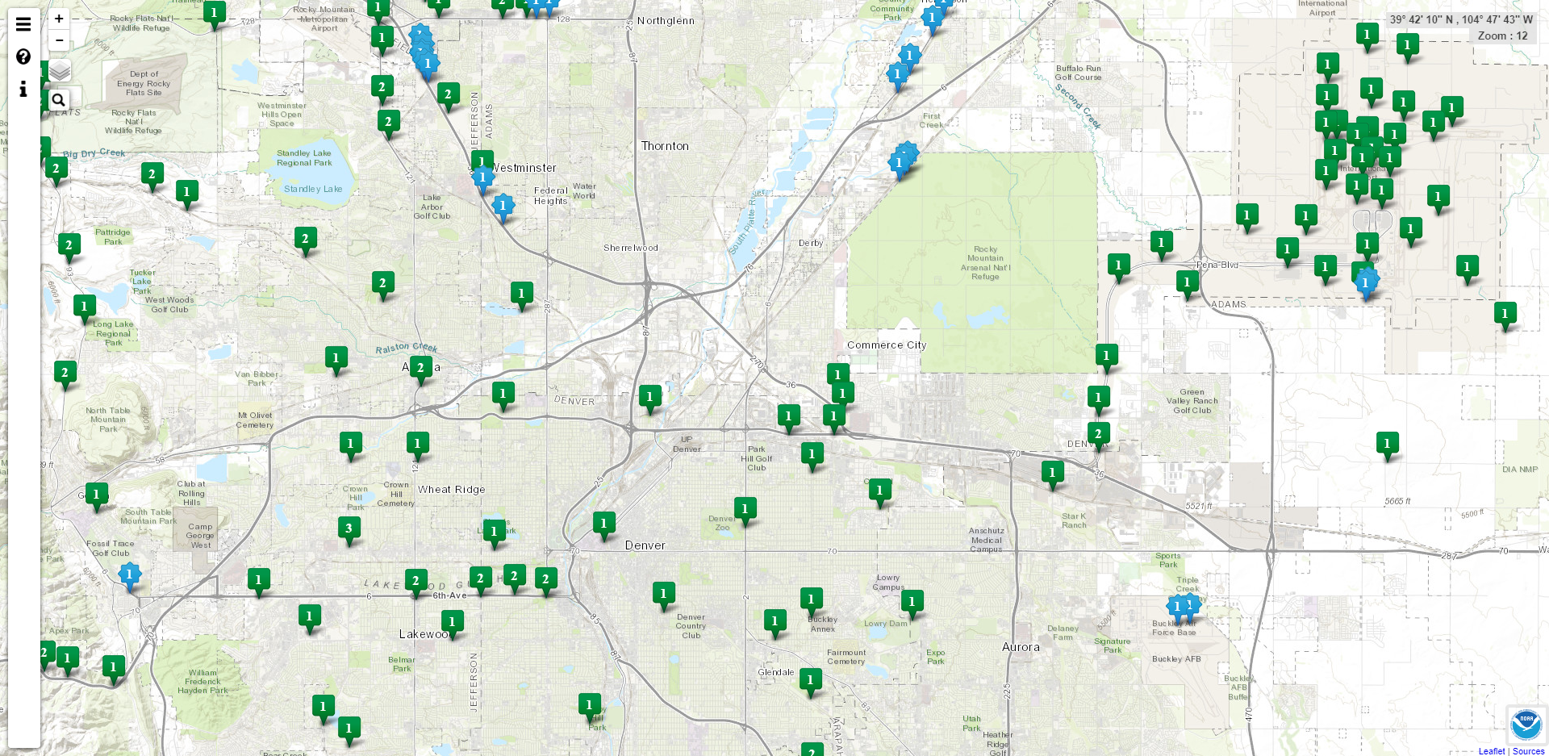
OPUS Share Map
https://geodesy.noaa.gov/opusmap/

Slide 30
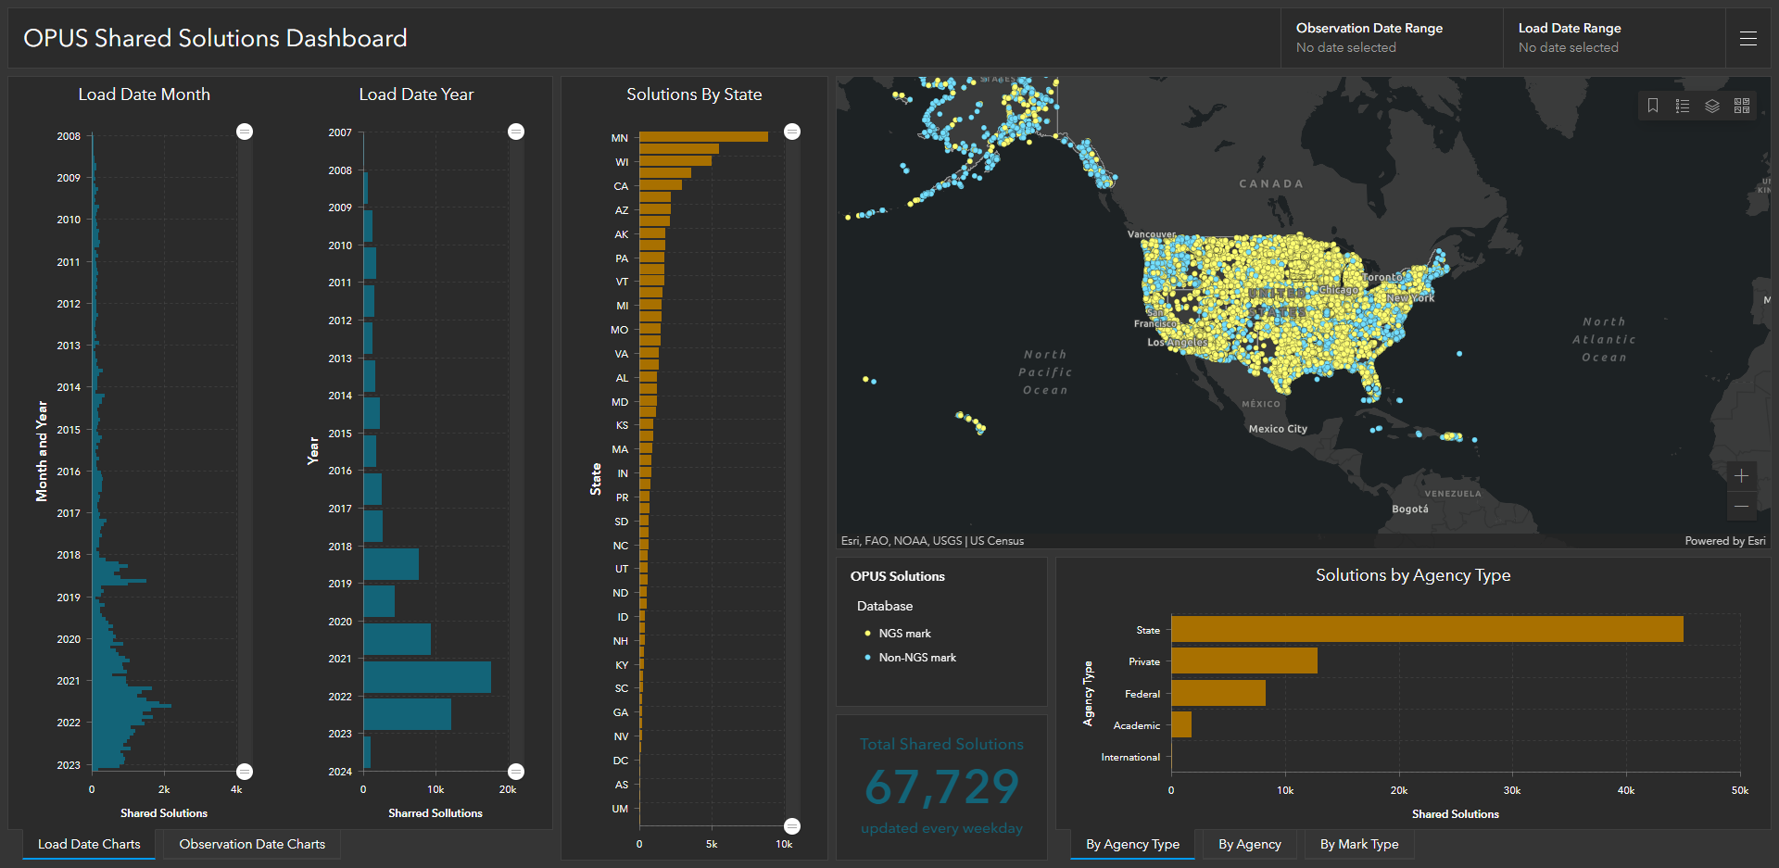
OPUS Shared Solutions Dashboard
Dashboard enables sorting and visualization of Shared Solutions by
Month & Year, State, Agency Type, and submitting agency
Agency type | # Shared Solutions on NGS marks
State | ~39,500
Private Sector | ~7,000
Federal | ~4,000
Academic | ~1,500
2018
Note the impact of GPSonBM Campaigns
2020
2021
2022

Slide 31
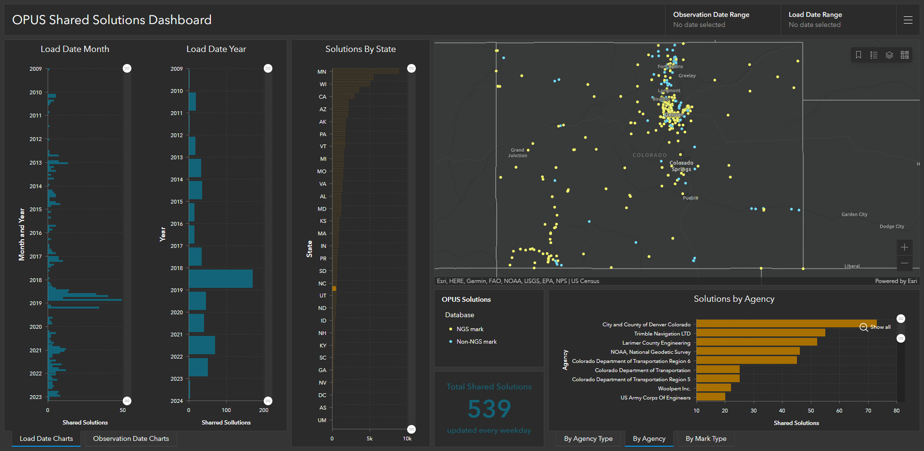
OPUS Shared Solutions in Colorado

Slide 32
OPUS Projects Deep Dive

Slide 33

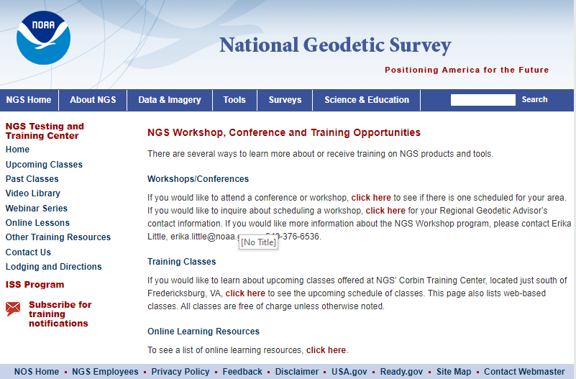
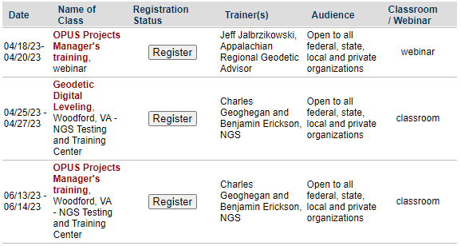
OPUS Projects Training

Slide 34
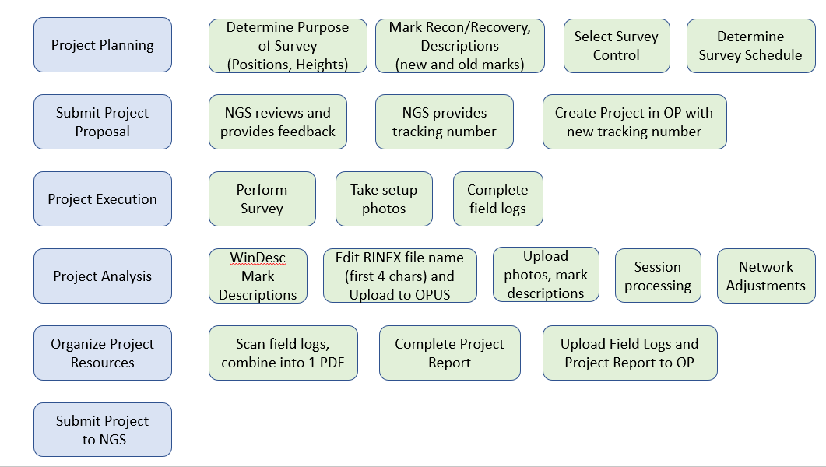
OPUS Projects Bluebooking Summary

Slide 35
OPUS Projects
Free, web-based software
  • Online training available
  • Designed for managing campaign-style GPS surveys
  • Multiple repeat occupations of several marks
  • Ability to add GPS data from NOAA CORS Network
  • Session baseline processing using PAGES
  • Customize tropospheric delay models, elevation cutoff masks,
  constraint weighting
  • Network least squares adjustments of multiple sessions
  • Choice of reference frames and geoid models
  • Currently requires ≥ 2-hour static GPS observation for post-processing

Slide 36
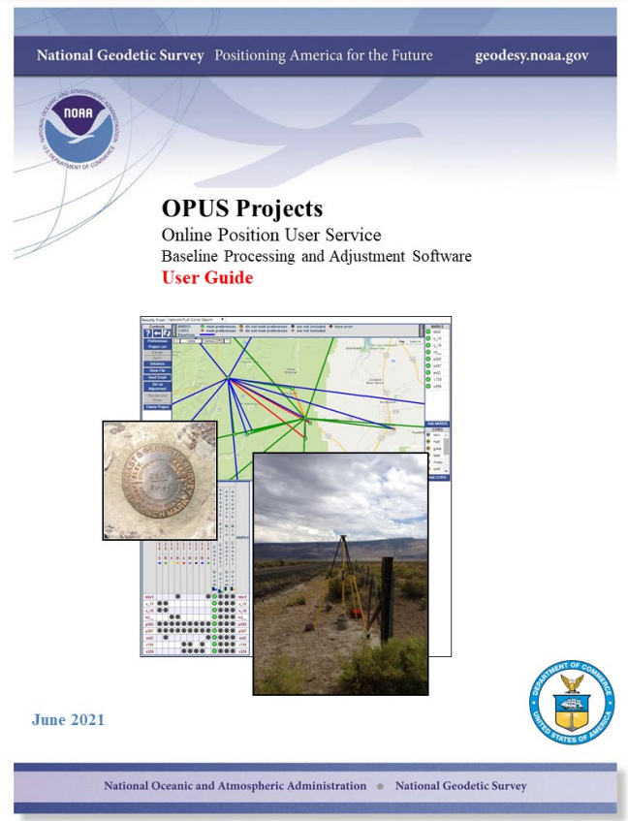
Great News!
There is a pdf User Guide with detailed instructions
Transitioning to an HTML User Guide with OPUS Projects 5.1 going to Production
https://geodesy.noaa.gov/OPUS-Projects/docs/Documentation.pdf
https://beta.ngs.noaa.gov/OPUS-Projects/user_guide/user_guide.html

Slide 37

Planning Your Project
Exploring the requirements for planning a successful GNSS project for submission to NGS for publication
What survey marks will I use as control?
What is the project’s objective?
How accurate does my survey need to be?

Slide 38
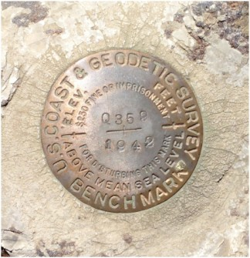
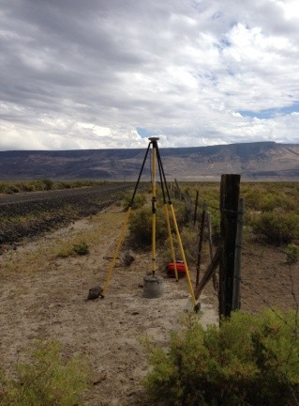
Project Objectives
If your project objectives include any of the following, OPUS-Projects is an excellent tool…
Least squares adjustment of a static GPS survey network
  - Network solution for simultaneously occupied user marks
  - Aligned to NAD 83, NAVD 88 or other datums in the NSRS
Establishment and publication of new control
          - Submittal of survey to NGS for consideration of inclusion in
          national database of survey control, available through NGS
          datasheets
Check on existing survey control
Verification of published coordinates and/or heights on
existing marks

Slide 39
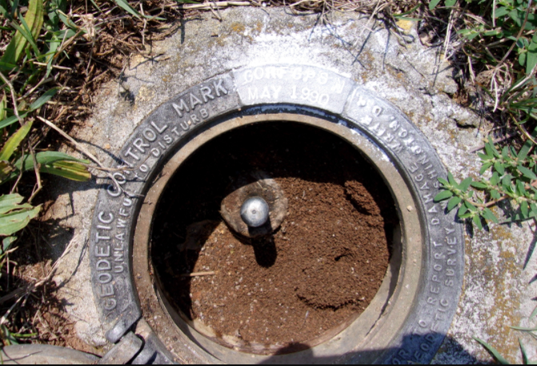
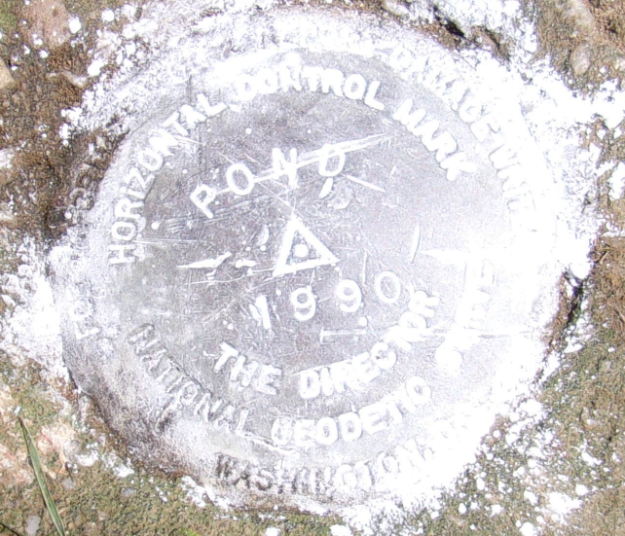
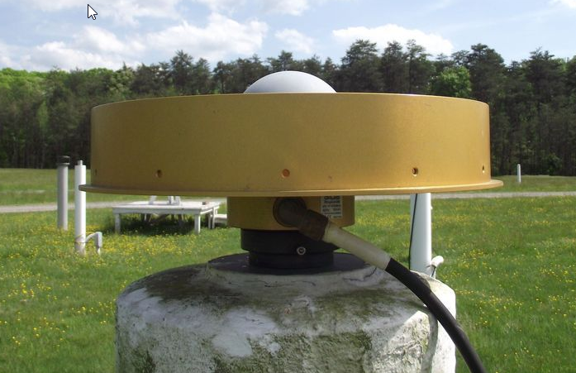
Important Considerations
1. Is the project horizontal (lat/lon) only?
What are good horizontal control stations? (Hint: CORSs)
2. Do you need vertical (orthometric heights), too?
What are valid vertical control marks? (Hint: BMs)

Slide 40
Important Considerations
GPS is 3-D technology
Latitude
Longitude
Ellipsoid Height
GPS is more accurate horizontally than vertically
Vertical requirements “drive” survey design

Slide 41
Planning Your Survey
Horizontal – only GPS Survey
Set/identify new marks for survey
Choose horizontal control
        - Select CORSs
- Recover passive marks in
project vicinity (if desired)
Develop a session schedule
- Occupation durations
- Repeat occupations
Assign a 4-character ID to your user marks
Horizontal + Vertical GPS Survey
Set/identify new marks for survey
Choose horizontal control
        - Select CORSs
- Recover passive marks in project vicinity
(if desired)
Find vertical control distributed throughout the project
        - Recover valid bench marks
- Spacing requirements
Develop a session schedule
- Occupation durations
- Repeat occupations
Assign a 4-character ID to your user marks

Slide 42
Outline
Set/identify new marks for survey
Choose horizontal control
  Select CORSs
  Recover passive marks in project vicinity (if desired)
Find vertical control distributed throughout the project
  Recover valid bench marks
  Spacing requirements
Develop a session schedule
  Occupation durations
  Repeat occupations
Assign a 4-character ID to your user marks

Slide 43
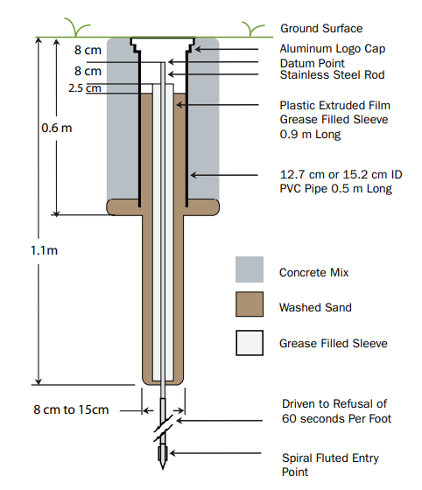
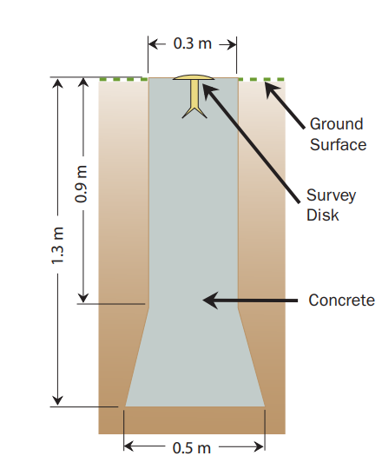
Setting New Marks
Smith, C.L. (2010). “Bench Mark Reset Procedures”, National Geodetic Survey, Silver Spring, MD

Slide 44
Outline
Set/identify new marks for survey
Choose horizontal control
  Select CORSs
  Recover passive marks in project vicinity (if desired)
Find vertical control distributed throughout the project
  Recover valid bench marks
  Spacing requirements
Develop a session schedule
  Occupation durations
  Repeat occupations
Assign a 4-character ID to your user marks

Slide 45
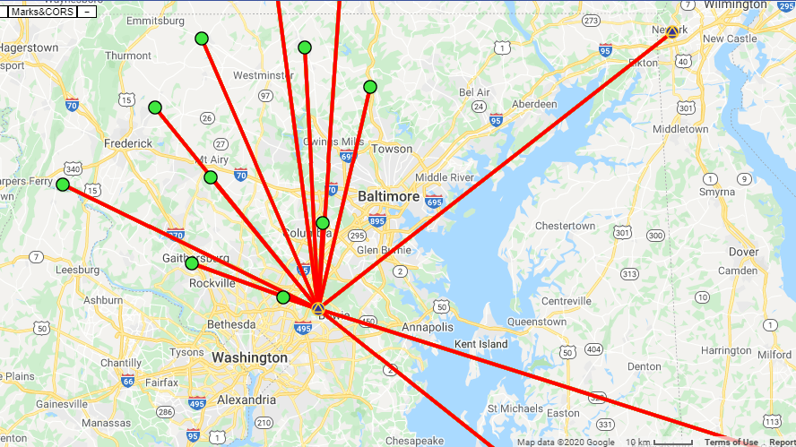
Select CORSs for Control
One of the more critical aspects of designing your project
OPUS-Projects automatically loads CORSs into each session from the OPUS-S solutions
Best practice is to check the quality of the CORSs prior to starting your project—have a plan before your survey!
The User Guide provides more details

Slide 46
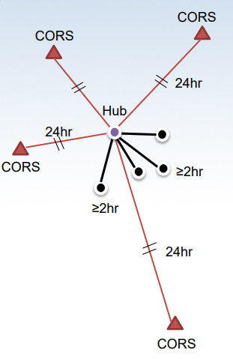
CORS Considerations
"Hub design" recommended by NGS
Hub to project marks recommended to be ~100 km
Use multiple CORSs
Use one very long baseline from hub to CORS (improves tropospheric modeling)
OPUS-Projects does session baseline processing

Slide 47
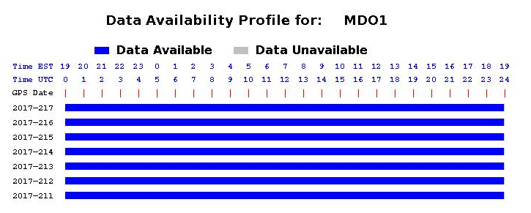
CORS Selection Criteria
Data must be available at the time of the survey!

Slide 48
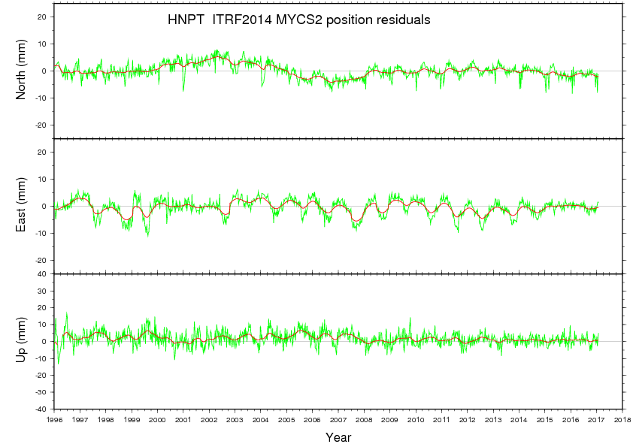
CORS Selection Criteria
Data must be available at the time of the survey!
Longer time series likely leads to better coordinates

Slide 49
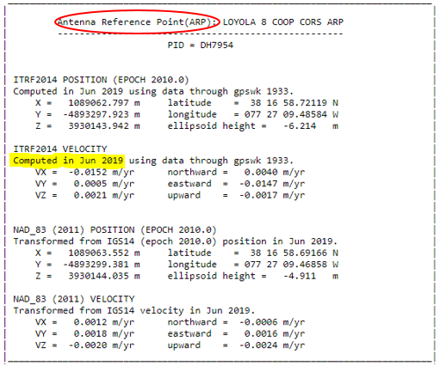
CORS Selection Criteria
Data must be available at the time of the survey!
Longer time series likely leads to better coordinates
Computed velocities (from CORS Position and Velocities page –as opposed to “modeled velocities”)

Slide 50
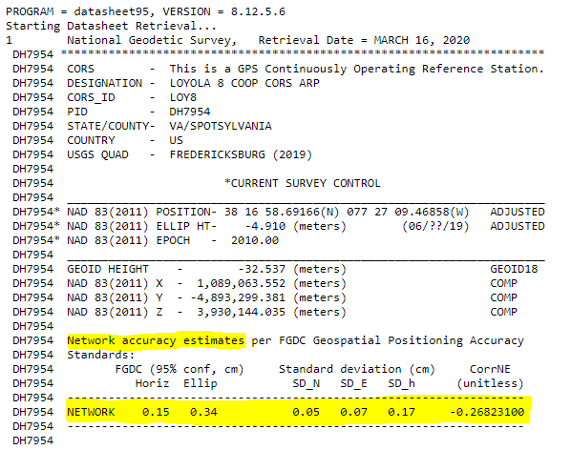
CORS Selection Criteria
Data must be available at the time of the survey!
Longer time series likely leads to better coordinates
Computed velocities (from CORS Position and Velocities page –as opposed to “modeled velocities”)
Good network accuracies (< 3cm EH, <1.5cm Lat/Lon) – see CORS datasheet

Slide 51
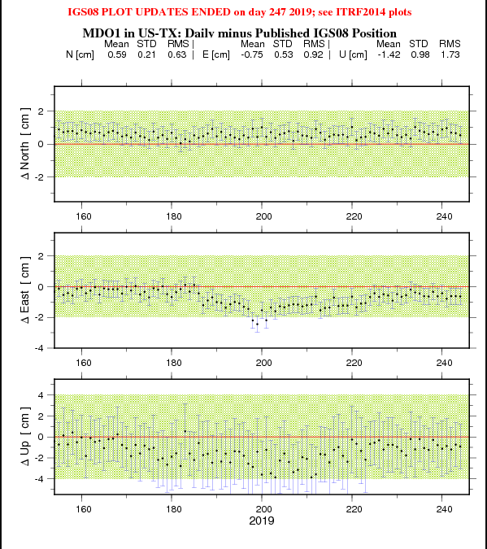
CORS Selection Criteria
Data must be available at the time of the survey!
Longer time series likely leads to better coordinates
Computed velocities (from CORS Position and Velocities page –as opposed to “modeled velocities”)
Good network accuracies (< 3cm EH, <1.5cm Lat/Lon) – see CORS datasheet
Short term plots show low RMS, no bias, and consistent data
Bias shown here

Slide 52
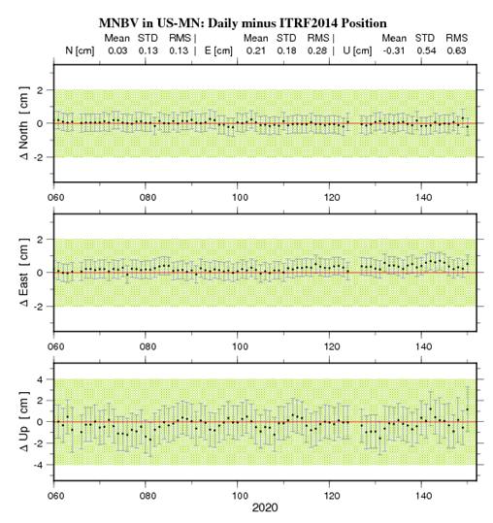
CORS Selection Criteria
Data must be available at the time of the survey!
Longer time series likely leads to better coordinates
Computed velocities (from CORS Position and Velocities page –as opposed to “modeled velocities”)
Good network accuracies (< 3cm EH, <1.5cm Lat/Lon) – see CORS datasheet
Short term plots show low RMS, no bias, and consistent data
Better Data!

Slide 53
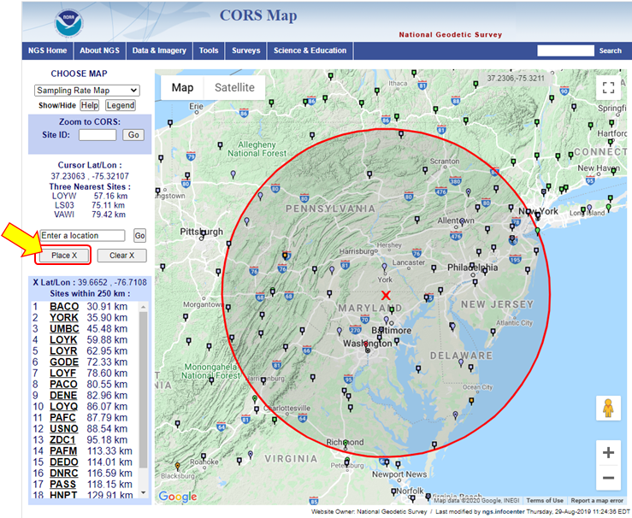
CORS Selection Criteria
Data must be available at the time of the survey!
Longer time series likely leads to better coordinates
Computed velocities (from CORS Position and Velocities page –as opposed to “modeled velocities”)
Good network accuracies (< 3cm EH, <1.5cm Lat/Lon) – see CORS datasheet
Short term plots show low RMS, no bias, and consistent data
Select a distant CORS (375 - 800 km away) for tropospheric modeling

Slide 54
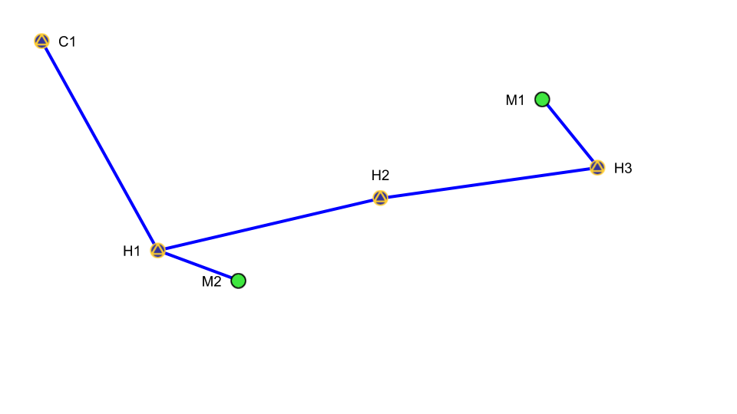
CORS Selection – additional thoughts
For most projects, plan to use the same hub in every session
EXCEPT:
For large projects, you may need more than one hub in a session
If user marks are spread out so far in a session that it is not possible to have one hub within 100 km, then designate more hub(s)
For multi-hub projects, designate the same CORSs as hubs in every session

Slide 55
Outline
Set/identify new marks for survey
Choose horizontal control
  Select CORSs
  Recover passive marks in project vicinity (if desired)
Find vertical control distributed throughout the project
  Recover valid bench marks
  Spacing requirements
Develop a session schedule
  Occupation durations
  Repeat occupations
Assign a 4-character ID to your user marks

Slide 56
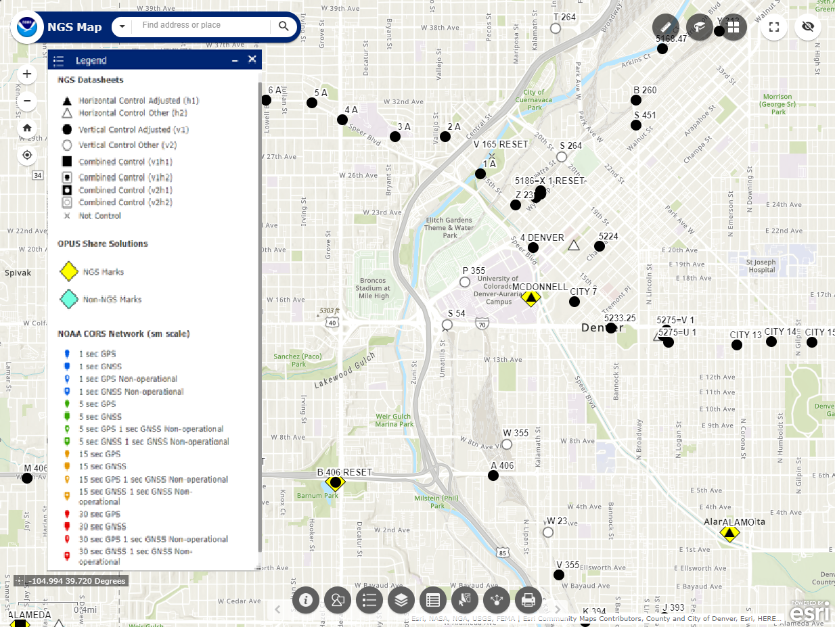
Passive Control
How to find control in your area: NGS Map
https://geodesy.noaa.gov/datasheets/ngs_map/
Includes Basic and Advanced Tutorials
You can use the Search utility at the top left to input city, state, or lat/lon
You can also search by PID, Designation and CORS Site ID
This will show you what control may be present. Use the NGS “Passive Mark Page” to get more detailed information on each mark of interest

Slide 57
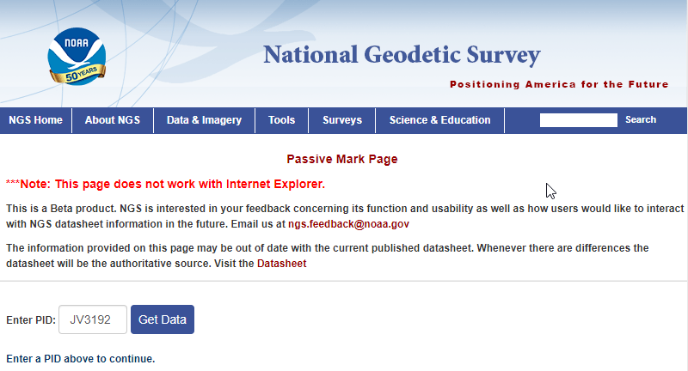
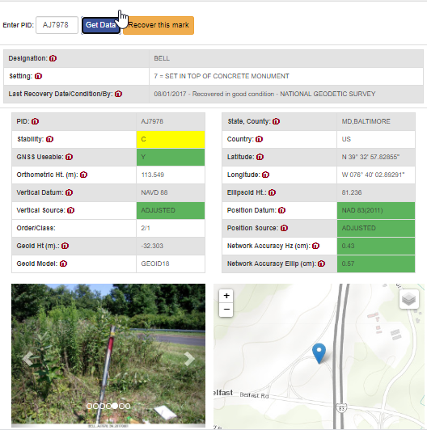
Passive Control
Try the NGS Passive Mark Page to get more information on each mark of interest (https://beta.ngs.noaa.gov/datasheets/passive-marks/index.html)
Input Permanent Identifier (PID)

Slide 58
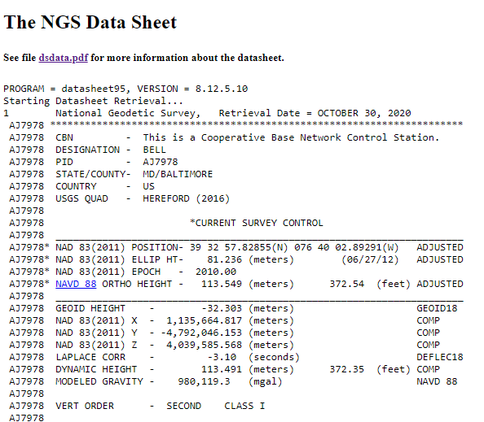
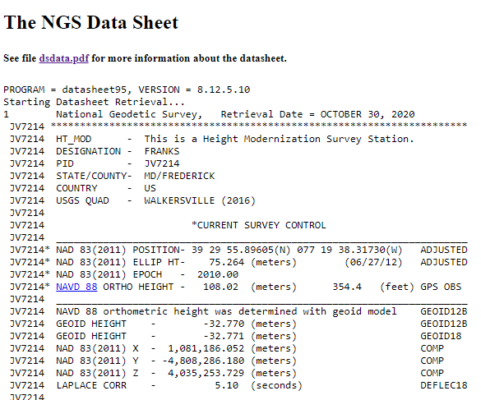
Recommended Vertical Control
Find bench marks that are:
Leveled heights (ADJUSTED and RESET)
GPS-Derived Orthometric Height
  Height Mod Heights (2cm/5cm)
“HT_MOD”
Height published to 2 decimal places
Leveled
Height published to 3 decimal places

Slide 59
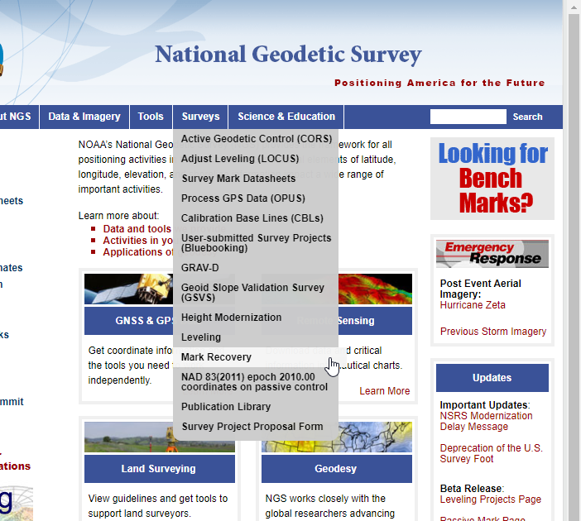
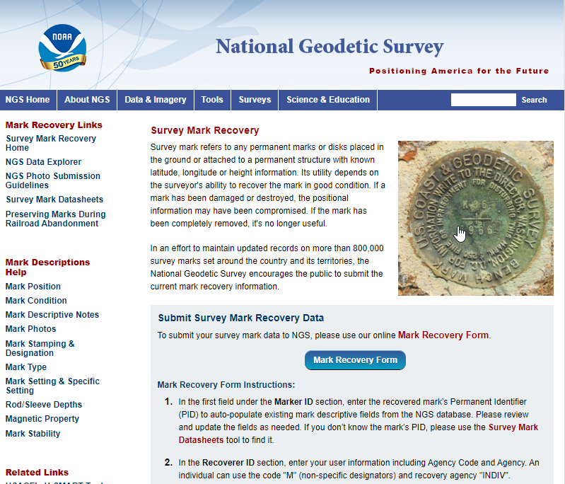
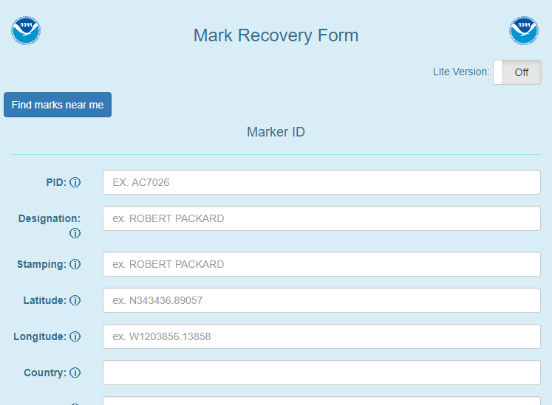
Mark Recovery
Try the NGS mark recovery tool for existing marks: https://geodesy.noaa.gov/cgi-bin/mark_recovery_form.prl
Note: Online mark recovery will not help you build your WinDesc Descriptions file

Slide 60
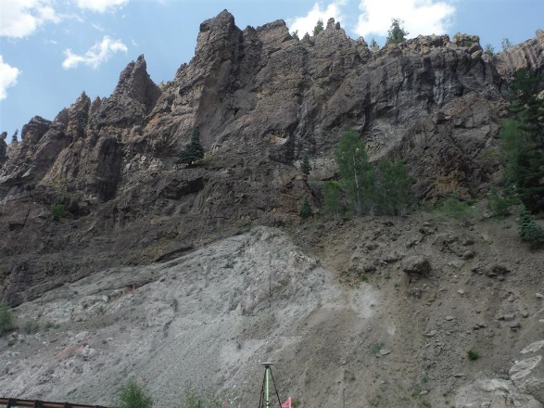


Field validation
Time to hit the field!
Are the marks still in good condition?
Do they have clear, unobstructed sky view?
Sky view from fish-eye camera lens

Slide 61
Outline
Set/identify new marks for survey
Choose horizontal control
  Select CORSs
  Recover passive marks in project vicinity (if desired)
Find vertical control distributed throughout the project
  Recover valid bench marks
  Spacing requirements
Develop a session schedule
  Occupation durations
  Repeat occupations
Assign a 4-character ID to your user marks

Slide 62
Requirements for Vertical Control
Non-control or “new” marks must be within a certain distance of 2 vertical control marks
OPUS-Projects currently* requires a minimum of 2-hour occupations per session
Maximum distance between new marks and vertical control is between 30-50 km, based on occupation session duration
Recommended/Permitted occupation per session
Not Permitted*
*OP 5.1 permits real-time vectors from shorter occupations

Slide 63
Requirements for Vertical Control
Deep dive on control mark spacing
30km radius
Occupy bench marks with “valid” orthometric heights
  Distributed every ~30-50 km
  Minimum of two (2) valid control marks per non-control or new mark
  Adhere to distance-occupation requirement
Use latest hybrid geoid model (i.e., GEOID18)
  H = h - N
Perform constrained vertical least squares adjustments of the GNSS network holding the vertical control heights constrained
Existing vertical survey control mark
New survey control mark

Slide 64
Requirements for Vertical Control
How many valid vertical control marks would you need* at a 30 km spacing?
*At a minimum
30km radius
Existing vertical survey control mark
New survey control mark

Slide 65
Requirements for Vertical Control
How many valid vertical control marks would you need at a 30 km spacing?
30km radius
6 valid vertical control marks within 30 km would cover minimum requirements for only 3 new marks!
30 km spacing require a minimum of only 2-hr occupations
Existing survey control mark
New survey control mark
New survey control mark with sufficient vertical control

Slide 66
Requirements for Vertical Control
By increasing your spacing to 40km all 9 new marks would be covered by at least two vertical control marks.
40km radius
However, minimum occupation time would increase from 2 to 4 hours
Existing survey control mark
New survey control mark
New survey control mark with sufficient vertical control

Slide 67
Outline
Set/identify new marks for survey
Choose horizontal control
  Select CORSs
  Recover passive marks in project vicinity (if desired)
Find vertical control distributed throughout the project
  Recover valid bench marks
  Spacing requirements
Develop a session schedule
  Occupation durations
  Repeat occupations
Assign a 4-character ID to your user marks

Slide 68
Requirements for Vertical Control
Now that we’ve discussed distance (X-axis), let’s talk Occupation Length (Y-axis)
To meet NGS requirements, you need to do a minimum of two 2-h observations on every mark in the network.
But how accurate will it all be?
Two important considerations:
Redundancy (how many reps)
Duration (how long an observation)
Recommended/Permitted
Not Permitted*
*Future developments of OP will permit real-time vectors from shorter occupations

Slide 69

Accuracy of OPUS versus Occupation Duration
How long should each occupation be?
A look at OPUS Accuracies
Source: Gillins et al. 2019

Slide 70

Accuracy of OPUS-Projects
OPUS Projects Network Accuracies
Most important variable for reducing error is Total Time
Note! Cumulative time, not individual occupations

Slide 71
Accuracy of OPUS-Projects
95% Confidence Interval values shown
(Ellipsoid Height)

Slide 72
“Design Curve” for OPUS-Projects
Vertical Network Accuracies, OPUS Projects
Source: Park et al. 2017
95% CI values shown
TOTAL time on mark

Slide 73
Recommendations
Summary on Expected Accuracy of OPUS-Projects
Expected Ellipsoid Height Accuracy | Expected Horizontal Accuracy | Total Time on Mark (h) | Recommended Sessions and duration
3.0 cm | 1.5 cm | 4 | (2) 2-h
2.5 cm | 1.3 cm | 8 | (2) 4-h or (3) 3-h
2.0 cm | 1.0 cm | 20 | (2) 10-h or (3) 7-h

Slide 74
Planning Your Project
Recap:
You have identified your project goals/objectives
You have determined the number/distribution of control marks required in your project area to meet these objectives
You have identified and recovered potential marks to control your project
You have identified CORSs that you intend to use as control for your project

Slide 75

Additional project considerations
FAA Airport Control Surveys: PACS and SACS/AC-16 -these project have separate requirements vis-a-vis control and occupation lengths
Equipment requirements and recommendations
  L1 & L2 calibrated antennas, same antenna types if possible
  Calibrated fixed-height GPS tripods
Best practices:
Best Practices for Minimizing Errors During GNSS Data Collection (video)
GNSS Positioning: Survey Planning and Data Acquisition (online lesson)
Foundations of Global Navigation Satellite Systems (online lesson)

Slide 76


Submit your Project Plan for Review
Now that you have your Project Plan, time to submit it to NGS for review!

Slide 77
NGS Survey Project Proposal
Why submit your GNSS Project Plan to NGS (https://geodesy.noaa.gov/SurveyProposal/ ):
Subject Matter Expert will review your plan, make sure it will meet NGS standards
NGS will assign a Project Tracking ID, which will enable you to use the advanced features of OPUS Projects
With a Project Tracking ID, you will be able to submit your project to NGS for consideration of inclusion into the national database of geodetic control, available through published datasheets
If you do not intend on submitting your project to NGS, but still wish your project to be tied to the national reference frames/datums, you can use the “dummy” tracking ID “0000”

Slide 78



Creating your OPUS Project
Ready to create your project!

Slide 79

Creating your OPUS Project
Insert your NGS Project Tracking ID here
By associating a NGS Project Tracking ID to your project, the advanced features of OP (which support submitting a project to NGS) will become available

Slide 80

Ready to Upload Data!
Congratulations!
You have successfully created a project:
The project plan has been reviewed by NGS
The advanced features of OPUS Projects are now enabled
Now you are ready to upload your data files

Slide 81
Outline
Set/identify new marks for survey
Choose horizontal control
  Select CORSs
  Recover passive marks in project vicinity (if desired)
Find vertical control distributed throughout the project
  Recover valid bench marks
  Spacing requirements
Develop a session schedule
  Occupation durations
  Repeat occupations
Assign a 4-character ID to your user marks

Slide 82










GNSS observation files
GNSS observation files are typically exported from GNSS receivers in proprietary files, with manufacturer-specific naming rules.
Although OPUS can accept some raw data files (e.g. *.DAT), better not to assume OPUS can read your raw data file
NGS recommends using vendor-specific RINEX converter
RINEX Converters
Rinex File

Slide 83

Best practices for GNSS observation files
When converting raw data files to RINEX, best practice is to ensure all header information is correct
For ease of associating specific RINEX files to specific user marks in your project, start each RINEX file name with the corresponding OPUS Projects 4-Character mark ID
Recommended RINEX file naming structure: start w/ 4CharID, Day-of-year, session#
e.g. PIP12810.20O
More on 4-Character IDs in OP Training
4CharID
DOY
Session#

Slide 84

Session Processing Overview
The software PAGES is used to process baselines
The network design specified in session processing is carried through to the eventual network solutions.
Results are sent via email and can be seen via “Show Files” button on the Manager or Session webpages.

Slide 85

Session Processing Overview
OPUS recommends one hub* constrained 3D
Nothing else constrained
*Note: user may have to select additional hubs if needed – see User Guide

Slide 86

Session Processing Results
Standard error of unit weight should be near 1.0
Verify total # of marks
OVERALL RMS should be small (≤ 2cm)
A priori coordinate shifts should be small (≤ 2 cm horizontal, ≤ 4 cm vertical)

Slide 87


Session Processing Results
Obs Used should be high
AMB Fixed should be high
P2P’s should typically be small

Slide 88
Network Solutions Overview
Network solutions apply least squares adjustments (and various amounts of error reduction) to session baselines.
Network solutions will not recreate different baselines than the ones already created in session processing.
Preliminary Network Solution
Seen in OP101: OP recommends holding the hub (CORS) constrained in 3D; many other adjustments possible*
Uses adjustment (and error reduction) software GPSCOM
Horizontal Network Solutions
Only available with NGS Project Tracking ID or “0000”
Uses adjustment software ADJUST
Requires a Preliminary Network Solution using GPSCOM
*User should use hub design for submitting project to NGS

Slide 89

Network Solutions Overview
To submit your project to NGS, a sequence of 5 network adjustments are needed:
Preliminary
Horizontal Free
Horizontal Constrained
Vertical Free
Vertical Constrained

Slide 90
Why 5 Adjustments?
Each adjustment plays a critical role:
Preliminary Adjustment: provides input to subsequent network adjustments
Horizontal Free Adjustment: evaluates that the observations are internally consistent while being minimally constrained to the geometric datum
Horizontal Constrained Adjustment: evaluates that your network is correctly and fully constrained to the geometric datum
Vertical Free Adjustment: equivalent to the horizontal free adjustment, but minimally constrained to the vertical datum
Vertical Constrained Adjustment: evaluates how your network should be correctly and fully constrained to the vertical orthometric datum

Slide 91
Solution Naming Conventions
OP will use a two-part name for your solutions. The first part of the name will be called “network.” This cannot be changed.
The second part of the name by default will be called “final,” so a Preliminary Adjustment will be called “network.final.”
If you run multiple solutions of the same adjustment, OP will overwrite each run unless the user provides a different name for each solution (e.g. network.test1).
Pro Tip: If multiple preliminary solutions are computed, it is recommended to delete all versions except the one to be carried forward to the next step (Horizontal Free Adjustment)

Slide 92
OPUS Projects Training will go into great depth
about Session and Adjustment Outputs

Slide 93

Beta OPUS-Projects 5.1 for RTK/RTN Vectors
In Production Soon
(4-6 weeks)
NGS is developing a new Standardized GNSS Vector EXchange Format (GVX) that will be used to ingest vectors into OPUS Projects

Slide 94

Beta OPUS-Projects 5.1 for RTK/RTN Vectors

Slide 95
Demonstrations

Slide 96


Magnitude of the Deflection of the Vertical
Questions?
Brian Shaw
brian.shaw@noaa.gov

