Slide 1
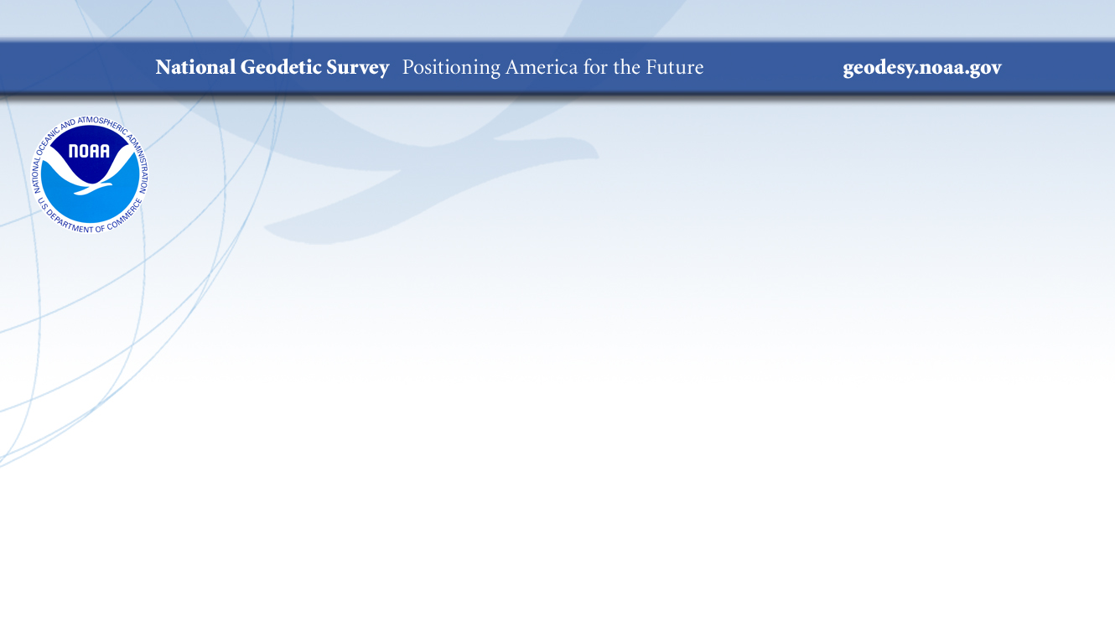
NSRS Maintenance and
Modernization Efforts
Rocky Mountain Surveyors Summit
2023 Conference
Brian Shaw
brian.shaw@noaa.gov
February 22, 2023

Slide 2

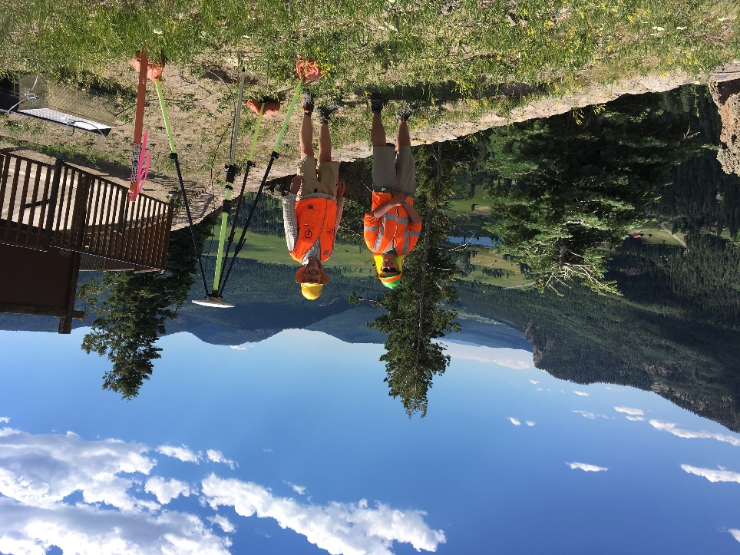

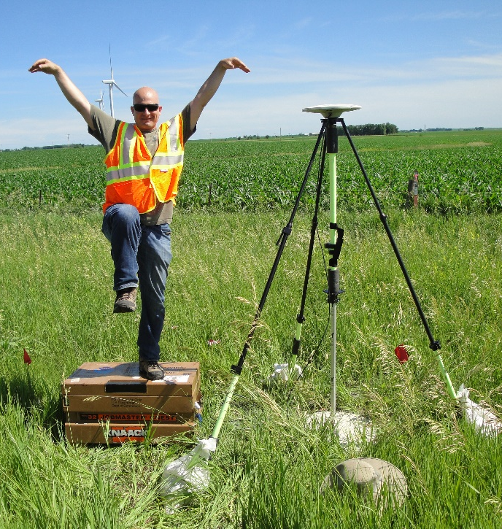
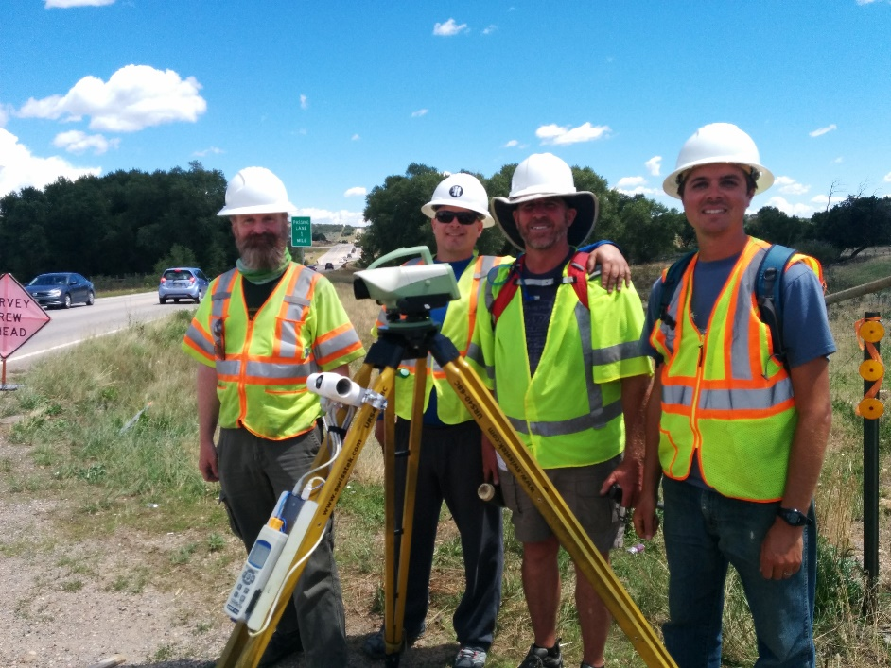
Brian Shaw
Rocky Mountain Advisor
brian.shaw@noaa.gov

Slide 3
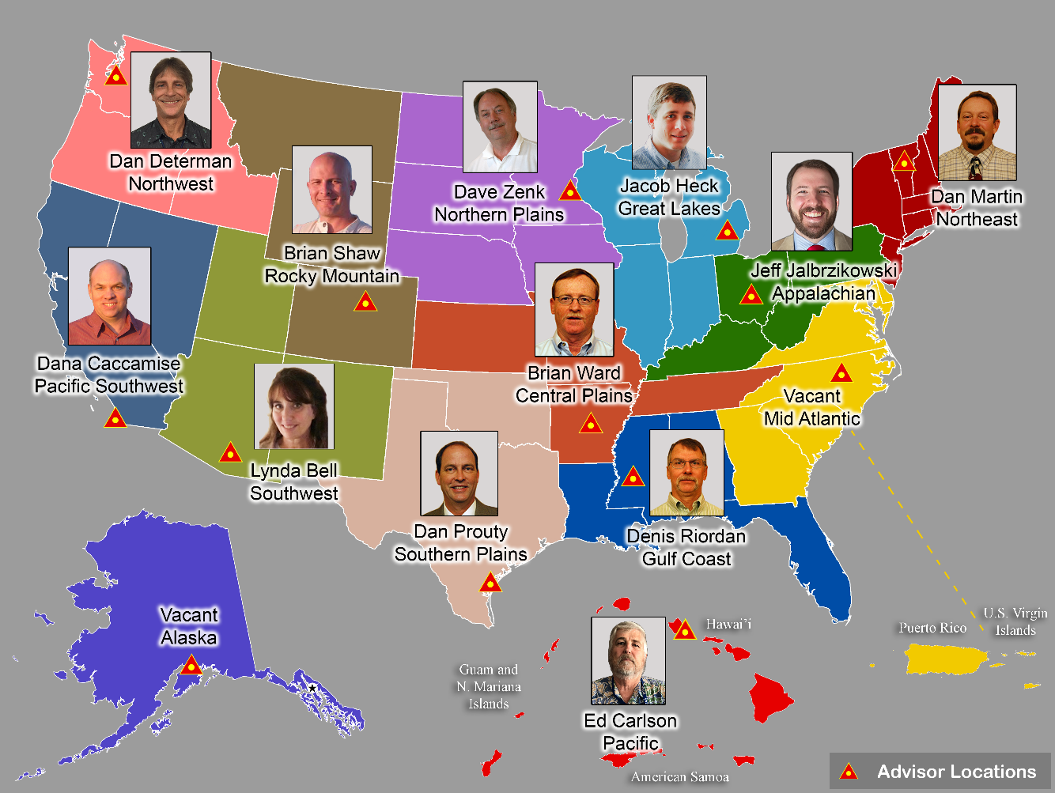
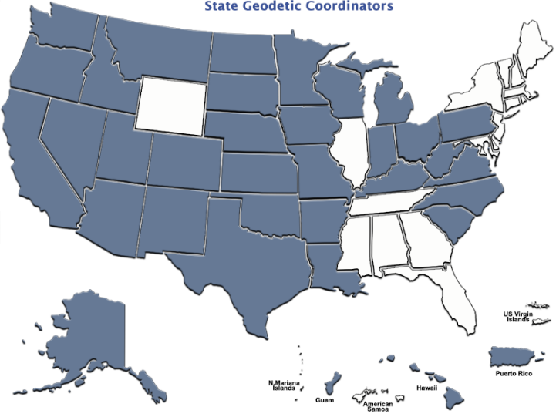
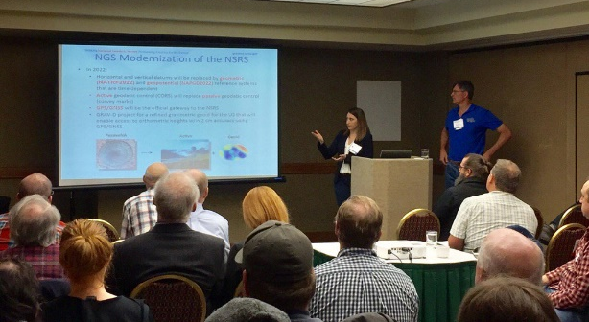
Importance of Coordination
14 Advisors
(2 acting)
38 Coordinators
Notes:
NGS Regional Geodetic Advisors
https://geodesy.noaa.gov/ADVISORS/
State Geodetic Coordinators
https://geodesy.noaa.gov/ADVISORS/state-geodetic-coordinators.shtml

Slide 4
NSRS Modernization Delay
Operational, workforce retention and other issues have delayed NSRS Modernization
SPCS2022 zones should be finalized in 2023 but will not be rolled out until all of the NSRS is modernized.
GPS on Bench Marks deadline extended
September 30, 2023
https://geodesy.noaa.gov/datums/newdatums/delayed-release.shtml
https://geodesy.noaa.gov/datums/newdatums/FAQNewDatums.shtml

Slide 5

NGS Resources –Webinar Series
  *Certificates of Attendance
  https://geodesy.noaa.gov/web/science_edu/webinar_series/

Slide 6

NGS Resources – Geospatial Summits
The NGS Geospatial Summit provided updated information about the planned modernization of the National Spatial Reference System (NSRS).
NGS plans to replace the North American Datum of 1983 (NAD 83) and the North American Vertical Datum of 1988 (NAVD 88) in the coming years.
NSRS Modernization will impact federal mapping agencies, engineers, surveyors, and many other geospatial applications and user groups.
(2021, 2019 recorded sessions) https://geodesy.noaa.gov/geospatial-summit/

Slide 7

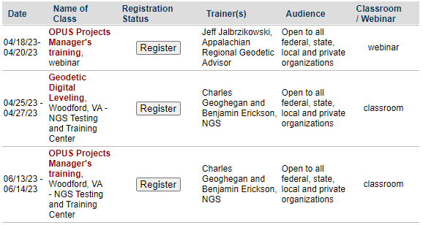
NGS Resources – NGS Training Center
https://geodesy.noaa.gov/web/science_edu/training/

Slide 8
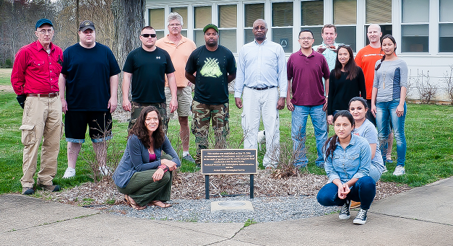
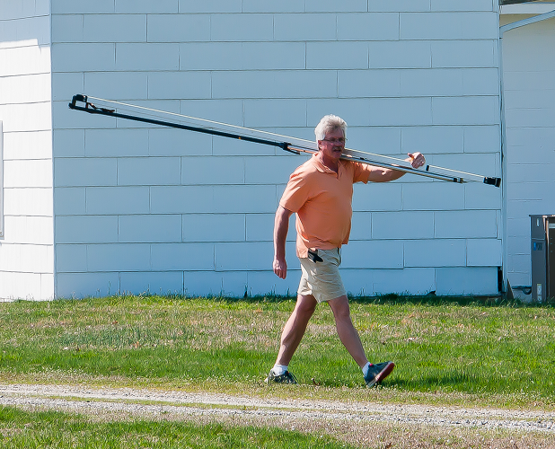
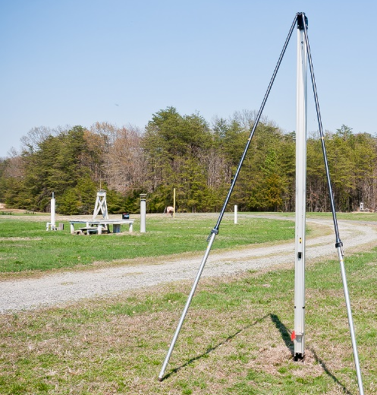
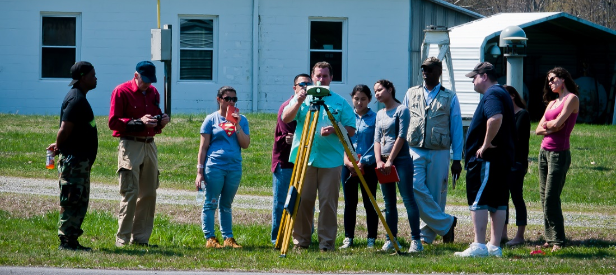
NGS Resources – NGS Training Center

Slide 9
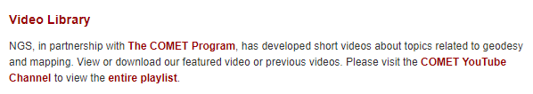
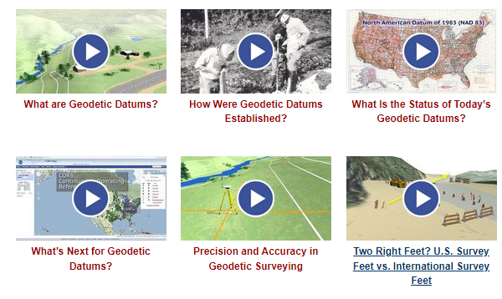
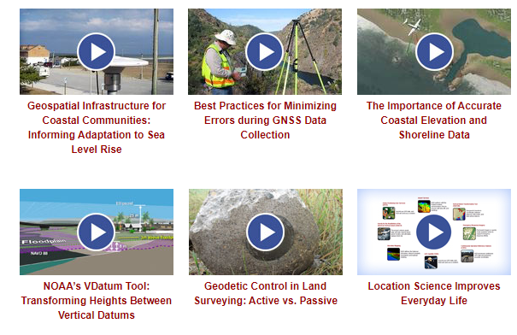
NGS Resources – Educational Videos
  https://geodesy.noaa.gov/datums/newdatums/WatchVideos.shtml

Slide 10
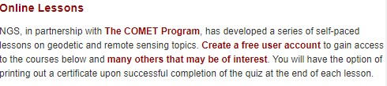
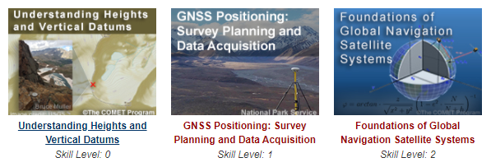
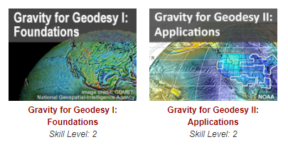
NGS Resources – Online Lessons
  https://geodesy.noaa.gov/web/science_edu/online_lessons/index.shtml

Slide 11
NGS Resources – Educational Videos
  https://geodesy.noaa.gov/datums/newdatums/WatchVideos.shtml

Slide 12
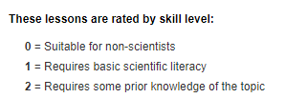
NGS Resources – Online Lessons
  https://geodesy.noaa.gov/web/science_edu/online_lessons/index.shtml

Slide 13
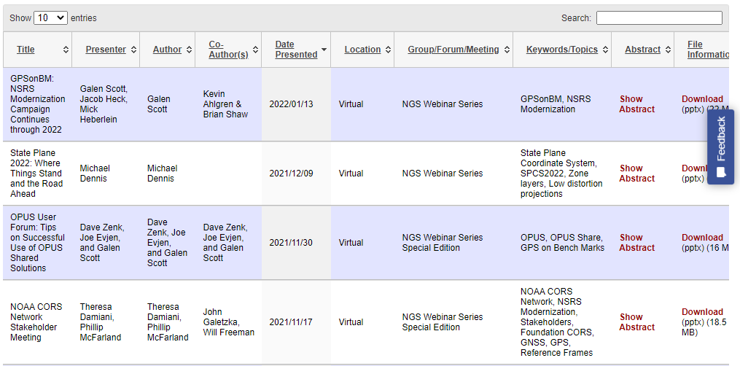
NGS Resources – Presentation Library
  https://geodesy.noaa.gov/web/science_edu/presentations_library/

Slide 14
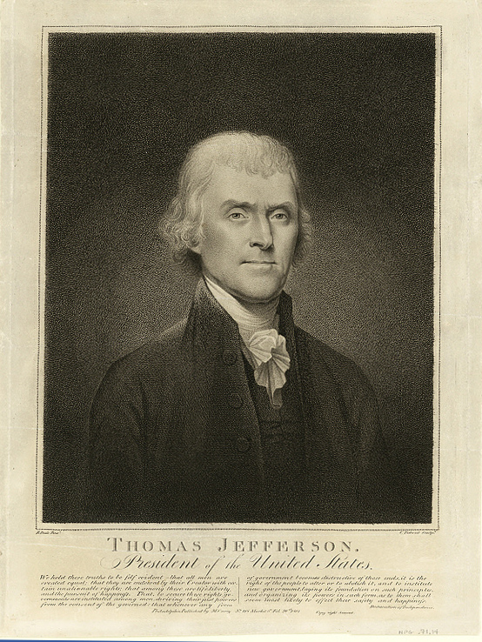
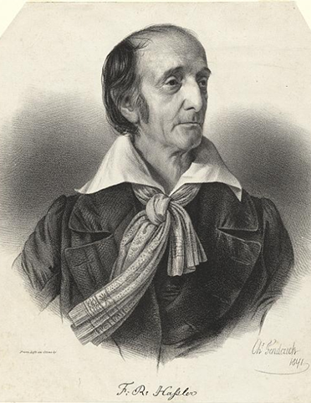



NOAA and NGS
Our Nation’s First Civilian Science Agency
1807
Thomas Jefferson
Survey of the Coast
1811
Ferdinand Hassler
Superintendent
1836
U.S. Coast
Survey
1878
U.S. Coast and
Geodetic Survey
1970
NOAA is established
Notes:
NGS has been around a long time. For more than 200 years, NGS and its predecessor agencies have collaborated with public and private organizations to establish reference stations at precisely determined locations.
We began on a mission established by Thomas Jefferson in 1807 to conduct a “Survey of the Coast” (as the United States Coast Survey).
(Pictured are Thomas Jefferson and Ferdinand Hassler, the first Superintendent of the Coast Survey). We were renamed the U.S. Coast and Geodetic Survey in 1878. NOAA was established in 1970.
Traditionally, precise positioning locations have been identified by setting a survey mark—usually a brass, bronze, or aluminum disk. Locations might also be identified by a deeply driven rod, or a prominent object, such as a water tower or church spire.

Slide 15
NGS’s Mission
To define, maintain and provide access
to the National Spatial Reference System (NSRS) to meet our Nation’s economic, social, and environmental needs.
…………………………………………….........................
The NSRS is a consistent coordinate system that defines latitude, longitude, height, scale, gravity, orientation, and shoreline throughout the United States.
Notes:
The National Spatial Reference System is our nations geospatial infrastructure from which all positioning (with the exclusion of military/DOD) is referenced to.
This system provides a consistent framework that allows people to use data in the same reference system to perform analysis and make meaningful comparisons and decisions from that analysis.

Slide 16
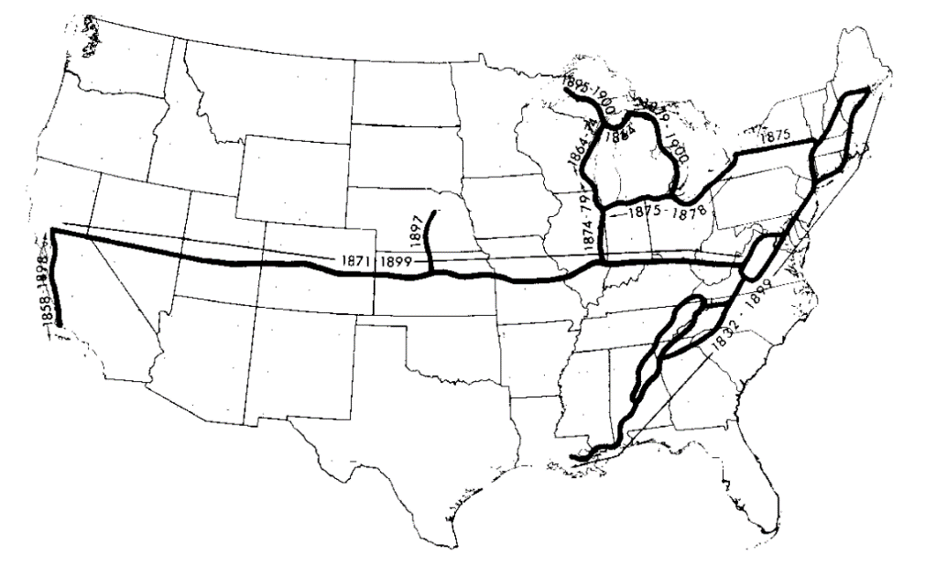
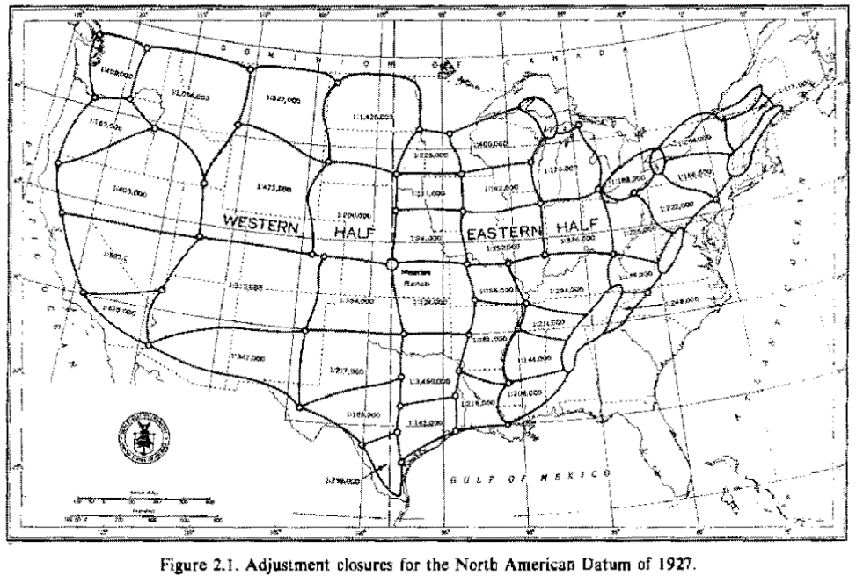
NGS’s Historical Horizontal Networks
US Standard Datum 1900
North American Datum of 1927 (NAD 27)
http://www.geodesy.noaa.gov/PUBS_LIB/NADof1983.pdf
Notes:
The National Spatial Reference System is our nations geospatial infrastructure from which all positioning (with the exclusion of military/DOD) is referenced to.
This system provides a consistent framework that allows people to use data in the same reference system to perform analysis and make meaningful comparisons and decisions from that analysis.

Slide 17
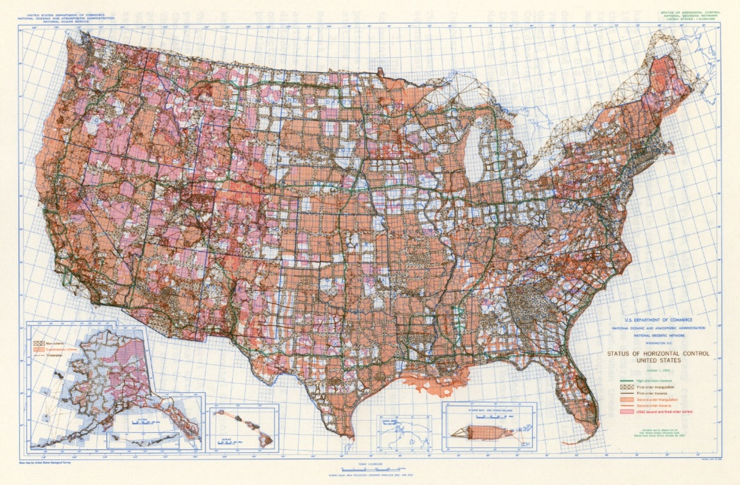
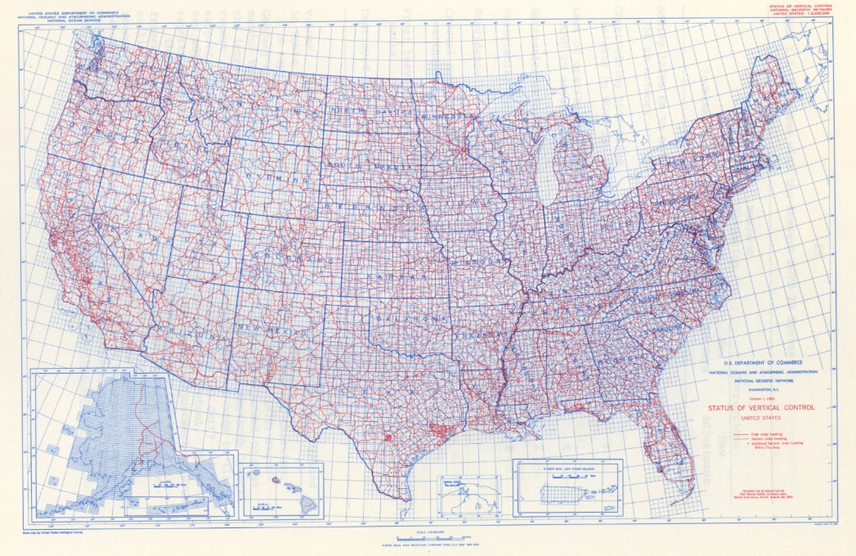
Status of Horizontal Control 1983
Status of Vertical Control 1983
Notes:
The National Spatial Reference System is our nations geospatial infrastructure from which all positioning (with the exclusion of military/DOD) is referenced to.
This system provides a consistent framework that allows people to use data in the same reference system to perform analysis and make meaningful comparisons and decisions from that analysis.

Slide 18
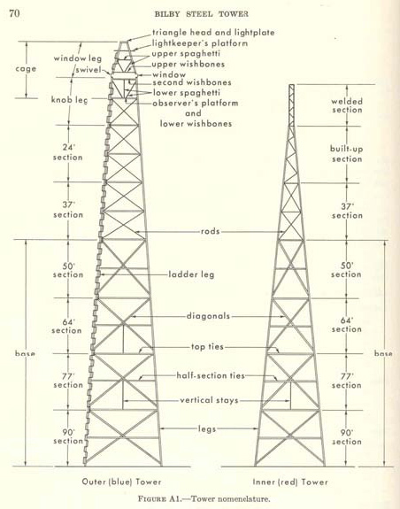
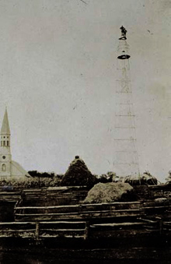
The Bilby Tower
Notes:
The National Spatial Reference System is our nations geospatial infrastructure from which all positioning (with the exclusion of military/DOD) is referenced to.
This system provides a consistent framework that allows people to use data in the same reference system to perform analysis and make meaningful comparisons and decisions from that analysis.

Slide 19
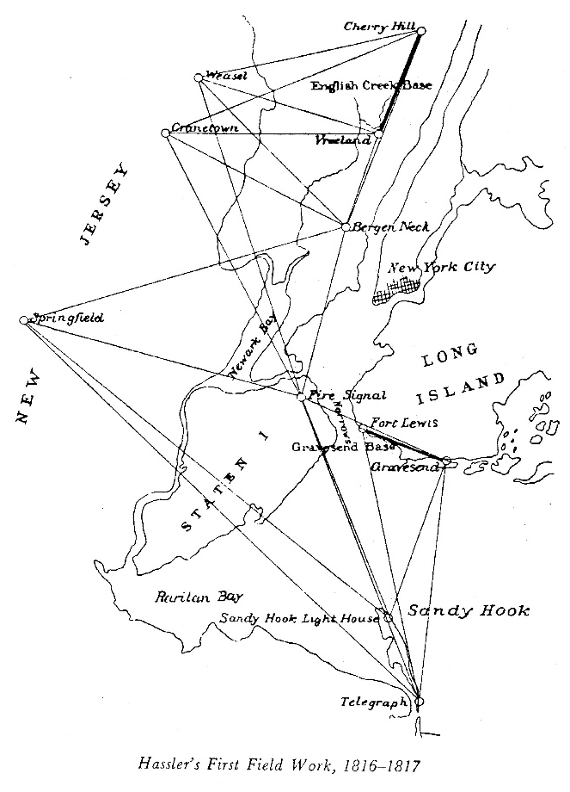
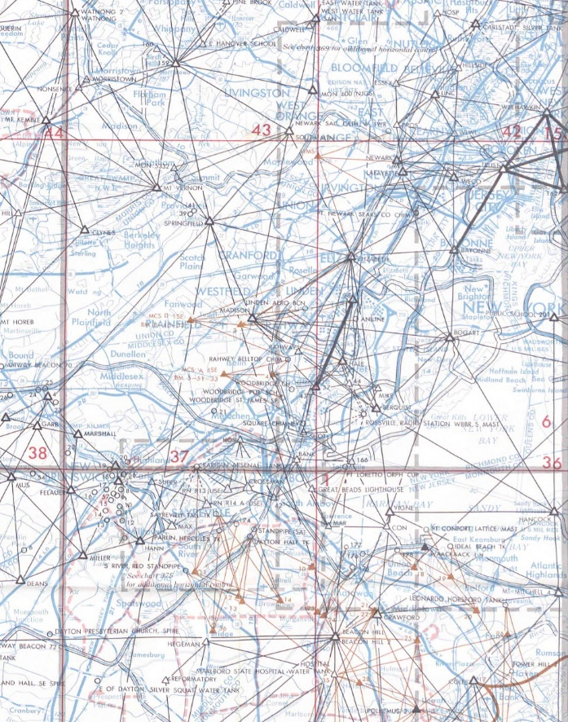
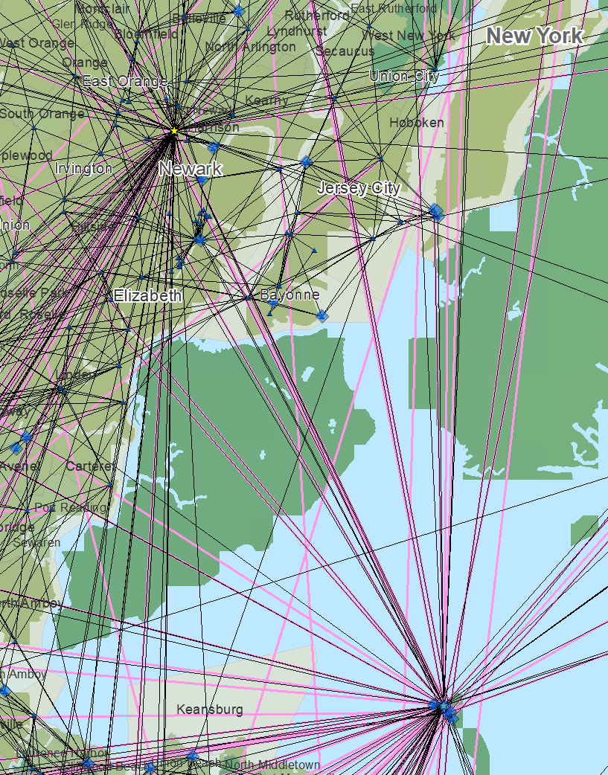
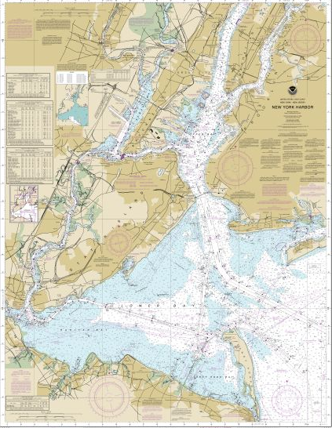
The Importance of Geodesy
1816-1817
1969
Today
Notes:
In 1807 Thomas Jefferson created the Survey of the Coast. Ferdinand Hassler was later appointed the first superintendent and completed the first survey of New York Harbor. Commerce from shipping has always been important and for safe shipping you need to know the bathymetry of the harbors. To understand the bathymetry accurately requires you to know where the land is and the bathymetry relative to these points on land which is where geodesy comes in. This is the reason why in 1878 the name was changed to the U.S. Coast and Geodetic Survey and remained in the name until it was combined with other agencies to form the National Oceanic and Atmospheric Administration.

Slide 20
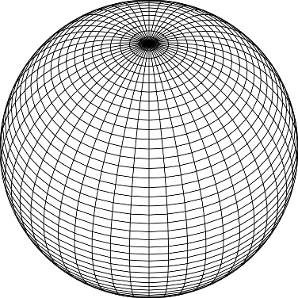
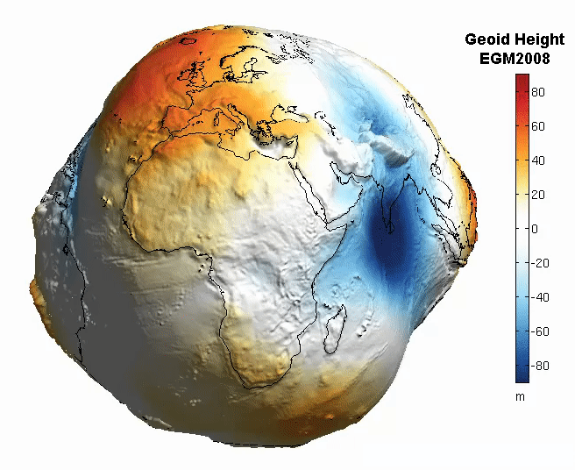
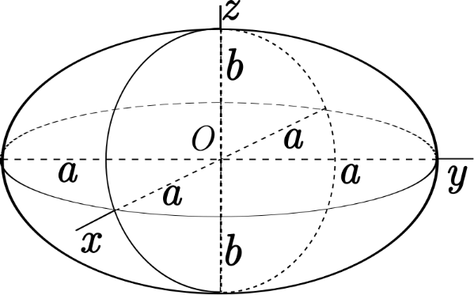
The Earth is Infinitely Complex
Build Models to Simplify
Notes:
Models are used to simplify complex phenomena for humans and computers to understand and perform calculations and analysis.
The geoid is an approximation of sea level and used to calculate elevations (orthometric heights) above this “sea level” surface
Spheroid image https://www.kisspng.com/png-sphere-shape-ball-grid-line-circle-draw-5378189/
Ellipsoid image https://www.kisspng.com/png-figure-of-the-earth-oblate-spheroid-ellipsoid-4129812/
Geoid Image https://www.reddit.com/r/MapPorn/comments/3xf6a0/geoid_height_of_new_global_gravity_field_models/

Slide 21
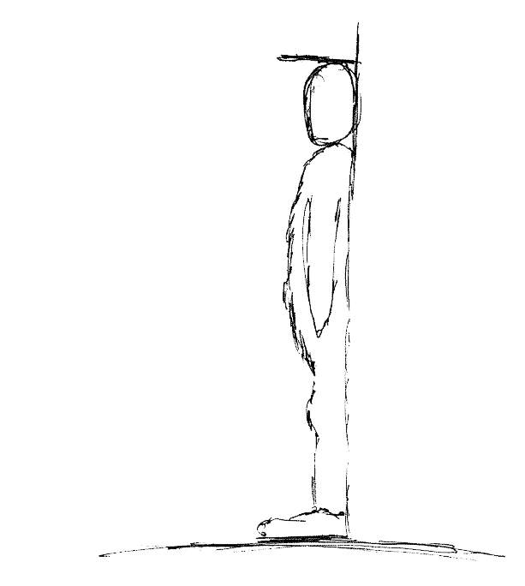
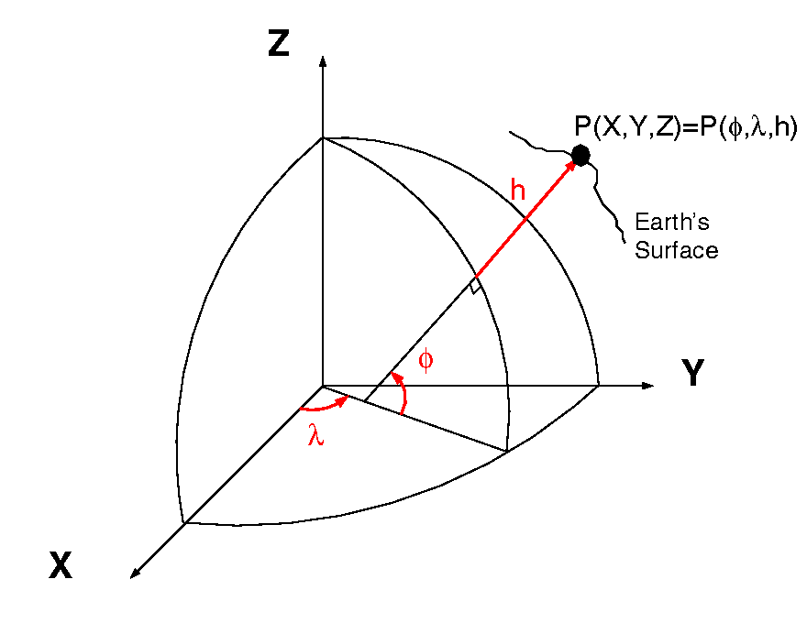
Datums and Reference Frames
60”, 2019
52”, 2018
46”, 2017
aka P(Lat,Lon,Ht)
= ht.
= lat.
= long.
A reference surface or framework to reference your data to for consistency
X,Y,Z vs Lat, Lon, Ht
Notes:
What is a datum? https://oceanservice.noaa.gov/facts/datum.html
Datums Overview https://geodesy.noaa.gov/datums/
New Datums https://geodesy.noaa.gov/datums/newdatums/
Horizontal and Geometric Datums https://geodesy.noaa.gov/datums/horizontal/
Vertical Datums https://geodesy.noaa.gov/datums/vertical/
A Datum or reference frame is in essence a reference surface or framework to reference your data to for consistency.
In the first image on the right there is a person who has been measuring their height over time (2017-2019 in this example). For consistency you can imagine that the floor next to the wall they are being measured is this ‘reference surface’ or datum. Lets say the first measurement was taken when the floor was carpet and you installed hard wood floors before the 2018 measurement you would have in essence changed the ‘reference surface’ and it would be inaccurate to compare the 2018 and 2019 values without a proper transformation, or height offset value.
The second image (when animating) shows why you should not try to compare values when using two different reference surfaces.

Slide 22

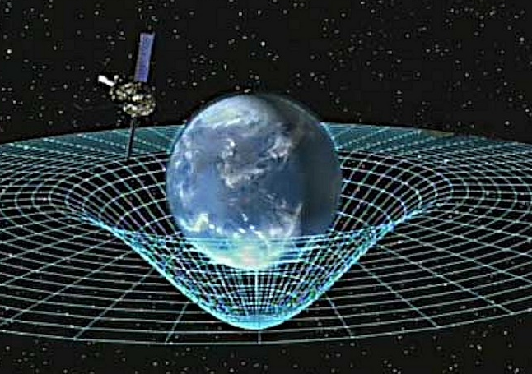
Gravity is Fundamental
Aristotle (350BC)
Objects fall proportional to mass
Al-Khazini (1121)
Gravitational potential energy
Galileo (1590)
Terminal velocity
Newton (1687)
Gravity inverse-square law
Einstein (1913)
Theory of general relativity
Notes:
Galileo graphic https://commons.wikimedia.org/wiki/File:GalilEXP.jpg
Spacetime curvature graphic https://www.nasa.gov/mission_pages/gpb/gpb_012.html
Aristotle (384–322 BCE)
Objects fall at a speed proportional to their mass.
The Aristotelian explanation of gravity is that all bodies move toward their natural place. For the elements earth and water, that place is the center of the (geocentric) universe;
al-Khazini (11th to 12th centuries)
In 1121, al-Khazini, in The Book of the Balance of Wisdom, proposed that the gravity and gravitational potential energy of a body varies depending on its distance from the centre of the Earth.
Galileo Galilei (1564-1642)
Leaning Tower of Pisa Experiment (1589-92) - Law of Falling Bodies
Objects fall at the same speed, independent of their mass or shape
Isaac Newton (1643-1727)
In 1687, English mathematician Sir Isaac Newton published Principia, which hypothesizes the inverse-square law of universal gravitation.
Albert Einstein (1879-1955)
Between 1911-1915 Einstein developed the theory of general relativity. In general relativity, the effects of gravitation are ascribed to spacetime curvature instead of to a force. To deal with this difficulty, Einstein proposed that spacetime is curved by matter, and that free-falling objects are moving along locally straight paths in curved spacetime. (This type of path is called a geodesic).

Slide 23
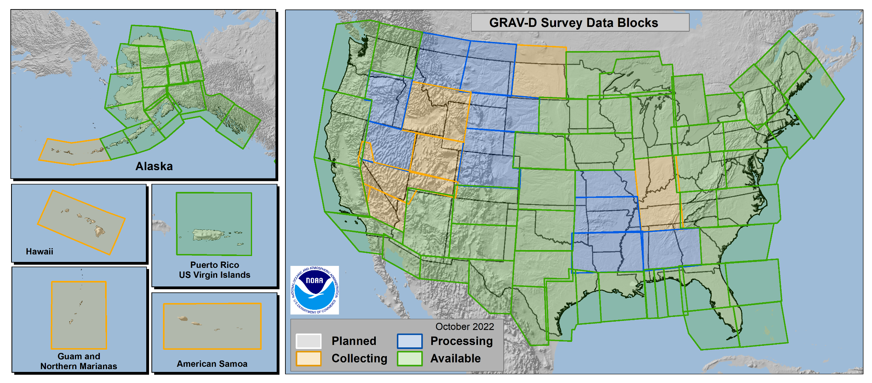
Gravity for the Redefinition of the
American Vertical Datum
GRAV-D
96.8% Complete (11/21/2022)
Notes:
More information on GRAV-D
https://geodesy.noaa.gov/GRAV-D/
Data Download for GRAV-D blocks
https://geodesy.noaa.gov/GRAV-D/data_products.shtml

Slide 24
Why Modernize the NSRS
Current models built on old technology
  NAD 83 not truly Geocentric (~2.2m)
  NAVD 88 relies on marks in the ground
  and is not easily maintained
  Today’s technology needs better accuracy
Notes:
NSRS Modernization News
https://geodesy.noaa.gov/datums/newdatums/TrackOurProgress.shtml

Slide 25
Main Benefits of Modernized NSRS
Fast, Accurate, Consistent Elevations Everywhere
Improved Public Safety
  Flood Plain Maps
  Emergency Route Planning
Accurate Positioning
  Autonomous vehicles, BIMs, Smart Cities
Notes:
NSRS Modernization News
https://geodesy.noaa.gov/datums/newdatums/TrackOurProgress.shtml

Slide 26
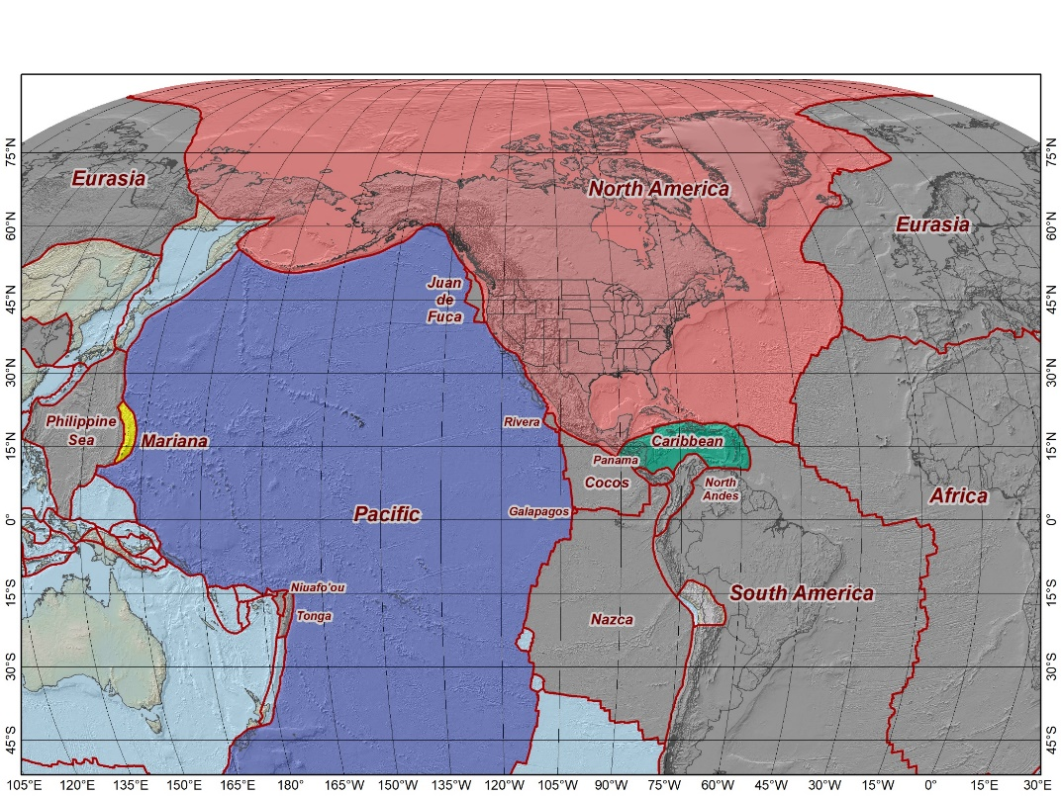
The Future Reference Frames
The tectonic plates “fixed” for the
2022 Terrestrial Reference Frames
Tectonic Plate based
Each Plate is based on the same
densified ITRF model
North America NATRF
Caribbean CATRF
Pacific PATRF
Mariana MATRF
NATRF2022
MATRF2022
PATRF2022
CATRF2022
Notes:
NSRS Modernization Naming Conventions https://geodesy.noaa.gov/datums/newdatums/naming-convention.shtml

Slide 27
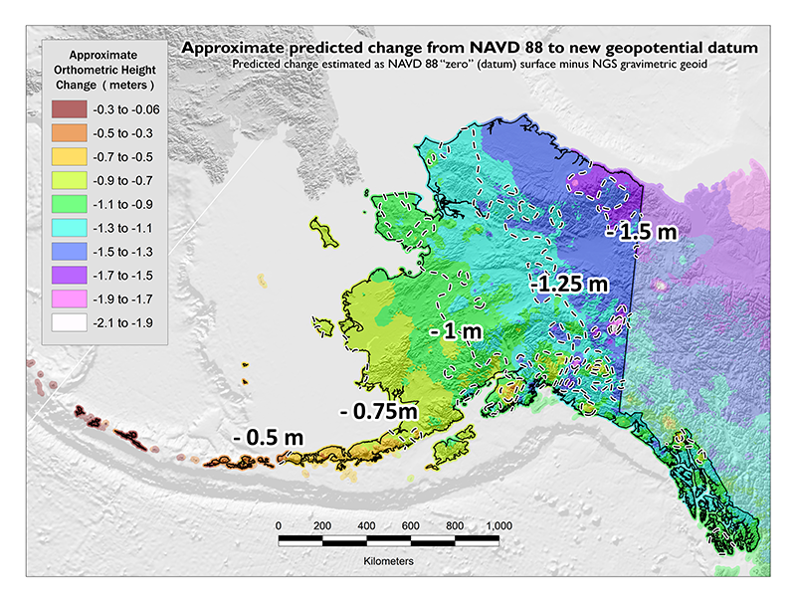
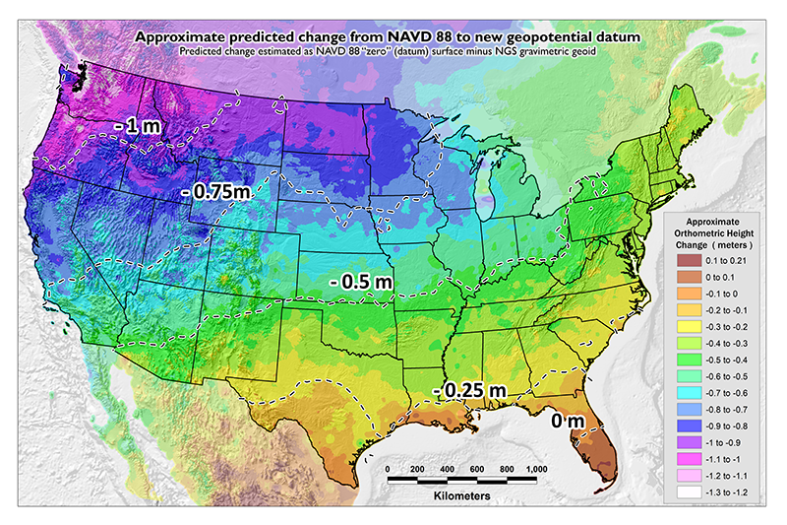
NAVD 88 Issues
Date of this slide: Sept 3, 2020
Modernized NSRS: 4 hour version
NAVD 88 suffers from a known bias and tilt
(about 1 meter across CONUS) relative to the gravimetric geoid
PID: EZ0840

Slide 28
NAVD 88 Issues
Date of this slide: Sept 3, 2020
Modernized NSRS: 4 hour version
NAVD 88 suffers from unknown movements before, during and after its original adjustment
A hypothetical example…
1954: Leveling Performed to bench mark
House
House
House
BM
BM
BM
1991: Original 1954 leveling data is used to compute the NAVD 88 height which is then published for this BM
1954-1991: Subsidence
H₈₈(published)
H₈₈(true)
NAVD 88 zero height surface
The true height relative to the NAVD 88
zero surface is not the published NAVD 88 height

Slide 29
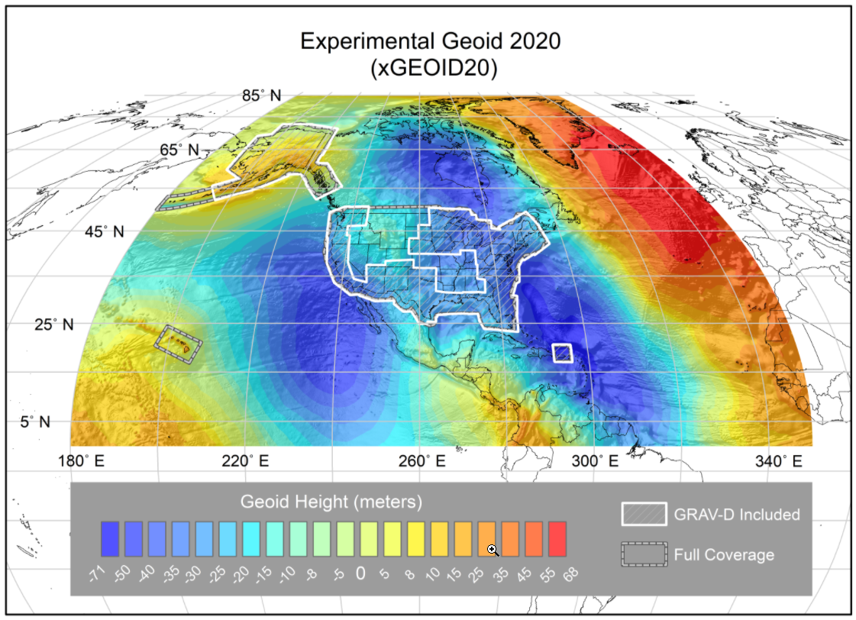
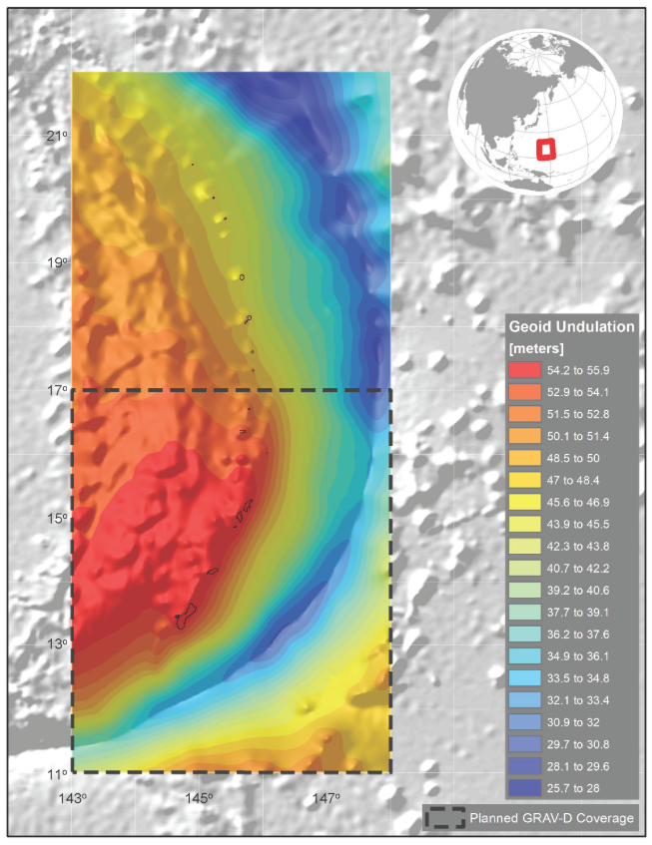
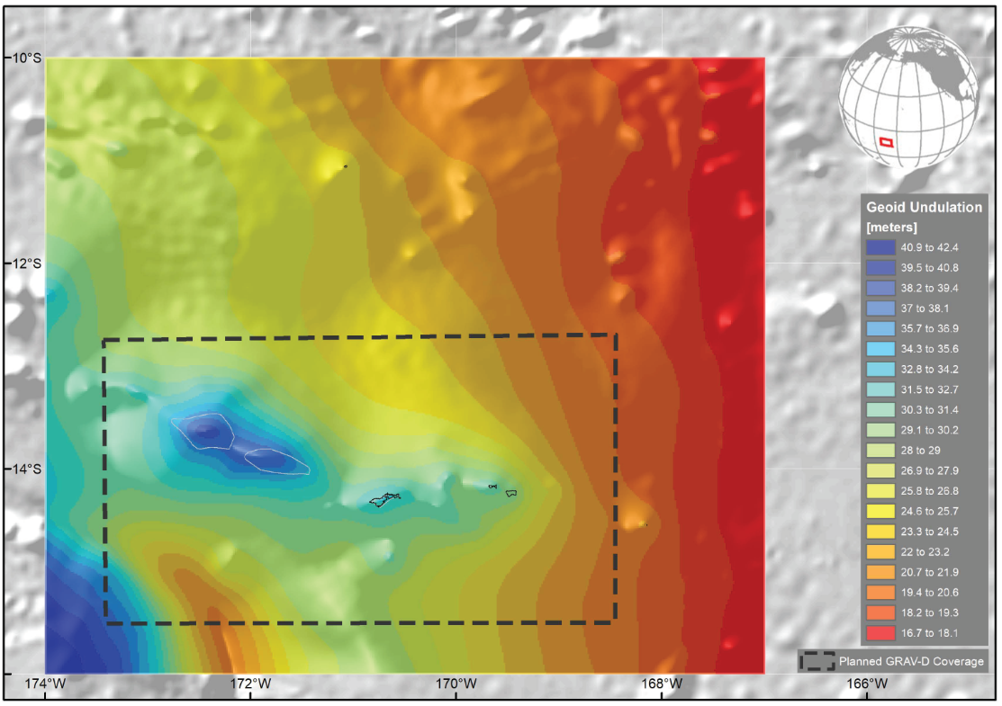
NAPGD2022 Geopotential Datum
Not a vertical datum, it is more than just heights.
Models included:
        Geopotential
        Deflection
        Gravity
        Geoid
¼ Earth’s Surface
Guam/CNMI
American Samoa
Notes:
Experimental Geoid Models
https://beta.ngs.noaa.gov/GEOID/xGEOID20/
As noted in the Blueprint 2 document
https://geodesy.noaa.gov/library/pdfs/NOAA_TR_NOS_NGS_0064.pdf
NAPGD2022 will include all of the following
Geopotential Model of 2022 (GM2022) will include:
Static Geopotential model of 2022 (SGM2022)
Dynamic Geopotential model of 2022 (DGM2022)
GEOID2022 will include:
Static Geoid model of 2022 (SGEOID2022)
Dynamic Geoid model of 2022 (DGEOID2022)
DEFLEC2022 will include:
Static Deflection of the Vertical model of 2022 (SDEFLEC2022)
Dynamic Deflection of the Vertical model of 2022 (DDEFLEC2022)
GRAV2022
Static Gravity model of 2022 (SGRAV2022)

Slide 30
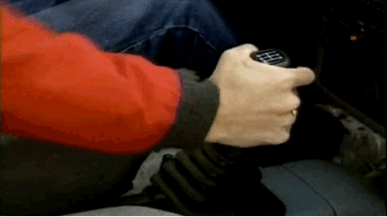

NSRS Modernization Catch Phrase
Shift and Drift
Not the Fast and Furious
Notes:
New Datums What to expect https://geodesy.noaa.gov/datums/newdatums/WhatToExpect.shtml
NGS is not shifting the land, merely shifting the reference surfaces to which we reference the geospatial data to.

Slide 31
Shift and Drift
A sudden shift
  Horizontal change: 0.5 to 4 m (1.5 to 13 ft)
  Ellipsoid height change: ±2 m (±6 ft)
  Elevation change: -0.5 to +2 m (-1.5 to +6 ft)
A continuous drift
  Coordinates associated with specific dates
Two components of drift:
  Tectonic plate rotation (easy to model, 2D only)
  All other residual motion (hard to model, 3D)
Notes:
New Datums What to expect https://geodesy.noaa.gov/datums/newdatums/WhatToExpect.shtml
NGS is not shifting the land, merely shifting the reference surfaces to which we reference the geospatial data to.

Slide 32
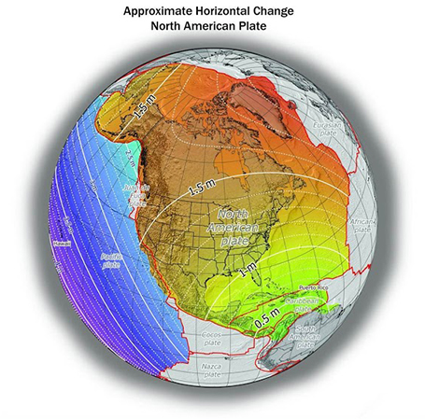
Shift: datum changes
~1 to 1.5 meters North America
~2.5 to 4 meters in Pacific
0 to 1.3 meters CONUS
Notes:
New Datums What to expect https://geodesy.noaa.gov/datums/newdatums/WhatToExpect.shtml
NGS is not shifting the land, merely shifting the reference surfaces to which we reference the geospatial data to.

Slide 33
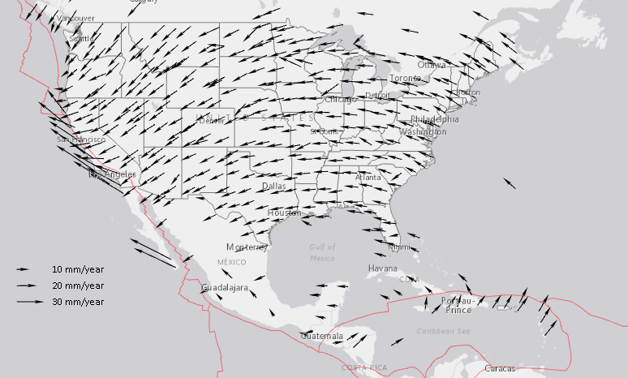
Drift: Plate Tectonics and Velocities
Annual changes to
ITRF2014 coordinates
Notes:
All plates are moving and through the constant collection of GNSS data using CORS we can now model where the land is moving. In the center of tectonic plates there is generally motion that can be measured but where plates converge can be thought of as a crunch zone and the modeling has much more uncertainty due to geophysical phenomena.

Slide 34
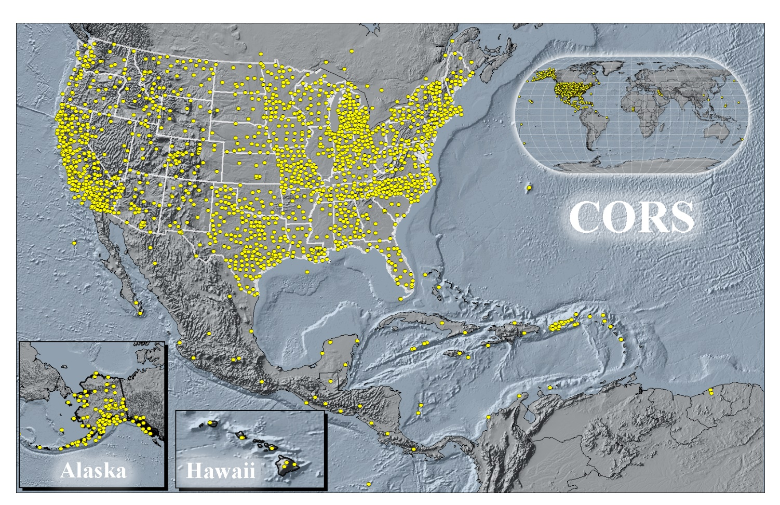
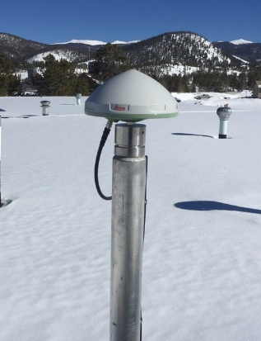

Continuously Operating Reference Stations
COBK
Breckenridge
Colorado
STBT
Steamboat Springs
Colorado
Notes:
All plates are moving and through the constant collection of GNSS data using CORS we can now model where the land is moving. In the center of tectonic plates there is generally motion that can be measured but where plates converge can be thought of as a crunch zone and the modeling has much more uncertainty due to geophysical phenomena.

Slide 35
Vertical Motion
Subsidence
  Ground fluid withdrawal, sedimentation
Glacial Isostatic Adjustment (GIA)
  Crustal rebound from glaciers (uplift)
Geophysical Phenomena
  Earthquakes, calderas, Earth tides

Slide 36



8.5 meters
50 years
Vertical Motion
May 2015
to
Sept 2016
Hudson Bay Uplifting
8 -13 mm/year
San Joaquin Subsiding
20-24” in 16 months
Notes:
San Joaquin Subsidence article
http://www.digitaljournal.com/tech-and-science/technology/sinking-san-joaquin-valley-of-california-seen-from-space/article/487393
Hudson Bay Uplift article
https://www.researchgate.net/figure/Contour-map-of-observed-CBN-vertical-rates-Preliminary-results-from-the-combination-of_fig3_286867540
GIA

Slide 37

Horizontal and Vertical Motion - Earthquakes
China Lake, CA
6-10 feet Horizontally
Puerto Rico
16 cm Vertically
Notes:
China Lake Earthquake
https://www.usgs.gov/news/update-magnitude-71-earthquake-southern-california?qt-news_science_products=7#qt-news_science_products
Puerto Rico Earthquake
https://cunycis.maps.arcgis.com/apps/webappviewer/index.html?id=5f516f41baa84f9ba9e8207c2005ee4d
GIA

Slide 38


GPS on Bench Marks
~3,400 Completed in 2020
~4,800 Completed in 2021
~2,200 Completed in 2022
Web Map Application
Dashboard
Notes:
GPS on Bench Marks Web Map
https://noaa.maps.arcgis.com/apps/webappviewer/index.html?id=6093dd81e9e94f7a9062e2fe5fb2f7f5
GPS on Bench Marks Dashboard
https://noaa.maps.arcgis.com/apps/dashboards/449e3051fbf44202ba6606e2dbcb0e29

Slide 39
GPS on Bench Marks
Demo
Notes:
GPS on Bench Marks Web Map
https://noaa.maps.arcgis.com/apps/webappviewer/index.html?id=6093dd81e9e94f7a9062e2fe5fb2f7f5
GPS on Bench Marks Dashboard
https://noaa.maps.arcgis.com/apps/dashboards/449e3051fbf44202ba6606e2dbcb0e29

Slide 40
GPS on Bench Marks CO Gaps
Notes:
GPS on Bench Marks Web Map
https://noaa.maps.arcgis.com/apps/webappviewer/index.html?id=6093dd81e9e94f7a9062e2fe5fb2f7f5
GPS on Bench Marks Dashboard
https://noaa.maps.arcgis.com/apps/dashboards/449e3051fbf44202ba6606e2dbcb0e29

Slide 41

OPUS Shared Solutions Dashboard
Dashboard enables sorting and visualization of Shared Solutions by
Month & Year, State, Agency Type, and submitting agency
Agency type | # Shared Solutions on NGS marks
State | ~35,900
Private Sector | ~6,200
Federal | ~3,900
Academic | ~1400
2018
Note the impact of GPSonBM Campaigns
2020
2021
Notes:
Links on the slide.

Slide 42
OPUS Shared Solutions
Dashboard Demo
Notes:
Links on the slide.

Slide 43



NGS Mark Recovery Webpage
Crowd sourced mark recoveries help update the GPSonBM map, let NGS and others know if the mark is still usable, and pictures make it easier to find.
https://geodesy.noaa.gov/surveys/mark-recovery
Now with Find Marks Near Me!
Maintain you local control network: Submit a Recovery Note for each mark you find (up to once per year)
Did you find it?
Is it GPSable?
Got new photos?
Notes:
Links on the slide.

Slide 44

Mark Recovery Dashboard
https://noaa.maps.arcgis.com/apps/dashboards/a61976366d1f4a19b3bc8a2d5a0d5498
Notes:
Links on the slide.

Slide 45

Mark Recoveries in Colorado
https://noaa.maps.arcgis.com/apps/dashboards/a61976366d1f4a19b3bc8a2d5a0d5498
Notes:
Links on the slide.

Slide 46
Best ways to determine coordinates in Modernized NSRS
Resurvey: Return to the field and collect new observations, relying upon geodetic control that has coordinates in the new datum
Readjust: Using existing observations, re-compute new coordinates based upon geodetic control (CORS) that has been defined in the new datum
Transform: Take finished products which have coordinates in the old datum and use transformation software to estimate coordinates in the new datum
Notes:
Links on the slide.

Slide 47
How Can You Prepare
Metadata is essential
    Improves reliability and accuracy of data
    Increases value and usefulness
Transform and collect data in current datums
    NAD 83 (2011), NAVD 88
Make sure to note Geoid Models used for GNSS data

Slide 48
Recent Publications
Blueprint Documents for 2022 (Updated in 2021)
  Part 1: Geometric Coordinates
  Part 2: Geopotential Coordinates
  Part 3: Working in the Modernized NSRS
The State Plane Coordinate System History, Policy, and Future Directions
  NOAA Special Publication NOS NGS 13
Notes:
Links on the slide.

Slide 49






Blue Print 3: Working in the Modernized NSRS
2020 Updated Edition with Use Cases
Working in the modernized NSRS:
NOAA TR NOS NGS 67
Notes:
Links on the slide.

Slide 50




State Plane Coordinate System of 2022 (CONUS, Alaska and Hawaii)
Three territory zones not shown:
    Puerto Rico and U.S Virgin Islands
  American Samoa
  Guam and Commonwealth of the
  Northern Mariana Islands
https://geodesy.noaa.gov/SPCS/
Notes:
State Plane Coordinate System
https://geodesy.noaa.gov/SPCS/index.shtml
2022 Policy Changes
https://geodesy.noaa.gov/SPCS/draft-policy.shtml

Slide 51


State Plane Coordinate System of 2022
https://geodesy.noaa.gov/SPCS/
Notes:
State Plane Coordinate System
https://geodesy.noaa.gov/SPCS/index.shtml
2022 Policy Changes
https://geodesy.noaa.gov/SPCS/draft-policy.shtml

Slide 52

State Plane Coordinate System of 2022
https://arcg.is/05L1D1
~36 LDPs
https://geodesy.noaa.gov/SPCS/
Notes:
State Plane Coordinate System
https://geodesy.noaa.gov/SPCS/index.shtml
2022 Policy Changes
https://geodesy.noaa.gov/SPCS/draft-policy.shtml

Slide 53


Deprecation of US Survey Foot
December 31, 2022
Will NOT impact current SPCS 83 coordinates. The US Survey Foot (sft) will
continue to be supported in the SPCS 83 system indefinitely.
The International Foot (ift) will be used in the Modernized NSRS and SPCS2022
Webinar
https://geodesy.noaa.gov/web/science_edu/webinar_series/ending-us-survey-foot.shtml
FRN
https://www.federalregister.gov/documents/2020/10/05/2020-21902/deprecation-of-the-united-states-us-survey-foot
Notes:
Links on the slide.

Slide 54

New NGS Map
https://noaa.maps.arcgis.com/apps/webappviewer/index.html?id=190385f9aadb4cf1b0dd8759893032db
Notes:
Links on the slide.

Slide 55
New NGS Map Demo
Notes:
Links on the slide.

Slide 56
NGS ArcGIS Online Resources
Feature Services
Raster Tile Services
NGS Datasheets
NOAA CORS Network
GPS on Benchmarks Priority List
(4 layers - marks, hexagons)
GEOID18 GPS on Benchmarks
GEOID12B GPS on Benchmarks
OPUS Shared Solutions
Mark Recoveries Submitted to NGS
GEOID18 Height (CONUS, PRVI)
GEOID18 Difference (CONUS, PRVI)
GEOID18 Uncertainty (CONUS, PRVI)
GEOID18 Improvements (CONUS, PRVI)
*Geospatial Resources Webinar
Notes:
Links on the slide.

Slide 57


Beta Passive Marks Page
Notes:
Links on the slide.

Slide 58

Beta OPUS-Projects 5.1 for RTK/RTN Vectors
NGS is developing a new Standardized GNSS Vector EXchange Format (GVX) that will be used to ingest vectors into OPUS Projects
Notes:
Links on the slide.

Slide 59

Beta OPUS-Projects 5.1 for RTK/RTN Vectors
Notes:
Links on the slide.

Slide 60



Geoid Slope Validation Survey of 2017
Notes:
Links on the slide.

Slide 61


Geoid Slope Validation Survey of 2017
Colorado along Hwy 160
Durango to Walsenburg
>1250m (~4100 ft) elevation change
221 new monuments, 221 miles of hwy
Notes:
Links on the slide.

Slide 62
Geoid Slope Validation Survey of 2017
Geoid Slope Validation Survey: three phases to validate accuracy of the gravimetric geoid model
  Phase 1- GSVS11
    2011; Low/Flat/Simple: Texas
  Phase 2- GSVS14
    2014; High/Flat/Complicated: Iowa
  Phase 3- GSVS17
    2017; High/Rugged: Colorado
Notes:
Links on the slide.

Slide 63
Geoid Slope Validation Survey of 2017
GPS: 20 identical units, 2 teams, 24 and 16 hour sessions on each mark.
  Trimble Zephyr Antennae and Trimble NetR5, NetR9, 5700 Receivers
Leveling: 1st order, class II, digital barcode leveling
  Due to tie marks some of the leveling will be 2nd order
Gravity: Absolute gravity and vertical gravity gradients are measured on each bench mark. Aerial gravity from GRAV-D collected for the project area.
DOV: ETH Zurich CODIAC zenith camera system is being used to measure the DOV
Notes:
Links on the slide.

Slide 64






GPS Survey
Notes:
Links on the slide.

Slide 65



GPS Survey Mark GSVS101
Notes:
Links on the slide.

Slide 66




GPS Survey Mark GSVS101
Obstruction Analysis
Notes:
Links on the slide.

Slide 67




GPS Survey Mark GSVS075
Notes:
Links on the slide.

Slide 68




GPS Survey Mark GSVS101
Obstruction Analysis
Notes:
Links on the slide.

Slide 69



Geoid Slope Validation Survey of 2017
Notes:
Links on the slide.

Slide 70



Leveling Survey
Notes:
Links on the slide.

Slide 71



Leveling Survey
Notes:
Links on the slide.

Slide 72



Leveling Survey
Notes:
Links on the slide.

Slide 73

Geoid Slope Validation Survey of 2017 Results
Literature Cited
van Westrum, D., Ahlgren, K., Hirt, C., and Guillaume, S. (2021). A Geoid Slope Validation Survey (2017) in the rugged terrain of Colorado, USA. Journal of Geodesy, 95(1). https://doi.org/10.1007/s00190-020-01463-8
Notes:
Links on the slide.

Slide 74

Geoid Slope Validation Survey of 2017 Results
Wolf Creek
La Veta Pass
Durango
Walsenburg
Blue : Observed Difference in gravity (NAVD 88 model and observed absolute)
Red : Difference in derived orthometric heights
Notes:
Links on the slide.

Slide 75


Geoid Slope Validation Survey Results
Two geoid profiles were derived from the GSVS17 observations
  One from GPS/spirit leveling
  One from Deflection of the Vertical data.
The two independent techniques were found to agree better than +/- 2 cm over the entire 360 km length of the survey at all length scales.
GSVS11 provided +/- 1 cm differential geoid accuracy at smooth terrain close to the geoid (sea level)
GSVS14 provided +/- 1-2 cm differential geoid accuracy over a complicated feature like the Mid Continental Rift.
GSVS17 provided +/- 3-5 cm differential geoid accuracy over high elevation and rugged terrain.
Notes:
Links on the slide.

Slide 76




Maintaining the National Spatial Reference System
Passive Control
Active Control
BOUNDARY ARC STONE 2 DE MD
Stone Monument
1765
BUTTERMILK
Drill Hole
Set in Rock Outcrop
1833
VAIL PASS
Horizontal Control Disk
Set in a Boulder
1994
CTMC
Golden, Colorado
Established 2007
Upgraded 2022
Notes:
BOUNDARY ARC STONE 2 DE MD JU3851 https://www.ngs.noaa.gov/cgi-bin/ds_mark.prl?PidBox=JU3851
BUTTERMILK LX4113 https://www.ngs.noaa.gov/cgi-bin/ds_mark.prl?PidBox=LX4113
VAIL PASS AB2084 https://www.ngs.noaa.gov/cgi-bin/ds_mark.prl?PidBox=AB2084
CTMC https://www.ngs.noaa.gov/cgi-cors/corsage.prl?site=CTMC

Slide 77
Passive Control Will Continue to be Important
Active Control
Modernized NSRS foundation built on top of CORS
Passive Control
Part of America’s Infrastructure
  Vertical transformations will utilize passive control data
  Will provide valuable references for check points (RTK/RTN)
  Will provide ability to revisit marks to monitor change
  Will be fundamental for control in catastrophe
Notes:
Links on the slide.

Slide 78
CA Professional Land Surveyors’ Act
Perpetuating Geodetic Control Monuments
  Maintaining the integrity of existing horizontal and vertical control
  monuments is required under Section 8771(b)
8771 Setting of Monuments in general; monument perpetuation
(b) When monuments exist that control the location of subdivisions, tracts, boundaries, roads, streets, or highways, or provide horizontal or vertical survey control, the monuments shall be located and referenced by or under the direction of a licensed land surveyor or licensed civil engineer legally authorized to practice land surveying prior to the time when any streets, highways, other rights-of-way, or easements are improved, constructed, reconstructed, maintained, resurfaced, or relocated, and a corner record or record of survey of the references shall be filed with the county surveyor.
http://www.bpelsg.ca.gov/laws/pls_act_unannotated.pdf
Notes:
Links on the slide.

Slide 79
Submitting Marks to be part of the NSRS
Bluebooking Survey Data
  Submit Project Proposal
  https://geodesy.noaa.gov/SurveyProposal/
    GPS Surveys submit using OPUS Projects
      Can now submit shorter occupation RTK/RTN surveys using GVX
    Leveling surveys submit to vertical branch
OPUS Share (for marks not currently in NGSIDB)
  OPUS Share will be combined and part of Modernized NSRS
  Ideal of cities/counties that have control established but not currently
  in the NSRS
Notes:
Links on the slide.

Slide 80



What to do before a mark will be destroyed?
Contact me!
Notes:
Links on the slide.

Slide 81



Two Important Documents
FGCS Specifications and Procedures to Incorporate Electronic Digital/Bar-Code Leveling Systems
Bench Mark Reset Procedures
https://geodesy.noaa.gov/library/pdfs/NOAA_Manual_NOS_NGS_0008.pdf
https://geodesy.noaa.gov/FGCS/tech_pub/Fgcsvert.v41.specs.pdf
Notes:
Links on the slide.

Slide 82

Establishing a New Bench Mark
  New Concrete Monument
Notes:
Links on the slide.

Slide 83

Establishing a New Bench Mark
  Survey Disk Set in Bedrock or Structure
Notes:
Links on the slide.

Slide 84

Establishing a New Bench Mark
  NGS 3-D Deep Driven Rod Mark
Notes:
Links on the slide.

Slide 85
Tying a New Bench Mark to NSRS
  Leveling determination
            Single Mark Level Tie (3rd Order) – Bench Mark Reset
            Two Mark Level Tie (2nd Order)
            Three Mark Level Tie (1st Order)
  GNSS determination
Height Modernization Two Mark GNSS Tie
Notes:
Links on the slide.

Slide 86

            Single Mark Level Tie (3rd Order Reset)
Elevation only published to 0.01 meter (0.1 feet)
FGCS Specifications and Procedures
Does not require current calibrated rods
Site lengths no more than 70 meters
Reset mark can be no more than 560 meters from original
            Without reference points
Notes:
Links on the slide.

Slide 87

            Single Mark Level Tie (3rd Order)
When an old mark has to be removed before a new mark can be established.
            With reference points
Notes:
Links on the slide.

Slide 88

            Two Mark Level Tie (2nd Order)
Elevation published to 0.001 meter (0.01 feet)
Same accuracy as order/class of original leveled line
Notes:
Links on the slide.

Slide 89

            Three Mark Level Tie (1st Order)
Elevation published to 0.001 meter (0.01 feet)
Same accuracy as order/class of original leveled line
Notes:
Links on the slide.

Slide 90
Height Modernization Two Mark GNSS Tie
Non-control or “new” marks must be within a certain distance of 2 vertical control marks
OPUS-Projects currently* requires a minimum of 2-hour occupations per session
Maximum distance between new marks and vertical control is between 30-50 km, based on occupation session duration
Recommended/Permitted occupation per session
Not
Permitted
Notes:
Links on the slide.

Slide 91
Height Modernization Two Mark GNSS Tie
Existing vertical survey control mark
A Minimum of two independent simultaneous occupation sessions on all 3 marks would be required.
(We recommend 3 sessions)
New survey control mark
30km radius
30 km spacing require a minimum of 2-hr occupations
40km radius
However, minimum occupation time would increase from 2 to 4 hours for 40 km spacing.
Notes:
Links on the slide.

Slide 92


1st Order Leveling Example L28462
Notes:
Links on the slide.

Slide 93


1st Order Leveling Example L28462
Notes:
Links on the slide.

Slide 94


1st Order Leveling Example L28462
Notes:
Links on the slide.

Slide 95
1st Order Leveling Example L28462
Tool Demo
Notes:
Links on the slide.

Slide 96



Ht Mod Example GPS3514 PIKES PEAK 2017
PIKES PEAK 2
4,299.32 m
14,105.4 ft
PIKES PEAK DMWW
4,299.22 m
14,105.0 ft
BATES
4,298.64 m
14,103.1 ft
Notes:
Links on the slide.

Slide 97

Ht Mod Example GPS3514 PIKES PEAK 2017
Notes:
Links on the slide.

Slide 98

Ht Mod Example GPS3514 PIKES PEAK 2017
Notes:
Links on the slide.

Slide 99

Ht Mod Example GPS3514 PIKES PEAK 2017
Notes:
Links on the slide.

Slide 100

Ht Mod Example GPS3514 PIKES PEAK 2017
Notes:
Links on the slide.

Slide 101


Ht Mod Example GPS3514 PIKES PEAK 2017
Notes:
Links on the slide.

Slide 102
Ht Mod Example GPS3514 PIKES PEAK 2017
OP Tool Demo
Notes:
Links on the slide.

Slide 103


Ht Mod Example Vail Survey
Matt Nichols, Survey Systems
Notes:
Links on the slide.

Slide 104

Magnitude of the Deflection of the Vertical
Questions?
Brian Shaw
brian.shaw@noaa.gov

