Slide 1
The North American-Pacific Geopotential Datum of 2022 (NAPGD2022)
Blueprint Part 2
Daniel R. Roman
Chief Geodesist
National Geodetic Survey

Slide 2
Abstract
With the advent of new national reference frames in 2022 by the National Geodetic Survey, a replacement for the North American Vertical Datum of 1988 (NAVD 88) will also be implemented. NAPGD2022 will be defined entirely by gravity field observations from satellite, airborne, terrestrial and shipborne platforms. In particular, data from the Gravity for the Redefinition of the American Vertical Datum (GRAV-D) program will be utilized to develop initially a static model. A time-varying component will also be developed with an eye to providing the change in the geopotential datum over time. These models will present a coherent and consistent image of the Earth's gravity field and more accurately define vertical control county-wide to country-wide and even across the water. Tools are also being developed to facilitate the merging of GNSS observations and local leveling to provide cm-level accurate vertical control.

Slide 3
Outline
North American-Pacific Geopotential Datum of 2022 (NAPGD2022)
Gravity for the Redefinition of the American Vertical Datum (GRAV-D)
Geoid Monitoring Service (GeMS)
The Future of Leveling

Slide 4
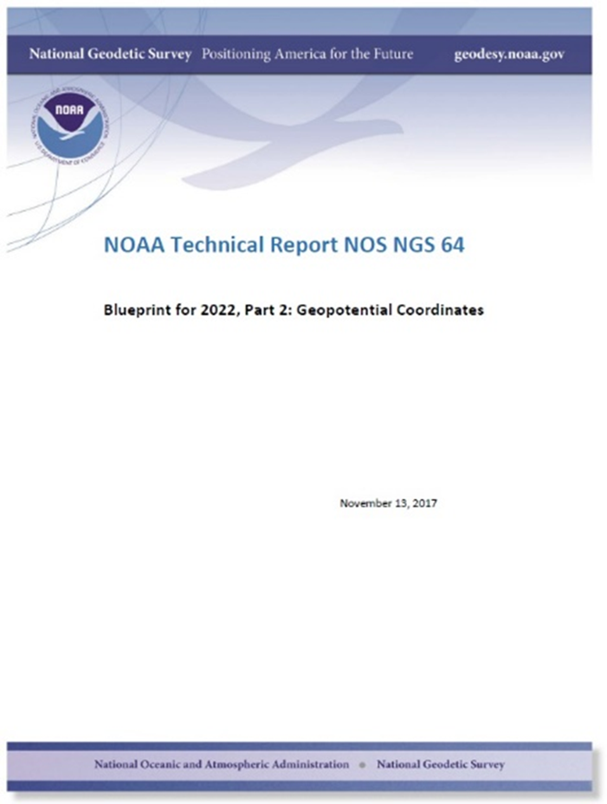
NAPGD2022
2007 (1st Ten Year Plan) : “Replace NAVD 88”
2012 (2nd Ten Year Plan) : “Replace NAVD 88”
Details were lacking, and therefore outreach material couldn’t properly prepare the user community for 2022

Slide 5
Replacing NAVD 88
  The Old:
  NAVD 88
  PRVD 02
  VIVD09
  ASVD02
  NMVD03
  GUVD04
  IGLD 85
  IGSN71
  GEOID12B
  DEFLEC12B
Orthometric
Heights
  The New:
  The North American-Pacific Geopotential Datum of 2022 (NAPGD2022)
  - Will include:
  GEOID2022
  DEFLEC2022
  GRAV2022
  DEM2022
  IGLD 2020
Normal
Orthometric
Heights
Dynamic
Heights
Gravity
Geoid
Undulations
Deflections of
the Vertical

Slide 6
NAPGD2022
“North American-Pacific…”
  Because the gridded components (geoid, DoV, gravity, DEM) will cover all major USA populated territories, and these happen to fall in the general regions of “North America” and “The Pacific Ocean”
    However, the foundation of the gridded components will be a global geopotential model
  Note that similar techniques and the same global geopotential model will be used to develop geopotential datums for (1) Guam & the Commonwealth of the Northern Mariana Islands and (2) for American Samoa

Slide 7
NAPGD2022
“…Geopotential…”
  Because it isn’t just about heights, but rather about all geodetic coordinates related to Earth’s geopotential field
  Hence, the products that will be developed include geoid heights, deflections of the vertical, gravity anomalies, & gravity disturbances
  Secondary products that are directly related include orthometric heights and dynamic heights

Slide 8
NAPGD2022
“…Datum…”
  Because a “geopotential reference frame” was, frankly, an unwieldy term that had no precedence in geodetic literature.
    “Reference Frame” only carries a geometric connotation in geodesy
  It is replacing, and expanding upon, the idea of a “vertical datum”

Slide 9
NAPGD2022
“…2022”
  Because that is our target release date

Slide 10
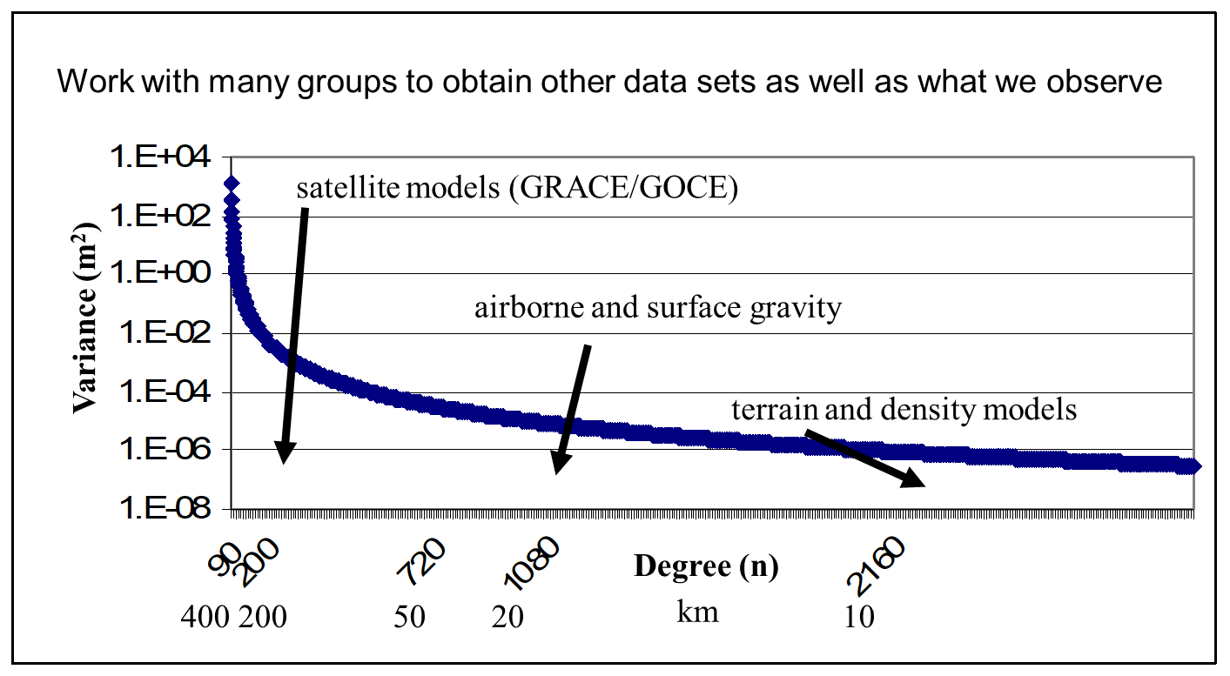
NAPGD2022 Sources
Satellite Gravity
  Longest wavelengths => largest sources (continental scale)
  Example: GOCO5S (GRACE/GOCE)
Airborne Gravity
  Intermediate scale resolving features down to 20-40 km
  Example: GRAV-D
Surface Gravity
  Literally millions of data points
Merge sources to obtain a seamless geopotential field
Work with neighboring countries to incorporate regional data (North American Vertical Datum/IAG SC 2.4c)
Use rigorous geodetic theory and/or forward modeling to make a geopotential model

Slide 11
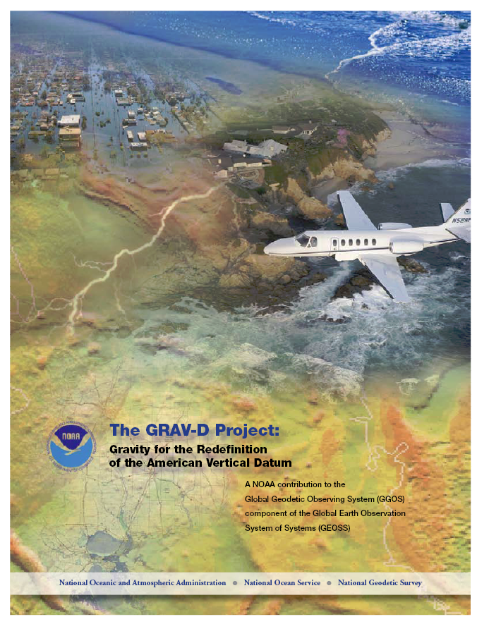
GRAV-D Project Overview
Overall Target: 2 cm accuracy orthometric heights from GNSS and a geoid model
GRAV-D Goal: Create gravimetric geoid accurate to 1 cm where possible using airborne gravity data
GRAV-D: Two thrusts of the project
  Airborne gravity survey of entire country and its holdings
  Long-term monitoring of geoid change
Leveraging partnerships to improve and validate gravity data
Notes:
Target is to be able to achieve 2 cm accuracy orthometric heights (where possible) using a GNSS receiver and a geoid model
Roughly 1 cm uncertainty from GNSS and 1 cm from the geoid model
GRAV-D
Phase 1: snapshot of the entire country to provide a consistent data set
Phase 2: long term monitoring of geoid change – in development
Work with partners to incorporate additional gravity data, particularly surface gravity data, validate existing data, and monitor change

Slide 12
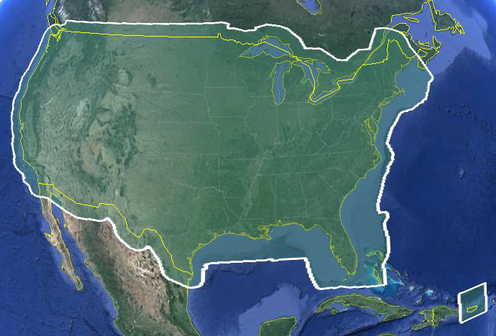
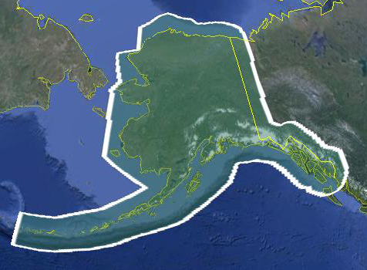
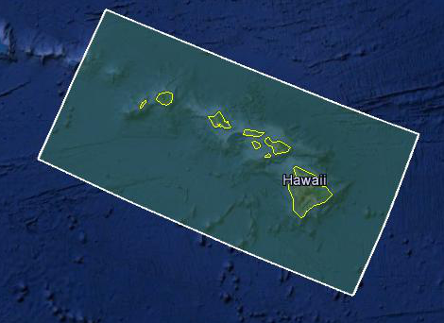
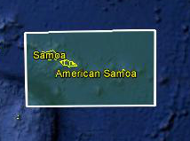
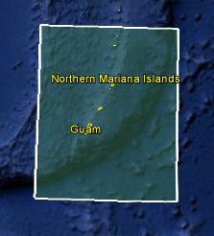
Data Collection Scope
Entire U.S. and territories
  Total Square Kilometers: 15.6 million
  Initial target area for 2022 deadline
  ~200 km buffer around territory or shelf break if possible
Notes:
Project Scope:
Scope of the project: cover roughly 15.6 million square kilometers – contiguous united states, Alaska, Hawaii, Guam, and American Samoa
In order to blend with satellite altimetry data the airborne survey is done to the continental shelf where possible or ~ 200 km beyond the shoreline or border, whichever is further
Deadline of 2022 for datum rollout, which means a target of 2021 to finish the airborne survey
Priority areas were defined as Alaska and coastal areas
Challenges:
Fixed annual budget and time → design of surveys had to fit within an annual budget of $3.5 million and meet the deadline
This was a major factor in setting altitude and line spacing

Slide 13
Performance Metric
For Airborne Surveys
FY09 Baseline | Targets vs Actual
 | FY10 | FY11 | FY12 | FY13 | FY14 | FY15 | FY16 | FY17 | FY18 | FY19 | FY20 | FY21 | FY22
6.14% | 7.5% | 12% | 20% | 28% | 36% | 45% | 53% | 62% | 70% | 79% | 87% | 96% | 100% and Implement
6.14 | 8% | 15% | 24% | 31% | 38% | 45% | 55% | 64% | 67%
Measure: Percentage of the U.S. and its territories with GRAV-D data available
to support a 1 cm geoid supporting 2 cm orthometric heights.
Notes:
We’ve set up a basic GIS GPRA monitoring in the War Room. We will report the coordinates of our survey monthly and they will calculate our percentages.

Slide 14
Geoid Monitoring Service (GeMS)
Goal: Track all changes to the geoid which would prevent 1 cm accuracy
Aspects included:
  Shape, Secular: e.g. Hudson Bay
  Shape, Episodic: e.g. Massive Earthquakes
  W0, Secular: Global Sea Level Change (see next slides)
Examples of things excluded:
  Size, Secular: Mass quantity of Earth is effectively static
  Shape, Periodic: Seasonal glacier cycle

Slide 15
Time and Mass
Mass quantity in the Earth system is effectively constant
Mass distributions in the Earth system are time dependent and some are large enough to be measurable
  Secular
    Shape change to every equipotential surface (like the geoid)
    Size change to global mean sea level
  Episodic
  Periodic

Slide 16
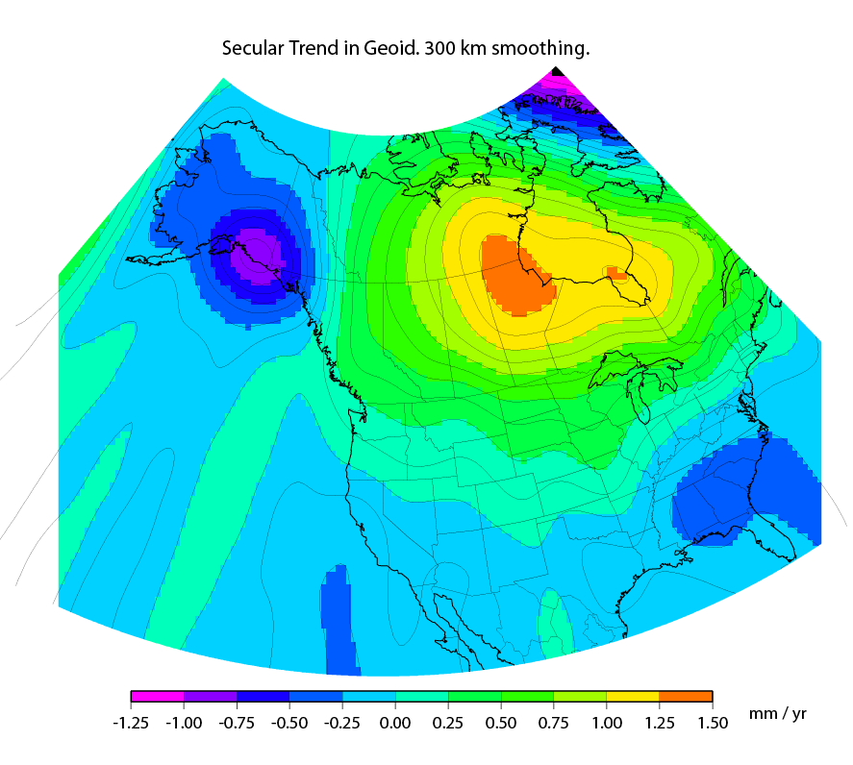
Secular Mass Movement
Mass is flowing in the mantle
to coalesce under Hudson
Bay, pushing the crust up.
GPS on the crust sees this
as one effect:
An increase in ellipsoid height
A gravimeter on the crust
sees two effects:
(small) decrease in gravity as the
gravimeter location gets
farther from the geocenter
(larger) increase in gravity as the
amount of mass below the
gravimeter pulls harder
This gravity change causes the
geoid to “swell” in the area
Notes:
There are two manifestations of the growing mass in the deep mantle under Hudson Bay:
Geometric – a GPS receiver will see the crust uplifting as the increase in mantle mass pushes the crust up in a displacement.
Geopotential – a gravimeter on the surface will sense the growing mass as an increase in the acceleration of gravity, BUT this will be slightly tempered by a reduction in gravity as well (because the gravimeter on the surface is getting farther from the Earth’s center). Still, the gain (from mass increase) is larger than the loss (from geometric movement) for a net gain. Because the net gain in gravity is not caused purely by being at a new crustal height, this translates into an increase in geoid undulations, or a “swelling” of the geoid in this region.
This is different than a purely geometric change caused by a compression of the crust. In that case, no significant mass is entering or leaving the region so, while GPS might sense a subsidence and a surface gravimeter might sense a slight increase as it moves closer to the Earth’s center, the geoid would not actually change.

Slide 17
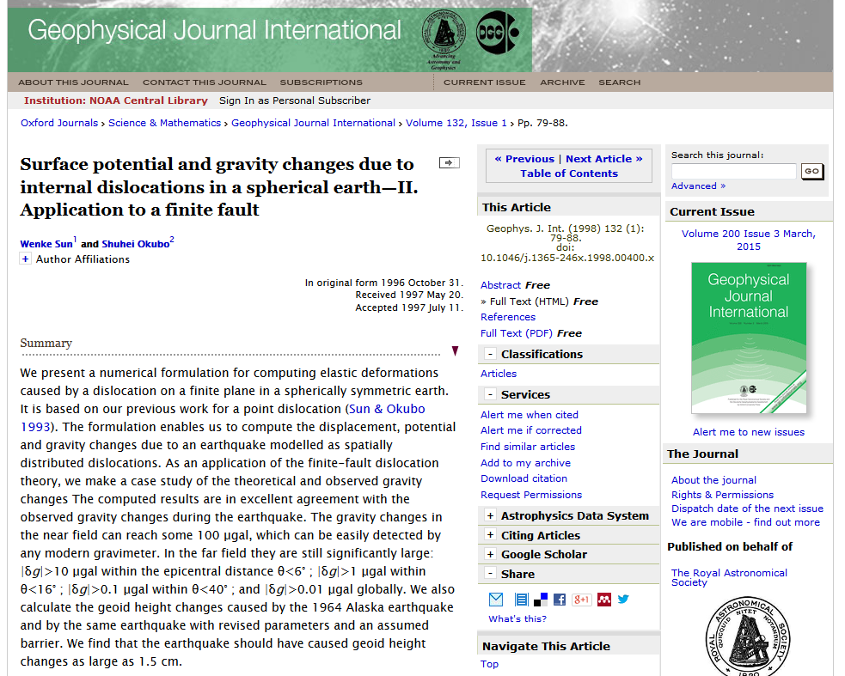
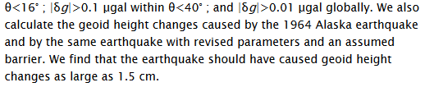
Episodic Mass Movement
Notes:
Rare, but worth monitoring, large earthquakes or volcanic eruptions can move enough mass locally to cause the geoid to make a permanent local shift.

Slide 18
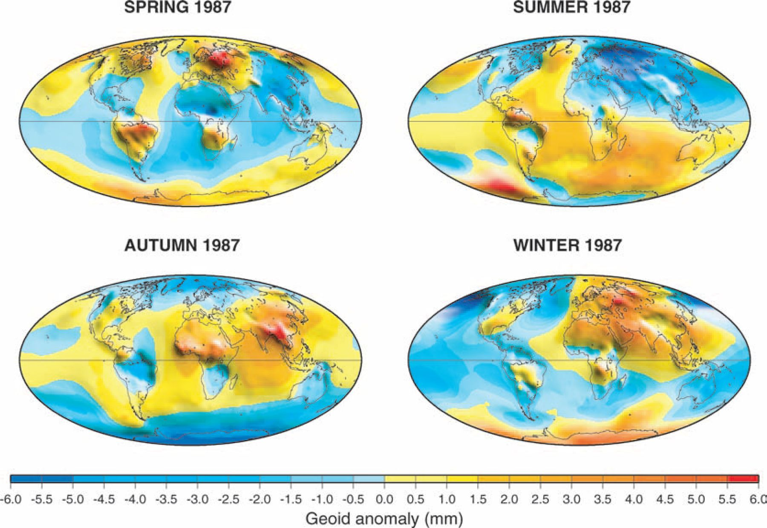

Periodic Mass Movement
Ramillien G et al. Geophys. J. Int. 2004;158:813-826
© 2004 RAS
Notes:
Seasonal variations of the synthetic geoids for 1987 computed using global model forecasts for the same period: atmosphere from ECMWF; oceans from POCM; total land water plus snow from LaD.
NGS sees this as a signal to be modelled and removed so users are not worried about “seasonal heights”.

Slide 19
High resolution products
All will be 1 x 1 arcminute grids
All will cover three finite regions of the globe
All will have a static and dynamic component
  Dynamic surface gravity not expected to be ready by 2022
GEOID2022
  Official converter of *TRF2022 ellipsoid heights into NAPGD2022 orthometric heights
DEFLEC2022
  Surface deflections of the vertical in N/S and E/W
GRAV2022
  Surface acceleration of gravity

Slide 20
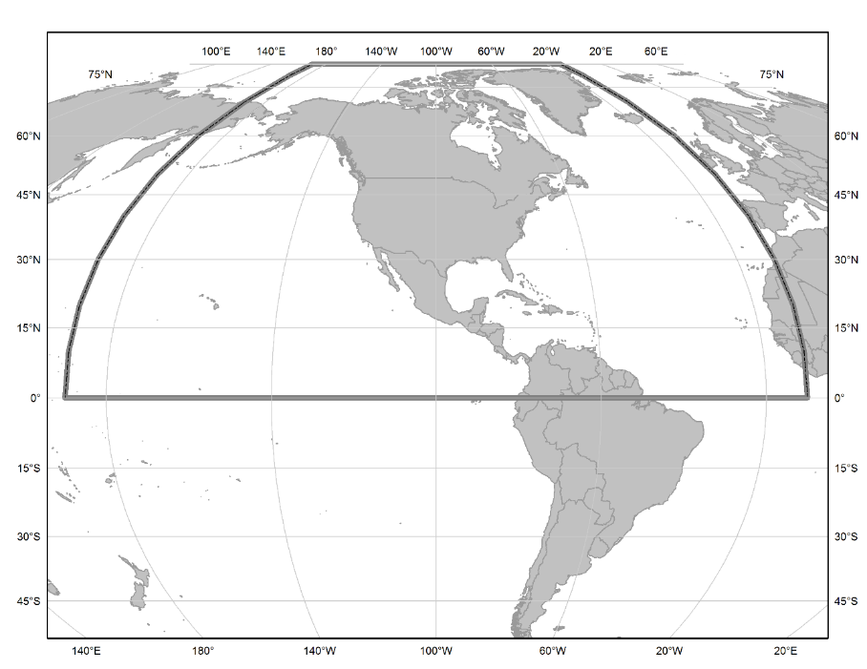
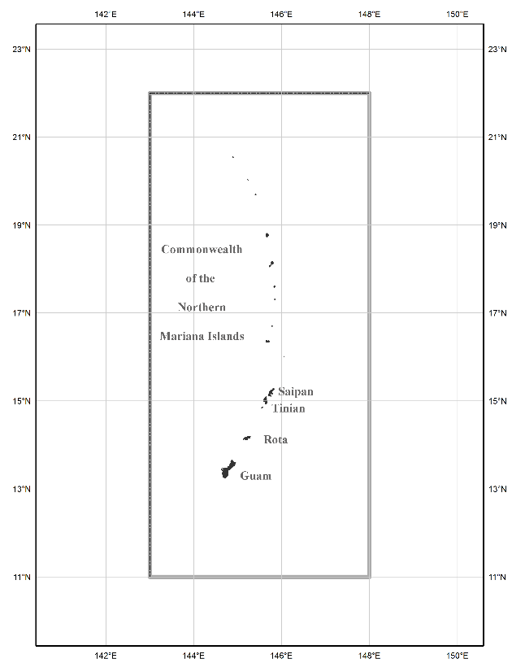
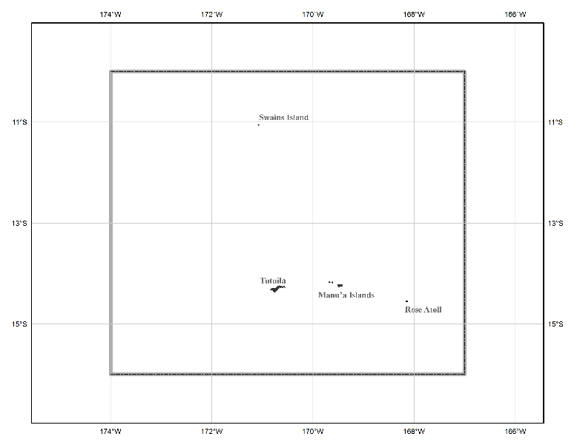
The three gridded regions
“North American region”
¼ of the Earth
“American Samoa region”
“Guam/CNMI region”

Slide 21
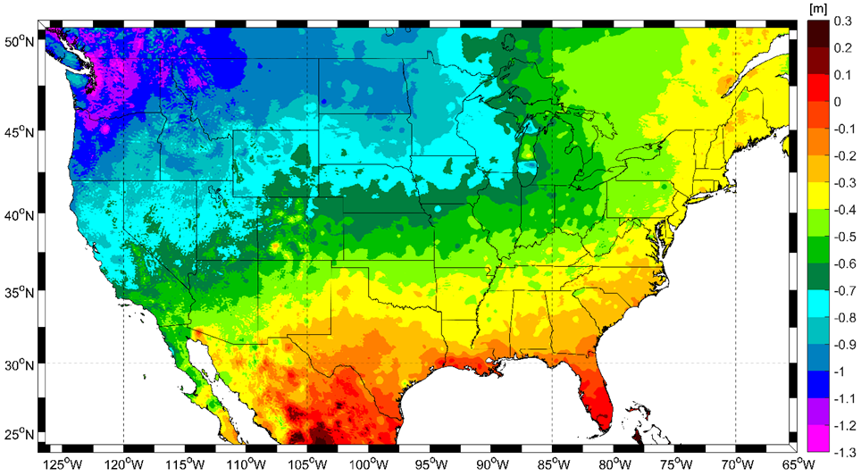
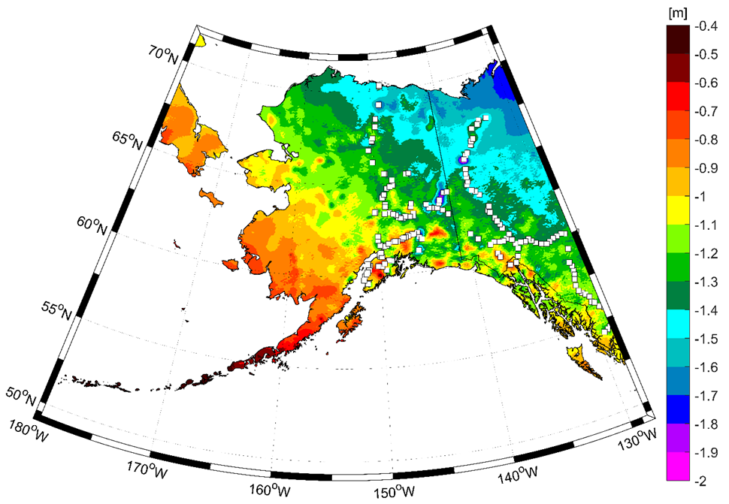
Expected changes to orthometric heights

Slide 22
The Future of Leveling
To develop absolute heights, known heights on passive control must be used. Currently this means a mark of unknown quality
In NAPGD2022, “known” heights for a leveling survey:
  Primary: Perform your own GPS survey
    Yields starting orthometric heights using GEOID2022
    RTK may be perfectly acceptable!
  Secondary: Find a “not stale” passive mark
    “Staleness” depends on the mark

Slide 23
Definitional Relationship
$H_{NAPGD2022}(t)≡h_{∗TRF2022}(t)−N_{GEOID2022}(t)$
Time-dependencies of ellipsoid heights
come from OPUS, where time-dependent
CORS coordinates serve as control for
your time-dependent GNSS survey.
Time-dependencies of geoid undulations
are captured in the dynamic component
of GEOID2022 (“DGEOID2022”), which
will come from the geoid monitoring
service, or GeMS.

Slide 24
Tools in Development
Several tools under development as variants of OPUS Projects
Control level marks created via GNSS survey and NAPGD2022
Leveling between these control would be adjusted separately
A unified adjustment software is being developed to replace GPSCOM, ADJUST, etc.
Submissions will be entirely online and streamlined
Replaces Bluebooking/submission process entirely

Slide 25
Questions?

Slide 26
Updates and Replacements
NAPGD2022 will come with a version number
Updates will change the version
  Bug fixes, new data, new theories, minor improvements
Replacements will change the name
  When GMSL has changed by some threshold (20 cm)
    About 50-70 years

