Slide 1
The Modernized National
Spatial Reference System (NSRS)
Dru Smith
NSRS Modernization Manager
NOAA’s National Geodetic Survey

Slide 2
Outline
Acknowledgements
BLUF
What I’ll be skipping…
Refresher / Shift and Drift
Replace NAD 83
Replace NAVD 88
EPP2022 and IFVM2022
Reference Epoch Coordinates from Time-Dependent Coordinates
Terminology
Using the modernized GNSS
Miscellaneous

Slide 3
Acknowledgments
Blueprint for 2022, Part 3 is the result of significant TEAM efforts over 18 months
GNSS Standard Operating Procedure (SOP) Team
Choi, Roman, Jalbrzikowski, Sun, Dennis, Prusky, Gillins, W. Wang, Saleh, Yoon, Damiani, Kanazir, Evjen, Sellars, Schenewerk, Caccamise, Heck, Hilla, Bilich, McFarland
Leveling Standard Operating Procedure (SOP) Team
Zenk, Kanazir, Dennis, Breidenbach, Fancher, Hanson, Hensel, Paudel, Ward, Zilkoski, Gillins, Geoghegan
BP3 Writing Team
Kinsman, Kanazir, Hensel, Jordan, Stone, Vogel, Heck, Dennis, Fromhertz, Winester, Zenk, Silagi, Roman, Grosh, Ahlgren
It is a team document, with input from dozens of individuals around NGS

Slide 4
Bottom Line, Up Front
If you teach any geospatial topics…
and those topics cover the current National Spatial Reference System (NAD 83, NAVD 88, etc.)
Every piece of educational material you have…
every lecture…
every book…
every figure…
WILL have the wrong information in 3 years…
Let’s talk about what this means, why it is happening, and how it will affect things going forward

Slide 5
What I’ll be skipping…
Not included today:
What is…
NGS and its mission
The NSRS
Bluebooking
GRAV-D
ITRF
Why we are modernizing in 2022
All of these topics have been covered extensively in multiple forums in the last few years

Slide 6
Refresher

Slide 7
“Modernizing the NSRS” means…
Replacing NAD 83
Replacing NAVD 88
Re-inventing Bluebooking
Improving the Geodetic Toolkit
Better Surveying Methodologies
Blueprint for 2022, Part 1
Blueprint for 2022, Part 2
Blueprint for 2022, Part 3
Notes:
There are actually 3 “NAD 83”s, NAD 83(2011), NAD 83(PA11) and NAD 83(MA11)
There are also many more vertical datums than NAVD 88 in the NSRS, each one for specific states or territories that have no line of sight to CONUS/Alaska

Slide 8
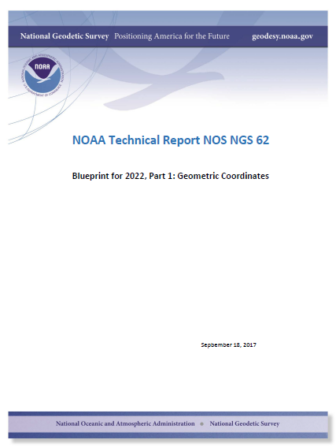
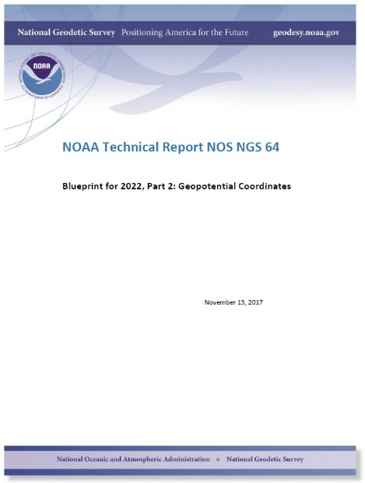
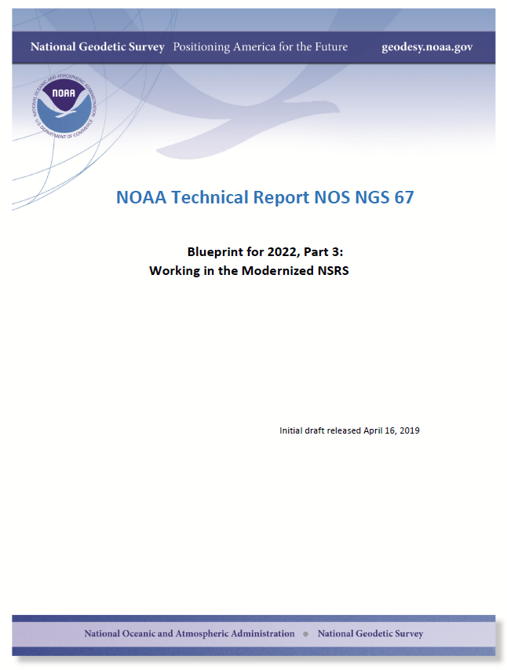
Modernizing the NSRS
The “blueprint” documents: Your best source for information
Geometric:
Sep 2017
NOAA TR NOS NGS 62
32 pages
Geopotential:
Nov 2017
NOAA TR NOS NGS 64
41 pages
Working in the modernized NSRS:
April 2019
NOAA TR NOS NGS 67
77 pages

Slide 9
Replacing NAD 83
The Old:
NAD 83(2011)
NAD 83(PA11)
NAD 83(MA11)
The New:
The North American Terrestrial Reference Frame of 2022
(NATRF2022)
The Caribbean Terrestrial Reference Frame of 2022
(CATRF2022)
The Pacific Terrestrial Reference Frame of 2022
(PATRF2022)
The Mariana Terrestrial Reference Frame of 2022
(MATRF2022)

Slide 10
Replacing NAVD 88
The Old:
NAVD 88
PRVD 02
VIVD09
ASVD02
NMVD03
GUVD04
IGLD 85
IGSN71
GEOID12B
DEFLEC12B
The New:
The North American-Pacific Geopotential Datum of 2022 (NAPGD2022)
Will include:
GEOID2022
DEFLEC2022
GRAV2022
DEM2022
More
Orthometric
Heights
Normal
Orthometric
Heights
Dynamic
Heights
Gravity
Geoid
Undulations
Deflections of
the Vertical

Slide 11
The preeminence of ITRF
Rotation of the
North American Plate
The North American Terrestrial Reference Frame of 2022
(NATRF2022)
The Caribbean Terrestrial Reference Frame of 2022
(CATRF2022)
The Pacific Terrestrial Reference Frame of 2022
(PATRF2022)
The Mariana Terrestrial Reference Frame of 2022
(MATRF2022)
Rotation of the
Caribbean Plate
ITRF2014
Rotation of the
Pacific Plate
Rotation of the
Mariana Plate
EPP2022
EPP for “Euler Pole Parameters”
(a way of describing a plate’s rotation)

Slide 12
Shift and Drift

Slide 13
Shift
One of the two major changes you’ll see in 2022 is a shift in coordinates
Latitude, Longitude, Ellipsoid Height: -2 to +4 meters
Non-geocentricity of NAD 83
Orthometric Height: -0.5 to +2.0 meters
Bias and tilt in NAVD 88
Other shifts will occur in non-CONUS, non-Alaska regions of the USA
There will be outliers!
“Old” unsurveyed points might be off by meters if they’ve moved!

Slide 14
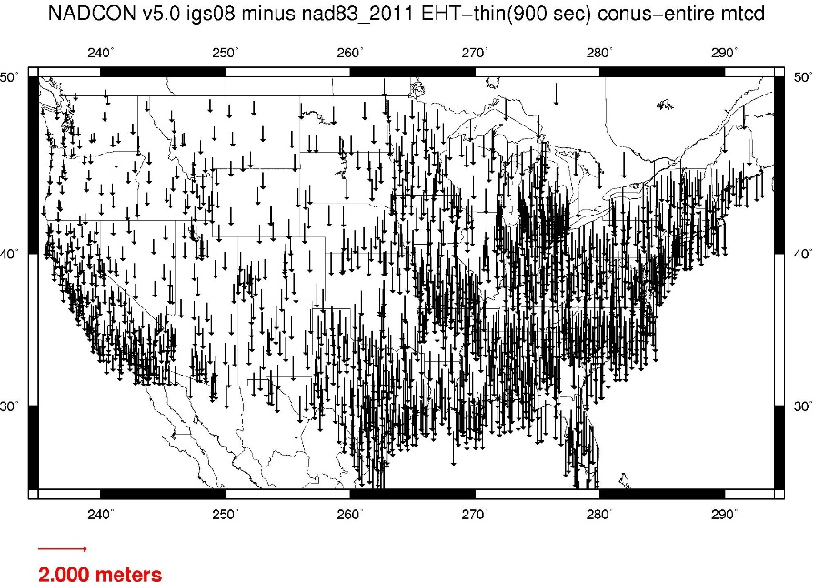
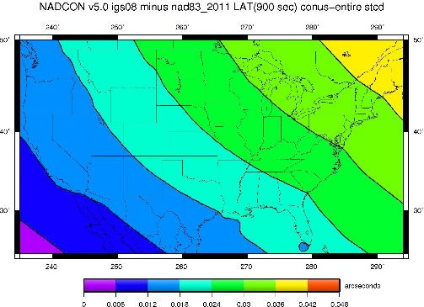
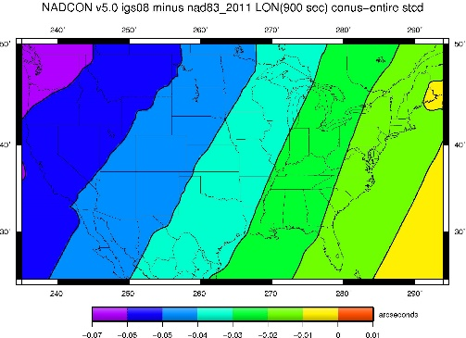
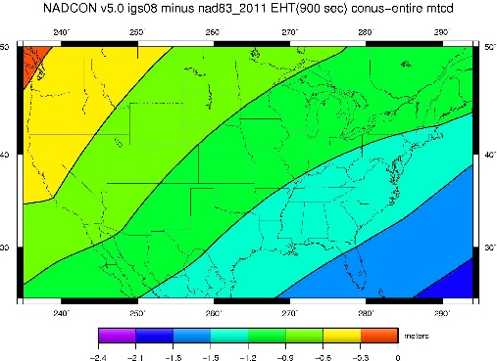
NAD 83(2011) epoch 2010.0 to NATRF2022 epoch 2020.00 (estimate)

Slide 15
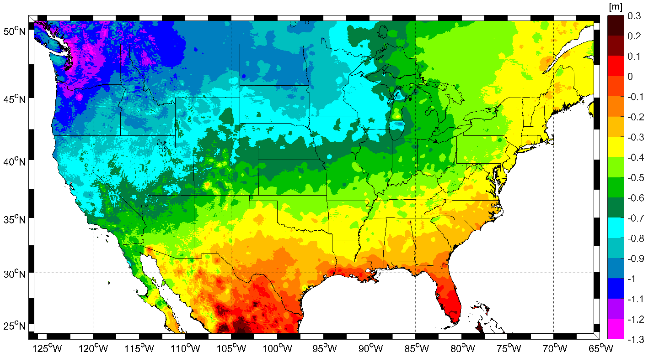
NAVD 88 to NAPGD2022 epoch 2020.00 (estimate)

Slide 16
Drift
The second major change you’ll see in 2022 is a drift in coordinates
Everything in the world moves
Coordinates will be associated with the actual date when the data was taken!

Slide 17
The wrong question, circa 2022:
“What is the latitude of that point?”
The right question, circa 2022:
“What is the latitude of that point, on some specific date?”

Slide 18
Drift
The second major change you’ll see in 2022 is a drift in coordinates
Everything in the world moves
Coordinates will be associated with the actual date when the data was taken!
Velocities at all marks can be estimated
Using a new tool, called the Intra-Frame Velocity Model (IFVM2022)
Two things will mitigate the pain of time-dependent coordinates:
“Plate Fixed” frames
“Reference Epoch” coordinates

Slide 19
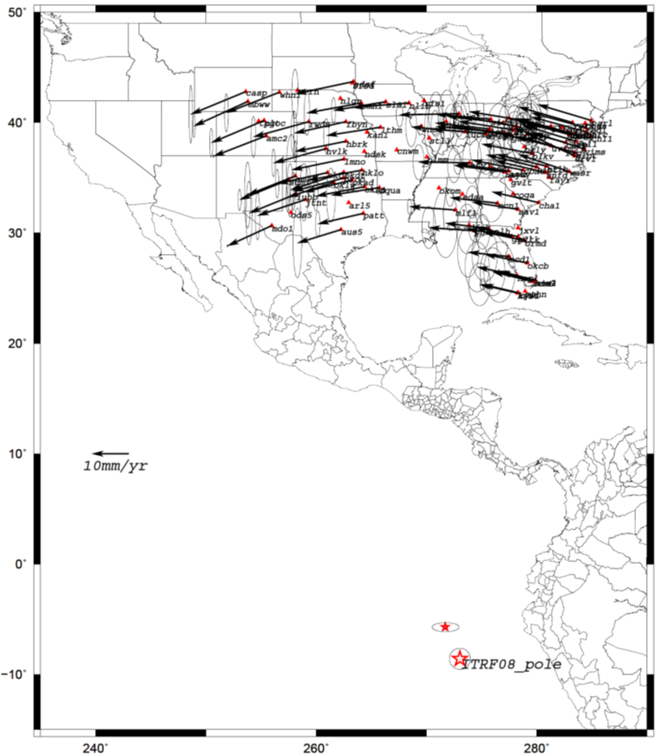
Euler Poles and “Plate Fixed”
In the ITRF, many tectonic plates have one dominant motion: rotation
Plus plenty of other motions
The point about which a continent rotates is called its “Euler Pole”
In summary:
Under ITRF
Frame = constant
N.A. Plate = rotating
It is a fairly simple matter to reverse this and define a rotating frame in which the plate is not rotating.
Under NATRF2022:
Frame = rotating (relative to ITRF)
N.A. Plate = constant (relative to NATRF2022 frame)
We say “NATRF2022” is “fixed” to the N.A. Plate, making it a “plate fixed” frame

Slide 20
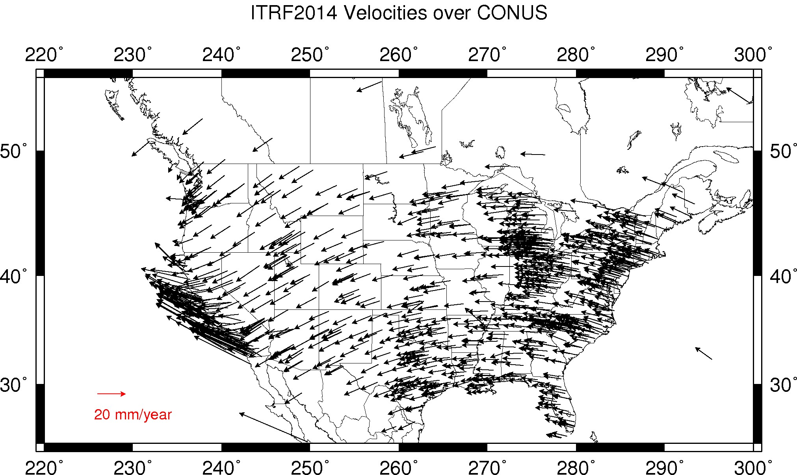
CORS Velocities – ITRF2014

Slide 21
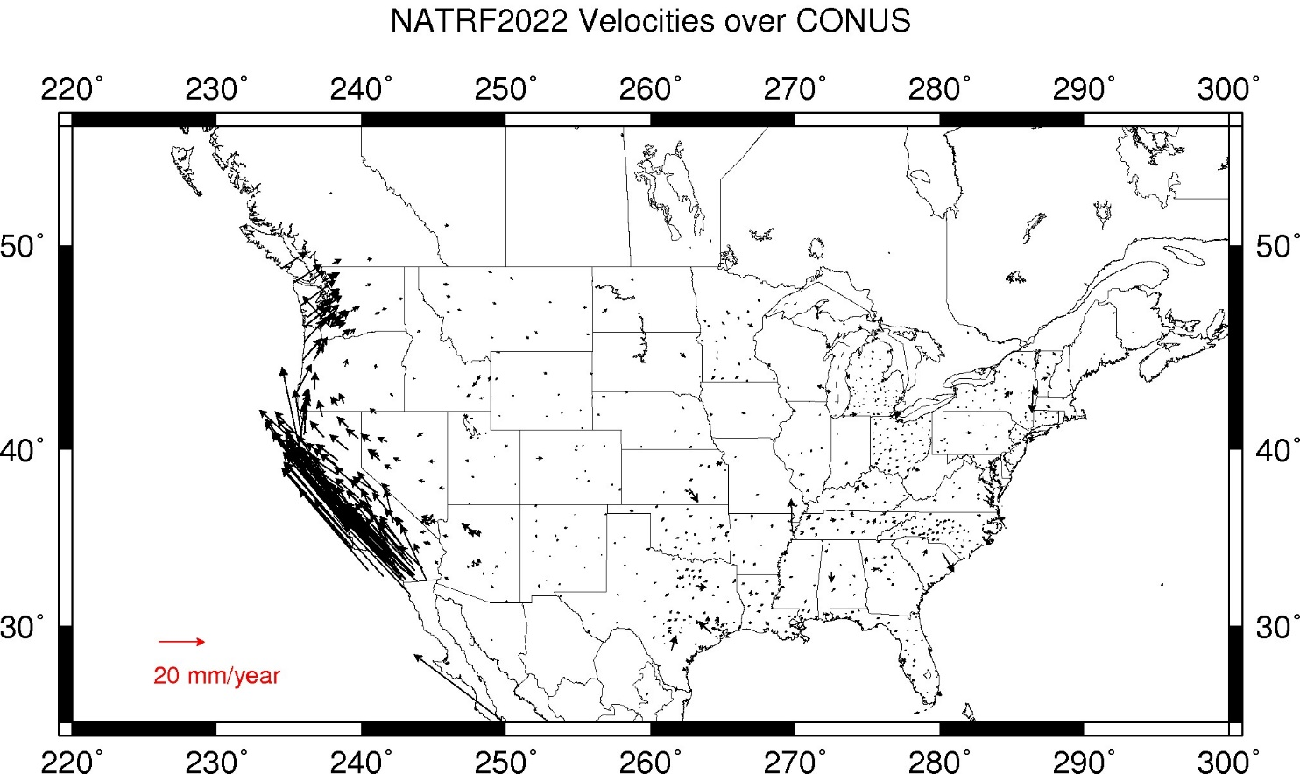
CORS Velocities – NATRF2022

Slide 22
EPP2022 and IFVM2022: The two tools that make time dependent geodetic control useable

Slide 23
There’s really two drifts
The plate rotation is simple (3 parameters per plate)
Captured in EPP2022
Horizontal (latitude/longitude) only
Changes the frame
ITRF2014 to NATRF2022, PATRF2022, CATRF2022 & MATRF2022
Doesn’t change the epoch
The residual motions (after removing plate rotation) are complex
Captured in IFVM2022
Residual horizontal motion
All vertical motion
Changes the epoch
Doesn’t change the frame
IFVM = “Intra-frame” velocity model

Slide 24
Example
Important: This slide only covers geometric coordinates.
It’s 2039 and you are working in San Diego using NATRF2022
You need to compare your work against a competitor’s survey
Done in 2028, using PATRF2022
PATRF2022
ep. 2028.048
EPP2022
ITRF2014
ep. 2028.048
EPP2022
NATRF2022
ep. 2028.048
IFVM2022
IFVM2022
PATRF2022
ep. 2039.704
EPP2022
ITRF2014
ep. 2039.704
EPP2022
NATRF2022
ep. 2039.704

Slide 25
Reference Epochs
It seems highly unlikely that surveyors will embrace coordinates with such diversity of epochs
To mitigate that, NGS will issue “snapshots” of the NSRS every five years (called “Reference Epochs”)
Estimates of coordinates at specific 5 year intervals, based on historic time-dependent coordinates and the IFVM2022
…and the Geoid Monitoring Service (GeMS), for non-geometric quantities
Beginning with 2020.00
Each “snapshot” will be published 2-3 years after the reference epoch
Thus the 2020.00 Reference Epoch Coordinates get published by the end of calendar year 2022

Slide 26
Reference Epoch Coordinates from Time-Dependent Coordinates

Slide 27
Assume “h” was determined four different times:
1990: 2.100
1994: 2.110
2002: 2.190
2009: 2.180
2.250
2.200
h
2.150
2.100
2.050
2.000
1990
‘95
‘00
‘05
‘10
‘15
‘20
‘25
‘30
time

Slide 28
All measurements have error. Shown here are the same
Values of “h”, but with their error estimates.
1990: 2.100 +/- 0.0375 (3.75 cm)
1994: 2.110 +/- 0.0250 (2.50 cm)
2002: 2.190 +/- 0.0200 (2.00 cm)
2009: 2.180 +/- 0.0250 (2.50 cm)
2.250
2.200
h
2.150
In the modernized NSRS these time-dependent
coordinates, estimated at the actual date when
the surveys took place, will be called
“Final Discrete Coordinates”
2.100
2.050
2.000
1990
‘95
‘00
‘05
‘10
‘15
‘20
‘25
‘30
time

Slide 29
In today’s NSRS, a height is held fixed until
replaced. So plotting the height as seen on a datasheet
over time would look like this:
2.250
2.200
h
2.150
2.100
2.050
2.000
1990
‘95
‘00
‘05
‘10
‘15
‘20
‘25
‘30
time

Slide 30
In the modernized NSRS we will also have an estimate of
crustal motion from IFVM2022
2.250
2.200
h
2.150
2.100
Combining Final Discrete Coordinates
with IFVM2022 allows
NGS to estimate Reference Epoch Coordinates
2.050
2.000
1990
‘95
‘00
‘05
‘10
‘15
‘20
‘25
‘30
time

Slide 31
2.250
2.200
The IFVM2022 model will (statistically)
match reference epoch coordinates.
This will allow for the elimination of a
stand-alone “NADCON” product for
coordinates after 2020.0, instead relying
entirely upon IFVM2022
h
2.150
2.100
2.050
2.000
1990
‘95
‘00
‘05
‘10
‘15
‘20
‘25
‘30
time

Slide 32
2.250
2.200
h
2.150
2.100
In the absence of new survey data, error estimates will
grow through time.
2.050
2.000
1990
‘95
‘00
‘05
‘10
‘15
‘20
‘25
‘30
time

Slide 33
The (in)ability of current approach to
properly inform users of the height of
this mark can be seen in green below.
2.250
2.200
h
2.150
2.100
2.050
2.000
1990
‘95
‘00
‘05
‘10
‘15
‘20
‘25
‘30
time

Slide 34
Example (v2)
It’s 2039 and you are working in San Diego using NATRF2022 (epoch 2035.00)
You need to compare your work against a competitor’s survey
Done in 2028, using PATRF2022 (epoch 2025.00)
PATRF2022
ep. 2025.00
EPP2022
ITRF2014
ep. 2025.00
EPP2022
NATRF2022
ep. 2025.00
IFVM2022
This would’ve been a “NADCON” function in the past
IFVM2022
PATRF2022
ep. 2035.00
EPP2022
ITRF2014
ep. 2035.00
EPP2022
NATRF2022
ep. 2035.00

Slide 35
Terminology

Slide 36
Terminology
The following terms (and more) are defined meticulously in BP3 in a coordinated effort within NGS and with the IERS:
Point, Mark, Station, Site, ARP, GRP, Site Marker, CORS, the NOAA CORS Network
GRP = Geometric Reference Point – the official point on a station to which all coordinates refer
As a direct fallout: NGS will no longer provide CORS coordinates at an ARP, only to a GRP
An antenna has an ARP.
A CORS only sometimes has an antenna.
Therefore a CORS only sometimes has an ARP.
But it always has a GRP.
The ARP and GRP are only sometimes coincident in space when the antenna is mounted at a CORS
The GRP gets a Permanent Identifier (PID)

Slide 37
ARP vs GRP
The purpose of a CORS can be debated
But at NGS: the continuous collection of GNSS data for the express purpose of determining the continuous coordinates of a unique, permanent, physical point on each CORS
Such a point is called the Geometric Reference Point, or GRP
Not to be confused with the Antenna Reference Point, or ARP
Which is part of each antenna, not a permanent, unique physical part of a CORS
Identification of GRPs has begun
Coordinates on a CORS will eventually be fully transitioned to be “coordinates of the GRP of the CORS”. Right now they are…unclear.

Slide 38
Terminology
“CORS” is an acronym
It is singular (S means “Station”, not “Stations”)
It will no longer be used to describe the network of all such stations
That will, for now, be called the NOAA CORS Network, or NCN
Which has a subset of stations called the NOAA Foundation CORS Network, or NFCN
Its plural form is CORSs
No apostrophe, No “es” and no skipping the “s”
GODE is a CORS
Not “a CORS site”
And definitely NOT “a CORS Station”
That’s like “an ATM machine”
GODE and 1LSU are CORSs
GODE and 1LSU belong to the NOAA CORS Network
TMG2 is a NOAA Foundation CORS
TMG2 and FLF1 are NOAA Foundation CORSs
TMG2 and FLF1 belong to the NOAA Foundation CORS Network

Slide 39
The NOAA CORS Network (NCN)
As of 2019, this is the official name of the network managed at NGS
Historically referred to as “CORS” or “the CORS”

Slide 40
GPS Month
A span of four consecutive GPS weeks, where the first GPS week in the GPS month is an integer multiple of 4
GPS Month 0 = GPS weeks 0, 1, 2 and 3
GPS Month 1 = GPS weeks 4, 5, 6 and 7
Etc.

Slide 41
New Types of Coordinates

Slide 42
Five types of coordinates
Name | Generally on… | Description
Reported | Passive | “Quick and Dirty”. Smartphone accuracy.
Preliminary | Passive | Computed by you with OPUS using your data. Unchecked by NGS.
Final Discrete | Passive | Most accurate. Time-dependent. Computed by NGS every four weeks.
Final Running | CORS | Continuous time-dependent CORS coordinates. Checked by NGS every day.
Reference Epoch | Passive and CORS | Modeled from Final Discrete, Final Running, IFVM2022 and GeMS. Computed by NGS every five years.

Slide 43
New Types of Coordinates
Reported
“These are from any source where the coordinate is directly reported to NGS without the data necessary for NGS to replicate the coordinate.”
Scaled
From NCAT or Vdatum
NGS Coordinate Conversion and Transformation Tool (NCAT)
Hand Held / Smartphone
Reported directly from an RTK rover without data files

Slide 44
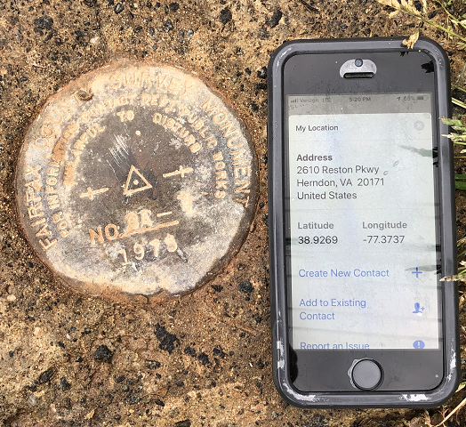
Reported Coordinates

Slide 45
New Types of Coordinates
Preliminary
“These are coordinates at survey epoch that have been computed from OPUS, but not yet quality checked and loaded into the National Spatial Reference System Database (NSRS DB).”
User-computed values, such as they might get today from either OPUS-S or OPUS-Projects
“Preliminary” coordinates are the only coordinates a user will get directly from OPUS

Slide 46
New Types of Coordinates
Reference Epoch
“These are coordinates which have been estimated by NGS, from time-dependent (final discrete and final running) coordinates, at an Official NSRS Reference Epoch (ONRE)”
NAD 83(2011) epoch 2010.00 (sort of) would’ve fallen under this category
These will be computed by NGS every 5 years
On a schedule 2-3 years past ONRE
2020.00 coordinates will be computed in CY 2022
2025.00 coordinates will be computed in CY 2027

Slide 47
New Types of Coordinates
Final Discrete
“These are coordinates computed by NGS using submitted data and metadata, checked and adjusted and referenced to a single survey epoch.”
These represent the best estimates NGS has of the time-dependent coordinates at any mark
Survey epochs:
GNSS: Each GPS Month
Stand-alone occupations, RTK/RTN, Campaigns, etc
Leveling: Annually
Orthometric heights: Leveling adjusted to GNSS-based orthometric heights

Slide 48
New Types of Coordinates
Final Running
“Of all types of coordinates on a mark, these are the only ones which will have a coordinate at any time.”
Generally will only be available at each CORS
Also being called the coordinate function
Which will be generated by a “fit” to daily processed data

Slide 49
Using the modernized NSRS
OPUS
Will include stand-alone GNSS (like “OPUS-S” and “OPUS-RS”)
Will include mark discovery, recovery and reporting
Will include project management and analysis for:
GNSS (including RTK and RTN!)
Leveling
Classical
Gravity
All in one project!
Will have a “submit to NGS” button which replaces “bluebooking”

Slide 50
Using the modernized NSRS
OPUS
Guidance (such as pre-selected CORSs and assistance in locating marks in project areas)
Users will decide what control to hold fixed and what epochs they wish to set for the adjustment
“Preliminary coordinates”
If submitted to NGS, we will harvest your raw data and use it to compute Final Discrete coordinates

Slide 51
Using the modernized NSRS
GNSS is your only entry (for now)
Leveling and Classical surveys will need some GNSS if you wish to submit your survey to NGS for inclusion in the NSRS database
Some GNSS = RTK or RTN is fine
No decision yet on whether OPUS will operate if projects have no GNSS
If it does, this tends to encourage reliance upon passive control
which is “so 90’s”
(1890s!)

Slide 52
So much more…
New version of PAGES
GPS, Galileo, GLONASS, Beidou, QZSS, etc.
Target: 15 minute occupations
OPUS expansion plan
RTK/RTN: 2019
Leveling, Classical, Gravity: 2020-2025
Fully integrated (GPS projects with leveling and gravity? No problem!)
Ease of submission to NGS for inclusion in the NSRS
New Mark Recovery Tool
Smart-phone enabled. In beta now! beta.ngs.noaa.gov/cgi-bin/recvy_entry_www.prl
Fully integrated toolkit
NCAT and VDatum

Slide 53
2020 NSPS National Student Competition
The 2022 North American and Pacific Terrestrial Reference Frames (NATRF2022 and PATRF2022) and the North American-Pacific Geopotential Datum of 2022 (NAPGD2022) and their application in your jurisdiction.
Observation: The Puerto Rico students may feel left out, without CATRF2022 explicitly called out.
Ideas for students:
Preparing massive coordinate files for transformation into NATRF2022 epoch 2020.00
Comparison of NATRF2022 and PATRF2022 in the deformation zone of CONUS
Designing GNSS surveys to work within GPS Month restrictions

Slide 54
Thank you!

Slide 55
Questions?

Slide 56
Extra Slides

Slide 57
Terminology
The following terms (and more) are defined meticulously in BP3 in a coordinated effort within NGS and with the IERS:
Point, Mark, Station, Site, ARP, GRP, Site Marker, CORS, the NOAA CORS Network
GRP = Geometric Reference Point – the official point on a station to which all coordinates refer
As a direct fallout: NGS will no longer provide CORS coordinates at an ARP, only to a GRP
An antenna has an ARP.
A CORS only sometimes has an antenna.
Therefore a CORS only sometimes has an ARP.
But it always has a GRP.
The ARP and GRP are only sometimes coincident in space when the antenna is mounted at a CORS
The GRP gets a Permanent Identifier (PID)

Slide 58
Terminology
“CORS” is an acronym
It is singular (S means “Station”, not “Stations”)
It will no longer be used to describe the network of all such stations
That will, for now, be called the NOAA CORS Network, or NCN
Which has a subset of stations called the NOAA Foundation CORS Network, or NFCN
Its plural form is CORSs
No apostrophe, No “es” and no skipping the “s”
GODE is a CORS
Not “a CORS site”
And definitely NOT “a CORS Station”
That’s like “an ATM machine”
GODE and 1LSU are CORSs
GODE and 1LSU belong to the NOAA CORS Network
TMG2 is a NOAA Foundation CORS
TMG2 and FLF1 are NOAA Foundation CORSs
TMG2 and FLF1 belong to the NOAA Foundation CORS Network

Slide 59
Terminology
“OPUS”
Online Positioning User Service
Adopted as the general term for all of our online positioning software
Rather than “-Projects” , “-S” , etc
Basically “do it with OPUS” should be applicable to a wide variety of tasks
Recon, Mark Recovery, GPS, Leveling, Gravity, Classical

Slide 60
New Way of Operating the NOAA CORS Network (NCN)

Slide 61
New Way of Operating the NOAA CORS Network (NCN)
Each CORS will get a coordinate function
Actually three functions, X(t), Y(t), Z(t), in the ITRF2014 frame
In the strict mathematical definition of “function”
For any given “t”, there is one and only one X , Y and Z
We actually do this today, just that the functions are piecewise linear
We are NOT limiting our “modernized NSRS” discussions of CORS coordinate functions to linear functions only!
But have made no further decisions yet

Slide 62
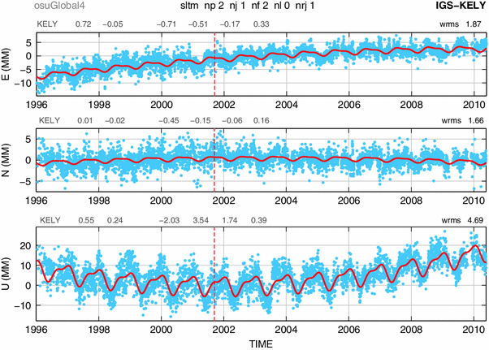
Examples of what non-linear CORS coordinate functions look like

Slide 63
New Way of Operating the NOAA CORS Network (NCN)
Philosophy:
The NOAA CORS Network (NCN) will be self-consistent, meaning:
The impact of a user’s CORS choices within their project will not exceed a small, statistically acceptable value:
Horizontal < 5 mm, Vertical < 10 mm
On a daily basis NGS must be able to detect, and react to, persistent disagreement between daily solutions and the current “coordinate function” assigned to any CORS in the NOAA CORS Network (NCN)

Slide 64
Persistent Disagreement
The point:
It’s not enough to say “each CORS is good to 1 cm in ellipsoid height”.
That phrase is vague, lacking what it means to be “good to 1 cm”.
NGS will define and publish “persistent disagreement”
Possible component: A persistent non-zero average disagreement
Possible component: A persistently deviating disagreement
And NGS will define what happens when a CORS exhibits “persistent disagreement”

Slide 65
New Way for USERS to Process GNSS Projects

Slide 66
GNSS: Time Span…
GNSS projects have no time limit.
(Leveling does. More on that later)
But they will be processed by NGS in GPS Months
*

Slide 67
GNSS: Processing by users in OPUS
GNSS projects, processed by users using OPUS, must always be processed by GPS month as a first step
Multiple occupations on a point within a GPS month will be adjusted together
Coordinate functions from the IGS network or the NOAA CORS Network are the only allowable control
These are effectively the identical steps NGS will use in-house to compute Final Discrete Coordinates (FDCs) from your data
Except NGS will merge your data with all other data in the nation during each GPS month
This process will be built into OPUS as the default, making it easy for users to quickly perform the adjustment
Afterwards, users may move on to a second step…
*

Slide 68
GNSS: Processing by users in OPUS
As a second step, a user may do many alternative things…
Adjust to some epoch that is convenient to them…
Hold any CORSs or passive control as constraints…
This two-step approach is a form of sequential adjustments and allows a win-win:
NGS gets to see the user-computed time-dependent “preliminary” coordinates, which have been computed by GPS Month
Which will be checked against “final discrete” coordinates computed by NGS
The user gets whatever adjustment and/or coordinates fulfill their contractual needs
Redundancy checks can occur both within a GPS month (at step 1, if multiple occupations occur in 1 GPS month) and across GPS months (at step 2, if occupations occur in different GPS months)

Slide 69
New Way of Processing Leveling Projects

Slide 70
Leveling: Time Span…
Leveling projects must not exceed 12 sequential months
Longer projects must be broken into sub-projects each spanning less than 12 sequential months
A compromise between:
Treating “1 GPS Month” as “simultaneous” in the GNSS arena, and
Acknowledging that leveling surveys often take weeks to months to conduct
Mixed with the reality that:
You can’t solve for time-dependent orthometric heights in most leveling projects

Slide 71
Leveling: GNSS required
For the immediate years following 2022, NGS will require that all leveling projects turned in have GNSS on primary control
Minimum of 3 points
Maximum spacing of 30 km
At least two occupations:
+/- 14 days of beginning of leveling
But also within the same GPS month
+/- 14 days of ending leveling
But also within the same GPS month
If leveling exceeds 6 months, must have a 3rd, middle occupation
A GNSS “occupation” can mean “RTK/N”!

Slide 72
Leveling: Step 1 Identify project marks

Slide 73
Leveling: Step 2 Identify primary control marks (PCM)
Each PCM is within 30 km of at least one other PCM
< 30 km
< 30 km
< 30 km
< 30 km

Slide 74
Leveling: Step 2 Identify primary control marks (PCM)
No point over 30 km from a PCM

Slide 75
Leveling: Step 3 Initial GNSS on all PCMs
All PCMs, required: within +/- 2 weeks of the start of leveling
Each PCM, required: 2+ occupations within the same GPS month
All PCMs, recommended: Use the same GPS month

Slide 76
Leveling: Step 4 Leveling
Finished in under 12 months
If greater than 6 months, need a mid-project GNSS set on PCMs

Slide 77
Leveling: Step 5 (if 6-12 months) Mid-project GNSS on all PCMs
All PCMs, recommended: Near midpoint of project
Each PCM, required: 2+ occupations within the same GPS month
All PCMs, recommended: Use the same GPS month

Slide 78
Leveling: Step 6 Final GNSS on all PCMs
All PCMs, required: within +/- 2 weeks of the end of leveling
Each PCM, required: 2+ occupations within the same GPS month
All PCMs, recommended: Use the same GPS month

Slide 79
Leveling: Processing
All GNSS data processed into GPS months, as per normal processing
These are then adjusted to a mean epoch of the entire leveling survey to yield “representative” orthometric heights that serve as control over the entire leveling project
Stochastic but no time dependency

Slide 80
Leveling: Processing
The pre-computed GNSS-based orthometric heights are held as stochastic constraints in the adjustment of leveling data
Use math model from NOAA TM NOS NGS 74
Separates out errors in GNSS from Leveling:
Absolute heights will have standard deviations that are “at GNSS accuracy levels”
Differential heights will have standard deviations that are “at leveling accuracy levels”

Slide 81
Leveling: Absolute errors
Consider this quote from a concerned user:
“In the old NSRS, I could pull the datasheet for a point in California and see that NGS trusted the NAVD 88 height to 1 millimeter. Now, you’re telling me to use RTN to establish orthometric heights in the same area, and I’m getting heights with 4 cm standard deviations! Why are your heights less accurate today than in the past?”

Slide 82
New Way for NGS to Process and store GNSS Data: Final Discrete Coordinates (FDCs)

Slide 83
GNSS: Monthly workflow…
Every GPS month (say the first Monday of that GPS month), NGS will “process the GPS month of 12-16 weeks ago” by doing the following:
Ensure that the “final” IGS orbits for the GPS month that spans 12-16 weeks prior are available
If not, hold off on this until they are
Create an in-house project named for that prior GPS month
Farm all data (collected during that GPS month) from all projects submitted to NGS, and put them all into the in-house project

Slide 84
Processing by GPS Month…
GPS Month 587
GPS Month 588
GPS Month 589
GPS Month 590
GPS Month 591
GPS Month 592
GPS Month 593
GPS Month 594
All GNSS data collected in this
GPS month…
…are processed in this GPS month…
…to create Final Discrete coordinates for
this GPS month….
…which are loaded into the
NSRS database in this GPS month.

Slide 85
Processing by GPS Month…
GPS Month 587
GPS Month 588
GPS Month 589
GPS Month 590
GPS Month 591
GPS Month 592
GPS Month 593
GPS Month 594
All GNSS data collected in this
GPS month…
…are processed in this GPS month…
…to create Final Discrete coordinates for
this GPS month….
…which are loaded into the
NSRS database in this GPS month.

Slide 86
GNSS: Monthly workflow…
Adjust all that data together
Take the results of this adjustment and load them into the NSRS database as “final discrete” coordinates

Slide 87
GNSS: Monthly workflow…
Q: What about users’ projects that span more than 12-16 weeks?
A: NGS will provide a way for a user to “allow NGS to farm my data as it is loaded to my ongoing project”
Thus NGS needn’t wait for them to finish their project and click “submit”.
Will require some sort of metadata validity statement from the user for each data file uploaded

Slide 88
GNSS: Monthly workflow…
Q: What if a user turns in data more than 12-16 weeks after it was collected?
A: NGS will have a “holding bin” for such data. Occasionally, but not more than 1/year, NGS will sweep up all data in the holding bin, and put that data into the proper in-house GPS-month-based projects, depending on the GPS month of that data.
Since those in-house projects have already been adjusted once before using data that WAS submitted within the 12-16 week limit, and “final discrete” coordinates were computed on those early-submitted data, NGS will hold the “final discrete” coordinates on that early-submitted data as “fixed”, and adjust the later-submitted data only.

Slide 89
New Way for NGS to Process and store GNSS Data: Reference Epoch Coordinates (RECs)

Slide 90
GNSS: Every five years…
Official NSRS Reference Epochs (ONREs) will happen every five years, beginning with 2020.00.
Every ONRE will have a project associated with it
To estimate the Reference Epoch Coordinates (RECs) at each ONRE
That project will begin 2 years after the ONRE and will end 3 years after it
Thus the project to create 2020.00 RECs will run January 1-December 31, 2022
Using data collected through the end of 2021
Error estimates in RECs will grow larger every five years for those points which are not regularly observed
Once computed, the REC at an ONRE for a point will stand forever, unless corrected for a blunder

Slide 91
Miscellaneous

Slide 92
Miscellaneous
OPUS-RS will be modified to work in the modernized NSRS online, but will not be used to populate the NSRS Database
To use the new terminology: it will provide preliminary coordinates
To acknowledge the problems with integrating this software with any other version of OPUS
In preparation for its eventual mothballing / replacement by the new multi-GNSS PAGES

Slide 93
Future Discussions/Decisions:
What will be the nature of the coordinate functions at each CORS?
How will those functions be used to detect, and correct, persistent disagreement between daily solutions and the coordinate functions?

Slide 94
Future discussions: What will be the nature of the “coordinate functions” at each CORS? How will those functions be used to detect, and correct, persistent disagreement between daily(?) final discrete coordinates and the coordinate functions?

Slide 95
CORS Processing
This is from the most recent
“short term” plots of GODE
Note, what could be called a “persistent
non-zero average disagreement” between
daily solutions and the assigned coordinate
function (about 5 mm in North, for example)
Not “persistently growing disagreement”, as
the average disagreement isn’t getting
worse.

Slide 96
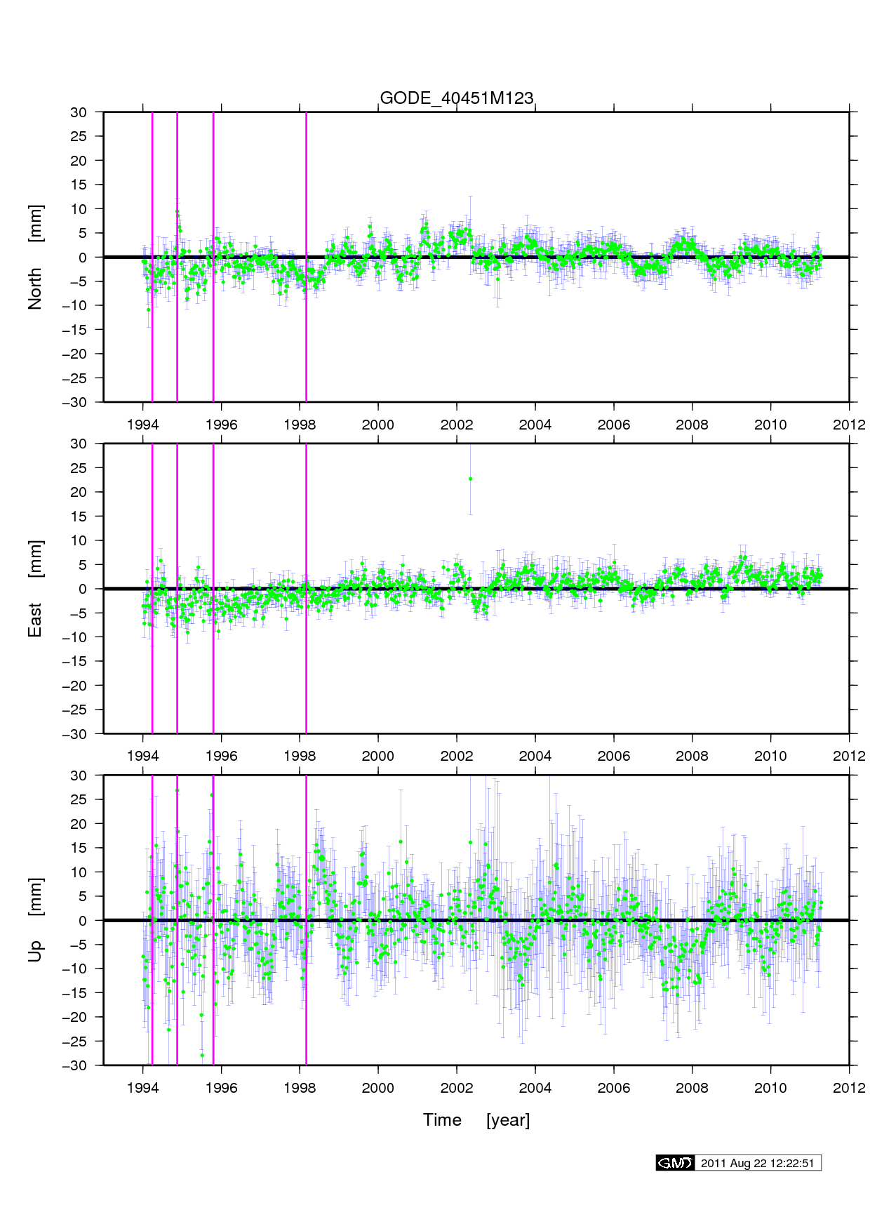
CORS Processing
This is from the most recent
“long term” plots of GODE

Slide 97
CORS Processing
An example of
how OSU processes
daily data (blue) into
“coordinate functions”
(red).
Coordinate functions
contain:
Linear terms
Polynomials (to 4)
Annual/Semi-Annual
Exponentials
Discontinuities

Slide 98
CORS Processing
An example of
how OSU processes
daily data (blue) into
“coordinate functions”
(red).

Slide 100
Why “1 GPS Month”?
The NSRS should be more accurate than everything built upon it
Has everything to do with systematic movement of passive marks, not random error in GPS
In order to properly adopt time-dependent coordinates, NGS must pick some time span that we call “simultaneous”
During that time span, the mark must not move systematically (in the ITRF2014 frame) by more than some set threshold

Slide 101
Why “1 GPS Month”?
What threshold to pick?
Do NOT confuse random errors with systematic movement
To the left is a daily
set of GPS-derived heights (blue) collected from an antenna which was systematically lowered by 1 mm every week over 14 weeks.
Random error: +/- 0.5 cm (OP)
See that the “mm/week” trend is definitely manifest in the blue curve, despite the “half cm of noise”!

Slide 102
Why “1 GPS Month”?
What threshold to pick?
Because we are an agency that has long cared about millimeters…
See, for example, leveling accuracy. See, for example, XYZ coordinates of all CORSs.
Because one half millimeter is the most systematic error one can absorb before rounding error could make you “off by a millimeter”…
Because GPS noise is not the same as systematic mark movement…
Because a SOP which works for the worst case will work for all cases…
Because the “worst case” (fastest horizontal movement) in the USA is in Hawaii at 0.5 mm in 3 days…
Because the “worst case” (fastest subsidence we’ve ever observed in the USA) is around 0.5 mm in 1 day…
The right answer should be “1 day”, but instead…
NGS has proposed that we call “1 GPS Month” as “Simultaneous”, which is worse than the “1 day” or even “3 days” we should use, but which is a round number, easy to work with and not too far outside of capturing 0.5 mm of movement everywhere in the USA.
Plus when we do the “GPS month” adjustments, we will ALSO introduce the IFVM, which will help account for any systematic movement over the four week time span
And four weeks is the median length of time of most projects turned in to NGS

Slide 103
New Way of Operating The CORS Network
100% of CORS available to OPUS every day will pass a regular statistical test for persistent disagreement
One possible definition of “persistent disagreement”: For 14 days in a row, the absolute value of the average of the difference between “daily solutions” and the “coordinate function” assigned to that CORS, since the last known discontinuity at that CORS, exceeds 5 mm in latitude or longitude or 10 mm in ellipsoid height
Just as reasonable, we might say “…since the last 6 months…” rather than “…since the last known discontinuity…” – More on that later.
If the CORS fails this test pull CORS out of OPUS
Watch, evaluate, update coordinate function and get the CORS back into OPUS as soon as the coordinate function has been updated so that the statistical test is passed
Likely: Do NOT update function for any days BEFORE the failure, only AFTER. This may mean introducing a derivative discontinuity, but not a functional discontinuity
This prevents users from having to continually respond to a changing historical function at each CORS

Slide 104
Persistent Disagreement
Notes:
Begin with daily solutions on a CORS, and an assigned coordinate function, in this case for ellipsoid height. While subtle, it should be clear that the daily solutions are drifting away from the assigned coordinate function.
And while, day to day, there is a large (5-10 cm) disagreement between the daily solutions and the coordinate function, due *mostly* to noise in the daily solutions, that disagreement begins to show a small (mm/year) non-random nature as time goes on. That is, there is seen a “persistent disagreement”. The question is “how to quantify that persistent disagreement”. The answer is: “by looking at the average of daily disagreements over some period of time, and seeing a consistent deviation from zero”.

Slide 105
Persistent Disagreement…
Notes:
We now introduce the “absolute value of the average difference between daily solutions and coordinate functions over ‘some span of time’ ”. The time span for the averages shown is:
Yellow: Just the last 6 months of data
Gray: The lifespan of the CORS

Slide 106
Persistent Disagreement…
Notes:
For the first 6 months or so, the absolute value of the average disagreement between the daily solutions and the assigned coordinate function is highly unstable, ruled mostly by the noise in the daily solutions

Slide 107
Persistent Disagreement…
Notes:
After six month, things settle down.
Note that, as would be expected, the good disagreement during the early life of the CORS causes the gray line to grow SLOWER than the yellow line. That is because the statistics of the gray line are always influenced by early, good data. The yellow line grows more quickly because it dismisses any data older than 6 months and so, as the systematic disagreement persists (see what I did there? “persistent disagreement”…), each new 6 month window gets a little worse than its predecessor and is not “improved” by good data at the beginning of the life of the CORS.

Slide 108
Persistent Disagreement…
14 days in a row, the absolute
average disagreement (looking
back the life of this CORS)
exceeded 1 cm.
CORS went “bad” at 2 ½ years
after last known discontinuity
Notes:
The persistent disagreement test might read “For 14 days in a row, the absolute value of the average disagreement between daily solutions and the CORS coordinate function exceeded 1 cm”, where “average” is over some time span:
Yellow: Just the last 6 months
Gray: Since the last discontinuity
In this case, it means that it takes 2 ½ years for persistent disagreement to occur at this CORS, under the “since last discontinuity” average.

Slide 109
Persistent Disagreement…
14 days in a row, the absolute average
disagreement (looking back just 6 months)
exceeded 1 cm.
CORS went “bad” at 1 ½ years
after last known discontinuity
Notes:
In this case, it means that it takes only 1 ½ years for persistent disagreement to occur at this CORS, under the “last six months” average.

