Slide 1
NGS Educational Offerings
Erika Little
NGS Training Coordinator
8/6/19

Slide 2
Current material
What we have and how we are getting the word out
Ideas for future content
Request for input

Slide 3
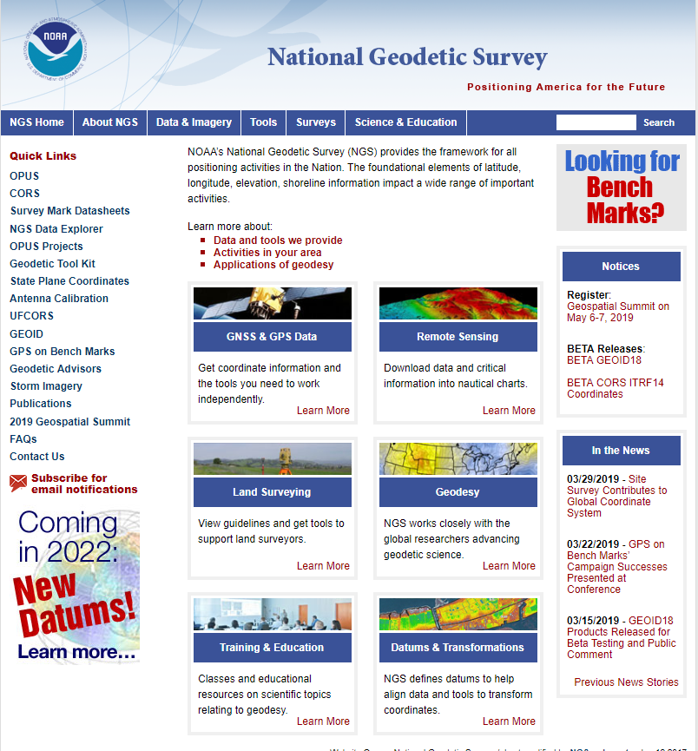

Slide 4
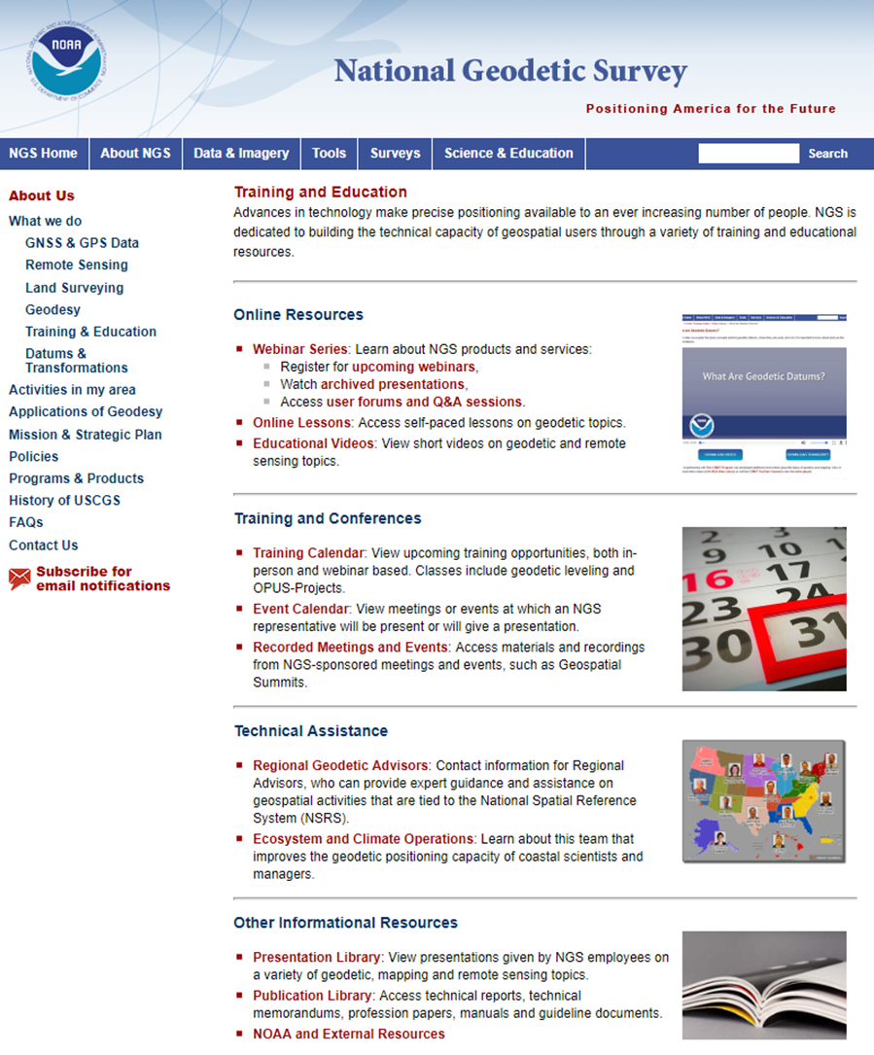

Slide 5
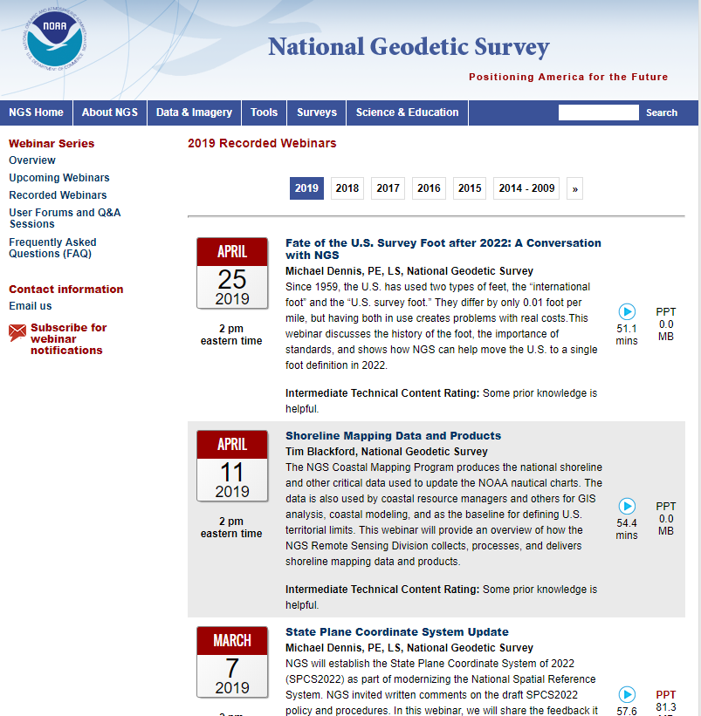
NGS Webinar Series
68 recordings available to date

Slide 6
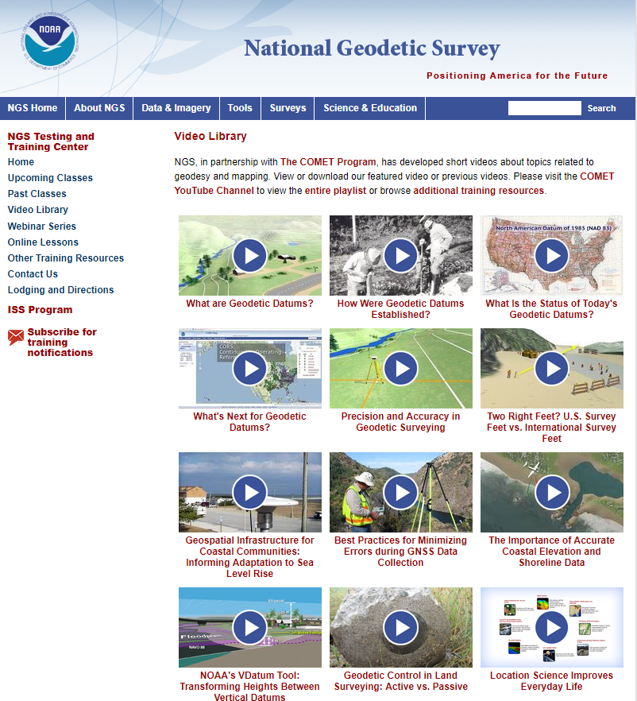
Educational Videos
Partnership with the University Corporation for Atmospheric
Research’s (UCAR) COMET Program
Most Viewed on COMET YouTube channel (through 4/30/19)
What are Geodetic Datums? | 105,837
Best Practices for Minimizing Errors During GNSS Data Collection | 43,315
Precision and Accuracy in Geodetic Surveying | 37,501
Over 242,000 views of all 12 videos

Slide 7
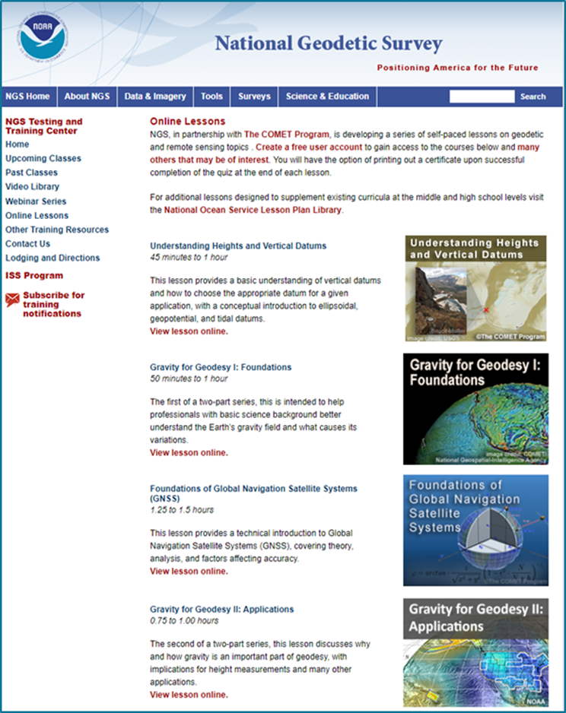
Online Lessons
Partnership with the University Corporation for Atmospheric Research’s (UCAR) COMET Program
Module completions to date by sector (through 2/2019)
Education | 763
Other | 282
Private Sector | 161
State or Local | 149
Weather Enthusiast | 81
NOAA | 80
DOD | 60
Other Federal US | 98
International | 38

Slide 8
Online Lessons
Partnership with the University Corporation for Atmospheric Research’s (UCAR) COMET Program
 | Quiz completions (through 6/2019) | Sessions (through 6/2019)
Understanding Heights and Vertical Datums | 983 | 3,249
Gravity for Geodesy I: Foundations | 294 | 1,263
Foundations of Global Navigation Satellite Systems (GNSS) | 425 | 3,195
Gravity for Geodesy II: Applications | 140 | 590
Coming Soon! GNSS II: Precise Surveys

Slide 9
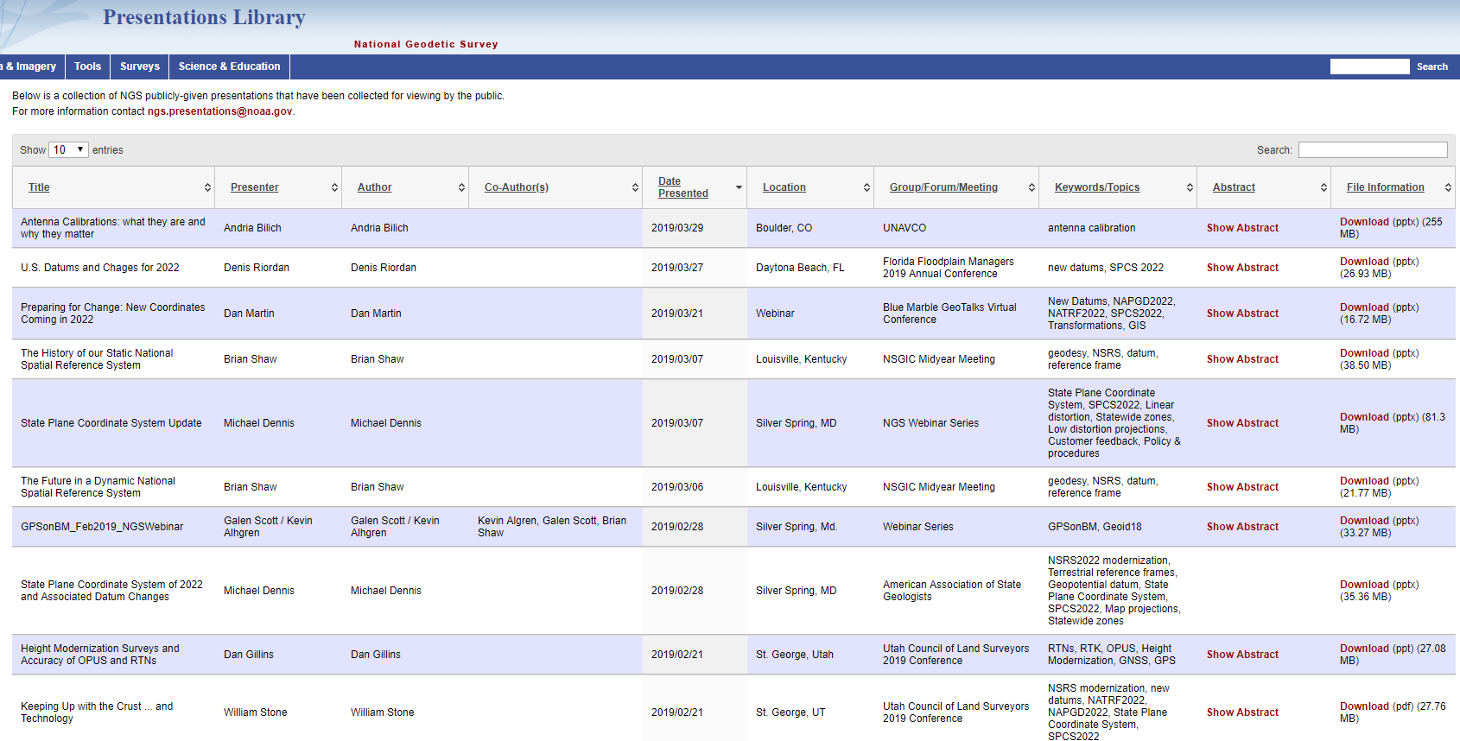
Presentation Library
Over 600 presentations given by NGS employees, available for your viewing and use

Slide 10
Subscription Lists
Subscribers | Aug 2018 | July 2019
News | 1,432 | 2,460
Training | 1,844 | 2,704
Webinar Series | 1,606 | 2,705
GPS on Bench Marks | 1,033 | 1,707

Slide 11
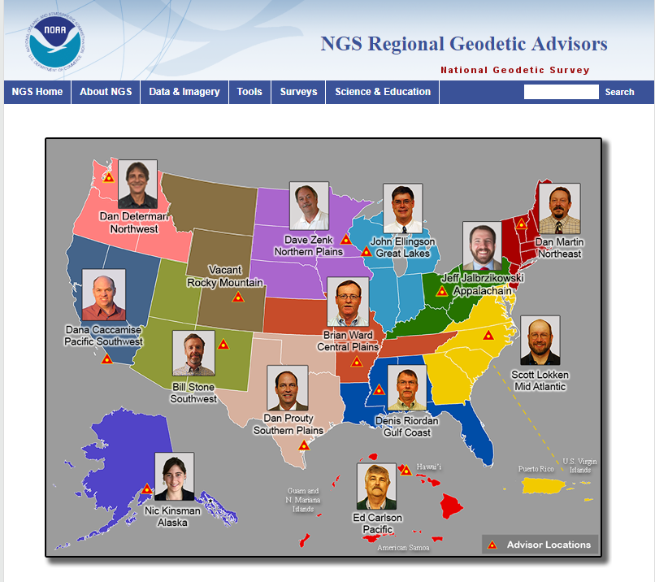
14 Regional Geodetic Advisors
Expert sources for training and education

Slide 12
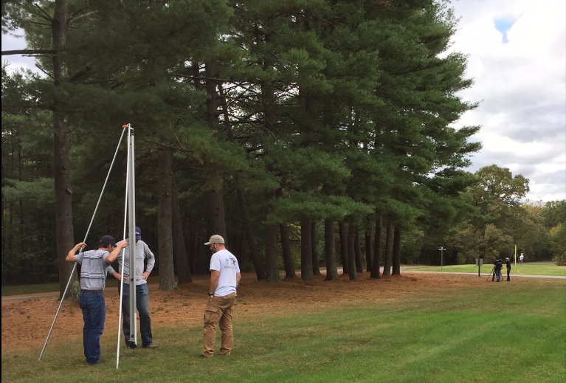
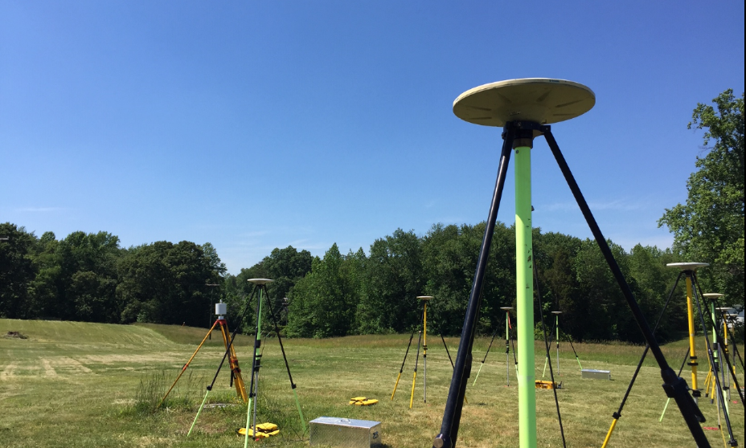
NGS Testing and Training Center
NSPS Student Competition
April 2020!!
Located near Fredericksburg, VA
In-person training classes such as OPUS Projects Manager’s Training and Geodetic Digital Leveling
Many acres of land for hands-on training and equipment testing

Slide 13
Future Content
Additional Online Lessons
Continued webinars
Series on basic/fundamental geodetic and remote sensing topics
Focus on NSRS Modernization

Slide 14
Your Input is needed and welcome on:
Topics
Content
Delivery methods
Send to ngs.feedback@noaa.gov

