Slide 1
Selecting CORS for your OPUS-Project
Dr. Kimber DeGrandpre
Geodesist - CORS Branch
Acting Central Plains Regional Advisor (KS, MO, TN, AR)
kimber.degrandpre@noaa.gov
(907) 209-7911
2024 KSLS Annual General Meeting and Conference
15 October 2024

Slide 2
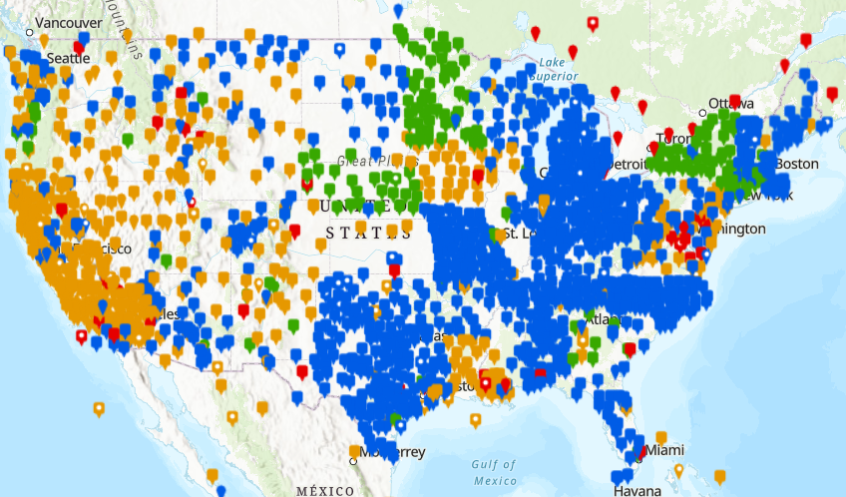
CORS Stations in the NCN
These are the CORS stations in the NCN
Kansas has a lower density, making CORS selection for OPUS Projects trickier
Understanding how CORS are selected could be helpful for designing in state networks and planning for future installations

Slide 3
Two Options for CORS Selection
We recommend using both in combination
CORS Selector (Used in OPUS-S)
What information does the CORS Selector consider
How does the CORS Selector makes a selection
Examples of the CORS Selector
User Choice (Used in OPUS Projects)
Things to consider when choosing your own station
NGS Tools used to evaluate CORS Stations
NCN Station Pages
https://geodesy.noaa.gov/CORS/ncn_station_pages/index.html?stationID=KSSL
NCN Residual Time Series Comparison Tool (NCN PloTS)
https://geodesy.noaa.gov/OPUS-Tools/ncn-plots/

Slide 4
CORS Selector
The CORS Selector is used by OPUS-S to select 5 stations surrounding the survey location and then takes the average baselines of the best 3 out of those 5. These solutions and the CORS that were used are then loaded into your OPUS Project. These slides will explain how those CORS are selected.
Information that goes into the CORS Selector
Horizontal score
Vertical score
Distance from survey location
Number of daily files available in the last 90 days
Number of constellations needed
Example: If the survey is using GPS, GLONASS, and Galileo constellations, CORS stations that have all 3/3 constellations get the most points, CORS stations that have 2/3 of the constellations get less points, and CORS stations that have 1/3 constellations get the least points
The CORS Metrics algorithm calculates these values every day based off of the RMS Error between the daily position and the MYCS model with different weighting schemes for historic, mid-term, and short-term performance

Slide 5
CORS Selector
Points | Horizontal Score | Vertical Score | Distance (km) | Number of Daily Data Files Per 90 Days | Number of Constellations
25 | ≤ 0.002 | ≤ 0.004
24 |  |  | 0.005 - 250
22.5 | ≤ 0.003 | ≤ 0.006
21 |  |  | < 500
20 | ≤ 0.004 | ≤ 0.008
18 |  |  | < 750
17.5 | ≤ 0.005 | ≤ 0.010
16 |  |  |  |  | All or More Than Requested
15 | ≤ 0.006 | ≤ 0.012 | < 2000
12.5 | ≤ 0.007 | ≤ 0.014
12 |  |  |  |  | 1 Less Than Requested
10 | ≤ 0.008 | ≤ 0.016 |  | > 80 or IGS Station
8 |  |  |  |  | 2 Less Than Requested
7.5 | ≤ 0.009 | ≤ 0.018
7 |  |  |  | > 70
5 | ≤ 0.010 | ≤ 0.020 |  | > 60
4 |  |  |  |  | 3 Less Than Requested
*2.5 | ≤ 0.011 | ≤ 0.022
2 |  |  |  | > 30
0 | > 0.011 | > 0.022 |  | ≤ 30 | 4 or More Less Than Requested
1. A list of all CORS at distances between 5 m and 2000 km from the survey location is generated
2. The score of each CORS station is calculated from the metrics listed in the table to the right
Maximum calculated score is 100
User selected CORS get a score of 101 so they are automatically used
3. Scores are then sorted into grades
A ≥ 91
B ≥ 81
C ≥ 71
D ≥ 61
F ≥ 51
4. Graded CORS are then sorted into quadrants (NE, SE, SW, and NW)
5. The best CORS of each quadrant is then selected
6. A 5th CORS is selected from the best remaining options regardless of quadrant

Slide 6
CORS Selector
Points | Horizontal Score | Vertical Score | Distance (km) | Number of Daily Data Files Per 90 Days | Number of Constellations
25 | ≤ 0.002 | ≤ 0.004
24 |  |  | 0.005 - 250
22.5 | ≤ 0.003 | ≤ 0.006
21 |  |  | < 500
20 | ≤ 0.004 | ≤ 0.008
18 |  |  | < 750
17.5 | ≤ 0.005 | ≤ 0.010
16 |  |  |  |  | All or More Than Requested
15 | ≤ 0.006 | ≤ 0.012 | < 2000
12.5 | ≤ 0.007 | ≤ 0.014
12 |  |  |  |  | 1 Less Than Requested
10 | ≤ 0.008 | ≤ 0.016 |  | > 80 or IGS Station
8 |  |  |  |  | 2 Less Than Requested
7.5 | ≤ 0.009 | ≤ 0.018
7 |  |  |  | > 70
5 | ≤ 0.010 | ≤ 0.020 |  | > 60
4 |  |  |  |  | 3 Less Than Requested
*2.5 | ≤ 0.011 | ≤ 0.022
2 |  |  |  | > 30
0 | > 0.011 | > 0.022 |  | ≤ 30 | 4 or More Less Than Requested
1. A list of all CORS at distances between 5 m and 2000 km from the survey location is generated
2. The score of each CORS station is calculated from the metrics listed in the table to the right
Maximum calculated score is 100
User selected CORS get a score of 101 so they are automatically used
3. Scores are then sorted into grades
A ≥ 91
B ≥ 81
C ≥ 71
D ≥ 61
F ≥ 51
4. Graded CORS are then sorted into quadrants (NE, SE, SW, and NW)
5. The best CORS of each quadrant is then selected
6. A 5th CORS is selected from the best remaining options regardless of quadrant
Score = 80.5
Grade = C

Slide 7
CORS Selector
This illustration shows the following decision making criteria for selecting the 5 CORS:
If there are no CORS, then the quadrant remains empty (SE)
If there is only one CORS in the quadrant it is selected (CORS 9, SW)
The best grade is selected from the quadrant (CORS 2, NW)
If there are multiple CORS stations with the same grade the closest one is selected (CORS 5, NE)
To achieve a total of 5 selected CORS the remaining need is filled by the best grades that are closest, regardless of quadrant (CORS 4 and CORS 6, NW and NE)
NW
NE
CORS 1 (D)
CORS 2 (A)
CORS 7 (B)
CORS 3 (F)
CORS 6 (B)
CORS 5 (B)
CORS 4 (B)
CORS 8 (B)
Project Location
CORS 9 (C)
SW
SE

Slide 8
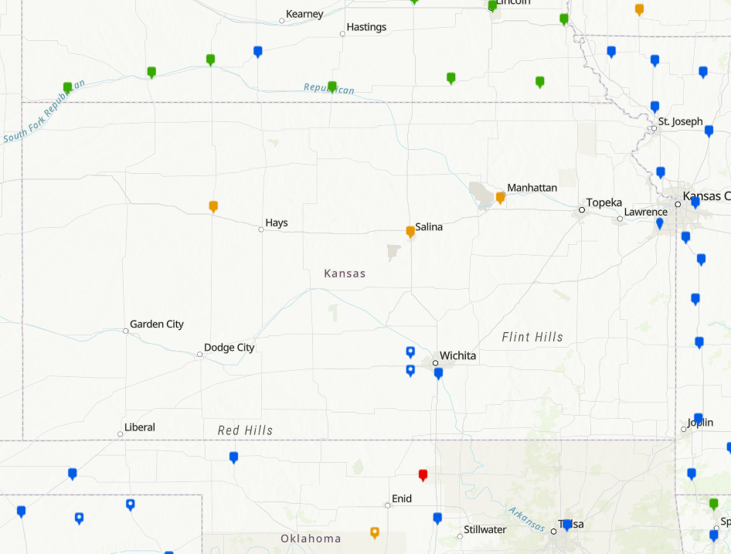
CORS Selector - Example
This example shows the results when the CORS Selector is used to select 5 stations for a survey location in Great Bend on 10 October 2024.
4 of the stations selected have a B grade (NEMC, KSU1, OKGM, OKPR)
1 selected station has an A grade (SGPO)
7 closer stations were not selected because of data ingest and quality issues (KSSL, ICT5, ICT4, ICT1, KSWK, NERC, OKBF)
NEMC (B)
~250 km
KSU1 (B)
Great Bend
OKGM (B)
SGPO (A)
OKPR (B)

Slide 9
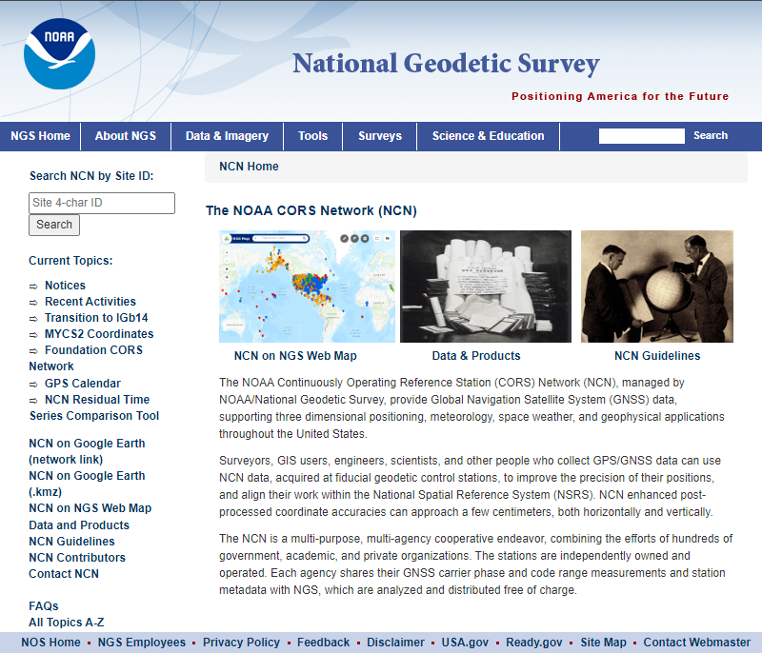
User Choice
The user can force OPUS-Projects to use specific CORS stations regardless of the grade it may get from the CORS Selector
To evaluate CORS in your area, there are the following tools available from NGS on the NCN Home Page:
NCN Map
NCN Station Pages
NCN Residual Time Series (NCN PloTS)
Reasons to do this:
You are required to use a specific CORS
You want to use the same CORS used in a previous/different project/survey
Your network design makes more sense with other CORS (spatial consideration)
There is a CORS that may be better for a longer period of time during the project (temporal consideration)
2
3
1

Slide 10
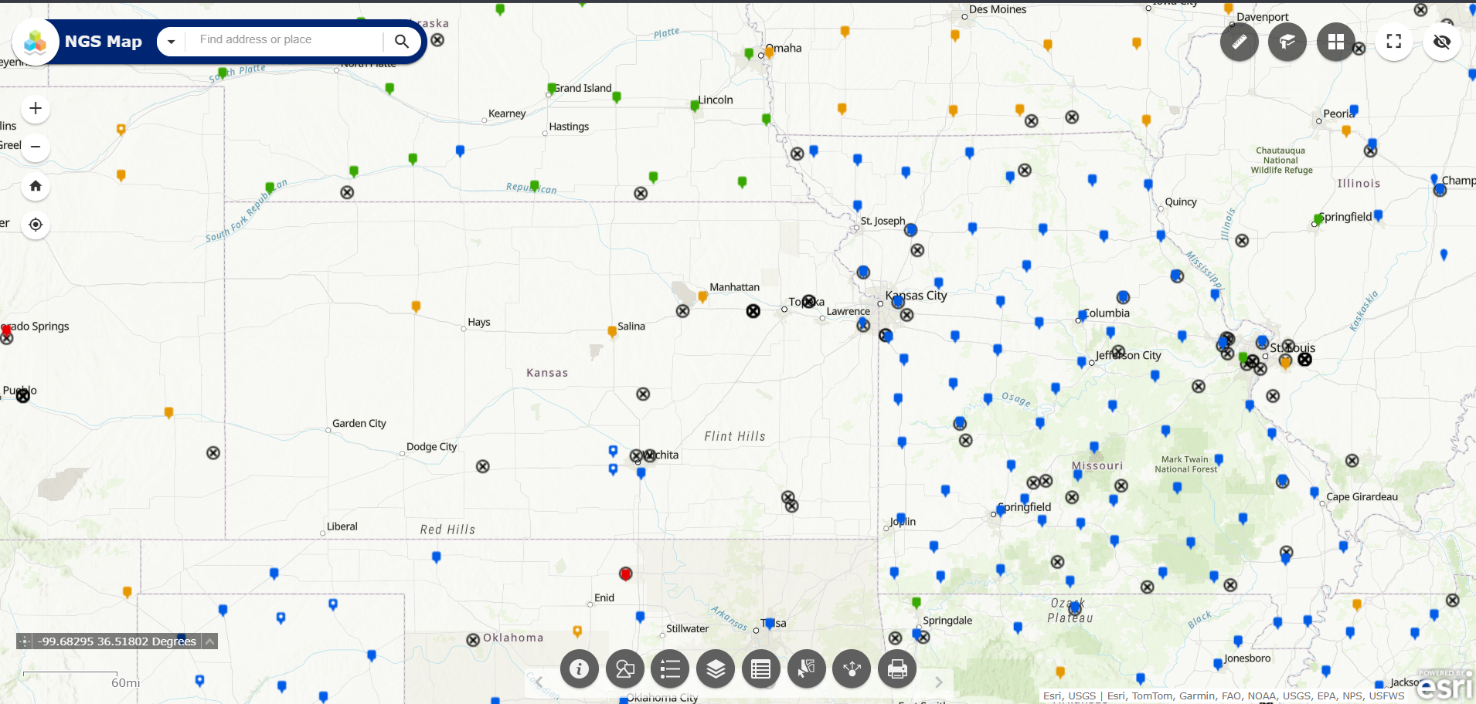
User Choice – NCN Map
The NCN Map is a good place to start by looking at CORS in your area

Slide 11
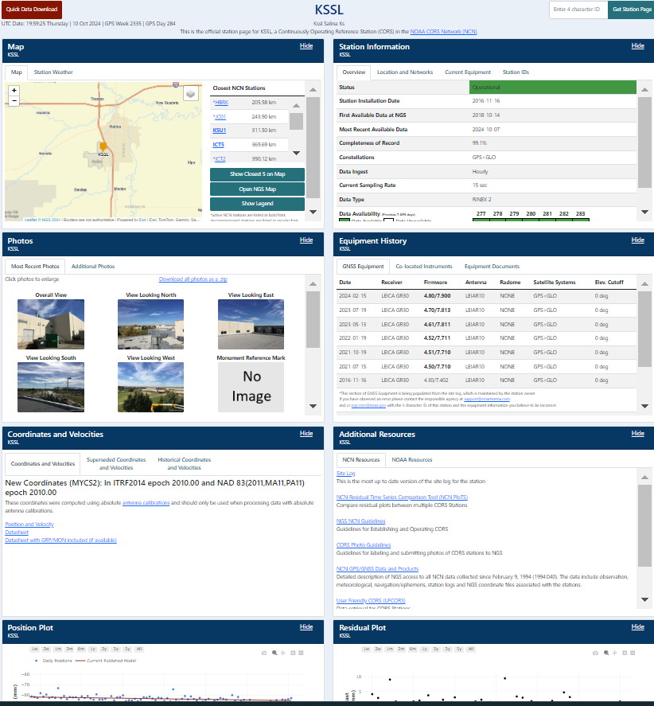
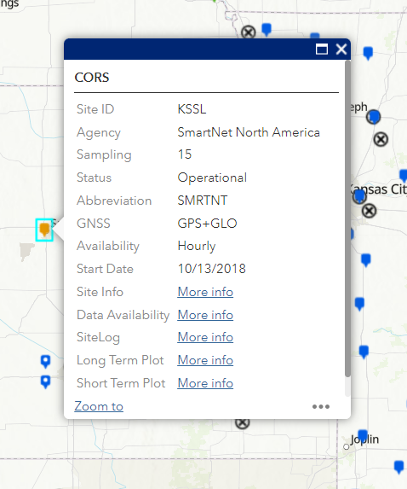
User Choice – NCN Station Pages
You can get to the NCN Station Pages by clicking the “Site Info” link on the NCN Map or by putting the 4 character site ID into the NCN Home Page search bar
Station Pages will give you information like sampling rate, equipment used, last date of available data, who owns
the station, as well as show you the position, model, and residual plots, some station quality metrics, and photos
This is a good place to start to familiarize yourself with any CORS stations in the area

Slide 12
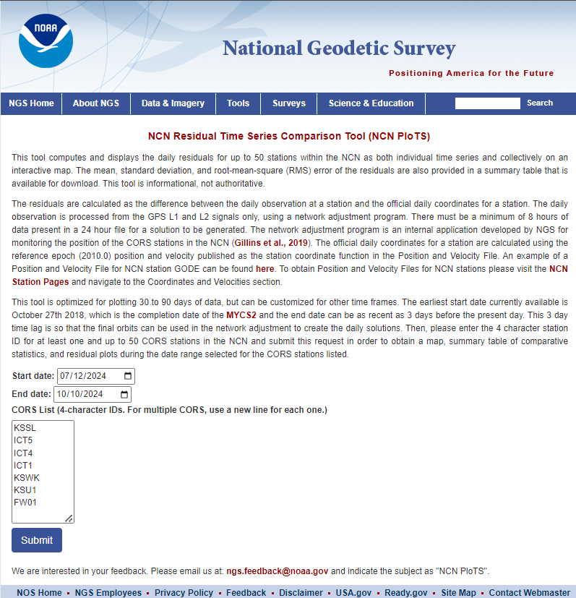
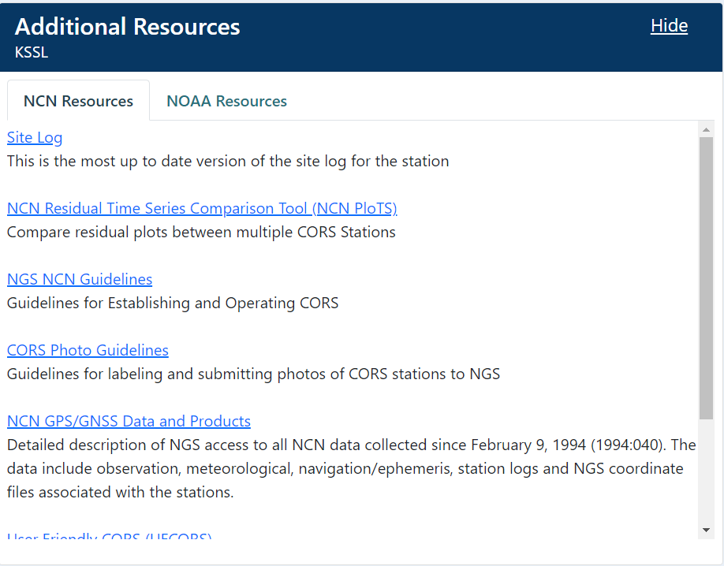
User Choice – NCN PloTS
You can get to the NCN Residual Time Series (NCN PloTS) by clicking the link in menu bar on the NCN Home Page or from the link in the Additional Resources section on the NCN Station Pages
The NCN PloTS tool is very useful for comparing CORS in your area and quantifying their relative accuracy so you can decide whether to use them and which ones to use

Slide 13
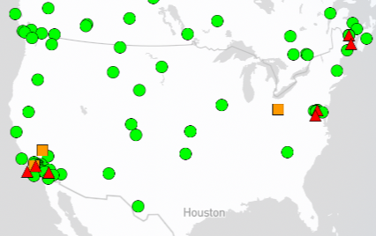
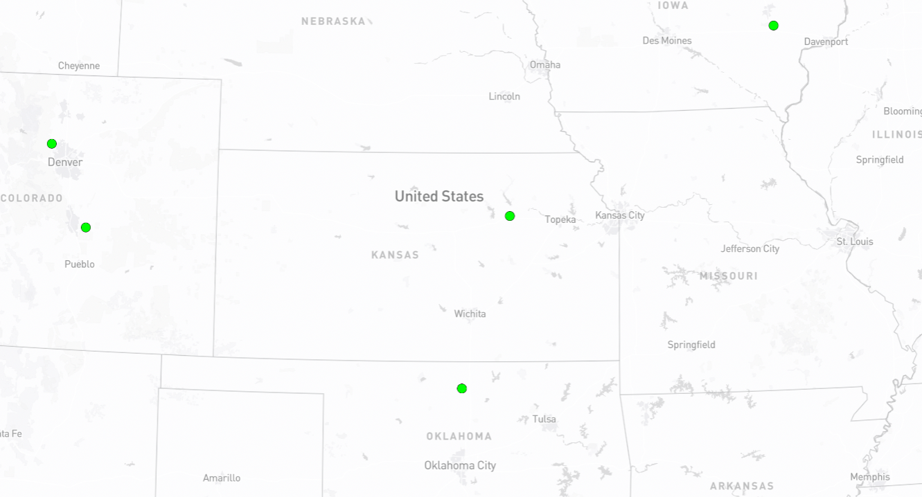
CORS Stations in the IGS
OPUS-S and OPUS Projects are special instances at NGS, they can use IGS stations that are not in the NCN
CORS Selector will evaluate them as it does the rest of the NCN
IGS has many resources for evaluating these stations as well, start with the IGS Network Map
These stations will not appear on the NCN Map or the NCN Station Pages, but are available on the NCN Residual Time Series (NCN PloTS) tool, so it is harder to evaluate as a user but not impossible
Less of an issue in Kansas as KSU1 is the local IGS station and it is in the NCN

Slide 14
Demo of NCN Map, NCN Station Pages, and NCN PloTS

