Slide 1
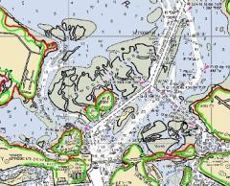
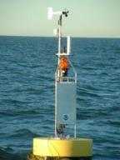
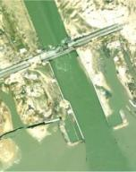
Data and Datum-Informed Decision-Making: Understanding Essential Integrated Data Needs for Informing SAGE
Juliana Blackwell
Director, National Geodetic Survey

Slide 2
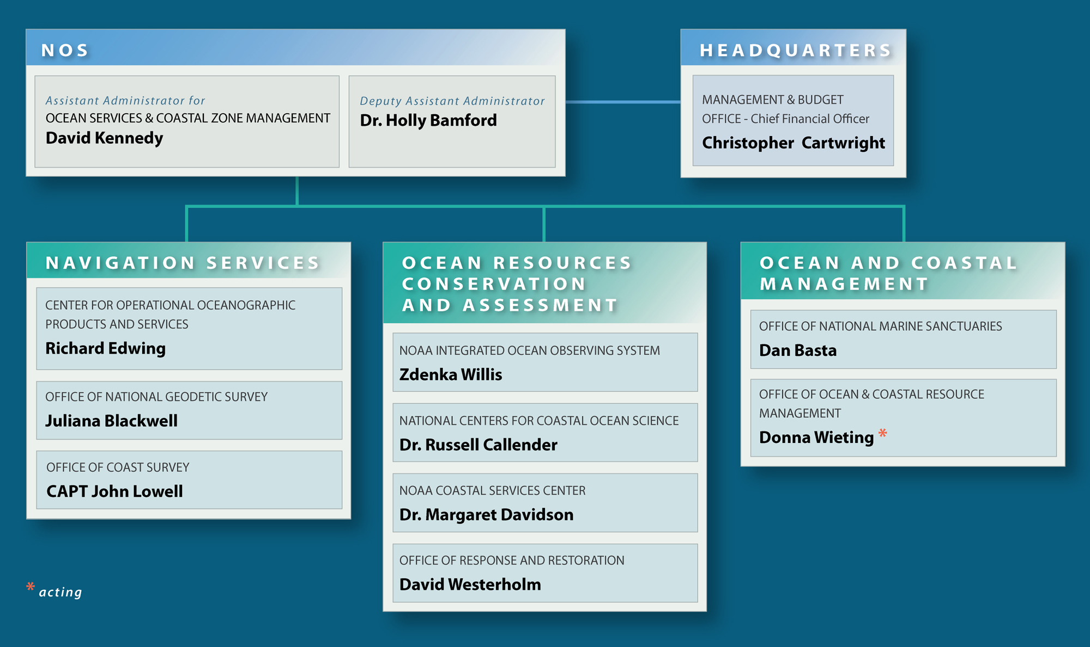

NOS Organization
*

Slide 3
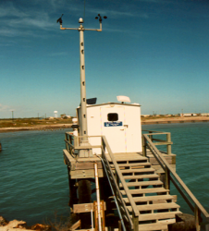
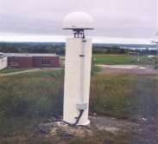
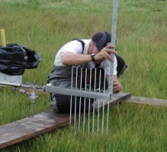
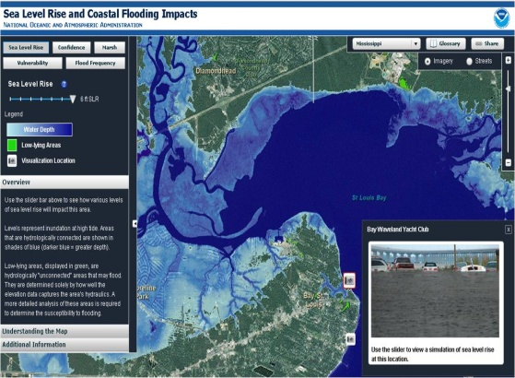
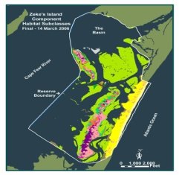
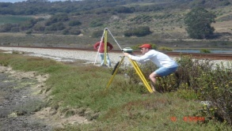
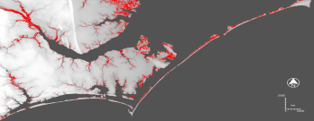


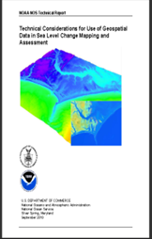
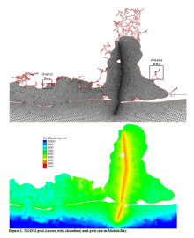
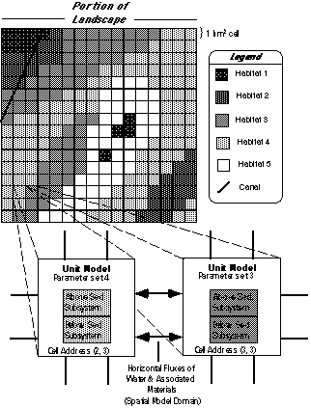
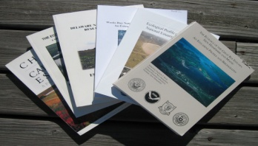
Observe & Monitor
Spatial Analysis & Visualization
Management &
Decision Making
Applied Research
Education & Outreach
Models & Predictions
Information Transfer
Science
Service
Stewardship
NOS activities could support the SAGE concept in a variety of ways

Slide 4
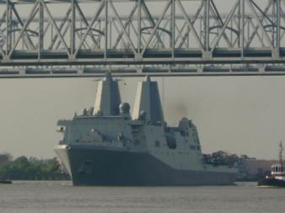
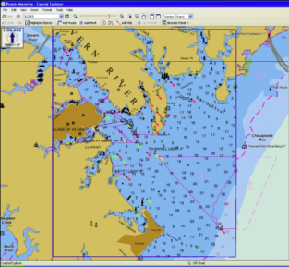
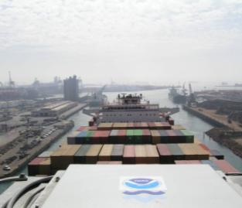
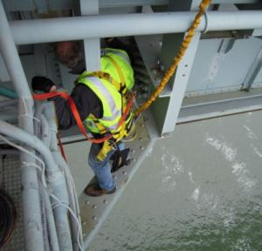
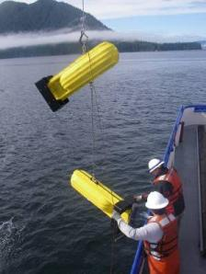
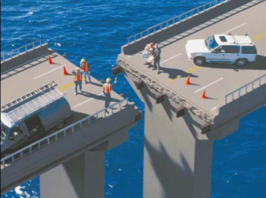
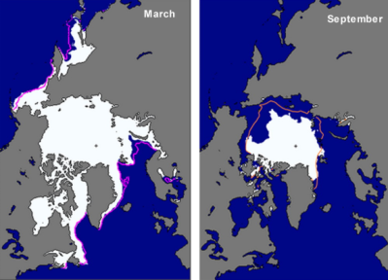
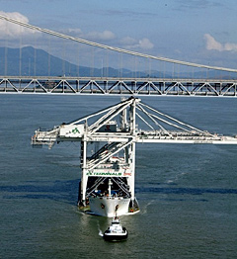
Precise Navigation, Water Level, Mapping, and Positioning Services
Coast Survey
Geodetic Survey
Operational Oceanographic
Products & Services
6

Slide 5
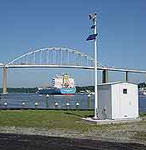
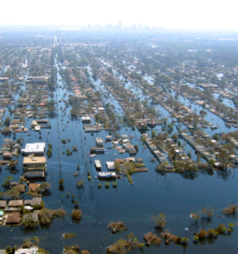

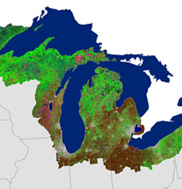
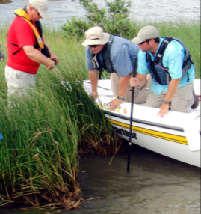
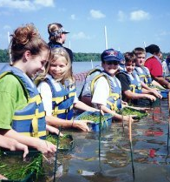
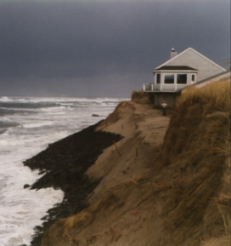
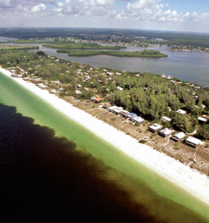
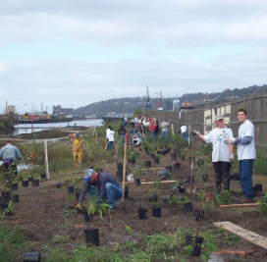
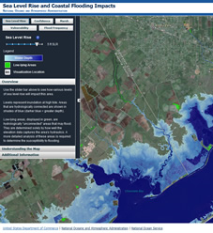
Research, Tools, and Technical Services
Ocean Observing
Coastal Services
Coastal Science
Response &
Restoration
7

Slide 6
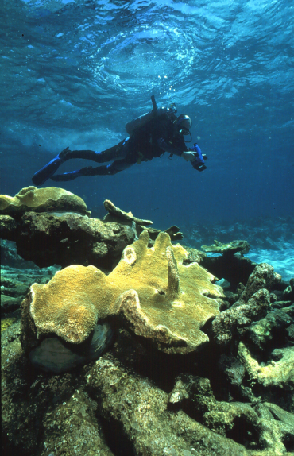
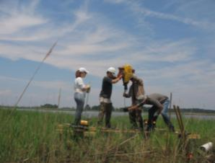
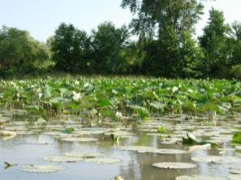
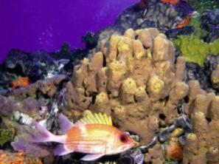
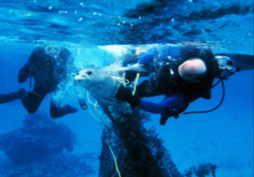
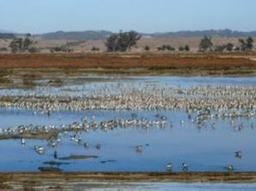
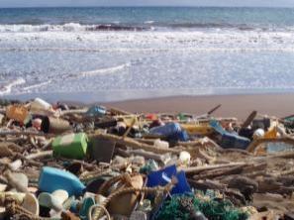
Management of Coastal and Marine Places
National Marine
Sanctuaries
Ocean & Coastal
Resource Management
8

Slide 7
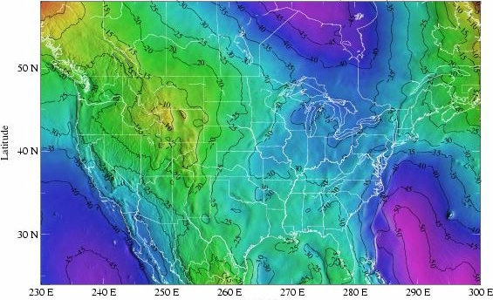
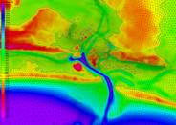
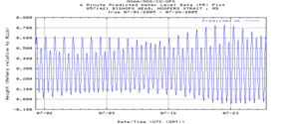
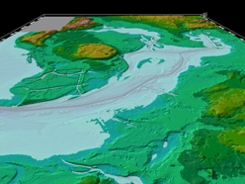
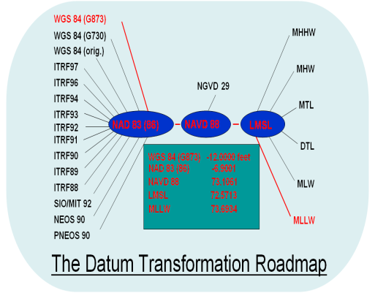
Integrating NOAA Tools and Models for Informing Coastal Management Decisions
Water level data
Geodetic data
Geophysical data
Models
Transformations
GIS applications
Subsidence/crustal movement

Slide 8
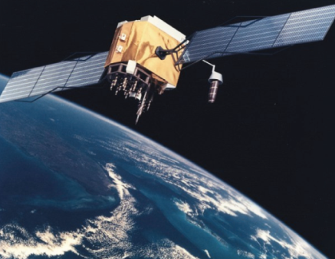
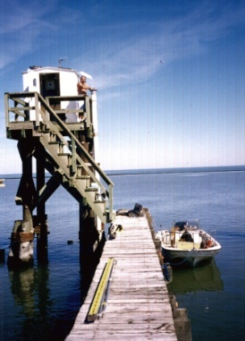
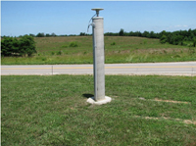
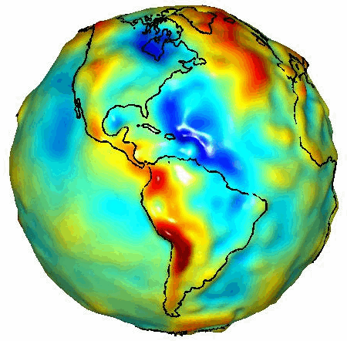
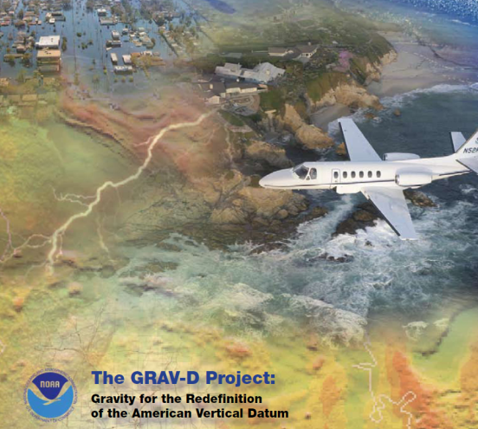
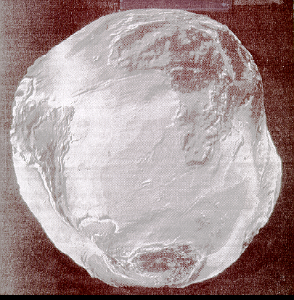

Datums
Vertical
Water Levels
Positioning - Integration
GPS
Horizontal
CORS
"A set of constants specifying the coordinate system used for geodetic control, i.e., for calculating the coordinates of points on the Earth."
NADCON
VDatum, GRAV-D

Slide 9











CORS/SETs/Tide Stations /Benchmarks
Survey control monuments
Continuously Operating Reference Stations (CORS)
Land Elevation Trend -1.1mm/yr
Local Sea-Level Rise 3.29 mm/yr
Surface Elevation Tables (SETs)
Long term tide stations
Wetland elevation dynamics
Local Marsh Trajectory - 2.1mm/yr

Slide 10

NOAA’s Coastal Mapping Program Supports:
NOAA nautical charts
Some other important applications:
Used in defining the United States’ territorial limits
Coastal resource management (Coastal and Marine Spatial Planning)
Storm surge and coastal flooding modeling
Coastal geomorphology studies
Archaeology
CMP Goal: Provide the Nation With Accurate, Consistent, Up-to-Date National Shoreline

Slide 11



Impacts of Coastal Development on Marine Ecosystem and Human Health
Contamination of seafood and beaches
Impaired ecosystems
Altered hydrography and increased flooding

Slide 12

Mobile Bay Project
NOAA in Mobile Bay
Leading the way to better science, more data, and integrated tools

Slide 13

NOAA’s Sentinel Sites:
Where Science and Management Meet

