Slide 1

S5-O6: An Update to Dynamic Heights Estimation on the Great Lakes
Daniel R. Roman
International Symposium: Gravity, Geoid and Height Systems 2
Session 5: Height systems and vertical datum unification

Slide 2
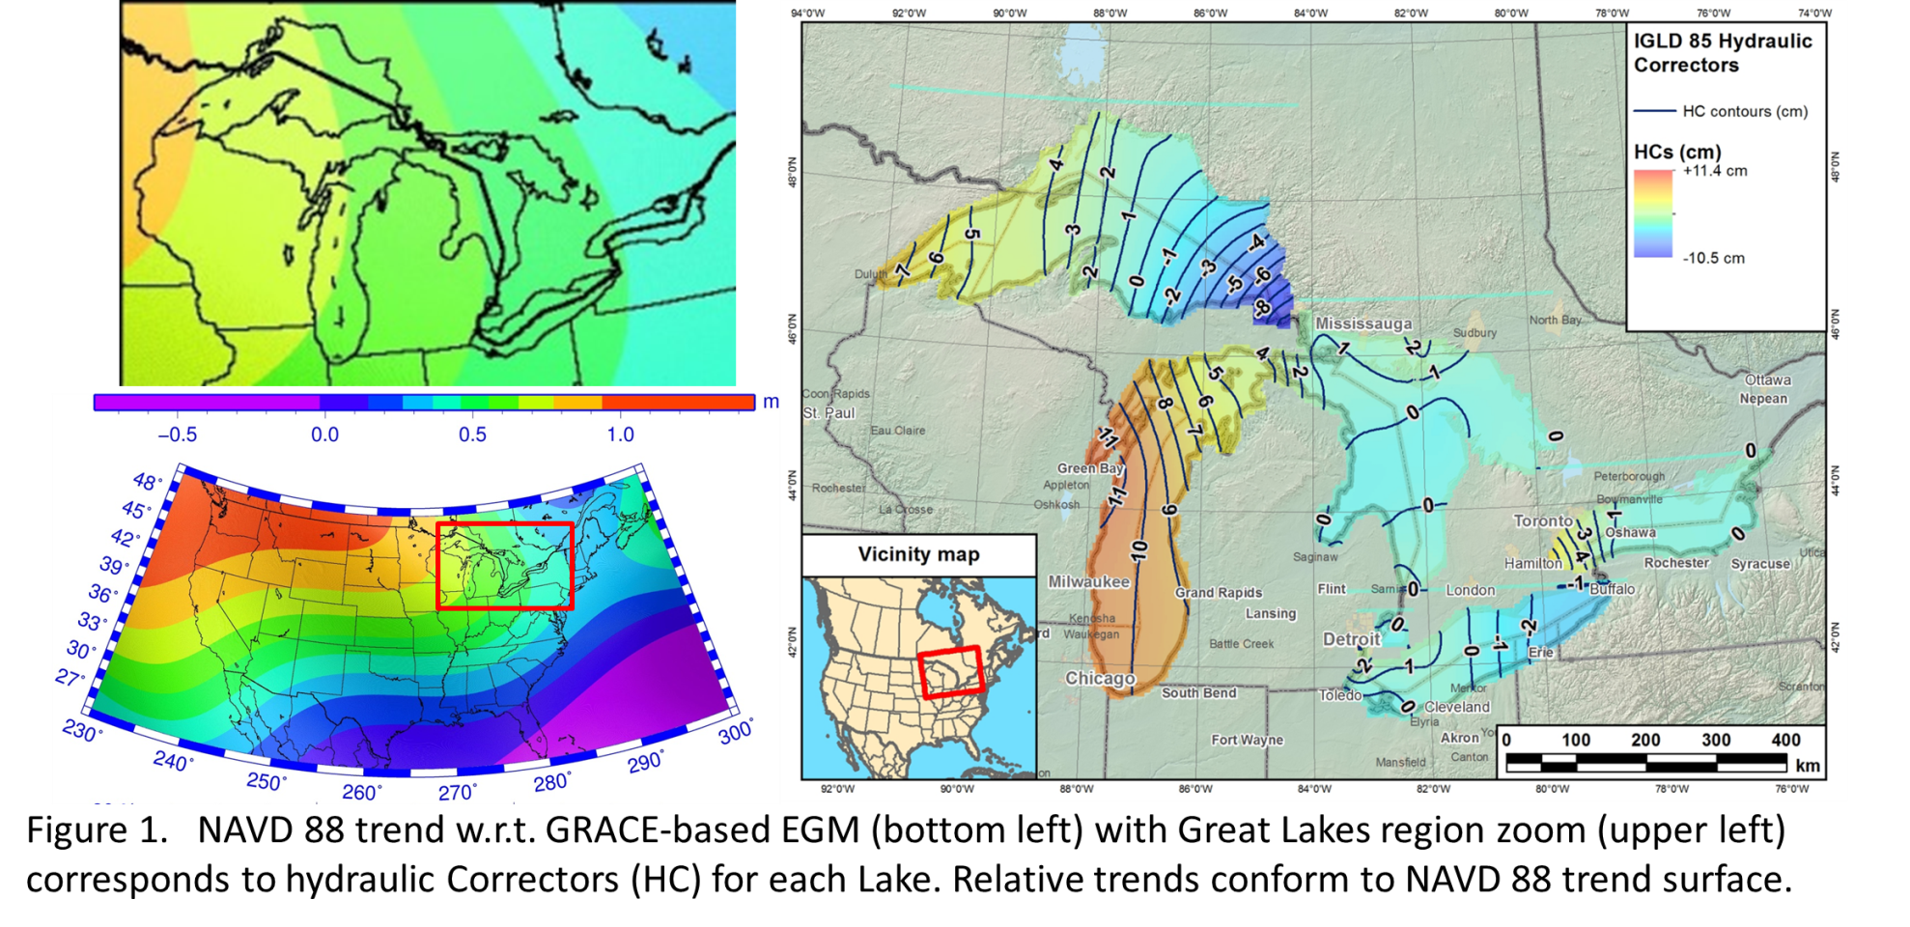
Hydraulic Corrector (HC) vs.
NAVD 88 Datum Defect

Slide 3
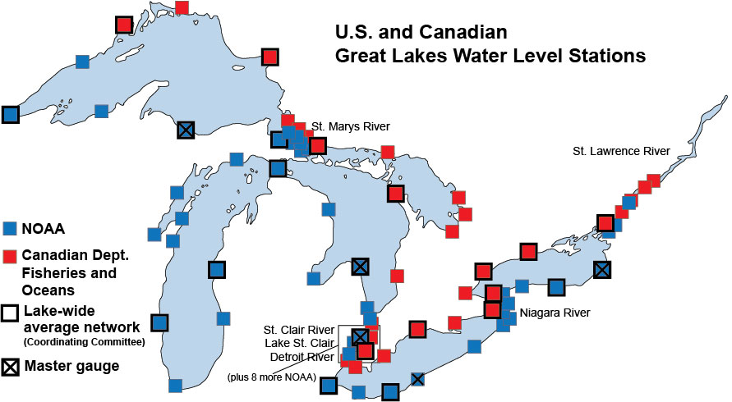
GL WLS Stations (U.S. NWLON)
CORS
Notes:
Of 53 WLS, 14 are CORS. At all sites, BM are adjacent to WLS. CO-OPS levels between BM’s and WLS table. NGS GPS’ BM. Results in transfer of geometric coordinates to table and then to water surface.
Will be exchanging CO-OPS leveling on US side with Canada for their WLS. Canada has completed their GPS analysis on BM (US still processing). Will look at various averages (Summer, yearly). Look forward to models removing metorological impacts as well as any standing topography.

Slide 4
Method at NWLON sites
Geometric coordinates of water surface
Inverted rod
CORS Antenna
WLS Housing
ETG
Receiver
ETG Table
(datum)
Great
Lake
leveling
BM
IGLD 85 Datum surface

Slide 5
2015 GPS Campaign (IGb08)
GPS
Camp.
1997
2005
2010
2015
2020
Uncertainties of 1-3 cm (2 sigma) for dynamic heights

Slide 6
Conceptual Plan
Each Lake surface conforms to a specific geopotential value (W_{i}) and dynamic height
C₃
C₂
DH3 = W₀ – W₃
gamma₄₅
C₁
DH2 = W₀ – W₂
gamma₄₅
DH1 = W₀ – W₁
gamma₄₅
C₀ (geoid)
ellipsoid
Notes: (1) Neglects any standing water topography (wind set)
(2) Assumes sufficient resolution of geopotential number

Slide 7

Blueprint Part 2
North American-Pacific Geopotential Datum of 2022 (NAPGD2022)
Four primary products:
  A global model (5’)- GM2022
  Regional geoids (1’) - GEOID2022
  Regional DoV’s (1’) - DEFLEC2022
  Surface gravity (1’) - GRAV2022
Three regions:
  North America
  American Samoa
  Guam/CNMI

Slide 8
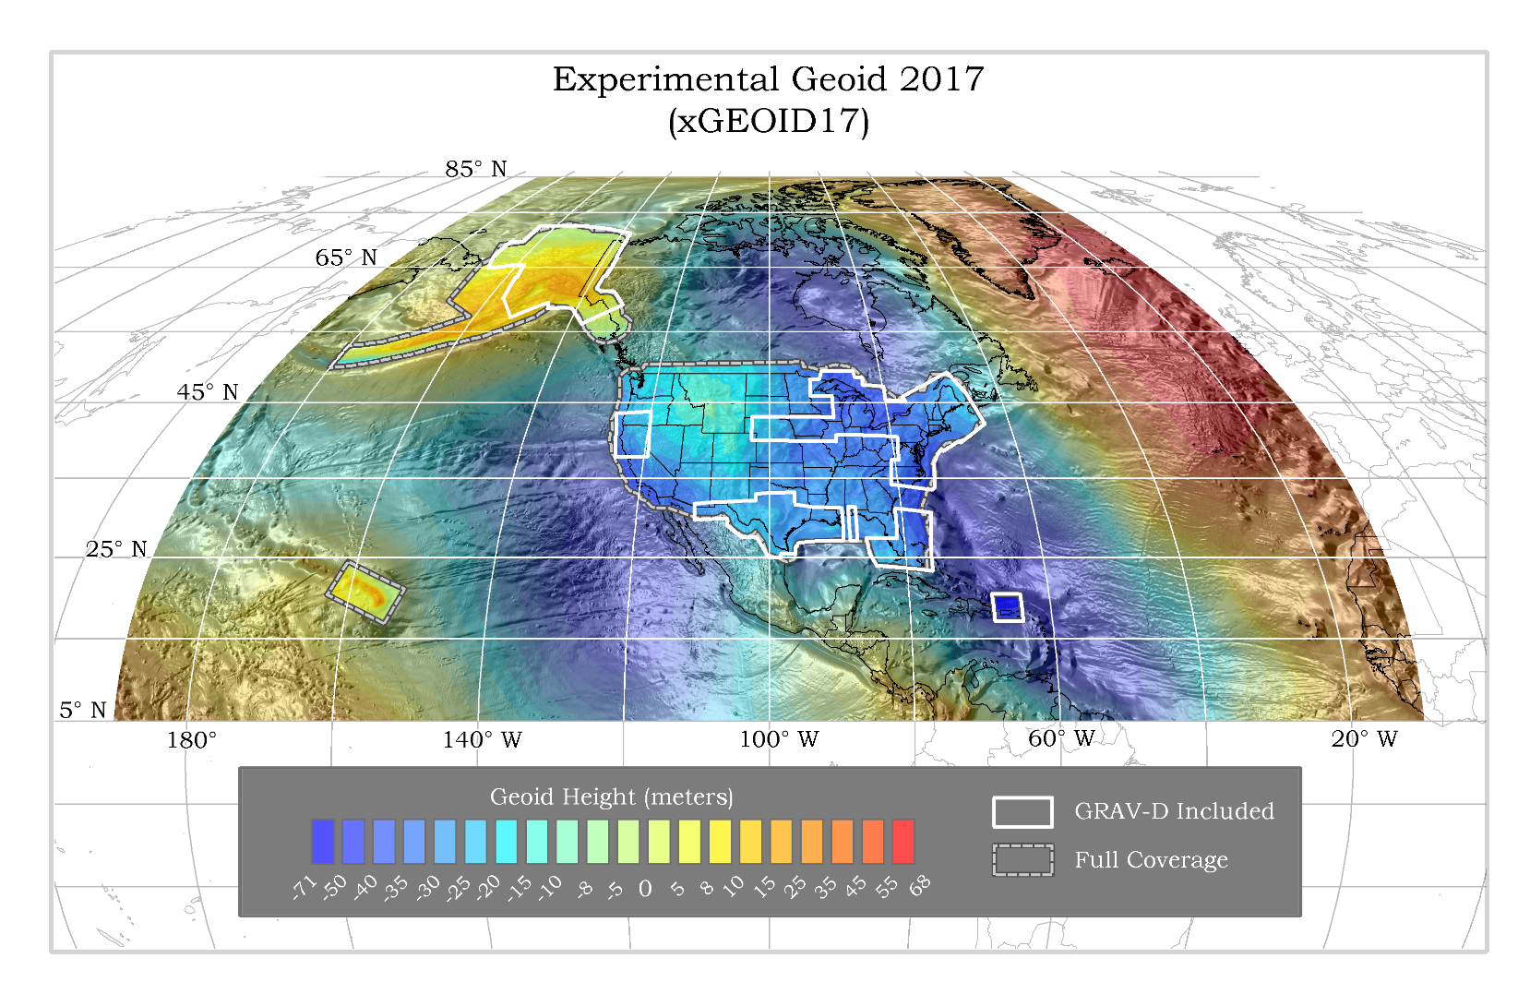

Slide 9
Practical Aspects
Need 1’ resolution⁽¹⁾ (d/o 10,800) SHM
Only have 5’ resolution ⁽²⁾ (d/o 2160) SHM plus 1’ geoid grid
W_{(5’)} g_{(5’)}
C₃
C₂
C₁
N _{(5’)}
N _{(1’)}
C₀ (geoid)
ellipsoid
Notes: (1) Previous analysis shows that omission from > 1’ resolution exceeds cm-level
(2) xGEOID17B available at https://beta.ngs.noaa.gov/GEOID/xGEOID17/
(3) W₀ by is defined as 62,636,856.00 m²/s²

Slide 10
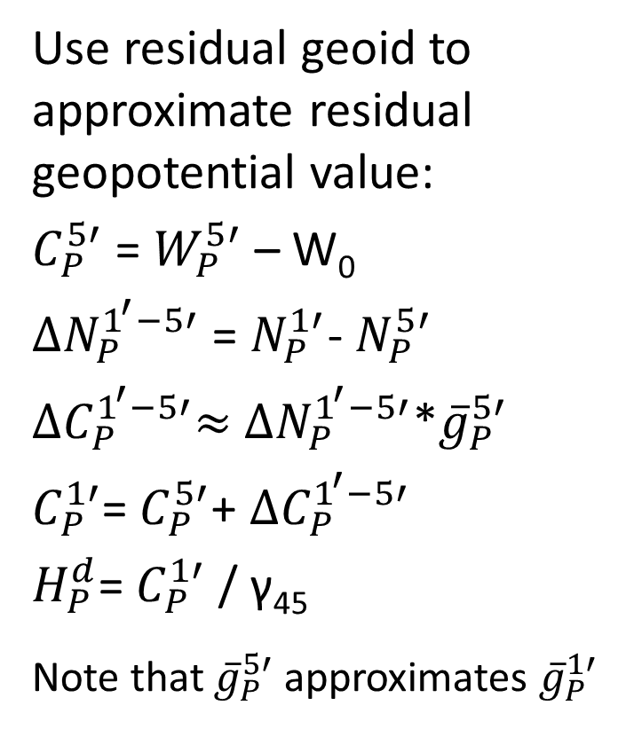
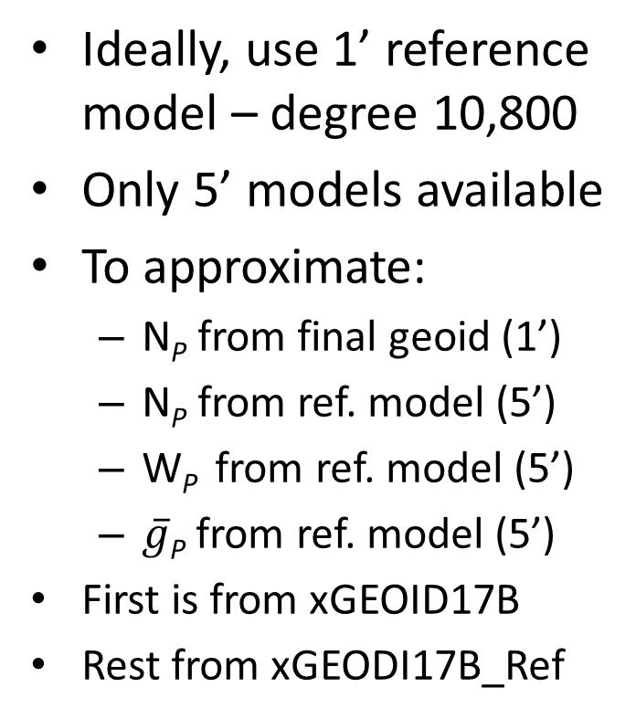
Method
Ideally, use 1’ reference model – degree 10,800
Only 5’ models available
To approximate:
  N_{P} from final geoid (1’)
  N_{P} from ref. model (5’)
  W_{P} from ref. model (5’)
  $\overline{g}$_{P} from ref. model (5’)
First is from xGEOID17B
Rest from xGEODI17B_Ref
Use residual geoid to approximate residual geopotential value:
$C_{P}^{5′}$ = $W_{P}^{5′}$ – W₀
${∆N}_{P}^{1^{′}−5′}$ = $N_{P}^{1′}$- $N_{P}^{5′}$
${∆C}_{P}^{1^{′}−5′}≈$ ${∆N}_{P}^{1^{′}−5′}$*${\overline{g}}_{P}^{5′}$
$C_{P}^{1′}$= $C_{P}^{5′}$+ ${∆C}_{P}^{1^{′}−5′}$
$H_{P}^{d}$= $C_{P}^{1′}$ / γ₄₅
Note that ${\overline{g}}_{P}^{5′}$ approximates ${\overline{g}}_{P}^{1′}$

Slide 11
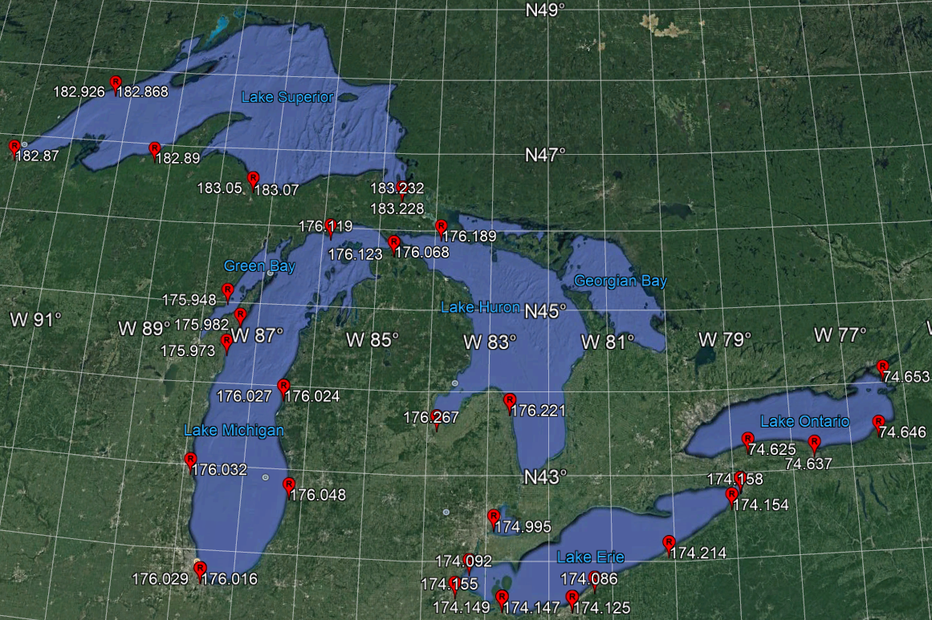
Dynamic Heights on the Lakes

Slide 12
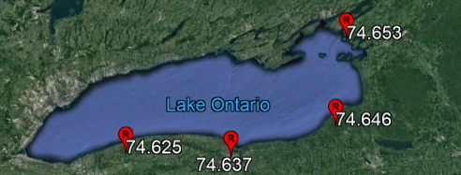
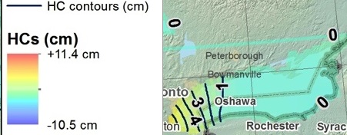
Lake Ontario
PID’s
  AH9233
  AH9232
  AH9231
  <F Reset>
Trend W-E is +3 cm
Consistent w/ GLERL MDT expectations
Not consistent with HC Map
Sense of sign is flipped from HC to MDT

Slide 13
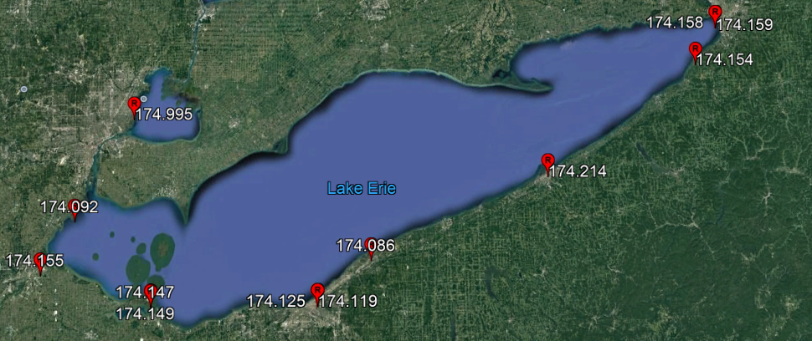
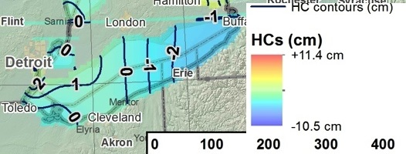
Lake St. Clair and Lake Erie
PID’s
  NE0898
  AH9238. AH9237
  DG9751-AB6927
  DH8999-MB1563
  MB1622, DN2578
  DE7802
  DE1764-AH9234
Trend W-E flat
Consistent w/ GLERL MDT expectations
Consistent w/ HC Map but that is flat, too

Slide 14
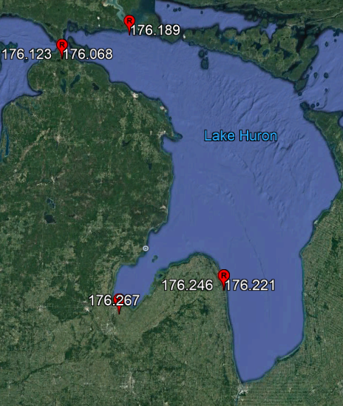
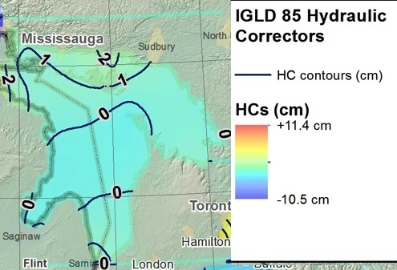
Lake Huron
PIDS: DN2580-QK0258, AH9228, PK0233, DF5769-OJ0219
Trend NW-SE is up 10 cm – but only 3 cm ignoring Mackinaw City
A little higher than expected MDT unless you ignore Mackinaw City
Lakes Michigan and Huron treated as one system – Mackinaw City is at transition
Not consistent with HC

Slide 15
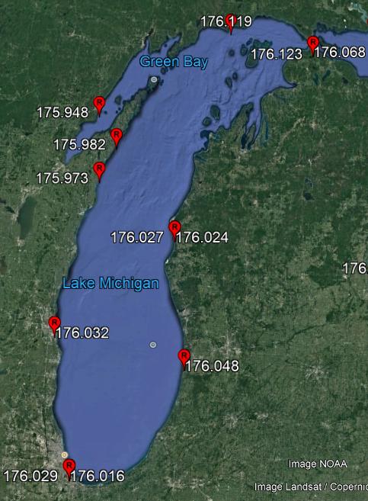
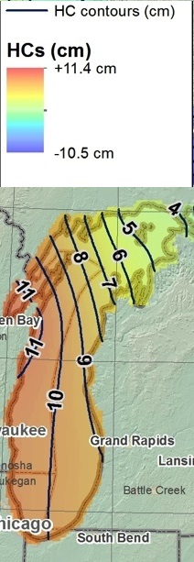
Lake Michigan
PID’s (CCW from North)
  DJ1577, DI7590, AA8057
  AH5304, AA8061
  DF5765-AE9231, AH5303
  DH3764-OL0303
Note Mackinaw City in NE is similar to DJ1577 In North
South end of Lake fairly flat
Possible step up from Lake Michigan to Lake Huron (10-15 cm)
Consistent with expected MDT
Relatively similar to HC

Slide 16
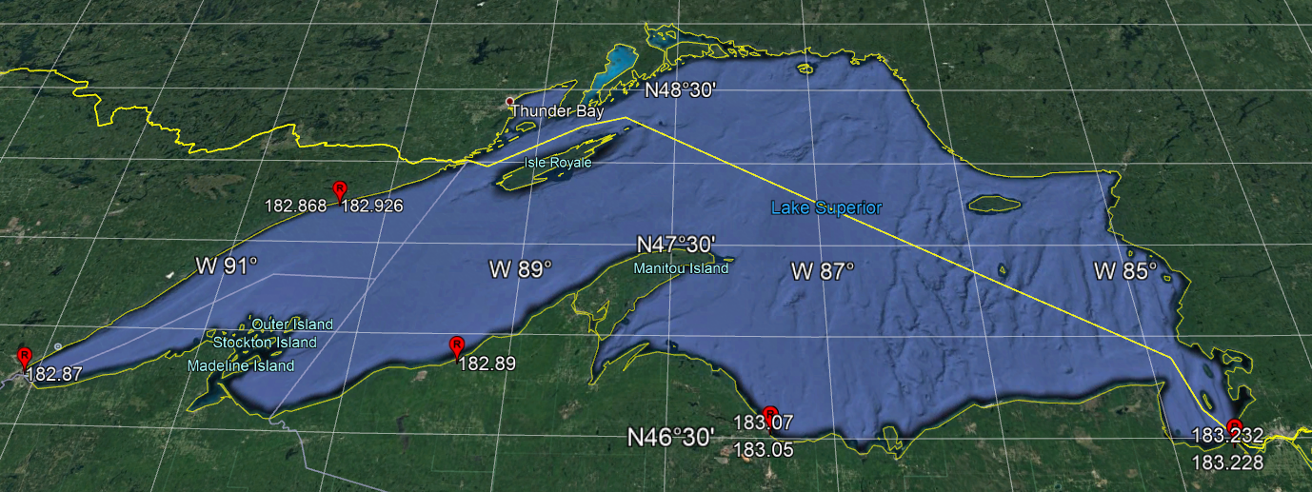
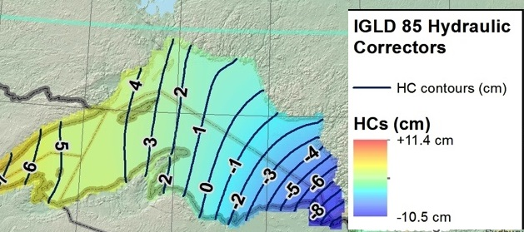
Lake Superior
PIDS
  AE8289, DE6003-AA2869, DJ1575
  DG9743-AH7272, DF5377-RJ0586
30 cm difference West-East is more of a step function
Not consistent with expected MDT nor HC map

Slide 17
Summary and Future Work
2015 GPS campaign at Great Lakes NWLON
  Good comparisons between all three techniques
  1-3 cm vertical uncertainty
  Use with xGEOID17 to estimate dynamic heights
Dynamic heights generally agrees with MDT
Lakes Michigan and Huron biased by 10-20 cm
Potential two zone behavior in Lake Superior
Reprocess all four GPS campaigns in ITRF2014
Comparisons to Canadian and Seasonal data

