Slide 1



RTN Field Procedures and Best Practices
New York State Association of Professional Land Surveyors
January 20, 2016
Dan Martin
Northeast Regional Geodetic Advisor
Dan.martin@noaa.gov
240-676-4762

Slide 2
“Human knowledge is doubling every 10 years. The scientific knowledge produced between 1987 and 1997 is greater than that produced in all mankind’s history”.
Michio Kaku- renowned theoretical physicist
THE CHANGE FROM LABOR INTENSIVE TO TECHNOLOGY!

Slide 3
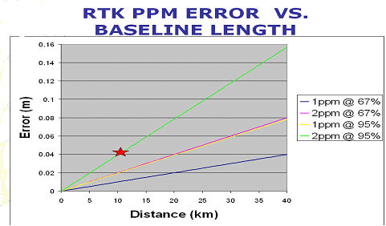
IONO, TROPO, ORBIT CONTRIBUTE TO PPM ERROR
REMEMBER GNSS EQUIPMENT MANUFACTURERS’ SPECS!

Slide 4
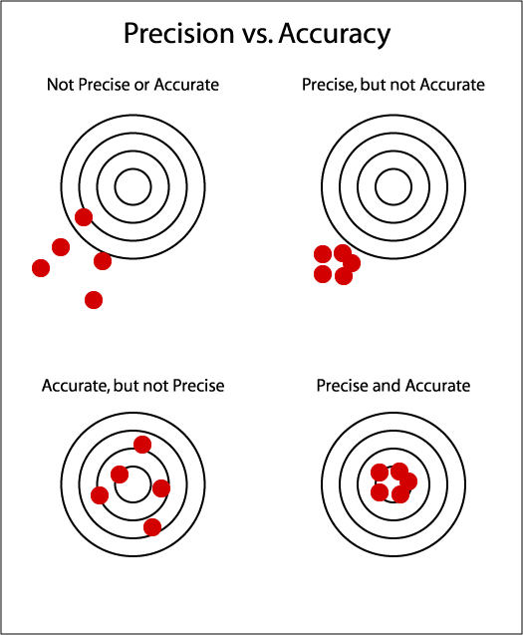
Precision vs. Accuracy measurement from RTN correctors
More questions?
Is there systematic bias, multipath, and atmospheric errors to overcome? Always some!
How is the accepted true (accurate) position determined?
Accurate - Accepted truth
Courtesy www.calguns.net
Notes:
Here are the basic targets with bulls eye representing the conceptual difference between precision and accuracy.
The upper left target depicts ‘neither precision or accuracy’. The group of shots is loosely scattered and offset from the center of the bulls eye.
The upper right target depicts ‘precision but not accuracy’. The group of shots is tight but offset from the center of the bulls eye.
The bottom left target depicts ‘accuracy but not precision’. The group of shots is loosely scattered but appear uniformly around the bulls eye.
The bottom right target depicts ‘accuracy and precision’. The group of shots is tight and at the center of the bulls eye.
The center of the bulls eye reflects accuracy and thus the accepted true coordinate position.
Since there is always some systematic bias, multipath, and atmospheric errors present with GNSS observations, the perfect condition of achieving both accuracy and precision will vary with different locations, time of day, and length of the observation time. As GNSS users, we know that additional RTK observation time on a mark provides more data, reflecting an improved mean precise coordinate.

Slide 5
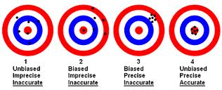
GNSS Errors and bias while observing a mark - to some degree always present and ever changing
Curtosy www.advanced-web-metrics.com
Notes:
Here is another set of similar targets, but with a little more insight into the affect of GNSS errors and bias which to some degree is always present and ever changing.
Target 1 depicts an unbiased situation with an even loose scatter of points around the bull eye, but still not a tight precise group and not accurate although the mean of all the points may be fairly accurate.
Target 2 depicts a definite bias of points loosely scattered off to one side. Again not precise and not accurate and the mean of all of the points may only slightly improve the accuracy.
Target 3 also depicts a bias, as all of the points are off to one side but grouped tightly together showing precision but certainly not accuracy and meaning them does little to improve the accuracy.
Target 4 depicts the best of all possible conditions where there is no apparent bias and the points are grouped tightly together and centered on the bulls eye.
So RTN rover users may expect to see any and perhaps all of these conditions depending on the location of the mark being measured, the local GNSS errors present (atmospheric and multipath) combined with the receiver systematic error, the setup error, and the RTN network corrections applied.

Slide 6
RTN Measurement Precision
Typical (normal) RTN precisions at the 95% confidence level:
  horizontal 2-3 cm
  vertical (ellipsoid height) 3-5 cm
  orthometric heights 5-7 cm (typical-using the NGS hybrid geoid model)
Exceptional RTN derived precisions at the 95% confidence level at the limit of RT technology:
  horizontal: ≤ 1 cm
  vertical (ellipsoid height) ≤ 1 cm
  orthometric heights ≤ 2 cm
http://www.geodesy.noaa.gov/PUBS_LIB/NGS.RTN.Public.v2.0.pdf
Notes:
So generally speaking, what precisions are RTN’s capable of?
Typical measurement precision (will call normal) where RTN precisions at the 95% confidence level have horizontal results known to within 2-3 cm; vertical (ellipsoid height) results are within 3-5 cm; and orthometric height results within 5-7 cm (are typical-using the NGS hybrid geoid model).
Beyond that…
Exceptional measurement precision (requiring great attention to GNSS conditions and system procedures) is possible where RTN derived precisions at the 95% confidence level are at the current limit of real time technology with horizontal results within less than or equal to (≤) 1 cm; vertical (ellipsoid height) results also less than or equal to (≤) 1 cm, and possible orthometric heights less than or equal to (≤) 2 cm depending on the hybrid geoid model local accuracy.
The link at the bottom is to the “NGS Guidelines for Real Time Networks” which is the reference for much of what is in these slides.

Slide 7
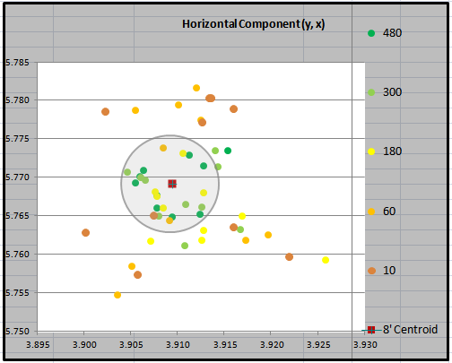
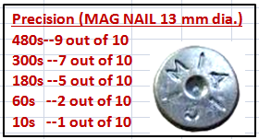
RTN Precision Measurement Field Testing
‘PRECISION’ is a computed statistical quantity to the source of the measurement. More measurements averaged = improved precision of the final coordinate.
RTN testing on a MARK:
-10 occupations at each interval in rotation for similar #SV and GDOP.
480s horiz. RMSE = 0.003 m
480s vert. RMSE = 0.009 m
Notes:
Here’s a look at an example field precision test and I will add the accuracy part to it later in another slide, but for now were dealing with just precision. So as previously stated… Precision is the computed statistical quantity to the source of measurement. The more RTK measurements averaged over time will lead to an improved precision for the final coordinate.
Here is a graph of 50 RTK coordinates (shots) taken on a mark. 10 of the shots were for 480 seconds each or 8 minutes, 10 shots for 300 seconds each or 5 minutes, 10 shots of 180 seconds each or 3 minutes, 10 shots for 60 seconds each or 1 minute and 10 shots for 10 seconds each. Each shot within the group of 10 were rotated as time progressed so that they all had a similar range of satellite availability and GDOP. It took about 3 hours to do a full set. This is just one typical example of several taken. The legend and color codes are just to the right of the graph.
The circle shown in the graph represents a MAG nail which has a 13 mm diameter circle and is superimposed in the graph for a relational scale reference only, and it is centered on the average coordinate of all 10 of the 480 second shots (the longest ones). What we are looking for here is how observation time might affect the tightness of the groups.
Then as shown in the table to the right in red, 480 seconds (8 minutes), 9 out of 10 coordinates (of the dark green dots) landed on the head of the MAG nail. The light green dots show 10 occupations of 300 seconds each and 7 out of 10 landed in the MAG nail circle. For the yellow dots (representing 180 seconds) 5 out of 10 landed in the MAG nail circle.
For the 10 shots of 60 seconds each (orange dots) only 2 landed in the circle and last for the 10 shots of 10 seconds each (brown dots) only one landed in the MAG nail circle. This is just one example to show how… less occupation time per shot progressively enlarged and loosened the spread… which you might expect. This proved to be consistent over many independent tests taken at different locations within the RTN. Also tested was the distance from the RTN master station which varied from 1k to 26k with no apparent change in these results.
At the bottom of the slide, the root mean square error (RMSE) for the group of 10 shots of 480 second each was 3 mm for the horizontal coordinate and 9mm for the vertical. Just to give you an idea of the statistics related to that.

Slide 8
What is Accuracy (Truth)
‘ACCURACY’ is a computed statistical quantity to the realization of the datum - Alignment of the RTN to the NSRS shows accuracy (typically by some method of post processing static observations of the RTN stations constrained by CORS coordinates)
Accuracy is a measure of how the positions are aligned to “truth”
NGS wishes to encourage all RTN’s to provide users with alignment to the NSRS as the representation of truth.
  NAD 83 (horizontal and ellipsoid height)
  NAVD 88 (orthometric height)
Initial NGS guidelines support this alignment to the NSRS as: within 2 cm latitude and longitude, and within 4 cm ellipsoid height (95% confidence) using the CORS network weighted as truth.
http://www.geodesy.noaa.gov/PUBS_LIB/NGS.RTN.Public.v2.0.pdf
Notes:
So far I talked about precision and grouping of shots relative to occupation time.
Now the discussion turns to ‘ACCURACY’ which is a computed statistical quantity to the realization of the datum - Alignment of the RTN to the National Spatial Reference System shows accuracy (typically by some method of post processing static observations of the RTN stations constrained by CORS coordinates). This could be achieved through the use of OPUS or OPUS-Projects or other post processing software etc.
Accuracy is a measure of how the positions are aligned to “truth”. Of course the NGS wishes to encourage all RTN’s to provide users with alignment to the NSRS as the representation of truth. Therefore, accuracy would be relative to the alignment to our national datum's consisting of the current realization of NAD 83 (horizontal and ellipsoid height) and NAVD 88 (orthometric height).
Initial NGS guidelines desire RTN alignment to the NSRS as: to within 2 cm in latitude and longitude, and within 4 cm in ellipsoid height (@95% confidence) using the CORS network weighted as truth.
Again, here is the link at the bottom of the slide to the “NGS Real Time Network Guidelines” where there is more information on alignment to the NSRS.

Slide 9
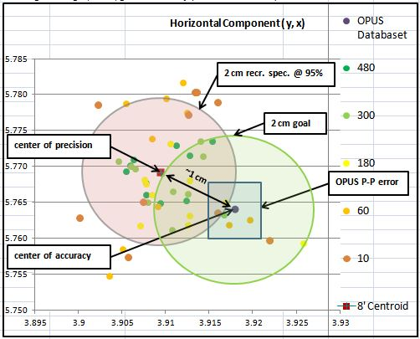
Field Test RTN Correctors
Horiz. Precision vs. Accuracy
Some Conclusions
Meets the project survey specification - horizontal component 2cm @ 95% conf. accuracy guidelines.
Meets the receiver specification @ 95% conf.
Different datasets may yield different results.
Notes:
Here is the slide shown previously that had just precision shown. Now… I’ve added accuracy and some comparisons to the bull eye targets shown in the earlier slides become obvious.
To determine what is accuracy for this remote field mark, an independent 4 hour static occupation was logged and then published to OPUS which returned a solution datasheet for the mark with peak-peak errors which are shown in the blue box around the coordinate labeled as the center of accuracy. The OPUS solution in this case represents the National Spatial Reference System as a TRUTH check.
Now we can see in this case there was some bias of the group of points shifted off to one side from the center of accuracy (the OPUS NSRS coordinate). But… the difference from the precision (8 minute average) center and the accurate (truth) center determined from OPUS was just about 1 cm and falling within our 2cm project specification goal.
And…also as seen within the 2 cm pinkish circle (centered on the average of all of the 480 epoch (8 minute) shots) are the longer RTK occupation times of 180 epochs (3 min) to 480 epochs (8 min) which appeared to met the receivers performance accuracy specification @ 95% confidence. Some of the shorter 60 second and 10 second epoch scattered shots fell outside of the circle appearing to not meet the receiver spec.
So you can field test RTN correctors (using a rover on a mark) to see if both precision and accuracy are within your project EXPECTED tolerance.
You may wish to test on multiple marks across the RTN to see how multipath, GDOP, and number of visible satellites might affect the result. Obtain average coordinates for varying times on a mark. Try observing for 8’ or perhaps even longer, down to 10” to see how the precision grouping changes with the different occupation times and then compare with a coordinate considered truth.

Slide 10
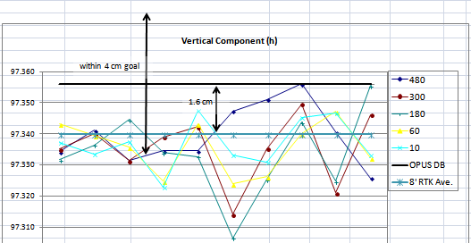
Field Test Vert. Precision vs. Accuracy
The black horizontal line represents the 4 hour independent published OPUS solution and considered the truth (and representing the NSRS) in this case, while the blue horizontal straight line is the average of the 10 individual 8 minute RTK shots. They are about 1.6 cm apart vertically but many of the individual shots were outside the 4 cm vertical project specification.
Notes:
Shown in this slide are all 50 of the same shots graphed by ellipsoid height. The black horizontal line represents the 4 hour independent published OPUS solution and considered the truth (and representing the NSRS) in this case, while the blue horizontal straight line is the average of the 10 individual 8 minute RTK shots.
They are about 1.6 cm apart vertically but many of the individual shots were outside the 4 cm vertical project goal. In this example case… the difference could be part GNSS error, part setup error, part receiver systematic error as the OPUS observation was observed in a different month and with different equipment.

Slide 11
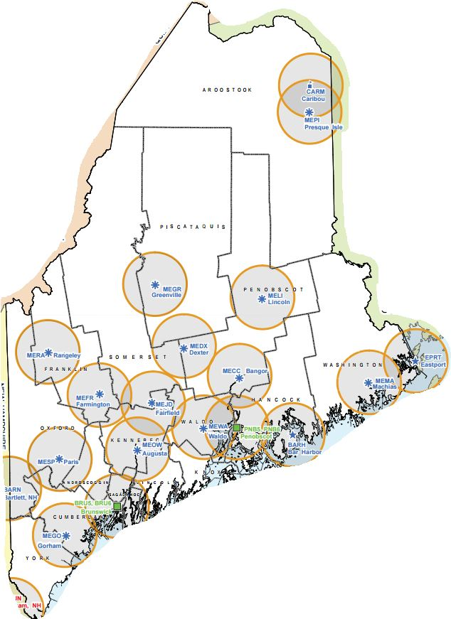
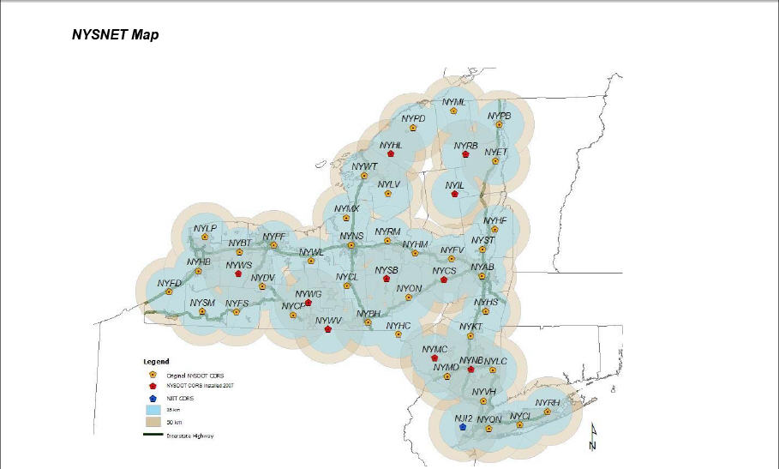
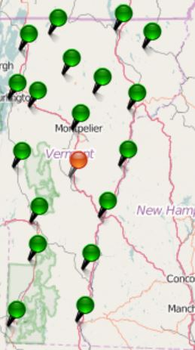
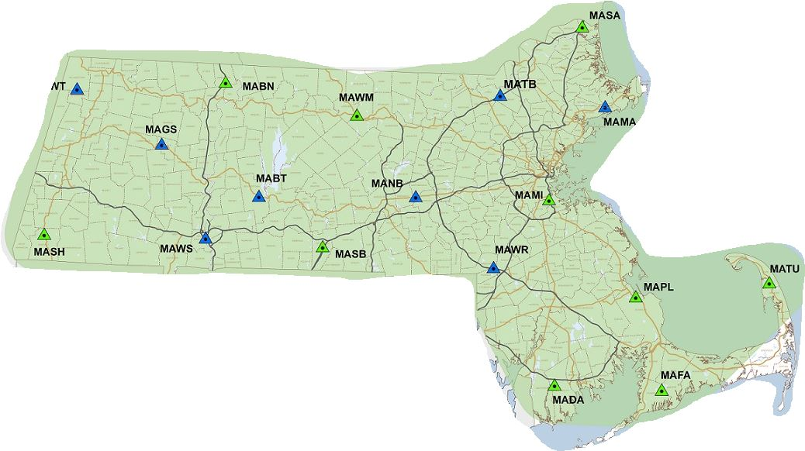
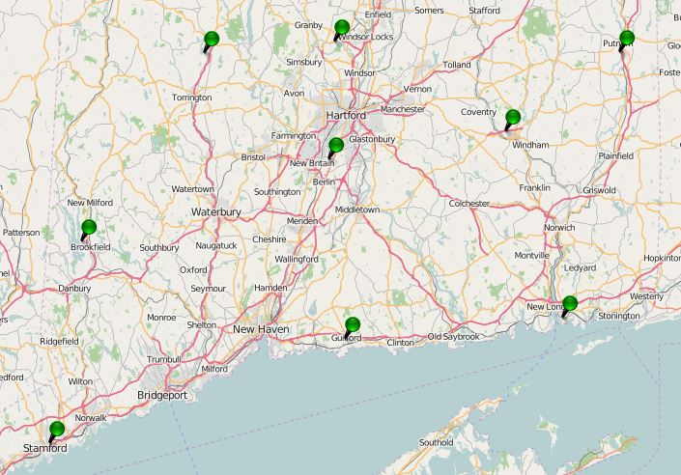
Real Time Networks

Slide 12
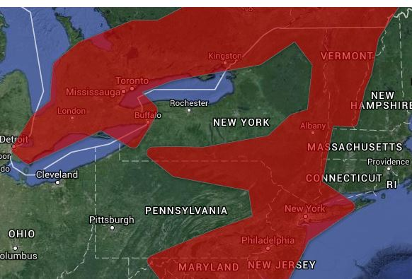
SmartNet (Leica)

Slide 13
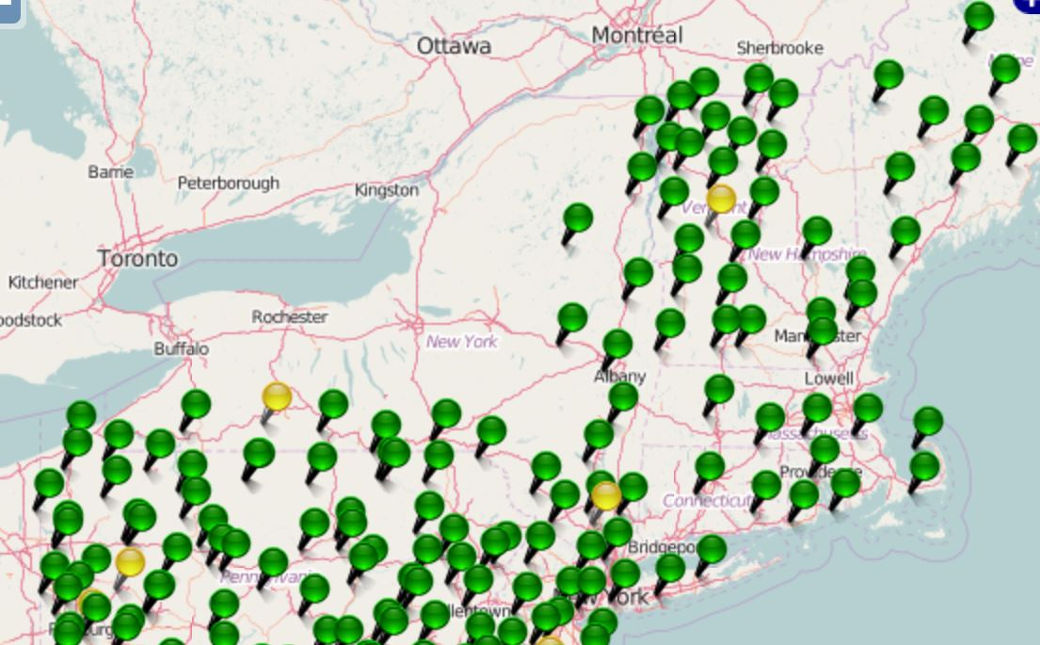
KeyNet GPS (Keystone Precision)

Slide 14
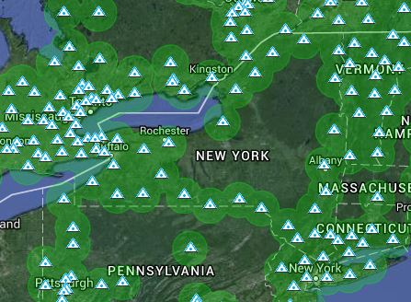
TopNet (Topcon)

Slide 15
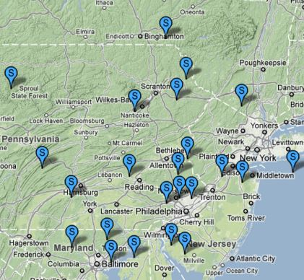
Boyd Instrument

Slide 16
BIG PICTURE ISSUES IN RT POSITIONING
⬇PASSIVE / ACTIVE – WHAT IS ‘TRUTH’?
⬇GEOID + ELLIPSOID / LOCALIZE –
QUALITY OF GEOID MODELS LOCALLY. ORTHOMETRIC HEIGHTS ON CORS?
ACCURACY / PRECISION- IMPORTANCE OF METADATA
SINGLE SHOT / REDUNDANCY
RTK / RTN
NATIONAL DATUMS / LOCAL DATUMS / ADJUSTMENTS- DIFFERENT WAYS RTN GET THEIR COORDINATES-VARIOUS OPUS, OPUS-DB, CORS ADJUSTED, PASSIVE MARKS.
VELOCITIES - NEW DATUMS, “4 -D” POSITIONS
GNSS / GPS

Slide 17
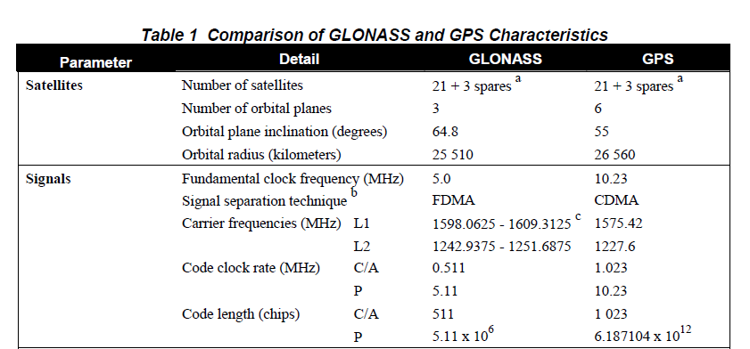
GPS AND GLN
DUAL CONSTELLATION RT POSSIBILITIES:
GPS ≥ 5, GLN = 0
GPS = 4, GLN = 2
GPS = 3, GLN = 3
GPS = 2, GLN = 4
(Can't initialize with only GLN Sats.)
BEST SCENARIO = 7 OR MORE GPS

Slide 18
SOME RT FIELD CONSIDERATIONS
- Multipath
- Position Dilution of Precision (PDOP)
- Baseline Root Mean Square (RMS)
- Number of satellites
- Elevation mask (or cut-off angle)
- Base accuracy- datum level, local level
- Base security
- Redundancy, redundancy, redundancy
- Part(s) Per Million Error (ppm) – iono, tropo models, orbit errors
- Space weather- sunspot numbers, solar maximum
- Geoid quality
- Site calibrations (a.k.a. Localizations)
- Bubble adjustment
- Latency, update rate
-- Accuracy versus Precision
- Signal to Noise Ratio (S/N or C/N0)
- Float and Fixed Solutions
- Carrier phase precisions
- Code phase precisions
- VHF/UHF radio communication
- GSM/CDMA/SIM/Cellular TCP/IP communication
WGS 84 versus NAD 83, or other local datums
GPS, GLONASS, Galileo, Compass Constellations

Slide 19
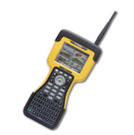
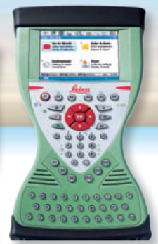

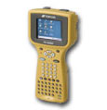
GNSS TO ANY DATUM
GNSS ECEF X,Y,Z (WGS 84 & PZ90)
NAD 83 (φ,λ,h) SPC N,E,h
+ GEOID XX = SPC N,E,H
OR
CALIBRATE TO 4-5 SITE POINTS IN THE DESIRED DATUM. THIS IS USED TO LOCK TO PASSIVE MONUMENTATION IN THE PROJECT AREA.

Slide 20
BEST METHODS FROM THE GUIDELINES:
THE 7 “C’s”
CHECK EQUIPMENT
COMMUNICATION
CONDITIONS
CONSTRAINTS(OR NOT)
COORDINATES
COLLECTION
CONFIDENCE

Slide 21
FROM NGS SINGLE BASE GUIDELINES CHAPTER 5 - FIELD PROCEDURES, AND “USERS” CHAPTER OF RTN GUIDELINES:
RT = single base, either active or passive
B = Both Single base and RTN
ACHIEVING ACCURATE, RELIABLE POSITIONS USING GNSS REAL TIME TECHNIQUES
3

Slide 22
CHECK EQUIPMENT
B BUBBLE- ADJUSTED?
RT BATTERY- BASE FULLY CHARGED 12V?
B BATTERY – ROVER SPARES?
RT USE PROPER RADIO CABLE (REDUCE SIGNAL LOSS)
RT RADIO MAST HIGH AS POSSIBLE? (5’ = 5 MILES, 20’ = 11 MILES, DOUBLE HEIGHT=40% RANGE INCREASE). LOW LOSS CABLE FOR >25’.
RT DIPOLE (DIRECTIONAL) ANTENNA NEEDED?
RT REPEATER?
RT CABLE CONNECTIONS SEATED AND TIGHT?
B“FIXED HEIGHT” CHECKED?
RT BASE SECURE?

Slide 23
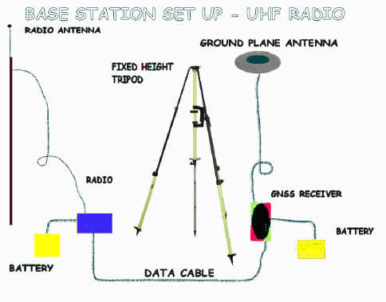
COMMUNICATION
RT UHF FREQUENCY CLEAR?
B CDMA/CELL - STATIC IP FOR COMMS?
B CONSTANT COMMS WHILE LOCATING
RT BATTERY STRENGTH OK?
B CELL COVERAGE?
B KEEP FIRMWARE UPDATED!

Slide 24
CONDITIONS
RT WEATHER CONSISTENT?
B CHECK SPACE WEATHER?
B CHECK PDOP/SATS FOR THE DAY?
RT OPEN SKY AT BASE?
RT MULTIPATH AT BASE?
B MULTIPATH AT ROVER?
B USE BIPOD?
DUAL CONSTELLATION RT POSSIBILITIES:
GPS ≥ 5, GLN = 0
GPS = 4, GLN = 2
GPS = 3, GLN = 3
GPS = 2, GLN = 4
(Can't initialize with only GLN Sats.)
3

Slide 25
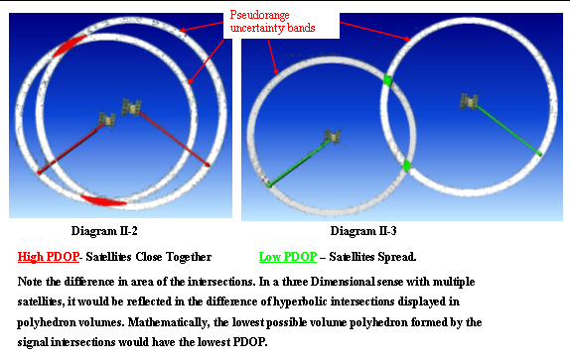
Dilution Of Precision - DOP

Slide 26
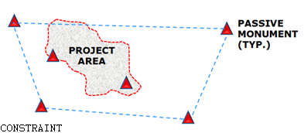
CONSTRAINTS (OR NOT)
B ≥ 4 H & V, KNOWN & TRUSTED POINTS?
B LOCALIZATION RESIDUALS-OUTLIERS?
B DO ANY PASSIVE MARKS NEED TO BE HELD?
RT BASE WITHIN CALIBRATION (QUALITY TIE TO NEAREST CALIBRATION POINT)?
B SAME OFFICE & FIELD CALIBRATION USED?
FYI: GNSS CAN PROVIDE GOOD RELATIVE POSITIONS IN A PROJECT WHILE STILL NOT CHECKING TO KNOWNS IN AN ABSOLUTE SENSE

Slide 27
RT DERIVED ORTHO HEIGHTS - LOCALIZE OR NOT?
PASSIVE MARKS ARE A SNAP SHOT OF WHEN THEY WERE LEVELED OR DERIVED FROM GPS
IF YOU BUILD FROM A MONUMENTED BM AND THE DESIGN WAS DONE REFERENCED TO IT, IT IS “THE TRUTH”, UNLESS IN GROSS ERROR.
CONSTRAINING TO PASSIVE BMs IS A GOOD WAY TO NOT ONLY LOCK TO THE SURROUNDING PASSIVE MARKS, BUT ALSO TO EVALUATE HOW THE CONTROL FITS TOGETHER.
HOW GOOD IS THE NGS HYBRID GEOID MODEL IN YOUR AREA? (SIDE NOTE: GEOID 09 IS THE CURRENT MODEL USED BY OPUS)

Slide 28
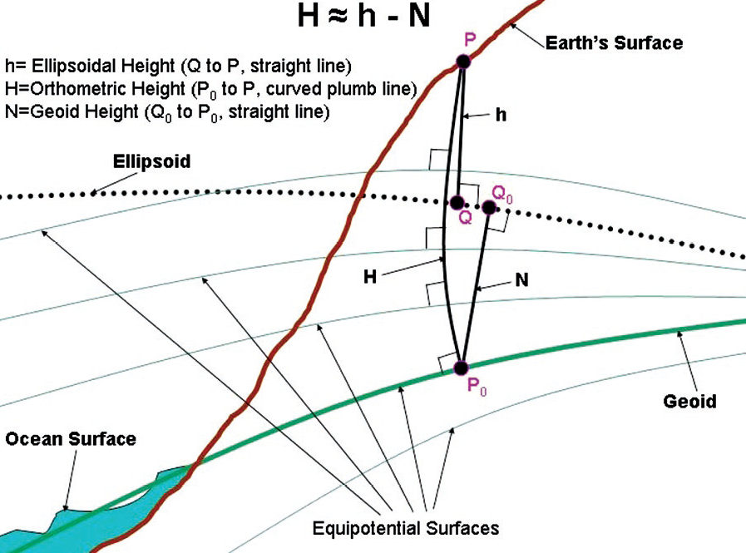
ELLIPSOID, GEOID & ORTHO HEIGHTS
H₈₈ = h₈₃ – N₀₃

Slide 29
Which Geoid for Which NAD 83?
NAD 83(2011)
NAD 83(2007)
NAD 83(1996) & CORS96
Geoid12A/12B
Geoid09
Geoid06 (AK only)
Geoid03
Geoid99
Geoid96

Slide 30
COORDINATES
B TRUSTED SOURCE?
B WHAT DATUM/EPOCH ARE NEEDED?
RT GIGO⬇
B ALWAYS CHECK KNOWN POINTS.
B PRECISION VS. ACCURACY
B GROUND/PROJECT VS. GRID/GEODETIC
B GEOID MODEL QUALITY
B LOG METADATA
⬇ AUTONOMOUS LOCAL BASE STATION POSITION ARE OK IF CORRECT COORDINATES ARE INTRODUCED IN THE PROJECT FIRMWARE/SOFTWARE LATER

Slide 31
COLLECTION
B CHECK ON KNOWN POINTS!
B SET ELEVATION MASK
B ANTENNA TYPES ENTERED OK?
B SET COVARIANCE MATRICES ON (IF NECESSARY).
B RMS SHOWN IS TYPICALLY 68% CONFIDENCE (BRAND DEPENDENT)
B H & V PRECISION SHOWN IS TYPICALLY 68% CONFIDENCE
B TIME ON POINT? QA/QC OF INTEGER FIX
B MULTIPATH? DISCRETE/DIFFUSE
B BUBBLE LEVELED?
B PDOP?
B FIXED SOLUTION?
B USE BIPOD?
B COMMS CONTINUOUS DURING LOCATION?
B BLUNDER CHECK LOCATION ON IMPORTANT POINTS.

Slide 32
CONFIDENCE
B CHECK KNOWN BEFORE, DURING, AFTER SESSION. COMPARE POSITIONS WITH/WITHOUT GLONASS.
B NECESSARY REDUNDANCY? (U. of Newcastle)
B WHAT ACCURACY IS NEEDED?
RT REMEMBER PPM
RT BASE PRECISION TO NEAREST CALIBRATION POINT
B AVERAGE REDUNDANT SHOTS – PRECISION DIFFERENCE WITHIN NEEDS OF SURVEY
B BE AWARE OF POTENTIAL INTERFERENCE (E.G., HIGH TENSION TOWER LINES)
CAN’T INITIALIZE? BAD CHECKS? PLENTY OF SATS? TRY:
TURN OFF GLONASS IF YOU HAVE ≥6 COMMON GPS SATS
REININTIALIZE
CHECK FOR “NOISY” SATS IN DATA COLLECTOR
LOOK FOR MULTIPATH NEARBY
ALSO-COMPARE GNSS POSITION TO GPS ONLY POSITION

Slide 33
Two Days/Same Time
-10.254
-10.251
THE IMPORTANCE OF REDUNDANCY
> -10.253
Difference = 0.3 cm
“Truth” = -10.276
Difference = 2.3 cm
Two Days/
Different Times
-10.254
-10.295
> -10.275
Difference = 4.1 cm
“Truth” = -10.276
Difference = 0.1 cm
Notes:
Dh is computed for a series of 30 minute sessions over 2 days and the average dh is found
Taking the observation from the same time each day (when the satellite geometry is similar), the difference in the dh is only .3 cm, but the difference from the average is 2.3 cm.
Now if you take the dh from different times on the 2 days (different geometry), the difference between the 2 vectors is 4.1 cm, but the difference from the average is only .1 cm

Slide 34
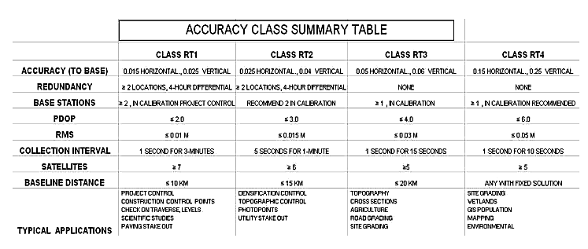
DRAFT GUIDELINES- 95% CONFIDENCE

Slide 35
Precision/Accuracy
NGS Accuracy Classes defined by 2d horizontal, 1d vertical precision (Repeatability) at 95% per redundant observation set
 | 2σ Horizontal | 2σ Vertical
RT1 | 0.024663 | 0.020933
RT2 | 0.021754 | 0.023475
RT3 | 0.020684 | 0.027002
RT4 | 0.025223 | 0.027488
 | 2σ Horizontal (m)
RT1 | 0.010786
RT2 | 0.011772
RT3 | 0.013639
RT4 | 0.014448
Notes:
These graphs show the ability for each observer to agree with other observers within a certain horizontal radius and vertical separation from “truth” on the ground

Slide 36
Example of a “bad” initialization

Slide 38
QUICK FIELD SUMMARY:
Set the base at a wide open site
Set rover elevation mask between 12° & 15°
The more satellites the better
The lower the PDOP the better
The more redundancy the better
Beware multipath
Beware long initialization times
Beware antenna height blunders
Survey with “fixed” solutions only
Always check known points before, during and after new location sessions
Keep equipment adjusted for highest accuracy
Communication should be continuous while locating a point
Precision displayed in the data collector can be at the 68 percent level (or 1σ), which is only about half the error spread to get 95 percent confidence
Have back up batteries & cables
RT doesn’t like tree canopy or tall buildings

Slide 39
METADATA !
BESIDES ATTRIBUTE FIELDS, THE RT PRACTICIONER MUST KEEP RECORDS OF ITEMS NOT RECORDED IN THE FIELD, FOR INSTANCE:
WHAT IS THE SOURCE OF THE DATA?
WHAT WAS THE DATUM/ADJUSTMENT/EPOCH?
WHAT WERE THE FIELD CONDITIONS?
WHAT EQUIPMENT WAS USED, ESPECIALLY- WHAT ANTENNA?
WAS COMMUNICATION SOLID?
WHAT FIRMWARE WAS IN THE RECEIVER & COLLECTOR?
WERE ANY GUIDELINES USED FOR COLLECTION?
WHAT REDUNDANCY, IF ANY, WAS USED?
WERE ANY PASSIVE MARKS CONSTRAINED?
(GOOD IDEA TO CREATE A TABLULAR CHECK LIST FORM)

Slide 40
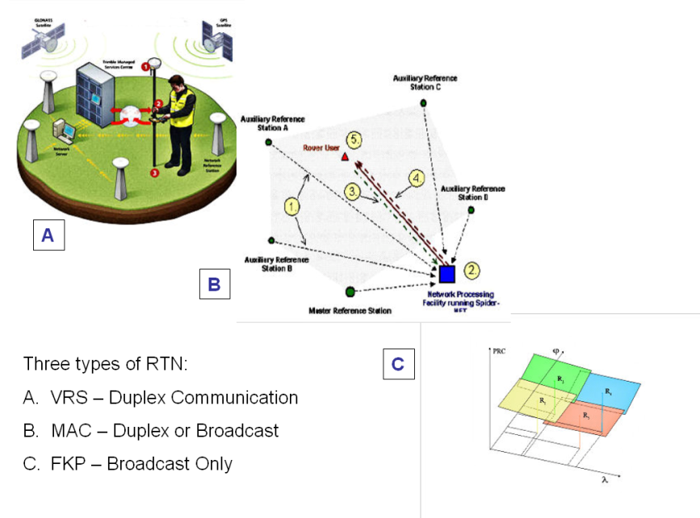
THE QUICK SUMMARY BOILED DOWN:
FOUR CARDINAL RULES FOR RT POSITIONING
COMMUNICATIONS: THE KEY TO SUCCESS
CHECK SHOT: FIRST BEFORE NEW WORK
REDUNDANCY: FOR CONFIDENCE
MULTIPATH: AVOID UNSUITABLE CONDITIONS
≥200 RTN WORLDWIDE
≥80 RTN IN THE USA
≥37 DOT WITH STATEWIDE NETWORKS OPERATING OR PLANNED

Slide 41
RTK Observation Procedures
Initialize “in the clear”
Observe as “control” for 60 epochs
Monitor RMS
Enter feature and attribute information
Store point
Repeat steps 1-5 (4 hours later/next day), consider initializing using a different CORS

