Slide 1

Preparing for National Spatial
Reference System Modernization
Dr. Daniel Roman Mr. Galen Scott
Senior Advisor for Geodesy Constituent Resource Manager
DOC/NOAA/NOS
National Geodetic Survey

Slide 2
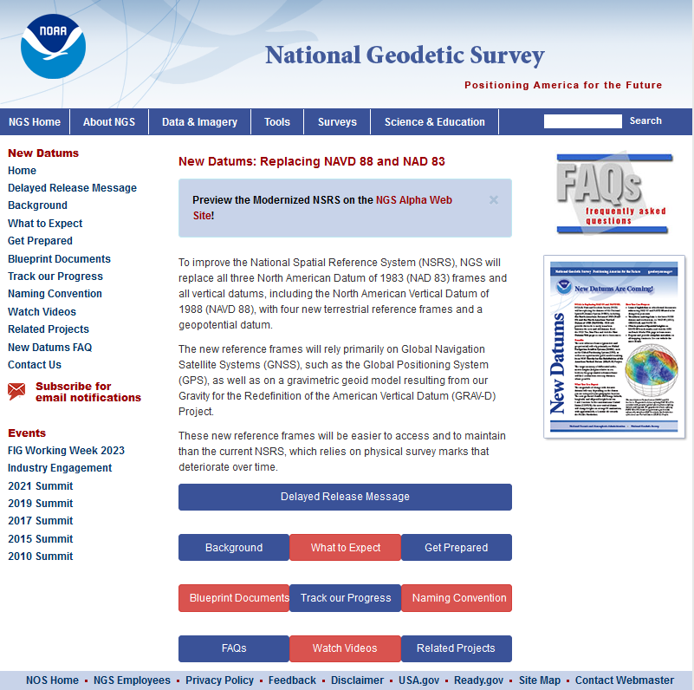
Agenda
Basics
  Planned Changes
  Significance
  Motivations
  Activities
GPS on BM Campaign
Customer Tools
  OPUS
  NCAT
https://geodesy.noaa.gov/datums/newdatums/
Notes:
I’m not going into detail here on the roll out and plans
I’ll a little more detail on data collection and tool development
This I more of an executive summary to provide broad understanding and motivations
To help you see the merit when your technical people come to you and ask how they should proceed
There are other presentations and greater detail on our website

Slide 3
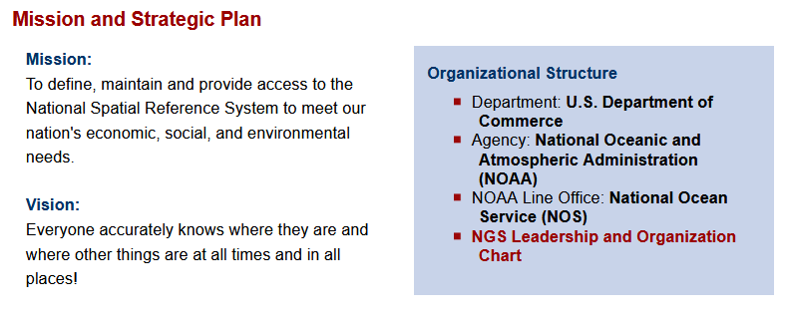
The National Geodetic Survey
https://geodesy.noaa.gov/

Slide 4

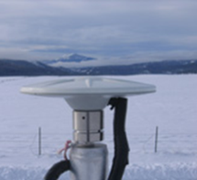

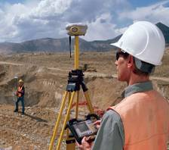


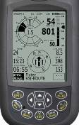





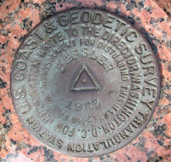
NGS Provides the Geodetic Infrastructure Critical to Our Geospatial Economy through the NSRS
Aviation
The “P” in PNT
CORS
Satellite
Operations
Surveying
and Mapping
Disaster Response
Precision Agriculture
Personal
Navigation
Navigation
Oil Exploration
Fishing and Boating
Trucking and Shipping
Survey Marks
Notes:
For more information see 2019 Report: Scaling the Heights: Socio-Economic Study of the NGS Gravity Program
NGS-Gravity-Program-Socio-Economic-Report.pdf (noaa.gov)
Study Values NGS Gravity Program at $4.2 to $13.3 Billion over Ten Years
Friday, November 1, 2019
A new study estimates the value of the NGS Gravity Program to be between $4.2 and $13.3 billion over ten years, with a middle scenario of $8.7 billion. The socio-economic study was conducted for NGS by ARCBridge Consulting of Herndon, Virginia. The NGS Gravity Program uses information about the gravity field to provide more accurate elevation data (or "heights") for the United States. The improved heights will result from a new vertical height reference system created from the Gravity Program's GRAV-D Project (Gravity for the Redefinition of the American Vertical Datum), which lets surveyors and scientists employ GPS to determine more precise and accurate elevations than currently possible, in less time and with less effort.

Slide 5
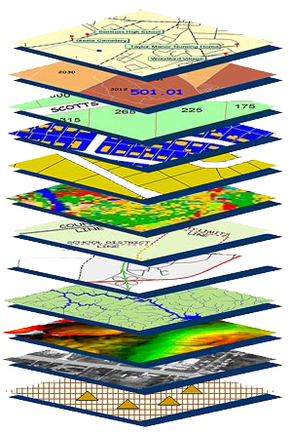
Accurate maps begin with
accurate coordinates!
Geodetic control (NSRS) is the foundation layer for all geospatial products.
Easiest way to think of “geodetic control”:
Points with Coordinates
***Soon to be Coordinates as a function of time
Without a geodetic control “base map” layer, GIS applications will not align properly!
Geodetic control needs to be more accurate than any survey or map which builds upon it
Notes:
There are three ways to organize geospatial data:
Have transformations stored to convert between reference systems
Put all the data into one database
Provide a set of tools to enable users to create the geodetic components in the same reference system
Digital services should ensure geo-referenced data collected and published are consistent with NOAA’s National Spatial Reference System (NSRS), which provides the foundation for all positioning and navigation activities in the United States and is defined and maintained by NGS.
This is more adamant for US Agencies but a good guideline for others as well

Slide 6
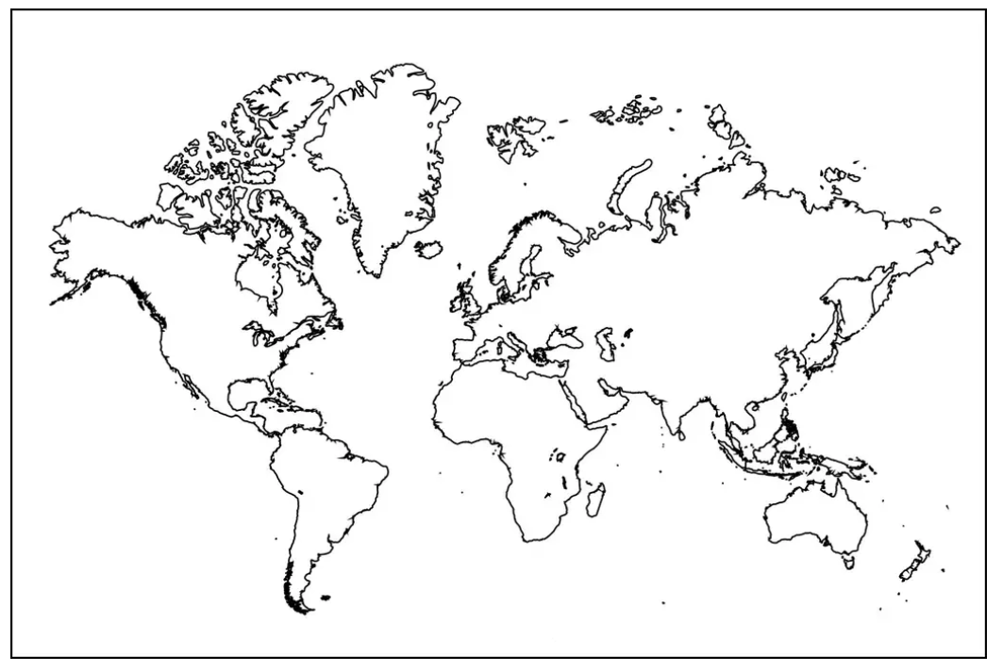
Extent of the current NSRS
Frames: Truly global but used regionally
Geoid/Vertical: Regional
Conterminous US (CONUS; “Lower 48”)
Alaska
Hawaii
Territories: Puerto Rico, U.S. Virgin Islands, American Samoa, Guam, CNMI

Slide 7
Planned Changes: Replacing NAD 83
The Old:
NAD 83(2011)
NAD 83(PA11)
NAD 83(MA11)
The New:
The North American Terrestrial Reference Frame of 2022
(NATRF2022)
The Caribbean Terrestrial Reference Frame of 2022
(CATRF2022)
The Pacific Terrestrial Reference Frame of 2022
(PATRF2022)
The Mariana Terrestrial Reference Frame of 2022
(MATRF2022)

Slide 8
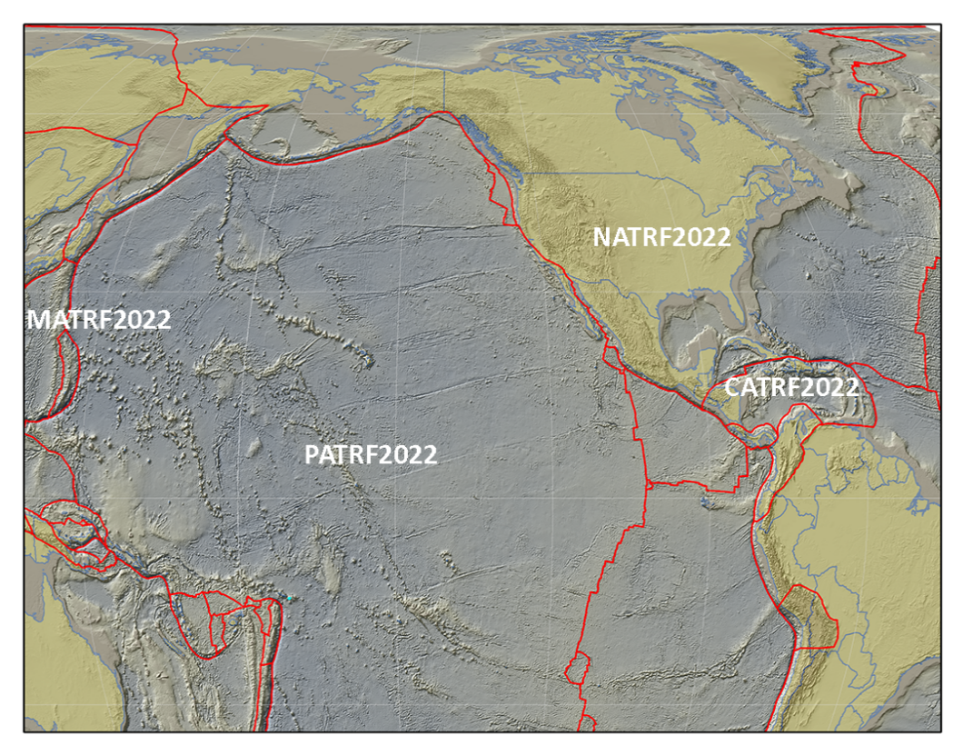
The Future Reference Frames
Will be based on a densified ITRF model (e.g. SIRGAS)
Tectonic Plate based
Each Plate is based on the same densified
ITRF model
North America
Caribbean
Pacific
Mariana
NATRF
CATRF
PATRF
MATRF
Notes:
ITRF fixed PLATE specific reference frame. 5th frame will be SIRGAS
Will rely upon Euler Pole Parameters to related plates to ITRF2020
NSRS Modernization Naming Conventions https://geodesy.noaa.gov/datums/newdatums/naming-convention.shtml

Slide 9
Planned Changes: Replacing NAVD 88
  The Old:
  NAVD 88
  PRVD 02
  VIVD09
  ASVD02
  NMVD03
  GUVD04
  IGLD 85
  IGSN71
  GEOID18
  DEFLEC18
  The New:
  The North American-Pacific Geopotential Datum of 2022 (NAPGD2022)
  Will include:
  GEOID2022
  DEFLEC2022
  GRAV2022
  DEM2022
  More
Orthometric
Heights
Normal
Orthometric
Heights
A HUGE component of this
effort is GRAV-D:
Gravity for the Redefinition of
the American Vertical Datum
Dynamic
Heights
Gravity
Geoid
Undulations
Deflections of
the Vertical

Slide 10
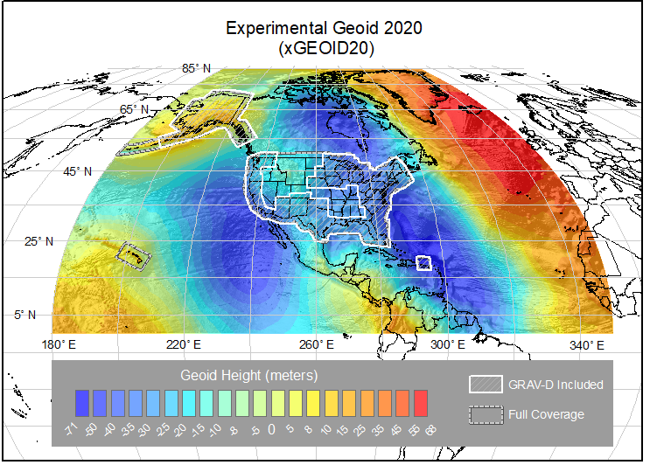
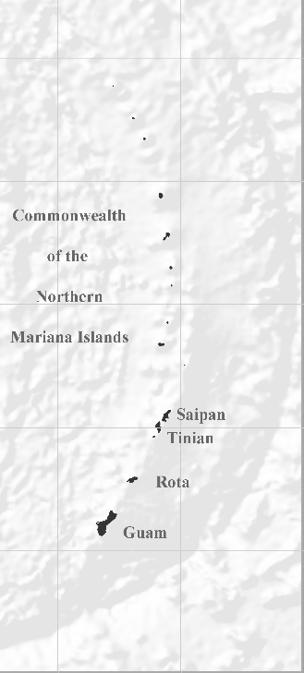
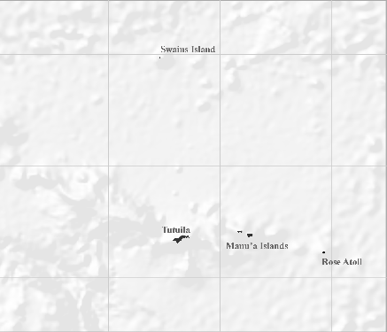
NAPGD2022 Geopotential Datum
Not just a vertical datum, it is more than just heights.
NGS, Canada, and Mexico released the first-ever joint geoid model
¼ Earth’s Surface
Models included:
Geopotential, Geoid Deflection of Vertical,
& Gravity
Guam/CNMI
American Samoa
Notes:
The North American-Pacific Geopotential Datum of 2022 is more than just heights!
NGS, Canada, and Mexico released the first-ever joint geoid model between our countries xGEOID20.
The final GEOID2022 model will also be a joint model.
.... BACK to slide.
As noted in the Blueprint 2 document
https://geodesy.noaa.gov/library/pdfs/NOAA_TR_NOS_NGS_0064.pdf
NAPGD2022 will include all of the following
Geopotential Model of 2022 (GM2022) will include:
Static Geopotential model of 2022 (SGM2022)
Dynamic Geopotential model of 2022 (DGM2022)
GEOID2022 will include:
Static Geoid model of 2022 (SGEOID2022)
Dynamic Geoid model of 2022 (DGEOID2022)
DEFLEC2022 will include:
Static Deflection of the Vertical model of 2022 (SDEFLEC2022)
Dynamic Deflection of the Vertical model of 2022 (DDEFLEC2022)
GRAV2022
Static Gravity model of 2022 (SGRAV2022)

Slide 11
Significance to Users
Global models accurate and precise at local scales
  Datum shifts create meter-level changes (more in GPSonBM section)
  Will tie NSRS to ITRS directly
  Will more closely relate to current realizations of WGS-84
  Minimizes impacts to navigation
Better geospatial products for improved results in government, business and research

Slide 12
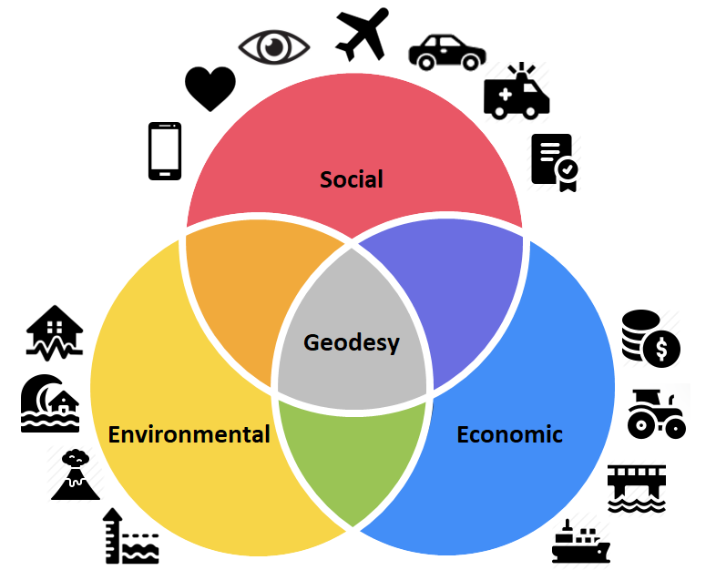
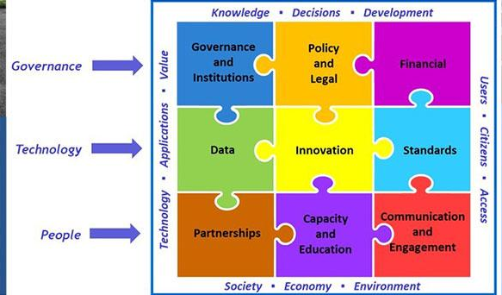
International Motivations: UN-GGIM
Integrated Geospatial information Framework
Geodetic Component of Geospatial Data
Focus is on building capacity in governments but also the broader geospatial sector to build the NSDI
Notes:
UN Integrated Geospatial Information Framework
It provides a basis and guide for developing, integrating and strengthening geospatial information management
Anchored by nine strategic pathways, the Framework is a mechanism for articulating and demonstrating national leadership in geospatial information, and the capacity to take positive steps.
Underpinning that effort, the UN voted on resolutions supporting the Global Geodetic Reference Frame (GGRF).
The GGRF is being implemented by the Subcommittee on Geodesy and now the Global Geodetic Centre of Excellence.

Slide 13
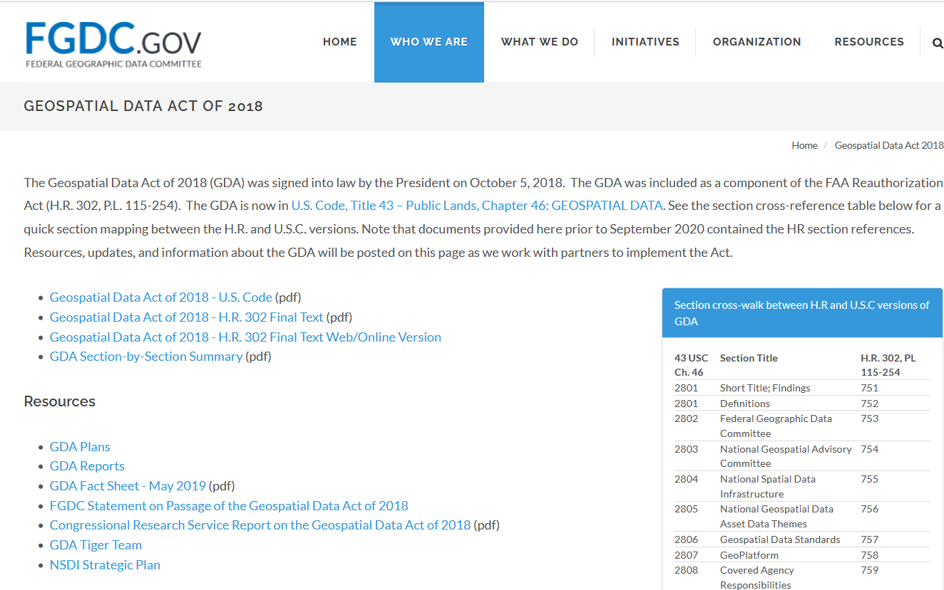
National Motivations: the GDA and FGDC
Geospatial Data Act
  Many aspects of IGIF
  Standards, etc.
  Empowered FGDC
  NGDA’s and other data
Governance piece
  only US Agencies are covered by it
This GeoGov Summit broadens the reach
  Private sector, State, local, tribal & academia
Notes:
In support of that, the U.S. passed the Geospatial Data Act of 2018 that codified many previous Directives and better aligned the US to global norms.
Hence, NOAA/NGS is the tip of the spear implementing what has been agreed to internationally and codified into law inside the U.S.

Slide 14

Geoplatform.gov
Making U.S. Government data more F.A.I.R.
  Findable, Accessible, Interoperable and Reusable
Interoperable includes metadata
  Includes coordinate reference systems
  such as the NSRS
Data harvested from NOAA through data.gov to geoplatform.gov
However, it is also on our website

Slide 15
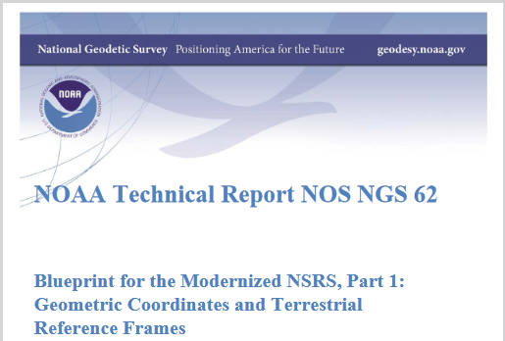
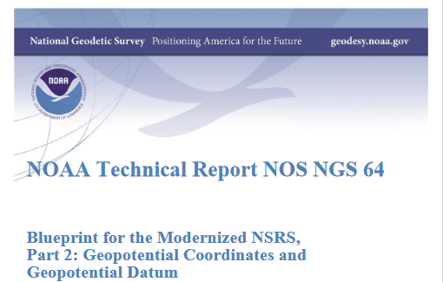
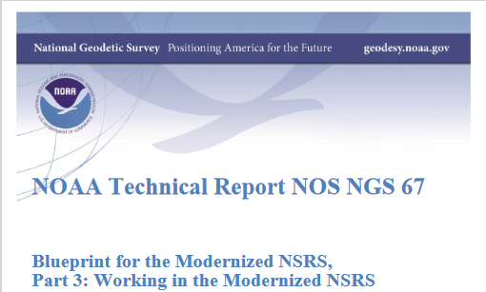
How: NSRS Modernization Blueprints
Part 1 - Geometric and TRF’s
  EPP - TRF’s tied to ITRF2020
  IFDM - deformation in TRF
Part 2- Geopotential
  Vertical Datum
  Gravity
  DoV’s
Part 3 - User Access
  GNSS observations by user
  NOAA CORS Network
  OPUS processing (more later)
  GNSS obs to get to vertical: H = h - N
Notes:
Part 1 relates to the broader definitions of the four TRF’s and practical aspects of them
Part 2 details how the new vertical datums and other aspects of the gravity field will be created/maintained/accessed
Part 3 then relates to how the users will access geodetic coordinates for their geospatial data
Previously, the vertical (NAVD 88) was realized separate from the geometric (NAD 83) datums.
In the modernized NSRS, geometric coordinates must be determined first and then the vertical can be accessed.

Slide 16
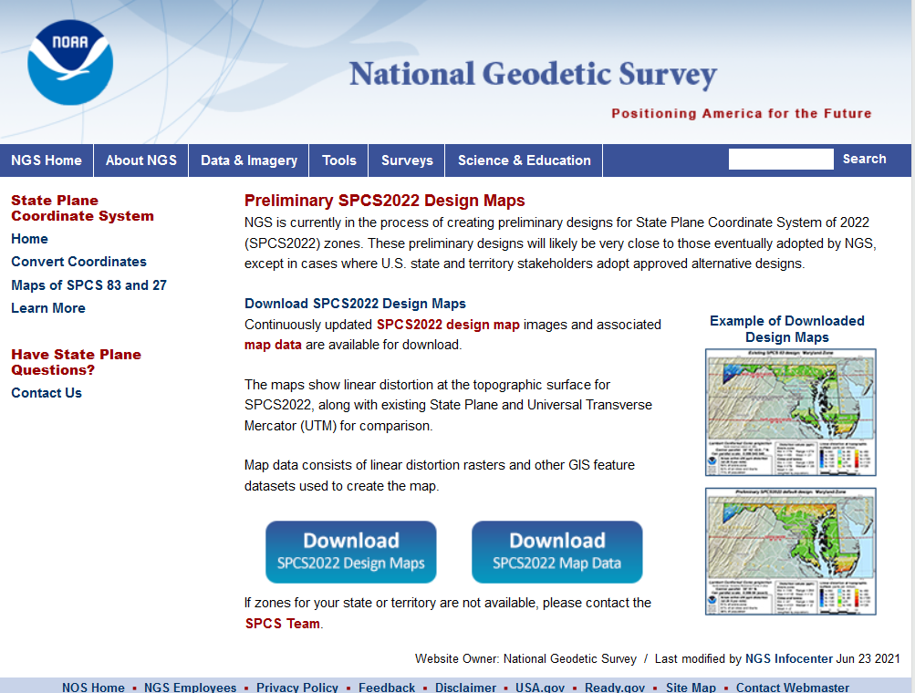
What – Modernizing the NSRS
Defining new TRF parameters
GRAV-D for NAPGD2022
State Plane Coordinate Systems
Continued Data collection
  GPS on BM (next section)
Geospatial data tools
  OPUS and OPUS Projects (OP)
  NGS Coordinate Conversion and Transformation Tool (NCAT)
Notes:
SPCS are projections from the NSRS.
Hence, they inherit the NSRS definitions including the modernized NSRS.
Efforts are being made to make obvious if the SPCS are older (e.g. 83) or modernized (2022).

Slide 17
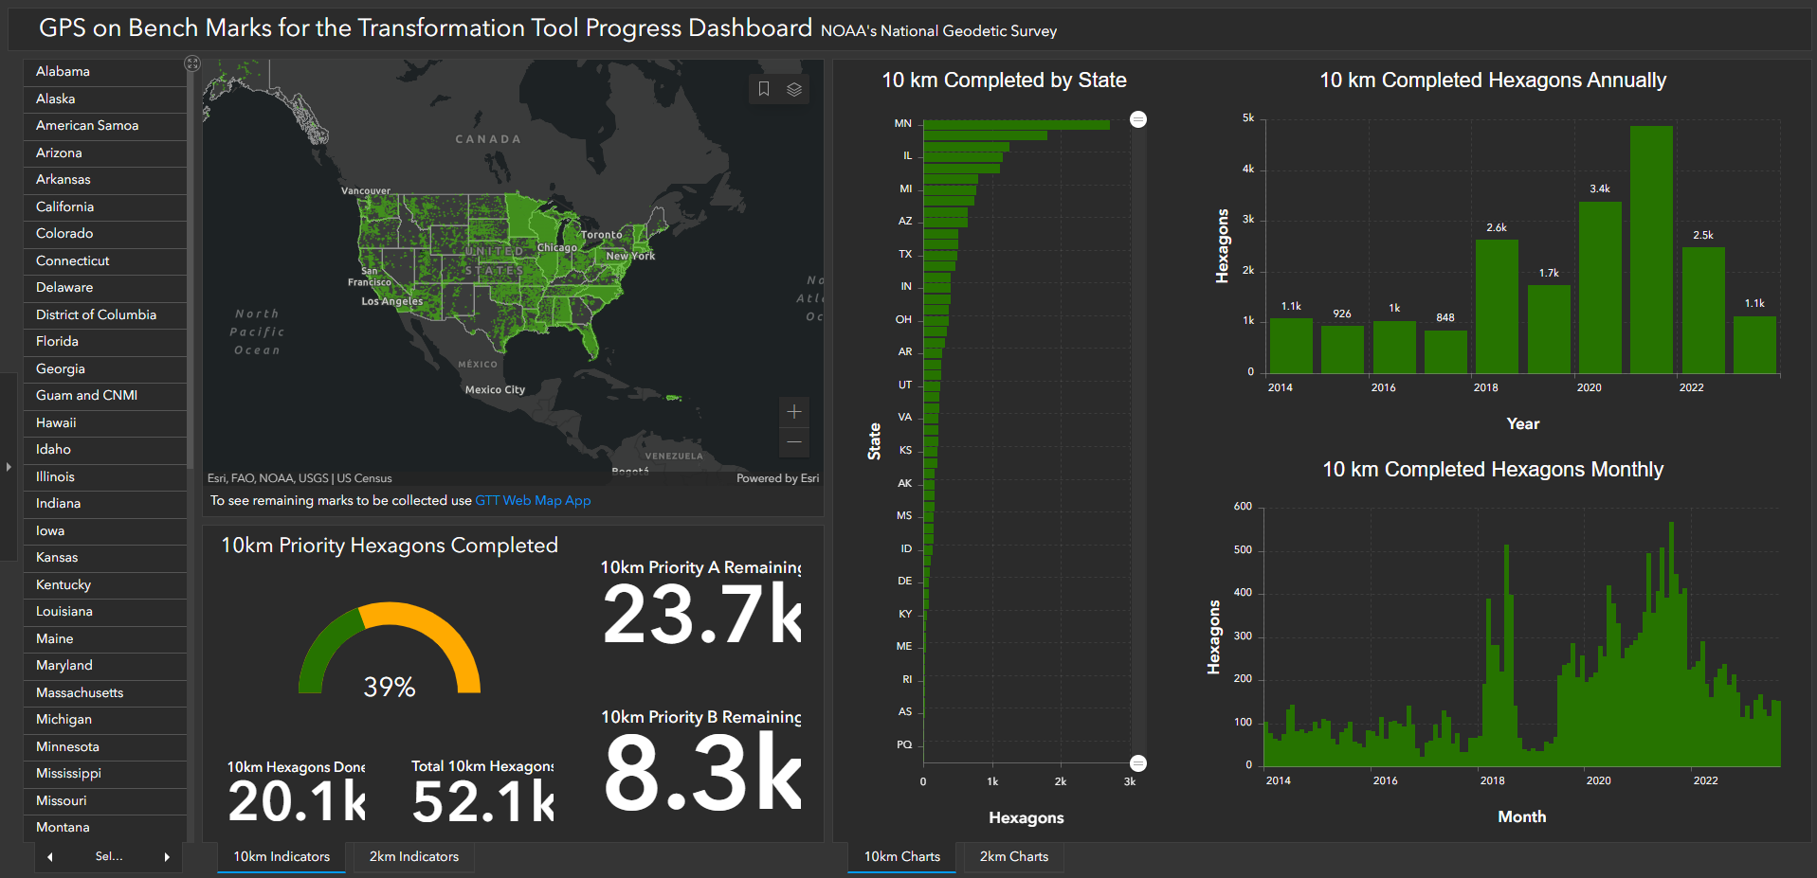
BT

Slide 18
Agenda
Basics
  Planned Changes
  Significance
  Motivations
  Activities
GPS on BM Campaign
Customer Tools
  OPUS
  NCAT
https://geodesy.noaa.gov/datums/newdatums/
Notes:
I’m not going into detail here on the roll out and plans
I’ll a little more detail on data collection and tool development
This I more of an executive summary to provide broad understanding and motivations
To help you see the merit when your technical people come to you and ask how they should proceed
There are other presentations and greater detail on our website

Slide 19
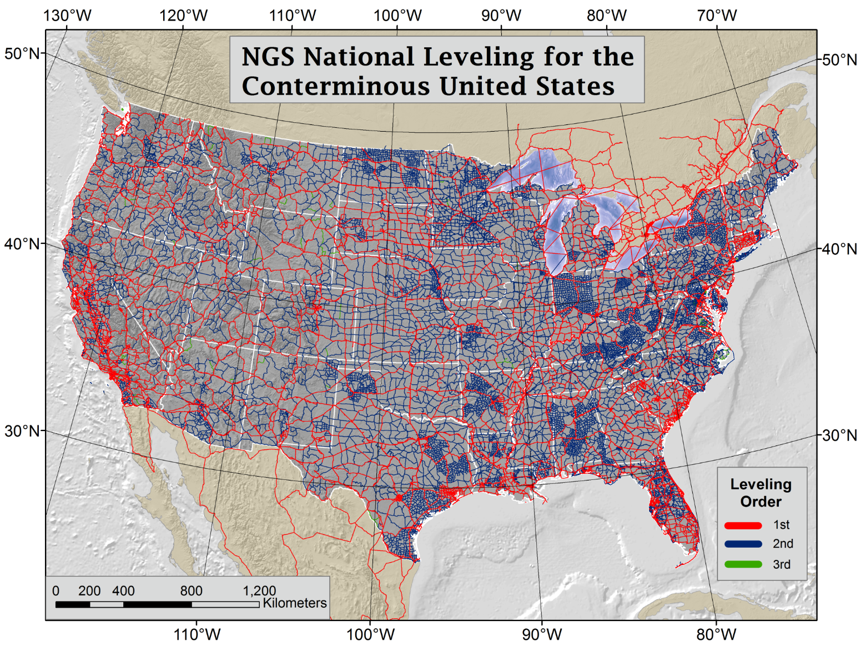
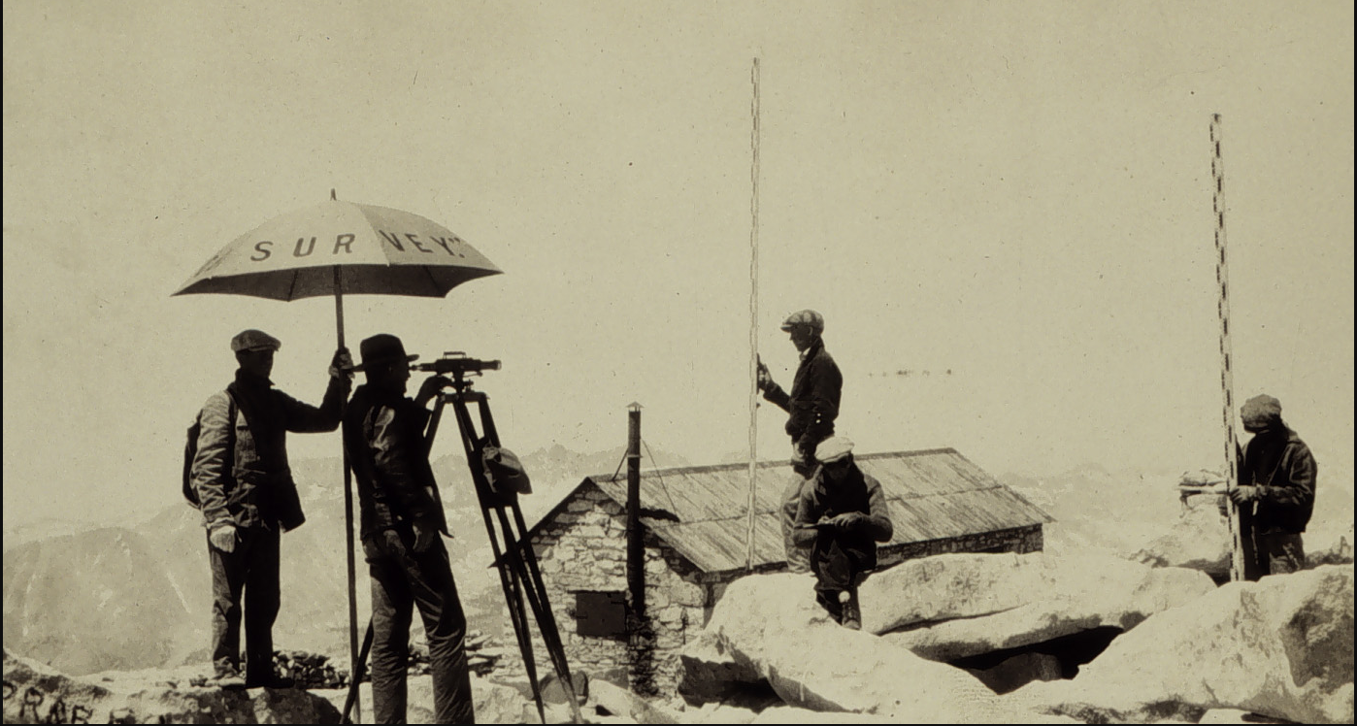

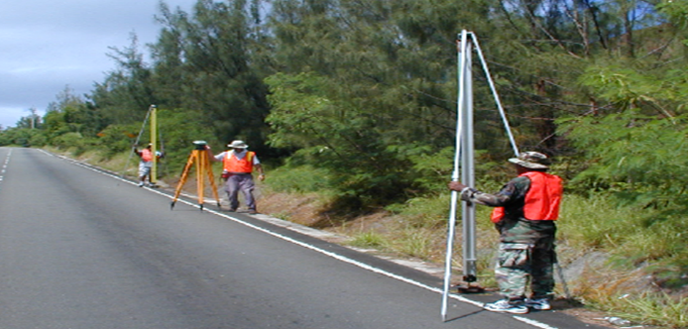
First, a little history - NAVD 88 was released in 1991, created using decades of Continental-Scale Geodetic Leveling
Then, along came GPS!
NAVD 88 consists of about 800,000 bench marks connected by about 2.2M km of leveling over 80 years
Notes:
NAVD 88, the US current Orthometric height datum, consists of about 800,000 benchmarks and ~2.2M km of leveling. Data was collected over many decades by roving bands of surveyors who walked across the country multiple times over the years, east to west, north to south and back again. It is currently the official vertical datum of the US and is required for federal mapping projects. It would cost tens to hundreds of millions of US dollars to do again.
GPS data on those leveled marks were used to create GEOID18 – the model used to derive NAVD88 heights from GPS ellipsoid heights, as well as the transformation tools that will be released with NAPGD2022.

Slide 20
NAVD 88 Issues
NAVD 88 suffers from unknown movements before, during and after its original adjustment
By way of example…
1954: Leveling Performed to bench mark
House
House
BM
BM
1991: Original 1954 leveling data is used to compute the NAVD 88 height which is then published for this BM
1954-1991: Subsidence
House
BM
H₈₈(published)
H₈₈(true)
NAVD 88 zero height surface
Obviously the true height relative to the NAVD 88
zero surface is not the published NAVD 88 height

Slide 21
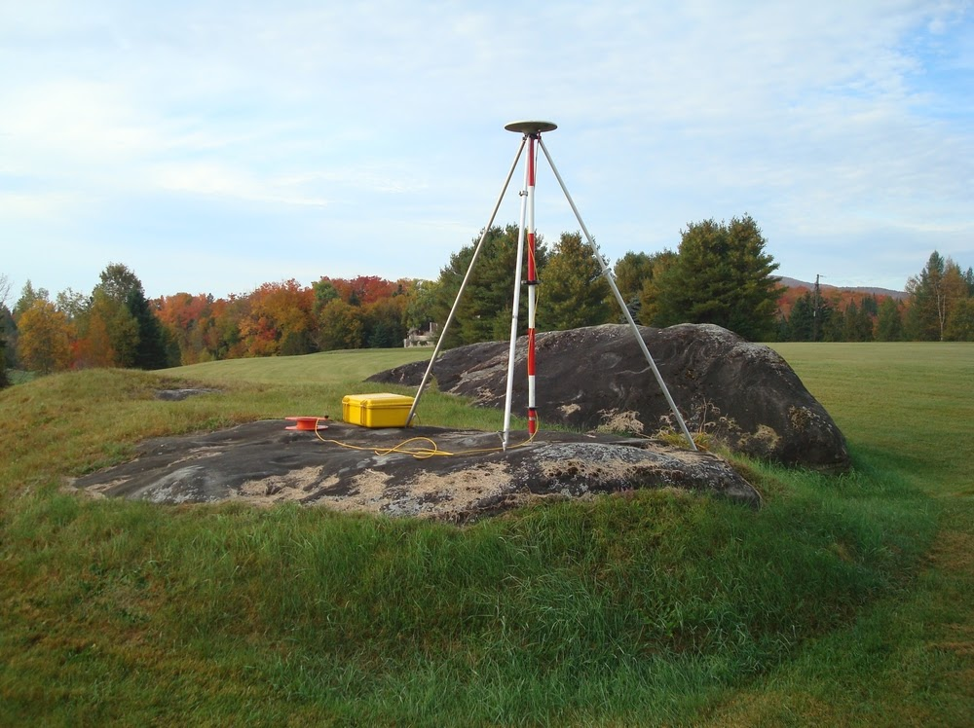
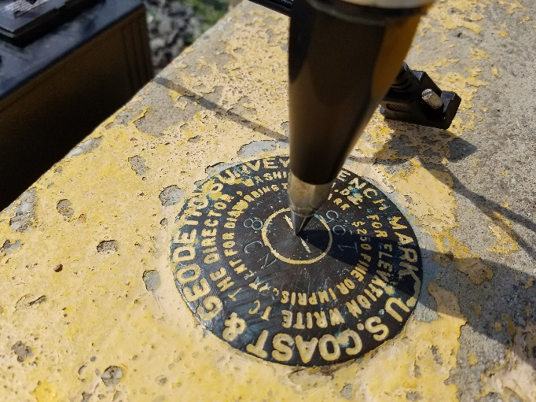
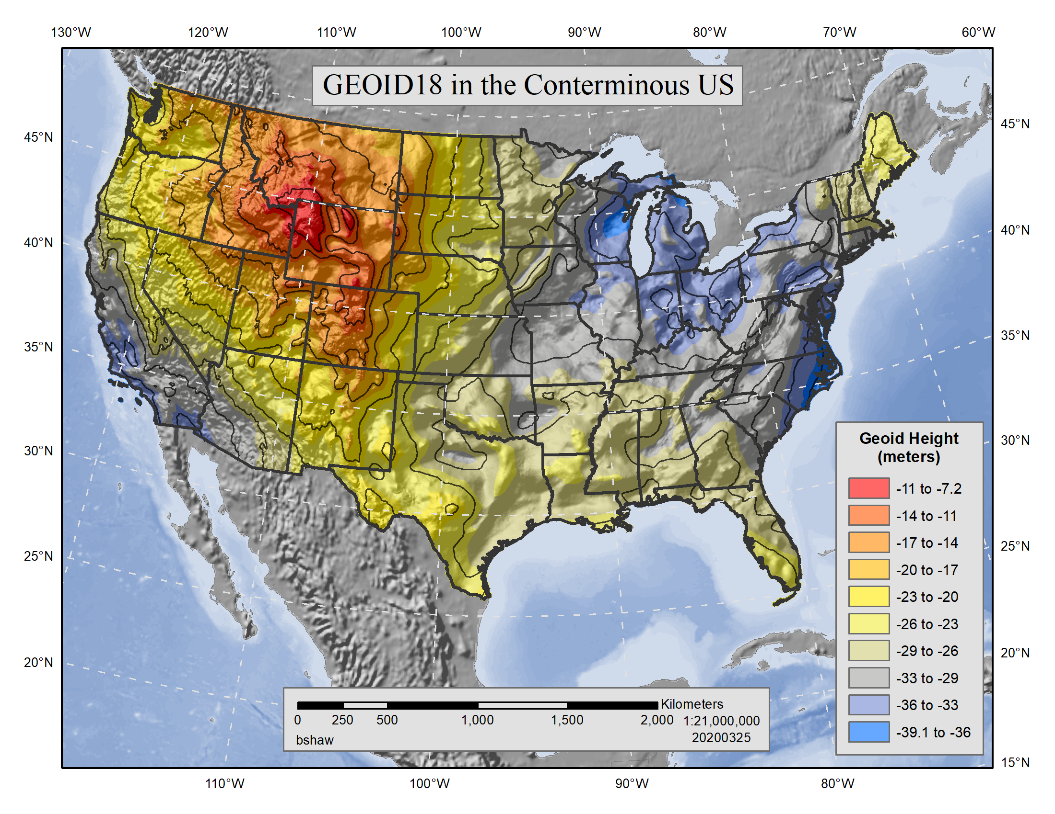
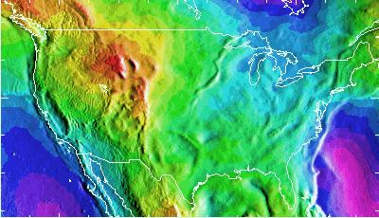
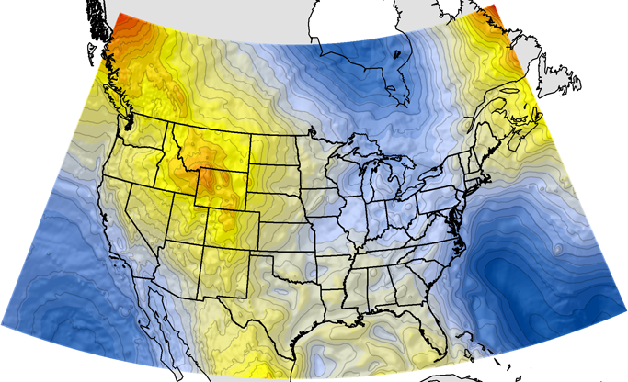
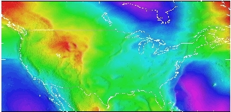
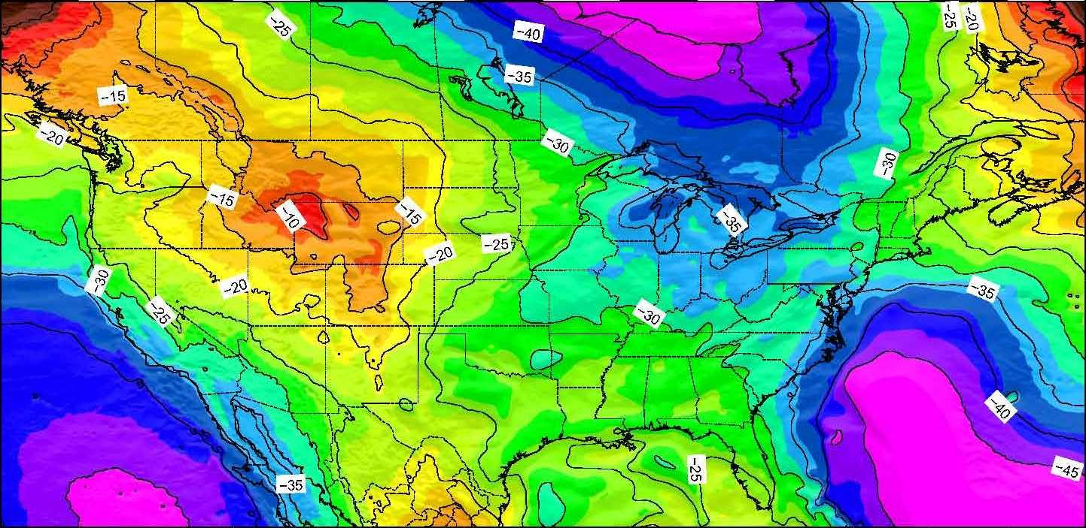
Starting in the late 1990’s, NGS created a series of hybrid geoid models by using GPS observations on NAVD88 marks, providing users a way to produce GPS derived NAVD88 heights.
The GPSonBM crowd sourced data collection effort provided nearly 7,000 new data points for use in GEOID18
Notes:
NAVD 88, the US current Orthometric height datum, consists of about 800,000 benchmarks and ~2.2M km of leveling. Data was collected over many decades by roving bands of surveyors who walked across the country multiple times over the years, east to west, north to south and back again. It is currently the official vertical datum of the US and is required for federal mapping projects. It would cost tens to hundreds of millions of US dollars to do again.
GPS data on those leveled marks were used to create GEOID18 – the model used to derive NAVD88 heights from GPS ellipsoid heights, as well as the transformation tools that will be released with NAPGD2022.

Slide 22
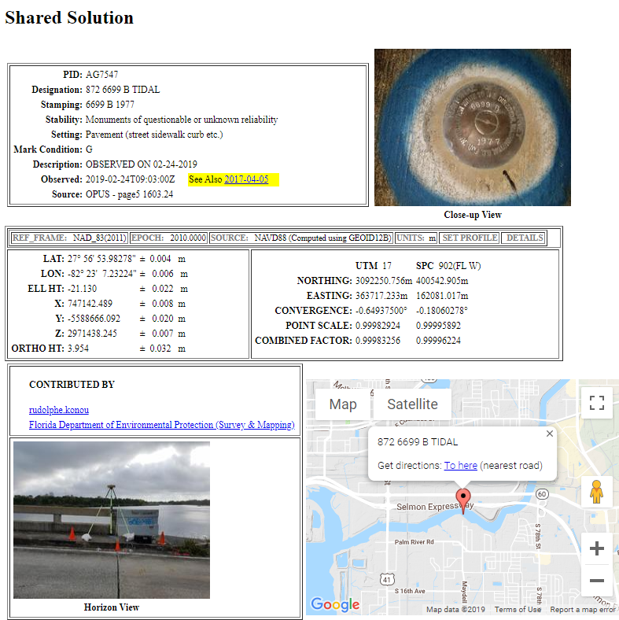
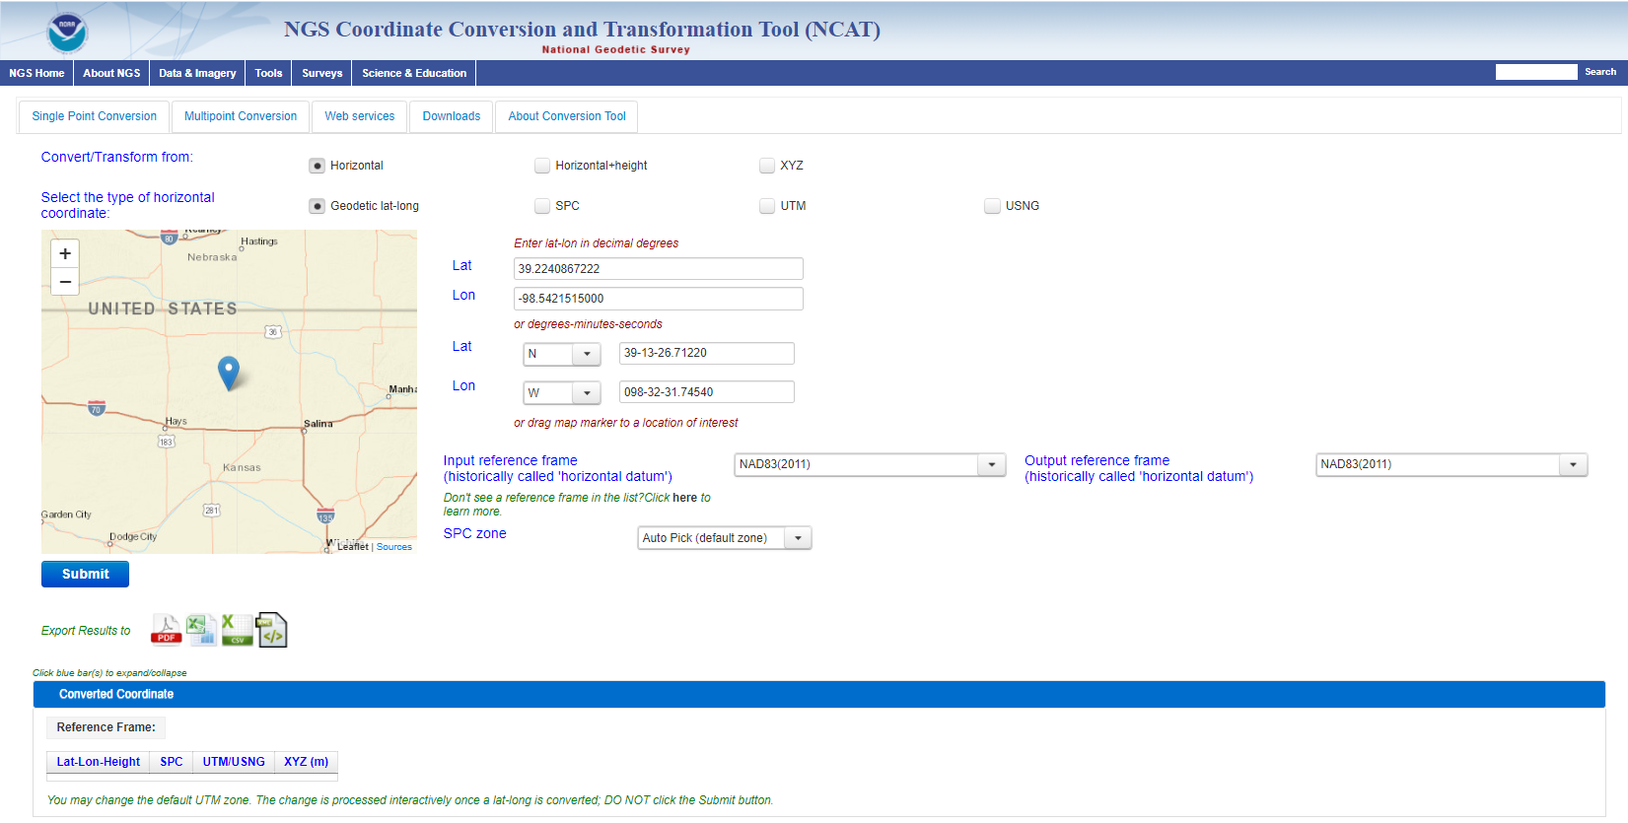
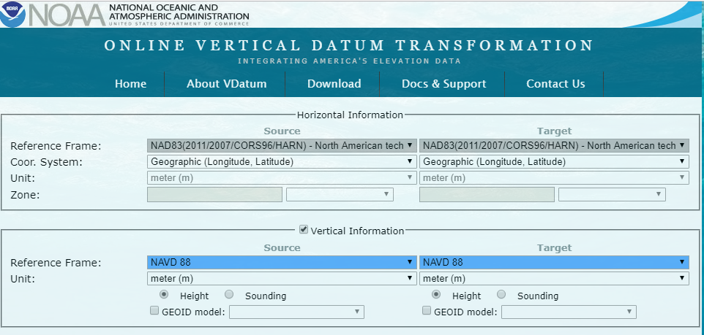
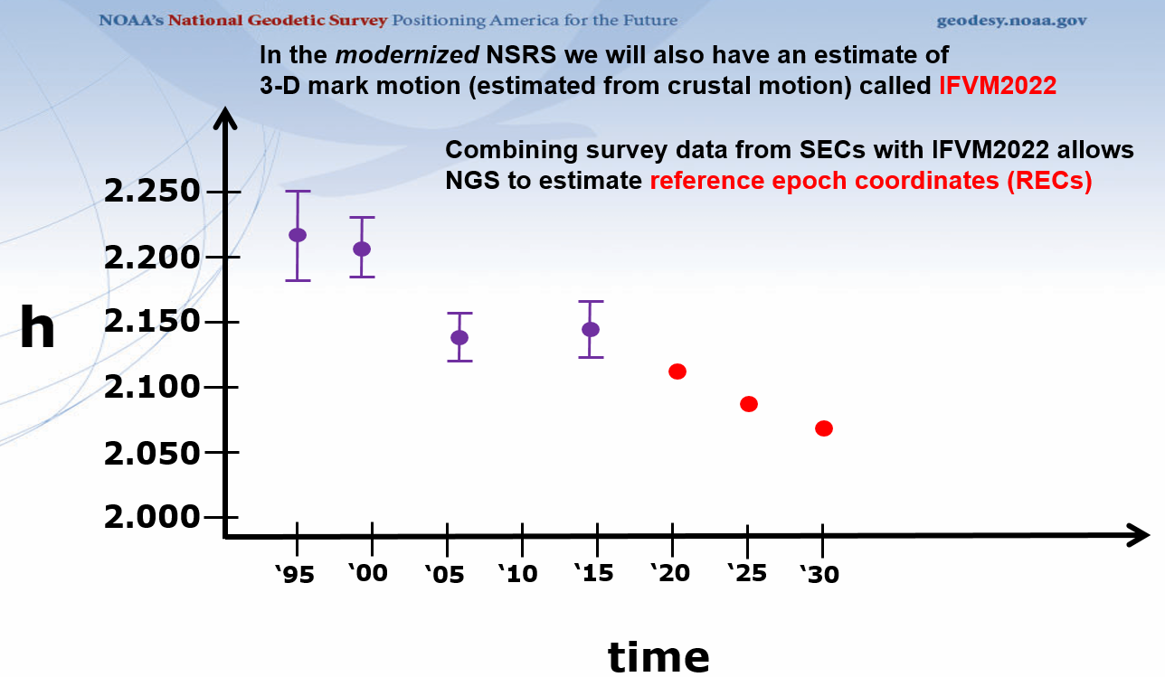
GPS on Bench Marks - What & Why?
GPS on Bench Marks is about preparing the country and our communities to take full advantage of the benefits of the Modernized NSRS, by collecting new GPS observations on bench marks with published NAVD 88 heights.
Primary GPSonBM Campaign Benefits:
Improved Geoid18 - the last hybrid geoid for NAVD 88
2020.0 Reference Epoch Coordinates (REC’s)
Data for NAVD 88 – NAPGD2022 Transformation Tools
Build time series of observations in areas of motion
Added benefits:
Evaluate gravimetric geoid models
Check your RTN results
Update and maintain passive control marks
Identify marks suspected of movement
Notes:
NGS’ GPSonBM program is now requesting data to build the models that NCAT and VDatum will use to transform geospatial data from existing datums to the Modernized National Spatial Reference System.
These are the benefits that we derive that other countries could derive as well. The processes, tools, workflow, and technical specifications that we have developed can be applied in other places. We are keeping in house the definition of the NSRS, outsourcing the observations to realize the frames
Went back to marks that were set before that are no longer accessible or gpsable – so this provides ongoing maintenance. Marks were set open fields and now are developments – road widening (Chicago grew)
revisit Geodetic infrastructure regularly for maintenance

Slide 23
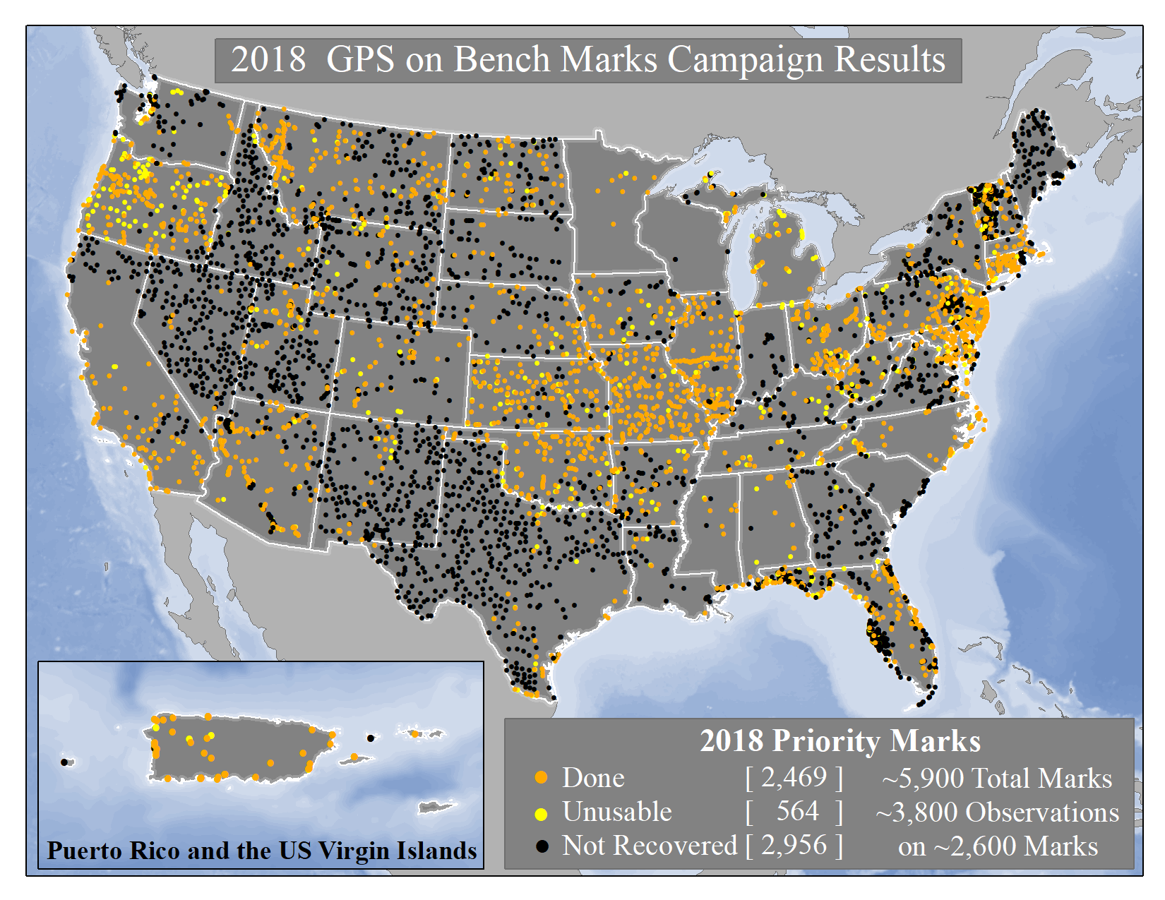
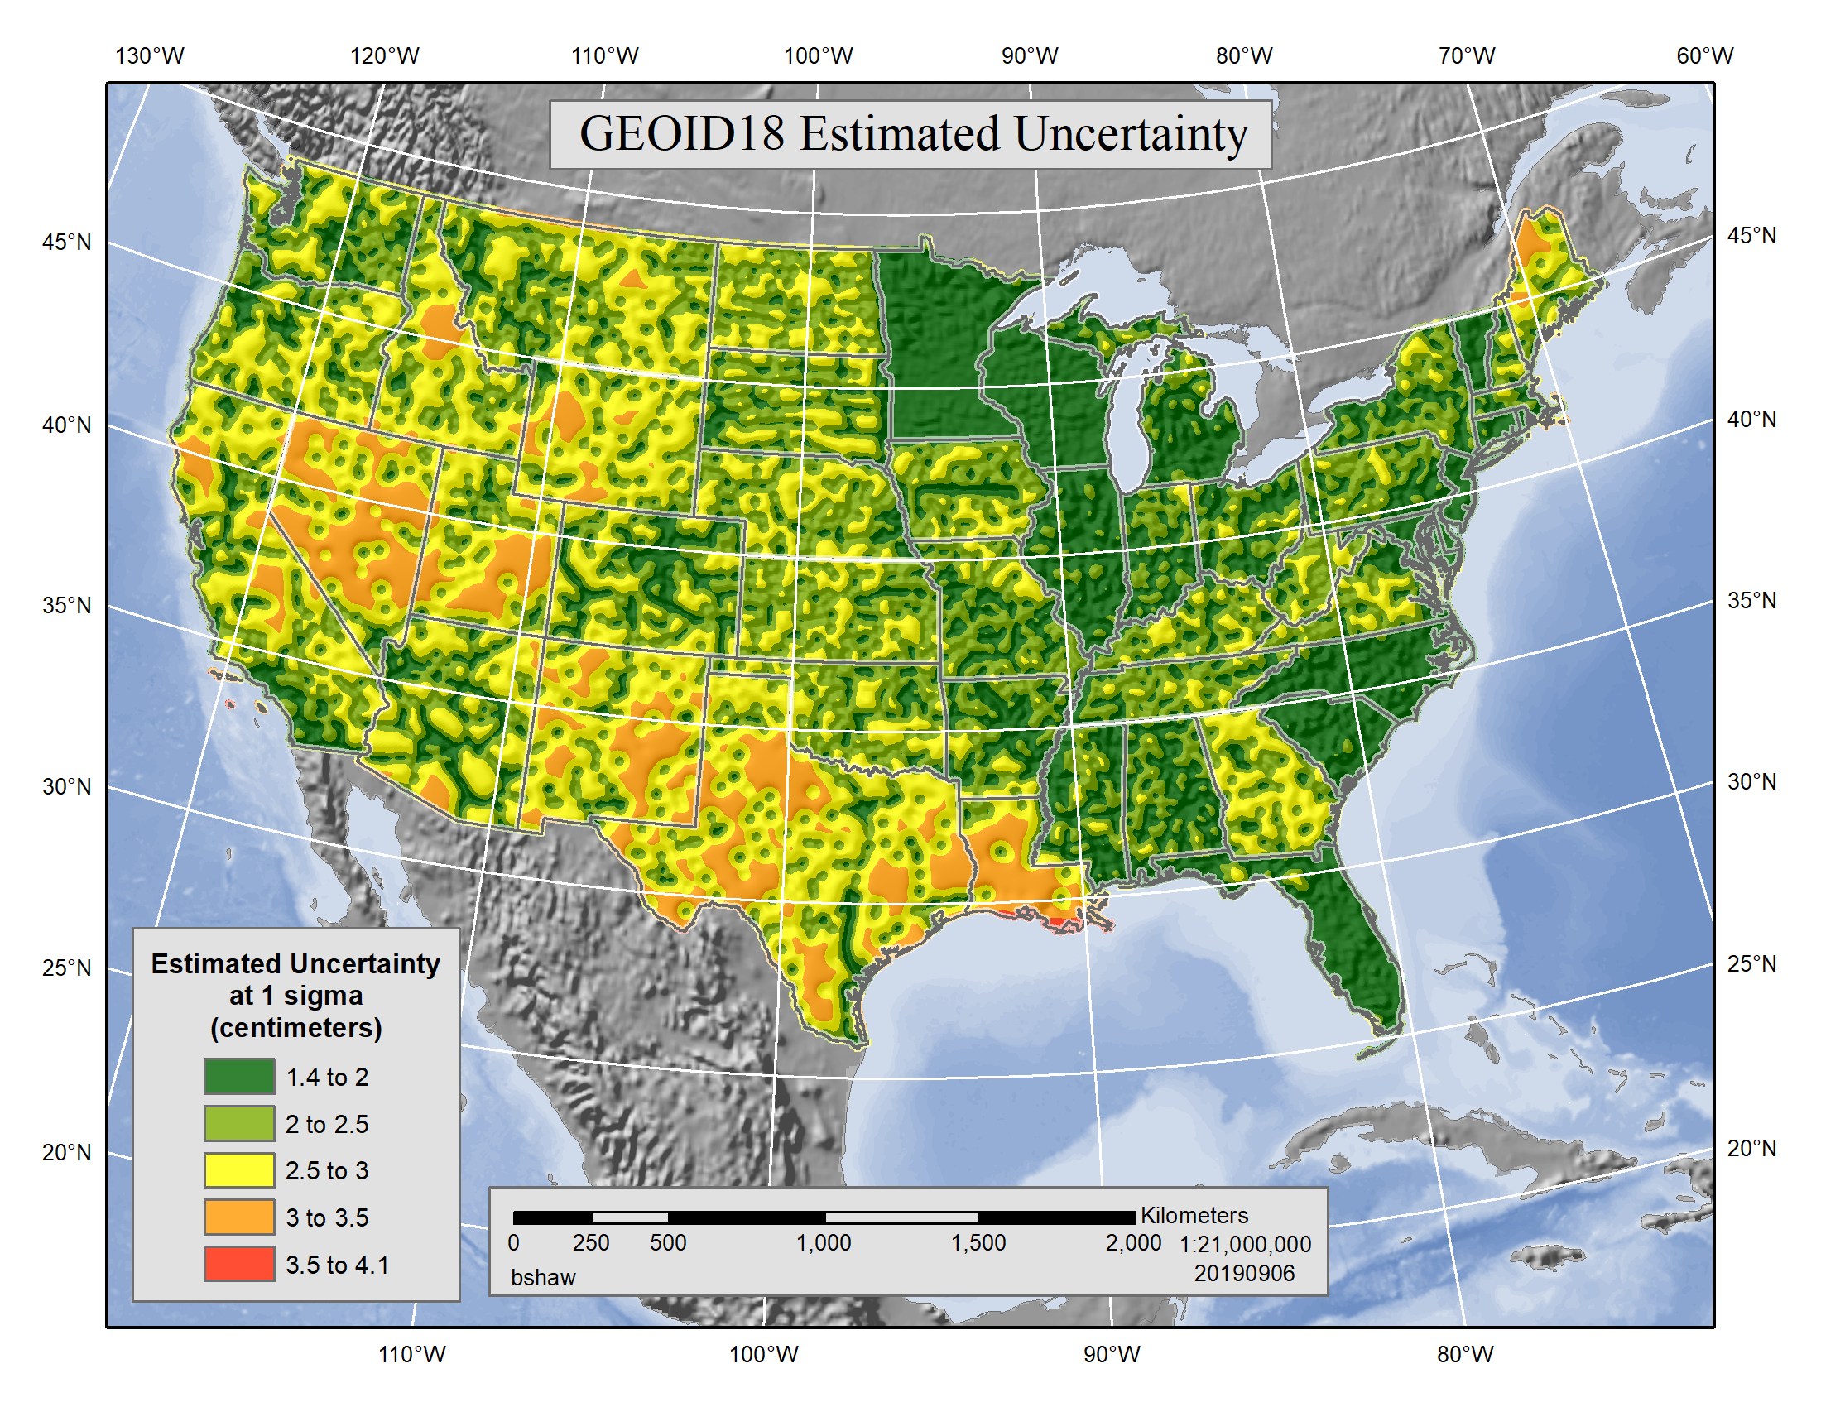
GPSonBM & Geoid 18 - last hybrid geoid for NAVD88
an increase of ~6,800 marks (26%) over GEOID12B
Estimated uncertainty – how well the model matches published NAVD88 orthometric heights
Notes:
The 2019 GPSonBM Campaign will be kicking off during Surveyor’s Week in March.
Local data improves the local accuracy of national scale products and tools.
2018 GPSonBM Priority marks were targeted to fill data gaps and reduce uncertainty in GEOID18 which will replace GEOID12B
New GSPonBM efforts in 2019 will focus on collecting data to improve the transformation tools to the new datums in 2022

Slide 24
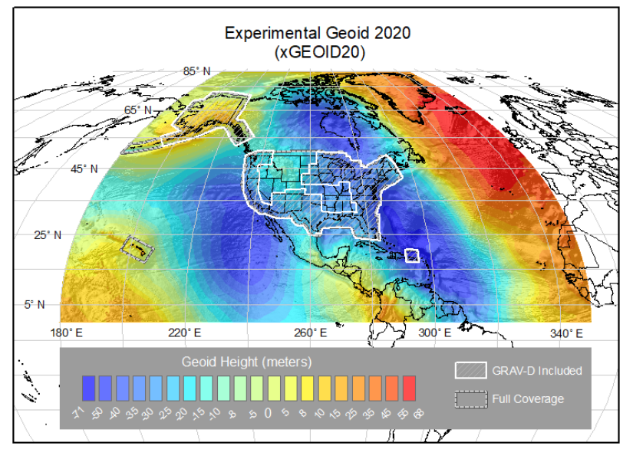
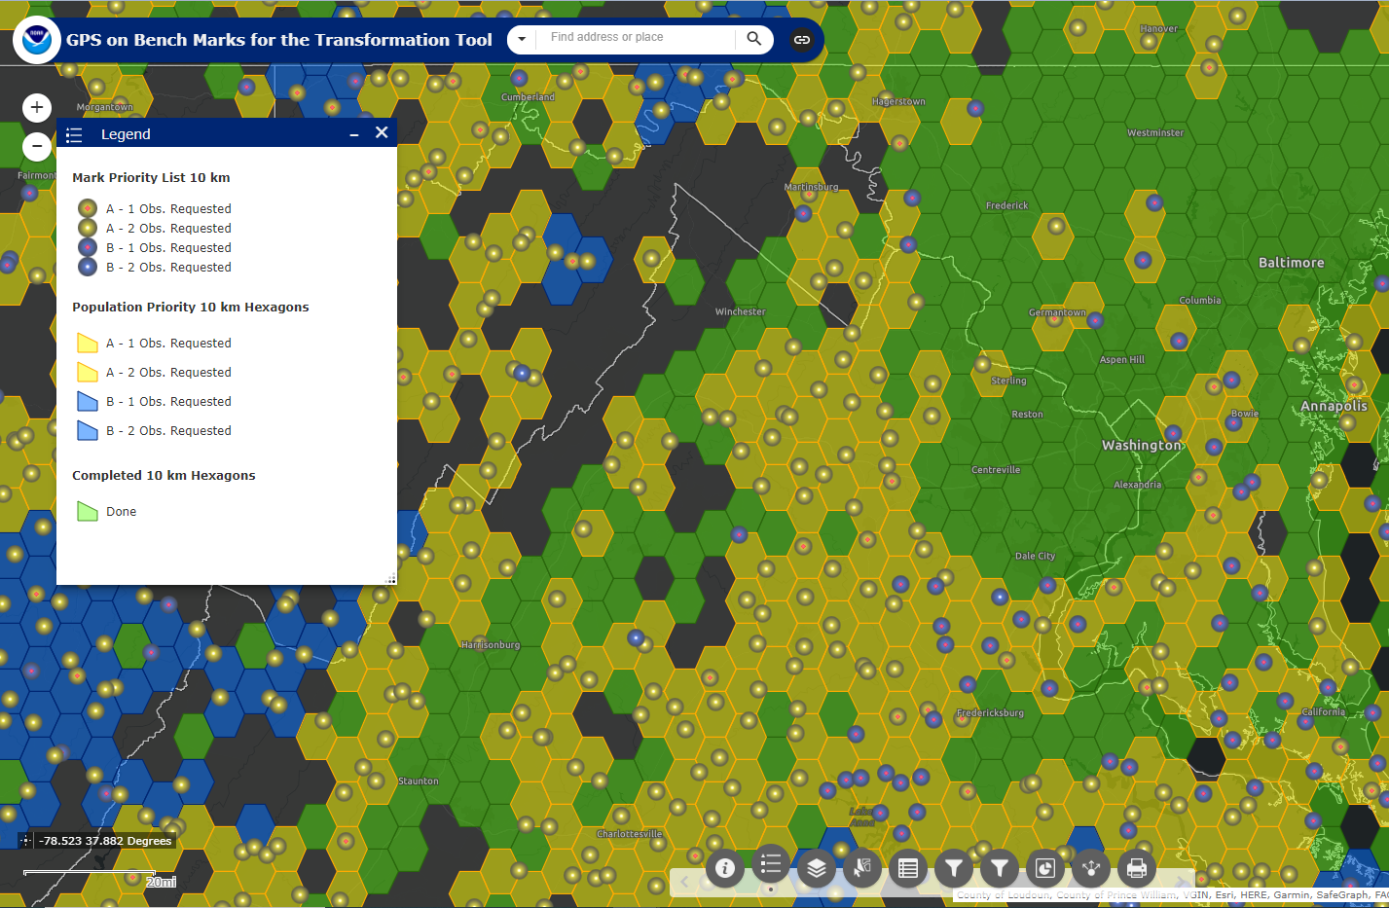
GPS on Bench Marks is currently crowdsourcing data to improve the local accuracy of the NAVD 88 - NAPGD2022 Transformation Tool
NGS will make a national scale, mapping grade transformation tool with the data we have in the NGS Database and Shared through OPUS. We have set a goal of 10 km spacing across the nation and by necessity must interpolate over areas with data gaps.
NAVD88
GPSonBM WebMap
NAPGD2022
NCAT & VDatum
Notes:
NAVD 88, the US current Orthometric height datum, consists of about 800,000 benchmarks and ~2.2M km of leveling. Data was collected over many decades by roving bands of surveyors who walked across the country multiple times over the years, east to west, north to south and back again. It is currently the official vertical datum of the US and is required for federal mapping projects. It would cost tens to hundreds of millions of US dollars to do again.
GPS data on those leveled marks were used to create GEOID18 – the model used to derive NAVD88 heights from GPS ellipsoid heights, as well as the transformation tools that will be released with NAPGD2022.

Slide 25
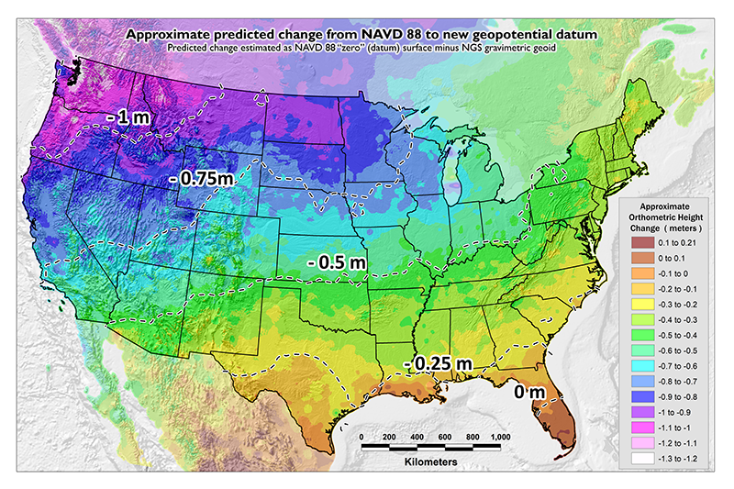
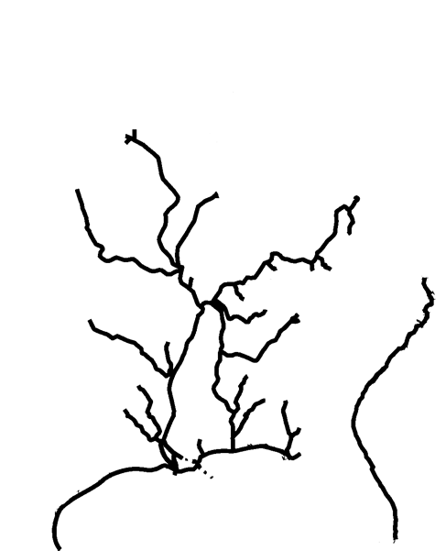
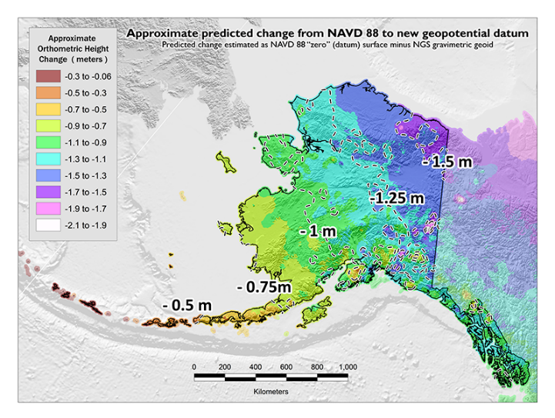
GPSonBM Measurements Connect
Current and Future Datums
The relationship between the old and new datums vary by location. GPSonBM data is used to measure that relationship. The accuracy of the transformations in any particular place will be directly related to the density of GPSonBM data available in that area.
  In moving from NAVD 88 to NAPGD2022, there will be a Shift: A one-time 0 to 2 meter jump in orthometric heights
  -From fixing biases and/or tilts in NAVD 88
PID: EZ0840
GPSonBM data is used to measure the Shift
Inland Waterways system

Slide 26
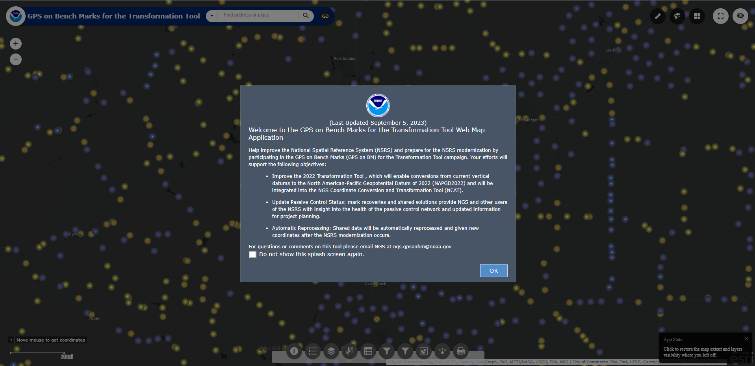
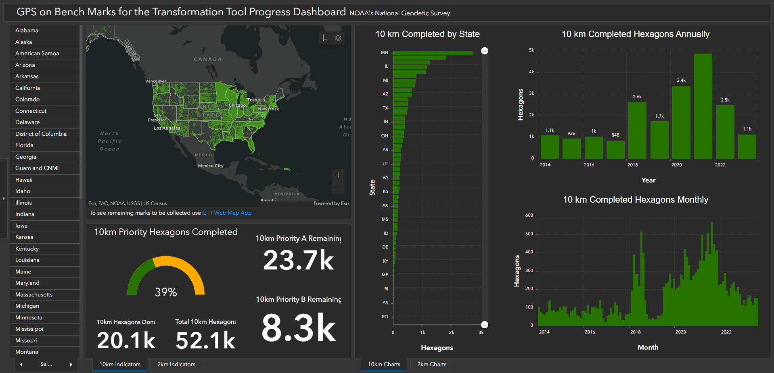
Contact the GPSonBM team:
ngs.gpsonbm@noaa.gov
Provide Feedback:
ngs.feedback@noaa.gov

Slide 27
How Can You Prepare
Stay up to date and check available resources
  Participate in NGS webinars, Geospatial summits, and online training
  Contact NGS Regional Advisor
Metadata is essential
  Improves reliability and accuracy of data
  Increases value and usefulness
Consider whether to transform old data and/or collect new data
  Know your accuracy requirements

Slide 28
How Can You Prepare
Require/provide complete metadata for all mapping contracts
    What datum(s)
    How data was collected and processed
Preserve all original observations
    particularly when referenced to ellipsoid (GNSS)

Slide 29
Use Complete Nomenclature
NAD83
NAVD88
MLLW
Notes:
METADATA - you must document the datum you are referencing, but the datum itself is not enough.
Particularly in time leading up to 2022!

Slide 30
Use Complete Nomenclature
NAD83(2011) epoch 2010.00
H. Datum
Realization/Adjustment
Reference Epoch
NAVD88 (GRS80, GEOID18)
V. Datum
Reference Ellipsoid
Geoid Model
MLLW(9452210; 1960-78 #2128)
Tidal Datum
NOAA Tide Station
National Tidal Datum Epoch & Published Sheet Number (if available)
Notes:
Note: exact content and format may vary; these general recommendations are specific to projects with a vertical emphasis.
Also keep a record of source/date of survey whenever possible, even before 2022.
Start now: Also keep a record of source/date of survey whenever possible, even before 2022.

Slide 31
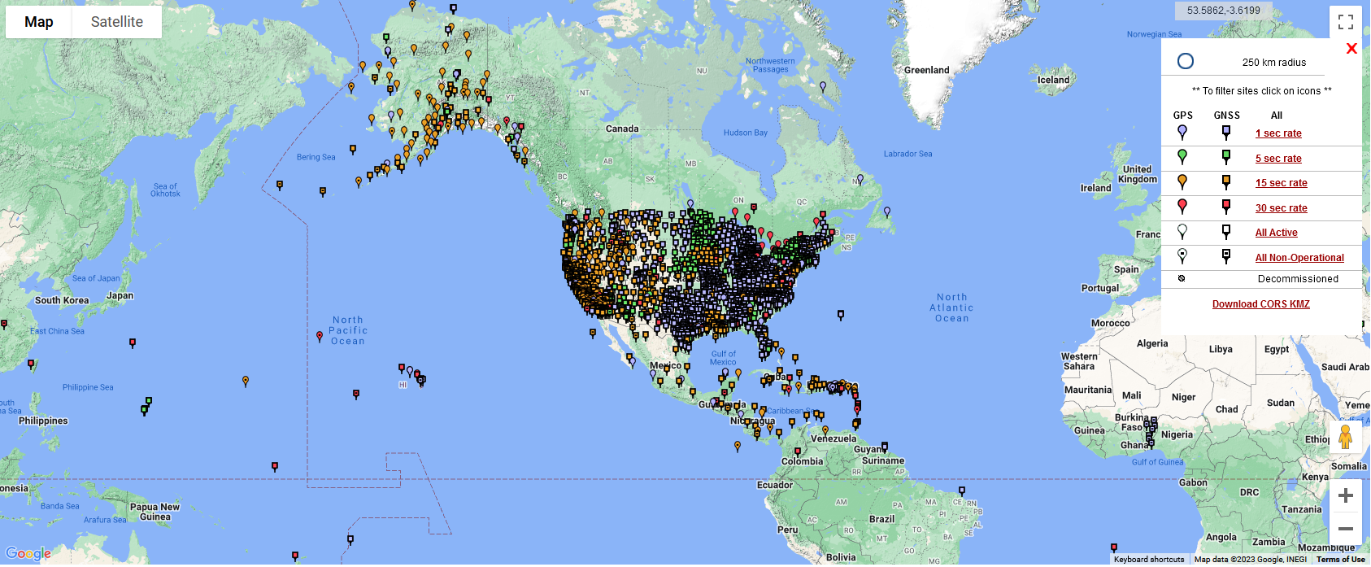
BT

Slide 32
Agenda
Basics
  Planned Changes
  Significance
  Motivations
  Activities
GPS on BM Campaign
Customer Tools
  OPUS
  NCAT
https://geodesy.noaa.gov/datums/newdatums/
Notes:
I’m not going into detail here on the roll out and plans
I’ll a little more detail on data collection and tool development
This I more of an executive summary to provide broad understanding and motivations
To help you see the merit when your technical people come to you and ask how they should proceed
There are other presentations and greater detail on our website

Slide 33
Tools: New and In Progress
OPUS - Single point solutions
OPUS Projects 5.1 - Geometric solutions for Campaign GNSS
  Calls OPUS but organizes and adjusts campaign data
  Upload real-time (RTK) and post-processed vectors via GVX format
  Export adjustments to various geospatial formats
  OPUS 6 will also adjust leveling data but is still IP
There will be a new leveling manual out next year
  Must Include 3+ GNSS occupations on points 30 km or more apart
Updating the Leveling Online Computations User Service LOCUS to support leveling adjustments until OPUS 6

Slide 34
New types of Coordinates
Reference Epoch Coordinates
Survey Epoch Coordinates
An estimated “snapshot” of entire network
Every 5 or 10 years
Similar to NAD 83(2011) epoch 2010.00
Time-dependent!
Reflects coordinates at the time of observation
Multiple Survey Epoch Coordinates (SECs) can show changes over time

Slide 35
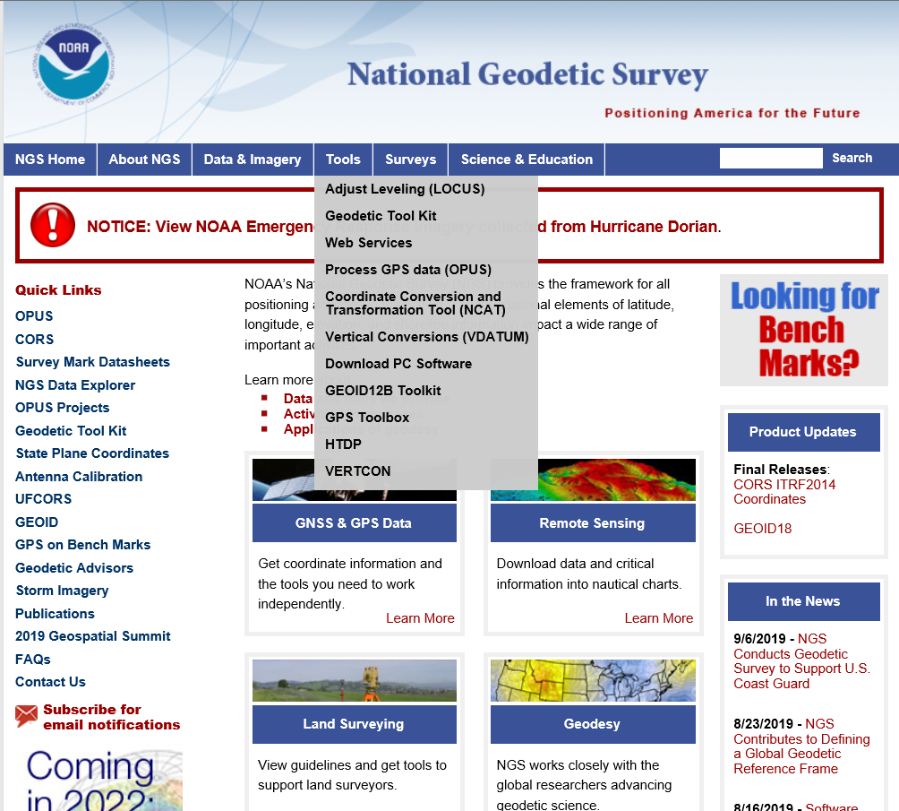
NGS Products Update - NCAT

Slide 36
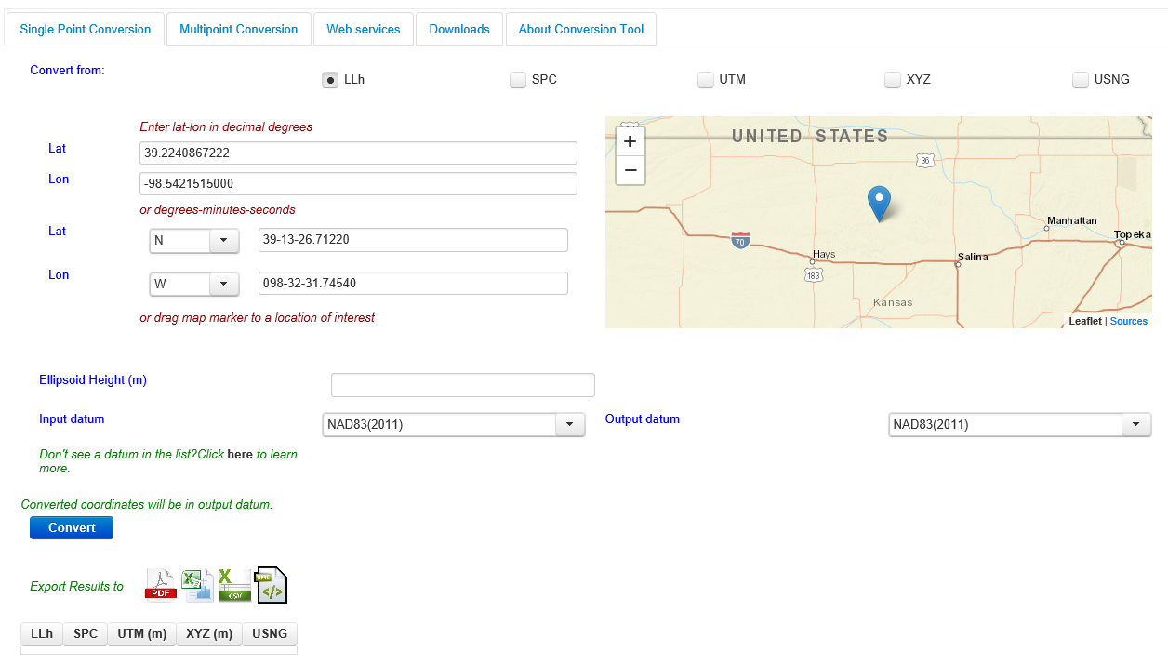
NGS Products Update - NCAT

Slide 37
X, Y, Z
φ, λ, h
Region: CONUS
SPC
UTM
φ, λ, h
USSD
2022
X, Y, Z
USNG
UTM
φ, λ, h
GEOCON 11
φ, λ, h
NAD 27
NAD 83 (2011)
X, Y, Z
SPC
X, Y, Z
SPC
USNG
UTM
NADCON
GEOCON
USNG
UTM
NAD 83 (NSRS2007)
φ, λ, h
NAD 83 (1986)
φ, λ, h
NAD 83 (FBN)
NAD 83 (HARN)
φ, λ, h
X, Y, Z
SPC
X, Y, Z
SPC
φ, λ, h
USNG
UTM
USNG
UTM
X, Y, Z
SPC
X, Y, Z
SPC
USNG
UTM
USNG
UTM

Slide 38
X, Y, Z
Region: CONUS
φ, λ, h
2022
SPC
UTM
φ, λ, h
USSD
X, Y, Z
USNG
UTM
φ, λ, h
φ, λ, h
NAD 27
NAD 83 (2011)
X, Y, Z
SPC
X, Y, Z
SPC
NCAT
USNG
UTM
USNG
UTM
NAD 83 (NSRS2007)
φ, λ, h
NAD 83 (1986)
φ, λ, h
NAD 83 (FBN)
NAD 83 (HARN)
φ, λ, h
X, Y, Z
SPC
X, Y, Z
SPC
φ, λ, h
USNG
UTM
USNG
UTM
X, Y, Z
SPC
X, Y, Z
SPC
USNG
UTM
USNG
UTM

Slide 39
Tools available in 2025 (rollout)

Slide 40
A new least-squares adjustment suite: LASER
Least-squares Adjustments: Statistics, Estimates and Residuals
Replaces all existing NGS LSA software
  ADJUST, ASTA, CALIBRAT, others
Supports 3D networks (GNSS+total station), leveling, CBLs, gravity networks
C++, no Helmert blocking needed, numerous support tools
Will be the main engine in OPUS for the modernized NSRS

Slide 41
A common geodetic data format: GDX
In 2021, NGS released GVX
  GNSS Vector Exchange format
  After lengthy discussions with industry
    Today, OPUS and many industry receivers make use of GVX
In 2022, NGS announced it will replace GVX with GDX
  Geodetic Data Exchange format
  Expands upon and corrects some issues with GVX
  Supports data from:
    GNSS receivers, total stations, levels and relative gravimeters
  Will replace GVX in late 2023

Slide 42
A common grid format
USA and Canada are nearing an agreement on a common grid format
  When finalized:
    Future gridded products from either country’s geodetic agencies will be in the chosen format
    Work will begin translating existing gridded products to the chosen format
  Current leading candidate: GGXF
    This is pre-decisional
GeoTIFF?
GeoPDF?
ASCII?
GGXF?

Slide 43
Dynamic Heights from GPS
Current NSRS relations:
Modernized NSRS relations:
Geopotential
Numbers
Geopotential
Numbers
Gravity model
Dynamic Heights
Orthometric Heights
Dynamic Heights
Orthometric Heights
Geoid model
Geoid model
Ellipsoid Heights
Ellipsoid Heights

Slide 44
Reference Epoch Coordinates
Geometric
  Epoch: 2020.00
  ITRF2020
    Then to N/P/C/MATRF2022
  All GNSS and classical observations
  Constrained to GRPs at CORSs
  ~115,000 pts will get XYZ coords
    Then to lat/lon/eht
      Then to orthometric and dynamic heights
Orthometric
  Epoch: 2020.00
  NAPGD2022
  All leveling observations
  Constrained to Geometric RECs + GEOID2022 (orthometric constraints)
  ~960,000 pts will get H coords
    Then to eht and dynamic heights

Slide 45
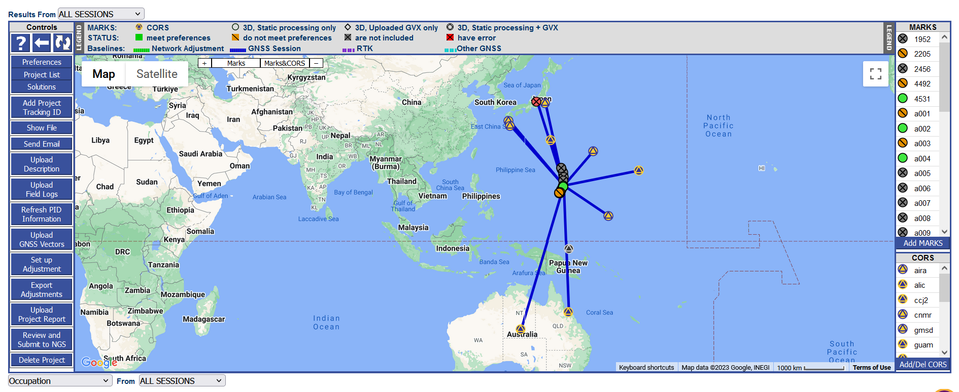
OPUS
OPUS-S and OPUS-Projects are being transitioned
  From current NSRS to modernized NSRS
Both current and modernized:
  GNSS only (for now)*
  ITRF2020
  M-PAGES (multi constellation)
  Simultaneous GNSS vector processing
Modernized:
  GDX, not bluebooking
  LASER, not ADJUST
  Choose your epoch
  N/P/M/CATRF2022
  IFDM2022, not HTDP
  OPUS recommendations
  OPUS coordinates
* OPUS 6 will come after 2025

Slide 46
Survey data
OPUS
Did you follow OPUS recommendations?
yes
no
OPUS Coordinates that are
“tied to the NSRS”
OPUS Coordinates that are
“not tied to the NSRS”
yes
Did you submit your data to NGS?
no
Do you want to “share” your results with the world?
yes
no
NGS will use your survey data in future REC and SEC adjustments
NGS will not use your survey data in future REC and SEC adjustments
Unique, public URL for this survey which you can share with anyone
Your results are shown to you on screen or via email only

Slide 47
NADCON
Current version: 5.0.1
  Expansion will bridge current NSRS to modernized NSRS
Region | Current | Modernized
CONUS | NAD 83(2011) epoch 2010.00 | NATRF2022 epoch 2020.00
Alaska | NAD 83(2011) epoch 2010.00 | NATRF2022 epoch 2020.00
Hawaii | NAD 83(PA11) epoch 2010.00 | PATRF2022 epoch 2020.00
PR / USVI | NAD 83(2011) epoch 2010.00 | CATRF2022 epoch 2020.00
American Samoa | NAD 83(PA11) epoch 2010.00 | PATRF2022 epoch 2020.00
Guam / CNMI | NAD 83(MA11) epoch 2010.00 | MATRF2022 epoch 2020.00

Slide 48
VERTCON
Current version: 3.0.0
  Expansion will bridge current NSRS to modernized NSRS
Region | Current | Modernized
CONUS | NAVD 88 | NAPGD2022 epoch 2020.00
Alaska | NAVD 88 | NAPGD2022 epoch 2020.00
Hawaii | Has no defined vertical datums. VERTCON will not work here.
PR | PRVD02 | NAPGD2022 epoch 2020.00
USVI | VIVD09 | NAPGD2022 epoch 2020.00
American Samoa | ASVD02 | NAPGD2022 epoch 2020.00
Guam | GUVD04 | NAPGD2022 epoch 2020.00
CNMI | NMVD03 | NAPGD2022 epoch 2020.00

Slide 49
Data Delivery System
Everything NGS uses will be stored in the NSRS Database
Requests made of that database will go through the Data Delivery System (DDS)
  “Datasheets” are being designed for MARKS and STATIONS
    Similar to, but much better than existing datasheets
  Support for querying about other things (papers, models, surveys, adjustments, etc.) will be added over time

Slide 50
What will have to wait…
Promises we intend to keep, but not until after the initial release of the modernized NSRS include:
  Integrating leveling, classical data and gravity into OPUS
  Full integration of all old tools into NCAT and Vdatum
  SECs for pre-1994 (AKA “pre-NCN”) years, plus SECs for post-2020

Slide 51
Summary
Align NSRS to ITRS (ITRF2020)
International agreements
  UN GGRF
  SIRGAS/Americas
  Pacific
Meets U.S. Law (GDA)
  F.A.I.R.
  Geoplatform and Data.gov
Modernized NSRS
  Four new TRFs
  One new Geopotential datum
Blueprints describe
GPS on BM for better transforms
Keep GNSS obs/metadata
New tool to transform - NCAT
  14-parameter/grids for realizations
  OP 5.1 for Capaign GNSS
  LOCUS for leveling
Future OP tool will adjust leveling

Slide 52
Get Prepared
Evaluate your business models, practices and geospatial data
  Transform Data - NCAT
  Record metadata - time/date/CRS
  Perform GPS on BM operations
    Will improve conversion grids
  Review SPCS 2022
  Prepare to update legislation
    Some states have codified NAD 83
    Need to make non-unique
    Use NSRS - not specific realization
Keep your GNSS Observations
  Can re-run in later realizations

Slide 53
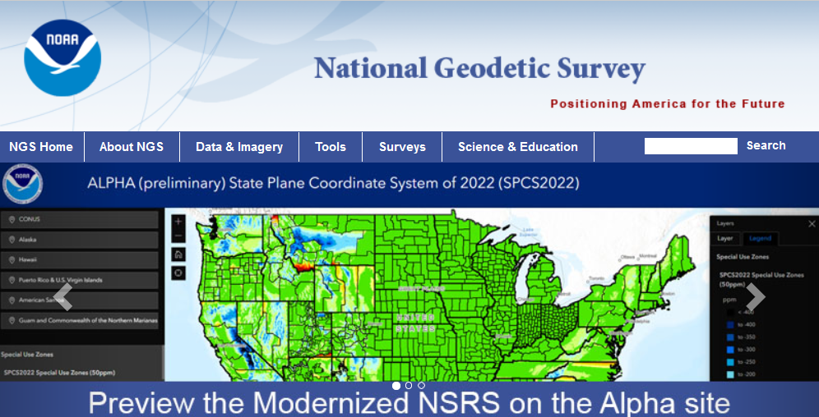
Points of Contact
Juliana Blackwell, Director, NGS, Juliana.Blackwell@noaa.gov
Brad Kearse, Deputy Director, NGS, Brad.Kearse@noaa.gov
Daniel Roman, Senior Advisor for Geodesy, NGS, Dan.Roman@noaa.gov
Dru Smith, NSRS Modernization Manager, NGS, Dru.Smith@noaa.gov
Galen Scott, Constituent Resource Manager, NGS, Galen.Scott@noaa.gov
Regional Geodetic Advisers
NGS Webpage, Presentation Library
Publication Library, Webinars
Educational Videos

Slide 54
DISCUSSION
Moderator
Mr. Galen Scott
Aviation
CORS
Satellite
Operations
Surveying
and Mapping
Disaster Response
Precision Agriculture
Personal
Navigation
Navigation
Oil Exploration
Fishing and Boating
Trucking and Shipping
Survey Marks

Slide 55
Extra Slides

Slide 56
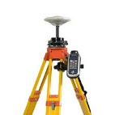
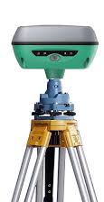

Science behind the tools: replacing HTDP
Currently:
HTDP:
Changes to lat/lon only
Projected GNSS obs at t₀
GNSS obs at t₁
HTDP:
Changes to lat/lon only
Least-squares
adjustment
Projected GNSS obs at t₀
GNSS obs at t₂
…
HTDP:
Changes to lat/lon only
GNSS obs at t_{n}
Projected GNSS obs at t₀

Slide 57
Science behind the tools: replacing HTDP
“The multi-epoch least-squares adjustment problem” (ME-LSA)
  NOAA TR NOS NGS 79
IFDM2022:
Changes to lat/lon/eht
Error propagation through time
Projected GNSS obs
and errors at t₀
GNSS obs at t₁
IFDM2022:
Changes to lat/lon/eht
Error propagation through time
Least-squares
adjustment
Projected GNSS obs
and errors at t₀
GNSS obs at t₂
…
IFDM2022:
Changes to lat/lon/eht
Error propagation through time
Projected GNSS obs
and errors at t₀
GNSS obs at t_{n}

Slide 58
Tools available after 2025

Slide 59





Static GNSS
RTK/RTN
Classical
Leveling
Rel. Gravity
RINEX
GDX
GDX
GDX
GDX
RINEX
GDX
GDX
GDX
GDX
RINEX
GDX
GDX
GDX
GDX
RINEX
GDX
GDX
GDX
GDX
Upload multiple types of data and multiple files into a single survey project
Process RINEX into a position (like today’s OPUS-S)
Process RINEX into mark-to-mark vectors
Process Classical into mark-to-mark angles/distances
Process Leveling into mark-to-mark ortho. differences
Process Rel. Gravity into mark gravity
Combine GNSS, RTK/N, Classical in a Geometric Adjustment
Combine Classical and Leveling in an Orthometric Adj.
Adjust Relative Gravity for either gravity or vertical gradients in a Gravimetric Adjustment
Special settings for Calibration Base Lines
Choose your epoch and frame
All coordinates returned are OPUS Coordinates
Submit your data to NGS for QA/QC, database loading, and improvement of future passive mark coordinates (RECs and SECs)
OPUS 6
Notes:
OPUS 6 will allow you to upload multiple types of data, and multiple files for each type, to a single survey project. You can then process/reduce the data, and adjust it.
The colors imply how finished each format is. RINEX is well established, GVX was released in 2021 but requires an update, likely in 2022 in a joint roll-out with CVX and LVX. RGX has not been substantially fleshed out yet.

