Slide 1
OPUS-Database: Supplemental Data for Better Datum Conversion Models
D.R. Roman and N.D. Weston
F.I.G. Working Week
Session TS04A: National Geodesy I
Marrakech, Morocco 18-22 May 2011

Slide 2
OUTLINE
Intro to hybrid geoid modeling
NGSIDB versus OPUS-DB
Comparison to Common Points
Implications of New Control Points
Examining Some of the Suspect data
Conclusions

Slide 3
Relationship Between Heights
“h = H + N”
Earth’s
Surface
P
Ellipsoid
Plumb Line
h
Q
Mean
N
Sea
“Geoid”
Level
PO
Ocean
h (Ellipsoid Height) = Distance along ellipsoid normal (Q to P)
N (Geoid Height) = Distance along ellipsoid normal (Q to PO)
H (Orthometric Height) = Distance along plumb line (PO to P)

Slide 4
Hybrid Geoid Height Models (e.g., GEOID09) are determined from Gravimetric Geoid Height Models (e.g., USGG2009) and Conversion Surfaces based on GPS on BM data
Residual = h – H - N
Earth’s Surface
h
h
h
h
h
H
H
Ellipsoid
H
H
H
N
N
N
Hybrid Geoid
N
N
-0.737 M in
Salt Lake –
2009 model
Gravimetric Geoid
Gravimetric Geoid systematic misfit to BM’s but best fits “true” heights
Hybrid Geoid “converted” to fit local BM’s, so best fits NAVD 88 heights
Conversion Surface model of systematic misfit derived from BM’s in IDB
Notes:
Salt Lake City North ZLC A AA3680 40 47 06.80308 (N) 111 57 09.07339 (W)
GEOID09: -16.943 + -0.717 - -16.923 = -0.737
GEOID03: -16.958 + -0.717 - -17.266 = -0.409

Slide 5
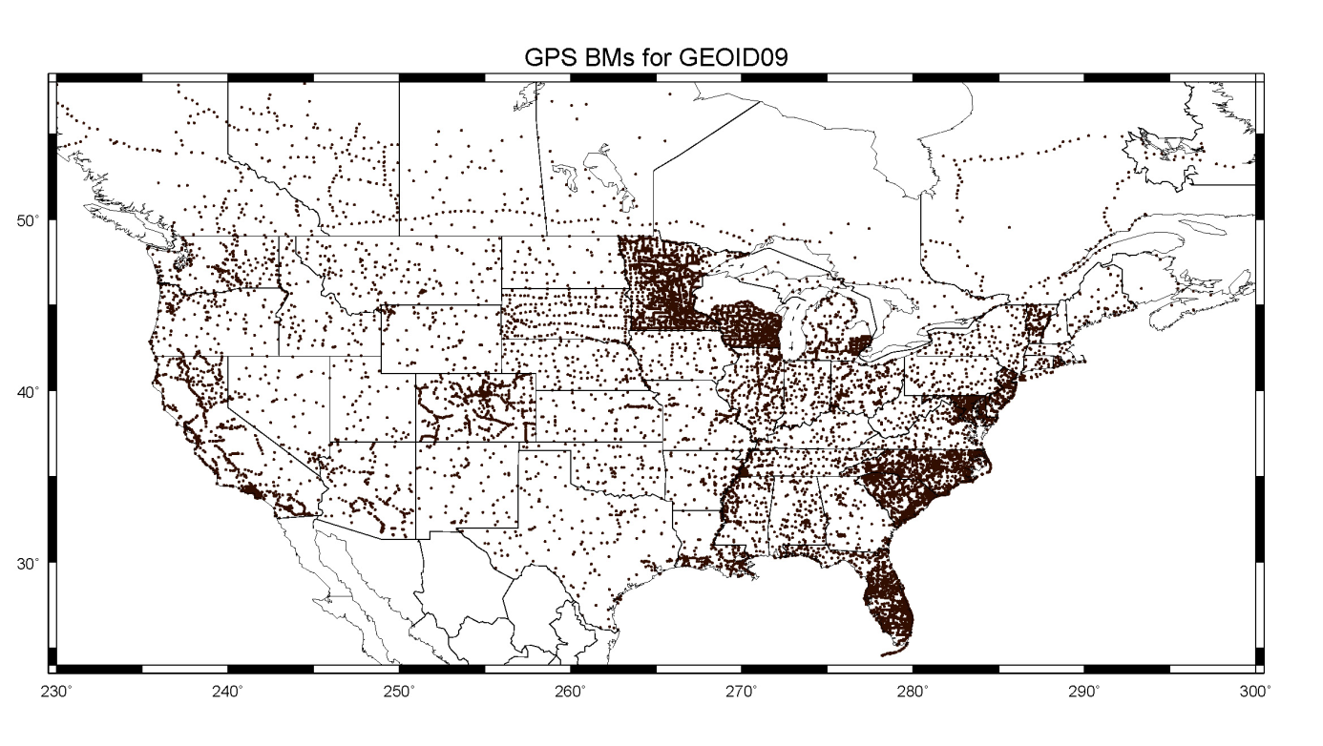
Distribution of GPSBM2009
18,398 points in CONUS plus 579 in Canada
Notes:
500,000 leveled bench marks on NAVD 88
Only 10% have been occupied with GPS
Less than half of those are useful for geoid
These are poorly distributed with half the control points available in just 4 states out of the 48

Slide 6
NGSIDB Versus OPUS-DB
NGSIDB
Passive control adjustment of stored data
Episodically refined (NA2011 starting very soon)
Traditional surveying
A lot of (important!) numbers and text
OPUS-DB
Actively determined from CORS
Constantly refined using current CORS
Dynamic Surveying
A lot of numbers/text as well as some useful images

Slide 7
Developing a Better Distribution
Selectively occupy bench marks with no previous GPS
Targeted campaign in coordination with states
Fill voids to reduce the interpolated signal
Modeling for hybrid geoid using multi-matrix least squares collocation
Spacing of the control data directly impacts the interpolated signal

Slide 8
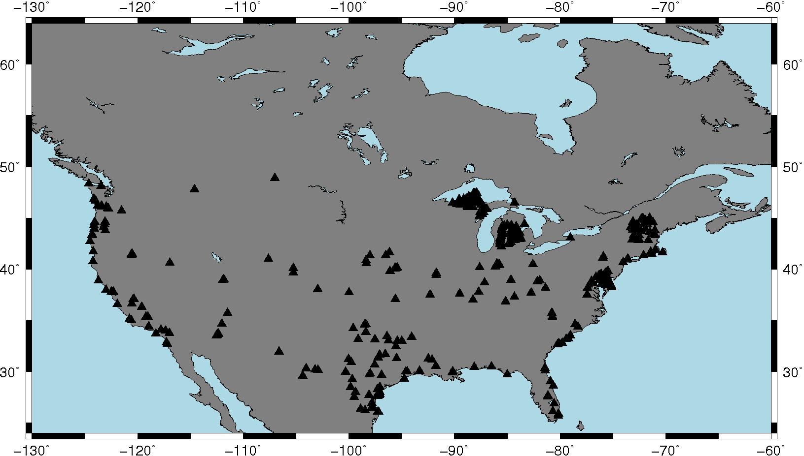
Leveled Bench Marks Occupied by GPS and stored in OPUS-DB
Notes:
80 are in common with NGSIDB and were used in making GEOID09
57 are in common with NGSIDB and were *NOT* used in making GEOID09
285 are new points never before occupied with GPS
Distribution is fair, but you can see that some states are more active than others

Slide 9
 |  | A |  | B |  | C
Groups of the 422 points pulled from OPUS-DB | No. Pts | NGSIDB Res. |  | OPUS-DB Res. |  | OPUS-DB–NGSIDB
 |  | Ave | SD | Ave. | SD | Ave | SD
(1.a) All Common Points that were used in GEOID09 | 80 | -0.009 | 0.065 | 0.004 | 0.036 | 0.013 | 0.060
(1.b) Common Points less the 9 rejects | 71 | -0.004 | 0.015 | 0.003 | 0.031 | 0.006 | 0.028
(2) Common Points but not used to make GEOID09 | 57 | 0.001 | 0.043 | 0.007 | 0.037 | 0.006 | 0.044
(3.a) Points Not Previously Observed with GPS | 285 | n/a | n/a | -0.011 | 0.112 | n/a | n/a
(3.b) Points Not Previously Observed less the 11 rejects | 274 | n/a | n/a | -0.008 | 0.047 | n/a | n/a
Notes:
Review conclusions in paper here.
For 1.b, recall that these NGSIDB points were used in making GEOID09 – so no surprise that NGSIDB does better than OPUS-DB
For 2, real test of how NGSIDB and OPUS-DB compare – OPUS-DB does marginally better
For 3.b, OPUS-DB doesn’t perform at same level as before in 2 but is on par with direct comparison of the two (column C)

Slide 10
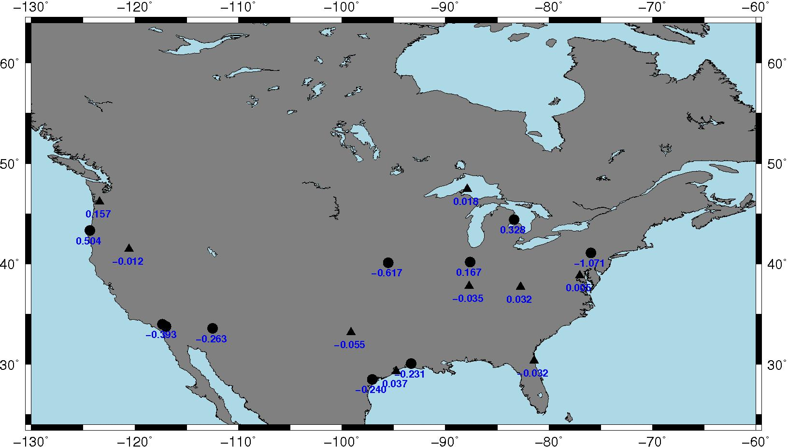
Rejected Points
Notes:
Based on magnitude of residual signal
9 are common between NGSIDB and OPUS-DB
11 are unique to OPUS-DB

Slide 11
Rejected Points Common to NGSIDB
PID | Reject Code | NAVD88 ortho. ht. | GEOID09 height | NGSIDB ellips. ht. | NGSIDB Residual | OPUSDB Ellips. ht. | OPUSDB Residual
AW5707 | S | 0.709 | -26.638 | -25.916 | 0.013 | -25.892 | 0.037
HA0997 | h | 118.247 | -30.526 | 87.726 | 0.005 | 87.686 | -0.035
DO0454 | H | 383.465 | -28.982 | 353.943 | -0.540 | 354.428 | -0.055
GY1636 | h | 218.677 | -32.382 | 186.330 | 0.035 | 186.327 | 0.032
HV9071 | h | 3.505 | -32.143 | -28.656 | -0.018 | -28.633 | 0.005
MW0121 | h | 1337.183 | -22.185 | 1314.984 | -0.014 | 1314.986 | -0.012
SC0330 | H | 17.233 | -21.296 | -3.923 | 0.140 | -3.906 | 0.157
SG0004 | h | 189.404 | -35.290 | 154.085 | -0.029 | 154.132 | 0.018
BC2486 | H | 1.247 | -28.527 | -27.343 | -0.063 | -27.312 | -0.032

Slide 12
Rejected New Points
PID | Reject Code | NAVD88 ortho. ht. | GEOID09 height | NGSIDB ellips. ht. | NGSIDB Residual | OPUSDB Ellips. ht. | OPUSDB Residual
AN1829 | not in IDB | 21.222 | -27.417 | n/a | n/a | -6.438 | -0.243
BK1521 | not in IDB | 1.319 | -27.163 | n/a | n/a | -26.075 | -0.231
DV0102 | not in IDB | 404.859 | -30.096 | n/a | n/a | 374.500 | -0.263
DX5394 | not in IDB | 467.098 | -32.369 | n/a | n/a | 434.548 | -0.181
EV3460 | not in IDB | 284.083 | -32.962 | n/a | n/a | 250.728 | -0.393
OA0650 | not in IDB | 4.600 | -26.362 | n/a | n/a | -21.258 | 0.504
PK0048 | not in IDB | 184.093 | -35.268 | n/a | n/a | 149.153 | 0.328
LB1860 | not in IDB | 201.307 | -32.618 | n/a | n/a | 168.856 | 0.167
LF0630 | not in IDB | 336.765 | -30.541 | n/a | n/a | 305.607 | -0.617
LY1475* | not in IDB | 372.450 | -32.186 | n/a | n/a | 339.193 | -1.071
TT0450 | not in IDB | 11.425 | 8.766 | n/a | n/a | 21.028 | 0.837
LY1475* has actually been pulled from OPUS-DB by the submitter

Slide 13
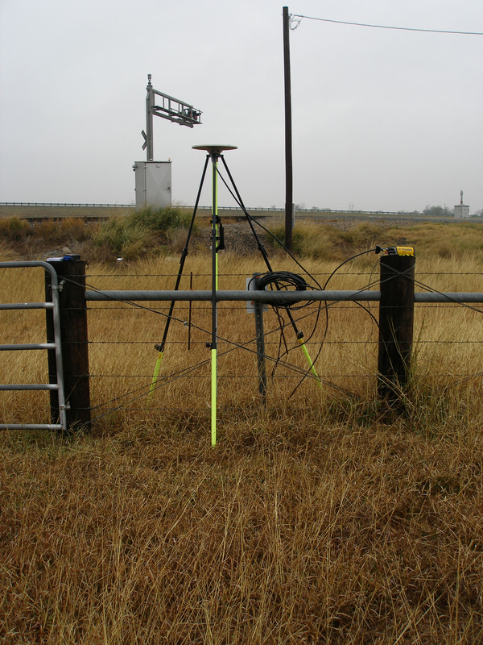
Possible Error Sources
Human-Induced Subsidence
Groundwater Pumping
Oil Extraction
Mining Operations
Earth Dynamics
Listric Faulting/Slumping
Coastal Erosion/Uplift

Slide 14
CONCLUSIONS
Only a fraction of the leveling has been GPS’d
Existing coverage in NGSIDB is very irregular
OPUS-DB offers better results
OPUS targeted to regions of poor coverage
NGSIDB values to be integrated into OPUS-DB
Problems remain in crustal movement regions
Non-simultaneity of GPS & leveling
changes over time pass erroneously into geoid

Slide 15
Questions?
Daniel R. Roman, Ph.D.
Research Geodesist/GRAV-D P.I.
Geosciences Research Division
dan.roman@noaa.gov
+1-301-713-3202 x161

