Slide 1

Update to IGLD 2020 Geodetic Analysis at Great Lakes NWLON stations
Daniel R. Roman
Chief Geodesist
North American Geodesy: Updates to Geopotential Datums and Reference Frames

Slide 2
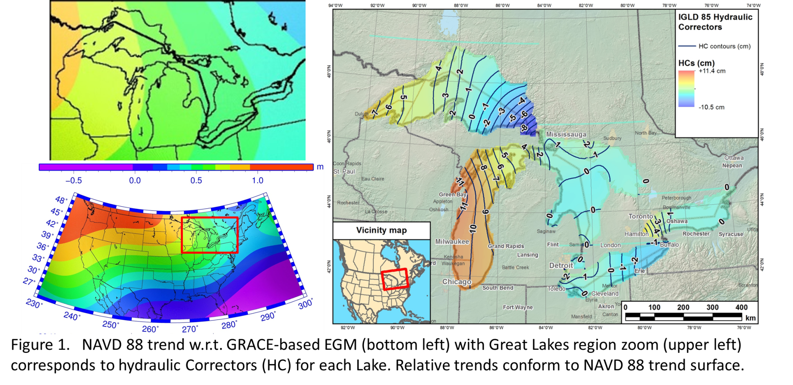
HC vs. NAVD 88 Datum Defect

Slide 3
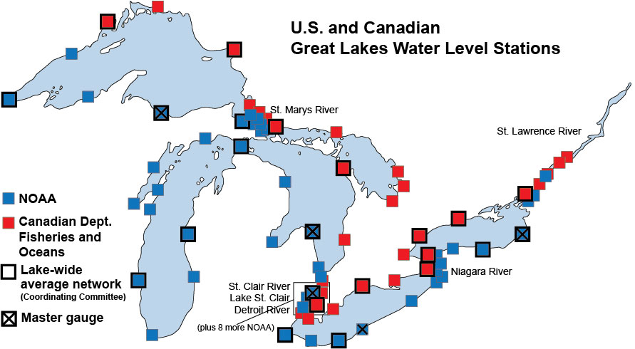
GL WLS Stations
Notes:
Of 53 WLS, 14 are CORS. At all sites, BM are adjacent to WLS. CO-OPS levels between BM’s and WLS table. NGS GPS’ BM. Results in transfer of geometric coordinates to table and then to water surface.
Will be exchanging CO-OPS leveling on US side with Canada for their WLS. Canada has completed their GPS analysis on BM (US still processing). Will look at various averages (Summer, yearly). Look forward to models removing metorological impacts as well as any standing topography.

Slide 4
Method
Geometric coordinates of water surface
Inverted rod
CORS Antenna
WLS Housing
ETG
Receiver
ETG Table
(datum)
Great
Lake
leveling
BM
IGLD 85 Datum surface

Slide 5
2015 GPS Campaign Comparisons
Solutions from same geometric data:
  Canadian Bernese (Mike Craymer)
  US PAGE-NT/ADJUST (Dan Callahan)
  US Modified OPUS Projects (Dan Gillins)
Majority within 0.3 cm hor. & 1.0 cm vert.
Nearly all were 1.0 cm hor. & 2.5 cm vert.
Five outliers exceeded this (GLER, ESSE, FTWB, RETA, FTWA)
Uncertainties of 1-3 cm for dynamic heights

Slide 6
Conceptual Plan
Each Lake surface conforms to a specific geopotential value (W_{i}) and dynamic height
C₃
C₂
DH3 = W₀ – W₃
gamma₄₅
C₁
DH2 = W₀ – W₂
gamma₄₅
DH1 = W₀ – W₁
gamma₄₅
C₀ (geoid)
ellipsoid
Notes: (1) Neglects any standing water topography (wind set)
(2) Assumes sufficient resolution of geopotential number

Slide 7
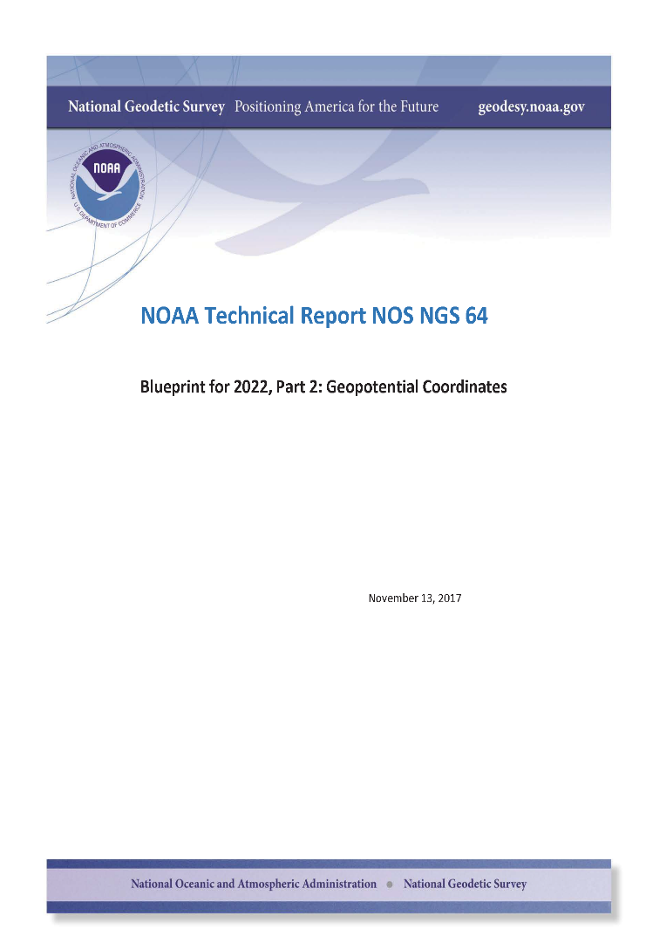
Blueprint Part 2
North American-Pacific Geopotential Datum of 2022 (NAPGD2022)
Four primary products:
  A global model (5’)- GM2022
  Regional geoids (1’) - GEOID2022
  Regional DoV’s (1’) - DEFLEC2022
  Surface gravity (1’) - GRAV2022
Three regions:
  North America
  American Samoa
  Guam/CNMI

Slide 8
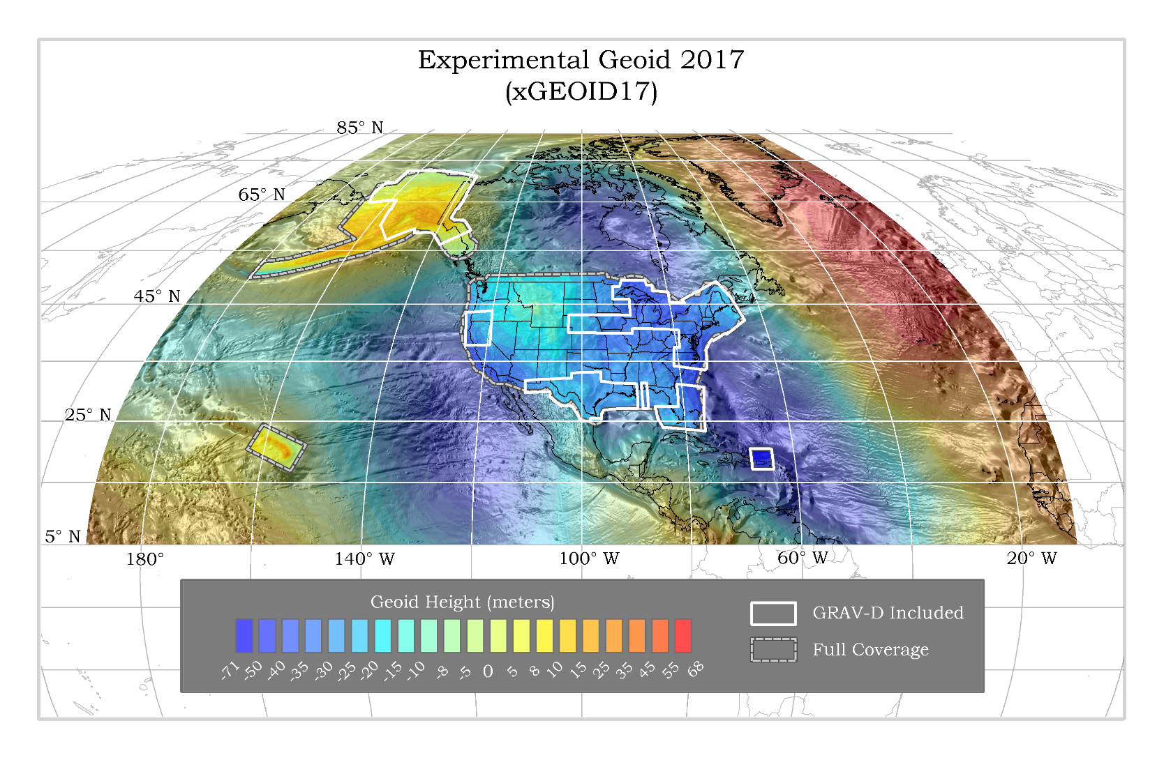

Slide 9
Practical Aspects
Need 1’ resolution⁽¹⁾ (d/o 10,800) SHM
Only have 5’ resolution ⁽²⁾ (d/o 2160) SHM plus 1’ geoid grid
W_{(5’)} g_{(5’)}
C₃
C₂
C₁
N _{(5’)}
N _{(1’)}
C₀ (geoid)
ellipsoid
Notes: (1) Previous analysis shows that omission from > 1’ resolution exceeds cm-level
(2) xGEOID17B available at https://beta.ngs.noaa.gov/GEOID/xGEOID17/
(3) W₀ by is defined as 62,636,856.00 m²/s²

Slide 10
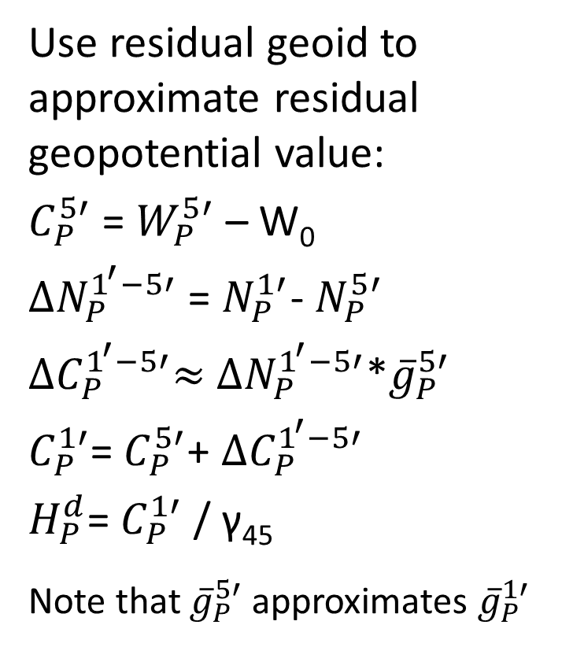
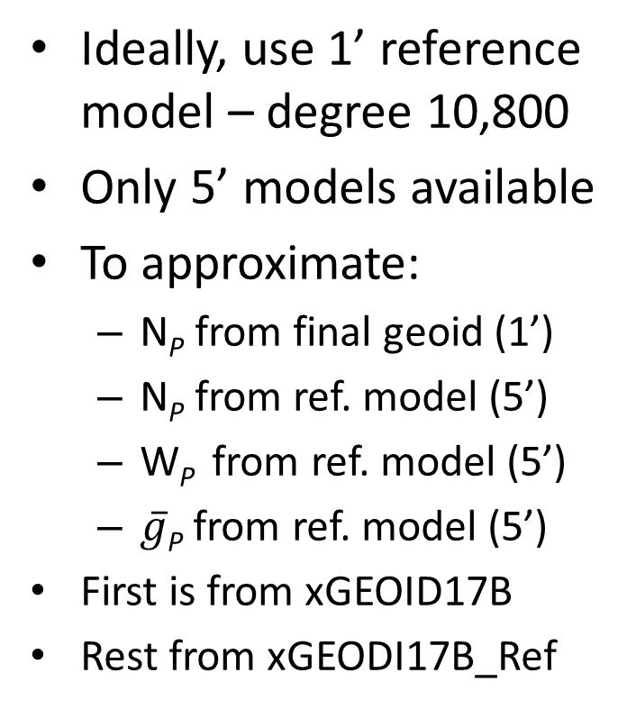
Method
Ideally, use 1’ reference model – degree 10,800
Only 5’ models available
To approximate:
  N_{P} from final geoid (1’)
  N_{P} from ref. model (5’)
  W_{P} from ref. model (5’)
  $\overline{g}$_{P} from ref. model (5’)
First is from xGEOID17B
Rest from xGEODI17B_Ref
Use residual geoid to approximate residual geopotential value:
$C_{P}^{5′}$ = $W_{P}^{5′}$ – W₀
${∆N}_{P}^{1^{′}−5′}$ = $N_{P}^{1′}$- $N_{P}^{5′}$
${∆C}_{P}^{1^{′}−5′}≈$ ${∆N}_{P}^{1^{′}−5′}$*${\overline{g}}_{P}^{5′}$
$C_{P}^{1′}$= $C_{P}^{5′}$+ ${∆C}_{P}^{1^{′}−5′}$
$H_{P}^{d}$= $C_{P}^{1′}$ / γ₄₅
Note that ${\overline{g}}_{P}^{5′}$ approximates ${\overline{g}}_{P}^{1′}$

Slide 11
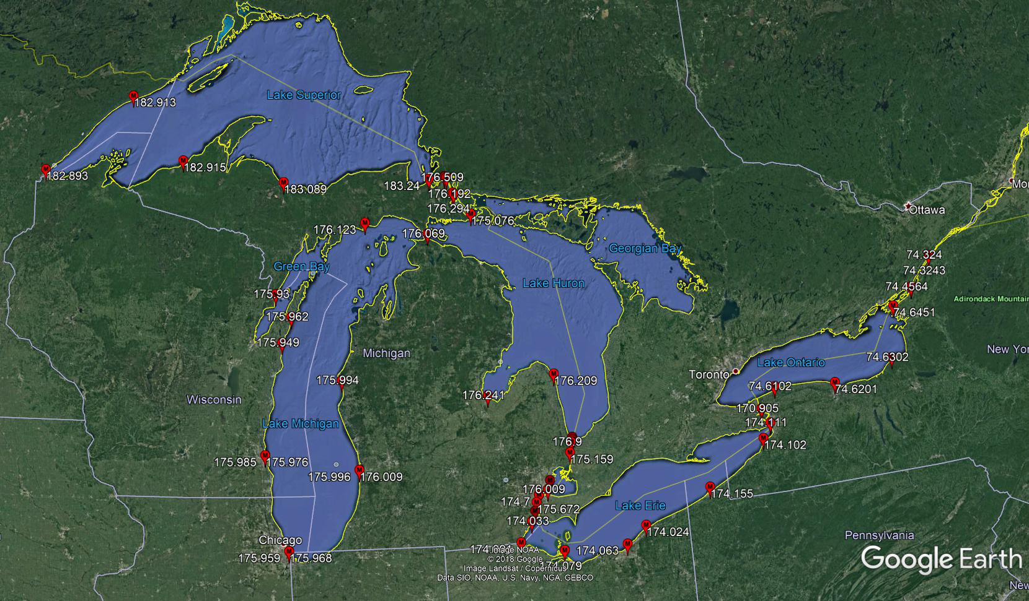
Dynamic Heights on the Lakes

Slide 12
Summary
Existing IGLD 85 datum will be replaced
IGLD 2020 will be based on NAPGD 2020
Current geopotential models not yet complete
Campaign geometric heights at 1-3 cm
Derived dynamic heights show consistency in many regions but can vary unexpectedly

