Slide 1

NSRS Modernization Overview:
Blueprint Part 2: Geoptential Coordinates
Dan Roman
Chief Geodesist
NOAA’s National Geodetic Survey

Slide 2
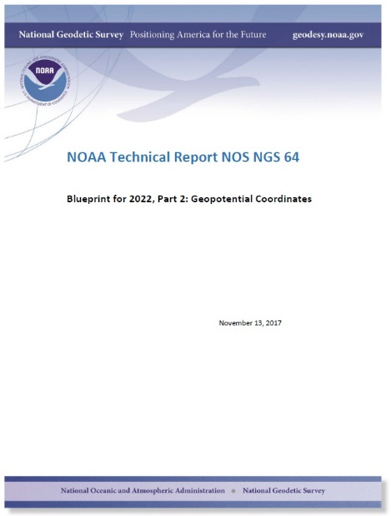
Overview
North American-Pacific Geopotential Datum of 2022
Gravity for the Redefinition of the American Vertical Datum
Geoid Monitoring Service
Summary

Slide 3
Replacing NAVD 88
  The Old:
  PRVD 02
  VIVD09
  ASVD02
  NMVD03
  GUVD04
  NAVD 88
  IGLD 85
  IGSN71
  GEOID12B
  DEFLEC12B
  ----
  The New:
  The North American-Pacific Geopotential Datum of 2022 (NAPGD2022)
  - Will include:
  NAPGD2022
  IGLD2020 (release in 2025)
  GRAV2022
  GEOID2022
  DEFLEC2022
  DEM2022
Normal
Orthometric
Heights
Orthometric Heights
Dynamic Heights
Gravity
Geoid Undulations
Deflections of
the Vertical
Elevation Model

Slide 4
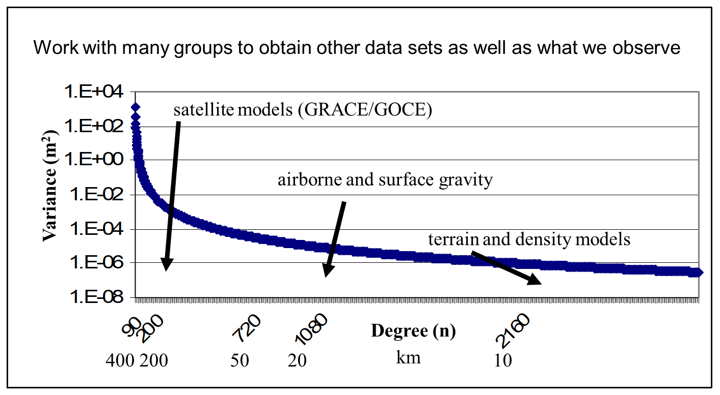
NAPGD2022 Sources
Satellite Gravity
  Longest wavelengths => largest sources (continental scale)
  Example: GOCO5S (GRACE/GOCE)
Airborne Gravity
  Intermediate scale resolving features down to 20-40 km
  Example: GRAV-D
Surface Gravity
  Literally millions of data points
Merge sources to obtain a seamless geopotential field
Work with neighboring countries to incorporate regional data (North American Vertical Datum/IAG SC 2.4c)
Use rigorous geodetic theory and/or forward modeling to make a geopotential model

Slide 5
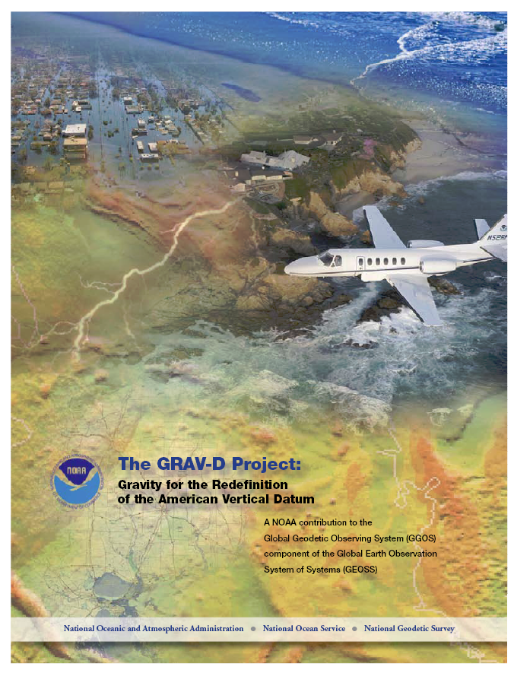
GRAV-D Project Overview
Overall Target: 2 cm accuracy orthometric heights from GNSS and a geoid model
GRAV-D Goal: Create gravimetric geoid accurate to 1 cm where possible using airborne gravity data
GRAV-D: Two thrusts of the project
  Airborne gravity survey of entire country and its holdings
  Long-term monitoring of geoid change
Leveraging partnerships to improve and validate gravity data
Notes:
Target is to be able to achieve 2 cm accuracy orthometric heights (where possible) using a GNSS receiver and a geoid model
Roughly 1 cm uncertainty from GNSS and 1 cm from the geoid model
GRAV-D
Phase 1: snapshot of the entire country to provide a consistent data set
Phase 2: long term monitoring of geoid change – in development
Work with partners to incorporate additional gravity data, particularly surface gravity data, validate existing data, and monitor change

Slide 6
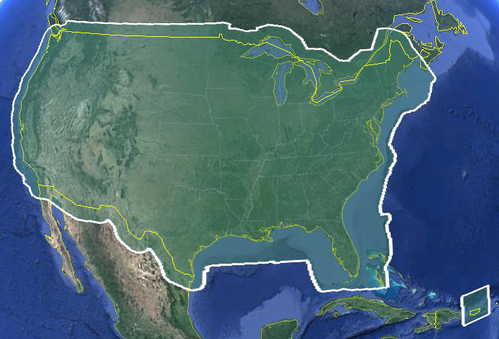
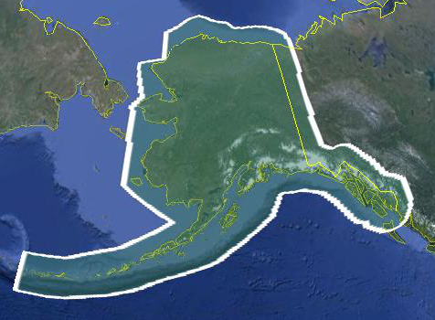
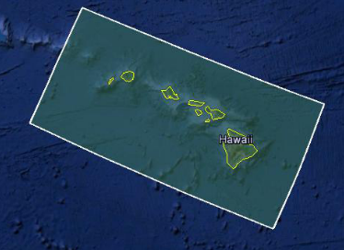
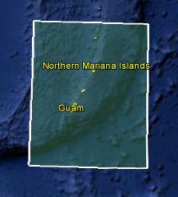
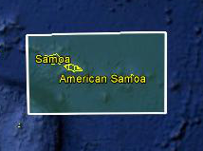
Data Collection Scope
Entire U.S. and territories
  Total Square Kilometers: 15.6 million
  Initial target area for 2022 deadline
  ~200 km buffer around territory or shelf break if possible
Notes:
Project Scope:
Scope of the project: cover roughly 15.6 million square kilometers – contiguous united states, Alaska, Hawaii, Guam, and American Samoa
In order to blend with satellite altimetry data the airborne survey is done to the continental shelf where possible or ~ 200 km beyond the shoreline or border, whichever is further
Deadline of 2022 for datum rollout, which means a target of 2021 to finish the airborne survey
Priority areas were defined as Alaska and coastal areas
Challenges:
Fixed annual budget and time → design of surveys had to fit within an annual budget of $3.5 million and meet the deadline
This was a major factor in setting altitude and line spacing

Slide 7
Performance Metric
For Airborne Surveys
FY09 Baseline | Targets vs Actual
 | FY10 | FY11 | FY12 | FY13 | FY14 | FY15 | FY16 | FY17 | FY18 | FY19 | FY20 | FY21 | FY22
6.14% | 7.5% | 12% | 20% | 28% | 36% | 45% | 53% | 62% | 70% | 79% | 87% | 96% | 100% and Implement
6.14 | 8% | 15% | 24% | 31% | 38% | 45% | 55% | 64% | 72% | 75.8%
Measure: Percentage of the U.S. and its territories with GRAV-D data available
to support a 1 cm geoid supporting 2 cm orthometric heights.
Notes:
We’ve set up a basic GIS GPRA monitoring in the War Room. We will report the coordinates of our survey monthly and they will calculate our percentages.

Slide 8
Geoid Monitoring Service (GeMS)
Goal: Track all changes to the geoid which would prevent 1 cm accuracy
Aspects included:
  Shape, Secular: e.g. Hudson Bay
  Shape, Episodic: e.g. Massive Earthquakes
  W0, Secular: Global Sea Level Change (see next slides)
Examples of things excluded:
  Size, Secular: Mass quantity of Earth is effectively static
  Shape, Periodic: Seasonal glacier cycle

Slide 9
Time and Mass
Mass quantity in the Earth system is effectively constant
Mass distributions in the Earth system are time dependent and some are large enough to be measurable
  Secular
    Shape change to every equipotential surface (like the geoid)
    Size change to global mean sea level
  Episodic
  Periodic

Slide 10
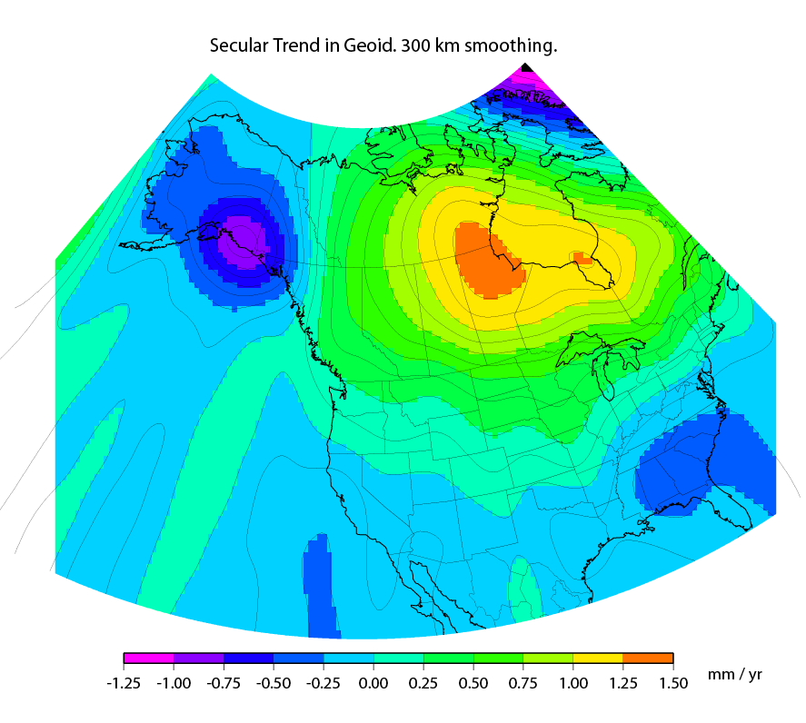
Secular Mass Movement
Mass is flowing in the mantle
to coalesce under Hudson
Bay, pushing the crust up.
GPS on the crust sees this
as one effect:
An increase in ellipsoid height
A gravimeter on the crust
sees two effects:
(small) decrease in gravity as the
gravimeter location gets
farther from the geocenter
(larger) increase in gravity as the
amount of mass below the
gravimeter pulls harder
This gravity change causes the
geoid to “swell” in the area
Notes:
There are two manifestations of the growing mass in the deep mantle under Hudson Bay:
Geometric – a GPS receiver will see the crust uplifting as the increase in mantle mass pushes the crust up in a displacement.
Geopotential – a gravimeter on the surface will sense the growing mass as an increase in the acceleration of gravity, BUT this will be slightly tempered by a reduction in gravity as well (because the gravimeter on the surface is getting farther from the Earth’s center). Still, the gain (from mass increase) is larger than the loss (from geometric movement) for a net gain. Because the net gain in gravity is not caused purely by being at a new crustal height, this translates into an increase in geoid undulations, or a “swelling” of the geoid in this region.
This is different than a purely geometric change caused by a compression of the crust. In that case, no significant mass is entering or leaving the region so, while GPS might sense a subsidence and a surface gravimeter might sense a slight increase as it moves closer to the Earth’s center, the geoid would not actually change.

Slide 11
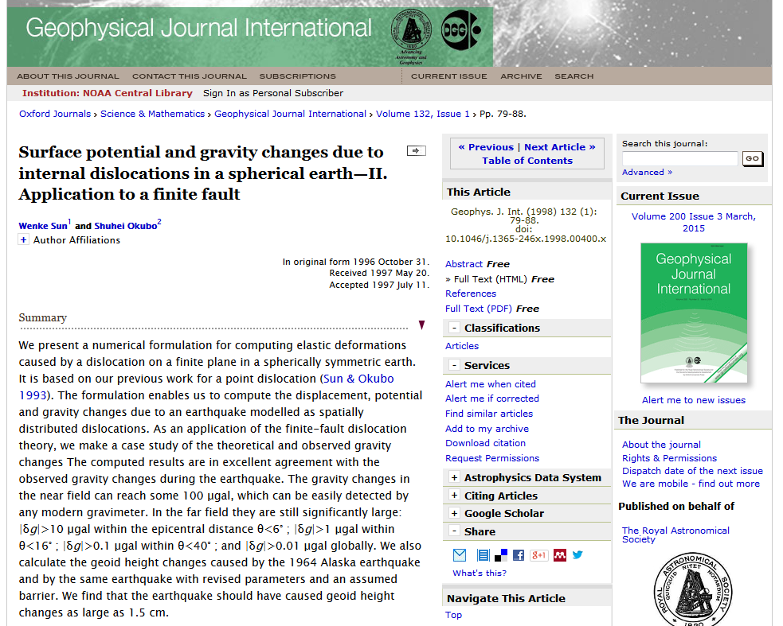
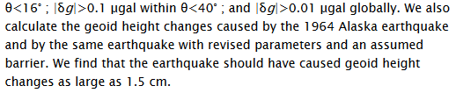
Episodic Mass Movement
Notes:
Rare, but worth monitoring, large earthquakes or volcanic eruptions can move enough mass locally to cause the geoid to make a permanent local shift.

Slide 12
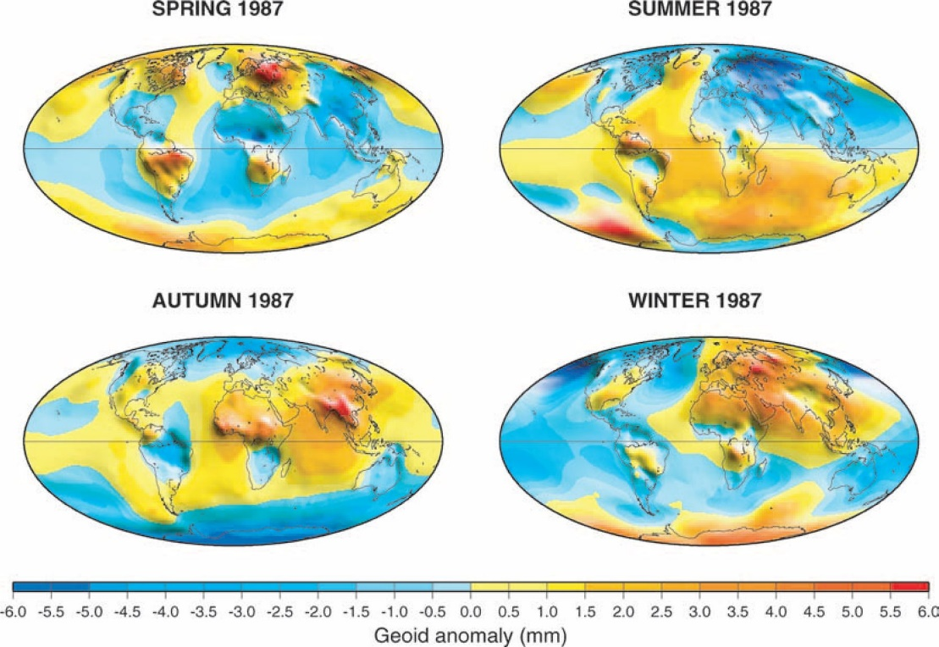

Periodic Mass Movement
Ramillien G et al. Geophys. J. Int. 2004;158:813-826
© 2004 RAS
Notes:
Seasonal variations of the synthetic geoids for 1987 computed using global model forecasts for the same period: atmosphere from ECMWF; oceans from POCM; total land water plus snow from LaD.
NGS sees this as a signal to be modelled and removed so users are not worried about “seasonal heights”.

Slide 13
High resolution products
All will be 1 x 1 arcminute grids
All will cover three finite regions of the globe
All will have a static and dynamic component
  Dynamic surface gravity not expected to be ready by 2022
GEOID2022
  Official converter of *TRF2022 ellipsoid heights into NAPGD2022 orthometric heights
DEFLEC2022
  Surface deflections of the vertical in N/S and E/W
GRAV2022
  Surface acceleration of gravity

Slide 14
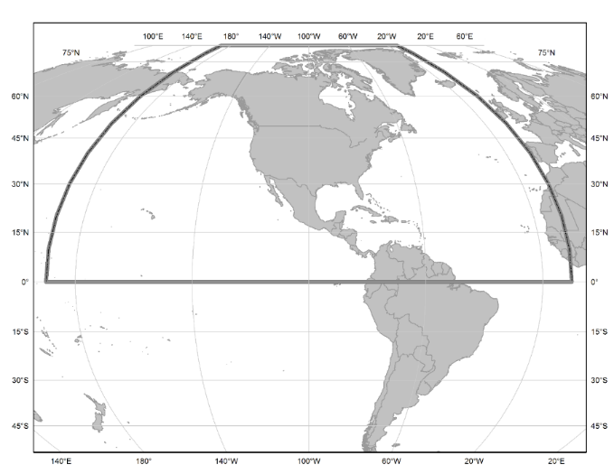
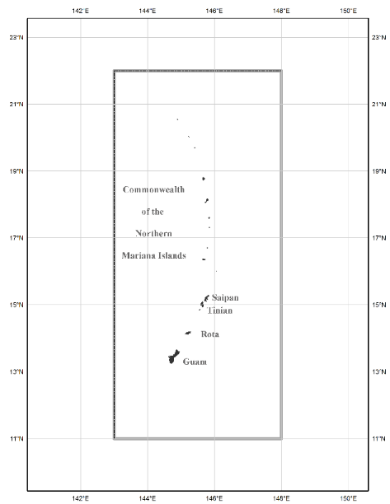
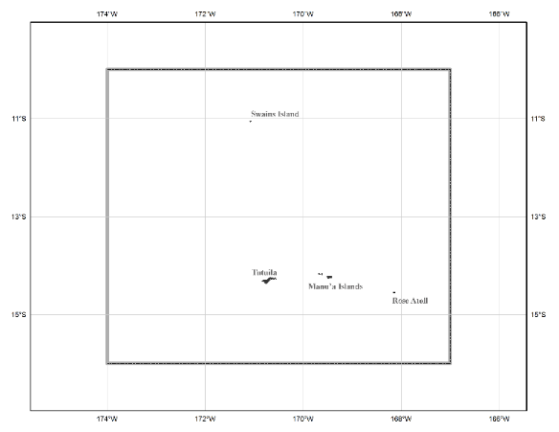
The three gridded regions
“North American region” - ¼ of the Earth
“American Samoa region”
“Guam/CNMI region”

Slide 15
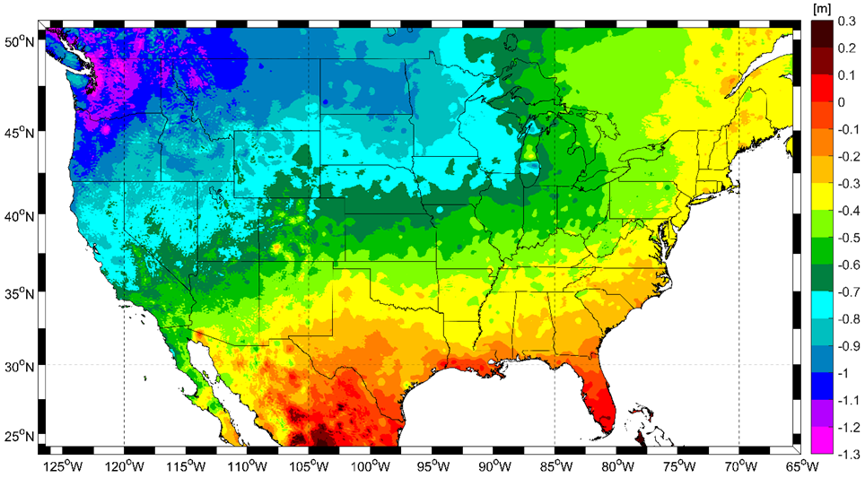
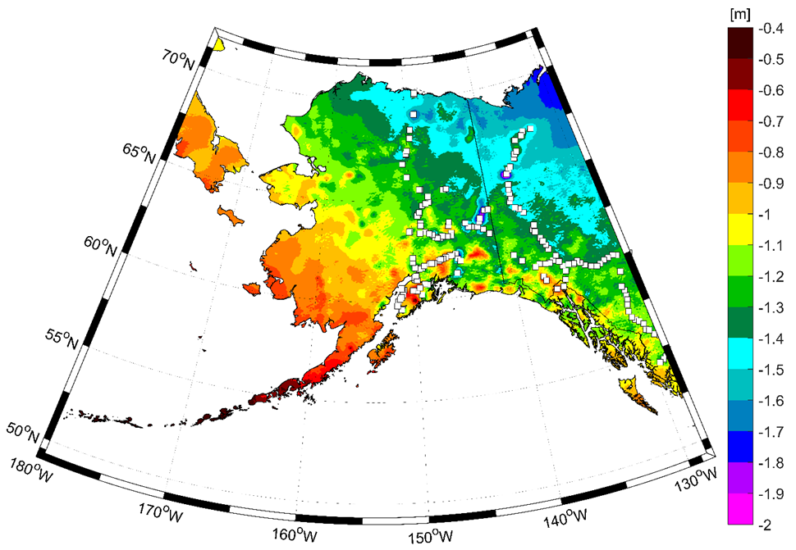
Expected changes to orthometric heights

Slide 16
Summary
Out: NAVD 88, datums for islands, gravity models, IGLD 85, etc.
In: NAPGD2022
  Can determine geoid heights, orthometric heights, gravity, DoV, etc.
  All related through five arcminute reference field
  Higher resolution products (one arcminute) for geoid, DoV, gravity
GeMS to account fo time variability of geopotential field
  Mass variations due to secular, episodic and periodic changes
  Apply a time varying field to account for changes in position/datum
  Works in conjunction with vertical component of IFVM

Slide 17
For more details on Blueprints Part 1 & 2 …
… please attend tomorrow morning for presentations on
NGS Ongoing Efforts / Interim Products Part 1 of 2 (Reference Frames/ Datums)
Ongoing Efforts / Interim Products Part 2 of 2 (Tools)

Slide 18
Hold Questions until the end.
Next up, Blueprint Part 3

Slide 19
Break

