Slide 1




Updates to Products and Models within the North American-Pacific Geopotential Datum of 2022
Presenters: Kevin Ahlgren and Ryan Hardy
Geoid Team(s): K Ahlgren¹, YM Wang¹, X Li¹, R Hardy¹, J Huang², I Foroughi², M Véronneau², D Avalos-Naranjo³
¹National Geodetic Survey – National Oceanic and Atmospheric Administration
²Canadian Geodetic Survey – Natural Resources Canada
³National Institute of Statistics and Geography, Mexico (INEGI)
https://alpha.ngs.noaa.gov/NAPGD2022/
 | NGS Webinar | 1/14/25

Slide 2

NSRS Modernization: Geometric Data and Tools
Geometric REC project puts N/P/C/MATRF2022 epoch 2020.00 coordinates on over 100,000 geodetic control points
NADCON / NCAT updated
FGDC vote
MYCS3 / ITRF2020
EPP2022:
N/P/C/MATRF2022 defined
NSRS DB
and
Data Delivery System
IFDM2022
SPROCCET
M-PAGES
LASER
SPCS2022
OPUS-S
and
OPUS-Projects
Notes:
NSRS modernization consists primarily of three overarching themes: Replacing NAD 83, replacing NAVD 88 and providing data and tools to work with these replacements. Replacing NAD 83 falls under the project of “Geometric Data and Tools”. In this category, a number of projects will be completed, in order, each one dependent upon the next. It begins with providing new CORS coordinate functions in ITRF2020, continues through the definition of the four plate-fixed frames of NATRF2022, PATRF2022, CATRF2022 and MATRF2022. After that, a national adjustment of geometric data, mostly GNSS vectors, will be used to estimate NSRS coordinates at 2020.00 on over 100,000 control points. These, in turn, will be used to build the NADCON tool. Once all of these data and tools are available for at least six months, there will be an FGDC vote to adopt the modernized NSRS. However, this won’t happen without the parallel project of “Geopotential Data and Tools” (see next slide).

Slide 3
NSRS Modernization: Geopotential Data and Tools
Orthometric REC project puts NAPGD2022 epoch 2020.00 orthometric heights on over 900,000 geodetic control points
VERTCON / NCAT updated
FGDC vote
GRAV-D
GM2022
Geometric REC project*
GEOID2022 / NAPGD2022 defined
NSRS DB
and
Data Delivery System*
IFDM2022*
SPROCCET*
OPUS-S
and
OPUS-Projects*
LASER*
* Seen on geometric slide as well
Notes:
Like the geometric project, “Geopotential Data and Tools” contains a number of chronologically dependent pieces. First was completion of the 17-year long GRAV-D project. With that data in hand, GEOID2022, which defines the zero-elevation surface in the modernized NSRS was created. This, combined with the ellipsoid heights from the national geometric adjustment (see previous slide), provides some 40,000 orthometric heights to which decades of leveling will be adjusted, estimating new orthometric heights at over 900,000 control points. These, in turn, will be used to build the VERTCON tool. Once all of these data and tools are available for at least six months, there will be an FGDC vote to adopt the modernized NSRS. This will only occur if both the geometric (previous slide) and geopotential tracks are both complete.

Slide 4
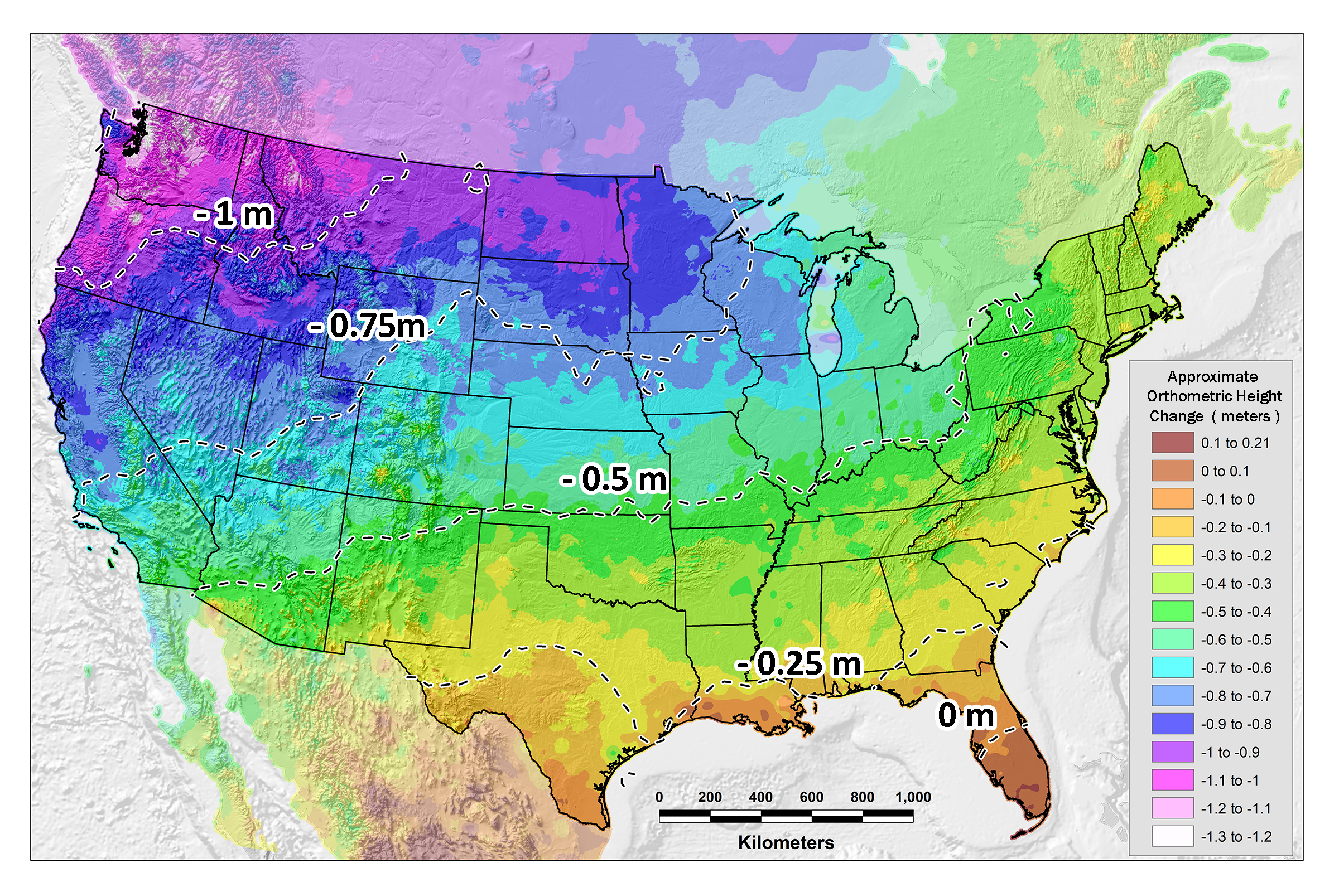
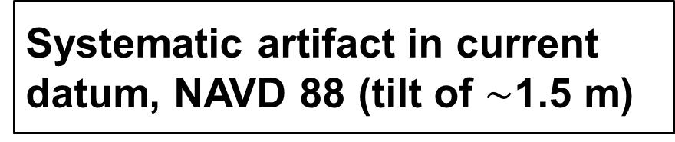
Issues with NAVD 88
PID: EZ0840
Systematic artifact in current datum, NAVD 88 (tilt of $\sim$1.5 m)

Slide 5
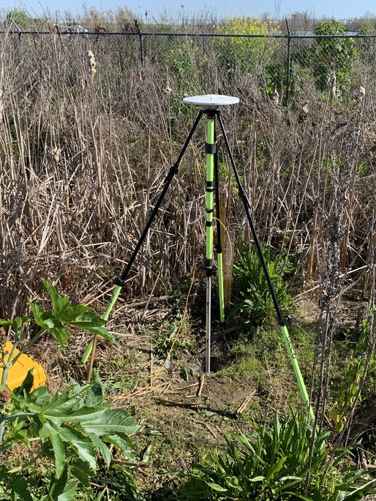
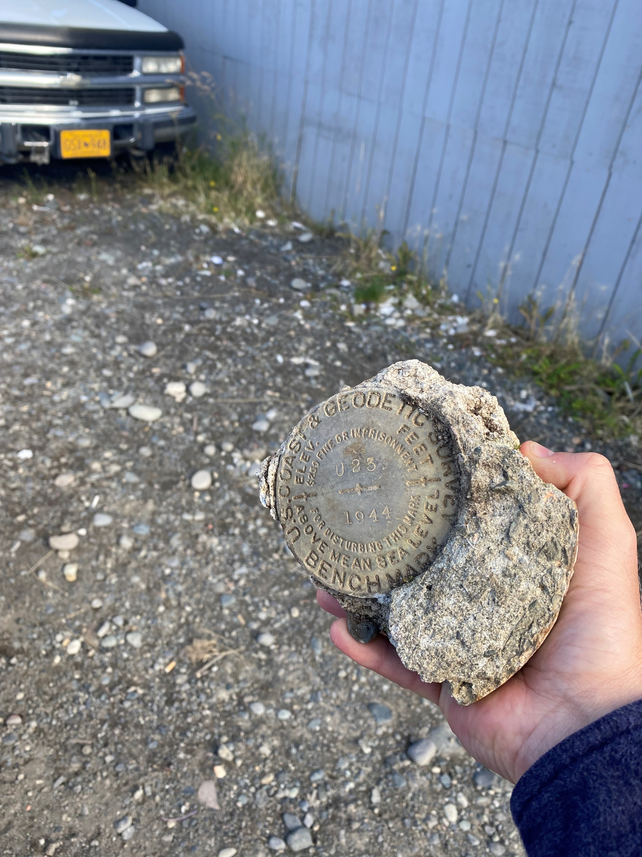
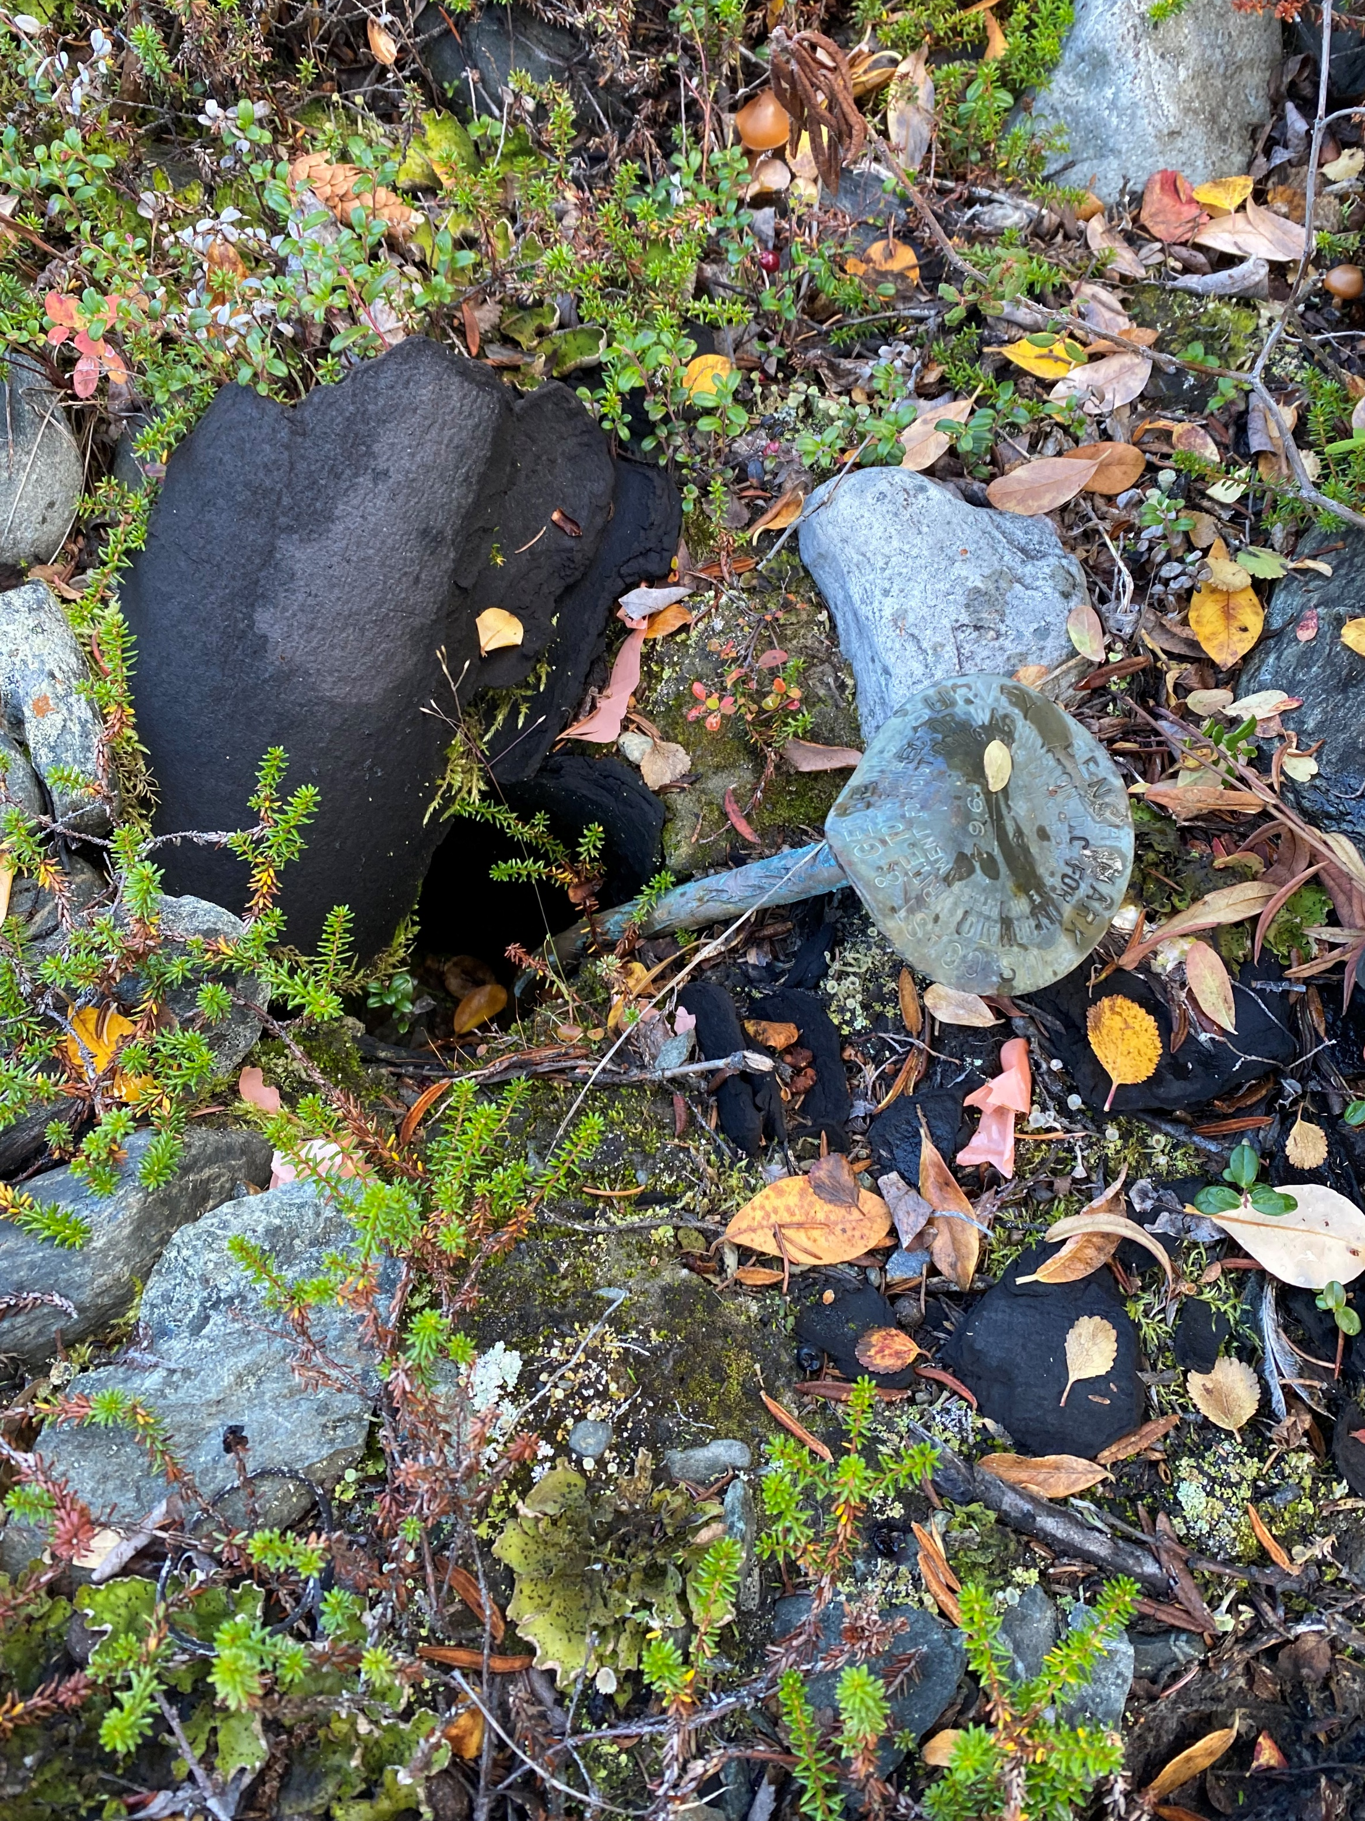
Issues with passive geodetic control
PID: EZ0840
Destroyed
Mutilated
Uplifted/Subsided

Slide 6

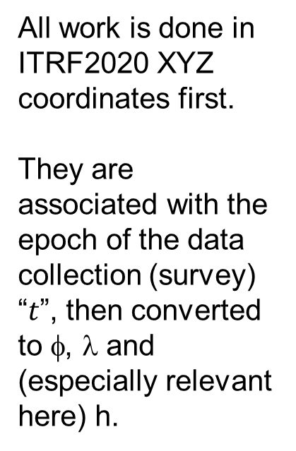
Definitional Relationship
$${H(t)}_{NAPGD2022}≡{h(t)}_{ITRF2020}−{N\left(t\right)}_{GEOID2022 }$$
We end with orthometric height in NAPGD2022 at the same epoch as the survey.
All work is done in ITRF2020 XYZ coordinates first.
They are associated with the epoch of the data collection (survey) “$t$”, then converted to φ, λ and (especially relevant here) h.
Conversion to orthometric heights is definitional through GEOID2022.
Contrast with NGS hybrid geoids where the equation H=h-N did not close.

Slide 7
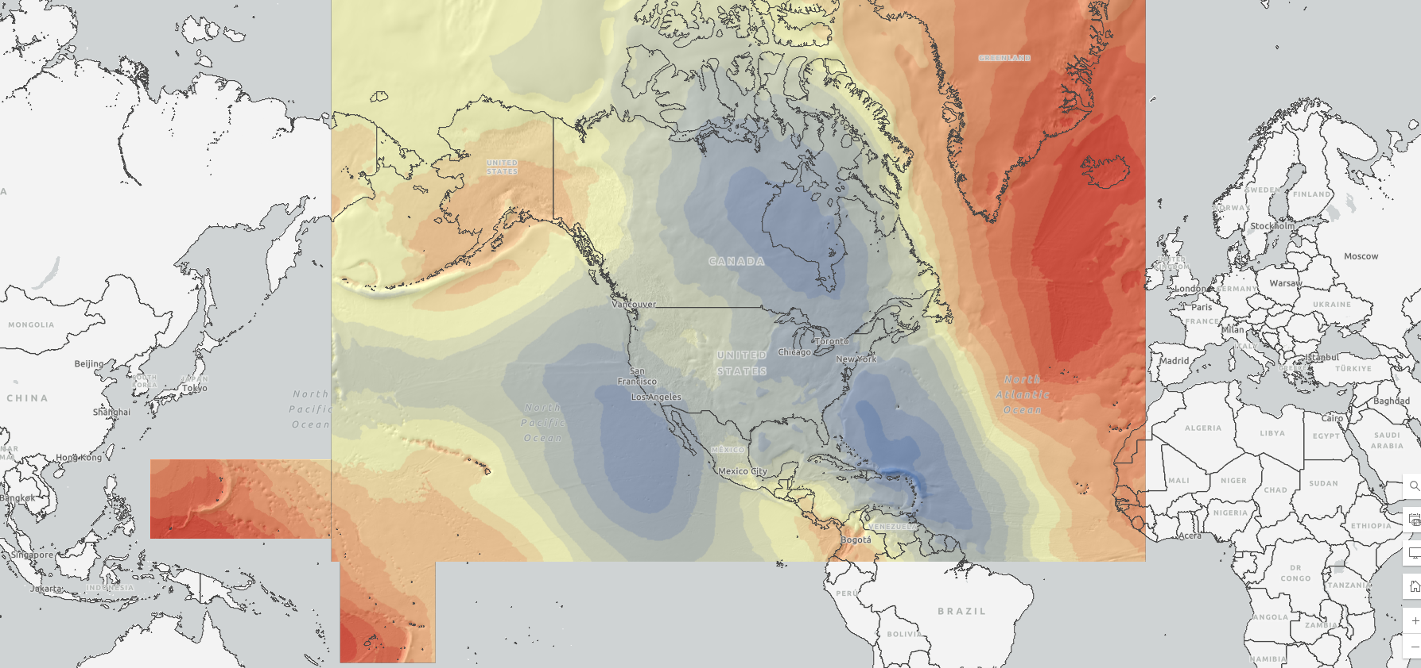
North American-Pacific Geopotential Datum of 2022
Definitions: | Value and realization:
W₀ | 62,636,856 m²s⁻²
GM | 3.986004415x10¹⁴ m³s⁻²
Realization | GEOID2022
Geometric RF | ITRF2020
Height (type) | Orthometric: H(t) = h(t) – N(t)
Tide system | Tide Free
Velocity of geoid height | Linear: $\dot{N}$
Reference epoch | 2020.0

Slide 8
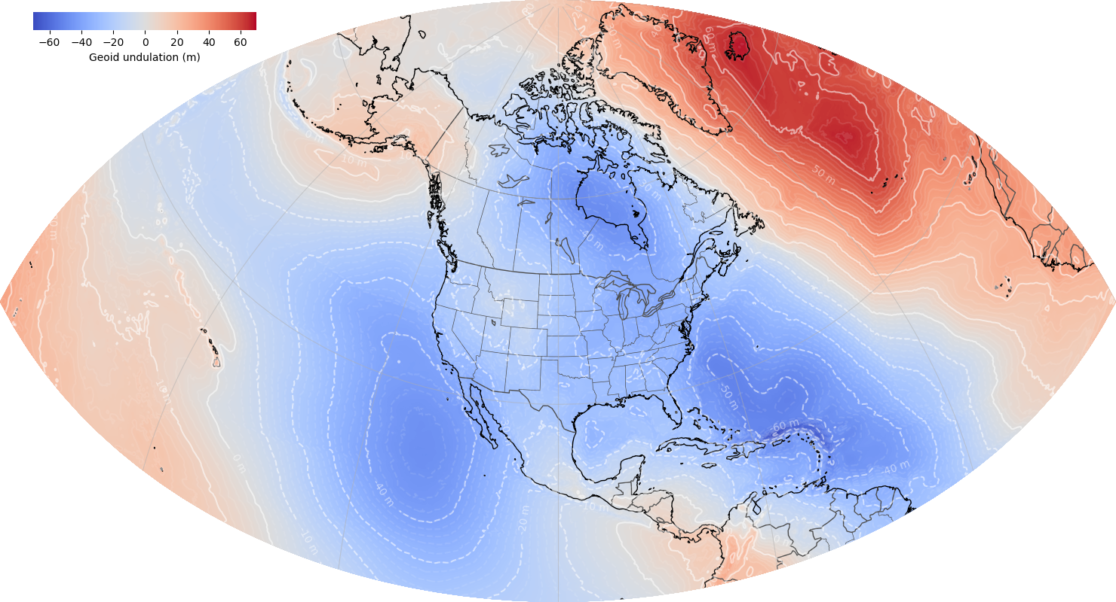
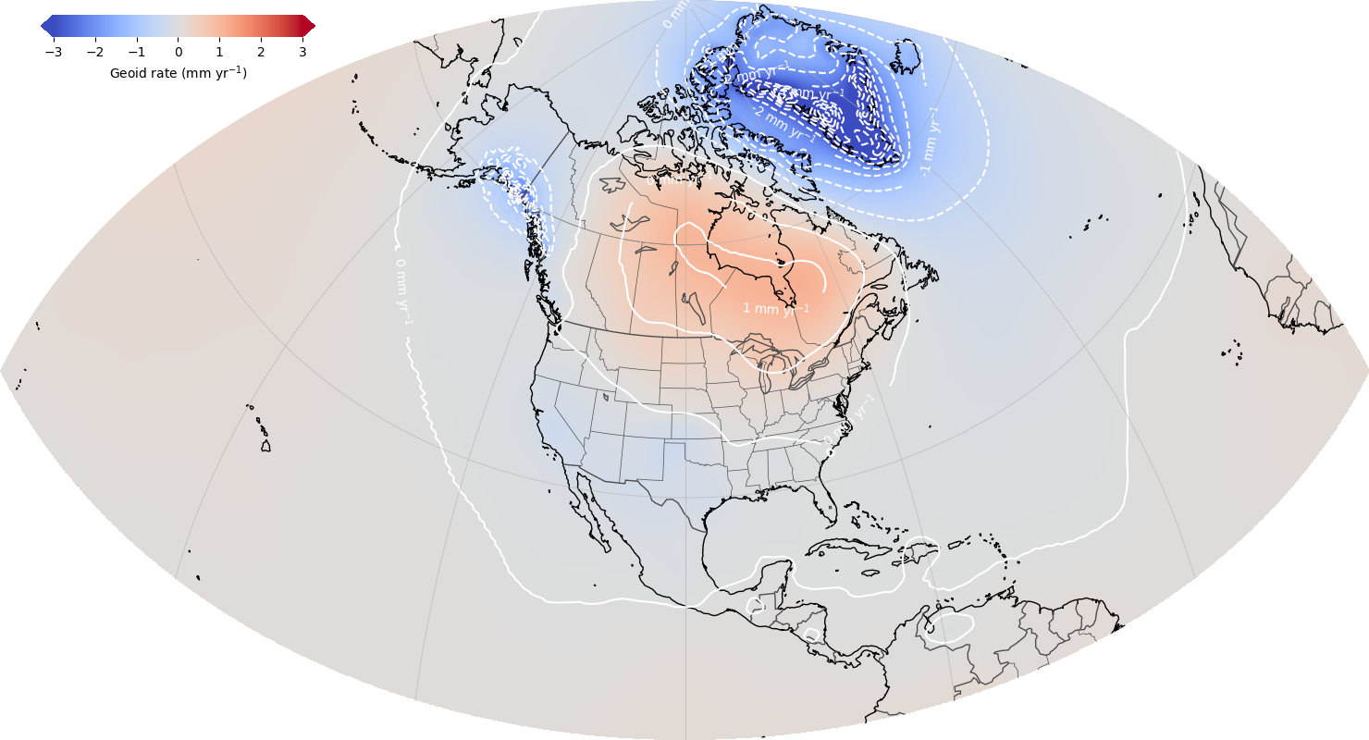
North American-Pacific Geopotential Datum of 2022
ALPHA Release: GEOID2022 / DEFLEC2022 / GRAV2022 / GM2022
GEOID2022: Combined model (CGS+NGS+INEGI)
¼ Earth’s Surface
GEOID2022: Static Component Dynamic Component

Slide 9
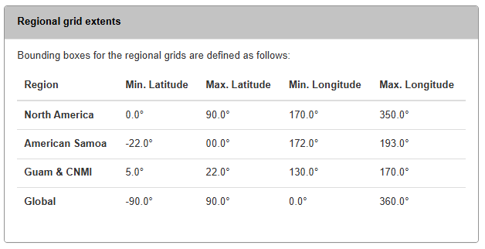
New Features on alpha site:
New products: GEOID2022, DEFLEC2022, DEM2022, GRAV2022, GM2022
  including uncertainties
  including regional models
Notes:
29 individual grids (GEOID – 6), (DEFLEC – 10), DEM (3), GRAV (9), GGM (1)

Slide 10
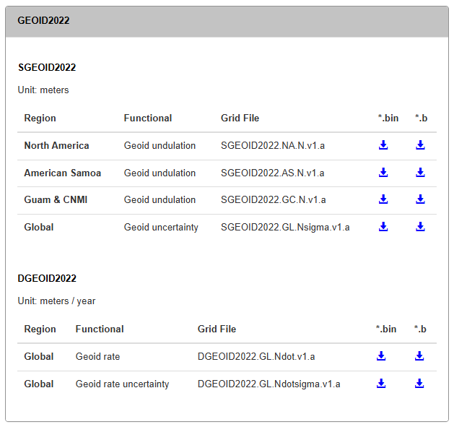
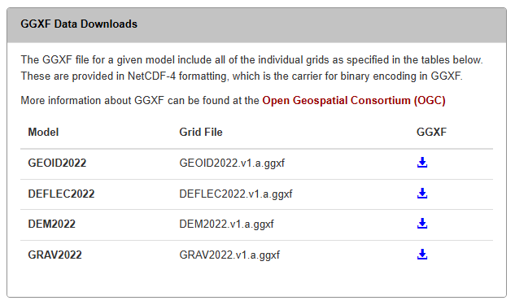
New Features on alpha site:
Grid formats: GGXF, legacy NGS format (*.bin and *.b)

Slide 11
New Features on alpha site:
Test cases:
  file with sample input, expected values, etc.
  87 examples representing major cities, model extrema values, and island regions.
Name | Category | Latitude | Longitude |  | SGEOID2022
Center | Grid | 45 | 260 |  | -22.554
New York | US Metro | 40.71296814 | -74.01361774 |  | -32.781
Los Angeles | US Metro | 34.05875104 | -118.27851290 |  | -35.252
Toronto | Metro | 43.64258362 | -79.38715210 |  | -37.195

Slide 12
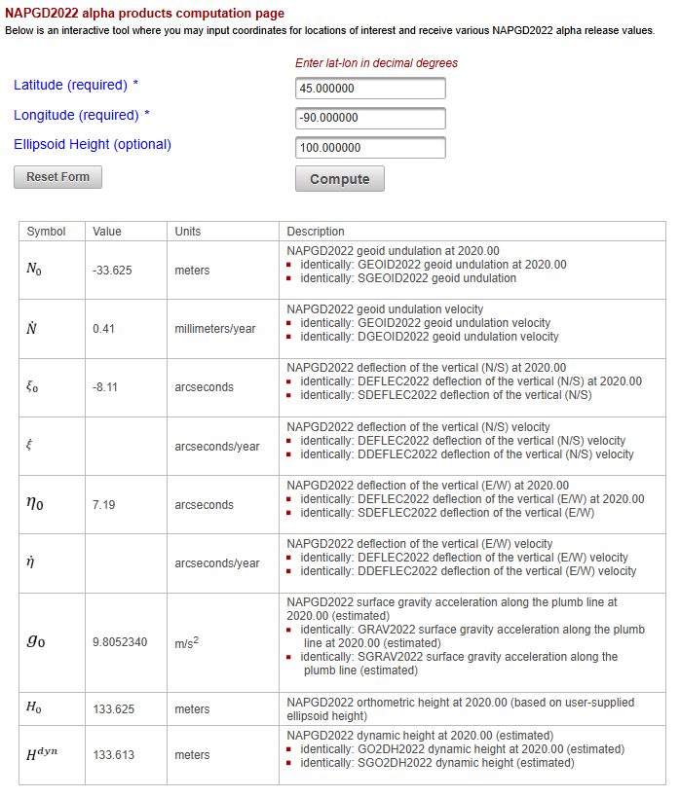
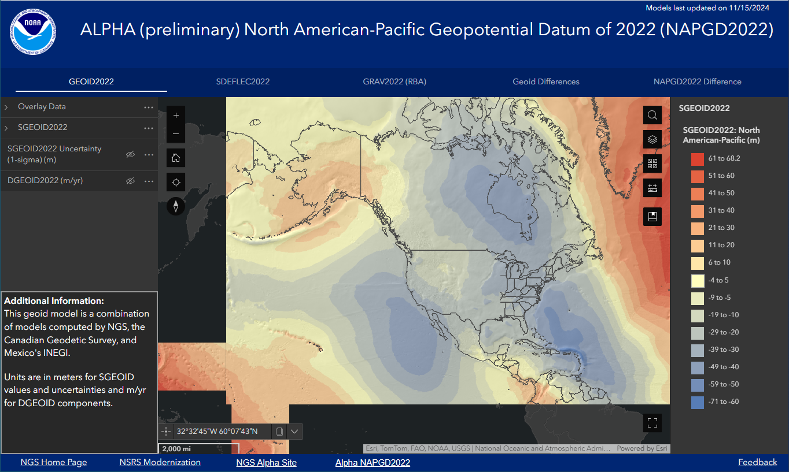
New Features on alpha site:
ArcGIS Experience for visualization that includes grids for geoid, deflections, gravity, geoid differences, datum differences, and their uncertainties
Computation tool for individual point input and exact values of NAPGD2022 quantities

Slide 13
Web map Demo

Slide 14
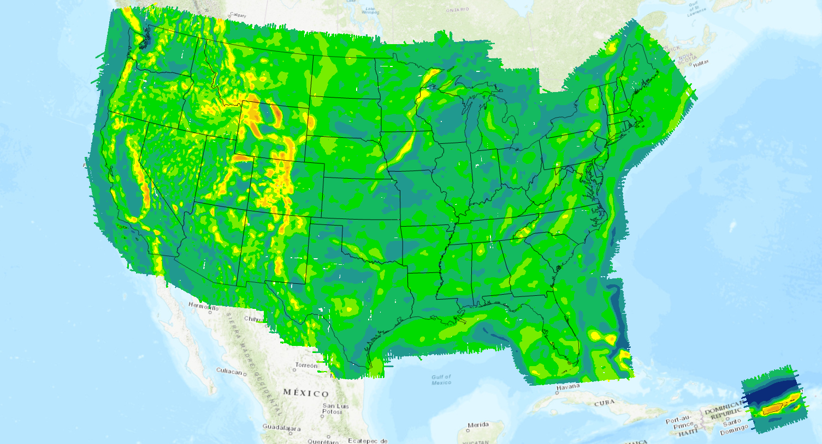
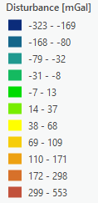
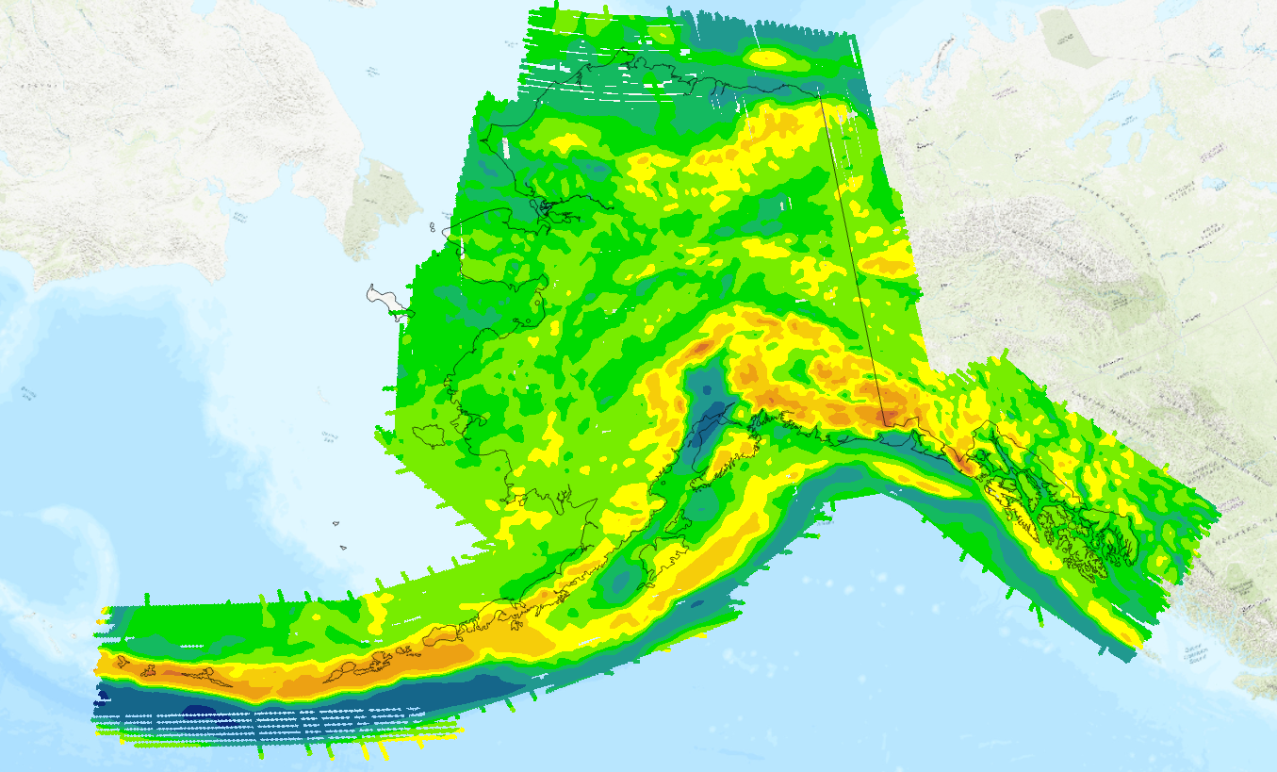
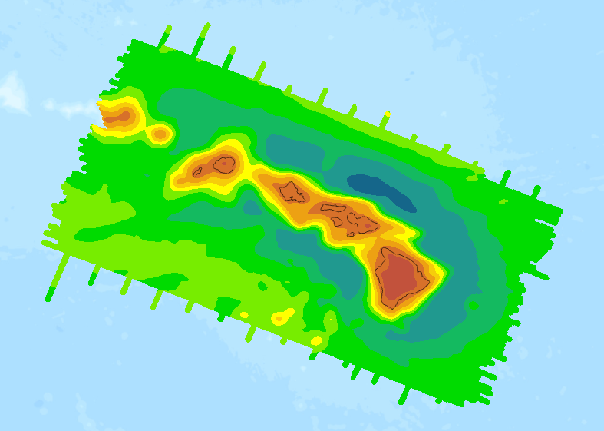
Data used in GEOID2022
Satellite gravity (GOCO06s)
Terrestrial gravity data
Altimetric gravity (DTU21) in 1’x1’ grid
DEM2022 (3′′, a combination of TanDEM-X, NED, and MERIT)
ArcGPv2020 in 3’x3’ grids from NGA
Ice thickness data sets over Greenland
Airborne gravity data (GRAV-D) (shown)
GRAV-D data coverage
Alaska
Hawaii

Slide 15
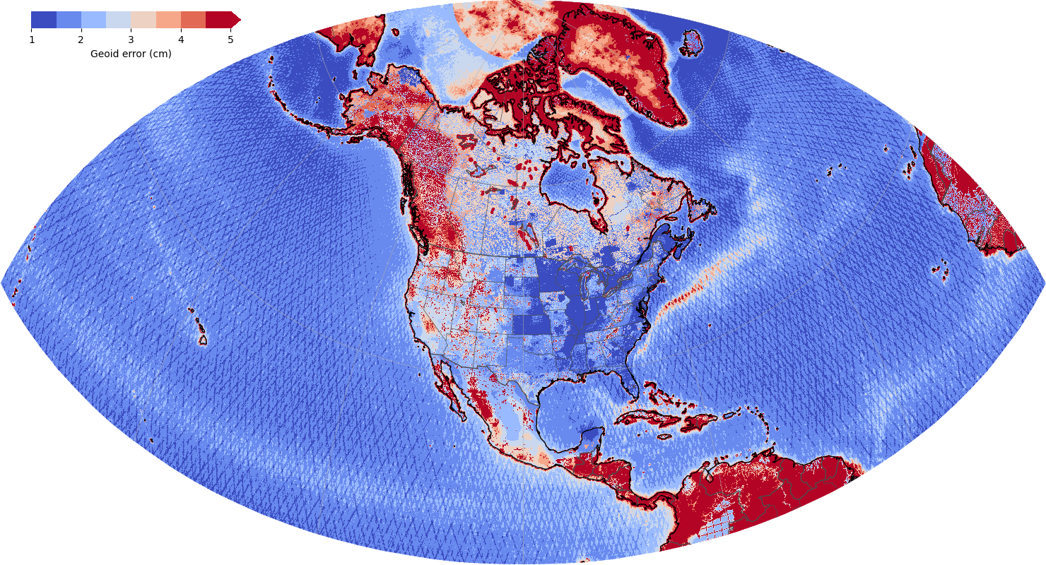
Geoid Uncertainty
Why care about geoid uncertainty?
  How should height observations be weighted?
  How much can the geoid model change in subsequent releases?
  Where does NGS need more gravity data?
NAPGD2022 Uncertainty Grids
  Geoid
  Deflection of the vertical
  Bouguer anomaly
Summary
  5 arcminute resolution
  1 cm over open ocean
  1-2 cm in CONUS
  2-3 cm in high elevations
  >5 cm in Alaska

Slide 16
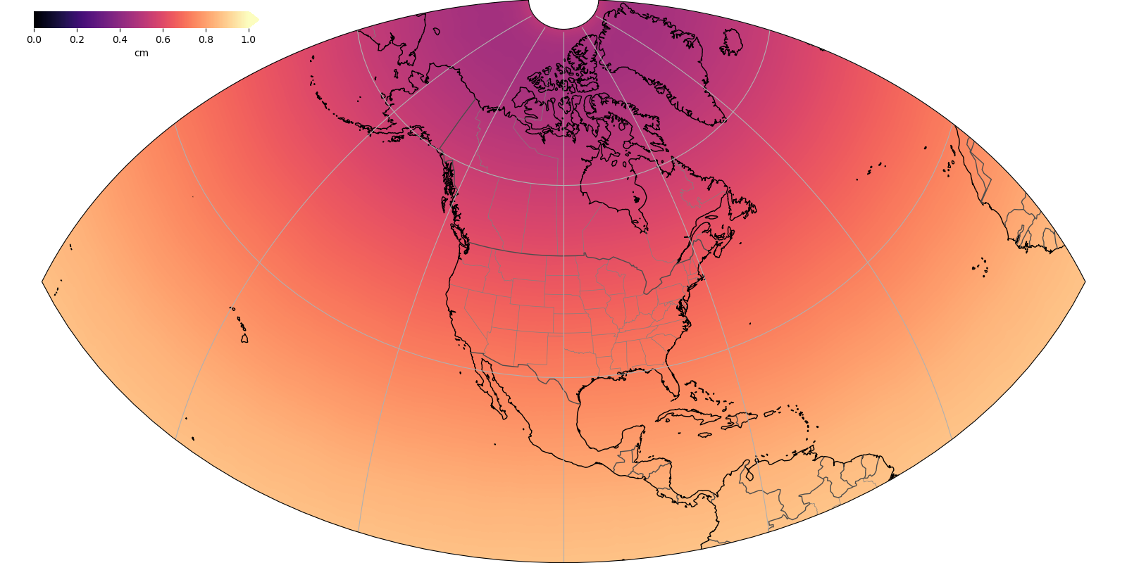
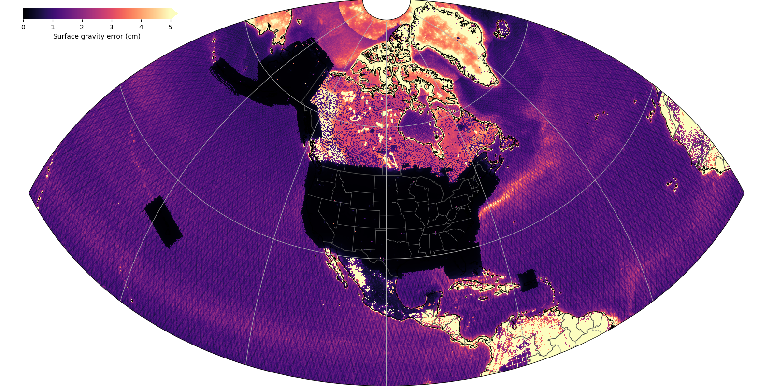
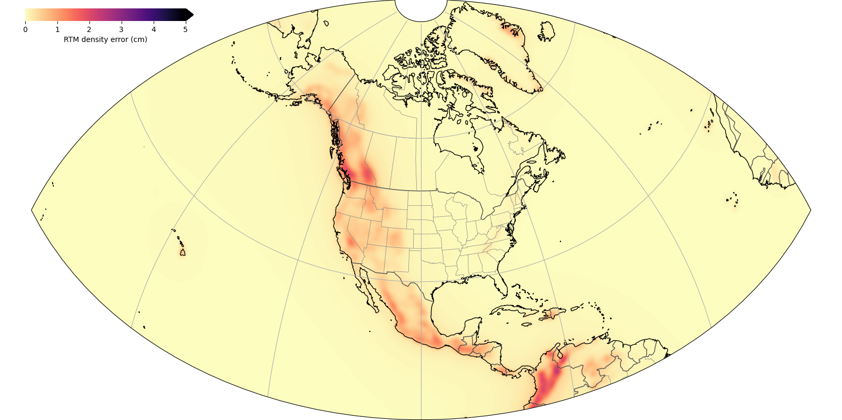
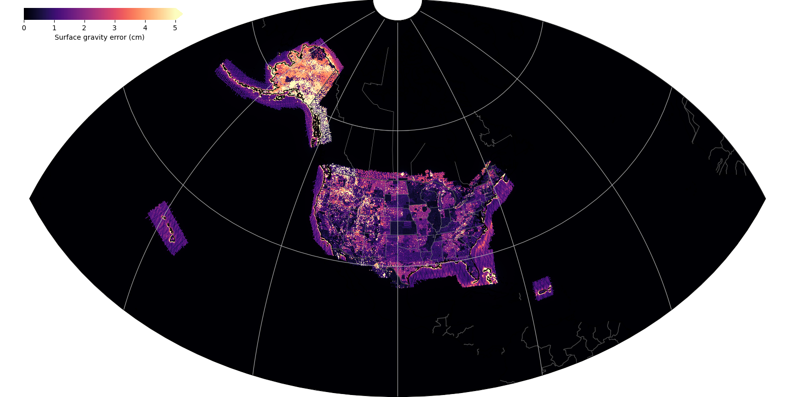
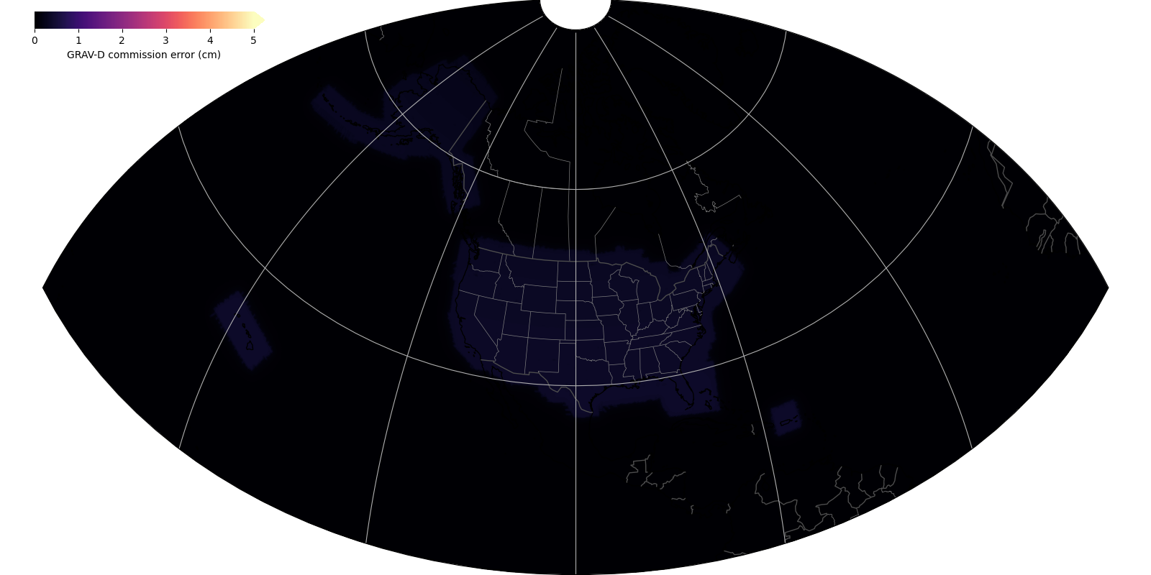
Geoid Uncertainty
Inputs
  GOCO06s variance-covariance matrix
  Sandwell-Smith satellite altimetry grids
  NGS terrestrial gravity database
  GRAV-D data extent raster layer
  DEM2022
Assumptions
  Linear error propagation of gravity anomaly errors with spectral filter (<100 km)
  Satellite model error informs long wavelengths (>100 km)
  10% density error and 1 m terrain elevation error captures effect of terrain roughness
  Gravity anomalies under GRAV-D domain have different spectral weights than those outside
  Kaula-based interpolation error below 1 arcminute
Satellite
Terrestrial outside GRAV-D
Terrain Roughness
Terrestrial under GRAV-D
GRAV-D
Commission

Slide 18
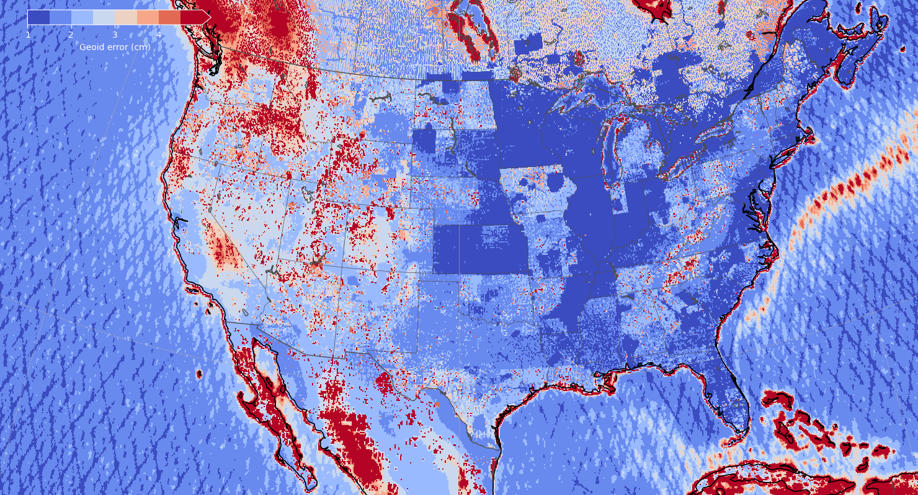

Slide 19
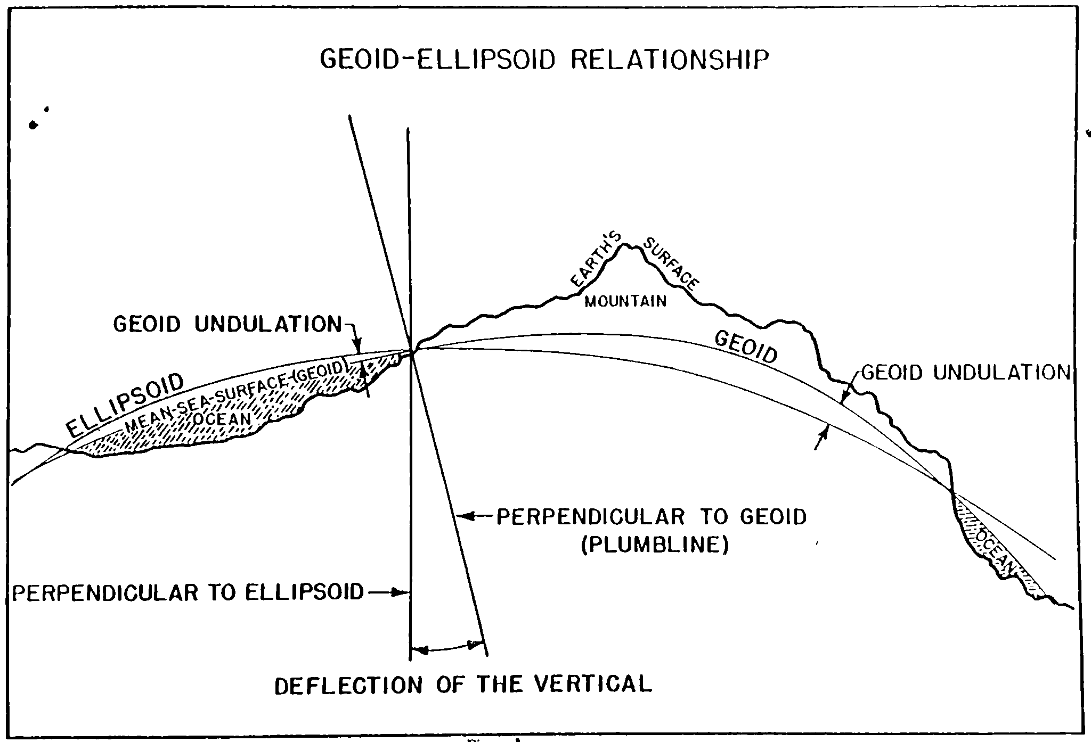
DEFLEC2022
DEFLEC2022 defines “up” in NAPGD2022
More precisely, DEFLEC2022 captures the deflection of the vertical, or how much the direction of gravity differs from the ellipsoid normal at Earth’s surface
The deflection of the vertical is used to convert locally oriented survey and navigation data to a global geometric frame
DEFLEC2022 is computed from the east and north horizontal derivatives (slopes) of the geoid plus corrections for the curvature of the plumbline
Poling (1967)

Slide 20
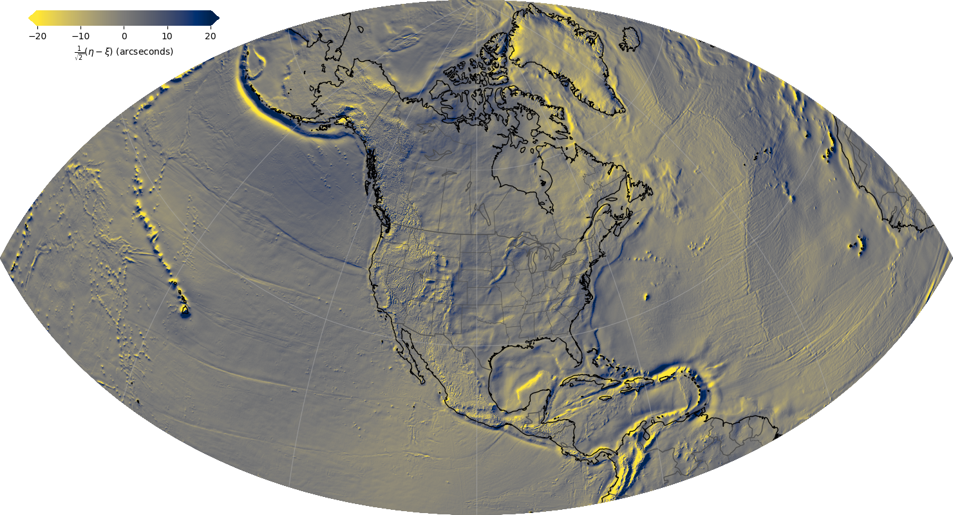
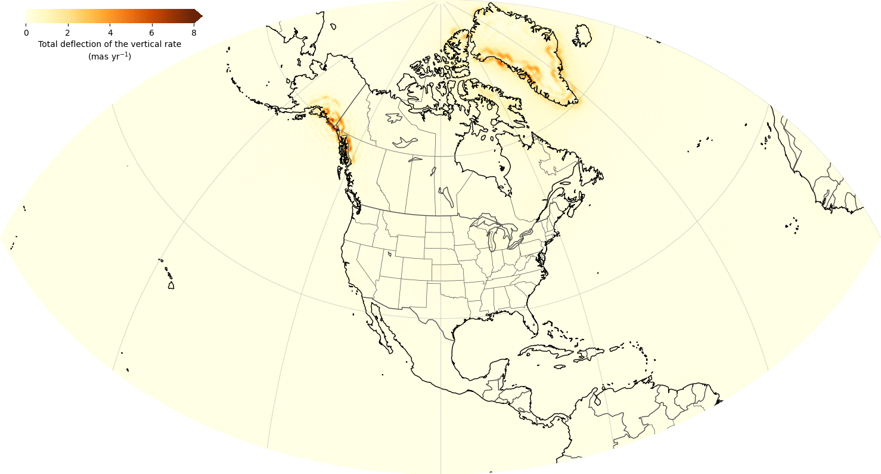
DEFLEC2022
Two components: SDEFLEC2022 and DDEFLEC2022
  Time-dependent components are negligible
  <0.14 arcseconds per century over 99% of NAPGD2022
  Maximum of 0.76 arcseconds per century in Alaska
Computation
  Geoid slopes computed using central-difference method
  Deflections above 85° N computed using polar interpolation to avoid singularities
  New Molodensky-based approach to computing deflections of the vertical using geoid-quasigeoid separation and gravity anomalies rather than classical topographic approach
Performance (1 sigma)
  ~0.8 arcseconds relative to historical astronomical measurements in CONUS
  ~0.2 arcseconds relative to GSVS lines in Texas and Iowa
  ~0.7 arcseconds on GSVS line in Colorado
SDEFLEC2022
DDEFLEC2022

Slide 21
DEFLEC2022

Slide 22
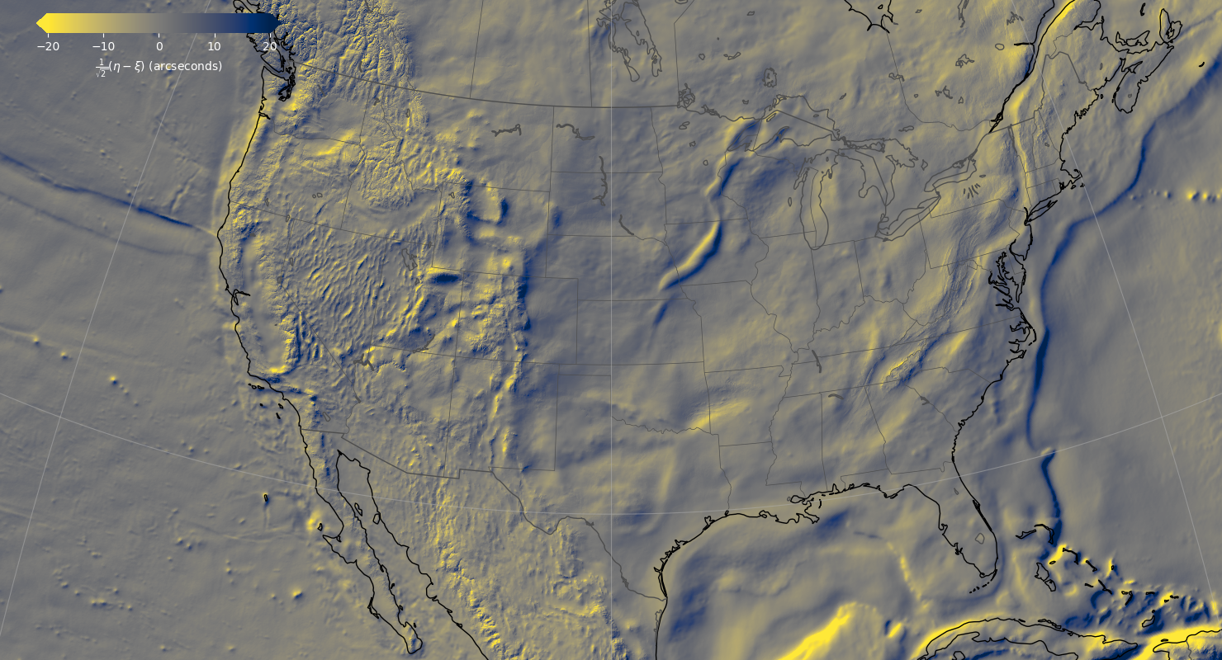

Slide 23
GEOID2022 Validation

Slide 24
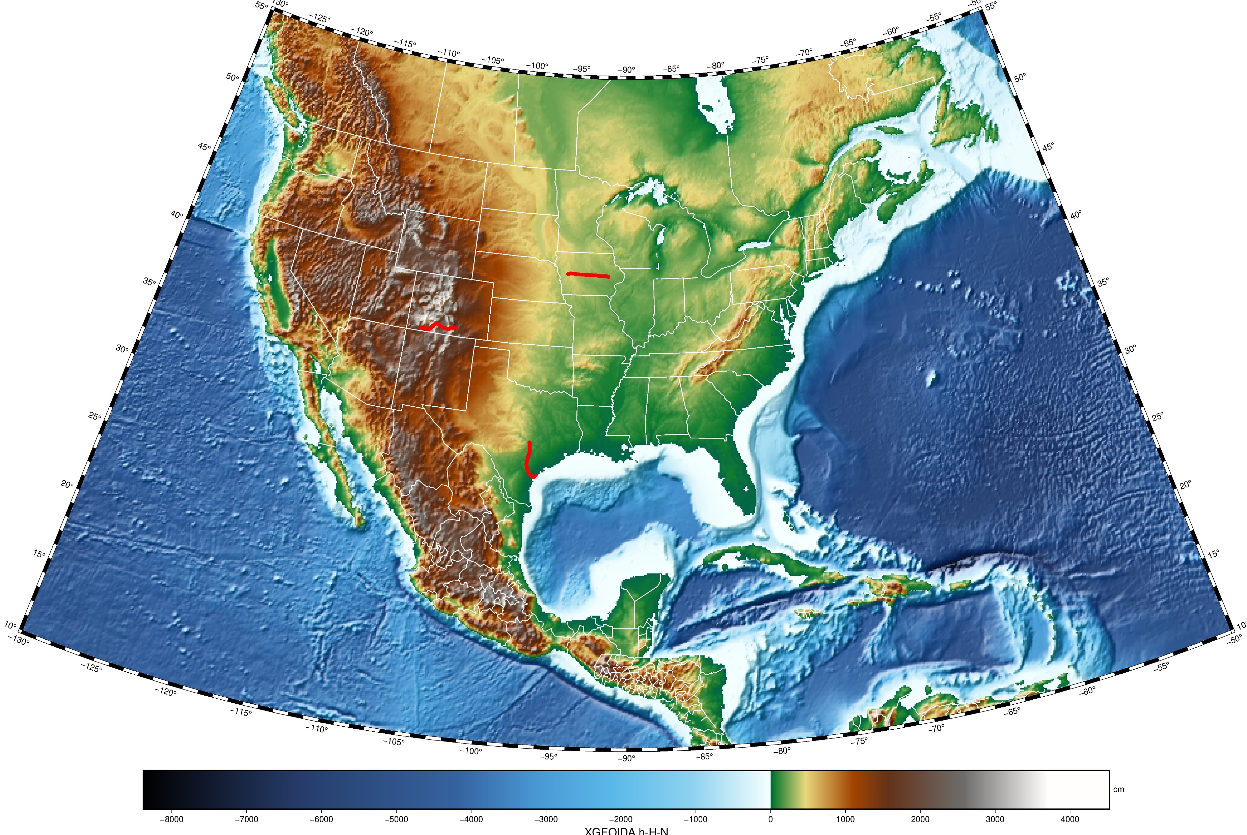
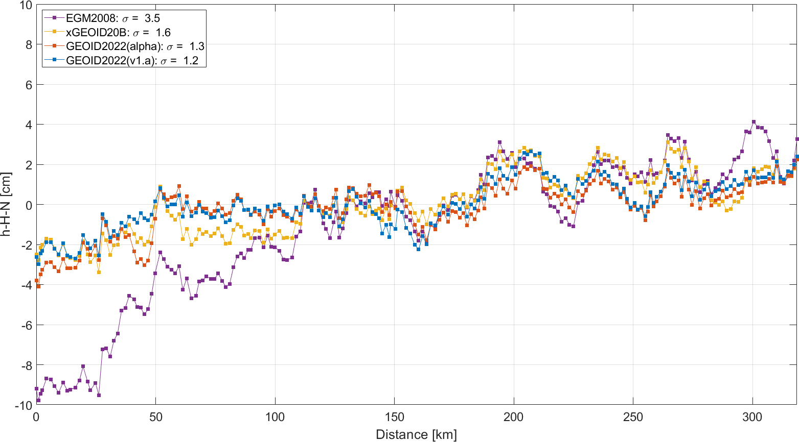
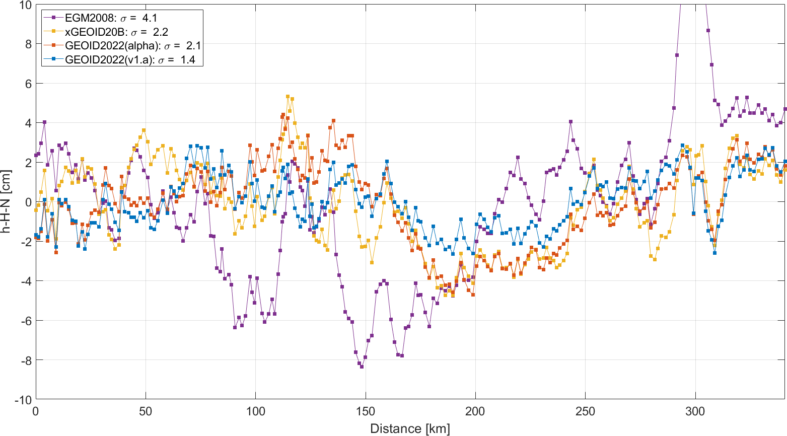
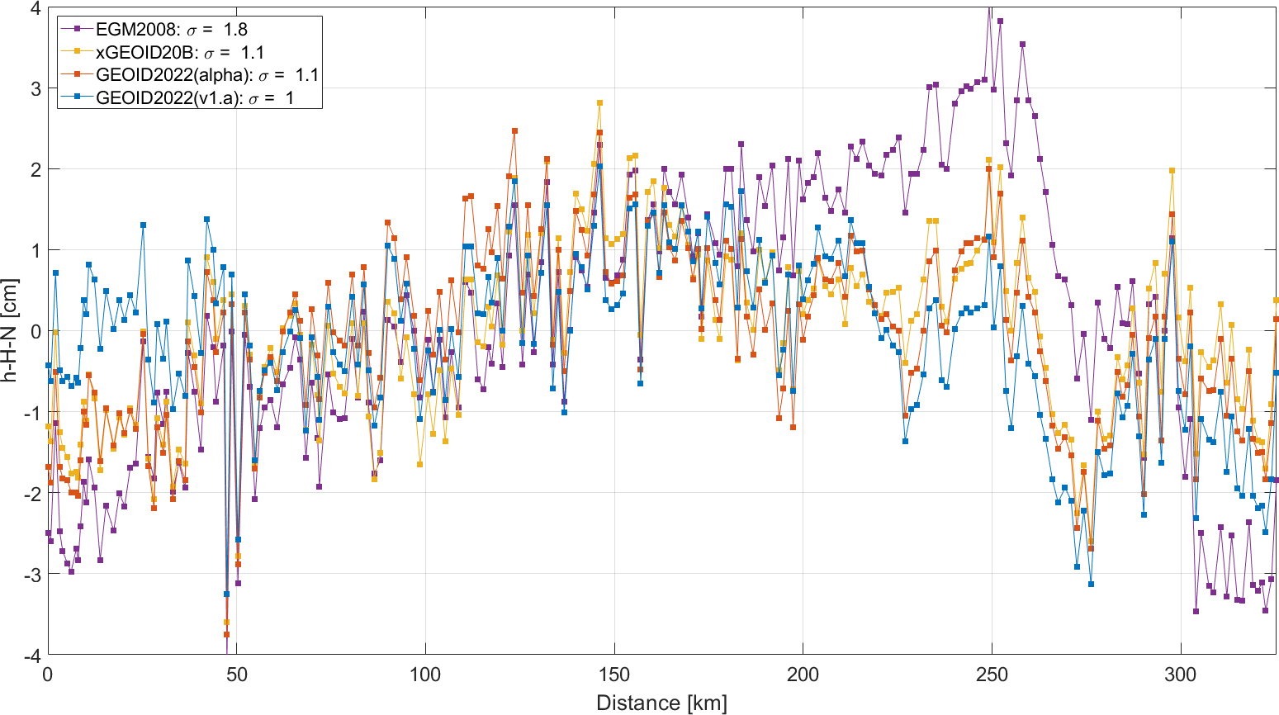
Residual geoid along three GSVS lines
Geoid Slope Validation Surveys (GSVS)

Slide 25
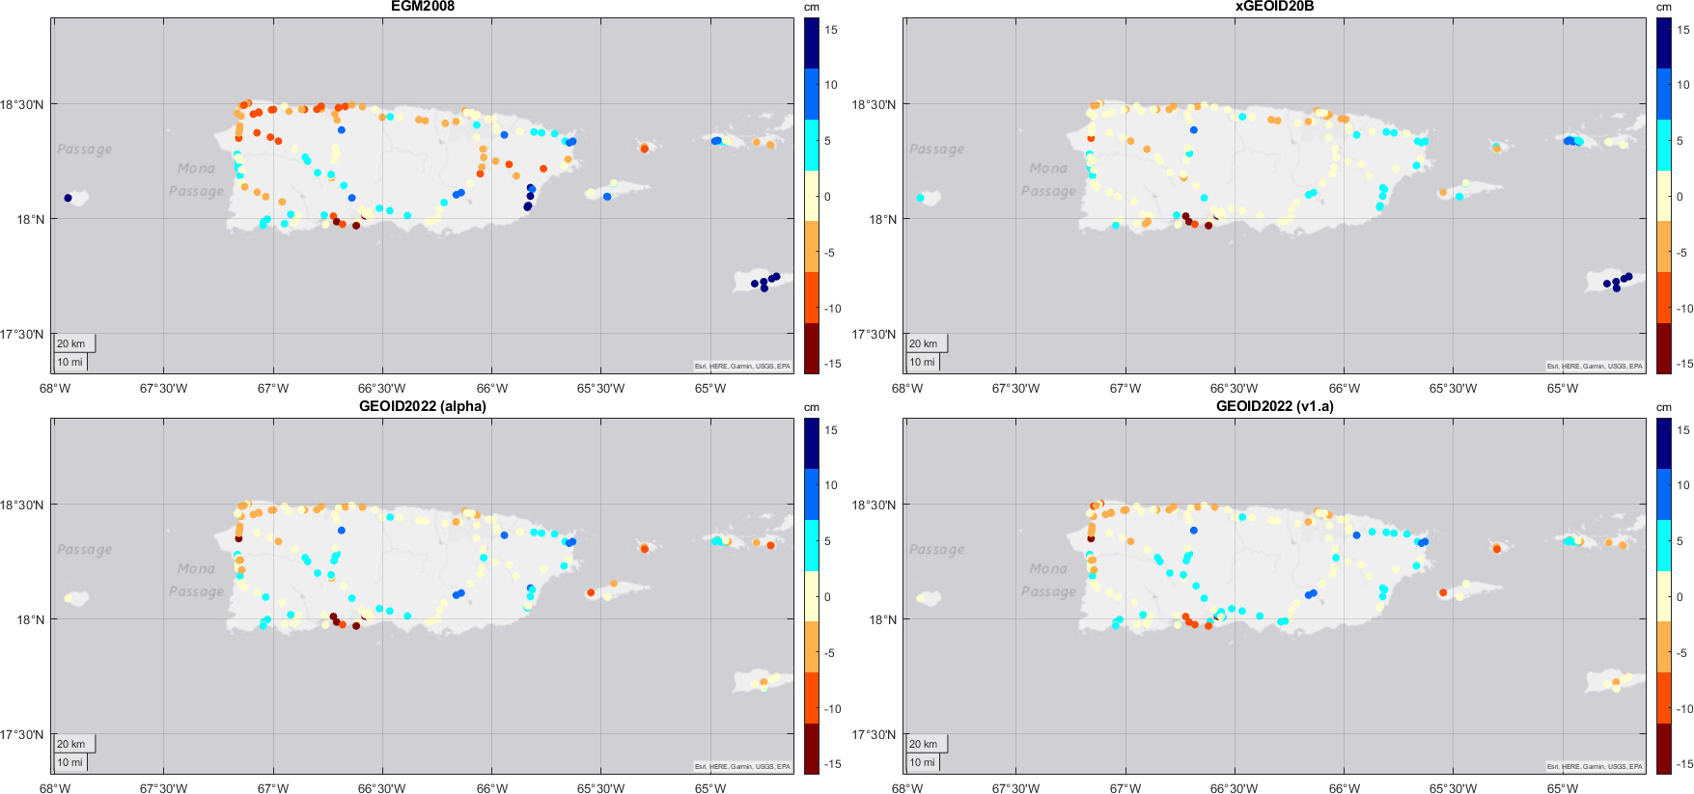
Puerto Rico / US Virgin Islands
Highlights the regional variability of GEOID2022
Not tailored to this region, specifically
Still showing improvement with respect to GPS\leveling but slightly higher than other regions:
  Likely due to combination of geoid and GNSS\leveling
σ = 6.8 cm
σ = 4.6 cm
σ = 3.7 cm
σ = 3.6 cm

Slide 26
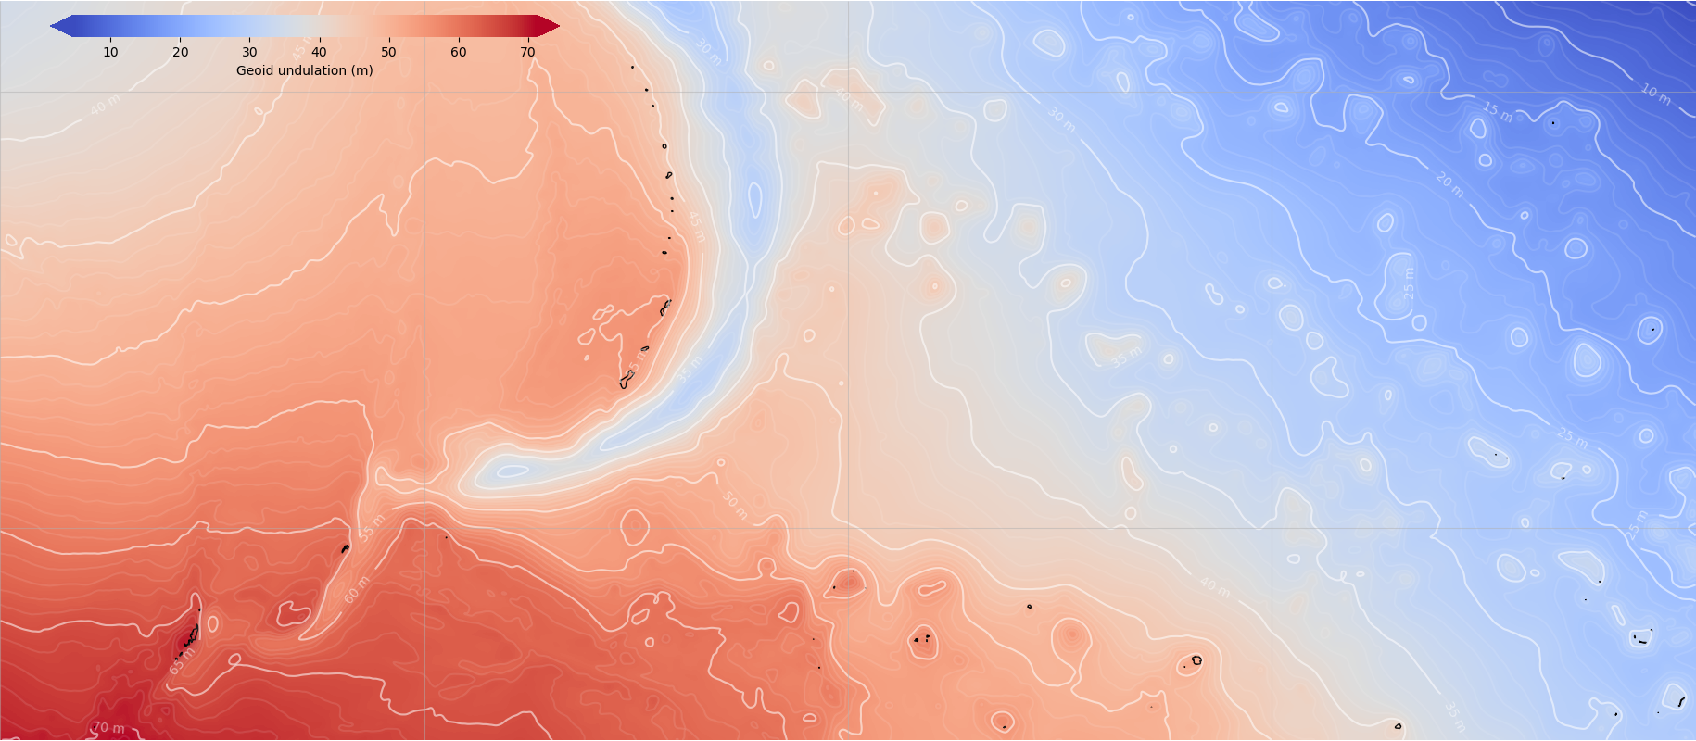
Guam and Commonwealth of Northern Mariana Islands
20º
Regional model tailored to the local region based on GPS \ leveling data
Very similar to the main, North American-Pacific geoid model
Coverage includes: Palau, Micronesia Wake Island, Marshall Islands
10º
140º
150º
160º

Slide 27
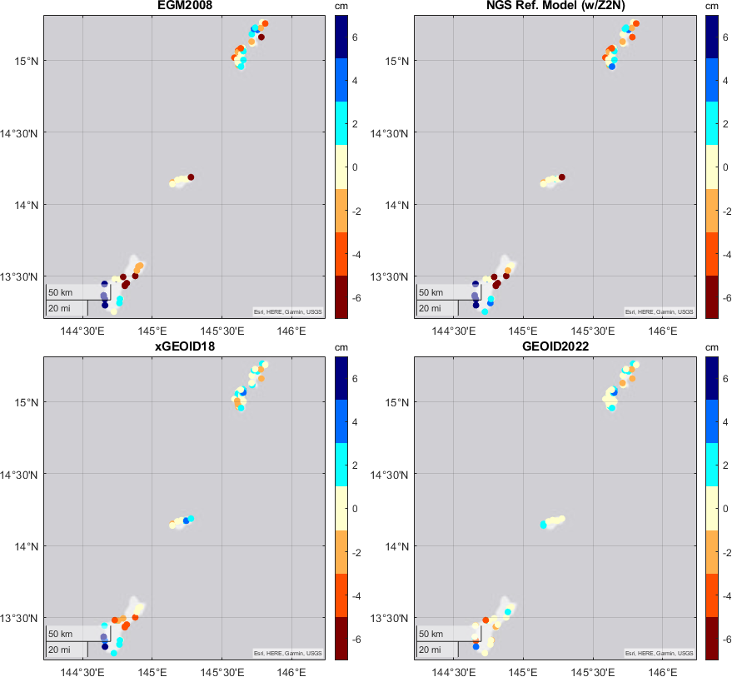
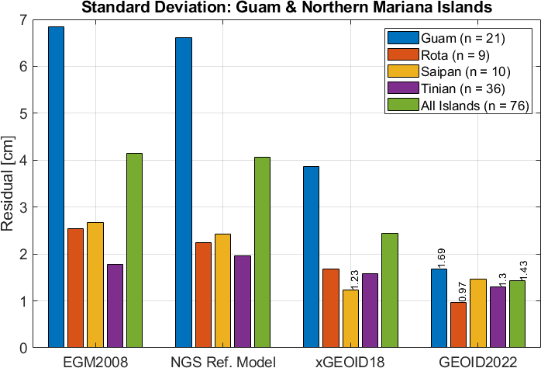
Guam and Commonwealth of Northern Mariana Islands
Saipan
Regional model tailored to the local region; very similar to the main, North American-Pacific geoid model
Coverage includes Palau, Micronesia, Wake Island, Marshall Islands
Comparisons with local GNSS\leveling show GEOID2022 has 65% improvement over EGM2008 and 40% improvement over most recent NGS model, xGEOID18
Tinian
Rota
Guam

Slide 28
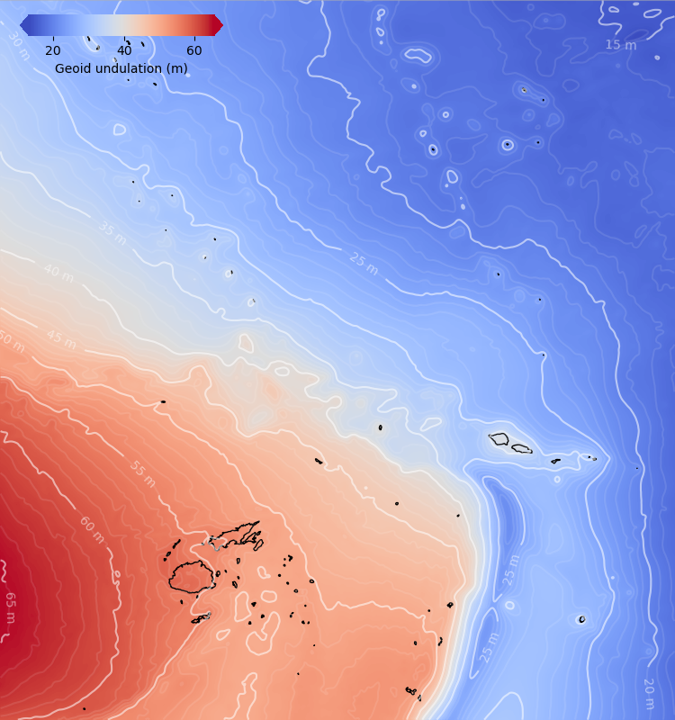
American Samoa
0º
Regional model tailored to the local region; very similar to the main, North American-Pacific geoid model
Coverage includes Fiji, Samoa, Tuvalu, Tokelau, Wallis and Futuna, Niue, Tonga
GNSS\Leveling and GEOID2022: 1.9 cm std. dev. | 11.4 cm for EGM2008 | 6.2 cm for xGEOID18 (83% | 69%)
-22º
172º
193º

Slide 29
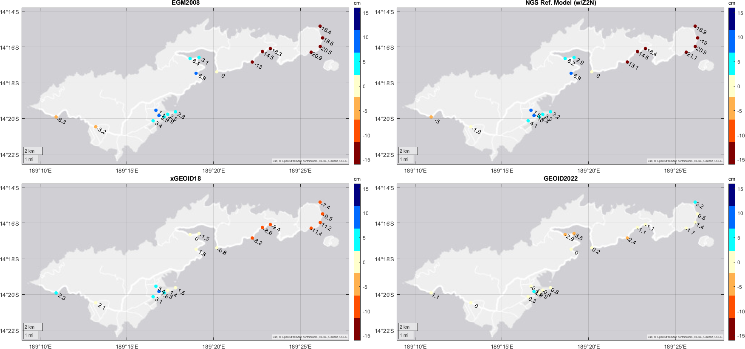
American Samoa: GNSS\leveling comparisons
σ = 11.4 cm
σ = 6.2 cm
σ = 6.2 cm
σ = 1.9 cm

Slide 30
Conclusions:
Updated GEOID2022:
  Contributions from NGS/CGS/INEGI
Additional models within NAPGD2022
  DEFLEC2022, GRAV2022, GM2022
Improvement to online tools / visualizations
Model performance continues to improve:
  GSVS: σ = 1 cm, 1.1 cm, 1.4 cm (30% improvement)
  Puerto Rico/US VI: σ = 3.6 cm
  Guam: σ = 1.4 cm
  American Samoa: σ = 1.9 cm
ngs.feedback@noaa.gov
Kevin Ahlgren
kevin.ahlgren@noaa.gov
NOAA’s National Geodetic Survey
https://alpha.ngs.noaa.gov/NAPGD2022

