Slide 1



Preparing for Change:
New Coordinates Coming in 2022
March 21, 2019
Dan Martin
Northeast Regional Geodetic Advisor
ME, NH, VT, MA, CT, RI, NY, NJ
Dan.martin@noaa.gov
240-676-4762

Slide 2
Session description and objectives
In 2022, the National Geodetic Survey will be replacing the U.S. horizontal and vertical datums (NAD 83 and NAVD 88). We will briefly discuss the history of these datums, their relationship to other reference frames, the reasons for the change, and how it affects positioning professionals and their access to these datums.
Objective…gain a fundamental understanding of:
  How and why our datums/reference frames have changed over time
  The need to further modernize the US reference frames
  How users will access the new reference frames
  New State Plane Coordinate Systems

Slide 3
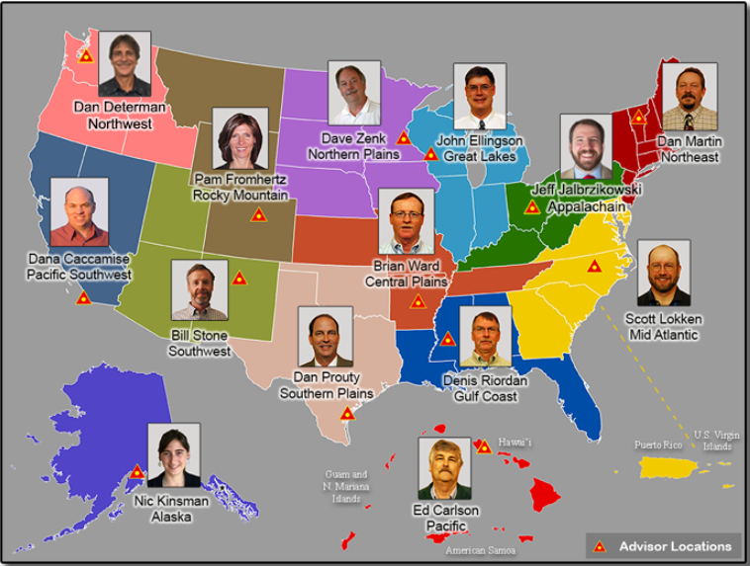

Slide 4
National Spatial Reference System
(NSRS)
NGS Mission: To define, maintain & provide access to the National Spatial Reference System (NSRS) to meet our Nation’s economic, social & environmental needs
Consistent National Coordinate System
Latitude/Northing
Longitude/Easting
Height
Scale
Gravity
Orientation
& how these values change with time

Slide 5
GEODETIC DATUMS
  HORIZONTAL
  2 D (Latitude and Longitude) (e.g. NAD 27, NAD 83 (1986))
  VERTICAL
  1 D (Orthometric Height) (e.g. NGVD 29, NAVD 88, Local Tidal)
  GEOMETRIC
  3 D (Latitude, Longitude and Ellipsoid Height)
  Fixed and Stable - Coordinates seldom change
  (e.g. NAD 83 (1996), NAD 83 (2007), NAD 83 (CORS96) NAD 83 (2011))
  also
  4 D (Latitude, Longitude, Ellipsoid Height, Velocities) Coordinates change with time
  (e.g. ITRF00, ITRF08)

Slide 6
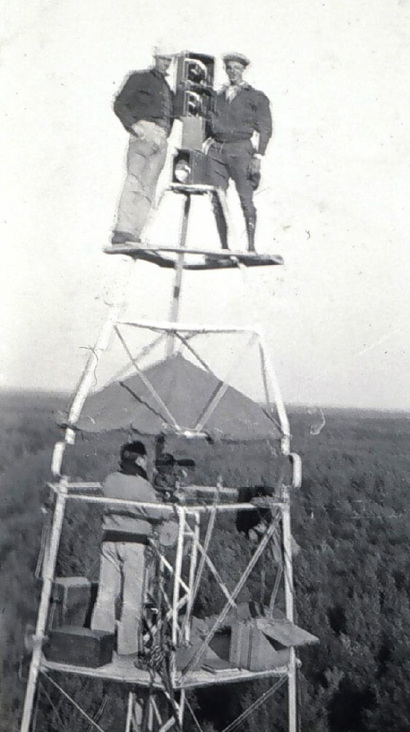
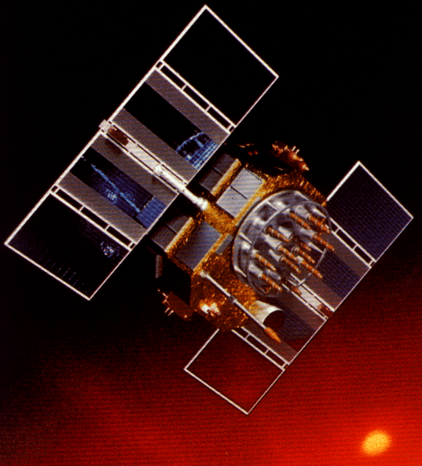
A (very) brief history of NAD 83
Original realization completed in 1986
  Consisted (almost) entirely of classical (optical) observations
“High Precision Geodetic Network” (HPGN) and “High Accuracy Reference Network” (HARN) realizations
  Most done in 1990s, essentially state-by-state
  Based on GNSS but classical stations included in adjustments
National Re-Adjustment of 2007
  NAD 83(CORS96) and (NSRS2007)
  Simultaneous nationwide adjustment (GNSS only)
New realization: NAD 83(2011) epoch 2010.00

Slide 7
Why change datums/realizations
NAD27 based on old observations and old system
NAD83(86) based on old observations and new system
NAD83(9x-96) based on new and old observations and same system (HARN/FBN)
NAD83(NSRS2007) based on new observations and same system. Removed regional distortions and made consistent with CORS
NAD83(2011) based on new observations and same system. Kept consistent with CORS

Slide 8
National Spatial Reference System (NSRS) Improvements over time
NETWORK TIME NETWORK LOCAL SHIFT
SPAN ACCURACY ACCURACY
NAD 27 1927-1986 10 meter s (1:100,000) 10-200 m
NAD83(86) 1986-1990 1 meter (1:100,000) 0.3-1.0 m
NAD83(199x)* 1990-2007 0.1 meter (1:1 million) 0.05 m
“HARN”, “FBN” (1:10 million)
NAD83(NSRS2007) 2007-2011 0.01 meter 0.01 meter 0.03 m
NAD83(2011) 2011- 0.01 meter 0.01 meter 0.01 m

Slide 9
Horizontal Datums/Coordinates…What do we (you) use in your state?
NAD 27
NAD 83 (Lat-Lon) SPC
  Which one???
    NAD 83 (1986)
    NAD 83 (19xx HARN)
    NAD 83 (1996)
    NAD 83 CORS96(2002)
    NAD 83 (NSRS2007)
    NAD 83 (2011) epoch 2010.00
WGS 84
  Which one???
    WGS 84 (1987)
    WGS 84 (G730)
    WGS 84 (G873)
    WGS 84 (G1150)
    WGS 84 (G1674)
    WGS 84 (G1762)
ITRFxx (epoch xxxx)
IGSxx (epoch xxxx)

Slide 10
ITRF2008
International Terrestrial Frame
For the geodesy, geophysics and surveying communities, the best International Terrestrial Reference Frame is the “gold standard.”
The global community adopted an updated expression for the reference frame, the ITRF2008.
10

Slide 11
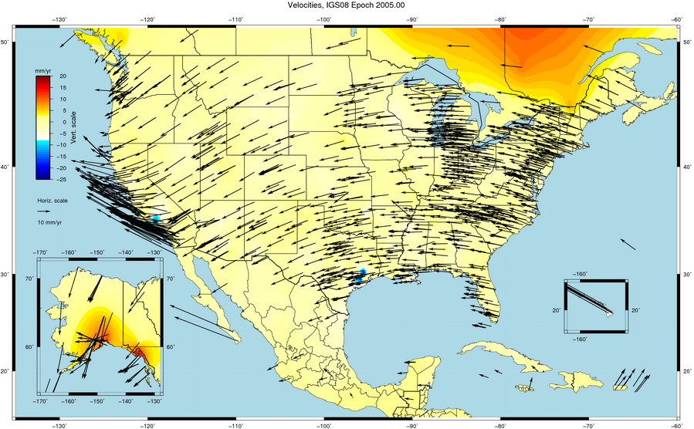

Slide 12
Simplified Concept of NAD 83 vs. ITRF08
h₈₃
h₀₈
Earth’s
Surface
ITRF 08
Origin
2.2 meters
NAD 83
Identically shaped ellipsoids (GRS-80)
a = 6,378,137.000 meters (semi-major axis)
1/f = 298.25722210088 (flattening)
Origin
Notes:
ITRF (International Terrestrial Reference Frame) just has an origin; take NAD83 shaped ellipsoid centered at the ITRF origin to derive ITRF97 ellipsoid heights.
Ellipsoid heights NAD83 vs. ITRF97 - Defined origins are best estimate of the center of mass; NAD83 is not geocentric. Move origin; move ellipsoid surface as illustrated.
Ellipsoid height differences reflect the non-geocentricity of NAD83.

Slide 13
History of vertical datums in the USA
NGVD 29
  National Geodetic Vertical Datum of 1929
  Original name: “Sea Level Datum of 1929”
  “Zero height” held fixed at 26 tide gauges
    Not all on the same tidal datum epoch (~ 19 yrs)
  Did not account for Local Mean Sea Level variations from the geoid
    Thus, not truly a “geoid based” datum

Slide 14
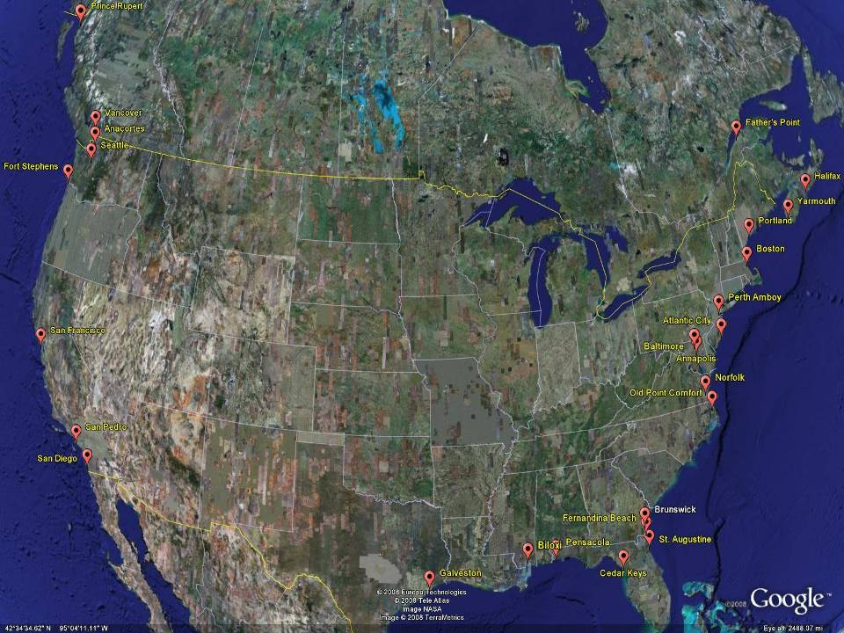
NGVD29
The National Geodetic Vertical Datum of 1929 is referenced to 26 tide gauges in the US and Canada
Notes:
It turns out that MSL is a close approximation to another surface, defined by gravity, called the geoid, which is the true zero surface for measuring elevations. Because we cannot directly see the geoid surface, we cannot actually measure the heights above or below the geoid surface. We must infer where this surface is by making gravity measurements and by modeling it mathematically. For practical purposes, we assume that at the coastline the geoid and the MSL surfaces are essentially the same. Nevertheless, as we move inland we measure heights relative to the zero height at the coast, which in effect means relative to MSL.
Definition: NGVD29 – The National Geodetic Vertical Datum of 1929…
The Sea Level Datum of 1929 was the vertical control datum established for vertical control surveying in the United States of America by the General Adjustment of 1929. The datum was used to measure elevation or altitude above, and depression or depth below, mean sea level (MSL).
Mean sea level was measured at 26 tide gauges: 21 in the United States and 5 in Canada. The datum was defined by the observed heights of mean sea level at the 26 tide gauges and by the set of elevations of all bench marks resulting from the adjustment. The adjustment required a total of 66,315 miles (106,724 km) of leveling with 246 closed circuits and 25 circuits at sea level.
Since the Sea Level Datum of 1929 was a hybrid model, it was not a pure model of mean sea level, the geoid, or any other equipotential surface. Therefore, it was renamed the National Geodetic Vertical Datum of 1929 (NGVD 29) in 1973. The NGVD 29 was subsequently replaced by the North American Vertical Datum of 1988 (NAVD 88) based upon the General Adjustment of the North American Datum of 1988.

Slide 15
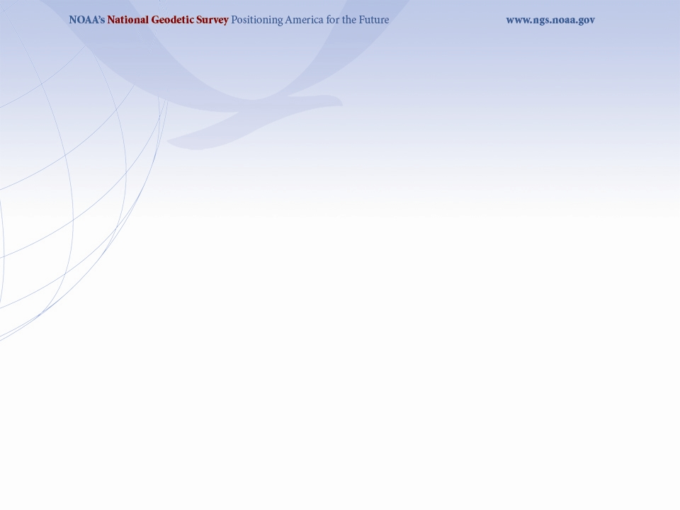
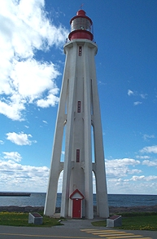
Current Vertical Datum in the USA
NAVD 88: North American Vertical Datum of 1988
Definition: The surface of equal gravity potential to which orthometric heights shall refer in North America*, and which is 6.271 meters (along the plumb line) below the geodetic mark at “Father Point/Rimouski” (NGSIDB PID TY5255).
Realization: Over 500,000 geodetic marks across North America with published Helmert orthometric heights, most of which were originally computed from a minimally constrained adjustment of leveling and gravity data, holding the geopotential value at “Father Point/Rimouski” fixed.
Father Point Lighthouse, Quebec
*Not adopted in Canada
Notes:
By fixing the geopotential value at the origin point, it was possible to ensure that the origins of IGLD 85 and NAVD 88 aligned.
*It should be pointed out that while the datum was defined in such a way as to be usable on the North American continent, it was never actually adopted in Canada. It can be used there, but it’s not their official civilian datum.
Note that the designation of the vertical control point at Father Point is “1250 G=NAVD 88 DATUM POINT” for PID# TY5255 and is not available from the publicly accessible NGSIDB.

Slide 16
History of vertical datums in the USA
NAVD 88 (continued)
  Use of one fixed height removed local sea level variation problem of NGVD 29
  Use of one fixed height did open the possibility of unconstrained cross-continent error build up
  But the H=0 surface of NAVD 88 was supposed to be parallel to the geoid…(close again)

Slide 17
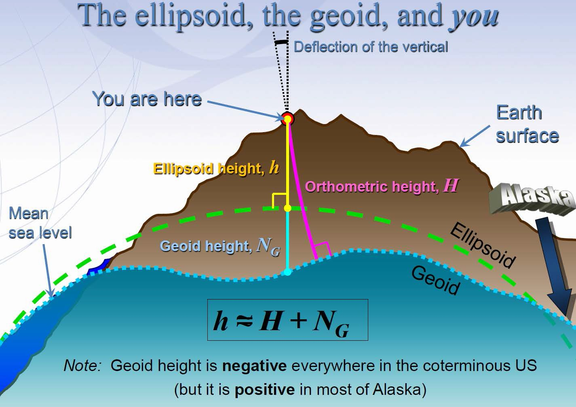
3

Slide 18
Which Geoid for Which NAD 83?
NAD 83(2011)
NAD 83(2007)
NAD 83(1996) & CORS96
Geoid12A/12B
Geoid09
Geoid06 (AK only)
Geoid03
Geoid99
Geoid96

Slide 19
Problems with NAD 83 and NAVD 88
NAD 83 is not as geocentric as it could be (approx. 2 m)
  Positioning Professionals don’t see this - Yet
NAD 83 is not well defined with positional velocities
NAVD 88 is realized by passive control (bench marks) most of which have not been re-leveled in at least 40 years.
NAVD 88 does not account for local vertical velocities (subsidence and uplift)
  Post glacial isostatic readjustment (uplift)
  Subsurface fluid withdrawal (subsidence)
  Sediment loading (subsidence)
  Sea level rise

Slide 20
Why isn’t NAVD 88 good
enough anymore?
Earth’s
Surface
H (NAVD 88)
H
NAVD 88 reference level
The Geoid
Errors in NAVD 88 : ~50 cm average,
100 cm CONUS tilt,
1-2 meters average in Alaska
Notes:
This slide shows what NGS now knows about the error in NAVD 88 itself. Using a continental geoid computed from the GRACE satellite, a bias and tilt in NAVD 88 has been computed using GPS derived ellipsoid heights on NAVD 88 bench marks. These are now known errors that exist in all NAVD 88 bench marks. This datum realization error, relative to the geoid, is over and above the errors from marks moving.

Slide 21
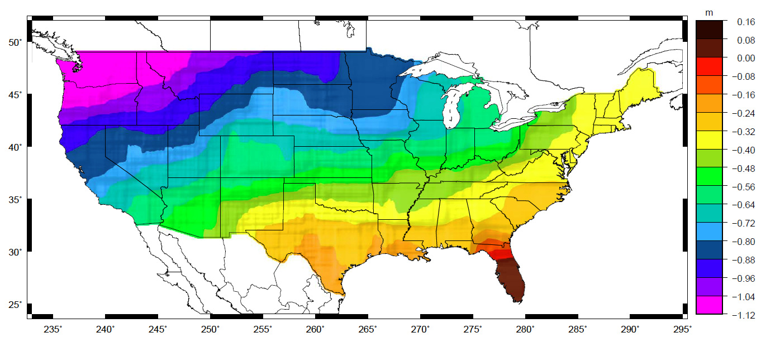
Why isn’t NAVD 88 good
enough anymore?
Approximate level of geoid mismatch known to exist in the NAVD 88 zero surface:
Notes:
This map reflects the sort of height changes that users could expect if NAVD 88 were replaced with a geoid-based vertical datum.
This is only a large scale approximation and should not be used as an absolute guide. Each benchmark might have its own level
Of mismatch, say from uplift or subsidence, not captured by this broad brush.
Also, this is the difference between the zero level of NAVD 88 and the actual geoid. The difference between NAD 83 ellipsoid heights and
ITRF/GRS-80 ellipsoid heights has NO influence on this graph and should not be part of the story.
Updated October 2010

Slide 22

The National Geodetic Survey 10 year plan
Mission, Vision and Strategy
2008 – 2018, 2013-2023
http://www.ngs.noaa.gov/INFO/NGS10yearplan.pdf
Official NGS policy as of Jan 9, 2008
  Modernized agency
  Attention to accuracy
  Attention to time-changes
  Improved products and services
  Integration with other fed missions
2022 Targets:
  NAD 83 and NAVD 88 re-defined
  Cm-accuracy access to all coordinates
  Customer-focused agency
  Global scientific leadership
Notes:
Realization and unification of NAD83 in Canada and the U.S. via the ITRF.
http://www.geod.nrcan.gc.ca > Geodetic Survey Division > Publications > Papers

Slide 23
Scientific Decisions
Blueprint for 2022, Part 1: Geometric
  Four plate-fixed Terrestrial Reference Frames
    And what “plate fixed” means
  Mathematical equation between IGS and TRFs
    Plate Rotation Model for each plate
    Coordinates at survey epoch
  Intra-frame velocity model
    To compare coordinates surveyed at different epochs

Slide 24
Names
The Old:
NAD 83(2011)
NAD 83(PA11)
NAD 83(MA11)
The New:
The North American Terrestrial Reference Frame of 2022
(NATRF2022)
The Caribbean Terrestrial Reference Frame of 2022
(CTRF2022)
The Pacific Terrestrial Reference Frame of 2022
(PTRF2022)
The Mariana Terrestrial Reference Frame of 2022
(MTRF2022)

Slide 25
Future Geometric Reference Frame
CORS-based, via GNSS
coordinates & velocities in ITRF and official US datum
Identical to the latest IGS reference frame (as available in 2022) at an epoch to be determined
replace NAD 83 with new geometric reference frame – by 2022
passive control tied to new datum; not a component of new datum
address user needs of datum coordinate constancy vs. accuracy
lat / long / ellipsoid height of defining points accurate to 1 mm, anytime
CORS coordinates computed / published daily; track changes
support development of real-time networks

Slide 26
Replace NAD 83
Simplified concept of NAD 83 vs. “2022”
Earth’s Surface
h_{”2022”}
h_{NAD83}
φ_{NAD83} – φ_{”2022”}
λ_{NAD83} – λ_{”2022”}
h_{NAD83} – h_{”2022”}
all vary smoothly by latitude and longitude
“2022” origin (aligned with ITRF)
~2.24 m
NAD 83 origin
Notes:
When NAD 83 was first developed, the intent was to make it as geocentric as possible. However as technology progressed, especially space geodesy, knowledge of the geocenter got better and showed that NAD 83 was over 2 meters non-geocentric. A decision was made at NGS to *not* update the origin, as that would have defined a new datum, and NAD 83 was still in the process of being adopted even 10 years after its debut.
Since then, however, the accessibility of cm level geocentric positioning has grown, and this mismatch (and its related horizontal errors in latitude and longitude) are now becoming more and more obvious. As such, when NAD 83 is replaced in 2022, the new system will be much more geocentric.

Slide 27
Scientific Decisions!!
Blueprint for 2022, Part 2: Geopotential
  Global 3-D Geopotential Model (GGM)
    Will contain all GRAV-D data
    Able to yield any physical value on/above surface
  Special high-resolution geoid, DoV and surface gravity products consistent with GGM
    Not global: NA/Pacific, American Samoa, Guam/CNMI
  Time-Dependencies
    Geoid monitoring service
      Impacts of deglaciation, sea level rise, earthquakes, etc

Slide 28
Names
  The Old:
  NAVD 88
  PRVD 02
  VIVD09
  ASVD02
  NMVD03
  GUVD04
  IGLD 85
  IGSN71
  GEOID12B
  DEFLEC12B
Orthometric
Heights
  The New:
  The North American-Pacific Geopotential Datum of 2022 (NAPGD2022)
  - Will include GEOID2022
Normal
Orthometric
Heights
Dynamic
Heights
Gravity
Geoid
Undulations
Deflections of
the Vertical

Slide 29
Future Geopotential Reference Frame
replace NAVD88 with new geopotential reference frame – by 2022
gravimetric geoid-based, in combination with GNSS
monitor time-varying nature of gravity field
develop transformation tools to relate to NAVD88
build most accurate ever continental gravimetric geoid model (GRAV-D)
determine gravity with accuracy of 10 microGals, anytime
support both orthometric and dynamic heights
Height Modernization is fully supported

Slide 30
Why replace NAVD 88 and NAD 83?
ACCESS!
  easier to find the sky than a 60-year-old bench mark
  GNSS equipment is cheap and fast
ACCURACY!
  easier to trust the sky than a 60-year old bench mark
  immune to passive mark instability
GLOBAL STANDARDS!
  systematic errors of many meters across the US
  aligns with GPS, international efforts
  aligns with Canada, Mexico
Notes:
Things are looking up! GNSS technologies simplify and improve access to and accuracy of our spatial reference system.
While we can continue to leverage this technology to maintain the old datums, it makes sense to adopt GRAV-D results in an unpolluted form, and align it to modern global standards.

Slide 31
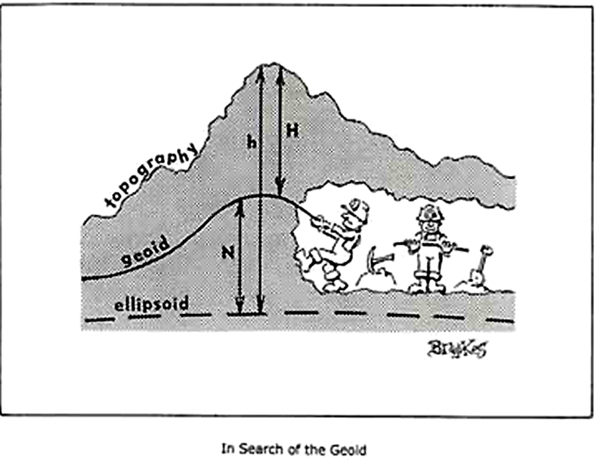

Slide 32
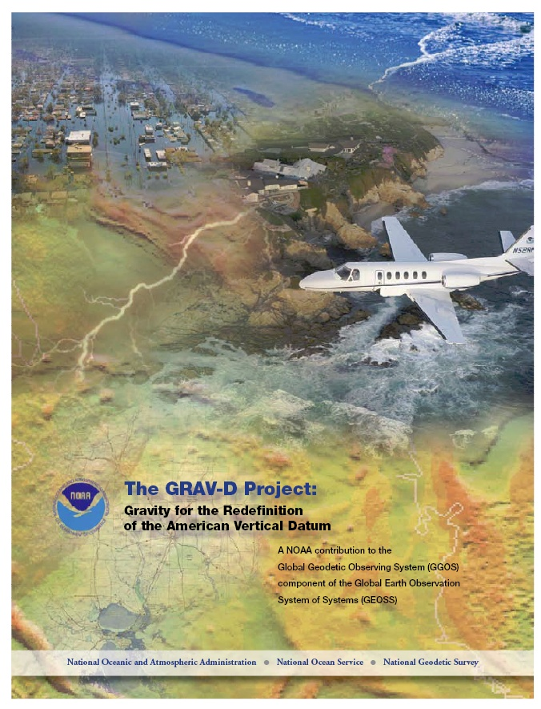
Gravity for the Redefinition of the American Vertical Datum (GRAV-D)
Replace the Vertical Datum of the USA by 2022 (at today’s funding) with a gravimetric geoid accurate to 1 cm
Orthometric heights accessed via GNSS accurate to 2 cm
Three thrusts of project:
  Airborne gravity survey of entire country and its holdings
  Long-term monitoring of geoid change
  Partnership surveys
Working to launch a collaborative effort with the USGS for simultaneous magnetic measurement
Gravity and Heights are
inseparably connected
Notes:
GRAV-D is the NGS project designed to replace NAVD88 with a vertical datum based upon a gravimetric geoid accurate to 1 cm. Heights above this datum will be accessed via GNSS measurements. Three thrusts of project. Launch USGS collaboration for simultaneous mag measurement.

Slide 33
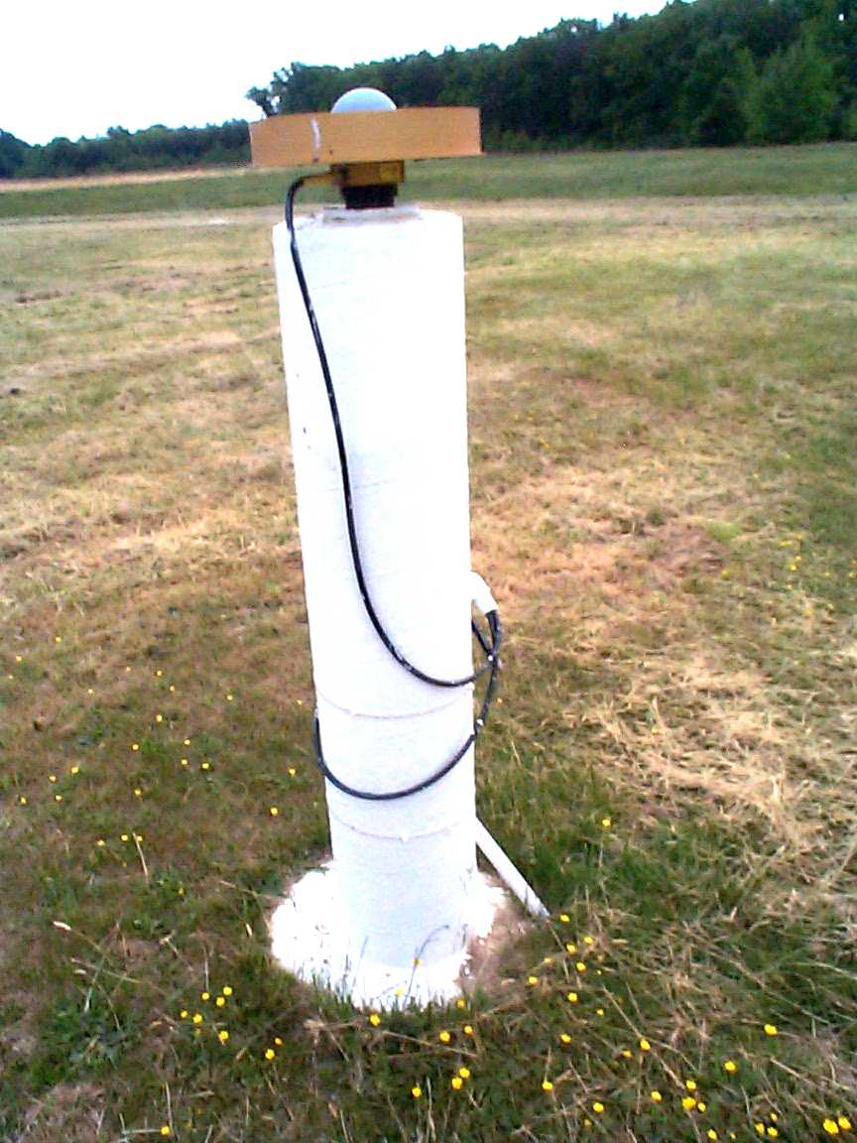
Accessing the New Datums
Primary access (NGS mission)
  Users with geodetic quality GNSS receivers will continue to use OPUS suite of tools
  Ellipsoid heights computed, and then a gravimetric geoid removed to provide orthometric heights in the new datum
  No passive marks needed
  But, could be used to position a passive mark
Secondary access (Use at own risk)
  Passive marks that have been tied to the new vertical datum
  NGS will provide a “data sharing” service for these points, but their accuracy (due to either the quality of the survey or the age of the data) will not be a responsibility of NGS
Continuously Operating Reference Station
Notes:
Multiple questions come up about using the new vertical datum. Two examples are given in the next few slides. The first is the example of how the new datum will address subsidence, say for floodplain mapping. The second example is about how the datum will be accessible when there aren’t bench marks in the immediate region of interest. Both examples rely on this simple formula:
Get an ellipsoid height (h) from GNSS in the latest geometric datum (the replacement for NAD 83)
Remove Subtract the NGS provided geoid model height (N)
The orthometric height in the new datum (H) is just H=h-N
NGS will eventually stop making the claim that we “know” the heights of bench marks as the method of providing access to the vertical datum. What NGS will do is provide the orthometric height to a user on the day of their survey (and with the disclaimer that this height should not be taken as “known” for very long, due to the dynamic nature of the Earth).

Slide 34
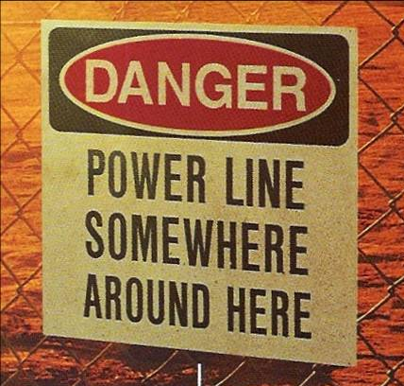
Why does all this stuff matter?
Geospatial data is everywhere
Usefulness diminished if stuff doesn’t line up
If problems easy to fix they already would be fixed
Courtesy of Michael Dennis

Slide 35
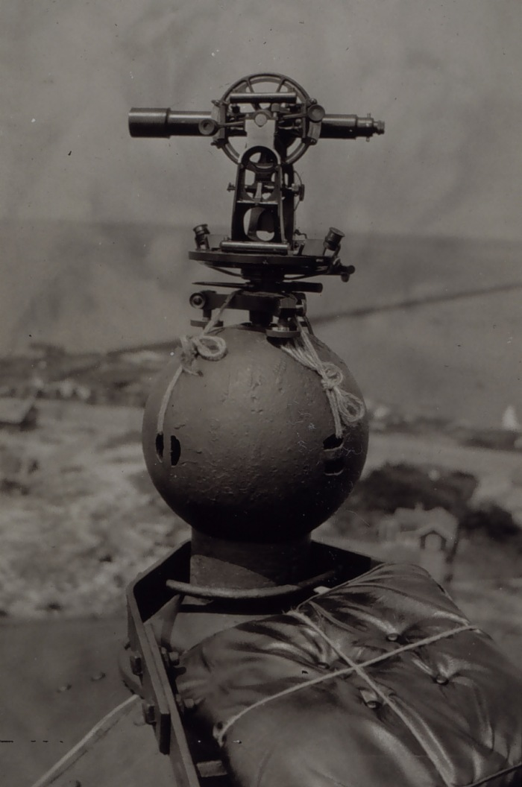
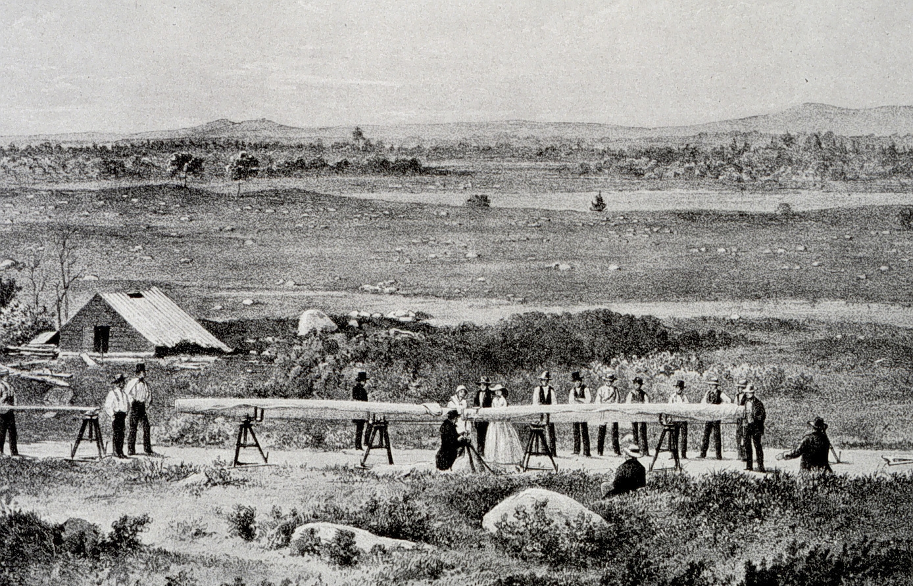
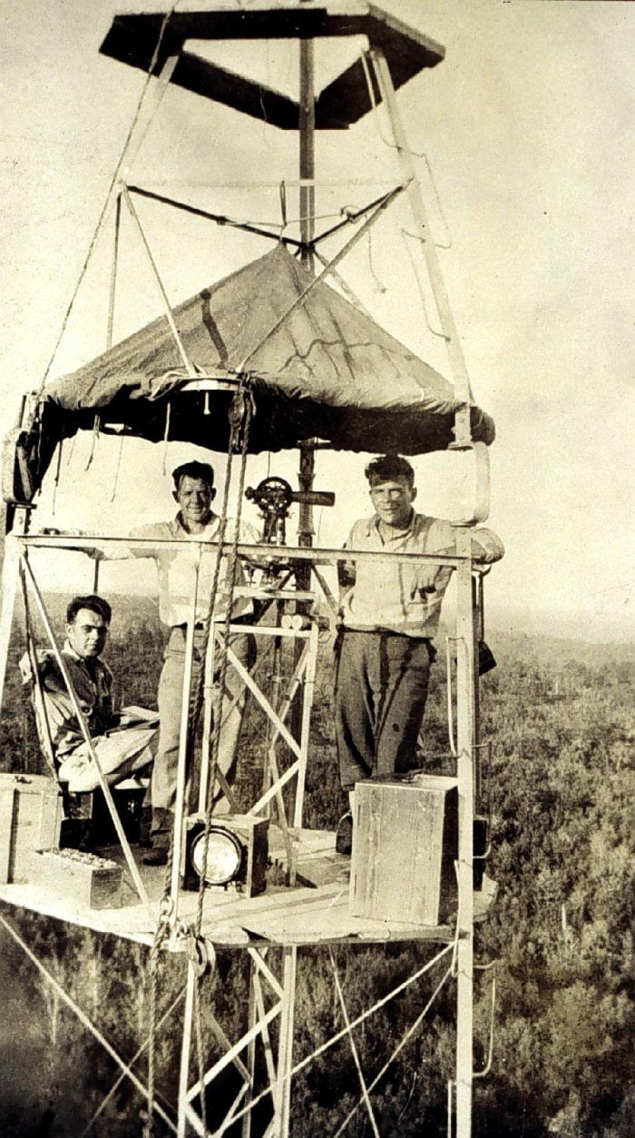
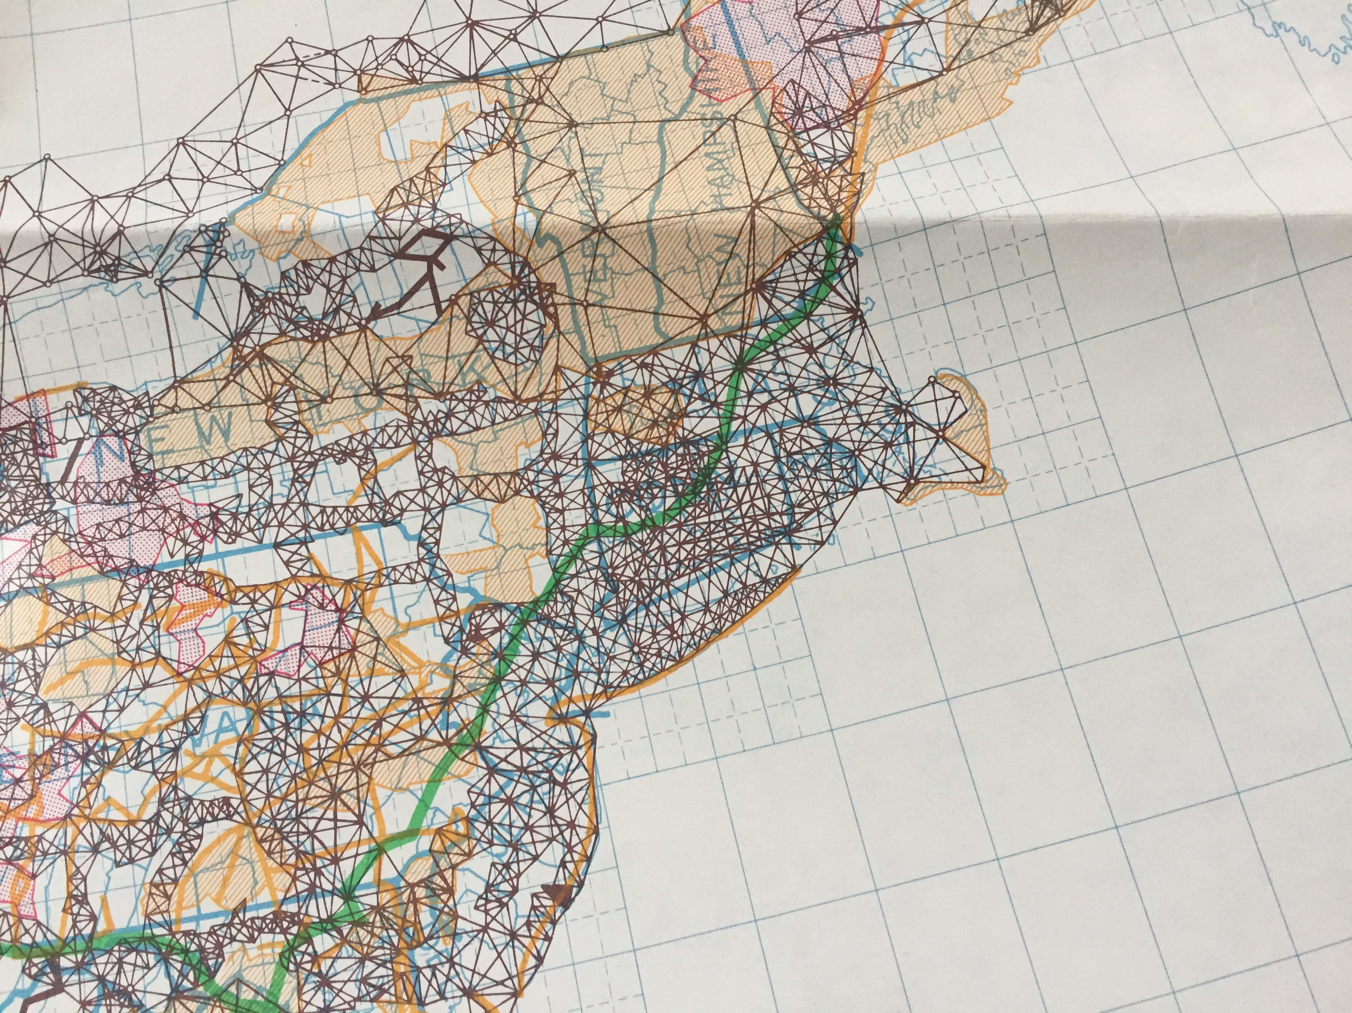
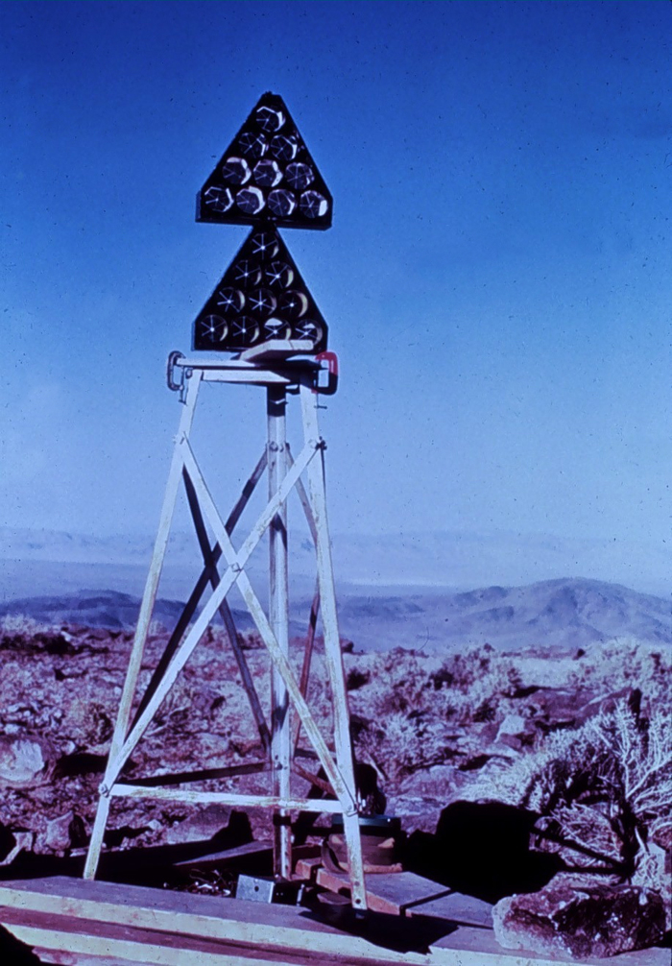
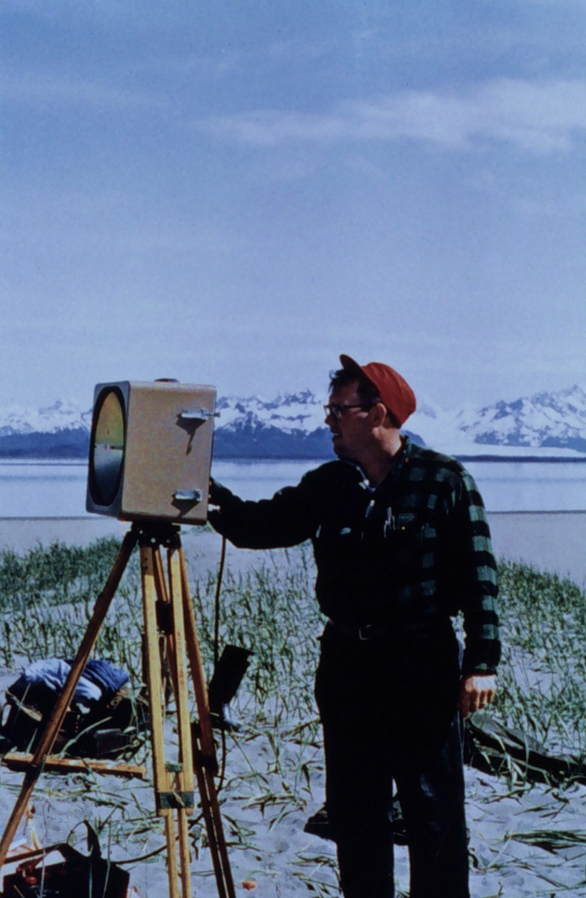
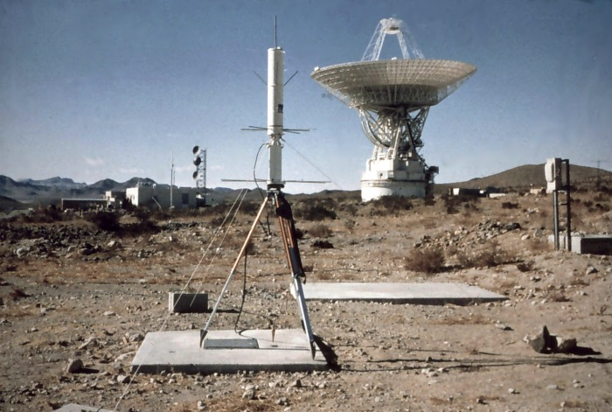
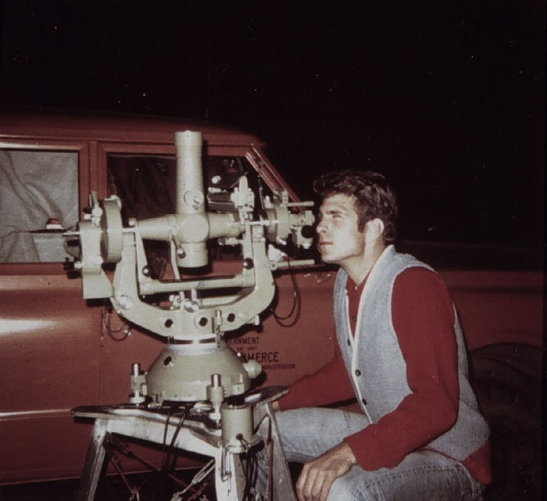
What does NAD 83(86) Imply?

Slide 36
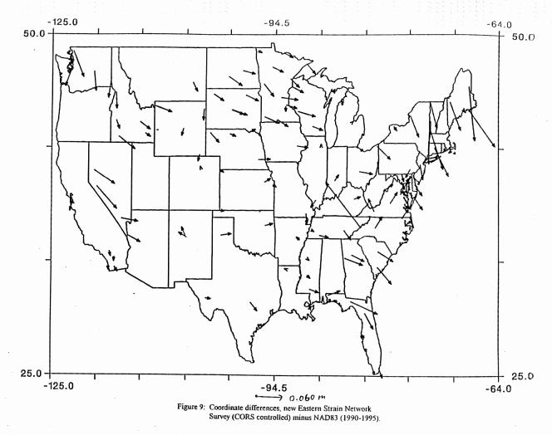
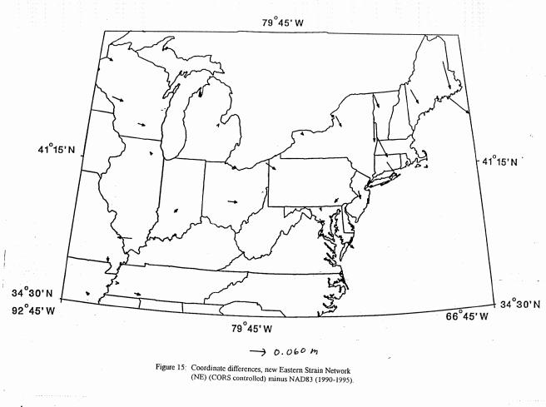
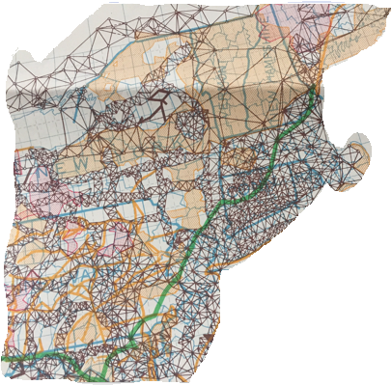
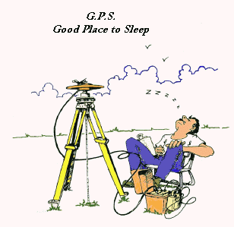
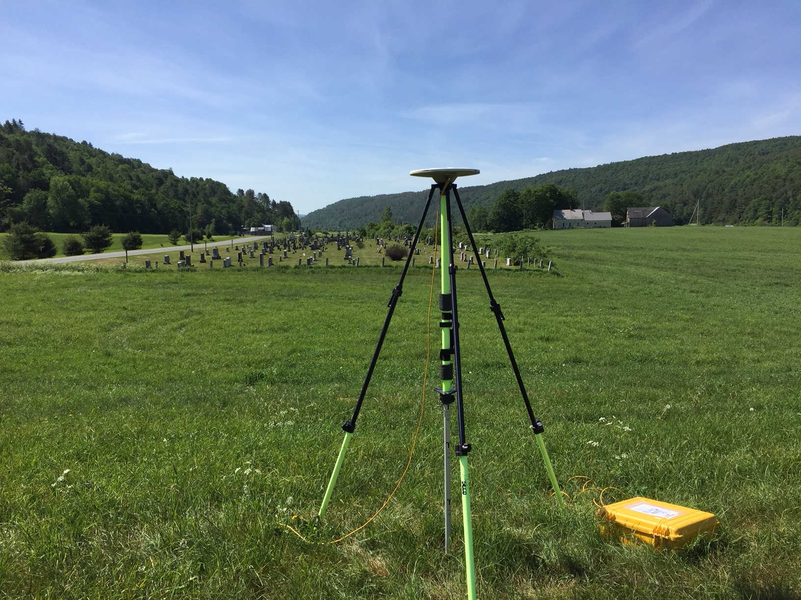
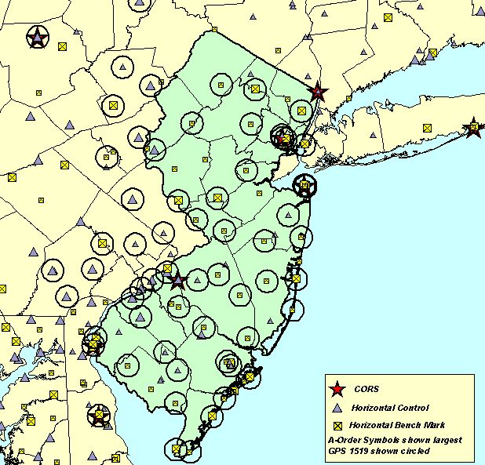
How about NAD 83(HARN/FBN)?

Slide 37
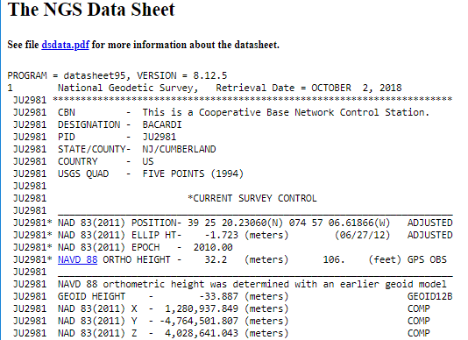
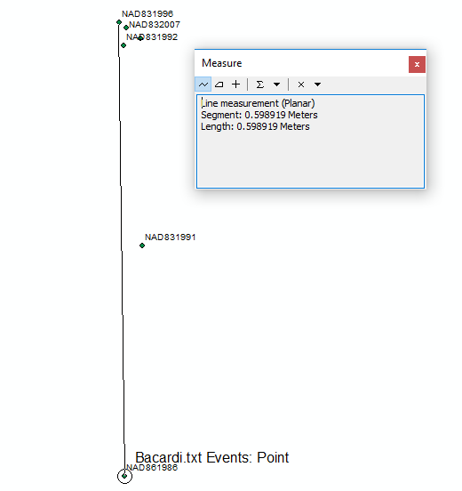
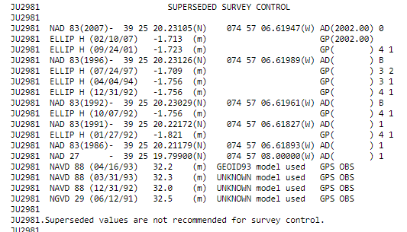
Where on Earth is this Mark?

Slide 38
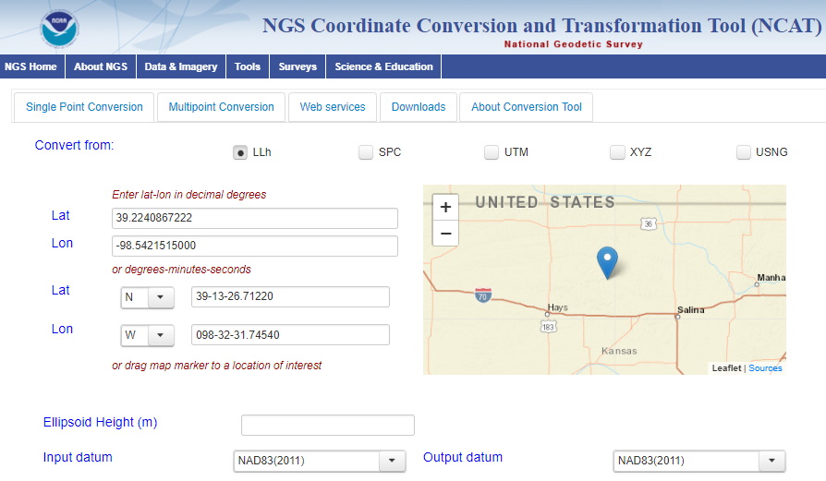
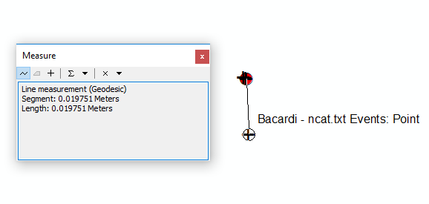
Transformations with NCAT
Actual NAD 83(2011) Position
+ Transformed Positions Using NCAT

Slide 39
Questions to ask before performing a datum transformation
What is the spatial accuracy?
What is the datum (geographic coordinate system)?
  Are you sure? How do you know?
What datum do you want to convert to?
  What method will you use?
  What is the accuracy?
  What if several to choose from?
Are there temporal issues?
  What is the input and output date (epoch)?
  How do you know the epoch?
Are you really sure you want to do this?

Slide 40
metadata to the rescue
your positional metadata should include:
  datum
  epoch
  source
these will facilitate transforming from current to new datum
maintaining your original survey data will provide more accurate results

Slide 41
New Datums: What to do now
Move to newest realizations.
NAD 83(2011) epoch 2010.00
USGG12 (gravimetric geoid) / GEOID12A (hybrid geoid)
Obtain precise ellipsoid heights on NAVD 88 bench marks.
(OPUS-DB, contact NGS Geodetic Advisor)
Improves hybrid geoid models and provides “hard points” in new vertical datum.
Follow new NGS Guidelines when released.
Move from NGVD 29 to NAVD 88.
Understand the accuracy of VERTCON in your area.
Move away from passive marks to GNSS.
Especially, move away from classical passive control.
Require/provide complete metadata for all mapping contracts.
How did they get the positions/heights? Document it!
Notes:
This slide is for more active users of the NSRS. So, we’ll be getting into a bit more technical detail than some need.

Slide 42
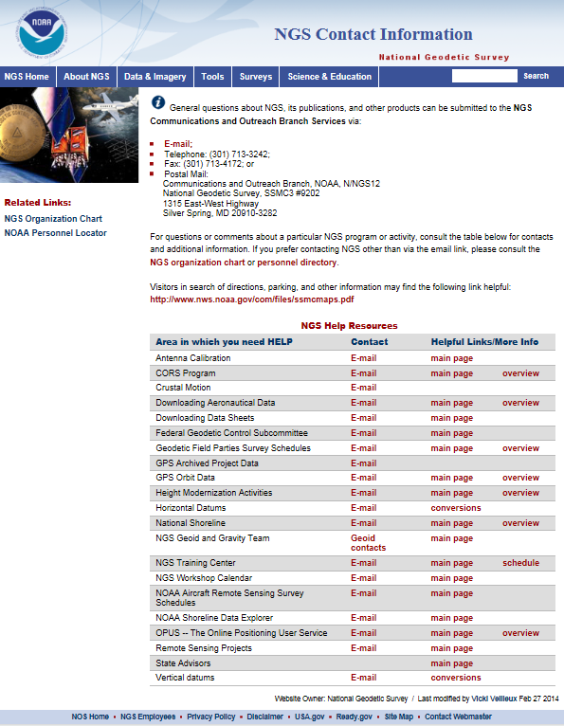
New Datums: How can you prepare?
Watch for upcoming NGS status
updates via conferences, reports, webinars.
Understand the impact of changing positions and heights for your community, company, or agency.
We’re here to help!
New Datums Webpage:
http://www.geodesy.noaa.gov/datums/newdatums/NewDatums.shtml
NGS Info Center: ngs.InfoCenter@noaa.gov
Find a Geodetic Advisor:
http://www.geodesy.noaa.gov/ADVISORS/AdvisorsIndex.shtml
Geometric Datum Manager:
Joe Evjen Joe.Evjen@noaa.gov
Geopotential Datum Manager:
Dr. Dru Smith Dru.Smith@noaa.gov

Slide 43
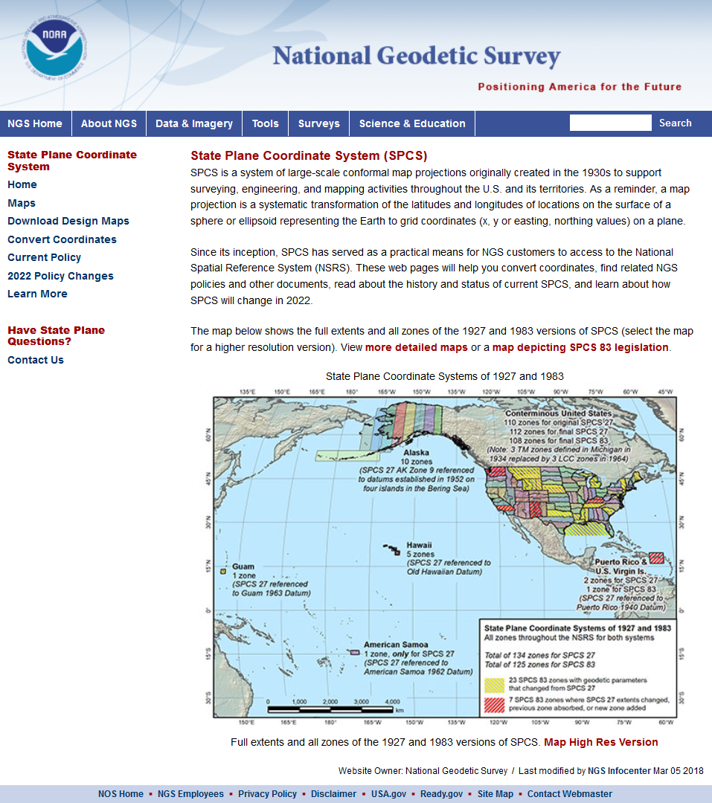
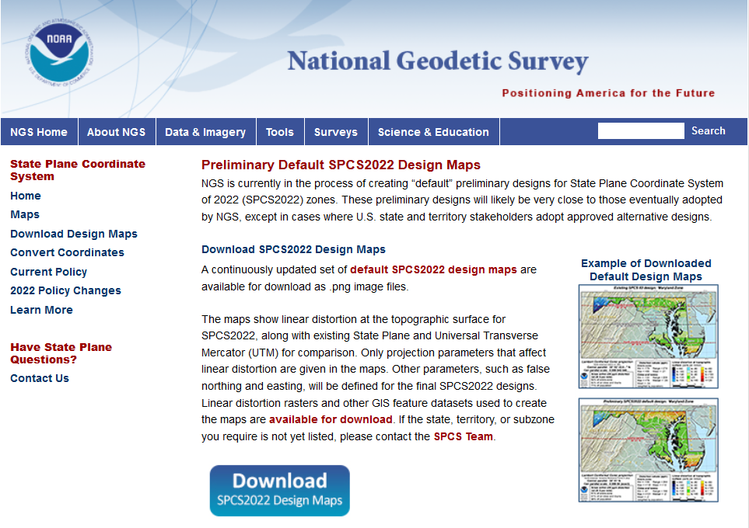
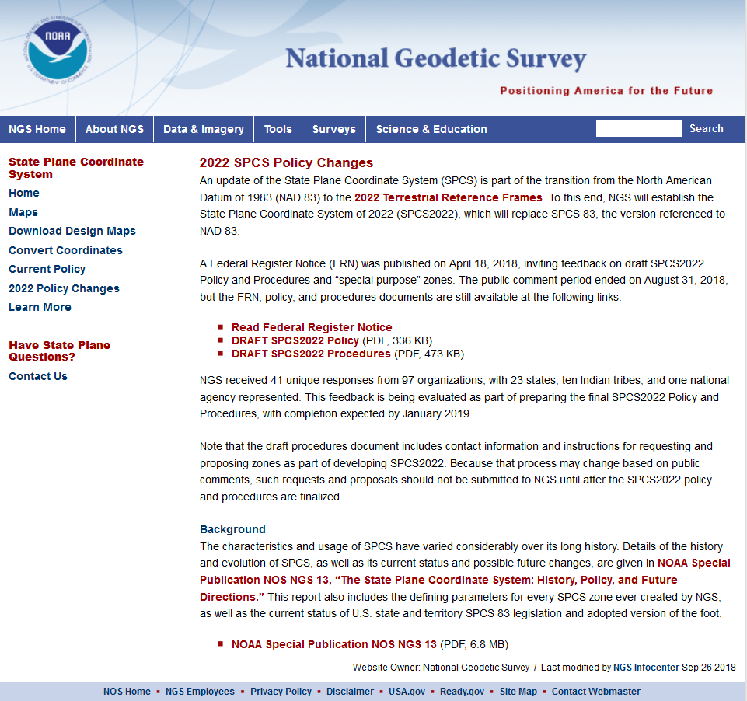

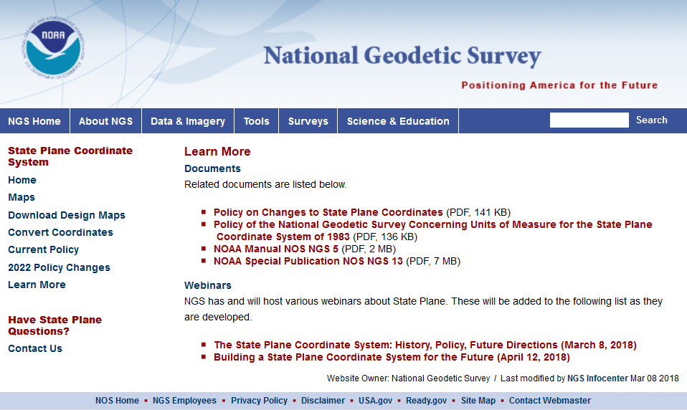
geodesy.noaa.gov/SPCS/
Notes:
A lot of information is available on the NGS website, including:
2022 policy changes
Supporting information (old policy and manuals, new report on SPCS history)
Maps of preliminary SPCS2022 designs available for download
Not all states yet available, but designs are in progress
Includes maps of existing SPCS 83 for comparison

Slide 44
Deadlines for SPCS2022 input
NGS.Feedback@noaa.gov by August 31, 2018
Anyone can comment!
Federal Register Notice (FRN)
Announcement and public comments
  On draft SPCS2022 policy & procedures
  On “special purpose” zones
SPCS2022 Procedures (draft)
Consensus input per SPCS2022 procedures
  Requests for designs done by NGS
  Proposals for designs by contributing partners
Submittal of approved designs
  Proposal must first be approved by NGS
  Designs must be complete for NGS to review
Later requests will be for changes to SPCS2022
NGS.SPCS@noaa.gov
by March 31, 2020 for requests and proposals
by March 31, 2021 for submittal of approved designs
State stakeholders only!

Slide 45
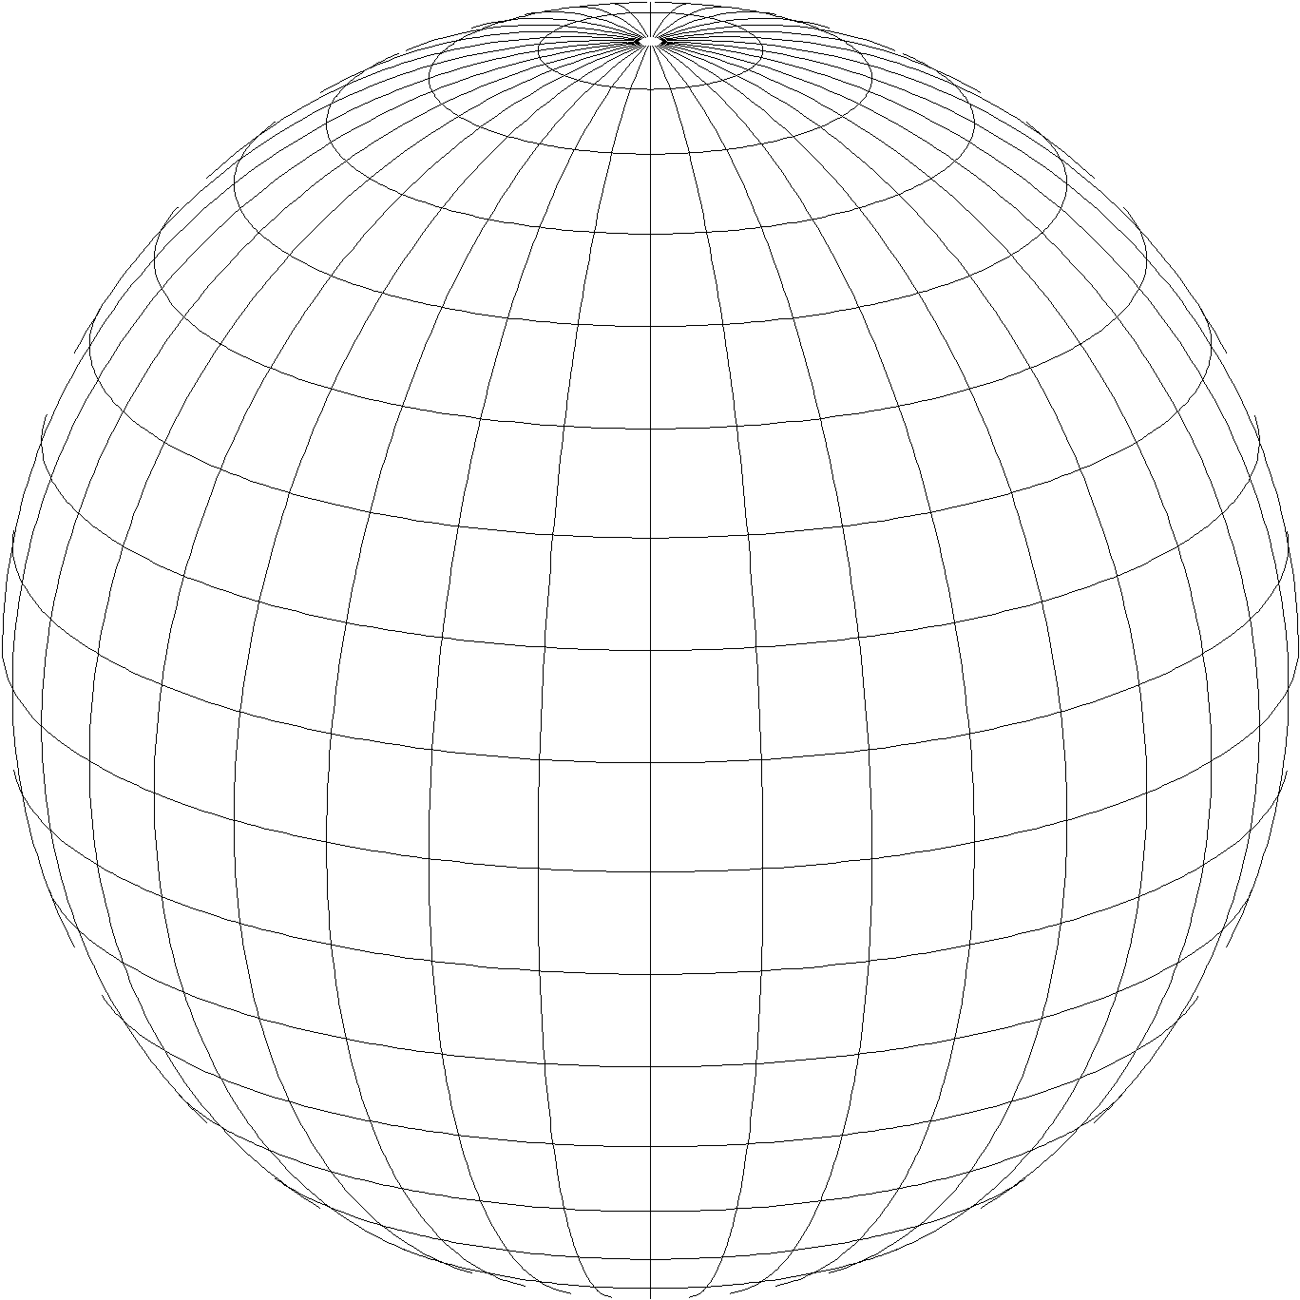
A New State Plane Coordinate System
State Plane Coordinate System of 2022 (SPCS2022)
  Referenced to 2022 Terrestrial Reference Frames (TRFs)
  Based on same reference ellipsoid as SPCS 83 (GRS 80)
  Same 3 conformal projection types as SPCS 83 and 27:
Lambert Conformal Conic (LCC)
Transverse Mercator (TM)
Oblique Mercator (OM)
Notes:
Now for the second part of the presentation, on new State Plane Coordinates
State Plane Coordinate System of 2022 (SPCS2022) is also part of modernizing the NSRS
Referenced to the new 2022 TRFs (not to NAD 83)
But still uses same reference ellipsoid (GRS 80) and same 3 conformal projections

Slide 46
SPCS2022 Policy & Procedures
Summary of main things that did NOT change
Policy
  Limited to LCC, TM, and OM projections
  Zones designed to reduce distortion at ground
  Default zones designed by NGS if no consensus input
  Parameters in meters, but feet allowed for output
Procedures
  Stakeholders must submit requests/proposals
  1-parallel LCC and local OM projection definitions
  Specified a linear distortion design criterion
  Limit NGS designs to minimum of ±50 ppm
  50 km min zone size for height range of 250 m or less
Notes:
A major component of SPCS2022 are stakeholders
Stakeholders have a role in helping define (and maintain) SPCS2022
A major stakeholder group is state DOTs, along with other geospatial groups as listed here
There is a formal process for stakeholders to submit REQUESTS and PROPOSALS for SPCS2022
Stakeholders must consist of one of the STATE groups listed, and
Input must be unanimous for NGS to act
NGS cannot act on input from individuals; they should work through a stakeholder group

Slide 47
Changes to SPCS2022 Policies
Summary of main changes
Allow “special use” zones
  But only for zone areas in more than 1 state
NGS will design statewide zone for every state
  Also will design default zones if no consensus request for something different from state stakeholders
Allow max of 3 layers (1 statewide + 2 multi-zone)
  But most states will have 1 or 2 layers
Added requirement that all zones be unique
Require positive east longitudes
Notes:
A major component of SPCS2022 are stakeholders
Stakeholders have a role in helping define (and maintain) SPCS2022
A major stakeholder group is state DOTs, along with other geospatial groups as listed here
There is a formal process for stakeholders to submit REQUESTS and PROPOSALS for SPCS2022
Stakeholders must consist of one of the STATE groups listed, and
Input must be unanimous for NGS to act
NGS cannot act on input from individuals; they should work through a stakeholder group

Slide 48
Linear distortion with respect to ellipsoid
Projection
axis
Projection surface (secant)
Ellipsoid distance
Grid distance > ellipsoid distance
Ellipsoid distance
Ellipsoid surface
This design approach
used for SPCS 27 and 83 (minimizes distortion with respect to ellipsoid)
Grid distance <
ellipsoid distance

Slide 49
Linear distortion with respect to topographic surface
Horizontal ground distance
> ellipsoid distance
and
> grid distance
Topographic surface
Projection
axis
Ellipsoid surface
Ellipsoid distance
Projection surface (secant)
Grid distance
> ellipsoid distance
< ground distance
This design approach
used for SPCS 27 and 83 (minimizes distortion with respect to ellipsoid)
Ellipsoid distance
Grid distance
< ellipsoid distance
< ground distance

Slide 50
“Non-intersecting” conformal map projection
Topographic surface
Grid distance = ground distance at a point
Projection
axis
Grid distance = ground distance at a point
Non-intersecting
Grid distance ≈ ground distance over finite distance
Purpose is to reduce linear distortion at “ground” (topographic surface).
But distortion can vary considerably across area of interest.
Ellipsoid surface

Slide 51
“Non-intersecting” conformal map projection
Topographic surface
Projection
axis
Non-intersecting
Ellipsoid surface

Slide 52
Changing projection axis to reduce distortion variation
Topographic surface
Grid distance = ground distance at many points
Projection
axis
Ellipsoid height of surface not constant:
h₁ ≠ h₂
h₂
Non-intersecting
h₁
Only way to reduce variation in distortion is to change projection axis location.
IMPORTANT: For large areas, there is no single defining ellipsoid height, h, for scaling the projection.
Ellipsoid surface
This design approach is being used for SPCS2022 (minimizes distortion with respect to topography)

Slide 53
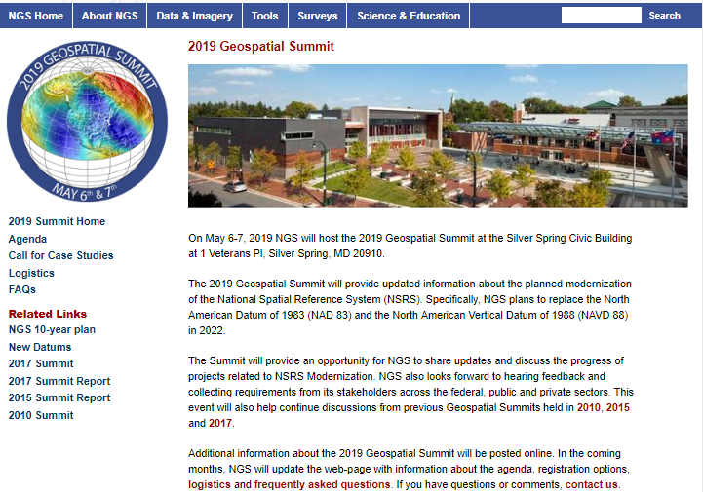
2019 Geospatial Summit

Slide 54
Questions?
Presentation available at:
https://www.ngs.noaa.gov/web/science_edu/presentations_library/
Dan Martin
Northeast Regional Geodetic Advisor
ME, NH, VT, MA, CT, RI, NY, NJ
Dan.martin@noaa.gov
240-676-4762

