Slide 1

Preparing for the Modernized NSRS - What Should You Do Now?
Dave Zenk, PE LS Northern Plains Regional Advisor
Dr. Dan Gillins, PhD Chief, Spatial Reference Systems Division
Dr. Kimber DeGrandpre, PhD Central Plains Regional Advisor (acting)
Galen Scott, Constituent Resources Manager
Notes:
Preparing for the Modernized NSRS - What Should You Do Now?
by
Dave Zenk
National Geodetic Survey
Northern Plains Regional Advisor
(MN, ND, SD, NE, IA)

Slide 2

Topics for Today
There are 3 Goals today
Provide an overall outline of the new datum,
Highlight current significant progress by NGS, and
Suggest preparatory steps for engineers, surveyors, and mappers.
Specific Topics:
GPS on BM for Transformation Tool
Passive Mark Network plots
Coordinate Shifts to Modernized NSRS
NGS Coordinate Conversion and Transformation Tool (NCAT)
M-Pages
NOS NGS 92
5 Preparation Steps
US Survey Foot & Unit Conversion
Additional Resources Lists
Notes:
There are 3 Goals today:
Provide an overall outline of the new datum,
Highlight current significant progress by NGS, and
Suggest preparatory steps for engineers, surveyors, and mappers.
Specific Topics:
GPS on BM for Transformation Tool
Passive Mark Network plots
Coordinate Shifts to Modernized NSRS
NCAT
M-Pages
NOS NGS 92
5 Preparation Steps
US Survey Foot
Unit Conversions
Additional Resources Lists

Slide 3

NSRS Background
The National Spatial Reference System (NSRS) consists of the nation’s latitude, longitude, height, scale, gravity, orientation, and how these values change over time.
https://geodesy.noaa.gov/INFO/OnePagers/NSRSOnePager.pdf
Notes:
The National Spatial Reference System (NSRS) consists of the nation’s latitude, longitude, height, scale, gravity, orientation, and how these values change over time.

Slide 4
NSRS Background
Background: Why is NGS replacing NAD 83 and NAVD 88?
NAD 83 and NAVD 88, although still the official horizontal and vertical datums of the National Spatial Reference System (NSRS), have been identified as having shortcomings that are best addressed through defining new horizontal and vertical datums. See the white paper:
  Improving the National Spatial Reference System (12 pages)
  https://geodesy.noaa.gov/2010Summit/Improving_the_NSRS.pdf
Specifically:
NAD 83 is non-geocentric by about 2.2 meters.
NAVD 88 is both biased (by about one-half meter) and tilted (by about 1 meter coast to coast) relative to the best global geoid models available today.
These issues derive from the fact that both datums were defined primarily using terrestrial surveying techniques at passive geodetic survey marks.
This network of survey marks deteriorates over time through unchecked physical movement and destruction, and resources are not available to maintain them.
Notes:
The NGS is replacing NAD 83 and NAVD 88
because they have shortcomings that are best addressed through defining new horizontal and vertical datums.
See the white paper:
Improving the National Spatial Reference System (12 pages)
https://geodesy.noaa.gov/2010Summit/Improving_the_NSRS.pdf
Specifically:
NAD 83 is non-geocentric by about 2.2 meters.
NAVD 88 is both biased (by about one-half meter) and tilted (by about 1 meter coast to coast) relative to the best global geoid models available today.
These issues derive from the fact that both datums were defined primarily using terrestrial surveying techniques at passive geodetic survey marks.
This network of survey marks deteriorates over time through unchecked physical movement and destruction, and resources are not available to maintain them.

Slide 5

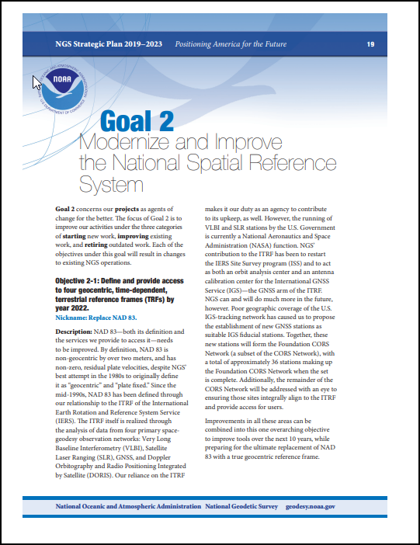
The NGS Strategic Plan
The NGS Strategic Plan - Goal 2: Modernize the NSRS.
https://www.ngs.noaa.gov/INFO/tenyearfinal.shtml
Notes:
The NGS Strategic Plan - Goal 2 specifically addresses the NSRS Modernization Plan.
You can read the plan at the web address shown on the screen.

Slide 6
Needed Research and Development
Major decisions needed to be made regarding how to define and maintain the Modernized NSRS.
These are documented. See the following reports:
  NOAA Technical Report NOS NGS 62
    Blueprint for 2022, Part 1: Geometric Coordinates (61 pages)
  NOAA Technical Report NOS NGS 64
    Blueprint for 2022, Part 2: Geopotential Coordinates (53 pages)
  NOAA Technical Report NOS NGS 67
    Blueprint for 2022, Part 3: Working in the Modernized NSRS (133 pages)
✓
https://geodesy.noaa.gov/library/
Note:
✓ = done
Notes:
Major decisions needed to be made regarding how to define and maintain the Modernized NSRS.
These are documented. See the following reports:
NOAA Technical Report NOS NGS 62
Blueprint for 2022, Part 1: Geometric Coordinates (61 pages)
NOAA Technical Report NOS NGS 64
Blueprint for 2022, Part 2: Geopotential Coordinates (53 pages)
NOAA Technical Report NOS NGS 67
Blueprint for 2022, Part 3: Working in the Modernized NSRS (133 pages)
Note that the checkmark means “done”.

Slide 7
Recent Progress at NGS
3 Geoid Slope Validation Survey (GSVS) success
  GSVS11 (Texas), GSVS14 (Iowa), GSVS17 (Colorado)
  to validate H = h-N
GRAV-D completion
  to enable computation of N in above equation
Vertical Datum Transformation Tool (GPS on BM Campaign)
NCAT Improvements
M-Pages
NOS NGS 92
Let’s take a brief look at these projects.
Notes:
Several enabling projects are needed for successful Modernization.
These include:
3 Geoid Slope Validation Surveys (GSVS)
GSVS11 (Texas), GSVS14 (Iowa), GSVS17 (Colorado)
to validate the equation H = h-N
GRAV-D completion
to enable the computation of N in the above equation
Vertical Datum Transformation Tool (GPS on BM Campaign)
NCAT Improvements
M-Pages
NOS NGS 92
Let’s take a brief look at these projects

Slide 8
Geoid Slope Validation success
NGS needed to prove that defining heights using gravity and a high-precision geoid model would be able to acceptably duplicate the results of traditional leveling.
Put in algebraic terms H = h - N:
Orthometric height (H) = Ellipsoid Height (h) – Geoid Model (N)
  Ellipsoid Height (h) will be measured using GPS
  Geoid Model (N) will be computed from the global gravity field
  Orthometric Height (H) will be computed.
NGS 10 Year Plan:
“the gravimetric geoid used in defining the NSRS should have an absolute accuracy of 1 centimeter at any place and at any time.”
by User
by NGS
Notes:
NGS needed to prove that defining heights using gravity and a high-precision geoid model would be able to acceptably duplicate the results of traditional leveling.
Quoting the NGS 10 Year Plan in part:
…the gravimetric geoid used in defining the NSRS should have an absolute accuracy of 1 centimeter at any place and at any time.”
Put in algebraic terms:
Orthometric height (H) = Ellipsoid Height (h) – Geoid Model (N)
Ellipsoid Height (h) will be measured using GPS
Geoid Model (N) will be computed from the global gravity field
Orthometric Height (H) will be computed.

Slide 9
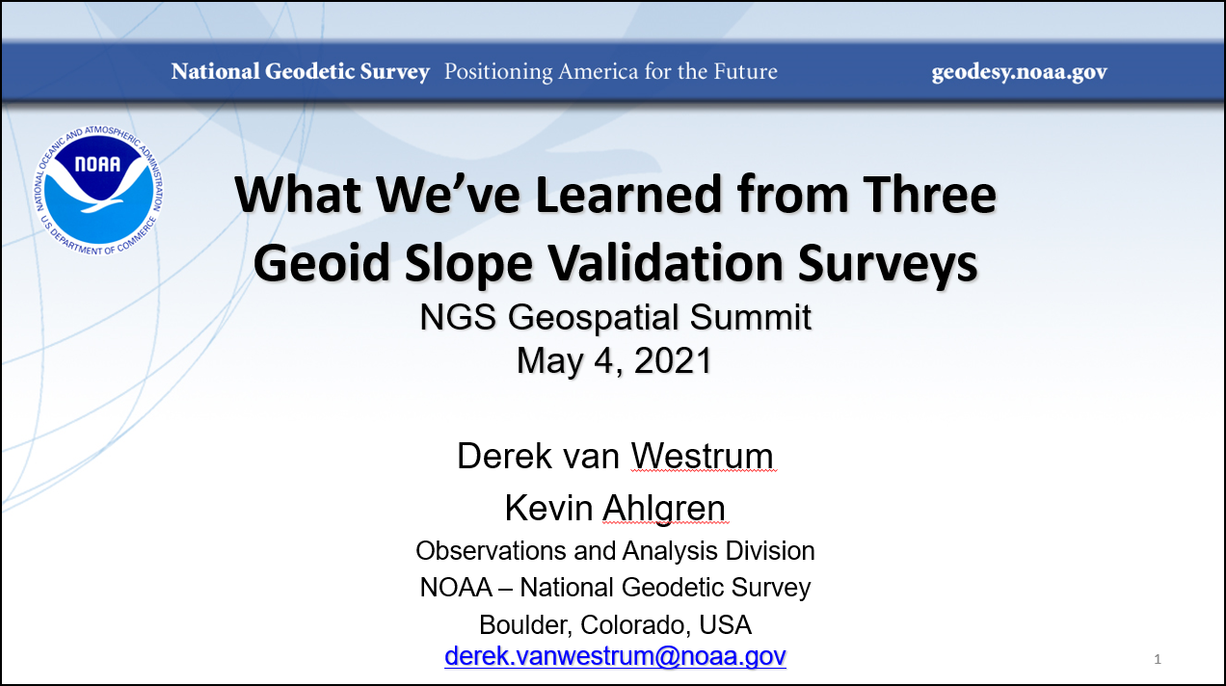
Geoid Slope Validation Success
Success, essentially complete!
✓
See NGS Presentations Library:
“Geoid Slope Validation Surveys - Ground Truth Tests of the Models” by Derek van Westrum
https://geodesy.noaa.gov/web/science_edu/presentations_library/files/vanwestrum_gsvssummary.pptx
Notes:
NGS has produced a summary slide set on the success of the GEOID Slope Validation Surveys.
You can view the slides at the NGS Presentation Library.

Slide 10
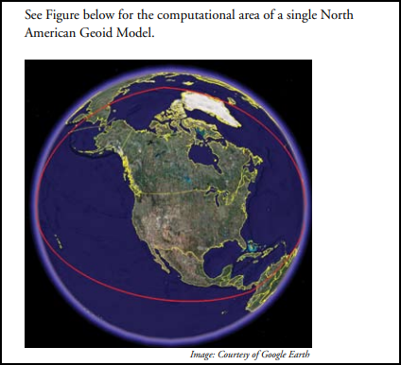

GRAV-D
Flying an airborne gravity meter at 20,000 feet.
Measure the Earth’s gravity field with sufficient density and accuracy to create a “geoid model” over ¼ of the Earth – to cover the USA.
Success
100% complete!
✓
https://www.ngs.noaa.gov/GRAV-D/pubs/GRAV-D_v2007_12_19.pdf
Notes:
The GRAV-D Mission required flying an airborne gravity meter at 20,000 feet to measure the Earth’s gravity field with sufficient density and accuracy to create a “geoid model” over ¼ of the Earth – to cover the USA.
The GRAV-D Mission passed the 99% complete status in October 2023.

Slide 11
Geoid Model (N)
GSVS proved that we are able to compute an acceptably accurate geoid model if we have adequate gravity field measurements.
Completion of GRAV-D provided the needed adequate gravity field measurements.
Result: NGS can now compute the needed Geoid Model (N)
✓
✓
Success, essentially complete!
Notes:
GSVS proved that we are able to compute an acceptably accurate geoid model if we have adequate gravity field measurements.
Completion of GRAV-D provided the needed adequate gravity field measurements.
With the result that NGS can now compute the needed Geoid Model (N)

Slide 12
GPS on BM Campaign
The NGVD29 and NAVD88 heights were defined by leveling, and the NAPGD2022 heights will be defined by H=h-N.
So, there is a need to transform heights in the former vertical datums to heights in the new datum.
A sample point for the transformation tool must have a published height from leveling (NGVD29 or NAVD88) and an ellipsoid height from GPS.
Since the presence of such marks is variable across the USA, NGS launched a GPS on BM Campaign to densify the collection of sample points.
Notes:
The NGVD29 and NAVD88 heights were defined by leveling, and the NAPGD2022 heights will be defined by H=h-N.
So, there is a need to transform heights in the former vertical datums to heights in the new datum.
A sample point for the transformation tool must have a published height from leveling (NGVD29 or NAVD88) and an ellipsoid height from GPS.
Since the presence of such marks is variable across the USA, NGS launched a GPS on BM Campaign to densify the collection of sample points.

Slide 13
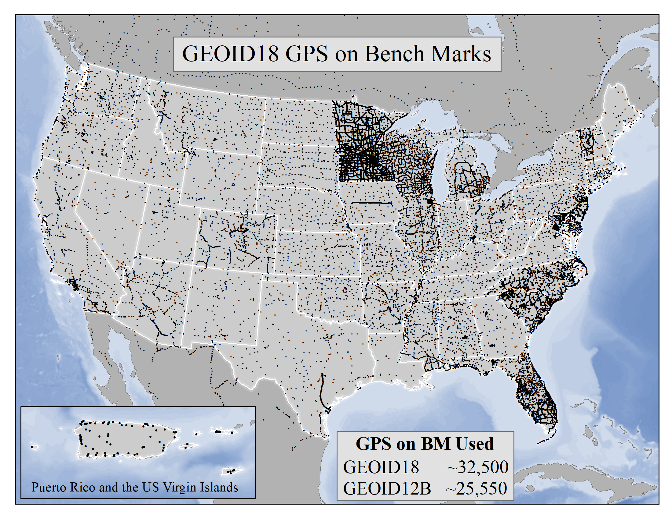
GPS on BM Campaign
Variable spacing of GPS on BM in USA for GEOID18
Notes:
This map shows the variable spacing of marks across the USA that were used in creating the GEOID18 Model.
The GSVS in Texas and in Iowa are included.

Slide 14
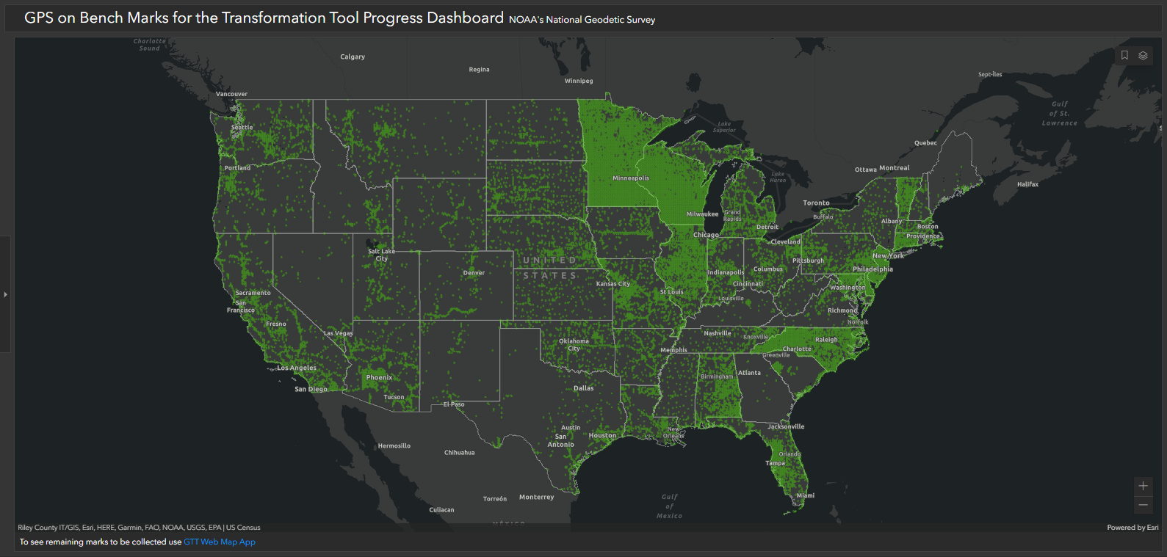
GPS on BM Campaign
Variable spacing of GPS on BM in USA persists.
October 11, 2023
Notes:
To increase the density of GPS on BM points for future geoid models, the GPS on BM Campaign was initiated.
Comparing this slide to the previous slide shows increased density in many areas. About 80,700 two-km hexagons now have data.
There are notable increases throughout USA.

Slide 15
GPS on BM Campaign
Q) Is it “too late” to densify the collection of GPS on BM in the state?
A1) The “deadline” was September 30, 2023 to guarantee that submitted data WOULD be included in the transformation tool.
A2) Data submitted after the deadline MAY be included up until a final data pull is made and the transformation tool is created.
No, it’s not “too late”.
Notes:
Q) Is it “too late” to densify the collection of GPS on BM in the state?
The simple answer is
“No, it’s not “too late”.
A1) The “deadline” was September 30, 2023 to guarantee that submitted data WOULD be included in the transformation tool.
A2) Data submitted after the deadline MAY be included up until a final data pull is made and the transformation tool is created

Slide 16

GPS on BM Campaign
Even if you miss the GPS on BM “cutoff” date, it is still valuable to submit observations.
…Adding GPS data on these marks allows them to be used in the modernized NSRS…
Means that observations on existing marks and new marks will pre-populate the Modernized NSRS in your community!
Notes:
Even if you miss the GPS on BM “cutoff” date, it is still valuable to submit observations.
Quoting the GPS on BM One Pager in part:
…Adding GPS data on these marks allows them to be used in the modernized NSRS…
Means that observations on existing marks and new marks will pre-populate the Modernized NSRS
in your community!
And the recoveries you submit will help perpetuate the existing passive marks network.

Slide 17
GPS on BM Campaign
If you have access to dual-frequency GPS equipment, you can submit data to the GPS on BM Campaign and to OPUS Share.
https://geodesy.noaa.gov/GPSonBM/GPSonBM-one-pager2022.pdf
Notes:
If you have access to dual-frequency GPS equipment, you can submit data to the GPS on BM Campaign and to OPUS Share.

Slide 18
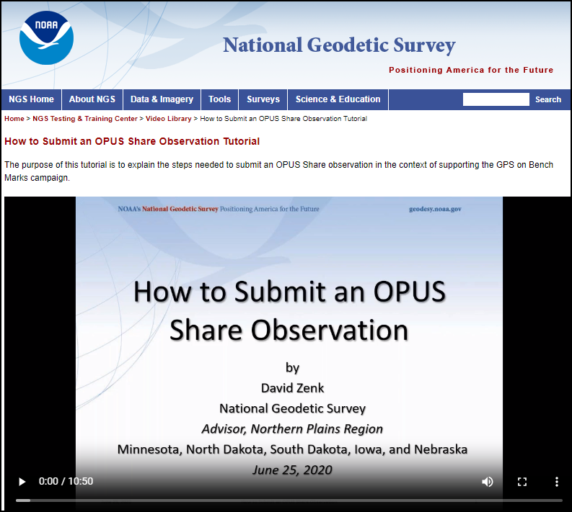
GPS on BM Campaign
GPS on BM requires
  a mark recovery
  2 OPUS Share Observations
Helpful 10 minute video
How to Submit an OPUS Share Observation
https://geodesy.noaa.gov/corbin/class_description/opus-share-tutorial/
Notes:
GPS on BM requires
a mark recovery and
2 OPUS Share Observations
Helpful 10 minute video is available:
How to Submit an OPUS Share Observation

Slide 19
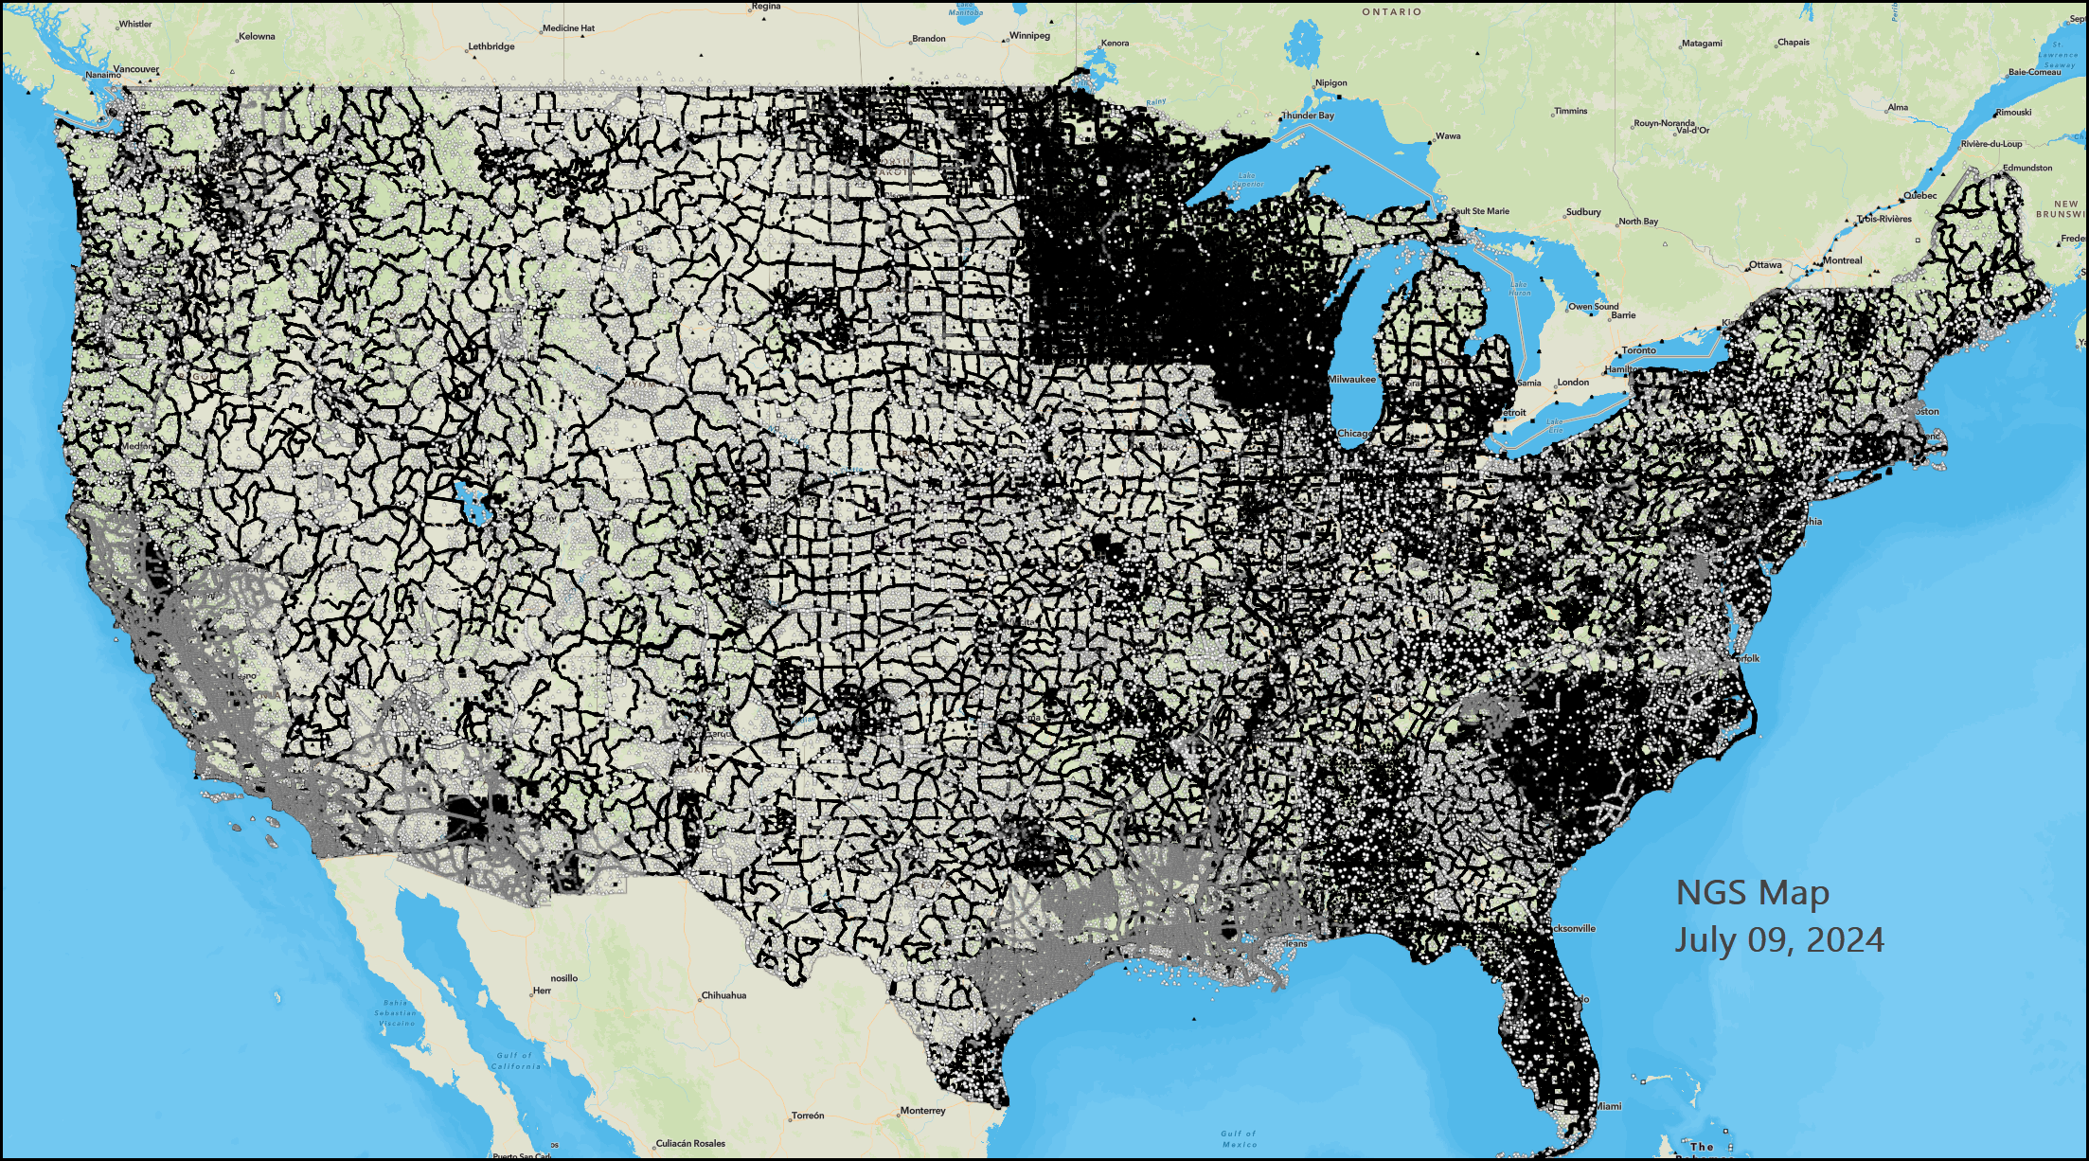
GPS on BM Campaign
You’ve decided to contribute to GPS on BM.
Where are the NGS Passive Marks in the USA?
NGS Passive Marks are not available everywhere – and some have likely been destroyed or disturbed.
https://geodesy.noaa.gov/datasheets/index.shtml
Notes:
You’ve decided to contribute to GPS on BM.
Where are the NGS Passive Marks in the USA?
NGS Passive Marks are not available everywhere – and some have likely been destroyed or disturbed.

Slide 20
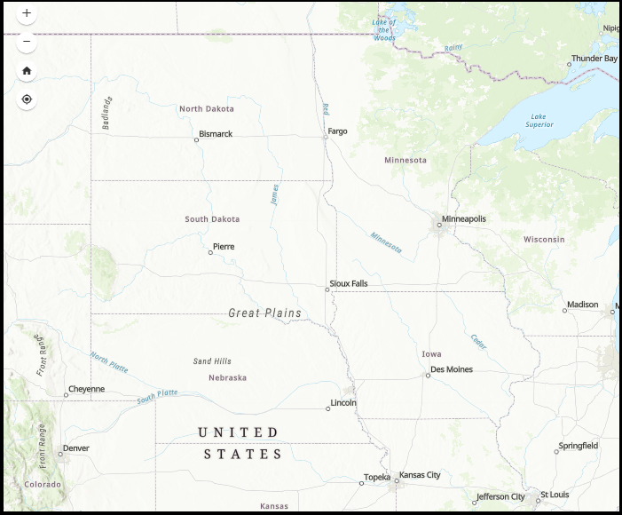
GPS on BM Campaign
You’ve decided to contribute to GPS on BM.
Where are the NGS Passive Marks in Your State?
Pre-populate the Modernized NSRS in your local area.
You can use GPS on BM and OPUS Share to add new passive marks in your local area in preparation for the Modernized NSRS
.
You are in control of where, when, and how many geodetic control marks are in your community.
Notes:
So, where are the NGS Passive Marks in Your State?
You can use GPS on BM and OPUS Share to add new passive marks and thereby pre-populate the Modernized NSRS in your local area.
You are in control of where, when, and how many geodetic control marks are in your community.

Slide 21
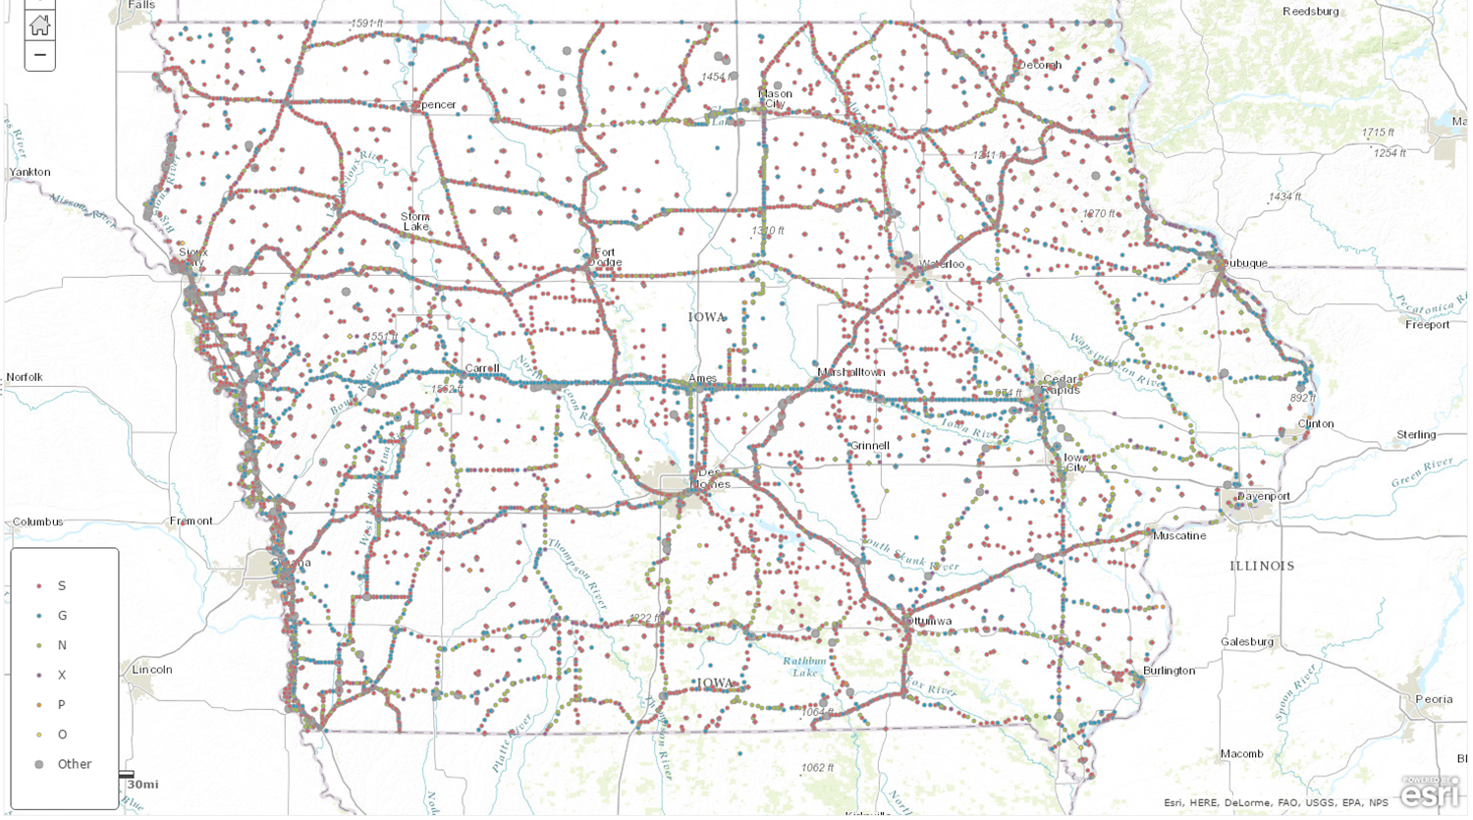
Iowa Passive Mark Network
Shows only NGS Database marks.
Local marks exist, too
Closely-spaced symbols = benchmarks along lines of leveling.
Scattered symbols = older triangulation marks and more recent GPS-derived marks
Notes:
This is a map of the Iowa Passive Mark Network.
The closely-spaced symbols are benchmarks along lines of leveling.
The scattered symbols represent older triangulation marks and more recent GPS-derived marks.
The map shows only NGS Database marks.
Local marks exist, too

Slide 22
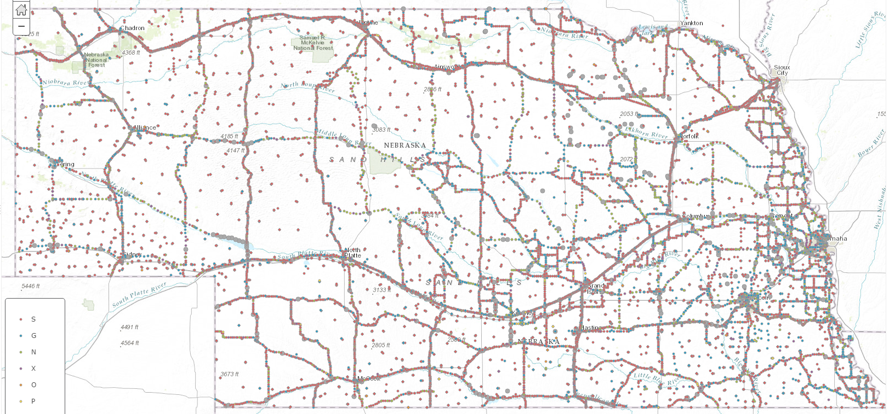
Nebraska Passive Mark Network
12 mile radius
Shows only NGS Database marks.
Local marks exist, too
Closely-spaced symbols = benchmarks along lines of leveling.
Scattered symbols = older triangulation marks and more recent GPS-derived marks
Notes:
The Nebraska Passive Mark Network.
This map, like the others, shows that there are many areas where NAD83 and NAVD88 marks are not available.
By participating in the GPS on BM and OPUS Share Campaigns, you can pre-populate theModernized NSRS in your local area and provide more readily-available passive marks in your community – today!

Slide 23
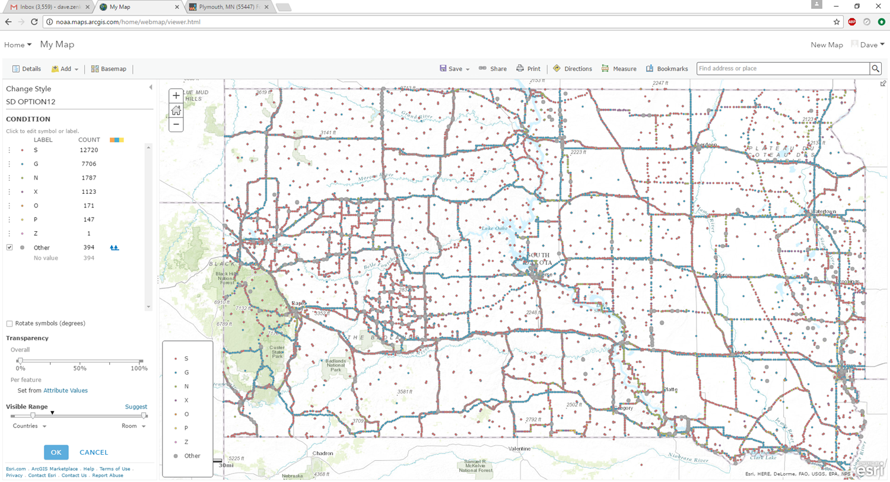
South Dakota Passive Mark Network
12 mile radius
Shows only NGS Database marks.
Local marks exist, too
Closely-spaced symbols = benchmarks along lines of leveling.
Scattered symbols = older triangulation marks and more recent GPS-derived marks
Notes:
The South Dakota Passive Mark Network.

Slide 24
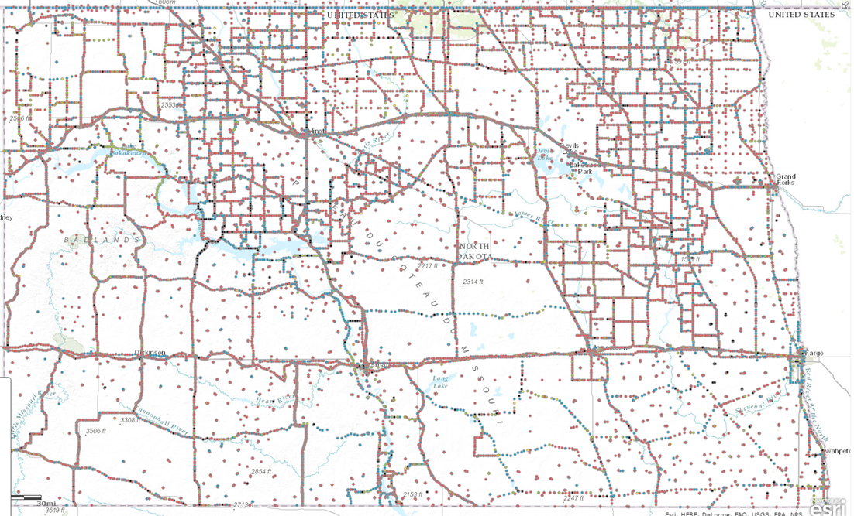
North Dakota Passive Mark Network
12 mile radius
Shows only NGS Database marks.
Local marks exist, too
Notes:
The North Dakota Passive Mark Network.

Slide 25
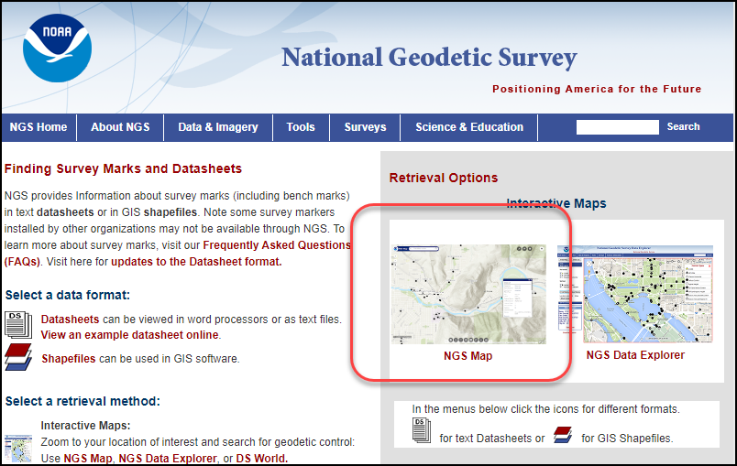
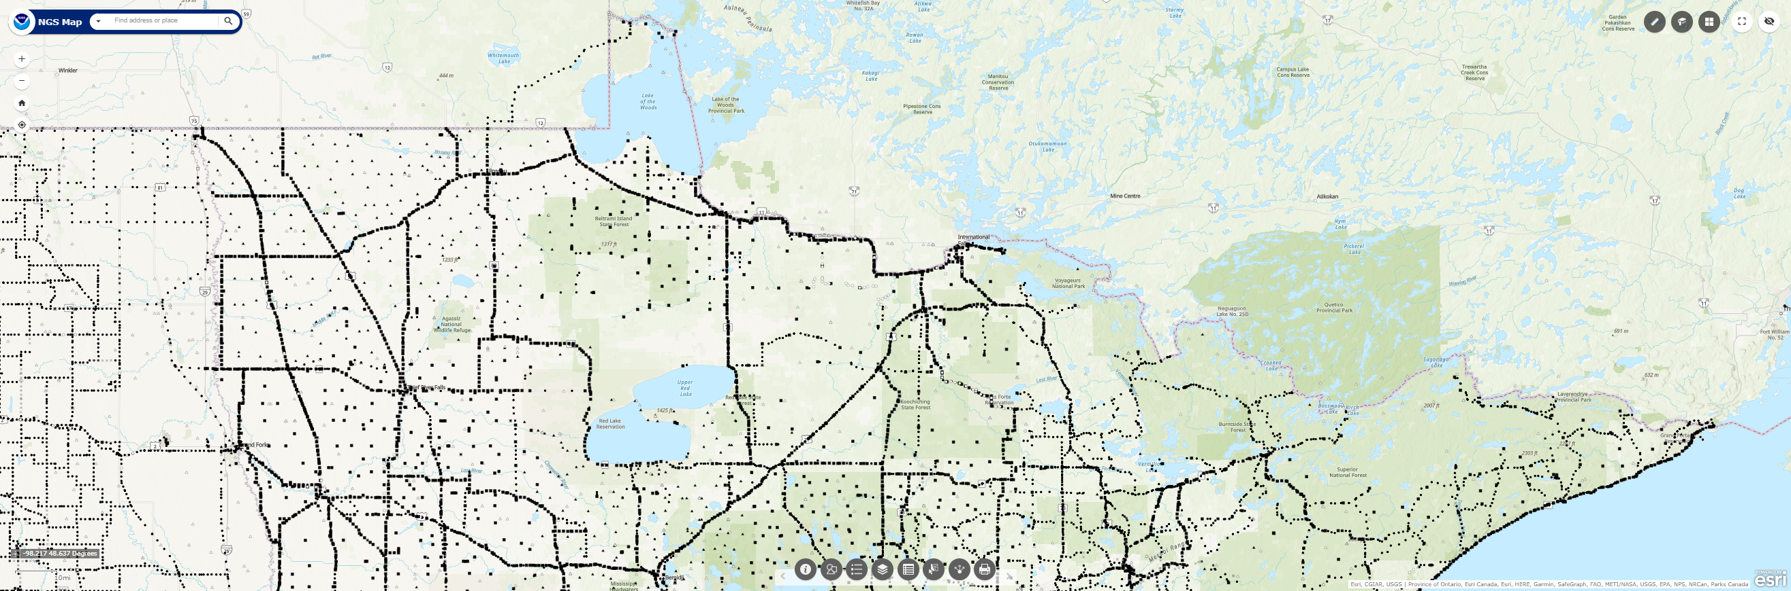
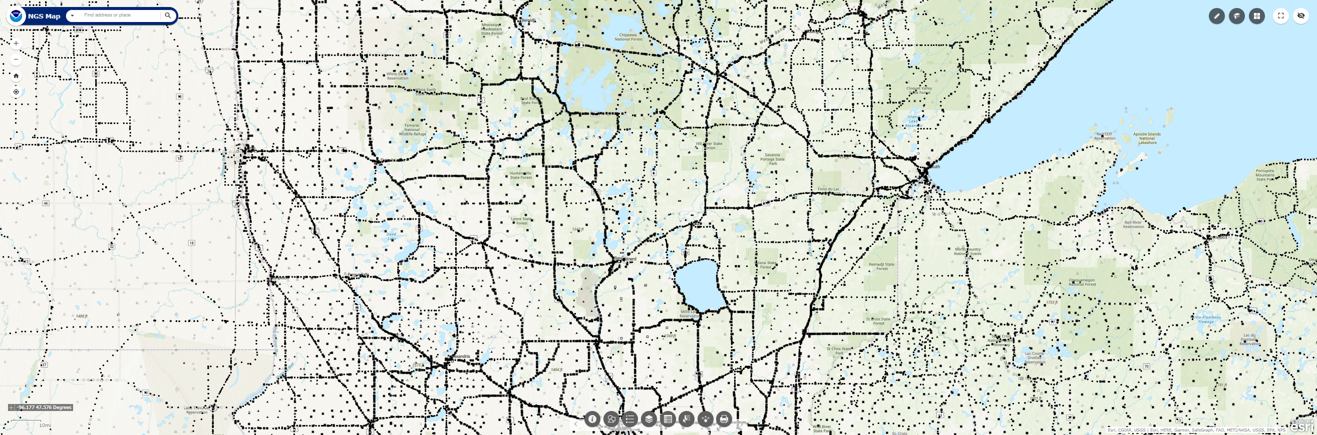
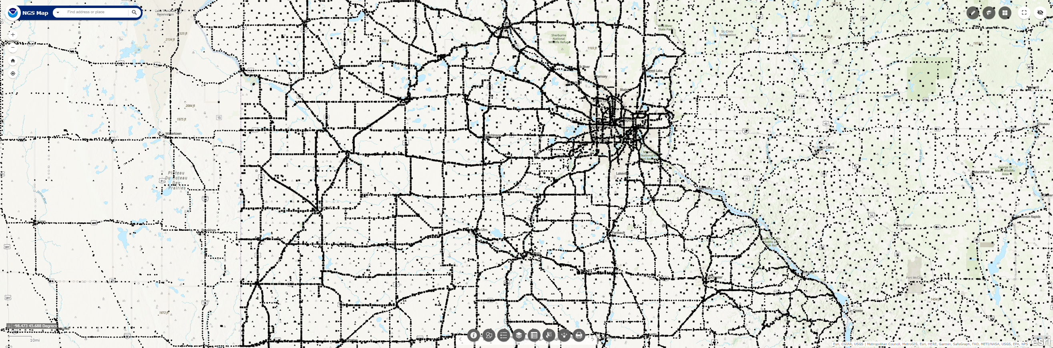
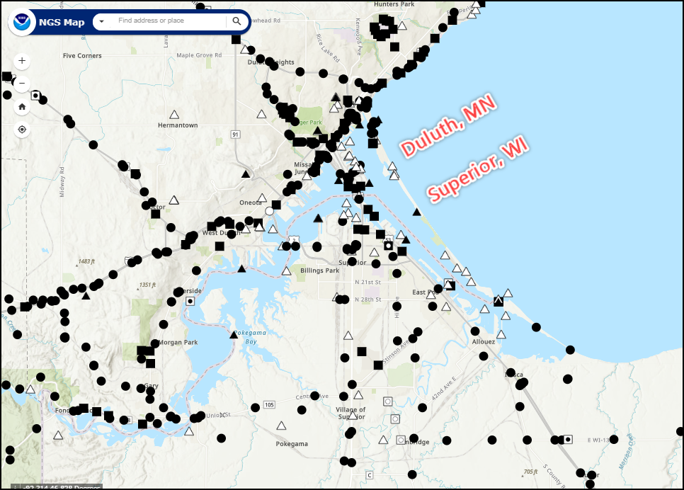
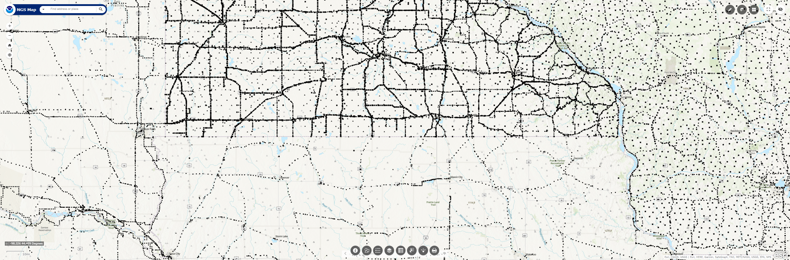
Minnesota Passive Mark Network
Use the NGS Map to zoom in on a local area
https://geodesy.noaa.gov/datasheets/
NGS Map:
https://geodesy.noaa.gov/datasheets/index.shtml
Shows only NGS Database marks.
Local marks exist, too
Notes:
The Minnesota Passive Mark Network.
Note that the NGS Passive Mark Map tool allows you to zoom in on any local area.

Slide 26
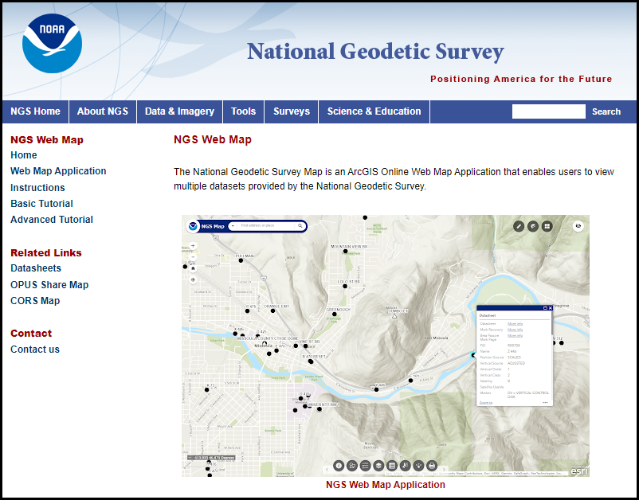
NGS Map and Mark Recovery Tools
Looking for Marks?
NGS Web Map:
https://geodesy.noaa.gov/datasheets/index.shtml
Notes:
If you’re looking for control marks in your local area try the NGS Web Map!

Slide 27
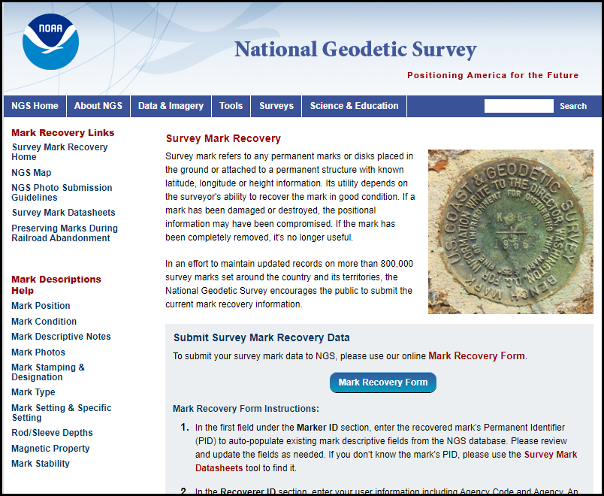
NGS Map and Mark Recovery Tools
Recovering and Reporting a Mark?
Help links
Survey Mark Recovery:
https://geodesy.noaa.gov/surveys/mark-recovery/index.shtml
Notes:
If you have a mark recovery to report, use the Online Mark Recovery Form.
Note the Help Links along the left margin.

Slide 28
Coordinate Shifts
It is expected that all 3 components of position (Lat/Lon/Ellht) will be different in the NATRF2022 datum.
The Orthometric height will also be different in the NAPGD2022 datum.
The NGS “New Datums” page has some diagrams for the expected differences (next 3 slides).
Notes:
It is expected that all 3 components of position (Lat/Lon/Ellht) will be different in the NATRF2022 datum.
The Orthometric height will also be different in the NAPGD2022 datum.
The NGS “New Datums” page has some diagrams for the expected differences (next 3 slides).

Slide 29
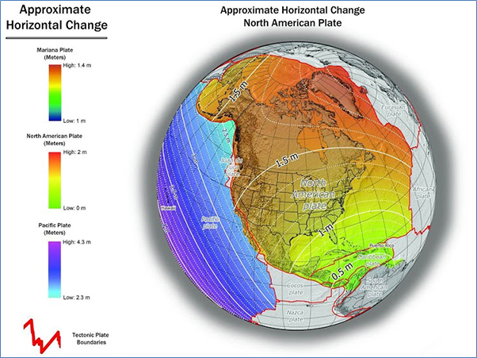
Coordinate Shifts
Ames IA
about 1.25 meters
Notes:
The approximate Horizontal Change varies, in Ames IA it will be about 1.25 meters

Slide 30
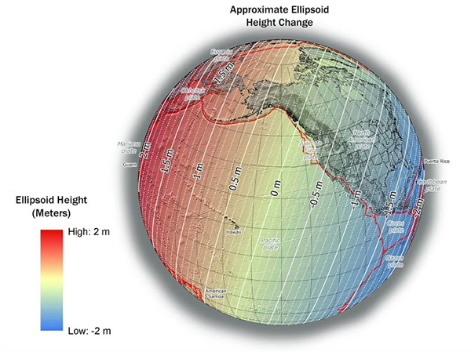
Coordinate Shifts
Ames IA
about -1.0 meters
Notes:
The approximate Ellipsoid Height Change varies, in Ames IA it will be about -1.0 meters

Slide 31
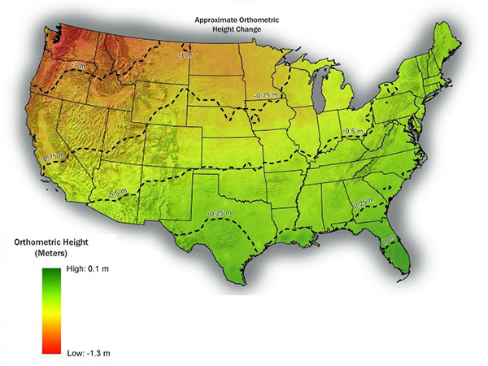
Coordinate Shifts
Ames IA
about -0.75 meters
Notes:
The approximate Orthometric Height change varies, in Ames IA it will be about -0.75 meters

Slide 32
Coordinate Shift
The OPUS Static solution contains a preview of the future coordinates. Example: Ames IA
REF FRAME: NAD_83(2011)(EPOCH:2010.0000) ITRF2014 (EPOCH:2023.7484)
X: -294704.762(m) 0.006(m) -294705.729(m) 0.006(m)
Y: -4737326.292(m) 0.009(m) -4737324.953(m) 0.009(m)
Z: 4246573.802(m) 0.003(m) 4246573.704(m) 0.003(m)
LAT: 42 0 34.52731 0.004(m) 42 0 34.55266 0.004(m)
E LON: 266 26 24.96815 0.006(m) 266 26 24.92261 0.006(m)
W LON: 93 33 35.03185 0.006(m) 93 33 35.07739 0.006(m)
EL HGT: 266.500(m) 0.008(m) 265.486(m) 0.008(m)
ORTHO HGT: 296.411(m) 0.045(m)
[NAVD88 (Computed using GEOID18)]
APPROX ORTHO HGT: 295.660(m) [PROTOTYPE (Computed using xGeoid19B,GRS80,ITRF2014)]
Diff LAT = 0.75 meters northerly
Diff LON = 1.04 meters westerly
Diff Ellht = - 1.014 meters
Diff Ortho = - 0.751 meters
Notes:
The OPUS Static solution contains the NAD83(2011) position and an ITRF2014 position - a preview of the future coordinates.
Example: Ames IA
By submitting a data file to OPUS Static, you can obtain a similar solution for your local area.

Slide 33
NCAT
NGS Coordinate Conversion and Transformation Tool (NCAT)
Transforms between several existing HORIZ and VERT datums.
You can use this tool now!
Notes:
The NGS Coordinate Conversion and Transformation Tool (known as NCAT)
transforms between several existing HORIZ and VERT datums.
The NCAT Tool is available for you to use now.

Slide 34
NCAT
NGS Coordinate Conversion and Transformation Tool (NCAT)
Will provide the needed transformation tool to transform heights in former datums to heights in the new datum.
Also provides the transformation tool to transform lat/lon/ellht in former datums to lat/lon/ellht in the new datum.
Notes:
The NCAT Tool
Will provide the needed transformation tool to transform heights in former datums to heights in the new datum.
Also provides the transformation tool to transform lat/lon/ellht in former datums to lat/lon/ellht in the new datum.

Slide 35
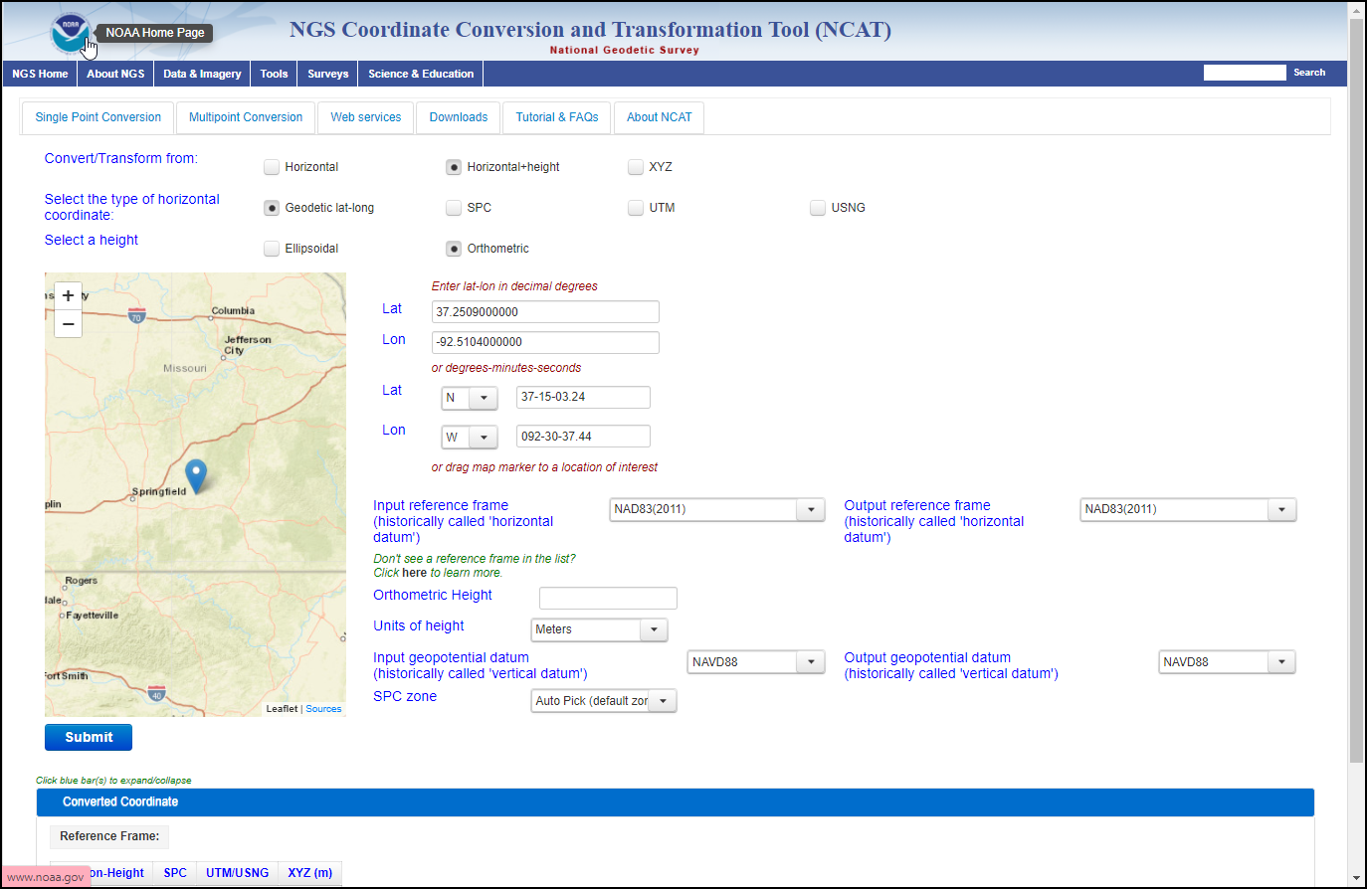
NCAT
NCAT allows
Single point conversion
Multipoint conversion
API-web services
Downloadable version
You can use this tool now!
Notes:
The NCAT tool allows
Single point conversion
Multipoint conversion
API-web services, and a
Downloadable version for large datasets

Slide 36
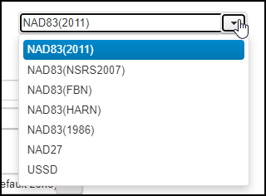
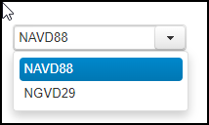
NCAT
Current datum selections
You can use this tool now!
Notes:
The current datum selections are available now for your use

Slide 37
NCAT
NCAT will include Modernized NSRS
Future datum selections
NCAT will include NAPGD2022
Notes:
Future datums selections for Modernized NSRS and NAPGD2022 will be added.

Slide 38
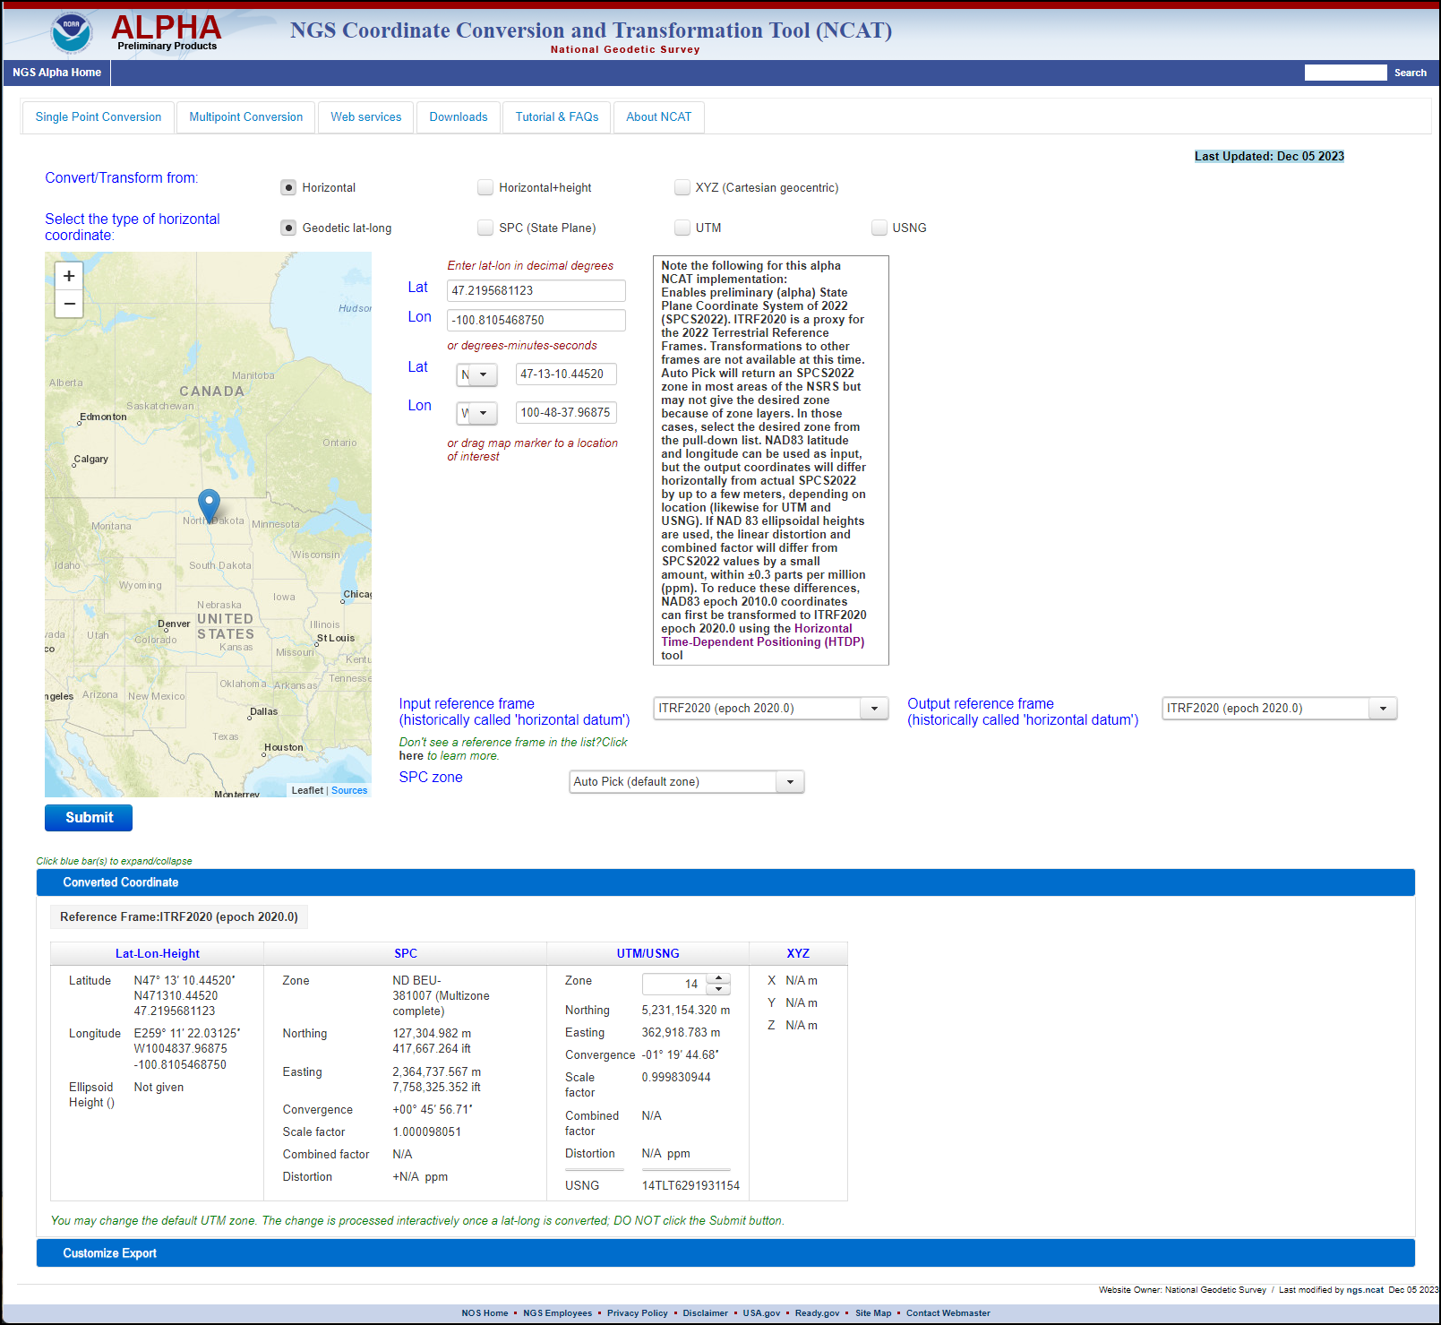
NCAT
Read the detailed text box.
Alpha NCAT allows you to explore the State SPCS and LDP Zones in ITRF2020.
https://alpha.ngs.noaa.gov/NCAT/
Notes:
Alpha NCAT allows you to explore the State SPCS and LDP Zones in ITRF2020.

Slide 39
M-PAGES
NGS is developing a new processor to replace PAGES, the NGS’ current GPS-only software.
  PAGES is the software behind OPUS and other NGS applications.
The replacement software, a multi-constellation processor called M-PAGES, will facilitate shorter observation times in more difficult conditions and provide more robust solutions.
Notes:
NGS is developing a new processor to replace PAGES, the NGS’ current GPS-only software.
PAGES is the software behind OPUS and other NGS applications.
The replacement software, a multi-constellation processor called M-PAGES, will facilitate shorter observation times in more difficult conditions and provide more robust solutions.

Slide 40
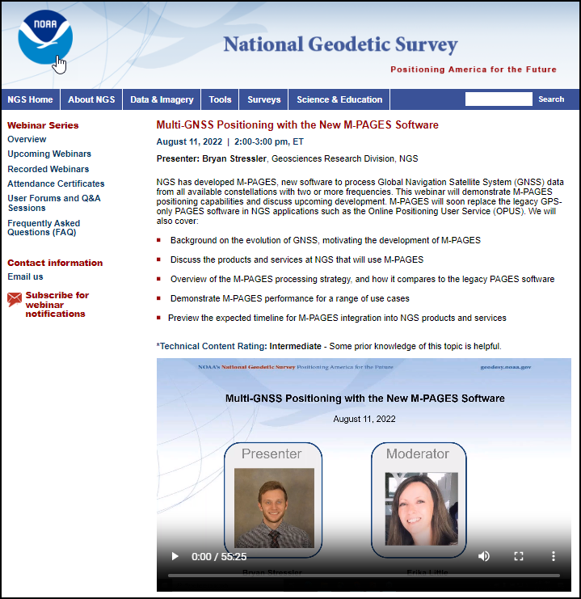
M-PAGES
View recorded webinar on M-PAGES
M-PAGES is not yet implemented.
Available on the NGS “beta” webpage.
https://geodesy.noaa.gov/web/science_edu/webinar_series/multi-ngss-world-at-ngs.shtml
Notes:
You can view a recorded webinar on M-PAGES.
Note that M-PAGES is not yet implemented.
But, it is available via the Beta OPUS upload page.

Slide 41
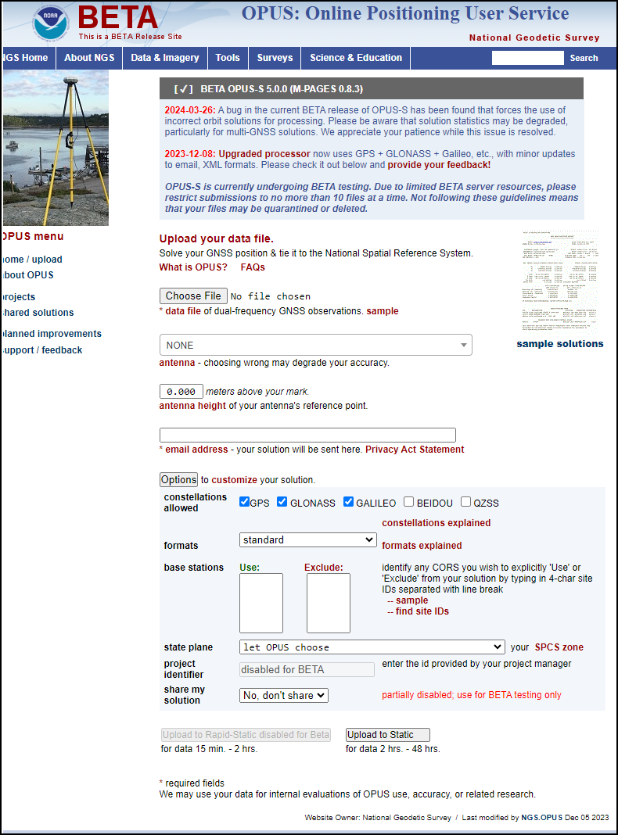
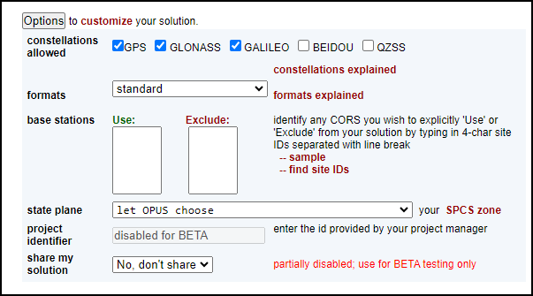
M-PAGES
https://beta.ngs.noaa.gov/OPUS/
Notes:
The OPTIONS pulldown allows you to choose among GPS, GALILEO, and GLONASS at this time.

Slide 42
NOS NGS 92
NOAA Technical Memorandum NOS NGS 92
  Sets Standards and Specifications for surveys that will be submitted to NGS for inclusion in the NGS Integrated Database (NGSIDB).
Facilitates the establishment and publication of local geodetic control (Lat/Lon/EllHt/OrthoHt) by engineers and surveyors.
  The passive mark network will dwindle unless users can maintain it as needed. You are in control of where, when, and how many geodetic control marks are in your community.
Notes:
NOAA Technical Memorandum NOS NGS 92
Sets Standards and Specifications for surveys that will be submitted to NGS for inclusion in the NGS Integrated Database (NGSIDB).
Facilitates the establishment and publication of local geodetic control (Lat/Lon/EllHt/OrthoHt) by engineers and surveyors.
The passive mark network will dwindle unless users can maintain it as needed.
You are in control of where, when, and how many geodetic control marks are in your community.

Slide 43

NOS NGS 92
To be released in draft form for public review and comment.
The important tables are already available (subject to change).
NGS Presentations Library
  https://geodesy.noaa.gov/web/science_edu/presentations_library/files/nos_ngs_92_webinar_2023-04-13.pptx
Recorded Webinar
  https://geodesy.noaa.gov/web/science_edu/webinar_series/videos/classifications-standards-specs-OP5-1.mp4
Notes:
NOS NGS 92 is to be released in draft form for public review and comment.
The important tables are already available (subject to change).
You can view the recorded April 13, 2023 NGS 92 webinar and download the slides.

Slide 44
Preparation Steps You Can Take
So while NGS continues developing and refining the tools and support needed for the new datum, what can you do?
Everyone’s situation is different, so no set of steps is universal.
However, a listing of positive, pro-active plans and actions can be suggested for consideration.
Notes:
So while NGS continues developing and refining the tools and support needed for the new datum, what can you do?
Everyone’s situation is different, so no set of steps is universal.
However, a listing of positive, pro-active plans and actions can be suggested for consideration.

Slide 45
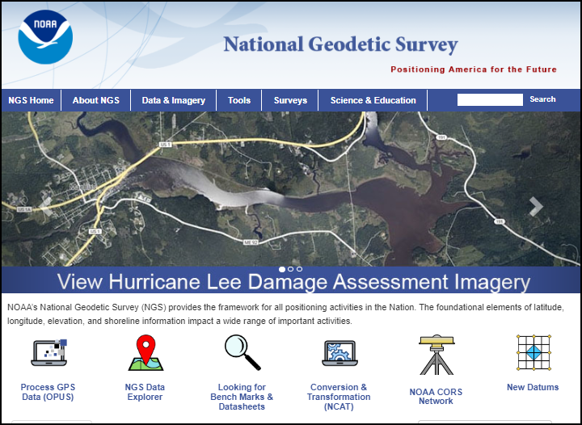
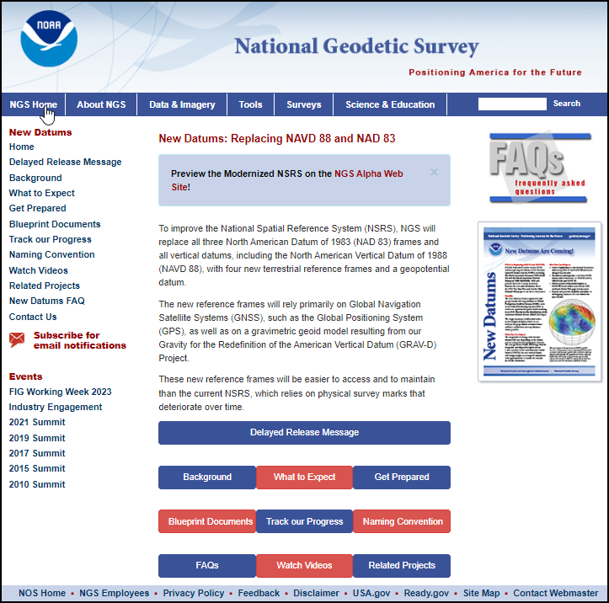
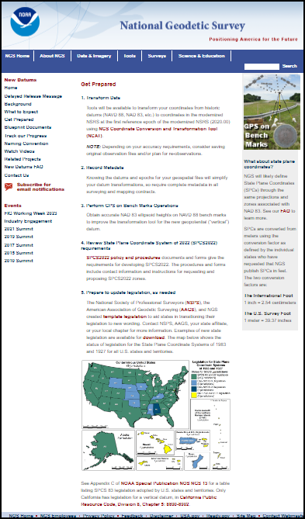
Preparation Steps You Can Take
NGS has listed 5 such steps on its New Datums page.
New Datums
Get Prepared
Notes:
NGS has listed 5 such steps on its New Datums page.

Slide 46
Preparation Steps You Can Take
  1. Transform, Reprocess, or Reobserve Data
  Tools will be available to transform your coordinates from historic datums (NAVD 88, NAD 83, etc.) to coordinates in the modernized NSRS at the first reference epoch of the modernized NSRS (2020.00) using NGS Coordinate Conversion and Transformation Tool (NCAT).
  Now would be a good opportunity to transform data collections from their legacy datums to the current datums (NAVD88 and NAD83) using NCAT.
  NOTE: Depending on your accuracy requirements, consider saving original observation files and/or plan for re-observations.
Notes:
1. Transform Data
Tools will be available to transform your coordinates from historic datums (NAVD 88, NAD 83, etc.) to coordinates in the modernized NSRS at the first reference epoch of the modernized NSRS (2020.00) using NGS Coordinate Conversion and Transformation Tool (NCAT).
Now would be a good opportunity to transform data collections from their legacy datums to the current datums (NAVD88 and NAD83) using NCAT.
NOTE: Depending on your accuracy requirements, consider saving original observation files and/or plan for re-observations.

Slide 47
Preparation Steps You Can Take
3 Options
  Transform, Reprocess, or Reobserve
    Transform using NCAT or a local tool.
    Reprocess and adjust using your stored collection of observations.
    Reobserve and adjust.
    In all cases, verify the accuracy using OPUS STATIC observations as a check.
Transform
Least cost, but least accurate
Reprocess
More cost, but more accurate
Reobserve
Most cost, but most accurate
Notes:
There are 3 options to consider in updating legacy coordinates to the current and future datums.
Transform, Reprocess, or Reobserve
Transform using NCAT or a local tool.
Reprocess and adjust using your stored collection of observations.
Reobserve and adjust.
In all cases, verify the accuracy using OPUS STATIC observations as a check.

Slide 48
Preparation Steps You Can Take
2. Review, Update, and Record Metadata
  Inventory the metadata of your existing geospatial files to enable prioritizing their transformations
  Knowing the datums and epochs for your geospatial files will simplify their datum transformations
  Require complete metadata in all surveying and mapping contracts.
Metadata is essential for efficient file management and transformational certainty.
Notes:
2. Record Metadata
Inventory the metadata of your existing geospatial files to enable prioritizing their transformations.
Knowing the datums and epochs for your geospatial files will simplify their datum transformations.
Require complete metadata in all surveying and mapping contracts.

Slide 49
Preparation Steps You Can Take
3. Perform GPS on Bench Mark Observations
  Obtain accurate NAD 83 (Lat/Lon/EllHt) on benchmarks, thus densifying the local geodetic network for use today.
  The NAD 83 ellipsoid heights on NAVD 88 bench marks will improve the transformation tool for the new geopotential “vertical” datum (NAPGD2022).
  These observations will also pre-populate your location with Modernized NSRS positions (Lat/Lon/EllHt/OrthoHt) without further action on your part.
Notes:
3. Perform GPS on Bench Mark Observations
You will obtain accurate NAD 83 (Lat/Lon/EllHt) on benchmarks, thus densifying the local geodetic network for use today.
The NAD 83 ellipsoid heights on NAVD 88 bench marks will improve the transformation tool for the new geopotential “vertical” datum (NAPGD2022).
And, these observations will also pre-populate your location with Modernized NSRS positions (Lat/Lon/EllHt/OrthoHt) without further action on your part.

Slide 50
Preparation Steps You Can Take
4. Review State Plane Coordinate System of 2022 (SPCS2022) requirements NOS NGS 13
  SPCS2022 policy and procedures documents and forms give the requirements for developing SPCS2022. The procedures and forms include contact information and instructions for requesting and proposing SPCS2022 zones.
  Low-Distortion Projections (LDPs) have been designed and adopted for all states.
  Many NGS webinars are available for viewing – see:
    NGS Presentations Library
    NGS Recorded Webinar
Notes:
4. Review State Plane Coordinate System of 2022 (SPCS2022) requirements
SPCS2022 policy and procedures documents and forms give the requirements for developing SPCS2022. The procedures and forms include contact information and instructions for requesting and proposing SPCS2022 zones.
Low-Distortion Projections (LDPs) have been designed and adopted for all states.
Many NGS webinars are available for viewing – see:
NGS Presentations Library
NGS Recorded Webinar

Slide 51
Preparation Steps You Can Take
5. Prepare to update legislation, as needed
  The National Society of Professional Surveyors (NSPS), the American Association of Geodetic Surveying (AAGS), and NGS created template legislation to aid states in transitioning their legislation to new wording.
Notes:
5. Prepare to update legislation, as needed
The National Society of Professional Surveyors (NSPS), the American Association of Geodetic Surveying (AAGS), and NGS created template legislation to aid states in transitioning their legislation to new wording.

Slide 52
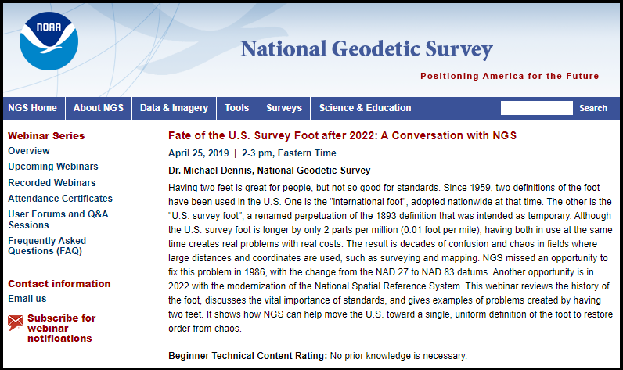
Preparation Steps You Can Take
Deprecation of US Survey Foot
  Review the excellent “Fate of the US Survey Foot” webinar by Dr. Michael Dennis
  https://www.ngs.noaa.gov/web/science_edu/webinar_series/fate-of-us-survey-foot.shtml
✓
Notes:
Deprecation of US Survey Foot
Review the excellent “Fate of the US Survey Foot” webinar by Dr. Michael Dennis

Slide 53
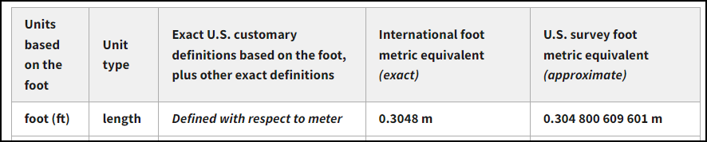
Preparation Steps You Can Take
Deprecation of US Survey Foot
  NGS will support legacy US Ft units for SPCS 83
  NGS will use only Intl Ft in the Modernized NSRS, SPCS2022, and LDPs
  The Meter can be correctly used in older and newer SPCS.
NIST Table of Conversions
Ratio = 1.000002 or 0.999998
https://www.nist.gov/pml/us-surveyfoot/revised-unit-conversion-factors
Notes:
Deprecation of US Survey Foot
NGS will support legacy US Ft units for SPCS 83
NGS will use only Intl Ft in the Modernized NSRS, SPCS2022, and LDPs
The Meter can be correctly used in older and newer SPCS.
These are the NIST Conversion Factors for the International Foot and the Survey Foot

Slide 54
Preparation Steps You Can Take
Deprecation of US Survey Foot
  Unit Conversions can be easily confused.
  If the conversion ratio between US Survey Feet and International Feet is near unity, then it is easy to multiply or divide by mistake, since the end result is so close to the starting values.
NIST Table of Conversions
Ratio = 1.000002 or 0.999998
https://www.nist.gov/pml/us-surveyfoot/revised-unit-conversion-factors
Notes:
Deprecation of US Survey Foot
Unit Conversions can be easily confused.
If the conversion ratio between US Survey Feet and International Feet is near unity, then it is easy to multiply or divide by mistake, since the end result is so close to the starting values.

Slide 55
Preparation Steps You Can Take
Deprecation of US Survey Foot
  For small distances, such as building dimensions, lot dimensions on plats, and heights, there is very little impact.
    That’s because
      1.00000 Meter = 3.280833333 US Survey Feet
      1.00000 Meter = 3.280839895 International Feet
      Or put another way:
      100.00000 US Survey Feet = 100.00020 International Feet
      5280.00000 US Survey Feet = 5280.01056 International Feet
The International Foot
1 inch = 2.54 centimeters
1 meter = 39.370078740 inches
The U.S. Survey Foot
1 meter = 39.37 inches
Ratio = 1.000002 or 0.999998
Should I multiply or divide by which ratio to convert one to the other?
Easy to confuse.
Notes:
Deprecation of US Survey Foot
For small distances, such as building dimensions, lot dimensions on plats, and heights, there is very little impact.
That’s because
1.00000 meter = 3.280833333 US Survey Feet
1.00000 meter = 3.280839895 International Feet
Or put another way:
100.000 US Survey Feet = 100.0002 International Feet
5280.00000 US Survey Feet = 5280.01056 International Feet
Ratio = 1.000002 or 0.999998
Should I multiply or divide by which ratio to convert one foot unit to the other?
Easy to confuse.

Slide 56
Preparation Steps You Can Take
Deprecation of US Survey Foot
  However, when using State Plane Coordinates or Low Distortion Projection Coordinates, the coordinate values are large numbers, so it is imperative to keep your UNITS correct in the metadata.
    Example:
    350,000.000 US Ft = 350,000.700 Intl Ft
The International Foot
1 inch = 2.54 centimeters
1 meter = 39.370078740 inches
The U.S. Survey Foot
1 meter = 39.37 inches
Notes:
Deprecation of US Survey Foot
However, when using State Plane Coordinates or Low Distortion Projection Coordinates, the coordinate values are large numbers, so it is imperative to keep your UNITS correct in the metadata.
Example:
350,000.000 US Ft = 350,000.700 Intl Ft

Slide 57
Preparation Steps You Can Take
Deprecation of US Survey Foot
  For maximal clarity and least confusion, consider switching all future measurements and future stored data to METRIC Units.
    Since the Meter is easily and correctly convertible to US Ft or Intl Ft, it will be less likely to be wrongly done.
    People are not machines, they often neglect the metadata and fail to label the dimensions as US Ft or Intl Ft, instead labeling as simply Ft, leading to mistakes.
The International Foot
1 inch = 2.54 centimeters
1 meter = 39.370078740 inches
The U.S. Survey Foot
1 meter = 39.37 inches
Definition of Meter not changed since 1792.
https://www.nist.gov/si-redefinition/meter
Notes:
Deprecation of US Survey Foot
For maximal clarity and least confusion, consider switching all future measurements and future stored data to METRIC Units.
Since the Meter is easily and correctly convertible to US Ft or Intl Ft, it will be less likely to be wrongly done.
People are not machines, they often duck the metadata and fail to label the dimensions as US Ft or Intl Ft, instead labeling as simply Ft, leading to mistakes.

Slide 58
Unit Cancellation
My college professor did not like Unit Conversion Factor Tables.
Professor showed us that if we only knew a FEW conversion ratios, that they could be multiplied together in strings, like fractions, and cancellation of units would help prevent errors.
Cancel units in numerator and denominator like fractions.
Seems like the simplest things cause the most trouble.
I don’t know if this will help you, but it was a real help to me at the time.
Notes:
Seems like the simplest things cause the most trouble.
My college professor did not like Unit Conversion Factor Tables.
Professor showed us that if we only memorized a FEW known conversion ratios, that they could be multiplied together in strings, like fractions, and cancellation of units would help prevent errors.
Cancel units in numerator and denominator like fractions.
I don’t know if this will help you, but it was a real help to me at the time.

Slide 59
Unit Cancellation
If a = b, then a/b = 1 and also b/a = 1
1 US Ft = 12 US Inches
Since all correct conversion ratios = 1, they can be used as multipliers without changing the equivalency.
100.00000 US Survey Feet = 100.00020 International Feet
But caution, the conversion ratios must in fact be correct.
1 US Ft
12 US Inches
=
1
12 US Inches
1 US Ft
=
1
100.00000 US Survey Feet
100.00020 International Feet
=
1
Notes:
Here’s the logic
If a = b, then a/b = 1 and also b/a =1
1 US Ft = 12 US Inches, can be expressed as inverse ratios, each equal to 1.
Since all correct conversion ratios are equal to 1, they can be used as multipliers without changing the equivalency.
This includes the US Survey Feet to International Feet equivalency.
But caution, the conversion ratios must in fact be correct.

Slide 60
Unit Cancellation
Conversion Factors – how to avoid errors?
You only need to KNOW a few, but then combine them as needed. Use UNIT CANCELLATION.
  Memorize a few Known Unit Conversions:
    1 US Ft = 12 US Inches
    1 Intl Ft = 12 Intl Inches
    1 Meter = 100 Centimeters
    1 Intl Inch = 2.54 Centimeters
    1 Meter = 39.37 US Inches
Express as a ratio:
1 US Ft
12 US Inches
or
12 US Inches
1 US Ft
The International Foot
1 inch = 2.54 centimeters
The U.S. Survey Foot
1 meter = 39.37 inches
These factors are all definitional and exact.
Notes:
Conversion Factors – how to avoid errors?
You only need to KNOW a few, but then combine them as needed. Use UNIT CANCELLATION.
Memorize a few Known Unit Conversions, then express them as RATIOs

Slide 61
Unit Cancellation
Example of Unit “cancellation” (numerator and denominator) - convert US Ft to Meters
1,306.247 US FT
x
12 US Inches
1 US Ft
x
1 Meter
39.37 US Inches
=
398.1449 Meters
Correct answer, units cancel
1,306.247 US FT
x
1 US Ft
12 US Inches
x
39.37 US Inches
1 Meter
=
Wrong answer, not all units cancel
NIST Table of Conversions
https://www.nist.gov/pml/us-surveyfoot/revised-unit-conversion-factors
Notes:
Example of Unit “cancellation” (numerator and denominator) - convert US Ft to Meters

Slide 62
Unit Cancellation
Example of Unit “cancellation” (numerator and denominator) - convert US Ft to Intl Ft
x
12 US Inches
1 US Ft
x
1 Meter
39.37 US Inches
x
100 Centimeters
1 Meter
x
1,306.247 US FT
1 Intl Inch
2.54 Centimeters
x
1 Intl Ft
12 Intl Inches
=
1306.24961249 Intl Ft
Correct answer, units cancel
NIST Table of Conversions
https://www.nist.gov/pml/us-surveyfoot/revised-unit-conversion-factors
Notes:
Example of Unit “cancellation” (numerator and denominator) - convert US Ft to Intl Ft

Slide 63
Additional Resources
Notes:
There are many additional resources on the NGS website to learn more about the topics in this presentation and related topics.

Slide 64
NGS Tools & Resources
NGS Map
Online Mark Recovery
GPS on BM Campaign
OPUS Share
OPUS Static
OPUS Rapid Static
OPUS Projects
NOS NGS 92
NCAT
NCN CORS

Slide 65
Additional Resources
GPS on BM - Preserve passive marks & online mark recovery
https://geodesy.noaa.gov/surveys/mark-recovery/index.shtml
GPS on BM - pre-populate Modernized NSRS locally
https://geodesy.noaa.gov/GPSonBM/
NGS Map Tool
https://geodesy.noaa.gov/datasheets/ngs_map/
NGS Level Projects Page
https://geodesy.noaa.gov/datasheets/leveling-projects/index.html
Notes:
Topics of note are
GPS on BM
NGS Map Tool
NGS Level Projects Page

Slide 66
Additional Resources
NGS Passive Mark Page
https://geodesy.noaa.gov/datasheets/passive-marks/index.html
CORS Time Series Tool (beta)
https://beta.ngs.noaa.gov/OPUS-Tools/cors-time-series-tool/index.html
DSWorld Upload Functions Page
https://geodesy.noaa.gov/datasheets/dsworld_web/upload_forms/
Alpha NCAT
https://alpha.ngs.noaa.gov/NCAT/
Notes:
Additional topics of note are
NGS Passive Marks Page
CORS Time Series Tool (beta)
DSWorld Upload Functions Page
Alpha NCAT

Slide 67
Additional Resources
OPUS Roadmap slides (Paving the Road to the Future NSRS.pptx)
https://geodesy.noaa.gov/web/science_edu/presentations_library/files/paving-road-future-nsrs.pptx
NOS NGS 92 Classifications, Standards and Specifications Supporting OPUS 5.1
https://geodesy.noaa.gov/web/science_edu/webinar_series/standards-specs-opus-projects.shtml
Notes:
Previous presentations on the NGS Presentations Library and the Recorded Webinars pages.

Slide 68
Additional Resources
Progress Toward a Modernized NSRS - by Dr. Dru Smith (https://geodesy.noaa.gov/web/science_edu/presentations_library/files/nsrs-mod-update-coops-v02.pptx)
Geometry of the Datum - by Dr. Dru Smith and Dr. Dan Roman (https://geodesy.noaa.gov/web/science_edu/presentations_library/files/roman-blueprint1.pptx)
Design of Low Distortion Projections - by Dr. Michael Dennis (https://geodesy.noaa.gov/web/science_edu/presentations_library/files/NSRS_SPCS_USft_Dennis_Caccamise_CPP_2019.pptx)
The State Plane Coordinate System -History, Policy, and Future Directions
NOAA Special Publication NOS NGS 13 - by Dr. Michael Dennis
(https://geodesy.noaa.gov/library/pdfs/SP_NOS_NGS_13.pdf)
Notes:
And finally, some large scale presentations by NGS scientists regarding:
The new datums.
The design of low distortion projections.

Slide 69
Preparing for the Modernized NSRS - What Should You Do Now?
Questions?
dave.zenk@noaa.gov
galen.scott@noaa.gov
daniel.gillins@noaa.gov
kimber.degrandpre@noaa.gov

Slide 70
Preparing for the Modernized NSRS - What Should You Do Now?
END

