Slide 1

NSRS Modernization II
PLSO Fall Seminar
October 2019
Jeff Jalbrzikowski, P.S., GISP
Appalachian Regional Geodetic Advisor
jeff.jalbrzikowski@noaa.gov
240-988-5486
Notes:
My background
-came to NGS from the USACE Pittsburgh where I spent 9 years in all phases from budgeting, planning, performing, and processing, of deformation

Slide 2
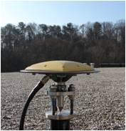
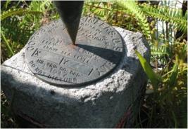

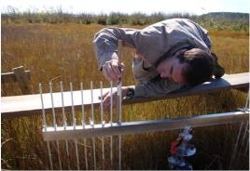
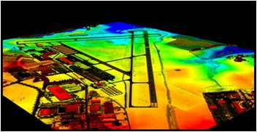
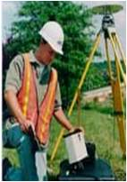
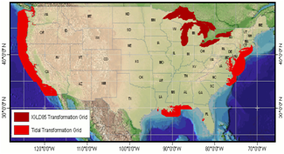

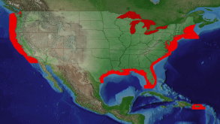
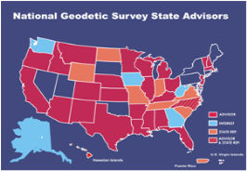

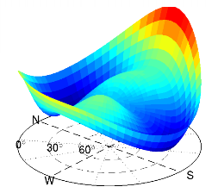
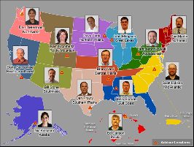
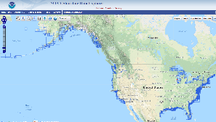
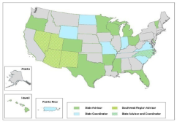
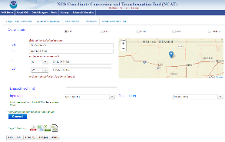
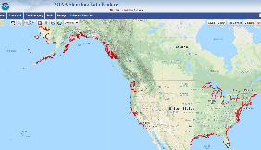
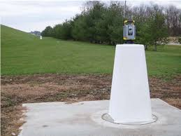
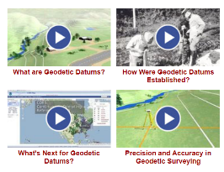
NGS Overview
Modernizing the NSRS
CORS
NHMP
GRAV-D
ECO
NGS Products and Services
ASP
OPUS
VDatum
Orbit Data
National Shoreline
Geodetic Advisors
ERI
Antenna Calibrations
NCAT
CUSP
CBL
Outreach/COMET
Notes:
This is not an exhaustive list of NGS programs

Slide 3
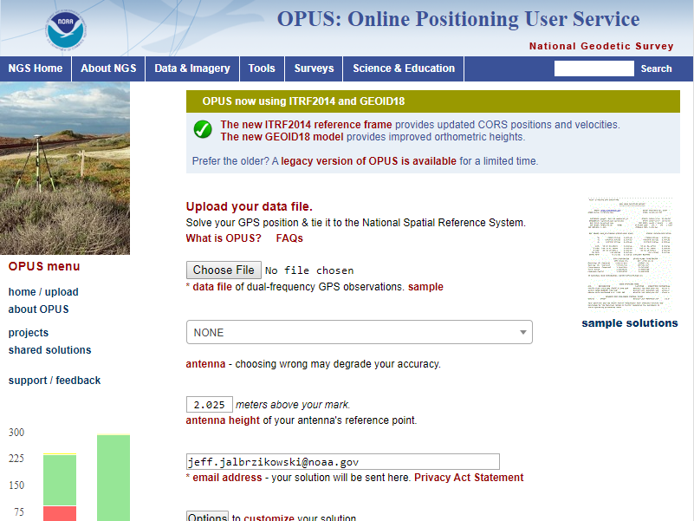
Notes:
Who’s used OPUS in the past year? Then this looks familiar huh?
Anyone noticed this message I have circled up there?
Anyone know what it means or did everyone just ignore it and click upload?
Ok, we’ll be talking about that message later.

Slide 4
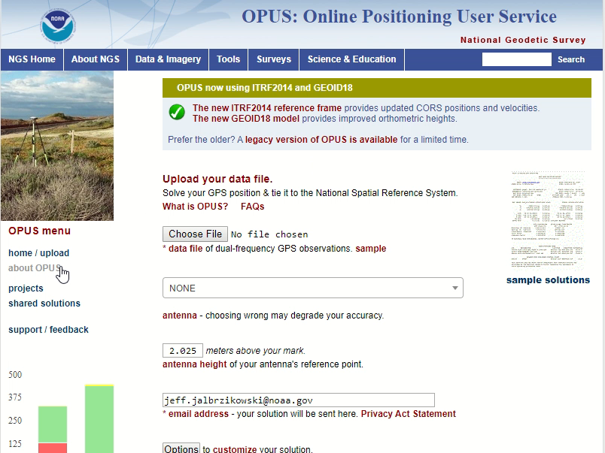
Notes:
So while we’re on the OPUS homepage I just want to point out the OPUS Team has a lot of great information on here in the “about OPUS” section.
Just click there, and for example under Solution Format there is a nice interactive

Slide 5
Online Positioning User Service
OPUS Rapid Static (OPUS-RS)
dual frequency receiver data
static sessions only
30 seconds epoch rate (aka recording interval)
15 minutes to 2 hours of GPS data
OPUS Static (OPUS-S)
same requirements as above
2 to 48 hours of GPS data
OPUS Projects (OP)
adds session processing and network adjustment
training by NGS required; typically 12 hours
files uploaded to OPUS with a “Project ID” keyed in Options
Beta OPUS Projects (BOP)
enhancements and added features
Notes:
Currently 4 types of OPUS.
*OPUS only supports GPS constellation data, last I talked to the OPUS developer the plan for incorporation of other constellations is Jan 2021.
Rapid Static – files uploaded that are 15 minutes to 2 hours in duration are processed using an NGS software called “RSGPS”
Static - files that are 2 to 48 hours in duration are processed using an NGS software called PAGES Your coordinates are the average of three independent, single-baseline solutions,
OP and Beta OP - these are not a different processing software, just a way to tie multiple OPUS-Static solutions together and use least squares methods to adjust them all as a coherent network
**the Beta serves as a testing bed for the developers to roll out new features or improvements and get feedback from users

Slide 6
What is OPUS Projects?
OPUS Projects offers Web-based access to simple visualization, management and processing tools for multiple marks and multiple occupations. Some of its advantages include:
Data uploading through OPUS.
Processing using the PAGES software.
Graphical visualization and management aids.
Limited support of bluebooking.

Slide 7
Why complicate OPUS?
OPUS
Session
Adjustment
CORS3
CORS5
CORS2
CORS1
CORS4
solution HATFIELD
solution MCCOY
Notes:
OPUS solutions are independent of each other, but they may be indirectly related …
Marks might “share” their environment (similar atmosphere over both).
Data might “share” the same GNSS constellation geometry.
OPUS solutions may “share” some or all of the same CORS.
Etc.
These correlations can increase with project size.

Slide 8
Why complicate OPUS?
OPUS
Session
Adjustment
CORS3
CORS5
CORS2
CORS1
CORS4
solution HATFIELD
solution MCCOY
session 001
Notes:
Combining your data logically can improve results:
Neutral atmosphere (tropo) corrections can be improved which, in turn, can help with other things like phase ambiguity resolution.
Common mode effects, like baselines connecting the same CORS common to different marks, can be de-correlated.
OPUS Projects tries to logically group data together:
Data from the same mark are associated with that mark.
Marks simultaneously occupied are grouped into sessions. Session processing improve consistency and accuracy.

Slide 9
Why complicate OPUS?
OPUS
Session
Adjustment
CORS3
CORS5
CORS2
CORS1
CORS4
solution HATFIELD
solution MCCOY
session 001
session 002
session N
Notes:
These concepts can be extended to other marks and other sessions.

Slide 10
Why complicate OPUS?
OPUS
Session
Adjustment
CORS3
CORS5
CORS2
CORS1
CORS4
solution HATFIELD
solution MCCOY
session 001
session 002
session N
network adjustment
Notes:
Ultimately, combining session solutions into an adjustment can improve accuracy for the entire network.

Slide 11
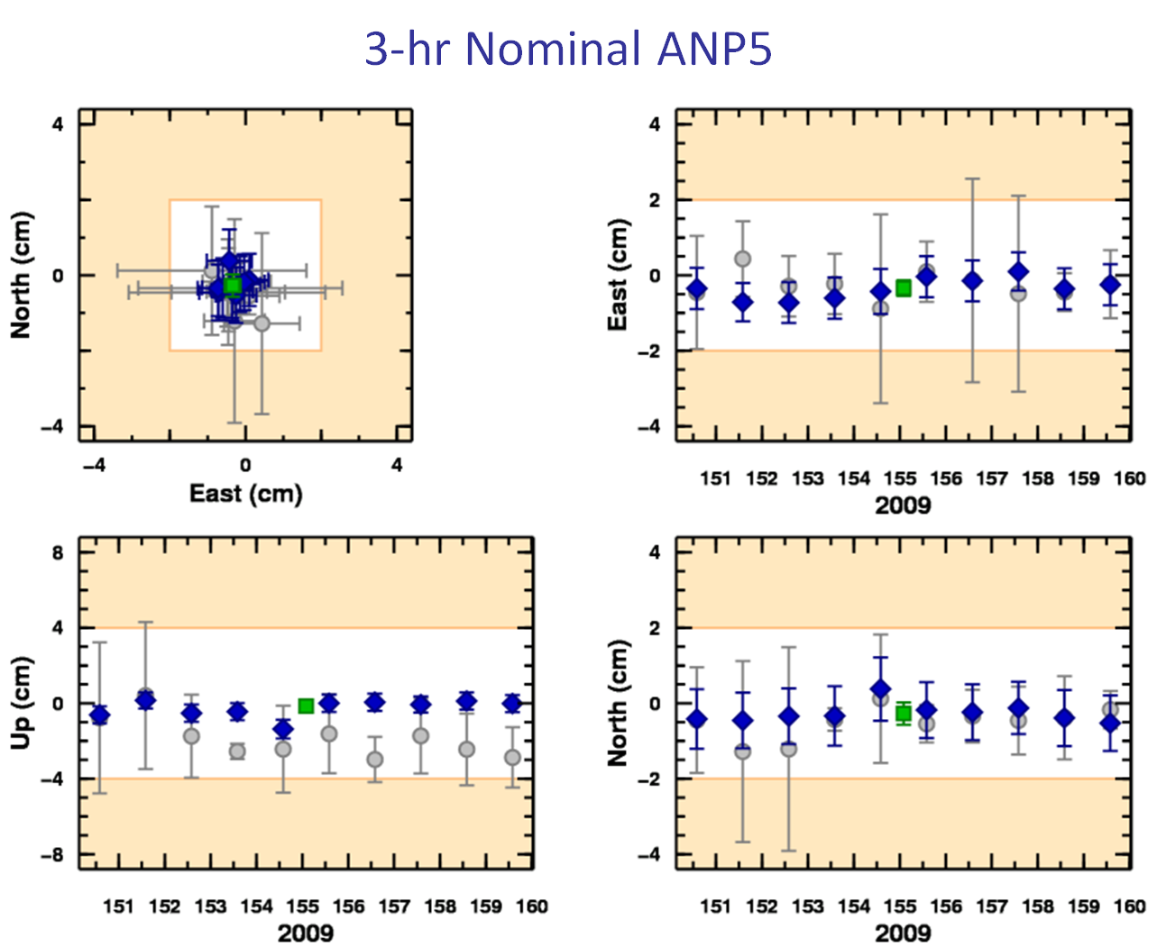
What’s in it for me?
OPUS solutions = pretty good, but each treated as independent and assumes “perfect” CORS.
Sessions = simultaneously-observed marks processed together in sessions increases consistency.
Adjustments = interlinking sessions through network adjustments increases accuracy.

Slide 12
Do we really need another OPUS flavor?
The practical answer is probably yes. The NGS and other groups have a history of projects whose specifications can’t be entirely supported by OPUS.
The academic answer is probably yes. As good as OPUS does, and that is very good indeed, sacrificing simplicity for flexibility can improve results.

Slide 13
OPUS-Projects can’t work magic.
does not make a project plan obsolete.
does not make field logs obsolete.
does not make mark descriptions obsolete.
does not make mark photos obsolete.
does not make remove sky obstructions.
does not make bad data good.
does not make processing decisions as well as you.
does not quality control processing results as well as you, the Professional Surveyor
Notes:
We can’t “spin straw into gold”.
-but if that’s what everyone wanted then I bet Mark could program us all right out of existence

Slide 14
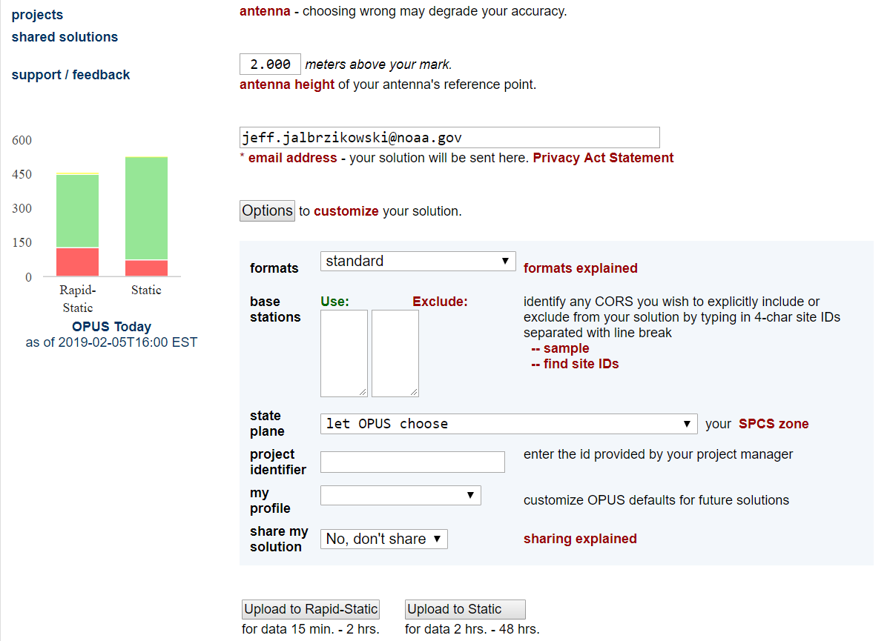
OPUS Projects – enter a Project ID
Project ID
for OP
Notes:
-orange box highlights on the OPUS upload where the user keys in a “project id”

Slide 15
a note on OPUS “my profile”
be careful!
Notes:
-be careful when using this, many folks experience their profile options being used even though they don’t select it

Slide 16
Online Positioning User Service
But wait… there’s more!
Coming soon…

Slide 17
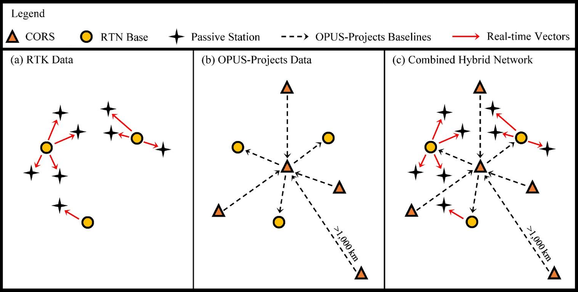
Hybrid Control Networks = Static + RTK/RTN
OPUS for RTK/RTN-GNSS
Notes:
OPUS-RTK/RTN … it’s coming, planned release date of Jan 2020. I’ve seen the Development/Alpha version
1 - Download RTN data from a data collector to software.
2 - Then, identify which base stations were chosen by the RTN as references during the survey.
3 - Go download the static data logged at the RTN base stations on the day(s) of the RTN survey.
4 - Upload this static data, preferably as 24-h files, to OPUS-Projects.

Slide 18
“What’s the benefit?” they say…
OPUS for RTK/RTN-GNSS
Run least squares adjustment(s) of the combined Static and RTN vectors
Hold NCN CORS (and possibly other published coordinates) in adjustments
Check quality of results
Submit survey project to NGS for review and publication in national database
…you’ll be able to Bluebook RTK/RTN data!
Notes:
-planned rollout date of Jan 2020.
-I said RTN vectors a lot there, so really important to keep in mind that to do any of this, you will need to be logging your vectors!
-if you’re using the ODOT network, or the KYCORS, and all you’re doing id

Slide 19
NGS Overview
Modernizing the NSRS
CORS
NHMP
GRAV-D
ECO
NGS Products and Services
ASP
OPUS
VDatum
Orbit Data
National Shoreline
Geodetic Advisors
ERI
Antenna Calibrations
NCAT
CUSP
CBL
Outreach/COMET
Notes:
This is not an exhaustive list of NGS programs

Slide 20
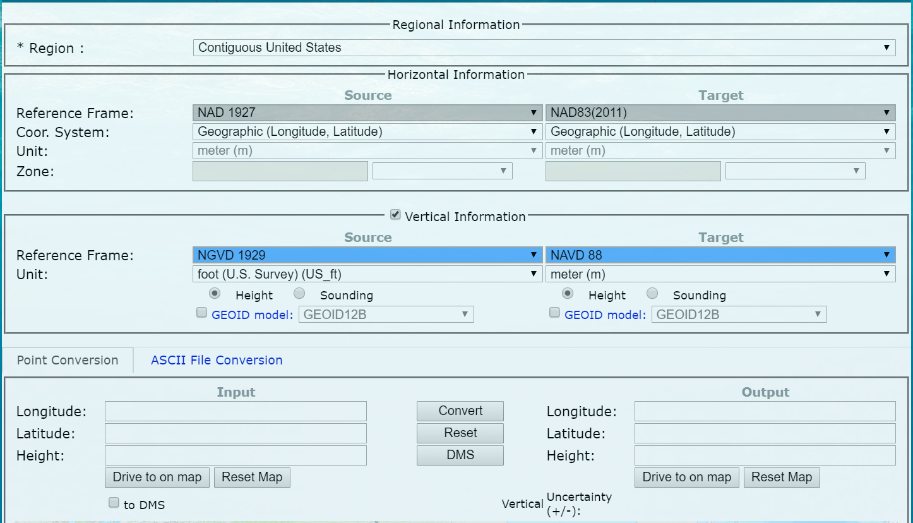
NOAA VDatum - online
Notes:
-The focus of this program is vertical datum transformations, especially transforming among water levels and geodetic
-But it handles some horizontal conversions and transformations
-Matter of fact, the newest version, v4.0, includes distinct options for the different realizations of NAD83

Slide 21
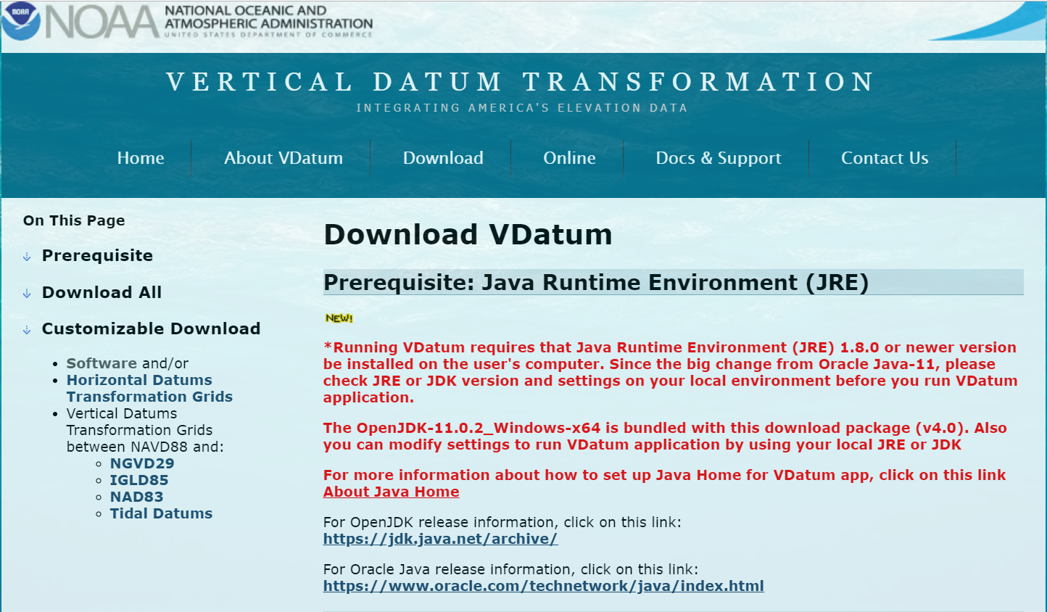
NOAA VDatum - download
Notes:
-the download version is a zip file that you extract, then just run the executable
-requires some version of Java on the computer, full details on the website, there in red text
-I’ve always been able to use it pretty easily, even on DoD machines

Slide 22
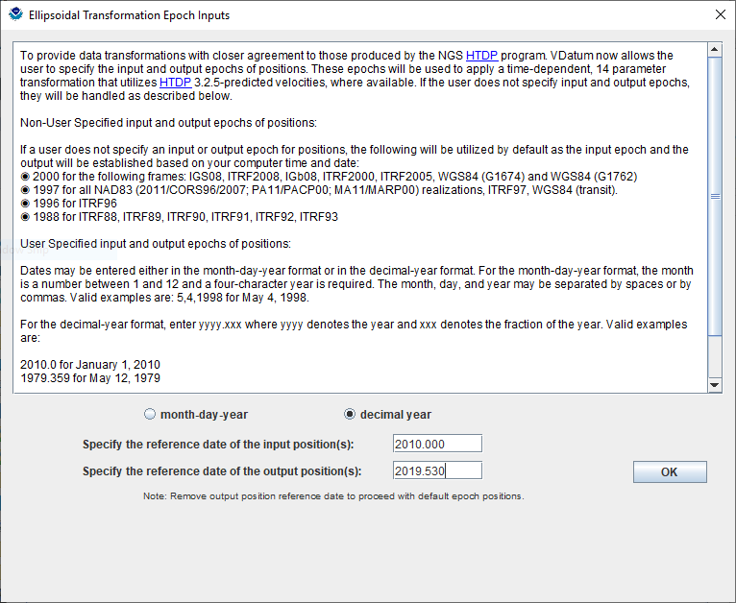
NOAA VDatum - download
Notes:
-cool thing about vdatum is that it incorporates the HTDP (Horzontal Time Dependent Positioning) software
-might not be something most surveyors, in this region anyway, are paying a whole lot of attention to
-but don’t those decimal year things look familiar?
-if you look at any of your OPUS Solution Reports, you’re going to see an epoch date, in the same format, on the right hand side next to the ITRF or IGS coordinates

Slide 23
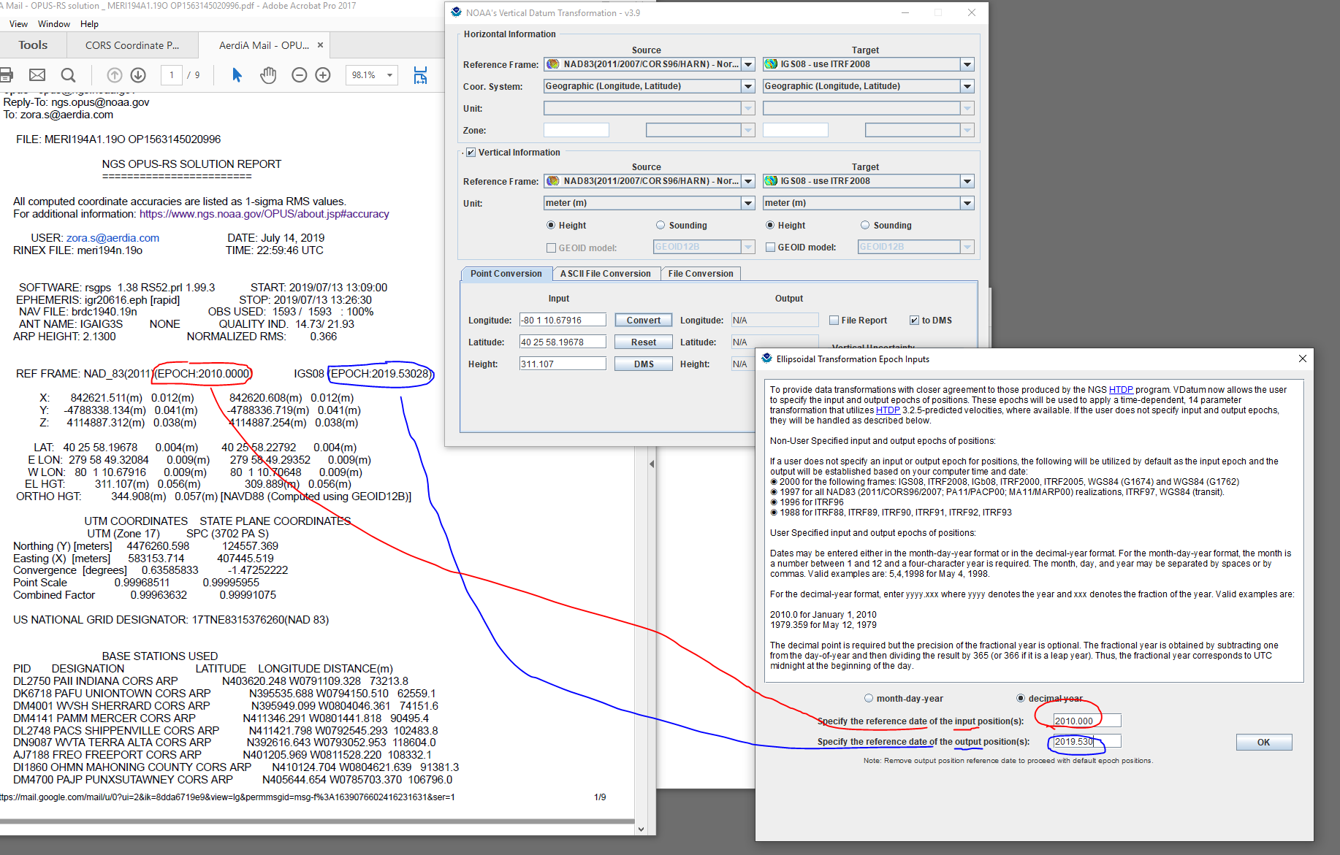
Notes:
-cool thing about vdatum is that it incorporates the HTDP (Horzontal Time Dependent Positioning) software
-might not be something most surveyors, in this region anyway, are paying a whole lot of attention to
-but don’t those decimal year things look familiar?
-if you look at any of your OPUS Solution Reports, you’re going to see an epoch date, in the same format, on the right hand side next to the ITRF or IGS coordinates

Slide 24
Notes:
-cool thing about vdatum is that it incorporates the HTDP (Horzontal Time Dependent Positioning) software
-might not be something most surveyors, in this region anyway, are paying a whole lot of attention to
-but don’t those decimal year things look familiar?
-if you look at any of your OPUS Solution Reports, you’re going to see an epoch date, in the same format, on the right hand side next to the ITRF or IGS coordinates

Slide 25
Notes:
-cool thing about vdatum is that it incorporates the HTDP (Horzontal Time Dependent Positioning) software
-might not be something most surveyors, in this region anyway, are paying a whole lot of attention to
-but don’t those decimal year things look familiar?
-if you look at any of your OPUS Solution Reports, you’re going to see an epoch date, in the same format, on the right hand side next to the ITRF or IGS coordinates

Slide 26
NOAA VDatum Website
vdatum.noaa.gov
Notes:
-the download version is a zip file that you extract, then just run the executable
-requires some version of Java

Slide 27
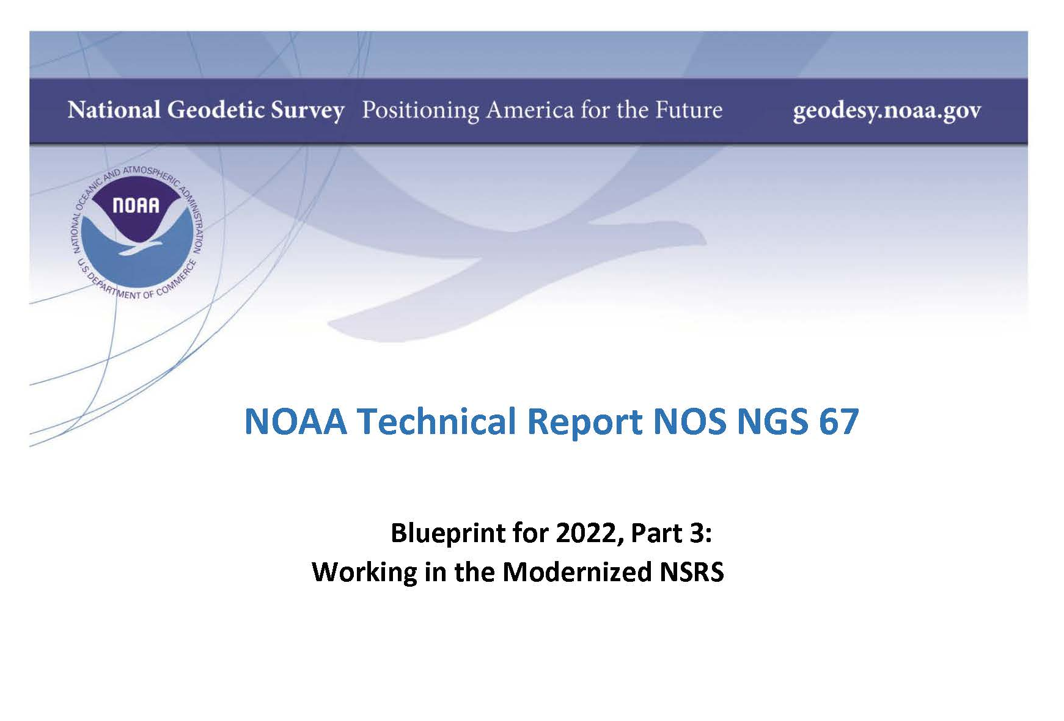
Blueprint for 2022, Part 3
Notes:
-the new coordinate types, along with methodologies and more are covered in Blueprint Part 3
-both of which are on our website and very easy to find via search engine, contact me if you can’t find it

Slide 28
EPP2022 IFVM2022
Two new tools that will make time dependent geodetic control practical
They work together to account for the Drift…

Slide 29
Example of application of EPP and IFVM
It’s 2039 and you are working in San Diego using NATRF2022
And you want to compare your work to another survey from 2028
Important: This slide only covers geometric coordinates.
…the catch is, that survey was done in PATRF2022
PATRF2022
ep. 2028.048
EPP2022
(PA)
ITRF2014
ep. 2028.048
EPP2022
(NA)
NATRF2022
ep. 2028.048
IFVM2022
(PA)
IFVM2022
(NA)
PATRF2022
ep. 2039.704
EPP2022
(PA)
ITRF2014
ep. 2039.704
EPP2022
(NA)
NATRF2022
ep. 2039.704

Slide 30
Daily Epochs?!?
It seems unlikely that the majority of surveyors will embrace these (e.g. 2028.048, 2039.074 from last slide)
To mitigate that, NGS will issue “snapshots” of the NSRS every five years
We’re calling these Reference Epochs
These will be estimates of coordinates at specific 5 year intervals - based on historic coordinates and the IFVM2022
Beginning with 2020.00
Each “snapshot” will be published 2-3 years after the reference epoch, so the 2020.00 Reference Epoch Coordinates get published by the end of calendar year 2022… thus the name/date of 2022
Notes:
-the NSRS Modernization team believes that it is “unlikely”
-above items are geometric only, the Geoid Monitoring Service (GeMS) will address geopotential

Slide 31
Reference Epoch Coordinates from Time-Dependent Coordinates

Slide 32
Assume “h” was determined four different times:
1990: 2.100
1994: 2.110
2002: 2.190
2009: 2.180
h
2.250
2.200
2.150
2.100
2.050
2.000
1990
‘95
‘00
‘05
‘10
‘15
‘20
‘25
‘30
time

Slide 33
All measurements have error. Shown here are the same
Values of “h”, but with their error estimates.
1990: 2.100 +/- 0.0375 (3.75 cm)
1994: 2.110 +/- 0.0250 (2.50 cm)
2002: 2.190 +/- 0.0200 (2.00 cm)
2009: 2.180 +/- 0.0250 (2.50 cm)
h
2.250
2.200
2.150
In the modernized NSRS these time-dependent
coordinates, estimated at the actual date when
the surveys took place, will be called
Final Discrete Coordinates
2.100
2.050
2.000
1990
‘95
‘00
‘05
‘10
‘15
‘20
‘25
‘30
time

Slide 34
h
In today’s NSRS, a height is held fixed until replaced. So plotting the height of these Final Discrete Coordinates as seen on a datasheet over time would look like this:
2.250
2.200
2.150
2.100
2.050
2.000
1990
‘95
‘00
‘05
‘10
‘15
‘20
‘25
‘30
time
Notes:
-but we don’t want to do this.

Slide 35
In the modernized NSRS we will also have an estimate of
crustal motion from IFVM2022
h
2.250
2.200
2.150
2.100
Combining Final Discrete Coordinates
with IFVM2022 allows NGS to estimate Reference Epoch Coordinates
2.050
2.000
1990
‘95
‘00
‘05
‘10
‘15
‘20
‘25
‘30
time

Slide 36
The IFVM2022 model will (statistically)
match reference epoch coordinates.
h
2.250
2.200
2.150
2.100
This will allow for the elimination of a
stand-alone “NADCON” product for
coordinates after 2020.0, instead relying
entirely upon IFVM2022
2.050
2.000
1990
‘95
‘00
‘05
‘10
‘15
‘20
‘25
‘30
time

Slide 37
In the absence of new survey data, error estimates will
grow through time.
h
2.250
2.200
2.150
2.100
2.050
2.000
1990
‘95
‘00
‘05
‘10
‘15
‘20
‘25
‘30
time
Notes:
-one thing very important to note, look at those error bars and how they expand over time

Slide 38
The (in)ability of current approach to
properly inform users of the height of
this mark can be seen in blue.
2.250
2.200
2.150
2.100
2.050
2.000
1990
‘95
‘00
‘05
‘10
‘15
‘20
‘25
‘30

Slide 39
EPP and IFVM with Reference Epochs
It’s 2039 and you are working in San Diego using NATRF2022 (epoch 2035.00)
And you need to compare your work to another survey from 2028
Important: This slide only covers geometric coordinates.
…the catch is, that survey was done in PATRF2022 (epoch 2025.00)
PATRF2022
ep. 2025.00
EPP2022
(PA)
ITRF2014
ep. 2025.00
EPP2022
(NA)
NATRF2022
ep. 2025.00
IFVM2022
(PA)
This would’ve been a NADCON function in the past
IFVM2022
(NA)
PATRF2022
ep. 2035.00
EPP2022
(PA)
ITRF2014
ep. 2035.00
EPP2022
(NA)
NATRF2022
ep. 2035.00

Slide 40
Let’s look at some new terminology

Slide 41
The NOAA CORS Network (NCN)
As of 2019, this is the official name of the network managed at NGS
Historically referred to as “CORS” or “the CORS”
Notes:
where else but the federal government are you going to see two acronyms within one acronym?

Slide 42
GPS Month
A span of four consecutive GPS weeks, where the first GPS week in the GPS month is an integer multiple of 4
GPS Month 0 = GPS Weeks 0, 1, 2 and 3
GPS Month 1 = GPS Weeks 4, 5, 6 and 7
GPS Month 2 = GPS Weeks 8, 9, 10, and 11
Etc.

Slide 43
New Types of Coordinates

Slide 44
Five types of coordinates in Modernized NSRS
Name | Generally on… | Description
Reported | Passive | “Quick and Dirty”. Smartphone accuracy. (aka HD_HELD)
Preliminary | Passive | Computed by you with OPUS using your data. Unchecked by NGS.
Final Discrete | Passive | Most accurate. Time-dependent. Computed by NGS every four weeks.
Final Running | CORS | Continuous time-dependent CORS coordinates. Checked by NGS every day.
Reference Epoch | Passive and CORS | Modeled from Final Discrete, Final Running, IFVM2022 and GeMS. Computed by NGS every five years.
Notes:
-is this necessary or does Dr. Dru just like to name things??
-it is necessary to accomplish what the community said they wanted during the early time period of public presentations on the new datums

Slide 45
Coordinates - Reported
Reported
“These are from any source where the coordinate is directly reported to NGS without the data necessary for NGS to replicate the coordinate.”
Scaled
From NCAT or Vdatum
Hand Held (HD_HELD) / Smartphone
Reported directly from RTK/RTN rover without data files
Notes:
-whats NCAT again? The NGS Coordiante Conversion and Transformation Tool, it’s online now with fully NADCON functionality and VERTCON currently in Development. I’ve seen that, it’s nice additions.

Slide 46
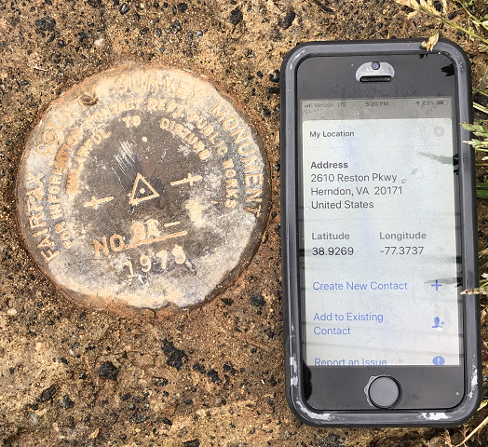
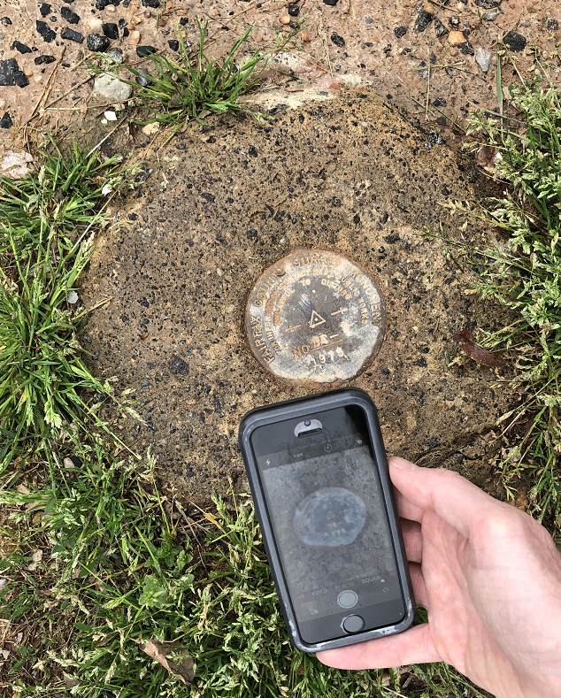
Reported Coordinates

Slide 47
Coordinates - Preliminary
Preliminary
“These are coordinates at survey epoch that have been computed from OPUS, but not yet quality checked and loaded into the National Spatial Reference System Database (NSRS DB).”
User-computed values, such as they might get today from either OPUS-S or OPUS-Projects
“Preliminary” coordinates are the only coordinates a user will get directly from OPUS
Notes:
-example … OPUS Static or Rapid Static

Slide 48
Coordinates – Final Discrete
Final Discrete
“These are coordinates computed by NGS using submitted data and metadata, checked and adjusted and referenced to a single survey epoch.”
Represent the best estimates of the time-dependent coordinates at any mark
Survey epochs:
GNSS: Each GPS Month
Stand-alone occupations, RTK/RTN, Campaigns, etc
Leveling: Annually
Orthometric heights: Leveling will be adjusted to GNSS-based orthometric heights
Notes:
-leveling projects to be submitted for inclusion in the NSRS will require GNSS ties
-perhaps any leveling you do in the future OPUS tool for that, no final decision made yet

Slide 49
Coordinates – Final Running
Final Running
“Of all types of coordinates on a mark, these are the only ones which will have a coordinate at any time.”
Generally will only be available at each CORS
Also being called the coordinate function
Which will be generated by a “fit” to daily processed data

Slide 50
Coordinates – Reference Epoch
Reference Epoch
“These are coordinates which have been estimated by NGS, from time-dependent (final discrete and final running) coordinates, at an Official NSRS Reference Epoch (ONRE)”
NAD 83(2011) epoch 2010.00 would (kinda) fall under this category
These will be computed by NGS every 5 years
On a schedule 2-3 years past ONRE
2020.00 coordinates will be computed in CY 2022
2025.00 coordinates will be computed in CY 2027

Slide 51
Using the modernized NSRS
OPUS
Guidance (such as pre-selected CORSs and assistance in locating marks in project areas)
Users will decide what control to hold fixed and what epochs they wish to set for the adjustment
“Preliminary coordinates”
If submitted to NGS (aka “Shared”), we will harvest your raw GNSS data and use it to compute Final Discrete coordinates
Notes:
it all starts and ends with OPUS

Slide 52
Using the modernized NSRS
GNSS is your only entry (for now)
Leveling and Classical/TS surveys will need some GNSS if you wish to submit your survey to NGS for inclusion in the NSRS database
Some GNSS = RTK or RTN is fine
No decision yet on whether OP will operate if projects have no GNSS
If it does, this tends to encourage reliance upon passive control
which is “so 90’s” …1890s brah!

Slide 53
So much more to NSRS Modernization!
New version of PAGES
Multi-Constellation → GPS, Galileo, GLONASS, Beidou, QZSS, etc.
Target: 15 minute occupations
OPUS expansion plan
RTK/RTN: 2020 rollout, already mentioned
Leveling, Classical, Gravity: 2020-2025
Fully integrated (GPS projects with leveling and gravity? No problem!)
Ease of submission to NGS for inclusion in the NSRS
New Mark Recovery Tool
mentioned earlier, search: “NGS mark recovery” and go to Beta
Fully integrated toolkit
NCAT and VDatum

Slide 54
Bluebooking a Project now
geodesy.noaa.gov/ project_tracking/
GPS survey
data files
photos
descriptions
etc.
Process data using vendor software or PAGE-NT.
Construct bluebook files using software and editor.
Run ADJUST.
review and publish to IDB

Slide 55
Bluebooking with OPUS Projects in the future
geodesy.noaa.gov/ project_tracking/
GPS survey
data files
photos
descriptions
etc.
Process data using vendor software or PAGE-NT.
Construct bluebook files using software and editor.
Run ADJUST.
review and publish to IDB
Available now, with certain caveats
Upload to OPUS-Projects
Process in OPUS-Projects

Slide 56
Mobile-enabled Mark Recovery website
use your smartphone to submit recovery
Any major search engine:
“NGS survey Mark Recovery”
beta.ngs.noaa.gov/cgi-bin/recvy_entry_www.prl
Try it out! Give us feedback!
NGS.Feedback@noaa.gov
Notes:
-INCLUDES A DIRECT PHOTO UPLOAD
--CURRENTLY HAVE A FEATURE TO SEARCH YOUR CURRENT AREA

Slide 57
State Plane Coordinate System of 2022
(SPCS2022)

Slide 58
SPCS2022 activity over the last year
Publish State Plane history report: March 6
Webinars on March 8 and April 12
Launch new SPCS web pages: March 19
Publish Federal Register Notice (FRN) and draft SPCS2022 Policy & Procedures: April 18
FRN response deadline: August 31
Provide first preliminary design maps: October 11
Finalizing policy & procedures: May 5
Notes:
A list of the things that have occurred in the SPCS2022 Project
Currently in process of finalizing the SPCS2022 Policy & Procedures, with goal of publishing them in March 2019

Slide 59
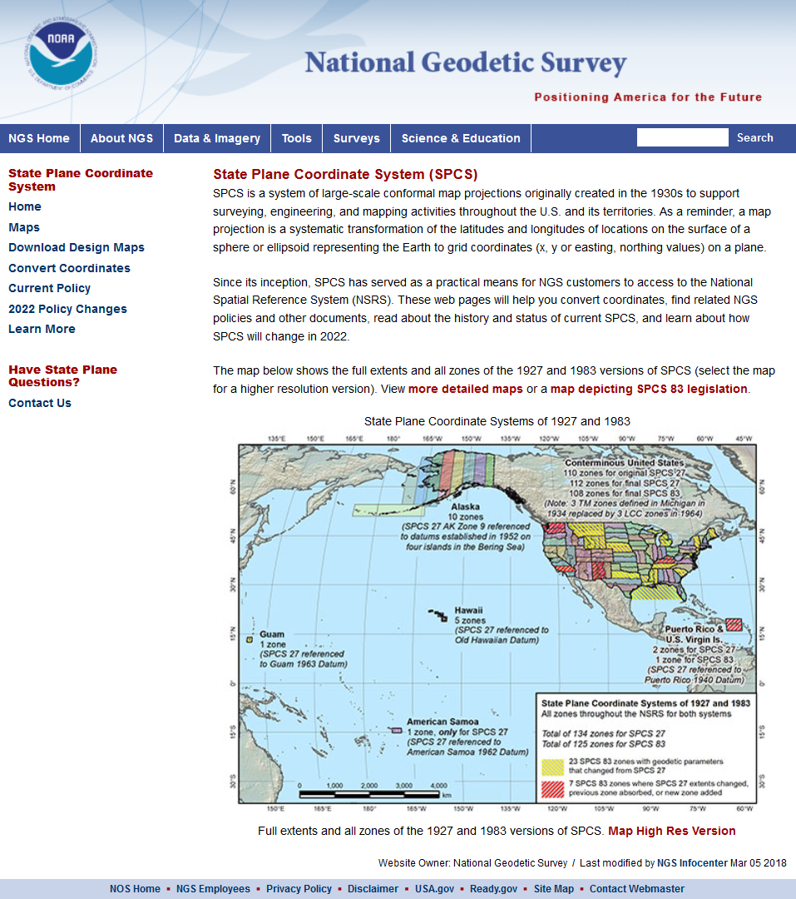
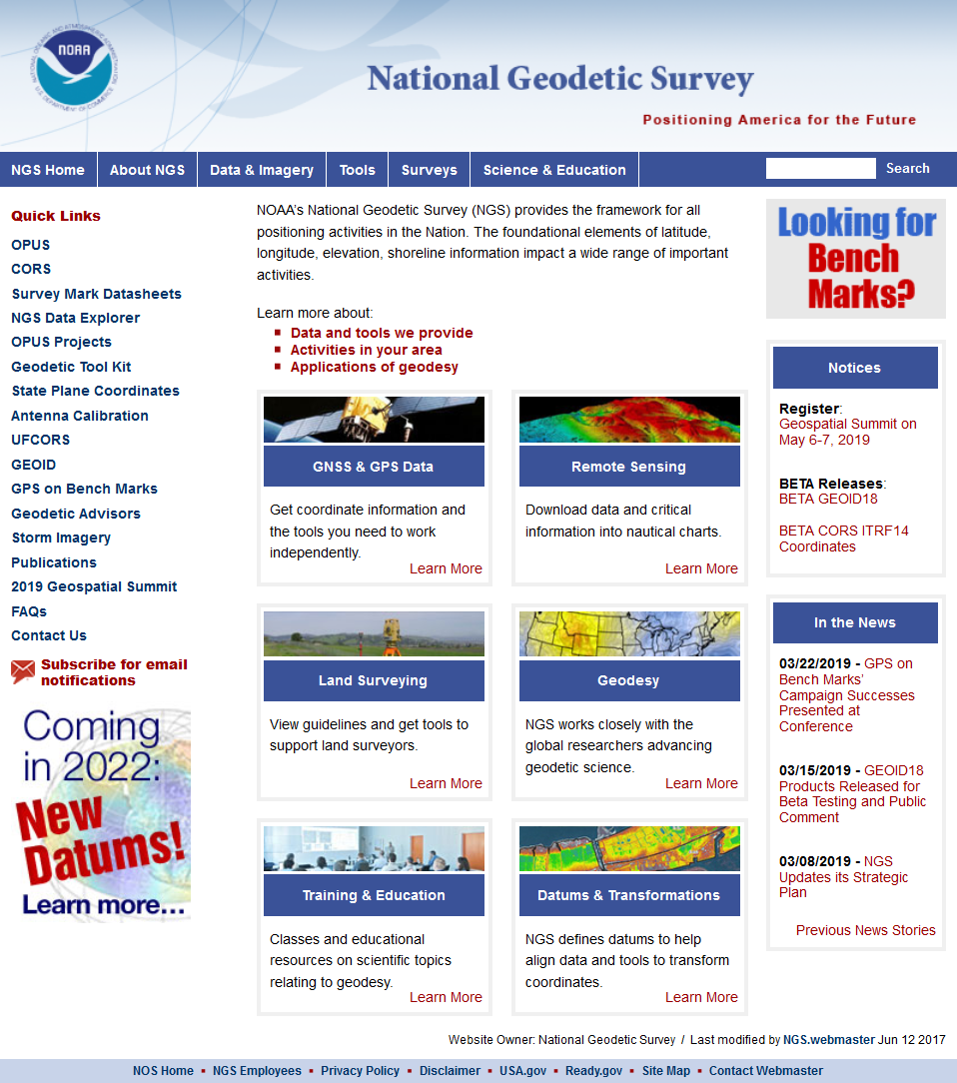

geodesy.noaa.gov
Notes:
A lot of information is available on the NGS website, including:
2022 policy changes
Supporting information (old policy and manuals, new report on SPCS history)
Maps of preliminary SPCS2022 designs available for download
Not all states yet available, but designs are in progress
Includes maps of existing SPCS 83 for comparison

Slide 60
SPCS2022 Policy & Procedures
Summary of main things that did NOT change
Policy
Limited to LCC, TM, and OM projections
Zones designed to reduce distortion at ground
Default zones designed by NGS if no consensus input
Parameters in meters, but feet allowed for output
Procedures
Stakeholders must submit requests/proposals
1-parallel LCC and local OM projection definitions
Specified a linear distortion design criterion
Limit NGS designs to minimum of ±50 ppm
50 km min zone size for height range of 250 m or less
Notes:
A major component of SPCS2022 are stakeholders
Stakeholders have a role in helping define (and maintain) SPCS2022
A major stakeholder group is state DOTs, along with other geospatial groups as listed here
There is a formal process for stakeholders to submit REQUESTS and PROPOSALS for SPCS2022
Stakeholders must consist of one of the STATE groups listed, and
Input must be unanimous for NGS to act
NGS cannot act on input from individuals; they should work through a stakeholder group

Slide 61
Changes to SPCS2022 Policies
Summary of main changes
Allow “special use” zones
But only for zone areas in more than 1 state
NGS will design statewide zone for every state
Also will design default zones if no consensus stakeholder request for something different
Allow max of 3 “layers” (1 statewide + 2 multi-zone)
But most states will have 1 or 2 layers
Added requirement that all zones be unique
Zones within a layer cannot overlap
Require positive east longitudes
Notes:
A major component of SPCS2022 are stakeholders
Stakeholders have a role in helping define (and maintain) SPCS2022
A major stakeholder group is state DOTs, along with other geospatial groups as listed here
There is a formal process for stakeholders to submit REQUESTS and PROPOSALS for SPCS2022
Stakeholders must consist of one of the STATE groups listed, and
Input must be unanimous for NGS to act
NGS cannot act on input from individuals; they should work through a stakeholder group

Slide 62
Changes to SPCS2022 Procedures
Summary of main changes
Delayed deadlines by 3 months
Removed “contributing partner” category
Moved submittal details to fillable forms
Added section on zones numbers and names
Added details on linear distortion design criterion
Removed minimum distortion limit
Added 10 km min zone size for height range > 250m
Notes:
A major component of SPCS2022 are stakeholders
Stakeholders have a role in helping define (and maintain) SPCS2022
A major stakeholder group is state DOTs, along with other geospatial groups as listed here
There is a formal process for stakeholders to submit REQUESTS and PROPOSALS for SPCS2022
Stakeholders must consist of one of the STATE groups listed, and
Input must be unanimous for NGS to act
NGS cannot act on input from individuals; they should work through a stakeholder group

Slide 63
SPCS2022 stakeholders
State groups that formally interface with NGS
Departments of transportation
Cartographer/GIS office
Professional surveying, engineering, GIS societies
Colleges/universities with geospatial curriculum
Can submit requests and proposals for designs
Requests are for designs by NGS
Proposals are designs by stakeholders
Stakeholder input must be unanimous
Notes:
A major component of SPCS2022 are stakeholders
Stakeholders have a role in helping define (and maintain) SPCS2022
A major stakeholder group is state DOTs, along with other geospatial groups as listed here
There is a formal process for stakeholders to submit REQUESTS and PROPOSALS for SPCS2022
Stakeholders must consist of one of the STATE groups listed, and
Input must be unanimous for NGS to act
NGS cannot act on input from individuals; they should work through a stakeholder group

Slide 64
General SPCS2022 characteristics
Distortion design requirements
Linear distortion minimized at topographic surface (not at ellipsoid surface)
Purpose: to reduce difference between projected “grid” and actual “ground” distances
Other characteristics
Default designs (if no consensus stakeholder input)
Statewide and “layered” zones
Positive east longitudes
Low-distortion projections (LDPs)
“Special use” zones
Notes:
Will go over main general characteristics of SPCS2022 (not enough time to go into detail)
This is based on final SPCS2022 Policy & Procedures (not yet published but most decisions have been made on content)
Final policy & procedures created based in part on public response to the FRN
A key element of SPCS2022 is linear distortion (“scale error”) design requirements
Linear distortion is the difference between a “grid” distance (between the projected coordinates of a pair of points) and the true horizontal “ground” distance (at the topographic surface of the Earth)
SPC2022 zones are designed to minimize linear distortion at the topographic surface, NOT at the ellipsoid surface (as was done for SPCS 83 and 27)
Other relevant characteristics are listed; each will be discussed in this presentation

Slide 65
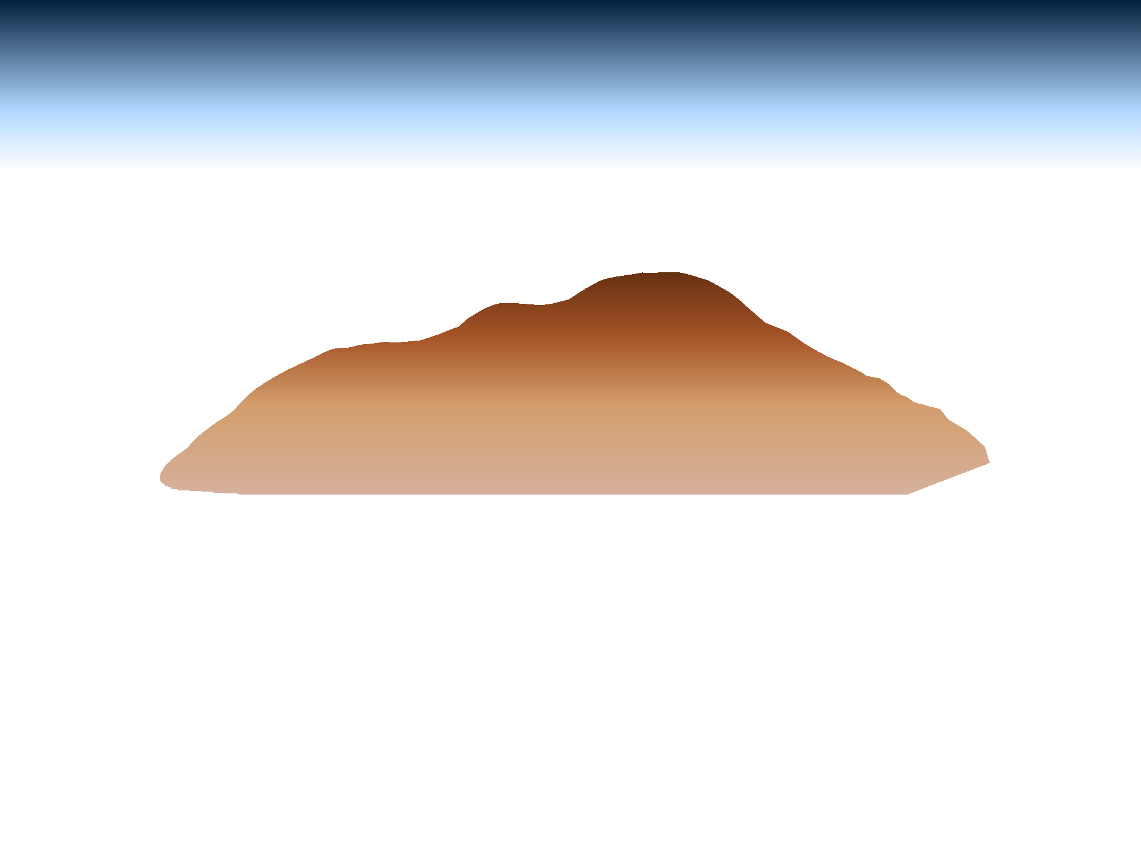

Linear distortion with respect to ellipsoid
Projection axis
Projection surface (secant)
Ellipsoid distance
Grid distance > ellipsoid distance
Ellipsoid distance
Ellipsoid surface
This design approach used for SPCS 27 and 83 (minimizes distortion with respect to ellipsoid)
Grid distance < ellipsoid distance

Slide 66










Changing projection axis to reduce distortion variation
Topographic surface
Grid distance = ground distance at many points
Projection axis
Ellipsoid height of surface not constant:
h₁ ≠ h₂
h₂
h₁
Only way to reduce variation in distortion is to change projection axis location.
IMPORTANT: For large areas, there is no single defining ellipsoid height, h, for scaling the projection.
Ellipsoid surface
This design approach is being used for SPCS2022 (minimizes distortion with respect to topography)

Slide 67



“Non-intersecting” conformal map projection
Topographic surface
Grid distance = ground distance at a point
Grid distance = ground distance at a point
Projection axis
Non-intersecting
Grid distance ≈ ground distance over finite distance
Purpose is to reduce linear distortion at “ground” (topographic surface).
But distortion can vary considerably across area of interest.
Ellipsoid surface
Notes:
-This is the base format of this type of non-intersecting conformal map projection
-Note the yellow dots indicated where grid = ground, so let’s look back at the small-zone LDP format, and notice the abundance of yellow dots.

Slide 68
Default SPCS2022 zones
To ensure all states and U.S. territories covered
For complete system if no consensus stakeholder input
Nearly same as SPCS 83 but with some changes
Almost all zone projection types and extents the same
Modify existing zones to meet SPCS2022 policy
Scale redefined with respect to topographic surface
Use 1-parallel Lambert and local Oblique Mercator
NGS will create a statewide zone for all states

Slide 69
Zone “layers” and LDPs
Each state may have max of THREE zone “layers”
One layer must be statewide zone (designed by NGS)
Other layers have two or more zones (“multi-zone”)
Only one layer can have discontinuous coverage
Multi-zone layer can consist of LDPs
Designed by stakeholder “contributing partners”
Minimum zone width 50 km (if height range < 250 m)
OR 10 km (if height range > 250 m)
LDP coverage can be discontinuous

Slide 70
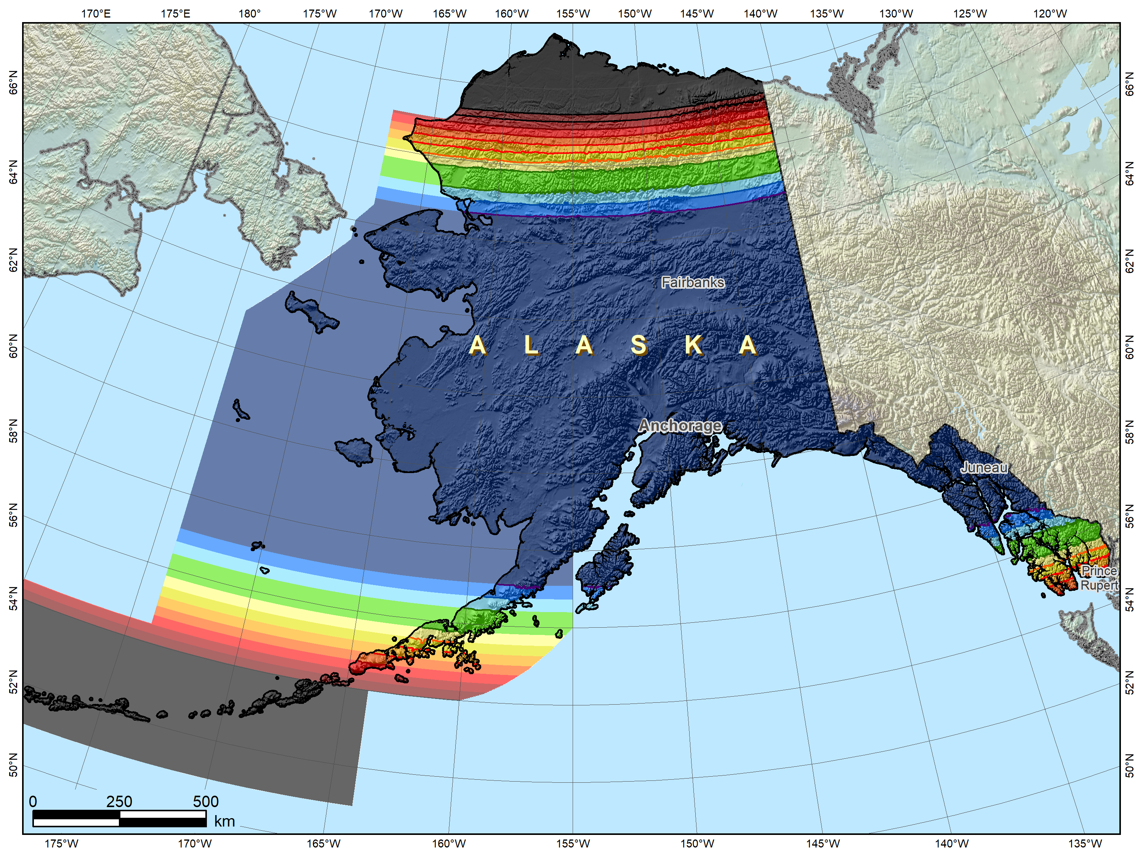
Alaska statewide “base” layer
Alaska zone layers
1. Statewide layer

Slide 71
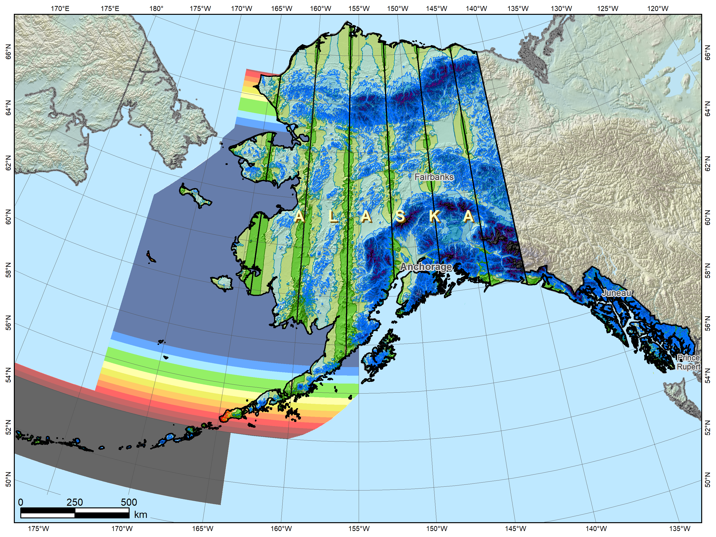
Alaska complete “intermediate” layer
Alaska zone layers
1. Statewide layer
2. “Intermediate” layer (complete state coverage)
71

Slide 72
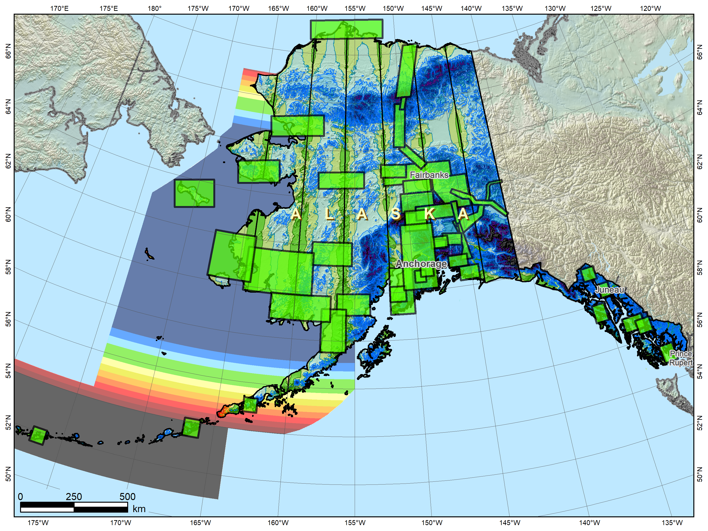

Alaska with THREE SPCS2022 layers
Alaska zone layers
1. Statewide layer
2. “Intermediate” layer (complete state coverage)
3. LDP layer (partial state coverage)
72

Slide 73
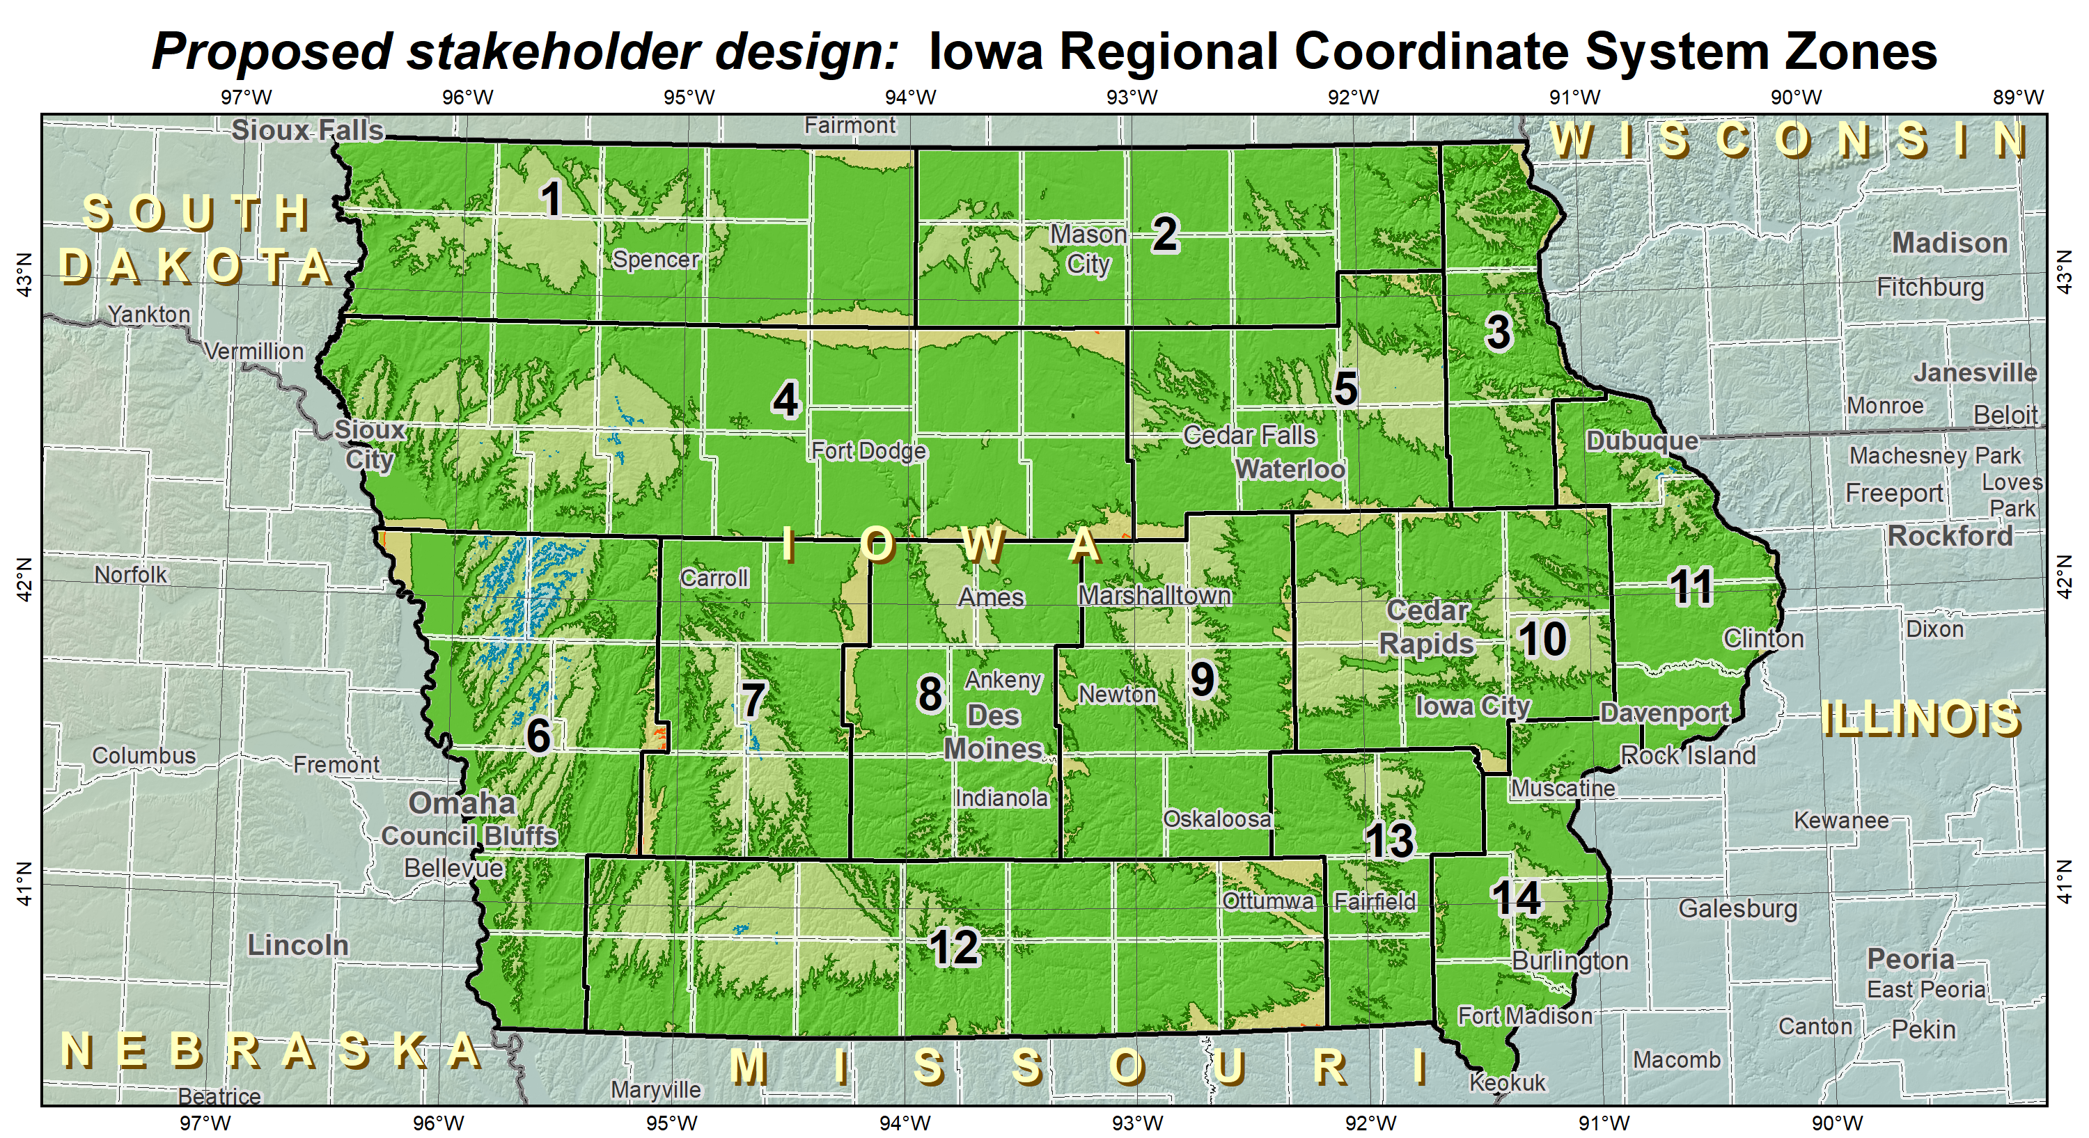
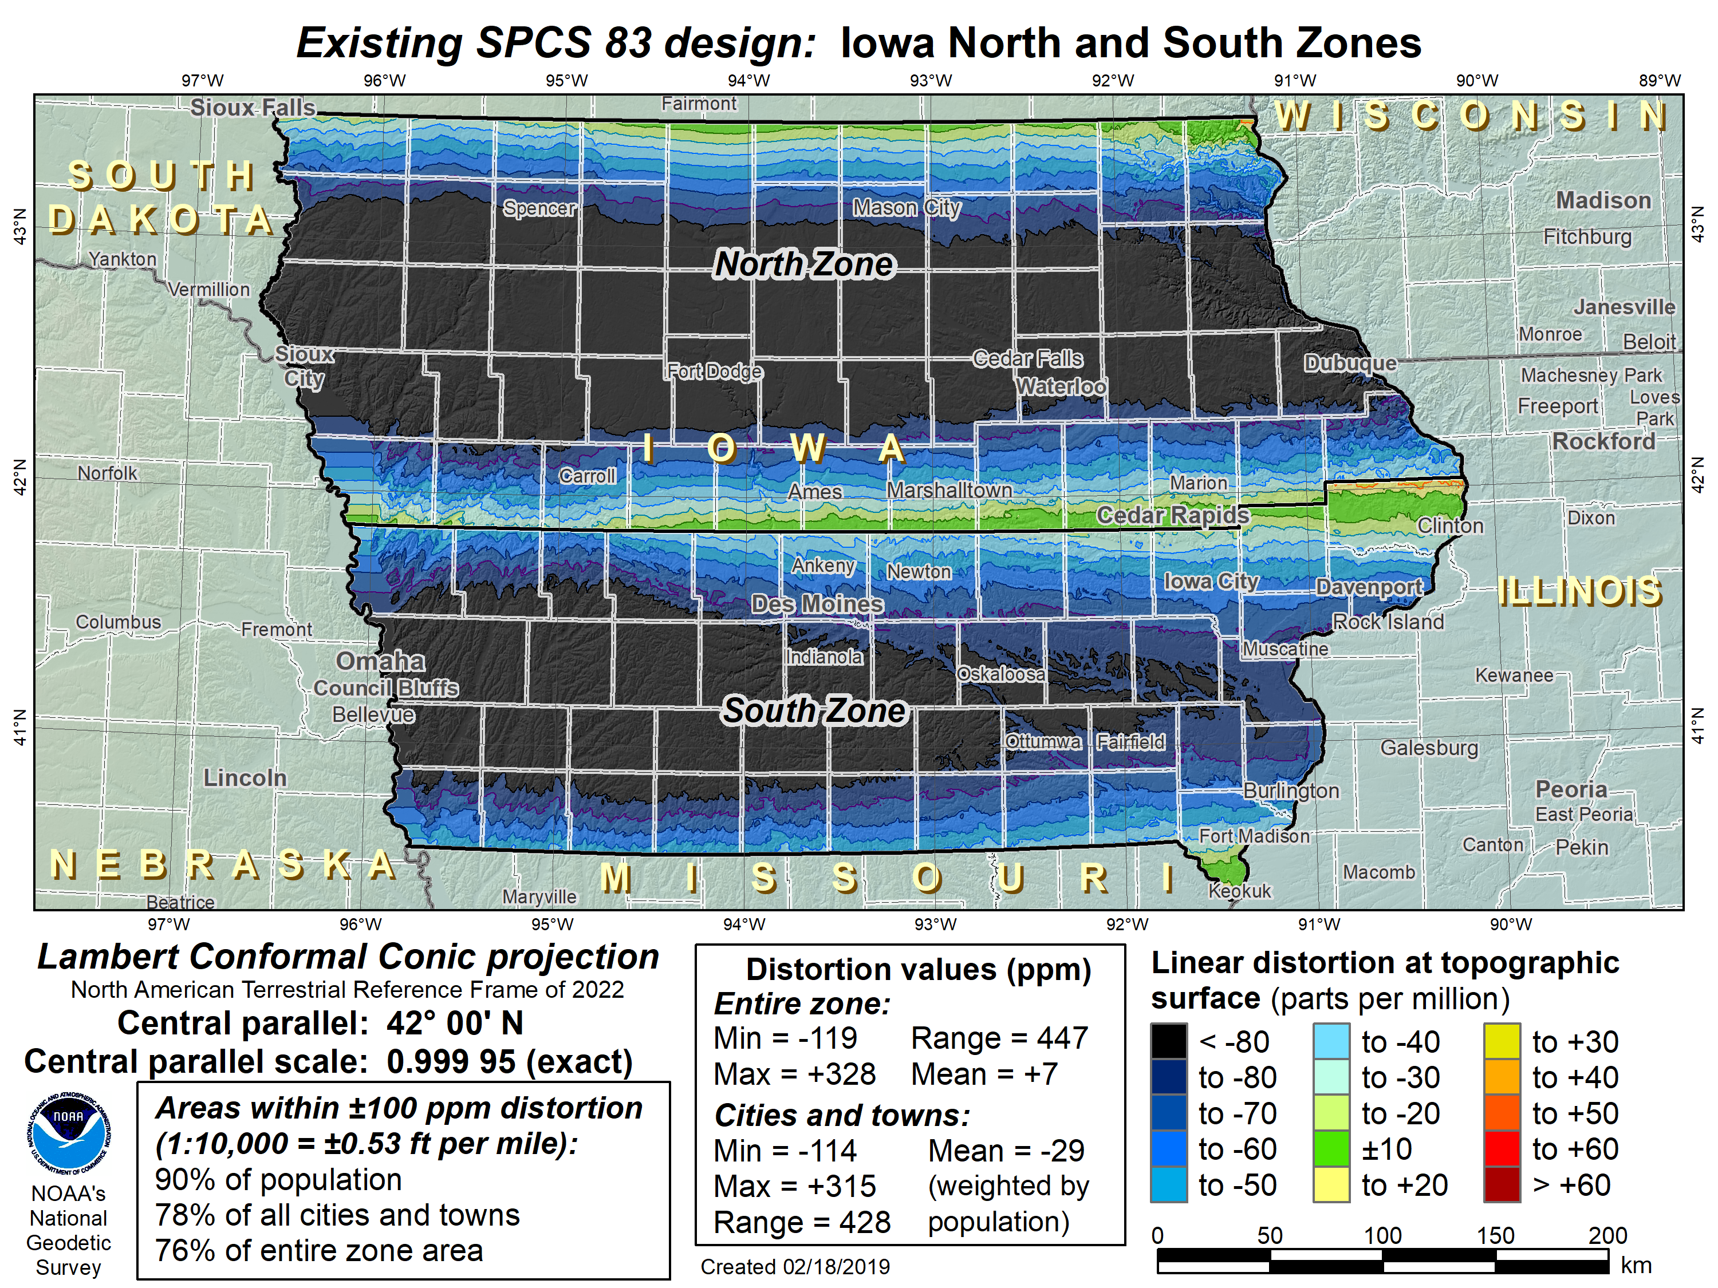
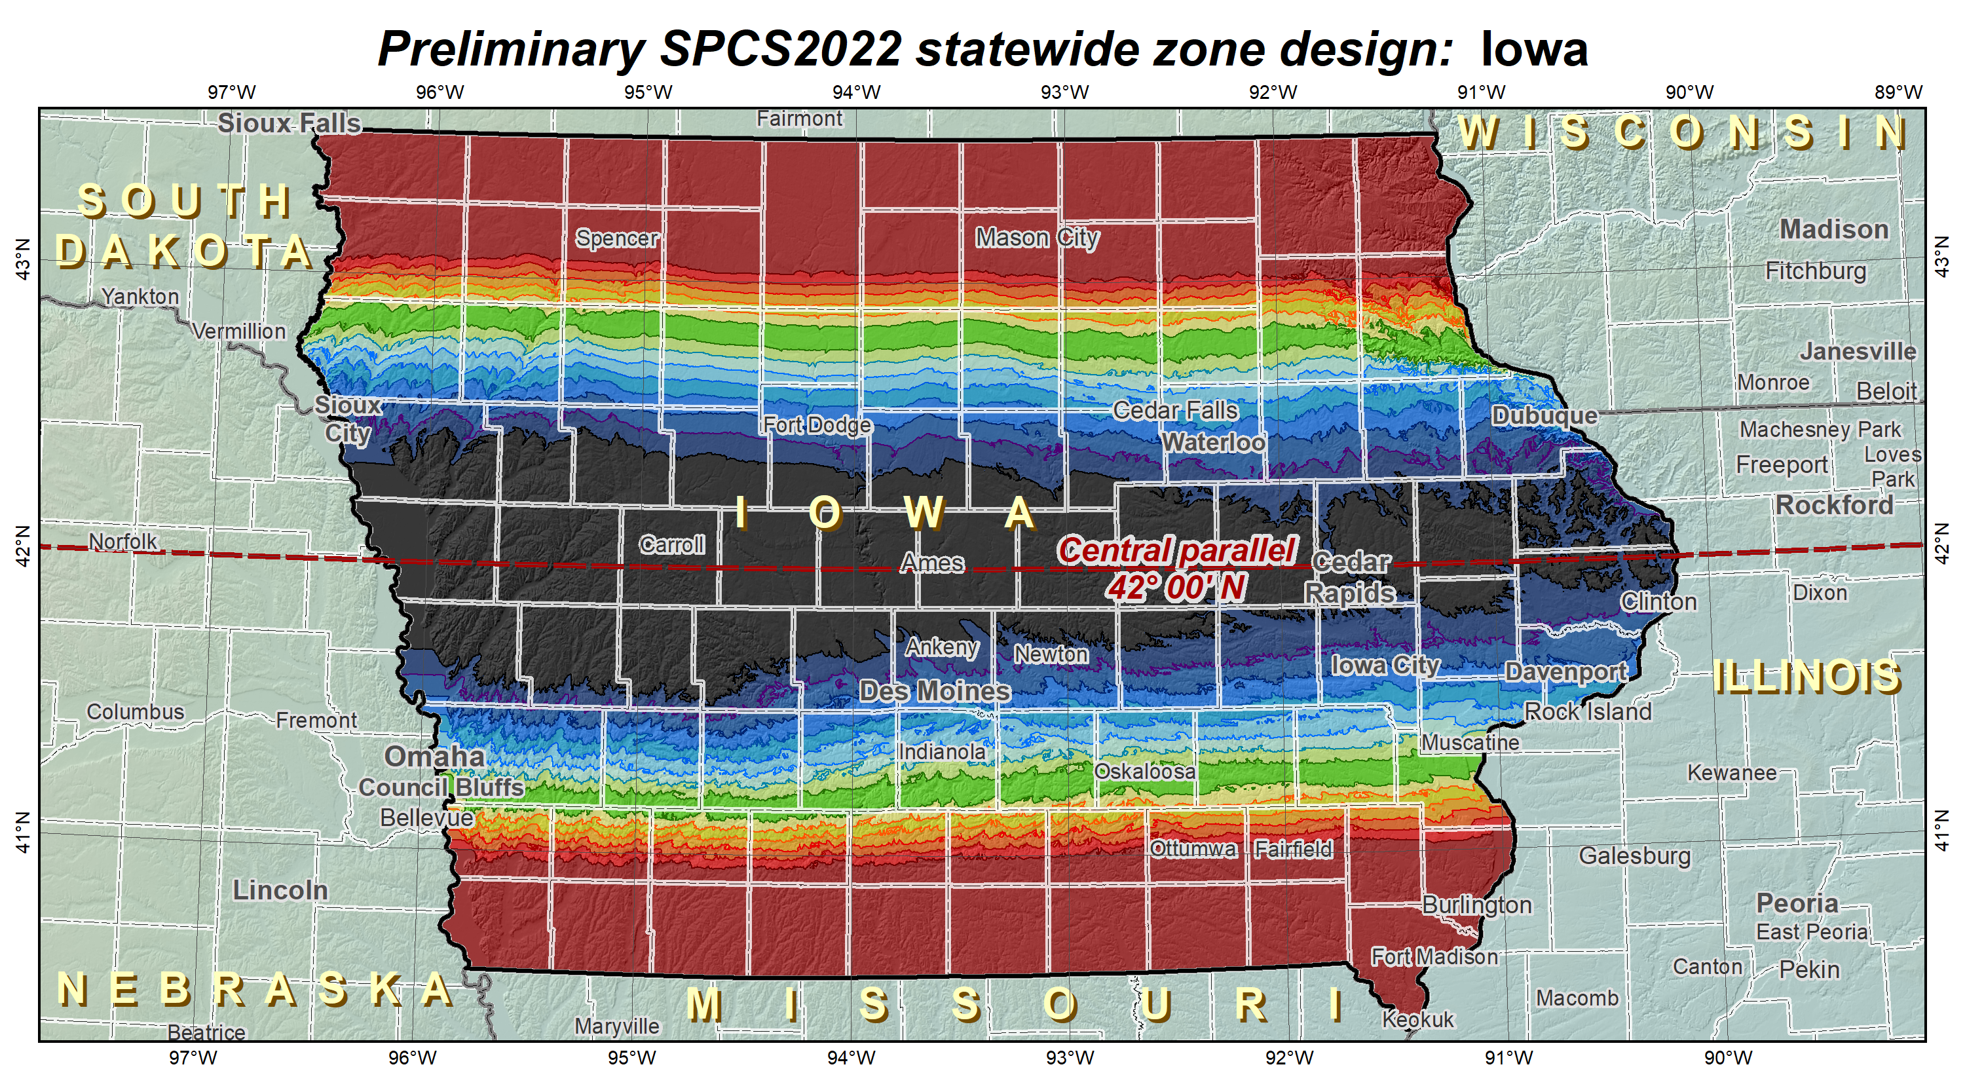
Iowa with TWO SPCS2022 layers
LDP multiple-zone layer (complete state coverage)
SPCS 83-like multiple-zone layer (complete state coverage)
OR
Statewide layer for EVERY state

Slide 74
Iowa with TWO SPCS2022 layers
LDP multiple-zone layer (complete state coverage)
SPCS 83-like multiple-zone layer (complete state coverage)
OR
Statewide layer for EVERY state

Slide 75
SPCS2022 deadlines
Consensus input per SPCS2022 procedures
Requests for designs done by NGS
Proposals for designs by contributing partners
Submittal of approved designs
Proposal must first be approved by NGS
Designs must be complete for NGS to review
Later requests will be for changes to SPCS2022
by March 31, 2020 for requests and proposals
by March 31, 2021 for submittal of approved designs

Slide 76
Fillable PDF stakeholder forms

Slide 77
SPCS2022 in Ohio
ODOT has designed (and currently field-testing) a set of 88 county-based SPCS zones
these will greatly reduce the difference between grid coordinates and “ground” coordinates
NGS will design a single SPCS Zone that covers the entire State (eliminate N-S zones)
this will enable state agencies to maintain all data within one zone
If ODOT is approved, then organizations can choose what is best for their needs
*I must mention, this is not yet a sure thing.*
This type of SPCS design does not comply with NGS Policy, which means an exception must be granted by our Director before this can become part of SPCS2022.
Notes:
-kind of like…
-but in all seriousness, NGS will be here to assist you if you’re struggling

Slide 78
State Plane Coordinate System of 2022
(SPCS2022)

Slide 79

US Survey Foot
and
International Foot
…or Feets Don’t Fail Me Now

Slide 80
The problem (and some questions)
Two versions of same unit in current use
“New” international foot and “old” U.S. survey foot
“New” shorter than “old” by 2 ppm (0.01 ft per mile)
A real problem with real costs
What’s in a name?
“U.S. survey” versus “international”
Who is using U.S. survey feet?
Surveyors exclusively, in most (not all) states
But it impacts everyone
Notes:
It’s likely everyone watching this webinar knows about the problem: there are two nearly identical versions of the foot in current use in the U.S.;
They differ by 2 parts per million (ppm), or only 0.01 ft per mile, or slightly more than a tenth of an inch in a mile.
Despite (or actually because of) the very small difference, it has become a REAL problem with REAL costs.
What’s in a name? That which we call a “foot” by any other word would smell as… sweet? Maybe that’s not he best analogy for the foot…
“U.S. survey foot” sounds patriotic, is surveyor-centric…
“International foot” sounds like a New World Order, UN sanctioned sort of thing, with perhaps a whiff of socialism…
Is the name really part of the problem? I hope note, but emotion does play a role. We are not entirely rational creatures after all (myself included).
Surveyors are really the only users of the U.S. survey foot (sft). They are also among the very few who even know of its existence. In schools and colleges they only teach students about the official international foot (ift). However, because people use the products created by surveyors, they end up using the sft without even knowing it.
Want to have a conversation about this, get all of us on the same page. So I will present facts to facilitate informed discussion (sprinkled with some opinions…)

Slide 81
What is this all about? The Big Picture
Science + Industry = COMMERCE
Standards essential
Without them we are lost
A history of change
Not for own sake, but to make things better
Vital component of progress
The law, and standards for weights & measures
Taken for granted because things just “work”
Many years of effort behind what we have today
Legally binding and critical to functioning of society
Notes:
Let’s step away from surveying and consider the Big Picture.
This is about much more than surveying. When reading about the U.S. history of weights and measures, the words “science” and “industry” are often used together. And together they mean commerce. Business. Trade. Efficiency. Money. That’s really what this is about. All of those things are facilitated by uniform standards (and compromised without standards).
As stated earlier, change is an integral part of progress. We cannot stand still.
This is also about the law, because there is a powerful legal basis for weights and measures. We did not get here by accident.

Slide 82




Who is responsible for standards?
National Institute of Standards and Technology
Notes:
Today, the National Institute of Standards and Technology (NIST) is responsible for defining and establishing standards. It is within their authority.
NIST is a bureau of the Department of Commerce (DOC)
The National Oceanic and Atmospheric Administration (NOAA) is also a bureau of DOC.
The National Geodetic Survey (NGS) is a program office in NOAA. It’s actually within the National Ocean Service (NOS) in NOAA.
It may seem odd to show NGS here along with NIST, but there is a reason for it, as you will soon see.

Slide 83
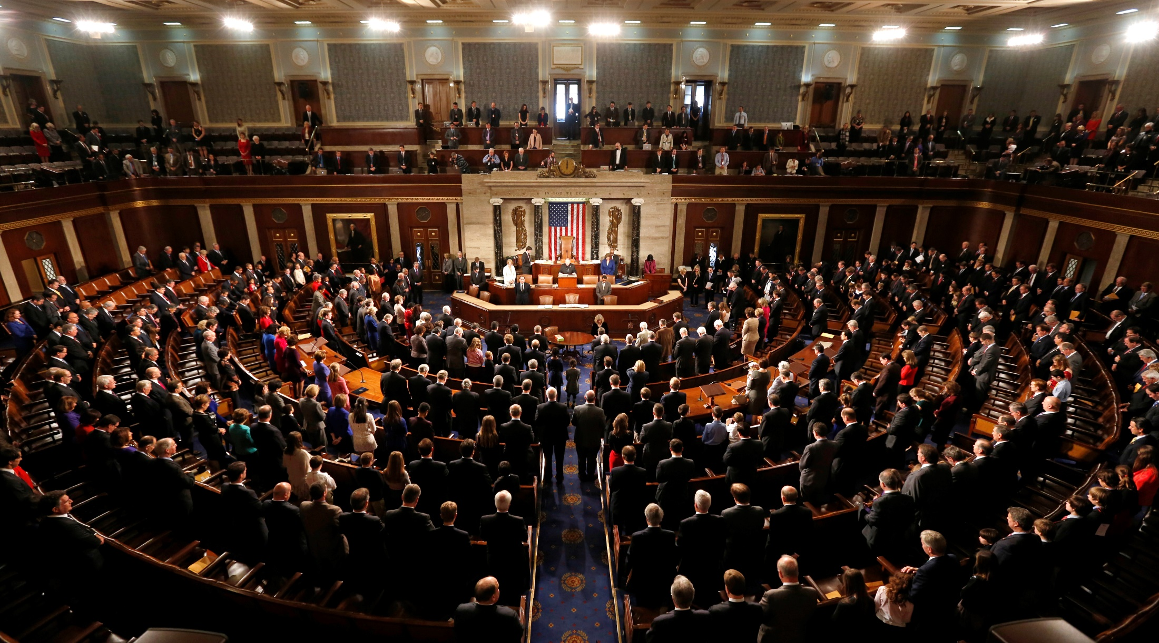
Congress is the Authority
Per the U.S. Constitution (Article I, Section 8, Clause 5)
“The Congress shall have Power … To coin Money … and fix the Standard of Weights and Measures”
Why? To avoid the “toothbrush problem”
Notes:
The authority of Congress is given in the U.S. Constitution, Article I, Section 8, Clause 5.
Congress delegated its power to the Office of Weights and Measures in the Department of the Treasury.
NBS then got this authority as the successor to the Weights and Measures, and NBS became part of DOC.
Why was something like standards of weights and measures so important that it was specifically listed as a congressional power in the Constitution?
Because standards for weights and measures are tightly connected to commerce, including coining of money. We’re going to come back to this near the end of the presentation.
In short, it was to avoid the “toothbrush problem”…

Slide 84

The trouble with standards…
Without uniformity, standards are useless
Image from beyondplm.com
Notes:
It does not good to have a bunch of conflicting standards. That’s the same as having no standards at all.

Slide 85
A new foot for a new century
1 foot = 0.3048 meter exactly (1 yard = 0.9144 m)
New foot definition adopted by NASA predecessor
National Bureau of Standards created
Adopted as “new” foot for entire U.S.
1901
1933
1952
1954
1959
With one little exception…
New foot definition adopted by ANSI predecessor
International nautical mile
1,852 m exact
Notes:
With increasing measurement precision and global trade, it became necessary to adopt a more precise definition of the foot, and one that agreed with international usage.
A motivation for a new definition of the foot was in gage-block standardization for precise machine shop work used by industry. It was a practical solution to a practical problem. Note this has nothing whatsoever to do with surveying.
The new (international) foot definition was 1 ft = 0.3048 m (exact), and is the same to this day (it will not change). The adoption of the ift was a gradual process (as such things often are):
1933. Adopted by American Standards Association, now American National Standards Institute (ANSI).
1952. Adopted by National Advisory Committee for Aeronautics, now National Aeronautics and Space Administration (NASA).
1954. Adopted International Nautical Mile as exactly 1852 m. This is not related specifically to ift, but shows overall move toward adopting “exact” (non-ratio) relationships to the meter.
1959. NSB officially adopts ift for the entire U.S., with one little notable exception…

Slide 86
Kicking the can (Federal Register)
“Any data expressed in feet derived from and published as a result of geodetic surveys within the United States will continue to bear the following relationship as defined in 1893:
1 foot = 1200/3937 meter
The foot unit defined by this equation shall be referred to as the U.S. Survey Foot and it shall continue to be used, for the purpose given herein, until such a time as it becomes desirable and expedient to readjust the basic geodetic survey networks in the United States, after which the ratio of a yard, equal to 0.9144 meter, shall apply.”
https://geodesy.noaa.gov/PUBS_LIB/FedRegister/FRdoc59-5442.pdf
Signed by NBS and C&GS directors, approved by Secretary of Commerce, June 25, 1959
Notes:
Federal Register Notice (1959) establishing ift and (temporary) sft
Official adoption of ift (1 ft = 0.3048 m) nationwide.
Temporary exception granted for geodetic surveys (including State Plane coordinates), to accommodate C&GS.
Mandates that ift shall be adopted after readjustment of U.S. geodetic network. This is not a “recommendation” or a “suggestion.” At the time this was published, “shall” was used in legal documents as mandatory (nowadays the usage of “shall” as mandatory is discouraged in legal documents).
Co-issued and signed by NBS and C&GS directors.
This FRN delayed full adoption of the ift, and promoted continued use of the sft for all surveying (not just geodetic surveys), and it is how we got into the situation we are in today.

Slide 87
More Federal Register Notices
Surveying and mapping only (pending analysis, never resolved)
Proposed permanent use of U.S. Survey Foot
Restatement that metric used for U.S.
International vs. U.S. Survey Foot
1975
1977
1988
1989
1990
NGS goes entirely metric (for NAD 83)
NAD 83 announced
International foot used for “engineering”
U.S. survey foot used for “mapping and land measurement”
Notes:
Other FRNs relevant to the ift vs. sft issue:
1975. Distinguishes between ift and sft, and gives both an exact (1200/3937 m) and approximate (0.304 800 61 m) definition of the sft. It states that the ift is used for “engineering” and the sft is used for “mapping and land measurement”, which by itself creates problems (since engineering and surveying are often done together for projects, so which should be used?). It also provides a clarification that the metric equivalents given in a previous (1968) FRN are approximate for lengths based on the sft. It gives an example of the U.S. survey mile = 1.609 347 km approximately, and the international mile = 1.609 344 km exactly.
1977. NGS policy on publication of plane coordinates based on NAD 83, stating that NGS will officially adopt the metric system. This effectively (but probably inadvertently) allowed NGS to side step the requirement of ending use of the sft, as required in the 1959 FRN.
1988. Proposal by NBS and NOAA/NGS to permanently retain U.S. survey foot for all surveying and mapping, pending analysis of public comment. It appears such a decision was never made.
1989. NGS announces adoption of NAD 83, with reference to publication of plane coordinates in 1977 FRN (and use of the metric system).
1990. A major FRN issued by NIST to reaffirm use and interpretation of the metric system (SI) in the U.S., partly in response to federal legislation on the metric system since the previous NIST FRN on this topic in 1982. Includes tables and descriptions that define the SI in the U.S. Does NOT include conversions between SI and U.S. customary units.
NOTE: In the webinar, I inadvertently mischaracterized the 1975 FR as saying the ift was “exact” and the sft was “approximate.” What that FRN actually says is that conversions in a previous (1968) FRN were only for the ift, and were therefore approximate for sft conversions. The 1975 FRN provides the exact sft conversions as a correction/clarification to the 1968 FRN. My apologies for any confusion this may have caused.

Slide 88
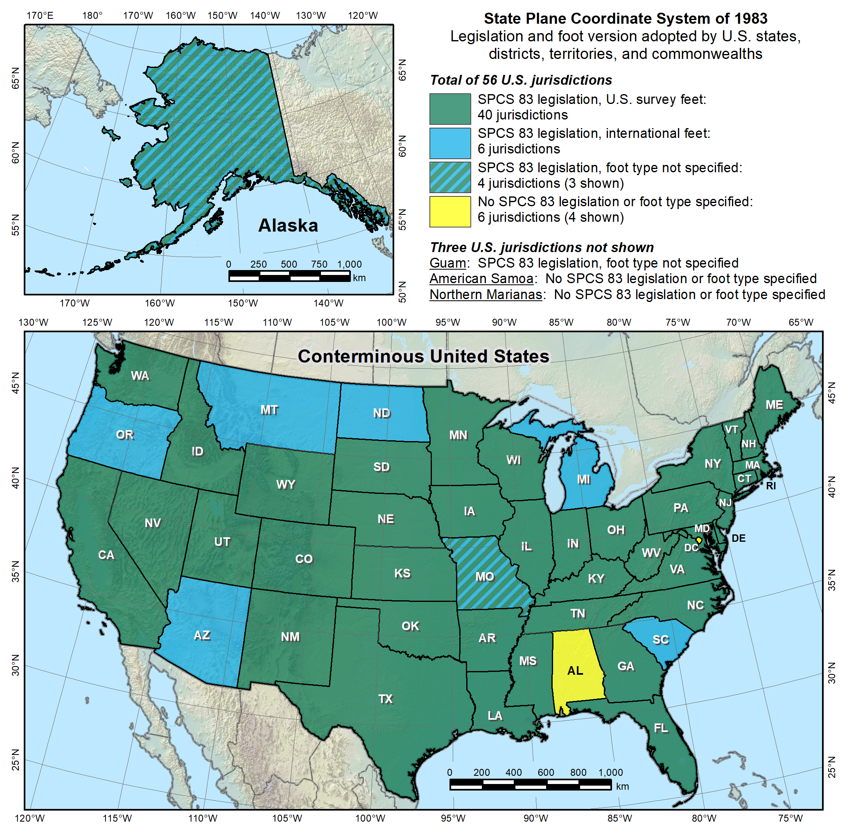
Notes:
Despite the mandate of the 1959 FRN, and the change to a new datum in 1986, NGS allowed states to choose whether they want State Plane coordinates in feet, including which type of foot.
Over time various states have taken actions to select the foot they want to use. Of the 40 states that have selected the sft, 28 have done so in statute, and 12 have done so by working with NGS to issue an FRN (the latest being in 2009, for Utah). So the situation with the 40 “green” states is more complicated than it appears.
Simply put, this is again chaos, just as it was before the Mendenhall Order of 1893. This is exactly the type of situation our five heroes wanted to avoid, having different standards of measure for different parts of the U.S. It is far worse than this map indicates, since jurisdictions within a state use a different foot than on this map. For example, Hawaii shows no foot selection (not even SPCS 83 legislation), yet it uses sft for most areas but ift on military bases. Arizona is shown as an ift state, yet the National Park Service uses sft within Arizona. It is a complete mess. There is no way for me to know for sure, but it is my opinion that our heroes would be spinning in their graves if they saw this.
Addendum: Some surveyors look at the CONUS map and ask why NGS is proposing the ift rather than the sft, since more states have officially selected the sft for SPCS 83 (40 vs. 6). It seems a reasonable question, but it is flawed, for the following reasons:
Minority vs. majority. This is not an issue of a minority overruling a majority. Although most states have adopted the sft (for SPCS 83), it’s important to recognize that surveying and mapping represents only a tiny fraction of overall economic activity in the U.S. Other major parts of the U.S. economy make use of the ift. For example, one of the reasons the ift was adopted in 1959 was for standardizing gauge blocks (the primary means of length standardization used by industry). So surveying is actually a small part of this issue. Because of that, there is essentially no chance that NIST will go back to the sft definition for the entire U.S. If there is going to be one foot, it will certainly be 1 ft = 0.3048 m (exact).
Uniformity. For standards to be useful, they must be uniform. That is why Congress is empowered by the U.S. Constitution to establish standards of weights and measures. Having two concurrent nearly identical definitions of the foot is inconsistent with the very idea of standards. And it is bad for business (i.e., commerce). Keeping the sft for surveying and mapping while using the ift for everything else would perpetuate the inconsistency.
Original intent. In the 1959 FRN that announced nationwide adoption of the ift, the previous foot was named the sft with the intent that it be temporary. It was an accommodation by NBS to C&GS, exclusively for geodetic work. The 1959 FRN mandated that the ift be adopted after readjustment of the U.S. geodetic networks. That occurred in 1986 with the change from NAD 27 to NAD 83. So use of the sft was supposed to end at that time, but it did not. It appears the main reason is that NGS side-stepped the issue by going metric in 1977, perhaps in the hope that the entire nation would go metric. Instead the “temporary” sft became embedded as part of how SPCS 83 is used (but not in how SPCS 83 is defined – the definitions for every zone are metric).
SPCS 83 vs. SPCS2022. In those states where the sft is specified (by state statute or FRN), it is associated with SPCS 83. Such specifications will not apply for SPCS2022. A state could legislate sft for SPCS2022, but if NIST mandates use of the ift, that would likely override state statute, per the U.S. Constitution.
Authority. Only NIST has the authority to deprecate the sft, not NGS. In the end, the fate of the sft will be up to NIST. The reason NGS is involved is that the existence of the sft is due entirely to NIST accommodating NGS in 1959. Because of that, NGS bears responsibility in trying to resolve the issue, as we should have done in 1986, and NGS will work with NIST to that end. If the decision is to deprecate the sft after 2022, it will be announced in an FRN, and NGS will also take other steps to inform our customers. But NGS will continue to support the sft for legacy applications in SPCS 83 and 27 in our products and services.

Slide 89
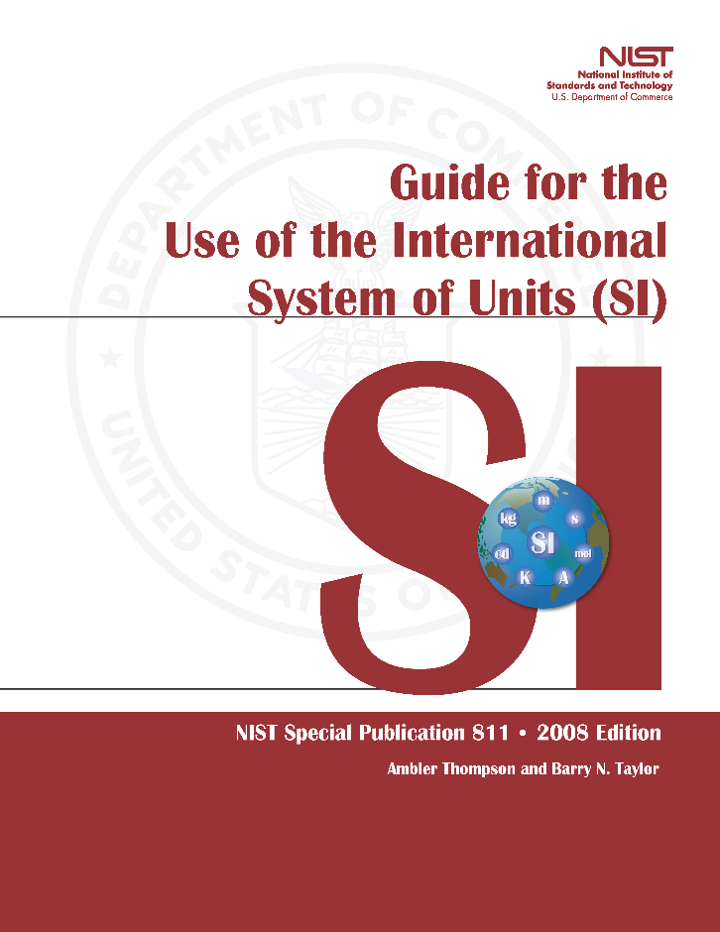
Out of order, chaos
A foot still in limbo
2008 - NIST “Guide to the Use of the SI”
U.S. survey foot still used
but never officially permanently adopted
Repeats 1975 FRN ideas about the two feet:
International ft used for engineering
U.S. ft used for surveying & mapping
At odds with very idea of “standards”
Notes:
After nearly 100 years of relative order in standards of measure (from the Mendenhall Order of 1893 to release of NAD 83 in 1986), a new chaotic situation was created by perpetuating the sft.
Despite a misguided effort in the 1988 FRN to make the sft “official”, it is still an unofficial nominally “temporary” unit, stuck in standards “limbo”
Latest NIST publication that discusses this (2008) notes that sft is still used, even though it has not been officially and permanently adopted.
Saying that ift is used for engineering and sft for surveying and mapping is absurd. The two are not mutually exclusive. Surveying is almost always a part of civil engineering projects.

Slide 90
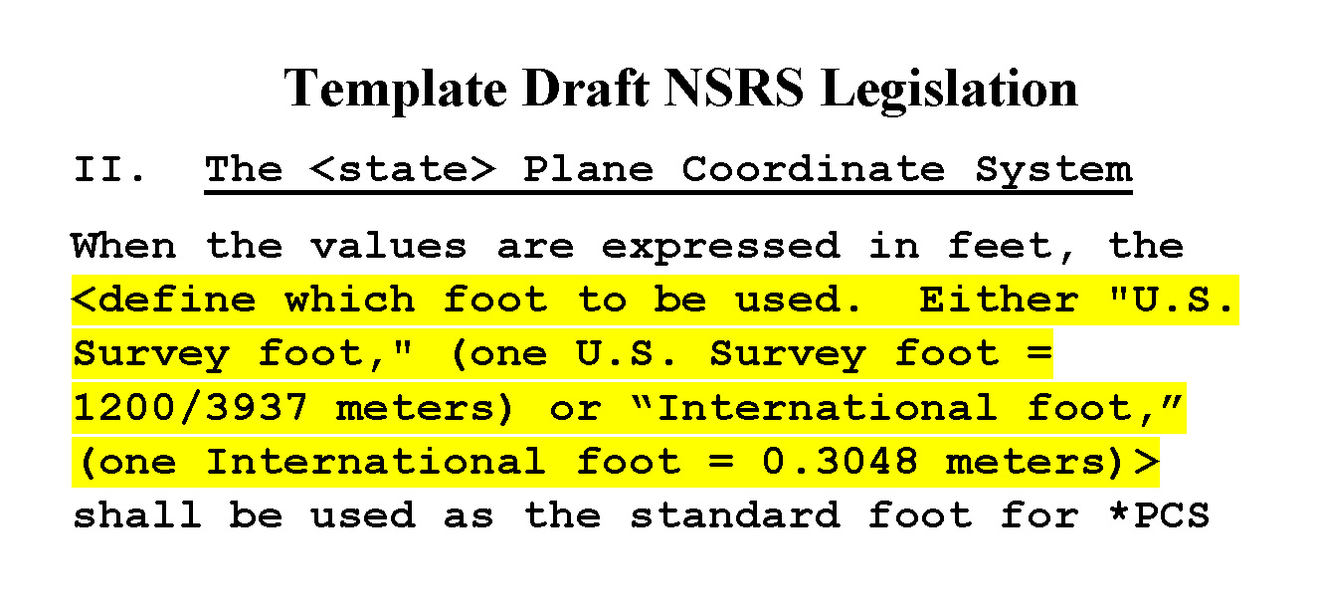
Oops!
Problem created and perpetuated by NGS
In 1959. Then in 1986. And again in 2016…
Notes:
NGS must take the bulk of responsibility for this situation.
NBS (NIST) accommodated us in 1959. Yes, NIST allowed it, but it was at the behest of NGS.
NGS perpetuated the problem by avoiding the required remedy in 1986.
We just recently perpetuated it again, in 2016, when we helped write template draft NSRS (National Spatial Reference System) legislation or “model law.”
Done cooperatively with NSPS and AAGS (American Association for Geodetic Surveying)
Explicitly allows selection of ift or sft for those states that want SPCS coordinates in feet.
This was a mistake. NGS went along with this mechanically because we had become inured to the absurd existence of dual feet. The idea of getting rid of the sft did not even occur to us at the time this draft legislation was prepared. Now we want to fix the problem we created.

Slide 91
What are the choices?
Do nothing (i.e., NGS stays “metric” only)
States choose whatever foot they want
The feet will creep back into NGS products & services
Officially adopt U.S. survey foot for specific things
U.S. survey foot for surveying and mapping
International foot for engineering (and everything else)
Use international foot for everything
Support only foot = 0.3048 meter after 2022, period
Use U.S. survey foot for everything (highly unlikely)
Go entirely metric (ideal situation, but also unlikely)
Notes:
There are five options for moving forward:
Do nothing. This one is interesting, because a number of people have recently proposed a solution where NGS just goes metric, and every state uses whatever foot they want. What they don’t seem to realize is that is exactly what we are doing now! NGS went metric in 1977. But customers wanted to get coordinates in feet, so we provided them. Which meant we had to make sure and give them the type of foot they wanted (even though some locations within sates use a different foot than other parts of states, as mentioned previously). The same thing would most definitely happen again for SPCS2022 if we tried to only give metric coordinates. So the situation would be exactly the same as now.
Officially adopt U.S. survey foot for specific things. This was what was proposed in the 1988 FRN. It would formally perpetuate a dual foot system in the U.S., making it even more entrenched. We would be stuck with a dual foot anti-standard.
Use international foot for everything. This is what NGS proposes. Only one foot after 2022, with same definition as ift. It is the only viable means of using a single foot definition for future work. Legacy work will always use appropriate units (of which there are many types such as chains and rods).
Use U.S. survey foot for everything. As discussed previously, this is extremely unlikely, so much so that it’s safe to say it is impossible. The ift is simply too well established in a vast majority of the economy. Surveying is a tiny minority, so it is not reasonable to expect the sft to prevail, even if the sft is used for surveying in most states.
Go entirely metric. This is my personal very strong preference! This is also the preference of most (all?) people at NGS and NIST. But alas it appears much too big a lift for NGS, and even for NIST at this time. Maybe some day in the not-too-distance future (but remember what happened when we tried to go metric in the late 70s). At least SPCS2022 parameters will all be defined in meters! On a positive note, of the people who have provided feedback so far on this topic, more are in favor of going metric than are of keeping the sft (although a large majority opted for the ift).

Slide 92
An NGS proposal
Only one foot after 2022 (1 foot = 0.3048 meter)
Make official through NIST
NO option for U.S. survey foot
NGS will help with the transition
Will fully support backward compatibility
Use “correct” foot for SPCS 83 and SPCS 27
Automatically done by NGS products and services
Guiding ideas
Of all changes in 2022, this is the least significant
About the future, not the past
Notes:
NGS proposes that there be only ONE official definition of the foot after 2022, and if done will be accomplished through NIST.
Considering getting rid of word “international”, and just call it the “foot” (that is how it is handled in some software, such Esri’s). People just seem to not like the “international” label. Maybe call if the “American freedom foot.” But seriously, dropping a descriptor solidifies the idea that there is only one foot in the U.S. Keeping the descriptor implies there is more than one foot.
Have NO option for sft after 2022. It will only be used for the past (legacy applications).
NGS will help!
We will try to make the change as simple and painless as possible.
Our products and services will automatically support backward compatibility.
Idea here is that we are trying to make things better by fixing a long-standing problem for the future (not the past). Yes, there will be some difficulties. But at least they will diminish over time. If we do nothing, these problems will never go away.
If you think changing from sft to ift is a big problem, then perhaps you don’t quite understand the other changes that are coming in 2022:
The change from sft to ift is really just a small (2 ppm) scale change. That is smaller than the change in scale for SPCS2022 zones, and that is only PART of the change that will occur for State Plane.
Coordinates in NSRS2022 will change with time. In fact, the entire frame will be time-dependent. Assumptions about control coordinates never changing will have to be abandoned.
The “vertical” datum will be replaced with a geopotential datum based on a gravimetric geoid (rather than leveling). This, too, will have a time-dependent component.
There will be changes in how GNSS, leveling, and total station survey surveys are performed, reduced, processed, and adjusted.
By comparison, the change from sft to ift is so miniscule that it is well within the noise of the other changes.
In short, if you think the change in foot definition is too difficult, then its hard to see how you could deal with these other much larger and vastly more complex changes.

Slide 93
Arguments for keeping “old” foot
Used for existing records and data
Circular argument because issue never goes away
Such logic means old foot will always be retained
That’s how we got into this mess in the first place
Old foot in state legislation
But statute is usually (always?) tied to NAD 83
New statute for 2022 could break that connection
Necessary to convey real property…
Notes:
There are of course reasons for keeping the “old” foot. Let’s talk about those.
Keep using sft because it is used for a large volume of existing records and data.
This is true, there is a huge amount if information in sft. That would have to be dealt with if a change is made. It can be handled through metadata and most times simply by context (e.g., before a certain date, you know it is sft).
But mean weakness is that this is a circular argument. Because such data will always exist, this problem never goes away. With such logic we could have never moved ahead from the old Troughton scale, or made the switch from NAD 27 to NAD 83.
This point of view is pretty much how we got in this sft/ift mess in the first place (through the 1959 FRN “exception” for geodetic surveys). That shows how problematic this is, because there is now FAR more data in sft than there was in 1959. The problem just gets worse with time.
Keep using sft because it is specified in state statute (and FRNs).
This is also true, but it’s not really relevant, since the statute and FRNs are explicitly for SPCS 83. That means they won’t apply to SPCS2022.
On a positive note, new statute for 2022 could create a new precedent for adopting the new foot (but my opinion is it is better to leave technical details such as linear units out of statute and place them where they are easier to manage, such as in state administrative rules).
Keep using sft because it’s needed to convey real property, since deeds are in sft. This comes up now and again, so let’s take a closer look…

Slide 94
Coordinates, deeds, and distances
Foot issue is a coordinate problem
Deeds are concerned with distances
Bigger issues with distances than type of foot
U.S. survey vs. int’l foot: 2 ppm = ±0.01 ft per mile
“Standard” foot varied by tens of ppm before 1893
Notes:
The sft/ift issue is really a coordinate problem, whereas deeds are concerned with distances.
Of course, a coordinate is a distance, but it is a special type of distance, from an origin of a coordinate system that is usually very far from a survey site (especially for State Plane and UTM systems).
The distances on a deed are almost always short (usually less than 1 mile), and are given between real or computed objects that represent or reference property corners.
There are much bigger issues with distances than whether it is given in ift or sft.
The ift and sft differ by 2 ppm = 0.01 ft/mile. That difference is smaller than the accuracy of a boundary survey. I would argue that there is probably not a single boundary survey in the U.S. that has been performed to that accuracy, for all the distances on the survey. That’s an easy statement to make, because most surveys include some truly short distances (note that 2 ppm is 0.0001 ft in 200 ft). Also, the foot definition varied by much more than 2 ppm before 1893, so this becomes even less relevant for records prior to 1893.
In many areas, surveyors must contend with versions of the “same” unit that differ vastly more than the ift and sft. This includes different versions of the chain, but also the “arpent” (with versions that differ by up to 7 ft/mile), the “vara” (can vary by up to 30 ft/mile), and especially the “rod” or “pole” or “perch”, which can vary tremendously, up to 1760 ft/mile. So clearly surveyors must understand the context of the distances given on a deed, in situations that far exceed the difference between ift and sft.
For long distances (greater than a mile), bigger problems come into play than the 2 ppm difference between ift and sft. In such cases, what is even meant by a horizontal ground distance? Does it curve with the Earth? If so, how is that calculated (there is more than one way)? If it is a projected distance (e.g. State Plane), how much does the combined factor vary along the line? What is the difference in the height of the line end points? These types of issues typically introduce more than 2 ppm systematic differences in “distance.” In other words, the ift/sft is nit really relevant for long distances, either.

Slide 95
In closing…
NGS created problem, will help fix it
Fully support backward compatibility
Will make simple and painless as possible
Foot change minor compared to other 2022 changes
Contact us at NGS.Feedback@noaa.gov
This is about the future
NSRS Modernization will bring many other changes
Can we foster a more organized future for the next generation of younger professionals?
Notes:
In closing, I want to reiterate that NGS essentially created this problem, and now we want to help fix it. Yes, we are coming at this some 30+ years late, but there is no better time to do this than when we are updating the entire NSRS. A change in the foot definition will be a minor part of the overall changes that will occur when we make the transition to a modernized NSRS in 2022. NGS will do everything we can to make a foot change – and all the other 2022 changes – as simple and painless as possible. Remember, the idea here is not change for its own sake, but change to make things better. And these changes will make things better.
I encourage you to provide questions and comments to NGS.Feedback@noaa.gov. If this change for the foot goes forward, there will also be opportunities for comments as part of issuing an FRN.
I remind you, again, that this is about the future, not the past. The past will always exist and will not change. But the future is something we can change, and make better. Please remember our heroes, and the incredible work they put into establishing standards for weights and measures. Their eyes were also on the future, and we are the beneficiaries of their vision.
For those of you who are surveyors (as I am), this is more than about how you practice surveying today, wherever you may work, and whatever type of surveying you do. For those who want to retain the U.S. survey foot, I implore you to please consider the larger picture, and the future. That future will be inherited by the young surveyors, GIS professionals, and all other U.S. citizens. We should strive to do well by them, and for them.

Slide 96
https://www.ngs.noaa.gov/ADVISORS/
-use any major search engine: “NGS advisors”
Jeff Jalbrzikowski, P.S., GISP
Appalachian Regional Geodetic Advisor
jeff.jalbrzikowski@noaa.gov
240-988-5486

