Slide 1
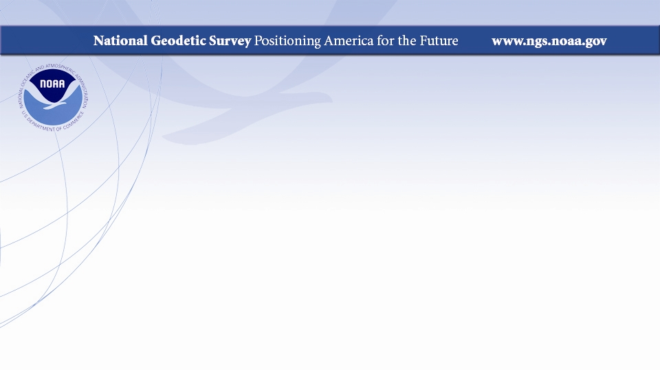
U.S. Department of Commerce
National Oceanic and Atmospheric Administration (NOAA)
National Ocean Service (NOS)
National Geodetic Survey (NGS)
Dr. Daniel Roman
Senior Advisor on Geodesy

Slide 2
topics
Capacity; Organizational functions
Capability; Expertise in which area of geospatial and surveying
Collaboration; Format of Partnership with Pacific Geospatial & Surveying Council and Pacific Island Countries
Initiative; one major project with Pacific Geospatial & Surveying Council (PGSC) and Pacific Island Countries (PICs)

Slide 3
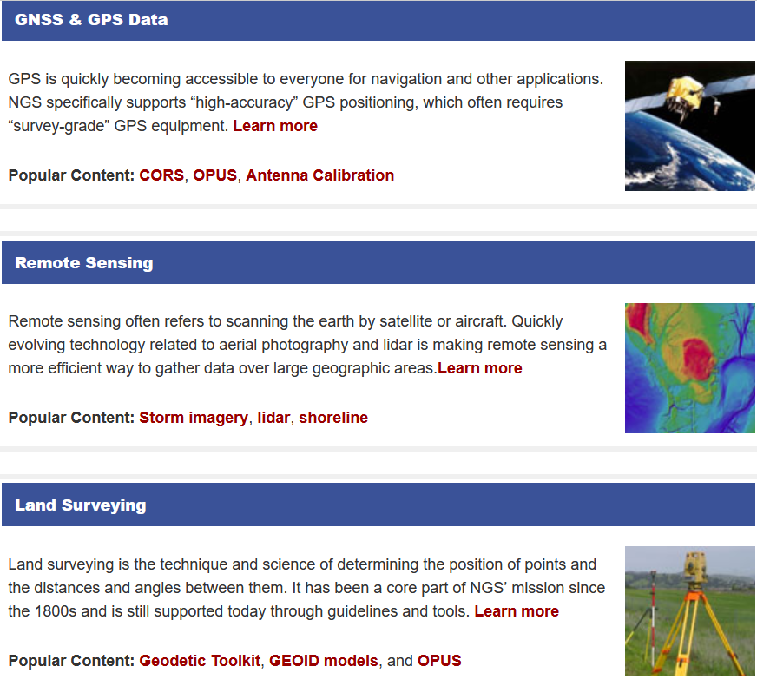
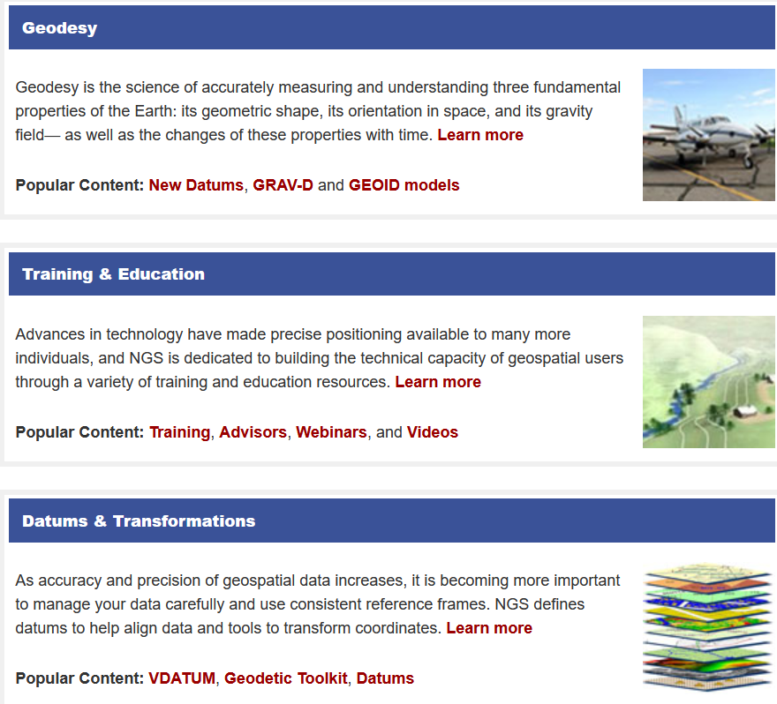
Capacity/Capability – What We Do
The mission of the National Geodetic Survey (NGS) is to define, maintain and provide access to the National
Spatial Reference System (NSRS) (PDF, 123 KB). The NSRS provides a consistent coordinate system that
defines latitude, longitude, height, scale, gravity, and orientation throughout the United States and its territories.

Slide 4

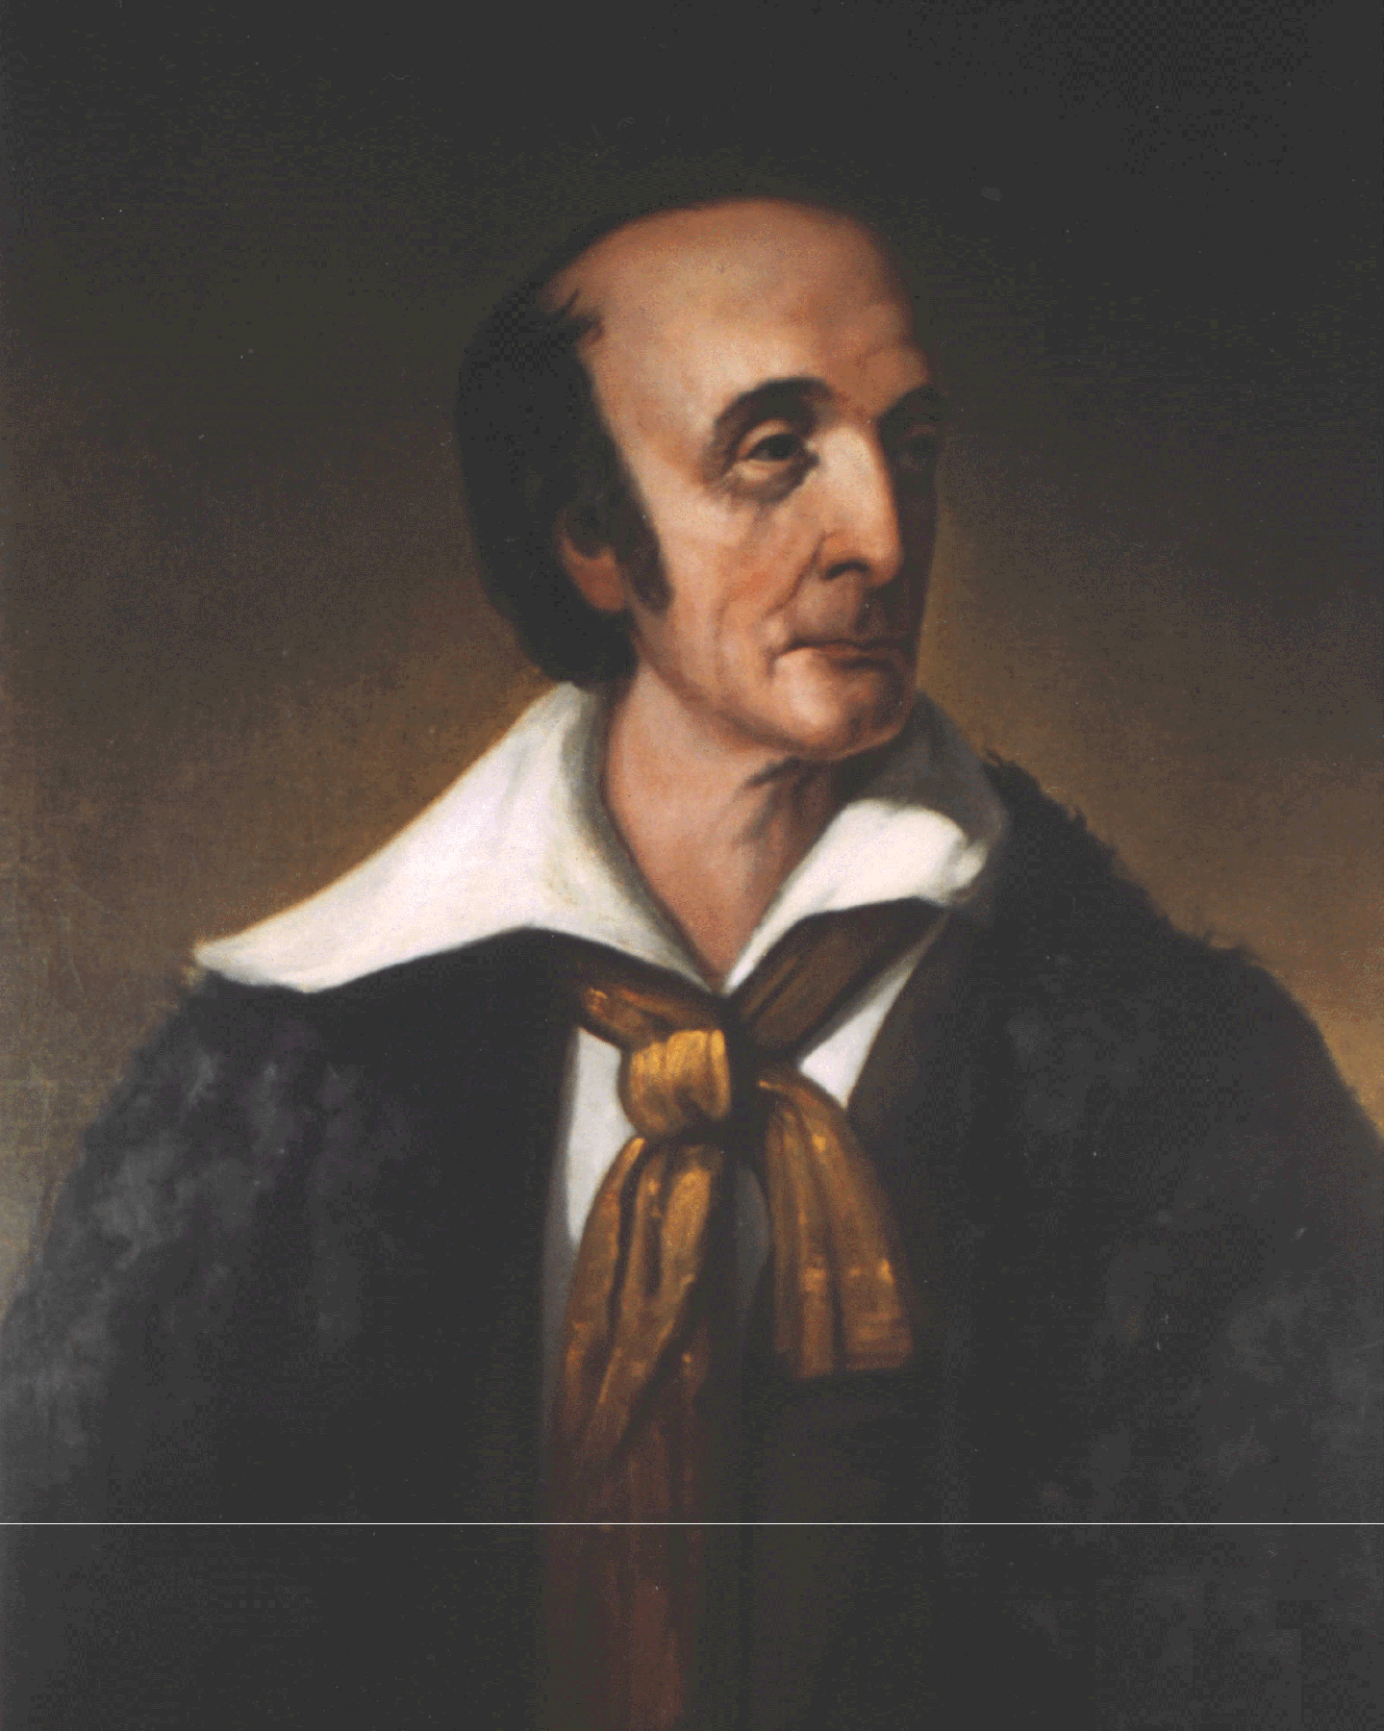


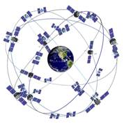
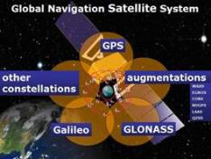
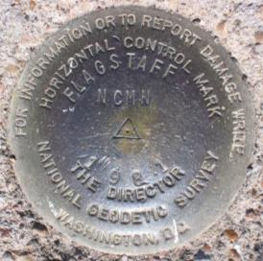
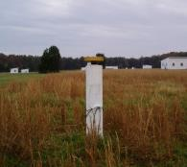
NGS and the NSRS continue to evolve!
The National Geodetic Survey (NGS)
has been around a long time!
Our Nation’s first civilian science agency.
  1807
  Thomas Jefferson
  Survey of the Coast
  1878
  Ferdinand Hassler
  U.S. Coast and Geodetic Survey
  1970
  NOAA is established
The National Spatial Reference System continues to evolve with us.
  GPS
Passive
Control
(Monuments)
Active
Control
(CORS)
  GNSS
Notes:
NGS has been around a long time. For more than 200 years, NGS and its predecessor agencies have collaborated with public and private organizations to establish reference stations at precisely determined locations.
We began on a mission established by Thomas Jefferson in 1807 to conduct a “Survey of the Coast” (as the United States Coast Survey).
(Pictured are Thomas Jefferson and Ferdinand Hassler, the first Superintendent of the Coast Survey). We were renamed the U.S. Coast and Geodetic Survey in 1878. NOAA was established in 1970.
Traditionally, precise positioning locations have been identified by setting a survey mark—usually a brass, bronze, or aluminum disk. Locations might also be identified by a deeply driven rod, or a prominent object, such as a water tower or church spire.
More recently, NGS has fostered a network of continuously operating reference stations (CORS), where each CORS includes a highly accurate receiver that continuously collects radio signals broadcast by Global Navigation Satellite System (GNSS) satellites.
GPS (United States)
Compass (China)
GLONASS (Russia)
Galileo (European Union)

Slide 5
Collaboration
APREF members – contributing CORS data for 20+ years
Regional Geodetic Advisors
  Branch Chief – Christine Gallagher
  Pacific Region Advisor (AS, CQ, GU and HI) – Ed Carlson
OPUS
  Process static and RTK data
  Baselines - not PPP
NGS Webpage, Presentation Library, Publication Library,
Webinars, Educational Videos

Slide 6
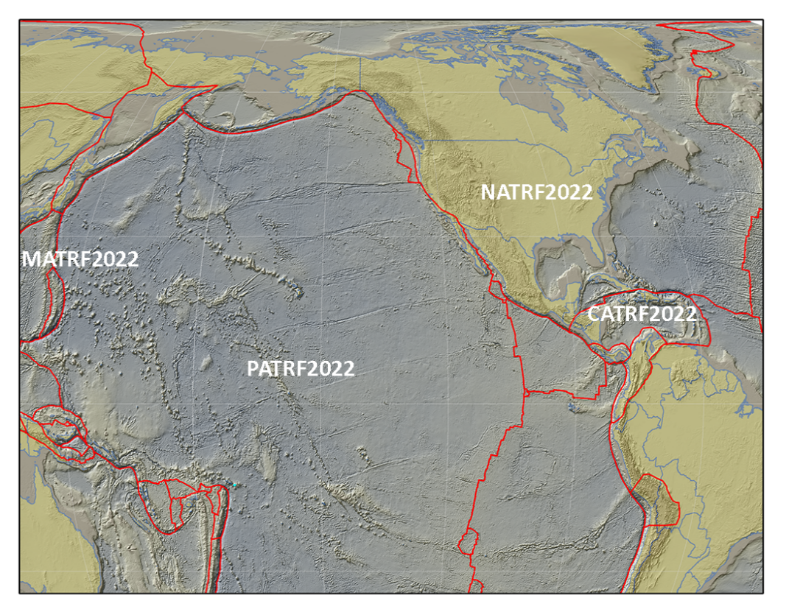
Initiative – NSRS Modernization: PATRF
The Future Reference Frames
Tectonic Plate based
Each Plate is based on the same densified
ITRF model
North America
Caribbean
Pacific
Mariana
NATRF
CATRF
PATRF
MATRF
Notes:
ITRF fixed PLATE specific reference frame. 5th frame will be SIRGAS
Will rely upon Euler Pole Parameters to related plates to ITRF2020
NSRS Modernization Naming Conventions https://geodesy.noaa.gov/datums/newdatums/naming-convention.shtml

Slide 7
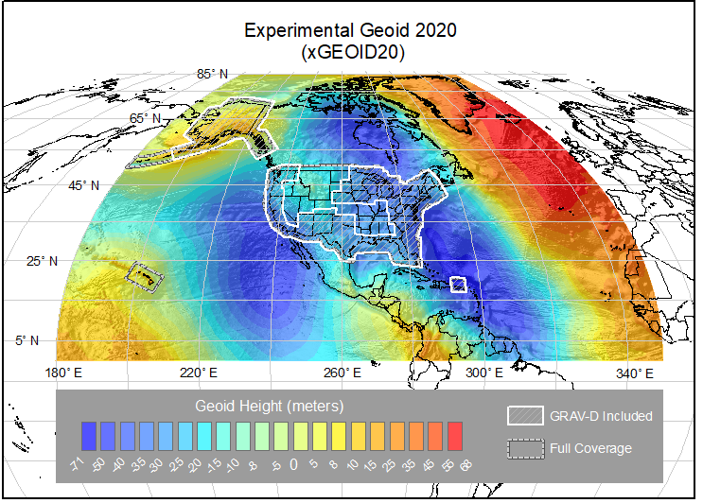
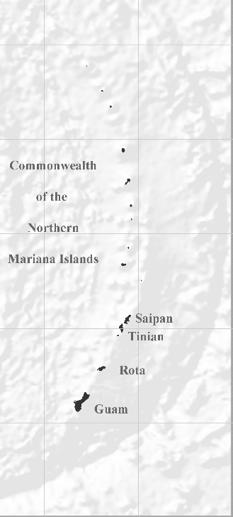
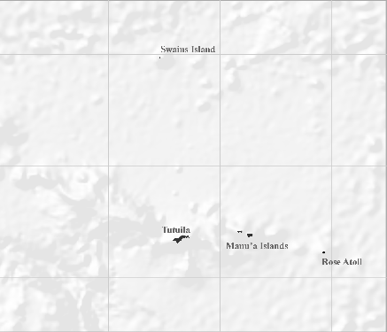
NAPGD2022 Geopotential Datum
Not just a vertical datum, it is more than just heights.
NGS, Canada, and Mexico released the first-ever joint geoid model
¼ Earth’s Surface
Models included:
Geopotential, Geoid Deflection of Vertical,
& Gravity
Guam/CNMI
American Samoa
Notes:
The North American-Pacific Geopotential Datum of 2022 is more than just heights!
NGS, Canada, and Mexico released the first-ever joint geoid model between our countries xGEOID20.
The final GEOID2022 model will also be a joint model.
.... BACK to slide.
As noted in the Blueprint 2 document
https://geodesy.noaa.gov/library/pdfs/NOAA_TR_NOS_NGS_0064.pdf
NAPGD2022 will include all of the following
Geopotential Model of 2022 (GM2022) will include:
Static Geopotential model of 2022 (SGM2022)
Dynamic Geopotential model of 2022 (DGM2022)
GEOID2022 will include:
Static Geoid model of 2022 (SGEOID2022)
Dynamic Geoid model of 2022 (DGEOID2022)
DEFLEC2022 will include:
Static Deflection of the Vertical model of 2022 (SDEFLEC2022)
Dynamic Deflection of the Vertical model of 2022 (DDEFLEC2022)
GRAV2022
Static Gravity model of 2022 (SGRAV2022)

Slide 8
Other Potential Collaborations
Kiribati
  CORS
    Helps factor local geometric observations in PATRF
    Reduced baselines
  Potential ties into TSS modeling with NOS/OCS
    Yields LMSL – cal/val at PIC tide gauges
    Region between American Samoa and Kiribati
  Requires funding from other Departments
Aerogravity in Micronesia – Funding from other Departments

Slide 9
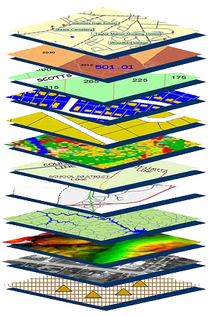
Thank you for your attention
Geodetic control (NSRS) is the foundation for all geospatial products.
Without a geodetic control “base map” layer, GIS applications will not work properly!
Dr. Daniel Roman
dan.roman@noaa.gov

