Slide 1
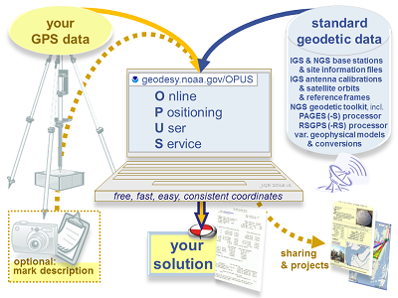
OPUS User Forum –
Overview of the NGS Online Positioning User Service: Where We Are and Where We’re Going
Brief update on Online Positioning User Service (OPUS) tools, including OPUS-S, OPUS-RS, and OPUS-Projects.
Open question and answer period on any OPUS topics.
February 3, 2020 | 2-3:30 pm
Content Rating: Intermediate- Prior knowledge of this topic is helpful.
Target Audience: OPUS Users
Certificate of Attendance: No
Notes:
Let’s talk about OPUS today,
OPUS: as the name suggests, is a service for positioning, designed for online users.
I’ll begin with a brief overview of what the service does now, describe some planned enhancements, then we’ll pivot, as this is a user forum, to answering your questions

Slide 2



Today’s Panel
Joe Evjen
joe.evjen@noaa.gov
National Geodetic Survey
Chief, Geodetic Standards and Applications Branch
Dan Gillins, Ph.D., P.L.S.
daniel.gillins@noaa.gov
National Geodetic Survey
Geodesist,
Observation & Analysis Division
David Zenk
dave.zenk@noaa.gov
National Geodetic Survey
Advisor, Northern Plains Region
Minnesota, North Dakota, South Dakota, Iowa, and Nebraska
Notes:
And here we are, I’m on the left, Dan and Dave will cut in as needed to correct me, and to answer your questions later.
Thanks also to the folks in the Geodetic Services division for organizing and facilitating the webinar.

Slide 3

This is an interactive forum!
Use your GoToMeeting question box.
We will answer them today, or soon.
Notes:
And YOU will ask most of the questions! You can start right now
You should have a GoToMeeting control panel which looks like this on your screen;
Use the QUESTION function on the bottom of that panel to send questions to us as they come to you.
We’ll harvest your questions while I’m speaking, then highlight the most popular seeming questions in part two.
Later, we’ll try to send out answers to ALL the questions asked.

Slide 4
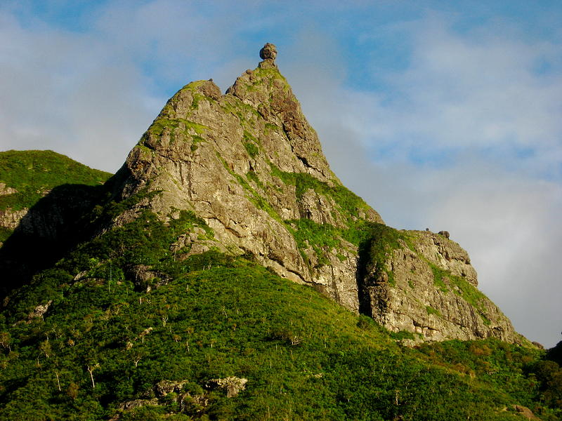
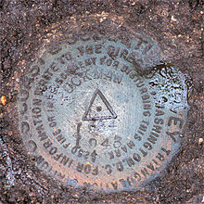
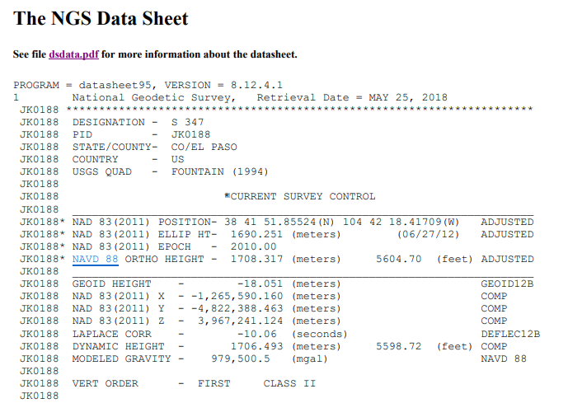
is part of the NSRS
Notes:
NGS modernization blueprints describe OPUS as a delivery mechanism for the same major product we’ve produced for 213 years, the National Spatial Reference System.
You should be familiar with our original method;
We’d climb every mountain, set PERMANENT disks, make careful measurements to stars and surrounding monuments, agonize over gigantic adjustments and tiny biases, and produce PERMANENT datasheets. The combination of the item (disk) and datasheet values made up a PERMANENT datum. Our hope was, when we got to the last mountain, we’d be PERMANENTLY DONE.

Slide 5
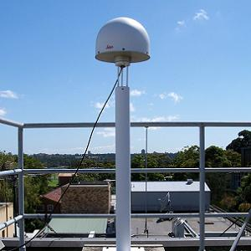
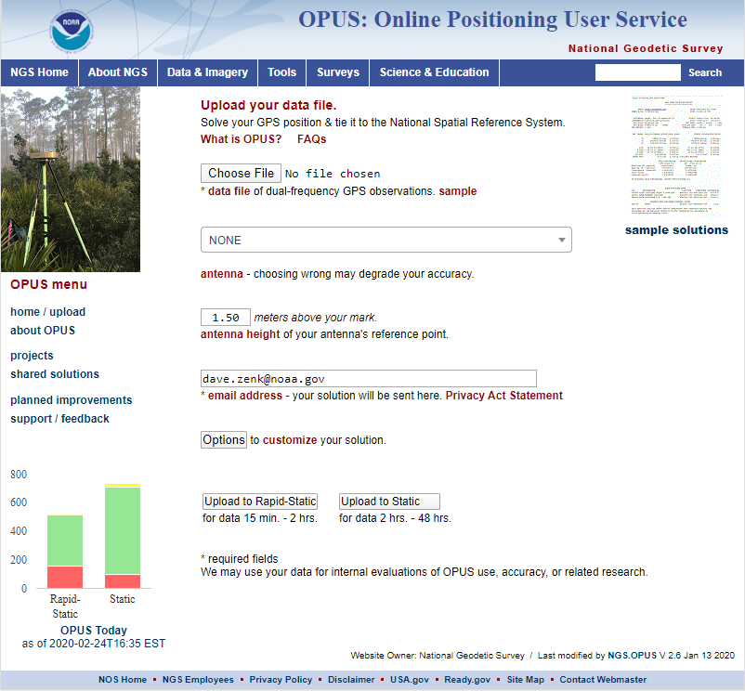
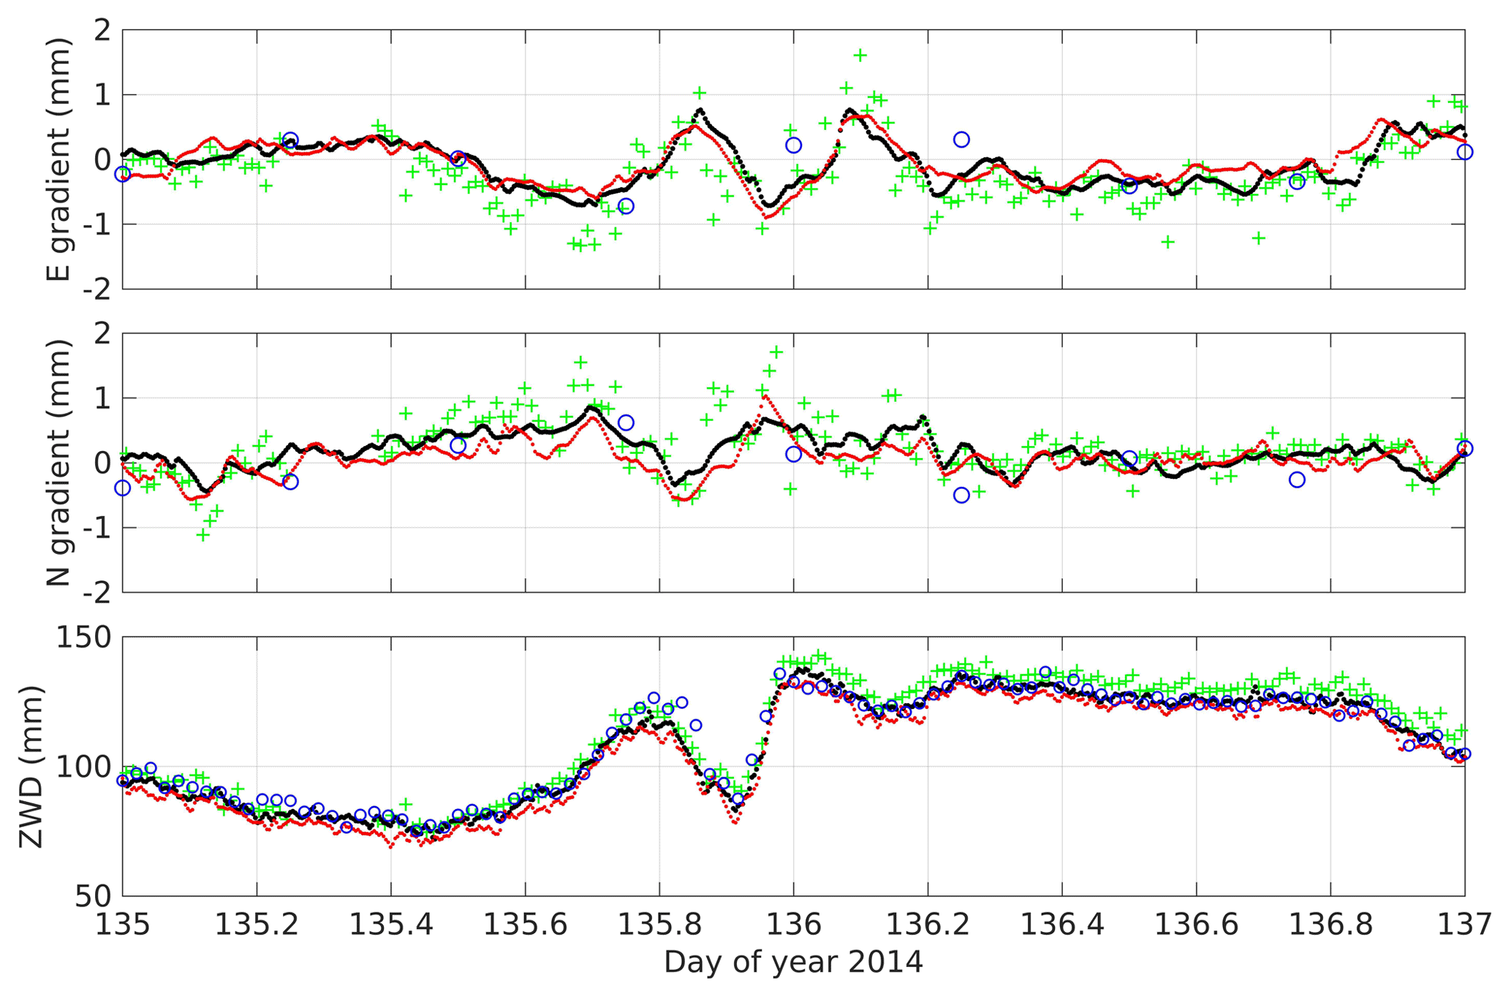
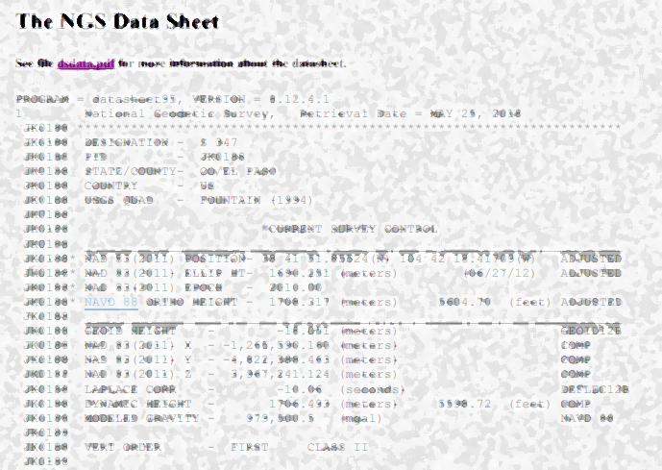
NGS OPUS SOLUTION REPORT
========================
All computed coordinate accuracies are listed as peak-to-peak values.
For additional information: https://www.ngs.noaa.gov/OPUS/about.jsp#accuracy
USER: joe.evjen@noaa.gov DATE: December 05, 2016
RINEX FILE: 5947299r.16o TIME: 18:45:47 UTC
SOFTWARE: page5 1209.04 master95.pl 160321 START: 2016/10/25 17:14:00
EPHEMERIS: igs19202.eph [precise] STOP: 2016/10/25 21:49:00
NAV FILE: brdc2990.16n OBS USED: 11436 / 12254 : 93%
ANT NAME: TRM57971.00 NONE # FIXED AMB: 82 / 83 : 99%
ARP HEIGHT: 2.0 OVERALL RMS: 0.010(m)
REF FRAME: NAD_83(2011)(EPOCH:2010.0000) IGS08 (EPOCH:2016.8164)
X: -2833371.235(m) 0.013(m) -2833372.332(m) 0.013(m)
Y: -1541100.973(m) 0.015(m) -1541099.963(m) 0.015(m)
Z: 5484647.219(m) 0.026(m) 5484647.459(m) 0.026(m)
LAT: 59 42 33.45847 0.003(m) 59 42 33.44896 0.003(m)
E LON: 208 32 32.07518 0.007(m) 208 32 31.98492 0.007(m)
W LON: 151 27 27.92482 0.007(m) 151 27 28.01508 0.007(m)
EL HGT: 503.684(m) 0.032(m) 504.134(m) 0.032(m)
ORTHO HGT: 494.346(m) 0.055(m) [NAVD88 (Computed using GEOID12B)]
UTM COORDINATES STATE PLANE COORDINATES
UTM (Zone 05) SPC (5004 AK 4)
Northing (Y) [meters] 6620045.124 636606.995
Easting (X) [meters] 586771.176 417957.136
Convergence [degrees] 1.33177427 -1.25880956
Point Scale 0.99969227 0.99998247
Combined Factor 0.99961346 0.99990364
US NATIONAL GRID DESIGNATOR: 5VNG8677120045(NAD 83)
BASE STATIONS USED
PID DESIGNATION LATITUDE LONGITUDE DISTANCE(m)
DM7460 AC61 CHICKENM61AK2006 CORS ARP N640145.332 W1420432.948 688041.0
DP9272 MCES MCNEIL CANYON ELE CORS ARP N594445.882 W1511528.107 11973.1
DL7665 AC39 SHUYAKISSPAK2006 CORS ARP N583634.993 W1522338.579 133691.6
NEAREST NGS PUBLISHED CONTROL POINT
UW5506 LOOKOUT MTN N594233.480 W1512727.891 0.8
meets criteria => is tied to the NSRS
meets criteria => is part of the NSRS
Notes:
We were cursed, or blessed with two complications: One, the world moves on, with better surveying techniques, and two, the world actually moves, quaking and shifting. PERMANENT = OBSOLETE. Our foundation cracked, and we found a better, faster, and simpler way to work.
Here’s the modern construct. Some of our best geometric measurements come from permanent GNSS receivers; these are the new mountains.
You access them not by climbing them, but by observing GNSS directly on your project site, wherever you need control, and tying your observations into our datum using any of several augmentation services, OPUS being one (we try to make it the best!) When we all share one datum, we can all be coordinated, in the purest sense of that phrase!
The NSRS are not only the base stations and their coordinates, but their positional time series, unique mathematical functions describing their position changes through time, and the many geophysical models which make the magic happen.
The datasheet’ can be a solution report that, when OPUS senses you have met certain procedural and data quality metrics, claims you are TIED TO the NSRS.
Users will contribute these solutions on permanent marks of public interest, so NGS can freshen the traditional datasheets with new observations. Lacking fresh observations, datasheet accuracy will erode over time.

Slide 6
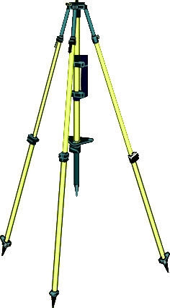
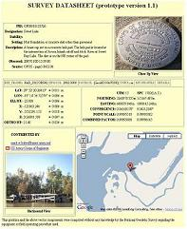
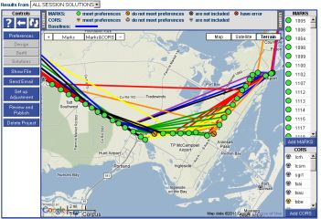
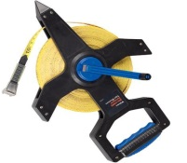
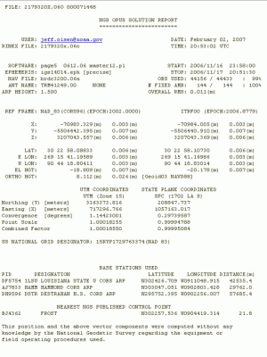


your
GPS data
IGS & NGS base stations
& site information files
IGS antenna calibrations
& satellite orbits
& reference frames
NGS geodetic toolkit, incl.
PAGES (-S) processor
RSGPS (-RS) processor
var. geophysical models
& conversions
standard geodetic data
O nline
P ositioning
U ser
S ervice
geodesy.noaa.gov/OPUS
JGE 2021 v1
free, fast, easy, consistent coordinates
your
solution
sharing
& projects
optional:
mark description
Notes:
Here’s a simple schematic. You we both have data. When you combine them in OPUS, your data align to the National Spatial Reference System.
Adding mark information facilitates sharing and projects options.

Slide 7
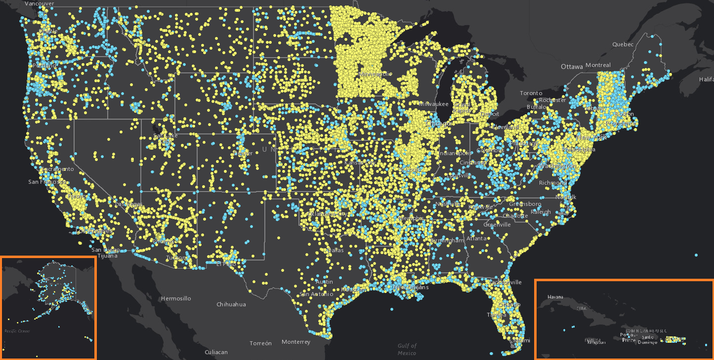
2018 Results
OPUS Share = 7,242
OPUS – S = 524,903
OPUS – RS = 118,515
Total = 650,660
Notes:
OPUS has grown to be quite popular over time.
OPUS now serves over a million data submissions per year!
Over 40,000 of those have been shared, improving datasheets and giving us the observations to improve height models such as GEOID18

Slide 8
OPUS upload
http://geodesy.noaa.gov/OPUS/
The OPUS upload page shows the minimum inputs.
GPS file
antenna type
antenna height
email
options
OPUS-S (2 hr)
Notes:
The OPUS screen shows the minimum 6 inputs.

Slide 9
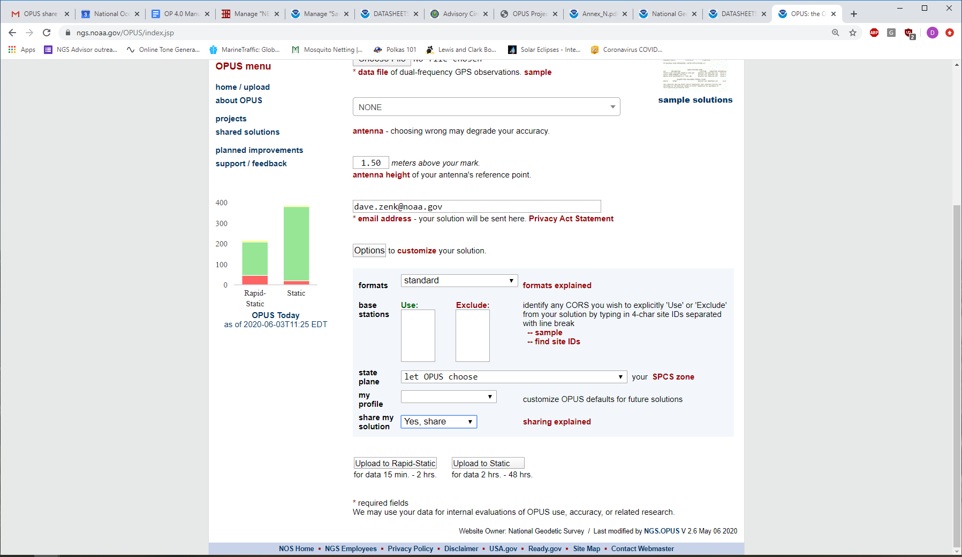
OPUS upload OPTIONS
Choose OUTPUT type
Standard or Extended
Specify CORS
Specify SPCS
OPUS-Projects Identifier
Set USER Profile
Choose “Yes, share” and then Upload to Static
Notes:
First, click on the “Options” button.
The screen will telescope open to show the options.
The user can choose from the 6 options shown.
Output Format. Most users will choose “standard” but you could also try the “extended” output and examine the useful results found there.
Users may choose to specifically “include” or “exclude” one or more specified CORS in their submission.
Most users should leave the selections blank and allow OPUS to choose.
Similarly, allow OPUS to choose the SPCS (State Plane Coordinate System)
Leave the OPUS Projects Identifier blank (if the box is shown)
And do not choose to Set a User Profile.
Choose “Yes, Share”. This choice will enable the OPUS SHARE application
And finally, press “Upload to STATIC”

Slide 10
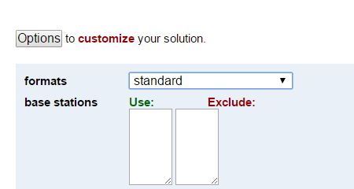
NGS OPUS SOLUTION REPORT
========================
All computed coordinate accuracies are listed as peak-to-peak values.
For additional information: https://www.ngs.noaa.gov/OPUS/about.jsp#accuracy
USER: joe.evjen@noaa.gov DATE: December 05, 2016
RINEX FILE: 5947299r.16o TIME: 18:45:47 UTC
SOFTWARE: page5 1209.04 master95.pl 160321 START: 2016/10/25 17:14:00
EPHEMERIS: igs19202.eph [precise] STOP: 2016/10/25 21:49:00
NAV FILE: brdc2990.16n OBS USED: 11436 / 12254 : 93%
ANT NAME: TRM57971.00 NONE # FIXED AMB: 82 / 83 : 99%
ARP HEIGHT: 2.0 OVERALL RMS: 0.010(m)
REF FRAME: NAD_83(2011)(EPOCH:2010.0000) IGS08 (EPOCH:2016.8164)
X: -2833371.235(m) 0.013(m) -2833372.332(m) 0.013(m)
Y: -1541100.973(m) 0.015(m) -1541099.963(m) 0.015(m)
Z: 5484647.219(m) 0.026(m) 5484647.459(m) 0.026(m)
LAT: 59 42 33.45847 0.003(m) 59 42 33.44896 0.003(m)
E LON: 208 32 32.07518 0.007(m) 208 32 31.98492 0.007(m)
W LON: 151 27 27.92482 0.007(m) 151 27 28.01508 0.007(m)
EL HGT: 503.684(m) 0.032(m) 504.134(m) 0.032(m)
ORTHO HGT: 494.346(m) 0.055(m) [NAVD88 (Computed using GEOID12B)]
UTM COORDINATES STATE PLANE COORDINATES
UTM (Zone 05) SPC (5004 AK 4)
Northing (Y) [meters] 6620045.124 636606.995
Easting (X) [meters] 586771.176 417957.136
Convergence [degrees] 1.33177427 -1.25880956
Point Scale 0.99969227 0.99998247
Combined Factor 0.99961346 0.99990364
US NATIONAL GRID DESIGNATOR: 5VNG8677120045(NAD 83)
BASE STATIONS USED
PID DESIGNATION LATITUDE LONGITUDE DISTANCE(m)
DM7460 AC61 CHICKENM61AK2006 CORS ARP N640145.332 W1420432.948 688041.0
DP9272 MCES MCNEIL CANYON ELE CORS ARP N594445.882 W1511528.107 11973.1
DL7665 AC39 SHUYAKISSPAK2006 CORS ARP N583634.993 W1522338.579 133691.6
NEAREST NGS PUBLISHED CONTROL POINT
UW5506 LOOKOUT MTN N594233.480 W1512727.891 0.8
Notes:
This is the standard OPUS solution, one-page report.

Slide 11
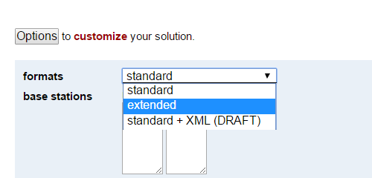
NGS OPUS SOLUTION REPORT
========================
All computed coordinate accuracies are listed as peak-to-peak values.
For additional information: https://www.ngs.noaa.gov/OPUS/about.jsp#accuracy
USER: joe.evjen@noaa.gov DATE: December 05, 2016
RINEX FILE: 5947299r.16o TIME: 18:45:47 UTC
SOFTWARE: page5 1209.04 master95.pl 160321 START: 2016/10/25 17:14:00
EPHEMERIS: igs19202.eph [precise] STOP: 2016/10/25 21:49:00
NAV FILE: brdc2990.16n OBS USED: 11436 / 12254 : 93%
ANT NAME: TRM57971.00 NONE # FIXED AMB: 82 / 83 : 99%
ARP HEIGHT: 2.0 OVERALL RMS: 0.010(m)
REF FRAME: NAD_83(2011)(EPOCH:2010.0000) IGS08 (EPOCH:2016.8164)
X: -2833371.235(m) 0.013(m) -2833372.332(m) 0.013(m)
Y: -1541100.973(m) 0.015(m) -1541099.963(m) 0.015(m)
Z: 5484647.219(m) 0.026(m) 5484647.459(m) 0.026(m)
LAT: 59 42 33.45847 0.003(m) 59 42 33.44896 0.003(m)
E LON: 208 32 32.07518 0.007(m) 208 32 31.98492 0.007(m)
W LON: 151 27 27.92482 0.007(m) 151 27 28.01508 0.007(m)
EL HGT: 503.684(m) 0.032(m) 504.134(m) 0.032(m)
ORTHO HGT: 494.346(m) 0.055(m) [NAVD88 (Computed using GEOID12B)]
UTM COORDINATES STATE PLANE COORDINATES
UTM (Zone 05) SPC (5004 AK 4)
Northing (Y) [meters] 6620045.124 636606.995
Easting (X) [meters] 586771.176 417957.136
Convergence [degrees] 1.33177427 -1.25880956
Point Scale 0.99969227 0.99998247
Combined Factor 0.99961346 0.99990364
US NATIONAL GRID DESIGNATOR: 5VNG8677120045(NAD 83)
BASE STATIONS USED
PID DESIGNATION LATITUDE LONGITUDE DISTANCE(m)
DM7460 AC61 CHICKENM61AK2006 CORS ARP N640145.332 W1420432.948 688041.0
DP9272 MCES MCNEIL CANYON ELE CORS ARP N594445.882 W1511528.107 11973.1
DL7665 AC39 SHUYAKISSPAK2006 CORS ARP N583634.993 W1522338.579 133691.6
NEAREST NGS PUBLISHED CONTROL POINT
UW5506 LOOKOUT MTN N594233.480 W1512727.891 0.8
BASE STATION INFORMATION
STATION NAME: ac61 a 1 (ChickenM61AK2006; Chicken, Alaska United States)
MONUMENT: NO DOMES NUMBER
XYZ -2209480.5269 -1721530.0262 5711814.2289 MON @ 2005.0000 (M)
XYZ -0.0186 -0.0040 -0.0083 VEL (M/YR)
NEU -0.0000 0.0000 0.0083 MON TO ARP (M)
NEU 0.0012 0.0008 0.0860 ARP TO L1 PHASE CENTER (M)
NEU 0.0006 -0.0006 0.1184 ARP TO L2 PHASE CENTER (M)
XYZ -0.2198 -0.0473 -0.0981 VEL TIMES 11.8163 YRS
XYZ -0.0029 -0.0022 0.0075 MON TO ARP
XYZ -0.0284 -0.0231 0.0778 ARP TO L1 PHASE CENTER
XYZ -2209480.7780 -1721530.0988 5711814.2161 L1 PHS CEN @ 2016.8164
XYZ -0.0000 -0.0000 -0.0000 + XYZ ADJUSTMENTS
XYZ -2209480.7780 -1721530.0988 5711814.2161 NEW L1 PHS CEN @ 2016.8164
XYZ -2209480.7496 -1721530.0757 5711814.1383 NEW ARP @ 2016.8164
XYZ -2209480.7468 -1721530.0735 5711814.1308 NEW MON @ 2016.8164
LLH 64 1 45.33033 217 55 26.94422 745.4942 NEW L1 PHS CEN @ 2016.8164
LLH 64 1 45.33029 217 55 26.94417 745.4082 NEW ARP @ 2016.8164
LLH 64 1 45.33029 217 55 26.94417 745.3999 NEW MON @ 2016.8164
STATION NAME: mces a 1 (McNeil Canyon Elem. Scho; Homer, AK USA)
MONUMENT: NO DOMES NUMBER
XYZ -2824840.8189 -1549258.4719 5486650.1678 MON @ 2005.0000 (M)
XYZ -0.0232 -0.0041 -0.0130 VEL (M/YR)
NEU -0.0000 0.0000 0.0083 MON TO ARP (M)
NEU 0.0012 0.0008 0.0860 ARP TO L1 PHASE CENTER (M)
NEU 0.0006 -0.0006 0.1184 ARP TO L2 PHASE CENTER (M)
XYZ -0.2741 -0.0484 -0.1536 VEL TIMES 11.8163 YRS
XYZ -0.0037 -0.0020 0.0072 MON TO ARP
XYZ -0.0367 -0.0210 0.0749 ARP TO L1 PHASE CENTER
XYZ -2824841.1335 -1549258.5434 5486650.0963 L1 PHS CEN @ 2016.8164
XYZ -0.0000 -0.0000 -0.0000 + XYZ ADJUSTMENTS
XYZ -2824841.1335 -1549258.5434 5486650.0962 NEW L1 PHS CEN @ 2016.8164
XYZ -2824841.0967 -1549258.5223 5486650.0214 NEW ARP @ 2016.8164
XYZ -2824841.0931 -1549258.5203 5486650.0142 NEW MON @ 2016.8164
LLH 59 44 45.87320 208 44 31.80206 430.7278 NEW L1 PHS CEN @ 2016.8164
LLH 59 44 45.87317 208 44 31.80201 430.6418 NEW ARP @ 2016.8164
LLH 59 44 45.87317 208 44 31.80201 430.6335 NEW MON @ 2016.8164
STATION NAME: ac39 a 1 (ShuyakIsSPAK2006; Shuayk Island, AK United States
MONUMENT: NO DOMES NUMBER
XYZ -2951218.9388 -1543248.7520 5421552.8890 MON @ 2005.0000 (M)
XYZ -0.0217 -0.0021 -0.0123 VEL (M/YR)
NEU -0.0000 0.0000 0.0083 MON TO ARP (M)
NEU 0.0012 0.0008 0.0860 ARP TO L1 PHASE CENTER (M)
NEU 0.0006 -0.0006 0.1183 ARP TO L2 PHASE CENTER (M)
XYZ -0.2559 -0.0242 -0.1452 VEL TIMES 11.8163 YRS
XYZ -0.0038 -0.0020 0.0071 MON TO ARP
XYZ -0.0385 -0.0210 0.0740 ARP TO L1 PHASE CENTER
XYZ -2951219.2370 -1543248.7992 5421552.8248 L1 PHS CEN @ 2016.8164
XYZ 0.0000 -0.0000 0.0000 + XYZ ADJUSTMENTS
XYZ -2951219.2370 -1543248.7992 5421552.8248 NEW L1 PHS CEN @ 2016.8164
XYZ -2951219.1986 -1543248.7782 5421552.7508 NEW ARP @ 2016.8164
XYZ -2951219.1947 -1543248.7762 5421552.7437 NEW MON @ 2016.8164
LLH 58 36 34.98418 207 36 21.33266 157.2528 NEW L1 PHS CEN @ 2016.8164
LLH 58 36 34.98414 207 36 21.33261 157.1668 NEW ARP @ 2016.8164
LLH 58 36 34.98414 207 36 21.33261 157.1585 NEW MON @ 2016.8164
REMOTE STATION INFORMATION
STATION NAME: 5947 1
MONUMENT: NO DOMES NUMBER
XYZ -2833373.6381 -1541099.5299 5484646.1624 MON @ 2016.8162 (M)
NEU -0.0011 0.0003 2.0000 MON TO ARP (M)
NEU 0.0011 -0.0003 0.0668 ARP TO L1 PHASE CENTER (M)
NEU 0.0001 0.0007 0.0578 ARP TO L2 PHASE CENTER (M)
XYZ -0.8869 -0.4827 1.7264 MON TO ARP
XYZ -0.0289 -0.0154 0.0582 ARP TO L1 PHASE CENTER
XYZ -2833374.5539 -1541100.0280 5484647.9470 L1 PHS CEN @ 2016.8164
BASELINE NAME: ac61 5947
XYZ 1.3009 -0.4407 1.3082 + XYZ ADJUSTMENTS
XYZ -2833373.2529 -1541100.4687 5484649.2552 NEW L1 PHS CEN @ 2016.8164
XYZ -2833373.2240 -1541100.4533 5484649.1970 NEW ARP @ 2016.8164
XYZ -2833372.3372 -1541099.9706 5484647.4706 NEW MON @ 2016.8164
LLH 59 42 33.44892 208 32 31.98518 506.2152 NEW L1 PHS CEN @ 2016.8164
LLH 59 42 33.44888 208 32 31.98520 506.1484 NEW ARP @ 2016.8164
LLH 59 42 33.44892 208 32 31.98518 504.1484 NEW MON @ 2016.8164
BASELINE NAME: mces 5947
XYZ 1.3044 -0.4324 1.3009 + XYZ ADJUSTMENTS
XYZ -2833373.2495 -1541100.4604 5484649.2479 NEW L1 PHS CEN @ 2016.8164
XYZ -2833373.2206 -1541100.4451 5484649.1897 NEW ARP @ 2016.8164
XYZ -2833372.3337 -1541099.9623 5484647.4633 NEW MON @ 2016.8164
LLH 59 42 33.44899 208 32 31.98483 506.2054 NEW L1 PHS CEN @ 2016.8164
LLH 59 42 33.44896 208 32 31.98484 506.1386 NEW ARP @ 2016.8164
LLH 59 42 33.44899 208 32 31.98483 504.1386 NEW MON @ 2016.8164
BASELINE NAME: ac39 5947
XYZ 1.3138 -0.4255 1.2820 + XYZ ADJUSTMENTS
XYZ -2833373.2400 -1541100.4535 5484649.2290 NEW L1 PHS CEN @ 2016.8164
XYZ -2833373.2111 -1541100.4382 5484649.1708 NEW ARP @ 2016.8164
XYZ -2833372.3243 -1541099.9554 5484647.4444 NEW MON @ 2016.8164
LLH 59 42 33.44901 208 32 31.98473 506.1832 NEW L1 PHS CEN @ 2016.8164
LLH 59 42 33.44897 208 32 31.98475 506.1164 NEW ARP @ 2016.8164
LLH 59 42 33.44901 208 32 31.98473 504.1164 NEW MON @ 2016.8164
G-FILES
Axx20161025 161025
B201610251714 1610252148 1 page5 v1209.04IGS 126 1 2 27NGS 201612 5IFDDPX
IIGS08_1918 IGS 20161009
C00090005 6238915904 10-1804301029 6 2271666602 18 X2996A5947X2996AAC61
D 1 2 7774339 1 3 -8228384 2 3 -8825965
Axx20161025 161025
B201610251714 1610252148 1 page5 v1209.04IGS 126 1 2 27NGS 201612 5IFDDPX
IIGS08_1918 IGS 20161009
C00090004 85312406 11 -81585580 6 20025510 18 X2996A5947X2996AMCES
D 1 2 6928518 1 3 -9013819 2 3 -8288560
Axx20161025 161025
B201610251714 1610252148 1 page5 v1209.04IGS 126 1 2 27NGS 201612 5IFDDPX
IIGS08_1918 IGS 20161009
C00090002-1178468705 9 -21488208 5 -630947006 17 X2996A5947X2996AAC39
D 1 2 8393794 1 3 -8142151 2 3 -8599565
POST-FIT RMS BY SATELLITE VS. BASELINE
OVERALL 02 05 07 08 09 10 11 13
ac61-5947| 0.010 ... 0.013 0.012 0.009 ... 0.007 0.012 0.017
15 16 18 20 21 24 25 26 27
ac61-5947| 0.011 0.008 0.007 0.008 0.017 ... 0.015 0.009 0.008
28 29 30 31 32
ac61-5947| ... 0.009 ... 0.014 0.026
OVERALL 02 05 07 08 09 10 11 13
mces-5947| 0.010 ... 0.012 0.015 0.011 ... 0.009 0.015 0.019
15 16 18 20 21 25 26 27 28
mces-5947| 0.014 0.009 0.008 0.008 0.016 0.013 0.006 0.009 ...
29 30 31 32
mces-5947| 0.010 ... 0.015 0.015
OVERALL 02 05 07 08 10 11 13 15
ac39-5947| 0.010 ... 0.013 0.014 0.008 0.007 0.016 0.017 0.014
16 18 20 21 25 26 27 28 29
ac39-5947| 0.008 0.008 0.009 0.017 0.011 0.006 0.008 ... 0.008
30 31 32
ac39-5947| ... 0.010 0.013
OBS BY SATELLITE VS. BASELINE
OVERALL 02 05 07 08 09 10 11 13
ac61-5947| 3756 ... 191 126 235 ... 289 20 231
15 16 18 20 21 24 25 26 27
ac61-5947| 317 409 339 413 50 ... 58 343 393
28 29 30 31 32
ac61-5947| ... 244 ... 56 42
OVERALL 02 05 07 08 09 10 11 13
mces-5947| 3783 ... 192 126 235 ... 292 53 185
15 16 18 20 21 25 26 27 28
mces-5947| 317 458 363 388 57 49 353 411 ...
29 30 31 32
mces-5947| 226 ... 59 19
OVERALL 02 05 07 08 10 11 13 15
ac39-5947| 3897 ... 190 126 235 299 40 231 300
16 18 20 21 25 26 27 28 29
ac39-5947| 457 366 412 58 59 366 411 ... 248
30 31 32
ac39-5947| ... 57 42
Covariance Matrix for the xyz OPUS Position (meters^2).
0.0000005444 0.0000000277 -0.0000000893
0.0000000277 0.0000001911 -0.0000000499
-0.0000000893 -0.0000000499 0.0000021000
Covariance Matrix for the enu OPUS Position (meters^2).
0.0000002485 0.0000001155 -0.0000000665
0.0000001155 0.0000008121 0.0000006550
-0.0000000665 0.0000006550 0.0000017750
Horizontal network accuracy = 0.00187 meters.
Vertical network accuracy = 0.00261 meters.
Derivation of NAD 83 vector components
Position of reference station ARP in NAD_83(2011)(EPOCH:2010.0000).
Xa(m) Ya(m) Za(m)
AC61 -2209479.69965 -1721531.10138 5711813.88119 2010.00
MCES -2824840.00682 -1549259.54388 5486649.77518 2010.00
AC39 -2951218.11931 -1543249.81594 5421552.49908 2010.00
Position of reference station monument in NAD_83(2011)(EPOCH:2010.0000).
Xr(m) Yr(m) Zr(m)
AC61 -2209479.69675 -1721531.09918 5711813.87369 2010.00
MCES -2824840.00312 -1549259.54188 5486649.76798 2010.00
AC39 -2951218.11551 -1543249.81394 5421552.49198 2010.00
Velocity of reference station monument in NAD_83(2011)(EPOCH:2010.0000).
Vx (m/yr) Vy (m/yr) Vz (m/yr)
AC61 -0.01860 -0.00400 -0.00830
MCES -0.00160 -0.00350 -0.00400
AC39 -0.02170 -0.00210 -0.01230
Vectors from unknown station monument to reference station monument
in NAD_83(2011)(EPOCH:2010.0000).
Xr-X= DX(m) Yr-Y= DY(m) Zr-Z= DZ(m)
AC61 623891.53825 -180430.12618 227166.65469 2010.00
MCES 8531.23188 -8158.56888 2002.54898 2010.00
AC39 -117846.88051 -2148.84094 -63094.72702 2010.00
********** New Reference Frame Preview **********
We are replacing the nation’s NAD 83 and NAVD 88 datums, to improve access and accuracy of the National Spatial Reference System. More at https://geodesy.noaa.gov/datums/newdatums/
Below are approximate coordinates for this solution in the new frames:
APPROX ORTHO HGT: 493.329 (m) [PROTOTYPE (Computed using xGeoid16B,GRS80,IGS08)]
This position and the above vector components were computed without any
knowledge by the National Geodetic Survey regarding the equipment or
field operating procedures used.
8002 Did you observe at LOOKOUT MTN?
https://geodesy.noaa.gov/cgi-bin/ds_mark.prl?PidBox=UW5506
8002 To help maintain the NSRS database, please consider sharing either your
8002 -- data & recovery notes (see https://geodesy.noaa.gov/marks/sharing/ )
8002 -- recovery notes only (see https://geodesy.noaa.gov/marks/recovery/ )
Notes:
This is the extended report, showing more detail about how the solution was derived, and providing SPCS values in feet.

Slide 12
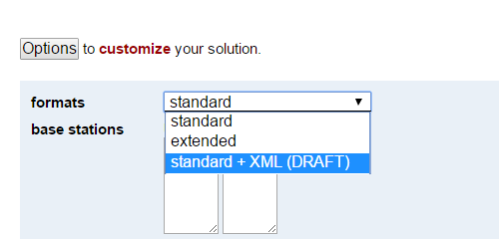
NGS OPUS SOLUTION REPORT
========================
All computed coordinate accuracies are listed as peak-to-peak values.
For additional information: https://www.ngs.noaa.gov/OPUS/about.jsp#accuracy
USER: joe.evjen@noaa.gov DATE: December 05, 2016
RINEX FILE: 5947299r.16o TIME: 18:45:47 UTC
SOFTWARE: page5 1209.04 master95.pl 160321 START: 2016/10/25 17:14:00
EPHEMERIS: igs19202.eph [precise] STOP: 2016/10/25 21:49:00
NAV FILE: brdc2990.16n OBS USED: 11436 / 12254 : 93%
ANT NAME: TRM57971.00 NONE # FIXED AMB: 82 / 83 : 99%
ARP HEIGHT: 2.0 OVERALL RMS: 0.010(m)
REF FRAME: NAD_83(2011)(EPOCH:2010.0000) IGS08 (EPOCH:2016.8164)
X: -2833371.235(m) 0.013(m) -2833372.332(m) 0.013(m)
Y: -1541100.973(m) 0.015(m) -1541099.963(m) 0.015(m)
Z: 5484647.219(m) 0.026(m) 5484647.459(m) 0.026(m)
LAT: 59 42 33.45847 0.003(m) 59 42 33.44896 0.003(m)
E LON: 208 32 32.07518 0.007(m) 208 32 31.98492 0.007(m)
W LON: 151 27 27.92482 0.007(m) 151 27 28.01508 0.007(m)
EL HGT: 503.684(m) 0.032(m) 504.134(m) 0.032(m)
ORTHO HGT: 494.346(m) 0.055(m) [NAVD88 (Computed using GEOID12B)]
UTM COORDINATES STATE PLANE COORDINATES
UTM (Zone 05) SPC (5004 AK 4)
Northing (Y) [meters] 6620045.124 636606.995
Easting (X) [meters] 586771.176 417957.136
Convergence [degrees] 1.33177427 -1.25880956
Point Scale 0.99969227 0.99998247
Combined Factor 0.99961346 0.99990364
US NATIONAL GRID DESIGNATOR: 5VNG8677120045(NAD 83)
BASE STATIONS USED
PID DESIGNATION LATITUDE LONGITUDE DISTANCE(m)
DM7460 AC61 CHICKENM61AK2006 CORS ARP N640145.332 W1420432.948 688041.0
DP9272 MCES MCNEIL CANYON ELE CORS ARP N594445.882 W1511528.107 11973.1
DL7665 AC39 SHUYAKISSPAK2006 CORS ARP N583634.993 W1522338.579 133691.6
NEAREST NGS PUBLISHED CONTROL POINT
UW5506 LOOKOUT MTN N594233.480 W1512727.891 0.8
<?xml version="1.0" encoding="UTF-8"?>
<OPUS_SOLUTION>
<USER_INFORMATION>
<USER_EMAIL> joe.evjen@gmail.com </USER_EMAIL>
<SOLUTION_DATE> February 19, 2008 </SOLUTION_DATE>
<SOLUTION_TIME> 01:16:22 UTC </SOLUTION_TIME>
<RINEX_FILE_NAME> zzyy1500.07o </RINEX_FILE_NAME>
</USER_INFORMATION>
<DATA_INFORMATION>
<SOFTWARE>
<PAGES_VERSION> page5 0612.06 </PAGES_VERSION>
<OPUS_VERSION> master3.pl </OPUS_VERSION>
</SOFTWARE>
<EMPHEMERIS> igs14293.eph [precise] </EMPHEMERIS>
<NAV_FILE> brdc1500.07n </NAV_FILE>
<ANTENNA_NAME> TRM41249.00 NONE </ANTENNA_NAME>
<ARP_HEIGHT> 0.0 </ARP_HEIGHT>
<START_TIME> 2007/05/30 00:00:00 </START_TIME>
<END_TIME> 2007/05/30 23:59:00 </END_TIME>
<OBS_USED>
<NUMBER_USED> 52955 </NUMBER_USED>
<TOTAL_OBS> 55069 </TOTAL_OBS>
<PERCENTAGE> 96 </PERCENTAGE>
</OBS_USED>
<FIXED_AMB>
<NUMBER_FIXED> 218 </NUMBER_FIXED>
<NUMBER_AMB> 242 </NUMBER_AMB>
<PERCENTAGE> 90 </PERCENTAGE>
</FIXED_AMB>
<OVERALL_RMS UNIT="m"> 0.021 </OVERALL_RMS>
</DATA_INFORMATION>
<POSITION>
<REF_FRAME> NAD_83(CORS96) </REF_FRAME>
<EPOCH> 2002.0000 </EPOCH>
<COORD_SET>
<RECT_COORD>
<COORDINATE AXIS="X" UNIT="m" UNCERTAINTY="0.003"> -496255.901 </COORDINATE>
<COORDINATE AXIS="Y" UNIT="m" UNCERTAINTY="0.022"> -5510741.494 </COORDINATE>
<COORDINATE AXIS="Z" UNIT="m" UNCERTAINTY="0.017"> 3162058.243 </COORDINATE>
</RECT_COORD>
<ELLIP_COORD>
<LAT>
<DEGREES> 29 </DEGREES>
<MINUTES> 54 </MINUTES>
<SECONDS> 48.44070 </SECONDS>
<UNCERTAINTY> 0.003 </UNCERTAINTY>
<UNCERTAINTY_UNIT>m </UNCERTAINTY_UNIT>
</LAT>
<EAST_LONG>
<DEGREES>264 </DEGREES>
<MINUTES>51</MINUTES>
<SECONDS>15.31122</SECONDS>
<UNCERTAINTY>0.002</UNCERTAINTY>
<UNCERTAINTY_UNIT>m</UNCERTAINTY_UNIT>
</EAST_LONG>
<EL_HEIGHT>
<VALUE>-7.199</VALUE>
<UNCERTAINTY>0.027</UNCERTAINTY>
<UNCERTAINTY_UNIT>m</UNCERTAINTY_UNIT>
</EL_HEIGHT>
</ELLIP_COORD>
</COORD_SET>
</POSITION>
<POSITION>
<REF_FRAME>ITRF00 (EPOCH:2007.4096)</REF_FRAME>
<EPOCH>2007.4096</EPOCH>
<COORD_SET>
<RECT_COORD>
<COORDINATE AXIS="X" UNIT="m" UNCERTAINTY="0.003">-496256.585</COORDINATE>
<COORDINATE AXIS="Y" UNIT="m" UNCERTAINTY="0.022">-5510740.027</COORDINATE>
<COORDINATE AXIS="Z" UNIT="m" UNCERTAINTY="0.017">3162058.057</COORDINATE>
</RECT_COORD>
<ELLIP_COORD>
<LAT>
<DEGREES>29</DEGREES>
<MINUTES>54</MINUTES>
<SECONDS>48.45813</SECONDS>
<UNCERTAINTY>0.003</UNCERTAINTY>
<UNCERTAINTY_UNIT>m</UNCERTAINTY_UNIT>
</LAT>
<EAST_LONG>
<DEGREES>264</DEGREES>
<MINUTES>51</MINUTES>
<SECONDS>15.28092</SECONDS>
<UNCERTAINTY>0.002</UNCERTAINTY>
<UNCERTAINTY_UNIT>m</UNCERTAINTY_UNIT>
</EAST_LONG>
<EL_HEIGHT>
<VALUE>-8.505</VALUE>
<UNCERTAINTY>0.027</UNCERTAINTY>
<UNCERTAINTY_UNIT>m</UNCERTAINTY_UNIT>
</EL_HEIGHT>
</ELLIP_COORD>
</COORD_SET>
</POSITION>
<ORTHO_HGT UNCERTAINTY="0.037" UNIT="m" SOURCE="[Geoid03 NAVD88]">20.154</ORTHO_HGT>
<PLANE_COORD_INFO>
<PLANE_COORD_SPEC TYPE="UTM" ZONE="15">
<NORTHING UNIT="m">3311130.625</NORTHING>
<EASTING UNIT="m">292843.826</EASTING>
<CONVERGENCE UNIT="deg">-1.07044705</CONVERGENCE>
<SCALE>1.00012949</SCALE>
<CF>1.00013062</CF>
</PLANE_COORD_SPEC>
<PLANE_COORD_SPEC TYPE="SPC" ZONE="4204(TXSC
)">
<NORTHING UNIT="m">4236668.327</NORTHING>
<EASTING UNIT="m">972105.452</EASTING>
<CONVERGENCE UNIT="deg">1.88824726</CONVERGENCE>
<SCALE>0.99991407</SCALE>
<CF>0.99991520</CF>
</PLANE_COORD_SPEC>
<USNG>15RTP9284411131(NAD 83)
</USNG>
</PLANE_COORD_INFO>
<BASE_STATION_USED>
<PID>DE5999</PID>
<STATION_ID>ADKS</STATION_ID>
<DESIGNATION>ADDICKS 1795 CORS ARP</DESIGNATION>
<LATITUDE>N294727.47185</LATITUDE>
<LONGITUDE>W0953511.04262</LONGITUDE>
<DISTANCE>44692.309</DISTANCE>
</BASE_STATION_USED>
<BASE_STATION_USED>
<PID>DJ8995</PID>
<STATION_ID>ROD1</STATION_ID>
<DESIGNATION>ROD1 CORS ARP</DESIGNATION>
<LATITUDE>N300420.45377</LATITUDE>
<LONGITUDE>W0953136.45801</LONGITUDE>
<DISTANCE>40769.489</DISTANCE>
</BASE_STATION_USED>
<BASE_STATION_USED>
<PID>DH3612</PID>
<STATION_ID>TXLI</STATION_ID>
<DESIGNATION>LIBERTY CORS ARP</DESIGNATION>
<LATITUDE>N300321.18092</LATITUDE>
<LONGITUDE>W0944615.67967</LONGITUDE>
<DISTANCE>39457.656</DISTANCE>
</BASE_STATION_USED>
<NGS_PUBLISHED_CONTROL_POINT>
<PID>AA9861</PID>
<DESIGNATION>LAKE HOUSTON 2050 CORS L1 PHS </DESIGNATION>
<LATITUDE>N295448.44005</LATITUDE>
<LONGITUDE>W0950844.68949</LONGITUDE>
<DISTANCE>0.000</DISTANCE>
</NGS_PUBLISHED_CONTROL_POINT>
<NOTE> This position and the above vector components were computed without any
knowledge by the National Geodetic Survey regarding the equiqment or
field operating procedure used. </NOTE>
</OPUS_SOLUTION>
Notes:
This is the XML report, it parses the solution into values usable by machines.

Slide 13
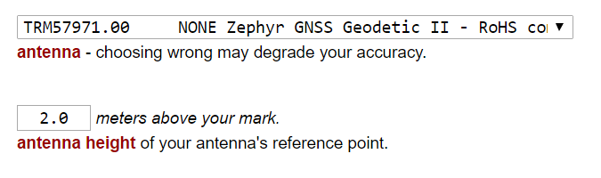
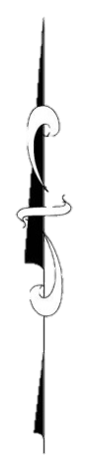
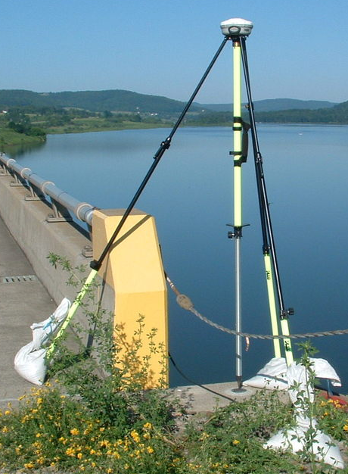
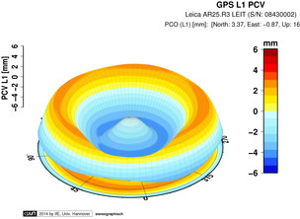
rotate NRP to face true north
ARP
antenna type & hgt are important for accurate results
antenna height
each type has unique biases
mark
For antenna calibrations, photos,
ARP and NRP diagrams, see geodesy.noaa.gov/ANTCAL/
JGE, 2015
Notes:
Antennas are the one area where OPUS users can force errors into their solutions.
ANTENNA TYPE:
GNSS antennas aren’t like survey telescopes, which have a point (reticule) where all measurements take place. The “phase center” measuring points of an antenna will wander as each satellite’s azimuth and elevation changes. These variations are unique for each model of antenna. OPUS mixes data from across long distances and from different antenna types (rover + CORS) so this is a source of error. However, the GNSS community has measured these phase center variations for many antenna types, a process known as “calibration” which measures the variations with respect to an antenna’s reference point, or ARP. You tell OPUS where the ARP is, and it will do the rest.
ANTENNA HEIGHT:
The height of the antenna is measure vertically (not slant height) up from the from the mark, to the Antenna Reference Point which is almost always the center of the bottom-most, permanently attached piece of the antenna. Some antennas have a short removable pipe or extension to them, these are NOT part of the antenna, and must be considered part of the tripod height.
If in doubt you can find photos and diagrams of each antenna (that we have calibrated) at the URL shown.
So if you leave the antenna height as “0” this will be the height OPUS returns, of the antenna’s ARP.
Image posted as http://geodesy.noaa.gov/sitemsgs/OPUS/about/images/ant_hgt_BBBK23.png

Slide 14
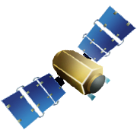

Static: OPUS determines your position with a differential GPS static solution, using hours of data.
This process is repeated 4x from other CORS.
baseline 5
baseline 4
baseline 1
baseline 3
baseline 2

Slide 15

“peak to peak” error ranges, explained:
LAT: 59 42 33.45847 0.003(m)
W LON: 151 27 27.92482 0.007(m)
EL HGT: 503.684(m) 0.032(m)
ORTHO HGT: 494.346(m) 0.055(m)
baseline 5
position:
averaged from the 3 most coherent baselines
ranges:
a bounding box enclosing 3 most coherent baselines
LON range
for ORTHO HGT, geoid model uncertainty is added
LAT range
ORTHO HGT range
CORS baseline 1
EL HGT range
=
baseline 3
baseline 4
baseline 2
2 outermost baselines are ignored
JGE, 2015

Slide 16

Rapid-static: OPUS first creates an atmospheric delay model from surrounding CORS data.
Your position is then quickly determined by differential GPS static solution.

Slide 17
  OPUS-NET:
  first, run OPUS to solve for CORS from IGS CORS
  then run OPUS-Static using improved CORS positions and tropospheric corrections, along with ocean-tide loading & absolute antenna calibration models

Slide 18
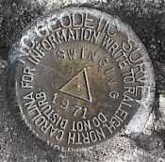
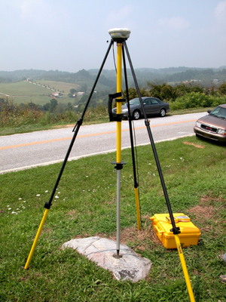

Shared solutions: describe the mark to share it.
Located in the SW corner of a 2 ft square concrete pad projecting 0.3 ft above ground, 3.3 ft S from S edge of sidewalk …
requires 4+ hours on a permanent mark of public interest
http://geodesy.noaa.gov/marks/sharing/

Slide 19
  OPUS-projects:
  first, run OPUS to harvest all project data
  OPUS automatically forms sessions from simultaneously observed marks, enabling multi-baseline processing and adjustment of redundant observations.
Improved solutions for simultaneous or repeated observations
harvest data from multiple observers
share upload & processing tasks
customize your processing using PAGES
simple data quality analysis
improve survey accuracy
constrain to local networks
publishing support (limited)

Slide 20
planned rollouts
version | Working title | Adds what? | Removes what? | Forum in 2021 | when?
in production www.ngs/OPUS | OPUS | -- | -- | today! | now
in BETA now beta.ngs/OPUS | OPUS adds publishing | Upgrade -projects to facilitate IDB publishing | -- | June? | spring 2021
DEV | OPUS adds GNSS (M-PAGES) | Upgrade CORS data & OPUS-static processing to add GNSS constellations beyond GPS. Use RINEX3 header metadata to make upload form more optional? | vendor data format support is eroding! OPUS-RS killer? | March? | fall 2021??
DEV | OPUS adds RTK | Upgrade -projects to ingest GVX vectors | -- | September? | winter??
DEV | OPUS adds everything | Overhaul OPUS interface and reports Upgrade -projects to ingest leveling and other standard data formats | outdated interfaces, old report formats |  | ??
pending | reference frame maintenance | updated reference frame: ITRF2020 | old version: ITRF2014 |  | early 2022
pending | reference frame upgrade | Support new datums: NAPGD2022, NATREF epoch 2020.0, SPCS2022 | old datums: NAVD88, NAD83, SPCS83, USFt |  | 2023/5?
Notes:
Here’s a list of six different enhancements to OPUS in various stages of planning, on the following slides we’ll address each one-by-one

Slide 21
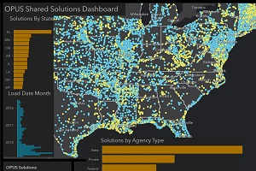
planned rollouts
version | Working title | Adds what? | Removes what? | Forum in 2021 | when?
in production www.ngs/OPUS | OPUS | -- | -- | today! | now
recent changes to OPUS:
Record usage!
Contributions to GPSBM project
We hired 3 geodesist programmers!
Clearer use of DEV, BETA, and PROD environments
Heights improved with GEOID18, more conservative accuracies
Accepts RINEX3, as well as RINEX2 and many vendor formats
Added OPUS API | Web Services
Added a discovery shared solutions dashboard
-projects improved CORS decisions
proven, OPUS can work in the ‘cloud’ (infinite scalability, at a price)
New Training Videos!
Tutorial: How to Submit an OPUS Share Observation
Lesson: GNSS Positioning: Survey Planning and Data Acquisition
[
{
"pid": "BBBH86",
"ts": "09127123108",
"designation": "50127",
"stCounty": "MD,Montgomery County",
"refFrame": "NAD_83(2011)",
"epoch": "2010.0000",
"lat": "39.0924957722",
"latDms": "N390532.98478",
"latP2p": "0.002",
"lon": "-77.2104948722",
"lonDms": "W0771237.78154",
"lonP2p": "0.009",
"ellHt": "109.699",
"ellHtP2p": "0.018",
"datum": "NAVD88 (Computed using GEOID18)",
"orthoHt": "141.408",
"orthoHtP2p": "0.054",
"observed": "2009-04-24T13:57:00Z",
"agency": "Montgomery County MD DOT",
"monumentType": "Other",
"monumentDesc": " Chiseled cross",
"setting": " Massive structures (other than listed below)",
"specificSetting": "CROSSCUT IN STORM DRAIN MANHOLE RIM",
"stamping": "NONE",
"stability": " Monument will probably hold position well",
"magnetic": " Marker is a steel pipe",
"condition": "G",
"description": "MARK IS IN GAITHERSBURG, MD. WEST OF THE INTERSECTION OF TRAVILAH ROAD AND MOLECULAR DRIVE. IT IS ON ADC MAP 28 GRID D 5 AND WSSC GRID 219 NW 10. IT IS 19 FEET NORTH OF A REBAR AND YELLOW CAP FOUND. IT IS 55.9 FEET NORTH OF A WATER VALVE. IT IS 41.6 FEET WEST OF A FIRE HYDRANT. IT IS 39.3 FEET EAST OF AN ELECTRIC POLE. NUMBERS FOR THE POLE ARE NOT AVAILABLE. IN THE CLOSE UP PHOTO, A CHISELED CROSSCUT CAN BE SEEN WITHIN THE PINK PAINT."
}
]
Notes:
First, let’s review OPUS as it is today, and the changes that have happened in the past year or so.
The first three bullets show that NGS is really growing our recognition that OPUS is a flagship product, in terms of the value it brings to users, and the value it brings to our own initiatives, like the harvested solutions which improved GEOID18 and will underpin the NADCON follow-on Transformation Tool product. In recognition of this, we hired just in December three new geodesists with programming experience to carry OPUS forward.
We’ve followed evolving formats, allowing OPUS to use RINEX v.3, and export JSON for shared solutions and datasheet interactions. These feed new discovery portals for shared solutions.
We’ve gotten better at outreach, with canned lessons, and a focus on OPUS for this year’s webinars.

Slide 22
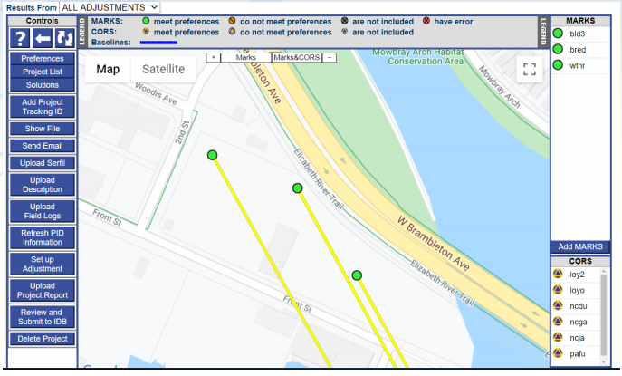
planned rollouts
version | Working title | Adds what? | Removes what? | Forum in 2021 | when?
in production www.ngs/OPUS | OPUS | -- | -- | today! | now
in BETA now beta.ngs/OPUS | OPUS adds publishing | Upgrade -projects to facilitate IDB publishing | -- | June? | spring 2021
Simplifies publishing your GPS projects
Runs ADJUST within OPUS
Prepares ‘bluebook’ files for you, assists with survey design
upload mark photos and descriptions
user manual = coming very soon!
Notes:
The first change you should see to production OPUS can now be seen on BETA, in the –PROJECTS option.
Here we’ve added new controls that give your project a path to go somewhere, to create NGS datasheets.

Slide 23
Bluebooking with OPUS Projects
geodesy.noaa.gov/ project_tracking/
GPS survey
data files
photos
descriptions
etc.
Process data using vendor software or PAGE-NT.
Construct bluebook files using software and editor.
Run ADJUST.
review and publish to IDB
available now on BETA!
(with certain caveats)
https://beta.ngs.noaa.gov/OPUS/
Upload to OPUS-Projects
Process in OPUS-Projects
Notes:
This has already simplified the creation of all the files needed to submit GPS survey projects to NGS.
For now, those bluebooking programs still exist, available for GPS projects processed outside of OPUS and still required for leveling projects.
After users have gotten used to this, and after we upgrade reference frames and databases, this should be the main way to contribute project data to NGS and maintain geodetic control datasheets.

Slide 24

Bluebooking with OPUS Projects
geodesy.noaa.gov/ project_tracking/
GPS survey
data files
photos
descriptions
etc.
Process data using vendor software or PAGE-NT.
Construct bluebook files using software and editor.
Run ADJUST.
review and publish to IDB
available now on BETA!
(with certain caveats)
https://beta.ngs.noaa.gov/OPUS/
Upload to OPUS-Projects
Process in OPUS-Projects
Notes:
For more information, sign up for the webinar NEXT WEEK on this topic!

Slide 25
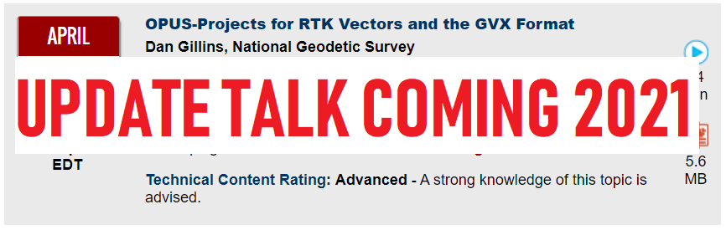
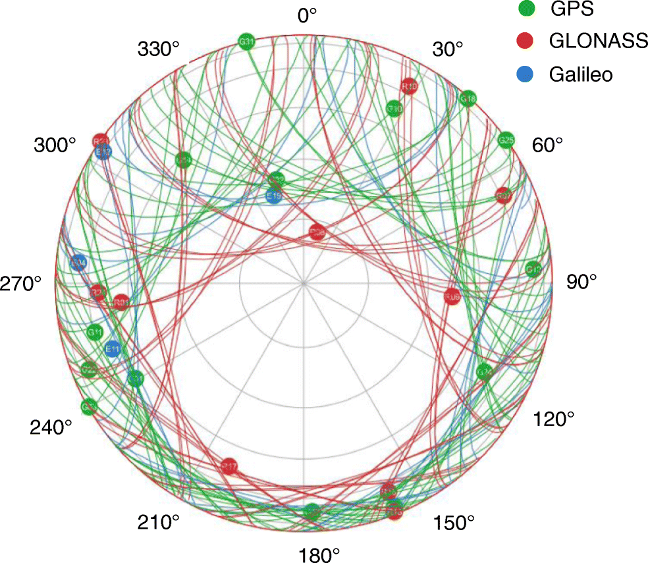
planned rollouts
version | Working title | Adds what? | Removes what? | Forum in 2021 | when?
in production www.ngs/OPUS | OPUS | -- | -- | today! | now
in BETA now beta.ngs/OPUS | OPUS adds publishing | Upgrade -projects to facilitate IDB publishing | -- | June? | spring 2021
DEV | OPUS adds GNSS (M-PAGES) | Upgrade CORS data & OPUS-static processing to add GNSS constellations beyond GPS. Use RINEX3 header metadata to make upload form more optional? | vendor data format support is eroding! OPUS-RS killer? | March? | fall 2021??
Comprehensive update to 30-year old PAGES software
An OPUS-RS killer? Testing will tell
smarter base station selection using improved CORS metrics
3.04 OBSERVATION DATA M RINEX VERSION / TYPE
sbf2rin-9.3.3 20140511 000610 LCL PGM / RUN BY / DATE
faa1 MARKER NAME
92201M012 MARKER NUMBER
joe.evjen@noaa.gov National Geodetic Survey OBSERVER / AGENCY
3001320 SEPT POLARX4 2.5.1p1 REC # / TYPE / VERS
725235 LEIAR25.R4 NONE ANT # / TYPE
-5246415.0000 -3077260.0000 -1913842.0000 APPROX POSITION XYZ
0.1262 0.0000 0.0000 ANTENNA: DELTA H/E/N
30.000 INTERVAL
2014 5 10 0 0 0.0000000 GPS TIME OF FIRST OBS
2014 5 10 23 59 30.0000000 GPS TIME OF LAST OBS
72 # OF SATELLITES
END OF HEADER
Notes:
Moving on, the next enhancement tackles the limitation of OPUS using only SOME of today’s abundance of navigation satellites.
USA was the first in space with GPS, but now we could enjoy GLONASS, GALILEO, BEIDOU, etc.
Tracking more satellites was a not-insubstantial complication for the PAGES processing engine, the workhorse behind OPUS which determines the position of your data file.
And that software is now 30-years old. We’ve rebuilt it from the ground up, engaging a whole new generation of programmers, with modern programming and modern inputs.
We are actively testing this now, using an instance running in the cloud. There is potential that this new –static processing will encroach on –rapid static preeminence for short duration observations.
Being modern, it lives for RINEX3 data. Also, the 3rd-party tool OPUS relies on to convert vendor data formats to RINEX2 is slowly failing. OPUS will want you to provide a standard format, RINEX (or BINEX?) in the future.

Slide 26
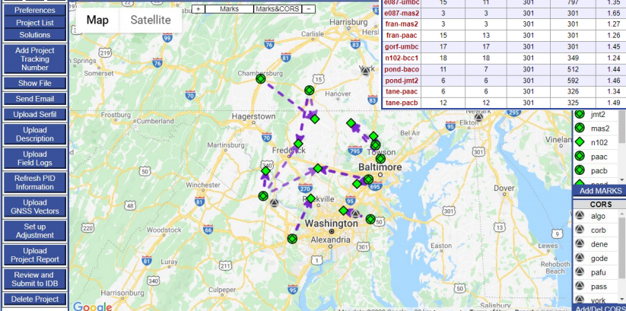
planned rollouts
version | Working title | Adds what? | Removes what? | Forum in 2021 | when?
in production www.ngs/OPUS | OPUS | -- | -- | today! | now
in BETA now beta.ngs/OPUS | OPUS adds publishing | Upgrade -projects to facilitate IDB publishing | -- | June? | spring 2021
DEV | OPUS adds GNSS (M-PAGES) | Upgrade CORS data & OPUS-static processing to add GNSS constellations beyond GPS. Use RINEX3 header metadata to make upload form more optional? | vendor data format support is eroding! OPUS-RS killer? | March? | fall 2021??
DEV | OPUS adds RTK | Upgrade -projects to ingest GVX vectors | -- | September? | winter??
MORE POINTS, FASTER AND CHEAPER!
Single-base RTK vectors
Network RTK vectors
Vectors processed in other software
Contribute to Transformation Tool project
Uses NEW GNSS Vector EXchange Format: geodesy.noaa.gov/data/formats/GVX/
Notes:
Moving on again, and back to OPUS projects,
we should this year see in BETA OPUS the ability to ingest RTK type GNSS vector data into an OPUS project, bringing in a high-productivity technique.
This requires a new vector file, GVX, we’ve worked with many GPS vendors to provide an export capability

Slide 27
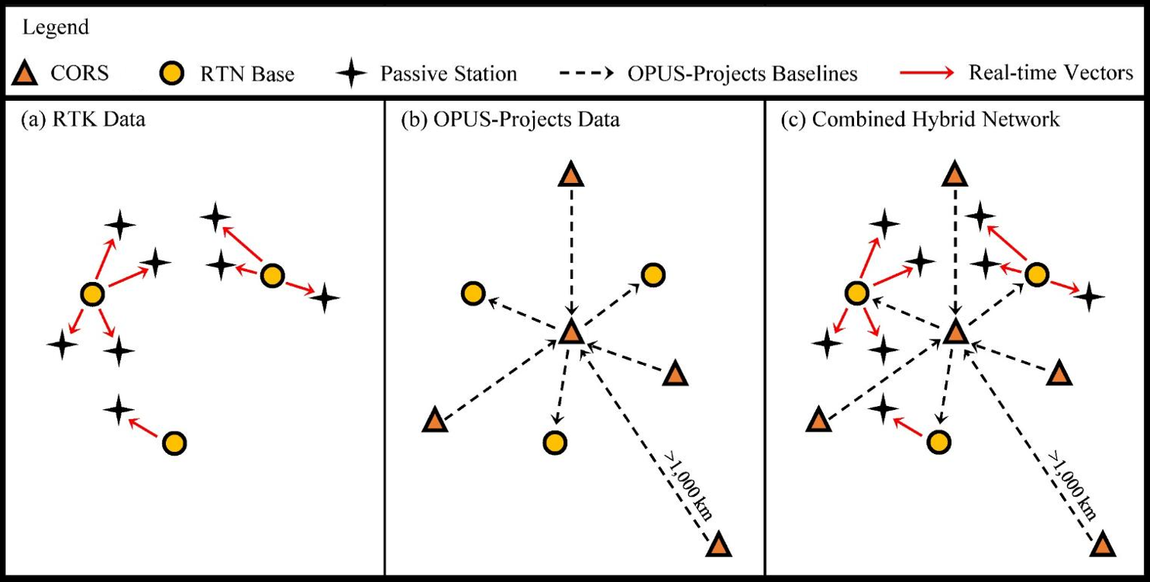
Hybrid Control Networks = Static + RTK/RTN
OPUS for RTK/RTN-GNSS

Slide 28
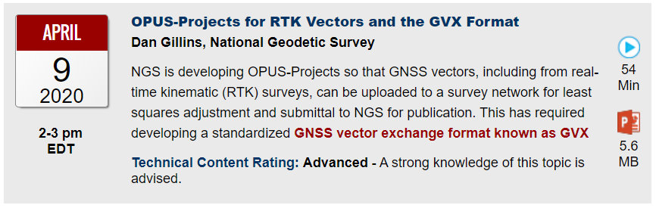
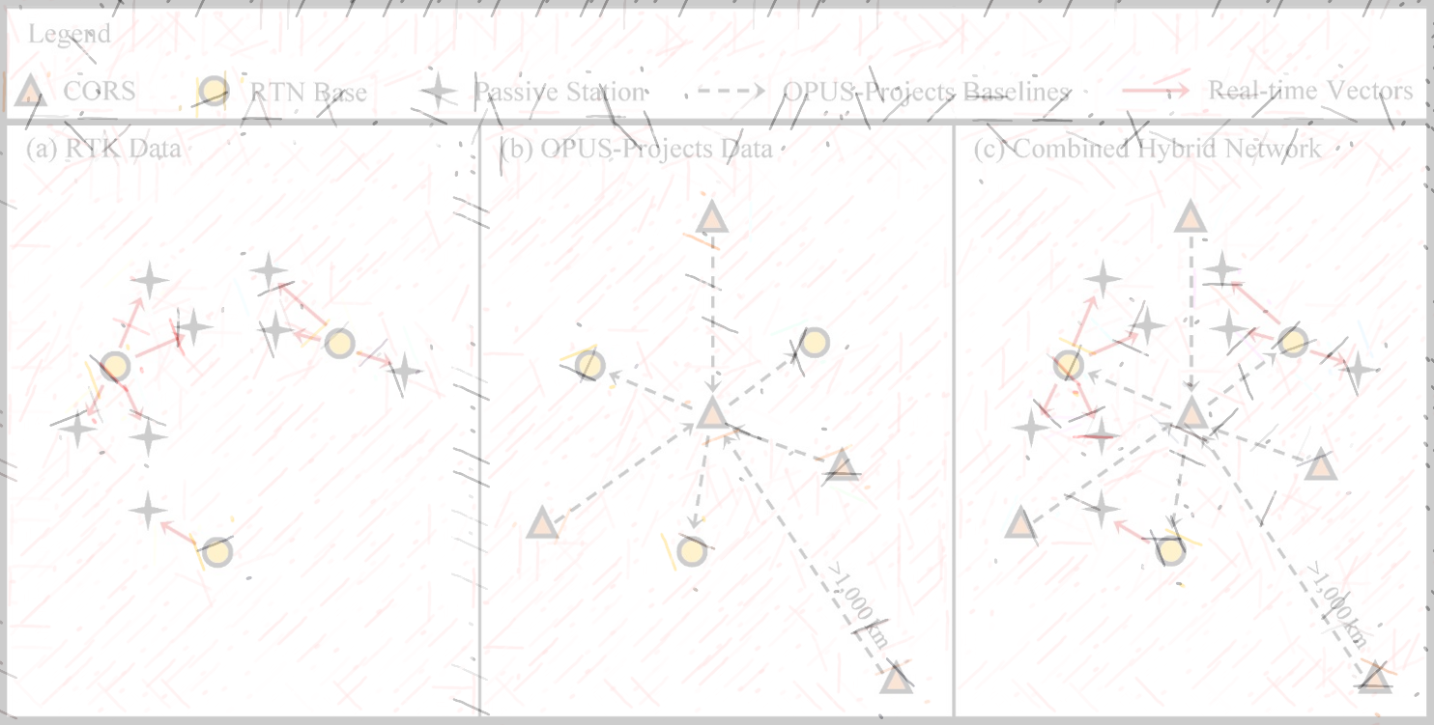
OPUS for RTK/RTN-GNSS
Hybrid Control Networks = Static + RTK/RTN

Slide 29

planned rollouts
version | Working title | Adds what? | Removes what? | Forum in 2021 | when?
in production www.ngs/OPUS | OPUS | -- | -- | today! | now
in BETA now beta.ngs/OPUS | OPUS adds publishing | Upgrade -projects to facilitate IDB publishing | -- | June? | spring 2021
DEV | OPUS adds GNSS (M-PAGES) | Upgrade CORS data & OPUS-static processing to add GNSS constellations beyond GPS. Use RINEX3 header metadata to make upload form more optional? | vendor data format support is eroding! OPUS-RS killer? | March? | fall 2021??
DEV | OPUS adds RTK | Upgrade -projects to ingest GVX vectors | -- | September? | winter??
DEV | OPUS adds everything | Overhaul OPUS interface and reports Upgrade -projects to ingest leveling and other standard data formats | outdated interfaces, old report formats |  | ??
What leaps forward .
can OPUS interface .
& reporting take? .
DESIGN UPGRADE! From the team that turned NADCON into NCAT
web-centric workflow, context-sensitive
email becomes OPTIONAL;
results accessible on-screen and via URL key
change units, zones, etc. AFTER solution is complete
improved data visualization
upload a leveling, classical angles and distances, gravity files

Slide 30
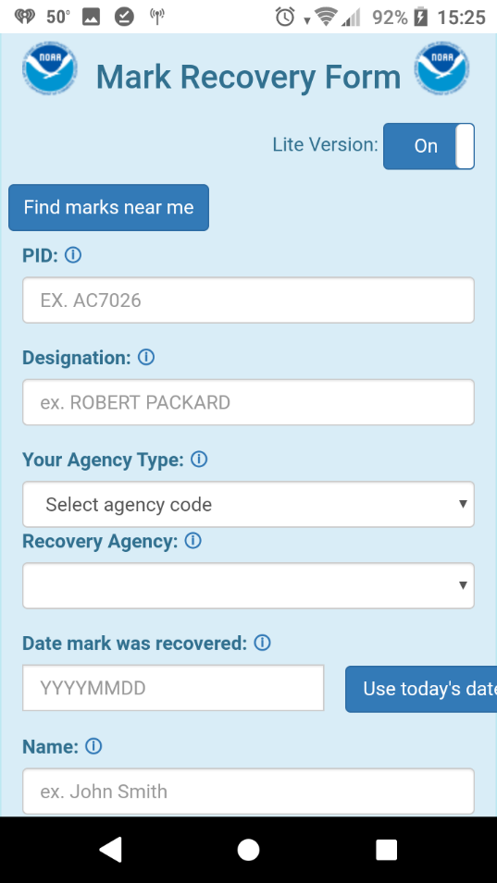
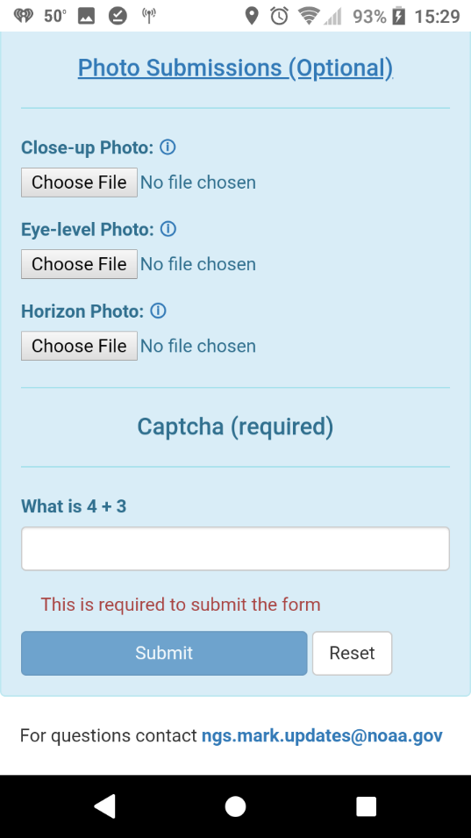


Mark Recovery – mobile browser compatible
Report new or recovered marks
  Minimum:
    Smartphone = photo
    Smartphone = scaled position
  Optional details:
    Full descriptions
    Add marks to projects

Slide 31
From Blueprint Part 3
“OPUS coordinates”
  These are coordinates computed by OPUS that have not been evaluated by anyone at NGS.
  Use OPUS recommendations
    Imprimatur “tied to the NSRS”
  Don’t use OPUS recommendations
    Warning “NOT tied to the NSRS”
  OPUS will guide users “down the paths of best practice”.
Notes:
OPUS coordinates. These are coordinates computed by OPUS that have not been evaluated by anyone at NGS.
If a user restricts OPUS to only use the constraints which OPUS recommends (specifically coordinates, weights, and other metadata pulled directly from the NSRS Database) then OPUS coordinates will have an additional label of “tied to the NSRS”, but they are never “part of the NSRS”.
Only coordinates pulled directly out of the NSRS database are “part of the NSRS”.
If a user modifies any of the OPUS-recommended constraints, they will still be able to use OPUS for computations, but such computations will not carry the moniker “tied to the NSRS”.

Slide 32
RTN Alignment Service or RAS
Two step process
  Base station alignment
    Should be solved at the network level
    Base stations part of the NCN?
  Rover alignment
    Should be solved within OPUS
    RTN position comparison to OPUS coordinate
Notes:
While useful, base station alignment is only half the story. The real payoff is determining the alignment of the coordinates at a rover location, and this is where the second component would be implemented. The most likely solution to this is not easy to automate, however. It would likely require two back-to-back occupations of some fiducial set of passive control within the RTN service range. Those occupations would be of two different types. The first type would be a long session of static GNSS data collection using OPUS and relying on no parts of the RTN. The second occupation would be with a rover, using RTN-provided data and software. A comparison of the differences between the two coordinates at these fiducial points would yield a statistical look at the biases and standard deviations in the RTN. That is, it would provide a quantification of the alignment of the RTN to the NSRS, at these fiducial marks.

