Slide 1

OPUS Adds New Functionality OPUS Projects Beta goes to Production!
NGS Webinar Series
Thursday, February 11 2021
Philippe Hensel, PhD, and the OP4.0 Team

Slide 2


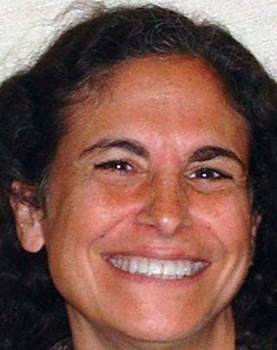

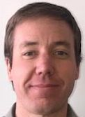

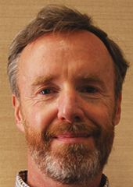




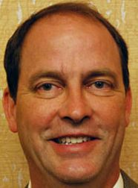

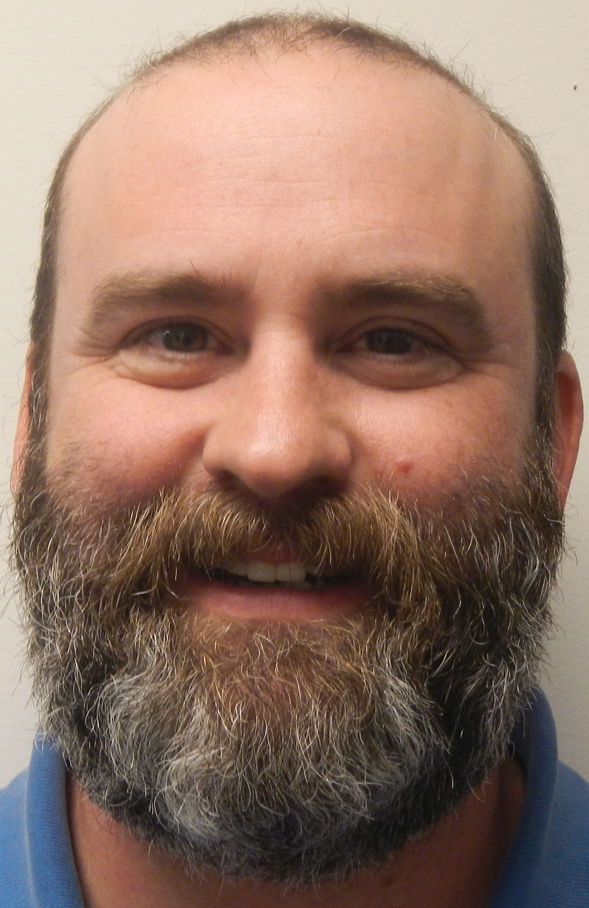
Acknowledgments
Thank you to the entire OP4.0 Team!
Mark Schenewerk
Julie Prusky
Boris Kanazir
Daniel Gillins
Dave Zenk
Jeff Jalbrzikowski
Bill Stone
Kevin Jordan
Erika Little
Michael Dennis
John May
Dan Prouty
Rick Foote

Slide 3
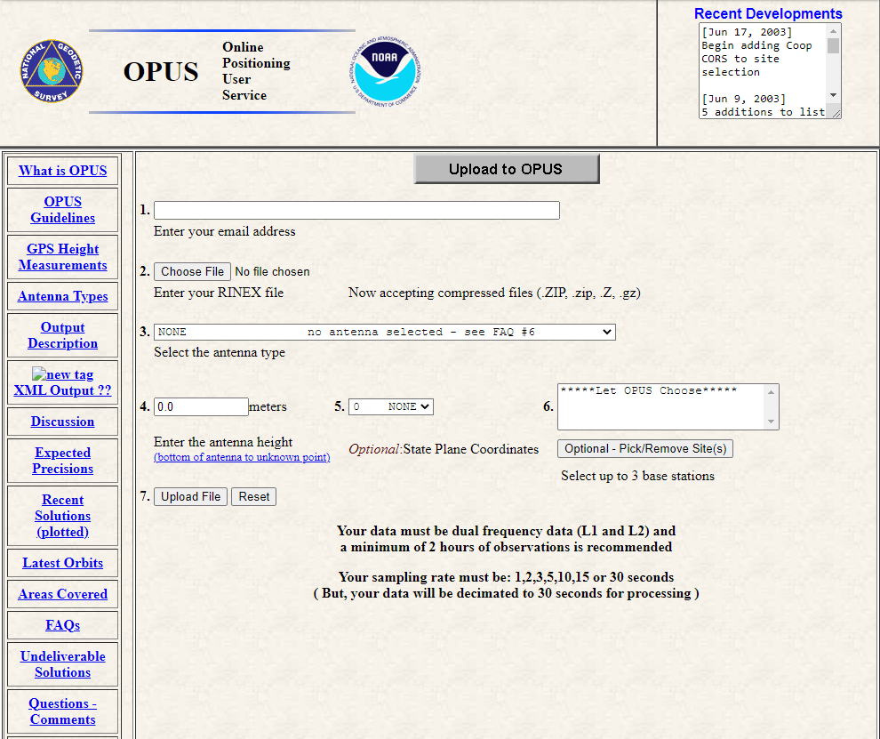
Major OPUS Milestones
2002: NGS’ new Online User Position Service is launched
Free, online GPS post-processing software for accurate positioning! >2hr observation files required. This is commonly referred to as “OPUS Static.”

Slide 4
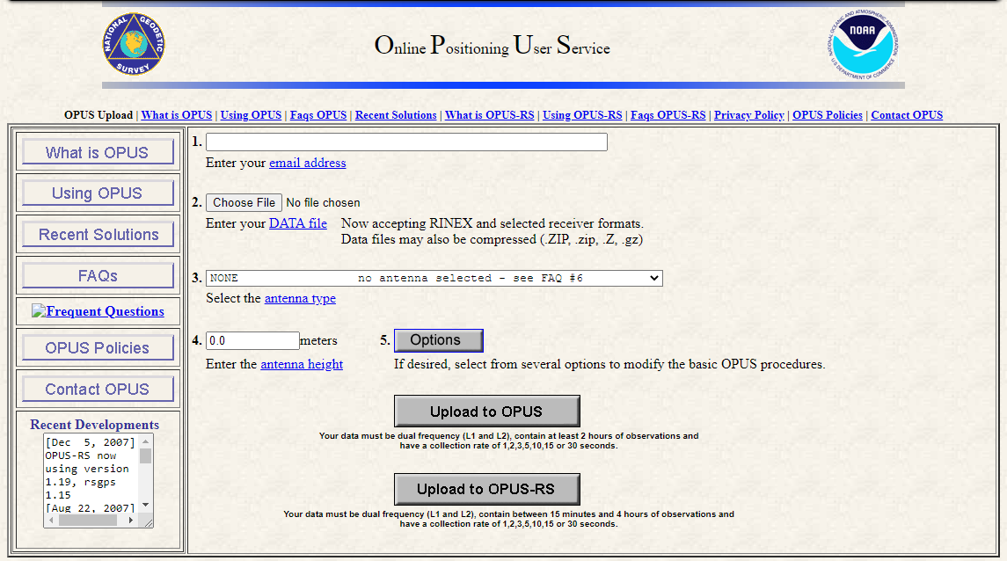
Major OPUS Milestones
2002: NGS’ new Online User Position Service is launched!
2007: OPUS Rapid-Static processes 0.25-2hr observation files

Slide 5
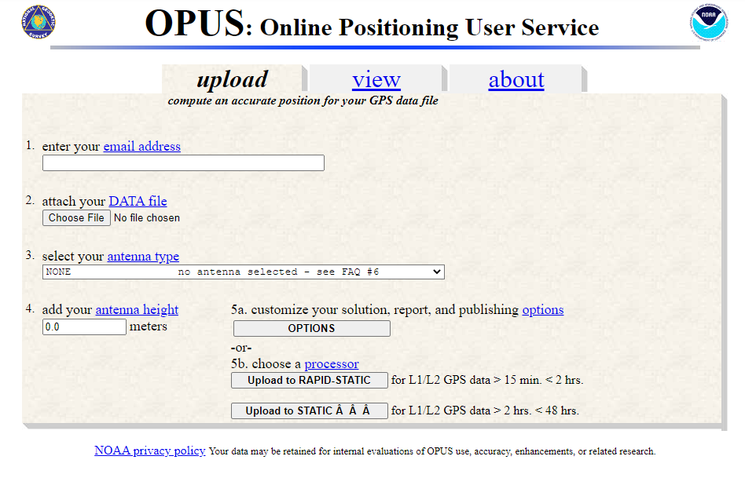
Major OPUS Milestones
2002: NGS’ new Online User Position Service is launched
2007: OPUS Rapid-Static processes 0.25-2hr observation files
2009: OPUS Share goes live
Users can upload their >4hr GPS observations and metadata, “sharing” their data with others online via OPUS datasheets

Slide 6
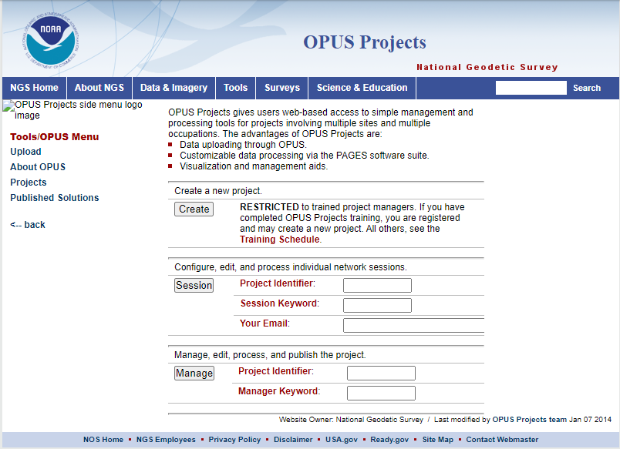
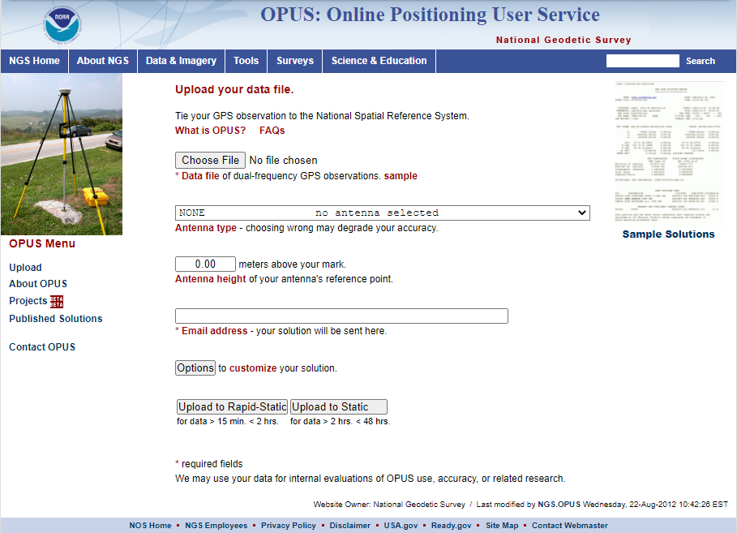
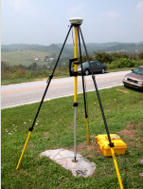
Major OPUS Milestones
2002: NGS’ new Online User Position Service is launched
2007: OPUS Rapid-Static processes 0.25-2hr observation files
2009: OPUS Share goes live
2012: OPUS Projects is launched
OPUS Projects enables users to process simultaneous GPS observations (sessions) and conduct a least-squares network adjustment.

Slide 7
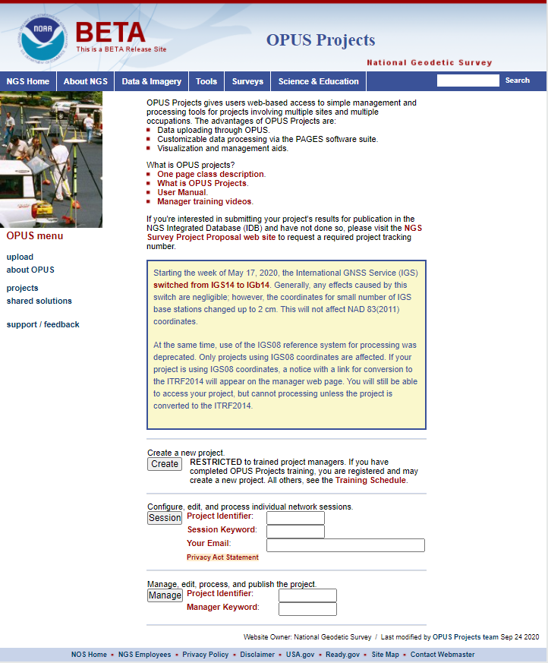
Major OPUS Milestones
2002: NGS’ new Online User Position Service is launched
2007: OPUS Rapid-Static processes 0.25-2hr observation files
2009: OPUS Share goes live
2011: OPUS Projects is launched
2021: OPUS Projects provides a path to publication

Slide 8


Major OPUS Milestones
2021: OPUS Projects automates and provides intuitive output for most of the steps traditionally involved in “bluebooking” a GPS project
Before:
After:
FCGS
Blue Book
You had to know BB file formats, you had to know how to resolve errors
You are freed from having to learn & understand BB files!
Let OPUS Projects do the heavy lifting so you can fly!

Slide 9
What the new OPUS-Projects will do for you
Automatically selects recommended session processing defaults
Arranges data files into intuitive (simultaneously observed) sessions
Selects appropriate CORSs/IGS stations to control your project
Suggests appropriate Session Processing
Suggests appropriate Preliminary Network Adjustment
Suggests appropriate sequence of Final Network Adjustments
Allows you to upload all files needed for submission to NGS

Slide 10
What OPUS-Projects won’t do for you.
OPUS-Projects does not make a project proposal obsolete.
OPUS-Projects does not make field logs obsolete.
OPUS-Projects does not make mark descriptions obsolete.
OPUS-Projects does not make mark photos obsolete.
OPUS-Projects does not make obstructed marks GNSS-able.
OPUS-Projects does not make bad data good.
OPUS-Projects does not automate all processing decisions but it will make good suggestions.
OPUS-Projects does not quality control results as well as you.

Slide 11
Guiding Principles
Session 1
Project Planning
Survey Mark 1 GPS File 1
Survey Mark 2 GPS File 1
Survey Project Proposal
Survey Mark 3 GPS File 1
Preliminary Adjustments
Preliminary Adjustments
Survey Mark 4 GPS File 1
Network Adjustment
NGS Survey Project Proposal Review
Session 2
Survey Mark 1 GPS File 2
No Project ID
Survey Mark 2 GPS File 2
Survey Mark 3 GPS File 2
Survey Mark 4 GPS File 2
Preliminary Adjustments
Preliminary Adjustments
Support all users of OP, but especially the new pathway to the IDB
Create new, comprehensive User Guide & associated training materials
Provide direction
Keep things simple (if possible)
Be clear
Avoid repetition
Session 3
OPUS
Session Baseline Processing
Survey Mark 1 GPS File 3
Survey Mark 2 GPS File 3
With Project ID
Survey Mark 3 GPS File 3
Survey Mark 4 GPS File 3
Survey Mark 1 All Field Logs
OPUS Solutions
Survey Mark 2 All Field Logs
Preliminary Adjustments
Preliminary Adjustments
Survey Mark 3 All Field Logs
OP4.0 Project
Preliminary Adjustment
Survey Mark 4 All Field Logs
Survey Mark 1 Description
Preliminary Adjustments
Preliminary Adjustments
Survey Mark 2 Description
QA/QC
Horizontal Fee Adjustment
Survey Mark 3 Description
Survey Mark 4 Description
Preliminary Adjustments
Survey Mark 1 Photos
Preliminary Adjustments
Horizontal Constrained Adjustment
Survey Mark 2 Photos
Survey Mark 3 Photos
Survey Mark 4 Photos
NGS Publication
Preliminary Adjustments
Preliminary Adjustments
Vertical Free Adjustment
Project Report
Preliminary Adjustments
Preliminary Adjustments
NGS Datasheets
Vertical Constrained Adjustment
Steps that remain unchanged from previous versions of OPUS Projects
Optional steps available with advanced features of OPUS Projects 4.0

Slide 12
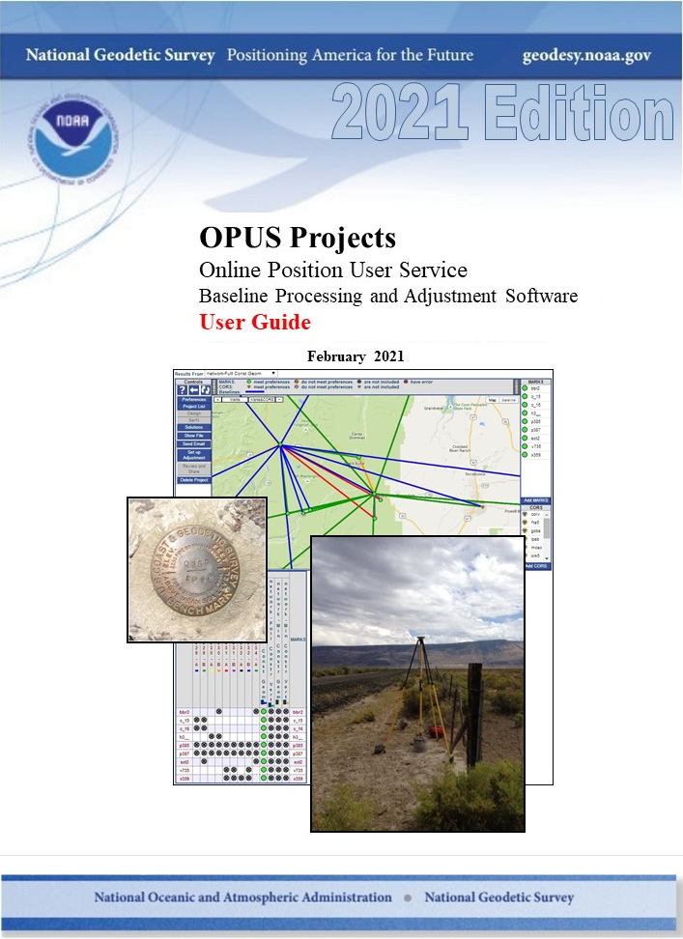
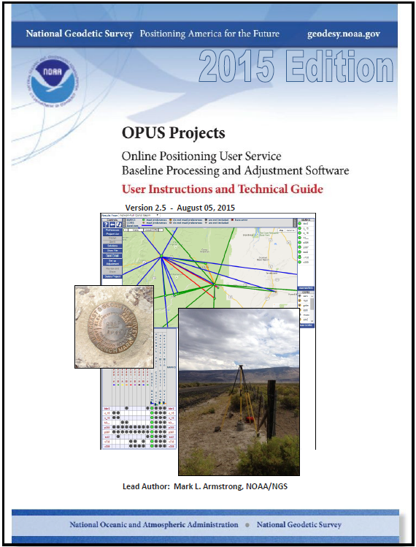
The New OPUS Projects User Guide
Only ONE OPUS Projects and User Guide
User Guide is:
Step-by-step guide to help you successfully use OP to meet your project goals and get your project through submission to NGS
User Guide is NOT:
New NGS 58/59 guidelines
Guarantee your project will be published
Substitute for least squares adjustment course
Substitute for learning good survey field practices

Slide 13
Where we are today
The User Guide has been successfully reviewed both internally and externally
NGS is preparing the document for release in the coming weeks, timed with the release of BetaOP to Production
Training will be provided at two levels
“OP101” –OPUS Projects for Managers Training
“OP102” –Using the advanced features of OPUS Projects for submitting your project to NGS (released later this spring)

Slide 14
Work Flow for OPUS Projects 102… in 12 easy steps!
Project Development
Create Project in OP
Load files into project
Preliminary Network Solution
Mark Recovery, Photos
Mark Descriptions
QA/QC OPUS solutions
Network Solutions
Project Proposal
Field Campaign
Session Processing
Submit to NGS
Topics covered in OP101
Topics covered in OP102

Slide 15
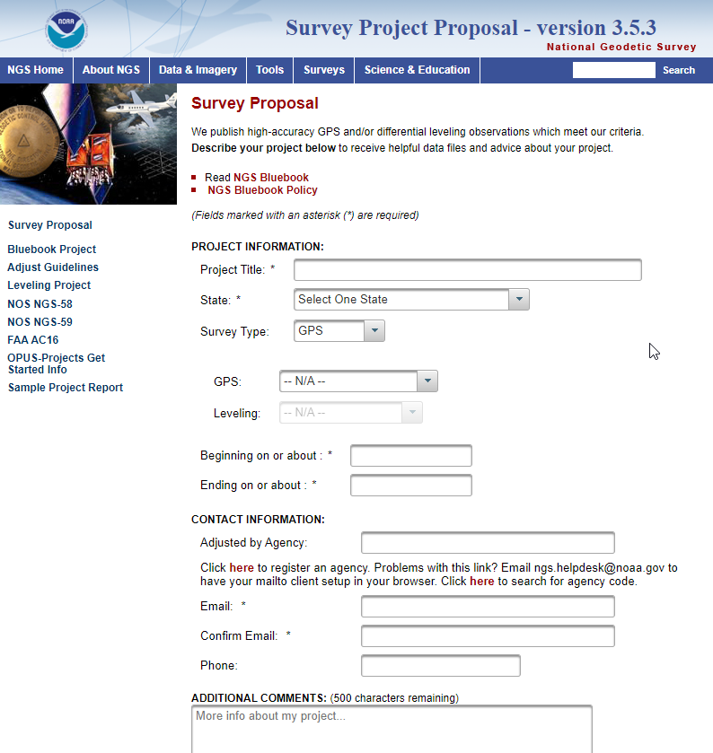
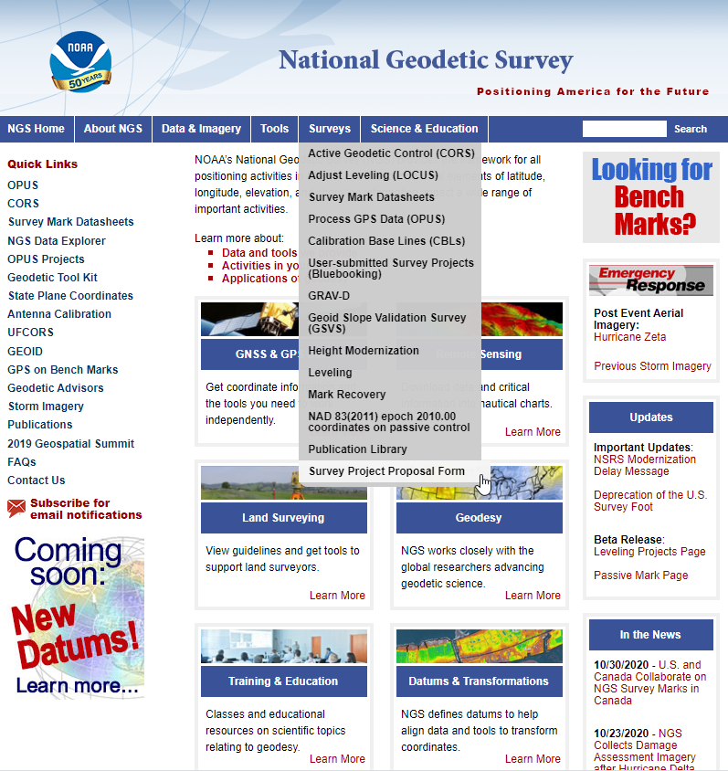
Submit your Project Proposal for Review
Recommended to submit your Project Proposal prior to conducting the survey

Slide 16
NGS Survey Project Proposal Form
Why submit your GNSS Project Plan to NGS (https://geodesy.noaa.gov/SurveyProposal/):
Subject Matter Expert will review your plan, make sure it will meet project objectives
NGS will assign a Project Tracking ID, which will enable you to use the advanced features of OPUS Projects
With a Project Tracking ID, you will be able to submit your project to NGS for consideration of inclusion into the national database of geodetic control, available through published datasheets
If you do not intend on submitting your project to NGS, but still wish your project to be tied to the national reference frames/datums, you can use the “dummy” tracking ID “0000”

Slide 17
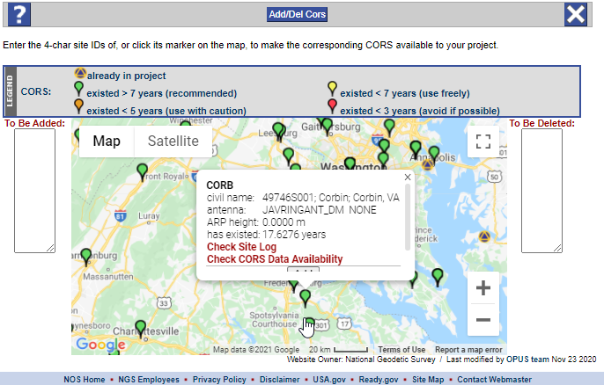
CORS Selection
One of the more critical aspects of designing your project
OP will select good CORSs, but don’t assume they are the best
OP’s selection of CORSs based on independent OPUS solutions; they may differ among sessions
Ideally, you will have the same, best CORSs in all sessions
You will have to add a “distant” CORS for tropospheric modeling
The OP User Guide steps you through the process of CORS selection

Slide 18
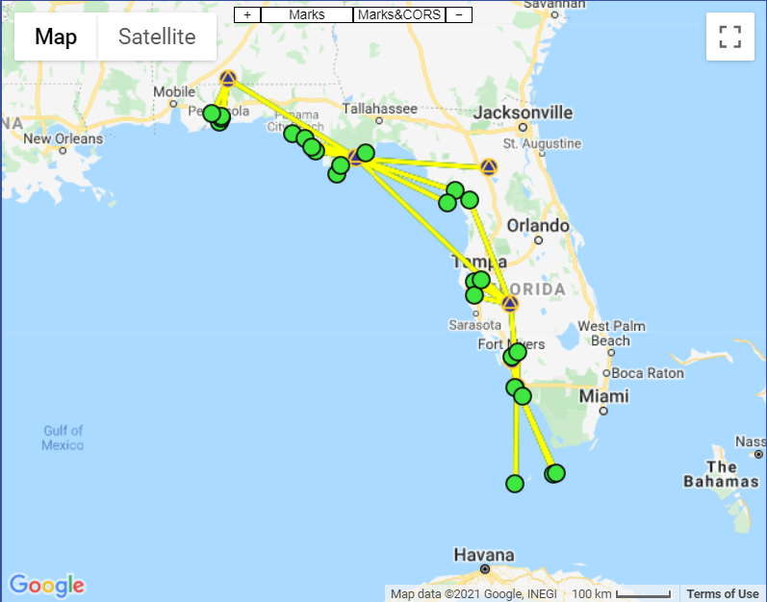
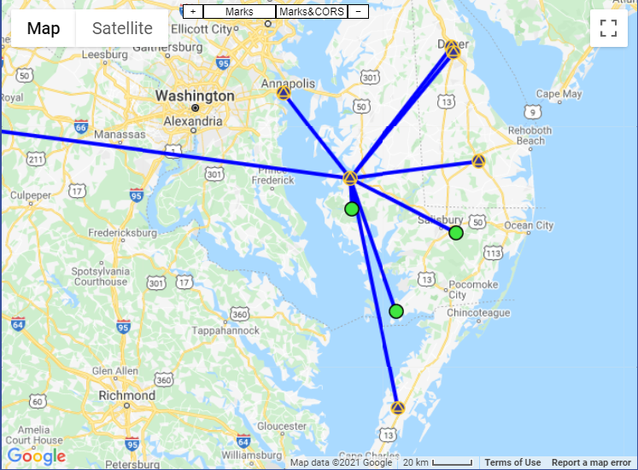
CORS Selection – choosing the hub
One of the CORSs selected will be chosen as the hub in session processing
Ideally, the hub should be centrally located to the project and within 100 km from any user mark
If hub lies more than 100 km away from any user mark, you should consider multiple hubs
All hubs have to have data for each session
All hubs must connect in all sessions
For more guidance on hubs, refer to the User Guide

Slide 19
Network Solutions
Network solutions apply least squares adjustments (and error reduction) to session baselines.
Network solutions will not recreate different baselines than the ones already created in session processing.
Preliminary Network Solution
Seen in OP101: OP recommends holding the hub (CORS) constrained in 3D; many other adjustments possible*
Uses adjustment (and error reduction) software GPSCOM
Horizontal Network Solutions
Only available with NGS Project Tracking ID
Uses adjustment software ADJUST
Requires a Preliminary Network Solution using GPSCOM
Vertical Network Solutions
*User should use hub design for submitting project to NGS
Notes:
In this slide, we discuss the differences between OP101 and OP102 with regards to Network Solutions.
In OP101, we discussed how one goes about processing sessions, and then running a network solution on the baselines solved in session processing.
OP will always recommend constraining the hub in 3D, but other adjustments are possible (user beware!!)
Note that in OP101, network adjustments are run using the baseline adjustment (and error reduction) software GPSCOM.
This is where OP101 ends.
GPSCOM is a very robust and highly effective network adjustment program, in many ways superior to ADJUST. However, it is not ideally configured to align the network solution to the latest realization of NAD83.
For this reason, for submitting a GPS project to NGS, we must use ADJUST. OP now supports the use of ADJUST in a sequential set of network solutions.
So in OP102, we take up where OP101 left off: the network adjustment we saw recommended after session processing is now called the “Preliminary Network Solution.”
This GPSCOM-based network solution is still REQUIRED, but additional horizontal ad vertical adjustments using ADJUST are needed.
In this module, we’ll cover the two separate horizontal adjustments needed to submit your project to NGS.

Slide 20
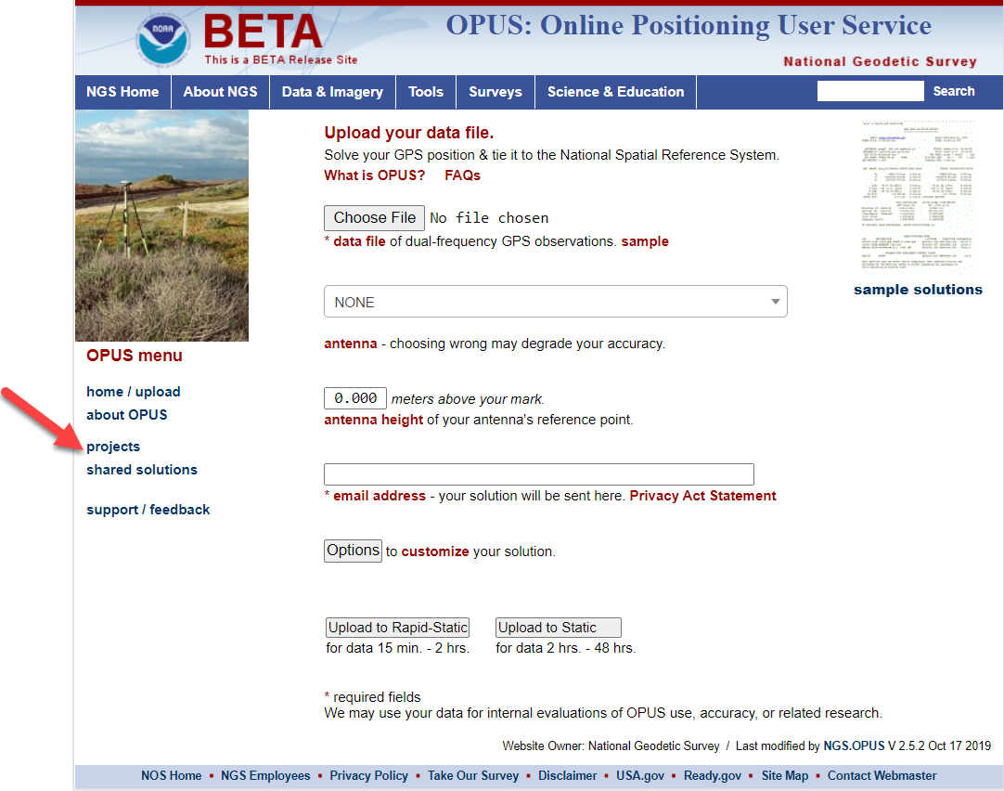

OPUS Projects Live Demo
http://beta.ngs.noaa.gov/OPUS/

Slide 21

Questions?

