Slide 1


Using and Understanding OPUS
NGS OPUS User Forum
August 23, 2022
Dan Martin
Northeast Regional Geodetic Advisor
Dan.martin@noaa.gov
240-676-4762

Slide 2
What is OPUS?
OPUS, the On-line Positioning User Service, is a growing set of applications offering web-based access to the tools and resources provided by the NGS.
Currently, OPUS is composed of
  OPUS-S………….static processing
  OPUS-RS…………rapid-static processing
  Sharing…………database of solutions
  OPUS Projects…..campaign survey processing and project submittal for publication
2

Slide 3
What is OPUS?
On-line Positioning User Service
  Submit dual frequency (GPS) Data
  15 min - 2 hours data OPUS_RS (Rapid Static)
  2 hours - 48 hours data OPUS_S (Static)
  Processed by NGS computers relative to NCN
  Results received in minutes via e-mail
  Provides consistent access to NSRS
3

Slide 4
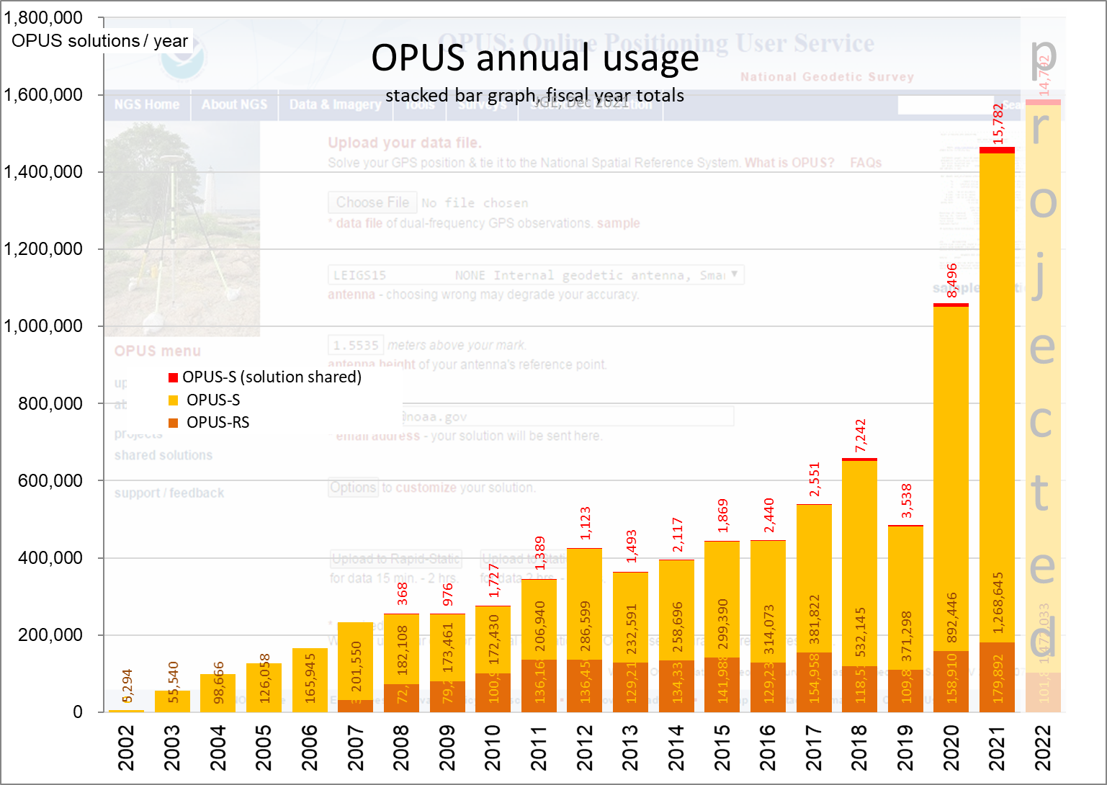

Slide 5
The OPUS-S Interface
Beautiful in its simplicity, the user need only provide:
Their email address.
The antenna model.
The offset to the antenna reference point (ARP).
2- to 48-hours of GPS L1 + L2 data.
In turn, the user receives:
Coordinates accurate to a few centimeters.
5

Slide 6
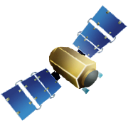

Static: OPUS determines your position with a differential GPS static solution, using hours of data.
This process is repeated four more times from other CORSs.
baseline 5
baseline 4
baseline 1
baseline 3
baseline 2

Slide 7
How Does OPUS-S Work?
The primary steps of OPUS-S processing are:
Prepare and quality control the submitted data.
Estimate a crude point-position.
Compute distances to every available CORS.
Select the five “best” CORSs based upon:
    Being closest to the user’s site.
    Having common satellite visibility with the user data.
    Having more than 80% of the possible data available.
    Having low multipath measures.
    Geometry of CORSs around you
  Complete the single-baseline processing using PAGES.
  Computes median solution and two closest to it then averages those three.
  Generate and email the report to the user.
7

Slide 8
How Does OPUS-S Work?
OPUS-S uses PAGES (Program for Adjustment of GPS Ephemerides) for data processing.
PAGES engine developed by the NGS.
Besides OPUS-S, PAGES is used for OPUS-Projects session processing, orbit production, reference frame definition, network monitoring and many other GPS data processing tasks.
http://geodesy.noaa.gov/GRD/GPS/DOC/toc.html
http://igscb.jpl.nasa.gov/igscb/center/analysis/noaa.acn
8

Slide 9
How Does OPUS-S Work?
OPUS-S modeling highlights:
Satellite coordinates from the International GNSS Service (IGS) precise ephemerides.
http://igscb.jpl.nasa.gov/components/usage.html.
CORS coordinates and hardware histories from the NGS site information data base.
Receiver antenna phase center offsets and variations from the NGS absolute antenna model data base.
http://geodesy.noaa.gov/ANTCAL/.
International Earth Rotation Service (IERS) 2003 solid Earth tide model.
http://www.iers.org/nn_11216/IERS/EN/Publications/TechnicalNotes/tn32.html.
Surface met from a climatological model.
Boehm et al., “Short Note: A global model of pressure and temperature for geodetic applications”,
J. Geod., 2007.
9

Slide 10
How Does OPUS-S Work?
OPUS-S processing highlights:
Everything is “done” in the IGS14 Reference Frame.
SV coordinates are held rigidly fixed.
CORS coordinates are heavily constrained.
Neutral atmosphere (tropo) dry component modeled.
Neutral atmosphere (tropo) wet component estimated.
Double-differenced, ion-free carrier phase observable.
Carrier phase ambiguities are fixed to their integer values where possible; float ambiguities are estimated otherwise.
Individual baselines are processed and the results combined generating mean coordinates and peak-to-peak uncertainties.
10

Slide 11
How Does OPUS-S Work?
Some thoughts on phase ambiguity integer fixing.
The ambiguities, (charged and neutral) atmosphere delays and station heights strongly alias into each other.
There are really only two ways to “break” this aliasing:
Introduce more data.
Introduce additional information.
11

Slide 12
How Does OPUS-S Work?
OPUS-S uses the former strategy.
Depending upon the circumstances, 1- to 2-hours of observations are sufficient to decorrelate the ambiguities, atmosphere and heights allowing reliable estimation of all. Thus the requirement for a minimum of 2-hours in OPUS-S.
As an aside, be aware that while simply having more data helps, it is actually the change in orientation of the satellites over the data span that forces the decorrelation.
12

Slide 13
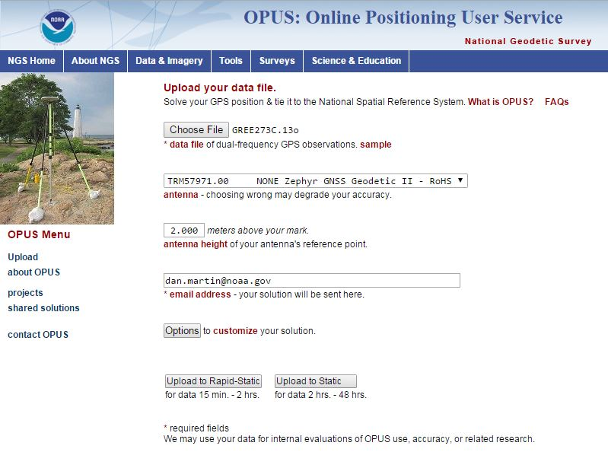
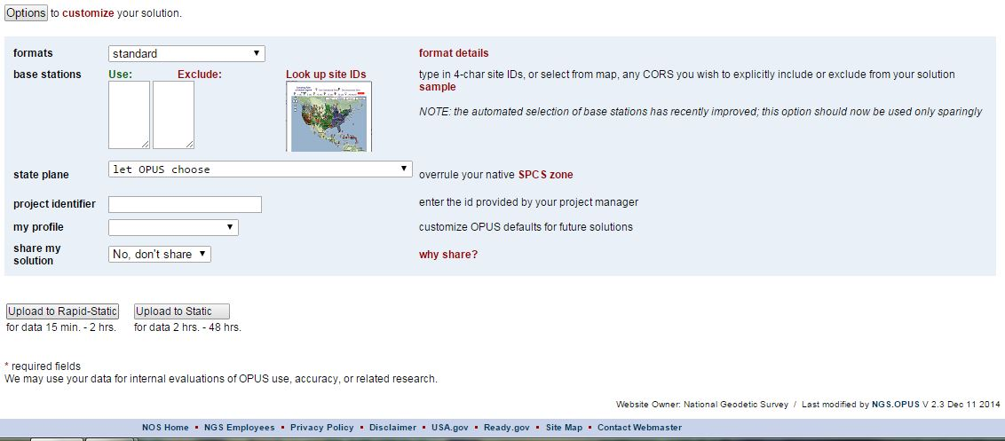
extended solution
GNSS file
antenna
in/exclude CORS
antenna height
SPC zone
project
e-mail
profile
share
OPTIONS
OPUS-RS or OPUS-Static
(15 min-2 hr) (2-48 hr)

Slide 14
Antenna Type, height – easy, right?
Type?
  Verify by looking up in ANTCAL https://geodesy.noaa.gov/ANTCAL/index.xhtml
  Orient the North Reference Point to true north
  Centered over the mark? (check plummet or bubble)
Height?
  Height to what? (antenna ARP, not L1-phase center)
  Fixed-height tripods are easier than slip-legs.
  Vertical, NOT slant-height.
  Is your fixed-height tripod really fixed? (measure!)
14

Slide 15
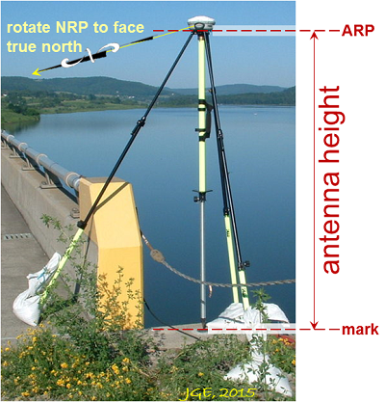
HOW IS THE ANTENNA HEIGHT MEASURED?
The height is measured vertically (NOT the slant height) from the mark to the ARP of the antenna.
The height is measured in meters.
The ARP is almost always the center of the bottom-most, permanently attached, surface of the antenna.
See GPS Antenna Calibration for photo’s and diagrams that show where the ARP is on most antennas:
http://geodesy.noaa.gov/ANTCAL/
If the default height of 0.0000 is entered, OPUS will return the position of the ARP.
15
Notes:
I promised we would talk more about antenna heights.
The height of the antenna is measure vertically from the from the mark, to the Antenna Reference Point which is almost always the center of the bottom-most, permanently attached piece o f the antenna.
Some antennas have a short pipe or extension to them.
If in doubt you can find photo’s and diagrams of each antenna (that we have calibrated) at the URL shown.
So if you leave the antenna height as “0” this will be the height OPUS returns.

Slide 16
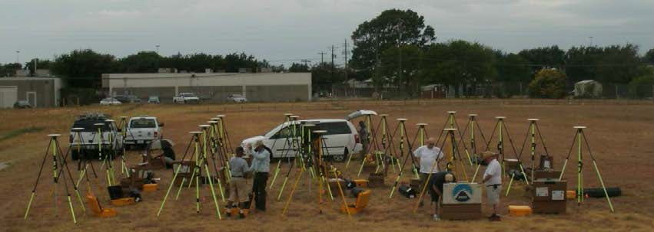
GSVS Equipment Calibration
Calibrated, fixed-height antennas, all identical models
In Texas 2011:
  20 complete sets of equipment (2 parties, 10 sets each)
  Each party observed 10 new stations each day
  20 hours of observation each day
  Project processed with OPUS Projects

Slide 17
Two-meter fixed height pole???
Full antenna recalibration check before survey
Each fixed height tripod height
measured before and after
20 complete sets of equipment -
2 parties (10 sets each)
Each party observe 5 new and 5
repeat stations each day
30 observation days
Project processed with OP
ID | before | after | a - b | avg.
A | 2.0028 | 2.0029 | 0.0001 | 2.0029
B | 2.0019 | 2.0018 | -0.0001 | 2.0018
C | 2.0005 | 2.0002 | -0.0003 | 2.0004
D | 2.0079 | 2.0079 | 0.0000 | 2.0079
E | 2.0011 | 2.0010 | -0.0001 | 2.0010
F | 1.9999 | 1.9998 | -0.0001 | 1.9998
G | 2.0006 | 2.0009 | 0.0003 | 2.0008
H | 2.0016 | 2.0017 | 0.0001 | 2.0017
I | 2.0020 | 2.0020 | 0.0000 | 2.0020
J | 2.0041 | 2.0041 | 0.0000 | 2.0041
K | 2.0003 | 2.0004 | 0.0001 | 2.0003
L | 2.0010 | 2.0007 | -0.0003 | 2.0008
M | 2.0000 | 2.0002 | 0.0002 | 2.0001
N | 1.9964 | 1.9963 | -0.0001 | 1.9963
O | 2.0005 | 2.0005 | 0.0000 | 2.0005
P | 2.0003 | 2.0002 | -0.0001 | 2.0002
Q | 2.0024 | 2.0029 | 0.0005 | 2.0027
R | 1.9999 | 1.9999 | 0.0000 | 1.9999
S | 2.0052 | 2.0052 | 0.0000 | 2.0052
T | 2.0026 | 2.0023 | -0.0003 | 2.0024
U | 2.0031 | 2.0031 | 0.0000 | 2.0031
V | 1.9995 | 1.9995 | 0.0000 | 1.9995
W | 2.0002 | 2.0003 | 0.0001 | 2.0003
X | 2.0020 | 2.0022 | 0.0002 | 2.0021
Y | 2.0053 | 2.0053 | 0.0000 | 2.0053
Z | 2.0016 | 2.0014 | -0.0002 | 2.0015

Slide 18
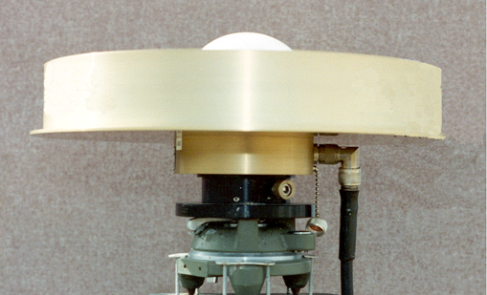
WHY DO I NEED THE ANTENNA TYPE?
The antenna phase centers are located somewhere around here.
phase ctr.
The antenna offsets are the distance between the phase centers and the ARP
ARP
You do not need to know these offsets. They are passed to the processing software through the antenna type
The Antenna Reference Point (ARP) is almost always located in the center of the bottom surface of the antenna.
Incorrect or missing antenna type → big vertical errors
18
Notes:
This is a close up of the last slide. You can see where the ARP is.
When you enter the correct Antenna type OPUS knows the antenna offsets and passes them to the software to determine the ARP
NGS uses the ARP rather than the phase center. The ARP is a known point on the antenna whereas the phase center varies depending on the elevation angle from the antenna to the satellite.

Slide 22
What else can go wrong?
Site
  instability, multi-path, obstructions
Weather
  wild, local troposphere issues?
  space weather: ionospheric issues? https://www.swpc.noaa.gov/
“Truth” (orbits, CORS, etc.)
  Ultra Rapid (immediate), Use as “sanity check”
  Rapid (next-day) about 1700 UTC
    Minimum required for sharing
  Final Precise (≈ 14 days) recommended
    Required for publishing
22

Slide 23
A Quick Example
USER: dan.martin@noaa.gov DATE: December 17, 2020
RINEX FILE: llcz124m.18o TIME: 15:14:13 UTC
SOFTWARE: page5 2008.25 master70.pl 160321 START: 2018/05/04 12:21:00
EPHEMERIS: igs19995.eph [precise] STOP: 2018/05/04 17:12:00
NAV FILE: brdc1240.18n OBS USED: 10773 / 11522 : 93%
ANT NAME: TRM41249.00 NONE # FIXED AMB: 72 / 72 : 100%
ARP HEIGHT: 1.9991 OVERALL RMS: 0.014(m)
REF FRAME: NAD_83(2011)(EPOCH:2010.0000) ITRF2014 (EPOCH:2018.3387)
X: 1375953.713(m) 0.004(m) 1375952.797(m) 0.004(m)
Y: -4377647.163(m) 0.007(m) -4377645.766(m) 0.007(m)
Z: 4415360.116(m) 0.006(m) 4415360.117(m) 0.006(m)
LAT: 44 5 19.75355 0.003(m) 44 5 19.78984 0.003(m)
E LON: 287 26 55.09907 0.002(m) 287 26 55.07862 0.002(m)
W LON: 72 33 4.90093 0.002(m) 72 33 4.92138 0.002(m)
EL HGT: 250.906(m) 0.010(m) 249.752(m) 0.010(m)
ORTHO HGT: 278.358(m) 0.049(m) [NAVD88 (Computed using GEOID18)]
UTM COORDINATES STATE PLANE COORDINATES
UTM (Zone 18) SPC (4400 VT)
Northing (Y) [meters] 4884653.345 176510.512
Easting (X) [meters] 696026.306 495886.797
Convergence [degrees] 1.70423611 -0.03573611
Point Scale 1.00007262 0.99996449
Combined Factor 1.00003328 0.99992515
US NATIONAL GRID DESIGNATOR: 18TXP9602684653(NAD 83)
BASE STATIONS USED
PID DESIGNATION LATITUDE LONGITUDE DISTANCE(m)
AF9563 VCAP VERMONT CAPITAL CORS ARP N441543.106 W0723456.554 19400.1
DN8745 VTRI RICHMOND CORS ARP N442447.726 W0725941.373 50539.4
DL2744 VTMI MIDDLEBURY CORS ARP N435955.025 W0730909.380 49220.7
Here is part of the report for this submission.
FYI, these results differ by 8 mm N, 3 mm E, & 8 mm Up from the accepted position.
Let’s take a look at a few items to gage the validity and quality of the solution
23

Slide 24
A Quick Example
USER: dan.martin@noaa.gov DATE: December 17, 2020
RINEX FILE: llcz124m.18o TIME: 15:14:13 UTC
SOFTWARE: page5 2008.25 master70.pl 160321 START: 2018/05/04 12:21:00
EPHEMERIS: igs19995.eph [precise] STOP: 2018/05/04 17:12:00
NAV FILE: brdc1240.18n OBS USED: 10773 / 11522 : 93%
ANT NAME: TRM41249.00 NONE # FIXED AMB: 72 / 72 : 100%
ARP HEIGHT: 1.9991 OVERALL RMS: 0.014(m)
REF FRAME: NAD_83(2011)(EPOCH:2010.0000) ITRF2014 (EPOCH:2018.3387)
X: 1375953.713(m) 0.004(m) 1375952.797(m) 0.004(m)
Y: -4377647.163(m) 0.007(m) -4377645.766(m) 0.007(m)
Z: 4415360.116(m) 0.006(m) 4415360.117(m) 0.006(m)
LAT: 44 5 19.75355 0.003(m) 44 5 19.78984 0.003(m)
E LON: 287 26 55.09907 0.002(m) 287 26 55.07862 0.002(m)
W LON: 72 33 4.90093 0.002(m) 72 33 4.92138 0.002(m)
EL HGT: 250.906(m) 0.010(m) 249.752(m) 0.010(m)
ORTHO HGT: 278.358(m) 0.049(m) [NAVD88 (Computed using GEOID18)]
UTM COORDINATES STATE PLANE COORDINATES
UTM (Zone 18) SPC (4400 VT)
Northing (Y) [meters] 4884653.345 176510.512
Easting (X) [meters] 696026.306 495886.797
Convergence [degrees] 1.70423611 -0.03573611
Point Scale 1.00007262 0.99996449
Combined Factor 1.00003328 0.99992515
US NATIONAL GRID DESIGNATOR: 18TXP9602684653(NAD 83)
BASE STATIONS USED
PID DESIGNATION LATITUDE LONGITUDE DISTANCE(m)
AF9563 VCAP VERMONT CAPITAL CORS ARP N441543.106 W0723456.554 19400.1
DN8745 VTRI RICHMOND CORS ARP N442447.726 W0725941.373 50539.4
DL2744 VTMI MIDDLEBURY CORS ARP N435955.025 W0730909.380 49220.7
When reviewing your OPUS solution, double check that the information you provided is correct.
24

Slide 25
A Quick Example
USER: dan.martin@noaa.gov DATE: December 17, 2020
RINEX FILE: llcz124m.18o TIME: 15:14:13 UTC
SOFTWARE: page5 2008.25 master70.pl 160321 START: 2018/05/04 12:21:00
EPHEMERIS: igs19995.eph [precise] STOP: 2018/05/04 17:12:00
NAV FILE: brdc1240.18n OBS USED: 10773 / 11522 : 93%
ANT NAME: TRM41249.00 NONE # FIXED AMB: 72 / 72 : 100%
ARP HEIGHT: 1.9991 OVERALL RMS: 0.014(m)
REF FRAME: NAD_83(2011)(EPOCH:2010.0000) ITRF2014 (EPOCH:2018.3387)
X: 1375953.713(m) 0.004(m) 1375952.797(m) 0.004(m)
Y: -4377647.163(m) 0.007(m) -4377645.766(m) 0.007(m)
Z: 4415360.116(m) 0.006(m) 4415360.117(m) 0.006(m)
LAT: 44 5 19.75355 0.003(m) 44 5 19.78984 0.003(m)
E LON: 287 26 55.09907 0.002(m) 287 26 55.07862 0.002(m)
W LON: 72 33 4.90093 0.002(m) 72 33 4.92138 0.002(m)
EL HGT: 250.906(m) 0.010(m) 249.752(m) 0.010(m)
ORTHO HGT: 278.358(m) 0.049(m) [NAVD88 (Computed using GEOID18)]
UTM COORDINATES STATE PLANE COORDINATES
UTM (Zone 18) SPC (4400 VT)
Northing (Y) [meters] 4884653.345 176510.512
Easting (X) [meters] 696026.306 495886.797
Convergence [degrees] 1.70423611 -0.03573611
Point Scale 1.00007262 0.99996449
Combined Factor 1.00003328 0.99992515
US NATIONAL GRID DESIGNATOR: 18TXP9602684653(NAD 83)
BASE STATIONS USED
PID DESIGNATION LATITUDE LONGITUDE DISTANCE(m)
AF9563 VCAP VERMONT CAPITAL CORS ARP N441543.106 W0723456.554 19400.1
DN8745 VTRI RICHMOND CORS ARP N442447.726 W0725941.373 50539.4
DL2744 VTMI MIDDLEBURY CORS ARP N435955.025 W0730909.380 49220.7
Check the quality control measures provided:
OBS USED > 90%
# FIXED AMB > 50% (80%)
OVERALL RMS < 3 cm
peak-to-peak < 5 cm
Which Ephemeris was used?
25

Slide 26
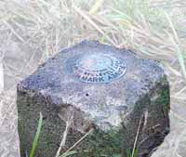
peak-to-peaks:
a box touching
all 3 baselines
φ
=
baseline 2
λ
CORS baseline 1
=
h
position:
average of 3 most
coherent baselines
baseline 3
=

Slide 27
peak-to-peaks:
a box touching
all 3 baselines
φ
=
baseline 2
λ
CORS baseline 1
=
h
position:
average of 3 most
coherent baselines
baseline 3
=

Slide 28
The Extended Report
BASE STATION INFORMATION
STATION NAME: p376 a 2 (EOLARESVR_OR2004; Salem, OR United States)
MONUMENT: NO DOMES NUMBER
XYZ -2469806.7634 -3788348.6049 4482853.4377 MON @ 1997.0000 (M)
XYZ -0.0141 0.0030 -0.0043 VEL (M/YR)
NEU -0.0000 0.0000 0.0083 MON TO ARP (M)
NEU 0.0009 0.0009 0.1068 ARP TO L1 PHASE CENTER (M)
NEU 0.0002 0.0017 0.1251 ARP TO L2 PHASE CENTER (M)
XYZ -0.1715 0.0365 -0.0523 VEL TIMES 12.1597 YRS
XYZ -0.0032 -0.0049 0.0059 MON TO ARP
XYZ -0.0402 -0.0633 0.0761 ARP TO L1 PHASE CENTER
XYZ -2469806.9782 -3788348.6366 4482853.4674 L1 PHS CEN @ 2009.1596
XYZ 0.0000 0.0000 0.0000 + XYZ ADJUSTMENTS
XYZ -2469806.9782 -3788348.6366 4482853.4674 NEW L1 PHS CEN @ 2009.1596
XYZ -2469806.9381 -3788348.5733 4482853.3913 NEW ARP @ 2009.1596
XYZ -2469806.9348 -3788348.5684 4482853.3855 NEW MON @ 2009.1596
LLH 44 56 28.32921 236 53 51.83975 180.9607 NEW L1 PHS CEN @ 2009.1596
LLH 44 56 28.32918 236 53 51.83971 180.8539 NEW ARP @ 2009.1596
LLH 44 56 28.32918 236 53 51.83971 180.8456 NEW MON @ 2009.1596
STATION NAME: mcso a 1 (MARION CNTY COOP; Salem, Oregon, U.S.A.)
MONUMENT: NO DOMES NUMBER
XYZ -2458668.9460 -3792427.4770 4485327.2930 MON @ 1997.0000 (M)
XYZ -0.0131 0.0018 -0.0047 VEL (M/YR)
NEU 0.0000 0.0000 0.0000 MON TO ARP (M)
NEU 0.0025 0.0013 0.1065 ARP TO L1 PHASE CENTER (M)
NEU -0.0007 0.0013 0.1254 ARP TO L2 PHASE CENTER (M)
XYZ -0.1593 0.0219 -0.0572 VEL TIMES 12.1597 YRS
XYZ 0.0000 0.0000 0.0000 MON TO ARP
XYZ -0.0389 -0.0624 0.0770 ARP TO L1 PHASE CENTER
XYZ -2458669.1442 -3792427.5176 4485327.3129 L1 PHS CEN @ 2009.1596
XYZ -0.0000 -0.0000 -0.0000 + XYZ ADJUSTMENTS
XYZ -2458669.1442 -3792427.5176 4485327.3129 NEW L1 PHS CEN @ 2009.1596
XYZ -2458669.1053 -3792427.4551 4485327.2358 NEW ARP @ 2009.1596
XYZ -2458669.1053 -3792427.4551 4485327.2358 NEW MON @ 2009.1596
LLH 44 58 25.71729 237 2 39.30118 52.9227 NEW L1 PHS CEN @ 2009.1596
LLH 44 58 25.71721 237 2 39.30112 52.8162 NEW ARP @ 2009.1596
LLH 44 58 25.71721 237 2 39.30112 52.8162 NEW MON @ 2009.1596
If the extended report option was selected, next you’ll see the BASE STATION section.
Here, the components contributing to the base stations’ coordinates are shown in detail. These and the following information are expressed in the ITRF currently in use.
28

Slide 29
The Extended Report
REMOTE STATION INFORMATION
STATION NAME: corv 1
MONUMENT: NO DOMES NUMBER
XYZ -2498423.7849 -3802820.9571 4454737.7025 MON @ 2009.1595 (M)
NEU -0.0014 0.0010 1.5210 MON TO ARP (M)
NEU 0.0014 -0.0010 0.1089 ARP TO L1 PHASE CENTER (M)
NEU 0.0010 0.0005 0.1274 ARP TO L2 PHASE CENTER (M)
XYZ -0.5945 -0.9067 1.0667 MON TO ARP
XYZ -0.0429 -0.0635 0.0774 ARP TO L1 PHASE CENTER
XYZ -2498424.4223 -3802821.9273 4454738.8466 L1 PHS CEN @ 2009.1596
BASELINE NAME: p376 corv
XYZ 0.4450 1.0132 -0.9754 + XYZ ADJUSTMENTS
XYZ -2498423.9773 -3802820.9141 4454737.8713 NEW L1 PHS CEN @ 2009.1596
XYZ -2498423.9344 -3802820.8506 4454737.7938 NEW ARP @ 2009.1596
XYZ -2498423.3399 -3802819.9439 4454736.7271 NEW MON @ 2009.1596
LLH 44 35 7.92601 236 41 43.42229 107.2518 NEW L1 PHS CEN @ 2009.1596
LLH 44 35 7.92597 236 41 43.42234 107.1429 NEW ARP @ 2009.1596
LLH 44 35 7.92601 236 41 43.42229 105.6219 NEW MON @ 2009.1596
BASELINE NAME: mcso corv
XYZ 0.4343 1.0202 -0.9746 + XYZ ADJUSTMENTS
XYZ -2498423.9880 -3802820.9071 4454737.8721 NEW L1 PHS CEN @ 2009.1596
XYZ -2498423.9451 -3802820.8436 4454737.7946 NEW ARP @ 2009.1596
XYZ -2498423.3506 -3802819.9369 4454736.7279 NEW MON @ 2009.1596
LLH 44 35 7.92603 236 41 43.42171 107.2523 NEW L1 PHS CEN @ 2009.1596
LLH 44 35 7.92599 236 41 43.42176 107.1434 NEW ARP @ 2009.1596
LLH 44 35 7.92603 236 41 43.42171 105.6224 NEW MON @ 2009.1596
BASELINE NAME: stay corv
XYZ 0.4437 1.0153 -0.9543 + XYZ ADJUSTMENTS
XYZ -2498423.9786 -3802820.9120 4454737.8923 NEW L1 PHS CEN @ 2009.1596
XYZ -2498423.9357 -3802820.8485 4454737.8149 NEW ARP @ 2009.1596
XYZ -2498423.3412 -3802819.9418 4454736.7482 NEW MON @ 2009.1596
LLH 44 35 7.92653 236 41 43.42219 107.2658 NEW L1 PHS CEN @ 2009.1596
LLH 44 35 7.92648 236 41 43.42224 107.1569 NEW ARP @ 2009.1596
LLH 44 35 7.92653 236 41 43.42219 105.6359 NEW MON @ 2009.1596
Near the top, in light blue, you can see the pieces need to compute the estimated (NEW) L1 phase center.
Below, in light green and yellow, are the three estimates from the each baseline.
XYZ -2498424.4223 -3802821.9273 4454738.8466 L1 PHS CEN @ 2009.1596
XYZ 0.4450 1.0132 -0.9754 + XYZ ADJUSTMENTS
XYZ -2498423.9773 -3802820.9141 4454737.8713 NEW L1 PHS CEN @ 2009.1596
XYZ -2498423.3399 -3802819.9439 4454736.7271 NEW MON @ 2009.1596
XYZ -2498423.3506 -3802819.9369 4454736.7279 NEW MON @ 2009.1596
XYZ -2498423.3412 -3802819.9418 4454736.7482 NEW MON @ 2009.1596
29

Slide 30
The Extended Report
POST-FIT RMS BY SATELLITE VS. BASELINE
OVERALL 03 06 07 08 10 13 16 19
p376-corv| 0.009 0.010 0.016 ... 0.007 0.014 0.005 0.015 0.009
20 23 25 27 28
p376-corv| ... 0.008 0.005 ... 0.010
OVERALL 03 06 07 08 10 13 16 19
mcso-corv| 0.009 0.010 0.014 ... 0.010 0.011 0.006 0.015 0.012
20 23 25 27 28
mcso-corv| ... 0.008 0.005 ... 0.010
OVERALL 03 06 07 08 10 13 16 19
stay-corv| 0.010 0.014 0.016 ... 0.009 0.014 0.006 0.013 0.012
20 23 25 27 28
stay-corv| ... 0.011 0.005 ... 0.012
OBS BY SATELLITE VS. BASELINE
OVERALL 03 06 07 08 10 13 16 19
p376-corv| 2000 238 237 ... 238 169 238 99 187
20 23 25 27 28
p376-corv| ... 227 238 ... 129
OVERALL 03 06 07 08 10 13 16 19
mcso-corv| 1973 238 234 ... 238 169 238 93 185
20 23 25 27 28
mcso-corv| ... 211 238 ... 129
OVERALL 03 06 07 08 10 13 16 19
stay-corv| 2011 238 238 ... 238 169 238 99 199
20 23 25 27 28
stay-corv| ... 229 238 ... 125
Following the Bluebook information are solution statistics and observation counts in tabular form ordered by satellite (rows) and baseline (columns)…
30

Slide 31
The Extended Report
The state plane coordinates expressed using the international foot or US Survey foot (depending on state legislation) rather than meters …
STATE PLANE COORDINATES - U.S. Survey Foot
SPC (4400 VT)
Northing (Y) [feet] 579101.571
Easting (X) [feet] 1626921.933
Convergence [degrees] -0.03573611
Point Scale 0.99996449
Combined Factor 0.99992515
31

Slide 32
The Extended Report
********** New Reference Frame Preview **********
We are replacing the nation’s NAD 83 and NAVD 88 datums, to improve access and accuracy of
the National Spatial Reference System. More at https://geodesy.noaa.gov/datums/newdatums/
Below are approximate coordinates for this solution in the new frames:
APPROX ORTHO HGT: 277.974 (m) [PROTOTYPE (Computed using xGeoid19B,GRS80,ITRF2014)]
32

Slide 33
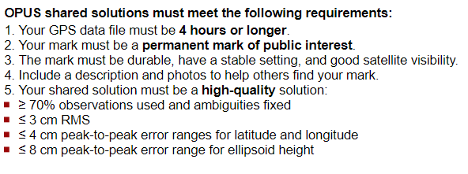
Sharing….

Slide 34
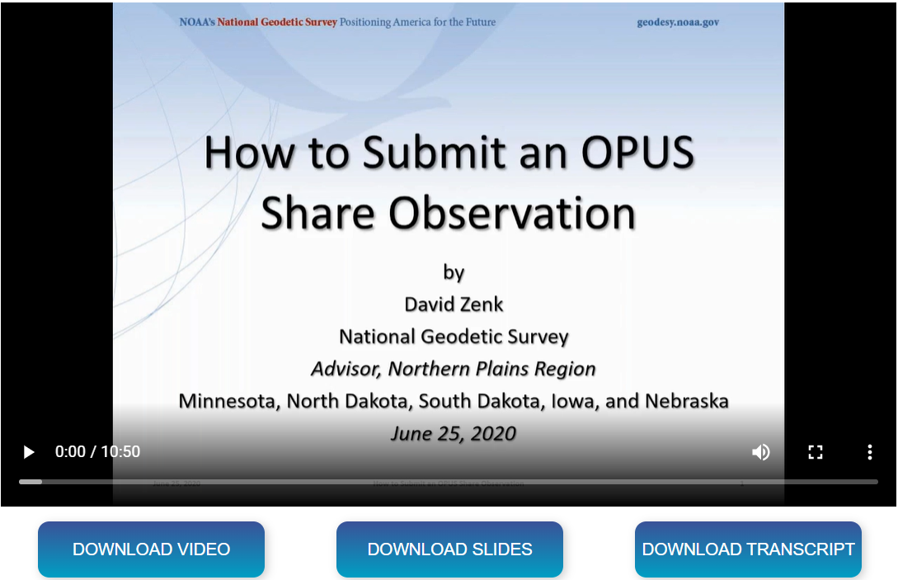
How to Submit an OPUS Share Observation Tutorial https://geodesy.noaa.gov/corbin/class_description/opus-share-tutorial/

Slide 35
The OPUS-RS Interface
http://geodesy.noaa.gov/OPUS/
The same interface is used except one clicks the “Upload to RAPID-STATIC” button instead.
35

Slide 36
How Does OPUS-RS Work?
OPUS-RS uses the RSGPS program which was developed specifically for this purpose.
Like OPUS-S, OPUS-RS uses state-of-the-art models, but the strategy to fix phase ambiguities to their integer values differs.
To fix integers, OPUS-RS introduces more information:
Pseudorange and carrier phase.
Uses P1 and P2 as well as L1 and L2 obs
More reference stations if possible.
36

Slide 37
How Does OPUS-RS Work?
OPUS-RS selects three to nine “best” CORS based upon:
    Having common satellite visibility with the user data.
    Having distances from the user’s site <250 km.
This is shown here graphically.
The star represents the user’s
site. The triangles are CORS.
No CORS farther than 250 km
from the user’s site will be
included.
The three CORS minimum is shown.
No more than nine are used.
s
>250km
250km
Choi, 2010, personal communication.
37

Slide 38
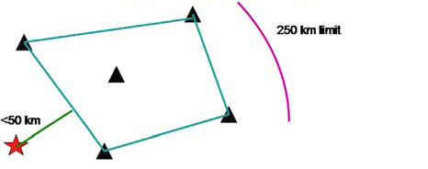
How Does OPUS-RS Work?
In addition, user’s site must be no more than 50 km from the (convex) polygon created by the selected CORS.
Again in this figure, the star represents the user’s site; the
triangles are CORS. Five CORS and their resulting polygon are shown in this example.
If the user’s site, the star, is
more than 50 km outside
this polygon, alternate
CORS will be considered.
If none can be found,
the processing will abort.
Schwarz et al., “Accuracy assessment of the National Geodetic Survey's OPUS-RS utility”, 2009, GPS Solutions, 13(2), 119-132.
38

Slide 39


Rapid-static: OPUS first creates an atmospheric delay model from surrounding CORS data.
Your position is then quickly determined by differential GPS static solution.

Slide 40
A Quick Example
USER: mark.schenewerk@noaa.gov DATE: April 01, 2010
RINEX FILE: corv059f.09o TIME: 16:17:51 UTC
SOFTWARE: rsgps 1.35 RS11.prl 1.57 START: 2009/02/28 05:00:00
EPHEMERIS: igs15206.eph [precise] STOP: 2009/02/28 06:59:30
NAV FILE: brdc0590.09n OBS USED: 5652 / 11169 : 51%
ANT NAME: ASH700936C_M QUALITY IND. 48.23/108.85
ARP HEIGHT: 1.521 NORMALIZED RMS: 0.280
REF FRAME: NAD_83(CORS96)(EPOCH:2002.0000) ITRF00 (EPOCH:2009.15959)
X: -2498422.589(m) 0.015(m) -2498423.330(m) 0.015(m)
Y: -3802821.147(m) 0.012(m) -3802819.929(m) 0.012(m)
Z: 4454736.644(m) 0.021(m) 4454736.717(m) 0.021(m)
LAT: 44 35 7.91061 0.004(m) 44 35 7.92619 0.004(m)
E LON: 236 41 43.48069 0.011(m) 236 41 43.42230 0.011(m)
W LON: 123 18 16.51931 0.011(m) 123 18 16.57770 0.011(m)
EL HGT: 105.986(m) 0.026(m) 105.602(m) 0.026(m)
ORTHO HGT: 128.517(m) 0.030(m) [NAVD88 (Computed using GEOID09)]
UTM COORDINATES STATE PLANE COORDINATES
UTM (Zone 10) SPC (3601 OR N)
Northing (Y) [meters] 4936954.909 105971.559
Easting (X) [meters] 475821.309 2277335.372
Convergence [degrees] -0.21381414 -1.98897509
Point Scale 0.99960719 0.99994603
Combined Factor 0.99959058 0.99992942
US NATIONAL GRID DESIGNATOR: 10TDQ7582136954(NAD 83)
BASE STATIONS USED
PID DESIGNATION LATITUDE LONGITUDE DISTANCE(m)
DH4503 P376 EOLARESVR_OR2004 CORS ARP N445628.313 W1230608.100 42648.2
DG5352 STAY STAYTON COOP CORS ARP N444950.530 W1224915.036 47030.9
DE6258 MCSO MARION CNTY COOP CORS ARP N445825.701 W1225720.639 51226.8
DI7529 P367 NEWPRTAIR_OR2007 CORS ARP N443506.870 W1240341.598 60113.5
⁞
Shown here is part of the OPUS-RS report for the same CORV data discussed earlier.
The results differ by
2.4 cm horizontally and 0.2 cm vertically from the accepted position projected to the epoch of the data.
40

Slide 41
A Quick Example
USER: mark.schenewerk@noaa.gov DATE: April 01, 2010
RINEX FILE: corv059f.09o TIME: 16:17:51 UTC
SOFTWARE: rsgps 1.35 RS11.prl 1.57 START: 2009/02/28 05:00:00
EPHEMERIS: igs15206.eph [precise] STOP: 2009/02/28 06:59:30
NAV FILE: brdc0590.09n OBS USED: 5652 / 11169 : 51%
ANT NAME: ASH700936C_M QUALITY IND. 48.23/108.85
ARP HEIGHT: 1.521 NORMALIZED RMS: 0.280
REF FRAME: NAD_83(CORS96)(EPOCH:2002.0000) ITRF00 (EPOCH:2009.15959)
X: -2498422.589(m) 0.015(m) -2498423.330(m) 0.015(m)
Y: -3802821.147(m) 0.012(m) -3802819.929(m) 0.012(m)
Z: 4454736.644(m) 0.021(m) 4454736.717(m) 0.021(m)
LAT: 44 35 7.91061 0.004(m) 44 35 7.92619 0.004(m)
E LON: 236 41 43.48069 0.011(m) 236 41 43.42230 0.011(m)
W LON: 123 18 16.51931 0.011(m) 123 18 16.57770 0.011(m)
EL HGT: 105.986(m) 0.026(m) 105.602(m) 0.026(m)
ORTHO HGT: 128.517(m) 0.030(m) [NAVD88 (Computed using GEOID09)]
UTM COORDINATES STATE PLANE COORDINATES
UTM (Zone 10) SPC (3601 OR N)
Northing (Y) [meters] 4936954.909 105971.559
Easting (X) [meters] 475821.309 2277335.372
Convergence [degrees] -0.21381414 -1.98897509
Point Scale 0.99960719 0.99994603
Combined Factor 0.99959058 0.99992942
US NATIONAL GRID DESIGNATOR: 10TDQ7582136954(NAD 83)
BASE STATIONS USED
PID DESIGNATION LATITUDE LONGITUDE DISTANCE(m)
DH4503 P376 EOLARESVR_OR2004 CORS ARP N445628.313 W1230608.100 42648.2
DG5352 STAY STAYTON COOP CORS ARP N444950.530 W1224915.036 47030.9
DE6258 MCSO MARION CNTY COOP CORS ARP N445825.701 W1225720.639 51226.8
DI7529 P367 NEWPRTAIR_OR2007 CORS ARP N443506.870 W1240341.598 60113.5
⁞
Note that the solution quality measures are slightly different.
OBS USED > 50% (90%)
QUALITY IND. > 3
NORM. RMS ≈ 1
Uncertainties < 5 cm
The uncertainties are standard deviations
from the solution, not
the peak-to-peak values reported by OPUS-S.
OBS USED: 5652 / 11169 : 51%
QUALITY IND. 48.23/108.85
NORMALIZED RMS: 0.280
41

Slide 42

A Quick Example
USER: mark.schenewerk@noaa.gov DATE: April 01, 2010
RINEX FILE: corv059f.09o TIME: 16:17:51 UTC
SOFTWARE: rsgps 1.35 RS11.prl 1.57 START: 2009/02/28 05:00:00
EPHEMERIS: igs15206.eph [precise] STOP: 2009/02/28 06:59:30
NAV FILE: brdc0590.09n OBS USED: 5652 / 11169 : 51%
ANT NAME: ASH700936C_M QUALITY IND. 48.23/108.85
ARP HEIGHT: 1.521 NORMALIZED RMS: 0.280
REF FRAME: NAD_83(CORS96)(EPOCH:2002.0000) ITRF00 (EPOCH:2009.15959)
X: -2498422.589(m) 0.015(m) -2498423.330(m) 0.015(m)
Y: -3802821.147(m) 0.012(m) -3802819.929(m) 0.012(m)
Z: 4454736.644(m) 0.021(m) 4454736.717(m) 0.021(m)
LAT: 44 35 7.91061 0.004(m) 44 35 7.92619 0.004(m)
E LON: 236 41 43.48069 0.011(m) 236 41 43.42230 0.011(m)
W LON: 123 18 16.51931 0.011(m) 123 18 16.57770 0.011(m)
EL HGT: 105.986(m) 0.026(m) 105.602(m) 0.026(m)
ORTHO HGT: 128.517(m) 0.030(m) [NAVD88 (Computed using GEOID09)]
UTM COORDINATES STATE PLANE COORDINATES
UTM (Zone 10) SPC (3601 OR N)
Northing (Y) [meters] 4936954.909 105971.559
Easting (X) [meters] 475821.309 2277335.372
Convergence [degrees] -0.21381414 -1.98897509
Point Scale 0.99960719 0.99994603
Combined Factor 0.99959058 0.99992942
US NATIONAL GRID DESIGNATOR: 10TDQ7582136954(NAD 83)
BASE STATIONS USED
PID DESIGNATION LATITUDE LONGITUDE DISTANCE(m)
DH4503 P376 EOLARESVR_OR2004 CORS ARP N445628.313 W1230608.100 42648.2
DG5352 STAY STAYTON COOP CORS ARP N444950.530 W1224915.036 47030.9
DE6258 MCSO MARION CNTY COOP CORS ARP N445825.701 W1225720.639 51226.8
DI7529 P367 NEWPRTAIR_OR2007 CORS ARP N443506.870 W1240341.598 60113.5
⁞
Although the quality indices, normalized RMS and uncertainties are OK, the percentage of observations used gives this solution a .
42
Notes:
On the OPUS-RS datasheet, only two entries have changed:
The name and version of the processing program
The number of fixed ambiguities has gone away, since LAMBDA fixes all the ambiguities. In its place are the quality indicators from the network and rover runs of RSGPS. The quality indicator in each run is the average of the W-ratio at the last three epochs. The W-ratio is a statistical measure of how well the best set of integer ambiguities is separated from the second best set. The W-ratio has been shown to be distributed as Student’s t. We like to see both of these numbers greater than 3.0. If the second number (the quality indicator for the rover solution) is less than 1.0, RSGPS may have been unable to find the correct integer ambiguities and the solution may be in error by many centimeters.

Slide 43
The Extended Report
Of necessity, the OPUS-RS extended report is larger than the corresponding OPUS-S solution. Too large to be conveniently shown here. But while seemingly intimidating, the OPUS-RS extended report sections are basically the same as those in the OPUS-S extended report.
Some additional sections include:
A covariance matrix for the reference-station-only solution.
A correlation as well as a covariance matrix.
Various Dilutions Of Precision (DOPs).
43

Slide 44
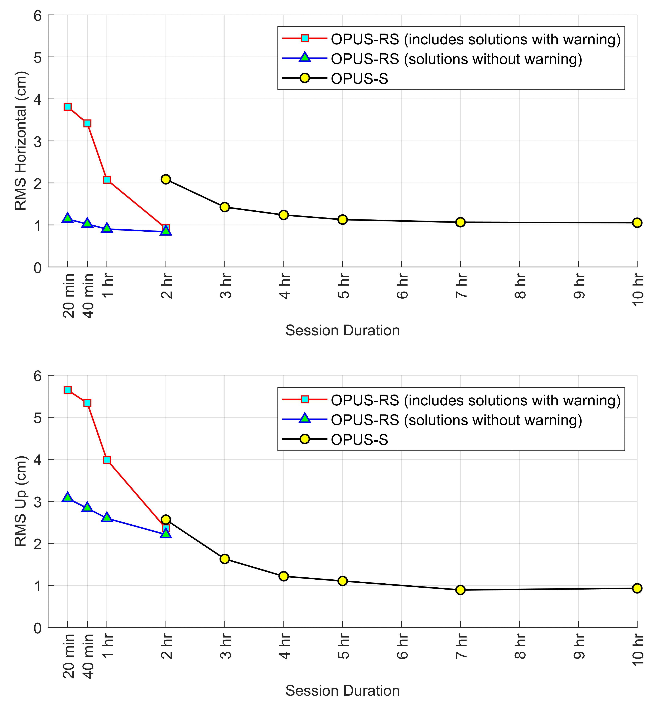
How Good Can I Do With OPUS?
Gillins, D.T., Kerr, D., and Weaver, B. (2019). "Evaluation of the Online Positioning User Service for Processing Static GPS Surveys: OPUS-Projects, OPUS-S, OPUS-Net, and OPUS-RS," ASCE Journal of Surveying Engineering, 145(3): 05019002
44
Notes:
Studies performed in 1999 indicate that the standard error of computed horizontal coordinates, expressed in centimeters, may be approximated by the mathematical expression: one divided by the square root of the length of the observing session in hours. Similarly, these studies indicate that the standard error of computed vertical coordinates, again in centimeters, may be approximated by the mathematical expression: 3.7 divided by the square root of the length of the observing session in hours. Newer studies of achievable accuracies are now being conducted, and these studies indicate that the same level of accuracy can be obtained with shorter observing sessions, when the atmospheric conditions measured at CORS sites are interpolated to the location where the user collected his/her data.

Slide 45
OPUS static vs. rapid static
 | static | rapid static
input (dual-frequency GPS) | 2-48 hours | 15 minutes-2 hours
output | normal, extended, XML datasheet, project | normal, extended, XML
accuracy (95%confidence) | 1-2 cm horizontal 2-4 cm ellipsoidal height | 1-2 cm horizontal 4-6 cm ellipsoidal height
network geometry | 3 CORS, preferably within 1000 km of rover | 3-9 CORS, surrounding & within 250 km of rover
availability | global | > 90% of CONUS (subject to CORS configuration)
45

Slide 46

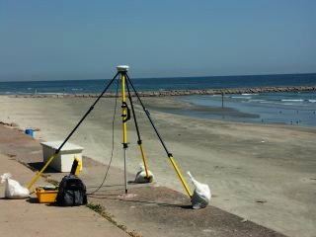

G.I.G.O.
We still need surveyors. We hope OPUS can help, but it can’t do your job for you or make bad data good.
Follow your project’s
specifications.
Use best practices and
careful field procedures.
Redundant Observations.
Good coordinates come
from good data.
http://gis.larc.nasa.gov/
Notes:
One thing that I feel I need to emphasize, is that, as with any of our tools, the responsibility for collecting good data is still the job of the surveyor. You need to follow your project specifications, use best practices while collecting data in the field, and select marks that are well suited to satellite observations. Remember Garbage In - Garbage Out. Good coordinates come from good data. NGS software cannot make bad data good.

Slide 47
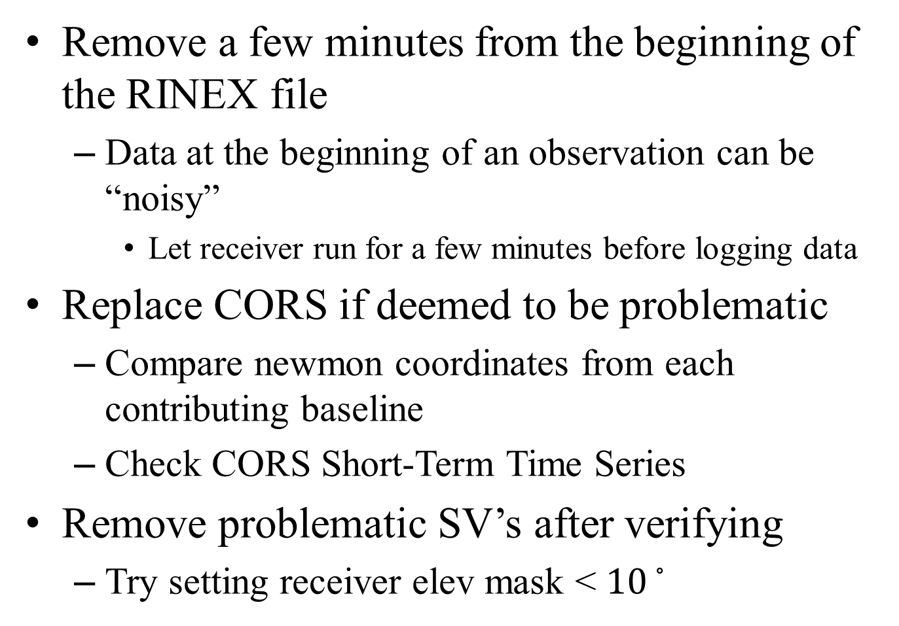
How to Improve Solutions
Remove a few minutes from the beginning of the RINEX file
  Data at the beginning of an observation can be “noisy”
    Let receiver run for a few minutes before logging data
Replace CORS if deemed to be problematic
  Compare newmon coordinates from each contributing baseline
  Check CORS Short-Term Time Series
Remove problematic SV’s after verifying
  Try setting receiver elev mask < ${10}^{◦}$

Slide 48
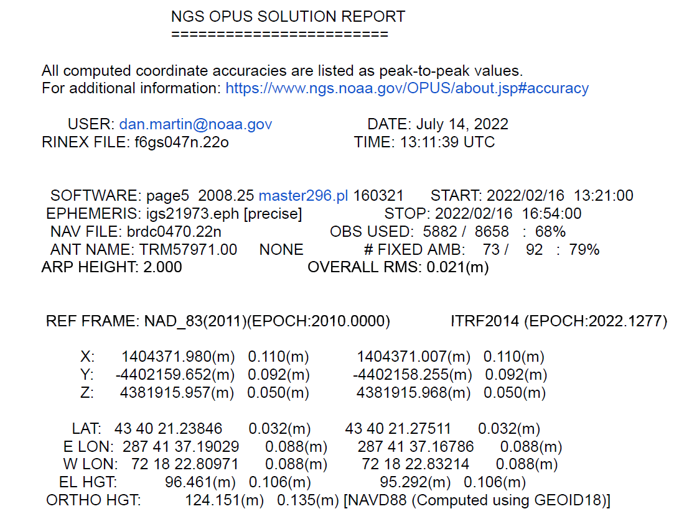

Slide 49
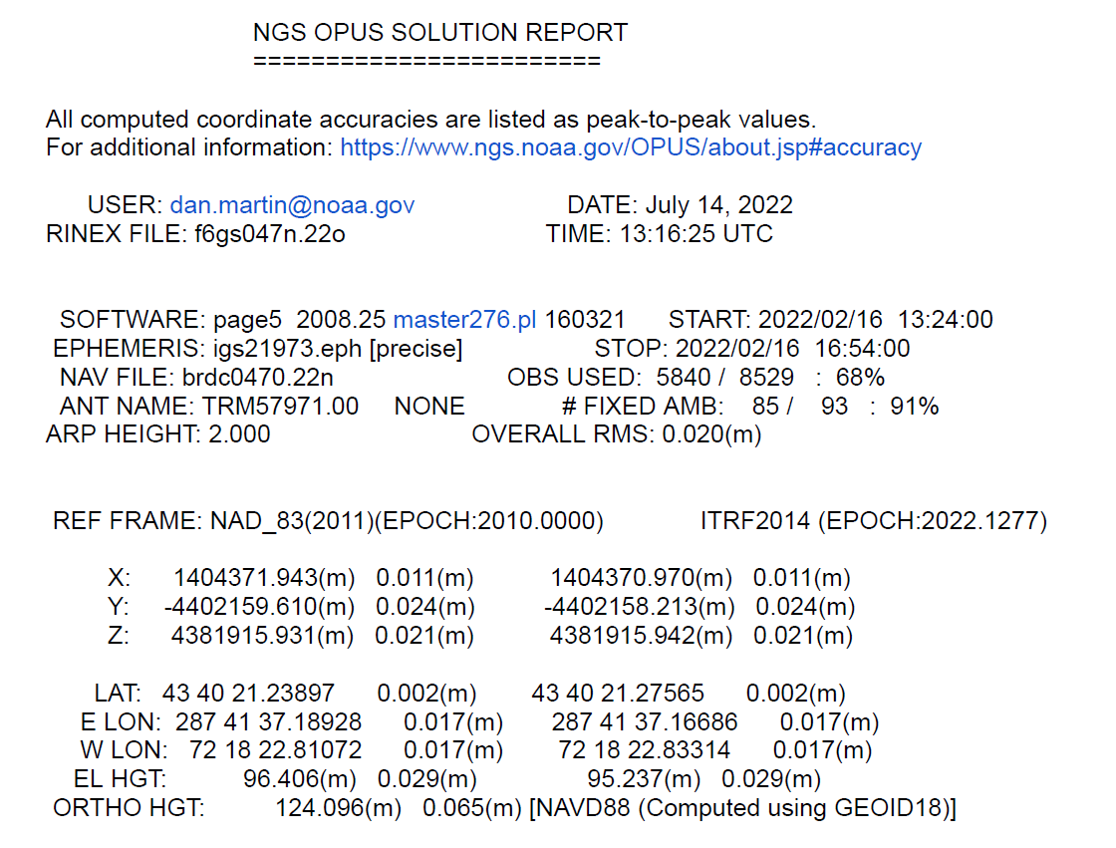
Removed 3 minutes of data from RINEX File
68%
79%

Slide 50
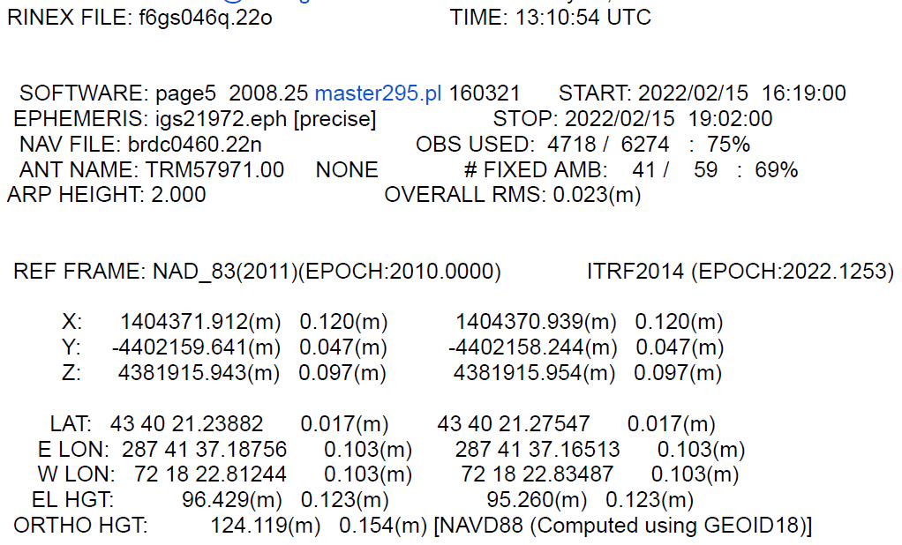

Slide 51
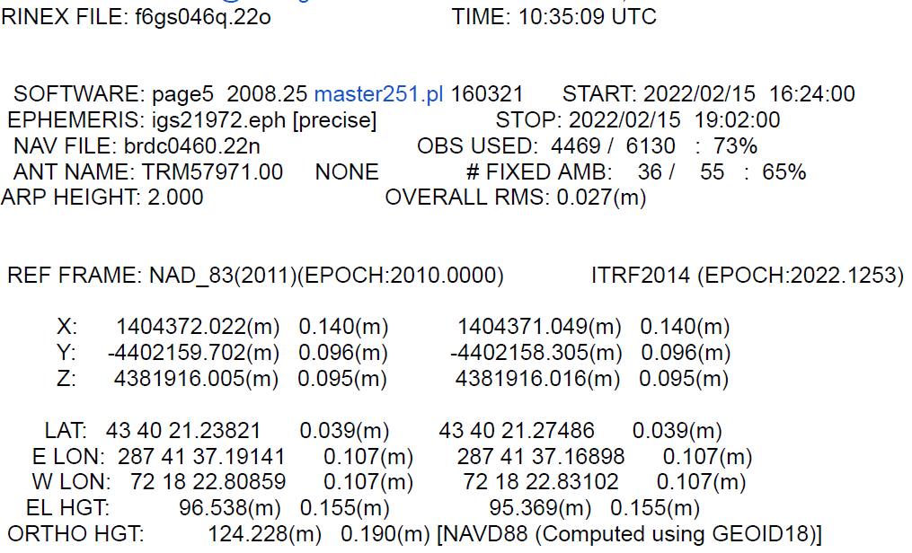
Removed 5 minutes of data from RINEX File
75%
69%
.023(m)
No improvement in quality indicators….they actually get worse!!

Slide 52
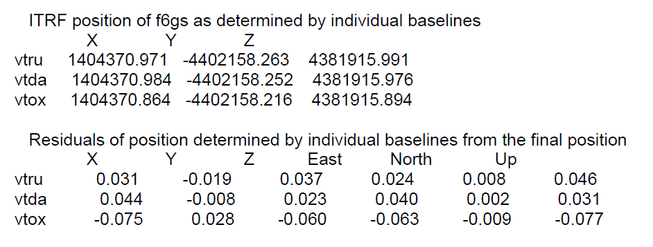

Slide 53
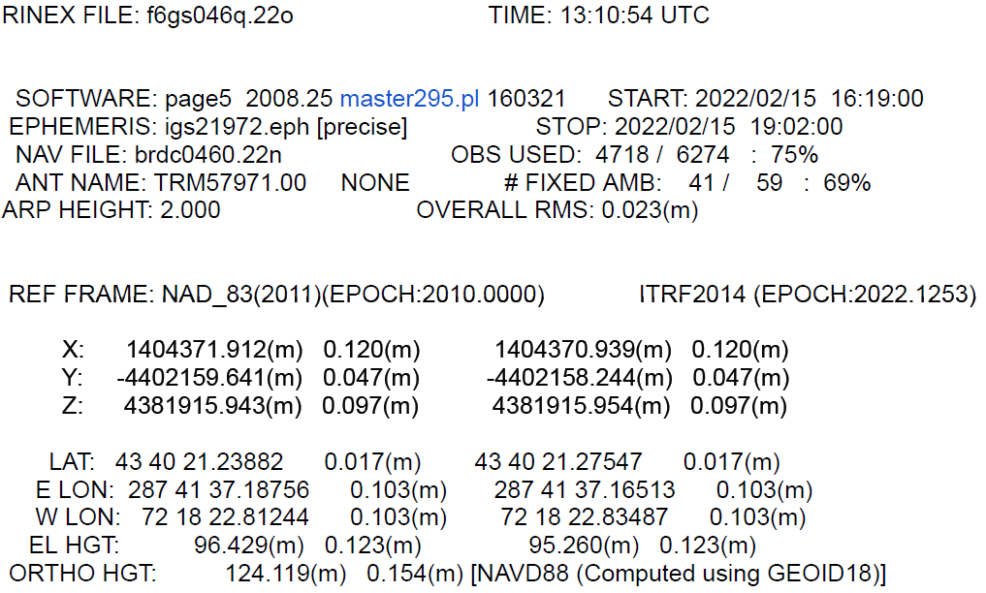
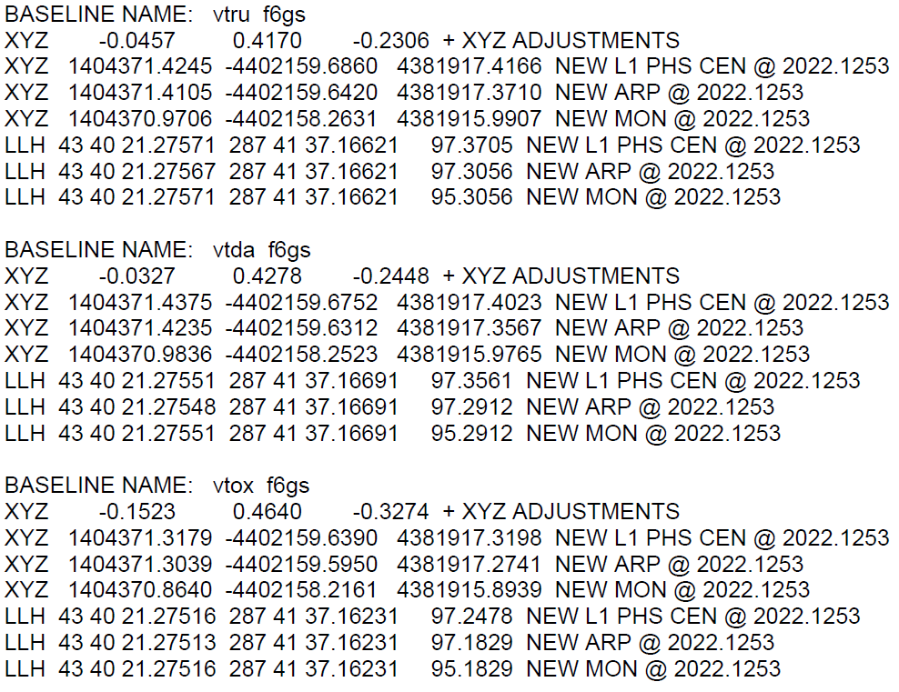
Try substituting a different CORS for VTOX

Slide 54
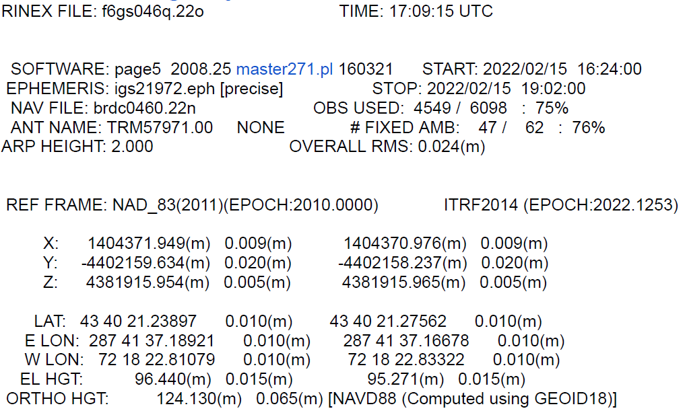
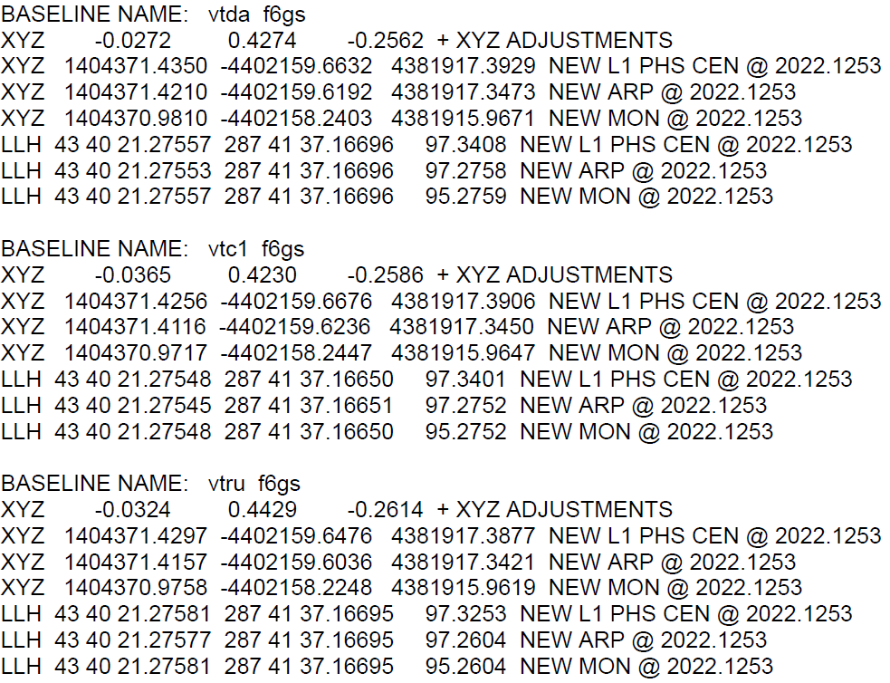
VTC1 Substituted for VTOX

Slide 55
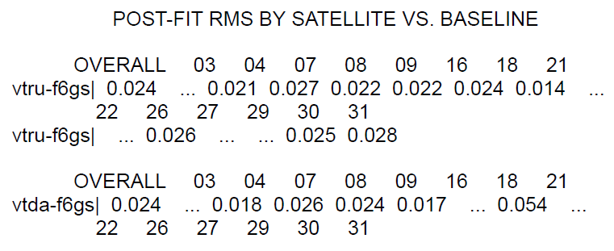
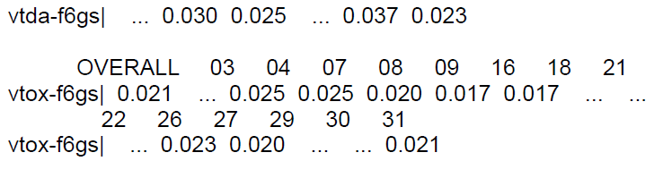

Slide 56
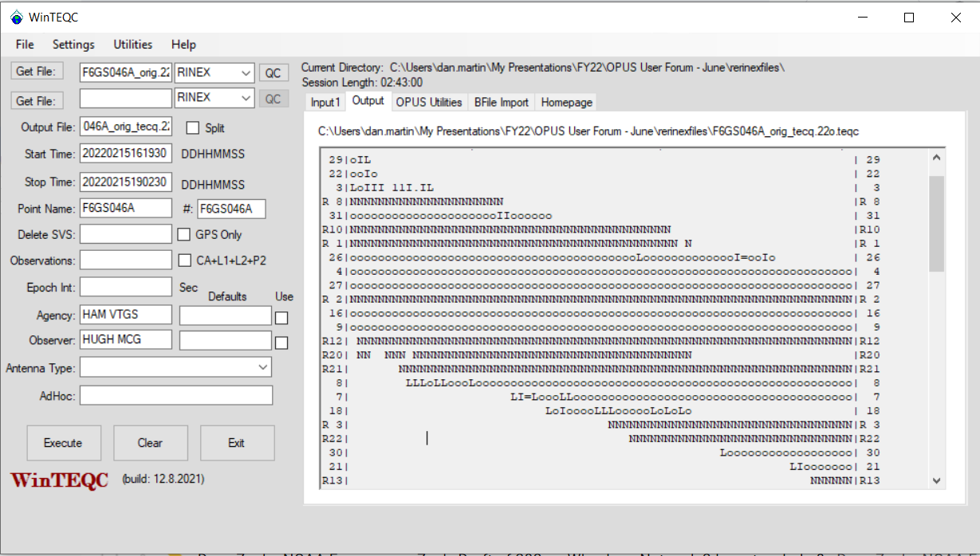

Slide 57
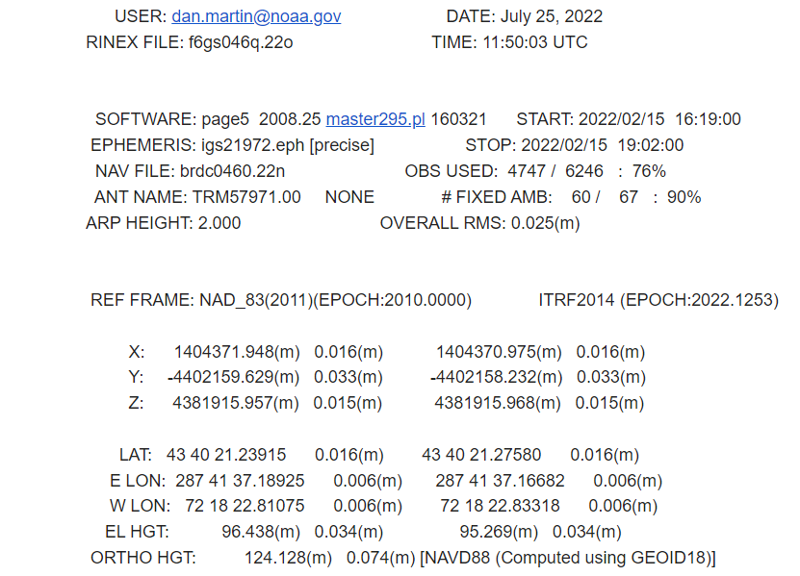
73%
65%

Slide 58



Try Processing in OPUS Projects
OPUS Statistics in OPUS Projects
Session Statistics in OPUS Projects

Slide 59
What’s New with OPUS??
OPUS Projects 4.0 (production)
OPUS Projects 5.1 (Beta) beta.ngs.noaa.gov
M-PAGES (Alpha) (internal only)

Slide 60

OP 4.0
Full Support for Submission to NGS (Bluebook)
Full manual developed with context sensitive help in app.
Creating training modules (OP101, OP102)

Slide 61
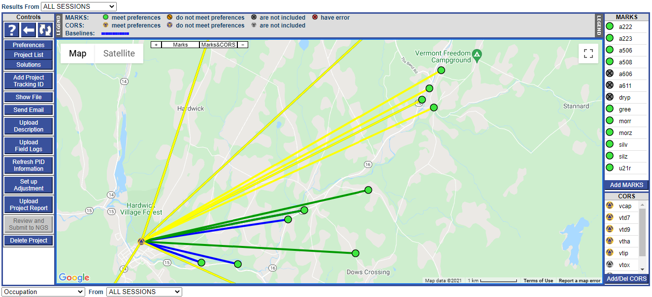
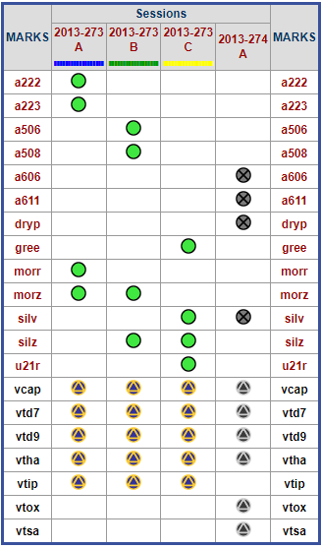
GPS Session Processing and Adjustment Software
Visualize processing by session
Processing statistics available through dropdown
Access to station information through station hyperlink
New “What is OPUS Projects” Projects Video
https://geodesy.noaa.gov/corbin/class_description/What_is_OPUS_Projects2.shtml
Notes:
The main user interface, referred to as the manager’s page, provides the access controls for all aspects of the project. It provides the visual interface to all data that has been collected as well as all data that has been processed and adjusted. Many convenience links are available to access information specific to any mark, session, or adjustment in the project.

Slide 62
OP 5.1
Released to BETA 08/03/2022
Ability to include RTK/RTN vectors (any GNSS vector for that matter)
  Has sample data to try
  Contact your vendor about converting to gvx format

Slide 63
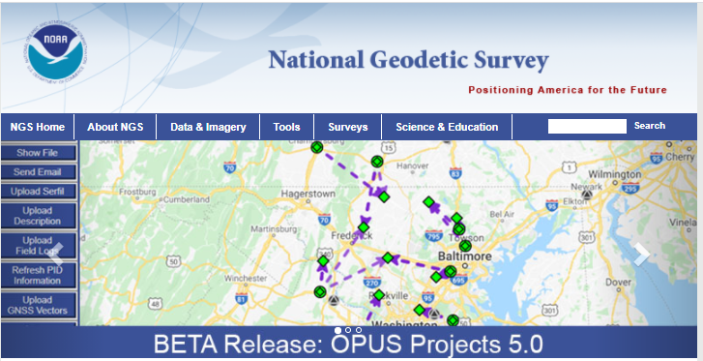

Slide 64
M-PAGES = Multi-GNSS PAGES
Capable of ingesting all GNSS observables currently supported by the global infrastructure.
Capable of using more than two frequencies.
Capable of ingesting RINEX 2 or 3.
Capable of using pseudorange and phase.
Capable of multi-GNSS processing.
Uses a single-difference processing strategy.
See August 11 Webinar
  https://geodesy.noaa.gov/web/science_edu/webinar_series/multi-ngss-world-at-ngs.shtml
Planned release to BETA by December 2022

Slide 65
Thank You!
Questions?
Dan Martin
Northeast Regional Geodetic Advisor
ME, NH, VT, MA, CT, RI, NY, NJ
Dan.martin@noaa.gov
240-676-4762

