Slide 1

So What’s New with the New Reference Frames?
Central Chapter NJSPLS
May 25, 2017
Dan Martin
Northeast Regional Geodetic Advisor
Dan.martin@noaa.gov
240-676-4762

Slide 2
Since 2008…
NGS has had two “ten year plans”
  Heavy on broad sweeping decisions
    e.g. “Replace NAD 83”
  Light on details
    How? What do we call it?
  2016 was a good year for filling in those details
Notes:
There are actually 3 “NAD 83”s, NAD 83(2011), NAD 83(PA11) and NAD 83(MA11)
There are also many more vertical datums than NAVD 88 in the NSRS, each one for specific states or territories that have no line of sight to CONUS/Alaska

Slide 3
Names
The Old:
NAD 83(2011)
NAD 83(PA11)
NAD 83(MA11)
The New:
The North American Terrestrial Reference Frame of 2022
(NATRF2022)
The Caribbean Terrestrial Reference Frame of 2022
(CTRF2022)
The Pacific Terrestrial Reference Frame of 2022
(PTRF2022)
The Mariana Terrestrial Reference Frame of 2022
(MTRF2022)

Slide 4
Names
  The Old:
  NAVD 88
  PRVD 02
  VIVD09
  ASVD02
  NMVD03
  GUVD04
  IGLD 85
  IGSN71
  GEOID12B
  DEFLEC12B
Orthometric
Heights
  The New:
  The North American-Pacific Geopotential Datum of 2022 (NAPGD2022)
  - Will include GEOID2022
Normal
Orthometric
Heights
Dynamic
Heights
Gravity
Geoid
Undulations
Deflections of
the Vertical

Slide 5
So…what’s new in 6 months?
Names
Scientific Decisions
  Codified in “Blueprint for 2022” documents

Slide 6
Scientific Decisions
Blueprint for 2022, Part 1: Geometric
  Four plate-fixed Terrestrial Reference Frames
    And what “plate fixed” means
  Mathematical equation between IGS and TRFs
    Plate Rotation Model for each plate
    Coordinates at survey epoch
  Intra-frame velocity model
    To compare coordinates surveyed at different epochs

Slide 7
Replacing the NAD 83’s
Three plate-(pseudo)fixed frames will be replaced with four plate-fixed reference frames
  N. Amer., Pacific, Mariana, Caribbean(new!)
Remove long-standing non-geocentricity of NAD 83 frames
All four : identical to IGSxx at a TBD epoch
  2020.00?
All four : differ from IGSxx by plate rotation only
  Updated Euler Pole determination for rigid plate only

Slide 8
Each frame will get 3 parameters
Euler Pole Latitude
Euler Pole Longitude
Rotation rate (radians / year)
This will be used to compute
time-dependent TRF2022
coordinates from time-dependent
IGS coordinates.

Slide 9
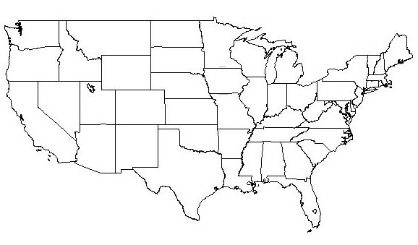
NATRF2022 frame is rigid and fixed to rigid part of the N.A. plate
Non-rigid part of the N.A. plate
(deformation)
area

Slide 10
NATRF2022 coordinates over time
(Remember: The NATRF2022 frame is rigid)
Point on deforming part of plate
Point on rigid part of plate
λ
λ
t
t

Slide 11
NATRF2022 coordinates over time
(Remember: The NATRF2022 frame is rigid)
Point on deforming part of plate
Point on rigid part of plate
λ
λ
t
t

Slide 12
NATRF2022 coordinates over time
(Remember: The NATRF2022 frame is rigid)
Point on deforming part of plate
Point on rigid part of plate
λ
λ
t
t

Slide 13
NATRF2022 coordinates over time
(Remember: The NATRF2022 frame is rigid)
Point on deforming part of plate
Point on rigid part of plate
λ
λ
t
t

Slide 14
Intra-frame velocities
This is the velocity of the
point in NATRF2022.
Rotation of plate removed.
It is not constant because
the point still suffers small
“intra-frame” velocities.
Such IFVs will be captured
in a model by NGS.
This is the velocity of the
point in ITRF. Includes all
movements, but the
dominant one is the
rotation of the N.A. Plate.

Slide 15
Scientific Decisions!!
Blueprint for 2022, Part 2: Geopotential
  Global 3-D Geopotential Model (GGM)
    Will contain all GRAV-D data
    Able to yield any physical value on/above surface
  Special high-resolution geoid, DoV and surface gravity products consistent with GGM
    Not global: NA/Pacific, American Samoa, Guam/CNMI
  Time-Dependencies
    Geoid monitoring service
      Impacts of deglaciation, sea level rise, earthquakes, etc

Slide 16
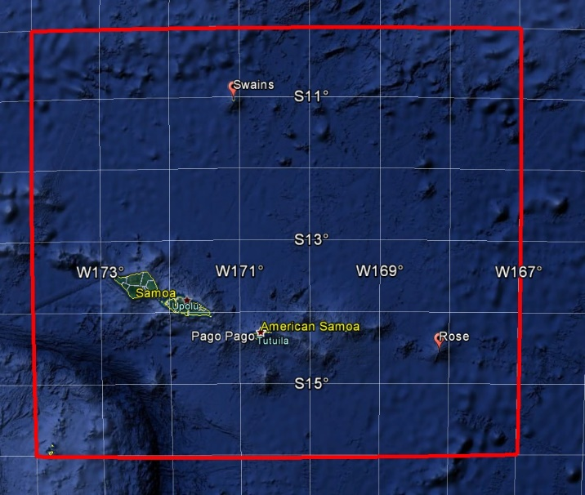
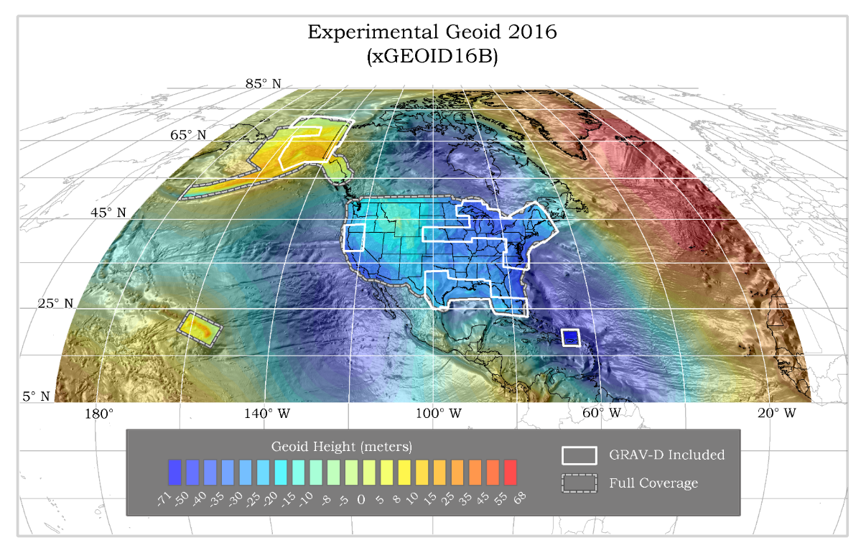
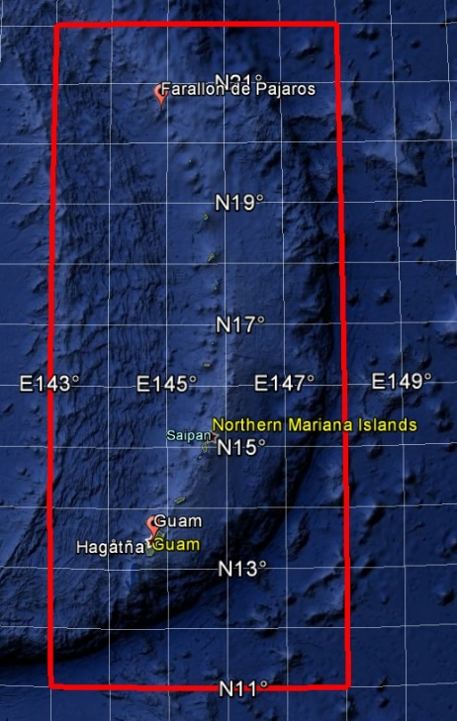
GEOID2022 (et al) over American Samoa:
-16 to -10, 186-193
GEOID2022 (et al) over Guam/CNMI:
11-22, 143-148
GEOID2022 (et al) over the North America/Pacific/Caribbean/Central America/Greenland region will range from
0 to 90 latitude and from 170 to 350 longitude.

Slide 17
Why replace NAVD 88 and NAD 83?
ACCESS!
  easier to find the sky than a 60-year-old bench mark
  GNSS equipment is cheap and fast
ACCURACY!
  easier to trust the sky than a 60-year old bench mark
  immune to passive mark instability
GLOBAL STANDARDS!
  systematic errors of many meters across the US
  aligns with GPS, international efforts
  aligns with Canada, Mexico
Notes:
Things are looking up! GNSS technologies simplify and improve access to and accuracy of our spatial reference system.
While we can continue to leverage this technology to maintain the old datums, it makes sense to adopt GRAV-D results in an unpolluted form, and align it to modern global standards.

Slide 18
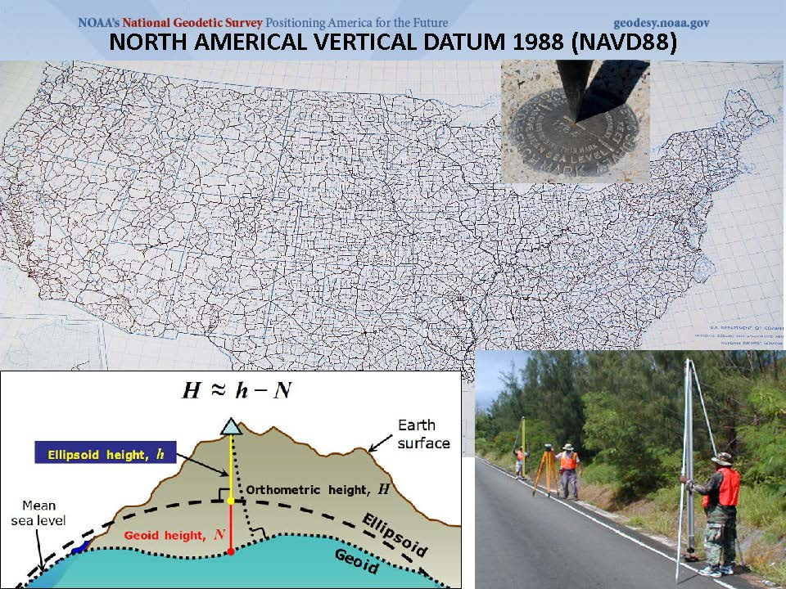

Slide 19
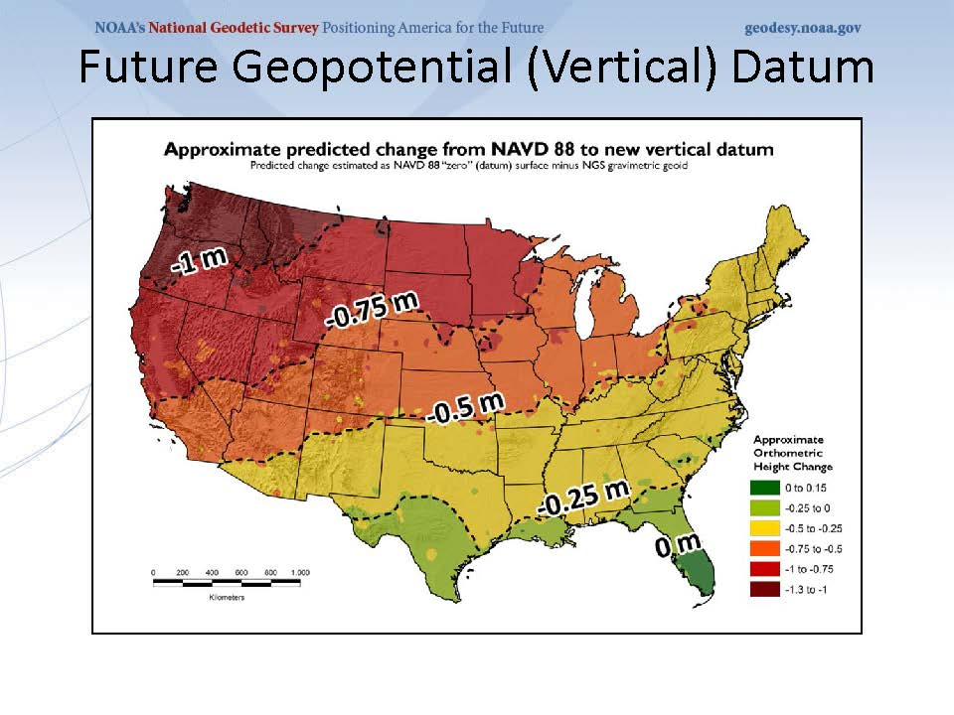
NAVD 88 is tilted and biased

Slide 20
passive marks are old

Slide 21
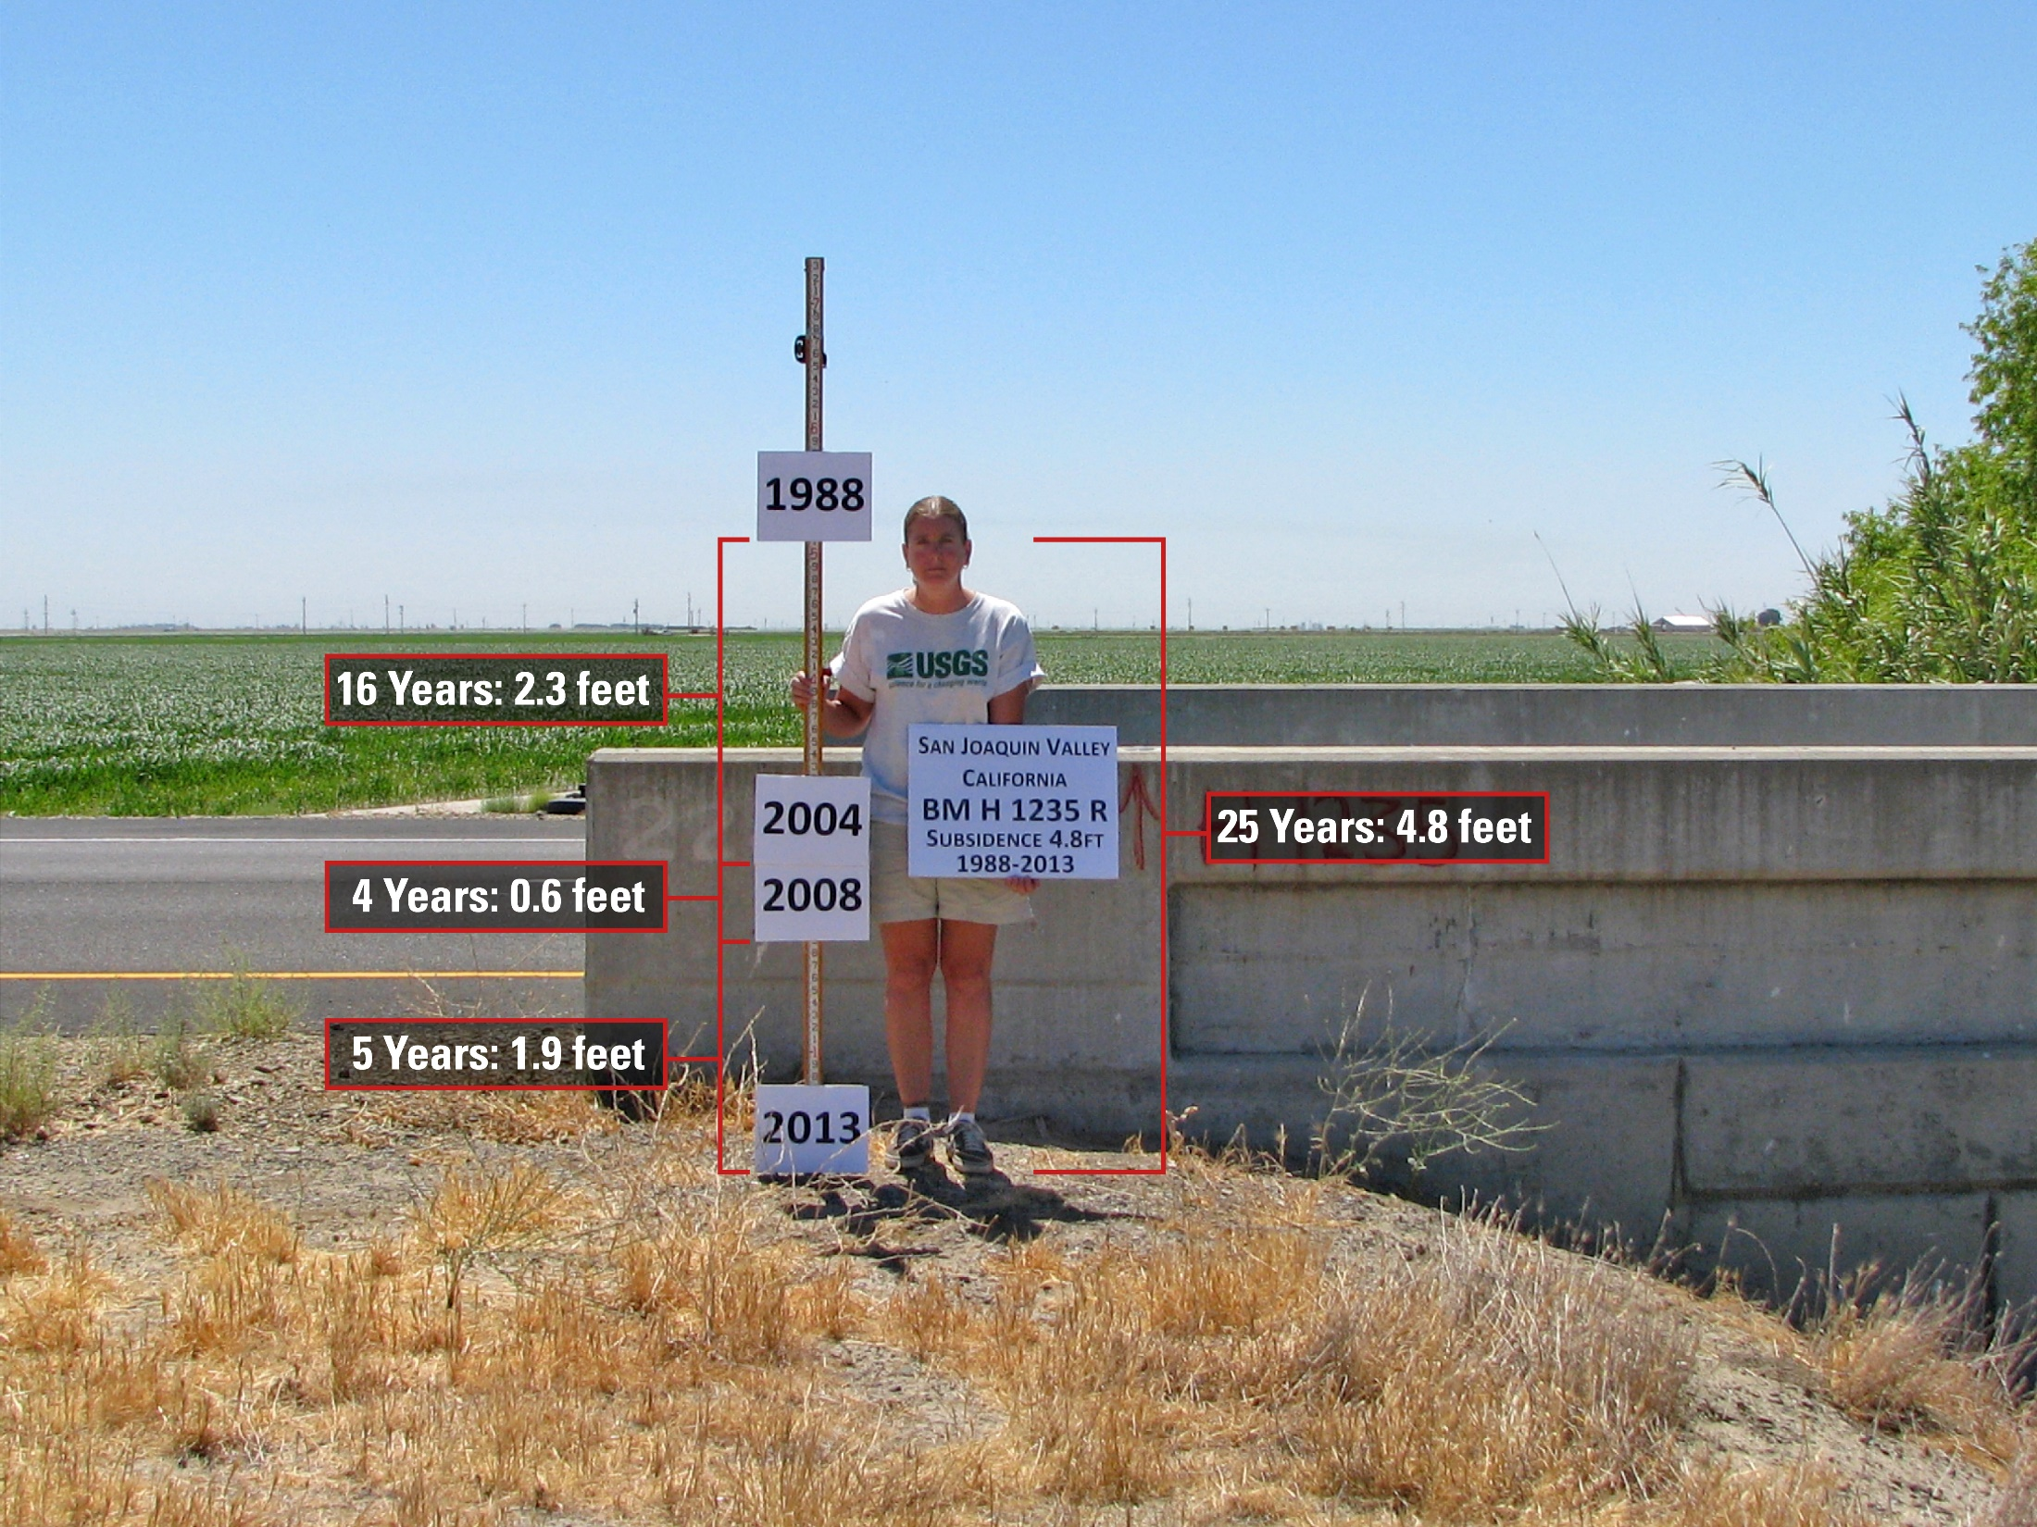
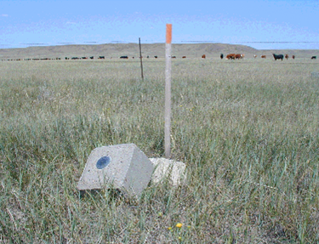
passive marks lie still, but still lie
small instability x long time = inaccuracy

Slide 22
NAVD 88 is not alone
NAVD 88 North American Vertical Datum of 1988
PRVD02 Puerto Rico Vertical Datum of 2002
ASVD02 American Samoa Vertical Datum of 2002
NMVD03 Northern Marianas Vertical Datum of 2003, 3 each
GUVD04 Guam Vertical Datum of 2004
VIVD09 Virgin Islands Vertical Datum of 2009, 3 each
Hawaii … Hawaiian Islands Vertical Datum (coming soon)
various local datums, as national datum is inaccessible
IGLD 85 International Great Lakes Datum of 1985
IGSN71 gravity dataset
GEOID12B geoid undulations
DEFLEC12B deflection of the vertical
one vertical datum
pole-to-equator

Slide 23
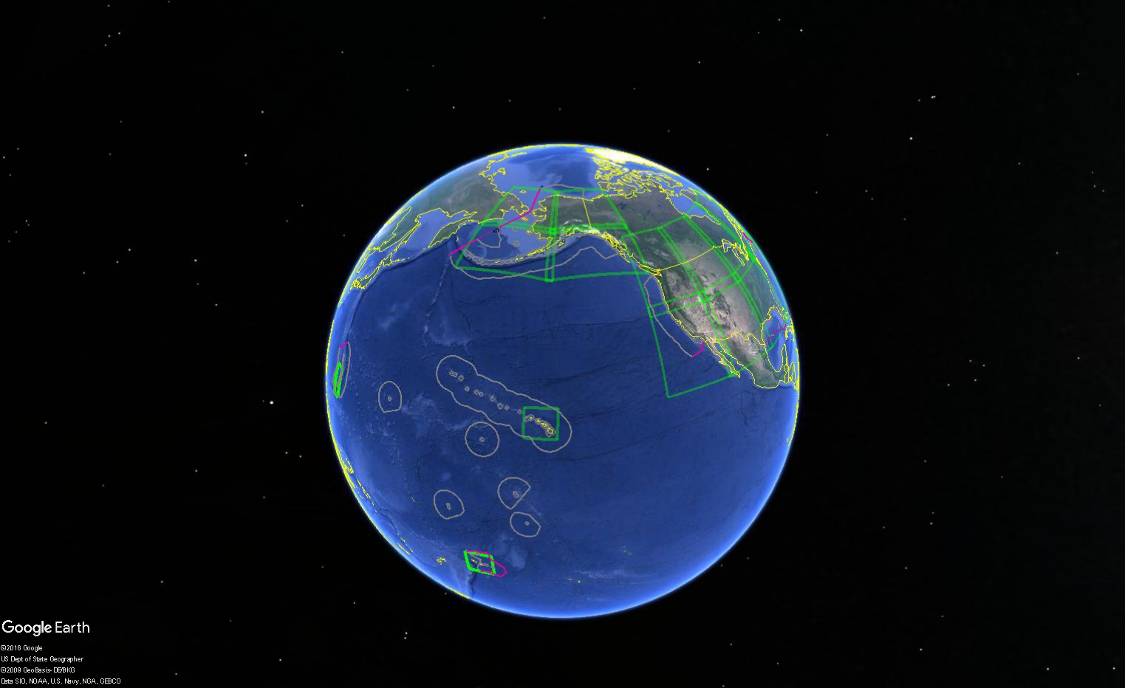

Slide 24
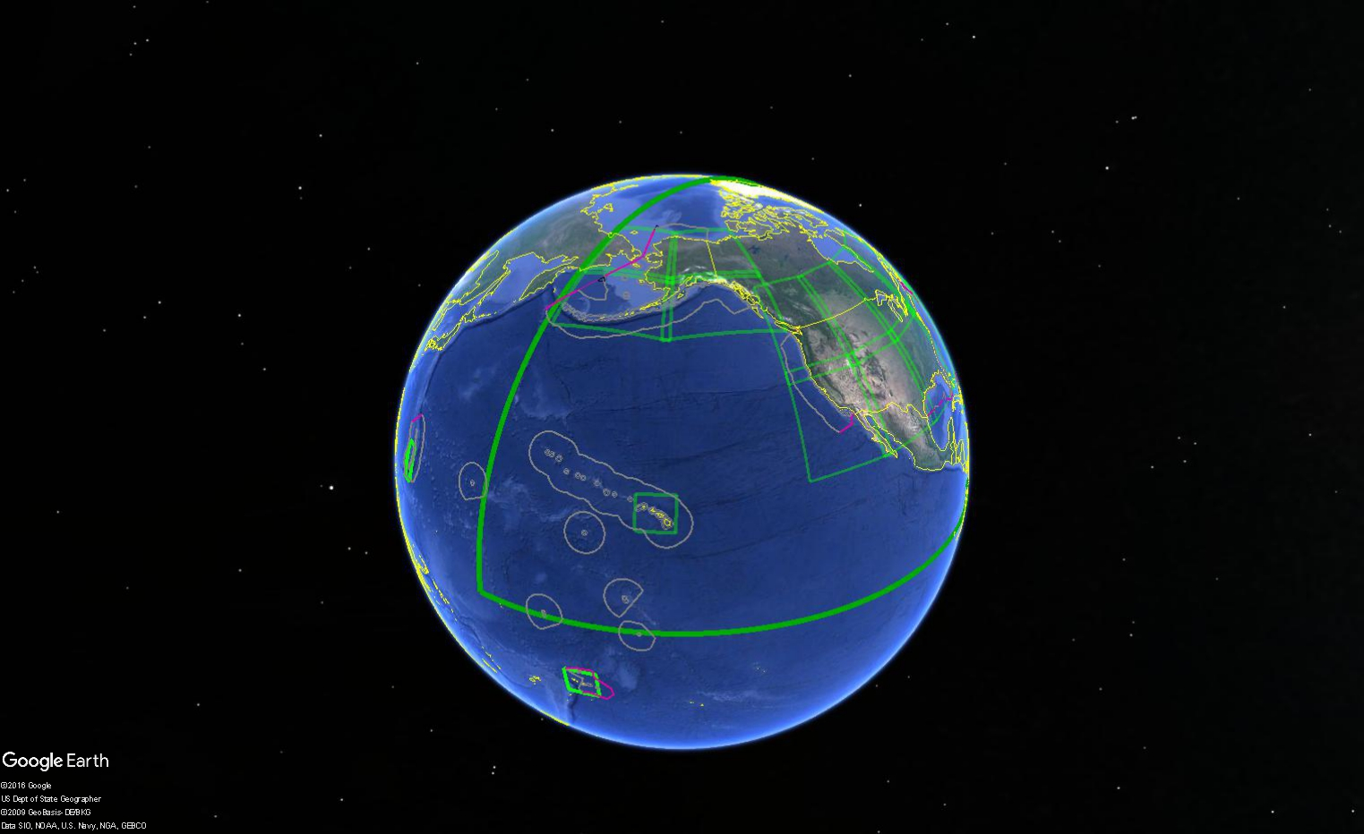

Slide 25
NAD 83 is non-geocentric
h₈₃
h_{yy}
Earth’s
Surface
same
GRS-80
ellipsoid
IGS yy
Origin
~2.2 meters
NAD 83
Origin
Notes:
ITRF (International Terrestrial Reference Frame) just has an origin; take NAD83 shaped ellipsoid centered at the ITRF origin to derive ITRF97 ellipsoid heights.
Ellipsoid heights NAD83 vs. ITRF97 - Defined origins are best estimate of the center of mass; NAD83 is not geocentric. Move origin; move ellipsoid surface as illustrated.
Ellipsoid height differences reflect the non-geocentricity of NAD83.

Slide 26
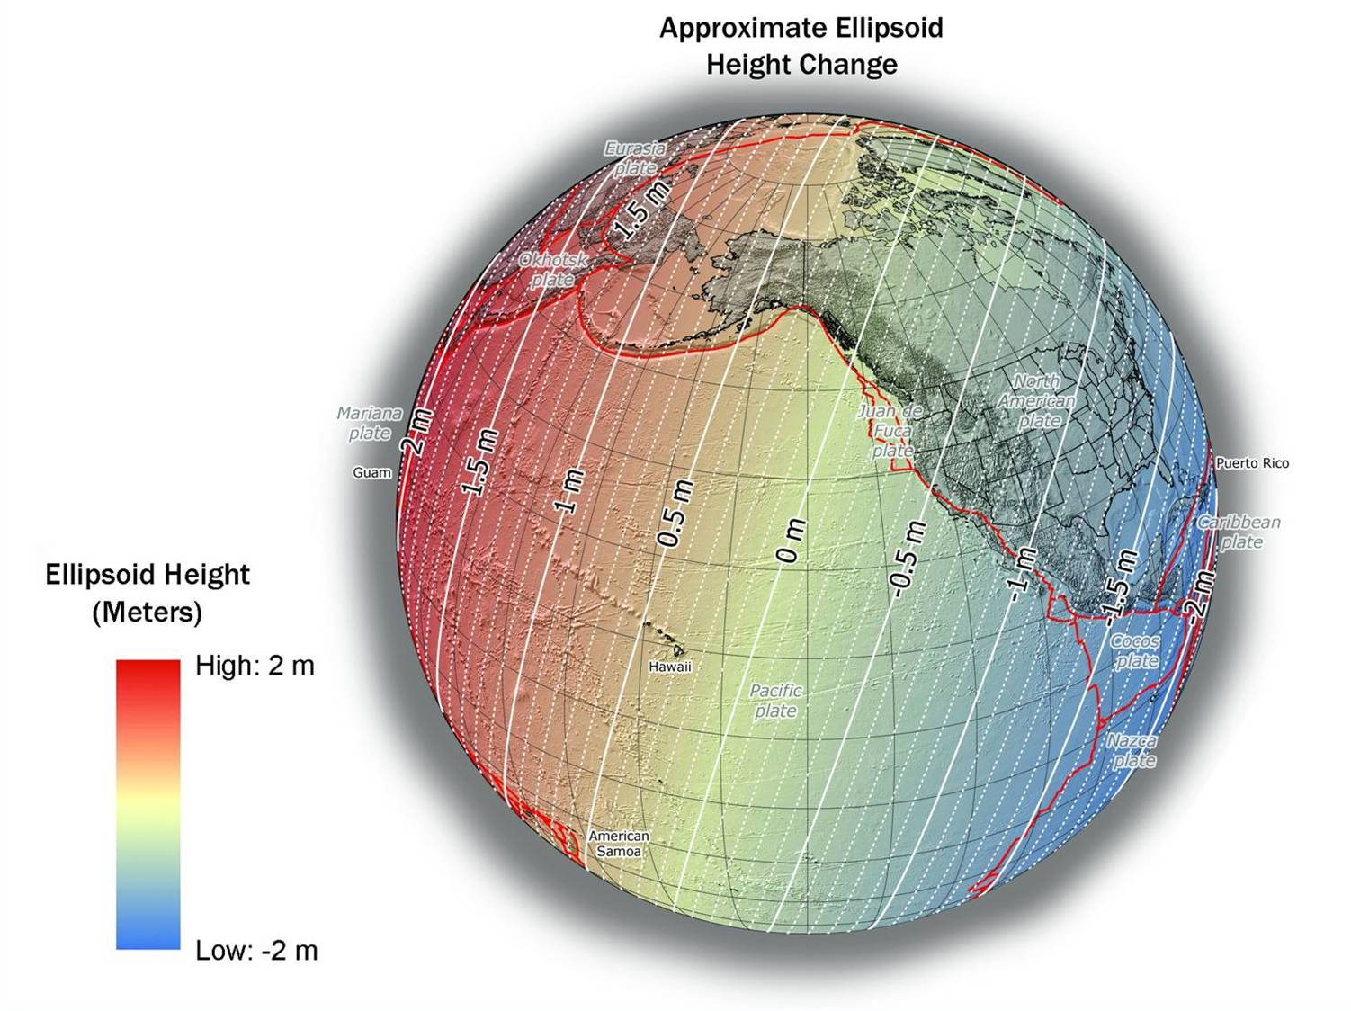
NAD 83(2011) to IGS08 at epoch 2022.0
Notes:
NGS has not yet determined the co-definitional epoch between IGSxx and the four TRFs. The epoch 2022.0 is for reference purposes only, and does not constitute a policy choice at this time

Slide 27
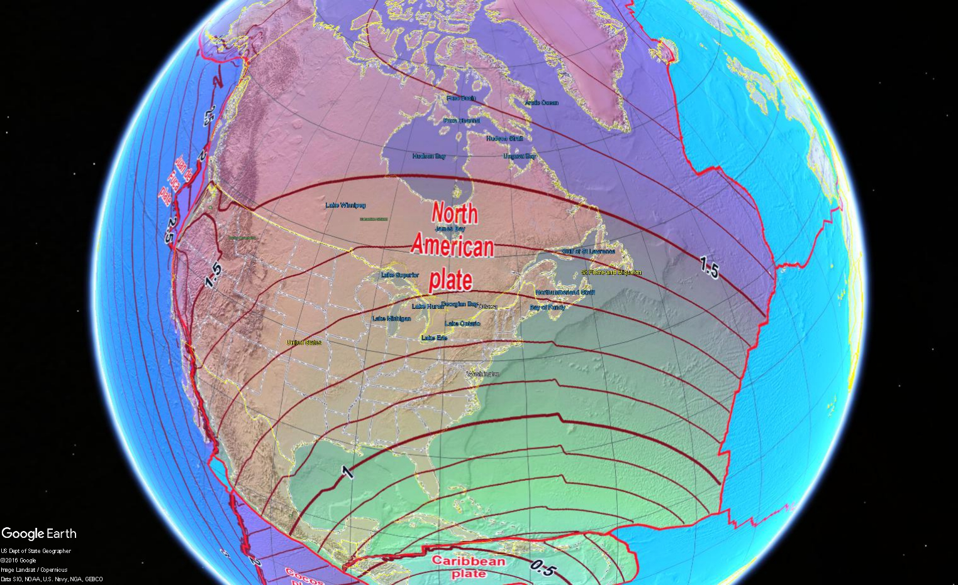
Notes:
NAD83_epoch2010_to_IGS08_epoch2022
Horizontal change in meters from NAD 83 (2011) epoch 2010.00 to IGS08 epoch 2022.00. Represents the expecetd change from NAD 83 to the new North American, Pacific, Caribbean, and Mariana terrestrial reference frames in 2022. Computed using HTDP v3.2.5.

Slide 28
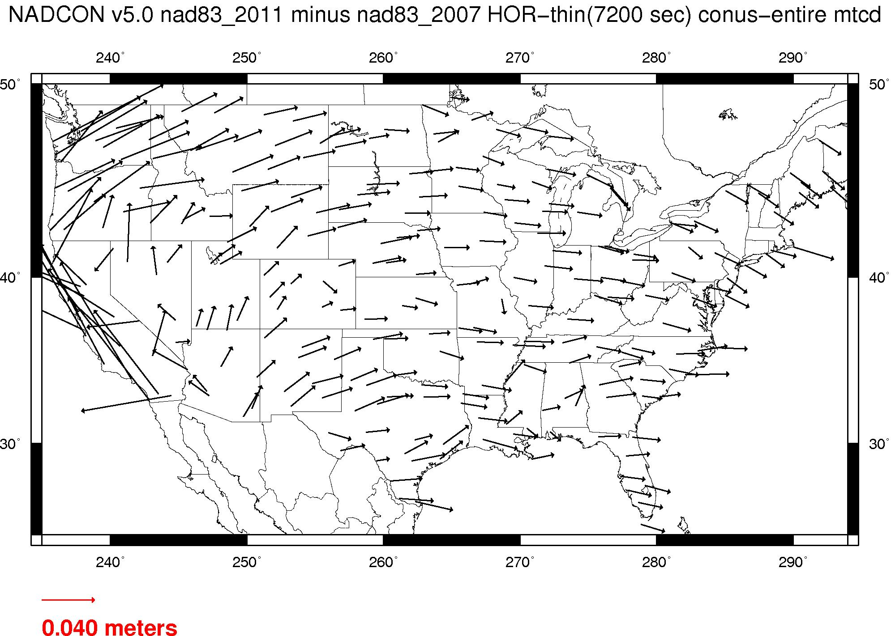
NAD 83 is not plate fixed very well
NAD 83(2011) epoch 2010.0 minus NAD 83(NSRS2007) epoch 2002.0
If NAD 83 were truly “plate fixed” then an 8 year epoch change would not yield the systematic plate rotation seen here.

Slide 29
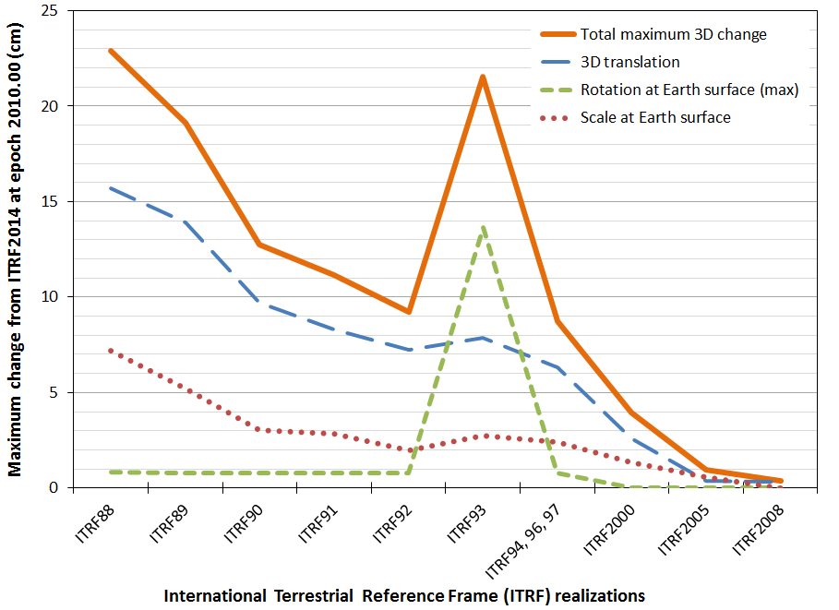
ITRF is now mature

Slide 30
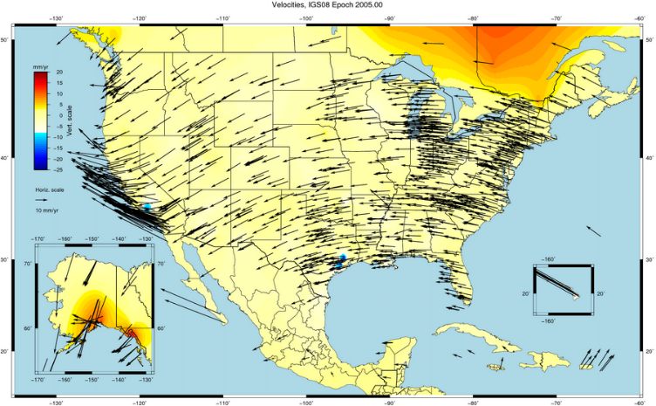
NAD 83 is not ITRF
GPS & WAAS navigation uses WGS84, aligned to ITRF
satellite orbits and other geospatial datasets use global frames
our TRFs will agree with ITRF (specifically, IGSyy) at the initial epoch
our TRFs will diverge from ITRF by a few cm each year to stay “plate-fixed”
  difference is a simple Euler plate rotation
  many areas will diverge further, as no plate is perfectly rigid
plate-fixed or ITRF-fixed; can’t have both

Slide 31
NAD 83 is not alone
NAD 83 (1986)
NAD 83 (HARNs)
NAD 83 (FBNs)
NAD 83 (NSRS)
NAD 83 (2011)
NAD 83 (PA11)
NAD 83 (MA11)
4 plate-fixed frames
North America, Caribbean, Pacific, Marianas

Slide 32
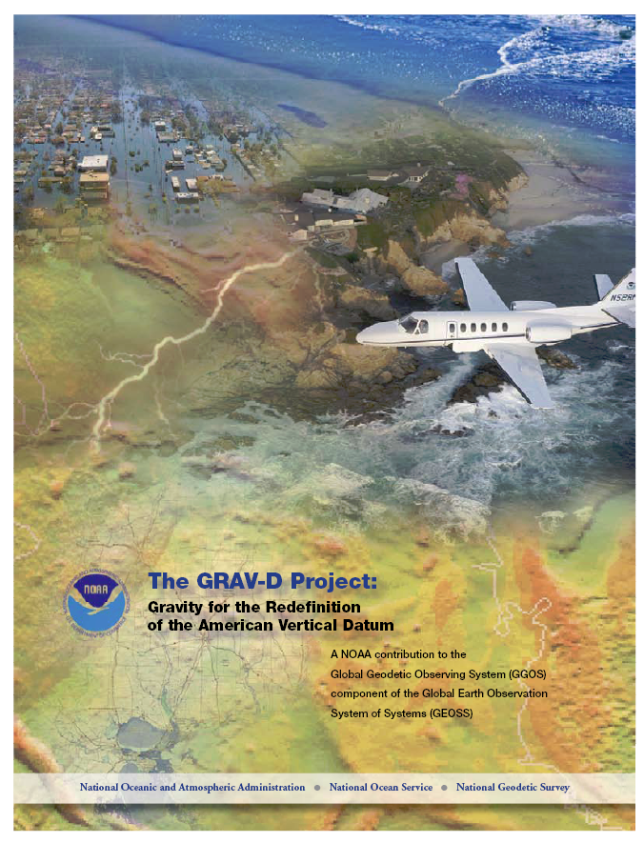
GRAV-D Project Overview
Overall Target: 2 cm accuracy orthometric heights from GNSS and a geoid model
GRAV-D Goal: Create gravimetric geoid accurate to 1 cm where possible using airborne gravity data
GRAV-D: Two thrusts of the project
  Airborne gravity survey of entire country and its holdings
  Long-term monitoring of geoid change
Leveraging partnerships to improve and validate gravity data
Notes:
Target is to be able to achieve 2 cm accuracy orthometric heights (where possible) using a GNSS receiver and a geoid model
Roughly 1 cm uncertainty from GNSS and 1 cm from the geoid model
GRAV-D
Phase 1: snapshot of the entire country to provide a consistent data set
Phase 2: long term monitoring of geoid change – in development
Work with partners to incorporate additional gravity data, particularly surface gravity data, validate existing data, and monitor change

Slide 33
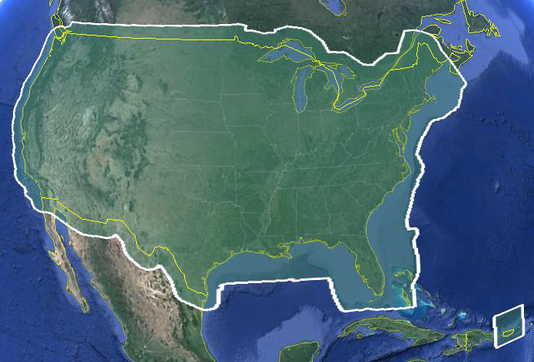
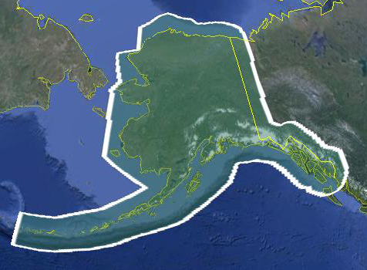
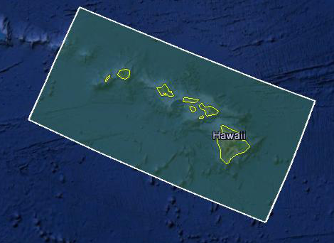
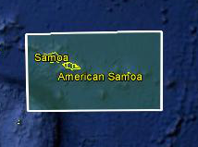
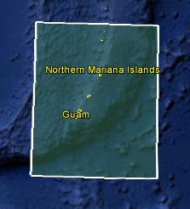
Data Collection Scope
Entire U.S. and territories
  Total Square Kilometers: 15.6 million
  Initial target area for 2022 deadline
  ~200 km buffer around territory or shelf break if possible
Notes:
Project Scope:
Scope of the project: cover roughly 15.6 million square kilometers – contiguous united states, Alaska, Hawaii, Guam, and American Samoa
In order to blend with satellite altimetry data the airborne survey is done to the continental shelf where possible or ~ 200 km beyond the shoreline or border, whichever is further
Deadline of 2022 for datum rollout, which means a target of 2021 to finish the airborne survey
Priority areas were defined as Alaska and coastal areas
Challenges:
Fixed annual budget and time → design of surveys had to fit within an annual budget of $3.5 million and meet the deadline
This was a major factor in setting altitude and line spacing

Slide 34
Performance Metric
For Airborne Surveys
FY09 Baseline | Targets vs Actual
 | FY10 | FY11 | FY12 | FY13 | FY14 | FY15 | FY16 | FY17 | FY18 | FY19 | FY20 | FY21 | FY22
6.14% | 7.5% | 12% | 20% | 28% | 36% | 45% | 53% | 62% | 70% | 79% | 87% | 96% | 100% and Implement
6.14 | 8% | 15% | 24% | 31% | 38% | 45% | 55% | 59%
Measure: Percentage of the U.S. and its territories with GRAV-D data available
to support a 1 cm geoid supporting 2 cm orthometric heights.
Notes:
We’ve set up a basic GIS GPRA monitoring in the War Room. We will report the coordinates of our survey monthly and they will calculate our percentages.

Slide 35
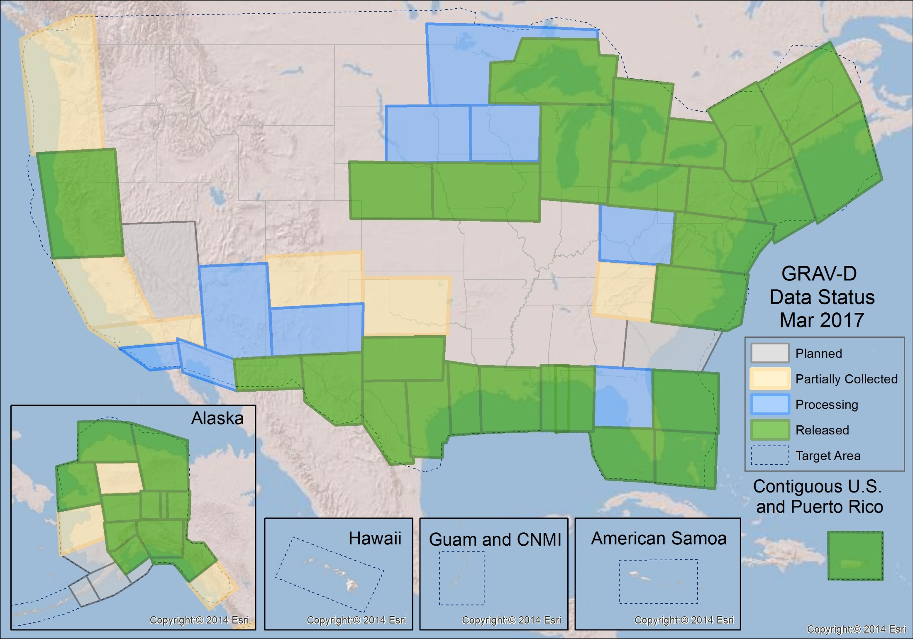
GRAV-D Status 3-31-17: 59%

Slide 36
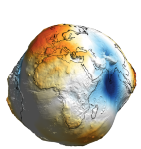

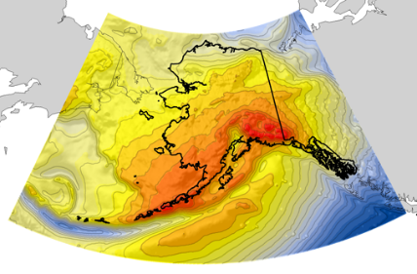
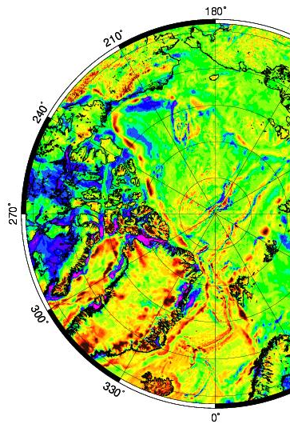
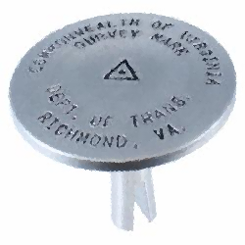
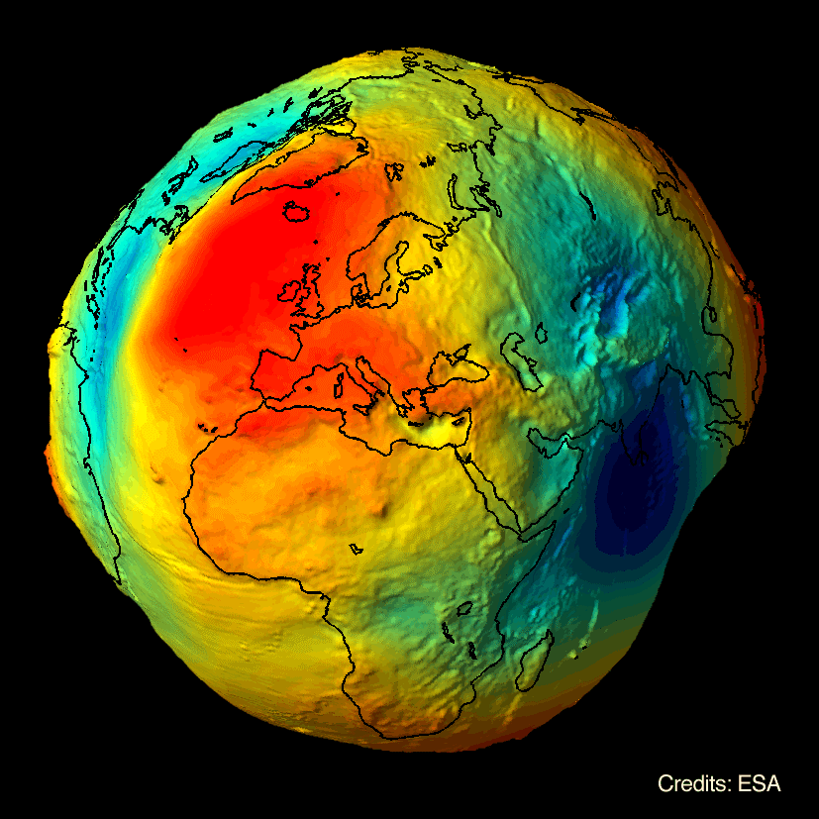

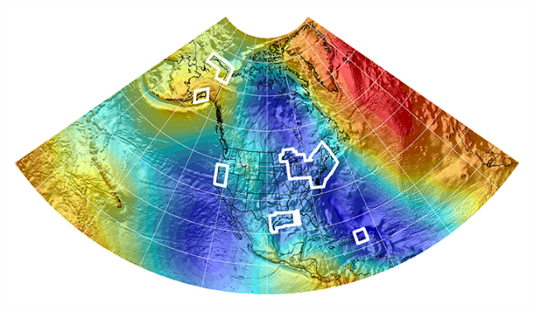
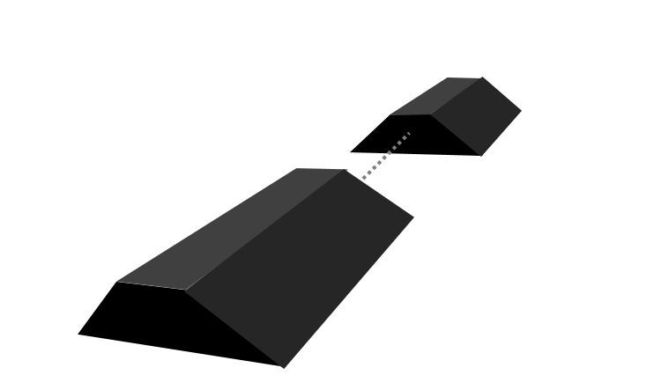



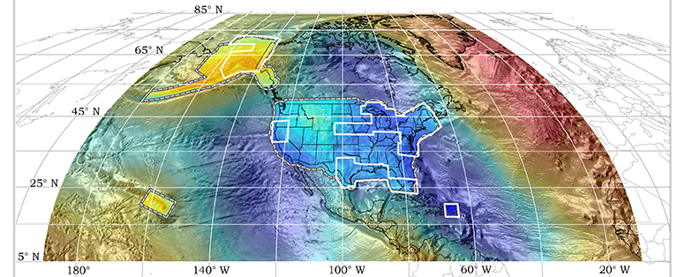
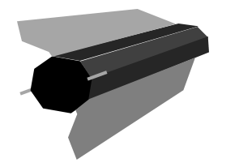

Evolution of the Geoid
EGM08
USGG2012
GEOID12A/B
NGA
ArcticGP
GRAV-D
2008
2012
2014
GOCO05S
2015
2016
xGeoid14B
GRACE
xGeoid15B
xGeoid16B
+
GOCE
Notes:
NGA Arctic Gravity Grid (2017)

Slide 37
Geoid Slope Validation Surveys
Basic Concept
GSVS11 in Texas
  Survey Techniques
GSVS14 in Iowa
GSVS17 in Colorado
  Differences
Current Status & Schedule
2

Slide 38
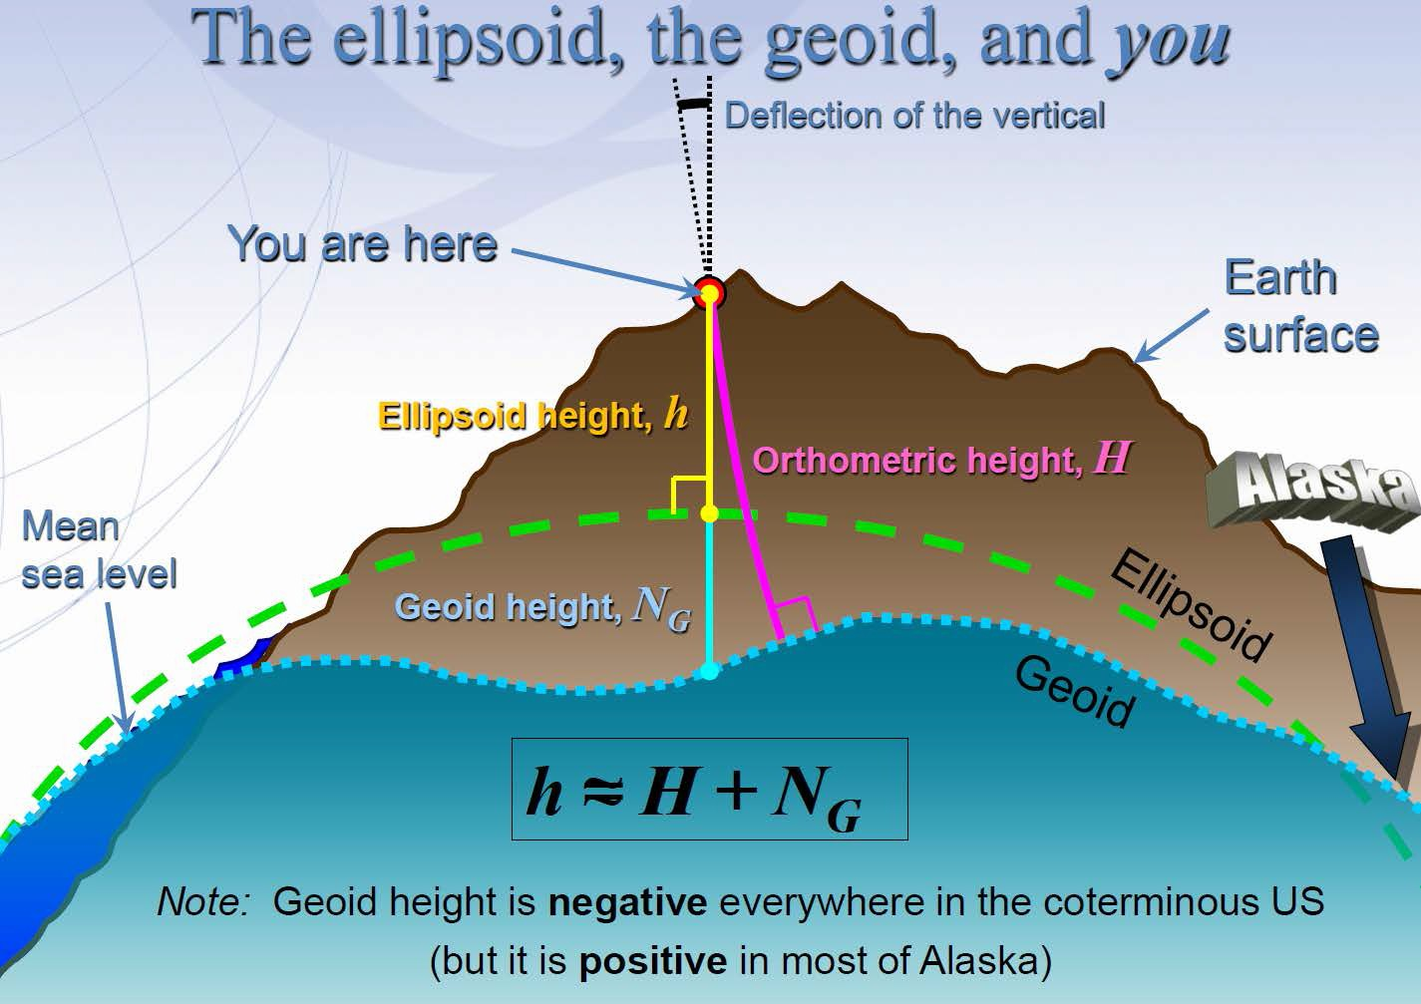
3

Slide 39
Objective of the GSVSs
How do we know that GRAV-D is working?
The Geoid Slope Validation Surveys (GSVSs) use high precision, high resolution (~1.5km spacing), ground-based survey techniques to determine the shape of the geoid consistently along a large (~300km) distance.
This allows for the direct comparison of the geoid shape predicted by various, gravity-based geoid models.
This also allows for a quantification of the airborne gravity’s contribution to the improvement of these models.

Slide 40
























Objective of the GSVSs (cont.)
Why compare the shape of the models?
Rather than using “absolute” values of the geoid at specific locations to compare models, it is actually more useful to look at the changes in the shape of the geoid over various distance scales (i.e. looking at the slope between various pairs of survey points separated by 1, 2, 5, 10, 20, 50, 100, 200 km, etc.) . Hence the name…
Example of slopes over various distance scales:
Every 1 interval
Every 2 intervals
Every 3 intervals
Every 4 intervals

Slide 41
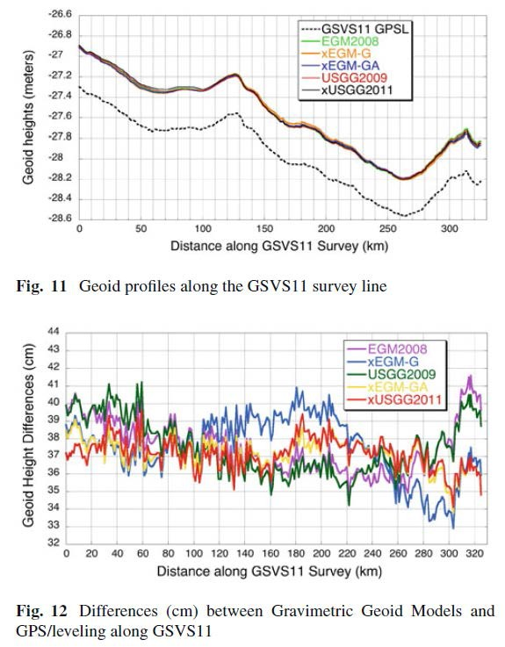
GSVS11, South Texas
The first survey was performed in south Texas in 2011
Low (close to the geoid) and flat.
Results were excellent!
"Confirming regional 1 cm differential geoid accuracy from airborne gravimetry: the Geoid Slope Validation Survey of 2011", Smith et al., Journal of Geodesy,
2013.

Slide 42
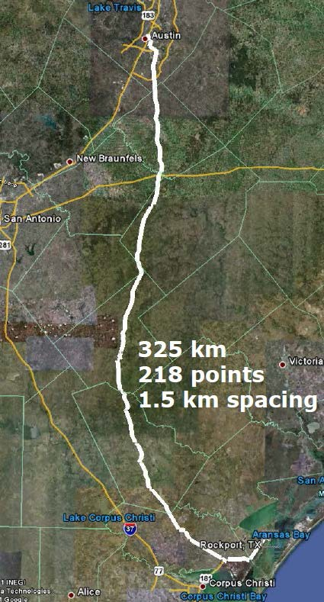
GSVS Survey Techniques
7
Survey techniques employed:
  Bechmarks installed ~1.5km
  Leveling
  Absolute/Relative Gravity
    Vertical Gravity Gradient
  Long-session GPS
  Deflection of Vertical

Slide 43
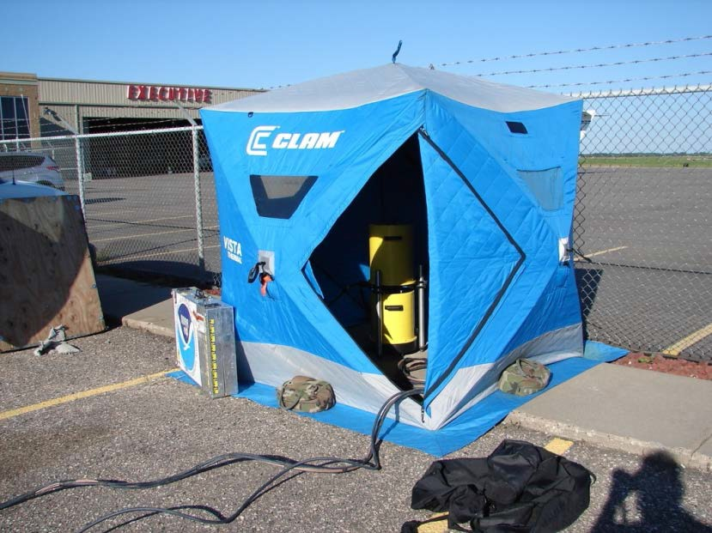
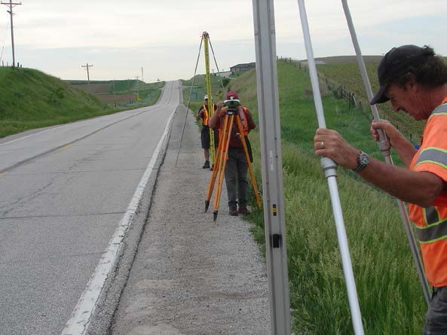
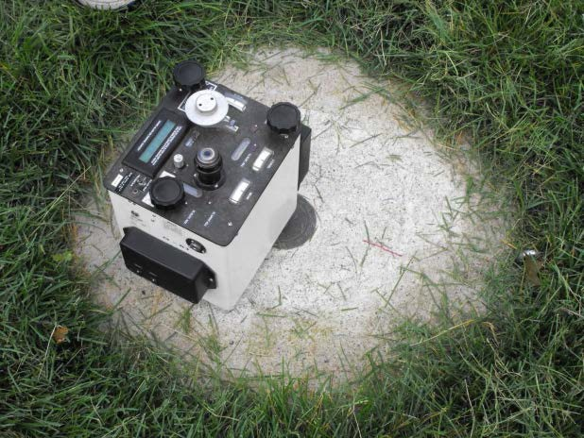
Leveling and Gravity
The entire line was leveled (double-run). Geodetic heights provided at each benchmark.
Leveling and gravity are both needed for orthometric height determination. Usually gravity is modeled, but in this case was actually measured at every point.
  Relative gravity and vertical gravity gradient at every benchmark
  Absolute gravity (A10 and/or FG5) at ~every 7th benchmark
8

Slide 44
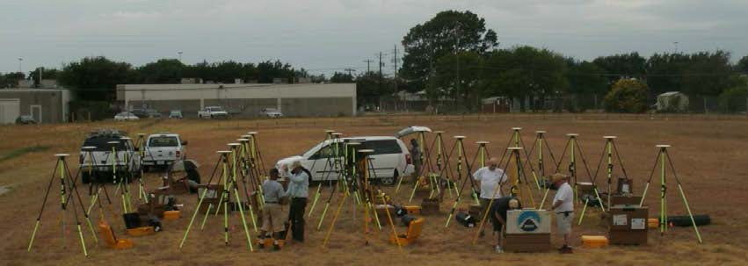
Long Period GPS
Calibrated, fixed-height antennas, all identical models
In Texas 2011:
  20 complete sets of equipment (2 parties, 10 sets each)
  Each party observed 10 new stations each day
  20 hours of observation each day
  Project processed with OPUS Projects
9

Slide 45
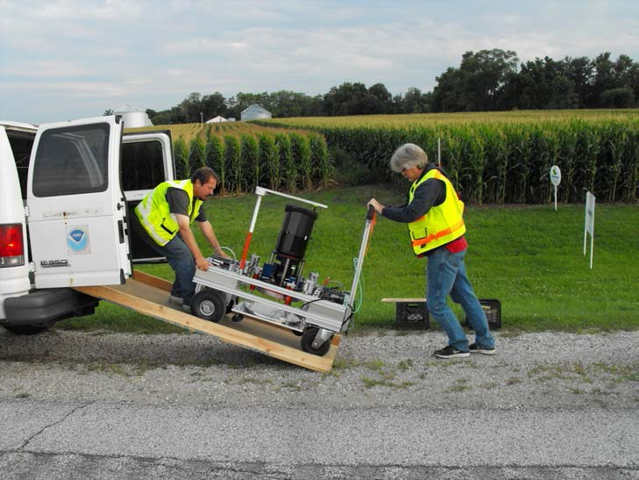
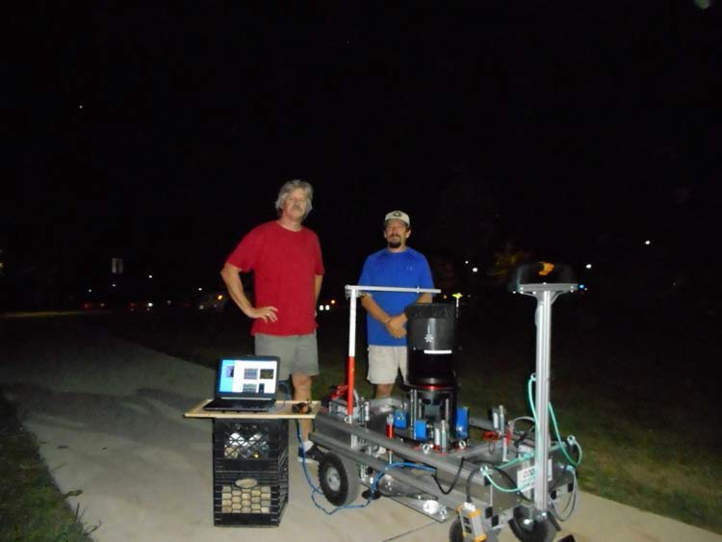
Deflection of the Vertical (DoV)
Measure the slope of the geoid directly!
Precision tilt meters provide alignment “level” to the geoid.
Celestial almanacs provide predicted alignment with star field (relative to ellipsoid).
The difference between the two vectors (broken into orthogonal components) are the Deflections of the Vertical (or “slopes”).
In Texas 2011:
  228 stations (204 official points, 11 redundant
observations, 3 reobservations)
  31 nights
  7 stations/night
  Observing with Swiss CODIAC (COmpact DIgital Astrometric Camera)
10

Slide 46
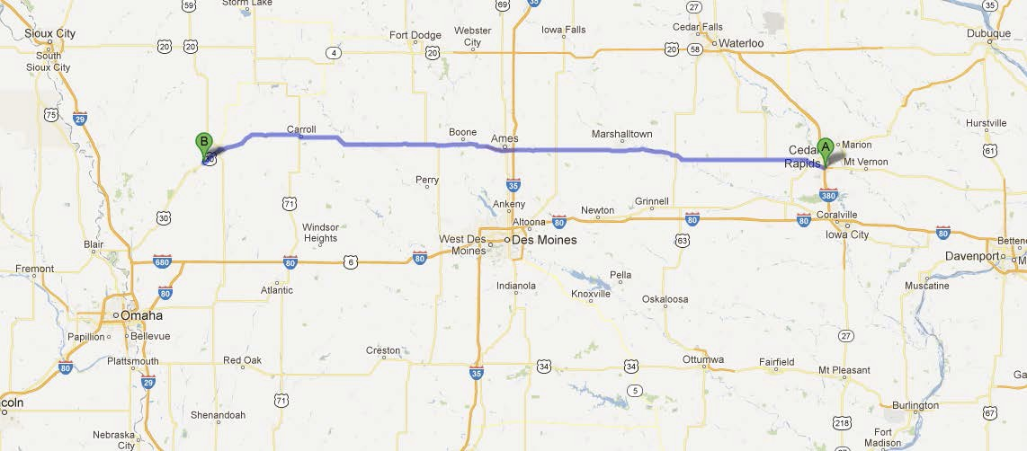
GSVS14 Iowa
After the success of GSVS11, Iowa was chosen for the next test in 2014.
Higher elevation and geologically interesting terrain (traversing the Midcontinent Rift System).
(Very) similar survey techniques were employed.
Preliminary results again show excellent (<2 cm geoid discrepancy) agreement and noticeable improvement when airborne data are included. March 2017: Accepted for publication in Journal of Geodesy
11

Slide 47
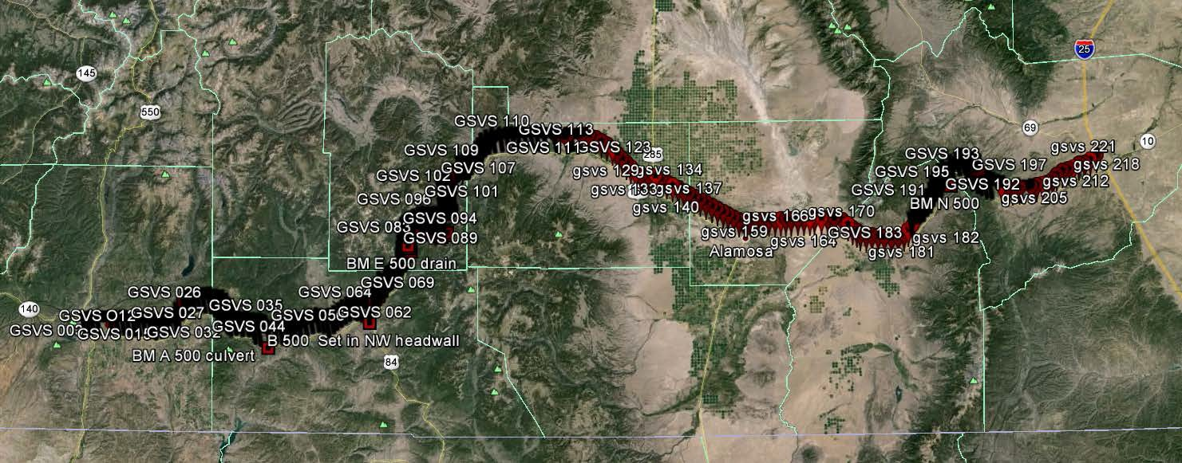
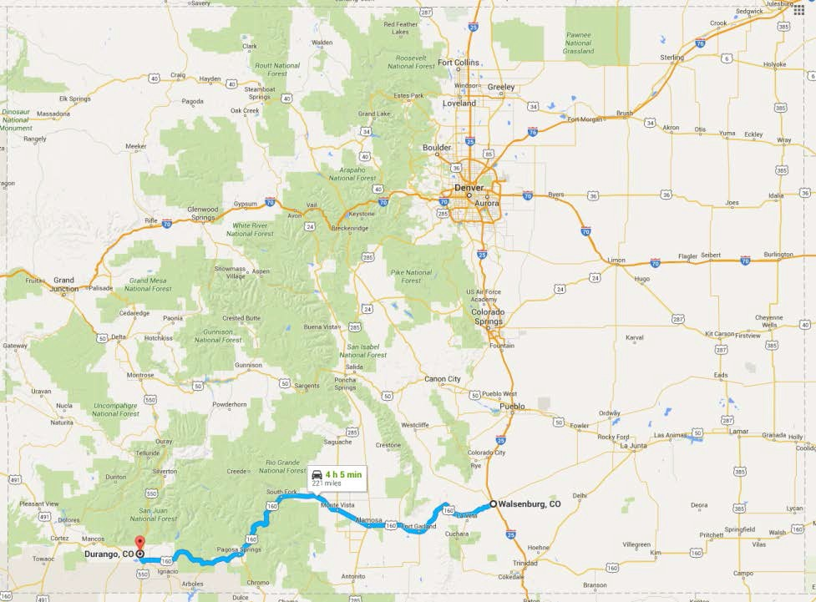
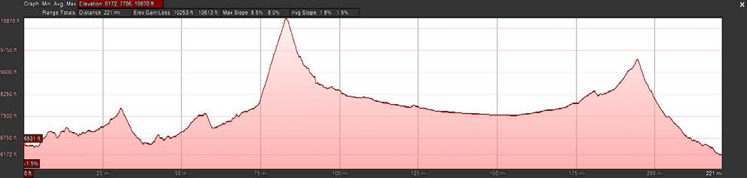
GSVS17 Colorado
The third (and likely final) GSVS will take place along US160, from Durango to Walsenburg, in southern Colorado.
High elevation and rugged topography. “Worst case” for geoid modeling.
Variation from 6,000’ (MSL) to 11,000’, over two passes.
12

Slide 48
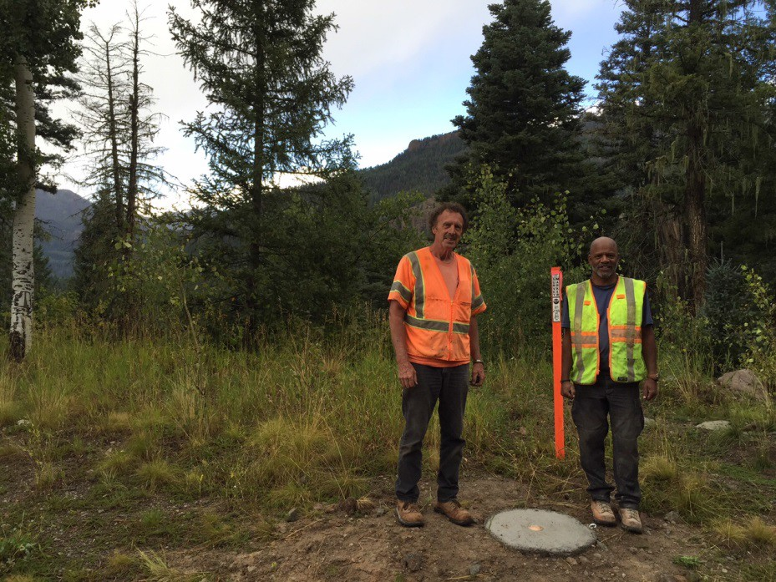
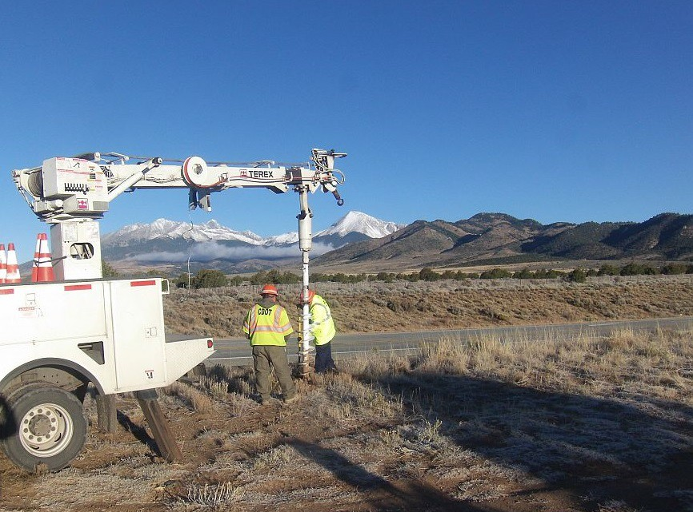
GSVS17 Colorado (cont.)
220 benchmark locations (approximately 1 per mile) have been installed
The survey will take place in overlapping phases beginning May 2017 and is expected to continue through September.

Slide 49
Differences with GSVS17
Numerous “extra” bench marks had to be installed for leveling accuracy purposes (very steep terrain in some sections).
Absolute gravity (A10) and quadratic (3 tier) gravity gradients will be measured at all benchmarks.
Topographic corrections are being developed to aid in field DoV quality control as well as post-survey geoid modeling.

Slide 50
Summary
Ground-based geoid slope measurements (derived from both classic techniques and direct measurements of DoV) over varying distance scales are used to compare various geoid models.
Comparing this “ground truth” to the models also allows for a direct quantification of the improvement when airborne gravity data are included.
To date, two such surveys have been conducted successfully in reasonably flat terrain.
Colorado is up next for a final, challenging test.

