Slide 1


National Geodetic Survey’s Modernization of the National Spatial Reference System (NSRS)
For WAGIC (Washington Geographic Information Council)
June 2, 2021
Daniel Determan
Northwest Regional Geodetic Advisor (WA, OR, ID)
dan.determan@noaa.gov
206-526-6874
Notes:
-First of all, thank you for attending this presentation on the NGS’s Modernization of the National Spatial Reference System (NSRS).
-I should also apologize for the fact that many of my slides present this material from a surveying/engineering perspective, as those are the folks that must meet the most stringent requirements.
-Before we get started with the presentation material, I would like to begin with a little show-and-tell.
*Here I have some visual aids that I hope will help you visualize the various models and surfaces that we are going to talk about.
In a world where all the land is constantly in motion… the NGS is here to help you factor out that motion from your surveys…

Slide 2



Who is NGS?
Federal Government – Executive Branch
  -Department of Commerce (DoC)
  (~47,000 employees)
  -National Oceanic and Atmospheric Administration (NOAA)
  -National Ocean Service (NOS)
  -National Geodetic Survey (NGS)
  (~175 employees)
Notes:
-We are the Federal Government’s oldest scientific agency.
-I know it can seem kind of strange that NGS is part of the NOS, but the origins of NGS lie with the C&GS.
-we are a “Program Office” of the NOS
Survey of the Coast – 1807
Coast Survey – 1836
Coast and Geodetic Survey – 1878
NGS since 1970

Slide 3
NGS Mission
To define, maintain and provide access to the National Spatial Reference System (NSRS) to meet our Nation’s economic, social, and environmental needs.
Notes:
NGS develops and maintains the National Spatial Reference System, a national coordinate system that provides the foundation for transportation, navigation, land record systems, mapping and charting efforts, and a multitude of scientific and engineering applications.
But there are many ancillary programs and products we will also discuss.

Slide 4
National Spatial Reference System (NSRS)
A consistent coordinate system that defines
latitude
longitude
height
scale
orientation
gravity
throughout the United States and its Territories
…and their time variants
Notes:
Let’s talk about the NSRS some more before we move on to looking at all of NGS.
This system defines position (latitude, longitude, and elevation), distances and directions between points, strength and direction of gravity (no, it is not simply “straight down”), shoreline, and their “time variants”.
Or how these change over time.
There will also be other parameters and models that contribute to the Modernized NSRS, such as Euler Pole Parameters (EPP2022), Deflection Of the Vertical (DOV2022), Intra-Frame Velocity Model (IFVM2022), and others.
Some documents will reference the National Shoreline as a component of the NSRS., we’ll briefly look at that later.

Slide 5
National Spatial Reference System (NSRS)
These items ARE part of the NSRS
Horizontal Datums (aka Geometric Reference Frames) | Vertical Datums | Great Lakes Datums | Geoid Models | Transformations and Conversions
NAD83 | NAVD88 | IGLD85 | GEOID12A & B | NADCON
NAD27 | NGVD29 | IGLD55 | GEOID09 | VERTCON
USSD | VIVD09 |  | GEOID06
 | GUVD04 |  | GEOID03 | SPCS83
 | NMVD03 |  | GEOID99 | SPCS27
 | ASVD02 |  | GEOID96
 | PRVD02 |  | ALASKA94
 |  |  | GEOID93
 |  |  | GEOID90
Notes:
Note the US Standard Datum, anyone done any work in the old USSD?
Good example highlighting that the term “NSRS” is used to encompass all historic datums of NGS and its predecessors.
Saw one project during my work with the USACE, in Johnstown, PA, that had original survey records in what turned out to be US Standard Datum.
All those vertical datums below NGVD29, I greyed them out slightly because those are all Caribbean and Pacific Island datums, so in CONUS it’s just those two that you hopefully already use… and hopefully are mostly using NAVD88.

Slide 6
National Spatial Reference System (NSRS)
These items are NOT part of the NSRS
Horizontal Datums (aka Geometric Reference Frames) | Vertical Datums | Geoid Models | Transformations and Conversions
WGS84 | IHRS (by IAG) | OSU91A | CORPSCON
WGS72 |  | EGM96 | Appendix B.6 of DMA TR 8350.2 (WGS 84)
ITRF (Intl. Terrestrial Reference Frame by IERS) |  | EGM2008 | Oregon Coordinate Reference System (ORCS)
IGS (Intl. GNSS Service reference frame) |  |  | The Kansas Regional Coordinate System
Hyperlink to ITRF station map
Notes:
WGS is a DoD system. Yes, that is the system native to the Global Positioning System, but it isn’t true that you “have to” work in WGS84 to get the most accurate coordinates. I’ve heard people say that.
The Intl. Terrestrial Ref. Frame is a product of the Intl. Earth Rotation and Reference Systems Service. More on that later.
The Intl. GNSS Service Ref. Frame is, well, it’s a reference frame based on that ITRF just mentioned, but with improvements, like a more dense network of stations and is more easily accessible.
The IHRS is an International Height Reference System, which is a product that was formally adopted by the IAG (Intl. Association of Geodesy) in 2015. Not an NGS product but folks from NGS were involved.
OSU geoid, it was a research thing and I don’t know much about it.
The Earth Gravity Models are DoD products just like the WGS products, used around the world by our Nation’s military (I used EGM based height sin Iraq and Afghanistan)… but are not at all tied to NSRS geoids. Future DoD geoid models may have a closer tie to future NGS geoid models.
CorpsCon. Ah yes, Corpscon. Everyone loves Corpscon, unfortunately as convenient as it is it isn’t truly an NGS product and has not been updated in well, a long time, and there are no plans to update it in the future. (confirmed via phone call to AGC personnel on 20FEB2019)
I like Mark Huber, awesome dude, I spent some time with him surveying on some god-forsaken island in the Indian Ocean, but the USACE doesn’t seem to want to support him in funding an update to Corpscon. So it is what it is.
Those regional coordinates systems, like the ORCS in Oregon and that one in Kansas, although they have rigorously defined transformations to the NSRS (which is great, they did it right) they are not part of the NSRS.

Slide 7
NSRS … do I have to use it?
OMB Circular A-16
  Requires Federal agencies to utilize geodetic control for their geospatial activities
  Places DoC in responsible charge of that control
  NGS has defined that control as the NSRS
  FGCS has issued requirements, via FRNs, to reference data to the most recent components of the NSRS
            1989 FRN designated NAD83
            1993 FRN designated NAVD88
Hyperlink to NAVD88 FRN
Hyperlink to NAD83 FRN
Notes:
What’s the Office of Management and Budget Jeff? It’s an agency within the Executive Office of the President, they too are part of the Executive Branch of Gov’t.
There’s four really important takeaways from OMB A-16.
*1
So it’s Federal policy at one of the highest levels of policy that Federal agencies (civilian agencies not the military/DoD/Intelligence) maintain their data in reference to the NSRS.
Why not DoD, NGA, and the Intelligence agencies? Well, they have their own DoD Directive that requires them to tie everything to WGS84 and EGM08.
*2
Ok, I got a little acronym heavy there so I broke up the four takeaways into 2 slides.
NGS had defined that A-16 required control as “the NSRS” (term adopted in 1994).
Why? Create one term to outlive trends & technology, reduce the need to keep spending time and money re-writing policy and documentation every time a new datum name.
The FGCS, the Federal Geodetic Control Subcommittee is a part of the FGDC, the Federal Geographic Data Committee
Anyway, the FGCS has issued Federal Register Notices

Slide 8
NSRS … do I have to use it?
OMB Circular A-16
All spatial data and GIS activities financed directly or indirectly, in whole or in part, by federal funds.
“this Circular applies to, but is not limited to: … the U.S. Army Corps of Engineers (USACE) inland waterway charting program … and other federal activities that involve national surveying, mapping, remote sensing, spatially referenced statistical data, and Global Positioning System”
Notes:
tribal activities not paid for by federal funds.
Classified DoD activities as determined by the SecDef (unless declassified by Executive Order 12951); also DoE activities, as determined by the Sec of Energy.
Intelligence activities, as specifically determined by the Director of the CIA.

Slide 9
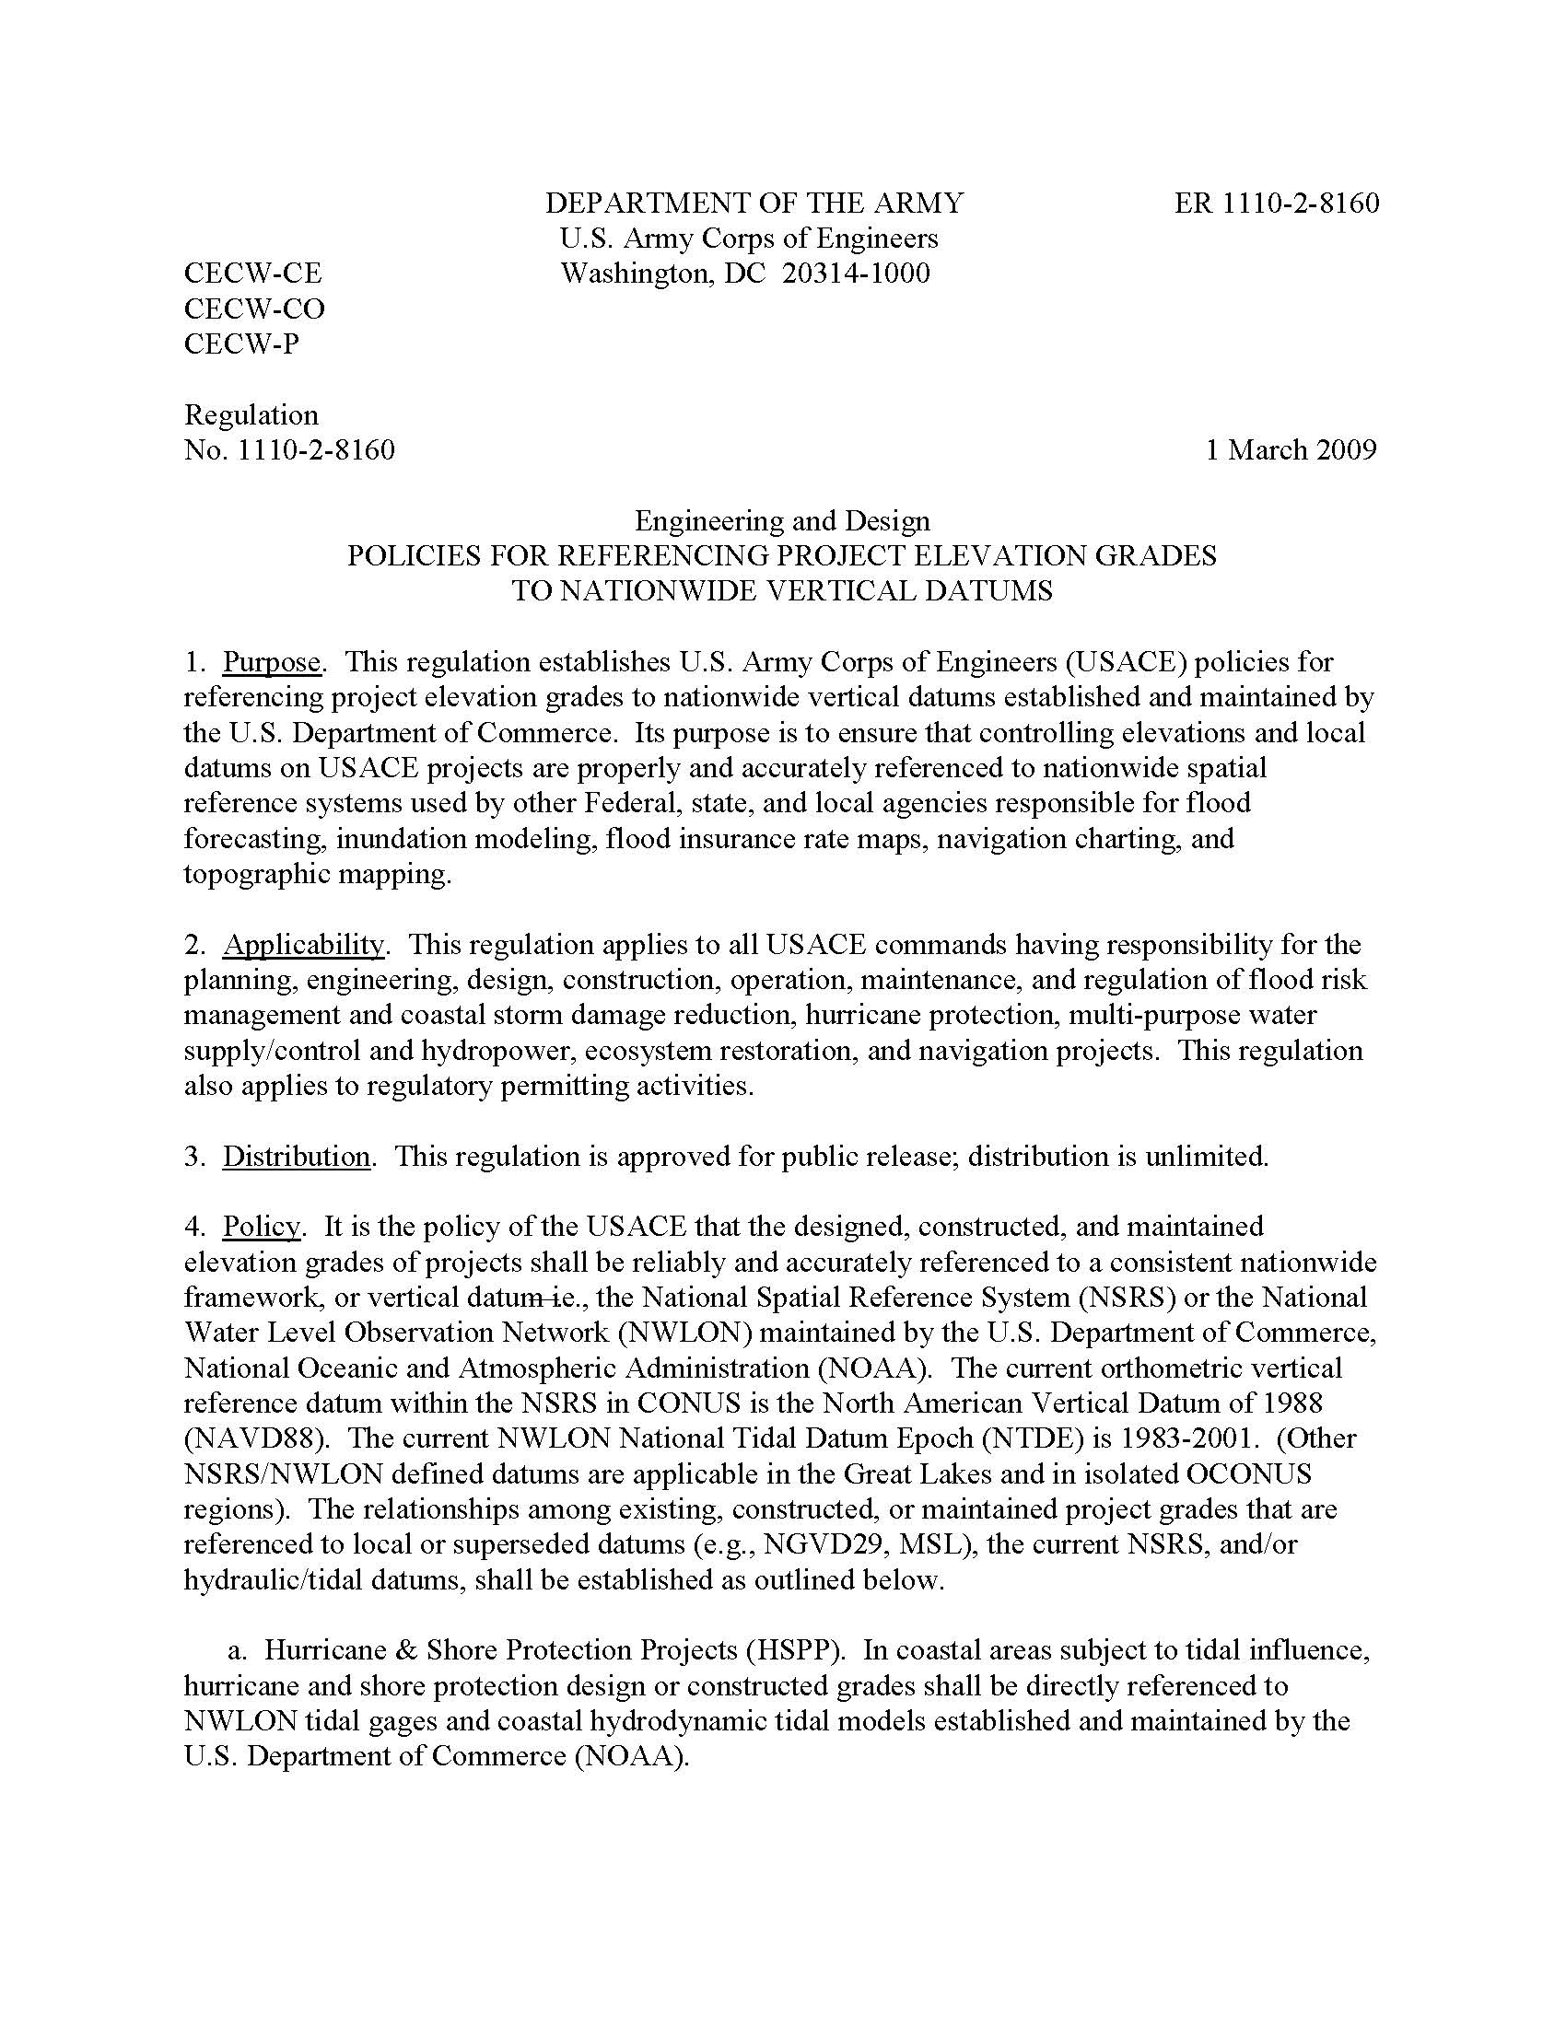
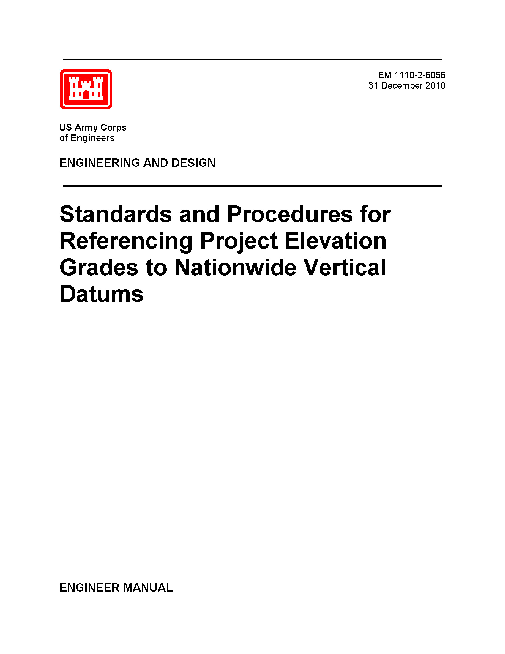
NSRS … do I have to use it?
Aside from OMB A-16, there are:
  ER 1110-2-8160 - Policies for Referencing Project Elevation Grades to Nationwide Vertical Datums
  EM 1110-2-6056 - Standards and Procedures for Referencing Project Elevation Grades to Nationwide Vertical Datums
Notes:
-EM is 422 pages of goodness! But there are a few items I’d love to follow up on that are a little ambiguous in that manual.
-what I’m trying to say here is … you should have all your dam data CLICK in the NSRS

Slide 10
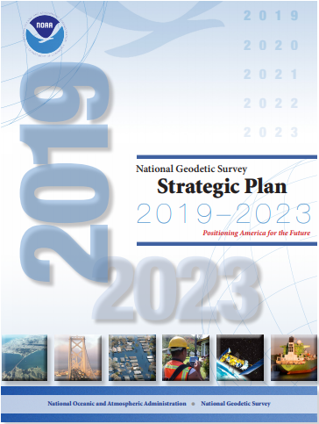
NGS Strategic Plan
  Reduce all definitional & access-related errors in geometric reference frame to 1 cm when using 15 min of GNSS data
  (aka “Replace NAD83”)
  Reduce all definitional & access-related errors in orthometric heights in geopotential datum to 2 cm when using 15 min of GNSS data
  (aka “Replace NAVD88”)
https://geodesy.noaa.gov/web/about_ngs/info/tenyearfinal.shtml
Notes:
Where did this all start?
How is all this possible?
And what will users get out of it?
It started before 2013, origins in NHMP and GRAV-D, but it became truly official once published in our 2013 strategic plan
What you get is more accurate positions and faster. (sure, most of you are using RTN for a lot, but static has its place)
We’re on track to achieve the goal of obtaining a 2cm by 1cm error ellipse with only 15 minutes of static GPS data.
Is that going to include other constellations, such as GLONASS and Galileo satellites? Yes, the Geodetic Research Division is already working to re-write software to include orbit data for those other constellations. (Jan 2021 is target)

Slide 11
Two Major Components of Modernized NSRS
Geometric (LLh)
Geopotential (H)
Notes:
-geometric component is latitude, longitude, and ellipsoid height
-geopotential component is combined with the geometric components to calculate an ortho height or capital H

Slide 12
Not just new datums…
  NSRS Modernization
Replace NAD83
Replace NAVD88
Re-invent Bluebooking
Improve Geodetic Toolkit
Better Surveying Methods
Blueprint for 2022, Part 1
Blueprint for 2022, Part 2
Blueprint for 2022, Part 3
Notes:
-so you’ve probably seen that phrase that I have front and center here, NSRS Modernization
-that’s the blanket term we use to refer to not just the new datums but other updates
-another phrase I want to mention are these “Blueprints for 2022”
-just about everything I cover today is mentioned in one of the Blueprints
-the Geodetic Toolkit, what’s that? another term that just refers to all those softwares NGS provides, like PAGES, ADJUST, etc.
-better methods – updating manuals like NGS-58 and 59 for example

Slide 13
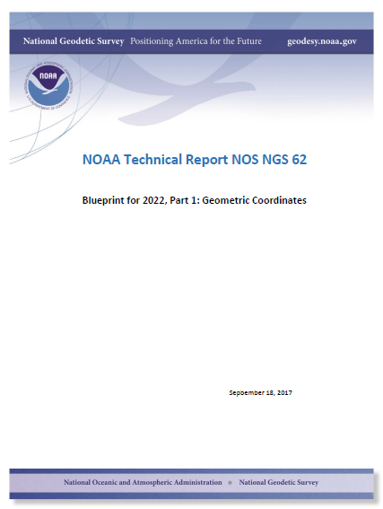
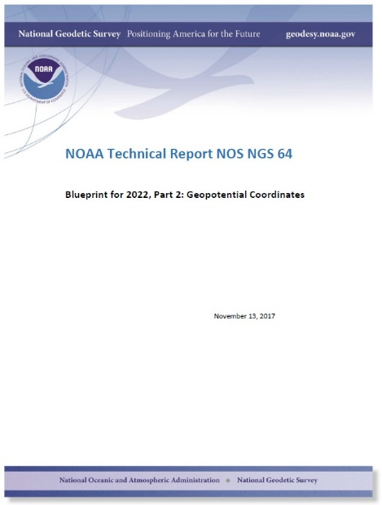
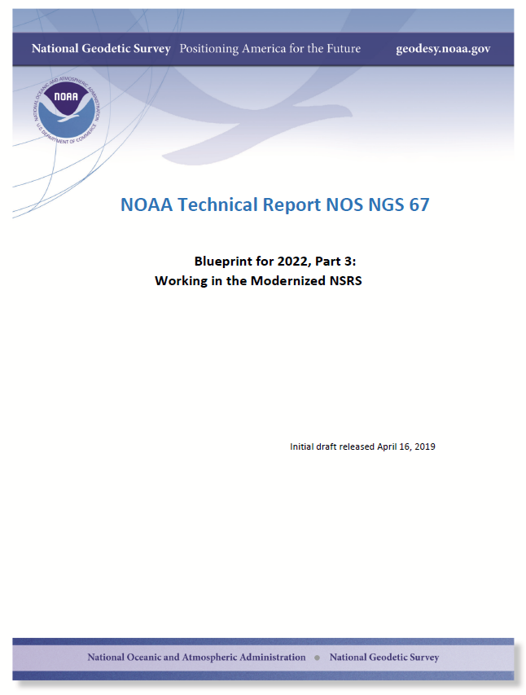
Modernizing the NSRS
The “blueprint” documents: Your best source for information
Geometric:
Sep 2017
NOAA TR NOS NGS 62
32 pages
Geopotential:
Nov 2017
NOAA TR NOS NGS 64
41 pages
Working in the modernized NSRS:
April 2019
NOAA TR NOS NGS 67
77 pages

Slide 14
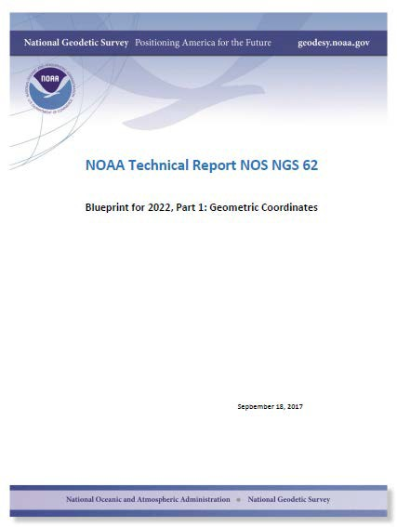
Majority of audience working in stable regions of North America…
North American Terrestrial Reference Frame of 2022
(NATRF2022)
Notes:
-remember, we covered 4 reference frames but if you’re just working in this region, you only have to be concerned with NATRF
-almost everything I’ve covered thus far is in this TR or Technical Report available on our website

Slide 15
Reference Frame Defined
A point of view or a ‘frame of reference’.
If your reference frame is North America, you are standing somewhere within North America, seeing how other places move from your point of view.
Notes:
--Also table/podium example

Slide 16
Replacing NAD83
develop four "plate-fixed" reference frames
remove non-geocentricity of NAD83
align to ITRF2014 at epoch 2020.00
remove most of tectonic plate rotation from ITRF2014 via Euler Pole Parameters
(pronounced: “oiler”)
Shift and Drift…
Notes:
-four geodetic tasks to this part of modernizing the NSRS
-note that afterthought at the bottom “shift and drift”

Slide 17
Replacing NAD83
develop four "plate-fixed" reference frames
remove non-geocentricity of NAD83
align to ITRF2014 at epoch 2020.00
remove most of tectonic plate rotation from ITRF2014 via Euler Pole Parameters
(pronounced: “oiler”)
Shift and Drift…

Slide 18
Four “Plate-Fixed” Reference Frames
North American Terrestrial Reference Frame of 2022
(NATRF2022)
Pacific Terrestrial Reference Frame of 2022
(PATRF2022)
Caribbean Terrestrial Reference Frame of 2022
(CATRF2022)
Mariana Terrestrial Reference Frame of 2022
(MATRF2022)
Notes:
-We refer them as “plate-fixed” because the frame moves with the plate, to minimize time-based coordinate shift. We’ll cover that in more detail, I have some slides I put together that I guarantee you’ll understand it, if not I’ll buy you a beer later. No, not really.

Slide 19
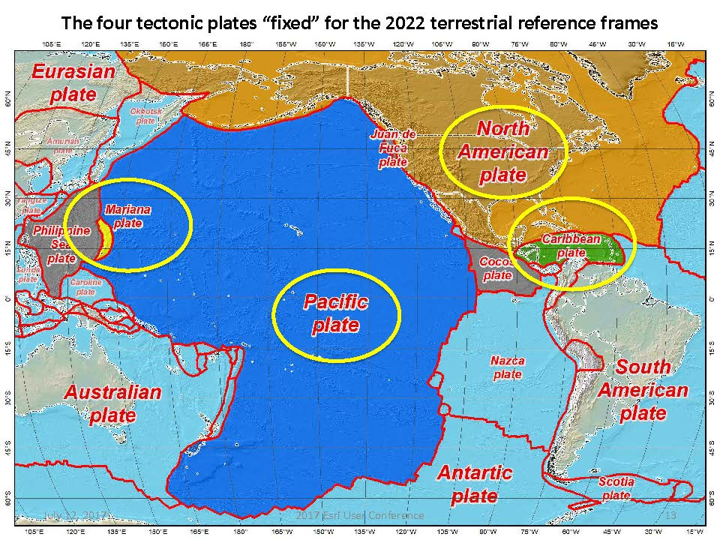
Notes:
-there’s four reference frames because there are four major tectonic plates within the NGS Area of Responsibility.
-As the National Geodetic Survey, we’re part of the DoC so we must cater to all US States and Territories
-thus we’ve got four tectonic plates in our Area of Operations, so four Ref Frames
-But…

Slide 20
North American Terrestrial Reference Frame of 2022
NATRF2022
I will use NATRF2022 as my examples, but same applies for each TRF.

Slide 21
The wrong question, circa 2022:
“What’s the position of that point?”
The right question, circa 2022:
“What’s the position of that point, on some specific date?”
Drift…
Notes:
-why??
-because of that word down there: drift

Slide 22
Replacing NAD83
develop four "plate-fixed" reference frames
remove non-geocentricity of NAD83
align to ITRF2014 at epoch 2020.00
remove most of tectonic plate rotation from ITRF2014 via Euler Pole Parameters
(pronounced: “oiler”)
Shift and Drift…
Notes:
-NON-geocentricity… well the goal was a geocentric NAD but it was the 80s, so they were off a little bit

Slide 23
Non-geocentricity of NAD83
Earth’s
Surface
h₁₄
h₈₃
NAD83
origin
ITRF2014
origin
~2.2 meters
GRS80
ellipsoid
Notes:
-picture this, there’s one quarter of an ellipsoid, notice they are the same geometry (size, shape) but different origin

Slide 24
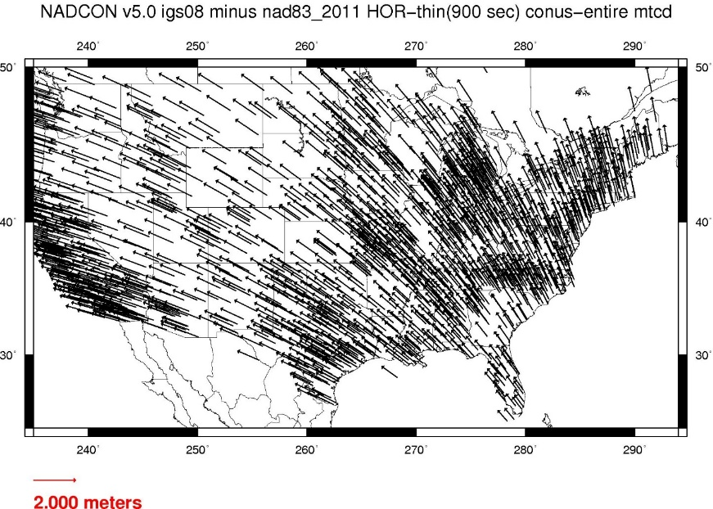
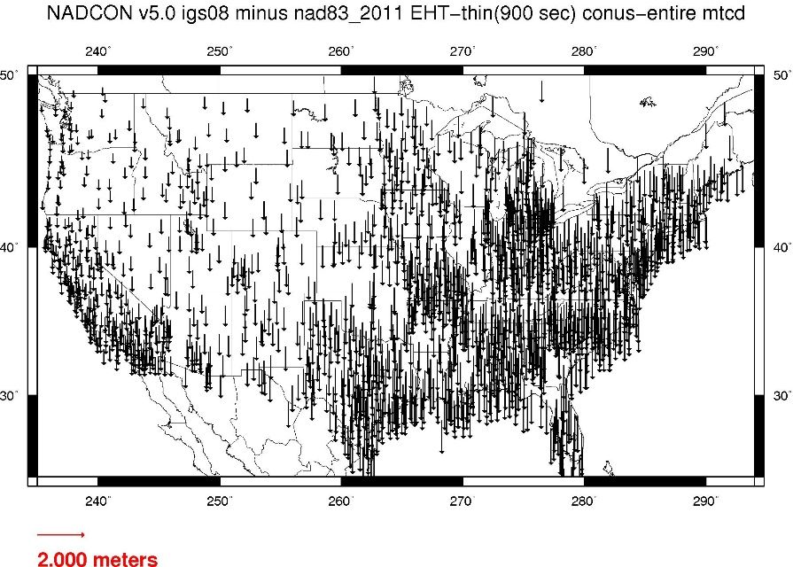
Geometric change due to ellipsoid non-geocentricity
Horizontal (Lat, Lon)
Ellipsoidal (h)
Shift…
Notes:
-Estimate of shift from NAD83(2011) epoch 2010.00 to NATRF2022 epoch 2020.00
-so this represents the positional shift due to non-geocentricity that we’re addressing/fixing
-now remember this is the Geometric component only, so the graphic on the right illustrates a somewhat constant shift because it is representing Ellipsoidal shift, not Orthometric
-Look at the size of those arrows, based on the scale bar there we’re looking at about 1 meter-ish lat,lon shift and somewhere around the same ellipsoidally around here
-REMEMBER, this is easy to address compared to geoid/ortho heights!

Slide 25
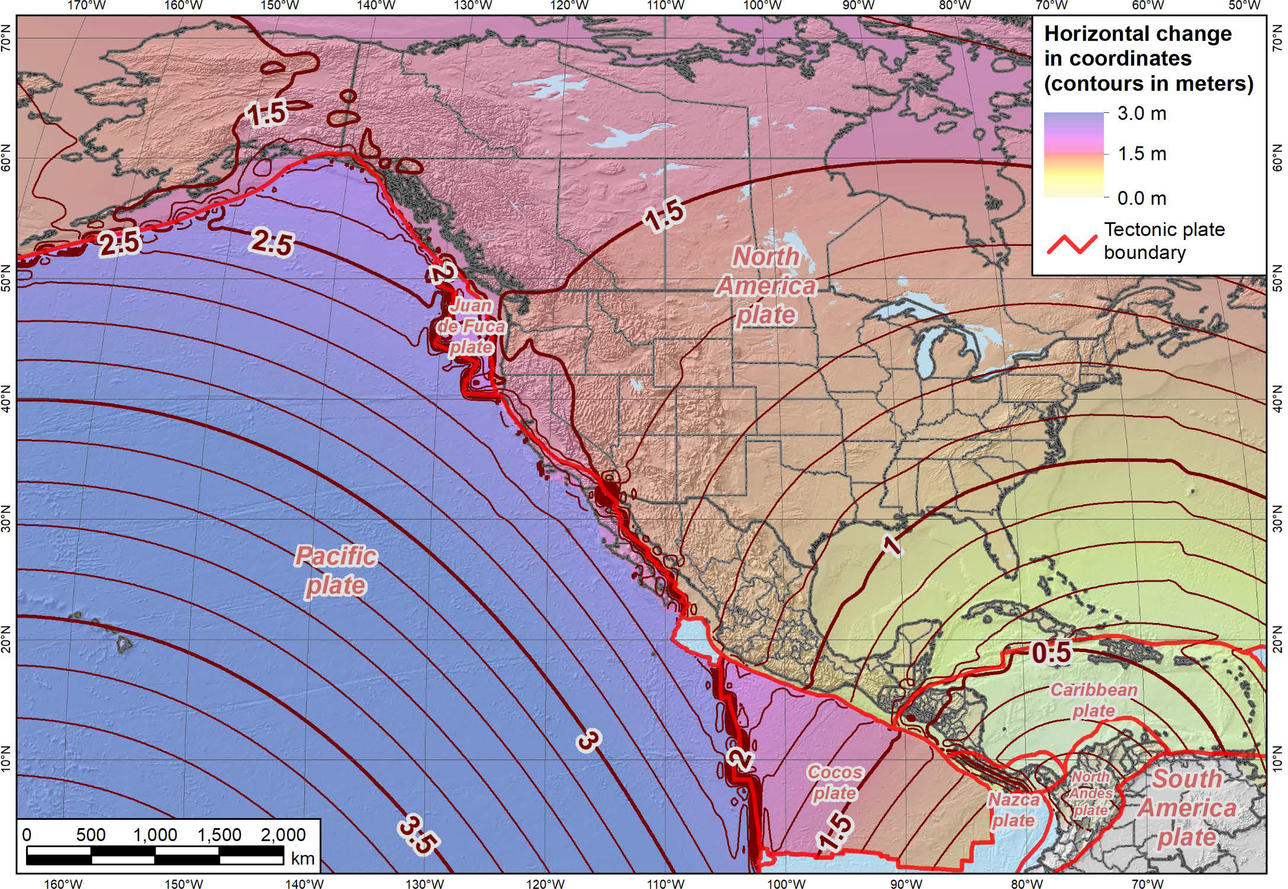
Notes:
-what’s the Magnitude of Horizontal Change?
-we will have tools online to simplify the process of estimating NAD83→NATRF2022

Slide 26
Replacing NAD83
develop four "plate-fixed" reference frames
remove non-geocentricity of NAD83
align to ITRF2014 at epoch 2020.00
remove most of tectonic plate rotation from ITRF2014 via Euler Pole Parameters
(pronounced: “oiler”)
Shift and Drift…
Notes:
We’ll talk about that ‘plate fixed’ later.
Now wait a minute Jeff, what is the IGS? You just explained the ITRF and told us about that!!
IGS Reference Frame is pretty much equivalent to the ITRF, created by the Intl. GNSS Service, of which NGS is a contributing partner.
The Intl. GNSS Service, let’s take a look at their website for a minute.
-pronounced “oiler” poles

Slide 27
International Terrestrial Reference Frame
The stable coordinate system that allows us to measure change over space, time and evolving technologies.
An accurate, stable set of station positions and velocities.
Network measurements interconnected by co-location of different space geodetic techniques.
“Approximately represents the motions of the tectonic plates with respect to the Earth's deep interior”… huh?
Notes:
What is the International Terrestrial Reference Frame
(ITRF)?
You’ve heard me mention the ITRF, but if you’ve been paying attention to OPUS Solution Reports you may’ve noticed the ITRF2014 coordinates over on the right hand side
Let’s try to visualize the ITRF. Last bullet,

Slide 28
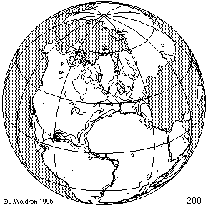
ITRF concept
Watch the grid!
Drift…
Notes:
Most simplistic way to explain ITRF is to watch this animation.
This is a very loose representation/visualization of what the ITRF is, a characterization only.

Slide 29
Replacing NAD83
develop four "plate-fixed" reference frames
remove non-geocentricity of NAD83
align to ITRF2014 at epoch 2020.00
remove most of tectonic plate rotation from ITRF2014 via Euler Pole Parameters
(pronounced: “oiler”)
Shift and Drift…
Notes:
We’ll talk about that ‘plate fixed’ later.
Now wait a minute Jeff, what is the IGS? You just explained the ITRF and told us about that!!
IGS Reference Frame is pretty much equivalent to the ITRF, created by the Intl. GNSS Service, of which NGS is a contributing partner.
The Intl. GNSS Service, let’s take a look at their website for a minute.
-pronounced “oiler” poles

Slide 30
Two types of drift
Tectonic Plate Rotation
    horizontal
Everything Else
    residual motions left after rotation
    regional linear motions
    localized subsidence or uplift
simple to model
complex
Notes:
-there’s two types of drift you’ll see

Slide 31
Tectonic Plate Rotation
    horizontal
simple to model
Notes:
-there’s two types of drift you’ll see

Slide 32
Euler Pole Parameters
of 2022
EPP2022

Slide 33
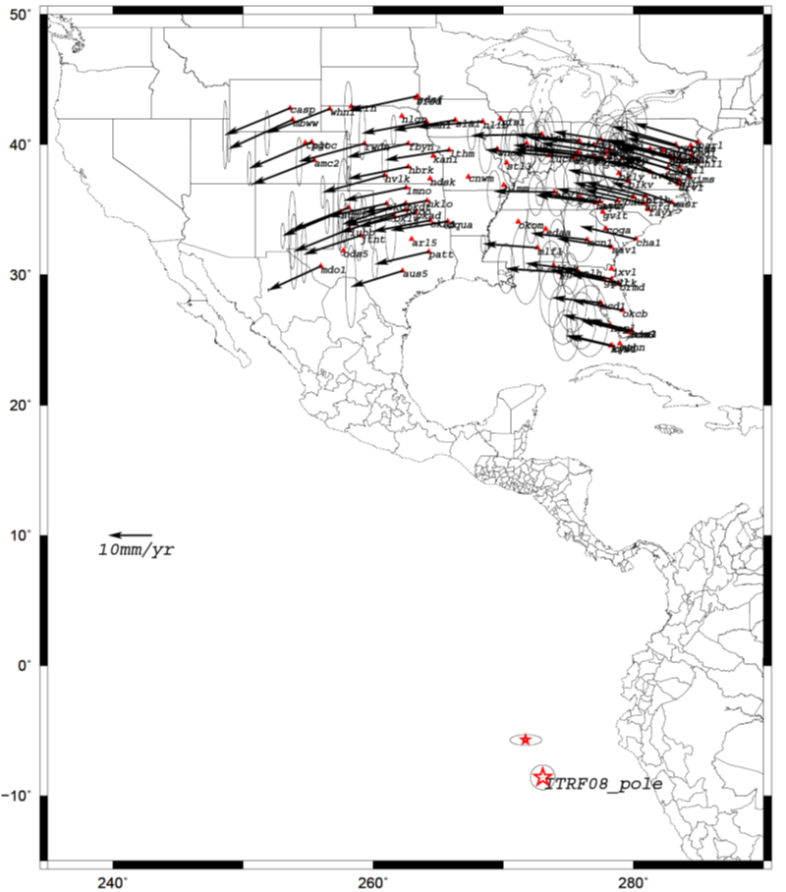
Euler Poles and “Plate-Fixed”
  In the ITRF, many tectonic plates have a dominant motion: rotation
  Euler Pole - point about which a plate rotates (yellow star)
NATRF2022 Euler Pole
Notes:
-these are ground-level horizontal velocities
-the arrows illustrate the positions and velocities of CORS plotted in ITRF2014
-our scale is on the left there, with that arrow representing 20mm of motion per year
-so right thru Ohio it’s a little cluttered but we’re seeing arrows about that length so about 2cm/20mm per yr
-what do we notice about the direction of these arrows?
-they look rotational, don’t they?
CLICK HERE
-Note the arrows in California do not conform to the rotation… those are CORS on a different PLATE which is moving in a different direction
CLICK HERE
-so when you look at those arrows you can see the rotation, but the point of rotation is obviously off the map, way down below the screen right?
-that point is what’s known as an Euler Pole
We say “NATRF2022” is “fixed” to the N.A. Plate, making it a “plate fixed” frame
-the frame is constant to itself, but rotating within ITRF, and moving in a different direction than the other 3 frames

Slide 34
Euler Poles and “Plate-Fixed”
ITRF
Frame = constant
NA Plate = rotating
NATRF
Frame = rotating
NA Plate = constant
Notes:
We say “NATRF2022” is “fixed” to the N.A. Plate, making it a “plate fixed” frame
-the frame is constant to itself, but rotating within ITRF, and moving in a different direction than the other 3 frames

Slide 35
Euler Poles and “Plate-Fixed”
ITRF
Frame = constant
NA Plate = rotating
NATRF
Frame = rotating
(relative to ITRF)
NA Plate = constant
(relative to NATRF2022)
Notes:
We say “NATRF2022” is “fixed” to the N.A. Plate, making it a “plate fixed” frame
-the frame is constant to itself, but rotating within ITRF, and moving in a different direction than the other 3 frames

Slide 36
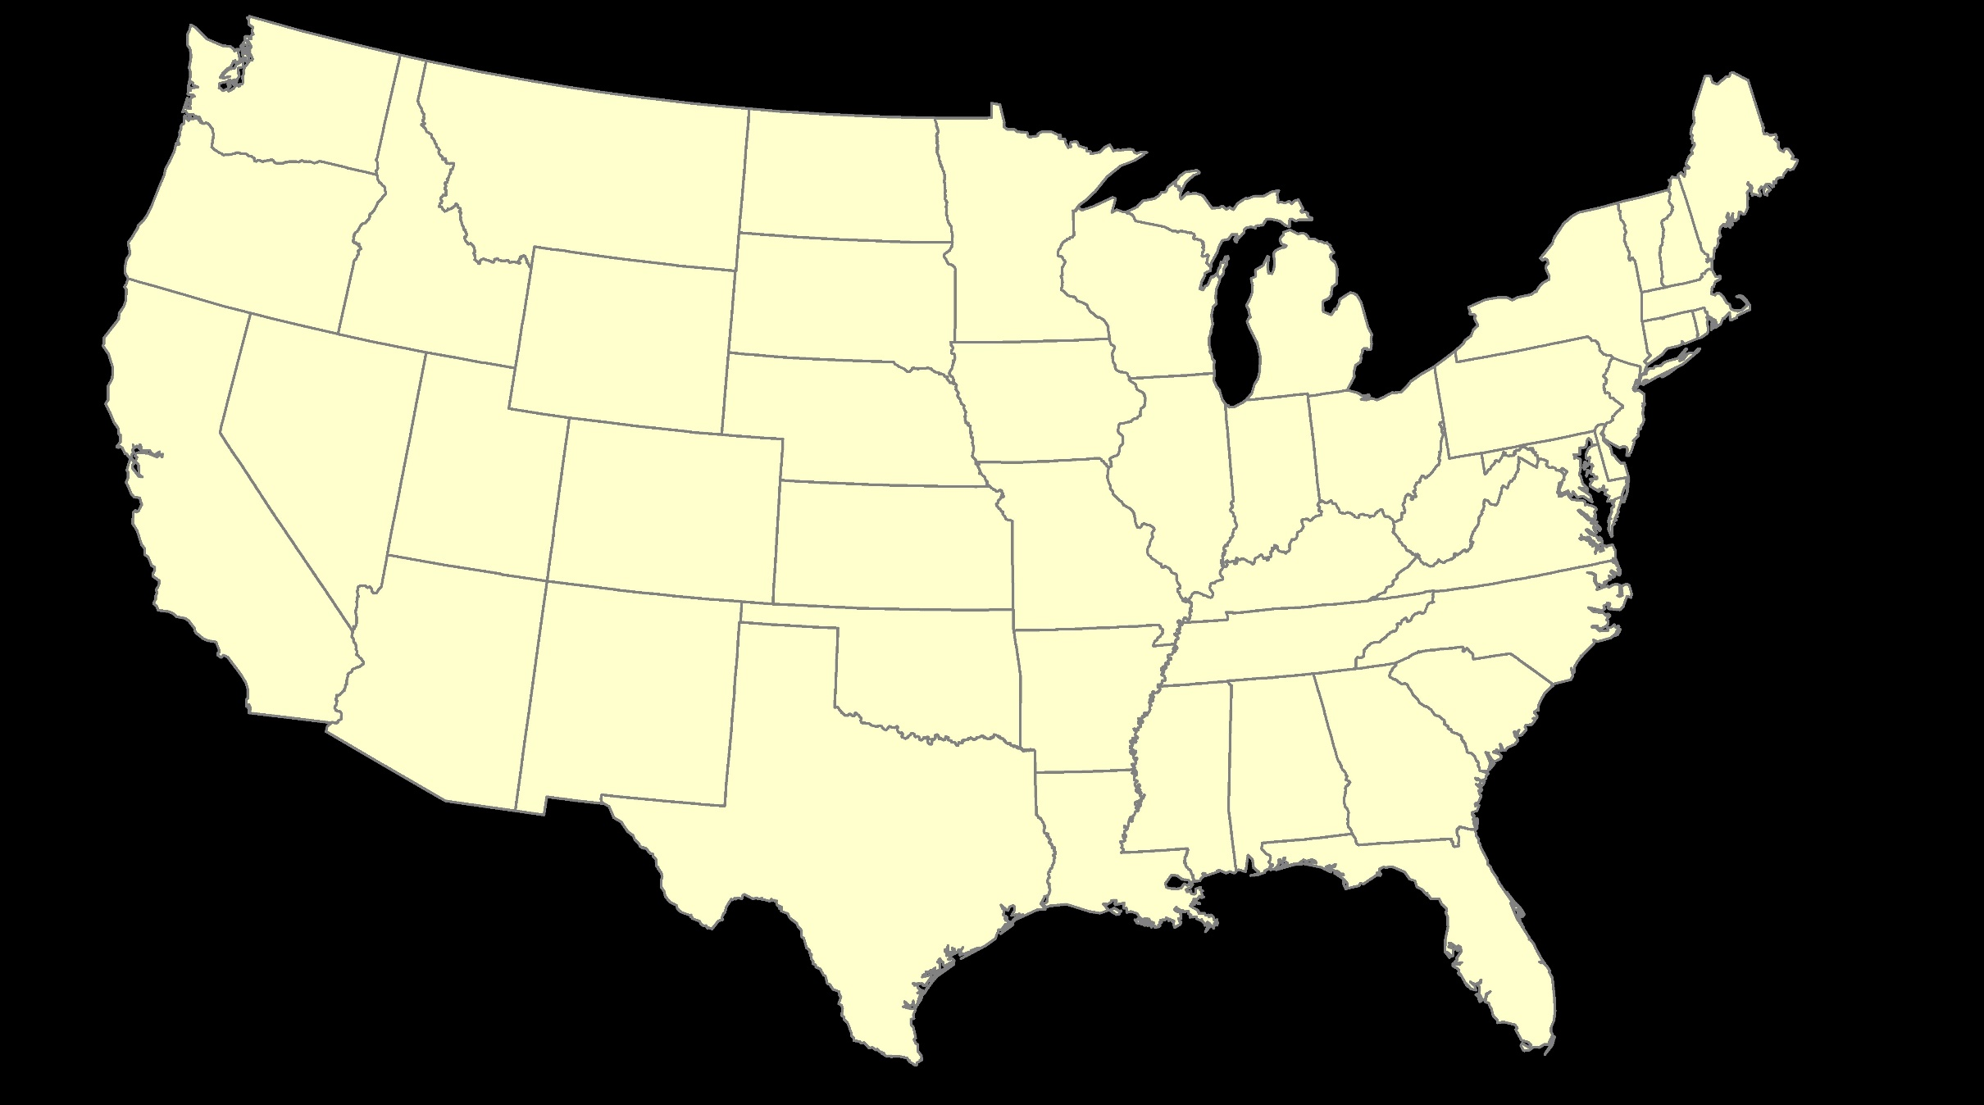
ITRF – constant frame, rotating plate

Slide 37
“Plate-Fixed”
NATRF – rotating frame, constant with plate

Slide 38
ITRF or NATRF – your choice, just use EPP

Slide 39
EPP – Euler Pole Parameters
Latitude
Longitude
Rotation Speed
yellow star off west coast of S. America
Notes:
-our EPP are that green arrow from the last slide
-the lat,lon being the good ol’ yellow star from a few slides ago

Slide 40
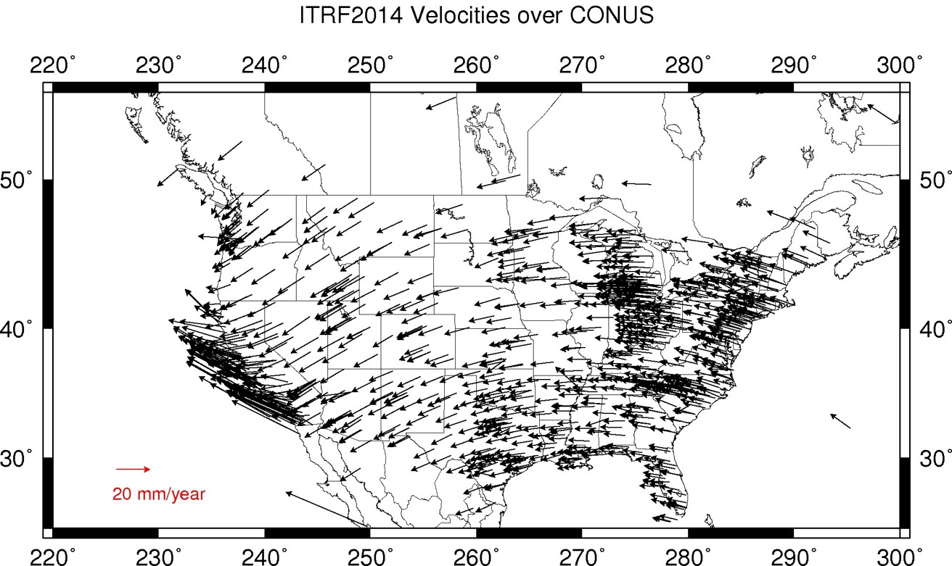
CORS Velocities in ITRF2014
Drift…

Slide 41
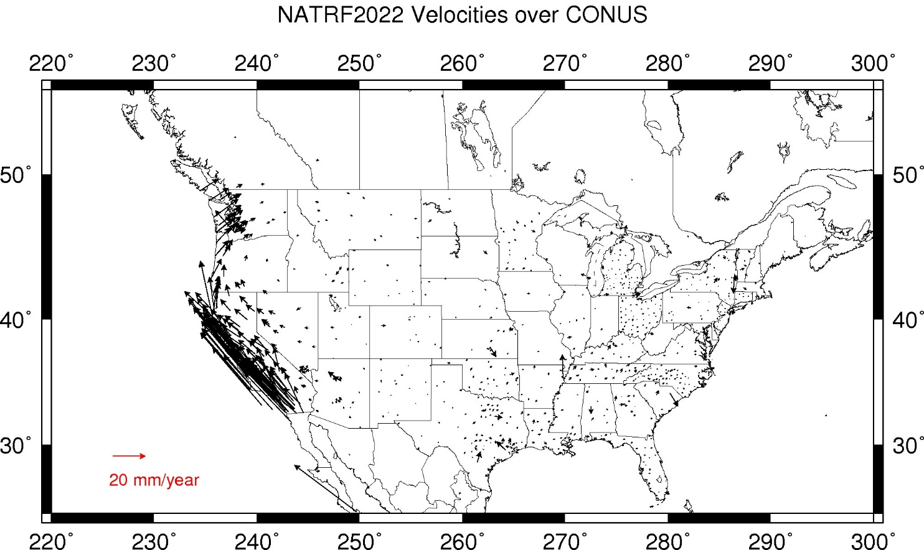
CORS Velocities in NATRF2022
Think of this map as ITRF2014 + EPP2022
Still SomeDrift…
Notes:
These velocities the motion that is left after removing Euler Pole rotation via it’s defining parameters, known simply as Euler Pole Parameters or EPP
These small bare visible arrows in our region are residual velocities leftover after modeling that Euler pole, which will then be modeled into the IFVM for NATRF2022.

Slide 42
ITRF2014 + EPP2022 = --TRF2022
Rotation of the
North American Plate
North American Terrestrial Reference Frame of 2022
(NATRF2022)
Caribbean Terrestrial Reference Frame of 2022
(CATRF2022)
Pacific Terrestrial Reference Frame of 2022
(PATRF2022)
Mariana Terrestrial Reference Frame of 2022
(MATRF2022)
Rotation of the
Caribbean Plate
ITRF2014
Rotation of the
Pacific Plate
Rotation of the
Mariana Plate
EPP2022
Notes:
-So it all starts with ITRF
-OPUS is already running all your processing in ITRF, take a look at one of your recent solution reports and you’ll see ITRF2014 coordinates on the right hand side (or IGS/IGb08)
-Not just North America, Each plate gets a set of EPP associated with it, as each plate is rotating around a different Euler Pole

Slide 43
Two types of drift
Tectonic Plate Rotation
    horizontal
Everything Else
    residual motions left after rotation
    regional linear motions
    localized subsidence or uplift
simple to model
complex
Notes:
-there’s two types of drift you’ll see

Slide 44
Everything Else
    residual motions left after rotation
    regional linear motions
    localized subsidence or uplift
Still SomeDrift…
complex
Notes:
-there’s two types of drift you’ll see

Slide 45
Intra-Frame Velocity Model of 2022
IFVM2022

Slide 46
Concept of goal of IFVM
Longitude (Easting) History of DI4044
Trend: -1.7 mm / year
RED IS NATRF2022
COORDINATE
Still Some Drift…
Trend: -14.3 mm / year
BLUE IS ITRF COORDINATE
2004 2006 2008 2010 2012 2014 2016 2018
Notes:
First look at that blue line, that is the velocity of DI4044 if we graph it’s easting coordinate in ITRF over 10+ years.
So look at the reddish line, that’s the longitude/easting of PID DI4044 after the EPP (rotation) is modeled and factored in, but before the IFVM is applied.
This is the velocity of the point in NATRF2022
Rotation of plate removed. It is not constant because the point still suffers small “intra-frame” velocities.
Such IFVs will be captured in a model by NGS.
The intent of the IFVM is to remove even that movement to better support coordinate comparisons, etc.

Slide 47
CORS Velocities in NATRF2022
Think of this map as ITRF2014 + EPP2022
Still SomeDrift…
Notes:
These velocities the motion that is left after removing Euler Pole rotation via it’s defining parameters, known simply as Euler Pole Parameters or EPP
These small bare visible arrows in our region are residual velocities leftover after modeling that Euler pole, which will then be modeled into the IFVM for NATRF2022.

Slide 48
Still Some Drift…
  Everything in the world moves
  Coordinates will be associated with the actual date when the data was collected!
  Velocities at all marks can be estimated using the IFVM
  IFVM goal is to move collected data thru time to Reference Epochs for coordinate comparisons/analysis
Notes:
Model of all residual velocities, after removal of tectonic rotation via EPP
Horizontal residual motion
Total vertical motion (ellipsoid heights)
Replaces / Improves upon HTDP

Slide 49
Majority of audience working in stable regions of North America…
North American Terrestrial Reference Frame of 2022
(NATRF2022)
Notes:
-remember, we covered 4 reference frames but if you’re just working in this region, you only have to be concerned with NATRF
-almost everything I’ve covered thus far is in this TR or Technical Report available on our website

Slide 51
State Plane
Coordinate System

Slide 52
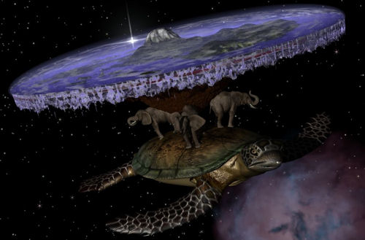
Alternative Earth models exist…

Slide 53
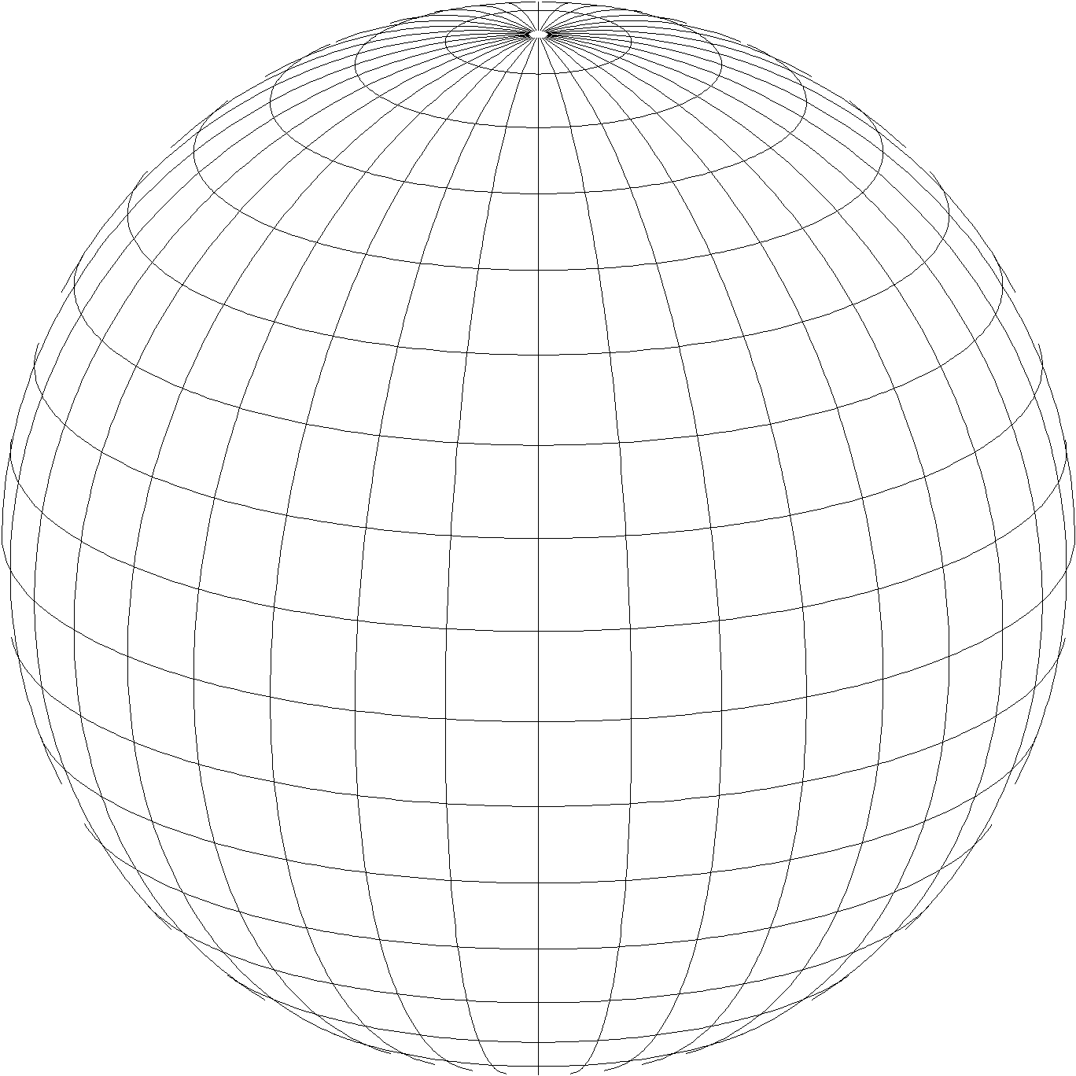
A “flat earth” for the future
State Plane Coordinate System of 2022 (SPCS2022)
  Referenced to 2022 Terrestrial Reference Frames
  Based on same reference ellipsoid as SPCS 83 (GRS 80)
  Same 3 conformal projection types as SPCS 83 and 27:
Lambert Conformal Conic (LCC)
Transverse Mercator (TM)
Oblique Mercator (OM)

Slide 54
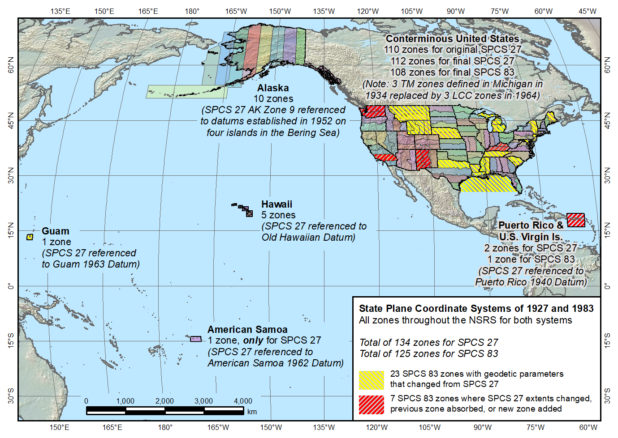
SPCS 83 and 27
State Plane Coordinate Systems of 1927 (134 zones) and 1983 (125 zones)
The shape of things to come for SPCS2022

Slide 55
Getting acquainted with SPCS2022
Distortion design philosophy
  Linear distortion minimized at topographic surface (not at ellipsoid surface)
  Purpose: to reduce difference between projected “grid” and actual “ground” distances
Other things:
  Zone “layers”
  Status of zone designs
  The timing of it all…
Notes:
Will go over main general characteristics of SPCS2022 (not enough time to go into detail)
This is based on final SPCS2022 Policy & Procedures (not yet published but most decisions have been made on content)
Final policy & procedures created based in part on public response to the FRN
A key element of SPCS2022 is linear distortion (“scale error”) design requirements
Linear distortion is the difference between a “grid” distance (between the projected coordinates of a pair of points) and the true horizontal “ground” distance (at the topographic surface of the Earth)
SPC2022 zones are designed to minimize linear distortion at the topographic surface, NOT at the ellipsoid surface (as was done for SPCS 83 and 27)
Other relevant characteristics are listed; each will be discussed in this presentation

Slide 56
Map projection linear distortion
Map projection designed to minimize linear distortion on ellipsoid (at “sea level”)
Topographic surface
Horizontal ground distance
Projection surface
Grid (“map”) distance
Grid distance < ground distance
Ellipsoid surface
(~“sea level”)
This design approach
used for SPCS 27 and 83 (minimizes distortion with respect to ellipsoid)

Slide 57
Map projection linear distortion
Map projection designed to minimize linear distortion at
ground surface
Topographic surface
Projection surface
Grid distance ≈ ground distance
Ellipsoid surface
(~“sea level”)
This design approach is being used for SPCS2022 (minimizes distortion with respect to topography)

Slide 58
SPCS2022 “layers” and designs
Max of up to 3 zone “layers” allowed
  One must be statewide zone
  Most states will have total of 2 layers
NGS designs:
  Statewide zone for every state
  Multiple zones not designed by stakeholders
Many states made requests and proposals
  Requests for zones designed by NGS
  Proposals for zones designed by stakeholders

Slide 59
Status of zone layout and designs
One layer (statewide): 18 states and territories
  Includes combined territories sharing 1 zone
    Puerto Rico and U.S. Virgin Islands
    Guam and Commonwealth Northern Mariana Islands
Two zone layers: 28 states
Three zone layers: 10 states
NOTE: Zones within a layer cannot overlap

Slide 60
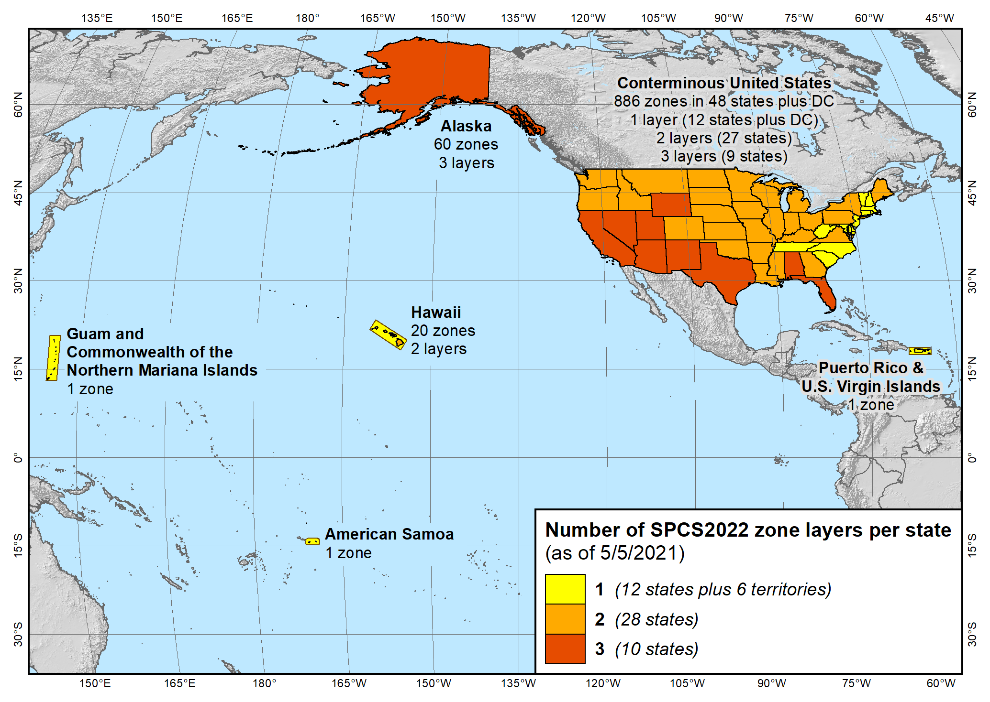
Maps of all SPCS2022 layers
State Plane Coordinate System of 2022 (940 zones in 56 states and territories)

Slide 61
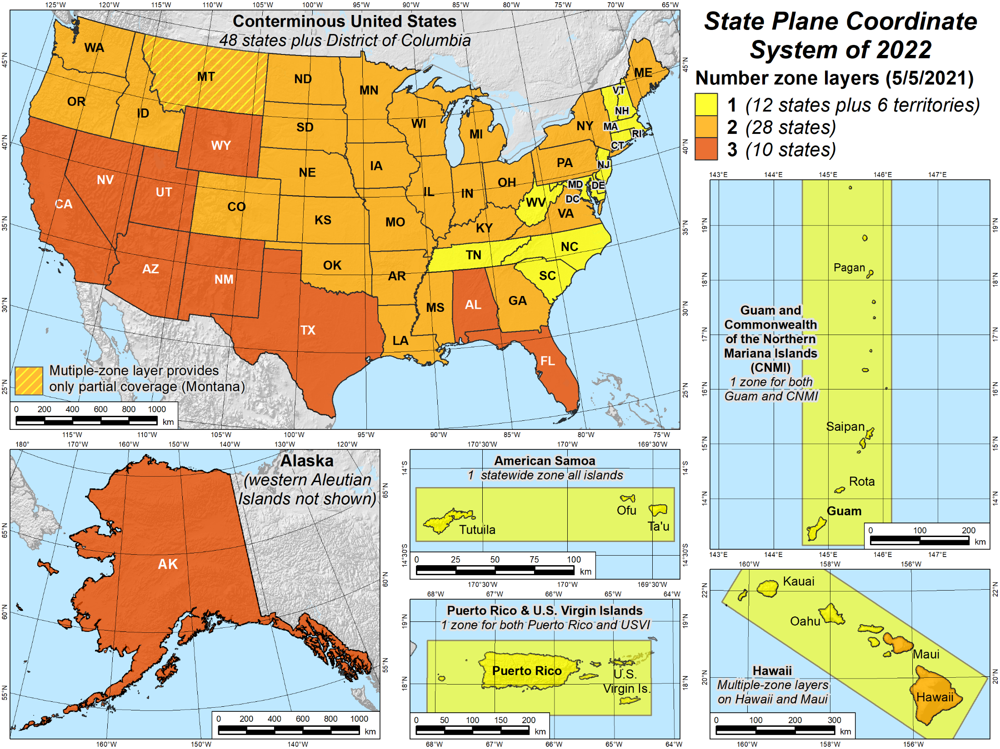
Maps of number of layers

Slide 62
Status of zone layout and designs
Designs by NGS
  159 zones (including 54 statewide)
  Range from 1 to 22 zones per state (max in Alaska)
Designs by state stakeholders
  810 zones in 28 states
  Range from 1 to 88 zones per layer (max in Ohio)
  Essentially all are “low distortion projections”
Total = 969 zones for 56 states and territories
  Number may decrease, but will not increase

Slide 63
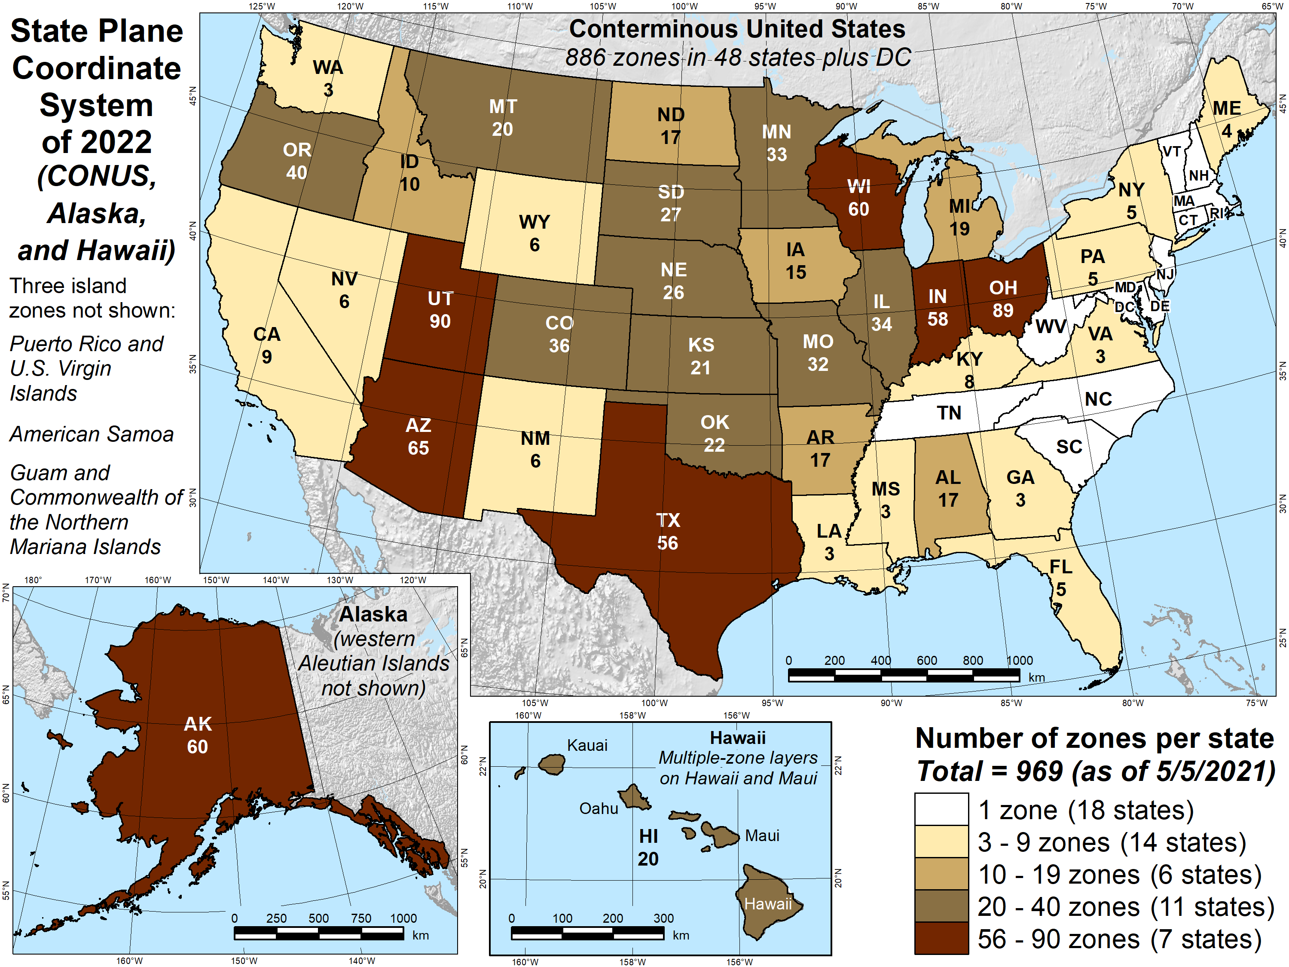
Map number of zones

Slide 64
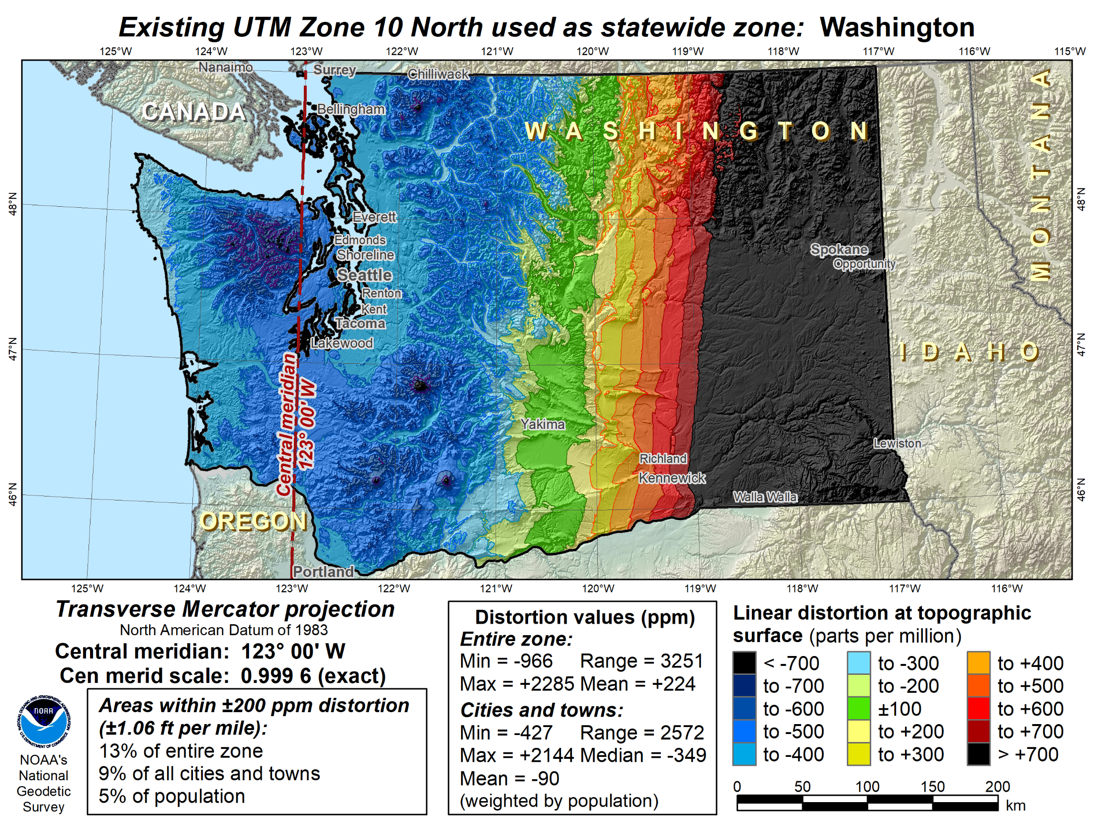

Slide 65
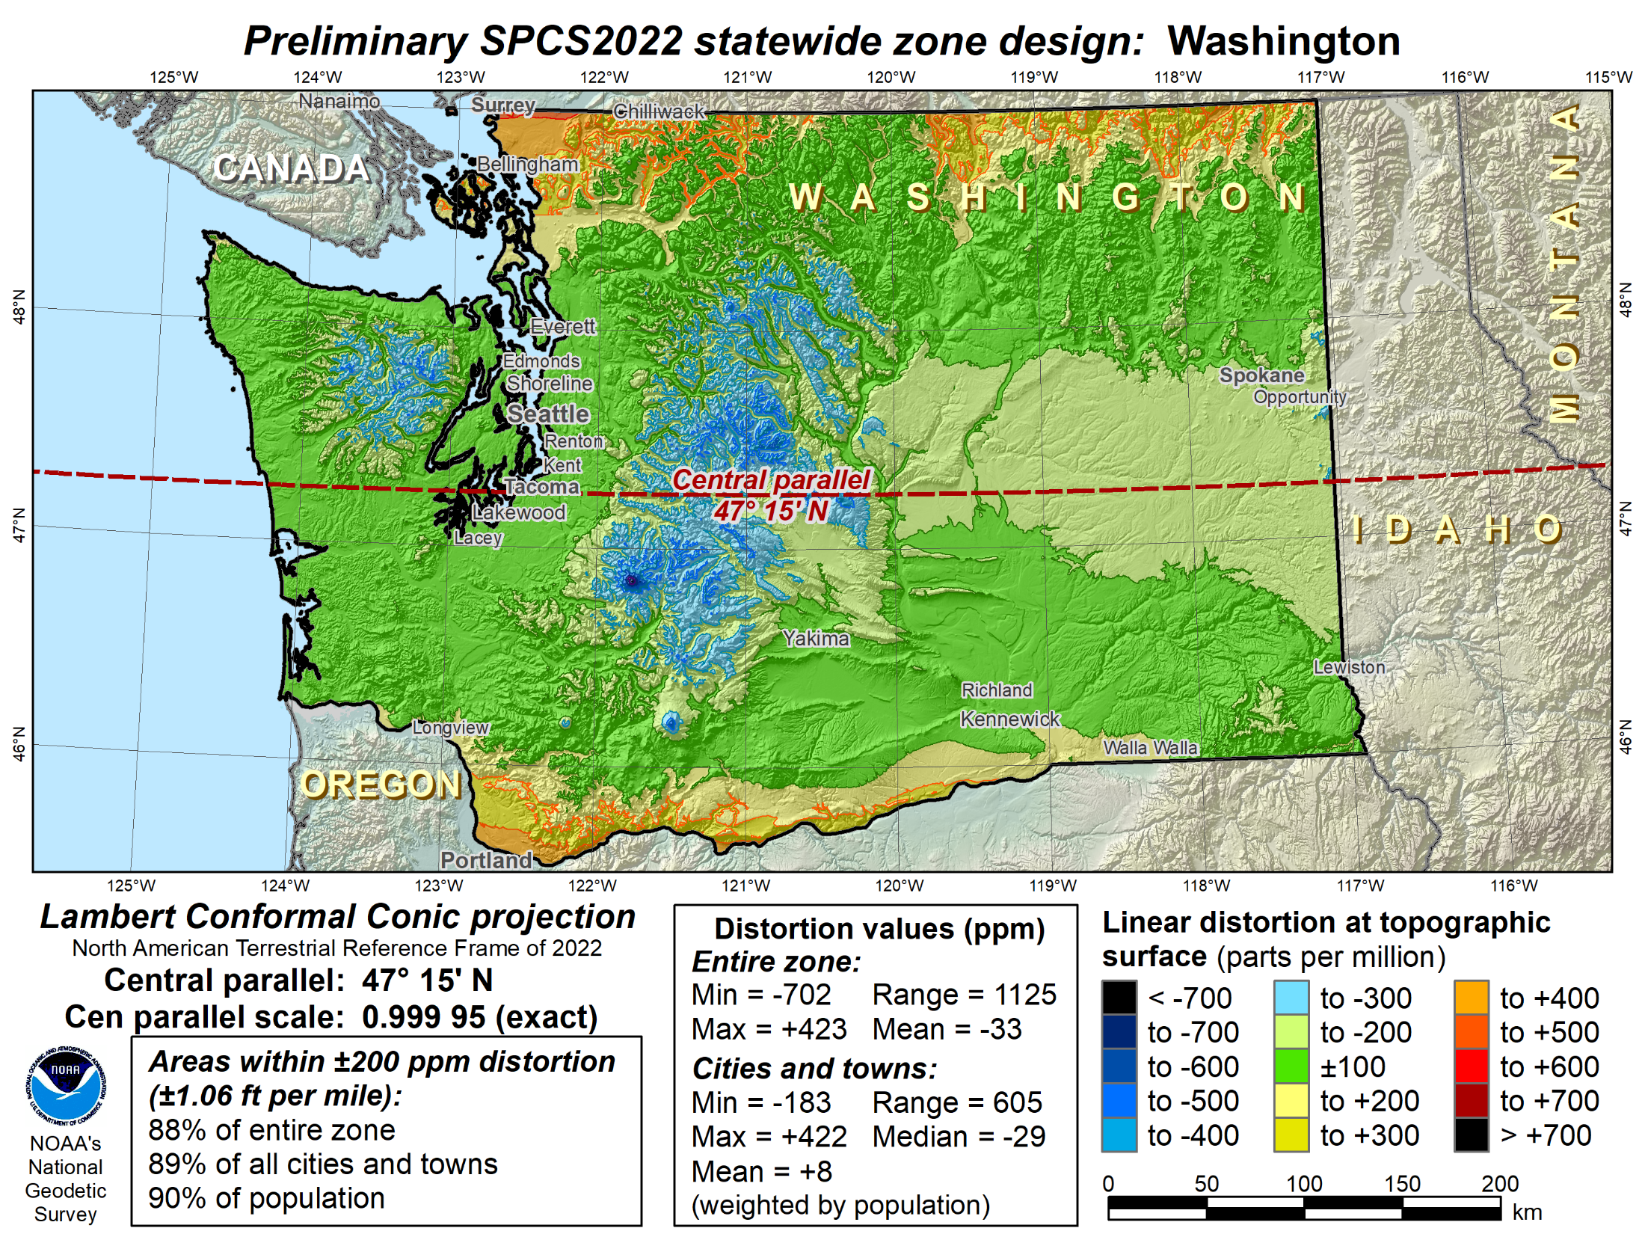

Slide 66
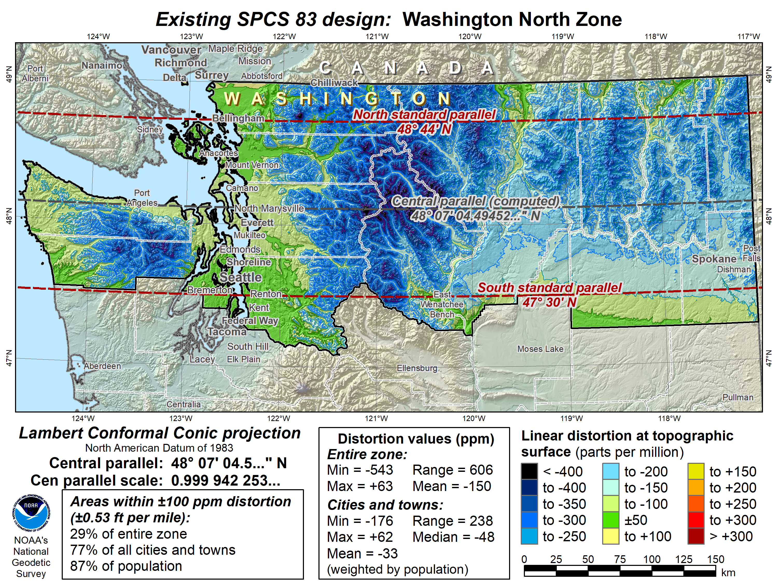

Slide 67
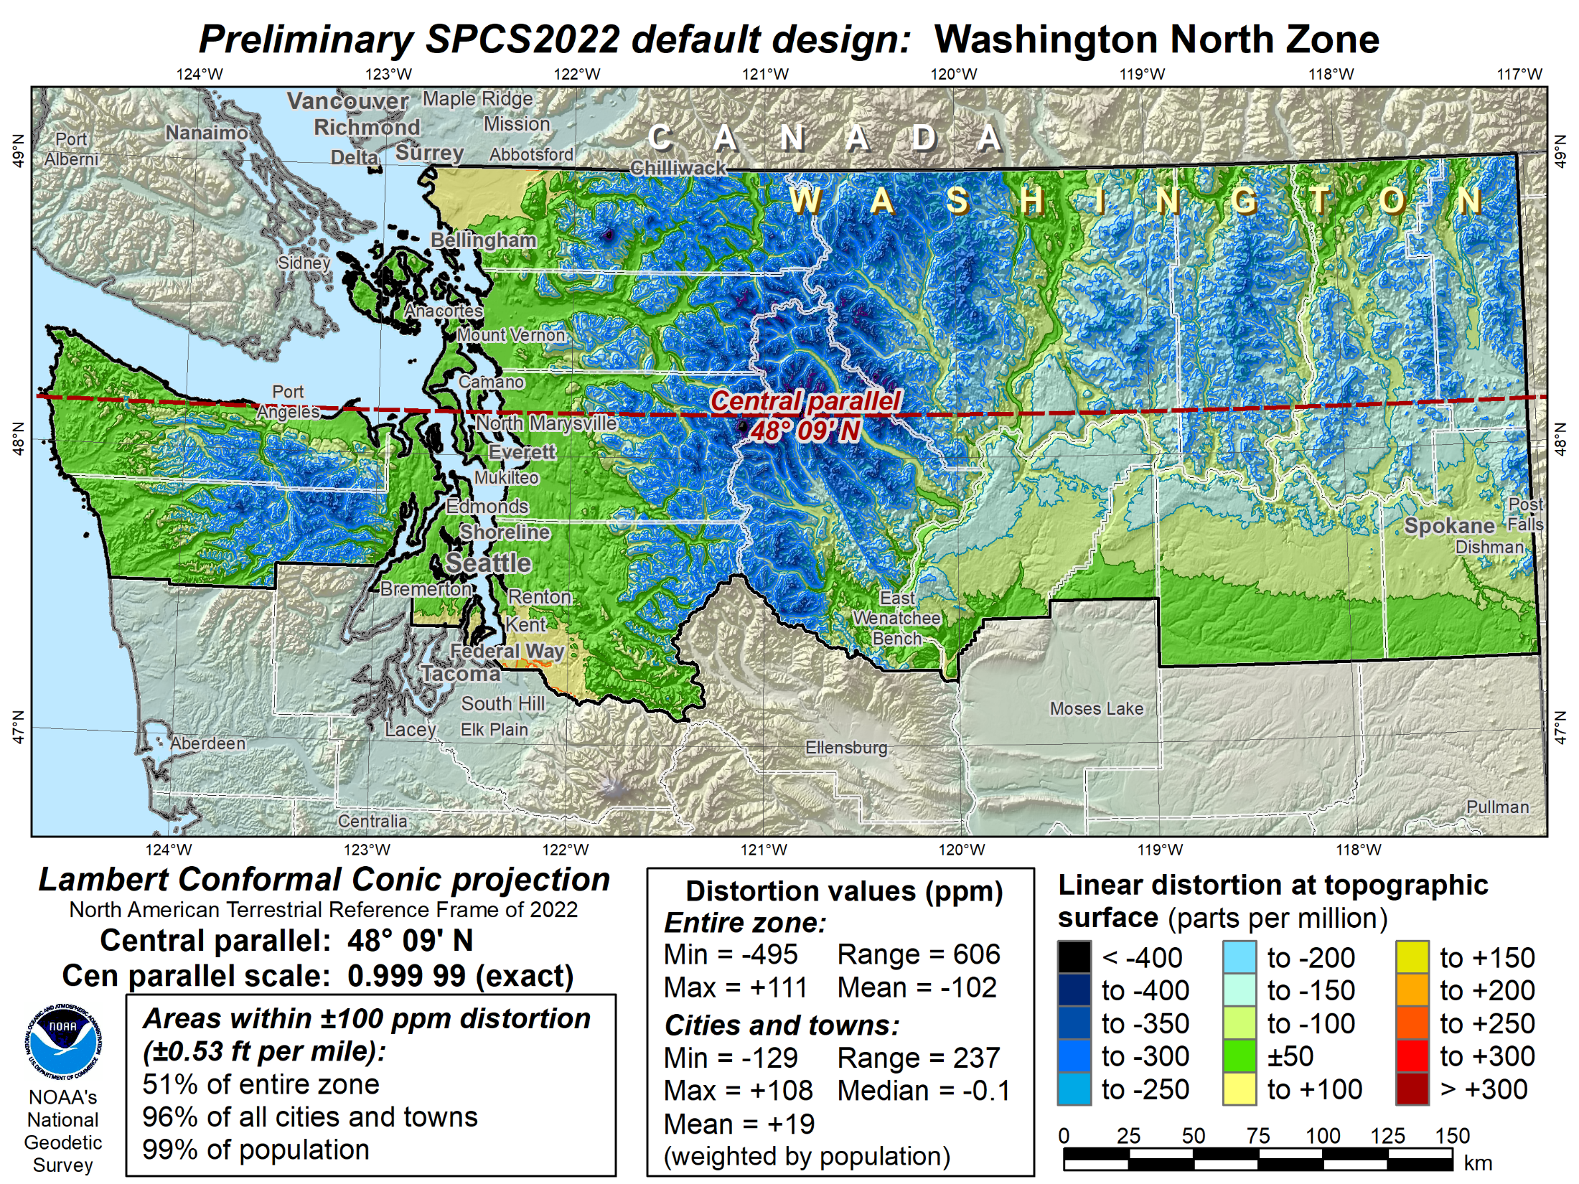

Slide 68
SPCS2022 zone designs
All designs so far are PRELIMARY
Begin finalizing designs NOW
  Compile and compare all designs
  Ensure consistent and correct
Get stakeholder input before finalizing
  Provide preliminary complete parameters
  Solicit input from stakeholders 2021/2022
  Finalize after stakeholder input

Slide 69
SPCS2022 summary
Minimize distortion at topo surface, not ellipsoid
Up to 3 zone “layers” allowed
  Some layers very similar to existing SPCS 83
  Some layers very different
Total 969 zone for initial rollout of SPCS2022
  NGS: 159 zones (includes 54 statewide)
  Stakeholders: 810 zones in 28 states
  Number of zones may decrease, will not increase
Will be implemented along with Modernized NSRS
  Earlier usage with NAD 83 will not be supported by NGS
  Can change/add/remove zones after modernized NSRS

Slide 70
About the timing of it all…
Finalize all designs in 2022 (maybe later…)
Other things in 2022 (maybe later…)
  Provide machine-readable definitions
  SPCS2022 report
  Modify NGS algorithms (e.g., 1-parallel Lambert)
Official release with rollout of modernized NSRS
  Final definitions available in 2022 (maybe later…)
  But will not release before modernized NSRS
  Likely after 2025…

Slide 71
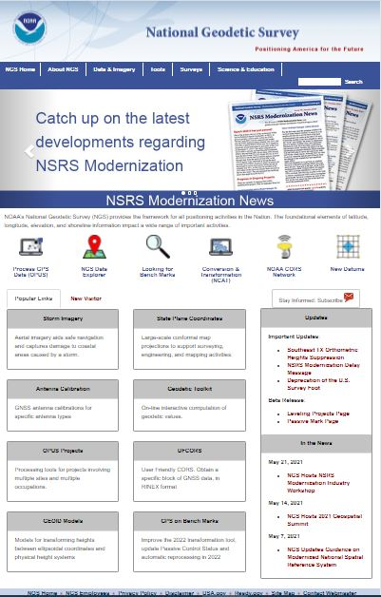

Slide 72
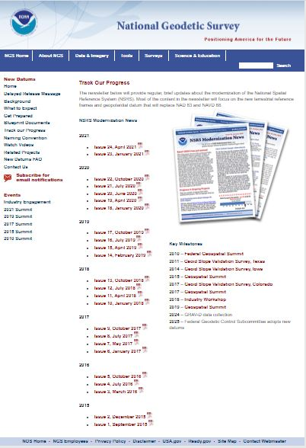

Slide 73
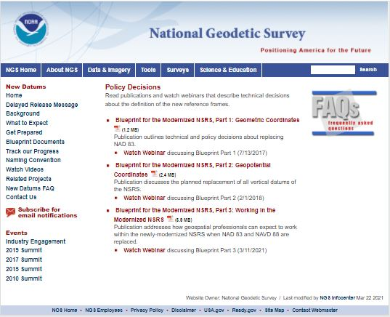

Slide 74
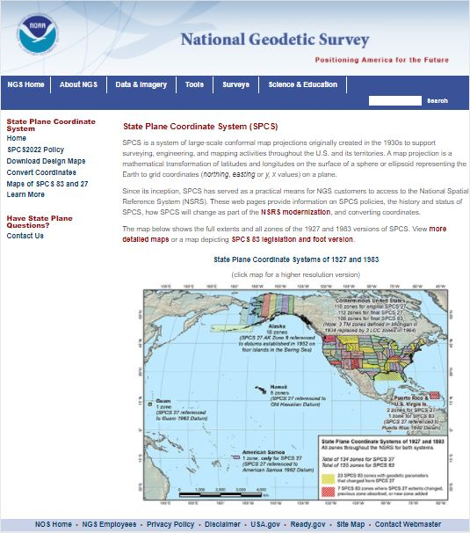

Slide 75
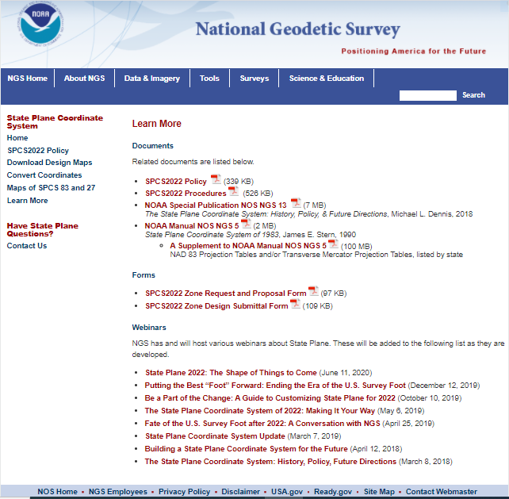

Slide 76
https://www.ngs.noaa.gov/ADVISORS/
-use any major search engine: “NGS advisors”
Daniel Determan
Northwest Regional Geodetic Advisor
dan.determan@noaa.gov
206-526-6874

