Slide 1


The Modernized National Spatial Reference System
Where Things Stand and the Road Ahead
Transportation Research Board
104th Annual Meeting
Washington DC, January 5-9, 2025
Michael Dennis, PhD, PE, PLS
SPCS2022 Project Manager

Slide 2
“Modernizing” the NSRS means:
Update all National Spatial Reference System (NSRS) coordinates
Replace existing datums with new datums
Account for coordinates changing with time
Improve NGS products and services
Simplify customer contributions
Make the NSRS:
More accurate
More accessible
More efficient
More compatible with GNSS
January 7, 2025
TRB Annual Meeting 2025
2

Slide 3
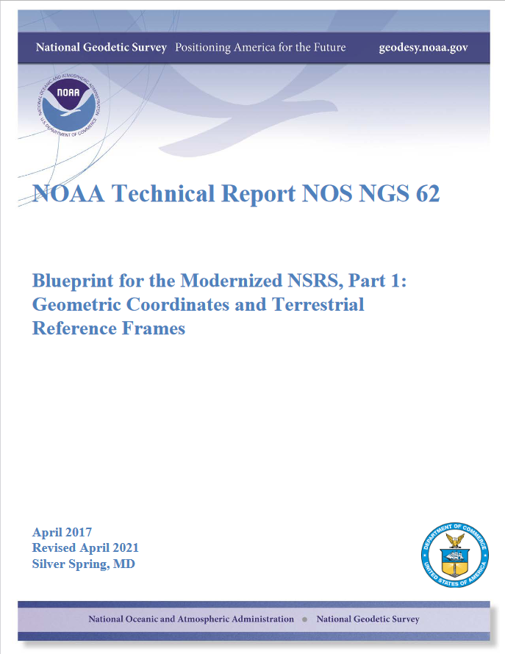
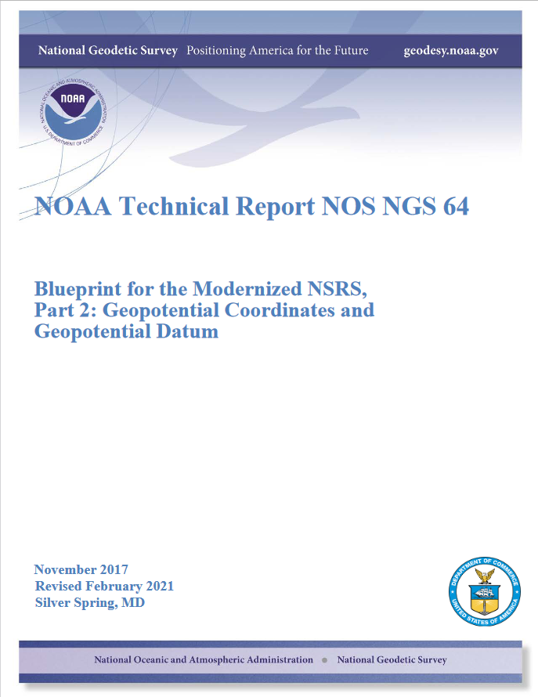
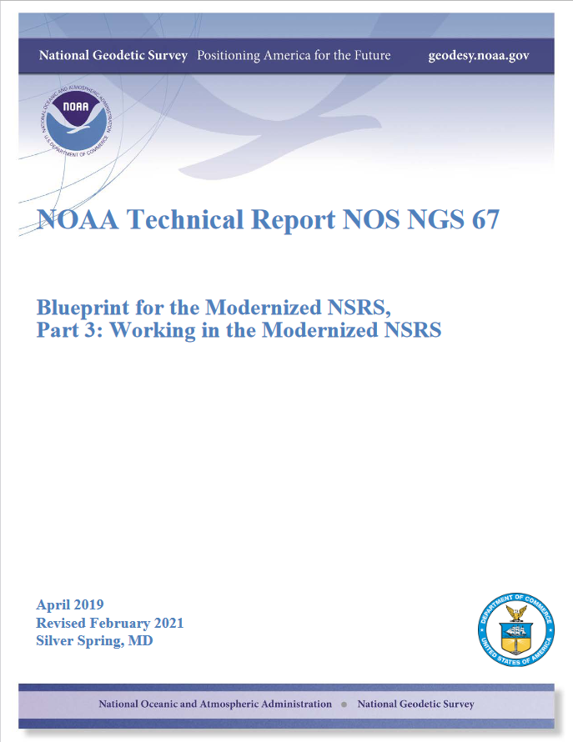
NSRS Modernization “Blueprint” documents
Geometric Coordinates and Terrestrial Reference Frames
Geopotential Coordinates and Geopotential Datum
Working in the Modernized NSRS
January 7, 2025
TRB Annual Meeting 2025
3

Slide 4
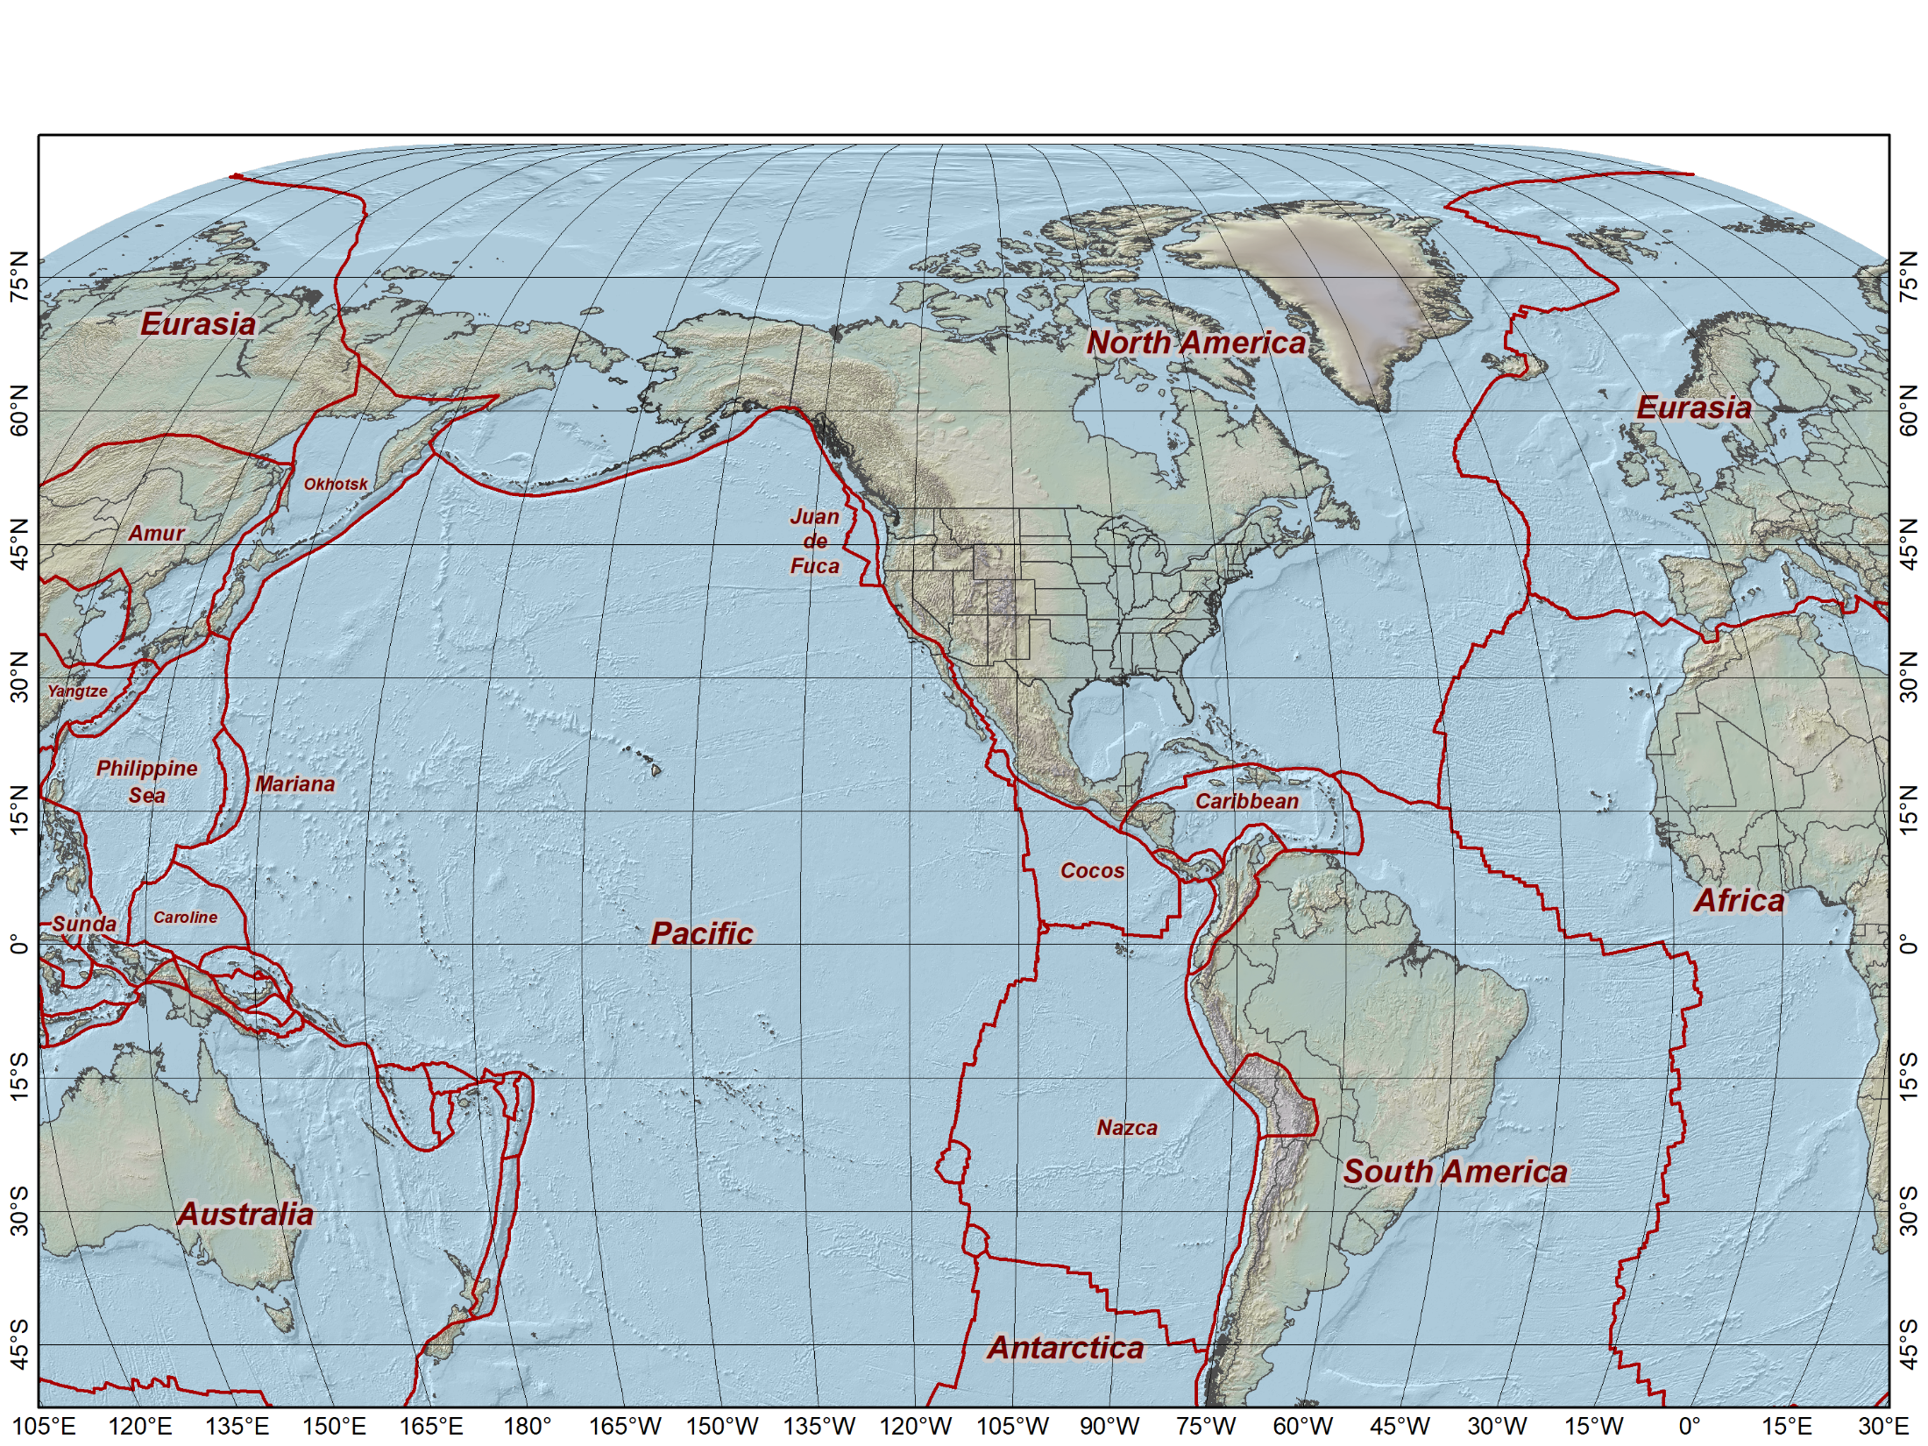
Tectonic plates
4

Slide 5
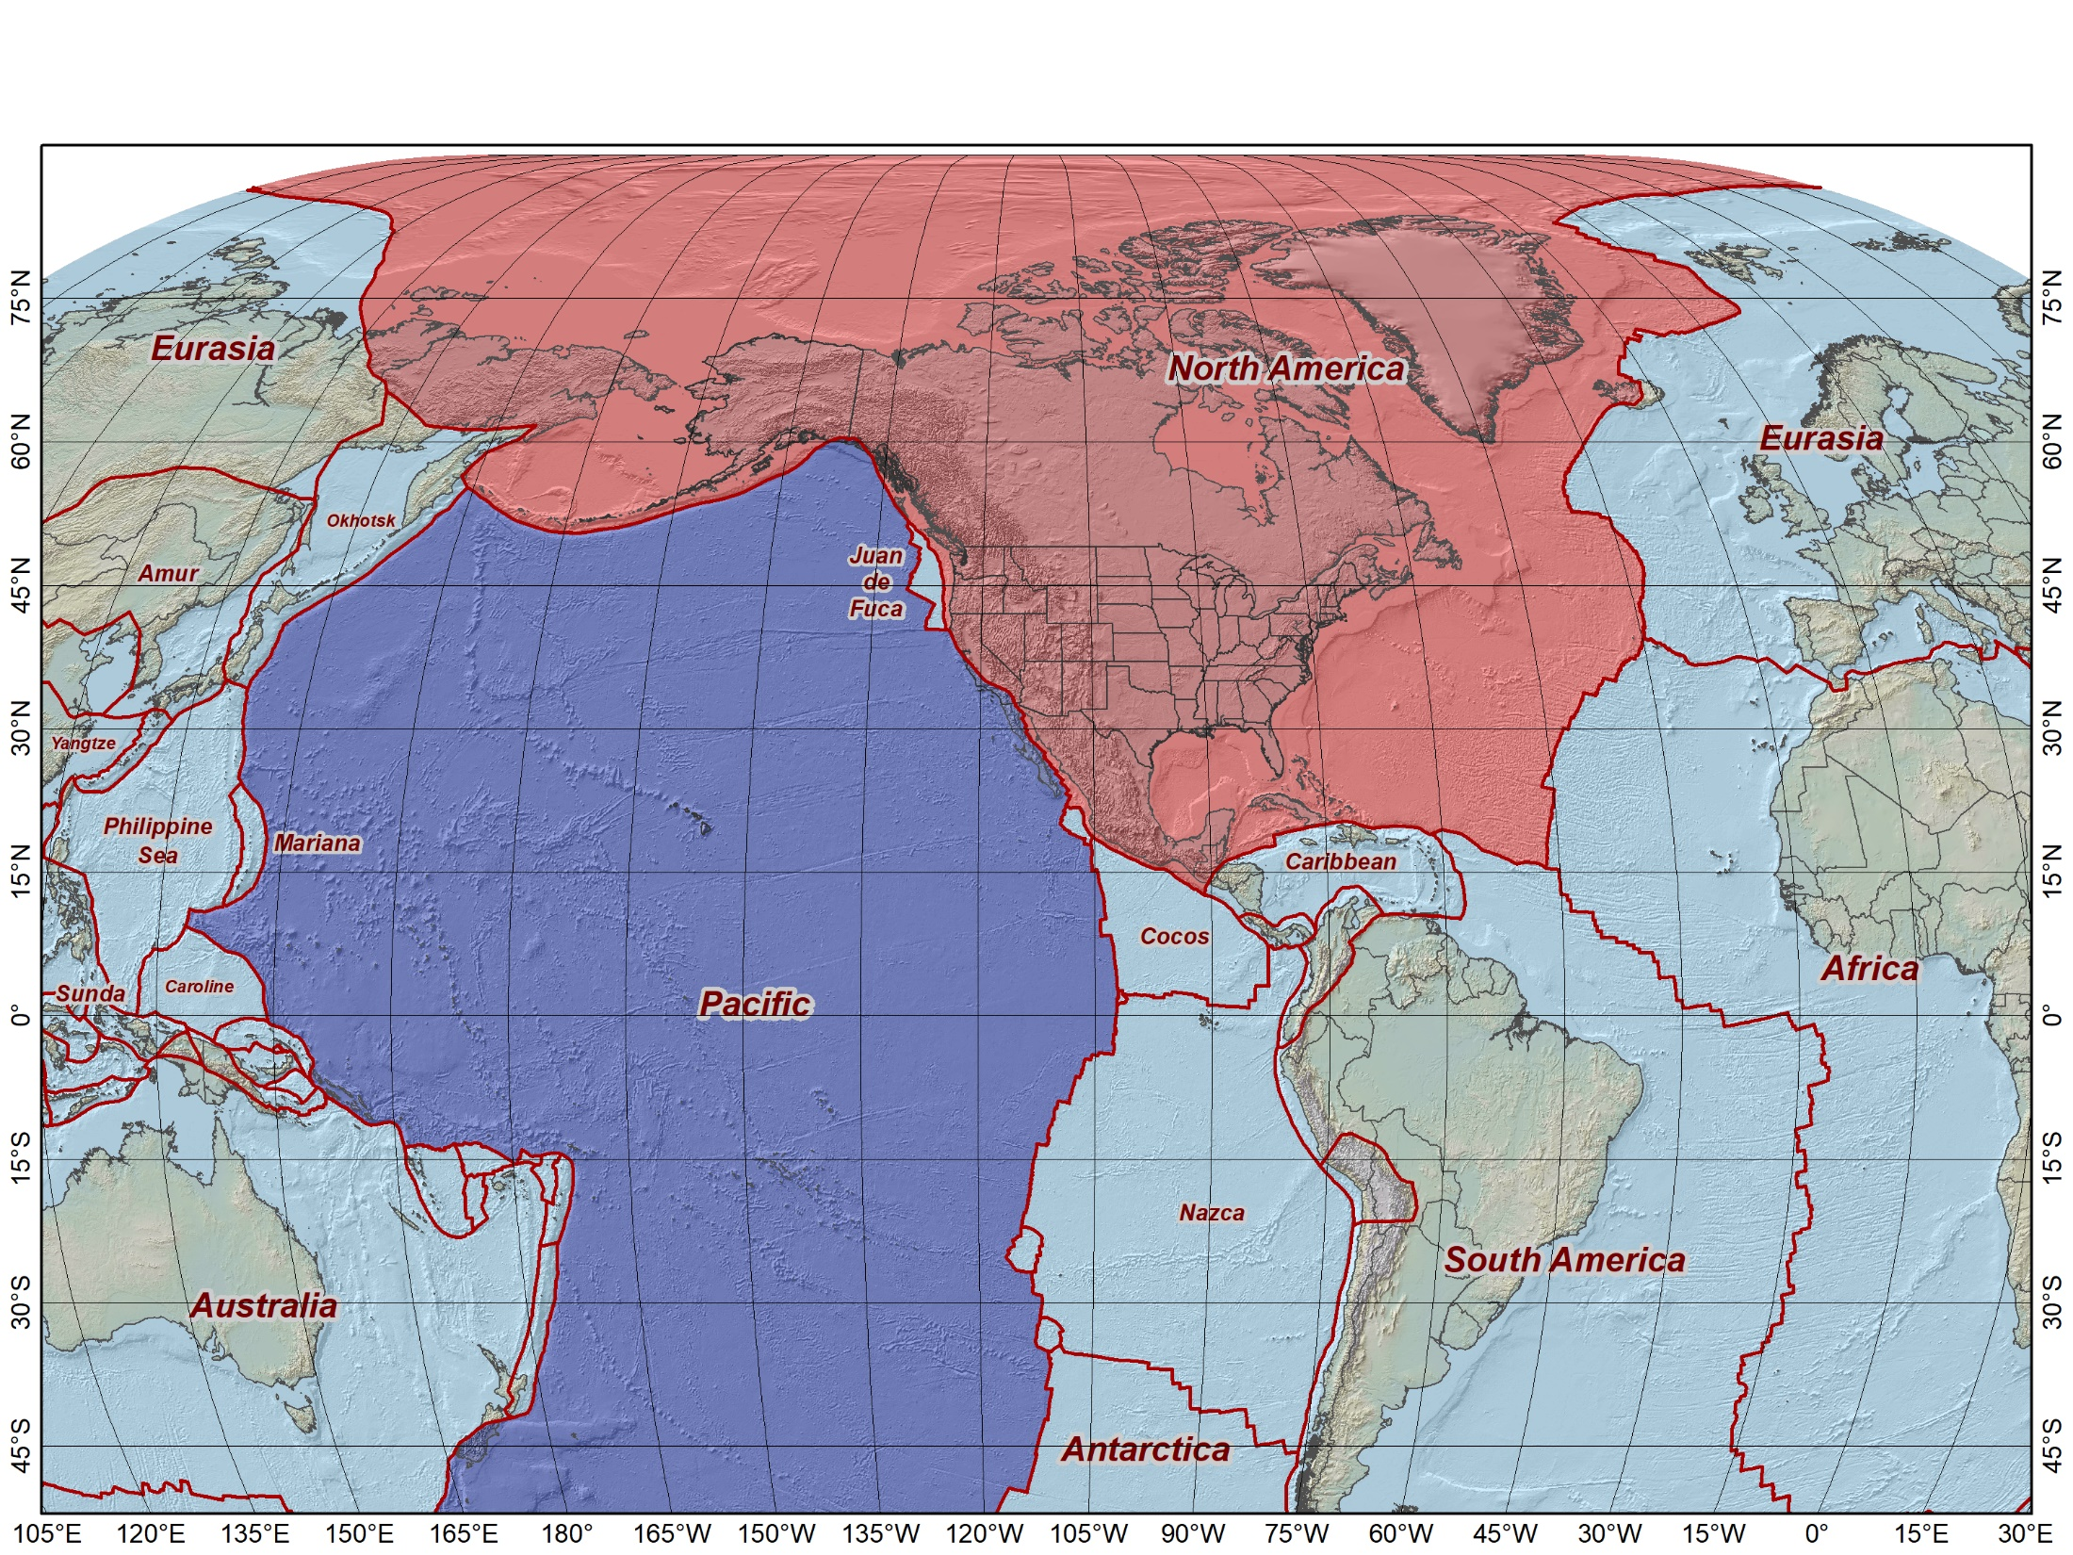

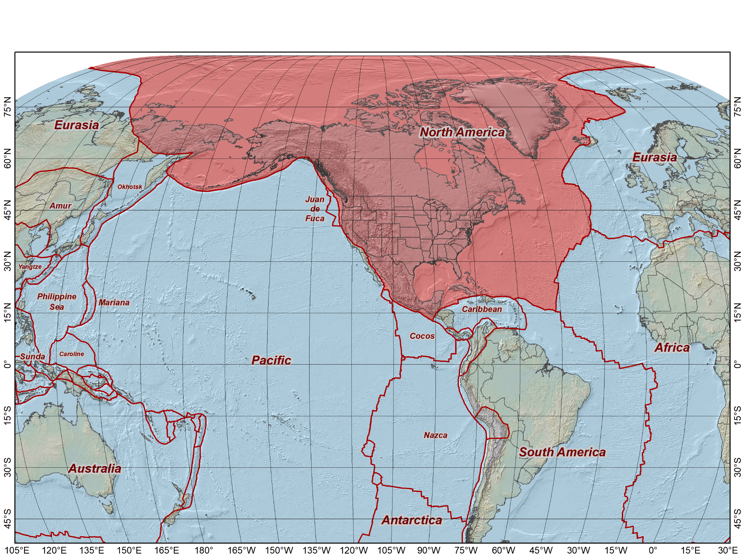
Tectonic plates “fixed” for the three existing NAD 83 frames
North American Datum of 1983 (2011) epoch 2010.0
North American Datum of 1983 (PA11) epoch 2010.0
North American Datum of 1983 (MA11) epoch 2010.0
NAD 83 (2011)
NAD 83 (MA11)
NAD 83 (PA11)
All at epoch 2010.0 (Jan 1, 2010)
5

Slide 6
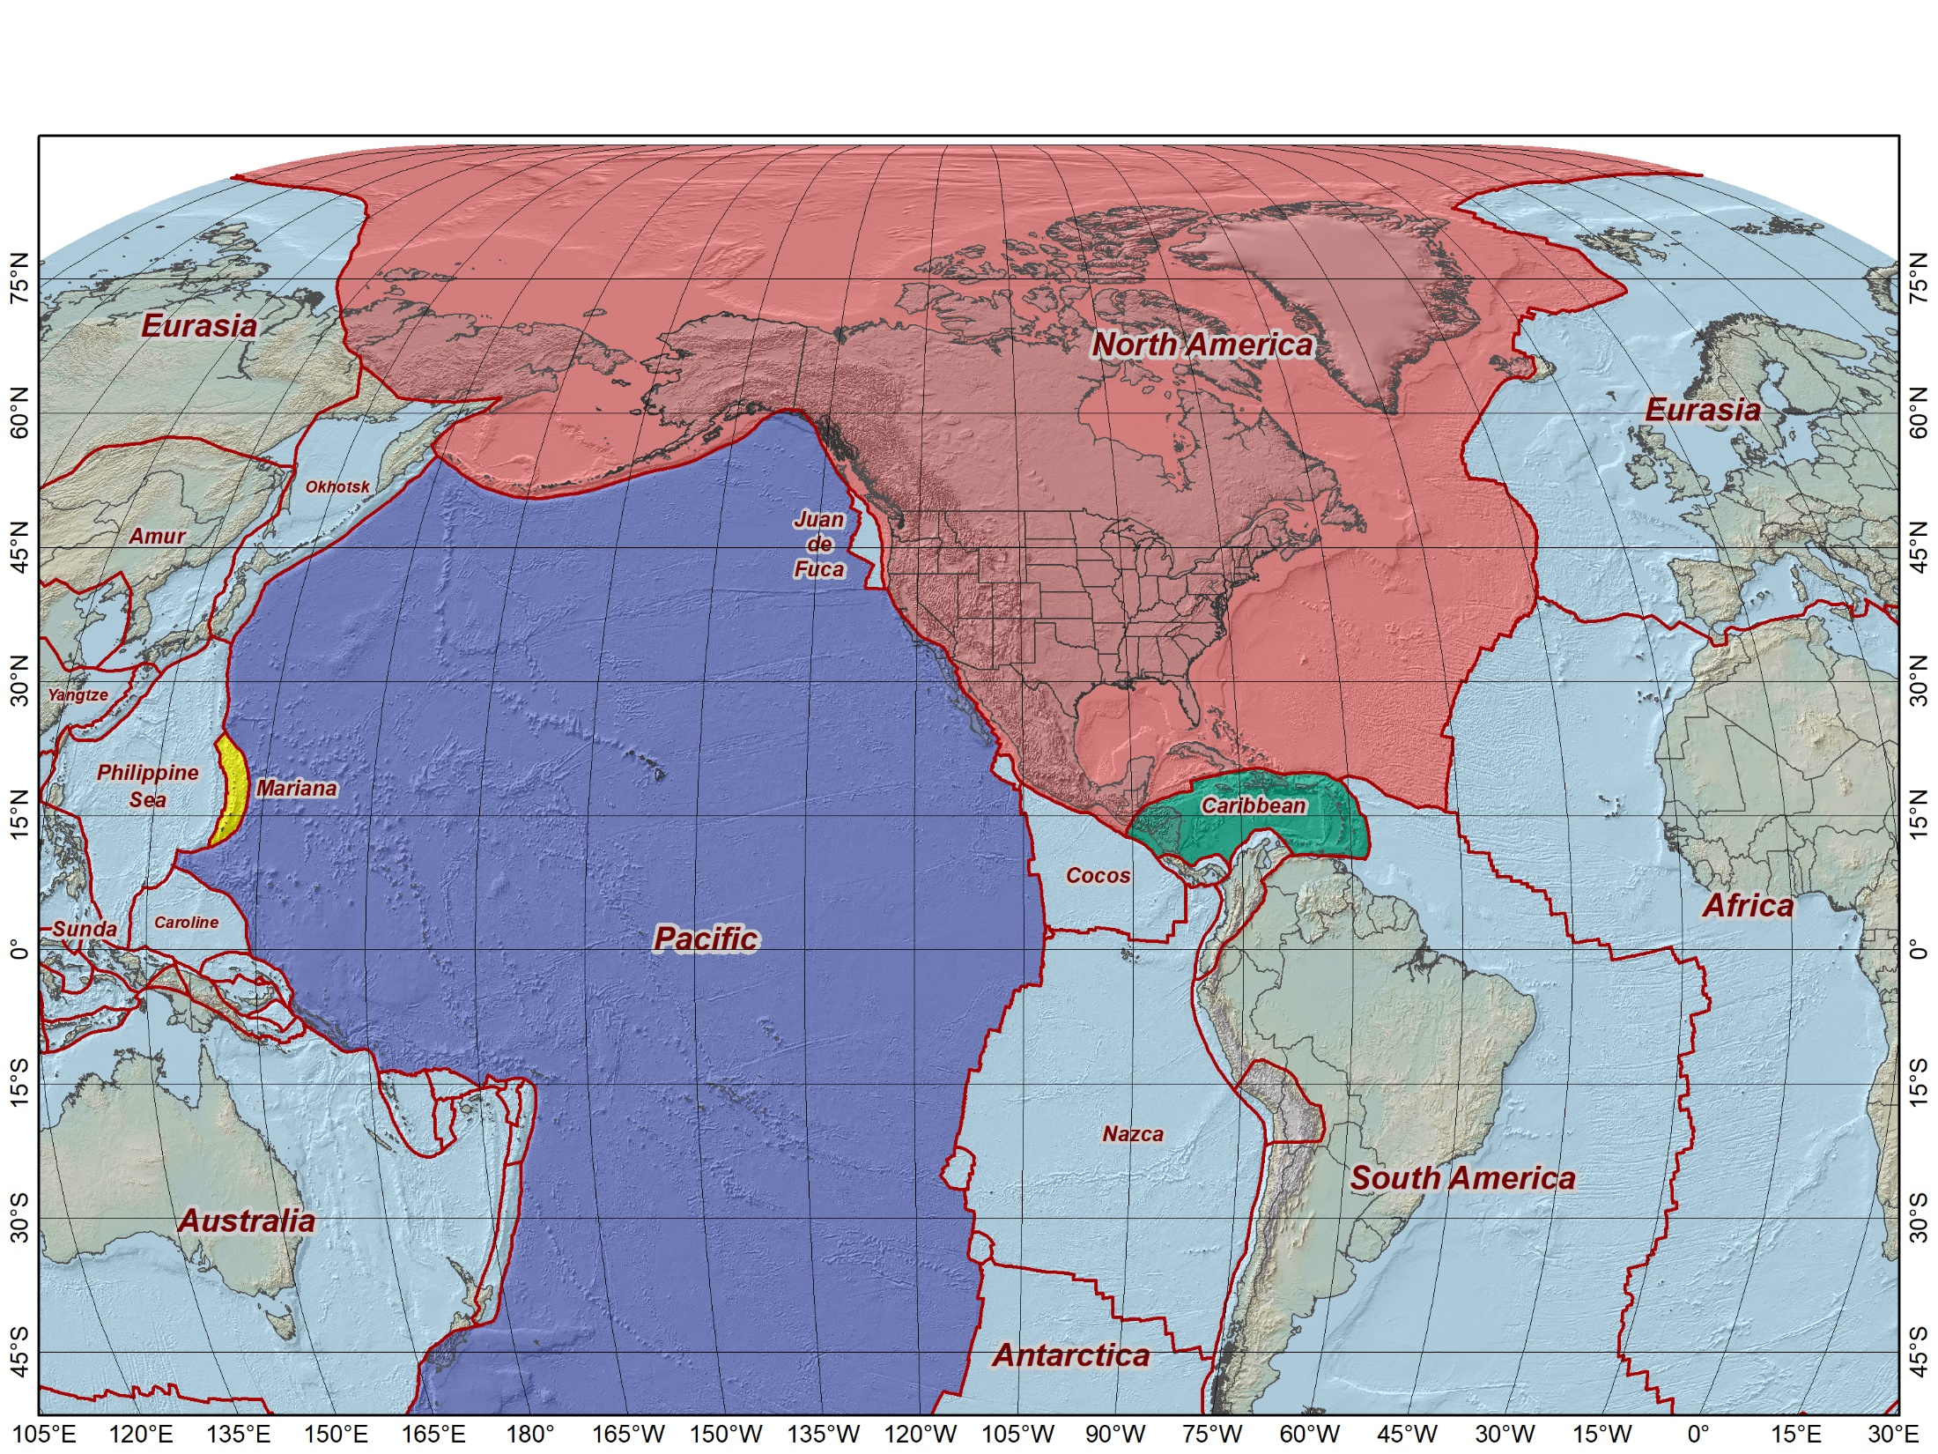
Tectonic plates “fixed” for the four 2022 Terrestrial Reference Frames
North American Terrestrial Reference Frame of 2022 (NATRF2022)
Pacific Terrestrial Reference Frame of 2022 (PATRF2022)
Mariana Terrestrial Reference Frame of 2022 (MATRF2022)
Caribbean Terrestrial Reference Frame of 2022 (CATRF2022)
NATRF2022
MATRF2022
PATRF2022
CATRF2022
Initially at epoch 2020.0 (Jan 1, 2020) and same as ITRF2020 at that epoch
6

Slide 7
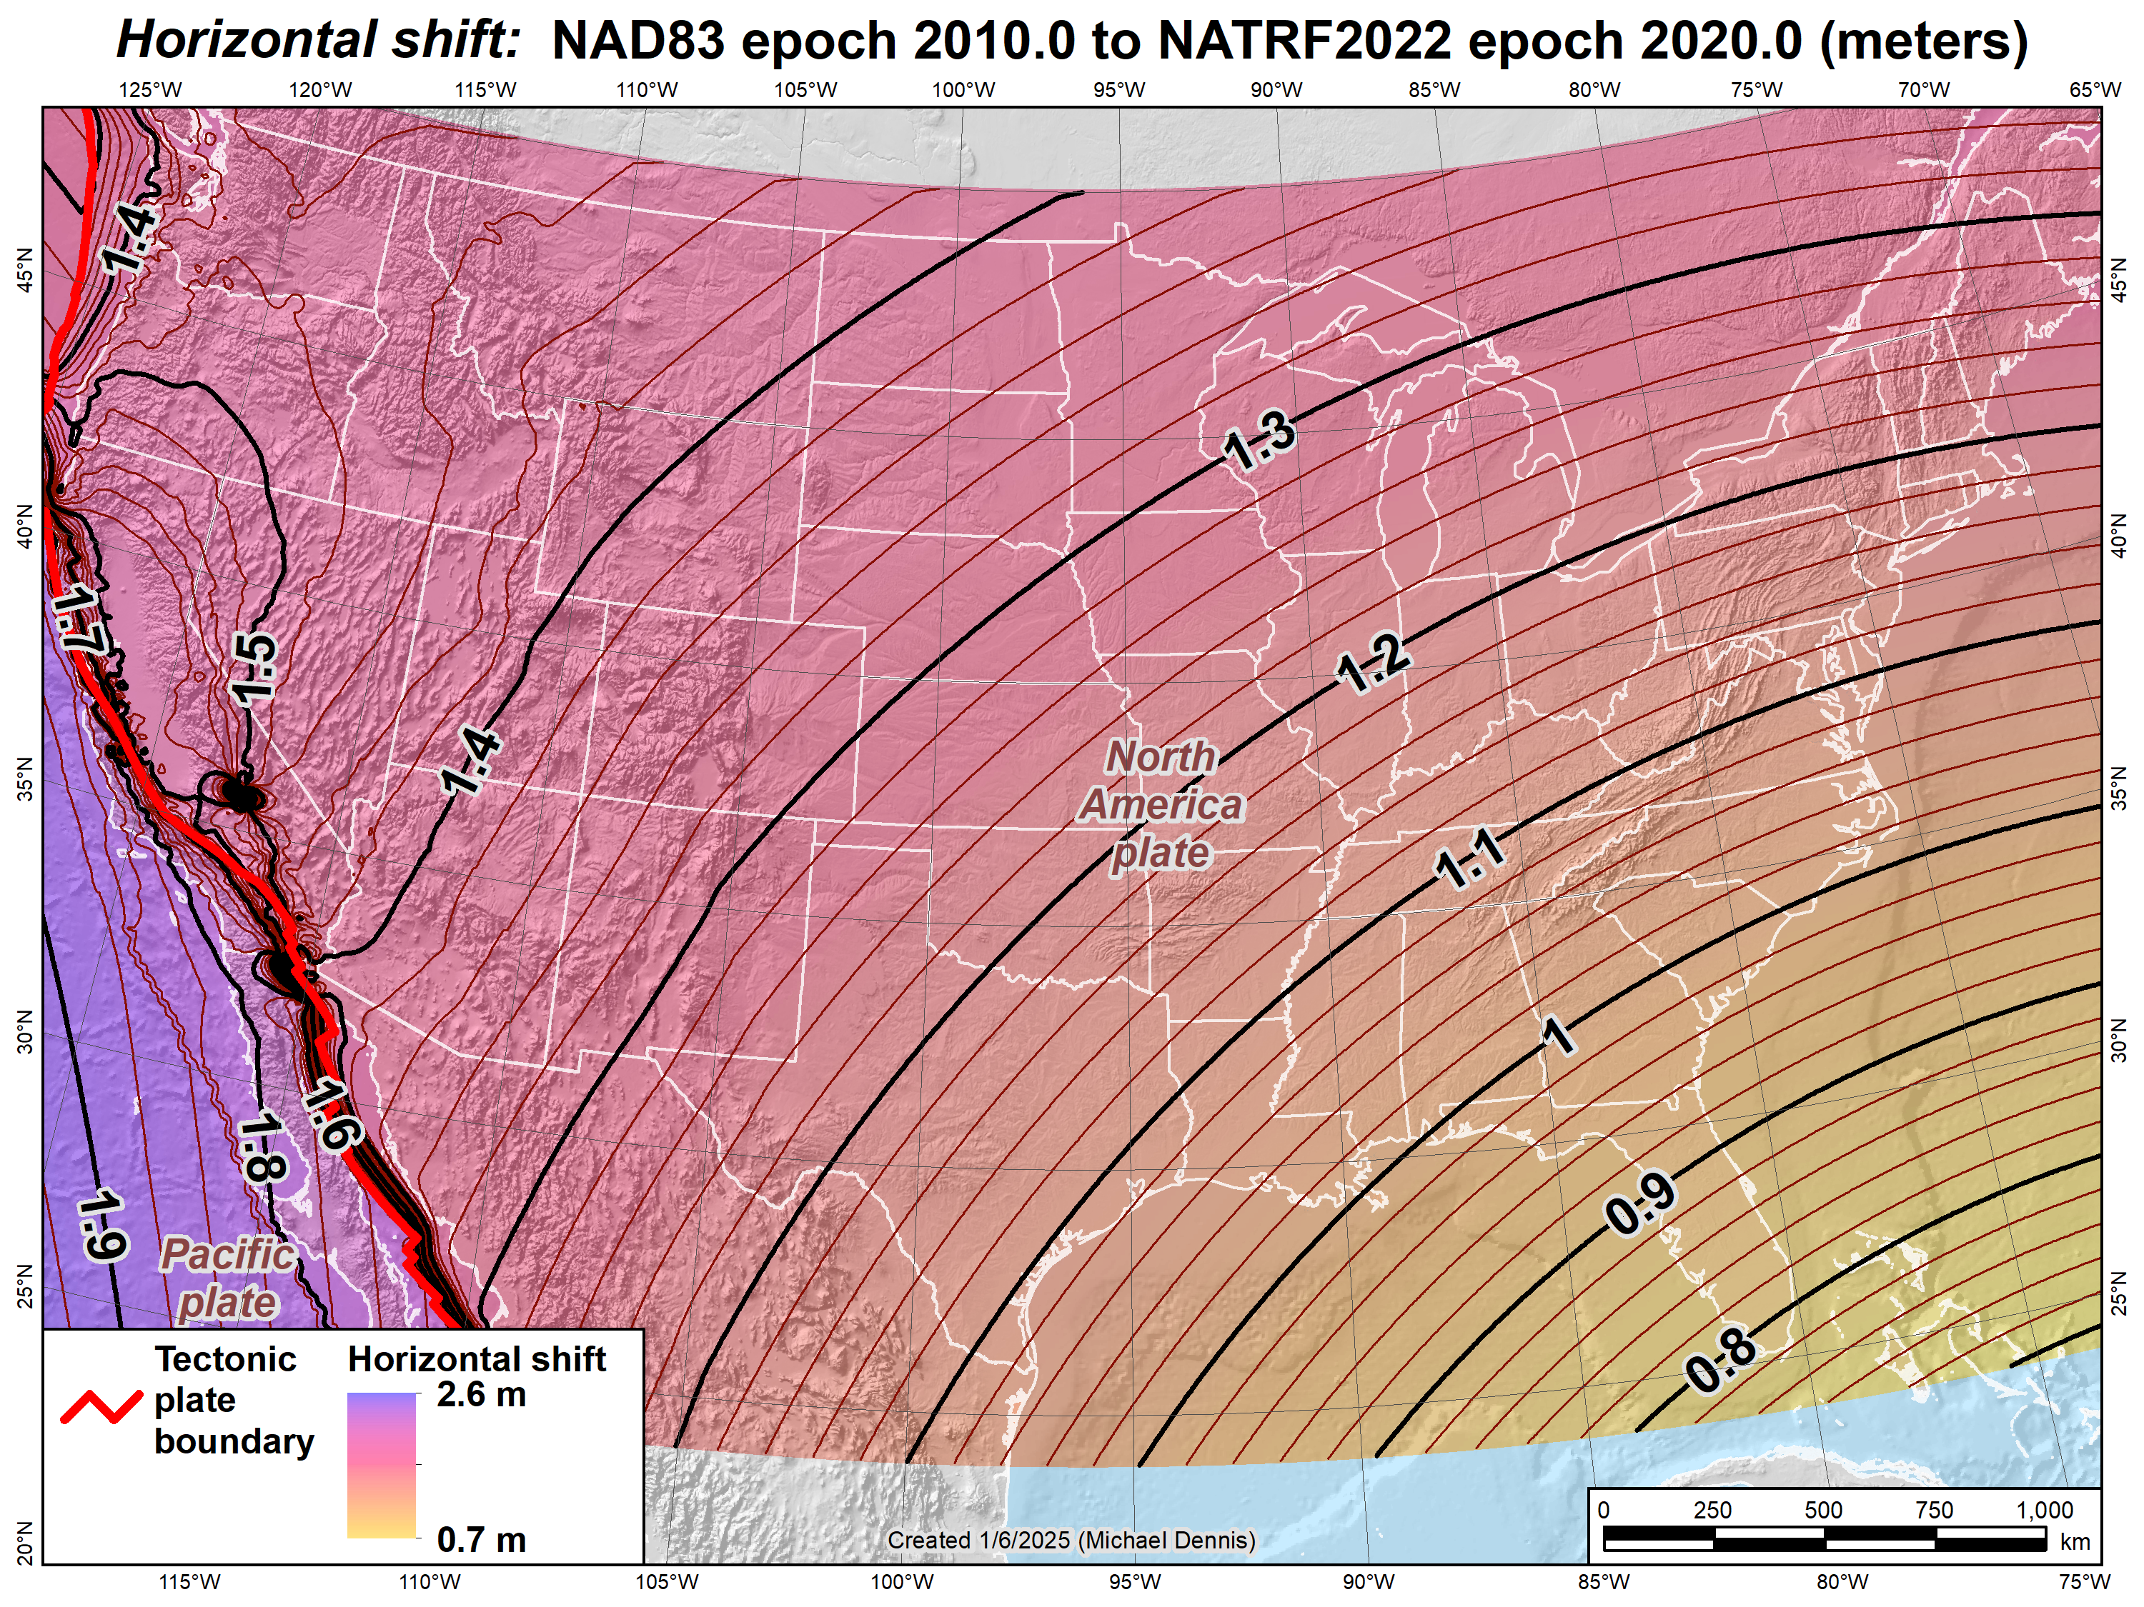
Estimated horizontal shifts (CONUS): NAD 83 epoch 2010.0 to NATRF2022 epoch 2020.0 (meters)
Ridgecrest earthquake (July 2019)
El Mayor-Cucapah earthquake (April 2010)
7

Slide 8
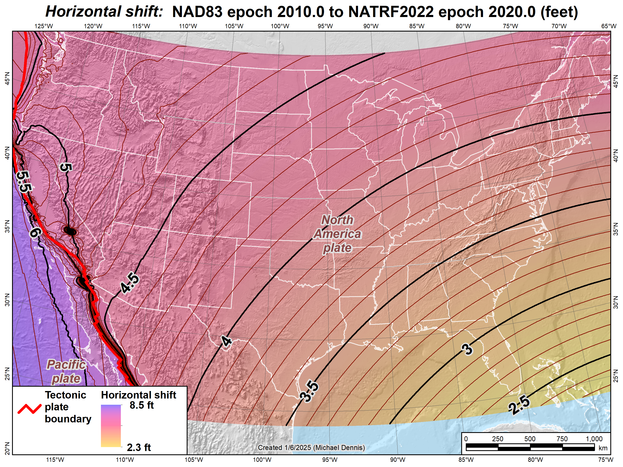
Estimated horizontal shifts (CONUS): NAD 83 epoch 2010.0 to NATRF2022 epoch 2020.0 (feet)
Ridgecrest earthquake (July 2019)
El Mayor-Cucapah earthquake (April 2010)
8

Slide 9
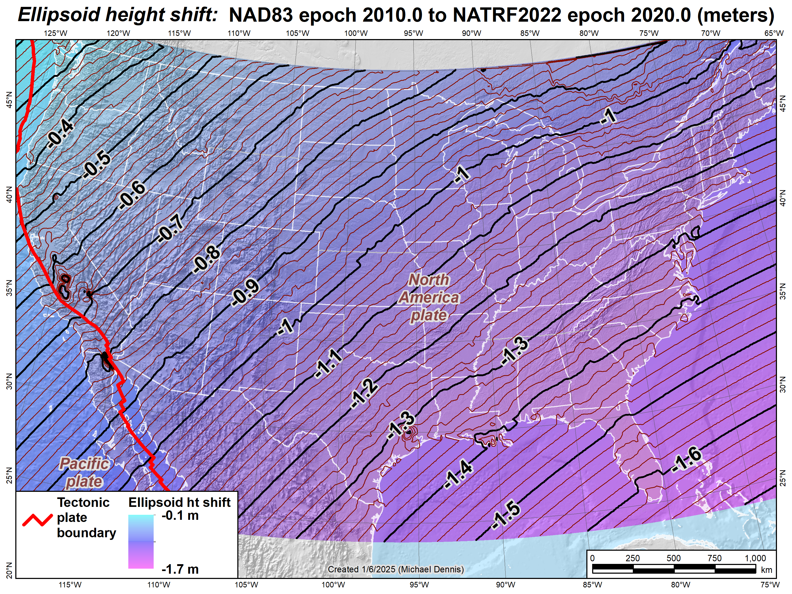
Estimated ellipsoidal height shifts (CONUS): NAD 83 epoch 2010.0 to NATRF2022 epoch 2020.0 (meters)
Ridgecrest earthquake (July 2019)
El Mayor-Cucapah earthquake (April 2010)
9

Slide 10

Estimated ellipsoidal height shifts (CONUS): NAD 83 epoch 2010.0 to NATRF2022 epoch 2020.0 (feet)
Ridgecrest earthquake (July 2019)
El Mayor-Cucapah earthquake (April 2010)
10

Slide 11
NSRS Modernization “Blueprint” documents
Geometric Coordinates and Terrestrial Reference Frames
Geopotential Coordinates and Geopotential Datum
Working in the Modernized NSRS
January 7, 2025
TRB Annual Meeting 2025
11

Slide 12
Current vertical datums of the National Spatial Reference System
North America and Caribbean
NAVD 88
IGLD 85
PRVD02
VIVD09
Pacific Ocean
GUVD04
NMVD03
ASVD02
NAVD 88
IGLD 85
NAVD 88
NMVD03
PRVD02
GUVD04
VIVD09
ASVD02
12

Slide 13
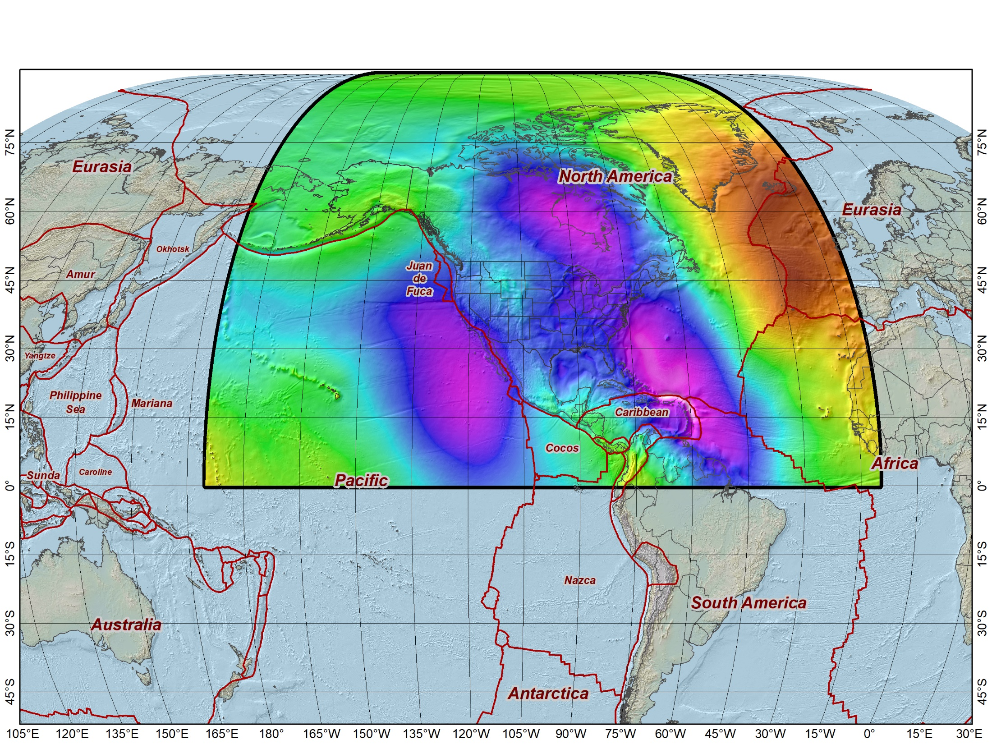
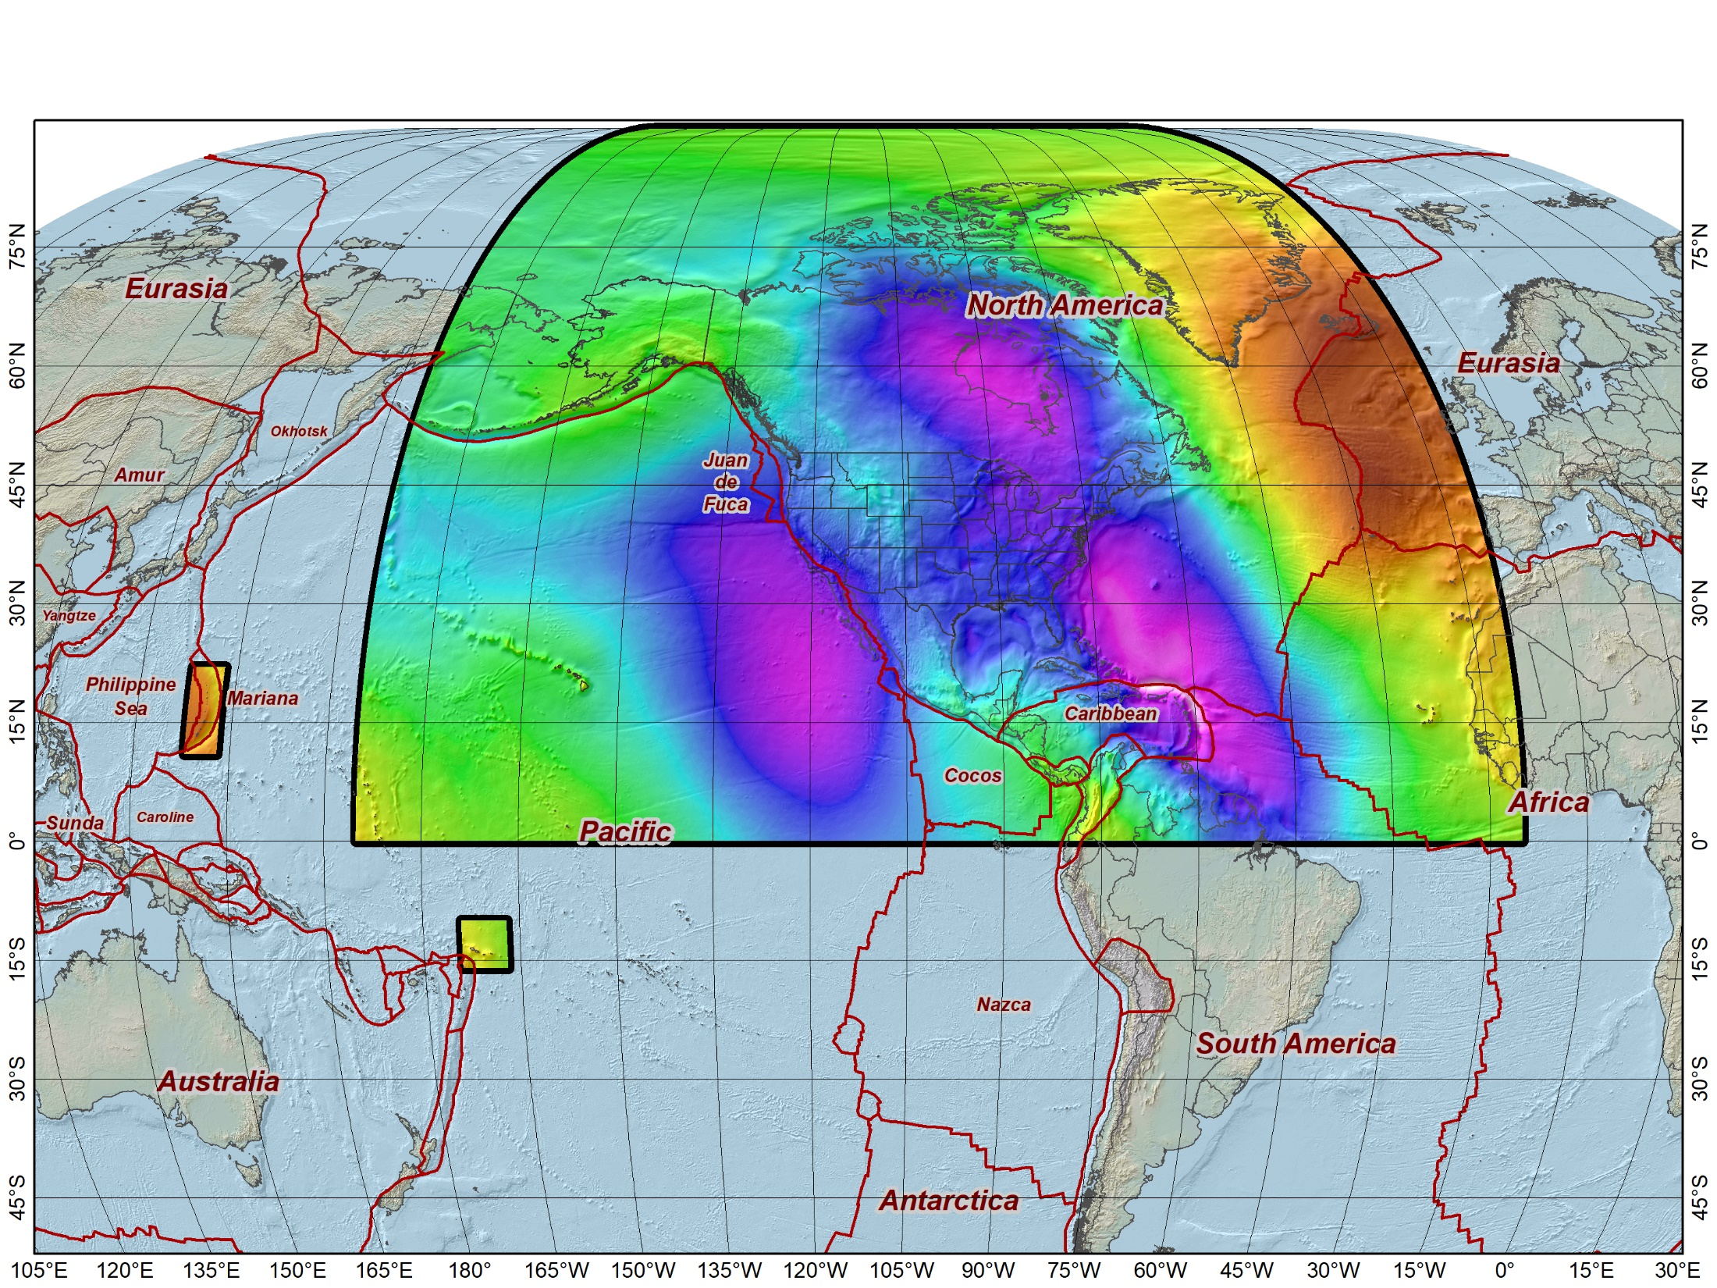
Extent of the new geopotential (“vertical”) datum
North American-Pacific Geopotential Datum of 2022 (NAPGD2022)
Includes the following (time-varying) models:
Geoid model (GEOID2022)
Surface gravity model (GRAV2022)
Deflection of the vertical model (DEFLEC2022)
Guam and Northern Marianas Islands
American Samoa
13

Slide 14
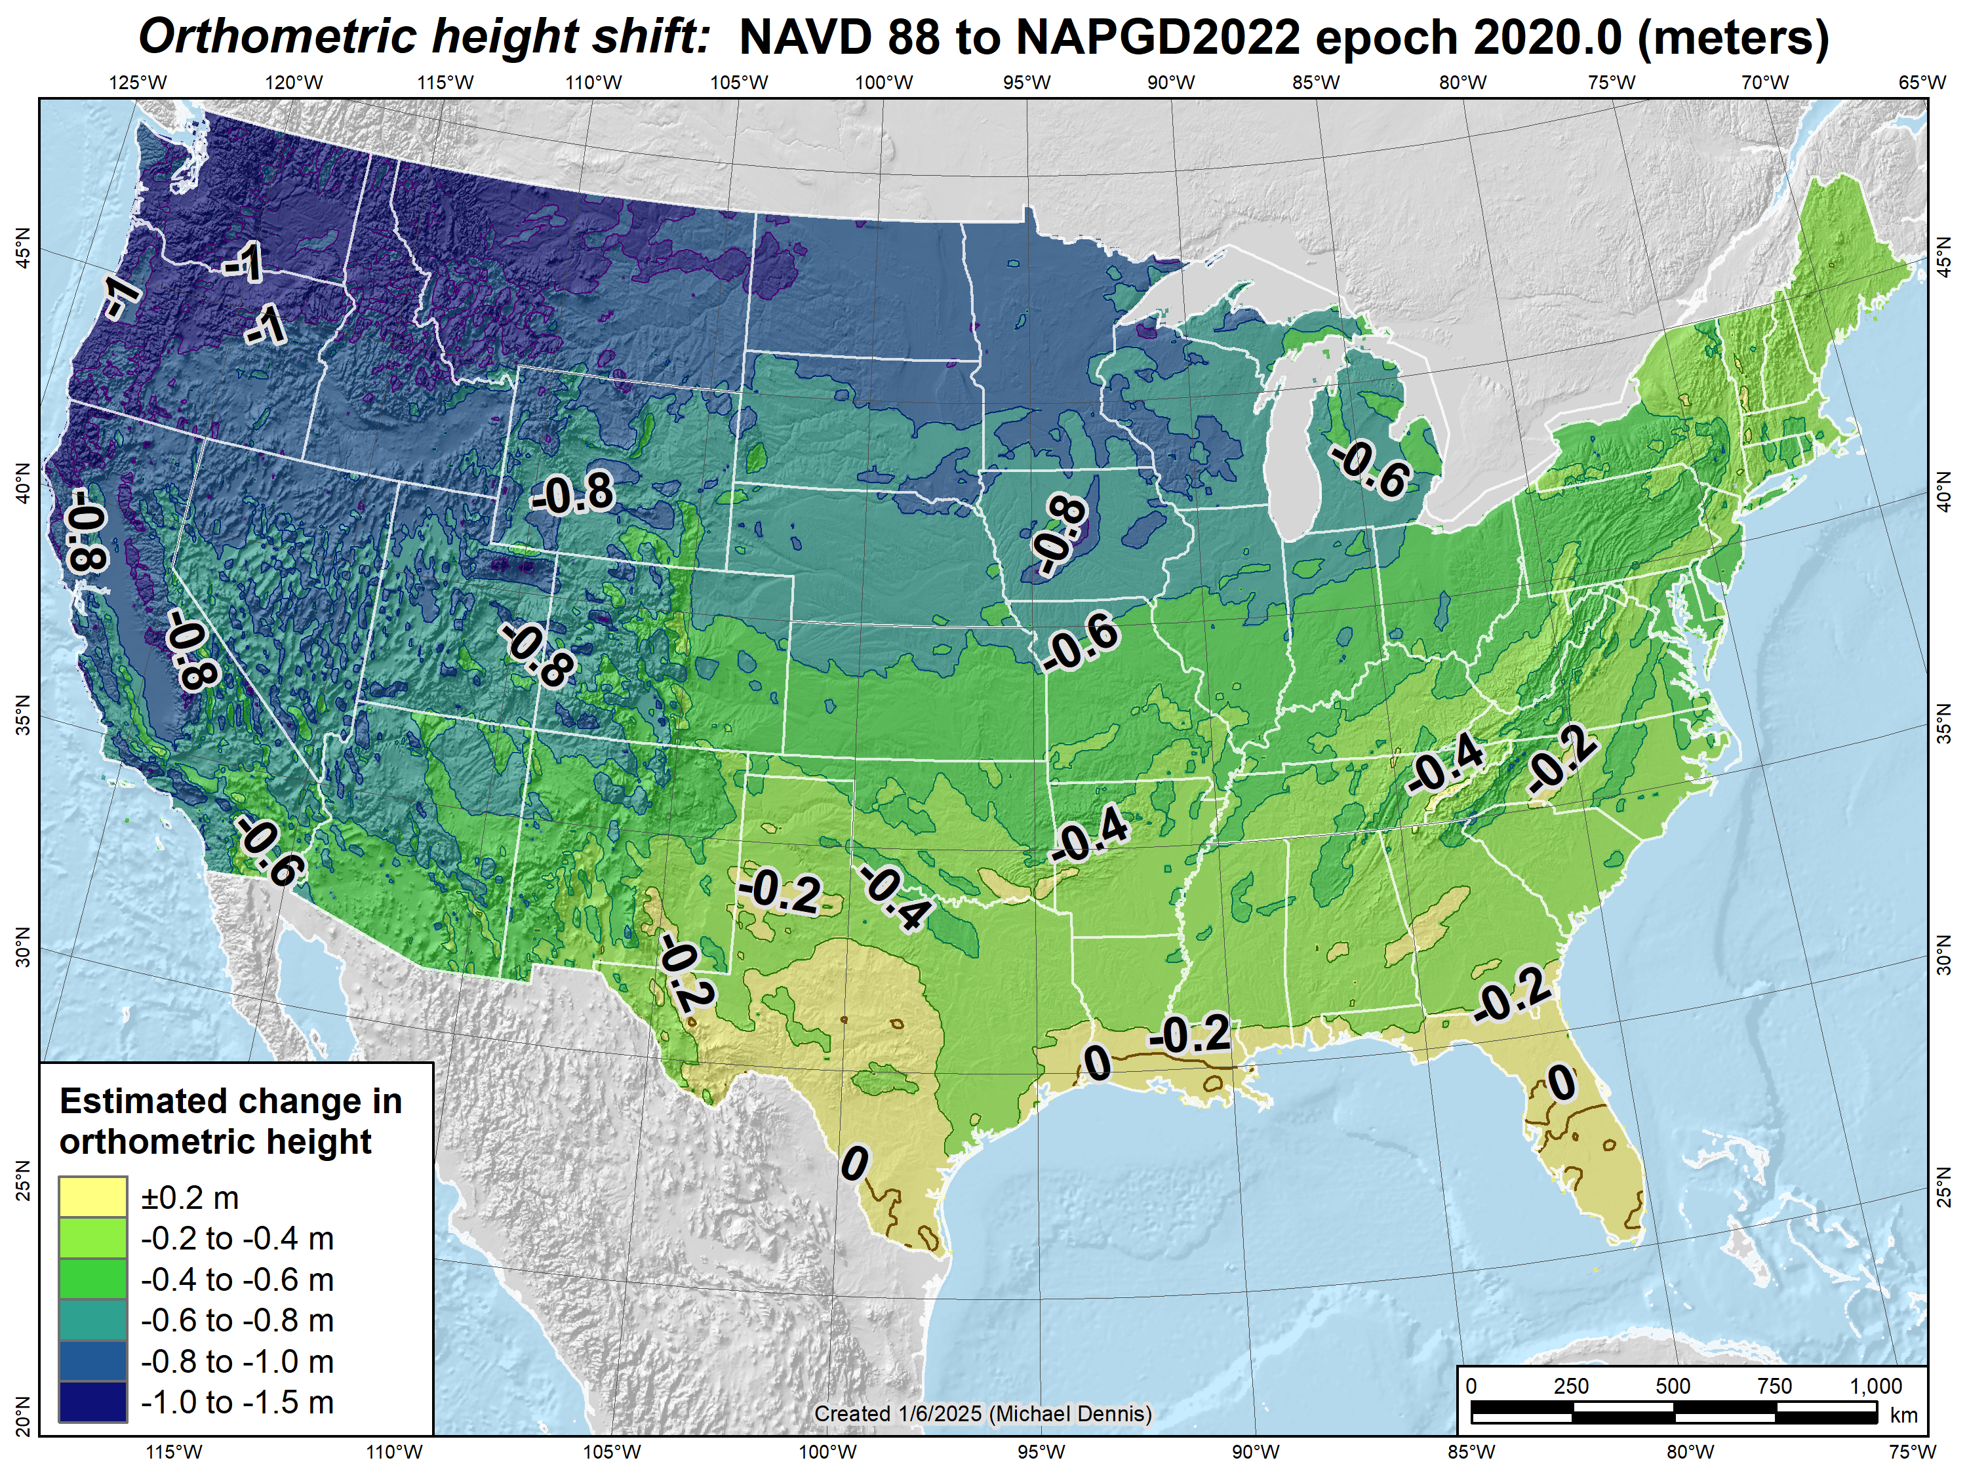
Estimated orthometric height shifts (CONUS): NAVD 88 to NAPGD2022 epoch 2020.0 (meters)
14

Slide 15
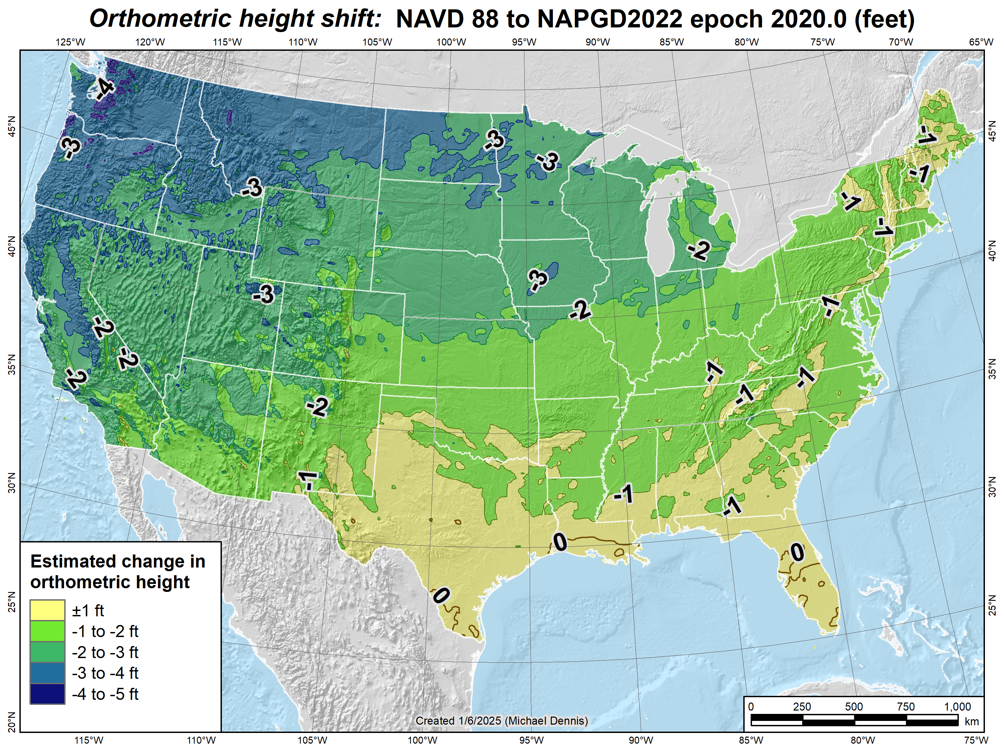
Estimated orthometric height shifts (CONUS): NAVD 88 to NAPGD2022 epoch 2020.0 (feet)
15

Slide 16
NSRS Modernization “Blueprint” documents
Geometric Coordinates and Terrestrial Reference Frames
Geopotential Coordinates and Geopotential Datum
Working in the Modernized NSRS
January 7, 2025
TRB Annual Meeting 2025
16

Slide 17
“Shift & Drift”
Sudden SHIFT. At epoch 2020.0 for change from NAD 83:
Horizontal change of about 0.5 to 4 meters (1.5 to 12 feet)
Ellipsoid and orthometric height change of about ±2 meters (±6 feet)
Continuous DRIFT due to crustal motion
Up to about 8 cm/yr (0.3 ft/yr) horizontal
Remove most by modeling tectonic plate (horizontal only)
Remaining 3D motion minimized with crustal motion models
Purpose:
Minimize change in coordinates with time
Determine coordinates at any time (epoch)
Coordinates in modernized
NSRS will always have a date
January 7, 2025
TRB Annual Meeting 2025
17

Slide 18
New types of coordinates
Reference Epoch Coordinates (RECs)
Temporal “snapshot” of entire network
Similar to NAD 83 (2011/PA11/MA11) epoch 2010.00
Initial epoch 2020.00
Every 5 or 10 years (TBD)
Survey Epoch Coordinates (SECs)
Time-dependent!
Gives coordinates at time of observation
Multiple SECs can show changes over time
Likely not included in initial rollout of Modernized NSRS
January 7, 2025
TRB Annual Meeting 2025
18

Slide 19
Modernized NSRS Tools and Applications
Data Delivery System
Serves as public access to NSRS Database (replaces NGS Integrated Data Base)
Detailed information on National CORS Network stations
Reference Epoch Coordinates and other information on geodetic control marks
Online Positioning User Service (OPUS)
GNSS baseline processing and network adjustments
Mechanism for submitting geodetic control observations to NGS
NGS Coordinate Conversion and Transformation Tool (NCAT)
Conversion between coordinate types (e.g., map projected, ellipsoidal, geocentric)
Transformation between reference frames, geopotential datums, height systems
Time projection (“propagation”) between different dates (epochs)

Slide 20
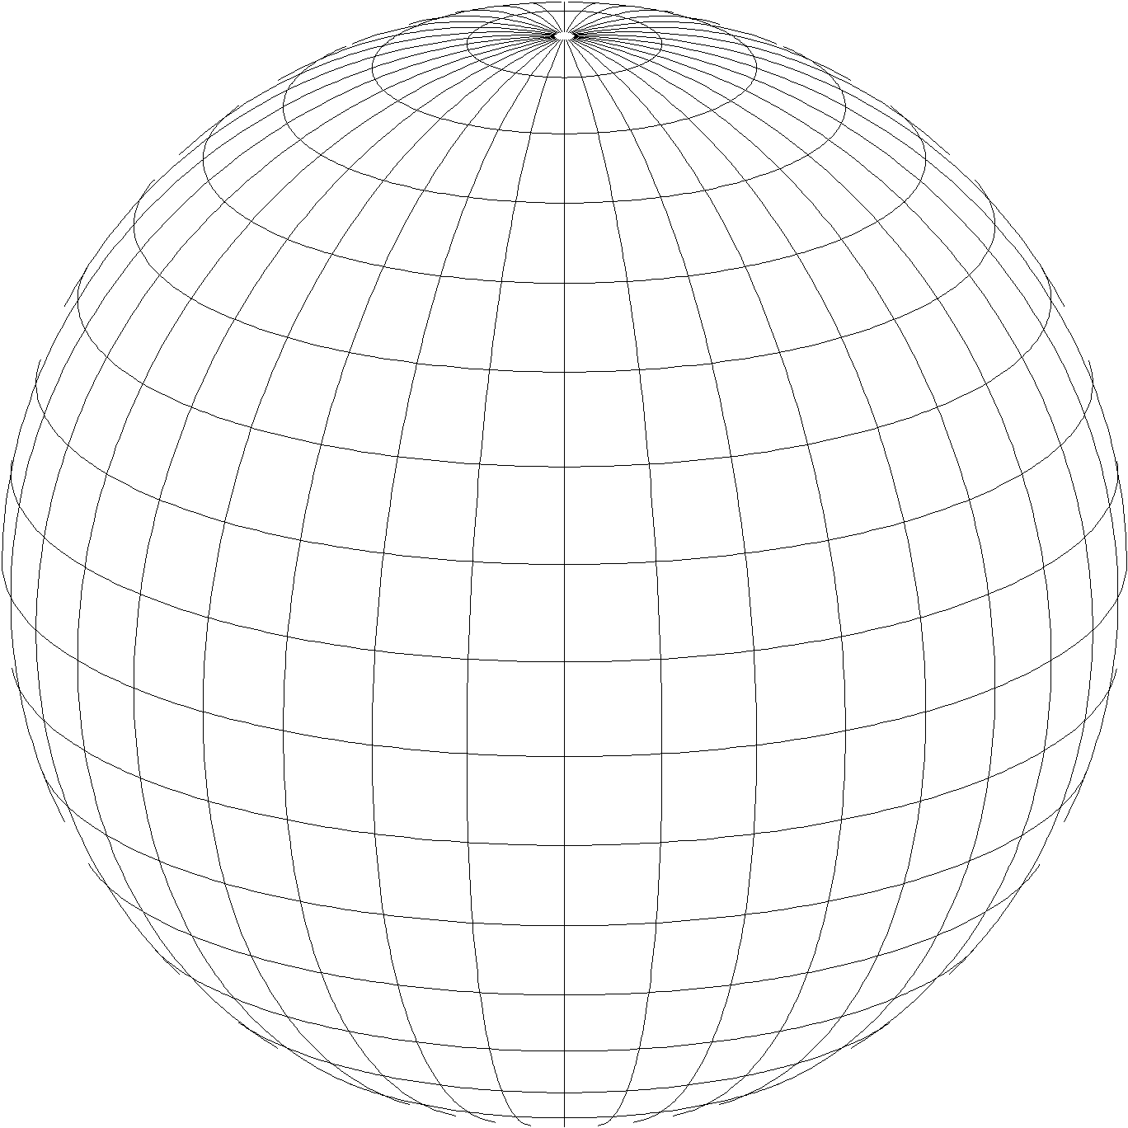
State Plane Coordinate System of 2022 (SPCS2022)
Third generation of State Plane
First in 1930s (SPCS 27), second in 1980s (SPCS 83)
Widely used in surveying, engineering, and GIS
Same 3 map projection types
Same ellipsoid as SPCS 83 (GRS80)
Same as existing State Plane, but different…
Based on new terrestrial reference frames instead of NAD 83
More zones, most designed by state stakeholders
Designed to reduce linear distortion at topographic surface (i.e., reduce difference between “grid” and “ground” distances)
Lambert Conformal Conic
Transverse Mercator
Hotine Oblique Mercator
January 7, 2025
TRB Annual Meeting 2025
20

Slide 21
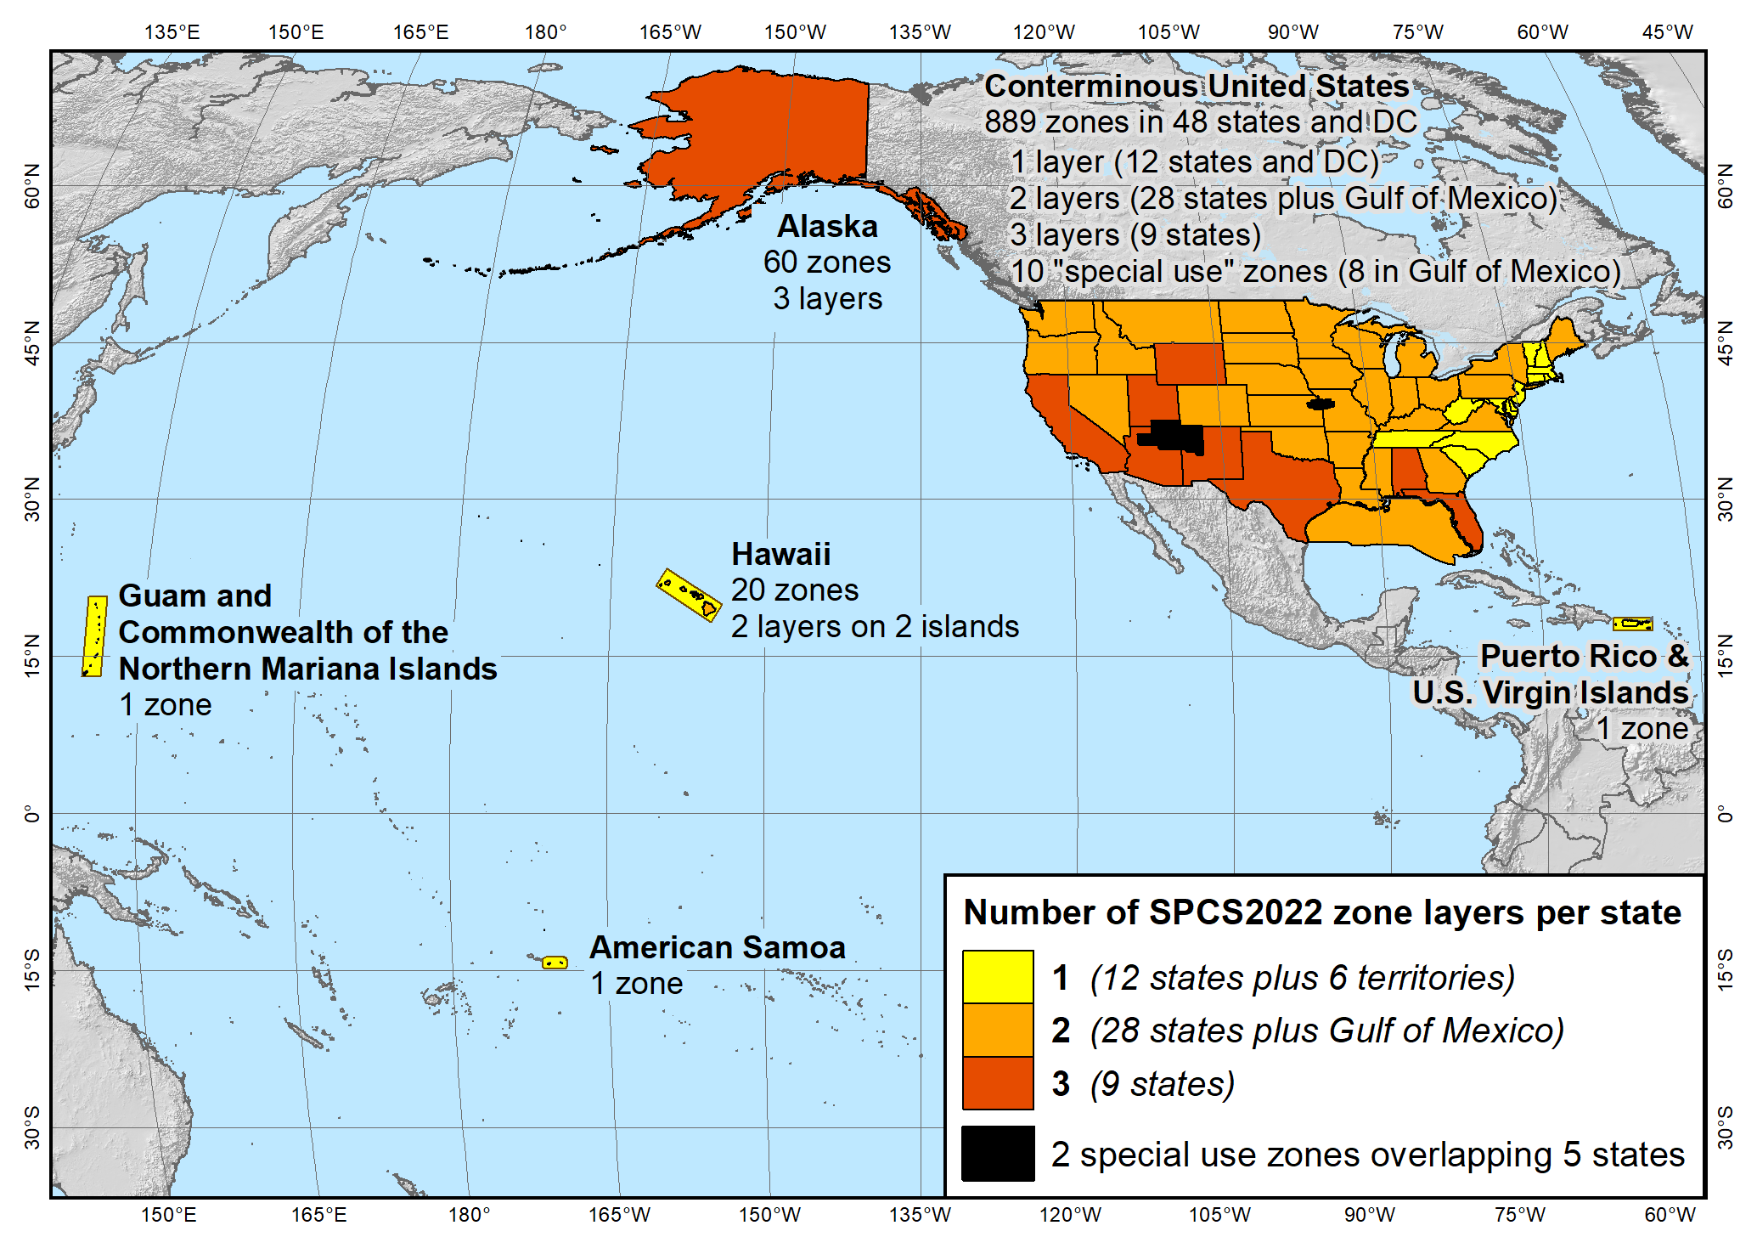
SPCS2022 zone layers
1 layer: 12 states plus 6 territories
2 layers: 28 states plus Gulf of Mexico
3 layers: 9 states
Plus 10 special use zones (2 zones overlap 5 states)
Every state and territory has a statewide zone layer
21

Slide 22
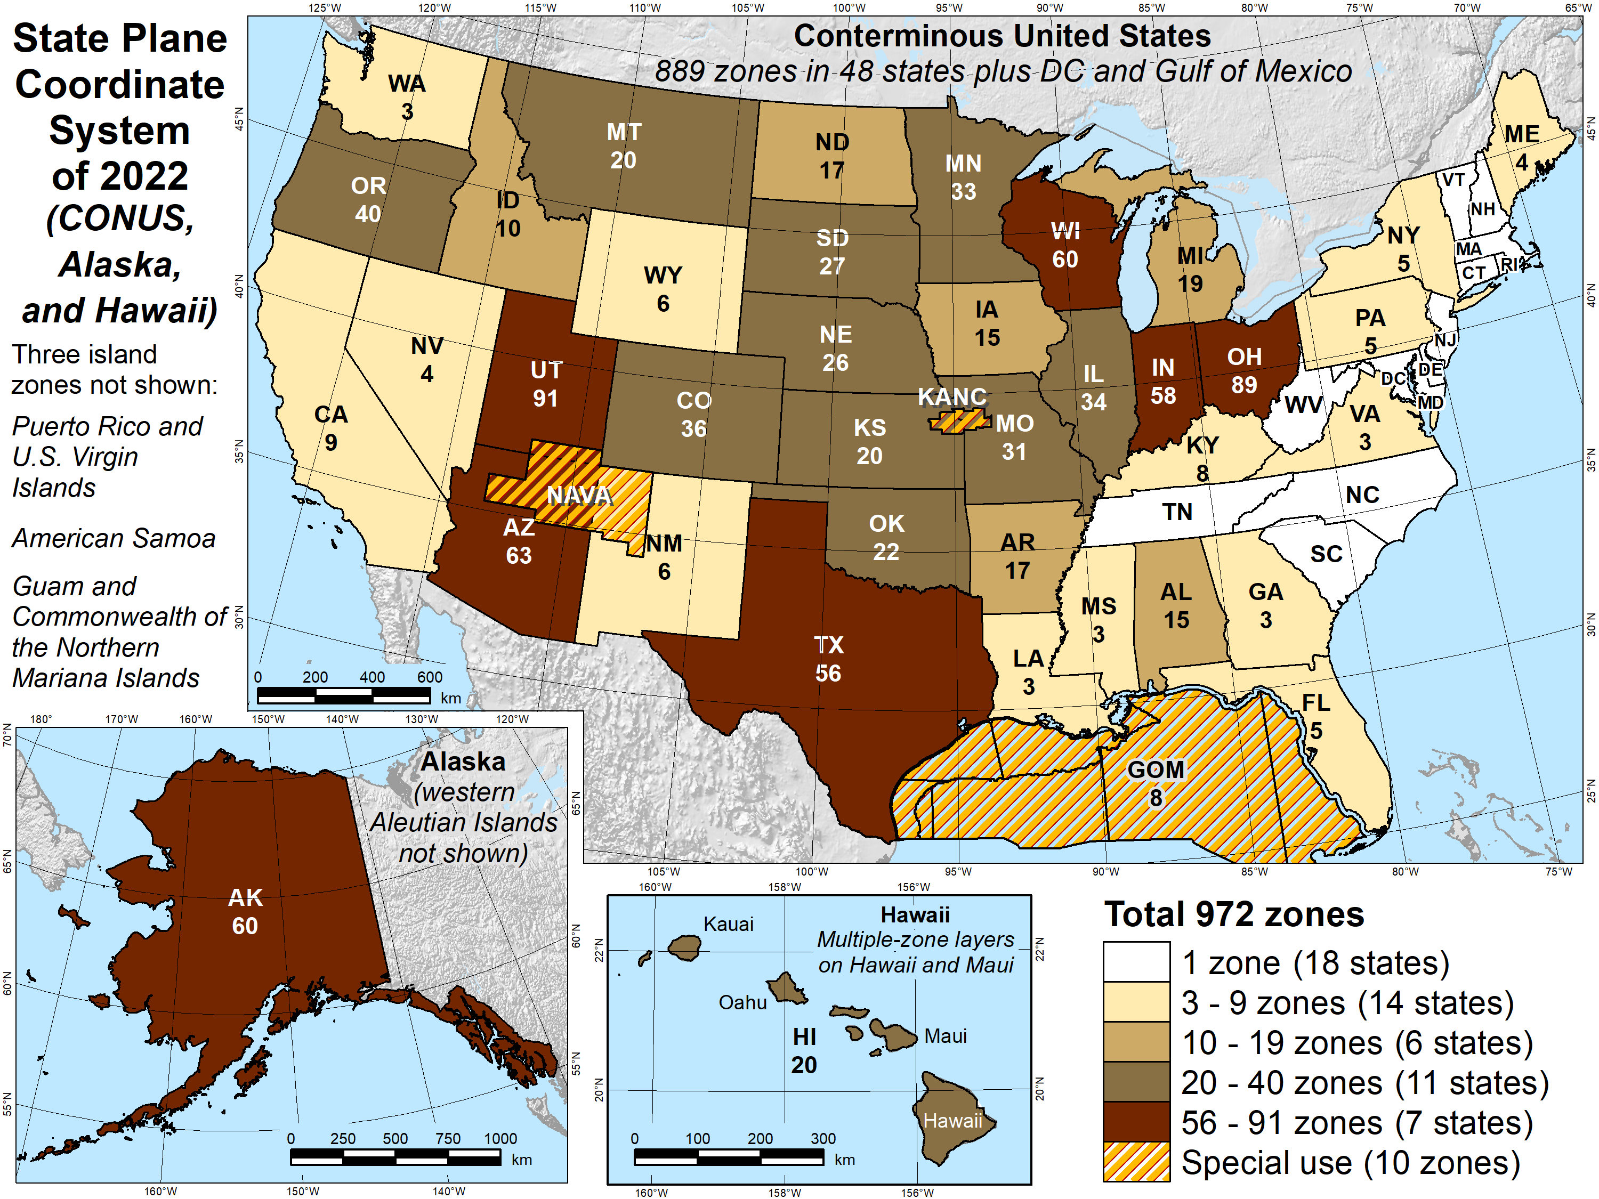
Number of SPCS2022 zones (preliminary)
Designs by NGS
153 zones
Includes 54 statewide zones…
…and 10 “special use” zones (in more than one state or no state at all)
Designs by state stakeholders
819 zones in 28 states
Total = 972 zones for 56 states and territories
Compare to 125 zones in existing State Plane (SPCS 83)
22

Slide 23
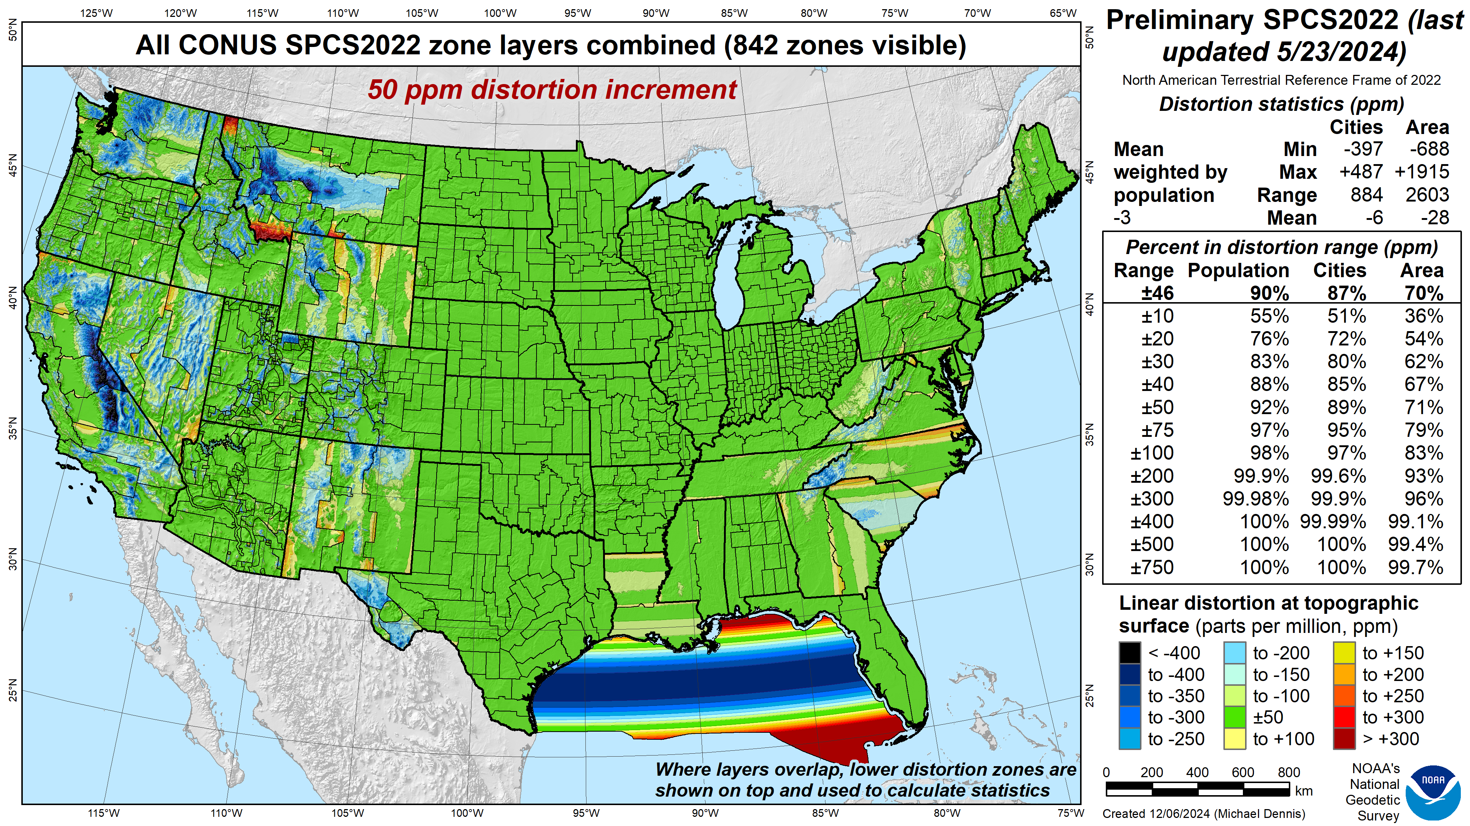
SPCS2022 linear distortion (preliminary)
Green is ±50 ppm (±0.26 ft/mile)
Distortion performance: ±46 ppm
Performance percentages:
90% population
87% cities & towns
70% total area
Mean weighted by population: -3 ppm
Grid versus ground distance
BLUE: grid SHORTER than ground
RED: grid LONGER than ground
GREEN: grid = ground (within ±50 ppm)

Slide 24
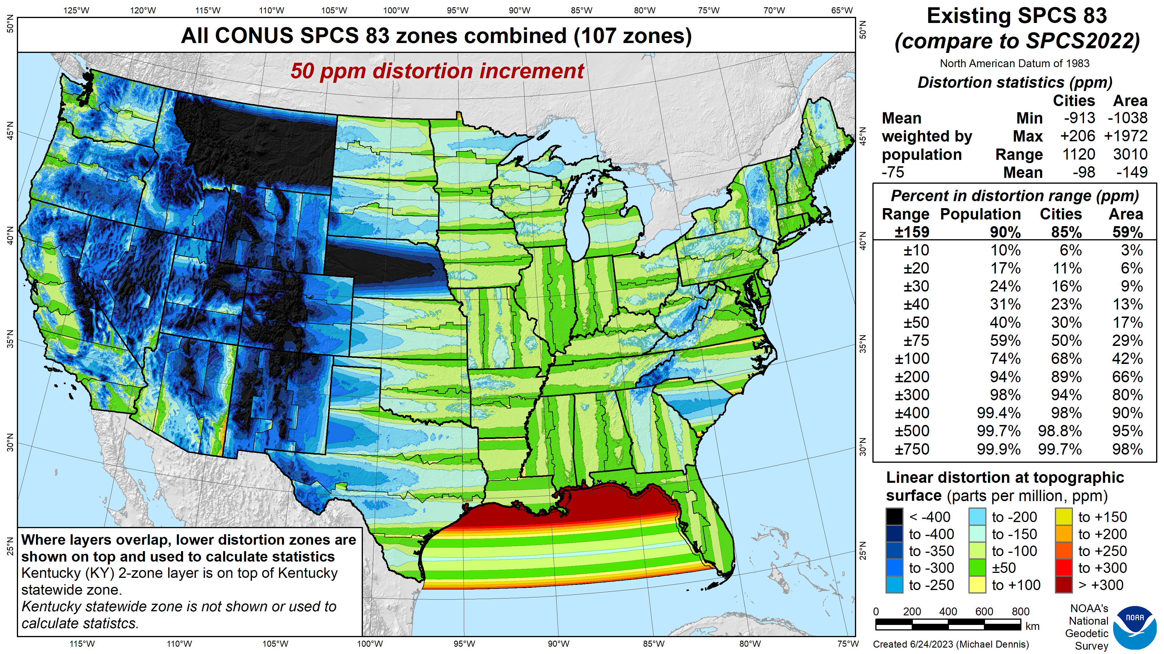
SPCS 83 linear distortion (existing)
Green is ±50 ppm (±0.26 ft/mile)
Distortion performance: ±159 ppm
Performance percentages:
90% population
85% cities & towns
59% total area
Mean weighted by population: -75 ppm

Slide 25
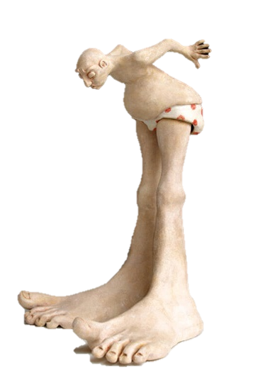
A tale of two feet
Two versions of “foot” in current use:
“Old” U.S. survey foot (adopted 1893)
“New” international foot (adopted 1959)
‭1 ft = 1200/3937 m (0.3048006096…‬ m)
1 ft = 0.3048 m exactly
Differ by
2 parts per million (ppm) or ~0.01 ft (~1/8 inch) per mile
A real problem with real costs (especially for State Plane of the NSRS)
January 7, 2025
TRB Annual Meeting 2025
25

Slide 26
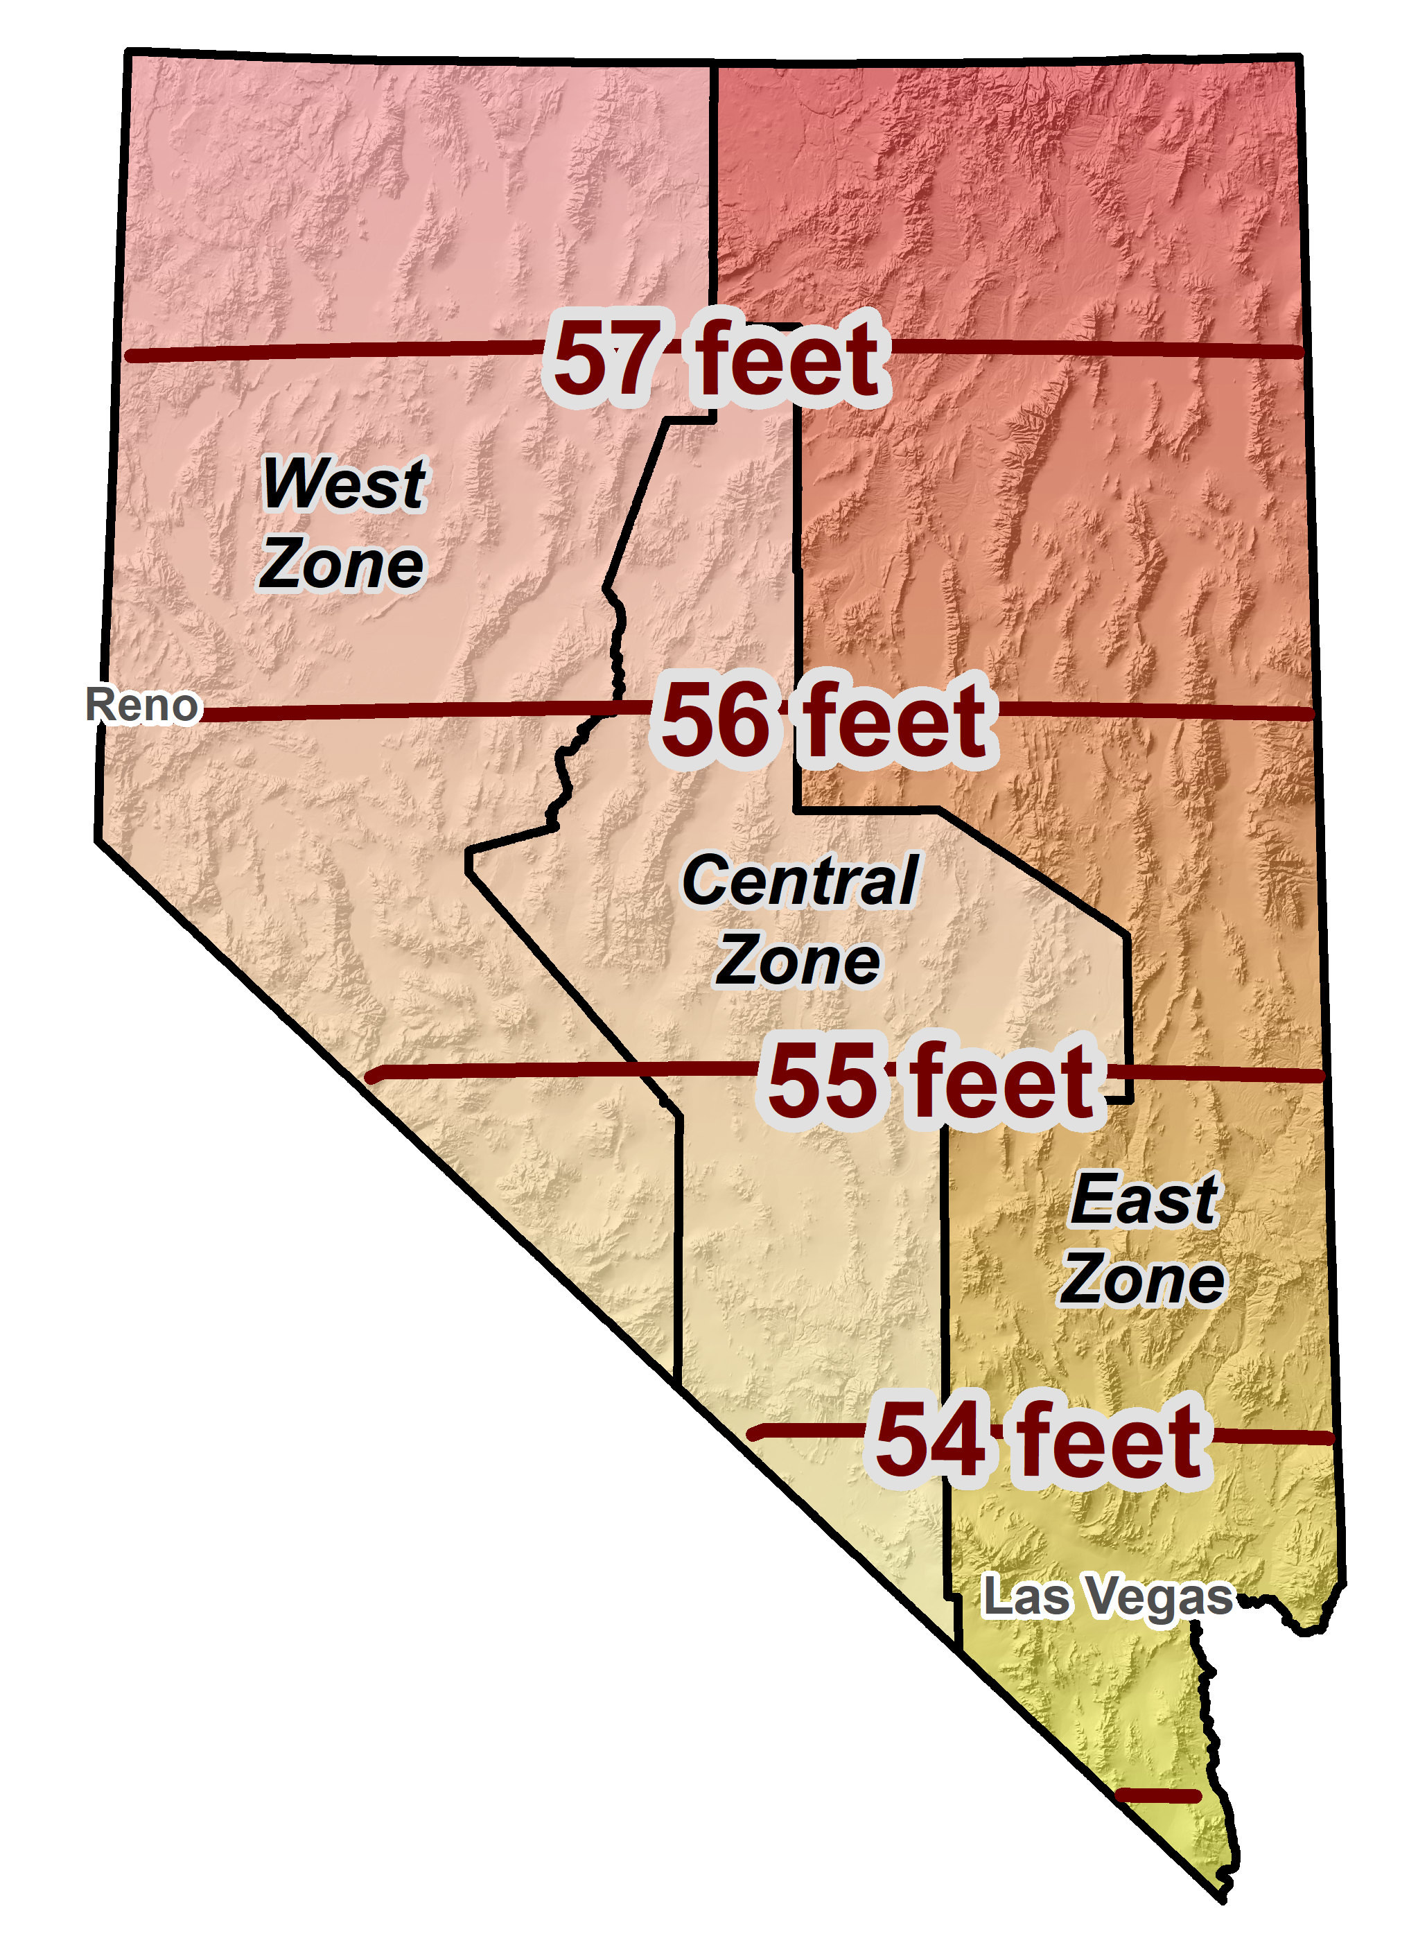
Horizontal error when mixing up feet…
SPCS 83 Nevada East Zone
January 7, 2025
TRB Annual Meeting 2025
26

Slide 27
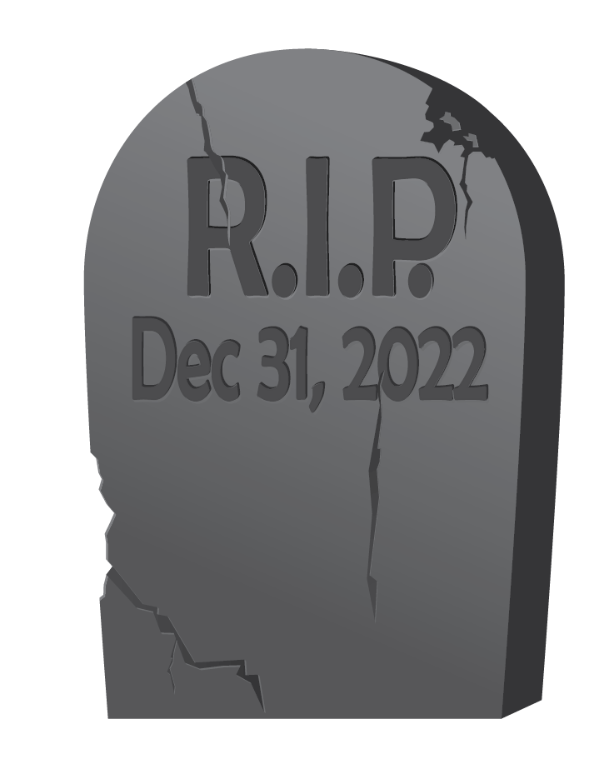
End of an era for the U.S. survey foot
U.S. survey foot has been “deprecated” (retired)
Not supported for State Plane Coordinate System of 2022 (or any part of modernized NSRS)
Only international foot definition will be supported by NGS
Effective December 31, 2022
But U.S. survey foot will still be supported for legacy products (e.g., existing State Plane)
However, NGS will NOT support NAD 83 after NSRS Modernization complete
NGS will always support U.S. survey foot for SPCS 83 and 27
Thank you.
January 7, 2025
TRB Annual Meeting 2025
27

Slide 28


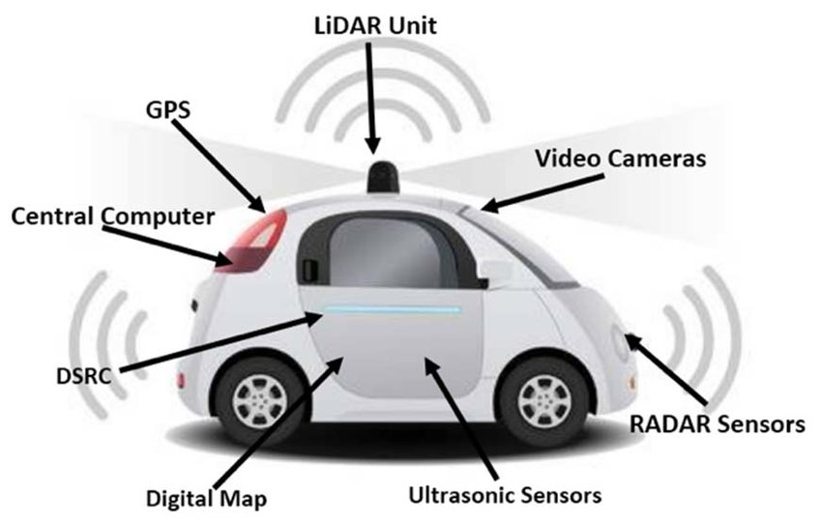
Benefits of a Modernized NSRS
Our society and economy are becoming more “spatially enabled”
The Modernized NSRS will help make this a reality
Digital twins
Project life cycles
Autonomous vehicles
Emergency response
Smart infrastructure
Facilities asset management
2D, 3D, 4D, 5D, etc. design

Slide 29
NSRS Modernization is nearly done!
Beta releases (for testing and evaluation only!)
Begin early 2025 with NCAT (includes SPCS2022, IFDM2022, 14H, GEOID2022)
End late 2025 (last beta release likely will be adding VERTCON to NCAT)
We encourage you to test each component as it is released
Replaces current datums in 2026
At least 6 months after last item added to beta release
After Federal Geodetic Control Subcommittee votes to approve in 2026
NGS will continue supporting current NSRS through the rollout and testing of the modernized NSRS

Slide 30



Where to learn more…
geodesy.noaa.gov
TRB Workshop 5009
Navigating the Modernized National Spatial Reference System: A Geospatial Odyssey
Thursday, Jan 9, 9:00 AM- 12:00 PM
Convention Center, 202B
Thank you!

