Slide 1
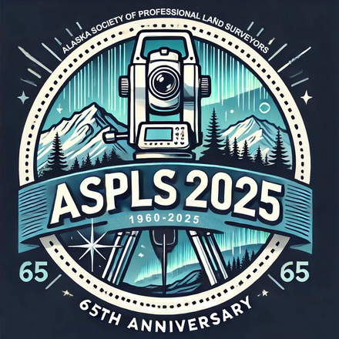
The Modernized National Spatial Reference System
Where Things Stand and the Road Ahead
Alaska Society of
Professional Land Surveyors
2024 Conference
Anchorage, AK ● Feb 20, 2025
Michael Dennis, PhD, PE, PLS
SPCS2022 Project Manager

Slide 2
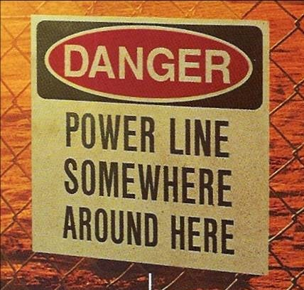
What is the National Spatial Reference System?
…and why should you care?
A set of consistent nationwide coordinate systems
Created in 1807 to support commerce and science
Defined and maintained by NOAA’s National Geodetic Survey
Geodesy: the science of where things are

Slide 3
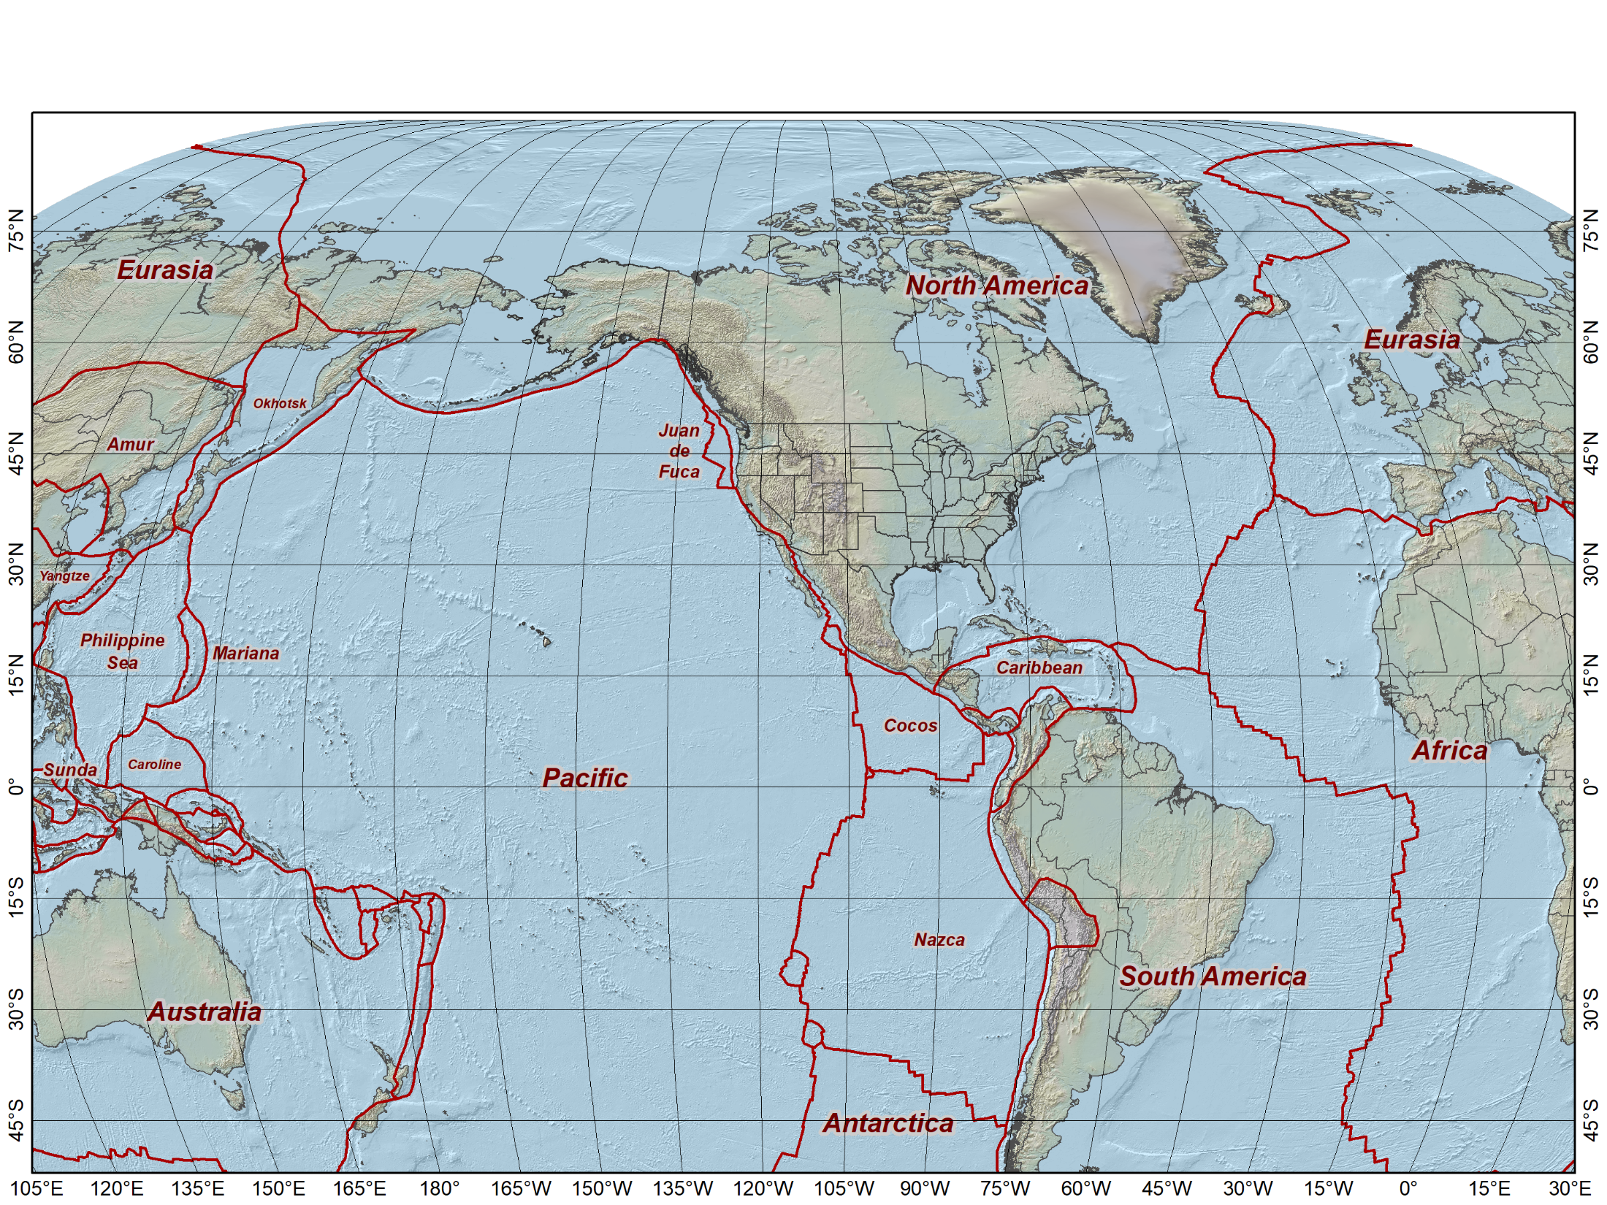
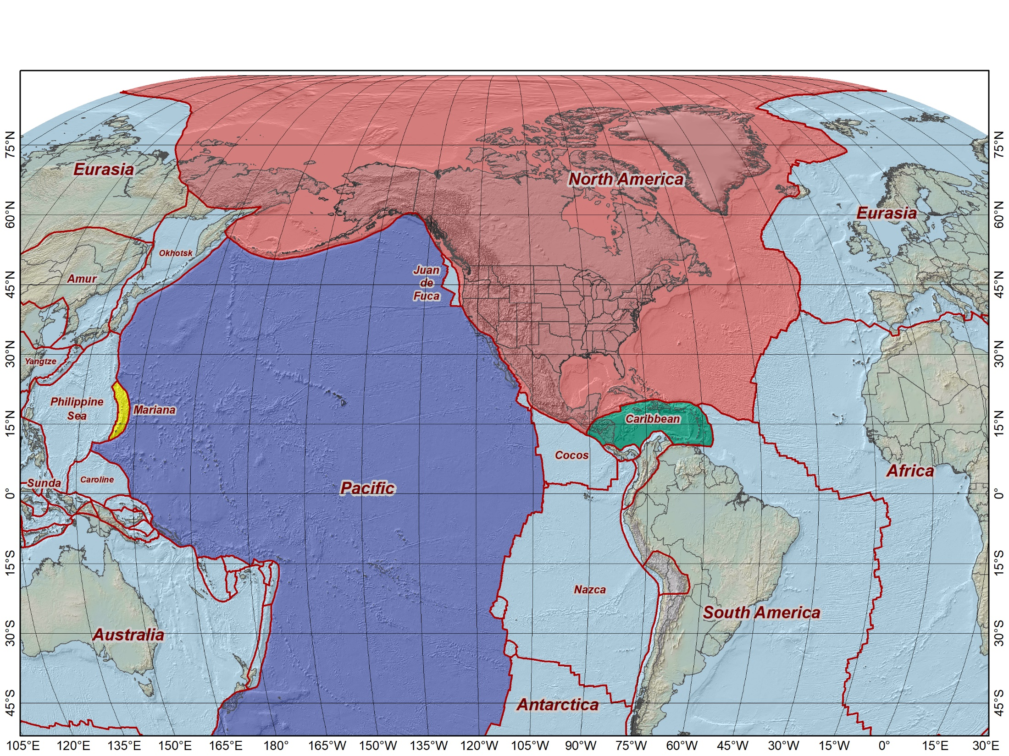
Why is the NSRS being modernized?
Things are moving
Modernized NSRS accounts for crustal motion
Tectonic plate rotation
Local deformation
Earthquakes
Subsidence
Earth center well known
Reduces systematic errors
Global rather than regional
Compatible with international reference systems
NATRF2022
MATRF2022
PATRF2022
CATRF2022

Slide 4
IFDM2022: Intra-Frame Deformation Model of 2022
New preliminary version nearly completed
Single 0.1° (6 arc-minute) grid covering entire Earth
3D velocities and their standard deviations
Built from best available information
Mainly latest Global Strain Rate Model and Global Land Vertical Motion Model
Augmented by:
NGS-computed rotations for North America, Pacific, Caribbean, and Mariana plates
NGS Multi-Year CORS Solution 3
Trans4D and NGS velocity computations in limited areas
Earthquake displacement grids
Replaces Horizontal Time-Dependent Positioning (HTDP) software
Combined with Helmert transformations to transform and project through time

Slide 5
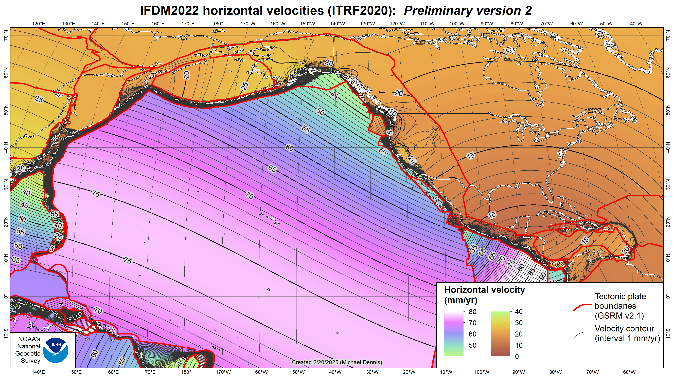

Slide 6
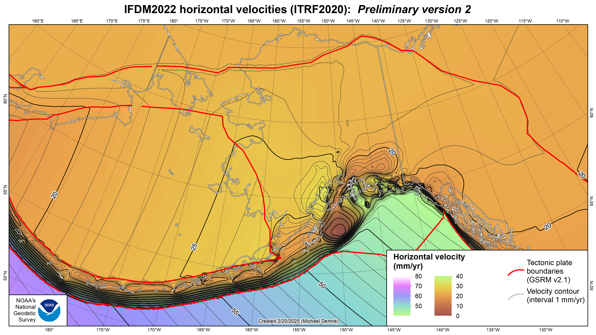

Slide 7
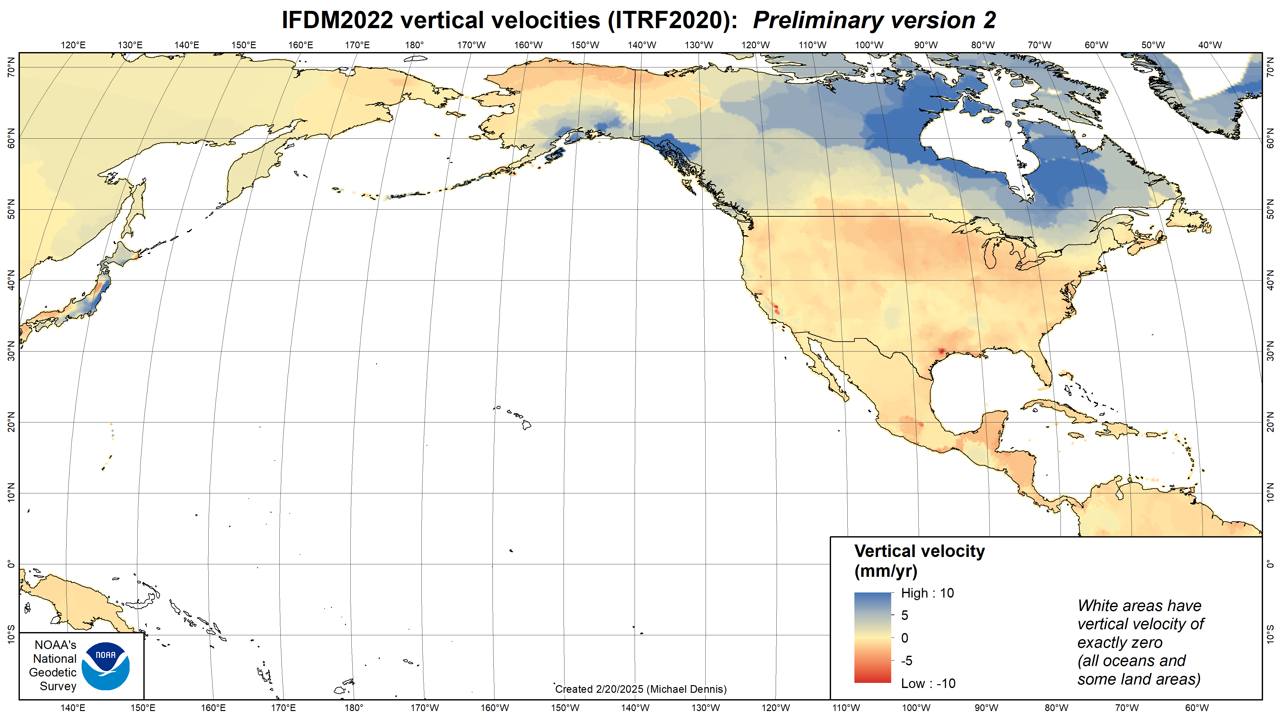

Slide 8
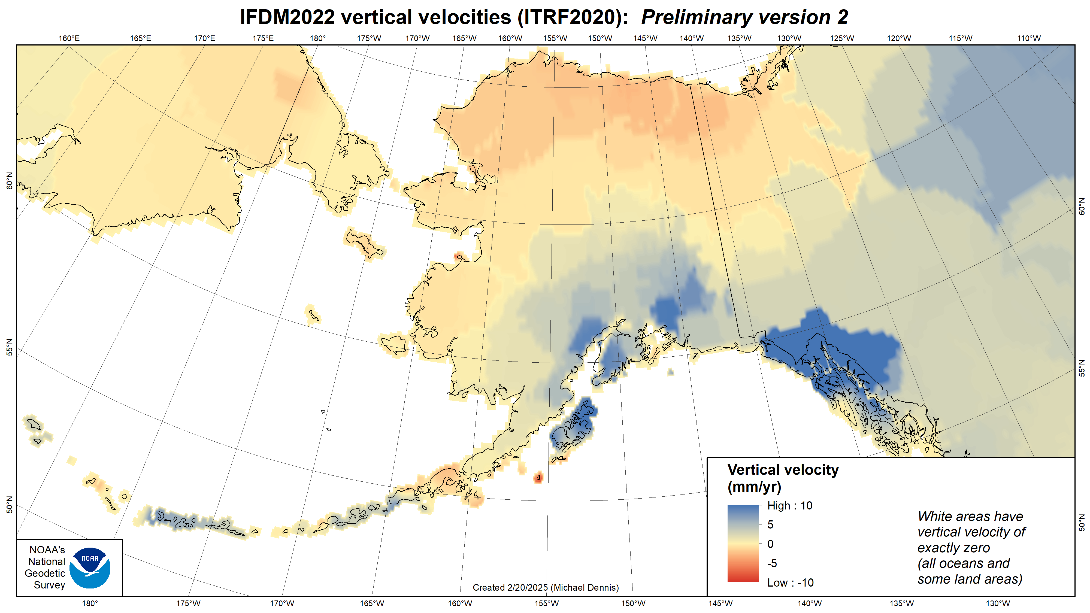

Slide 9
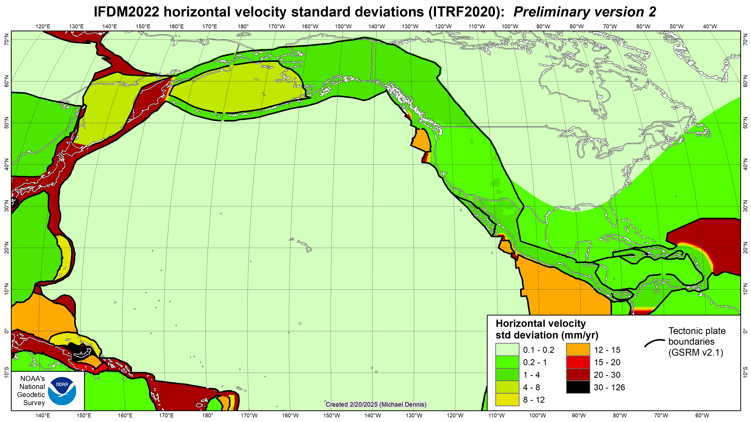

Slide 10
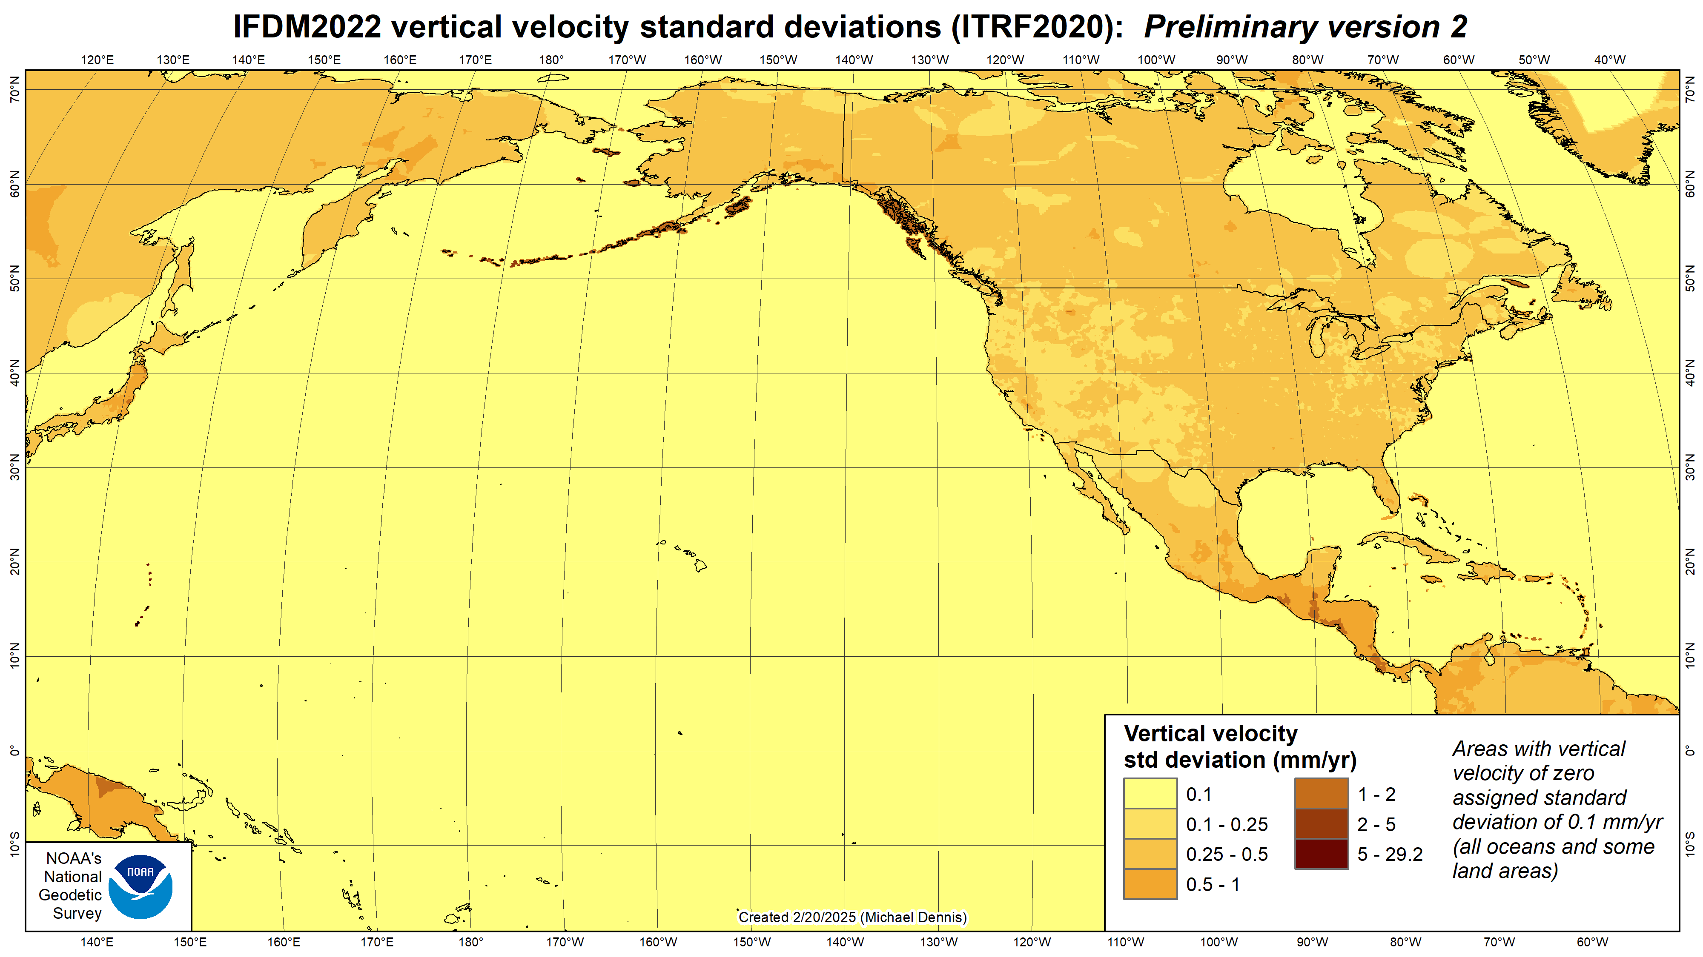

Slide 11
New types of coordinates
Reference Epoch Coordinates (RECs)
Temporal “snapshot” of entire network
Similar to NAD 83 (2011/PA11/MA11) epoch 2010.00
Initial epoch 2020.00
Every 5 or 10 years (TBD)
Survey Epoch Coordinates (SECs)
Time-dependent!
Gives coordinates at time of observation
Multiple SECs can show changes over time
Likely not included in initial rollout of Modernized NSRS

Slide 12
National adjustments of passive control
Initial adjustment underway, constrained to latest CORS coordinates
Geometric (latitude, longitude, ellipsoid height) and orthometric (elevation)
Geometric includes OPUS-Share solutions (currently 2126 in AK)
Observations transformed and time projected to ITRF2020 at epoch 2020.00
Two national adjustments
First being done now, results will be used for new NADCON and VERTCON grids
Second done when new datums released, constrained to results of first
New coordinates on passive control at epoch 2020.00
All 5 frames the same at that epoch (but only at that epoch)
ITRF2020 = NATRF2022 = PATRF2022 = CATRF2022 = MATRF2022
Beta release this year on new NSRS Datasheets
Will include beta SPCS2022 coordinates

Slide 13
The problem: we have this

Slide 14
But we want this
Credit: Scott Gelber, The Atlantic

Slide 15
What is the solution?
Just click this button in your favorite geospatial software!
My Map Projection
My Map Projection
Powered by AI
What could possibly go wrong?

Slide 16
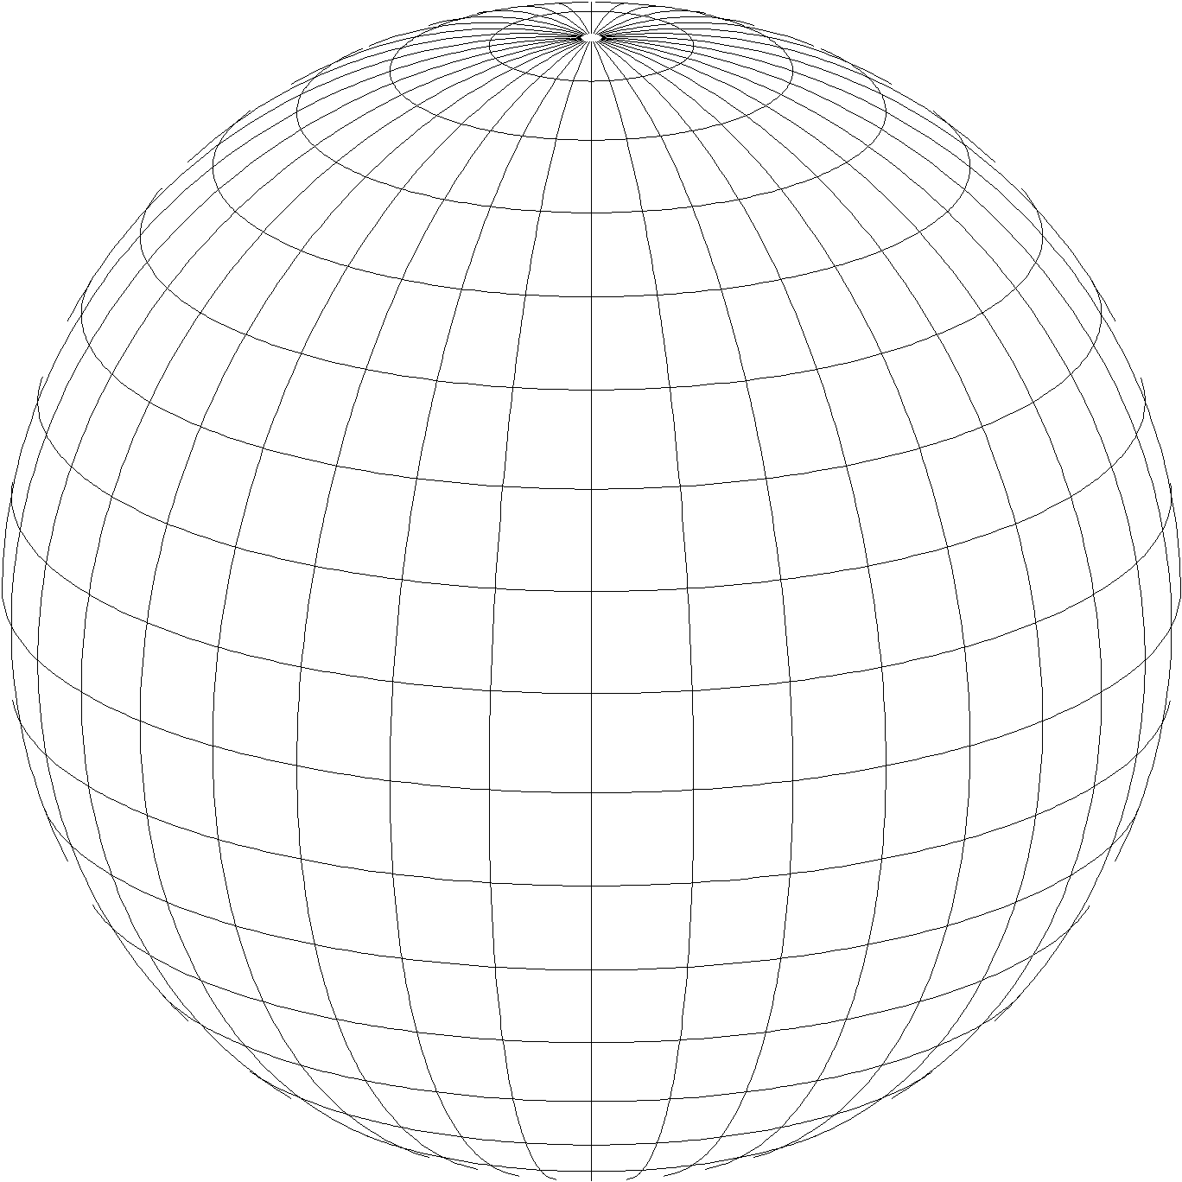
State Plane Coordinate System of 2022 (SPCS2022)
Third generation of State Plane
First in 1930s (SPCS 27), second in 1980s (SPCS 83)
Widely used in surveying, engineering, and GIS
Same 3 map projection types
Same ellipsoid as SPCS 83 (GRS80)
Same as existing State Plane, but different…
Based on new terrestrial reference frames instead of NAD 83
More zones, most designed by state stakeholders
Designed to reduce linear distortion at topographic surface (i.e., reduce difference between “grid” and “ground” distances)
Lambert Conformal Conic
Transverse Mercator
Hotine Oblique Mercator

Slide 17
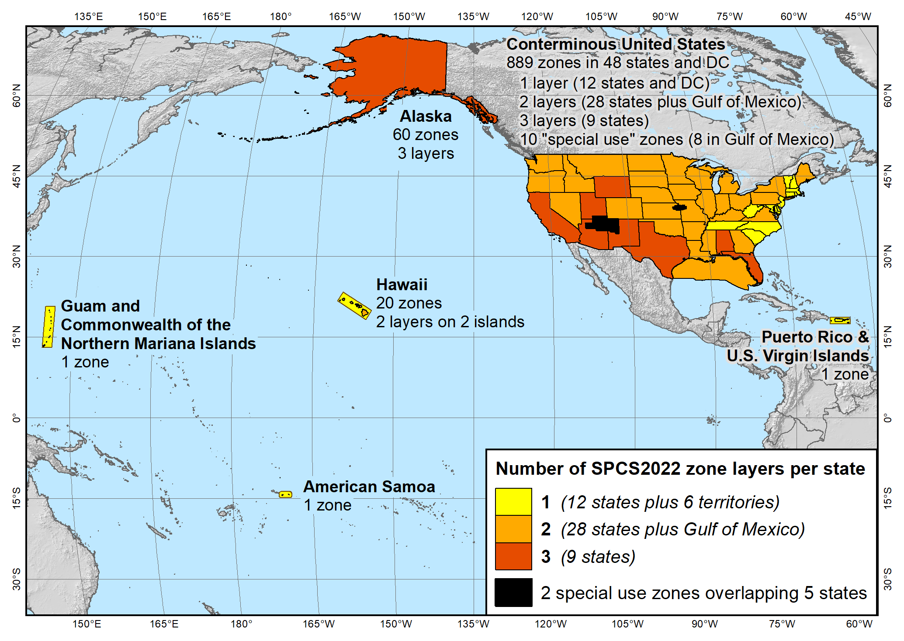
SPCS2022 zone layers
1 layer: 12 states plus 6 territories
2 layers: 28 states plus Gulf of Mexico
3 layers: 9 states
Plus 10 special use zones (2 zones overlap 5 states)
Every state and territory has a statewide zone layer

Slide 18
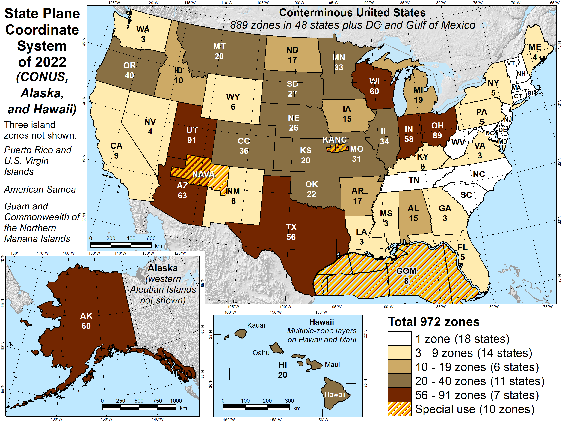
Number of SPCS2022 zones (preliminary)
Designs by NGS
153 zones
Includes 54 statewide zones…
…and 10 “special use” zones (in more than one state or no state at all)
Designs by state stakeholders
819 zones in 28 states
Total = 972 zones for 56 states and territories
Compare to 125 zones in existing State Plane (SPCS 83)

Slide 19
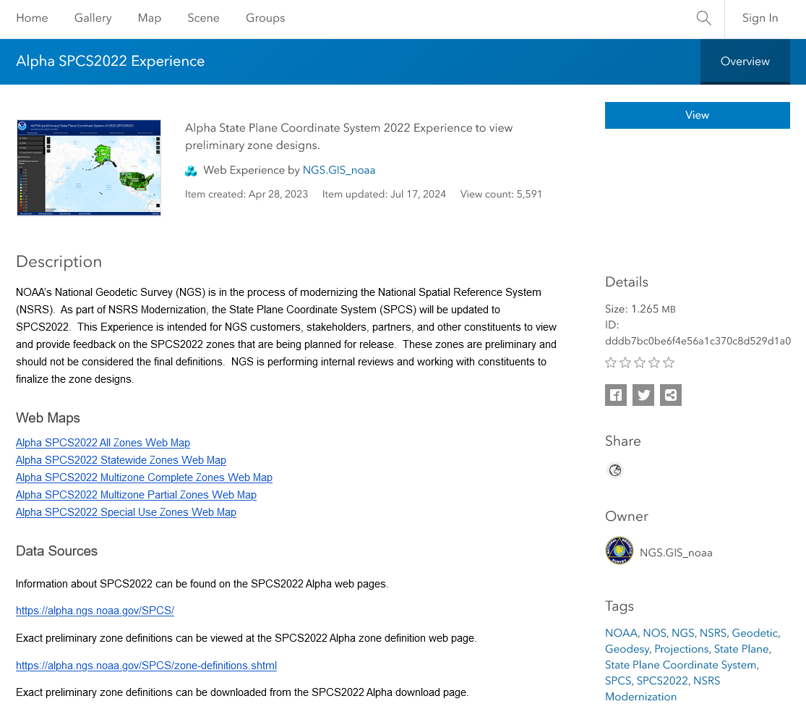
ArcGIS Online SPCS2022 Experience
Online interactive maps
Shows distortion and gives zone definitions
Recently updated
Accessible on mobile devices

Slide 20
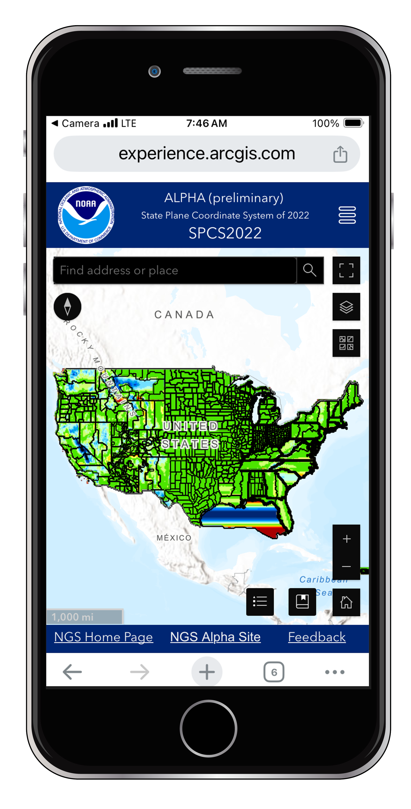
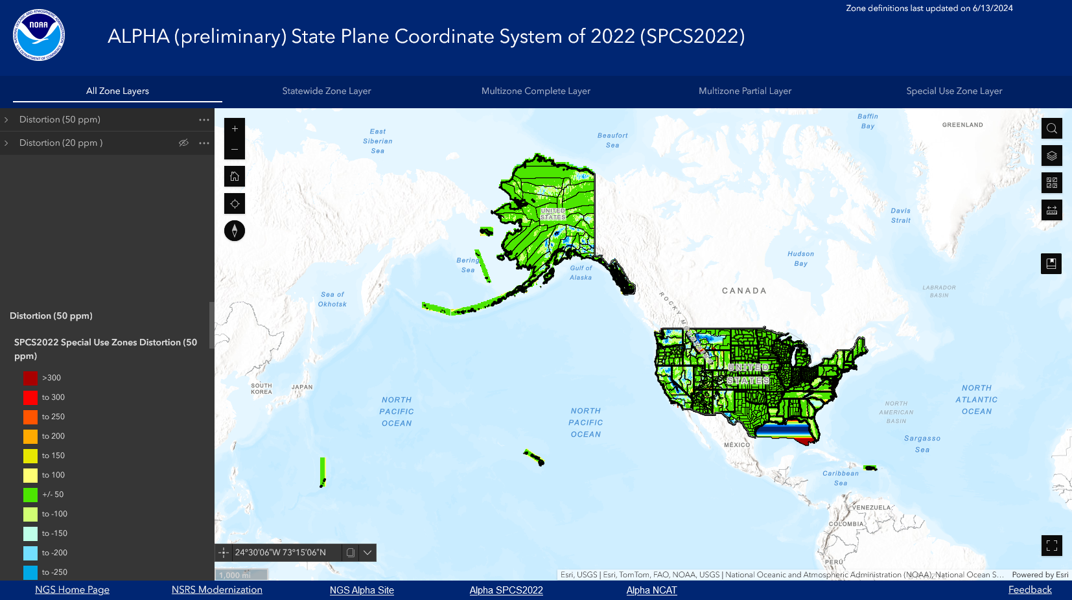
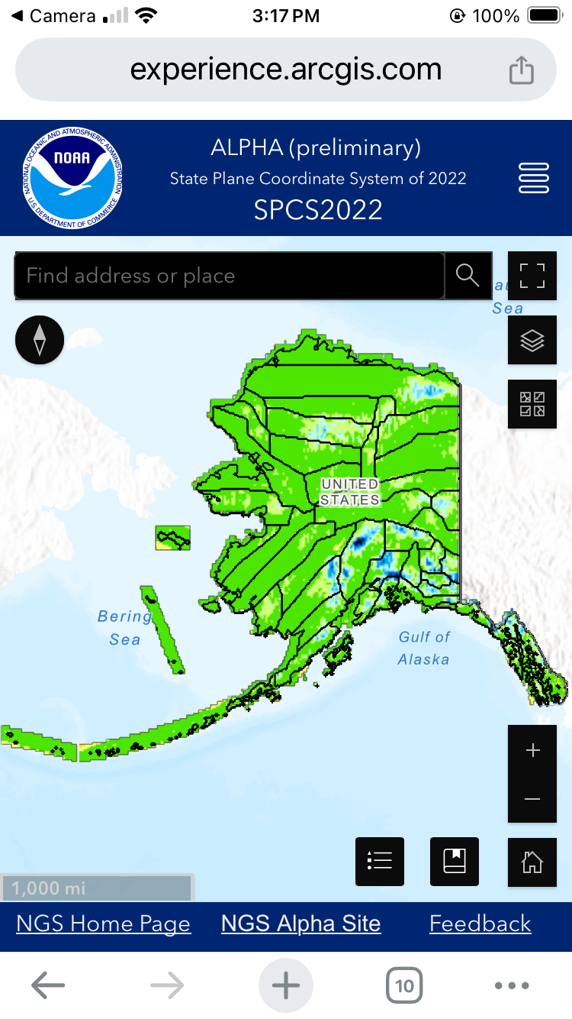

Slide 21
NSRS Modernization is nearly done!
Beta releases (for testing and evaluation only!) TENTATIVE schedule
National CORS Network station pages: May 2025
NSRS Datasheets for passive control: July 2025
NCAT v.01 (SPCS2022, IFDM2022, 14H, GEOID2022): July 2025
OPUS-Static v5.2 with M-PAGES: Sep 2025
NCAT v.02 (NADCON, VERTCON): Dec 2025
We encourage you to test each component as it is released
Replaces current datums in 2026
At least 6 months after last item added to beta release
After Federal Geodetic Control Subcommittee votes to approve in 2026
Current NSRS supported through rollout and testing of the modernized NSRS

Slide 22
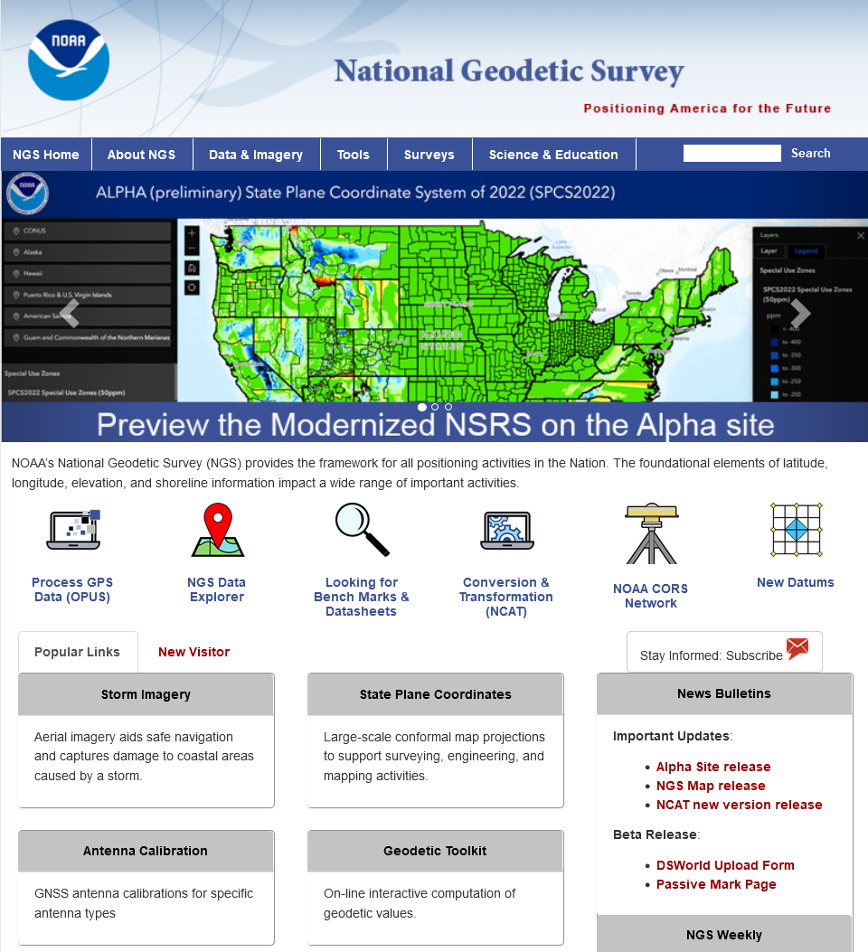
Where to learn more…
geodesy.noaa.gov
Thank you!
Questions?

