Slide 1
Upcoming Changes to Federal Survey Control and Standards
Presented at
County Engineer’s Association of Ohio
Winter Conference
Columbus, OH
Dec 6, 2016
geodesy.noaa.gov
Presented by:
David Conner, Regional Geodetic Advisor
National Geodetic Survey, NOAA
Dave.Conner@noaa.gov
www.ngs.noaa.gov

Slide 2
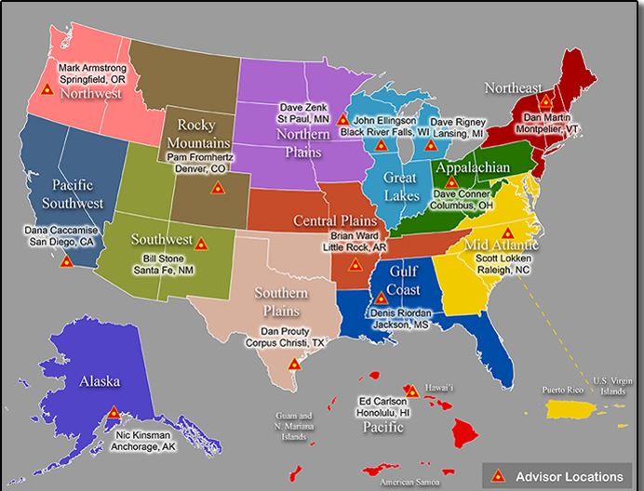
NGS Regional Geodetic Advisors
Serve as liaison between NGS and the user community
Notes:
The Regional Geodetic Advisor is a federal employee of NOAA’s National Geodetic Survey (NGS). The Advisor serves as a liaison between NGS and its public, academic and private sector constituents within their assigned region. They provide expert guidance and assistance to these constituents who are managing the geodetic component of geospatial activities that are tied to the National Spatial Reference System (NSRS). Geodetic advisors serve as subject matter experts in geodesy and regional geodetic issues, collaborating internally across NGS and NOAA to further the organizations’ missions.

Slide 3
NGS is part of NOAA a small part
… ~200 vs 10,000 people
Mission: To define, maintain & provide access to the National Spatial Reference System (NSRS) to meet our Nation’s economic, social & environmental needs
Notes:
The National Geodetic Survey was known as the U.S. Coast and Geodetic Survey (USC&GS) prior to 1970.
The USGS (U.S. Geological Agency) is an entirely different organization.
NGS’s focus is on geodetic control, whereas USGS’ focus is on making maps, among other things. USGS established a lot of control for mapping purposes, and a lot of their survey marks remain in the field.

Slide 4
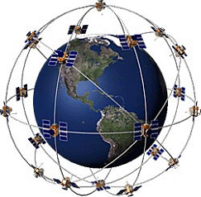
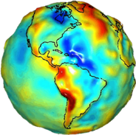
The National Spatial Reference System (NSRS) is a consistent coordinate system that defines latitude, longitude, height, scale, gravity, and orientation throughout the United States.
Notes:
Geodesy is the business of the National Geodetic Survey (NGS). NGS develops and maintains the National Spatial Reference System, a national coordinate system that provides the foundation for transportation, navigation, land record systems, mapping and charting efforts, and a multitude of scientific and engineering applications. This system defines position (latitude, longitude, and elevation), distances and directions between points, strength and direction of gravity (no, it is not simply “straight down”), and how these change over time.

Slide 5
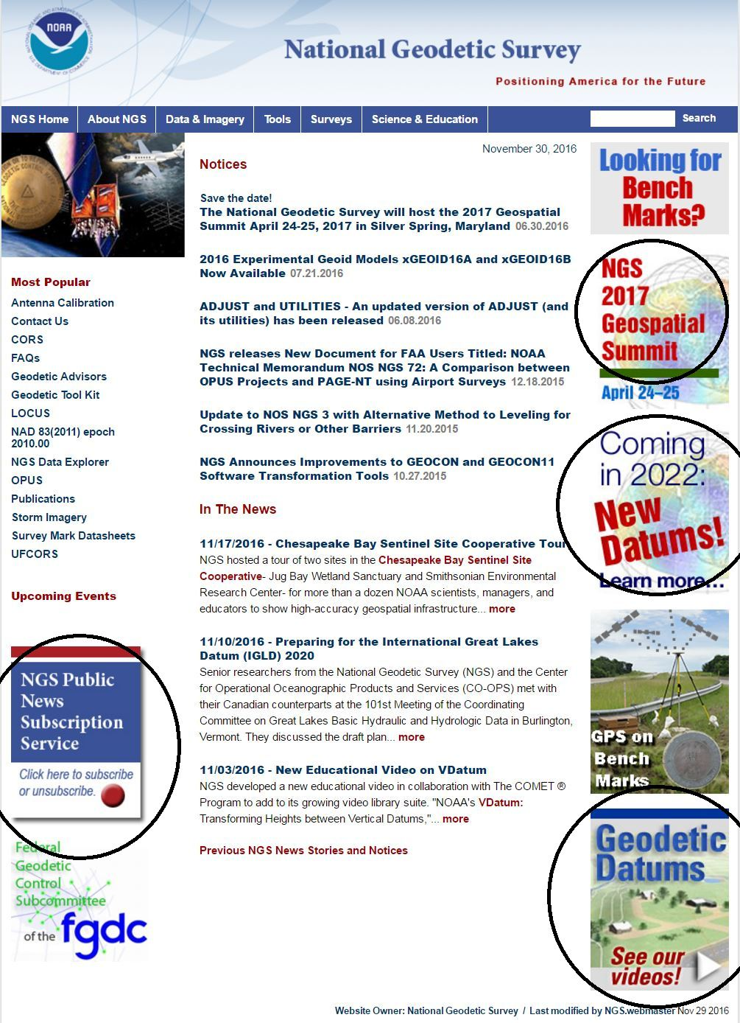

Slide 6
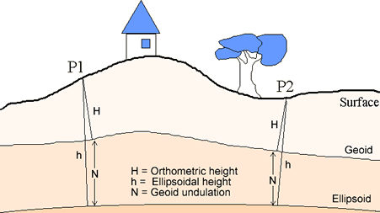
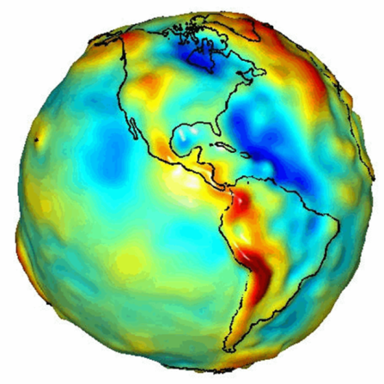
What is Geodesy?
Geodesy is a foundational science that defines position & height
Why is Geodesy important?
The Earth has an irregular surface and is difficult to model.
Accurate positions are required for a wide variety of applications
Notes:
Geodesy is the science of accurately measuring and understanding the Earth's geometric shape, orientation in space, and gravity field.
While we may tend to think of the Earth as a uniform, smooth globe, in reality its shape and surface are quite complex. This complexity provides challenges when trying to determine the latitude, longitude, or elevation of a point on the Earth’s surface. Figuring all this out is part of the science of geodesy.

Slide 7
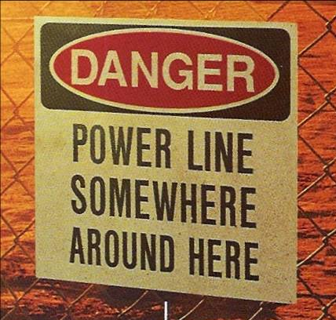
Why should we care about geodesy?

Slide 8
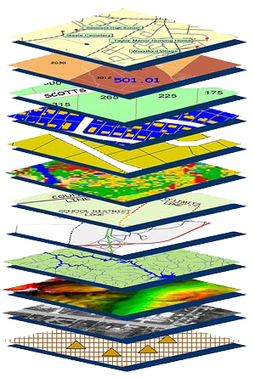
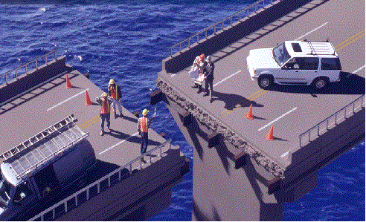
Accurate positioning begins
with accurate coordinates
Geodetic control is the foundation for all geospatial products…
Source: Zurich-American Insurance Group
Notes:
Digital services must ensure that geo-referenced data collected and published are consistent with NOAA’s National Spatial Reference System (NSRS), which provides the foundation for all positioning and navigation activities in the United States and is defined and maintained by NGS.

Slide 9

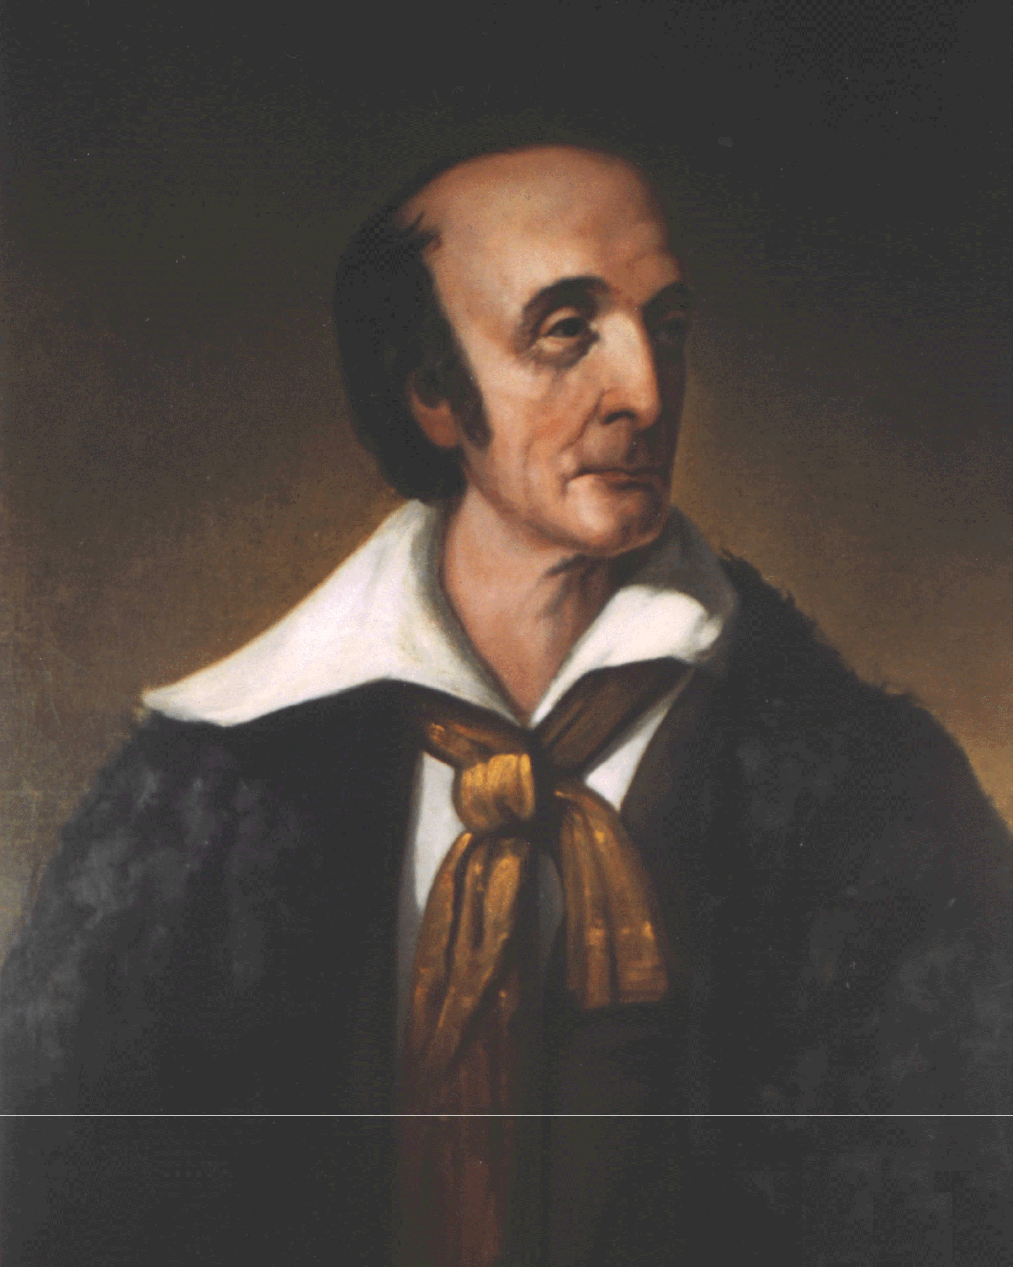
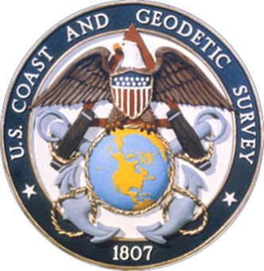

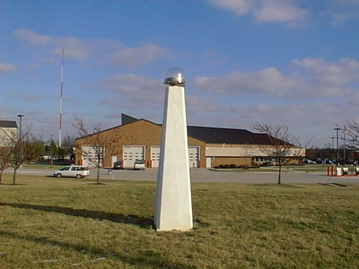
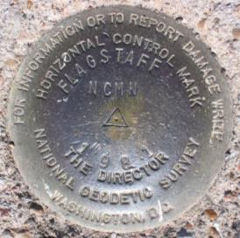
NGS and the NSRS continue to evolve
The National Geodetic Survey (NGS) has been around for a long time
  1878
  1970
  1807
  United States Coast Survey
And the NSRS continues to evolve with us
Passive
Control
(Monuments)
Active
Control
(CORS)
  SIDNEY est 2001
Notes:
NGS has been around a long time. For over 200 years, NGS and its predecessor agencies have collaborated with public and private organizations to establish reference stations at precisely determined locations. We began on a mission to conduct a “Survey of the Coast” (as the United States Coast Survey), established by Thomas Jefferson, in 1807 (pictured are Thomas Jefferson and Ferdinand Hassler, the first Superintendent of the Coast Survey). We were renamed US Coast & Geodetic Survey in 1878. And we became National Geodetic Survey in 1970 (when NOAA was created).
Traditionally, precise positioning locations have been identified by setting a survey mark—usually a brass, bronze, or aluminum disk. Locations might also be identified by a deeply driven rod or a prominent object, such as a water tower or church spire. More recently, NGS has fostered a network of continuously operating reference stations (CORS) where each CORS includes a highly accurate receiver that continuously collects radio signals broadcast by Global Navigation Satellite System (GNSS) satellites.
GPS (USA)
Compass, aka BeiDou (China)
GLONASS (Russia)
Galileo (EU)

Slide 10
Ohio Geodesy Firsts
Geodesy program in the U.S., est. 1952 at OSU
Network GPS Project, worldwide, Summit County 1983
Local government agency with GPS survey capability, worldwide, at Franklin County early 1980’s
Statewide Real Time GPS network, by ODOT in 2004
Others … ?

Slide 11
IMPROVING POSITIONAL ACCURACY
TIME NETWORK LOCAL
NETWORK SPAN ACCURACY ACCURACY
NAD 27 1927-1986 10 METERS 1 part in 100,000
NAD83(86) 1986-1990 1 METER 1 part in 100,000
HARN 1990-1997 0.1 METER B-order (1 part in 1 million)
A-order (1 part in 10 million)
CORS 1996 - 0.01 meter 0.01 meter

Slide 12
Example Coordinate Shifts
Actual shifts at central Ohio station SMITH (JY0742)
NAD 27 vs NAD 83 (1986) ~ 13 meters
NAD 83 (1986) vs NAD 83 (1995) ~ 20 cm
NAD 83 (1995) vs NAD 83 (2007) ~ 1.5 cm
NAD 83 (2007) vs NAD 83 (2011) ~ 2.3 cm
The future = ?
New datums, both horizontal and vertical

Slide 13
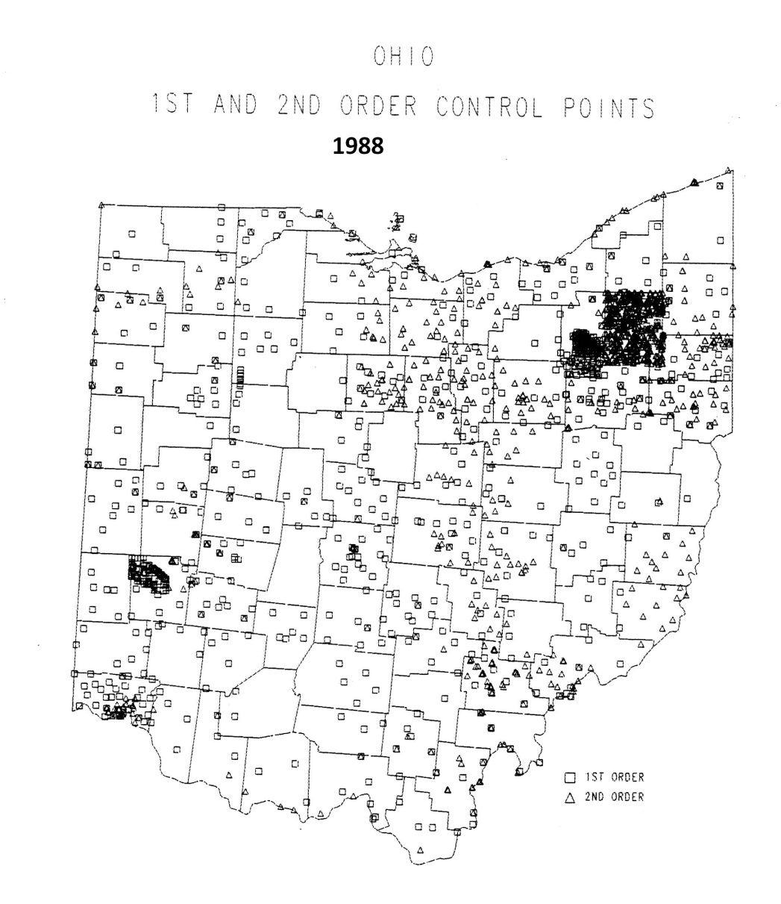
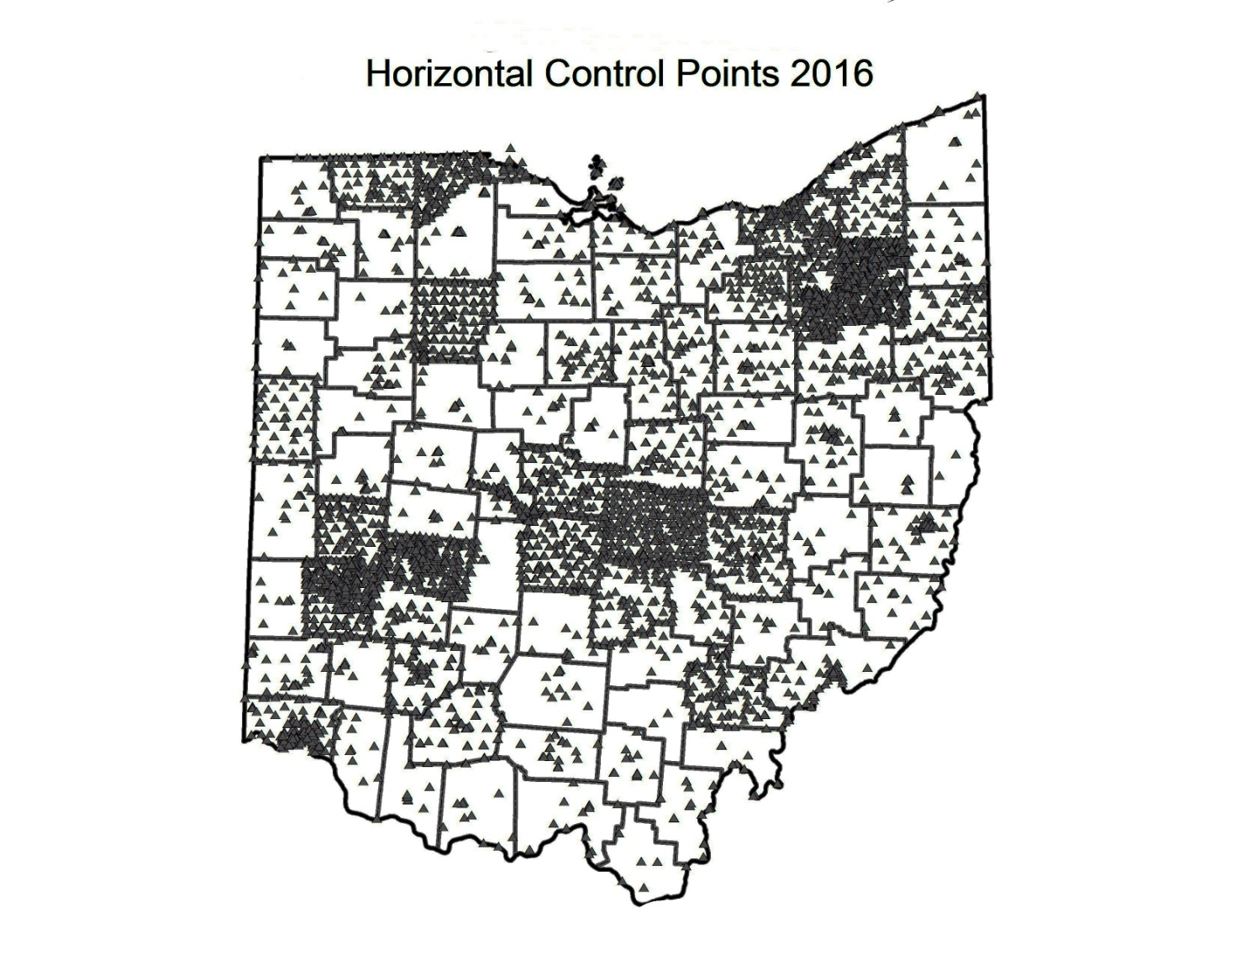
Horizontal control published by NGS
Prior to most GPS projects
Change due to GPS projects
Notes:
Red circles denote first two GPS projects ever published by NGS …
#1 – Summit County in 1983, GPS007

Slide 14
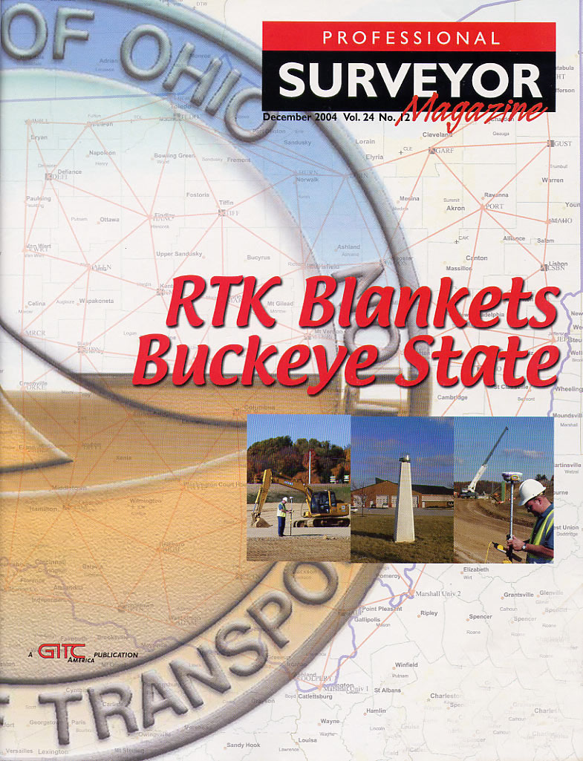
Then came GPS CORS
Followed by RTK
Enabling cm precision
In Real Time …
Anywhere,
Anytime!
Metadata ever more important!
Notes:
Precision vs Accuracy! Be very careful about believing cm accuracy GPS. CM precision (repeatability) is more readily achieved.

Slide 15
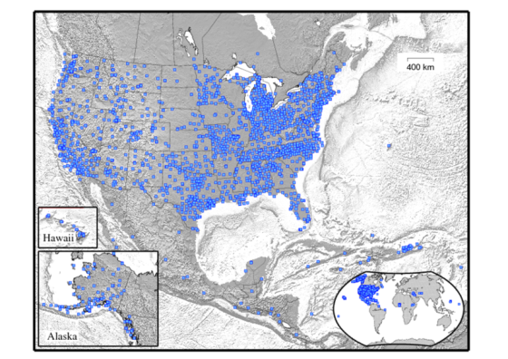
Continuously Operating Reference Stations (CORS)
~ 2000
Stations
Notes:
(Pictured above are a CORS antenna, CORS at tide station, US Total Electron Content model)
NOAA’s National Geodetic Survey (NGS) manages a network of Continuously Operating Reference Stations (CORS), that provide Global Navigation Satellite System (GNSS) data to support three-dimensional positioning,
meteorology, space weather, and geophysical applications throughout the United States, its territories, and a few foreign countries. The CORS network is a multi-purpose cooperative endeavor involving over 200 government, academic, and private organizations. Only a couple of dozen are actually owned by NGS.
As of June, 2014, there were over 1900 operational CORS in the NOAA CORS Network
CORS enables users to determine (with the proper tools and equipment) centimeter level positions with respect to the NSRS by simultaneously processing their own GNSS data with data from the CORS Network.
Co-located with tide stations, CORS can contribute to local and global sea-level rise calculations by measuring land subsidence relative to water levels.
CORS data can also used to monitor and predict the distribution of moisture and electrons in the atmosphere; as well as produce ionosphere models of total electron content (TEC) that impact GNSS-derived position accuracy.
A 2009 socioeconomic scoping study, estimated CORS benefits to the nation are $750 million per year.

Slide 16
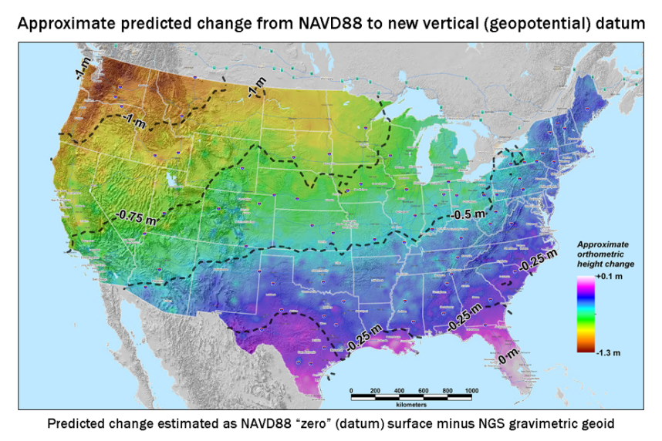
New Datums Are Coming in 2022
To replace NAD 83 and NAVD 88
New geometric (horizontal) and geopotential (vertical) datums
Realized through GPS and a geoid model
Target: 2-centimeter accuracy relative to sea level (orthometric heights) using GPS/GNSS and a geoid (gravity) model from NGS’ GRAV-D project.
NGS will provide transformation tools to easily transform between new and old datums.
Notes:
The new datums will be accessed via GNSS technology versus benchmarks
Current datums are not perfect and do not fully support current (and future) technology (such as GPS and Lidar)
New geopotential (vertical) datum to be released in 2022 will be a gravimetric geoid. Airborne gravity data for the geopotential datum collected by the Gravity for the Redefinition of the American Vertical Datum (GRAV-D) Project will allow for blending of data from satellite, airborn, and surface sources. Both datums will be released together in 2022. As of May 2015, GRAV-D is 50% complete.
Estimated Differences Between “Old” and “New” Datums:
Geometric Datum
Horizontal: 0.8 to 1.5 m in CONUS
Ellipsoidal heights: -0.2 to -1.6 m CONUS; AK 0 to 1.3 m
Geopotential Datum
Approx. +0.1 m (Florida) to -1.3 m (Washington)
More than 2 meters of change in Alaska
More info is available at the NGS New Datums Webpage. It has been four years since NGS held its first Geospatial Summit in 2010 to announce the replacement of the NAD 83(geometric) and NAVD 88 (geopotential) to other federal agencies within the mapping community. The April 2015 summit will provide an opportunity to share updates on the new geometric and geopotential datums to the general public allowing the opportunity to address their comments, questions and concerns to NGS.
Picture: Map reflects the type of height improvements users could expect if NAVD 88 were replaced with a geoid-based vertical datum. (This is only a large scale approximation and should not be used as an absolute guide. Each benchmark might have its own level of mismatch, for example from uplift or subsidence, not captured by this broad brush. Also, this is the difference between the zero level of NAVD 88 and the actual geoid. The difference between NAD 83 ellipsoid heights and ITRF/GRS-80 ellipsoid heights has NO influence on this graph and should not be part of the story.)
Picture: xGEOID14B. Beginning in 2014, the National Geodetic Survey will release annual gravimetric geoid models which incorporate all available gravity sources, including all airborne gravity collected through the GRAV-D project to that point. The image above shows the xGEOID14B model with the boxes showing the location of the input aerogravity data. These experimental geoid models will provide the public with the opportunity to evaluate how the geopotential (vertical) datum in their area will change when the new datums arrive.
Picture: GRAV-D data block for North Carolina. More than 40 percent of the U.S. and its territories have been covered by GRAV-D airborne data collection.

Slide 17
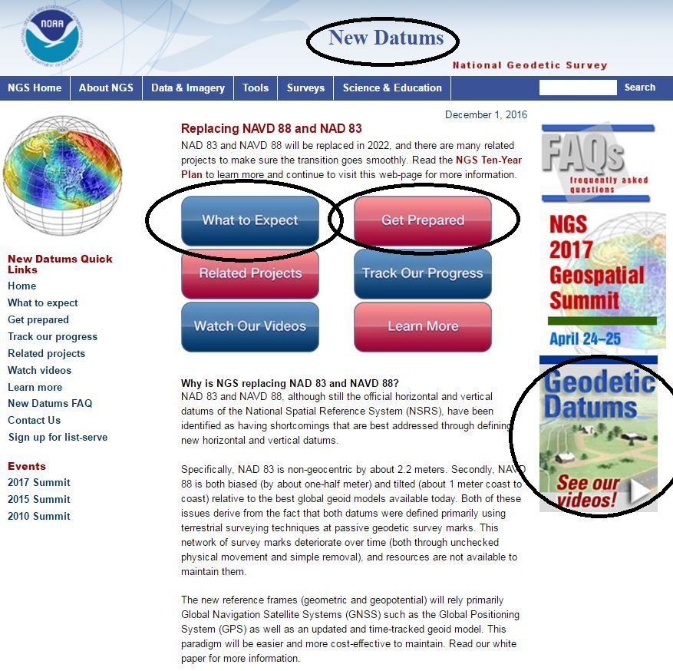

Slide 18
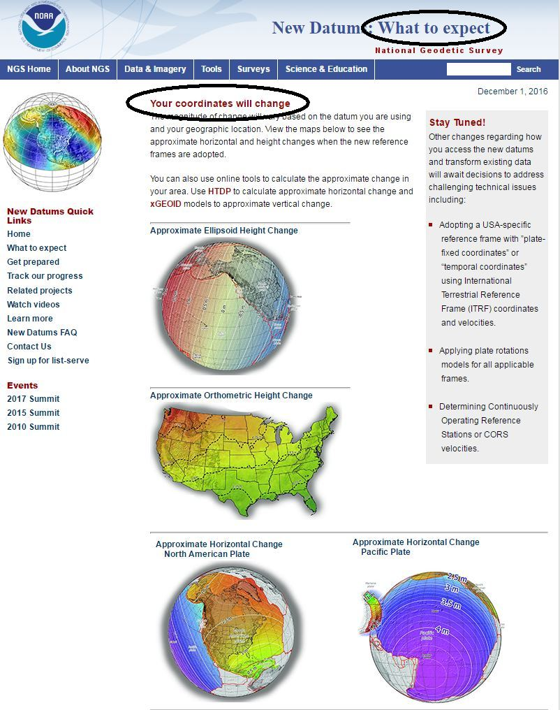

Slide 19
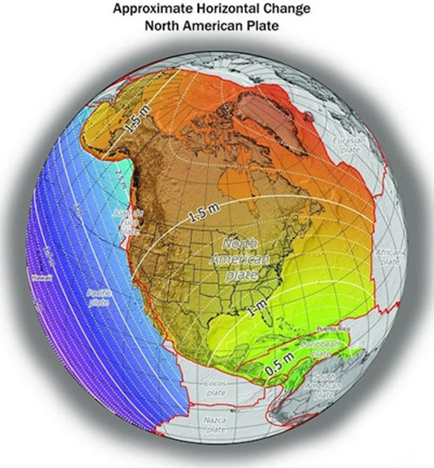
How will the new datums affect you?
Published Coordinates
Will Change
The new geometric datum will change latitude, longitude, and ellipsoid height by 1 - 2 meters (3 – 6 ft)
Notes:
Picture: Map reflects the type of height improvements users could expect if NAVD 88 were replaced with a geoid-based vertical datum. (This is only a large scale approximation and should not be used as an absolute guide. Each benchmark might have its own level of mismatch, for example from uplift or subsidence, not captured by this broad brush. Also, this is the difference between the zero level of NAVD 88 and the actual geoid. The difference between NAD 83 ellipsoid heights and ITRF/GRS-80 ellipsoid heights has NO influence on this graph and should not be part of the story.)
The new datums will be accessed via GNSS technology versus benchmarks
New vertical datum to be released in 2022 will be based upon a gravimetric geoid
Airborne gravity data for the geopotential datum collected by the Gravity for the Redefinition of the American Vertical Datum (GRAV-D) Project will allow for blending of data from satellite, altimetric, and surface sources.
Estimated Differences Between “Old” and “New” Datums:
Geometric Datum
Horizontal: 0.8 to 1.5 m in CONUS
Ellipsoidal heights: -0.2 to -1.6 m CONUS; AK 0 to 1.3 m
Geopotential Datum
Approx. +0.1 m (Florida) to -1.3 m (Washington)
More than 2 meters of change in Alaska

Slide 20
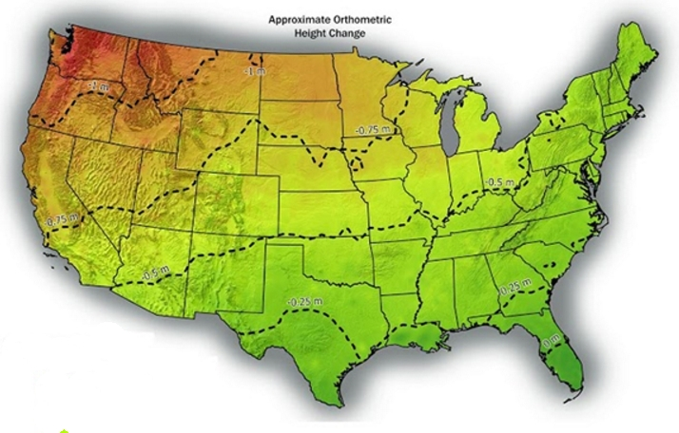
How will the new datums affect you?
Heights Will Change on average 50 cm (1.6 ft)
Notes:
Picture: Map reflects the type of height improvements users could expect if NAVD 88 were replaced with a geoid-based vertical datum. (This is only a large scale approximation and should not be used as an absolute guide. Each benchmark might have its own level of mismatch, for example from uplift or subsidence, not captured by this broad brush. Also, this is the difference between the zero level of NAVD 88 and the actual geoid. The difference between NAD 83 ellipsoid heights and ITRF/GRS-80 ellipsoid heights has NO influence on this graph and should not be part of the story.)
The new datums will be accessed via GNSS technology versus benchmarks
New vertical datum to be released in 2022 will be based upon a gravimetric geoid
Airborne gravity data for the geopotential datum collected by the Gravity for the Redefinition of the American Vertical Datum (GRAV-D) Project will allow for blending of data from satellite, altimetric, and surface sources.
Estimated Differences Between “Old” and “New” Datums:
Geometric Datum
Horizontal: 0.8 to 1.5 m in CONUS
Ellipsoidal heights: -0.2 to -1.6 m CONUS; AK 0 to 1.3 m
Geopotential Datum
Approx. +0.1 m (Florida) to -1.3 m (Washington)
More than 2 meters of change in Alaska

Slide 21
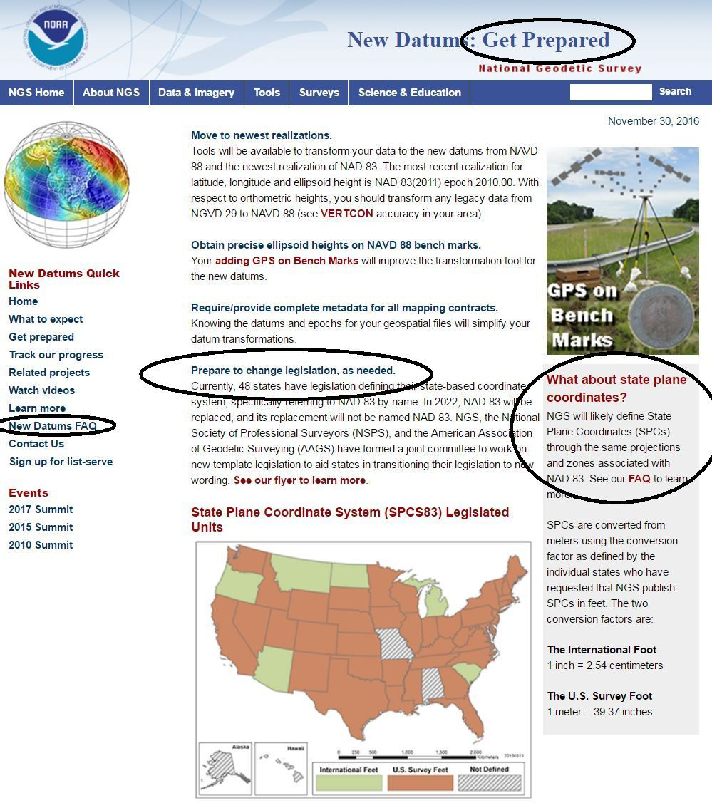

Slide 22
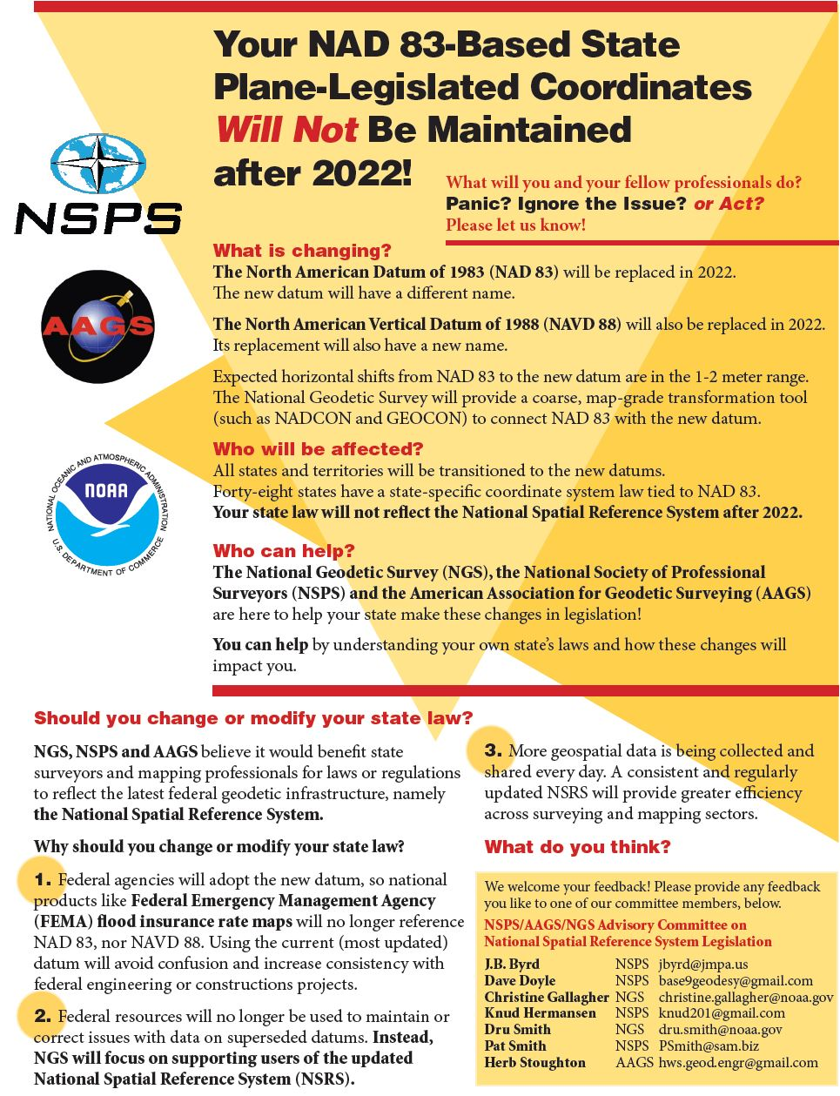
Prepare to change legislation as needed
Ohio Revised Code Ch 157:
Ohio Coordinate System

Slide 23
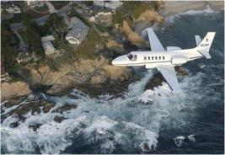
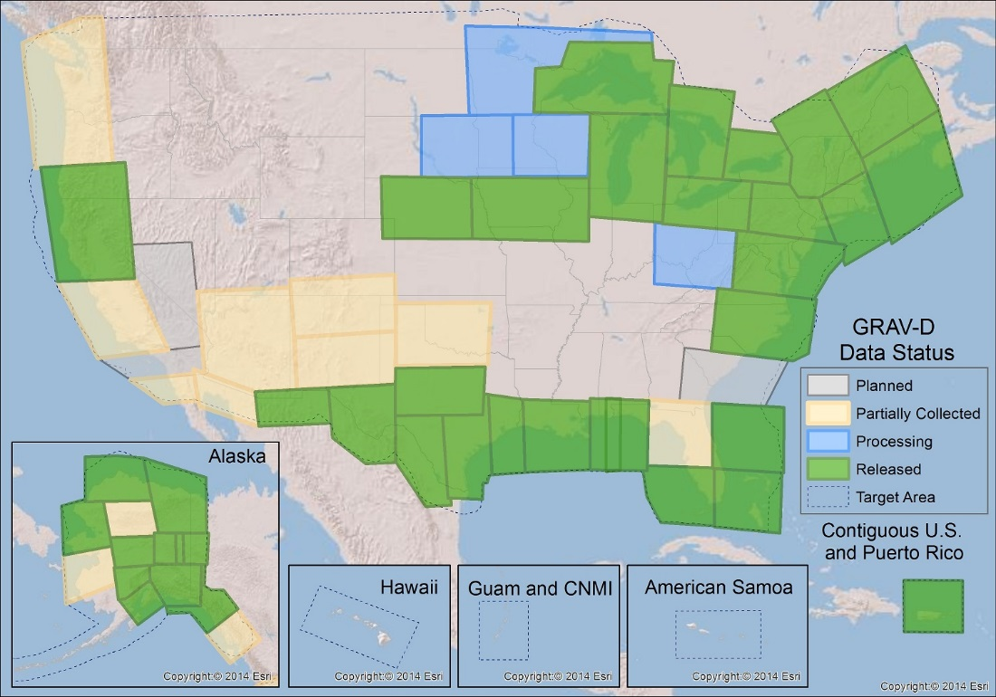
Gravity for the Redefinition of the
American Vertical Datum (GRAV-D)
Notes:
Pictured: Airborne gravity survey grid and the current status of GRAV-D, with more than 50 percent of the U.S. and its territories covered and GRAV-D airborne data collected.
In 2010, began operational collection of airborne gravity data to calculate a geoid model and ultimately a new vertical reference system for accurate height measurements up to 2 cm in the U.S. and territories.
Provides highly accurate height measurements to determine where water flows
Connects satellite and terrestrial gravity measurements for efficient and accurate gravity monitoring
Benefits include $240 Million from improved floodplain mapping alone

Slide 24
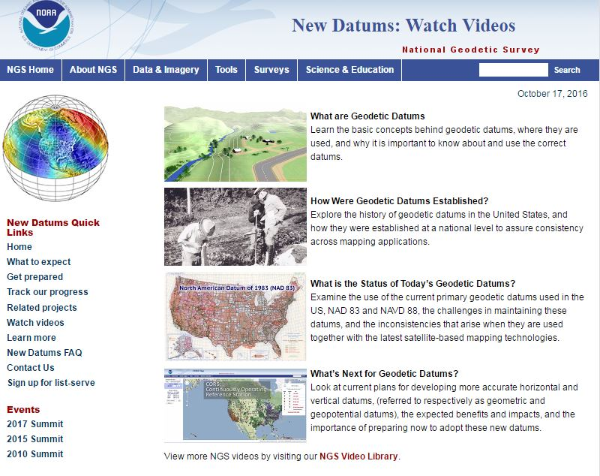

Slide 25
Questions?
Resources are available and continue to be developed at geodesy.noaa.gov

