Slide 1
National Spatial Reference System
Modernization Industry Workshop
Goals and Overview
geodesy.noaa.gov
Juliana Blackwell
Director, National Geodetic Survey

Slide 2

The National Geodetic Survey 10-Year Plan
Support the users of the National
Spatial Reference System.
Modernize and improve the National
Spatial Reference System.
Expand the National Spatial Reference
System stakeholder base through
partnerships, education, and outreach.
Develop and enable a workforce with
a supportive environment.
Improve organizational and administrative functionality.
http://www.geodesy.noaa.gov/web/news/Ten_Year_Plan_2013-2023.pdf
Notes:
The NGS Ten-Year Plan was adopted at the beginning of 2013, including four major goals and an enterprise goal:
Goal 1: Support the Users of the National Spatial Reference System.
Goal 2: Modernize and Improve the National Spatial Reference System.
Goal 3: Expand the National Spatial Reference System Stakeholder Base through Partnerships, Education and Outreach.
Goal 4: Develop and Enable a Workforce with a Supportive Environment.
Enterprise Goal: Improve Organizational and Administrative Functionality.
Also mention:
NGS has Implementation Plans for each Objective
NGS provides an Annual Guidance Memo
Strategic Planning - Why Do It?
To be able to measure your success.
To provide guidance in making resource management, staffing and other decisions.
To motivate staff.
To ensure that you achieve your organizational mission and vision for the future.
Because without a strategic plan your organization operates in a “reactionary” mode.

Slide 3
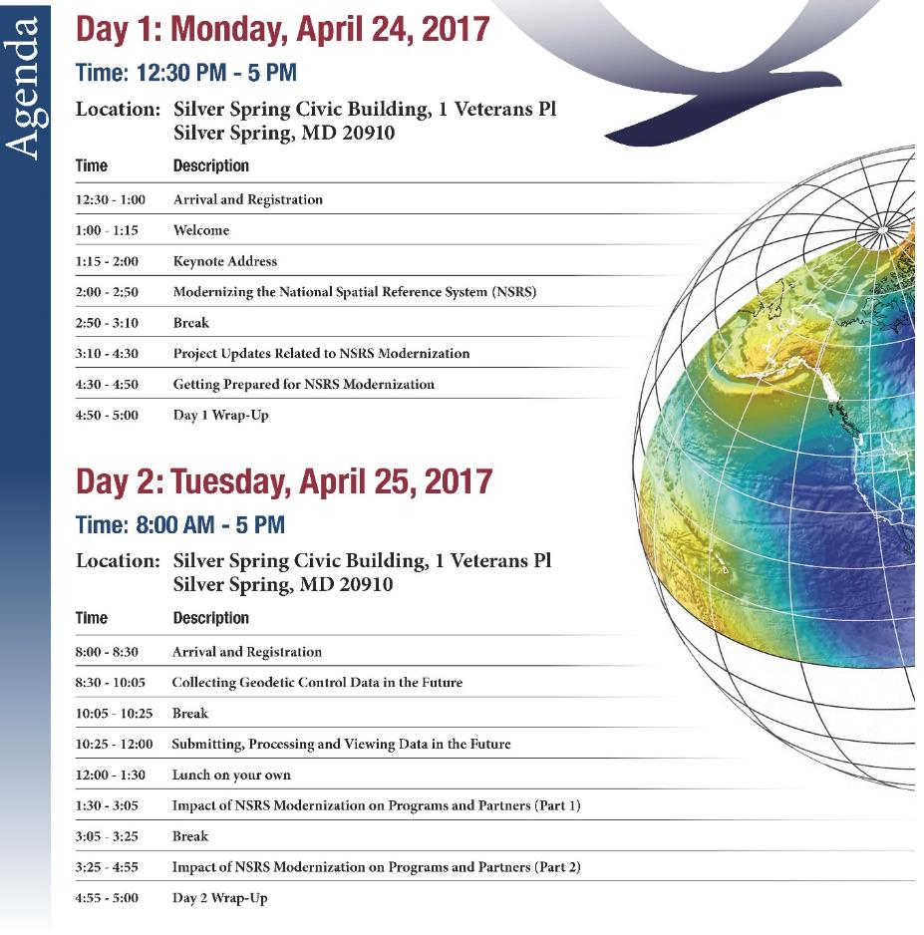

2017 Geospatial Summit
Focus on NSRS Modernization
NGS and external attendees
https://geodesy.noaa.gov/geospatial-summit/index.shtml
Notes:
Geospatial Summits held in 2010, 2015, 2017. More than 430 people attended last year’s Geospatial Summit.

Slide 4
What we heard from our industry partners
The products and services most needed from NGS:
Education, education, education
Outreach and more outreach
Geodetic tools and algorithms in modern programming languages
Standards, guidelines, and best practices
Greater focus on “geospatial” partners
Collaboration with industry partners

Slide 5

Updating the NGS 10-Year Plan
To be successful, NGS must:
Clearly define vision, mission, goals, objectives, strategies
Assess
Include everyone affected
Plan
Develop implementation plans
Measure results
Gain buy in
Monitor and evaluate

Slide 6
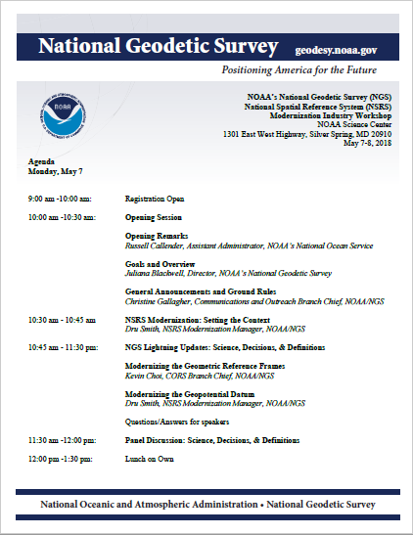
Let’s Get Started!

