Slide 1

Progress toward a modernized NSRS
Dru Smith
NSRS Modernization Manager
NOAA’s National Geodetic Survey

Slide 2
Outline
Refresher on NSRS Modernization
Recent progress
Coming soon
Timeline
Rollout/testing/replacement

Slide 3
Refresher on NSRS Modernization

Slide 4
The National Spatial Reference System
The NSRS
Official coordinate system for the USA
Defined by the National Geodetic Survey
Required to be used by all civilian federal government agencies
Often used by many state and local government agencies or private surveyors

Slide 5
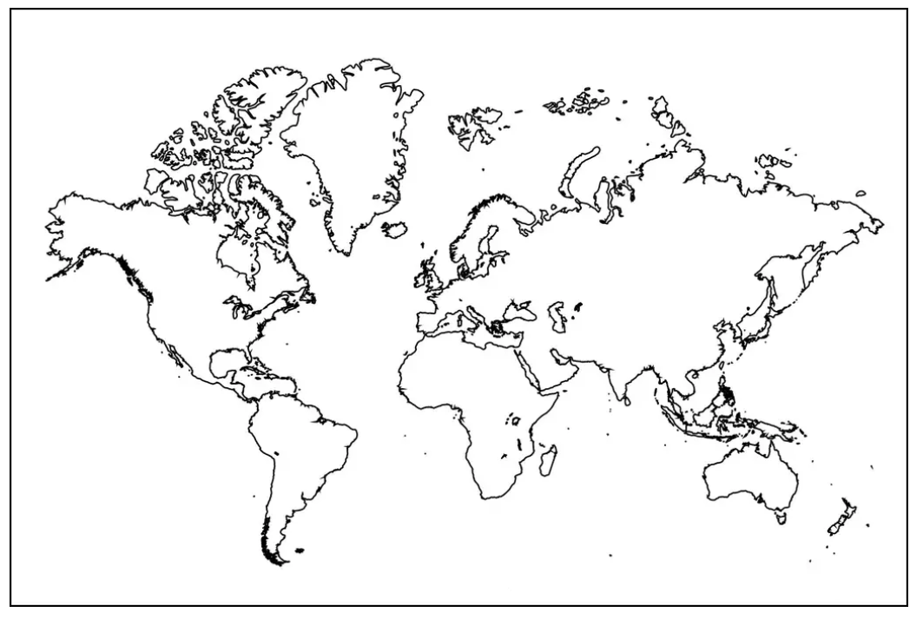
Extent of the current NSRS
Geometric Reference Frames:
NAD 83(2011)
NAD 83(PA11)
NAD 83(MA11)
Truly global but used regionally
Geoid models/Vertical Datums:
Regional
  Conterminous US (CONUS; “Lower 48”)
  Alaska
  Hawaii
  Territories: Puerto Rico, U.S. Virgin Islands, American Samoa, Guam, CNM

Slide 6
NSRS Modernization
Has been ongoing since 2007
This talk presumes some existing knowledge of NSRS Modernization. For finer details look here:
  NGS Presentation Library (https://geodesy.noaa.gov/web/science_edu/presentations_library/)
  NGS New Datums Page (https://geodesy.noaa.gov/datums/newdatums/index.shtml)
  The Blueprint Documents (https://geodesy.noaa.gov/datums/newdatums/policy.shtml)

Slide 7
NSRS Modernization in (very) brief
NATRF2022
NAD 83(2011)
NAD 83(PA11)
PATRF2022
Hybrid geoids
GEOID2022
NAD 83(MA11)
CATRF2022
MATRF2022
NAVD 88
ASVD 02
PRVD 02
NAPGD2022
Bluebooking
FORTRAN
Disparate tools
Outdated manuals
GDX / OPUS
Modern coding
Integrated tools
Updated manuals
NMVD 03
GUVD 04
VIVD 09

Slide 8
Recent Progress

Slide 9
Recent Accomplishments/Deliverables
GRAV-D: DONE!
  After 16 years, the GRAV-D flights are 100% done!!
  Final gravity set was delivered to the geoid team 2 days ago!!
OPUS-Projects updated
  Version 5.1: Bluebooking done for you, loads to the NGS IDB
New Least-squares adjustment software: DONE
  LASER version 2.4.0
  Support for 3-D geometric (GNSS + classical), orthometric, horizontal gravimetric, vertical gravimetric and calibration baselines

Slide 10
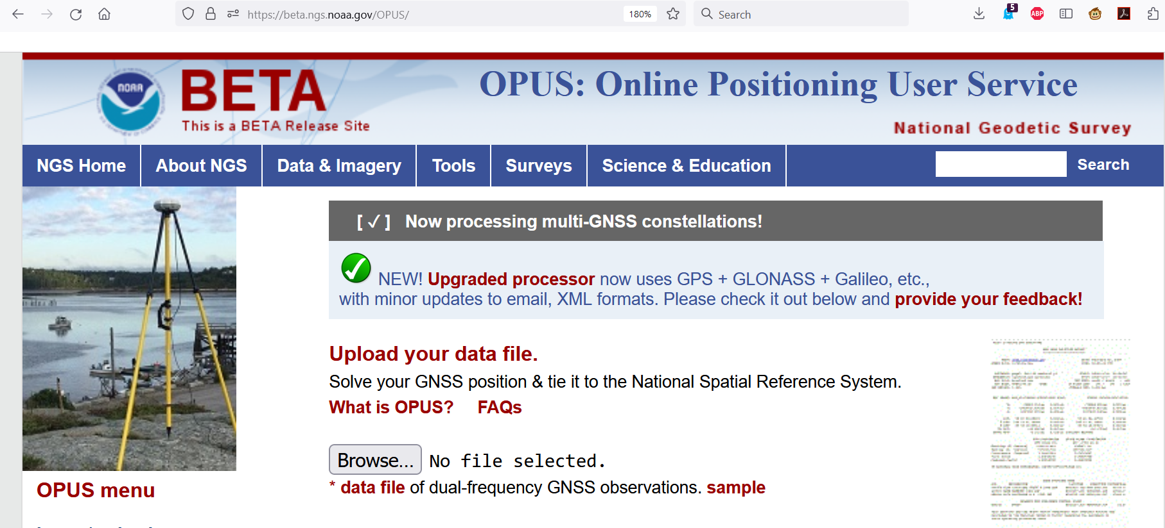
GPS/GLONASS/Galileo/Beidou/ETC
New M-PAGES software exists
  Can process any GNSS constellation with two frequencies
Can be accessed for testing through a BETA release of OPUS-S
beta.ngs.noaa.gov/OPUS

Slide 11
LSA Adjustment Methodology Documented
The Multi-Epoch Least-Squares Adjustment Problem: Models Relating Estimable Parameters at a Single Epoch to Geodetic Observations, Stochastic Constraints and Fixed Constraints at Multiple Epochs
See NGS Library (https://geodesy.noaa.gov/library/):
  NOAA TR NOS NGS 79
  NOAA TR NOS NGS 80
  NOAA TM NOS NGS 95
  NOAA TM NOS NGS 96
Codifies the mathematics of national adjustments (RECs) and OPUS adjustments

Slide 12
Alpha site launched
alpha.ngs.noaa.gov
First product: SPCS2022
More products coming soon
Not everything will go on Alpha
  “Incomplete, early, possibly incorrect”

Slide 13
Data Delivery System
New “datasheets” for Marks and Stations have been designed with a common look and feel

Slide 14
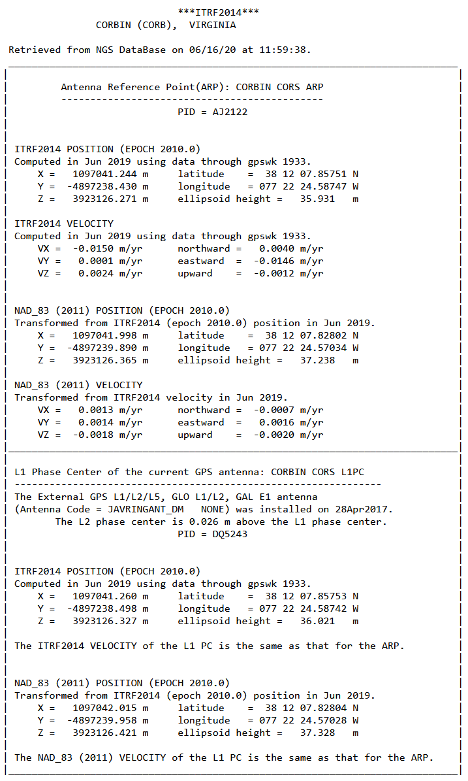
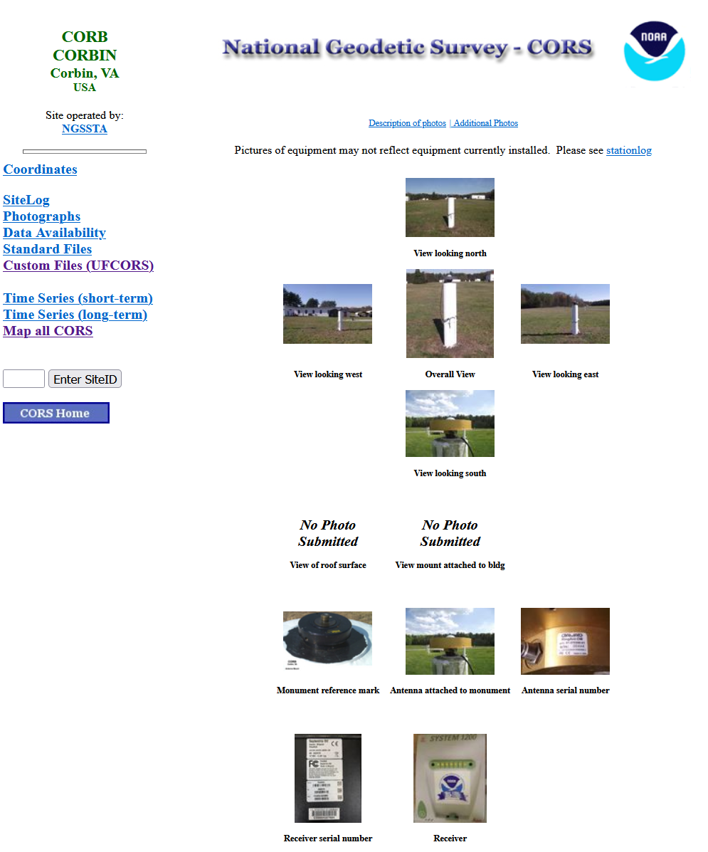
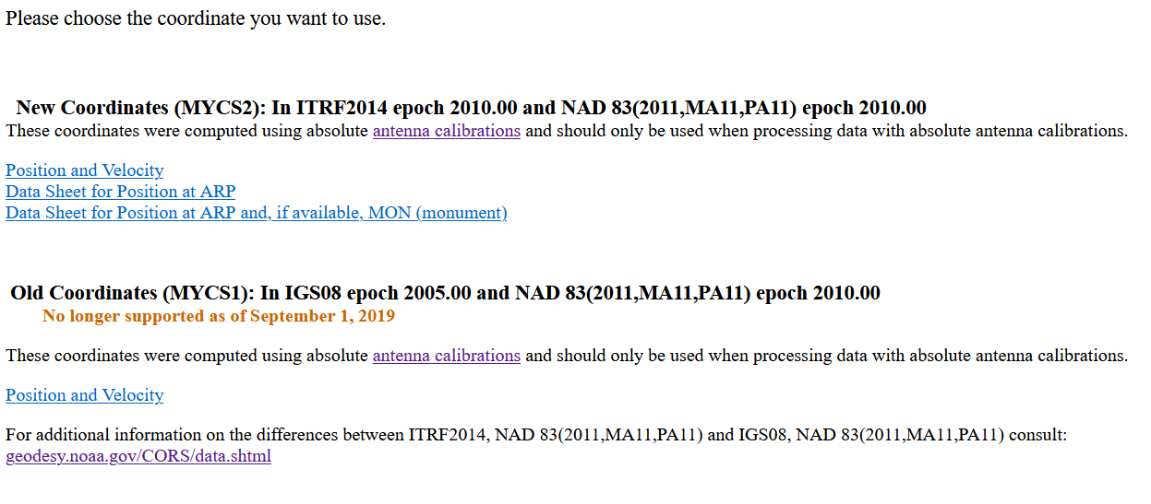
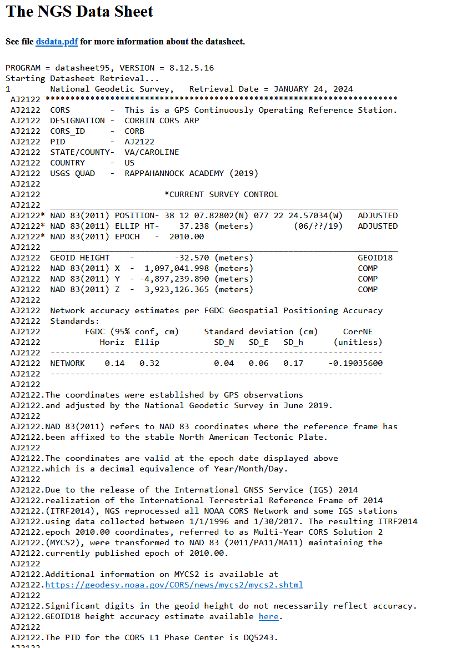
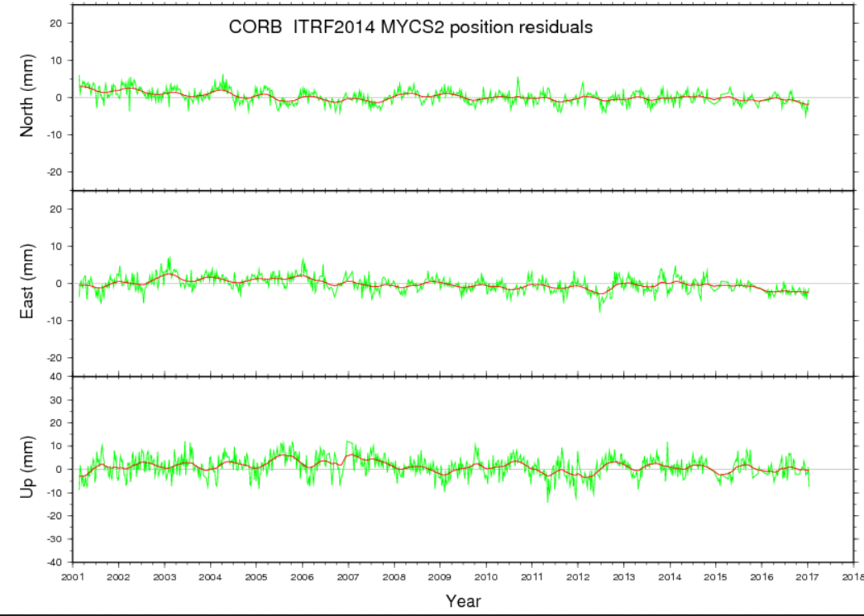
A new station “datasheet” (specific to CORS)
First, here’s what you have today:

Slide 15
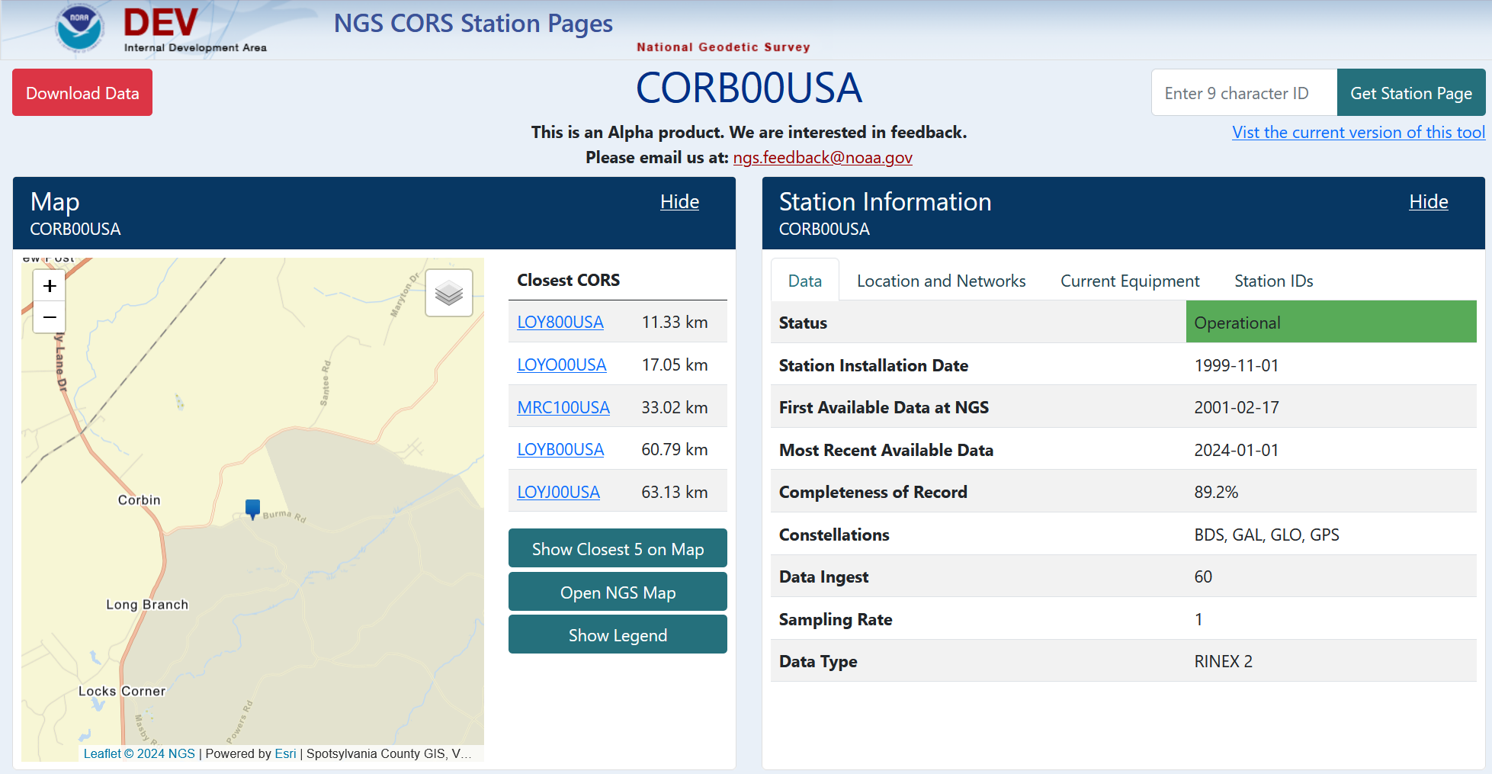
A new station “datasheet” (specific to CORS)

Slide 16
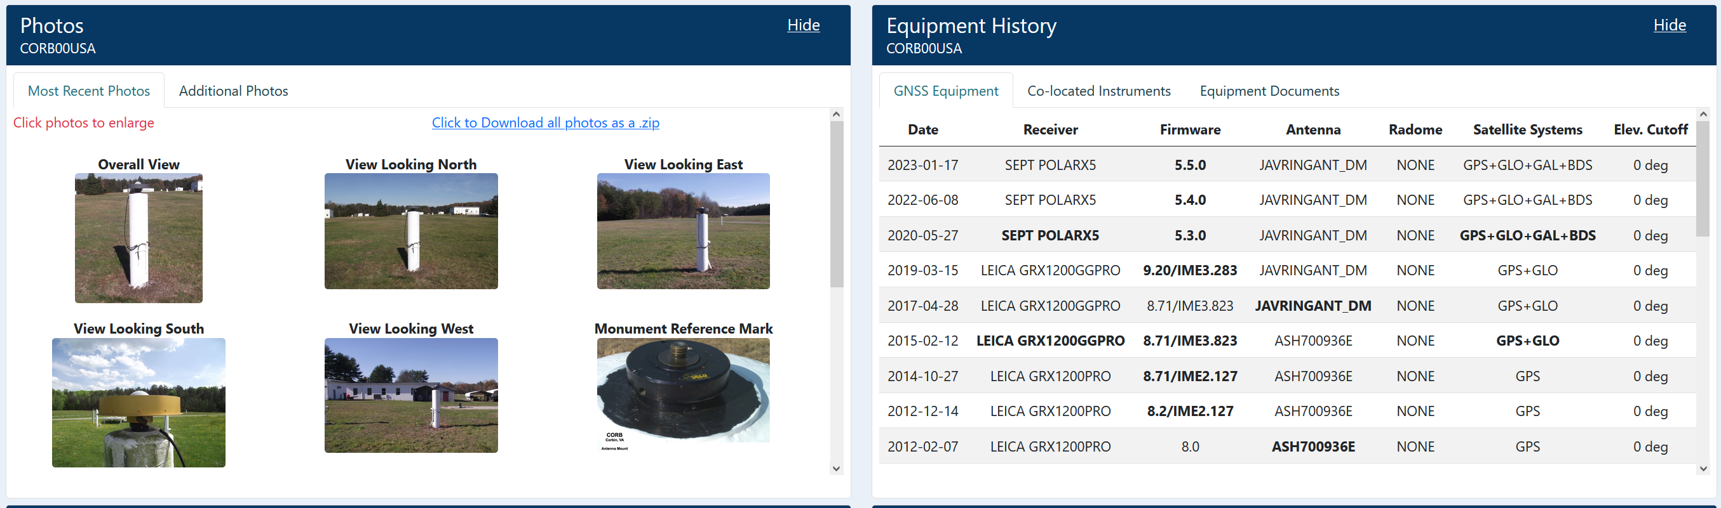
A new station “datasheet” (specific to CORS)

Slide 17
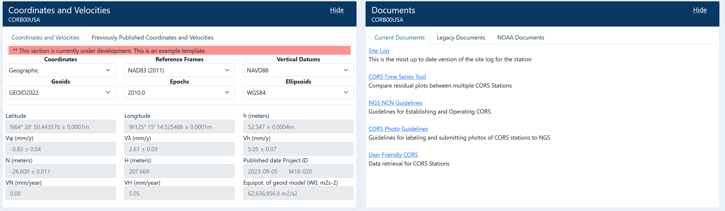
A new station “datasheet” (specific to CORS)

Slide 18
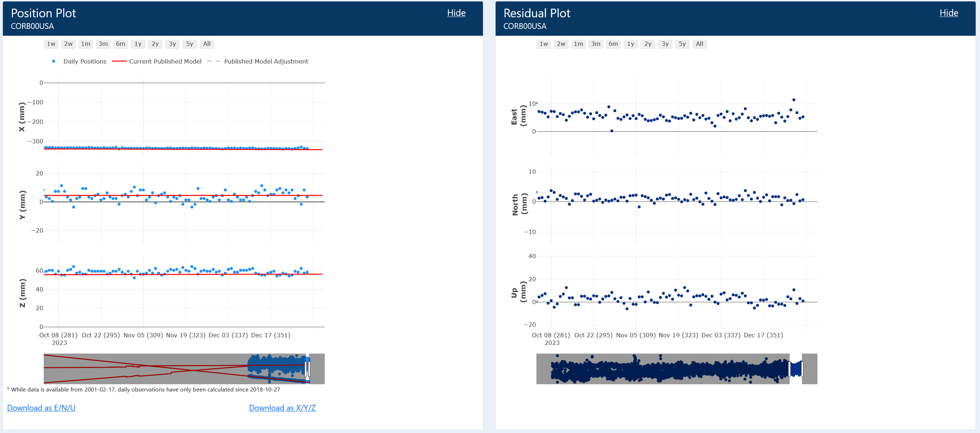
A new station “datasheet” (specific to CORS)

Slide 19
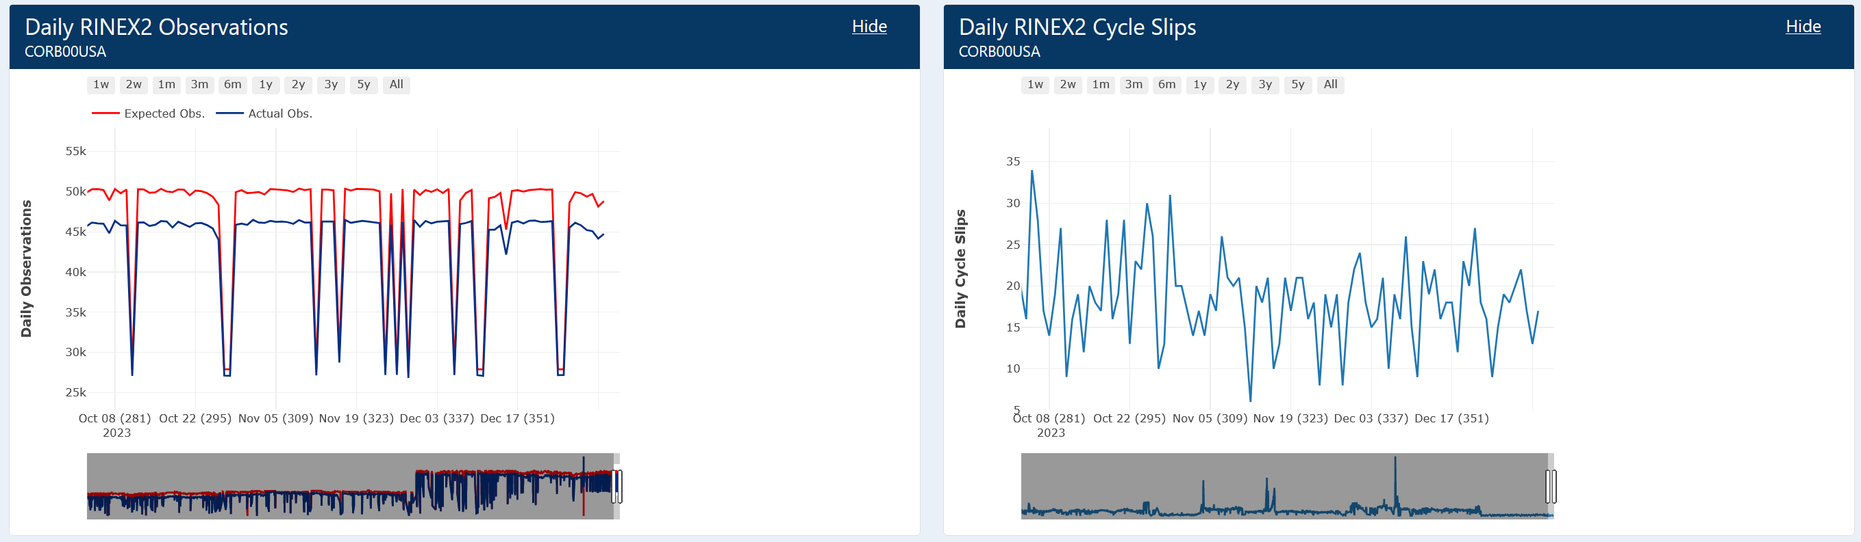
A new station “datasheet” (specific to CORS)

Slide 20
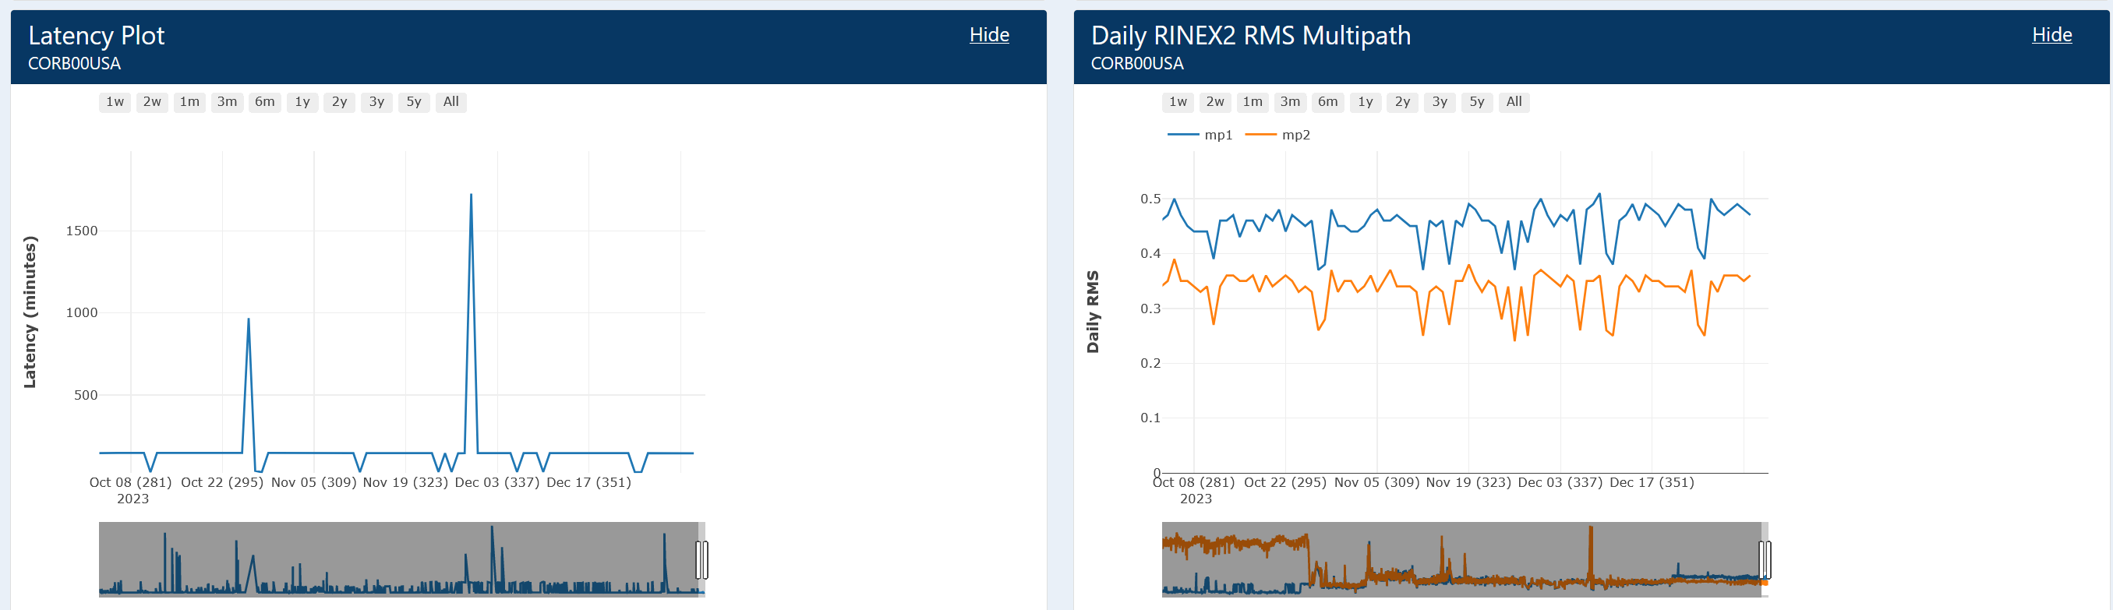
A new station “datasheet” (specific to CORS)

Slide 21
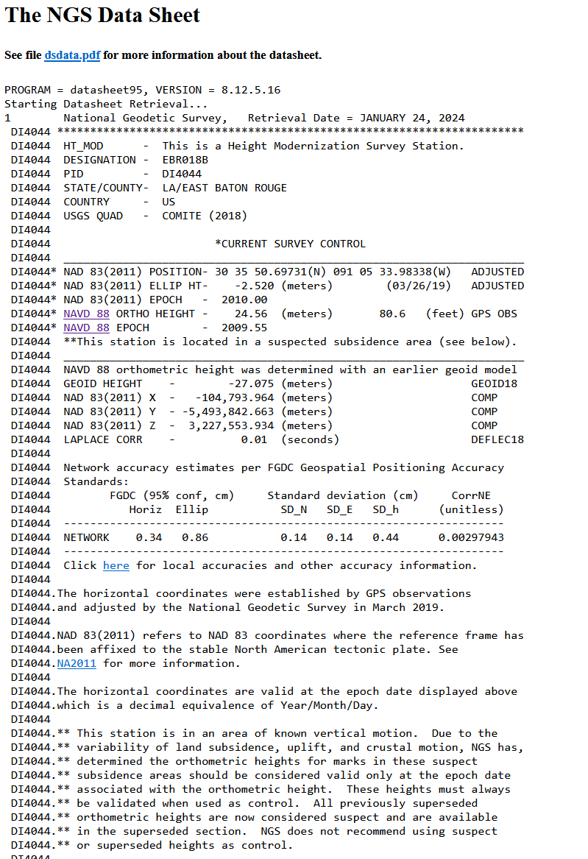
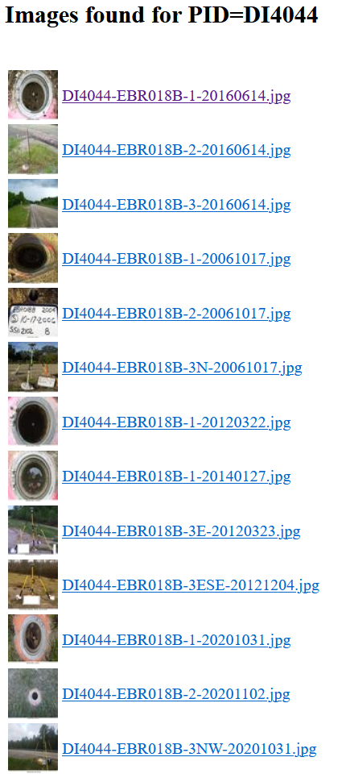
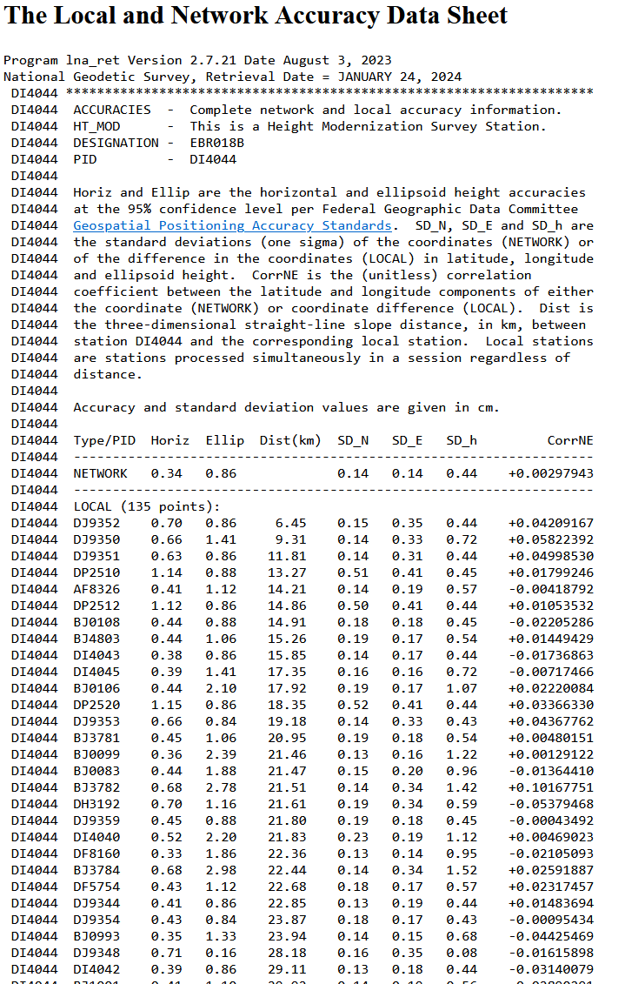
A new mark “datasheet”
First, here’s what you have today:

Slide 22
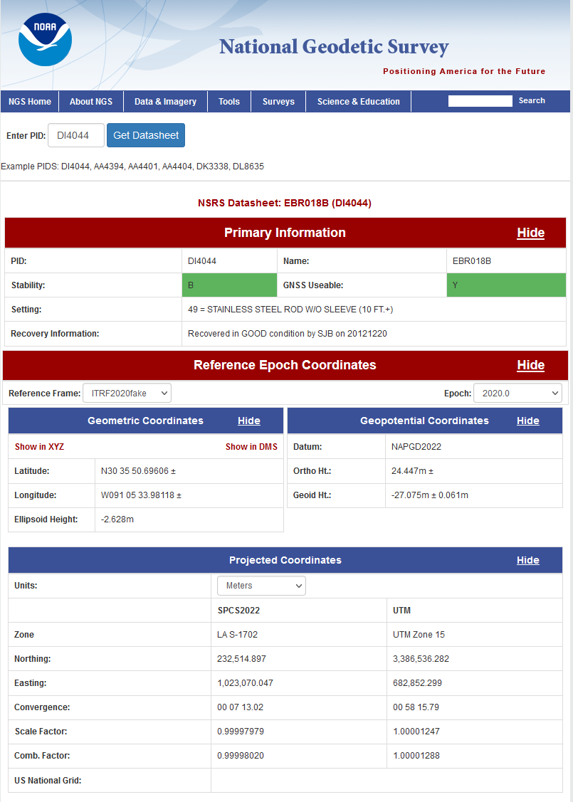
A new mark “datasheet”

Slide 23
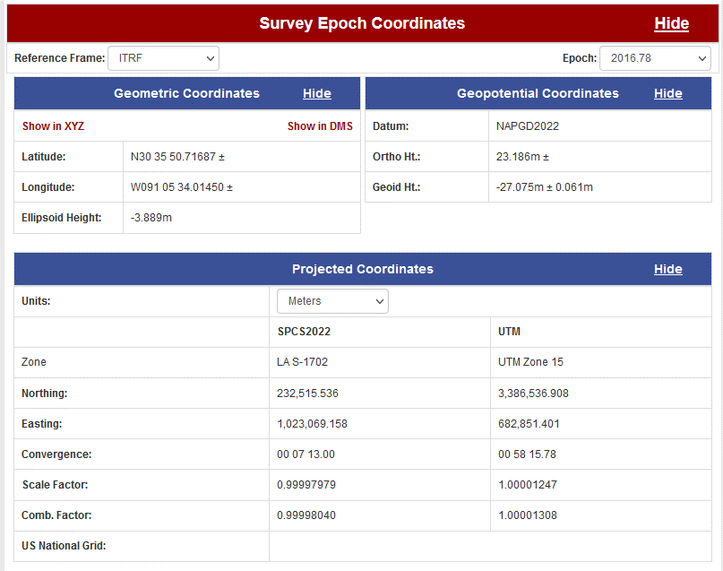
A new mark “datasheet”

Slide 24
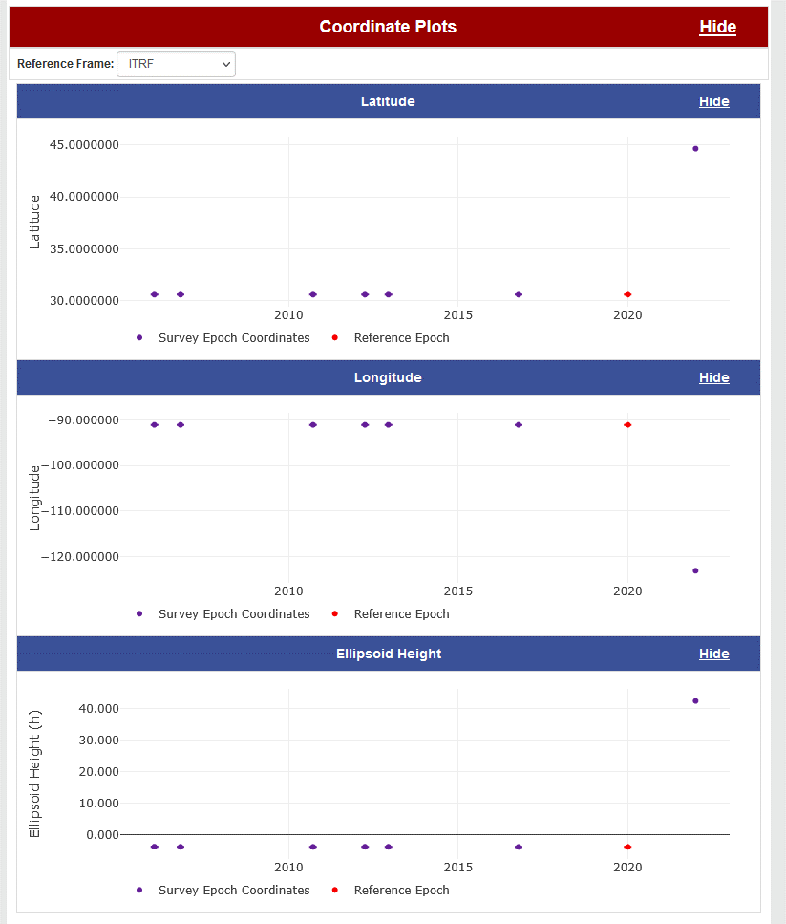
A new mark “datasheet”

Slide 25
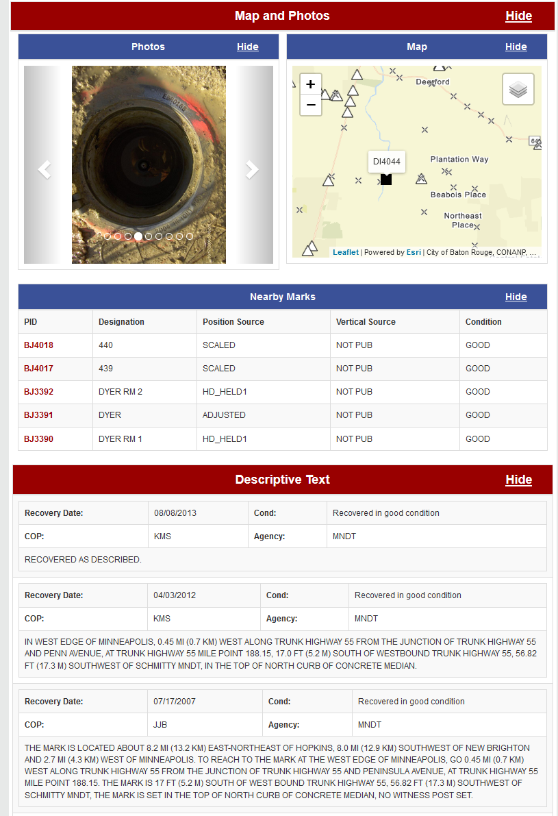
A new mark “datasheet”

Slide 26
Reference Epoch Coordinates (RECs)
The Geometric and Orthometric REC projects are underway!
  Geometric:
    N/P/C/MATRF2022 epoch 2020.00 XYZ coordinates (=> φλh coordinates)
    About 120,000 passive marks
  Orthometric
    NAPGD2022 epoch 2020.00 orthometric heights (H)
    About 950,000 passive marks
  Final data pull: April 2024
  Expected early results: Late 2024

Slide 27
SPROCCET: Replacing HTDP
Software for PRojecting Observations, Constraints and Cofactor matrices/Errors through Time
  Replaces HTDP
  Expands functionality:
    Geometric and orthometric
    Error propagation through time
    Modularization
    Earthquake error displacement estimates
    Bug fixes
Will be built into OPUS and all REC adjustments
Expected completion: Autumn 2024

Slide 28
Coming soon

Slide 29
Promises…
I’m not a fan of promising what is coming “soon”
  Few things in life go on schedule
  Still, the next few things are happening and are expected to be done in the next few months

Slide 30
Coming Soon
GDX
  Geodetic Data Exchange format
  Expands/improves/replaces GVX (GNSS Vector Exchange format)
  Replaces “Bluebooking”
  Will be the official format for data submissions to OPUS in the modernized NSRS
  Spring 2024?

Slide 31
Coming Soon
GEOID2022
  The official NGS/Canada/Mexico geoid model for North America
    Plus USA-only models for American Samoa and the Guam/CNMI region
    Will be up on beta.ngs.noaa.gov
  Summer 2024?
    Don’t be confused! An early-release will be posted on alpha.ngs.noaa.gov, however it will not contain the final GRAV-D datasets

Slide 32
Timeline

Slide 33
Timeline
In 2022, NGS diverted resources from tool-building to data assurance
  “Limited tools, excellent coordinates”
  Set a goal of roll-out by 2025
NGS is on-track to roll out the modernized NSRS by the middle of 2025.
Work on additional tools will continue in the out-years

Slide 34
Rollout, Testing, Replacement

Slide 35
Rollout, Testing, Replacement
NGS will roll out components of the modernized NSRS over time (2024-2025)
As each component is rolled out, it can be tested
Once the final component (likely VERTCON) is rolled out (likely late 2025), testing will continue for at least 6 months
Once enough testing is done, and all modernized NSRS components seem stable and correct, the FGCS will vote (likely 2026)
If affirmative, the modernized NSRS will replace the current NSRS

Slide 36
Initial rollout
NGS promised many things in the three Blueprint documents
Not all can be built in a timely manner
So when we say “rollout”, we mean initial rollout, which is at least the minimum viable products needed to replace the current NSRS with the modernized NSRS
Future products and services supporting the modernized NSRS will be rolled-out after the FGCS vote

Slide 37
Rollout: Alpha, Beta, Official
NGS will use three different websites (URLs) as we roll-out the modernized NSRS:
  Official: www.ngs.noaa.gov
    Will hold the current NSRS until the modernized NSRS has been fully tested and the FGCS has voted to replace the current NSRS with the modernized NSRS
  Beta: beta.ngs.noaa.gov
    Soon to be re-designed to hold:
      A) Modernized NSRS products
      B) Those few remaining improvements for the current NSRS that need testing before moving to Official
    Every component of the modernized NSRS will be placed here
    Products assumed to be complete and correct
    For testing
    Subject to change or deletion
  Alpha: alpha.ngs.noaa.gov
    “Incomplete, early, possibly incorrect”
    Not everything will go on alpha

Slide 38
Current NSRS during rollout and testing
While the modernized NSRS is being rolled out and tested, the current NSRS will remain the official NSRS of the United States
  This will not change until the FGCS vote (probably 2026)
URL www.ngs.noaa.gov will only hold the official NSRS
  Currently NAD 83, NAVD 88, etc.
Only one major improvement to the current NSRS is expected during this time:
  ITRF2020 in all products and services

Slide 39
Snapshot of the modernized NSRS at the end of initial rollout
Not everything promised in the Blueprint documents will be built in time for the initial rollout. But the following will be:
  ITRF2020, N/P/C/MATRF2022, NAPGD2022, SPCS2022
  NSRS Database, new datasheets for marks and stations
  RECs
  OPUS-S with multi-GNSS
  OPUS-Projects (GPS only):
    GDX, SPROCCET, LASER, NSRS DB submission
    The ability for NGS to generate RECs from OPUS submissions in a timely manner

Slide 40
Less stand-alone products
NGS is building SPROCCET
  Replaces HTDP
  Contains IFDM2022, 14H, DGEOID2022
    Projects any geodetic data through time
  Will be plugged directly into the modernized OPUS-Projects
  In 2025, users will engage with it via OPUS-Projects
  Post-2025, will be incorporated into NCAT and VDatum
    Like NADCON, VERTCON, UTMS, USNG, SPCS2022, GEOID2022
    This is a non-trivial change, but can be done correctly

Slide 41
Rollout onto Beta
www.ngs.noaa.gov:
ITRF2020 on NCN
SPCS 83
NAVD 88
OPUS-Share
NADCON 5
OPUS-S (GNSS)
NAD 83
GEOID18
OPUS-RS (GPS)
VERTCON 3
OPUS-Projects (GPS)
(Bluebooking, HTDP, ADJUST, NGS IDB, Datasheets)
DEFLEC18
beta.ngs.noaa.gov:
ITRF2020 on NCN
EPP2022
Geometric RECs
in N/P/C/MATRF2022
N/P/C/MATRF2022
NADCON 6?
SPCS2022
IFDM2022
GM2022
Orthometric RECs
in N/P/C/MATRF2022
VERTCON 4?
GEOID2022
GRAV2022
NAPGD2022
DEM2022
DEFLEC2022
OPUS-Projects (GPS)
(GDX, SPROCCET, LASER, NSRS DB, New Datasheets)
OPUS-S (GNSS)
Mid 2024
Late 2024
Early 2025
Late 2025

Slide 42
Official, Beta and Alpha
Websites
Work performed
by NGS employees,
not on any web site:
www.ngs.noaa.gov
beta.ngs.noaa.gov
SPCS2022
SPCS2022 (incomplete)
alpha.ngs.noaa.gov
Notes:
Only occasional products, not yet complete, will be put on Alpha.
Nothing will move from Alpha to Beta. Rather, work will continue on the incomplete product. When it is ready(complete), the Alpha version will be deleted and the complete version will be loaded onto Beta.

Slide 43
Official, Beta and Alpha
Websites
Work performed
by NGS employees,
not on any web site:
www.ngs.noaa.gov
ITRF2020 coordinate functions on NCN stations
beta.ngs.noaa.gov
SPCS2022
alpha.ngs.noaa.gov
Notes:
Most products will not be released in an incomplete state. Therefore they will be loaded directly onto Beta.

Slide 44
Testing into replacement
From late 2025 into sometime in 2026, all modernized NSRS components on Beta will go through testing and feedback
After the FGCS vote, a few months of work remain:
  The FGCS will issue an FRN officially announcing the adoption of the modernized NSRS as the official NSRS
  The beta website may be wiped of submitted data*
  All modernized NSRS components moved to the Official website
    Submissions will then begin in earnest and won’t be deleted
  All current NSRS components moved….elsewhere
    No further submissions to the NGS IDB will be allowed at this point
Notes:
Notes: NGS is considering what to do with data submitted during testing. The cleanest solution is to delete it as “test data” and not attempt to move it onto the Official website. If we were to consider moving it to Official, we would need to re-submit the data to ourselves, which is a tremendous amount of work. It is best to assume that NGS will ask submitters to re-submit after the switch.

Slide 45
After testing and the FGCS vote
www.ngs.noaa.gov:
ITRF2020 on NCN
SPCS 83
NAVD 88
OPUS-Share
NADCON 5
OPUS-S (GNSS)
NAD 83
GEOID18
OPUS-RS (GPS)
VERTCON 3
“Elsewhere”
OPUS-Projects (GPS)
(Bluebooking, HTDP, ADJUST, NGS IDB, Datasheets)
DEFLEC18
beta.ngs.noaa.gov:
ITRF2020 on NCN
EPP2022
Geometric RECs
in N/P/C/MATRF2022
N/P/C/MATRF2022
NADCON 6?
SPCS2022
IFDM2022
GM2022
Orthometric RECs
in N/P/C/MATRF2022
VERTCON 4?
GEOID2022
GRAV2022
NAPGD2022
DEM2022
DEFLEC2022
OPUS-Projects (GPS)
(GDX, SPROCCET, LASER, NSRS DB, New Datasheets)
OPUS-S (GNSS)
All submissions provided during testing may get deleted

Slide 46
After testing and the FGCS vote
www.ngs.noaa.gov:
ITRF2020 on NCN
EPP2022
Geometric RECs
in N/P/C/MATRF2022
N/P/C/MATRF2022
NADCON 6?
SPCS2022
IFDM2022
GM2022
Orthometric RECs
in N/P/C/MATRF2022
VERTCON 4?
GEOID2022
GRAV2022
NAPGD2022
DEM2022
DEFLEC2022
OPUS-Projects (GPS)
(GDX, SPROCCET, LASER, NSRS DB, New Datasheets)
OPUS-S (GNSS)
All submissions from this point forward get saved
“Elsewhere”
ITRF2020 on NCN
SPCS 83
NAVD 88
OPUS-Share
NADCON 5
OPUS-S (GNSS)
NAD 83
GEOID18
OPUS-RS (GPS)
VERTCON 3
OPUS-Projects (GPS)
(Bluebooking, HTDP, ADJUST, NGS IDB, Datasheets)
DEFLEC18
No submissions to the NGS IDB allowed any longer

Slide 47
Summary
The modernized NSRS is coming soon!
  Starting this year!
All components should be on Beta by 2025
  For testing only!
It won’t replace the current NSRS until an FGCS vote (2026)
NGS will continue to support the current NSRS through the rollout and testing of the modernized NSRS
We encourage you to test each component as it is released

Slide 48
Thank you!

Slide 49
Questions?

Slide 50
Extra Slides

Slide 51
Quick diversion: why is incorporating SPROCCET into NCAT and Vdatum so complicated?
NADCON: connects one datum (or realization) to another
  May or may not be epoch-specific
14H: connects one datum to another
  Must be a 3-D Cartesian datum (or “frame”)
  Without changing the epoch
IFDM2022: connects one epoch to another
  Within ITRF2020 only
  Geometric only. To deform orthometric quantities over time requires the addition of DGEOID2022

Slide 52
WGS72 (130)
WGS84_ORIG (140)
PNEOS90 (150)
NEOS9125 (160)
NEOS90 (170)
3
4
5
6
7
ITRF88 (100)
1
ITRF89 (110)
2
ITRF90 (120)
8
ITRF91 (180)
11
ITRF92 (210)
12
ITRF93 (220)
WGS84_G873 (240)
An ITRF
9
10
13
A 14 parameter Helmert transformation
14
Null transformations
SIO_MIT92 (190)
WGS84_G730 (200)
ITRF94 (230)
17
Two versions exist. See next slide.
NAD83_NA (260)
Defined/Additive direction of stored transformation
15
Frame Code (Frame Number)
IGB08 (400)
16
WGS72 (130)
WGS84_G1150 (370)
ITRF96 (250)
IGS20 (470)
IGB20 (480)
IGS08 (380)
WGS84_G1674 (390)
17
IGS97 (280)
28
29
18
IGS14 (430)
IGB14 (440)
30
ITRF97 (270)
38
WGS84_G1762 (410)
37
27
33
34
31
19
NAD83_MA (330)
ITRF2020 (460)
36
ITRF2014 (420)
32
ITRF2008 (360)
26
ITRF2005 (340)
24
ITRF2000 (290)
23
39
22
42
25
20
NATRF2022 (490)
40
41
35
21
NAD83_PA (320)
PATRF2022 (500)
CATRF2022 (510)
MATRF2022 (520)
WGS84_G2139 (450)
IGS05 (350)
IGS00 (300)
IGB00 (310)

Slide 53
Region: CONUS
NADCON 5 connections in GREEN
φ, λ, h
USSD
(195)
NATRF2022_2025?
(802?)
UTM
φ, λ
SPC
A,B,C = lat, lon, eht grid transformations, respectively
X, Y, Z
A horizontal datum (lat,lon only)
1A,1B
A 3-D geometric datum (lat, lon, eht)
USNG
UTM
Intersection point with 14H
Defined/Additive direction of stored grid transformation
Frame: NATRF2022
Time: 2025?
USSD
(195)
USNG
φ, λ
NAD27
(205)
Datum Code
(Datum Number)
?A,?B,?C
φ, λ, h
UTM
SPC
NATRF2022_2020
(801)
2A,2B
X, Y, Z
SPC
φ, λ
USNG
UTM
USNG
NAD83_1986
(215)
7A,7B,7C
Frame: NATRF2022
Time: 2020
UTM
SPC
NAD83_2011
(255)
3A,3B
φ, λ, h
NAD83_FBN
(235)
NAD83_NSRS2007
(245)
NAD83_HARN
(225)
6A,6B,6C
X, Y, Z
SPC
φ, λ, h
φ, λ, h
φ, λ, h
4A,4B,4C
5A,5B,5C
USNG
UTM
X, Y, Z
SPC
X, Y, Z
SPC
X, Y, Z
SPC
Frame: NAD83_NA
Time: 2010
USNG
UTM
USNG
UTM
USNG
UTM

Slide 54
(Earlier datums)
Region: CONUS
= NADCON grid
transformation #5
IFDM
t1=2010
t2=2020
= IFDM2022 between
2010 and 2020
14H
16
t=2010.00
= 14 parameter Helmert
transformation #16, at t=2010
NAD83_FBN
(235)
N
5
N
5
NAD83_NSRS2007
(245)
P1=P6+P7
P8+P9=P10
Path 1
Realization of
NAD83_NA
at t=2010.00
N
6
Realization of NATRF2022
at t=2020.00
Realization of NATRF2022
at t=2025.00?
NAD83_2011
(255)
N
7
NATRF2022_2020
(801)
N
TBD
NATRF2022_2025?
(TBD)
14H
16
t=2010.00
NATRF2022 (490)
t=2023.00
14H
39
t=2023
14H
39
t=2020
14H
39
t=2025?
ITRF96 (250)
t=2010.00
Path 6
Path 7
14H
(many)
t=2010.00
ITRF2020 (460)
t=2023.00
IFDM
t1=2020
t2=2023
IFDM
t1=2023
t2=2025?
Path 8
Path 9
ITRF2020 (460)
t=2010.00
IFDM
t1=2010
t2=2020
ITRF2020 (460)
t=2020.00
IFDM
t1=2020
t2=2025?
ITRF2020 (460)
t=2025.00?
Path 10

Slide 55
NSRS Modernization in (very) brief – Why?
The current NSRS was:
  Defined in the pre-GPS era
    Without GPS, the Earth’s center (frame origin) was very hard to detect
  Defined without aid of gravity-mission satellites
    Leveling, terrestrial gravity, disconnected from the geometric frame
  Defined right after punch-cards went away
    Tools relied upon 80-character ASCII files and FORTRAN
  Defined without a long-term strategy to acknowledge Earth’s dynamics
In short, the current NSRS has failed to keep up with emerging needs
  Sea level rise, floodplain mapping, coastal geohazards

Slide 56
The path to full roll-out
The next few slides show key elements, and their roll-out order, though with a purposefully vague timeline to allow some flexibility
To aid in readability, some details are omitted, but can be inferred, such as:
  All data will be loaded in the NSRS database
  A data delivery system will exist
  All tools will be incorporated into NCAT

Slide 57
The path to full roll-out: Frames
NCN
w/ ITRF2020
EPP2022
SPCS2022
2023
2024
2025
IFDM2022

Slide 58
The path to full roll-out: Geopotential
GRAV-D
Complete
(including
re-flights)
DEFLEC2022 Alpha
GM2022
DEFLEC2022
2023
2024
2025
GEOID2022 Alpha
GEOID2022

Slide 59
The path to full roll-out: OPUS
OPUS-Projects
w/ M-PAGES
OPUS-Projects
w/ LASER and
new adjustment
procedures
OPUS-S
w/ M-PAGES
OPUS-S
w/ ITRF2020
OPUS-Projects
w/ ITRF2020
OPUS-S
w/ EPP2022
Initial GDX
release
2023
LASER
completed
2024
2025
OPUS-S
w/ Simultaneous
Processing
OPUS-S
w/ replacement
for HTDP
OPUS-Projects
w/ replacement
for HTDP
OPUS-Projects
w/ IFDM2022
(not HTDP)

Slide 60
The path to full roll-out: Passive control
NCN
w/ ITRF2020
DEFLEC2022 Alpha
EPP2022
DEFLEC2022
Geometric RECs
SPCS2022
NADCON
VERTCON
LASER
completed
Orthometric RECs
2023
2024
2025
IFDM2022
GEOID2022

Slide 61
Preeminence of ITRF
Background Info!
Rotation of the
North American Plate
North American Terrestrial Reference Frame of 2022 (NATRF2022)
Caribbean Terrestrial Reference Frame of 2022 (CATRF2022)
Pacific Terrestrial Reference Frame of 2022 (PATRF2022)
Mariana Terrestrial Reference Frame of 2022 (MATRF2022)
EPP2022 is the set of four 14-parameter Helmert transformations which relates ITRF2020 to N/P/C/MATRF2022
Rotation of the
Caribbean Plate
ITRF2020
Each 14-parameter Helmert transformation inside EPP2022 consists of:
11 zero-value coefficients
3 non-zero coefficients
1 reference epoch (2020.00)
Rotation of the
Pacific Plate
Rotation of the
Mariana Plate
EPP2022
EPP for “Euler pole parameters”
(a way of describing a plate’s rotation)

Slide 62
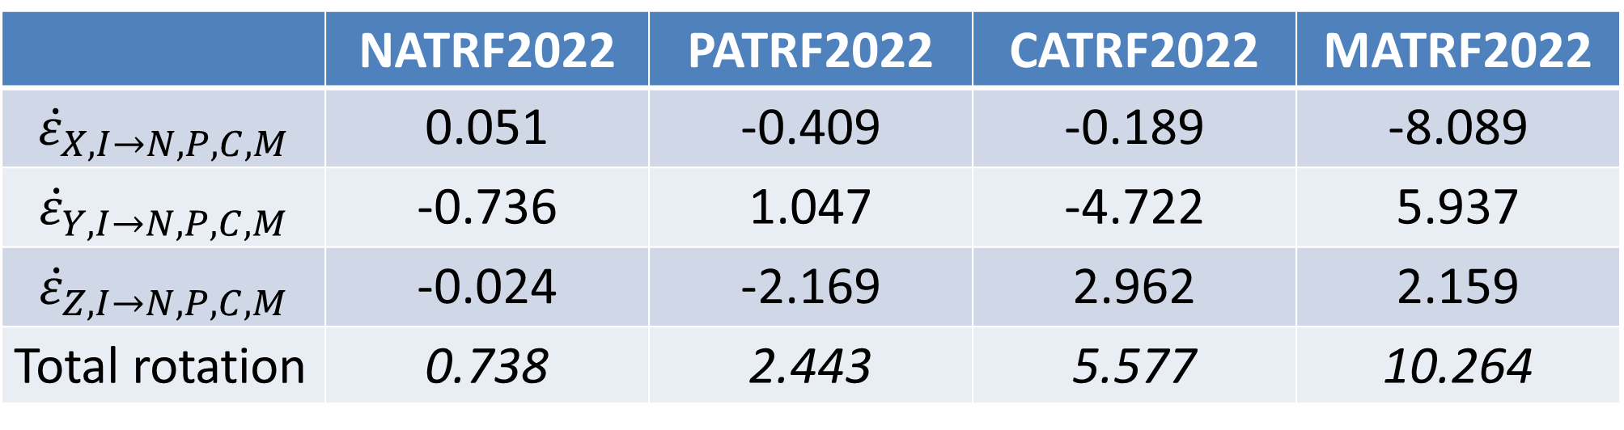
EPP2022 (alpha)
 | NATRF2022 | PATRF2022 | CATRF2022 | MATRF2022
$${\dot{ε}}_{X,I→N,P,C,M}$$ | 0.051 | -0.409 | -0.189 | -8.089
$${\dot{ε}}_{Y,I→N,P,C,M}$$ | -0.736 | 1.047 | -4.722 | 5.937
$${\dot{ε}}_{Z,I→N,P,C,M}$$ | -0.024 | -2.169 | 2.962 | 2.159
Total rotation | 0.738 | 2.443 | 5.577 | 10.264
All values in milliarcseconds / year

Slide 63
A Little Terminology…
Background Info!
A site is the smallest location name where station(s) are located
  e.g. Goddard Space Flight Center
A station is a collection of equipment for one geodetic purpose
  e.g. CORSs GODE00USA and GODN00USA
A mark is a stable physical structure attached to the crust. Only marks get PIDs
  e.g. AF9647 (GRP of GODE00USA) and JF5875 (REF pt for GODE00USA and GODN00USA)
  A mark’s job is to hold 1 point
  Some stations might share a mark
  Some marks might not be part of a station, but might be on a site
+
STATIONS
SITE
+
+
+
+
MARKS
+
Notes:
A site can contain 1 or more stations.
At a CORS, the “GRP” is the “point” and the “mark” is the permanent, physical part of the CORS which holds the GRP. The “ARP” is attached to the antenna, which can come and go and is therefore not a permanent part of the station. Therefore the ARP is not a mark and does not get a PID, despite decades of this terminology.

Slide 64
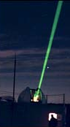
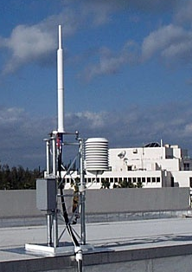
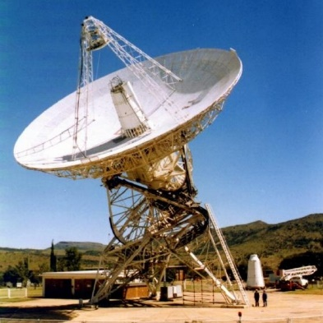
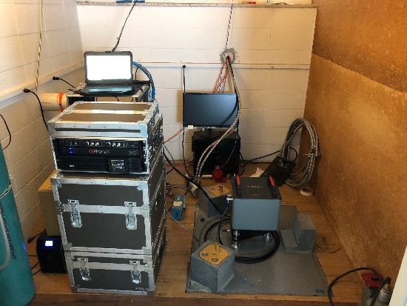
Geodetic Stations
Background Info!
SLR
DORIS
VLBI
Gravity
GNSS (CORS)

