Slide 1

NGS Webinar
NOAA Technical Memorandum NOS NGS 92
Classifications, Accuracy Standards, and General Specifications for GNSS Geodetic Control Surveys using OPUS Projects
April 13, 2023
presenters:
Dr. Dan Gillins Ph.D., Acting Chief, Spatial Reference Systems Division
Dave Zenk PE LS, Northern Plains Regional Advisor (MN, ND, SD, NE, IA)
Notes:
Welcome to today’s webinar.
The topic for the day is a preview of the
NOAA Technical Memorandum NOS NGS 92
Classifications, Accuracy Standards, and General Specifications for GNSS Geodetic Control Surveys using OPUS Projects
I’m Dan Gillins, Acting Chief, Spatial Reference Systems Division

Slide 2
NGS Webinar
Executive Summary
The Classifications, Standards, and Specifications are required for surveys which will become part of the NGS Integrated Database.
The Classifications, Standards, and Specifications document sets forth the NGS’ current standards and procedures for successful establishment of GNSS control using the OPUS Projects service.
The Classifications, Standards, and Specifications document is specifically limited to support:
  OPUS Projects (version 5)
  North American Datum of 1983 (NAD83)
  North American Vertical Datum of 1988 (NAVD88).
    Or other vertical datums that are part of the current NSRS
Future versions of OPUS Projects and future datums will require revision of this document.
Notes:
Executive Summary
The Classifications, Standards, and Specifications are required for surveys which will become part of the NGS Integrated Database.
The Classifications, Standards, and Specifications document sets forth the NGS’ current standards and procedures for successful establishment of GNSS control using the OPUS Projects service.
The Classifications, Standards, and Specifications document is specifically limited to support:
OPUS Projects (version 5)
North American Datum of 1983 (NAD83)
North American Vertical Datum of 1988 (NAVD88).
Or other vertical datums that are part of the current NSRS
Future versions of OPUS Projects and future datums will require revision of this document.

Slide 3
Need for New Classifications & Standards
NGS58 & NGS59 were published in 1997 & 2008, and GNSS technologies and survey methods have evolved and improved.
NGS58 & NGS59 did not allow use of real-time kinematic (RTK) technology, which is highly popular.
NGS has released the freely available, web-based software, OPUS Projects, to streamline the work of:
  Campaign-style GNSS surveys
  Baseline processing and network adjustments
  Preparing files in FGCS “Bluebook” format for uploading into IDB
  Organizing project data submissions to NGS for review and publication
Notes:
There is a need for New Classifications & Standards
NGS58 & NGS59 were published in 1997 & 2008, and GNSS technologies and survey methods have evolved and improved.
NGS58 & NGS59 did not allow use of real-time kinematic (RTK) technology, which is highly popular.
NGS has released the freely available, web-based software, OPUS Projects, to streamline the work of:
Campaign-style GNSS surveys
Baseline processing and network adjustments
Preparing files in FGCS “Bluebook” format for uploading into IDB
Organizing project data submissions to NGS for review and publication

Slide 4
Intent of New Classifications & Standards
This publication supplements
  “Standards and Specification for Geodetic Control Networks” issued September 1984, by Admiral John D. Bossler.
Notes:
This publication supplements
“Standards and Specification for Geodetic Control Networks” issued September 1984, by Admiral John D. Bossler.

Slide 5
Intent of New Classifications & Standards
This publication replaces the NOAA Technical Memorandum NOS NGS 58
  “Guidelines For Establishing GPS-Derived Ellipsoid Heights, (Standards: 2 cm and 5 cm), Version 4.3” November 1997 by David B. Zilkoski.
This publication replaces the NOAA Technical Memorandum NOS NGS 59
  “Guidelines for Establishing GPS-Derived Orthometric Heights” March 2008 by David B. Zilkoski.
Notes:
This publication replaces the NOAA Technical Memorandum NOS NGS 58
“Guidelines For Establishing GPS-Derived Ellipsoid Heights, (Standards: 2 cm and 5 cm), Version 4.3” November 1997 by David B. Zilkoski.
This publication replaces the NOAA Technical Memorandum NOS NGS 59
“Guidelines for Establishing GPS-Derived Orthometric Heights” March 2008 by David B. Zilkoski.

Slide 6
Intent of New Classifications & Standards
This publication provides Classification, Standards, and Specifications for GNSS geodetic control surveys which use Global Navigation Satellite Systems (GNSS) and which will be submitted to NGS for review and publication.
These types of surveys were not well-established at the date of the 1984, 1997, & 2008 publications.
Research into best practices and analysis of achievable results supports this publication.
Notes:
This publication provides Classification, Standards, and Specifications for GNSS geodetic control surveys which use Global Navigation Satellite Systems (GNSS) and which will be submitted to NGS for review and publication.
These types of surveys were not well-established at the date of the 1984, 1997, & 2008 publications.
Research into best practices and analysis of achievable results supports this publication.

Slide 7
Intent of New Classifications & Standards
This publication is specifically limited to support:
  OPUS Projects (version 5)
  North American Datum of 1983 (NAD83)
  North American Vertical Datum of 1988 (NAVD88).
    and other vertical datums that are part of the NSRS
Future versions of OPUS Projects and future datums will require revision of this publication.
Notes:
This publication is specifically limited to support:
OPUS Projects (version 5)
North American Datum of 1983 (NAD83)
North American Vertical Datum of 1988 (NAVD88)
and other vertical datums that are part of the NSRS
Future versions of OPUS Projects and future datums will require revision of this publication.

Slide 8
Classifications
The Standards define the following 3 Classifications of Network and Local Accuracy for GNSS geodetic control surveys which will be submitted to NGS for review and publication.
Table 1 - Classifications of Network and Local Accuracy
 | Description | PRIMARY | SECONDARY | LOCAL
1.1 | Ellipsoid Height (cm) * | 2 cm | 3 cm | 5 cm
1.2 | Horizontal (cm) * | 1 cm | 1.5 cm | 2.5 cm
1.3 | Orthometric Height (cm) * | 3 cm | 4 cm | 6 cm
* Network Accuracy is stated at the 95% confidence level
Notes:
The Standards define the following 3 Classifications of Network and Local Accuracy for GNSS geodetic control surveys which will be submitted to NGS for review and publication.
Research and experience has shown that achieving accurate ellipsoid heights is more difficult than achieving accurate latitude and longitude, and that orthometric heights have additional uncertainty.
Accordingly, there are separate standards for each and all standards must be met to achieve the intended Classification.

Slide 9
Mark Types in Network Design
The Standards define 3 Mark Types as listed and described in Table 2.
Table 2 - Description of Mark Types and Anticipated Usage
 | Mark Type | Description and Anticipated Usage
2.1 | NCN CORS | NOAA CORS Network (NCN). The NCN CORS are well-known and monitored by the NGS. These will be referred to later as “NCN”.
2.2 | GVX Base | A GVX base is an inclusive term for a mark which will be used as the origin of a GVX vector. These will be referred to later as “GVX base marks”. Since GVX vectors can be derived by 3 methods, the specific terms – GVX PP Base, GVX NRTK Base, and GVX SRTK Base may sometimes be used for clarity. GVX PP base A GVX PP base can be a NCN CORS, a non-NCN CORS, or a mark which will be used as a base station for GVX PP vectors. The non-NCN CORS are not well-known or monitored by NGS. These will be referred to later as “GVX PP base marks”. GVX NRTK base A GVX NRTK base can be an NCN CORS, or a non-NCN CORS which will be used as a base station for GVX NRTK vectors. The non-NCN CORS are not well-known or monitored by NGS. These will be referred to later as “GVX NRTK base marks”. GVX SRTK base A GVX SRTK base can be an NCN CORS, a non-NCN CORS, or a mark which will be used as a GVX SRTK base station. The non-NCN CORS are not well-known or monitored by NGS. These will be referred to later as “GVX SRTK base marks”.
2.3 | Passive | A passive mark is a mark which will not be used as a GVX PP base, nor GVX NRTK base, nor as a GVX SRTK base. These will be referred to later as “passive marks”.
Notes:
The Standards define 3 Mark Types as listed and described in Table 2.

Slide 10
Network Designs and Observation Methods
The Standards set Observation Methods for the 3 mark types.
Table 3 - Observation Method Requirements for Mark Types
 | Mark Type | Observation Method Requirements for Mark Type
3.1 | NCN CORS | NONE. OPUS Projects will automatically gather all needed information.
3.2 | GVX Bases GVX PP GVX NRTK GVX STRK | Follow Requirements for OPUS PP in Table 4.2 Follow Requirements for OPUS PP in Table 4.2 Follow Requirements for OPUS PP in Table 4.2
3.4 | Passive | Follow Requirements for OPUS PP in Table 4.2 - or- Follow Requirements for GVX PP in Table 4.3 - or - Follow Requirements for GVX NRTK in Table 4.4 - or - Follow Requirements for GVX SRTK in Table 4.5
Notes:
The Standards set Observation Methods for the 3 mark types.

Slide 11
Standards for each Observation Method
Table 4 - Standards for Observation Requirements by Method
 | Requirement | PRIMARY | SECONDARY | LOCAL
4.1 | Requirements for ALL METHODS - Repeat occupations and offset time | Offset sessions/occupations by 3 to 21 hours.
4.2 | Requirements for OPUS PP - Required TOTAL Static GNSS Observation Time (T) - Recommended GNSS Session Durations | T = 20 hours (for 0 to 200 km) Requires at least 2 sessions, with at least 1 session on a different day (2) 10 hour sessions or (3) 7 hour sessions or (4) 5 hour sessions | T = 8 hours (for 0 to 200 km) T = 6 hours (for 0 to 150 km) T = 4 hours (for 0 to 100 km) Requires at least 2 sessions. (2) 4 hour sessions (2) 3 hour sessions (2) 2 hour sessions | T = 4 hours (for 0 to 200 km) Requires at least 2 sessions. (2) 2 hour sessions
Notes:
Table 4 - Standards for Observation Requirements by Method
4.1 requires that start times of repeat occupations be offset (or staggered) by 3 hours to 21 hours.
This will ensure that diversity of satellite geometry and mitigation of multipath are accomplished, and also ensure that weather diversity is accomplished by observing on different days.
The term “offset” refers to the difference in the starting times of successive occupations.
Since satellite geometries essentially repeat at approximately every 12 hours, offset times of 3 to 21 hours are logical.
In the case of repeat sessions/occupations whose durations are between 5 hours and 24 hours, no specific offset is required since these durations already provide adequate satellite diversity and multipath mitigation.
4.2 lists the required TOTAL TIME (T) for OPUS PP observations.
Note that these Total Times are selected to reflect varying baseline distances and intended classifications.
Total Time is the sum of all the individual occupation times.
The Recommended Session Durations suggest several options to achieve the Total Time.
A few longer sessions are better than many short sessions.

Slide 12
Standards for each Observation Method
Table 4 - Standards for Observation Requirements by Method (continued)
4.3 | Requirements for GVX PP - Number and duration of sessions | 3 sessions 60 minutes each (for 0 to 25 km) 90 minutes each (for 25 to 50 km) Requires at least 1 session on a different day. | 3 sessions 30 minutes each (for 0 to 25 km) 60 minutes each (for 25 to 50 km) | 3 sessions 15 minutes each (for 0 to 25 km) 30 minutes each (for 25 to 50 km)
4.4 | Requirements for GVX NRTK - Number and duration of occupations | (6) 5 minutes Requires at least 3 occupations on a different day. | (3) 5 minutes | (3) 5 minutes
4.5 | Requirements for GVX SRTK - Number and duration of occupations | Not allowed | (5) 5 minutes Requires at least 2 occupations on a different day. | (4) 5 minutes Requires at least 1 occupation on a different day.
Notes:
Table 4 - Standards for Observation Requirements by Method (continued)
4.3 lists the number and duration of sessions for the GVX PP Method.
Note that the occupation times are less than for the OPUS PP Method,
but so too are the allowable baseline distances, and 3 sessions are required rather than 2.
4.4 lists the number and duration of occupations for the GVX NRTK Method.
The Primary Classification requires 6 occupations with at least 3 occupations on a different day.
4.5 lists the number and duration of occupations for the GVX SRTK Method.
GVX SRTK is not allowed in the Primary Classification.
Note also that there are more occupations and that some must be on a different day.

Slide 13
Standards for Network Design
Table 5 – Standards for Network Design
 | Requirement | PRIMARY | SECONDARY | LOCAL
5.1 | All HUBS are NCN CORS | Yes.
5.2 | Distance between HUBS | 100 km minimum, 400 km maximum.
5.3 | Project includes 3 or more NCN CORS | 1 local NCN CORS used as HUB (0 to 200 km) plus 1 or more nearby NCN CORS (0 to 300 KM) plus 1 or more distant NCN CORS (400-800 km)
5.4 | Project includes 1 or more OPUS PP verified passive marks as checkpoints (GVX Validation Stations) | Yes, if GVX vectors are uploaded to the Project.
Notes:
Table 5 – Standards for Network Design
It is not possible to set Standards that fit every possible situation.
In those unique circumstances, the Project Proposal must request pre-approval of variation from the Standards and discuss the situation.
5.1 states that the NOAA CORS NETWORK (NCN) must be the hub for all OPUS Projects networks.
There are situations where the nearest NCN station is far away from the survey site.
A non-NCN mark can then be located very near the survey site and be used as a HUB to shorten the local vector ties from the HUB to the local marks.
The use of non-NCN marks as hubs should be avoided when possible and used only when necessary.
5.2 lists the spacing of hubs in a project.
There is little benefit in spacing hubs closer than 100 km and in general the NCN CORS are not spaced much closer than that.
And baselines longer than 200 km can be avoided by adding an NCN hub.
5.3 the selection of the minimum CORS for a project should follow these spacings.
Avoid Distant CORS further than 800 km, there is no benefit from greater distance and the shorter baselines are better.
5.4 There are many error sources in GVX PP, GVX NRTK, and GVX SRTK field and office operations that might lead to incorrect positions or heights.
To guard against such errors, it is required that:
The Project includes 1 or more OPUS PP verified passive marks as checkpoints within the vicinity of the cluster of GVX vectors, if GVX vectors are uploaded to the Project.
But given the variability of survey conditions, terrain, accessibility, and other factors, it is not possible to set absolute requirements for quantity or proximity.
A checkpoint should be in close geographic proximity to the GVX observed marks and that sufficient checkpoints be included so that they can be routinely included in the GVX observations.

Slide 14
Standards for Network Design
Table 5 – Standards for Network Design (continued)
5.5 | Longest OPUS PP Vector from HUB to mark (excluding from HUB to NCN CORS) | 200 km (for T = 20 hrs) | 200 km (for T = 8 hrs) 150 km (for T = 6 hrs) 100 km (for T = 4 hrs) | 200 km (for T = 4 hr)
5.6 | Longest GVX Vector - GVX PP - GVX NRTK - GVX SRTK | 50 km 40 km Not allowed | 50 km 40 km 10 km | 50 km 40 km 20 km
5.7 | Maximum Number Of Vector Steps In A Vector Chain | 2 vector steps, consisting of: 1 OPUS derived vector, plus 1 GVX vector.
5.8 | Minimum Spacing Distance Between Adjacent Marks | 1000 meters | 500 meters | 100 meters
5.9 | Timeliness of Projects | Start to end of observations = 12 months End of observations to date of submission = 6 months
Notes:
Table 5 – Standards for Network Design (continued)
5.5 sets limits for the baseline distance for OPUS PP Methods.
The limit does not apply to HUB-to-NCN CORS because the HUB and NCN CORS will have 24 hour data files available and these long duration data files facilitate the longer baselines.
If hubs are 400 km or less (Table 5.2) the resulting baselines will seldom exceed this limit.
5.6 sets limits on baseline length for the GVX Methods.
5.7 sets limits on the number and type of vectors in a vector chain.
We will show examples later in the presentation.
5.8 sets minimum spacing between adjacent marks by Classification.
The purpose of submitting projects to NGS for review and publication is to provide primary, secondary, or local geodetic control.
Once that purpose is accomplished there is no gain by closer spacing.
The Standard limits the spacing of adjacent control marks to a reasonable spacing within which local surveying practices can reliably be followed.
5.9 sets limits on the beginning to ending of observations and how soon to submit the project.

Slide 15
Standards for Monumentation
Table 6 - Standards for Monumentation
 | Requirement | PRIMARY | SECONDARY | LOCAL
6.1 | General Requirement | Stable, publicly-accessible, identifiable, and permanent monuments.
6.2 | Stamping/Designation | Prefer unique stampings (see Annex D).
6.3 | Vertical Stability Code | A or B (See Annex P) | A, B, or C (See Annex P) | A, B, C, or D (See Annex P)
Notes:
Table 6 - Standards for Monumentation
6.1 states that stable, publicly-accessible, identifiable, and permanent monuments be used in all projects.
And that Project Proposals Include a “typical monument” diagram in Project Proposal.
6.2 states that unique stampings are preferred.
Marks which are in close proximity and which have similar designations are often the source of misidentification and confusion.
NGS provides several tools to facilitate checking for nearby designations.
6.3 The stability of a mark is of utmost importance in geodetic surveys.
Annex P (see section A.29 Setting Class Code) lists vertical stability codes for many types of marks based on their settings.
The Project Proposal may request pre-approval of lower stability marks based on local conditions.

Slide 16
Standards for Session Processing and Adjustment Results
Table 7 - Standards for Session Processing and Adjustment Results
 | Requirement | PRIMARY | SECONDARY | LOCAL
7.1 | Achieved Network Accuracy, less than or equal to HORIZ (cm) UP (cm) ORTHO (cm) | 1.0 2.0 3.0 | 1.5 3.0 4.0 | 2.5 5.0 6.0
7.2 | Achieved Local Accuracy, less than or equal to HORIZ (cm) UP (cm) ORTHO (cm) | 1.0 2.0 3.0 | 1.5 3.0 4.0 | 2.5 5.0 6.0
7.3 | Peak-to-peak Coordinate Comparison, less than or equal to NORTH (cm) EAST (cm) UP (cm) | 3.0 3.0 6.0 | 4.0 4.0 8.0 | 5.0 5.0 10.0
Notes:
Table 7 - Standards for Session Processing and Adjustment Results
7.1 Network accuracy represents the uncertainty of a mark’s position relative to a geodetic reference frame (datum).
The maximum HORIZ, UP, and ORTHO network accuracies must be less than or equal to the allowed value in Table 7.1.
If any values exceed the allowed value, the survey has not met the intended classification and must be assigned a different classification.
7.2 Local accuracy represents the uncertainty of a mark’s position relative to other directly connected, adjacent control points.
The maximum HORIZ, UP, and ORTHO local accuracy must be less than or equal to the allowed value in Table 7.2.
If any values exceed the allowed value, the survey has not met the intended classification and must be assigned a different classification.
7.3 Sets maximum peak-to-peak coordinate comparisons.
If any values exceed the allowed value, the survey has not met the intended classification and must be assigned a different classification.

Slide 17
Standards for Session Processing and Adjustment Results
Table 7 - Standards for Session Processing and Adjustment Results (continued)
7.4 | Maximum Residuals per Vector, less than or equal to, (in any adjustment) DN (cm) DE (cm) DU (cm) | 1.5 absolute value 1.5 absolute value 3.0 absolute value | 2.0 absolute value 2.0 absolute value 4.0 absolute value | 2.5 absolute value 2.5 absolute value 5.0 absolute value
7.5 | Statistical Checks from Constrained Adjustment - Horizontal Constrained Adjustment.txt file F-Statistic Test Maximum Allowable Mark Constraint Ratio N: E: U: - Vertical Constrained Adjustment.txt file F-Statistic Test Maximum Allowable Mark Constraint Ratio N: E: U: | PASS 3.5 3.5 3.5 PASS n/a n/a 3.5
Notes:
Standards for Session Processing and Adjustment Results (continued)
7.4 The maximum residuals per vector are tabulated in the PREPLT2 output.
The PREPLT2 output is summarized from the detailed Processing Log (.sum) file in the adjustment.
Note that these are absolute values.
7.5 sets statistical quality checks.
The F-Statistic Test is listed in the Horizontal Constrained Adjustment (.TXT) and in the Vertical Constrained Adjustment (.TXT).
The Mark Constraint Ratios are listed in the Horizontal Constrained Adjustment (.TXT) and in the Vertical Constrained Adjustment (.TXT).

Slide 18
Standards for Achieving Valid Orthometric Heights
Table 8 - Standards for Achieving Valid Orthometric Heights
 | Requirement | PRIMARY | SECONDARY | LOCAL
8.1 | Minimum Number Of Existing Valid Bench Marks | 2
8.2 | Order/Class Of Existing Valid Bench Marks | Adjusted Leveling (3rd Order or better), and GPS derived Height Modernization (K-heights), See Specification 8.2 for detail.
8.3 | Maximum Allowable Distance From Newly Established Control Mark to 2 Existing Valid Bench Marks | 30 km to 50 km
Notes:
Table 8 - Standards for Achieving Valid Orthometric Heights
General Limitation
The requirements of Table 8 are applicable only to surveys which seek to establish valid orthometric heights via GNSS Geodetic Control Surveys using OPUS Projects.
The Project Proposal must state whether the project proposes to establish valid orthometric heights and
The Project Report must state the surveyors intent regarding the orthometric heights in the project.
8.1 requires that new benchmarks must be within the proximity requirements of Standard 8.3 of at least 2 existing valid benchmarks.
8.2 requires that existing valid benchmarks be chosen from a limited set of acceptable orthometric height types.
The OPUS Projects User Guide has a very extensive discussion of these orthometric height types with examples.
8.3 sets the maximum allowable distance from new benchmarks to existing valid benchmarks.
This presentation will show examples later.

Slide 19
Standards for Equipment Used in Field Observations and Office Procedures
Table 9 - Standards for Equipment Used in Field Observations and Office Procedures
 | Requirement | PRIMARY | SECONDARY | LOCAL
9.1 | Tripod Type | Fixed height | Fixed height | Adjustable height
9.2 | Antenna Calibration | Listed on NGS Antenna Calibration page
9.3 | RINEX version | 2.11 or newer
9.4 | Ephemeris OPUS PP GVX PP GVX NRTK GVX SRTK | Final Final Broadcast Broadcast | Rapid Rapid Broadcast Broadcast | Rapid Rapid Broadcast Broadcast
Notes:
Table 9 - Standards for Equipment Used in Field Observations and Office Procedures
9.1 requires either fixed height or adjustable height tripods in each Classification.
A fixed height tripod is one in which the distance from the pole tip to the ARP cannot be adjusted or modified.
An adjustable height tripod is one in which the distance from the pole tip to the ARP can be adjusted or modified.
All tripods and level bubbles in good repair and adjusted.
Carefully measured tripod heights are required.
9.2 NGS maintains a list of known NGS-calibrated GPS/GNSS antennas in an ANTCAL file.
Antennas which are not on this list are not allowed by the Standard.
9.3 GNSS raw data in RINEX version 2.11 or newer is acceptable for OPUS PP methods.
GVX methods may use whatever raw data file the non-NGS software requires.
9.4 Projects submitted to the NGS for review and publication should use the ephemeris version as listed by method in Table 9 to achieve the desired Classification.

Slide 20
Standards for Required Documentation
Table 10 - Standards for Required Documentation
 | Requirement | PRIMARY | SECONDARY | LOCAL
10.1 | Project Proposal | See: OPUS Projects User Guide
10.2 | Field Observation Logs | See: OPUS Projects User Guide
10.3 | Windesc | See: OPUS Projects User Guide
10.4 | Project Report | See: OPUS Projects User Guide
Notes:
Table 10 makes it clear that certain supporting documentation is required.
The OPUS Projects User Guide has detailed information.

Slide 21
Specifications
The Specifications explain each standard and/or describe how to meet the standard.
The Specifications section is arranged by Table and then each standard is discussed separately in the order found in the Table.
Notes:
The Specifications explain each standard and/or describe how to meet the standard.
The Specifications section is arranged by Table and then each standard is discussed separately in the order found in the Table.

Slide 22
Examples
The next several slides will illustrate a few key concepts.
  Vector steps & vector chains
  Multi-hub network, joining of vector chains
  Multi-hub network, limiting vector lengths
Notes:
The next several slides will illustrate a few key concepts.
Vector steps & vector chains
Multi-hub network, joining of vector chains
Multi-hub network, limiting vector lengths

Slide 23
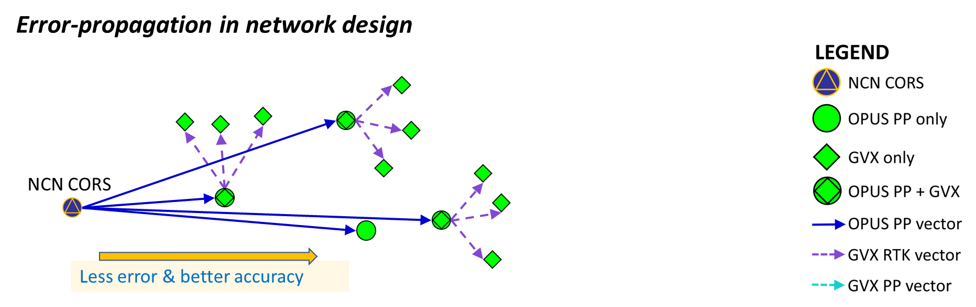
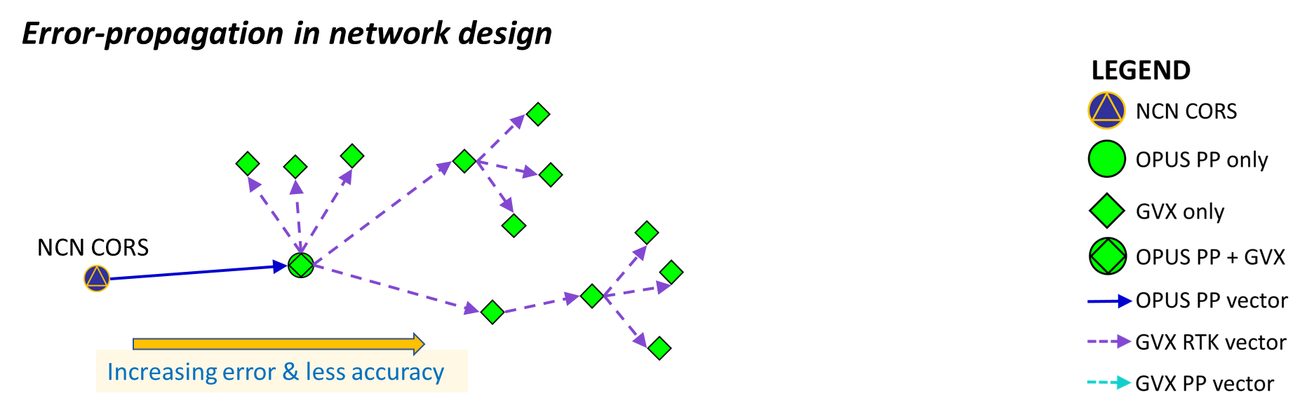
Table 5.7 – Limits vector chains to 2 vector steps
Table 5.7 – also effectively prohibits “daisy-chaining” or “leap-frogging” of vectors
Vector Steps & Vector Chains
Notes:
Table 5.7 – Limits vector chains to 2 vector steps, and also effectively prohibits “daisy-chaining” or “leap-frogging” of vectors.
By making direct connections from the NCN to a GVX Base Station, error-propagation is minimized.
Connecting several GVX Base stations and vectors in succession provides many opportunities for error accumulation.

Slide 24
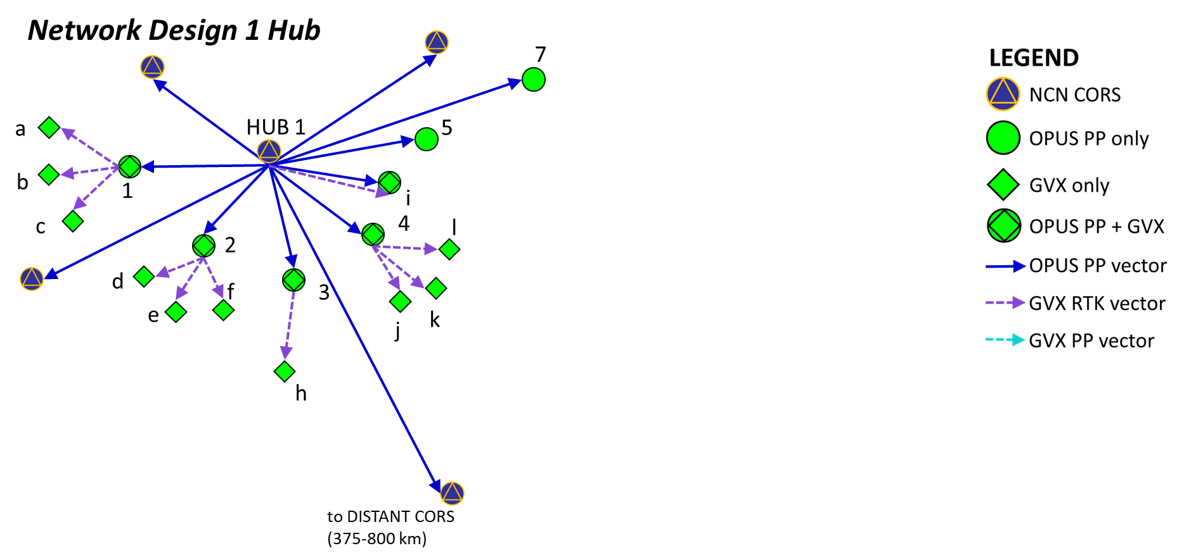
Figure 1 - Simplified Network Design Example 1
In this simplified network diagram, the longest vector chain is 2 vectors.
Each vector chain starts at a remote mark and steps back toward the HUB.
Some of these vector chains are only 1 vector step, the others are 2 vector steps.
Vector Steps & Vector Chains
Notes:
In this simplified network diagram, the longest vector chain is 2 vectors.
Each vector chain starts at a remote mark and steps back toward the HUB.
Some of these vector chains are only 1 vector step, the others are 2 vector steps.

Slide 25
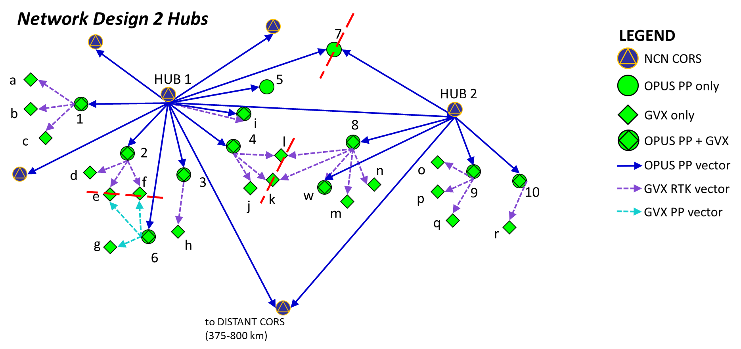
Figure 2 - Simplified Network Design Example 2
In this simplified network diagram, the longest vector chain is 2 vectors.
Each vector chain starts at a remote mark and steps back toward the HUB.
Some of these vector chains are only 1 vector step, the others are 2 vector steps.
In this diagram, it is evident that a vector chain which starts at a remote mark might have 2 (or more) paths back to a HUB or HUBs. The dashed red lines show the vector chain junctions.
It shows how passive marks might be located from more than one GVX Base or HUB.
It also shows that the cumulative length of the vector steps may sometimes exceed the HUB-to-HUB spacing.
Joining of Vector Chains
Notes:
When projects extend about 100 km or more from HUB 1, it may be advantageous to include a HUB 2.
The first advantage is that vectors from HUB 2 may attach to the same marks as vectors from HUB 1, making joined vector chains possible.
In this diagram, it is evident that a vector chain which starts at a remote mark might have 2 (or more) paths back to a HUB or HUBs.
The dashed red lines show the vector chain junctions.
It shows how passive marks might be located from more than one GVX Base or HUB.
It also shows that the cumulative length of the vector steps may sometimes exceed the HUB-to-HUB spacing.

Slide 26
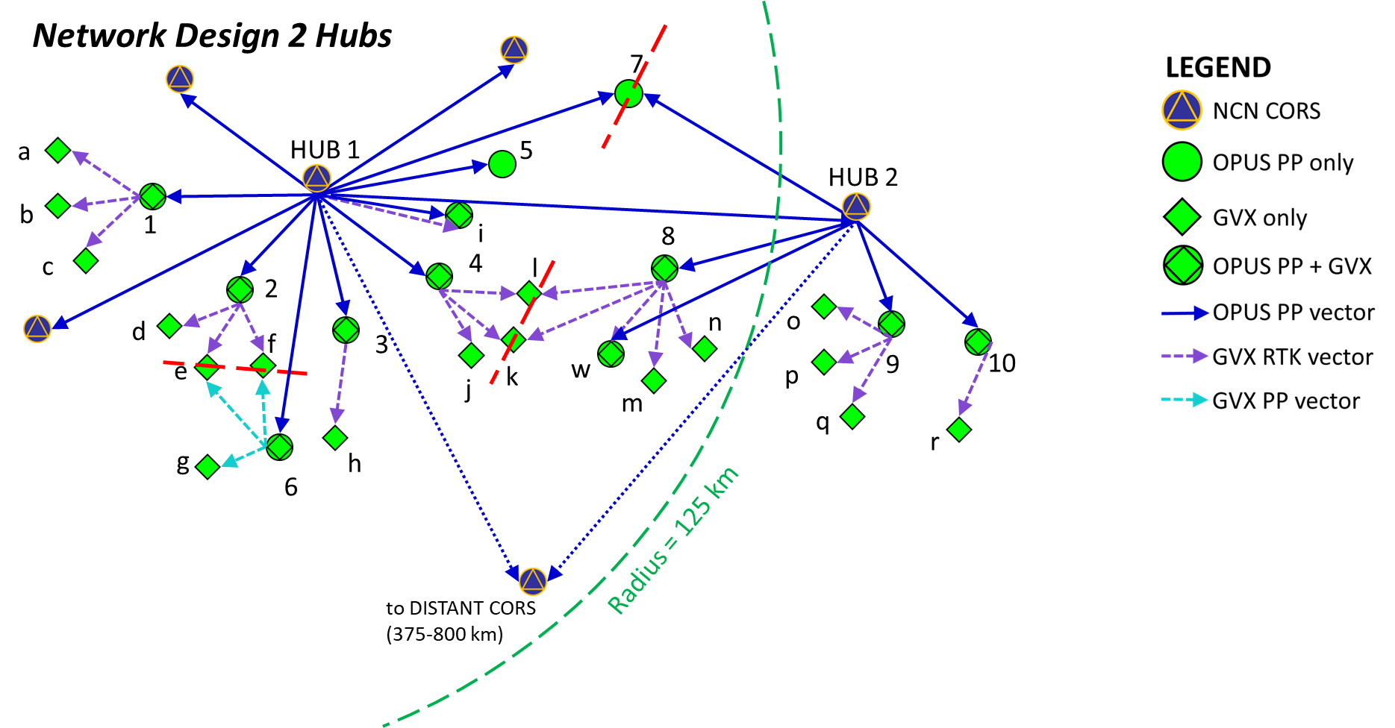
Figure 3 - Simplified Network Design Example 3
In this simplified network diagram, the longest vector chain is 2 vectors.
Each vector chain starts at a remote mark and steps back toward the HUB.
Some of these vector chains are only 1 vector step, the others are 2 vector steps.
This diagram shows how a second hub is used to extend the project beyond 100-200 km (see Table 4 and Table 5) thereby limiting the length of the vectors.
Limiting Vector Lengths
Notes:
The second advantage is that vectors from HUB2 to marks 8, 9, and 10 are shorter than would have been the case in a 1 HUB project.
This diagram shows how a second hub is used to extend the project beyond 100-200 km (see Table 4 and Table 5) thereby limiting the length of the vectors.

Slide 27
Examples
The next several slides will show examples of the implementation of selected Standards of interest.
  Checkpoints (RTN Validation Stations)
  Minimum CORS arrangements
  Establishing Orthometric Heights
Notes:
The next several slides will show examples of the implementation of selected Standards of interest.
Checkpoints (RTN Validation Stations)
Minimum CORS arrangements
Establishing Orthometric Heights

Slide 28
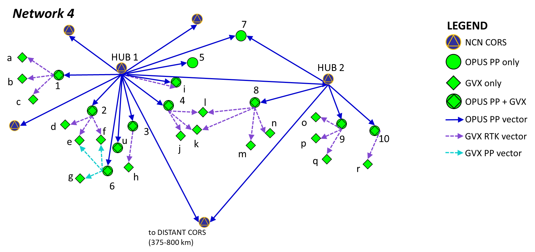
NETWORK 4 - OPUS Projects will process, but is not submittable to NGS
All passive marks and GVX Bases (numbers 1 through 10) are directly connected to the NCN by OPUS PP derived vectors (blue). Additional marks (green diamonds, lettered “a” through “r”) are positioned from them via GVX vectors (purple and cyan).
Taking a look at the vector steps from HUB 1 to mark 4 to mark “k” to mark 8 to HUB 2, one can see that it is composed of 2 vector chains, each ending in a GVX vector (and therefore meeting the Standards) joined at a single mark (“k”). This example has several such linked chains. Network 4 can be processed in OPUS Projects. But, Network 4 does not contain OPUS PP verified checkpoints. Network 4 is not submittable to NGS for review and publication.
Table 5.4 – Requires Checkpoints
Notes:
NETWORK 4 - OPUS Projects will process, but is not submittable to NGS
All passive marks and GVX Bases (numbers 1 through 10) are directly connected to the NCN by OPUS PP derived vectors (blue). Additional marks (green diamonds, lettered “a” through “r”) are positioned from them via GVX vectors (purple and cyan).
Taking a look at the vector steps from HUB 1 to mark 4 to mark “k” to mark 8 to HUB 2, one can see that it is composed of 2 vector chains, each ending in a GVX vector (and therefore meeting the Standards) joined at a single mark (“k”). This example has several such linked vector chains.
Network 4 can be processed in OPUS Projects.
Network 4 does not contain OPUS PP verified checkpoints.
Network 4 is not submittable to NGS for review and publication.

Slide 29
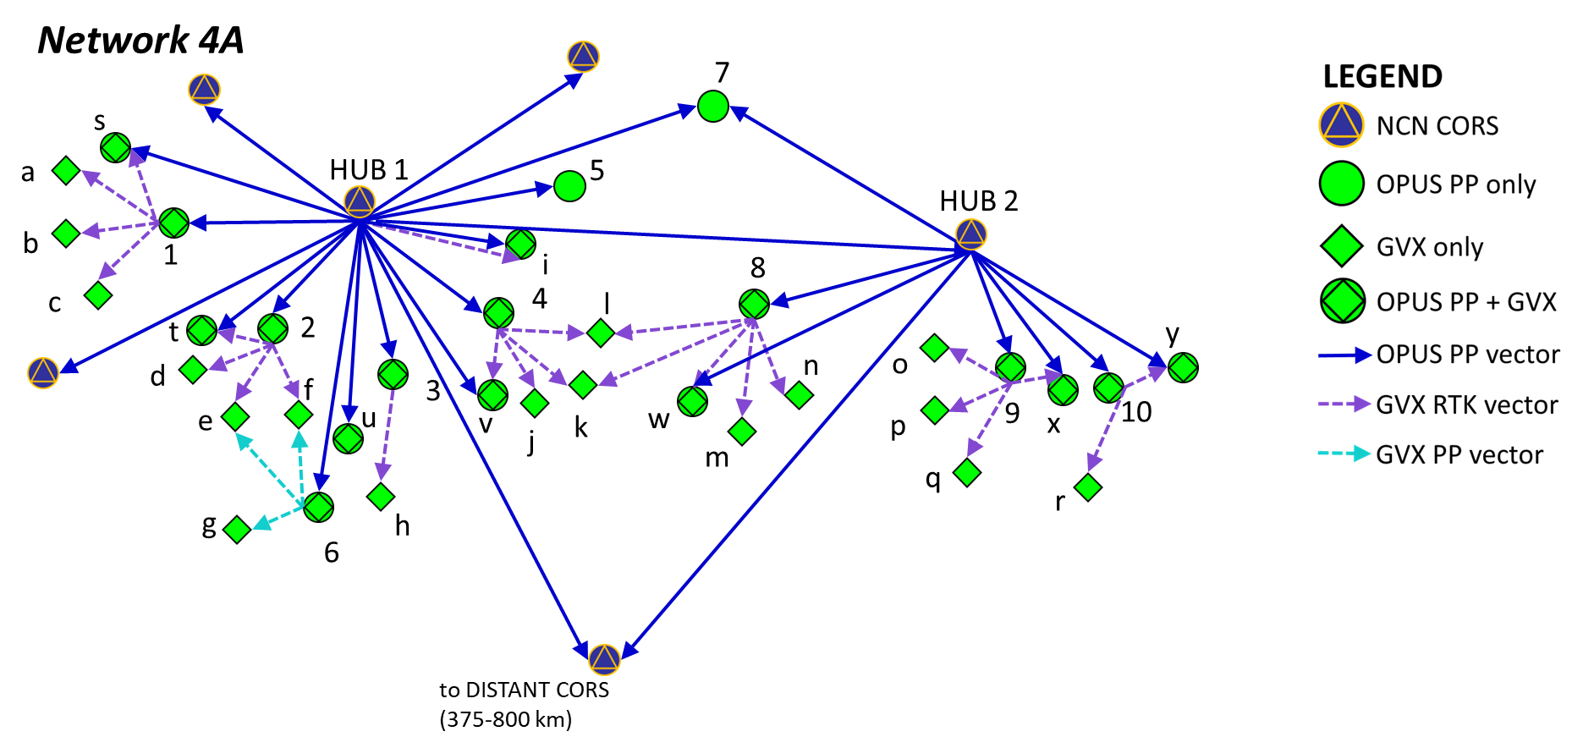
NETWORK 4A - submittable to NGS.
All passive marks and GVX Bases (numbers 1 through 10) are directly connected to the NCN by OPUS PP derived vectors (blue). Additional marks (green diamonds, lettered “a” through “r”) are positioned from them via GVX vectors (purple and cyan).
Network 4A implements the requirement in Table 5.4 that “Project includes 1 or more OPUS PP verified passive marks as checkpoints within the vicinity of the cluster of GVX vectors”. The marks designated i, s, t, u, v, w, x, and y are GVX observed and OPUS PP verified and are used as checkpoints. These checkpoints provide independent verification that the GVX related field work, data collector settings, and office computations are within acceptable error limits. Network 4A is submittable to NGS for review and publication.
Table 5.4 – Requires Checkpoints
Notes:
Network 4A implements the requirement in Table 5.4 that “Project includes 1 or more OPUS PP verified passive marks as checkpoints within the vicinity of the cluster of GVX vectors”. The marks designated i, s, t, u, v, w, x, and y are GVX observed and OPUS PP verified and are used as checkpoints.
These checkpoints provide independent verification that the GVX related field work, data collector settings, and office computations are within acceptable error limits.
Network 4A is submittable to NGS for review and publication.

Slide 30
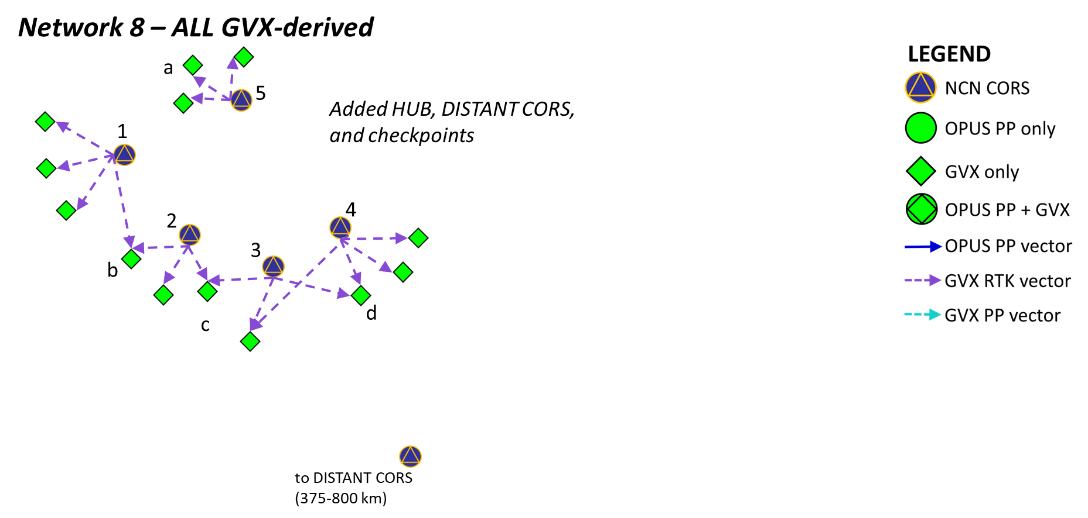
NETWORK 8 - OPUS Projects will process, but is not submittable to NGS
In this network marks 1, 2, 3, 4 and 5 are NCN CORS (used as GVX NRTK bases).
Therefore, they have constrainable positions.
The surveyor uses data from the NCN CORS and from local GNSS rovers to compute GVX vectors from the NRTK bases to the green diamonds, and then uploads them to an OPUS Project. OPUS PROJECTS can adjust the resulting network.
Network 8 does not contain OPUS PP verified checkpoints. Network 8 is not submittable to NGS for review and publication.
All GVX-Derived
Notes:
NETWORK 8 - OPUS Projects will process, but is not submittable to NGS
In this network marks 1, 2, 3, 4 and 5 are NCN CORS (used as GVX NRTK bases).
Therefore, they have constrainable positions.
The surveyor uses data from the NCN CORS and from local GNSS rovers to compute GVX vectors from the NRTK bases to the green diamonds, and then uploads them to an OPUS Project.
OPUS PROJECTS can adjust the resulting network.
Network 8 does not contain OPUS PP verified checkpoints.
Network 8 is not submittable to NGS for review and publication.

Slide 31
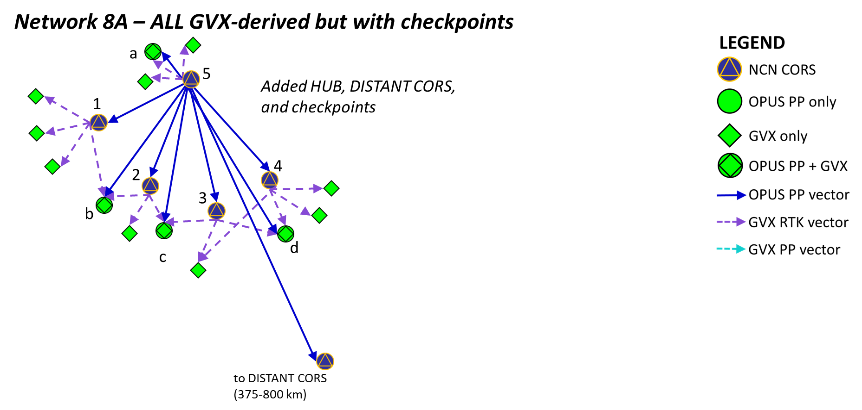
NETWORK 8A - submittable to NGS
In this network marks 1, 2, 3, 4 and 5 are NCN CORS (used as GVX NRTK bases).
Therefore, they have constrainable positions.
The surveyor uses data from the NCN CORS and from local GNSS rovers to compute GVX vectors from the NRTK bases to the green diamonds, and then uploads them to an OPUS Project. OPUS PROJECTS can adjust the resulting network.
By also collecting raw data files at marks a, b, c, and d and submitting them to OPUS PROJECTS, the surveyor can create checkpoints and also tie the entire network together. Network 8A does contain OPUS PP verified checkpoints and is submittable to NGS for review and publication.
All GVX-Derived, but with checkpoints
Notes:
By also collecting raw data files at marks a, b, c, and d and submitting them to OPUS PROJECTS, the surveyor can create checkpoints and also tie the entire network together.
Network 8A does contain OPUS PP verified checkpoints and is submittable to NGS for review and publication.

Slide 32
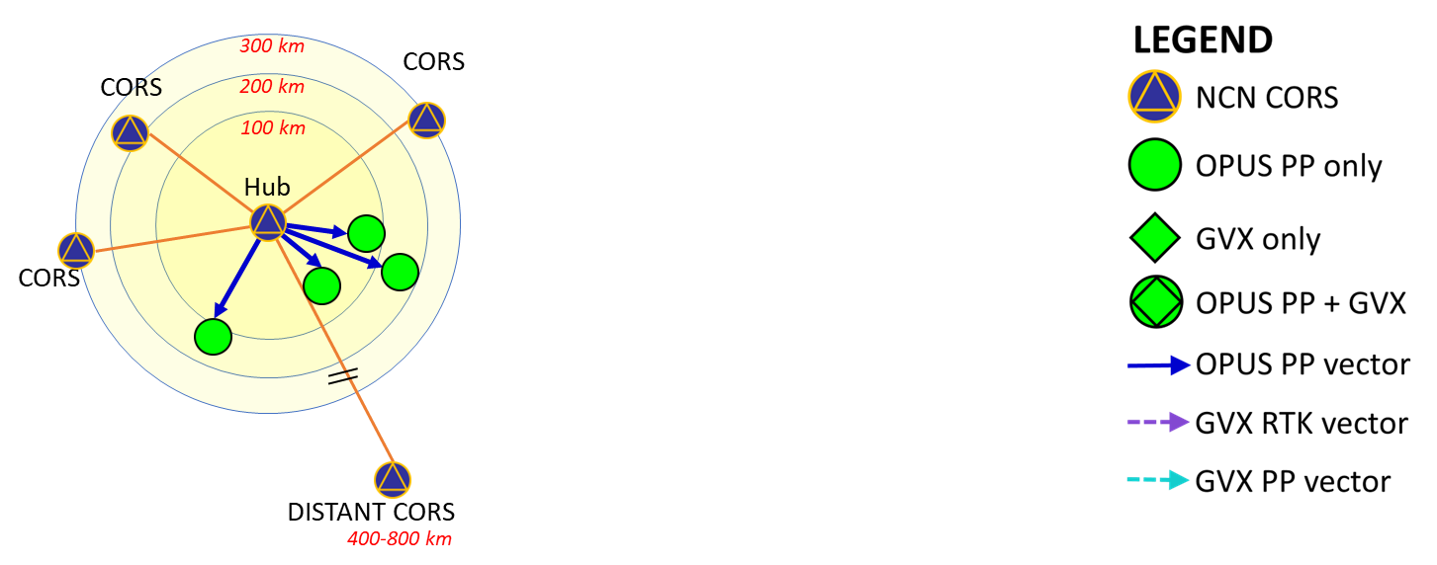
Figure 10 - Diagram of a proposed network showing proposed CORS selections and locations of marks within targeted distance ranges.
5.3 | Project includes 3 or more NCN CORS | 1 local NCN CORS used as HUB (0 to 200 km) plus 1 or more nearby NCN CORS (0 to 300 KM) plus 1 or more distant NCN CORS (400-800 km)
Table 5.3 – 3 or more CORS
Notes:
5.3 requires 3 or more CORS spaced within designated distance ranges.
Figure 10 - This diagram of a proposed network shows proposed CORS selections and locations of marks within targeted distance ranges.
Given the non-uniform distribution of NCN CORS, project mark locations, and other considerations, adherence to this Standard can best be judged by selecting a local CORS to use as HUB, then selecting the needed surrounding CORS, and finally selecting a distant CORS.
After these selections are made, one can measure:
from the proposed local HUB to the project marks (should be less than 100 to 200 km)
from the proposed local HUB to the nearby CORS (should be less than 300 km)
from the proposed local HUB to the distant CORS (should be 400 km to 800 km)

Slide 33
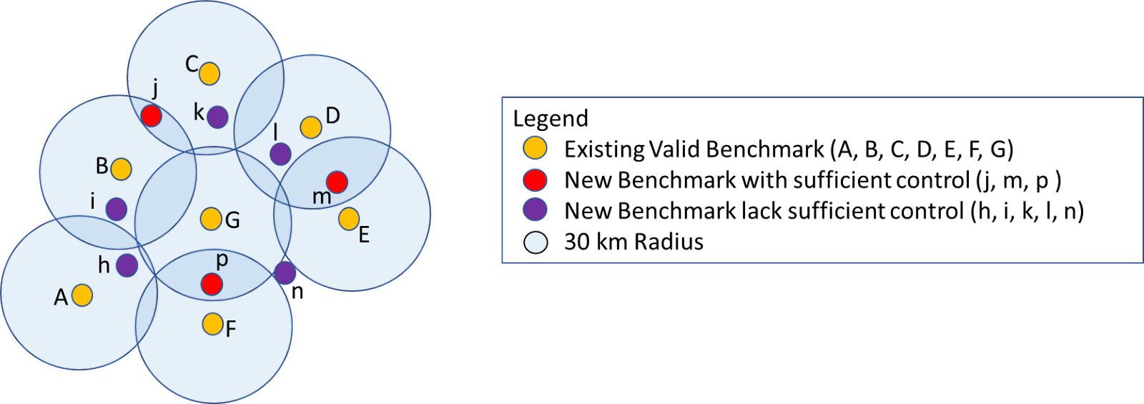
Figure 12 - Benchmark Location and Spacing Diagram
Table 8 - Standards for Achieving Valid Orthometric Heights
8.1 | Minimum Number Of Benchmarks | 2
8.2 | Order/Class Of Benchmarks | 3rd Order or better, and K-heights, (see Specification 8.2 for detail.)
8.3 | Maximum Allowable Distance From Newly Established Benchmarks to 2 Existing Valid Benchmarks Unless pre-approved in Project Proposal | Varies. 30 km to 50 km, see Specification 8.3 for detail.
Establishing Orthometric Heights
Notes:
Figure 12 - Benchmark Location and Spacing Diagram
For small projects
An easy way to determine if a proposed new benchmark lies with the allowable maximum distance to 2 or more existing valid benchmarks is to make a scaled plot, then draw circles of the appropriate radius around each existing valid benchmark.
If the proposed new benchmark lies within 2 or more overlapping circles, then it meets the Standard.
However, this is potentially cumbersome and error prone since the overlaps can be visually difficult to determine.

Slide 34
Figure 13 - Benchmark Distance Tabulation
Existing Valid BenchmarkList | New Benchmark List
 |  | h | i | j | k | l | m | n | p
 | A | 20 | 34 | 44 | 46 | 47 | 52 | 48 | 40
 | B | 50 | 20 | 25 | 37 | 40 | 53 | 40 | 37
 | C | 46 | 38 | 23 | 19 | 35 | 43 | 52 | 49
 | D | 49 | 46 | 47 | 35 | 18 | 25 | 44 | 51
 | E | 45 | 44 | 43 | 39 | 32 | 14 | 32 | 40
 | F | 37 | 42 | 47 | 46 | 44 | 40 | 34 | 21
 | G | 34 | 35 | 39 | 34 | 35 | 38 | 32 | 25
Note: all distances are tabulated in units of kilometers (km).
Color Code: 0 to 30 km = bold font w/green color, 30 km or more = normal font w/pink color.
A column with 2 or more bold font w/green color is within 30 km of 2 or more existing valid benchmarks.
Establishing Orthometric Heights
Notes:
Figure 13 - Benchmark Distance Tabulation
For small projects
An alternative method is to measure on the scaled plot from a proposed new benchmark to each existing valid benchmark and tabulate the results in a multi-column format.
By inspection, one can find which new benchmarks are within the maximum allowable distance to 2 or more existing valid benchmarks.
In this example, colors were applied to the table.

Slide 35
Figure 13A - Benchmark Distance Tabulation (3-column format)
Sort the table by Distance.
From | To | Distance (km)
h | A | 20
h | B | 50
h | C | 46
h | D | 49
h | E | 45
h | F | 37
h | G | 34
i | A | 34
i | B | 20
i | C | 38
i | D | 46
i | E | 42
etc | etc | etc
From | To | Distance (km)
m | E | 14
l | D | 18
k | C | 19
h | A | 20
i | B | 20
p | F | 21
j | C | 23
j | B | 25
m | D | 25
p | G | 25
n | E | 32
n | G | 32
etc | etc | etc
j, m, p have 2 or more entries less than 30 km
Establishing Orthometric Heights
Notes:
Figure 13A - Benchmark Distance Tabulation (3-column format)
Since every mark in a project has a coordinate, the distance between any pair of marks can be computed by coordinate geometry.
A 3 column design for the output will allow easy sorting.
First, sort by Distance.
The small distances will be easily located.
And the marks which have 2 or more entries in the table within the allowable distance can be found by inspection.
Here shown in colored ellipses.

Slide 36
Figure 13A - Benchmark Distance Tabulation (3-column format)
Question:
What can you do to increase the number of new marks that are within the Maximum Allowable Distance of 2 or more existing valid benchmarks?
Re-sort the top part of the table by From column.
From | To | Distance (km)
h | A | 20
i | B | 20
j | C | 23
j | B | 25
k | C | 19
l | D | 18
m | E | 14
m | D | 25
p | F | 21
p | G | 25
Answer:
Increase the Radius.
But How?
Longer Distances require Longer Duration Occupations.
(see Figure 14 – next slide)
Inspecting the tabulated distances reveals that you could include all the new benchmarks if you use a 40 km Maximum Allowable Distance criterion.
You decide on 45 km to be certain.
j, m, p have 2 or more entries less than 30 km
Establishing Orthometric Heights
Notes:
Figure 13A - Benchmark Distance Tabulation (3-column format)
For larger projects, a second sorting of just the top part of the table will put the FROM marks in alphabetical order and make selecting marks having 2 or more entries easier.
Here shown in colored ellipses.
It may advantageous to develop a computerized algorithm to automate the identification of those new benchmarks that fall within the maximum allowable distance to 2 or more existing valid benchmarks.
If you need more new benchmarks to meet the Standard, then a larger radius will be needed.
Let’s assume 45 km will be sufficient.

Slide 37
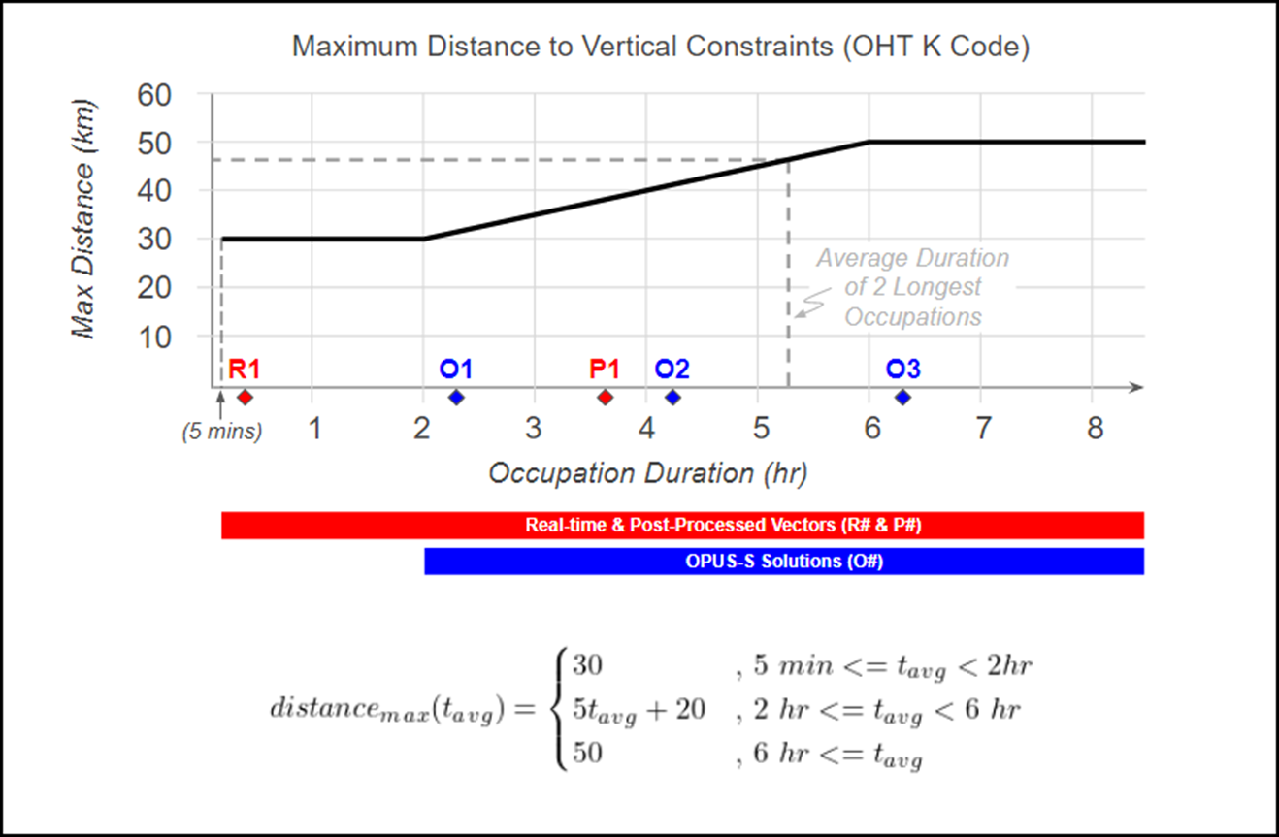
Figure 14 - Allowable Distance to Vertical Constraints to Achieve Orthometric Height (K-Code)
Maximum Allowable Distance (km) | Occupation Duration (hrs)
30 km | 2 hrs
35 km | 3 hrs
40 km | 4 hrs
45 km | 5 hrs
50 km | 6 hrs
45 km
5 hrs
Average Duration of 2 Longest Occupations
Occupation Duration times apply to the new marks where you want to derive its orthometric height with GNSS.
Establishing Orthometric Heights
Notes:
Figure 14 - Allowable Distance to Vertical Constraints to Achieve Orthometric Height (K-Code)
This figure shows a chart which relates the Maximum Allowable Distance to the Occupation Duration.
As an example, your Benchmark Tabulation shows that you need a 45 km allowable distance to achieve your goals.
The chart shows that you would need to occupy the new benchmarks for an average of 5 hours.

Slide 38
Figure 14 - Allowable Distance to Vertical Constraints to Achieve Orthometric Height (K-Code)
Tips on Using Figure 14
The chart in Figure 14 is only meant to help you plan how long to occupy new marks in order to determine high accuracy orthometric heights with GNSS (i.e., to get the so-called K-height classification in the IDB). The session duration on such new marks is dependent on the distance to two nearby existing valid benchmarks. For a given new mark, you would look at your project map, find the two nearest existing valid benchmarks, and plot their distances on this chart.
Say one is at 30 km, and the other is at 50 km. The more distant benchmark is further so select 50 km. The chart indicates to occupy the new mark for 6 hours.
Since the Standard requires a minimum of 2 or 3 sessions depending on Classification, then the surveyor should occupy the new mark for an average of 6 hours for the 2 or 3 sessions to meet the Specification.
For existing valid benchmarks, they already have published orthometric heights. In that case, this chart doesn't apply (you are not determining their orthometric height). Instead, they should be occupied according to the desired Standard for ellipsoid heights.
The general rule for Figure 14: Occupation Duration times apply to the new marks where you want to derive its orthometric height with GNSS.
Establishing Orthometric Heights
Notes:
Tips on Using Figure 14
The chart in Figure 14 is only meant to help you plan how long to occupy new marks in order to determine high accuracy orthometric heights with GNSS (i.e., to get the so-called K-height classification in the IDB). The session duration on such new marks is dependent on the distance to two nearby existing valid benchmarks. For a given new mark, you would look at your project map, find the two nearest existing valid benchmarks, and plot their distances on this chart.
Say one is at 30 km, and the other is at 50 km. The more distant benchmark is further so select 50 km. The chart indicates to occupy the new mark for 6 hours.
Since the Standard requires a minimum of 2 or 3 sessions depending on Classification, then the surveyor should occupy the new mark for an average of 6 hours for the 2 or 3 sessions to meet the Specification.
For existing valid benchmarks, they already have published orthometric heights. In that case, this chart doesn't apply (you are not determining their orthometric height). Instead, they should be occupied according to the desired Standard for ellipsoid heights.
The general rule for Figure 14: Occupation Duration times apply to the new marks where you want to derive its orthometric height with GNSS.

Slide 39
Why the Long Occupations for OPUS PP?
Q: WHY does OPUS PP require such long durations?
A: Because OPUS uses a post-processing engine that takes into account many variables that might or might not be considered in non-NGS softwares.
  These include ocean loading, earth tides, correction for the motion of the earth's center-of-mass.
  Successfully solving for these variables requires more data over a longer duration.
  NGS does not know whether any particular software (or the surveyor's choice of settings within) has included any of these effects, so NGS limits the GVX PP and other GVX methods to shorter baselines and sets shorter occupation durations for them.
Notes:
Q: WHY does OPUS PP require such long durations?
A: Because OPUS uses a post-processing engine that takes into account many variables that might or might not be considered in non-NGS softwares.
These include ocean loading, earth tides, correction for the motion of the earth's center-of-mass.
Successfully solving for these variables requires more data over a longer duration.
NGS does not know whether any particular software (or the surveyor's choice of settings within) has included any of these effects, so NGS limits the GVX PP and other GVX methods to shorter baselines and sets shorter occupation durations for them.

Slide 40
Survey Design for Greatest Efficiency
No absolute rule.
  Use OPUS PP methods to connect to NSRS at CORS (and other control) and to establish verifiable positions on points from which shorter duration GVX methods can be employed.
  A combination of methods (OPUS PP + GVX) is likely the most efficient.
  But, it all depends on local trade-offs, capability, and survey requirements.
Notes:
No absolute rule.
Use OPUS PP methods to connect to NSRS at CORS (and other control) and to establish verifiable positions on points from which shorter duration GVX methods can be employed.
A combination of methods (OPUS PP + GVX) is likely the most efficient.
But, it all depends on local trade-offs, capability, and survey requirements.

Slide 41
Project Proposal
It is the surveyor’s responsibility to plan the survey project carefully, then submit a Project Proposal to NGS for approval.
  NGS provides a web page and Sample Project Proposal template for this purpose.
The Standards make several mentions of “unless pre-approved in the Project Proposal”. The project proposal must address the need for such pre-approvals and discuss the justification for the requested pre-approvals.
Notes:
It is the surveyor’s responsibility to plan the survey project carefully, then submit a Project Proposal to NGS for approval.
NGS provides a web page and Sample Project Proposal template for this purpose.
The Standards make several mentions of “unless pre-approved in the Project Proposal”. The project proposal must address the need for such pre-approvals and discuss the justification for the requested pre-approvals.

Slide 42
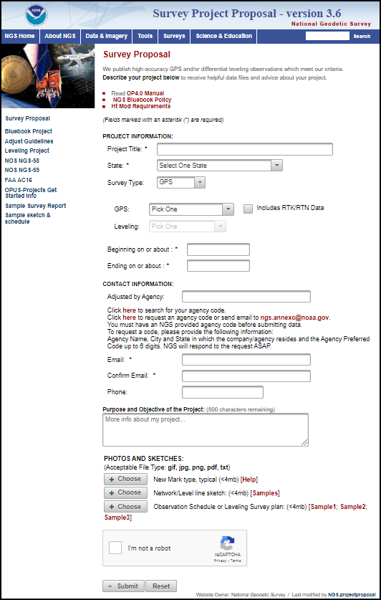
Project Proposal Page
https://geodesy.noaa.gov/SurveyProposal/
Sample Project Reports
Sample Project Proposals
Notes:
The NGS Project Proposal web page has link to sample Project Proposal and Project Reports.

Slide 43
Project Report
The surveyor must analyze the survey project carefully to verify adherence to the Standards as listed in these Tables.
Upon completion of the project analysis, the surveyor must write a Project Report which summarizes and discusses the results of the project.
The Project Report must contain a tabulation of the various Tables’ requirements which the surveyor will use to support a provisional classification.
  NGS provides a Sample Project Report template for this purpose.
Notes:
The surveyor must analyze the survey project carefully to verify adherence to the Standards as listed in these Tables.
Upon completion of the project analysis, the surveyor must write a Project Report which summarizes and discusses the results of the project.
The Project Report must contain a tabulation of the various Tables’ requirements which the surveyor will use to support a provisional classification.
NGS provides a Sample Project Report template for this purpose.

Slide 44
Project Report
The Project Report must discuss any pre-approvals that were requested in advance, what final impact these had on the project, and also discuss unexpected circumstances which may justify post-approval of additional variances from the Standards.
The Project Report will be used by the NGS acceptance personnel to efficiently determine whether the requirements for the intended classification have been achieved.
Notes:
The Project Report must discuss any pre-approvals that were requested in advance, what final impact these had on the project, and also discuss unexpected circumstances which may justify post-approval of additional variances from the Standards.
The Project Report will be used by the NGS acceptance personnel to efficiently determine whether the requirements for the intended classification have been achieved.

Slide 45
Status
NOAA Technical Memorandum NOS NGS 92 is in Draft Status.
Awaiting several final approvals before making it available for public comment.
  Note the contents of this slide show are subject to minor changes as we receive feedback

Slide 46
The End
Q & A discussion

