Slide 1
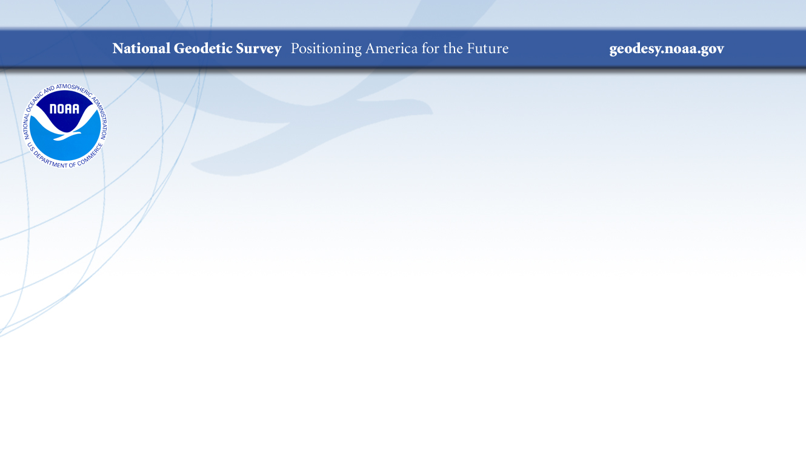
Gravity at NGS: Why We Need it and How We Measure It
Derek van Westrum, Ph.D.
NGS Observations and Analysis Division
derek.vanwestrum@noaa.gov
NOAA’s National Geodetic Survey
geodesy.noaa.gov

Slide 2
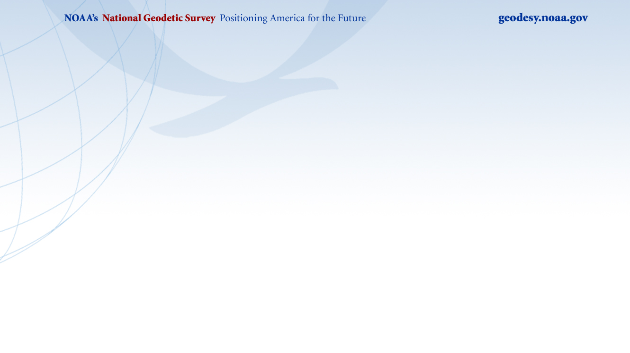

A Bit About Me
I’m Derek van Westrum
I’ve been a physicist with NOAA’s National Geodetic Survey for 5 years
I’m located in Boulder, Colorado
I measure gravity
I spent 15 years before NGS making gravity meters
I ride bikes and climb mountains (and so I think about gravity a lot…)
Hi, I’m Derek!

Slide 3
Outline
Warning: There’s some Physics + Math* ahead!
A History Lesson
Different ways of describing gravity
Okay, so apparently measuring gravity is “a thing”. How do you do it?
  Types of gravity meters
  And how they work
What does NGS do with Gravity Data?
  Height Systems, old and new
The Future
  Cold atoms and fancy clocks(even more physics!)
*Think of math like tough love: a little bit, every now and then, is good for us.

Slide 4
What is Gravity?
Wikipedia entry for “Gravity”:
Gravity (from Latin gravitas, meaning 'weight'), or gravitation, is a natural phenomenon by which all things with mass or energy including planets, stars, galaxies, and even light—are brought toward (or gravitate toward) one another.”
That’s actually a very good definition, but you might be surprised to learn that nobody actually knows why this phenomenon exists…

Slide 5
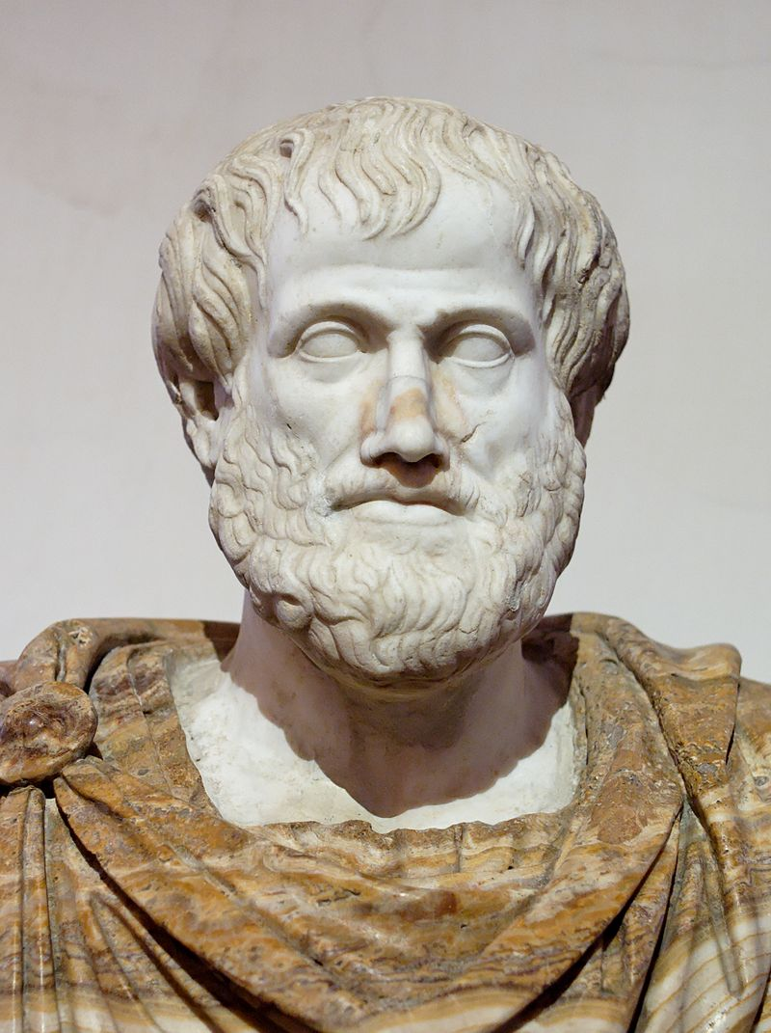
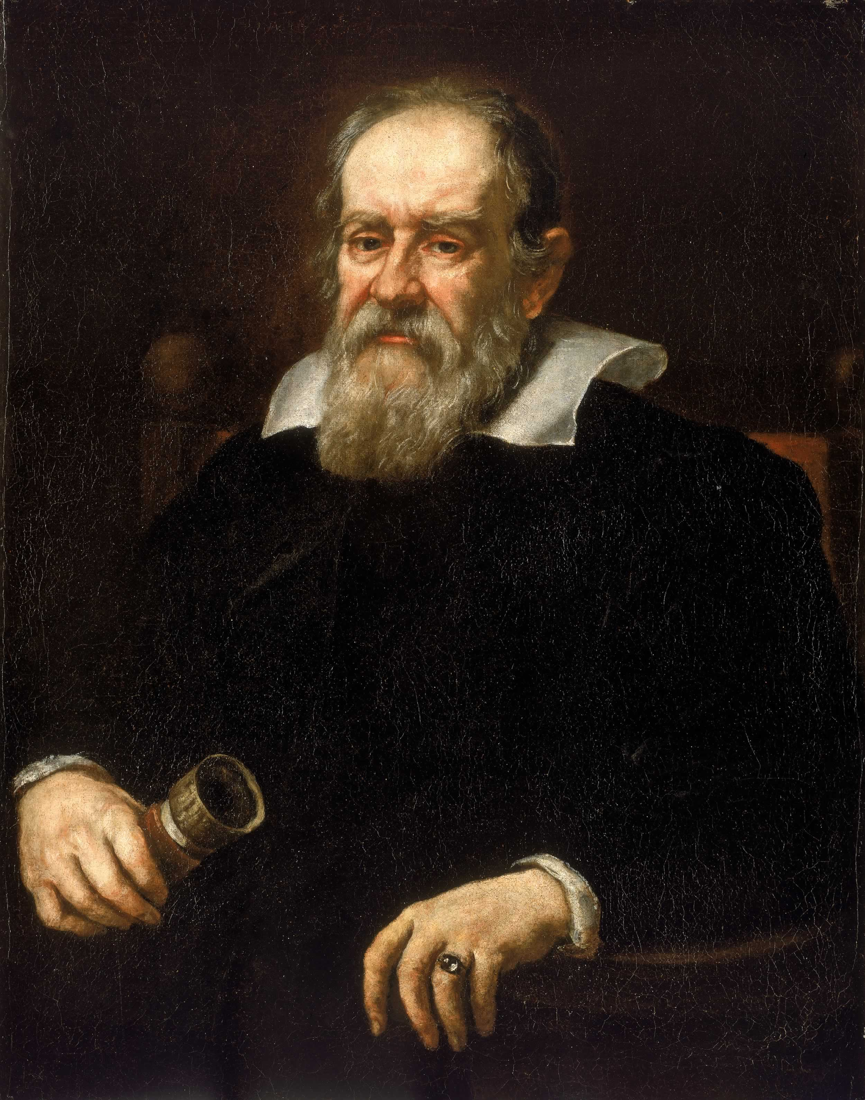
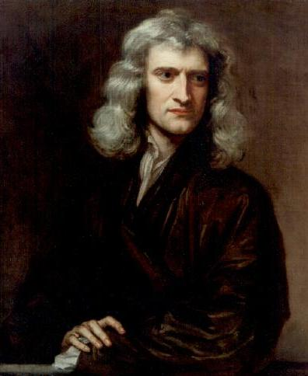
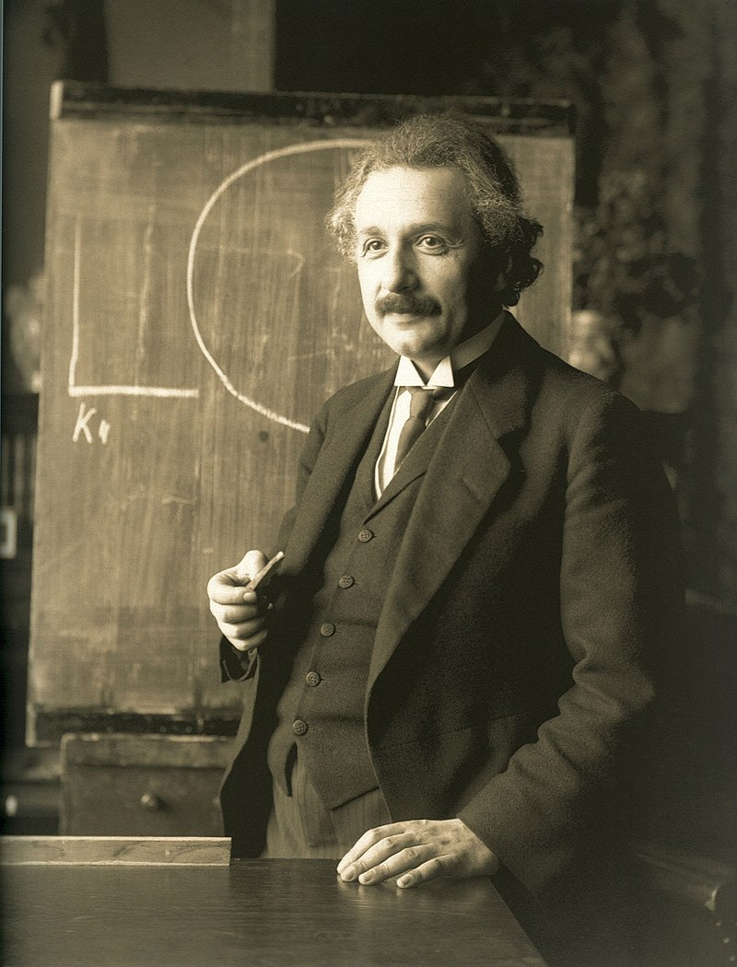
Some History
Setting aside the question of “why is gravity” (that’s really hard…), humans have set out to answer “what is gravity” for centuries:
Aristotle (300 BCE): Objects fall at a speed proportional to their weight and inversely proportional to the density of the fluid they are immersed in.
Galileo (~1600): Used experiments to demonstrate that objects accelerate due to gravity at the same rate, regardless of mass. (More later)
Newton (1687): Inverse square law of universal gravitation. Objects attract each other with a force proportional to their masses, and inversely proportional to the square of the distance between them.
Einstein (1907-1915): The theory of General Relativity describes a space-time continuum which is curved by the presence of masses.
Not actually that crazy!

Slide 6
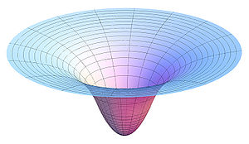
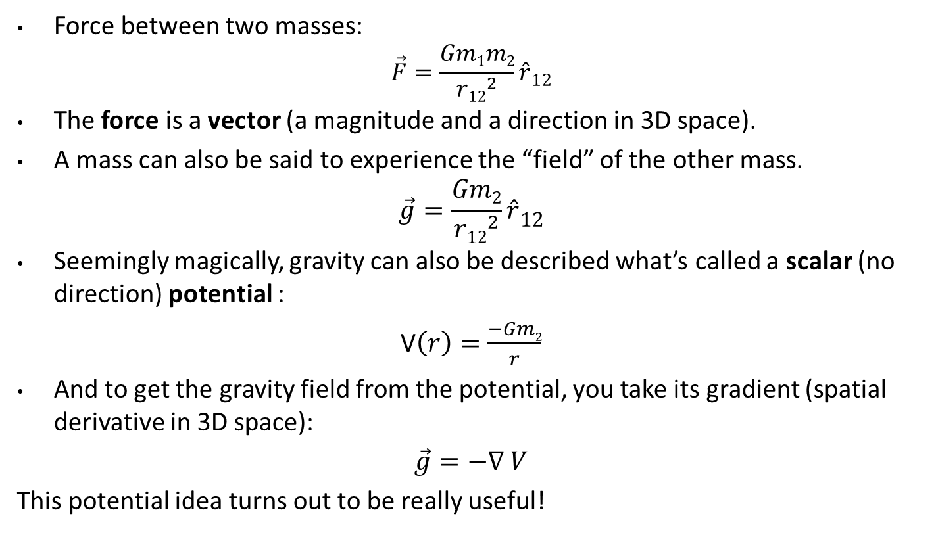


A Closer Look at Newtonian Gravity
Force between two masses:
$$\vec{F}=\frac{Gm1m2}{{r12}^{2}}\hat{r}12$$
The force is a vector (a magnitude and a direction in 3D space).
A mass can also be said to experience the “field” of the other mass.
$$\vec{g}=\frac{Gm2}{{r12}^{2}}\hat{r}12$$
Seemingly magically, gravity can also be described what’s called a scalar (no direction) potential :
V$\left(r\right)=\frac{−Gm2}{r}$
And to get the gravity field from the potential, you take its gradient (spatial derivative in 3D space):
$\vec{g}=−∇$ $V$
This potential idea turns out to be really useful!
$$m2$$
$$m1$$

Slide 7
A Few Words About General Relativity
Time and space are combined into a special “4D” spacetime continuum
Every mass warps the spacetime around them. This warping is how we experience gravity.
With no external force, objects travel on “straight lines” in spacetime, but the warping of spacetime by other objects makes these paths appear to curve (e.g. orbits)
“Spacetime tells matter how to move; matter tells spacetime how to curve” - Wheeler
Newton’s theory can’t explain the speedy orbit of Mercury, black holes, the bending of light paths, clocks that run faster up on a hill… Einstein’s description is the most accurate.
However, the effects of relativity usually require very high speeds and/or very large masses. Newton’s description works great for NGS’s purposes.
Believe it or not though, Einstein will be back later in this talk!

Slide 8
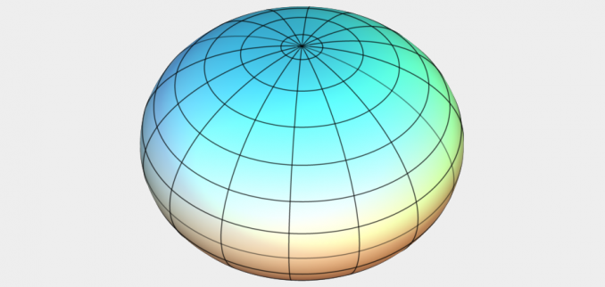
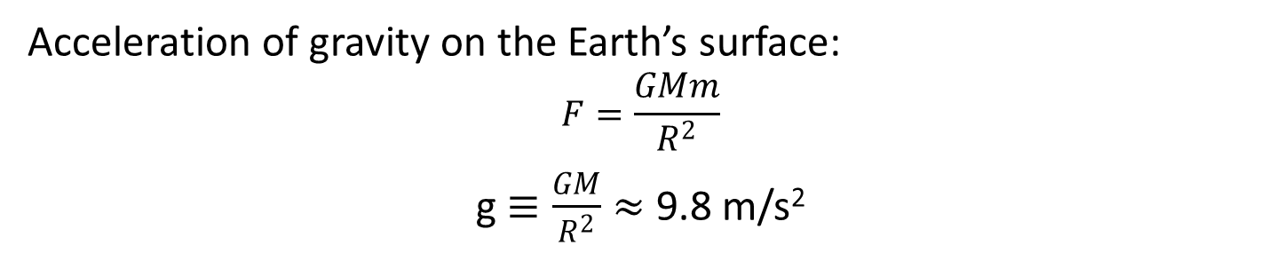
Earth’s Gravity (Newton-style)
Acceleration of gravity on the Earth’s surface:
$$F=\frac{GMm}{R^{2}}$$
g $≡\frac{GM}{R^{2}}≈$ 9.8 m/s²
No idea why it’s called W
Because the Earth spins on its axis, there is a centrifugal acceleration. It too can be described by a scalar potential function, Φ. This, plus the gravitation potential, V, add to give the total, or geopotential: “W”.
The upshot is that the Earth “bulges out” at the equator and its shape is best approximated by an ellipsoid (not a sphere).
Because of this, g varies from approximately 9.78 at the equator to 9.82 m/s² at the north pole – you’re closer to the center of the Earth at the North Pole.
Mountain tops are further from the center of the Earth than valley floors. g is smaller up high (“gravity is weaker”)
And of course, some rocks are more dense than others, so locally g can be higher or lower than you might expect.

Slide 9
Understanding “Potential” Part 1
h
The resting water has “potential” energy just by being high up on this cliff.
That potential energy can turn into real (kinetic) energy by falling.
Think of the Earth as creating a “gravity field” that masses experience. I’ve drawn potential “field lines”
Energy = mgh
Energy = ½ mv² (= mgh)
Potential = gh
Gravity x Height is “Geopotential”. This is what water “feels”.
Notes:
Mention that the geoid is not an ellipsoid shape, but lumpier. Only 170m_pp though!

Slide 10
Understanding “Potential” Part 2
Imagine pouring water onto a dry lake bed. If everything is level it will simply pool up. It would “like” to get to lower potential (darker lines), but the lake bed is in the way.
If the lake bed is tilted (it’s now the side of a hill), the water can move towards lower potential (towards darker lines). Water appears to flow because of a change in height
If the lake bed appears flat, but there is a mass anomaly under one end, the resulting geopotential difference causes water to flow to lower potential (again, from light to dark lines). It appears to flow because of gravity.
In all scenarios, water only flows when it has a path to lower geopotential – this is always a combination of gravity and height, g x H.
Notes:
Mention that the geoid is not an ellipsoid shape, but lumpier. Only 170m_pp though!

Slide 11
Properties of Earth’s Gravity Field, W
Each line around the Earth is where W is equal to some constant.
It’s a surface of constant geopotential enveloping the Earth.
Water doesn’t flow along a surface – remember, they’re level.
There are infinitely many level surfaces. They are not necessarily parallel to each other, but never intersect.
Up close they’re lumpy blobs, but farther out they become more and more ellipsoidal.
Plumb lines are always perpendicular to every surface they intersect.
There is one level surface that, on average, best matches sea level – it’s called the Geoid. Remember that one!
Incidentally, here’s the Ellipsoid. It’ll come in handy later – it’s what the GNSS satellites “see”.
Notes:
Mention that the geoid is not an ellipsoid shape, but lumpier. Only 170m_pp though!

Slide 12
Aside: Basic (Archaic…) Gravity Units
Acceleration of gravity on the Earth’s surface, g ≈ 9.8 m/s²
1 Gal ≡ 1 cm/s²
So g ≈ 980 Gal
Absolute gravity meters typically measure to 1 to 10 μGal:
1 μGal = 1x10⁻⁶ Gal= 1x10⁻⁸ m/s²,
or about 1 part per billion of the acceleration of gravity!
A real life example: g (at TMGO, north of Boulder, CO) = 9.79 622 743 m/s²
Lifting the gravity meter up just 3mm reduces this digit by 1!
mGal digit (the 6th)
μGal digit (the 9th)

Slide 13
Okay cool, so gravity changes.
How do we measure it?

Slide 14
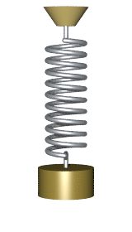
It’s all Relative, Absolutely!
Absolute gravity meters measure the acceleration of an object, and are tied to standards of length and time. This gives you the actual, “full field” value of g. State of the art instruments are good to 1-2µGal.
Relative gravity meters tell you the difference in g between two locations and/or at one location over time. Typically some sort of mass on a spring. The spring stretches more when g is larger. State of the art instruments can resolve 1-2µGal.

Slide 15
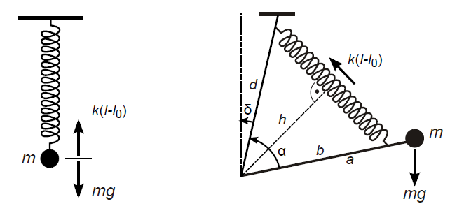
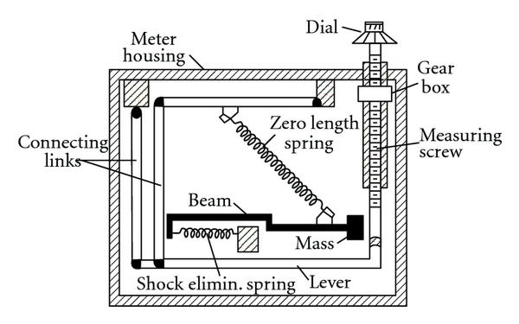

Relative Instrument Principles
LaCoste & Romberg g-Meter
The force of gravity stretches a calibrated spring, and the displacement is proportional to gravity. Roughly: g ~ (k/m)x
Geometric “tricks” (zero length springs) allow a small change in gravity to cause a larger displacement of the test mass.
Modern systems use an electric force to keep the mass position fixed, and the electric force required is proportional to gravity.
Both the spring and feedback unit must be calibrated and are subject to drift and offsets (tares) over time.

Slide 16
Relative Instrument Principles
Each relative instrument has its own
  Test mass
  Spring Constant
  Damping coefficient
  Etc.
These parameters can change with
  Time
  Temperature
  Pressure
  Magnetic fields
  Humidity
  Etc.
To measure g at the µGal level, each parameter (or overall combination of parameters) must be known, controlled, and monitored to a precision of 10⁻⁹ or better.
(Note though that these parameters often change lineally with time and are easily corrected for.)

Slide 17
Relative Instrument Pros and Cons
Advantages of relative instruments include
  No (or few) moving parts
  Small, portable size (portable survey units: gMeter, CG-5, etc.)
  Continuous, high rate measurements (SG)
  High precision (but low dynamic range)
  Operable in dynamic applications
The disadvantages include
  Long term changes in calibration factors
  Un-modeled sensitivity of calibration factors to environmental conditions
  Possibility of nonlinear drift
  Offsets (tares)
  Difficult to transport
  “Memory” after an anomaly. For example, the “decay” of an offset after a dynamic meter encounters an air pocket.

Slide 18
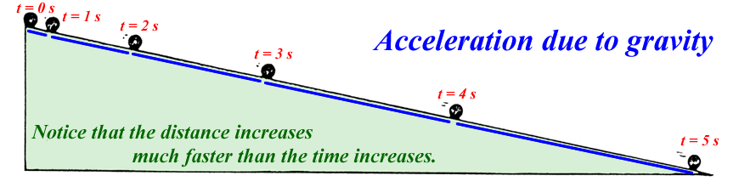

Absolute Gravity Meters
Mark distances along the slope and note position at time intervals
g is measured “directly” in meters / second²
First absolute gravity instruments were Galileo’s inclined planes
x
θ
Note that if θ = 90⁰, x = ½ gt², the usual freefall equation.
Galileo cleverly slowed time down (to accurately time things) by tilting the vertical way over on its side…

Slide 19
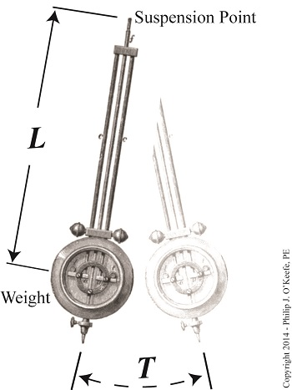

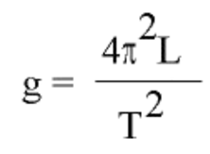
Pendulums
For small angles the period of pendulum is independent of the angle. They make good clocks.
1656. Huygens makes a pendulum clock
1749. Bouguer measures g. Again, note we just need length and time
1817. Kater introduces the reversible pendulum
(Kater also introduces relative gravity: keep L fixed and ∆g ~ ∆T⁻²)
Vacuum chambers and multiple pendulums were state of the art through 1940s.
Best accuracy ~100 µGal
Eventually spring gravity meters had significantly better precision, indicating problems and “absolute offsets” in the pendulum results

Slide 20
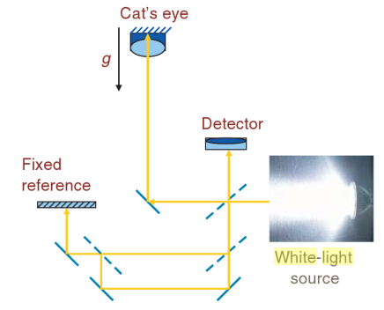
Freefall Absolute Gravity Meters
1963. Faller and Dicke introduce white light interferometer
White light makes interference “flashes” when the path length of the “test beam” is equal in length to the reference beam.
This occurs 3 times during free fall. The timing of the flashes and the measured path lengths serve to determine g.
Length (meters) and time (seconds) give us acceleration in m/s²
Initial accuracy ~700 µGal

Slide 21
“Classic” Contemporary Freefall Absolute Gravimeters
Through the 1970s - 1990s, the freefall method was improved using lasers, active seismic isolation, precise timing, etc.
Current state of the art is ~2µGal accuracy (observed agreement between absolute instruments).
JILA-g, IMGC, FG5(X), A10, GABL, NIM, MPG…
These devices all drop macroscopic objects and use conventional mirrors and beam splitters
Length (lasers) and time (atomic clocks) are stabilized by being tied to atomic transitions (primary frequency standards in most cases)
  Lasers accurate to ~1x10⁻¹²
  Clocks accurate to ~1x10⁻¹⁰ (calibrated to Cesium, 1x10⁻¹⁵)
Who knew so many folks were making gravity meters?

Slide 22
FG5 Principle of Operation
Vacuum
Chamber
Freefalling
Upper Mirror
Interferometer
Interference
A freely falling reflective test mass is dropped in a vacuum. This causes optical fringes to be detected at the output of an interferometer. This signal is used to determine the local gravitational acceleration.
Detector
Stationary Lower
Mirror

Slide 23
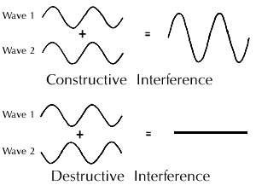
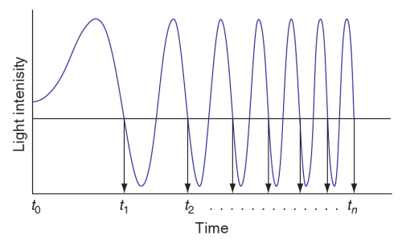
Interferometry
MAX
λ/2
min
λ, the wavelength of the laser light, can be tied to absolute atomic transitions frequencies.
Photodiode
Laser
B.S.
Fringes
fringe signal sweeps in frequency as test mass falls under influence of gravity
time recorded (w.r.t. rubidium oscillator) at each zero crossing, creating (t,x) pairs at every λ/2
Michelson’s interferometer

Slide 24
g Determination
Needles to say: computers help a lot here…
Fringe = l/2 x_{i}
For each x_{i} , a measured time t_{i,}
The following function is fitted to the data x_{i} , t_{i} :
x_{i} , t_{i} , i = 1, …,700
γ is the vertical gravity gradient (~3 µGal/cm),
c the speed of light
x₀ the initial position
v₀ the initial velocity
g₀ the initial acceleration

Slide 25
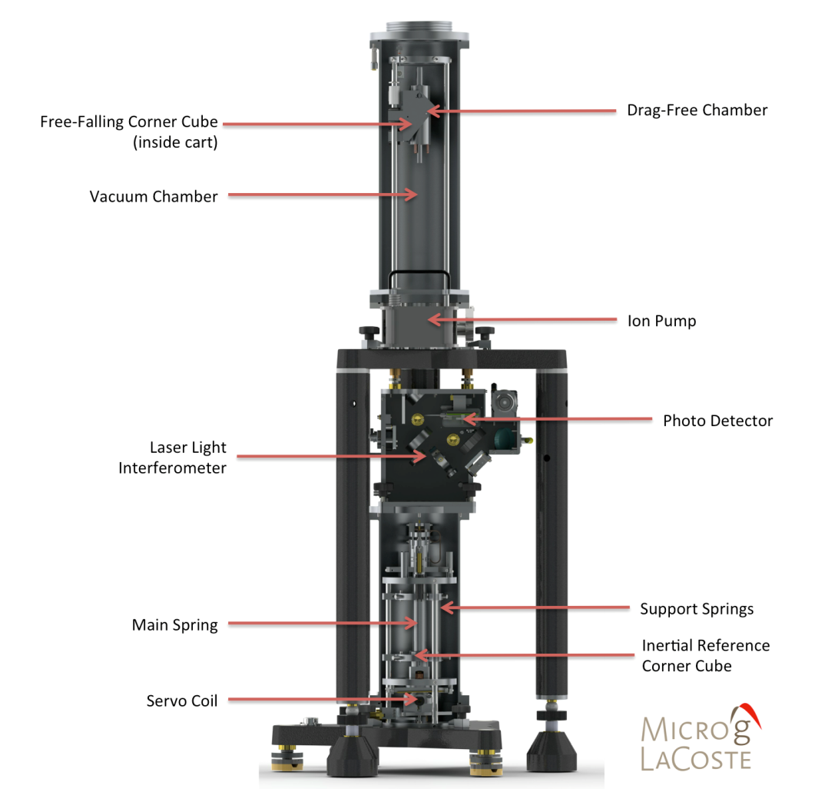

Slide 26
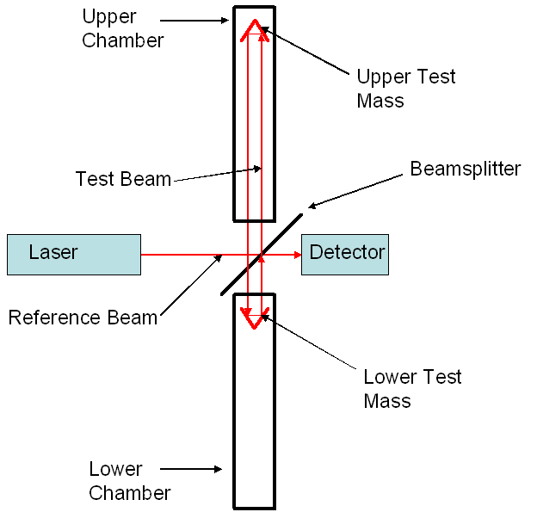
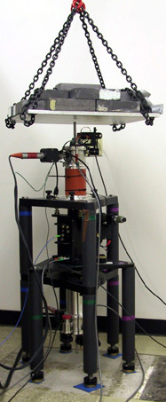
An Aside: Absolute Gradiometers
Δz
Same interferometer set up, but the lower reflector is also placed into freefall. It falls more quickly because gravity is stronger closer to the center of the Earth.
γ = Δg/Δz is the “vertical gravity gradient”

Slide 27
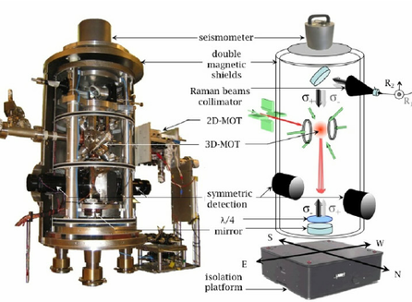
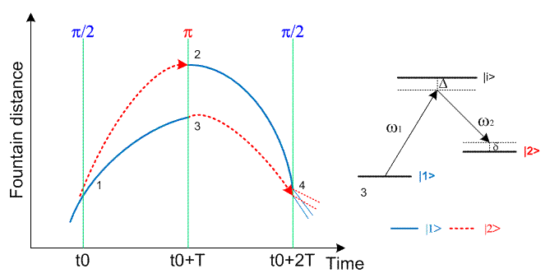
Cold Atom Gravimeters
Also a free fall method, but the role of matter and light is reversed: atoms are split into two paths, and light is used to form “mirrors” and “beam splitters”
Length and time standards are still provided by ties to atomic transitions
Advantages: no recoil force into the ground (low noise), no moving parts, fast and continuous measurements

Slide 28
Practical Limitations on Absolute Accuracy
Absolute measurements routinely corrected for
  Earth tides (changing shape of dry earth due to sun and moon)
  Ocean loading (loading on continental plates due to sloshing of oceans from earth tides)
  Barometric pressure changes (more or less mass above the instrument)
  Polar motion (changes in centrifugal acceleration as the earth’s axis changes orientation)
All are known to about 1-2 µGal, and these uncertainties add in quadrature
Other phenomena can affect gravity meters at this level
  Water table fluctuations
  Volcanic activity
  Subsidence, uplift
To get to sub-µGal accuracies, it becomes necessary to monitor small and complicated signals and/or create complex models
  For example: barometric loading (tilt caused by differential atmospheric loading across a continental plate) can be observed, but is very difficult to model accurately

Slide 29
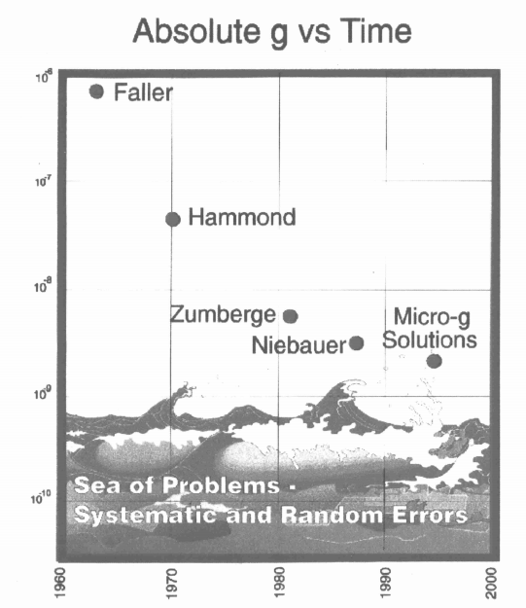
Jim Faller’s “Sea of Problems”
Yet more folks who’ve made absolute gravity meters over the years…
10⁻⁶
10⁻⁷
10⁻⁸
10⁻⁹
10⁻¹⁰
Meaningful accuracies below 1µGal are hard to come by…

Slide 30
Hydrology* Signal at TMGO
*Well, hydrology is the bulk of this signal

Slide 31
Okay, so NGS can get weirdly accurate gravity data. What does it do with these data sets exactly?

Slide 32
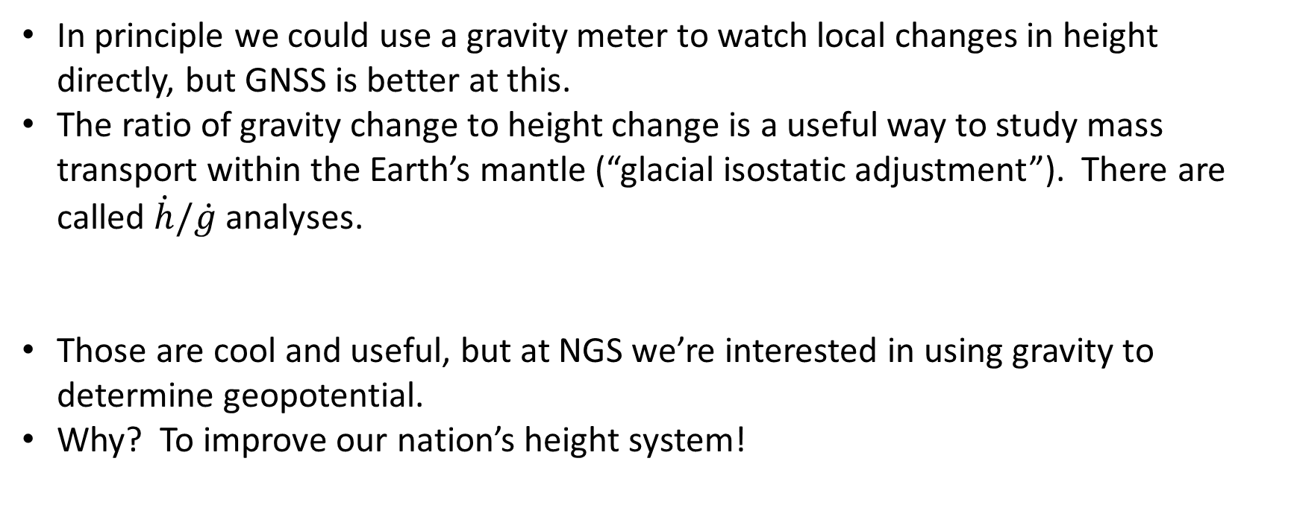
All about Heights
In principle we could use a gravity meter to watch local changes in height directly, but GNSS is better at this.
The ratio of gravity change to height change is a useful way to study mass transport within the Earth’s mantle (“glacial isostatic adjustment”). There are called $\dot{h}/\dot{g}$ analyses.
Those are cool and useful, but at NGS we’re interested in using gravity to determine geopotential.
Why? To improve our nation’s height system!

Slide 33
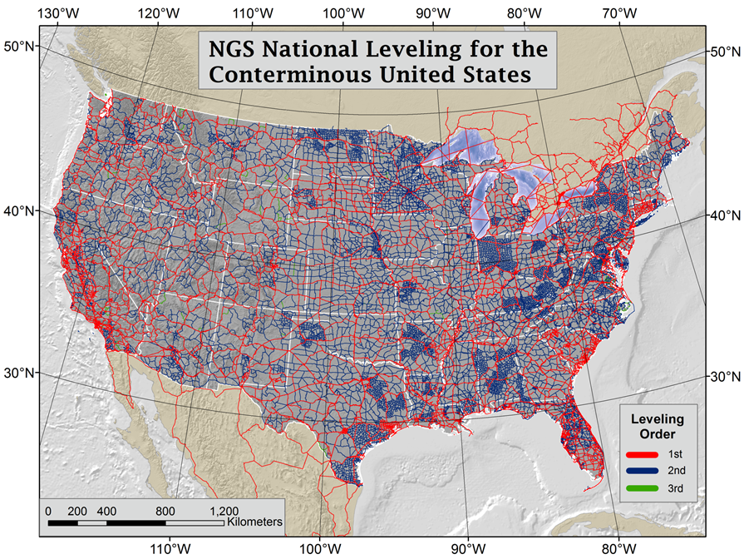
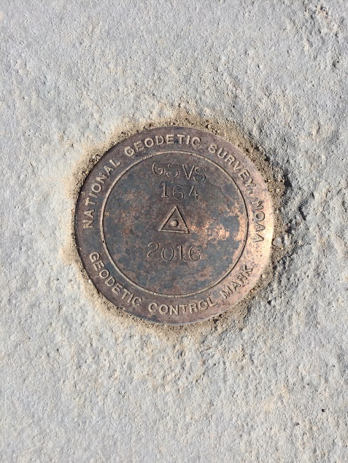
Our current vertical datum, NAVD88
  Massive leveling and gravity campaign across the country yielded measurements at over 800,000 benchmarks

Slide 34
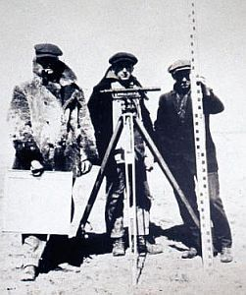
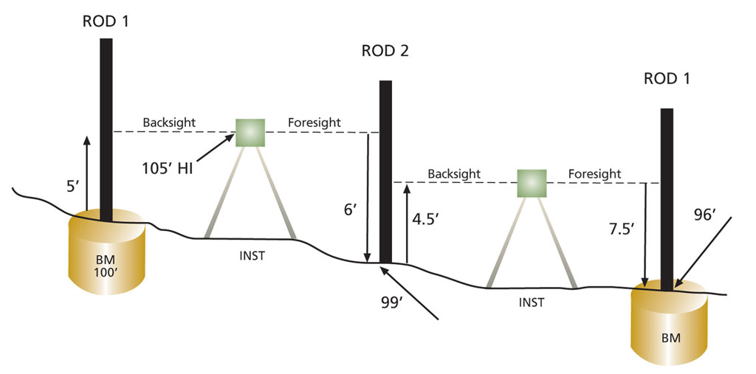
Leveling
Once you have a zero, or a datum, start walking inland with rulers
“Simply” keep track of accumulated height differences.
“First order” accuracy: 0.7mm/√km
You’re digging these jackets, aren’t you?

Slide 35
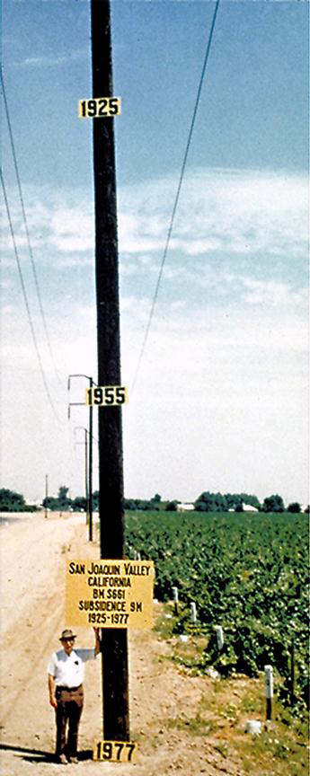
Problems with NAVD88
Benchmarks change (height, especially) or disappear with time:
  Hydrology – subsidence from ground water usage (10s of meters in California!)
  Cryospheric – glacial isostatic adjustment (post-glacial rebound)
  Earthquakes, volcanoes
  Pesky vandals…
It is only realized at the benchmarks it occupies. “New” points, or local survey control, must be leveled to an existing benchmark
So yeah, we’re going to need a fancy new sea level

Slide 36
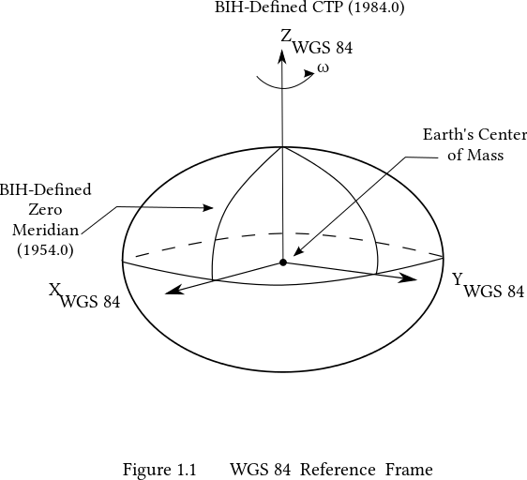
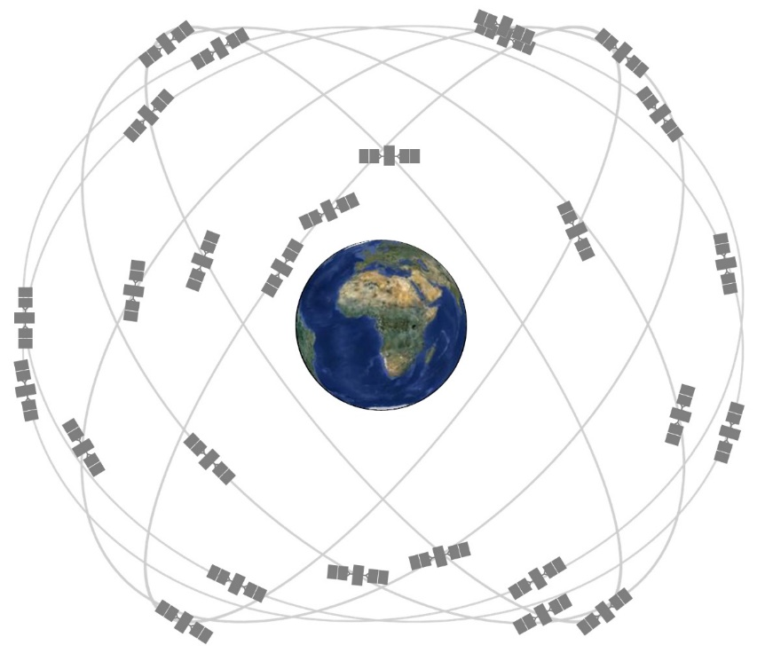
Start Over and Use Satellites! GPS and the Ellipsoid
Way out at the altitudes of GPS satellites (~20,000km), the Earth looks like a perfectly smooth, squished sphere called an ellipsoid. GPS allows for very accurate (~1cm) location determinations relative to this mathematically well-defined Ellipsoid.
The ellipsoid model currently used by GPS is WGS84. Its origin is located at the CM of the Earth.

Slide 37
Remember the Geoid? Yes, you do!
The Earth obviously has mountains and valleys, but even if there was enough water to cover all the land, the shape would be irregular. This is because the mass of the Earth isn’t distributed evenly – gravity is stronger in some places compared with others. The underwater mountains would pull water towards “peaks” until water stopped flowing.
Again, the resulting surface is “level” everywhere (W = constant).
This vale of W, at a global mean sea level, defines the geoid

Slide 38
Putting all these Surfaces Together
The actual, really jaggedy, surface of the earth – with mountains and canyons and climbing walls – that we see
The Ellipsoid, that GPS sees
The Geoid (easy to see if you look at the ocean surface), but is well defined under the continents too

Slide 39

H = h-N! That’s awesome. Thanks fancy new sea level!
“You” are Here
Earth’s Surface
Ellipsoid Height, h
From GPS
Orthometric Height, H
Mean Sea
Level
Alaska
Ellipsoid
Geoid Height, N
From NGS
Geoid
h - N = H
Note: Geoid height is negative in coterminous US, but is positive in most of Alaska

Slide 40
An Actual, Practical Example: Shorelines
Precise height determination is critical in low lying areas near water.
A tiny change in height can be a huge change in horizontal distance.
And tiny changes in gravity can cause water to flow where you don’t expect it to.
*gulp*

Slide 41
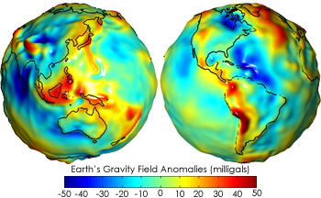

A few, minor, details….
Getting N_{G}, the geoid model, isn’t trivial…
  You’ve got to know the difference in true surface gravity from what you’d expect if the earth was a perfect ellipsoid. This is referred to as the gravity anomaly, ∆g.
  Then solve Stokes’ integral:
  Which also means you need to know ∆g over the entire surface of the earth (or, at least a continental-sized chunk of it…)
  (R is the mean radius of the earth, ɣ₀ is mean surface gravity on an equivalent ellipsoidal earth, S is an analytic (geometrical) function of position.)
So, how do we get Δg everywhere?...

Slide 42
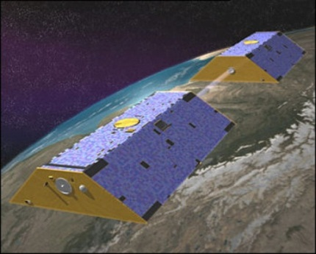
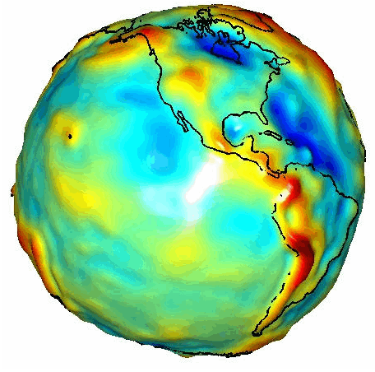
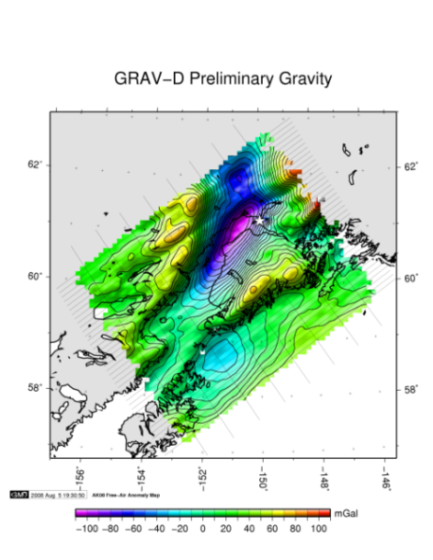
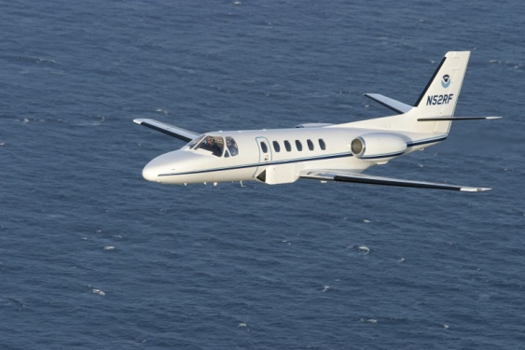
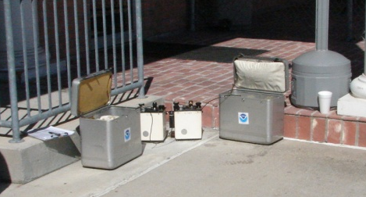
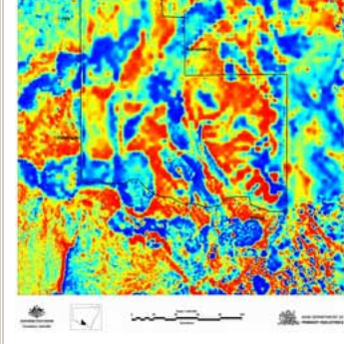
How to Build a Gravity Field, Δg
Long Wavelengths
(≥ 250 km)
GRACE/GOCE/Satellite Altimetry
+
Intermediate Wavelengths
(500 km to 20 km)
Airborne Measurement
+
Short Wavelengths
(< 100 km)
Surface Measurement and
Predicted Gravity from Topography

Slide 43
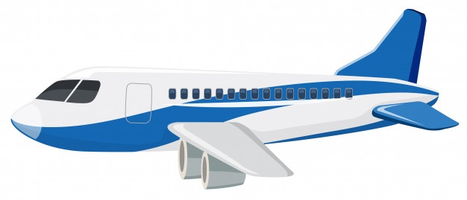
Airborne Gravimetry
a
a
a
g
g
g
The accelerations, a, of the aircraft are measured using GNSS. They are subtracted from what the gravimeter observes. The resultant is, g, the value of gravity at the aircraft position.
Notes:
Mention that the geoid is not an ellipsoid shape, but lumpier. Only 170m_pp though!

Slide 44
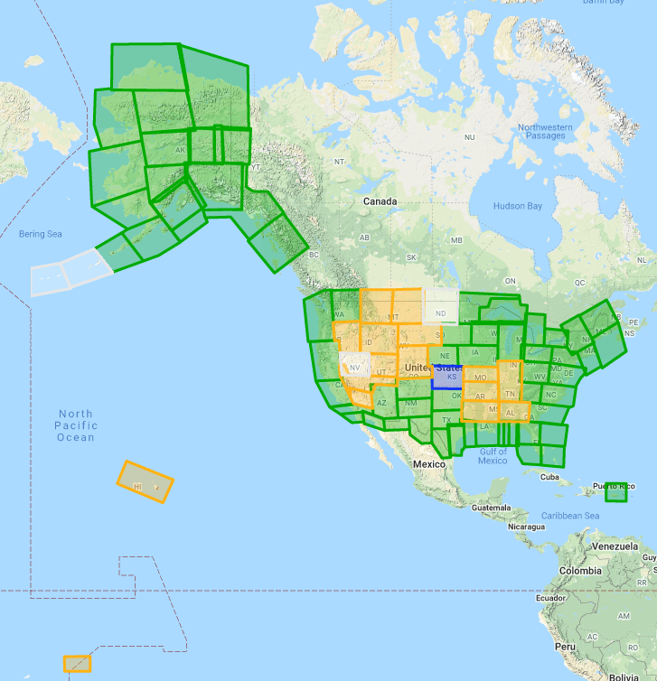
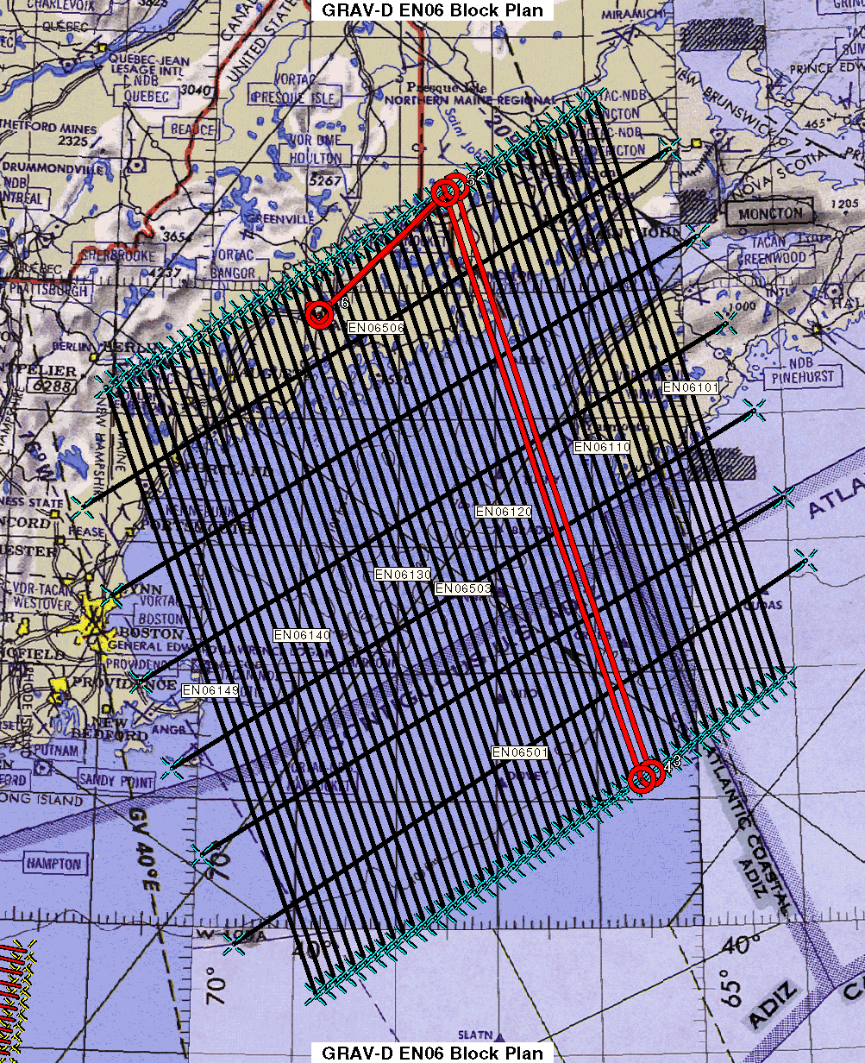
GRAV-D Status March 2020: 81%
Data lines spaced 10 km apart
Cross lines spaced 60-80 km apart (QC purposes)
Flight altitude 20,000 ft
Nominal speed 220-250 kts

Slide 45
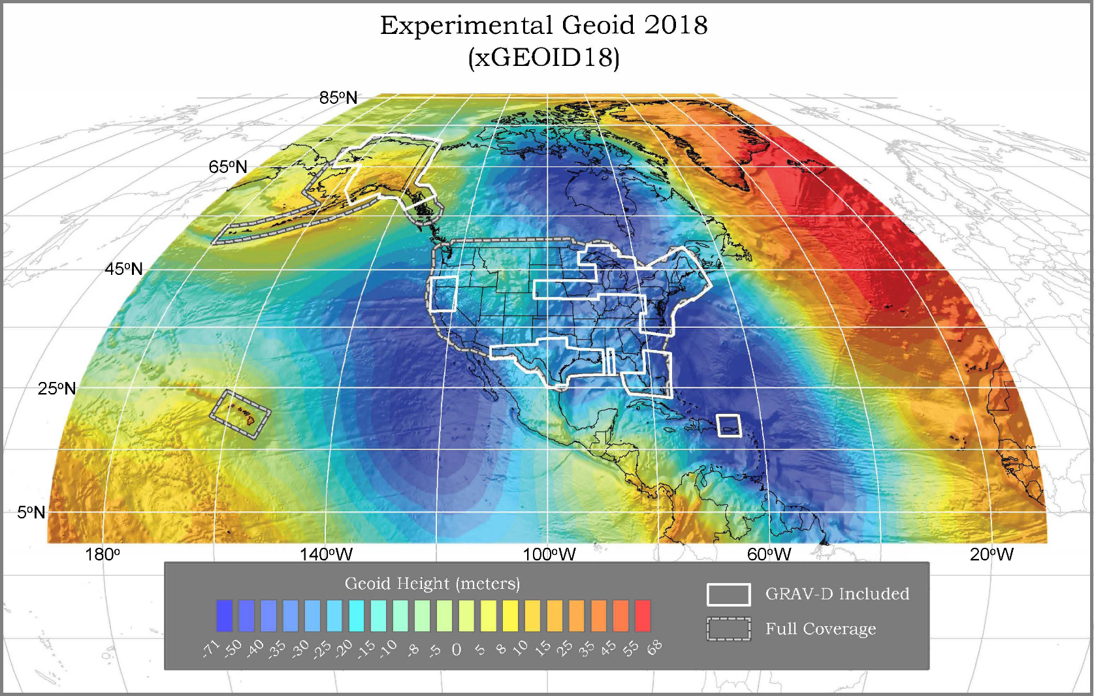
A Preview of the latest Geoid Model*
The gravity data from satellites, airborne, corrected surface data, and terrain predictions will be blended into a gravity anomaly field, ∆g, and then used to calculate geoid undulations, N_{G}.
Methods for blending will be tested to prepare for 2022
Available on the Website: http://beta.ngs.noaa.gov/GEOID/xGEOID/
*xGEOID19 to be released soon

Slide 46
Other uses of Terrestrial Gravity at NGS
Gravity prediction tool. We incorporate ground data to improve our gravity models and for quality control purposes.
Gravity for leveling – remember it’s the combination of height and gravity that water “sees”. We use models of surface gravity to correct raw leveling data.
Improved geoid models. These will become important as NGS ramps up the Geoid Monitoring Service (GeMS) project – keeping track of change in the geoid over time.

Slide 47

The Future: Networked Atomic “Optical” Clocks
Einstein’s (he’s back!) theory of general relativity indicates that when any clock is operated at a location “higher” than another it will be observed to run faster.
It’s actually true: Time flies when you’re high, dude.
$$\frac{Δf}{f}=\frac{gΔh}{c2}$$

Slide 48
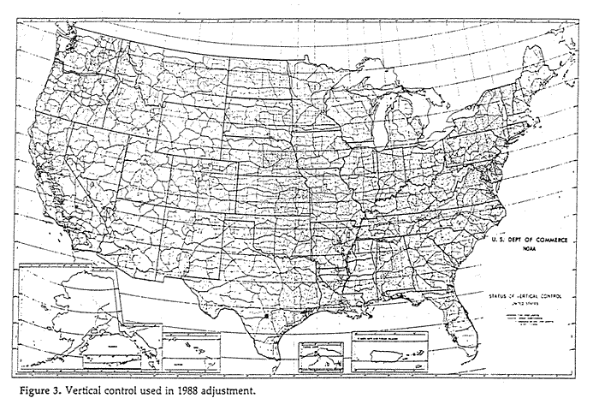
Networked Atomic “Optical” Clocks cont.
Linking identical clocks between different locations gives an instant measure of the difference in geopotential.
“Inland Tide Gauges”
Clocks accurate to 1 part in 10¹⁸ can differentiate between heights of 1cm
The goal for JILA/NIST (Boulder) clocks is 1 part in 10²⁰ (or 100µm)!
Linking has been demonstrated over 100s of km, but not 1000 (intercontinental distances) yet
Practical in 5 years? 10 years?

Slide 49
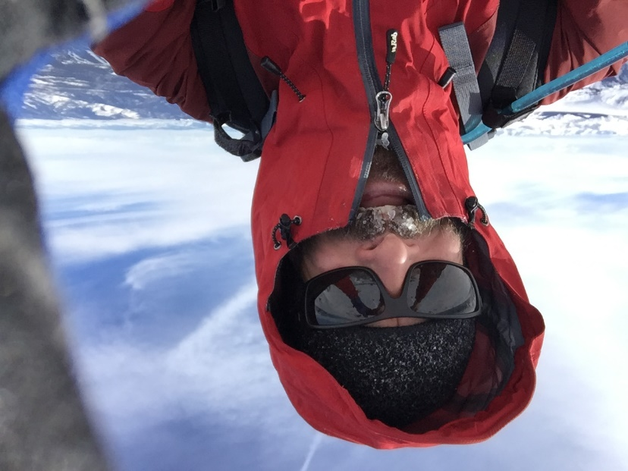
Thank you!
Questions, comments?
Please don’t hesitate to contact me: derek.vanwestrum@noaa.gov
BTW, its height looks set to drop a couple o’ feet…
Summit of Quandary Peak, Colorado. December, 2013

Slide 50
Absolute Gravity “Networks” Today
Currently there are over 100 absolute gravity meters in the world (about 100 from Micro-g LaCoste alone)
What need is there for a traditional, worldwide network if each absolute measurement is a “network” unto itself?
The current IAG strategy, in conjunction with the Consultative Committee on Mass (CCM) at the CIPM (International Center for Weights and Measures) is to create an absolute database, Agrav*, of all absolute measurements (volunteer basis)
The instruments are tied to absolute standards (and thus each other) through validations and calibrations at international or regional comparisons. (ICAGs and xCAGs)
*http://agrav.bkg.bund.de/agrav-meta/

Slide 51
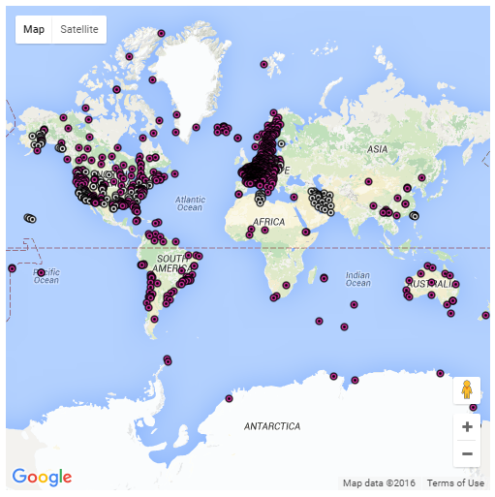
Agrav Holdings (2016)

Slide 52
Absolute comparisons – how we know these things work!
First comparison of seven absolute gravity meters was performed at BIPM (Sevres, France) 1981.
International comparisons every four years, regional comparisons every two years.
Key comparisons and pilot studies.
  Key comparison is validation between certified metrological institutes (equivalent to comparing kilogram standards owned by different government agencies). Goal is to verify uncertainties
  Pilot studies are comparisons and/or calibrations of non-metrological institutes’ instruments (geodesists, for example…)
Least-squares reduction of various meters on various piers over various days provides “degree of equivalence” between instruments measured in µGals.
Typical agreement ~3 µGals

Slide 53
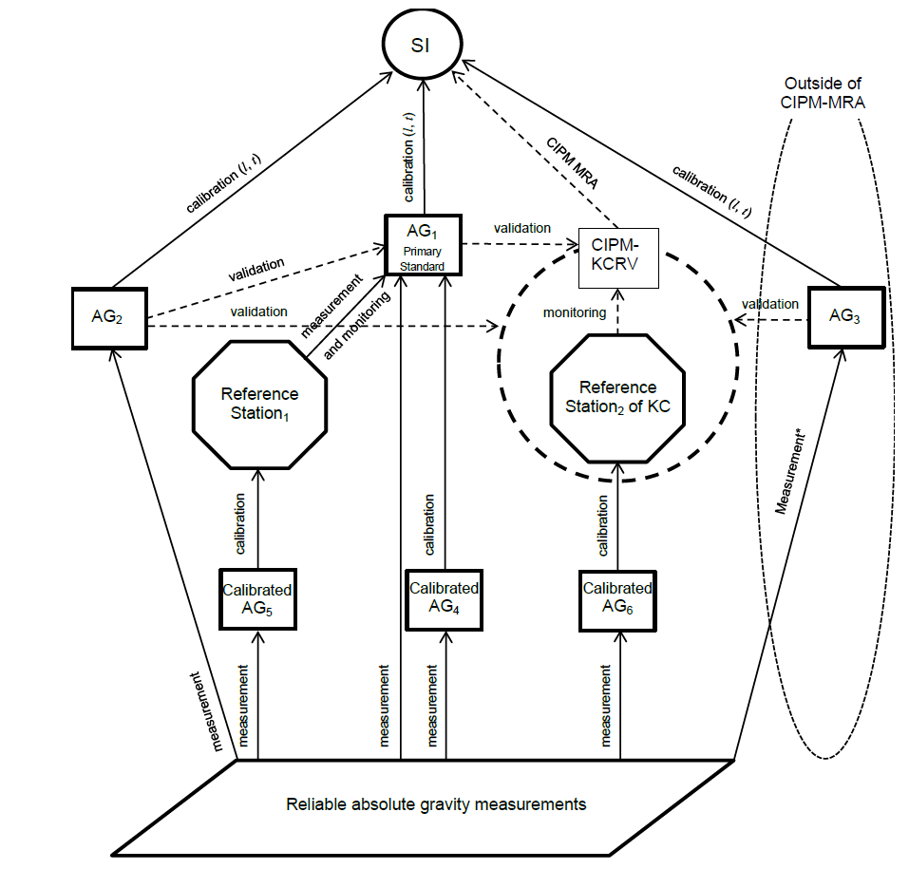
Absolute Comparisons
http://www.bipm.org/wg/CCM/CCM-WGG/Allowed/2015-meeting/CCM_IAG_Strategy.pdf

Slide 54
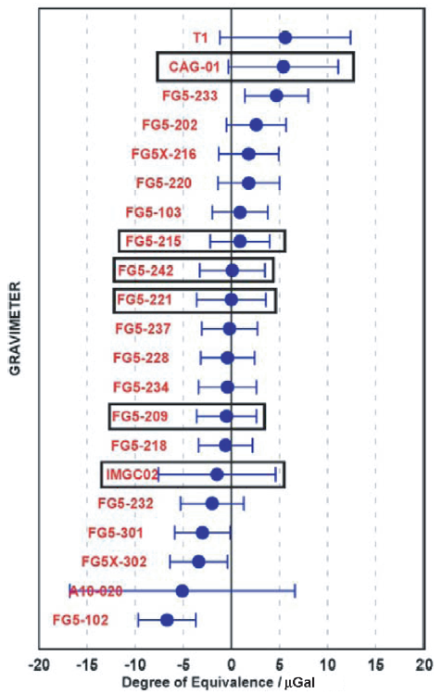
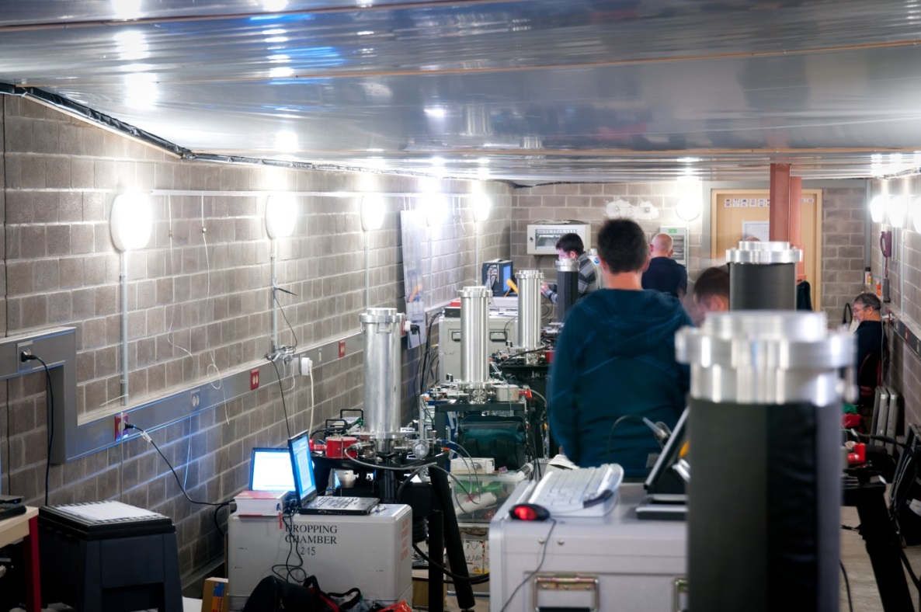
Absolute Comparison Results
ICAG2011 Luxembourg results: σ=3.1µGal

Slide 55



Regional Comparison Example
North American Comparison of Absolute Gravimeters (NACAG) at TMGO
  1995, 1997, 2010, 2014, 2016
2016 will be the first certified by the CIPM
10 piers, ~10 instruments, 7 countries, 5 days*
*Details pending…

Slide 56

Table Mountain Geophysical Observatory (TMGO)
Isolated location ~15km north of Boulder, Colorado
Over 20 years of gravity (permanent SG, A10, FG5X, and relative meter calibration base

Slide 57
Going Forward:
The International Gravity Reference Frame
Wziontek and Wilmes: “The global gravity reference system is [now] realized by a network of ‘gravity gauges’ connected by AG comparisons.”
Mean, worldwide accuracy of ~5 µGal
Regional comparisons for temporal stability and consistency
Local ad hoc networks as necessary (absolute and/or relative)

