Slide 1
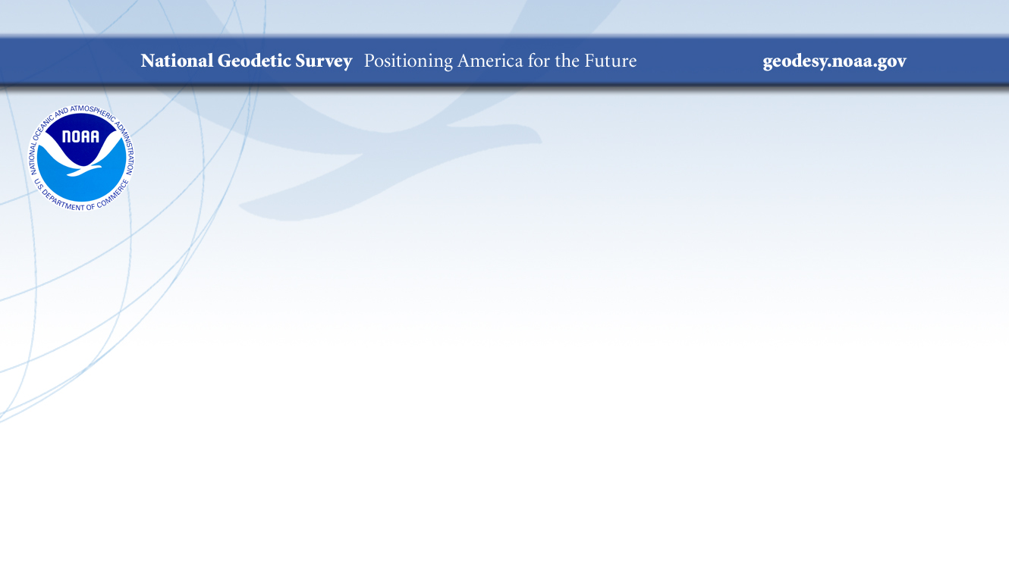
How Do Absolute Gravity Meters Work,
and How Do We Know They Work?
Derek van Westrum, Ph.D.
NGS Spatial Reference Systems Division
derek.vanwestrum@noaa.gov
NOAA’s National Geodetic Survey
geodesy.noaa.gov

Slide 2


A Bit About Me
I’m Derek van Westrum
I’ve been a physicist with NOAA’s National Geodetic Survey for 10 years
I’m located in Boulder, Colorado
I measure gravity
I spent 15 years before NGS making gravity meters
I ride bikes and climb mountains (and so I think about gravity a lot…)
Hi, I’m Derek!

Slide 3
Outline
A short background on gravity and some definitions
How NGS Uses Gravity
Okay, so apparently measuring gravity is “a thing”. How do you do it?
  Types of gravity meters
  And how they work
How we know they work? Head-to-head comparisons
How this helps the community(ies): metrology and geodesy

Slide 4
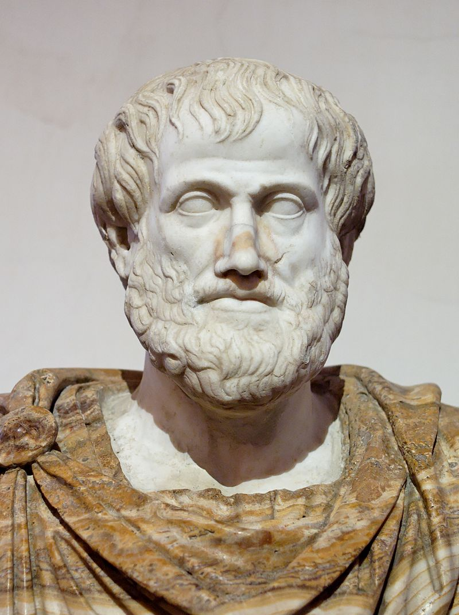
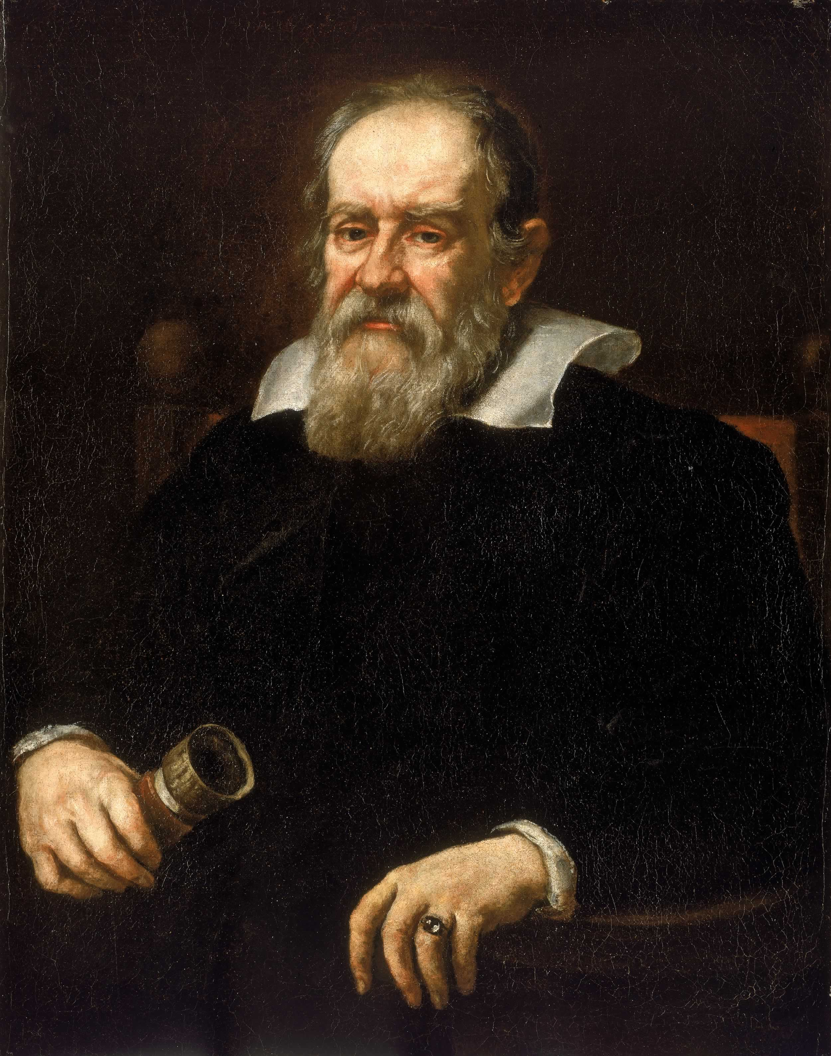
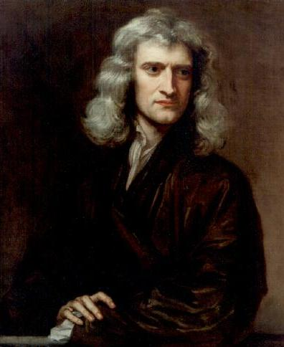
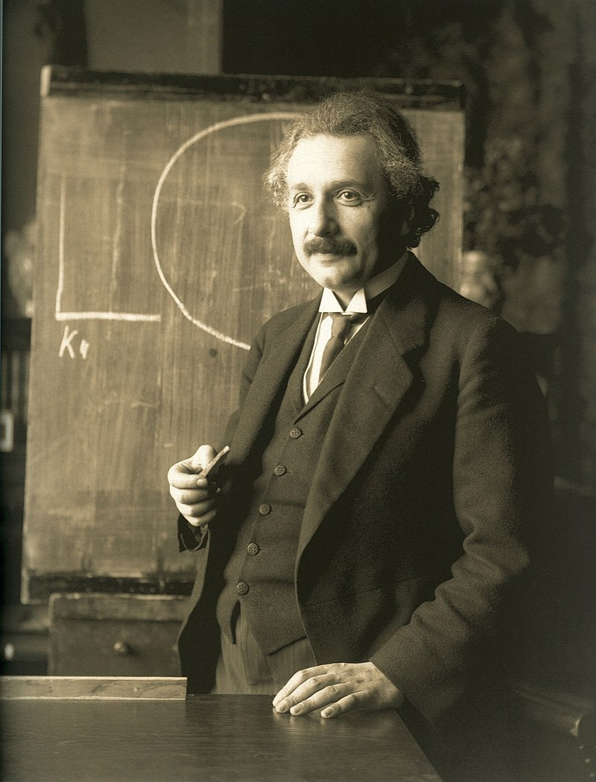
Gravity Descriptions Throughout History (Western Civ. Version…)
Humans have set out to answer “what is gravity” for centuries:
Aristotle (300 BCE): Objects fall at a speed proportional to their weight and inversely proportional to the density of the fluid they are immersed in.
Galileo (~1600): Used (thought!) experiments to demonstrate that objects accelerate due to gravity at the same rate, regardless of mass. (More later)
Newton (1687): Inverse square law of universal gravitation. Objects attract each other with a force proportional to their masses, and inversely proportional to the square of the distance between them.
Einstein (1907-1915): The theory of General Relativity describes a space-time continuum which is curved by the presence of masses.
Not actually that crazy!

Slide 5
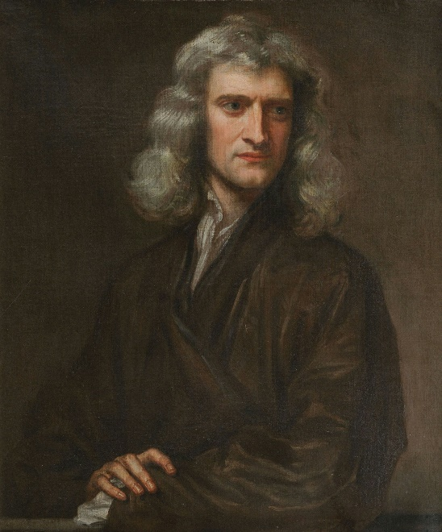
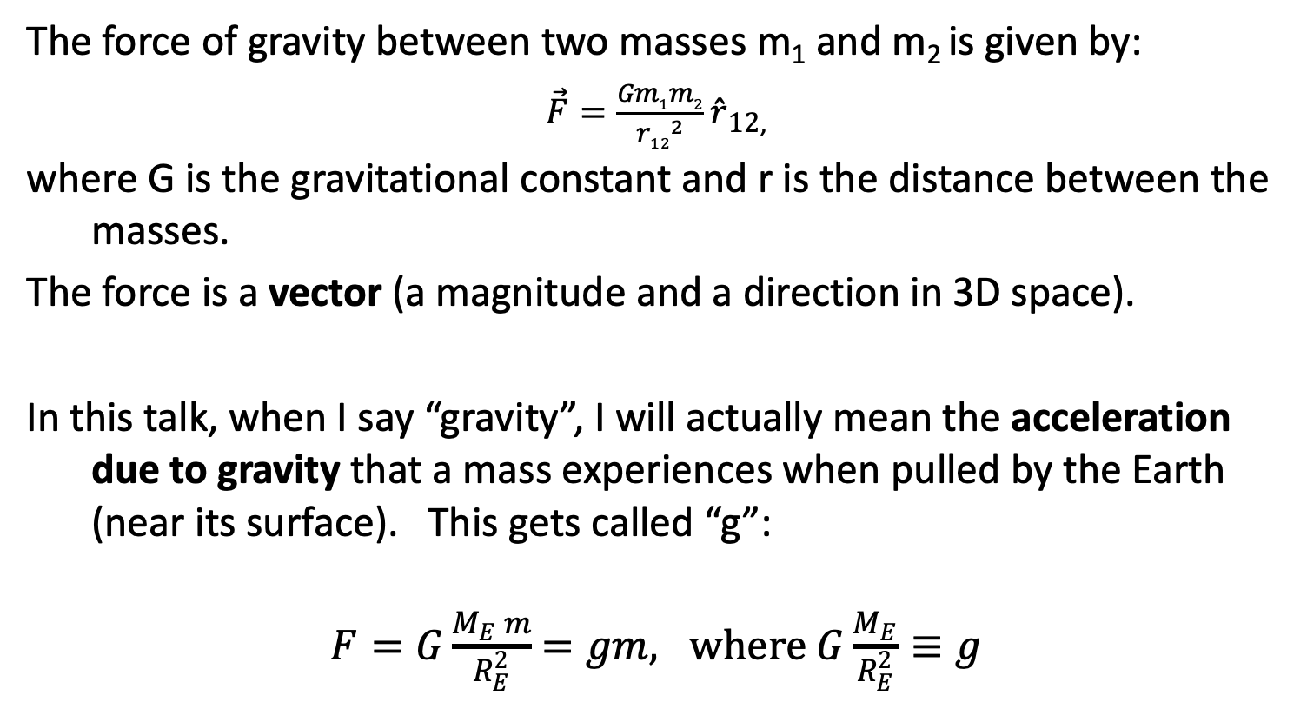
Background: Force of Gravity
The force of gravity between two masses m₁ and m₂ is given by:
$\vec{F}=\frac{Gm1m2}{{r12}^{2}}\hat{r}12$,
where G is the gravitational constant and r is the distance between the masses.
The force is a vector (a magnitude and a direction in 3D space).
In this talk, when I say “gravity”, I will actually mean the acceleration due to gravity that a mass experiences when pulled by the Earth (near its surface). This gets called “g”:
$F=G\frac{M_{E} m}{R_{E}^{2}}$ $=gm, where$ $G\frac{M_{E}}{R_{E}^{2}}≡g$
The most dashing portrait of Isaac Newton I could find…

Slide 6
Aside: Basic (Archaic…) Gravity Units
Acceleration of gravity on the Earth’s surface, g ≈ 9.8 m/s²
1 Gal ≡ 1 cm/s²
So, g ≈ 980 Gal
Absolute gravity meters typically measure to 1 to 10 μGal:
1 μGal = 1x10⁻⁶ Gal= 1x10⁻⁸ m/s²,
or about 1 part per billion of the acceleration of gravity!
A real life example: g (at TMGO, north of Boulder, CO) = 9.79 622 743 m/s²
Lifting the gravity meter up just 3mm reduces this digit by 1!
mGal digit (the 6th)
μGal digit (the 9th)

Slide 7
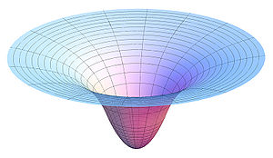
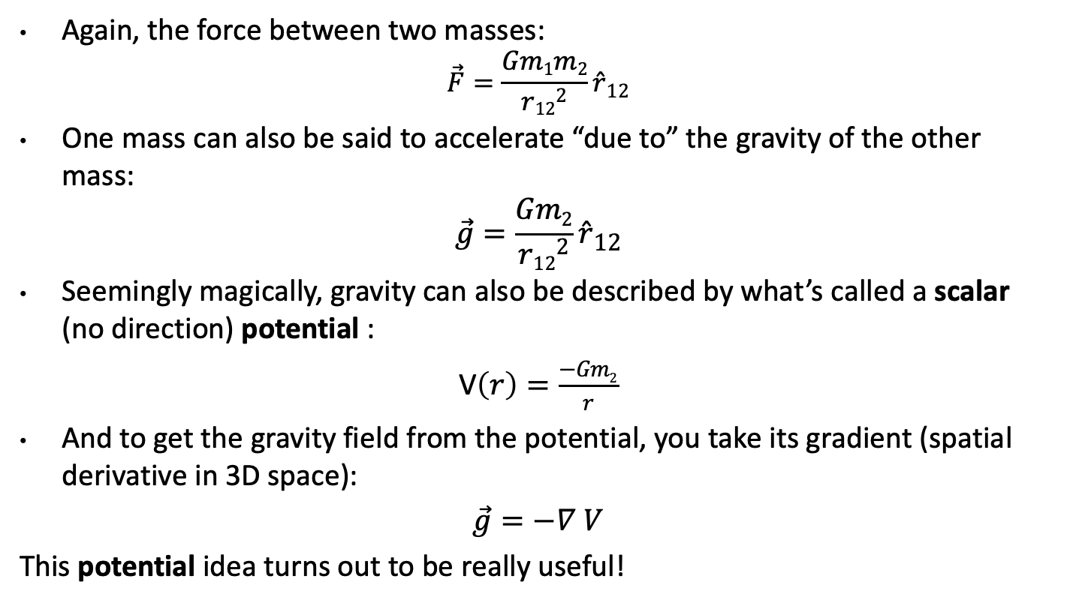


A Closer Look at Newtonian Gravity
Again, the force between two masses:
$$\vec{F}=\frac{Gm1m2}{{r12}^{2}}\hat{r}12$$
One mass can also be said to accelerate “due to” the gravity of the other mass:
$$\vec{g}=\frac{Gm2}{{r12}^{2}}\hat{r}12$$
Seemingly magically, gravity can also be described by what’s called a scalar (no direction) potential :
V$\left(r\right)=\frac{−Gm2}{r}$
And to get the gravity field from the potential, you take its gradient (spatial derivative in 3D space):
$\vec{g}=−∇$ $V$
This potential idea turns out to be really useful!
$$m2$$
$$m1$$

Slide 8
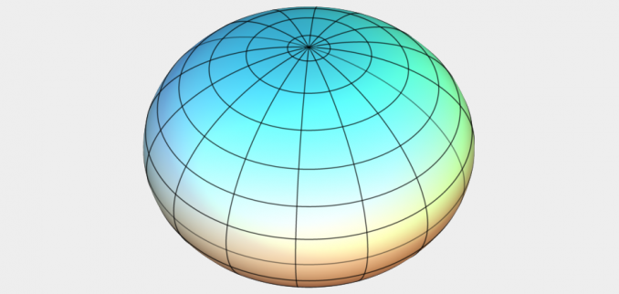
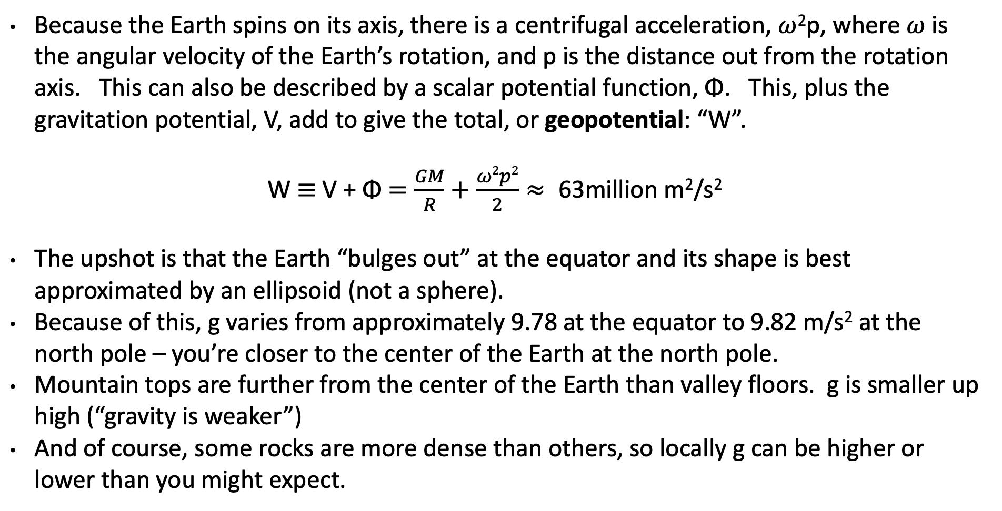
Earth’s Gravity (Newton-style)
No idea why it’s called W
Because the Earth spins on its axis, there is a centrifugal acceleration, $ω$²p, where $ω$ is the angular velocity of the Earth’s rotation, and p is the distance out from the rotation axis. This can also be described by a scalar potential function, Φ. This, plus the gravitation potential, V, add to give the total, or geopotential: “W”.
W $≡$ V + Φ $=\frac{GM}{R}+\frac{ω2p2}{2}≈ \text{63}\text{million} \text{m}\text{2}\text{/}\text{s}\text{2}$
The upshot is that the Earth “bulges out” at the equator and its shape is best approximated by an ellipsoid (not a sphere).
Because of this, g varies from approximately 9.78 at the equator to 9.82 m/s² at the north pole – you’re closer to the center of the Earth at the north pole.
Mountain tops are further from the center of the Earth than valley floors. g is smaller up high (“gravity is weaker”)
And of course, some rocks are more dense than others, so locally g can be higher or lower than you might expect.

Slide 9
Understanding “Potential” Part 1
h
The resting water has “potential” energy just by being high up on this cliff.
That potential energy can turn into real (kinetic) energy by falling.
Think of the Earth as creating a “gravity field” that masses experience. I’ve drawn potential “field lines”
Energy = mgh
Energy = ½ mv² (= mgh)
Potential = gh
Gravity x Height is “Geopotential”. This is what water “feels”.
Notes:
Mention that the geoid is not an ellipsoid shape, but lumpier. Only 170m_pp though!

Slide 10
Understanding “Potential” Part 2
Imagine pouring water onto a dry lake bed. If everything is level it will simply pool up. It would “like” to get to lower potential (darker lines), but the lake bed is in the way.
If the lake bed is tilted (it’s now the side of a hill), the water can move towards lower potential (towards darker lines). Water appears to flow because of a change in height
If the lake bed appears flat, but there is a mass anomaly under one end, the resulting geopotential difference causes water to flow to lower potential (again, from light to dark lines). It appears to flow because of gravity.
Exaggerated (!), but you can imagine a scenario where the height difference and gravity attraction “conspire” to keep the water still on the side of a hill!
In all scenarios, water only flows when it has a path to lower geopotential – this is always a combination of gravity and height, g x H.
Notes:
Mention that the geoid is not an ellipsoid shape, but lumpier. Only 170m_pp though!

Slide 11
Properties of Earth’s Gravity Field, W
Each line around the Earth is where W is equal to some constant.
It’s a surface of constant geopotential enveloping the Earth.
Water doesn’t flow along a surface – remember, they’re level.
There are infinitely many level surfaces. They are not necessarily parallel to each other, but never intersect.
Up close they’re lumpy blobs, but farther out they become more and more ellipsoidal.
Plumb lines are always perpendicular to every surface they intersect.
There is one level surface that, on average, best matches sea level – it’s called the Geoid. Remember that one!
Incidentally, here’s the Ellipsoid. It’ll come in handy later – it’s what the GNSS satellites “see”.
Notes:
Mention that the geoid is not an ellipsoid shape, but lumpier. Only 170m_pp though!

Slide 12
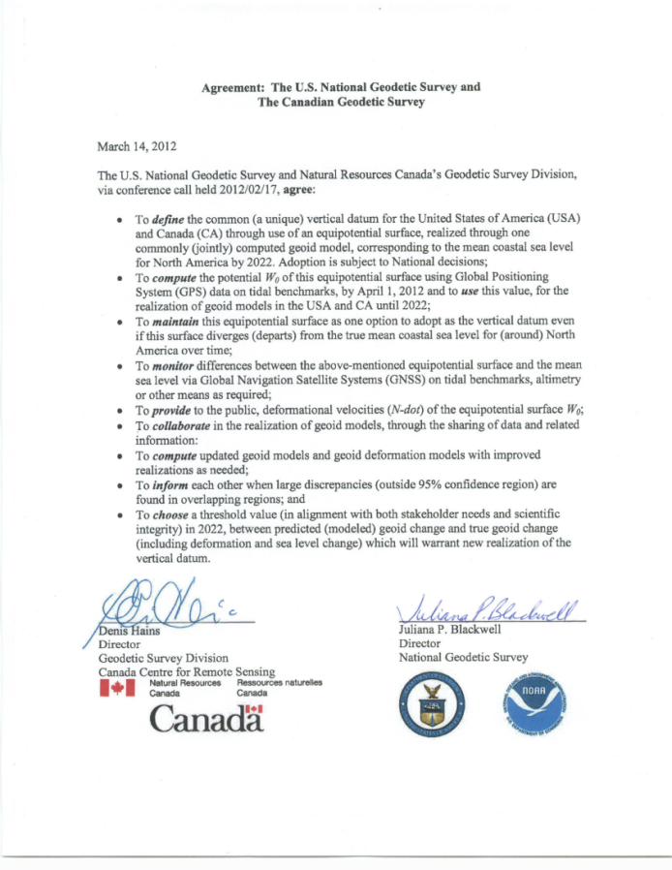
Wait, one last detail!
We still have to pick the W value that best matches “sea level” – at least in our region of the globe. This defines specifically which geopotential surface is the geoid.
That’s the fancy new sea level, right there*
W₀ ≡ 62,636,856.0 m²/s²
(Note: W₀ ~ GM_{e}/R_{e}. The above definition effectively defines the combination of the gravitational constant and the mass and radius of the Earth, convenient for North America.)
The North American-Pacific Geopotential Datum of 2022 (NAPGD2022) will contain information for:
  N, the geoid undulation (GEOID2022 – purely gravity)
  Gravity anomalies (GRAV2022)
  Orthometric heights
  Deflections of the vertical (DEFLEC2022)
  & other gravity field information (GM2022)
*Subject to change in roughly 2025…

Slide 13
Okay, so gravity is apparently important for “correcting” heights to better predict where water will flow. How does this work in practice?

Slide 14

All about Heights!
H = h-N! That’s awesome. Thanks fancy new sea level!
“You” are Here
Earth’s Surface
Ellipsoid Height, h
From GPS
Orthometric Height, H
Mean Sea
Level
Alaska
Ellipsoid
Geoid Height, N
From NGS
Geoid
h - N = H
Note: Geoid height is negative in coterminous US, but is positive in most of Alaska

Slide 15
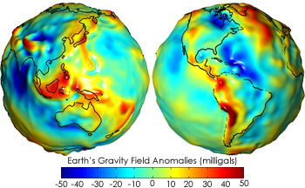
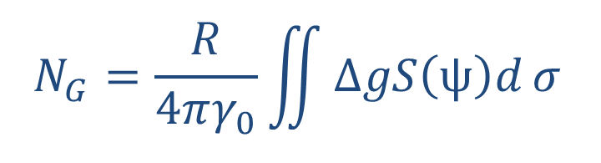
To get Orthometric Heights, We Need the Undulation…
Getting N_{G}, the geoid model, isn’t trivial…
  You’ve got to know the difference in true surface gravity from what you’d expect if the earth was a perfect ellipsoid. This is referred to as the gravity anomaly, ∆g.
  Then solve Stokes’ integral:
N_{G}
  Which also means you need to know ∆g over the entire surface of the earth (or, at least a continental-sized chunk of it…)
  (R is the mean radius of the earth, ɣ₀ is mean surface gravity on an equivalent ellipsoidal earth, S is an analytic (geometrical) function of position.)
So, how do we get Δg everywhere?...

Slide 16
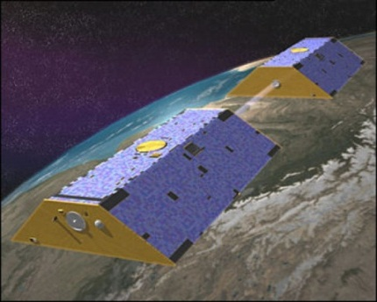
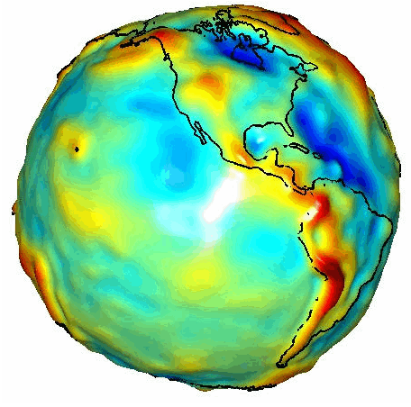
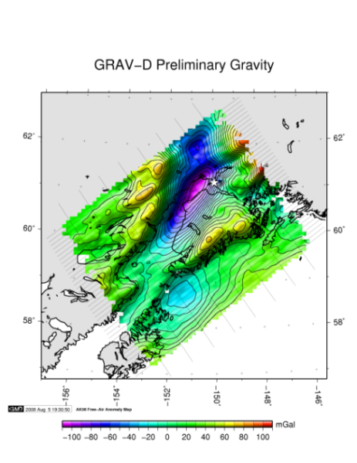
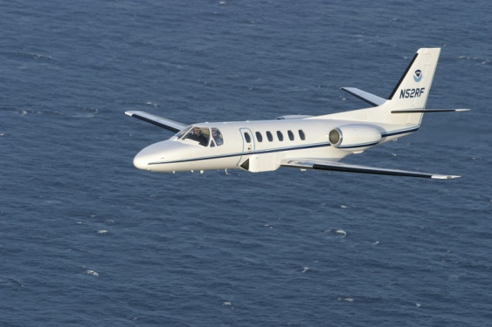
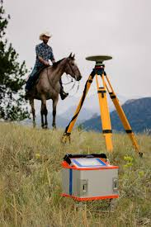
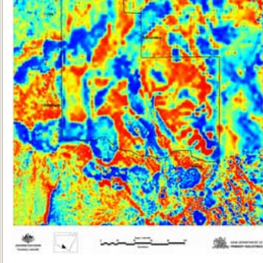
To Get the Undulation We Need the Gravity Anomaly, Δg
Long Wavelengths
(≥ 250 km)
GRACE/GOCE/Satellite Altimetry
+
Intermediate Wavelengths
(500 km to 20 km)
Airborne Measurement
+
Short Wavelengths
(< 100 km)
Surface Measurements and
Predicted Gravity from Topography

Slide 17
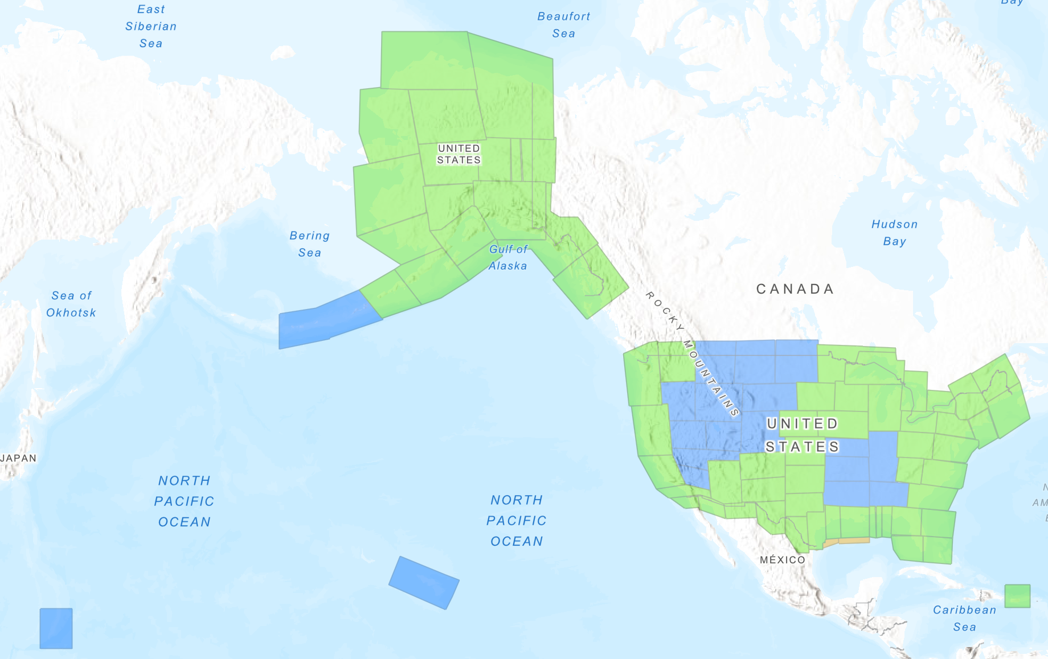
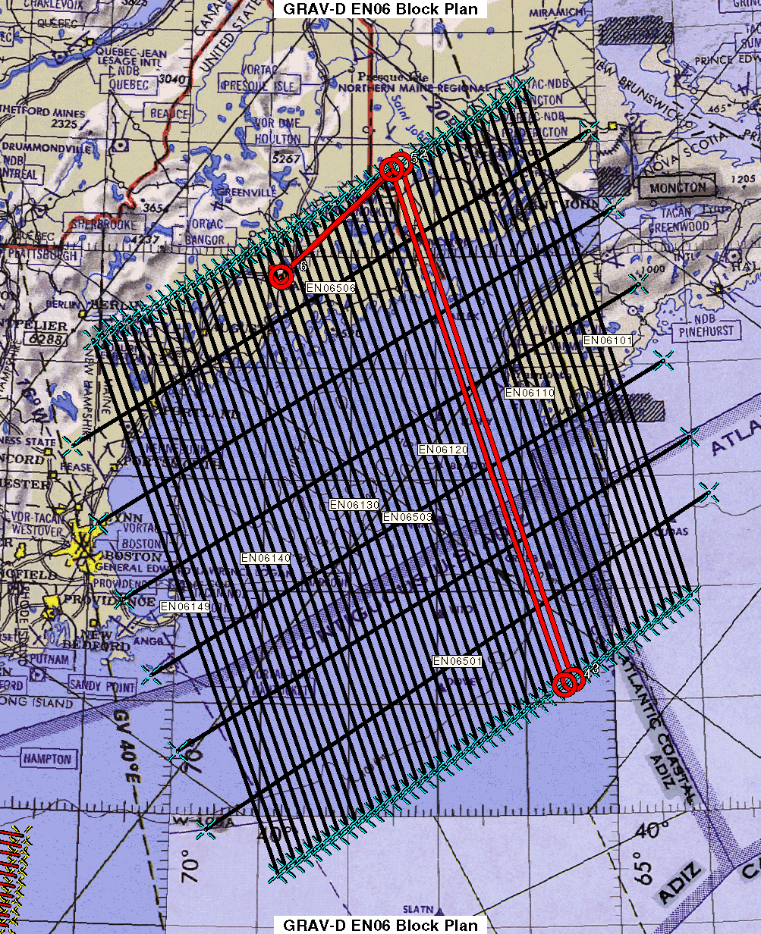
GRAV-D Status April 2024: 100%
Data lines spaced 10 km apart
Cross lines spaced 60-80 km apart (QC purposes)
Flight altitude 20,000 ft
Nominal speed 220-250 kts
All blocks have completed data collection. Green blocks have published data and blue are still being processed

Slide 18

Airborne Gravimetry
a
a
a
g
g
g
The accelerations, a, of the aircraft are measured using GNSS. They are subtracted from what the gravimeter observes. The resultant is, g, the value of gravity at the aircraft position.
Notes:
Mention that the geoid is not an ellipsoid shape, but lumpier. Only 170m_pp though!

Slide 19
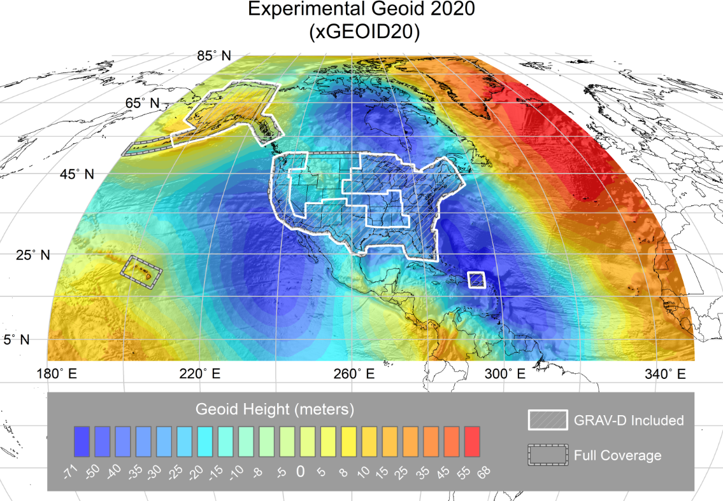
And Finally, The Undulation: The Latest “Beta” Geoid Model
Think of this as a picture of how sea level undulates – even under land masses.
Available on the Website: http://beta.ngs.noaa.gov/GEOID/xGEOID/

Slide 20
An Actual, Practical Example: Shorelines
Precise height determination is critical in low lying areas near water.
A tiny change in height can be a huge change in horizontal distance.
And tiny changes in gravity can cause water to flow where you don’t expect it to.
*gulp*

Slide 21
Other uses of Terrestrial Gravity at NGS
Gravity prediction tool. We incorporate ground data to improve our gravity models and for quality control purposes.
Gravity for leveling – remember it’s the combination of height and gravity that water “sees”. We use models of surface gravity to correct raw leveling data.
Improved geoid models. These will become important as NGS ramps up the Geoid Monitoring Service (GeMS) project – keeping track of change in the geoid over time.

Slide 22
Okay cool, so gravity is interesting and important.
How do we measure it?

Slide 23
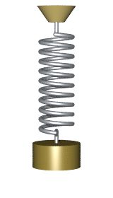
It’s all Relative, Absolutely!
Absolute gravity meters measure the acceleration of an object and are tied to standards of length and time. This gives you the actual, “full field” value of g. State of the art instruments are good to 1-2µGal.
Relative gravity meters are fundamentally different. They measure specific force (not acceleration) and tell you the difference in g between two locations and/or at one location over time. Typically, some sort of mass on a spring. The spring stretches more when g is larger: kx = mg. State of the art instruments can resolve 1-2µGal.

Slide 24
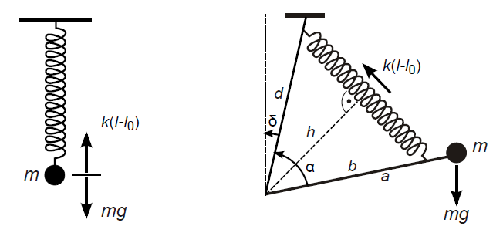
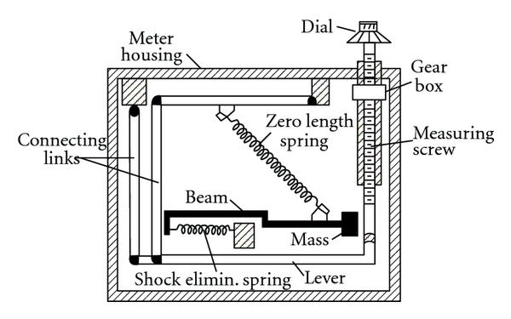

Relative Instrument Principles
LaCoste & Romberg g-Meter
The force of gravity stretches a calibrated spring, and the displacement is proportional to gravity. Roughly: g ~ (k/m)x
Geometric “tricks” (zero length springs) allow a small change in gravity to cause a larger displacement of the test mass.
Modern systems use an electric force to keep the mass position fixed, and the electric force required is proportional to gravity.
Both the spring and feedback unit must be calibrated and are subject to drift and offsets (tares) over time.

Slide 25
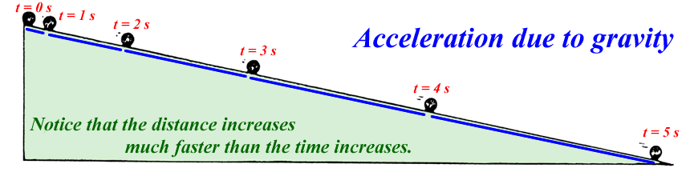

Absolute Gravity Meters
Mark distances along the slope and note position at time intervals
g is measured “directly” in meters / second²
First absolute gravity instruments were Galileo’s inclined planes
x
θ
Note that if θ = 90⁰, x = ½ gt², the usual freefall equation.
Galileo cleverly slowed time down (to accurately time things) by tilting the vertical way over on its side…

Slide 26
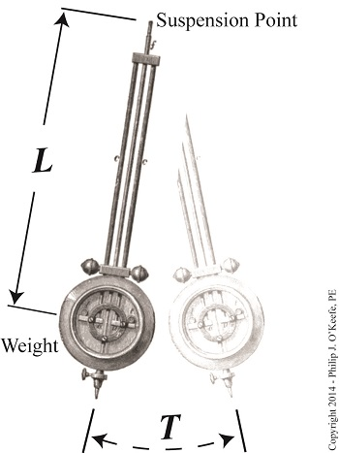

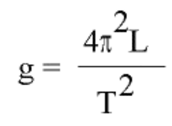
Pendulums
For small angles the period of pendulum is independent of the angle. They make good clocks.
1656. Huygens makes a pendulum clock
1749. Bouguer measures g. Again, note we just need length and time
1817. Kater introduces the reversible pendulum
(Kater also introduces relative gravity: keep L fixed and ∆g ~ ∆T⁻²)
Vacuum chambers and multiple pendulums were state of the art through 1940s.
Best accuracy ~100 µGal
Eventually spring gravity meters had significantly better precision, indicating problems and “absolute offsets” in the pendulum results

Slide 27
FG5 Principle of Operation
Vacuum
Chamber
Freefalling
Upper Mirror
Interferometer
Interference
A freely falling reflective test mass is dropped in a vacuum. This causes optical fringes to be detected at the output of an interferometer. This signal is used to determine the local gravitational acceleration.
Detector
Stationary Lower
Mirror

Slide 28
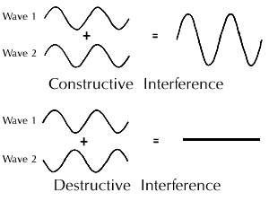
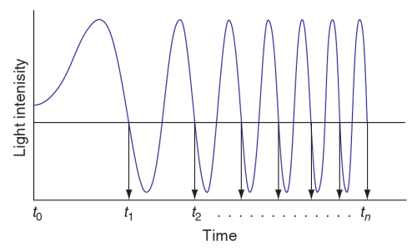
Interferometry
MAX
λ/2
min
λ, the wavelength of the laser light, can be tied to absolute atomic transitions frequencies.
Photodiode
Laser
B.S.
Fringes
fringe signal sweeps in frequency as test mass falls under influence of gravity
time recorded (w.r.t. rubidium oscillator) at each zero crossing, creating (t,x) pairs at every λ/2
Michelson’s interferometer

Slide 29
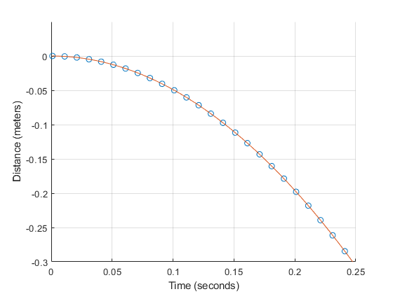
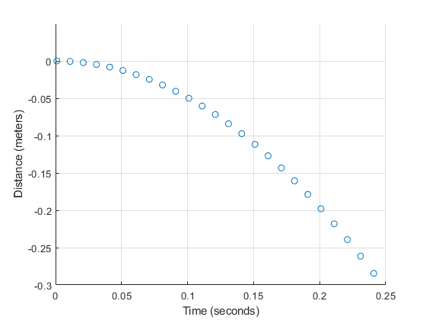
g Determination
Needles to say: computers help a lot here…
Fringe = l/2 x_{i}
For each x_{i} , a measured time t_{i,}
The following function is fitted to the data x_{i} , t_{i} :
x_{i} , t_{i} , i = 1, …,700
γ is the vertical gravity gradient (~3 µGal/cm),
c the speed of light
x₀ the initial position
v₀ the initial velocity
g₀ the initial acceleration

Slide 30
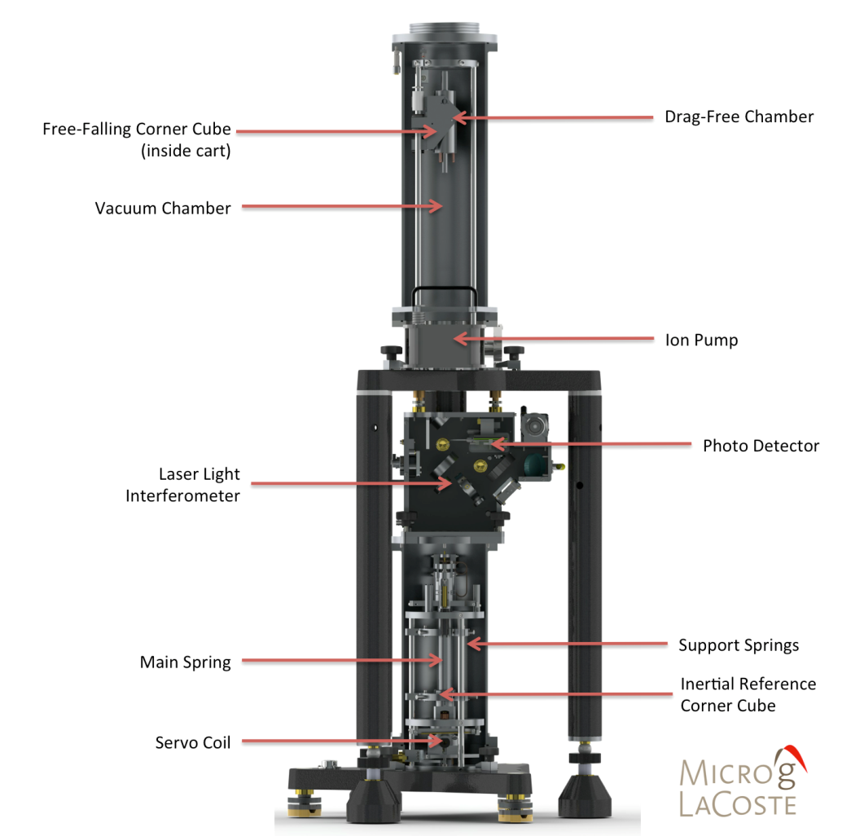

Slide 31
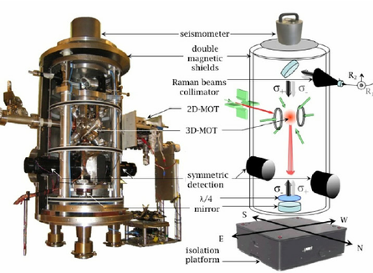
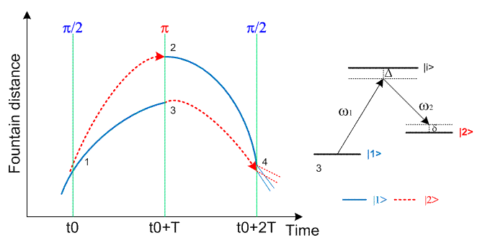
Cold Atom Gravimeters
Also a free fall method, but the role of matter and light is reversed: atoms are split into two paths, and light is used to form “mirrors” and “beam splitters”
Length and time standards are still provided by ties to atomic transitions
Advantages: no recoil force into the ground (low noise), no moving parts, fast and continuous measurements

Slide 32
Standard Corrections in Absolute Accuracy
Absolute measurements routinely corrected for
  Earth tides (changing shape of dry earth due to sun and moon)
  Ocean loading (loading on continental plates due to sloshing of oceans from earth tides)
  Barometric pressure changes (more or less mass above the instrument)
  Polar motion (changes in centrifugal acceleration as the earth’s axis changes orientation)
All are known to about 1-2 µGal, and these uncertainties add in quadrature
Other phenomena can affect gravity meters at this level
  Water table fluctuations
  Volcanic activity
  Subsidence, uplift
To get to sub-µGal accuracies, it becomes necessary to monitor small and complicated signals and/or create complex models
  For example: barometric loading (tilt caused by differential atmospheric loading across a continental plate) can be observed, but is very difficult to model accurately

Slide 33
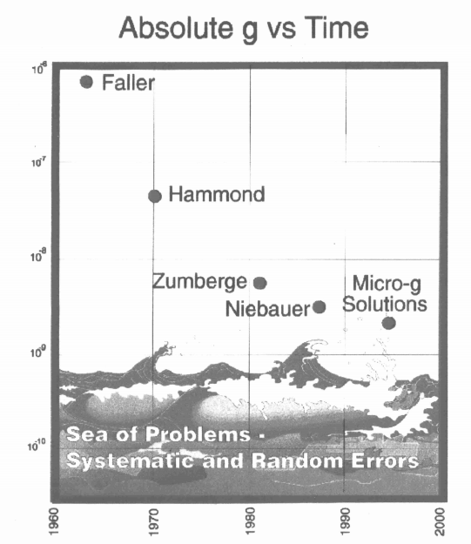
Jim Faller’s “Sea of Problems”
Lotsa folks making absolute gravity meters over the years. Who’d a thought?
10⁻⁶
10⁻⁷
10⁻⁸
Meaningful accuracies below 1µGal are hard to come by…
10⁻⁹
10⁻¹⁰
2025…

Slide 34
Okay, so how do we know these things work?
First comparison of seven absolute gravity meters was performed at BIPM (Sevres, France) 1981.
International comparisons every four years, regional comparisons every two years.
Key comparisons and pilot studies.
  Key comparison is validation between certified metrological institutes (equivalent to comparing kilogram standards owned by different government agencies). Goal is to verify uncertainties
  Pilot studies are comparisons and/or calibrations of non-metrological institutes’ instruments (geodesists, for example…)
Least-squares reduction of various meters on various piers over various days provides “degree of equivalence” between instruments measured in µGals.
Typical agreement ~3 µGals

Slide 35
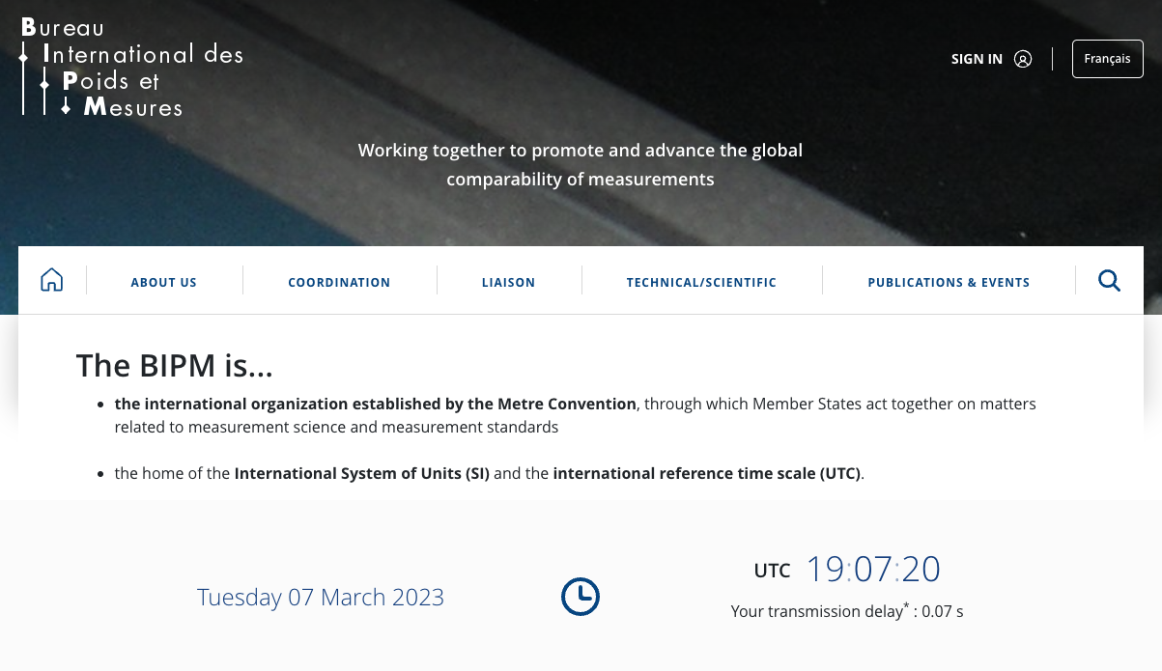
Aside: Metrology and the BIPM
Metrology is the science of measurement. Who knew?
The holy temple of metrology is the BIPM in Sevres, France (near Paris)
With help from lots of national agencies, they define the second, the meter, the kilogram, the volt, the ohm…

Slide 36
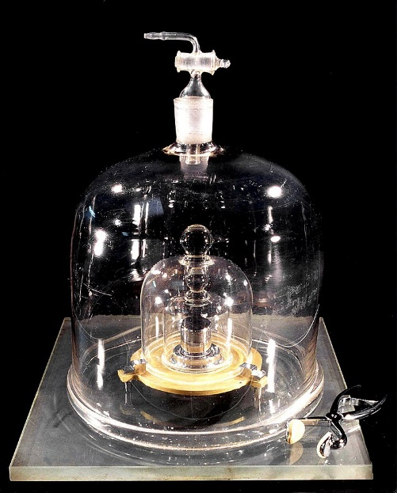
Metrology - How do we know these things work?
There is no perfect instrument, and there is no location on Earth where we know the value of g perfectly. What to do?
In principle, any absolute meter should measure the same value of g (within its instrumental uncertainty) at a given time and place. Let’s compare them!
A simple example of a “Key Comparison” was the kilogram. This lump of platinum housed at the BIPM* near Paris was THE kilogram – by definition – for over 100 years. It’s official name was the “International Prototype”.
Other agencies would bring their kilogram samples to Paris for direct comparisons (placing them on each side of a balance) every 4 years or so. They would then take their offset, relative to the prototype, back to their home country for further, national/regional comparisons.
p
2
2
p
This was replaced with something way more complicated in 2019
Side A
Side B
Side A
Side B
Test 1
Test 2

Slide 37
Back to Comparing Absolute Instruments…
Comparing instruments is inherently different from comparing artefacts. There is no “golden” (or, er, platinum?) instrument that gives the “true answer”.
In principle, any instrument can have a small, but persistent offset (within its uncertainty).
Worse, if you want to compare two gravity meters, you still can’t put them in the exact same place at the same time!
What to do?
Answer: Measure, change locations, and repeat!
There’s the metrology
1
2
3
3
1
2
2
3
1
Pier A
Pier B
Pier C
Pier A
Pier B
Pier C
Pier A
Pier B
Pier C
Day 1
Day 2
Day 3

Slide 38
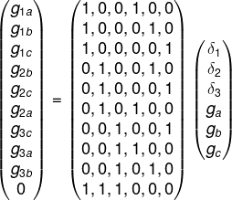
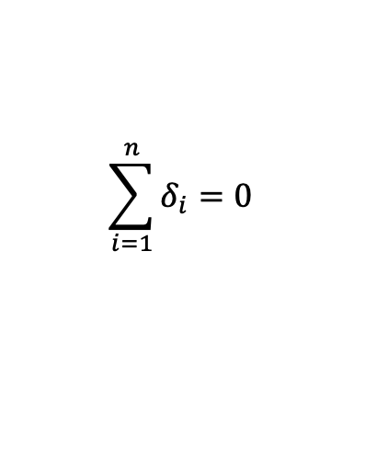
Absolute Instrument Comparisons – cont.
If the value from instrument 1 is consistently higher than 2 from pier to pier, and say 2 is similarly higher than 3, then we know how much 1 should be above 3, right?
But each measurement will have some uncertainty and “noise”… The results may not even be self-consistent!
Least-squares analysis to the rescue! We write that the value of g measured by the ith instrument on pier j is:
g_{ij} = g_{j} + δ_{i} +ε_{ij}
g_{A}
where δ_{i} is a (possible) instrument offset, and ε_{ij} is the measurement uncertainty.
1
$$\sum_{i=1}^{n}{δ_{i}}=0$$
Note that the offsets for each instrument have to add to zero:
Pier A
g_{B}
2
Plug and chug, and the LSA spits out:
best estimate of each instrument’s offset relative to the overall mean:
  δ₁ , δ₂ , and δ₃
the best estimate of the “true” gravity values on Piers A, B, and C
Pier B
g_{C}
3
Pier C

Slide 39
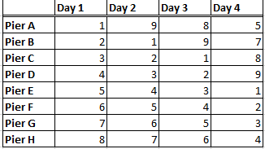
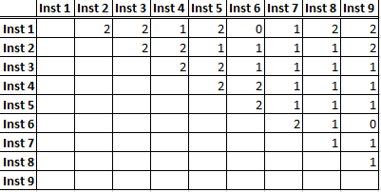
(And there’s even more math…)
Of course, this also has a fancy name: Combinatorics
3 instruments on 3 piers over 3 nights is a pretty simple comparison
What if you have 8 instruments on 8 piers over 4 nights?
Or 9 instruments on 8 piers over 4 nights?
Who measures where, when?
Getting the maximum overlap of all instruments is crucial!
We* have software for that! Here are the 9,8,4 results:
The optimal schedule:
The resulting # of overlaps between instruments:
The statistics of the overlaps:
*Dru and Derek came up with some independent – but consistent! – code for this way back in 2015…

Slide 40
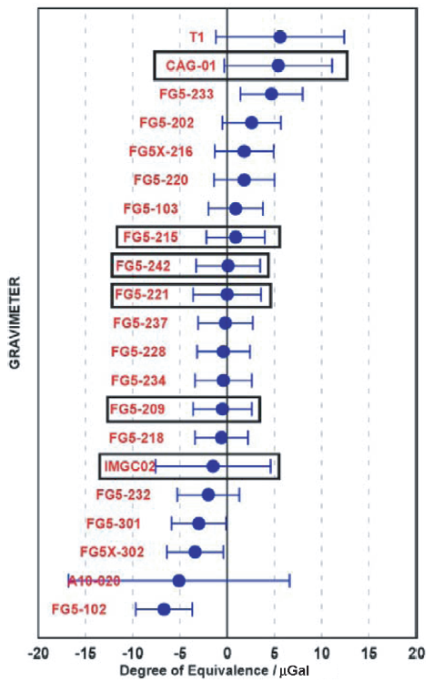
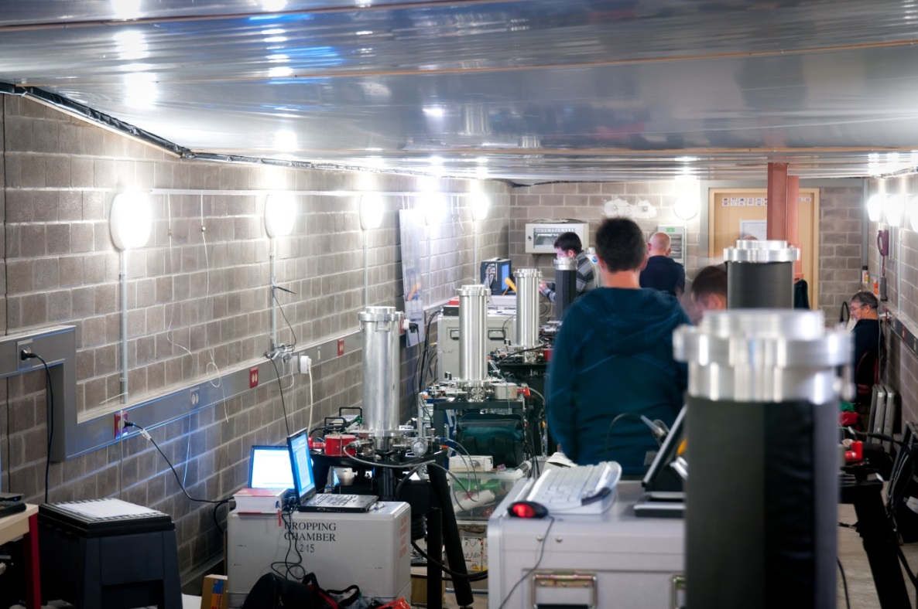
Example of Absolute Comparison Results
This all took place about a mile underground in an old gypsum mine!
ICAG2011 Luxembourg results:
21 instruments
σ=3.1µGal

Slide 41
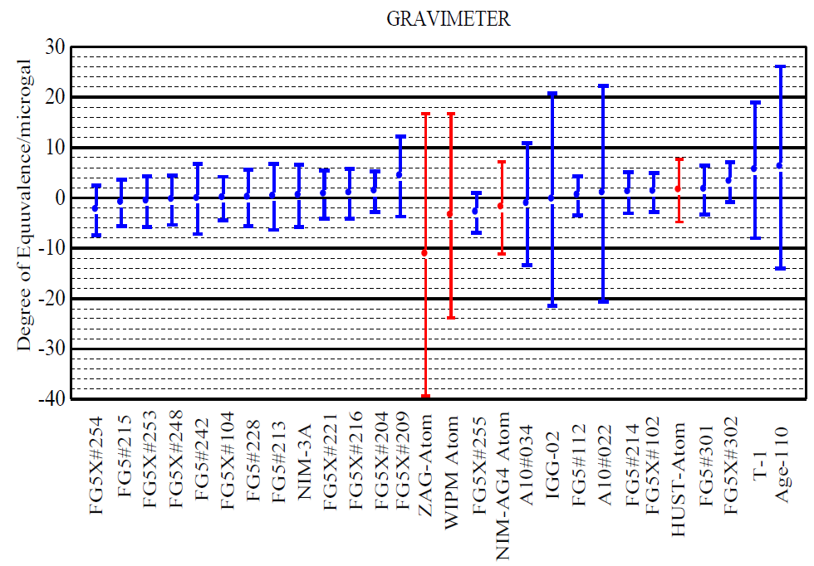
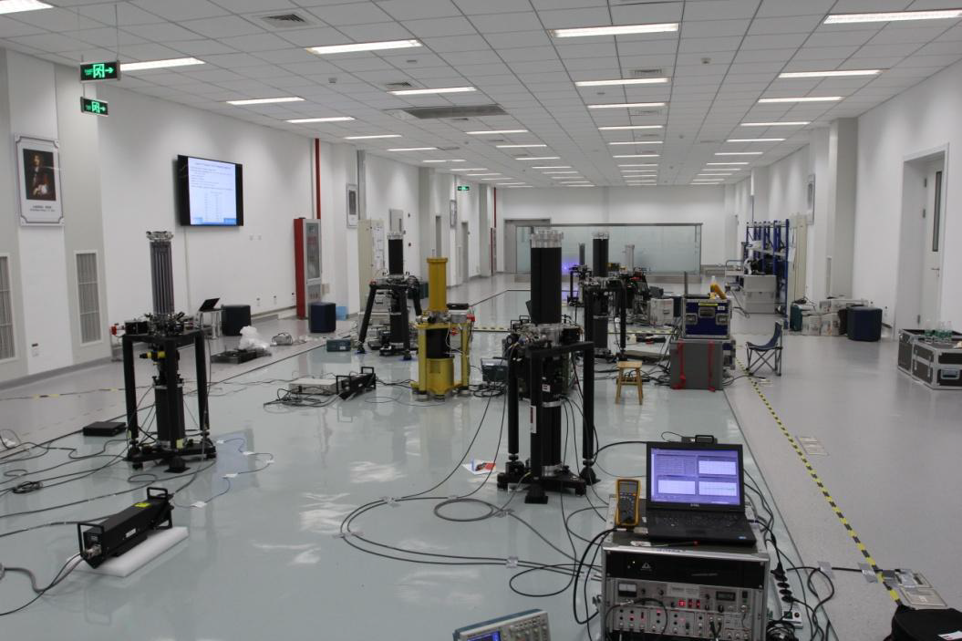
Another Example…
And this all took place in a brand new facility built just for ICAG17!
ICAG2017 Beijing results:
28 instruments
σ=2.0µGal

Slide 42
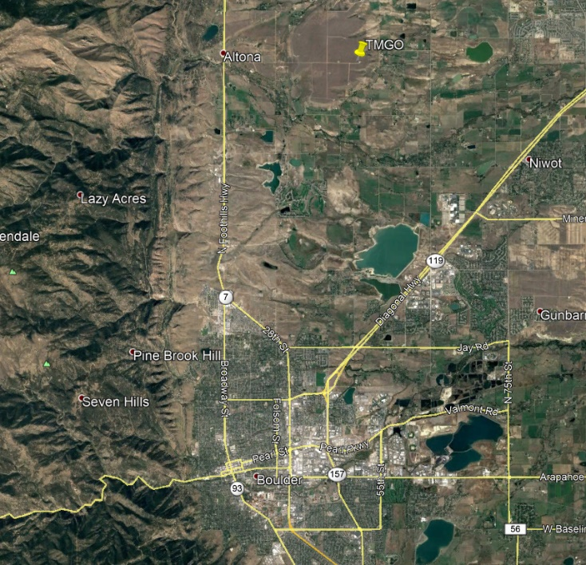
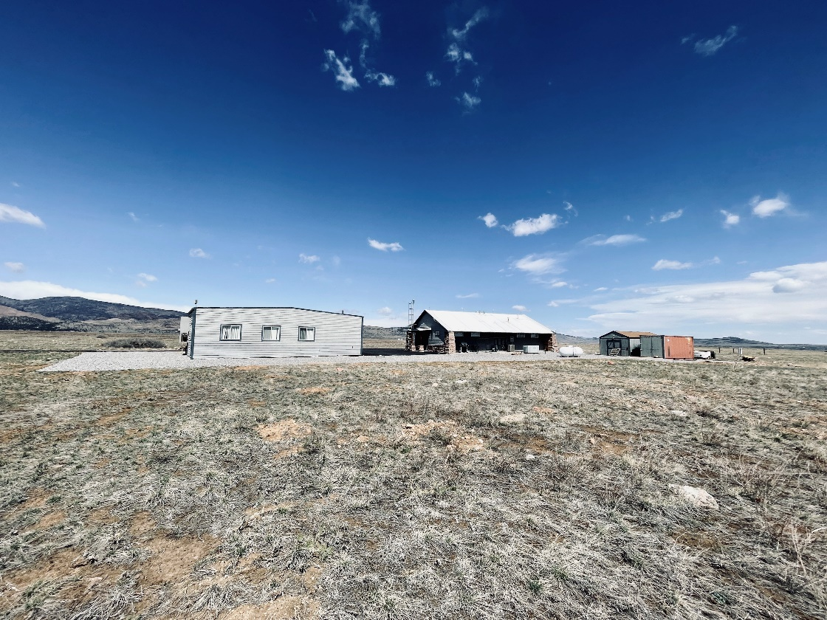
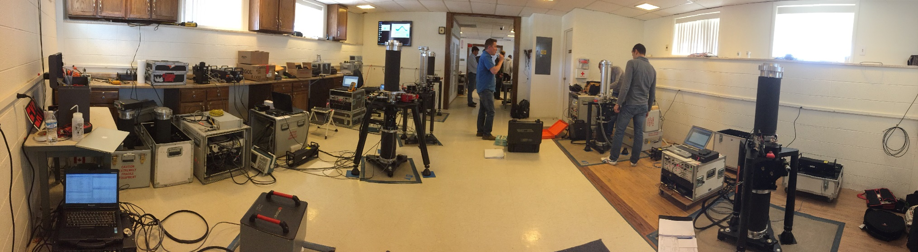
The Latest ICAG was at Table Mountain, Boulder Colorado
First in 7 years!
Pilot Laboratory: NIST
Site Host: NOAA-NGS
30 instruments participated
23 different countries!
5 weeks of measurements
Boulder, Colorado, USA

Slide 43
TMGO Pier Layout
North
Counter and Cabinets
~1m²
gPhoneX(s)
AJ
AI
AQ
AN
AO
AP
AS
AT
AG
AH
bathroom
utility

Slide 44
Comparison “Overlap” Statistics
The schedule had to accommodate
Up to 8 instruments per week
Occupying 8 piers
4 nights of observations per week, over 5 weeks (20 nights)
Instrument Overlaps
1 | 2 | 3 | 4 | 5 | 6 | 7 | 8 | 9 | # | 11 | 12 | 13 | 14 | 15 | 16 | 17 | 18 | 19 | 20 | 21 | 22 | 23 | 24 | 25 | 26 | 27 | 28 | 29 | 30
2 | 2 | 2 | 1 | 2 | 1 | 3 | 3 | 1 | 1 | 2 | 2 | 2 | 2 | 3 | 3 | 2 | 1 | 2 | 2 | 3 | 3 | 1 | 1 | 2 | 3 | 3 | 1 | 1 | 2
3 |  | 2 | 2 | 2 | 2 | 2 | 3 | 3 | 1 | 1 | 2 | 2 | 2 | 3 | 3 | 2 | 2 | 2 | 2 | 2 | 3 | 3 | 1 | 1 | 2 | 3 | 3 | 1 | 1
4 |  |  | 2 | 2 | 1 | 2 | 2 | 3 | 3 | 1 | 1 | 2 | 2 | 2 | 3 | 2 | 3 | 2 | 2 | 2 | 2 | 3 | 3 | 1 | 2 | 2 | 3 | 3 | 1
5 |  |  |  | 2 | 2 | 2 | 2 | 2 | 3 | 3 | 1 | 1 | 2 | 1 | 2 | 1 | 3 | 1 | 2 | 2 | 2 | 2 | 3 | 3 | 2 | 2 | 2 | 3 | 3
6 |  |  |  |  | 1 | 2 | 1 | 2 | 2 | 2 | 1 | 2 | 4 | 3 | 2 | 2 | 1 | 2 | 4 | 2 | 1 | 2 | 2 | 2 | 2 | 1 | 2 | 2 | 2
7 |  |  |  |  |  | 1 | 2 | 2 | 2 | 2 | 3 | 3 | 1 | 1 | 1 | 3 | 2 | 3 | 1 | 1 | 2 | 2 | 2 | 2 | 1 | 2 | 2 | 2 | 2
8 |  |  |  |  |  |  | 2 | 1 | 2 | 2 | 2 | 1 | 2 | 3 | 3 | 1 | 2 | 1 | 2 | 4 | 2 | 1 | 2 | 2 | 4 | 2 | 1 | 2 | 2
9 |  |  |  |  |  |  |  | 2 | 1 | 2 | 2 | 2 | 1 | 2 | 3 | 2 | 2 | 2 | 1 | 2 | 4 | 2 | 1 | 2 | 2 | 4 | 2 | 1 | 2
10 |  |  |  |  |  |  |  |  | 2 | 1 | 2 | 2 | 2 | 2 | 2 | 2 | 3 | 2 | 2 | 1 | 2 | 4 | 2 | 1 | 1 | 2 | 4 | 2 | 1
11 |  |  |  |  |  |  |  |  |  | 2 | 1 | 2 | 2 | 1 | 2 | 2 | 3 | 2 | 2 | 2 | 1 | 2 | 4 | 2 | 2 | 1 | 2 | 4 | 2
12 |  |  |  |  |  |  |  |  |  |  | 2 | 1 | 2 | 1 | 1 | 1 | 2 | 1 | 2 | 2 | 2 | 1 | 2 | 4 | 2 | 2 | 1 | 2 | 4
13 |  |  |  |  |  |  |  |  |  |  |  | 2 | 1 | 2 | 1 | 2 | 2 | 2 | 1 | 2 | 2 | 2 | 1 | 2 | 2 | 2 | 2 | 1 | 2
14 |  |  |  |  |  |  |  |  |  |  |  |  | 2 | 2 | 2 | 4 | 1 | 4 | 2 | 1 | 2 | 2 | 2 | 1 | 1 | 2 | 2 | 2 | 1
15 |  |  |  |  |  |  |  |  |  |  |  |  |  | 3 | 2 | 2 | 1 | 2 | 4 | 2 | 1 | 2 | 2 | 2 | 2 | 1 | 2 | 2 | 2
16 |  |  |  |  |  |  |  |  |  |  |  |  |  |  | 3 | 2 | 1 | 2 | 3 | 3 | 2 | 2 | 1 | 1 | 3 | 2 | 2 | 1 | 1
17 |  |  |  |  |  |  |  |  |  |  |  |  |  |  |  | 2 | 2 | 2 | 2 | 3 | 3 | 2 | 2 | 1 | 3 | 3 | 2 | 2 | 1
18 |  |  |  |  |  |  |  |  |  |  |  |  |  |  |  |  | 1 | 4 | 2 | 1 | 2 | 2 | 2 | 1 | 1 | 2 | 2 | 2 | 1
19 |  |  |  |  |  |  |  |  |  |  |  |  |  |  |  |  |  | 1 | 1 | 2 | 2 | 3 | 3 | 2 | 2 | 2 | 3 | 3 | 2
20 |  |  |  |  |  |  |  |  |  |  |  |  |  |  |  |  |  |  | 2 | 1 | 2 | 2 | 2 | 1 | 1 | 2 | 2 | 2 | 1
21 |  |  |  |  |  |  |  |  |  |  |  |  |  |  |  |  |  |  |  | 2 | 1 | 2 | 2 | 2 | 2 | 1 | 2 | 2 | 2
22 |  |  |  |  |  |  |  |  |  |  |  |  |  |  |  |  |  |  |  |  | 2 | 1 | 2 | 2 | 4 | 2 | 1 | 2 | 2
23 |  |  |  |  |  |  |  |  |  |  |  |  |  |  |  |  |  |  |  |  |  | 2 | 1 | 2 | 2 | 4 | 2 | 1 | 2
24 |  |  |  |  |  |  |  |  |  |  |  |  |  |  |  |  |  |  |  |  |  |  | 2 | 1 | 1 | 2 | 4 | 2 | 1
25 |  |  |  |  |  |  |  |  |  |  |  |  |  |  |  |  |  |  |  |  |  |  |  | 2 | 2 | 1 | 2 | 4 | 2
26 |  |  |  |  |  |  |  |  |  |  |  |  |  |  |  |  |  |  |  |  |  |  |  |  | 2 | 2 | 1 | 2 | 4
27 |  |  |  |  |  |  |  |  |  |  |  |  |  |  |  |  |  |  |  |  |  |  |  |  |  | 2 | 1 | 2 | 2
28 |  |  |  |  |  |  |  |  |  |  |  |  |  |  |  |  |  |  |  |  |  |  |  |  |  |  | 2 | 1 | 2
29 |  |  |  |  |  |  |  |  |  |  |  |  |  |  |  |  |  |  |  |  |  |  |  |  |  |  |  | 2 | 1
30 |  |  |  |  |  |  |  |  |  |  |  |  |  |  |  |  |  |  |  |  |  |  |  |  |  |  |  |  | 2
Optimal Schedule
Pier/Day | 1 | 2 | 3 | 4 | 5 | 6 | 7 | 8 | 9 | 10 | 11 | 12 | 13 | 14 | 15 | 16 | 17 | 18 | 19 | 20
AG | 1 | - | - | 3 | 7 | 14 | 13 | 10 | 15 | - | - | 16 | 19 | 20 | 21 | 24 | 26 | 5 | 17 | 29
AH | 2 | 1 | - | 4 | 8 | 7 | 14 | 11 | 16 | 15 | - | - | 20 | 21 | 22 | 25 | 27 | 26 | 5 | 30
AI | 3 | 2 | 1 | - | 9 | 8 | 7 | 12 | - | 16 | 15 | 18 | 21 | 22 | 23 | - | 28 | 27 | 26 | -
AJ | 4 | 3 | 2 | 6 | 10 | 9 | 8 | 13 | 18 | - | 16 | - | 22 | 23 | 24 | 19 | 29 | 28 | 27 | 17
AQ | - | 4 | 3 | - | 11 | 10 | 9 | 14 | - | 18 | - | - | 23 | 24 | 25 | 20 | 30 | 29 | 28 | 5
AS | 6 | - | 4 | - | 12 | 11 | 10 | 7 | - | - | 18 | - | 24 | 25 | - | 21 | - | 30 | 29 | 26
AT | - | 6 | - | 1 | 13 | 12 | 11 | 8 | - | - | - | - | 25 | - | 19 | 22 | 17 | - | 30 | 27
AO | - | - | 6 | 2 | 14 | 13 | 12 | 9 | - | - | - | 15 | - | 19 | 20 | 23 | 5 | 17 | - | 28
The statistics of the overlaps:

Slide 45

Keeping track of small gravity changes during the comparison…
ICAG23 Boulder
30 instruments
σ = 1.5µGal
= cold atom gravimeter
It turns out those relative spring gravity meters are still very handy!

Slide 46

And the Envelope, Please: Preliminary Results from ICAG23
ICAG23 Boulder
30 instruments
σ = 1.5µGal
= cold atom gravimeter

Slide 47
Okay, so we know these instruments work!
Now what?
Most countries have a designated standards agency (for the US, that’s NIST). Their gravity meters come home with (we hope) a small offset and can then “share” their info through Regional Comparisons.
These are just like the ICAGs, but typically smaller in both size and duration.
Local agencies and companies can then go on and do their survey work, being able to trace back to the current International standard.

Slide 48

A Picture is Worth a Thousand Words (?)
It all sounded so simple, right?
http://www.bipm.org/wg/CCM/CCM-WGG/Allowed/2015-meeting/CCM_IAG_Strategy.pdf

Slide 49

Moving Forward – the International Terrestrial Gravity Refence System/Frame
Currently there are over 100 absolute gravity meters in the world (about 100 from Micro-g LaCoste alone), and agreement is at the ~2 µGal level
The current IAG strategy, in conjunction with the Consultative Committee on Mass (CCM) is to Replace IGSN71 with the ITGRS/F:
  Create an absolute database, Agrav, of all absolute measurements (volunteer basis)
  Employ standard Earth tide, ocean load, barometric, and polar motion corrections
  Ensure the consistency of the instruments by periodic comparisons.
Wziontek and Wilmes (BKG, Germany): “The global gravity reference system is [now] realized by a network of ‘gravity gauges’ connected by AG comparisons.”
Expect a mean, worldwide accuracy of all gravity meters better than ~5 µGal
Local ad hoc networks as necessary (absolute and/or relative)
https://doi.org/10.1007/s00190-020-01438-9

Slide 50






Final Slide! How good is 2 µGal?
Imagine two blue whales whose masses are within 0.000 000 2%, or 2 parts in 1 billion, of each other
Two ladybugs would be enough to tip the balance between them!
One blue whale ≈ 200,000 kg, and two ladybugs ≈ 0.4 g

Slide 51
Thank you!
Questions, comments?
Please don’t hesitate to contact me: derek.vanwestrum@noaa.gov

Slide 52
A Short History of Global Gravity Observations
1671. Richer notices his pendulum clock runs slower near the equator. It’s now interesting to measure gravity everywhere!
Early 1900s Vienna and Potsdam Gravity Systems, pendulums wit a relative accuracy of ~3mGal
  (corrected Vienna by -16mGal)
  Based on reversible pendulum measurements at Geodetic Institute Potsdam (a single datum point)
  Transferred worldwide via relative pendulums
  Problems revealed as early as 1930: the datum itself was about 14mGal too high, and transfers had errors of many milliGals.
  New spring-based gravimeters revealed discrepancies between absolute sites.
1970s. The International Gravity Standardization Net is born and freefall instruments are on the horizon…

Slide 53

IGSN71
International Gravity Standardization Net of 1971

Slide 54

IGSN71
International Gravity Standardization Net of 1971 of Morelli et al.
1854 gravity stations worldwide
500 “primary” stations
10 absolute stations (mostly Faller)
~25,000 relative measurements (mostly LaCoste)
Mean accuracy ~ 100 µGal
But…
“It would seem that a solution would be impossible : we need the [spring] gravity-meters to be sure of the pendulums and the pendulums to calibrate the [spring] gravity-meters.“

Slide 55
A Few Words About General Relativity
Time and space are combined into a special “4D” space-time continuum
Every mass warps the space-time around them. This warping is how we experience gravity.
With no external force, objects travel on “straight lines” in space-time, but the warping of spacetime by other objects makes these paths appear to curve (e.g. orbits)
“Space-time tells matter how to move; matter tells space-time how to curve” - Wheeler
Newton’s theory can’t explain the speedy orbit of Mercury, black holes, the bending of light paths, clocks that run faster up on a hill… Einstein’s description is the most accurate.
However, the effects of relativity usually require very high speeds and/or very large masses. Newton’s description works great for NGS’s purposes.
Believe it or not though, Einstein’s ideas have practical implications for the future of surveying – the subject of another Webinar!

